Slide 1


Whole-Farm Model Holos
Applications in Utah
Katie Slebodnik, Utah State University
Roland Kröbel, AAFC Lethbridge
Salt Lake City, Feb. 21st, 2019

Slide 2



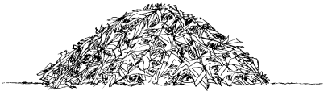


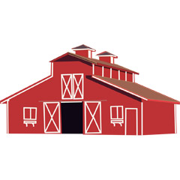




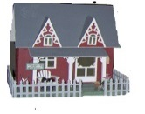





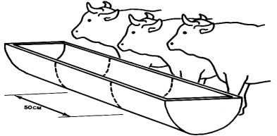

Farm emissions
Carbon Dioxide
Off-farm CO₂ from production
Nitrous Oxide
Synthetic N
fertilizer
Methane
N inputs /
supply
Shelterbelt
Sale
Sale
Manure
N mineralization
Cropland
Pasture
Calves and backgrounders
Feed from feed mill

Slide 3
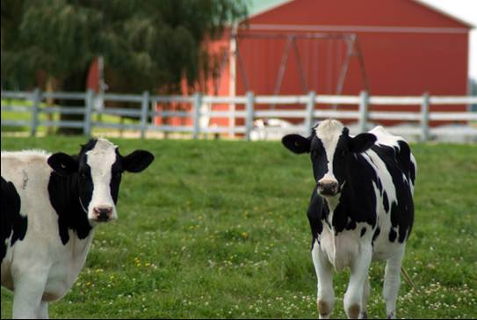
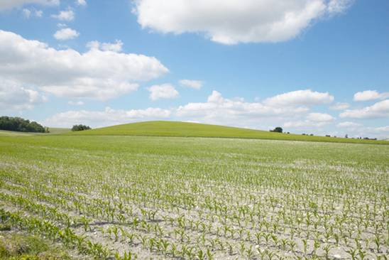
Estimating impacts?
Comprehensive research
Collaborate
across
disciplines
Multiple sub-systems
Complex interaction
Ripple- and
trade-off
effects
Machines & Infrastructure
Whole-farm
Analysis
Livestock system
Crop system

Slide 4


“The whole is more than the sum of its parts“…
Aristotle
... a Greek word meaning all, entire, total (holistic).
Transparent & Science based
Science mentors: H.H. Janzen, K.A. Beauchemin, E. Smith
Software development: A.W. Alemu, A. McPherson, C. Vanin
Postdoctoral researchers: S.J. Pogue, M. Cordeiro
Team (past): S.M. Little, B. Helgason, J. Lindemann, J. Barbieri, K. Maclean, M. Martel, L.L. Chai, R. Karimi-Dekhordi

Slide 5
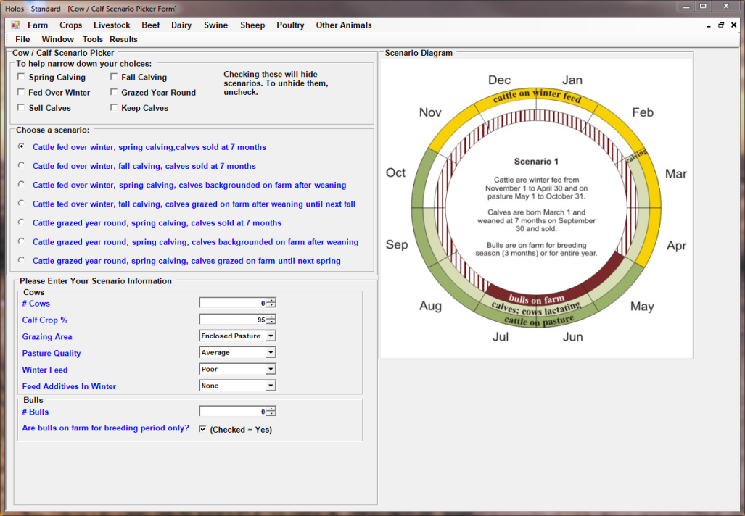
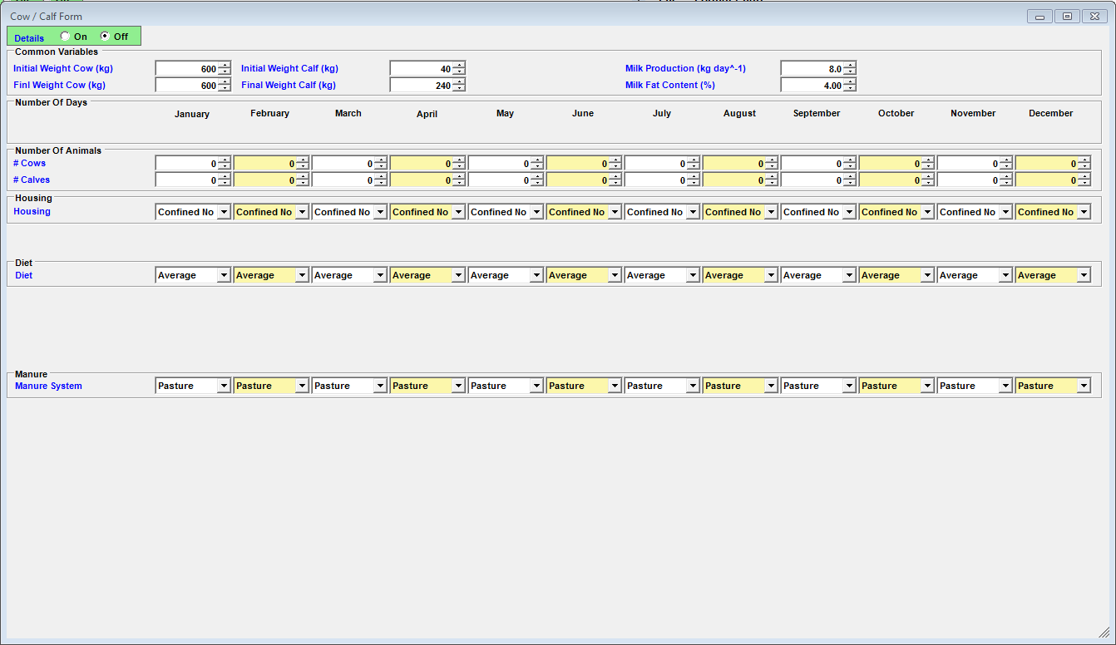
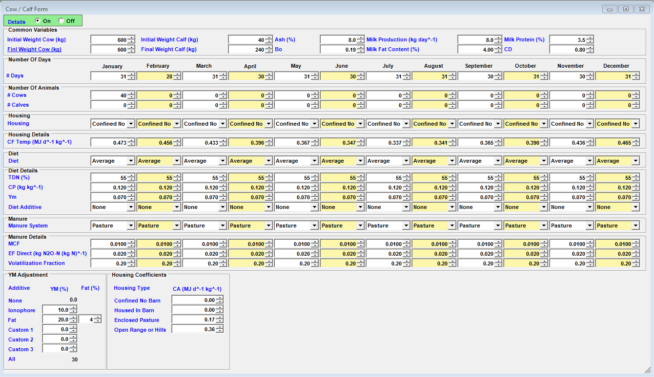
Holos interface
Simple -> complex
Holos provides defaults
User override where needed

Slide 6




Agriculture pressured by metrics
Marketing demand:
Carbon footprint
(= GHG intensity
= GHG efficiency)
Next:
Water footprint
Energy footprint
Nitrogen footprint

Slide 7
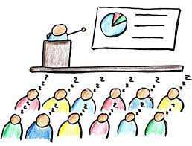

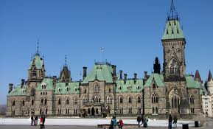
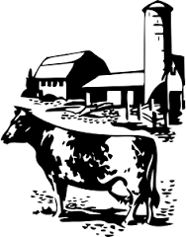
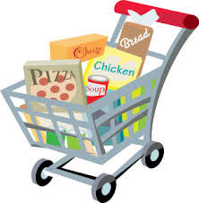
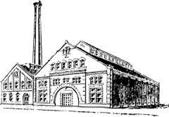
Annual workshop
Workshop “Sustainability of Canadian Agriculture”
Calgary, AB, March 13 & 14
Av. by webinar
https://www.eventbrite.ca/e/sustainability-of-canadian-agriculture-2019-holos-workshop-webinar-tickets-53305670696

Slide 8
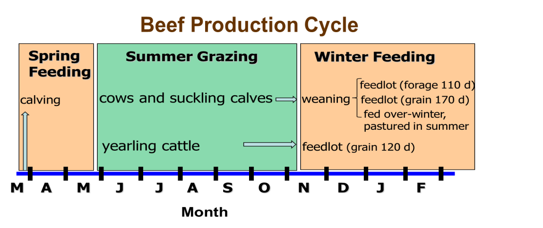
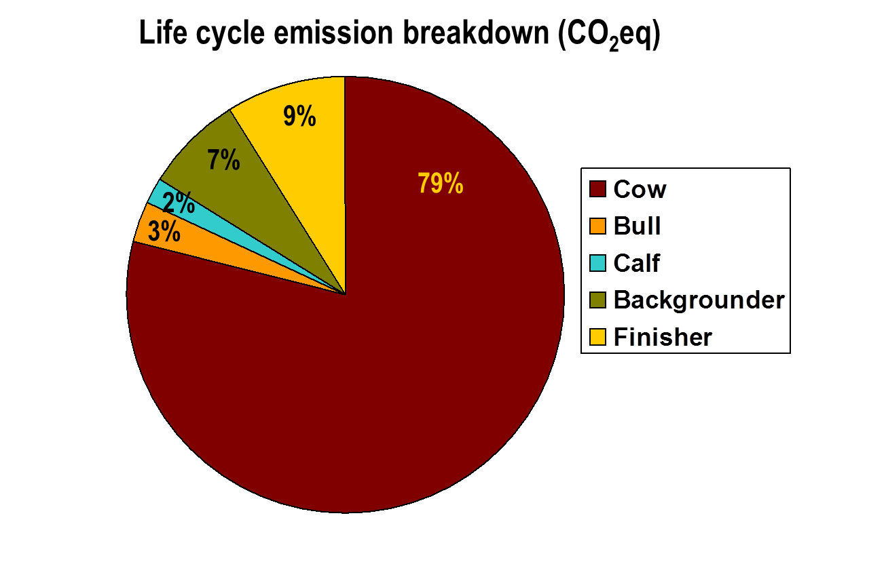
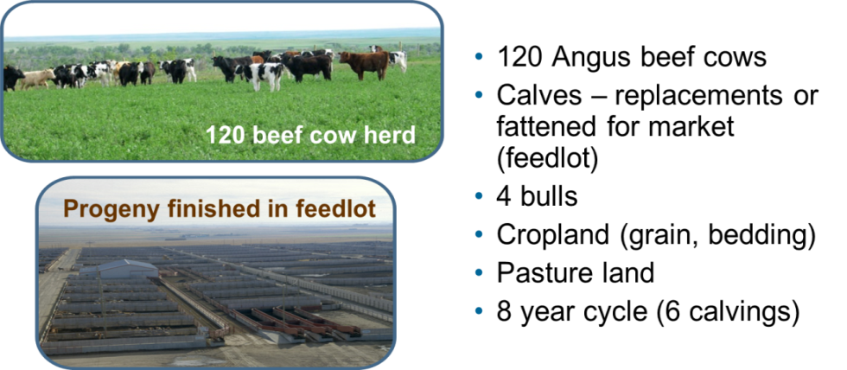
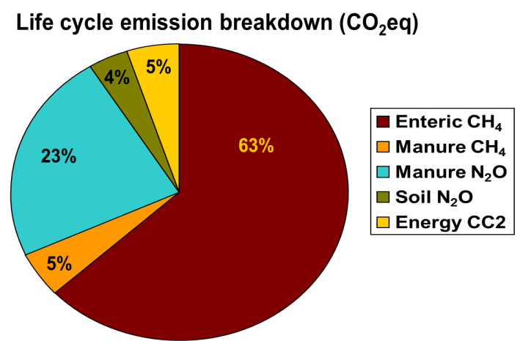
GhG from beef production in Western Canada: A case study
Beauchemin et al. (2010). Agr. Syst. 103:371–379

Slide 9
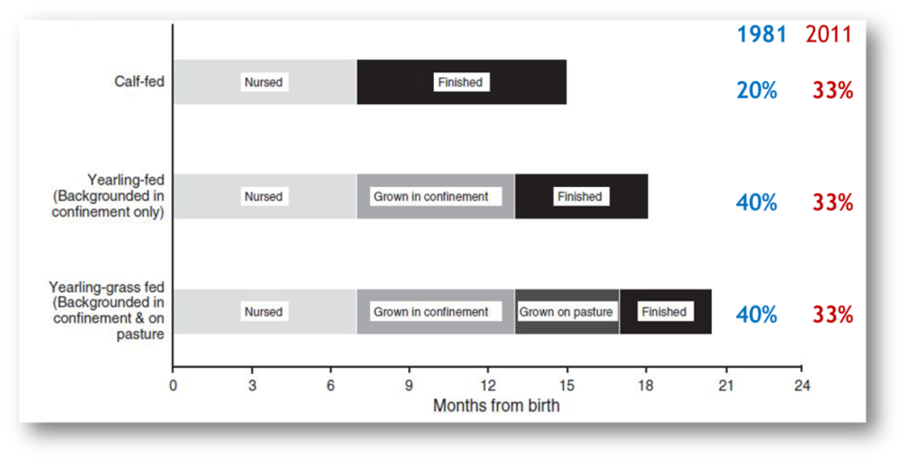
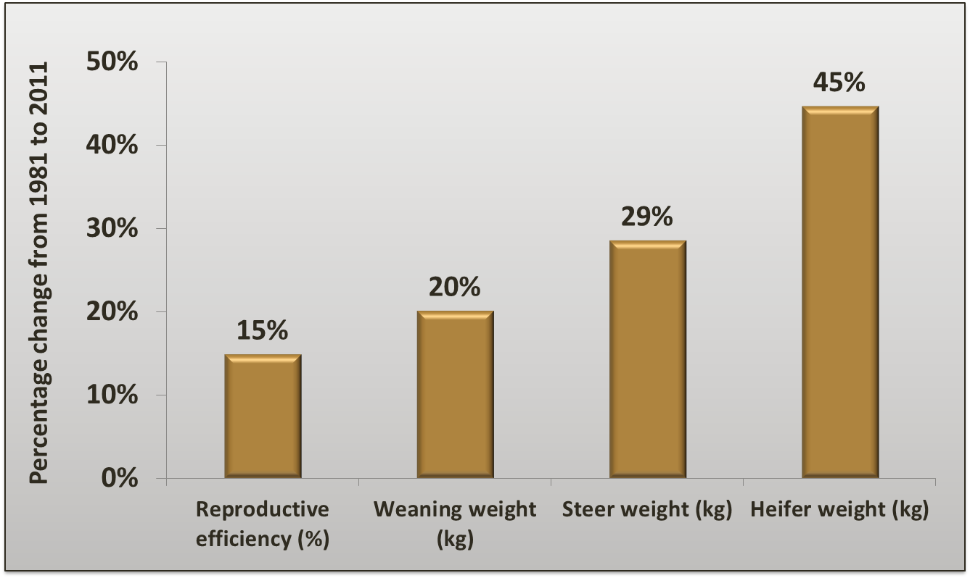
Canadian Beef GhG in 1981 as compared with 2011
  14% lower carbon footprint per kg beef
  29% fewer cattle are required for breeding
To produce the same quantity now:
  27% fewer slaughter cattle are required
  24% less land is required
Legesse et al. 2016. Animal production science 56 (3): 153 - 168

Slide 10
Summary & Application
  Whole-farm model to:
  assess management decisions
  teach environmental impacts
  test experimental finding
  Modeling projects:
  beef
  dairy
  watershed

Slide 11
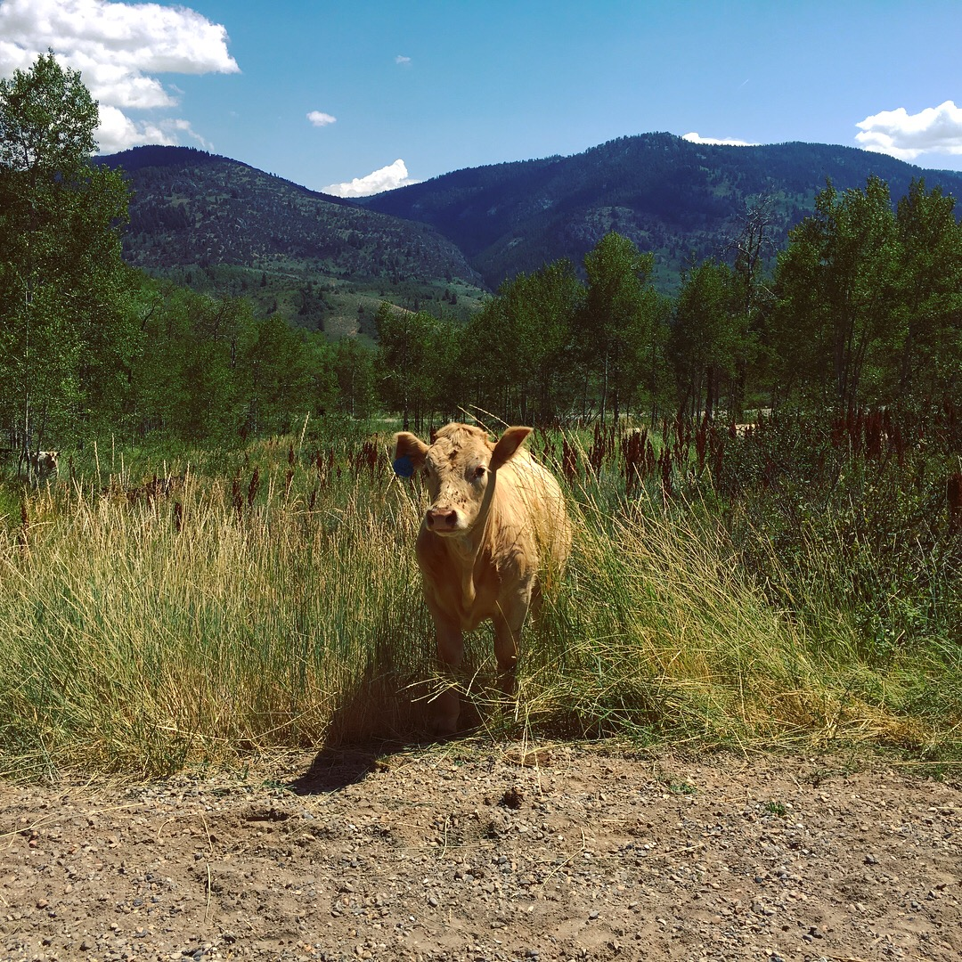
Why Utah?
Significant animal agriculture
Need for
  Improved land management
  Reduced environmental impact
K. Slebodnik
Notes:
Why do we need this type of analysis in Utah?
In 2012, market value of livestock, poultry, and their products worth $1.2 billion
Concern regarding overgrazing of pasturelands since 78% UT ag land = pastureland
Concerns: soil erosion, degrading water quality, nutrient mgmt., and support of native species

Slide 12
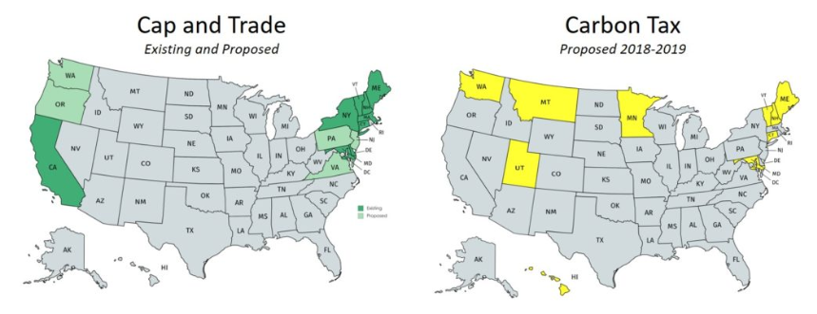
Why Utah?
Proposed carbon tax
Image courtesy of https://priceoncarbon.org/business-society/state-actions/
Notes:
The need to quantify the impact of GHG producing activities is increasing in the state
Utah bill HB403 was proposed in 2018
Was not finalized in time to pass, indicative of future policy interests

Slide 13
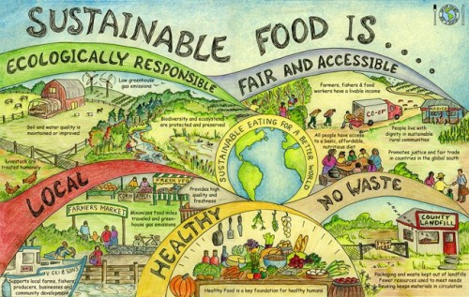
Why Small & Urban Farms?
Flexibility
Environmental impact often given higher importance
https://www.du.edu/news/du-increases-offerings-local-sustainable-food-through-real-food-challenge
Notes:
Why is this accounting of interest to small and urban farms?
Small farms (<$250,000/year by USDA stds) account for 94% of the total # of farms in Utah
Important to a lot of people!
Small farms have several advantages that cater to this type of modeling and experimental decision making

Slide 14
Benefits of Modeling
Track complex systems and activities
Understand economic and environmental outcomes
Compare outcomes
Optimize resources
Notes:
Farms are complex systems of inputs, outputs, recycling, nutrient & animals flows
Being able to track all of these can allow you to compare management outcomes & optimize resource base.

Slide 15
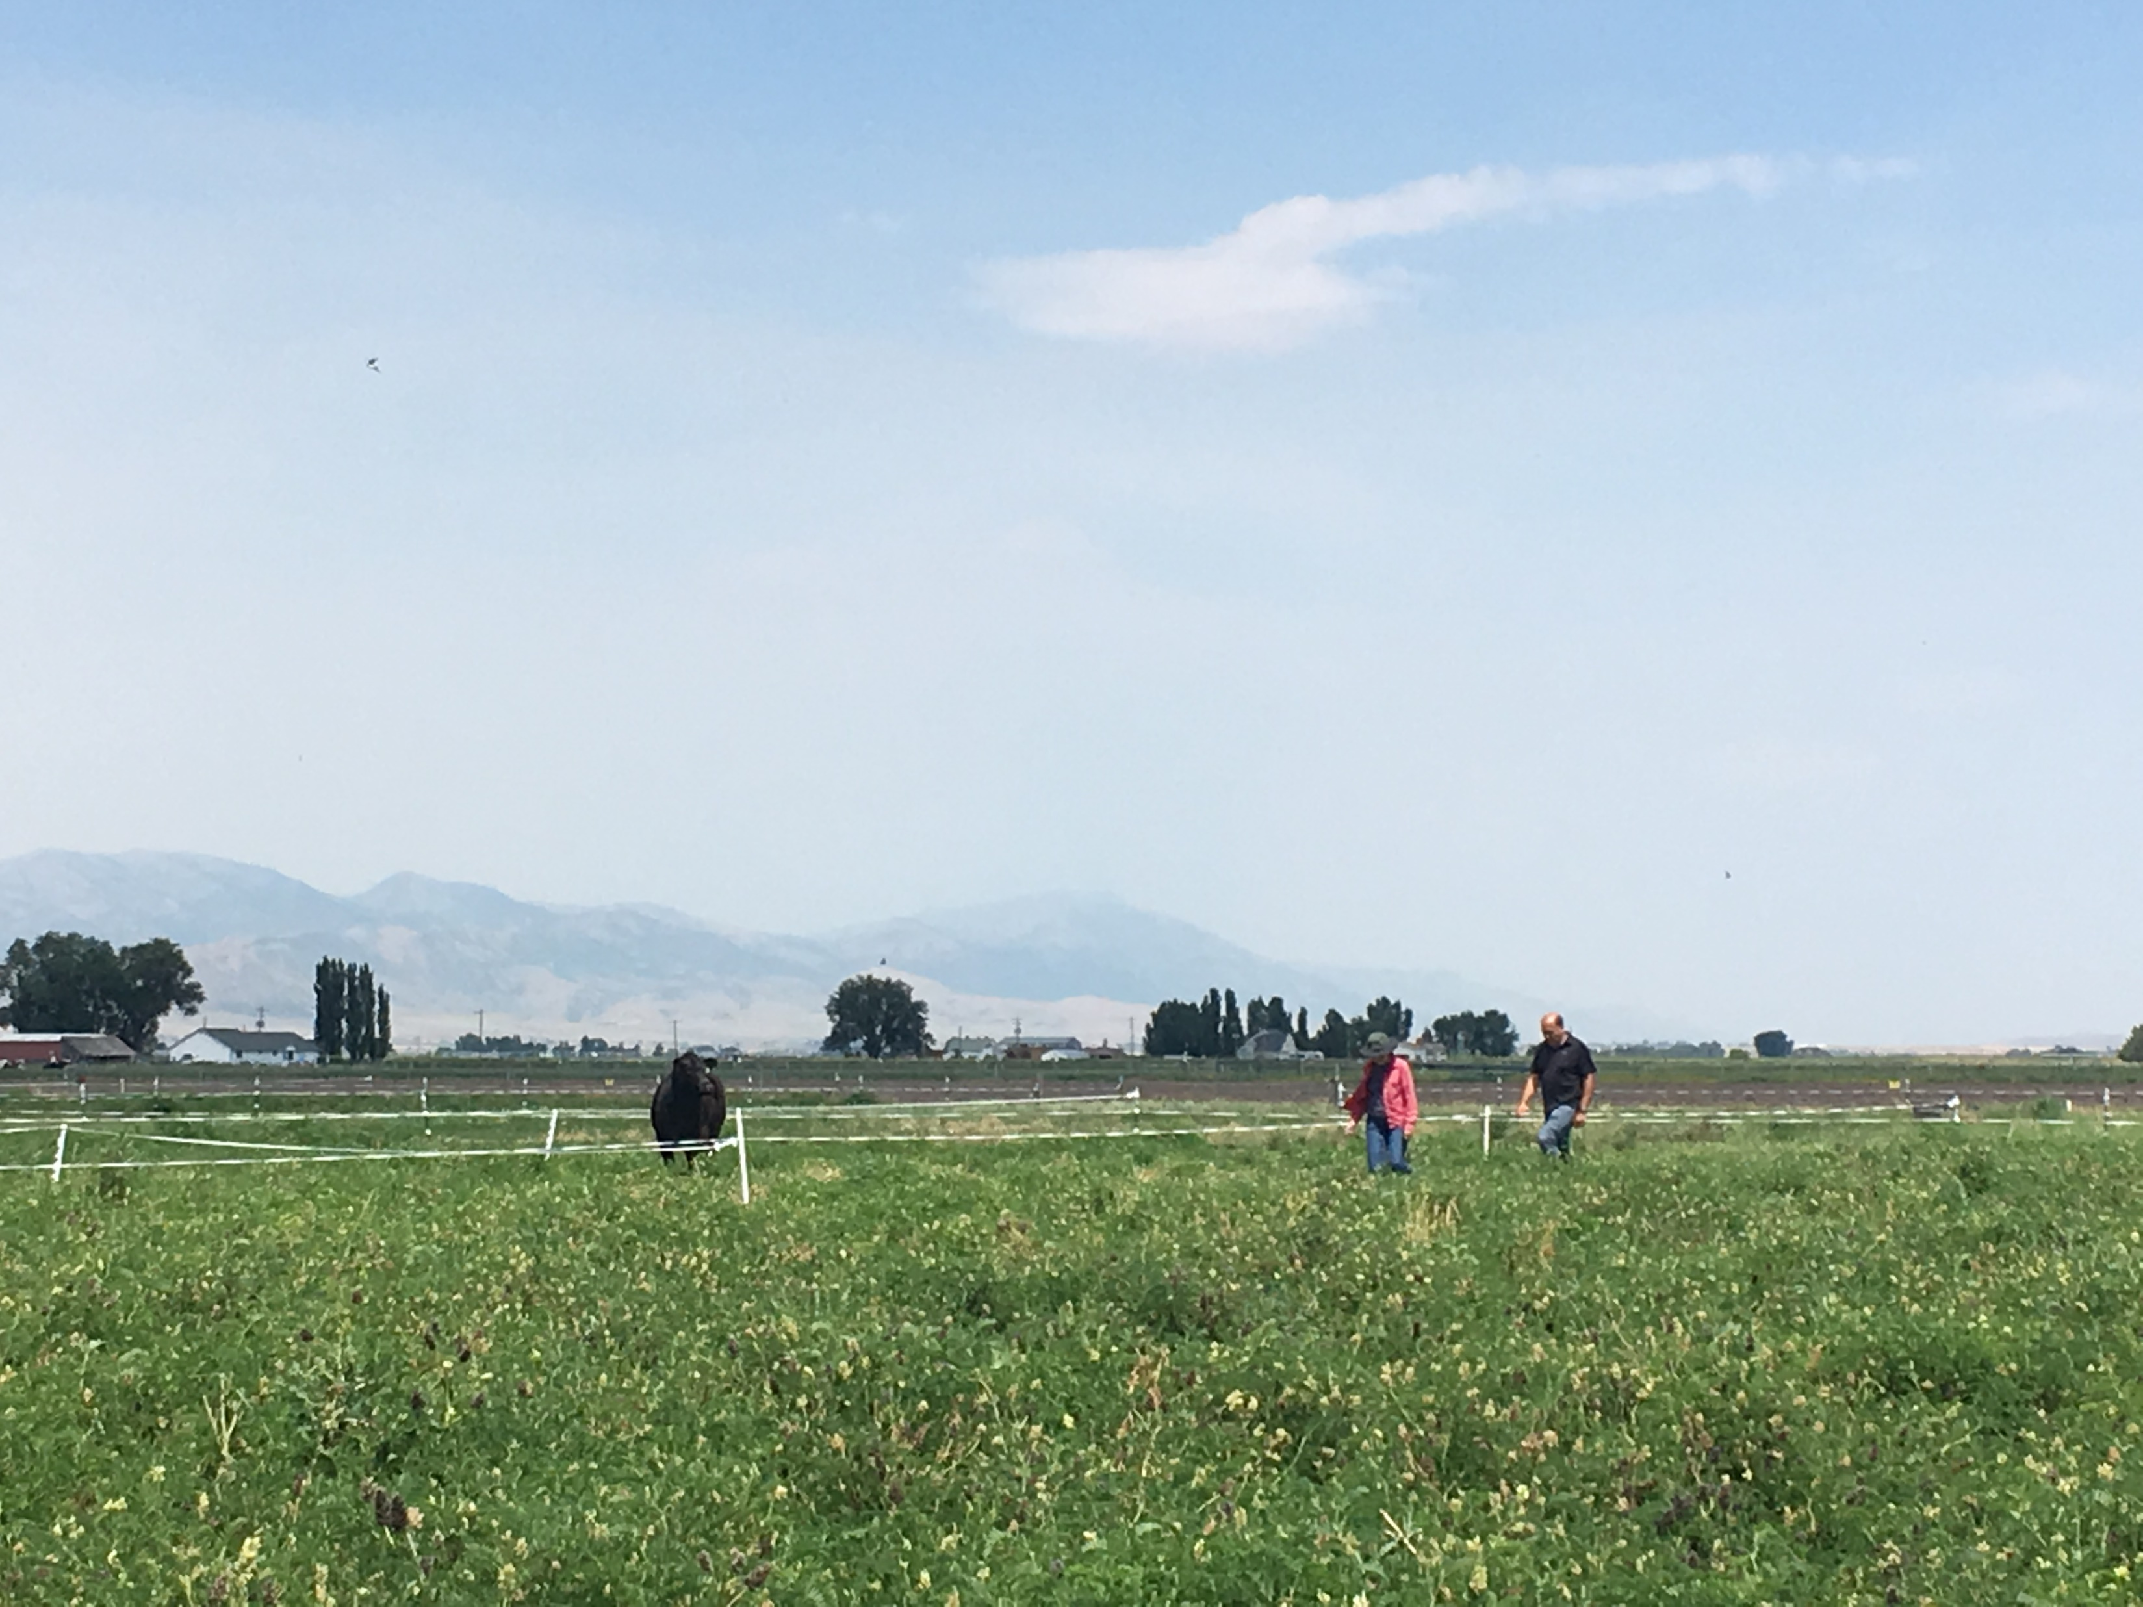
Why Holos?
Flexible:
  Location
  Size
  Application
  Animal & cropping systems
K. Slebodnik

Slide 16
Why Holos?
Variety of operations:
Beef
Dairy
Swine
Sheep
Poultry
Goats
Llamas
Alpacas
Deer
Elk
Horses
Mules
Bison

Slide 17
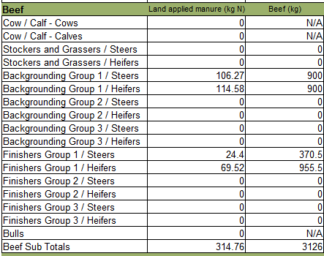
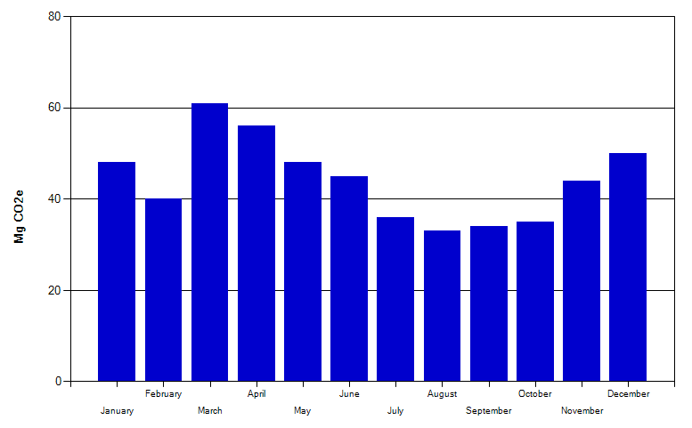
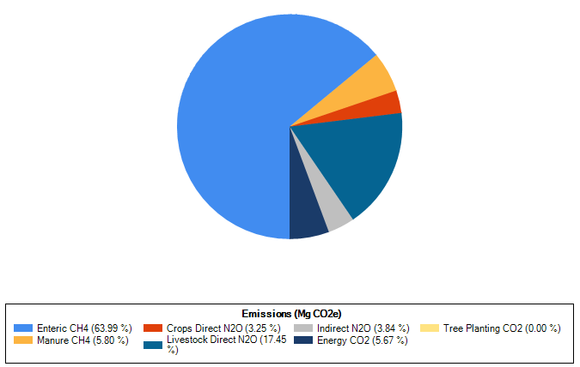
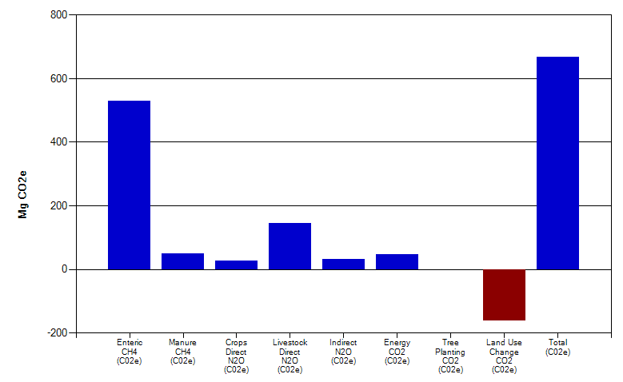
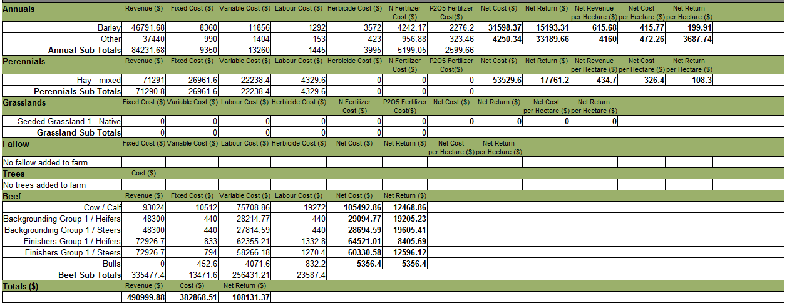
Why Holos?
Results
Notes:
These are some example results from a demo farm with 120 cows, 98 calves, and 4 bulls on a mixed grazing and cropped operation
Starting in the cow/calf operation, moving to the backgrouding feedlot, and entering the finishing feedlot over the course of 16 months

Slide 18
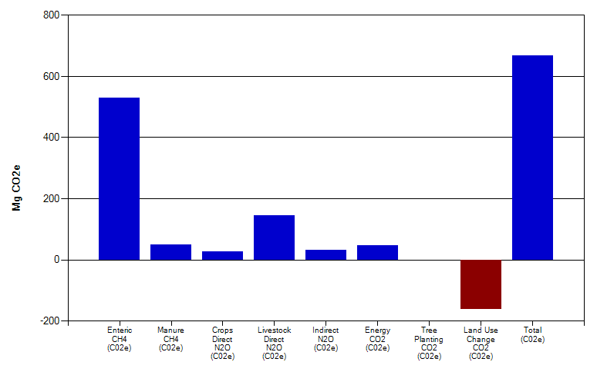
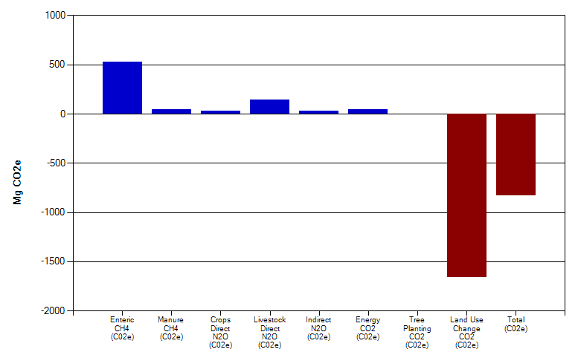
Platform for Comparison
Beef production operation
Native grassland
Net emissions: +668 Mg CO2-Eq
Seeded grassland, est. 30 years ago
Net emissions: -831 Mg CO2-Eq
Notes:
Beef farm operation. Only difference is 4,900 acres native grassland to seeded.
Red is misleading, we want negative total GHG eq, means sequestration

Slide 19
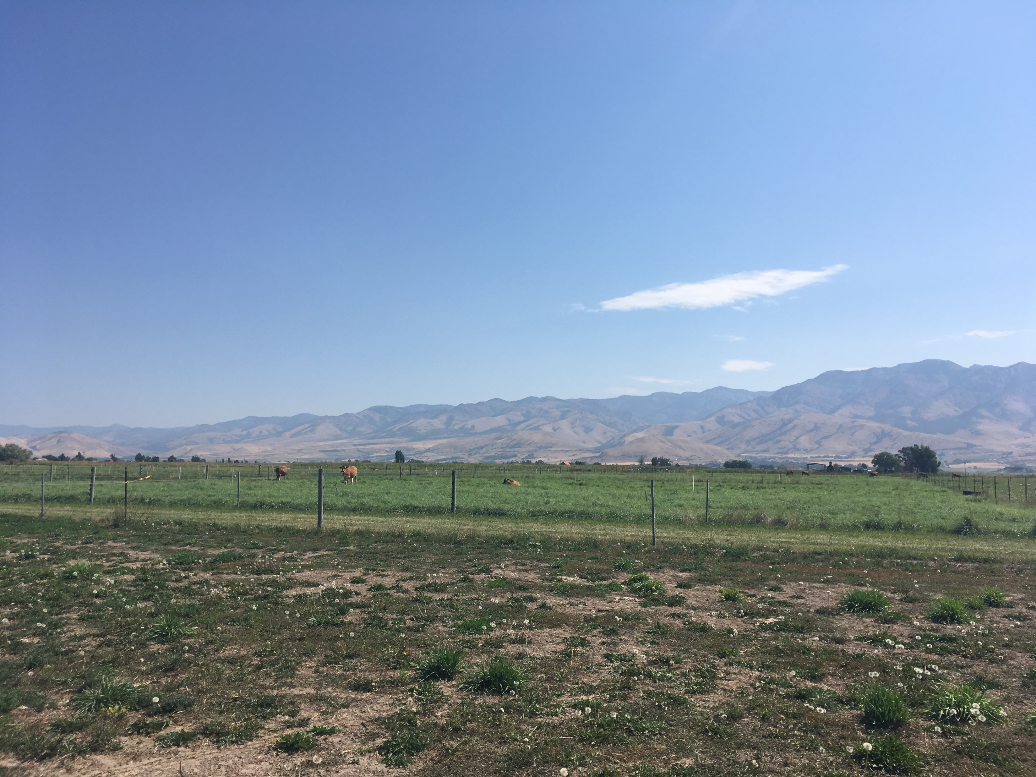
Current Research
Feedlot vs legume pasture finished beef
  Improve ADGs
  Decreased GHGs
  Increase N retention
K. Slebodnik

Slide 20
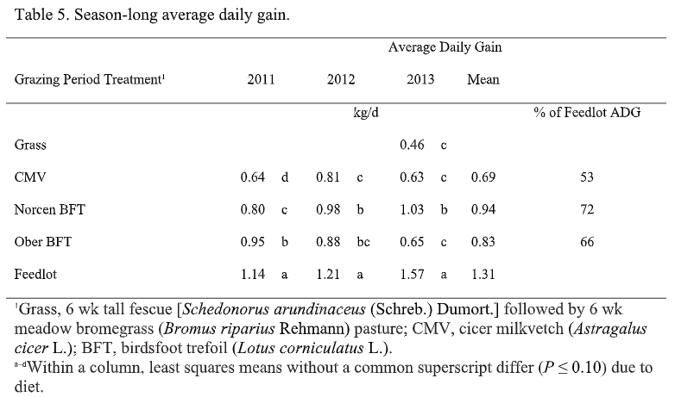
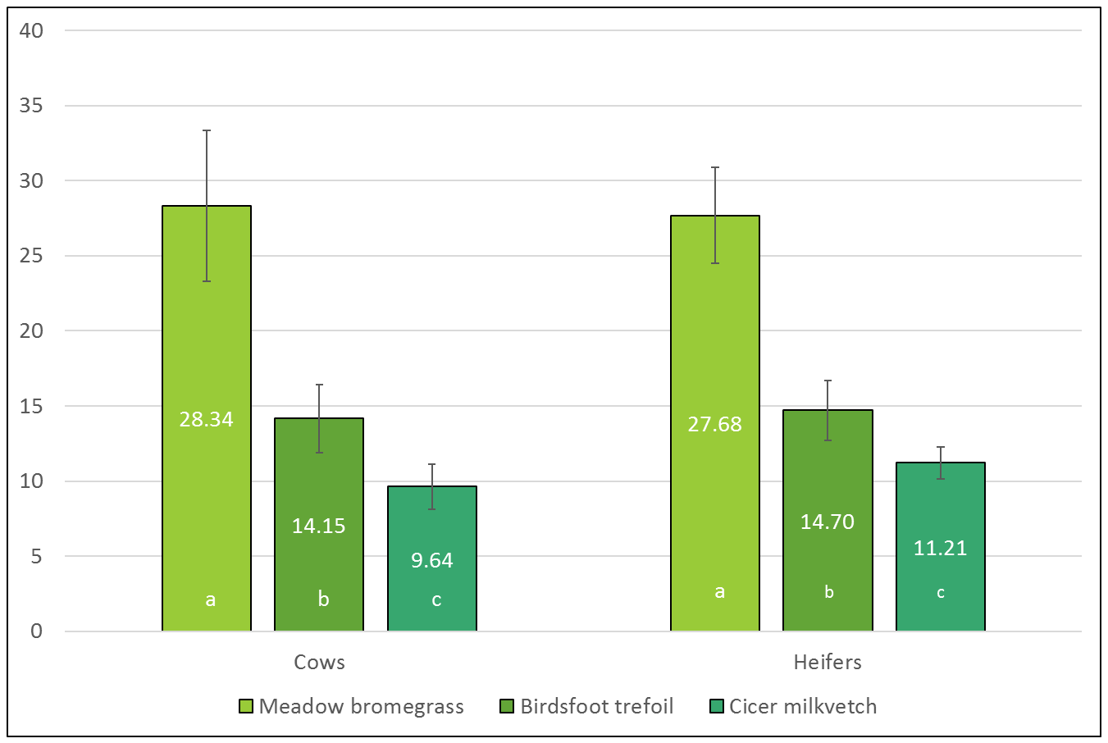
Current Research
Enteric Methane Emissions (g/Kg of forage intake)
Lower for tannin-containing legumes than for grass
CH4, g/Kg Forage Intake/d

Slide 21

Interested?
Download Holos:
www.agr.gc.ca/holos-ghg
Hands-On Holos Workshop:
Today, 5-7 pm. Refreshments Provided
UCCC Room 201/202
*Bring Windows compatible laptop if possible*

Slide 22






o
H
L
S
Roland Kroebel
+1 (403) 317-3434
roland.kroebel@canada.ca / holos@canada.ca
@roland_kroebel / @AAFC_Holos
https://ca.linkedin.com/in/rkroebel
Katie Slebodnik
Kathryn.Slebodnik@aggiemail.usu.edu
https://www.linkedin.com/in/kathryn-slebodnik
This material is based upon work that is supported by the National Institute of Food and Agriculture, U.S. Department of Agriculture, under award number 2017-38640-26913 through the Western Sustainable Agriculture Research and Education program under subaward number GW18-156. USDA is an equal opportunity employer and service provider. Any opinions, findings, conclusions, or recommendations expressed in this publication are those of the author(s) and do not necessarily reflect the view of the U.S. Department of Agriculture.

