Slide 1
Challenges to Installing Conservation Practices on Leased Land
This work is supported by the National Institute of Food and Agriculture, U.S. Department of Agriculture, through the Northeast Sustainable Agriculture Research and Education program under subaward number ENE18-151.

Slide 2
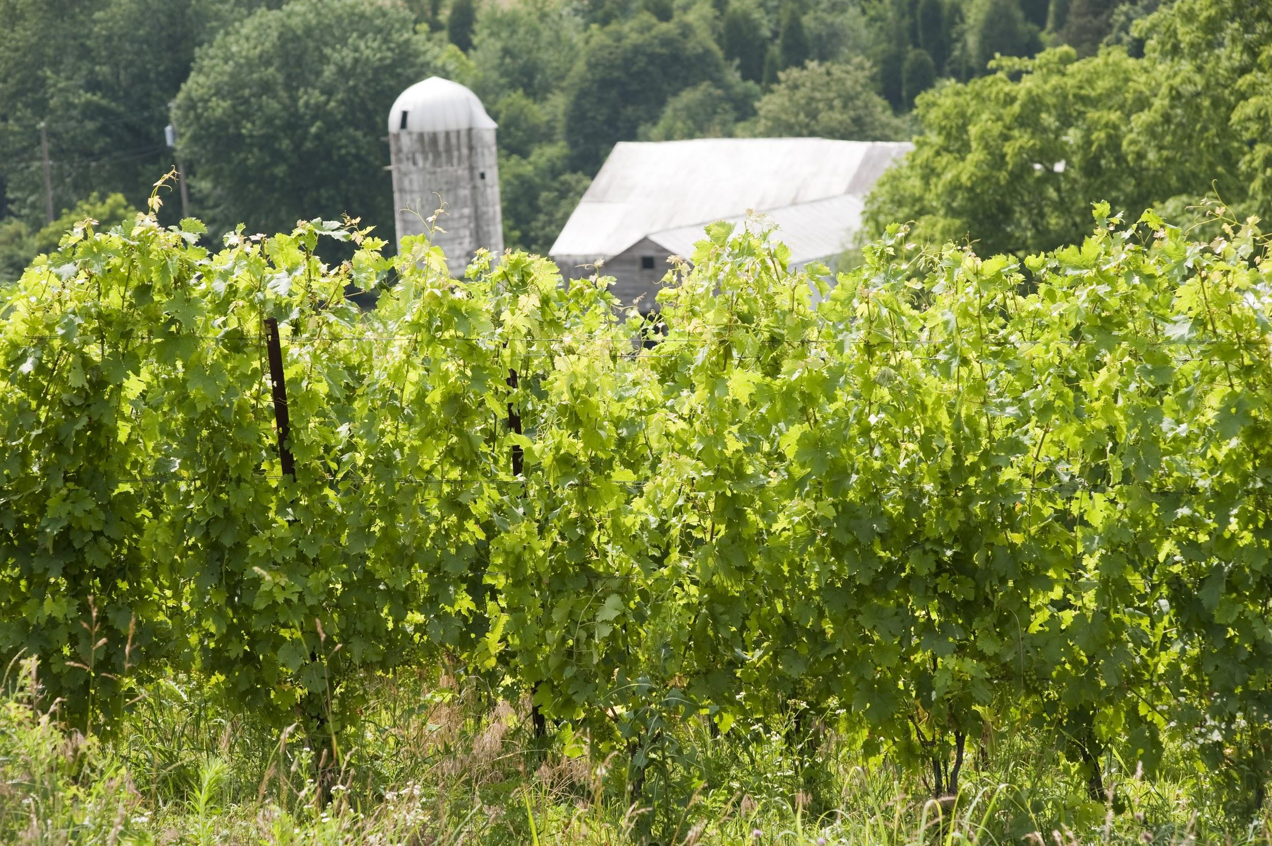
Agricultural Conservation Leasing Project
In Maryland, 42% of agricultural acres are in a formal or informal lease arrangement.
Conservation practices are less prevalent on leased acres.
Notes:
Why?
Poor communications between landowners/farmers
Lack of understanding of the cost-share funding
Concern about losing the lease
Complicated beaurocracy for federal programs that require landowner participation

Slide 3
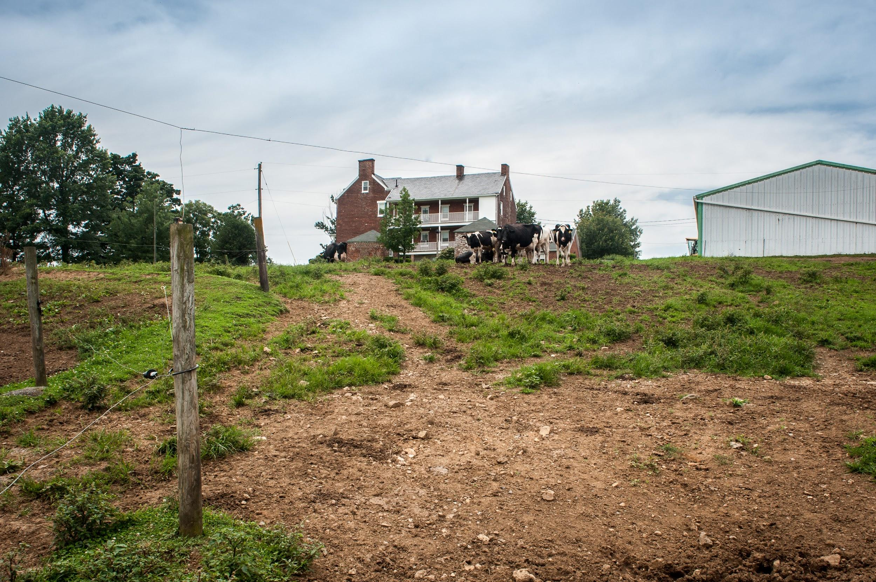
Agricultural Conservation Leasing Project
At registration you provided reasons you think conservation practices are less common on rented farmland.
We have a panel of experts to discuss their experiences in this area.
Notes:
Why?
Poor communications between landowners/farmers
Lack of understanding of the cost-share funding
Concern about losing the lease
Complicated bureaucracy for federal programs that require landowner participation

Slide 4
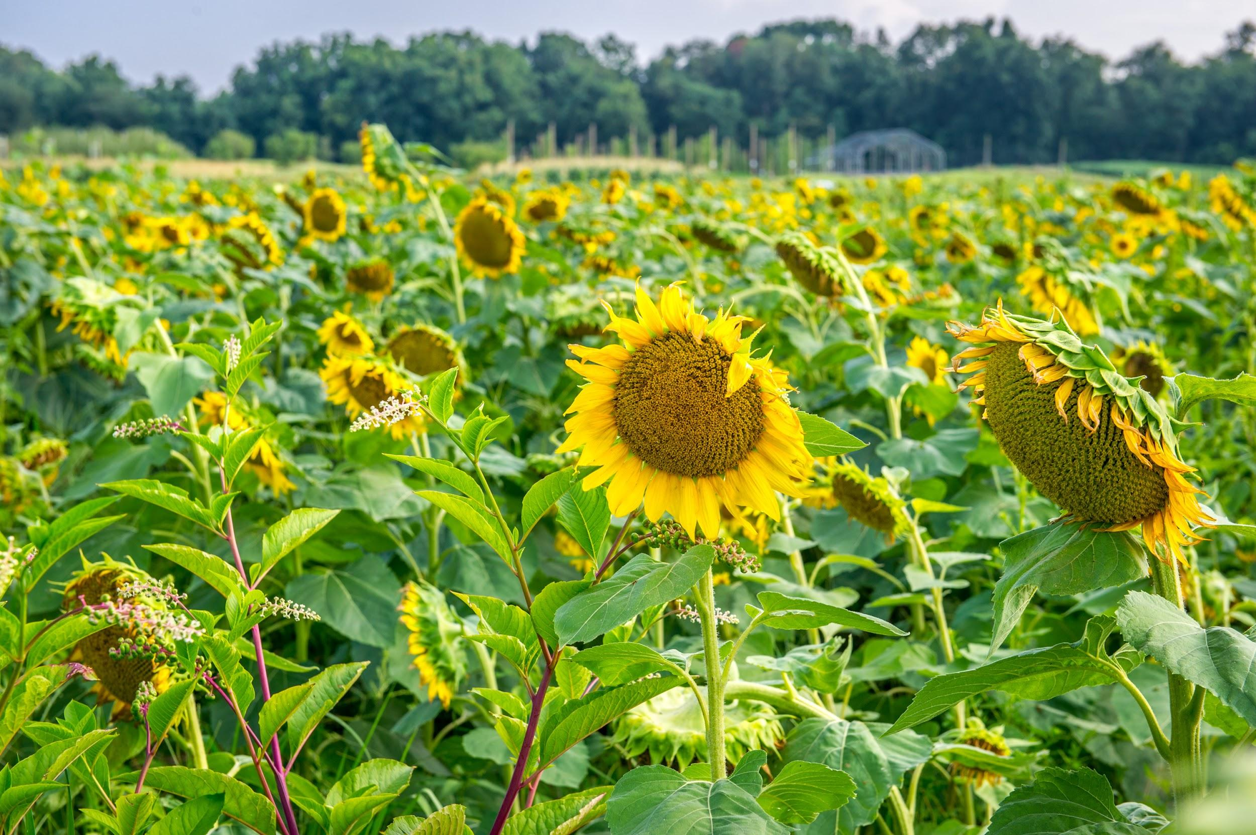
Panelists
Charlotte Brewster, NRCS, District Conservationist,
Andy Kness, UMD Extension
Zach Rose, Farmer

Slide 5
Division of Cost-Share Funding
Think of cost-share funding as an opportunity but consider:
how each party should receive funding
whether the lease or contract reflects the terms of the funding agreement and
each party’s responsibilities related to the conservation practice

Slide 6
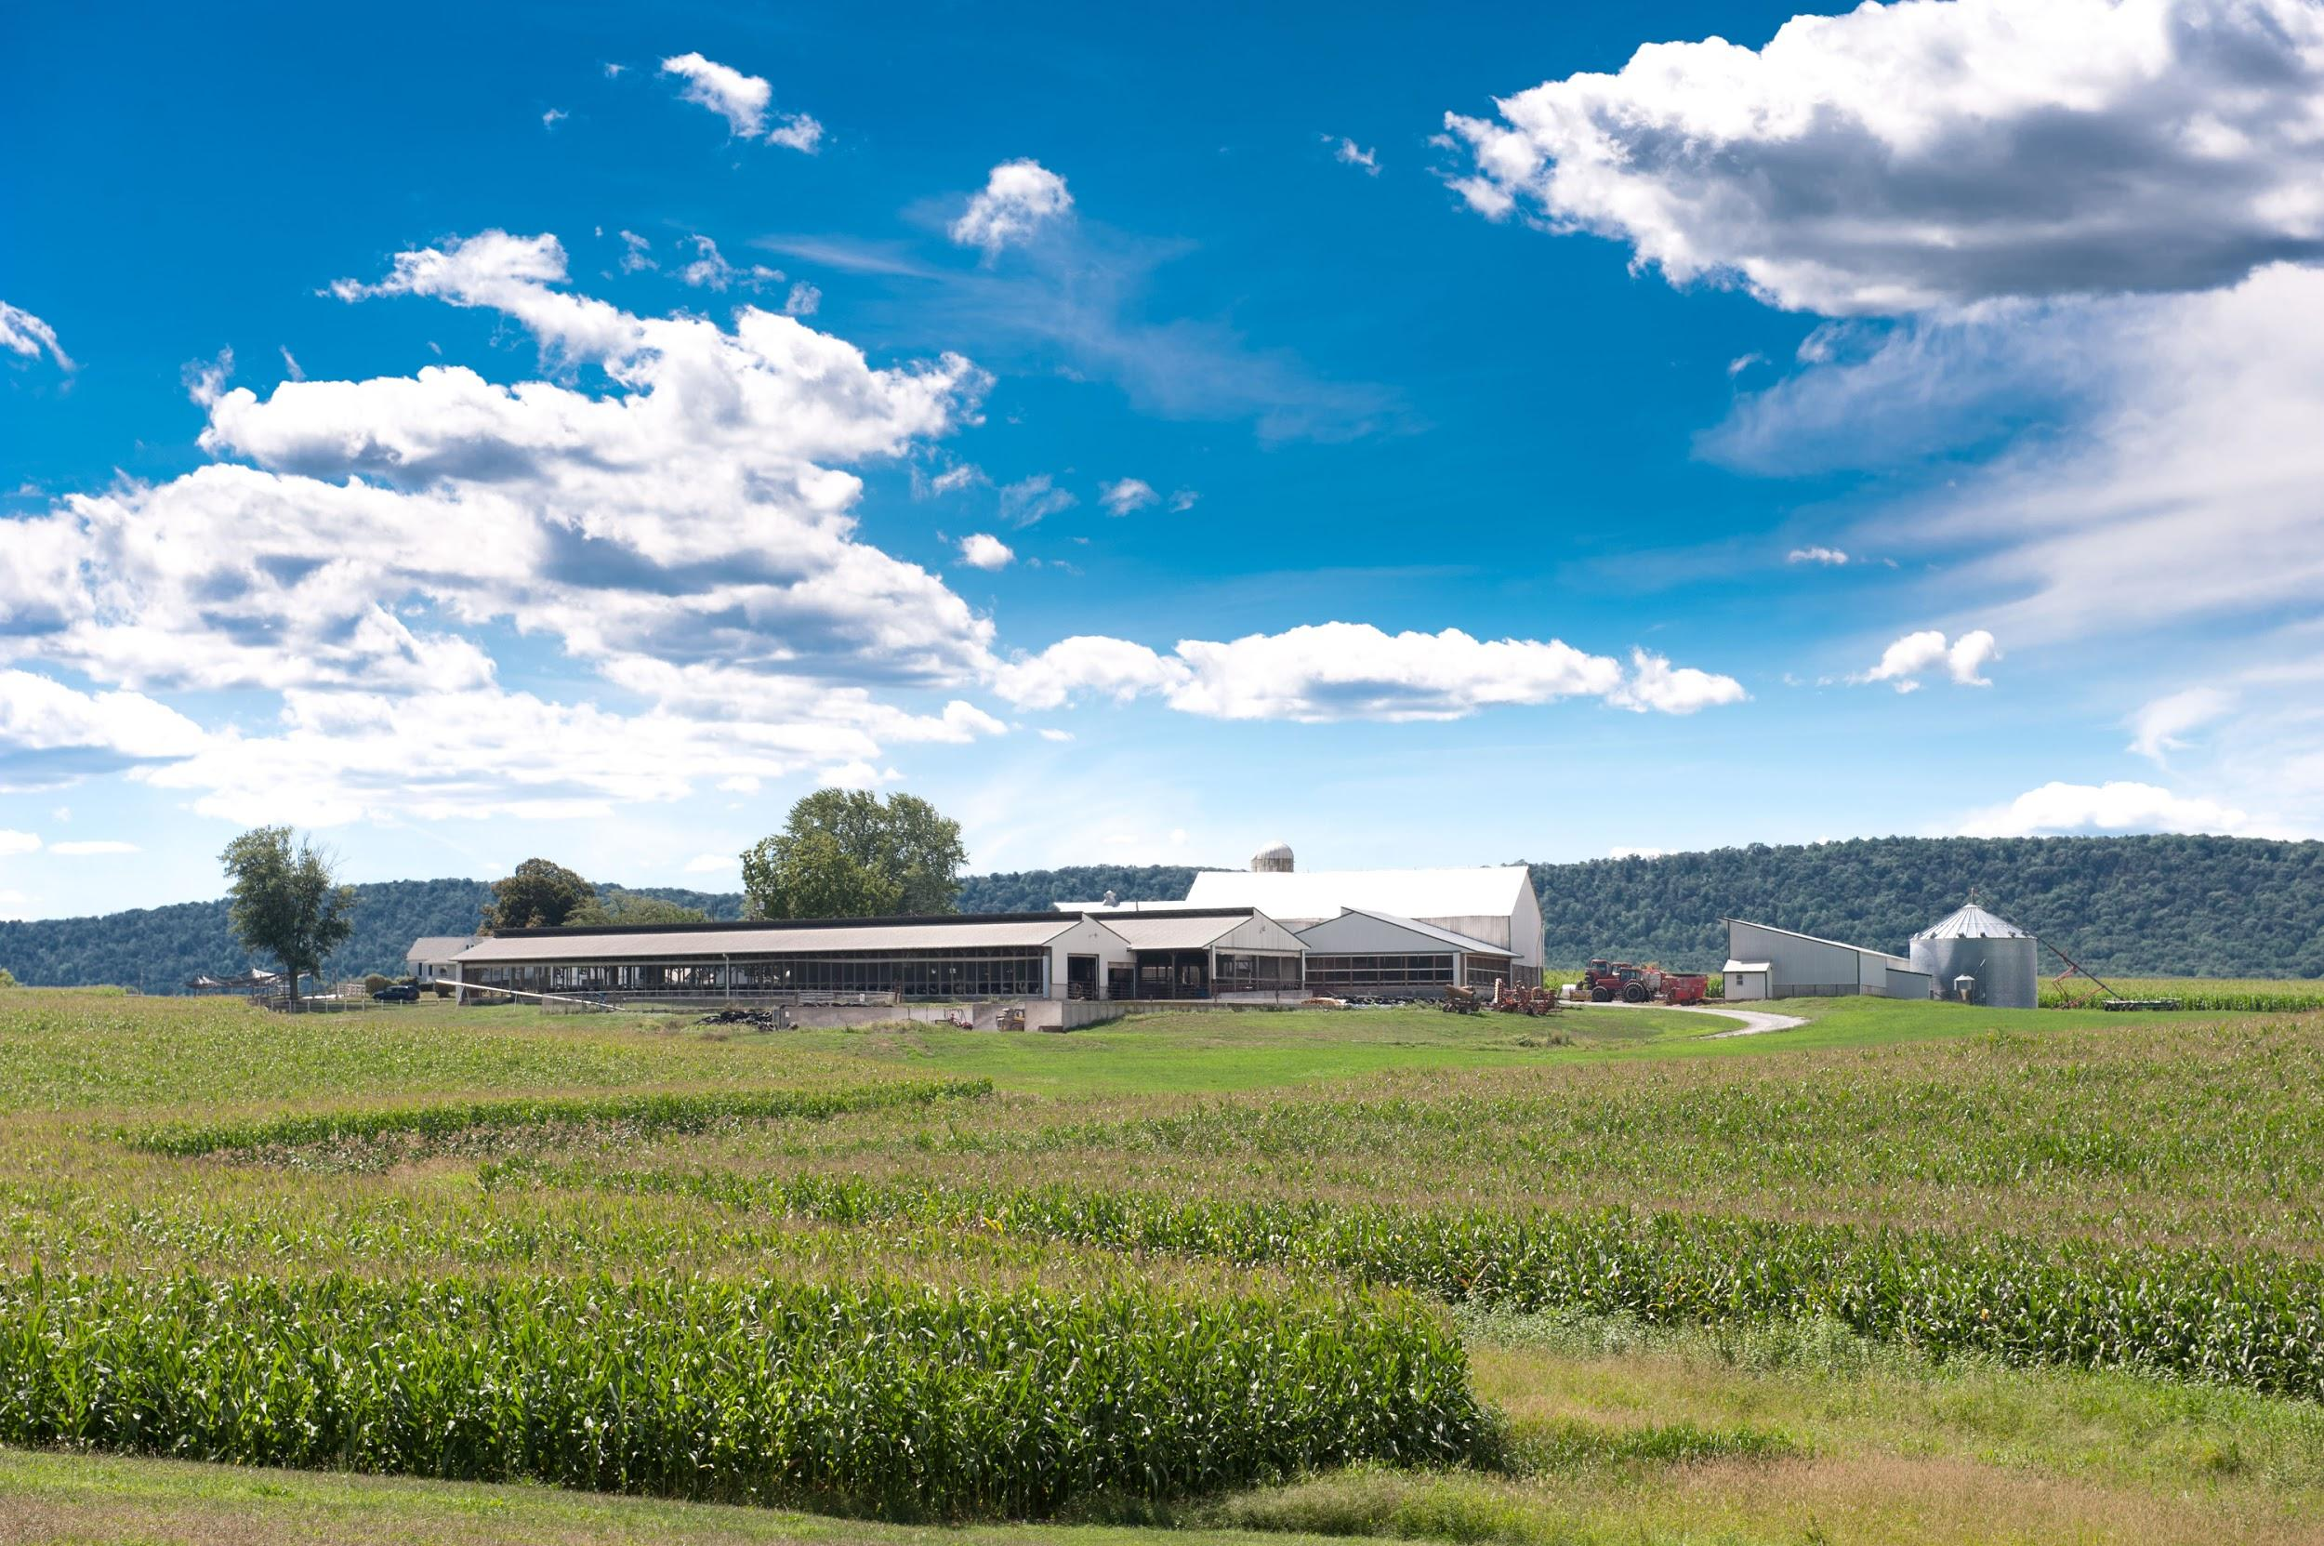
Division of Cost Share Funding
A farmer may be unable to fulfill a cost-share contract if the lease is terminated.
A landowner may be at risk, if he/she signed the contract and the practice is not properly maintained.

Slide 7
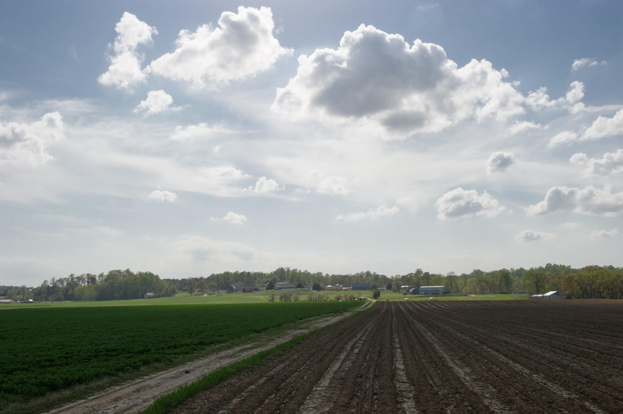
Division of Cost-Share Funding
Landowners and farmers can enter into a cost-share contract together and agree to split payments.
Alternatively, landowners and farmers can agree to share in payments in a lease.

Slide 8
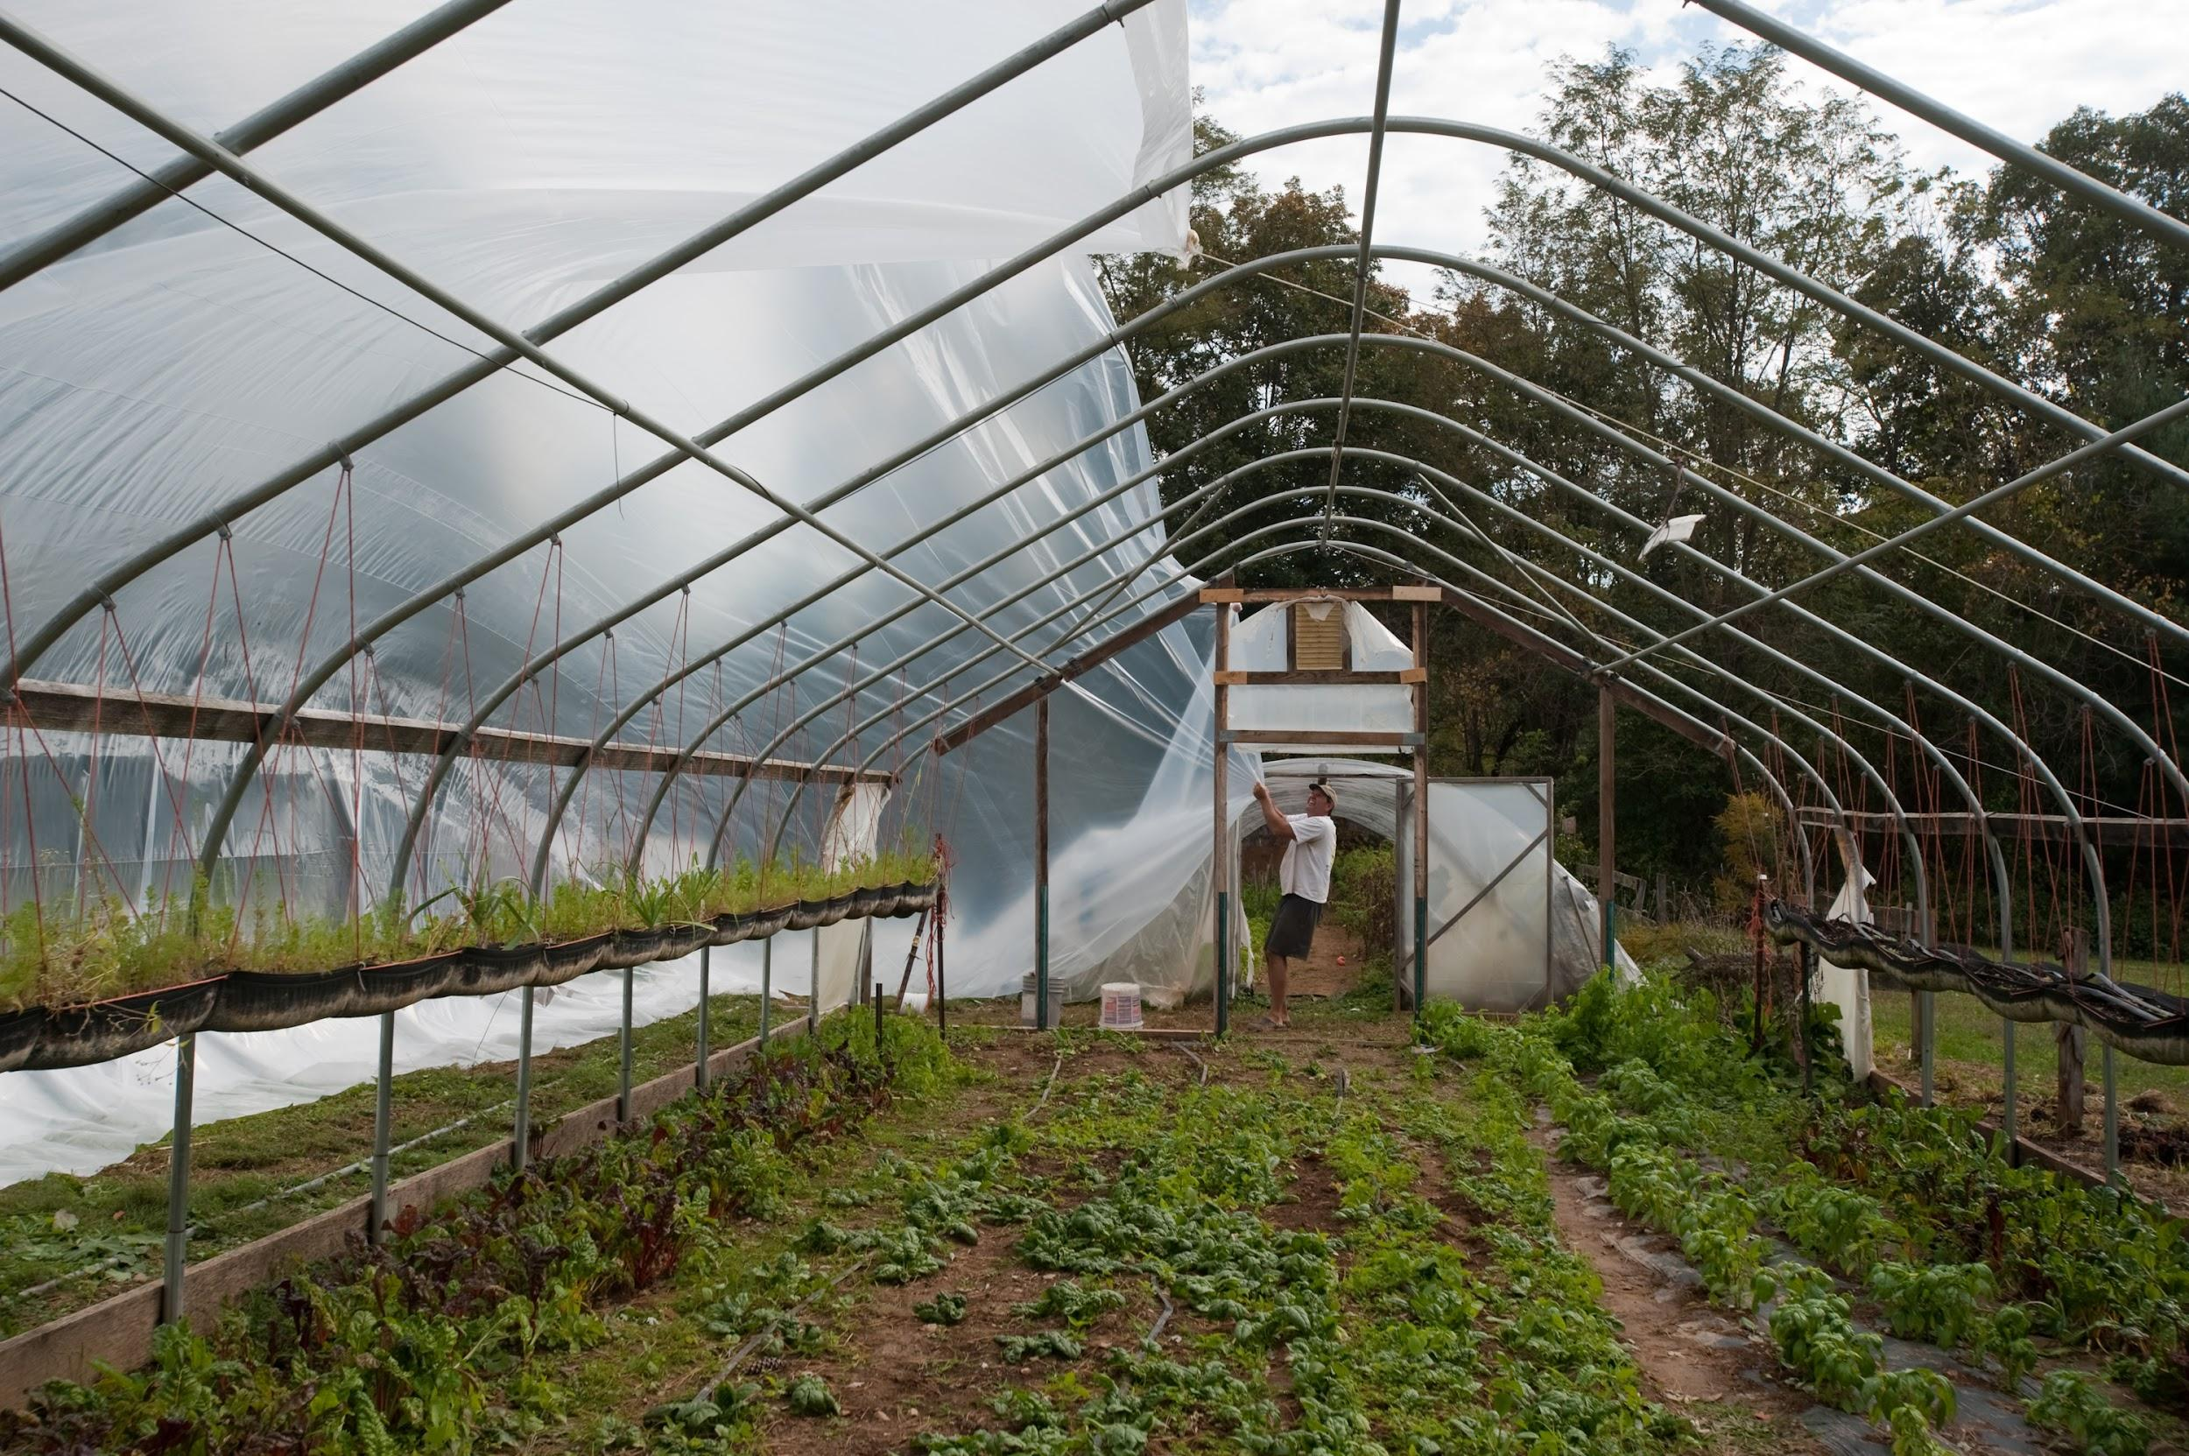
Farmers and Landowners Challenges
What challenges do farmers and landowners face?

Slide 9
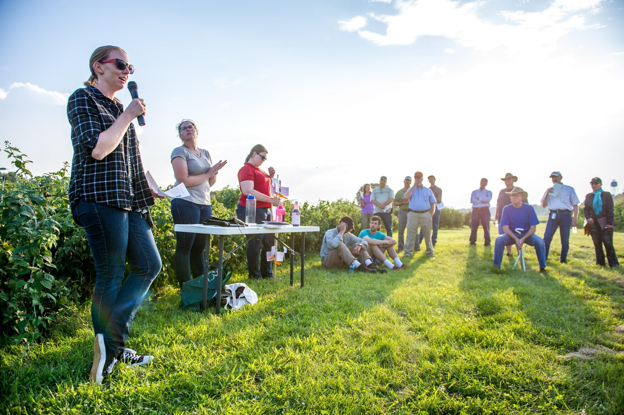
Ag Service Providers’ Challenges
What challenges do Agricultural Service Providers face?

Slide 10
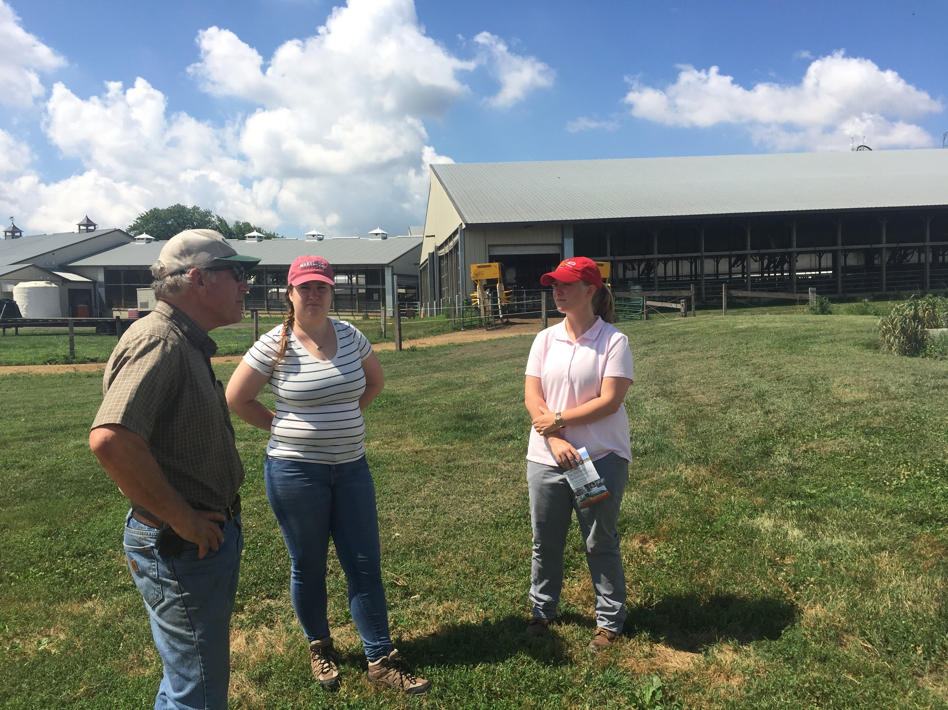
Solutions
We wanted to give you an opportunity to discuss and understand the challenges to help you be better prepared to reach creative solutions.
This afternoon you will get a chance to put your skills to work.

Slide 11
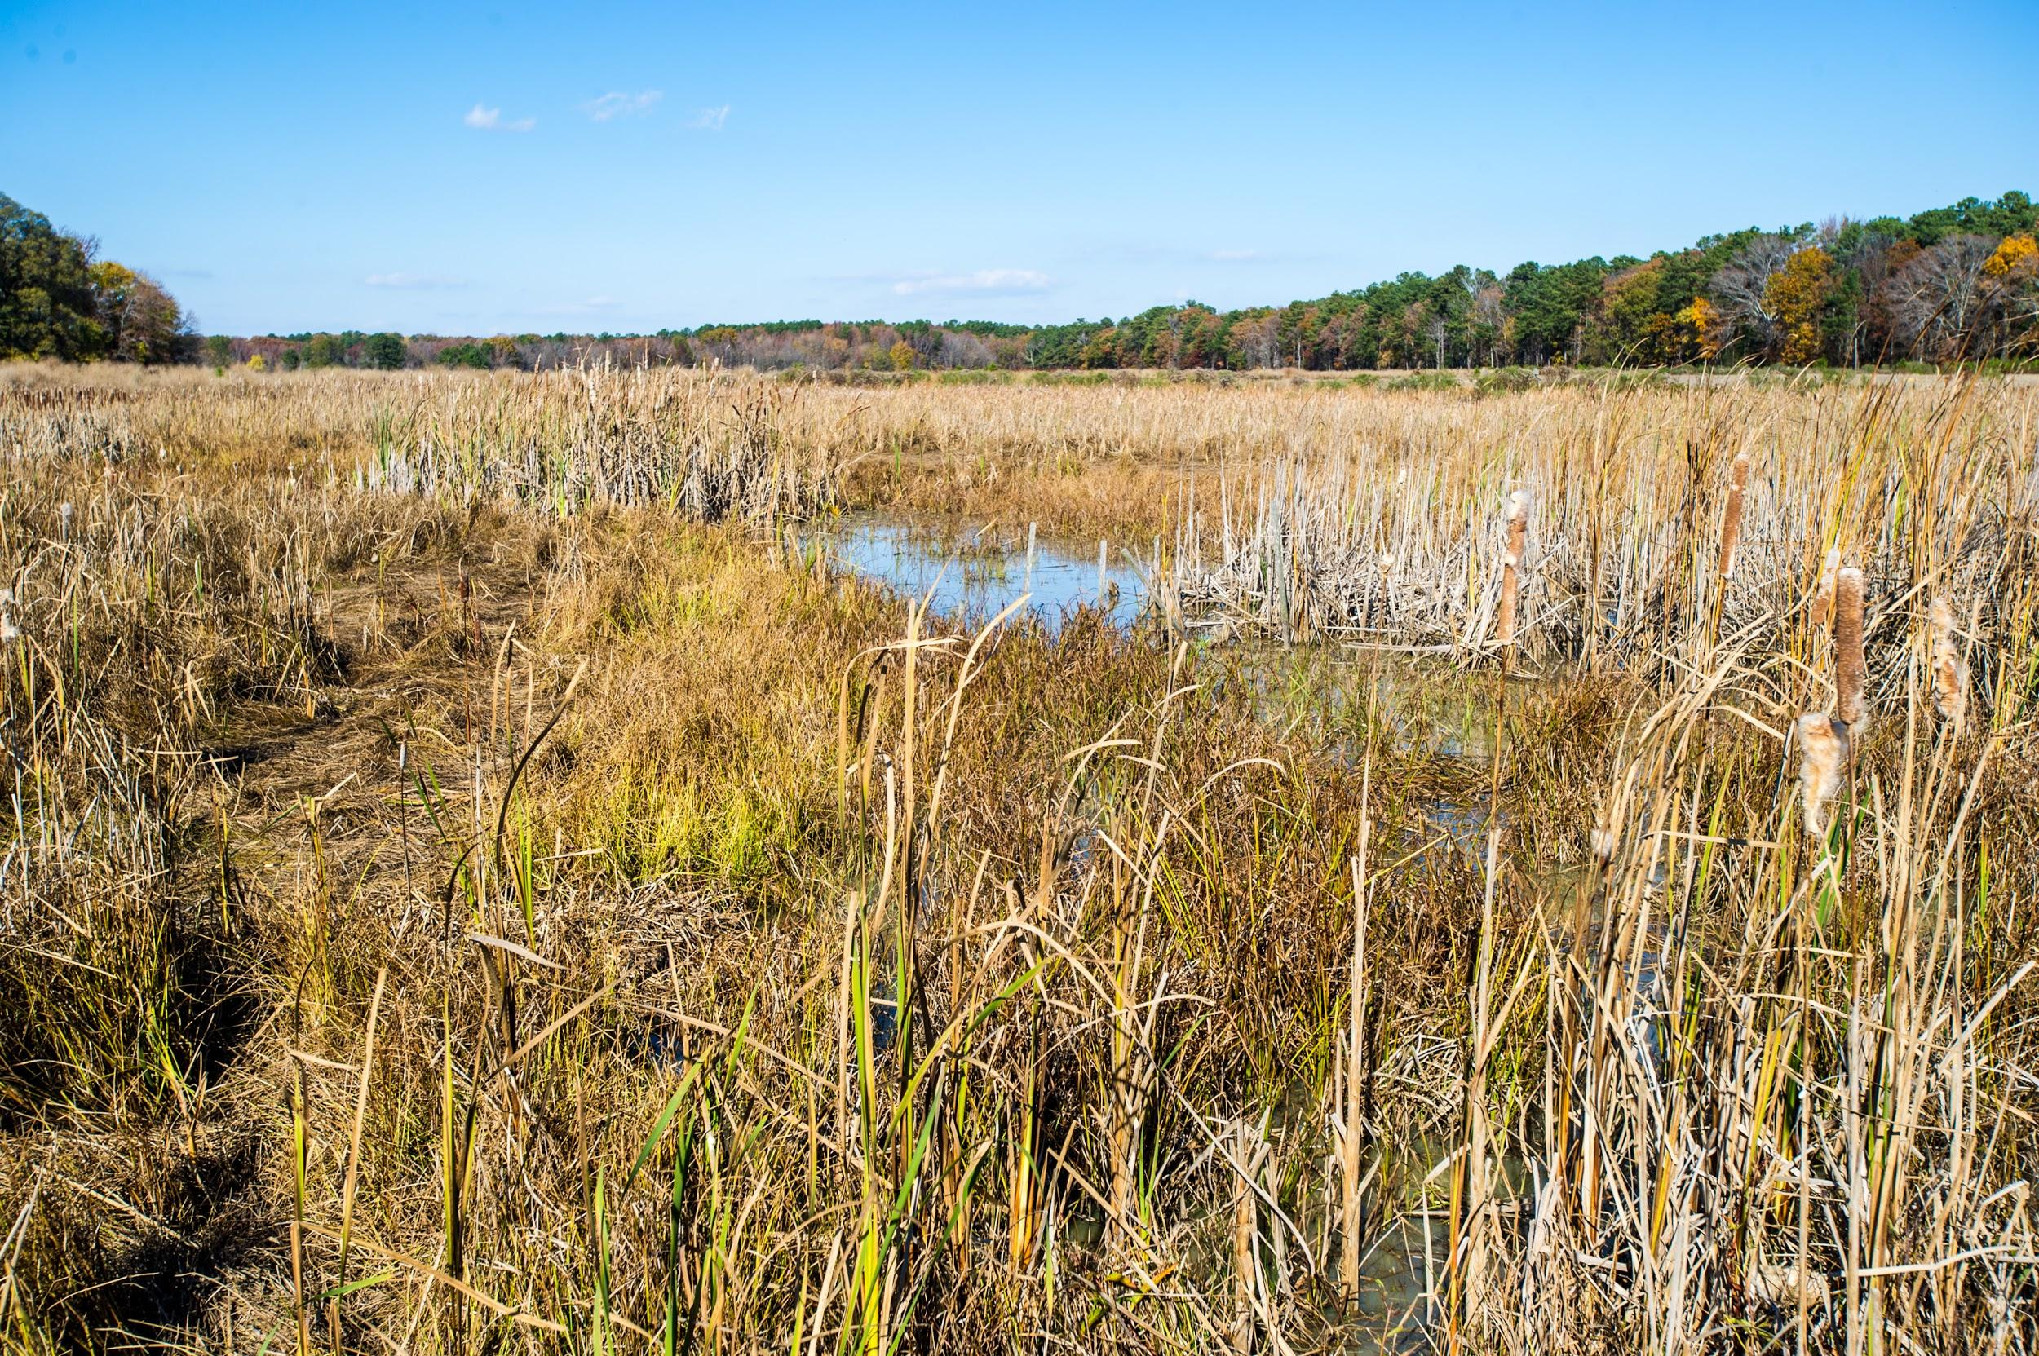
Questions?

