Slide 1
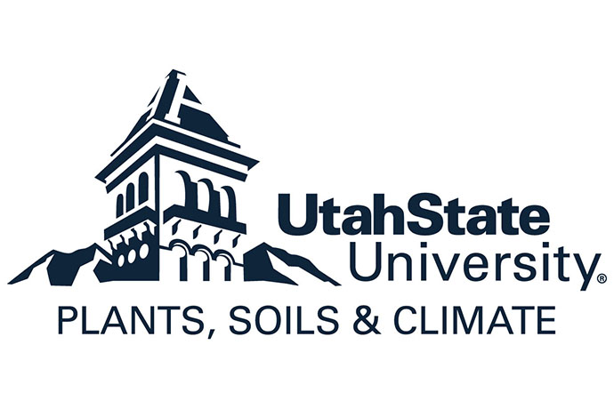

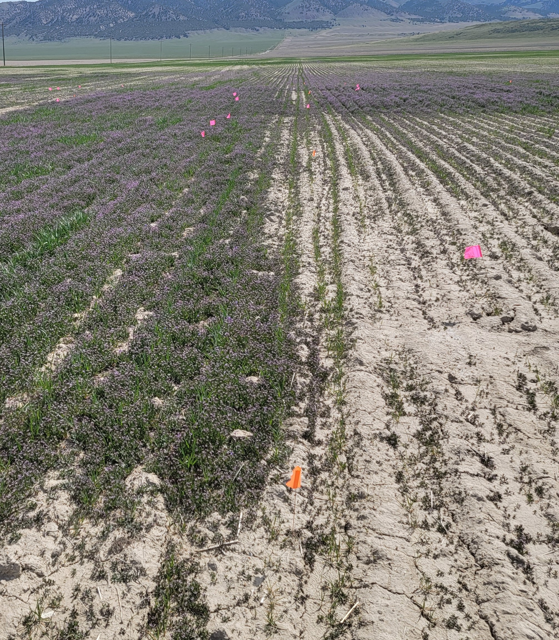
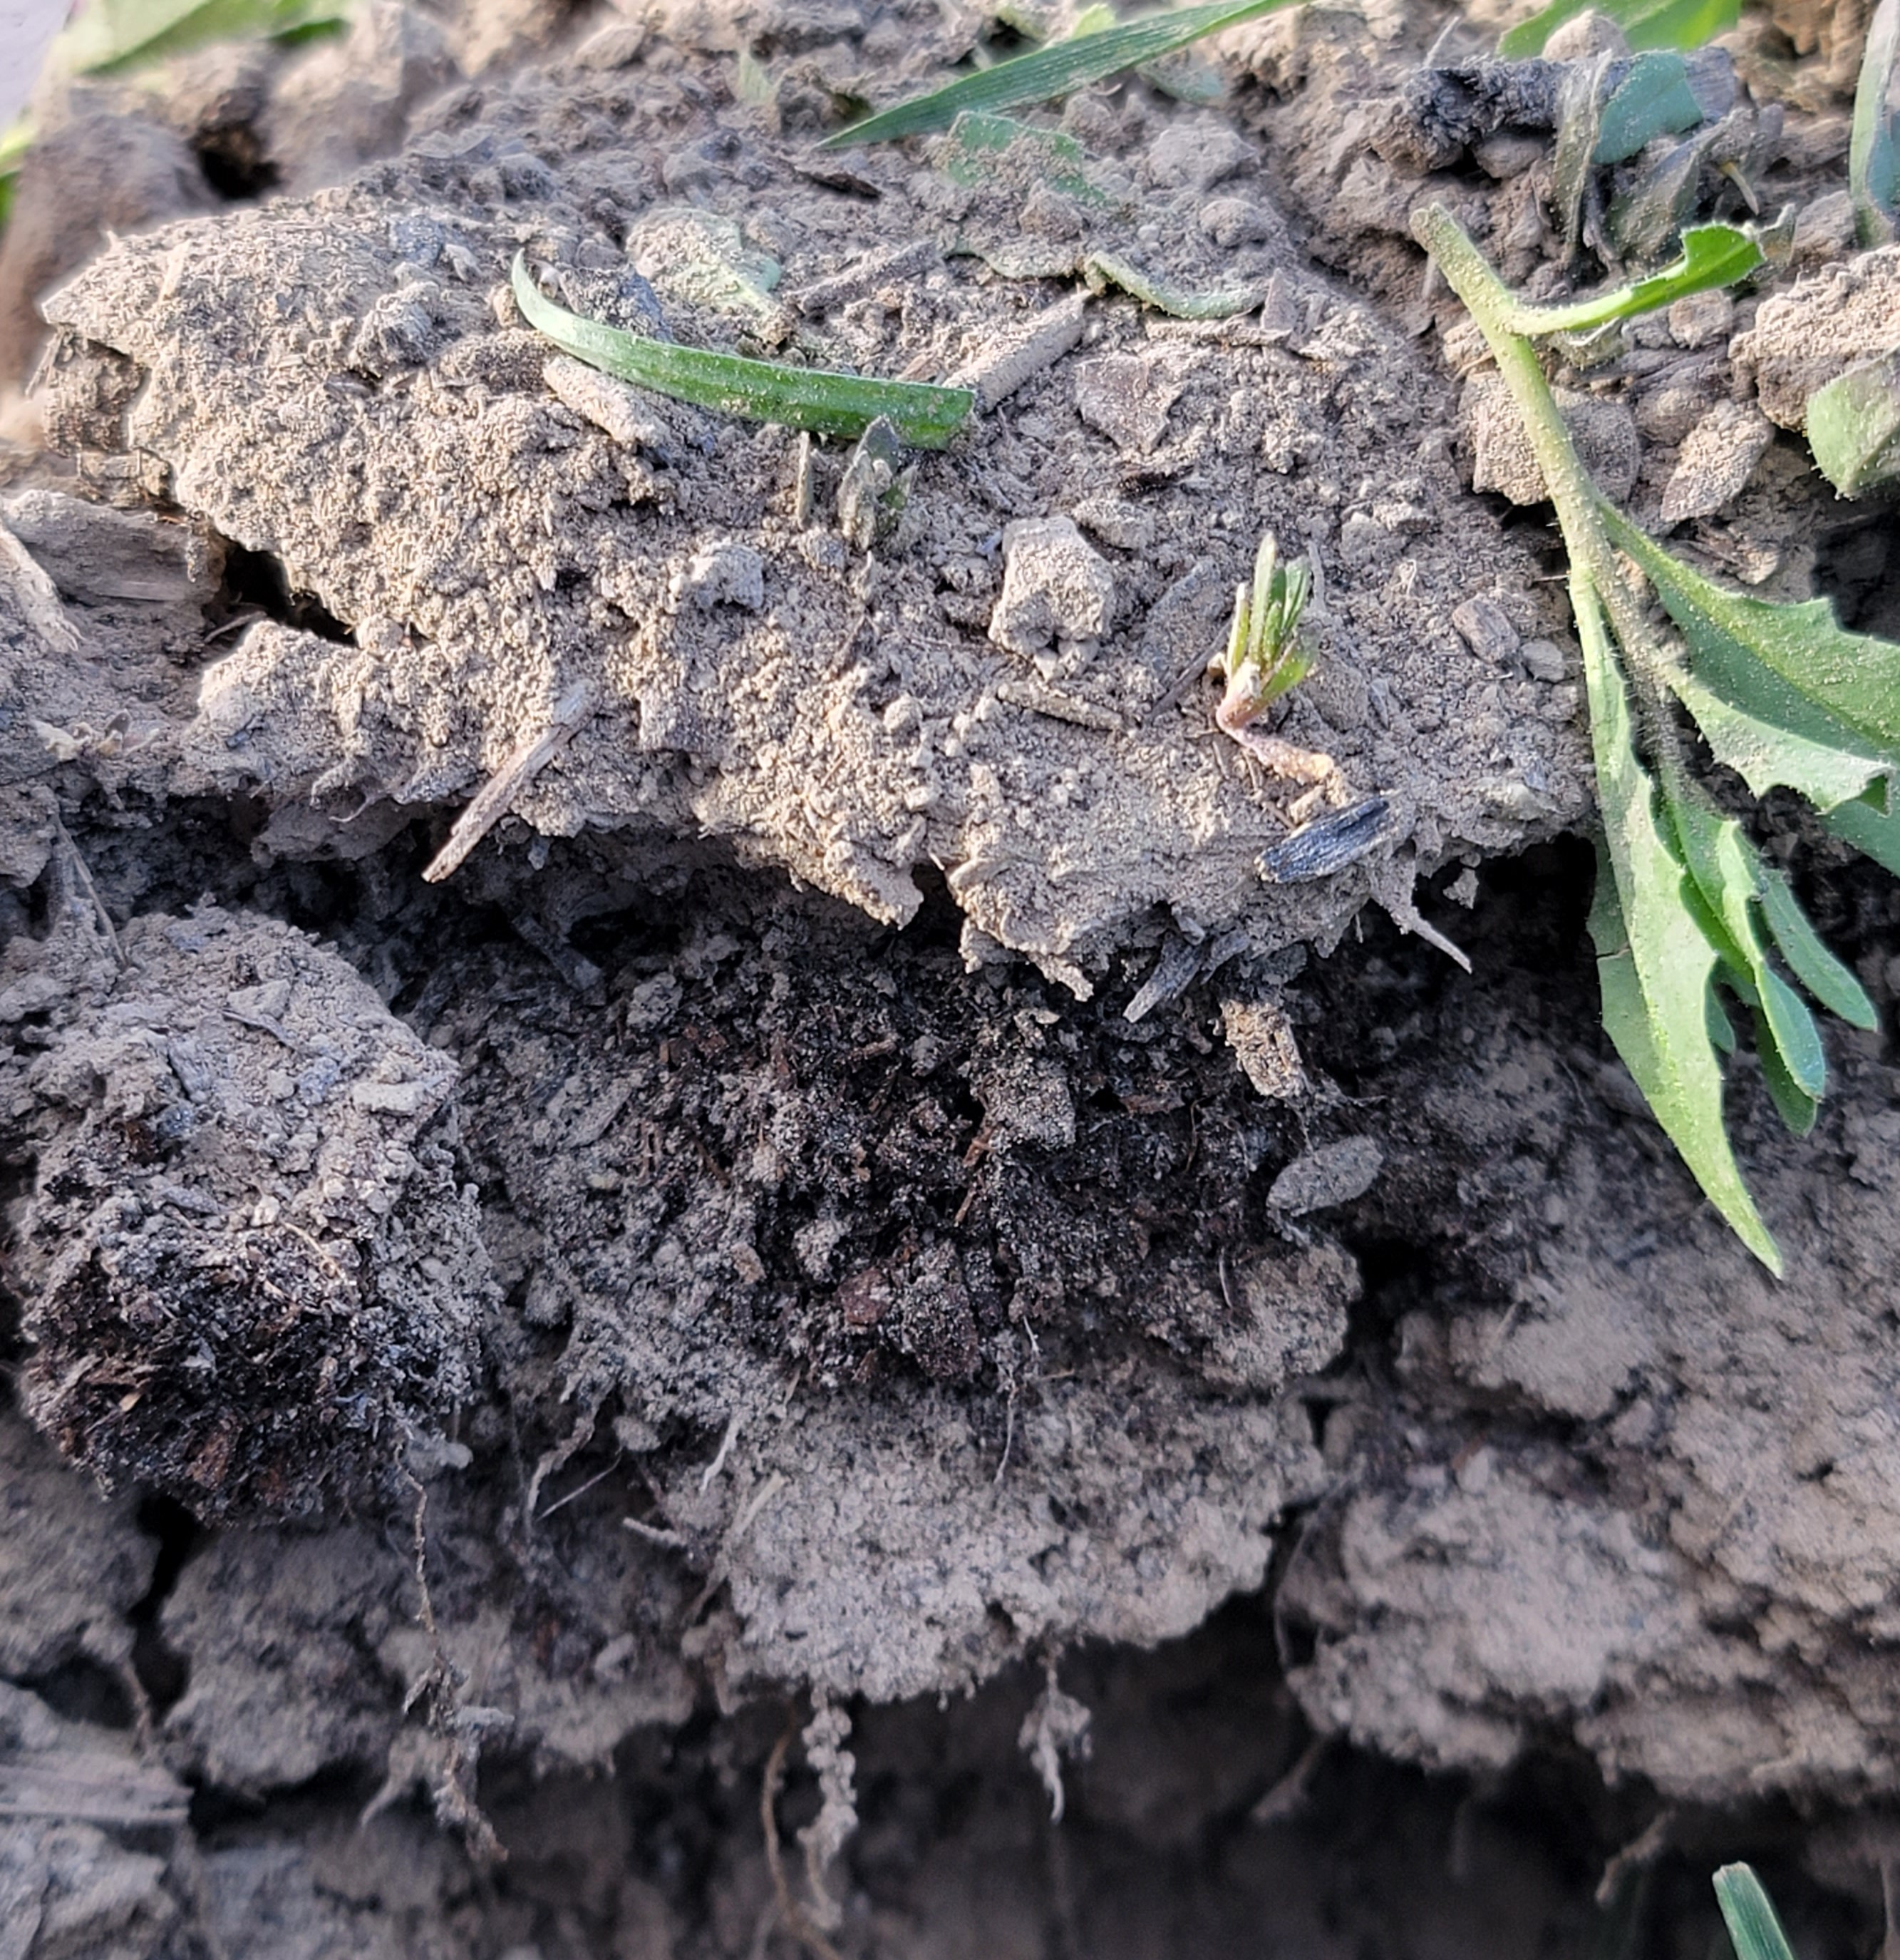
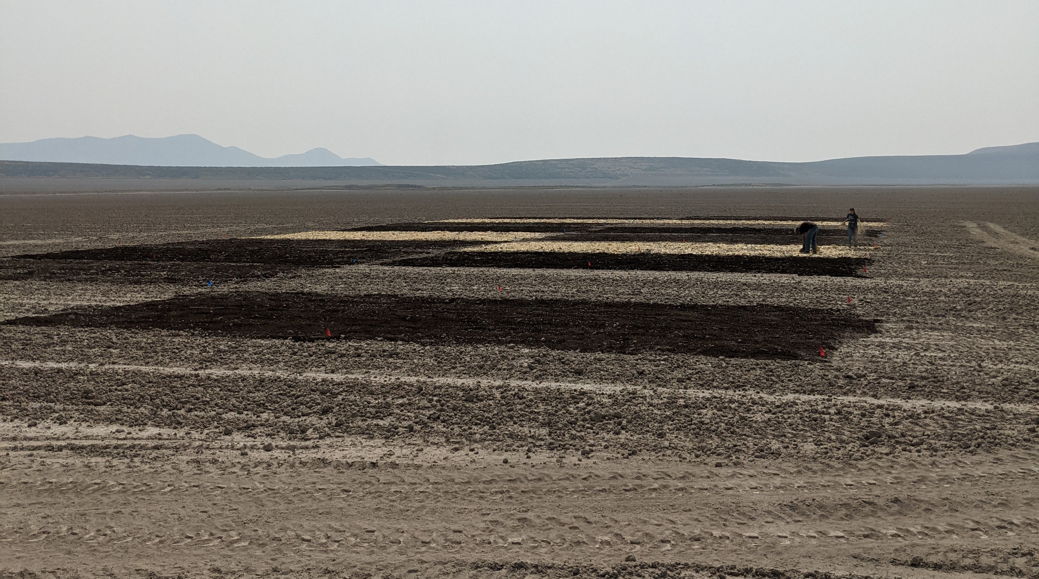
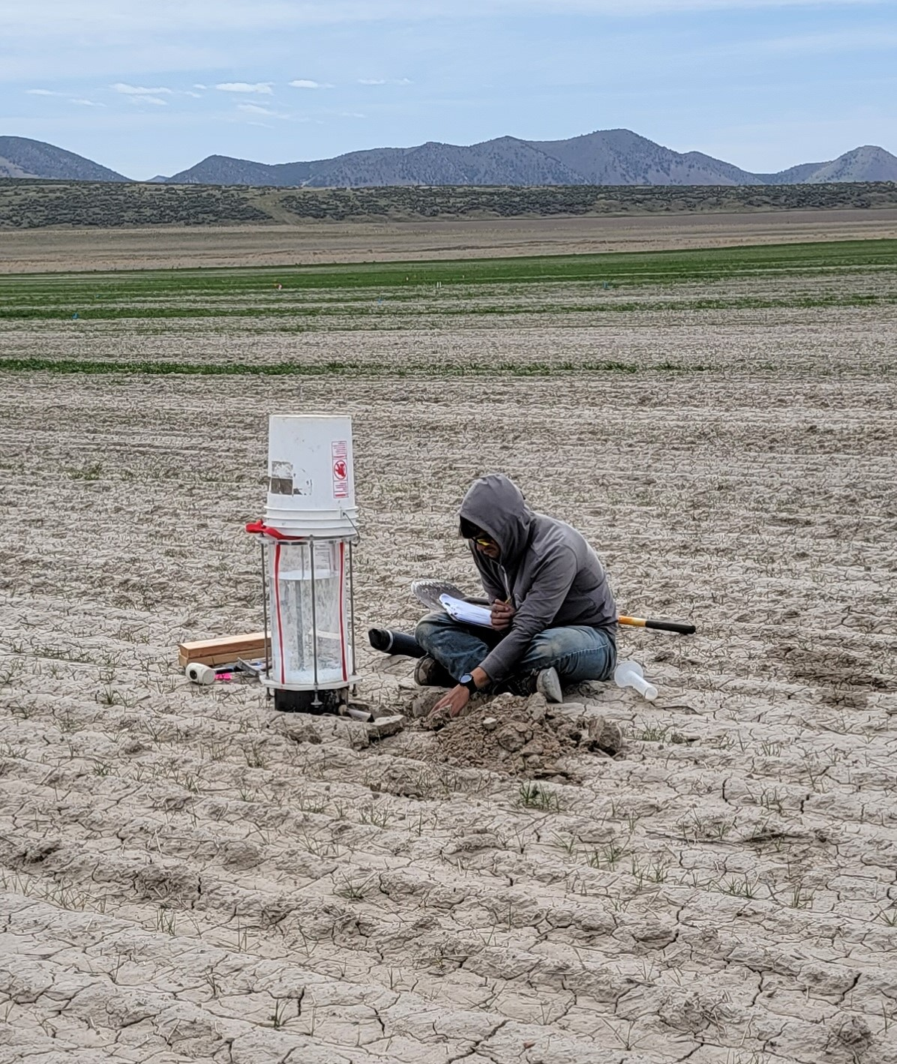
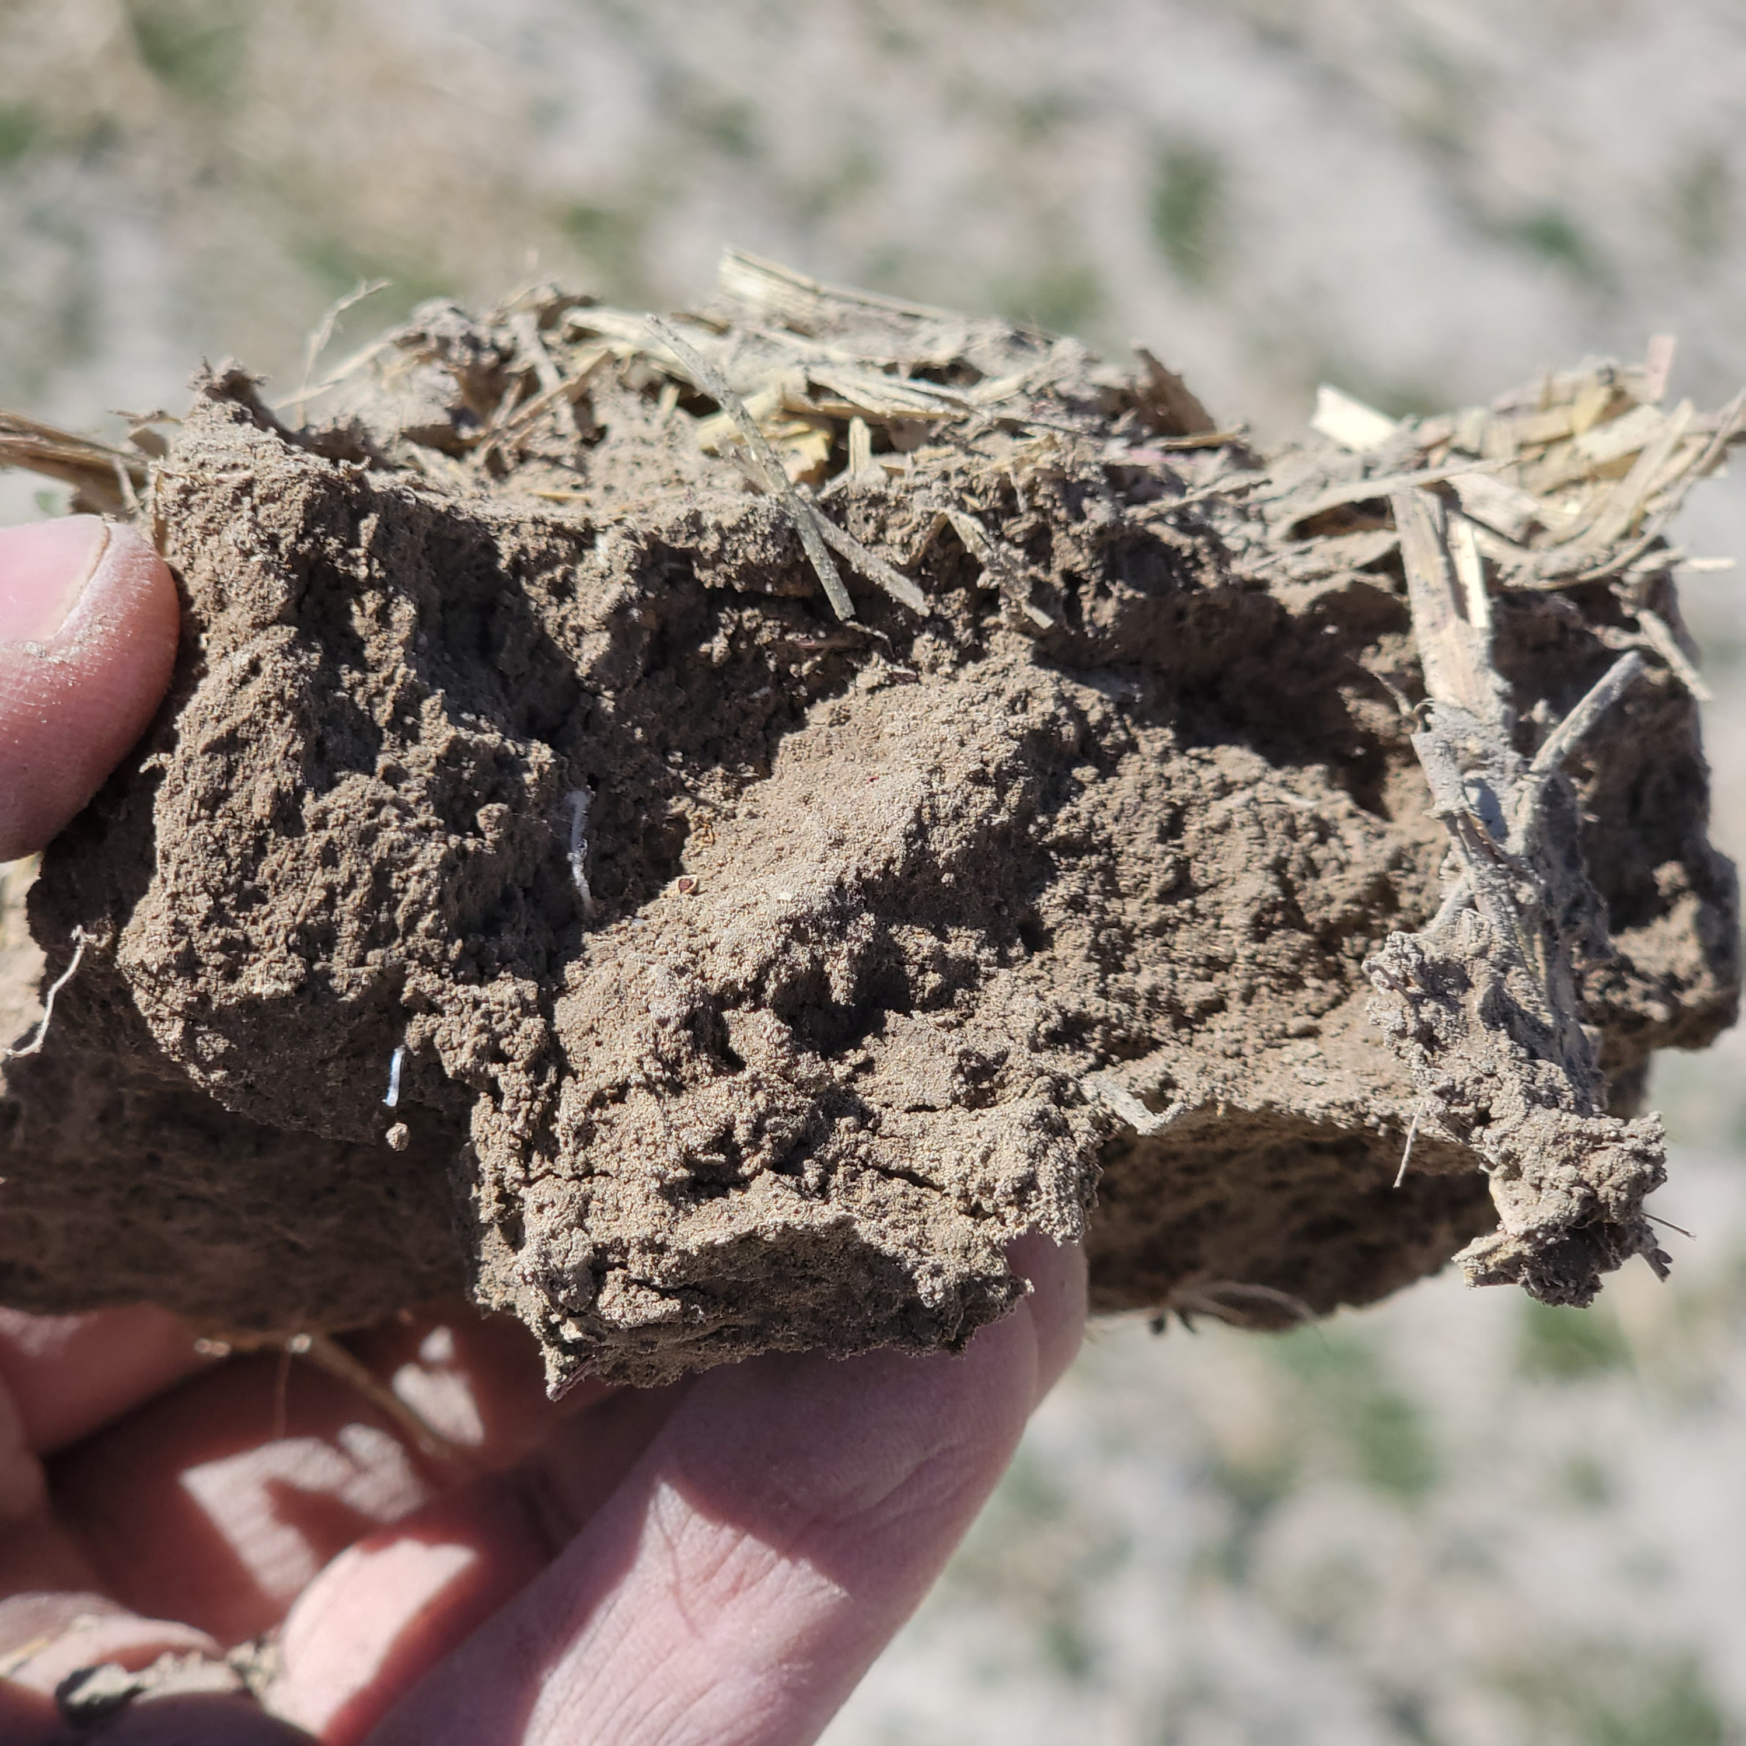
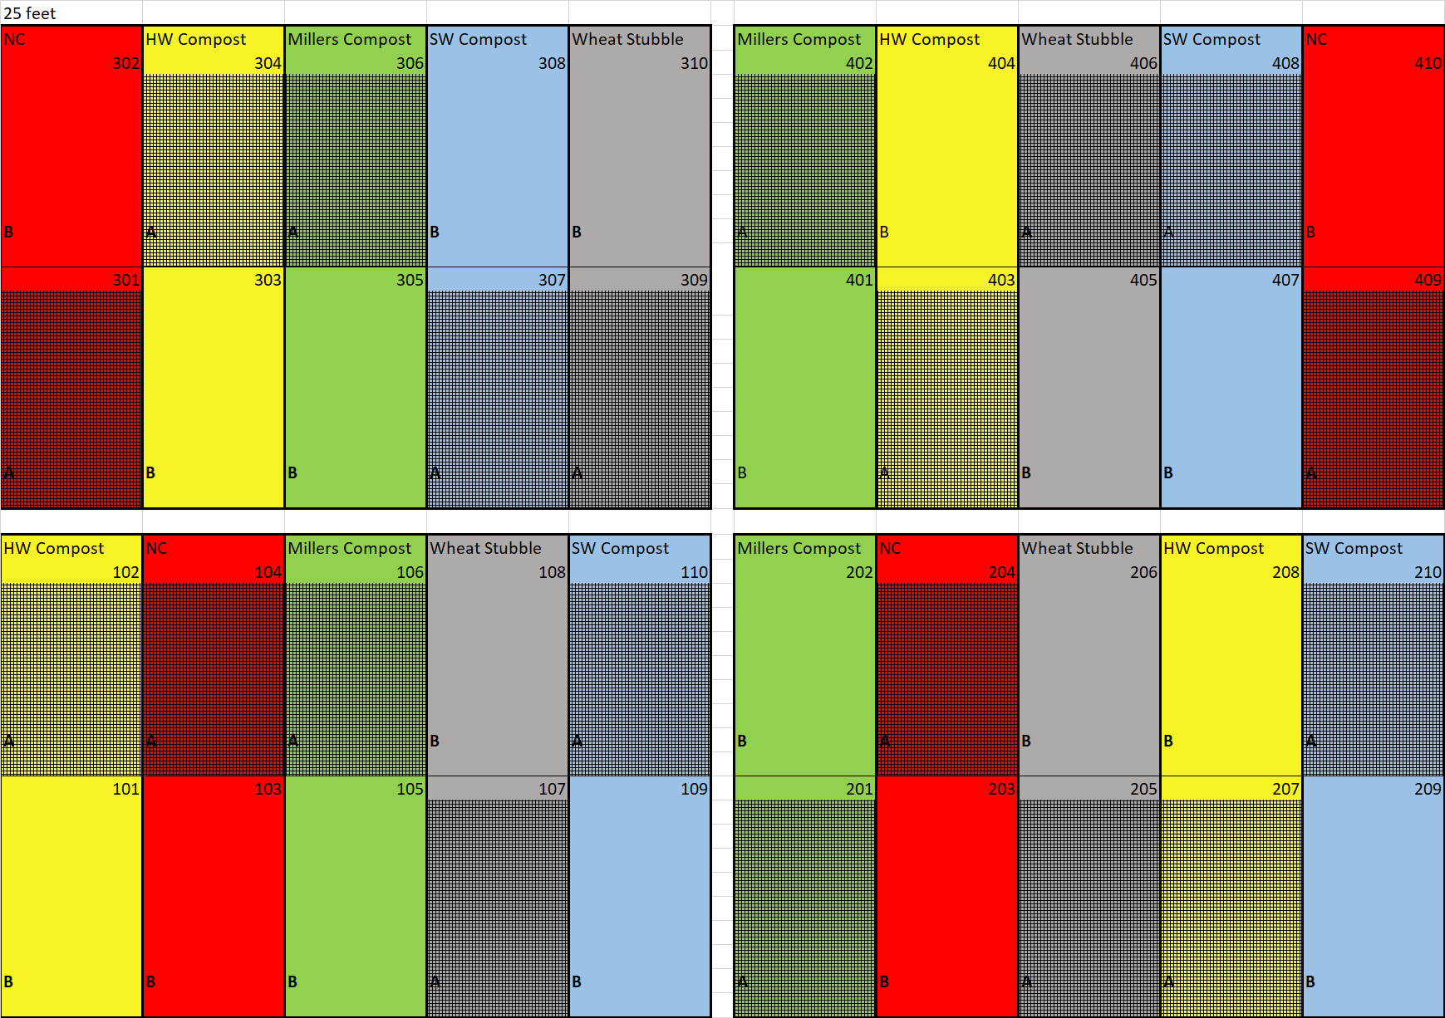
Amendment Type Influences Aspects of Soil Physical Health in Dryland Organic Wheat Systems
Preston Christensen¹, Astrid R. Jacobson², Earl Creech³ and Jennifer R Reeve³, Plants, Soils and Climate Department, Utah State University, Logan, UT
Introduction
Results
Conclusion
Soil structure, aggregate stability, and water infiltration are all fundamental aspects of assessing soil physical health.
Low SOM decreases overall soil health; Dryland organic wheat systems have < 1% SOM which leads soil crusting, water ponding and erosion.
The aim of this study is to assess of different amendment types on soil water infiltration and aggregate stability.
Amendment type influenced soil water infiltration and surface crust development.
Aggregate stability data support infiltration data.
Preliminary penetrometer data shows a decrease in soil compaction and surface crust development for compost amended plots.
Infiltration data showed differences in time to runoff and sorptivity.
Methods
Snowville Compost Study
RCBD with 4 reps
  Subplot treatments: Feather Mill: 50 Mg/ha
    Amendments: Control (NC)
    Wheat Straw (WS): 5 tons/ha
    Millers Compost: 50 Mg/ha
    Softwood Compost: 50 Mg/ha
    Hardwood Compost: 50 Mg/ha
References
Wet Aggregate Stability
Wet Aggregate stability analyzed with Kemper and Rosenau method.
Penetrometer data collected using FieldScout penetrometer.
Cornell Sprinkle Infiltrometer for Infiltration
Estimation of Field-Saturated Infiltrability
i_{fs}= i_{t} * 0.80
Runoff Rate (cm/min)
ro_{t} = V_{t}/(457.30*t)
Sorptivity (cm/min)
S= (2­­_{R­})^{0.5}* r
C.J. Bronick, R. Lal. Soil structure and management: a review. Geoderma, 124 (2005), pp. 3-22
Kemper and Rosenau, 1986Kemper, W.D., Rosenau, R.C., 1986. Aggregate stability and size distribution. In: Methods of Soil Analysis, Part 1. Physical and Mineralogical Methods. Agronomy Monograph no. 9. Society of Agronomy/Soil Science Society of America, pp. 425–442.
Schindelbeck, R. R., Moebius-Clune, B.N., Moebius-Clune,D. J.,Kurtz,
K. S., & van Es, H. M. (2016). Cornell University comprehensive
assessment of soil health laboratory standard operating procedures.
Ithaca, NY: Cornell University.
Special thank you to Dr. Matt Yost: Assistant Professor Utah State University and Greg Vandas: Field Technician
Funded through USDA AFRI OREI (2019-51300-3476)

