Slide 1
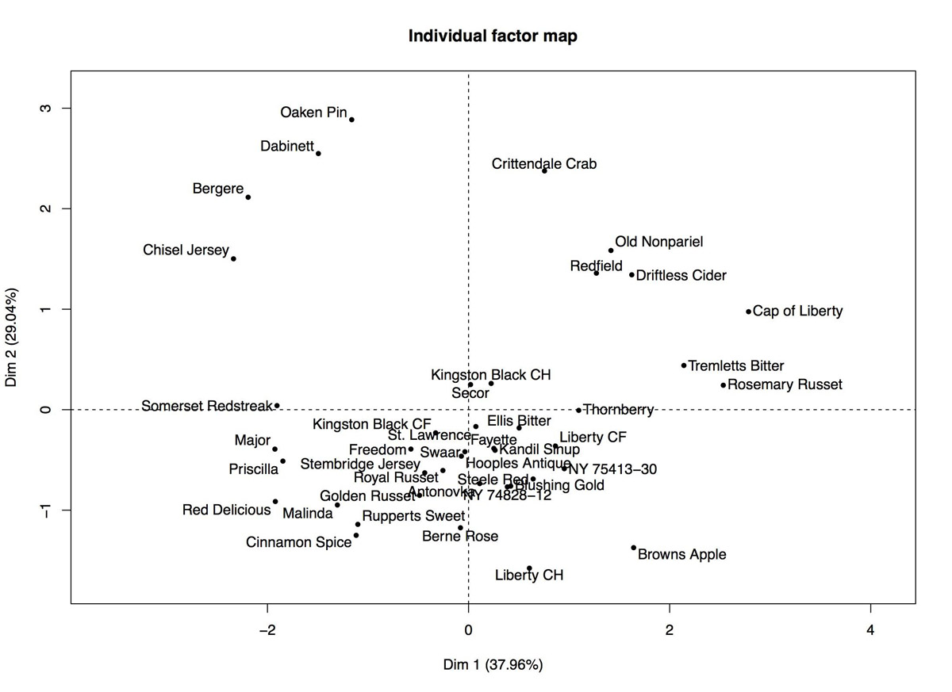
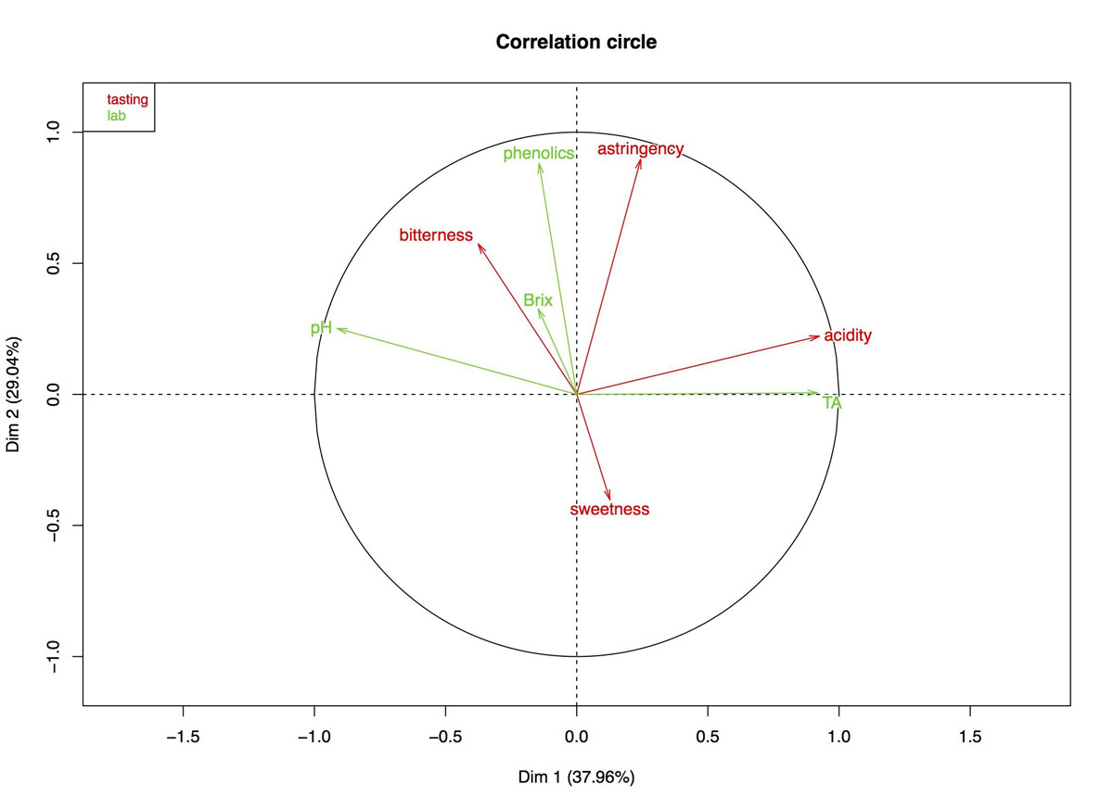
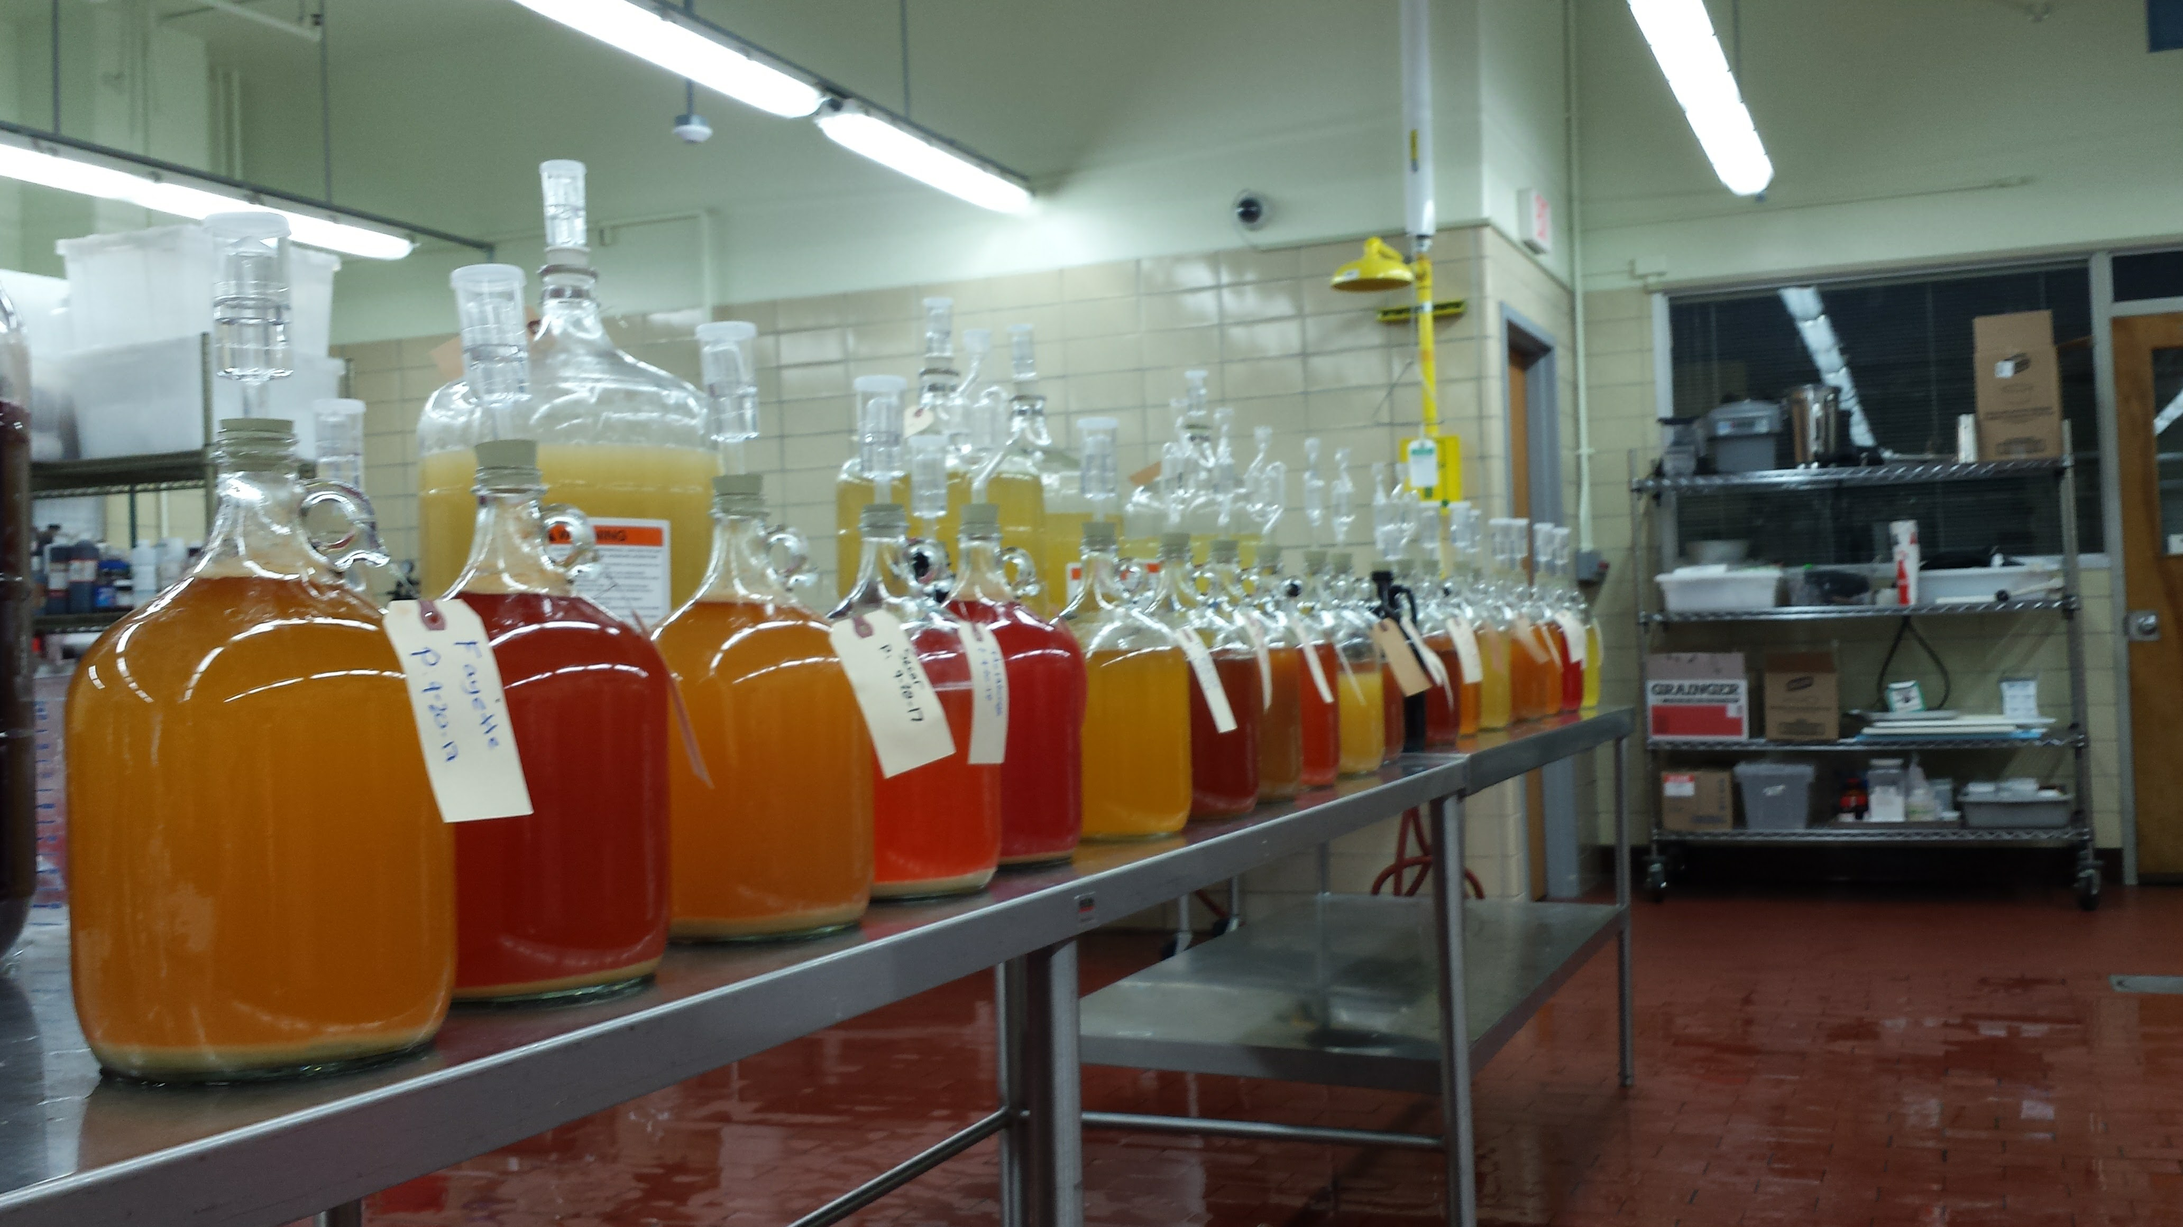
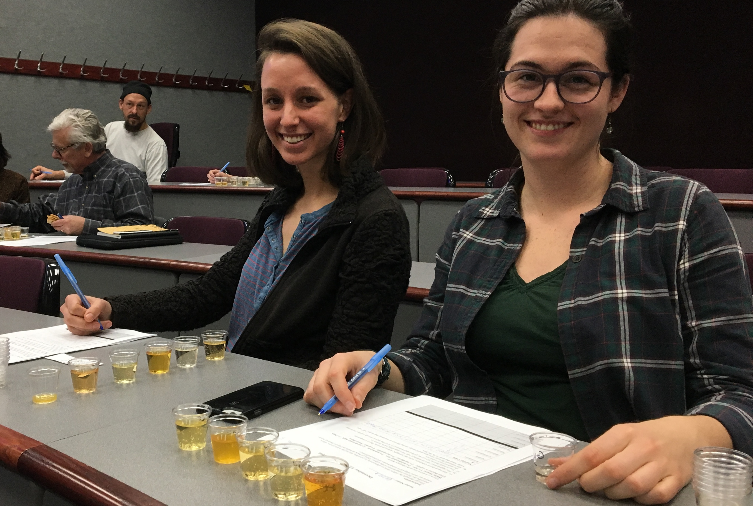
Lab measures as a proxy for sensory testing hard cider
Principle Component Analysis (PCA) allows us to display data on multiple variables and varieties at once. It takes a dataset with multiple variables, finds the most important sources of variation, and creates a two-dimensional map to represent as much of the variation as possible, showing their relationships. Variety placement corresponds to the levels of each of the variables for that variety. Ciders in the upper left corner are highest in TA, while those in the upper right are higher in ˚Brix and phenolics. Ciders close to the center are close to the mean for all values.
The directions of the arrows show the direction of increasing values for that variable. The angle between the arrows show the correlation among variables. ˚Brix and phenolics are positively correlated, for example, while ˚Brix and TA are uncorrelated. The length of each arrow corresponds to amount of variation contributed by that factor (the TA arrow is slightly longer than the ˚Brix and phenolics arrows for example, and therefore contributed more to the overall variation). The percentages on the axes represent the percent of the total variation accounted for by that axis.
This research tested flavor on 41 single-varietal hard ciders in the lab and with sensory taste panels. Lab tests are easier and less expensive than sensory analysis. We wanted to see if there were correlations between the two types of tests, especially since taste can vary from year to year, orchard to orchard. This graph shows both the laboratory and sensory variables on the same chart. The contribution of the lab (phenolics, ˚Brix and TA) and sensory (sweetness, acidity, bitterness, astringency) variables are balanced by giving each set equal weight in the analysis. This approach allows us to compare lab results on each apple variety with tasting results. We see in comparison that lab results may serve as a proxy for taste characteristics. Phenolics and ˚brix are perceived as astringency, bitterness and alcoholic strength. TA is perceived as acid. Of the 41 samples, Dabinette was the only cider that was perceived as more acidic than would be indicated by its TA. It had a high ˚brix (18), and high phenolics (2256). TA measured 1.6. We think this is a result of how flavors interact.
Research team: Nick Smith, UW-Food Science Fermentation Lab; Julie Dawson, UW Horticulture; Michelle Miller and Elly Voigt, UW Center for Integrated Agricultural Systems; Albion Prairie Farm, ˚Brix, Cider House of Wisconsin, The Cider Farm
Phase one: USDA NCR–SARE ONC17-030 and David Borne Foundation. Phase two: USDA-AFRI 2017 - 08308

