Slide 1
Communicating Conservation Goals & Priorities
Dr. Suzanne Dorsey
Harry R. Hughes Center for Agro-Ecology, Inc.
This work is supported by the National Institute of Food and Agriculture, U.S. Department of Agriculture, through the Northeast Sustainable Agriculture Research and Education program under subaward number ENE18-151.

Slide 2
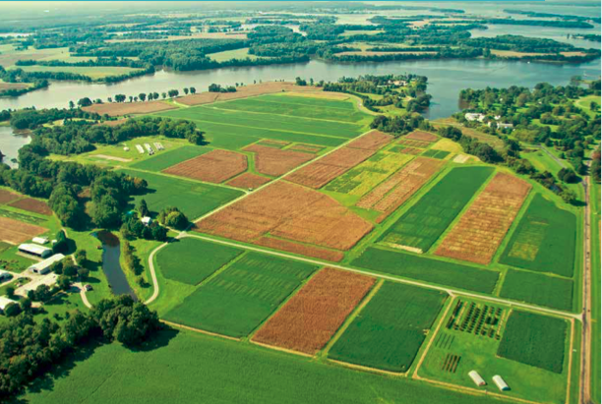
Communicating Leasing Priorities
Communication Priorities:
How will the land be farmed;
Basic lease:
term,
rent,
termination,
concerns about the property.

Slide 3
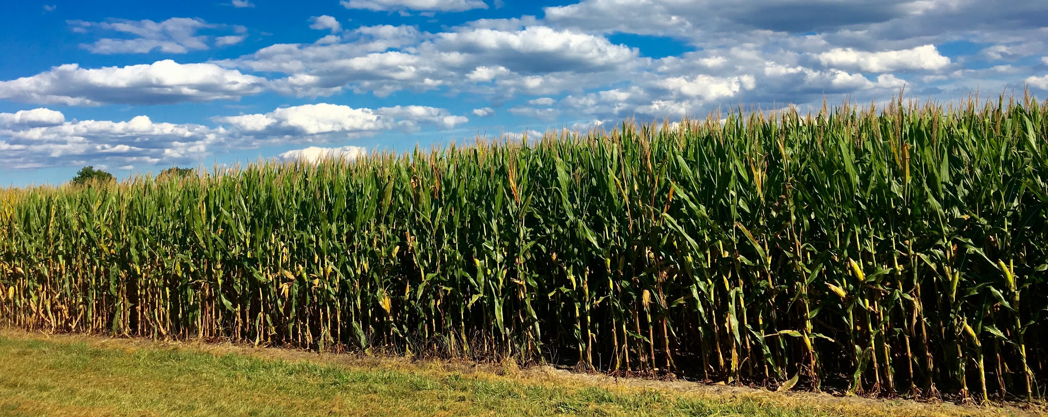
Communicating Leasing Priorities
Landowners and farmers
need to recognize where interests align and differ.

Slide 4
Communicating Leasing Priorities
Farmers should not assume landowners have no preferences
Landowners should not assume farmers can or will use best management practices.

Slide 5
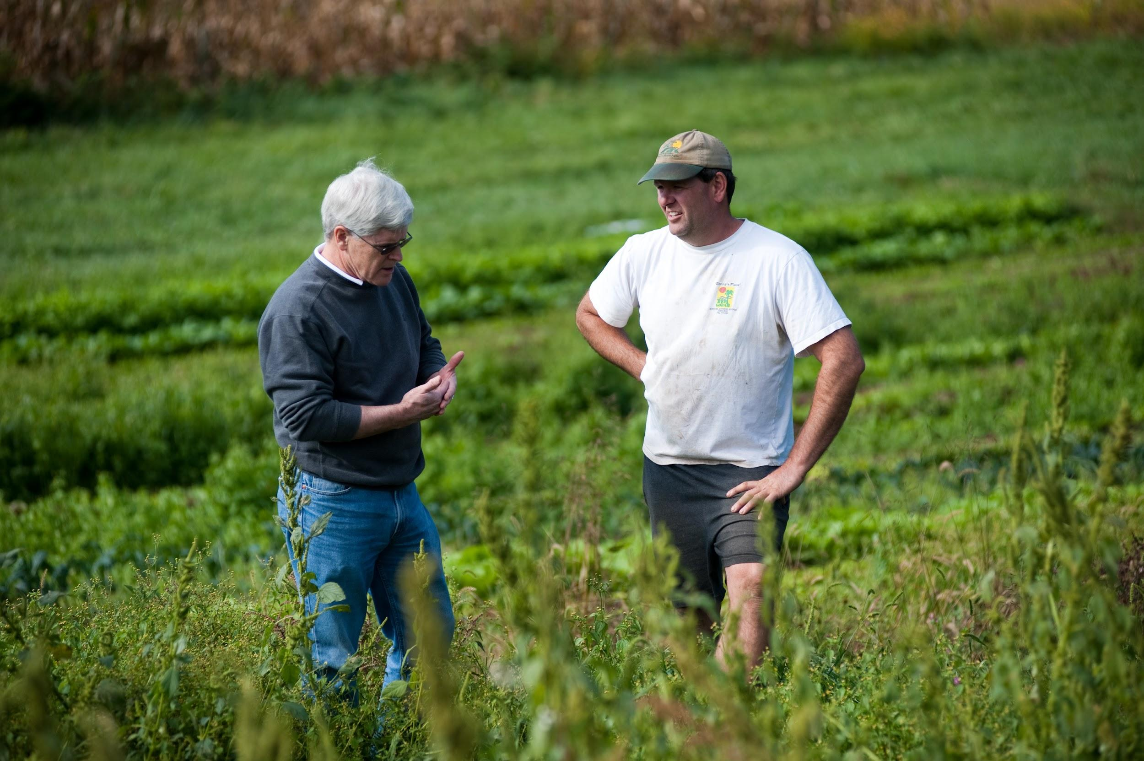
Value of Communication
Most lease disputes arise out of misunderstanding,
Open communication:
Sets expectations;
Delineates responsibilities; and
Reduces the likelihood of conflict.

Slide 6
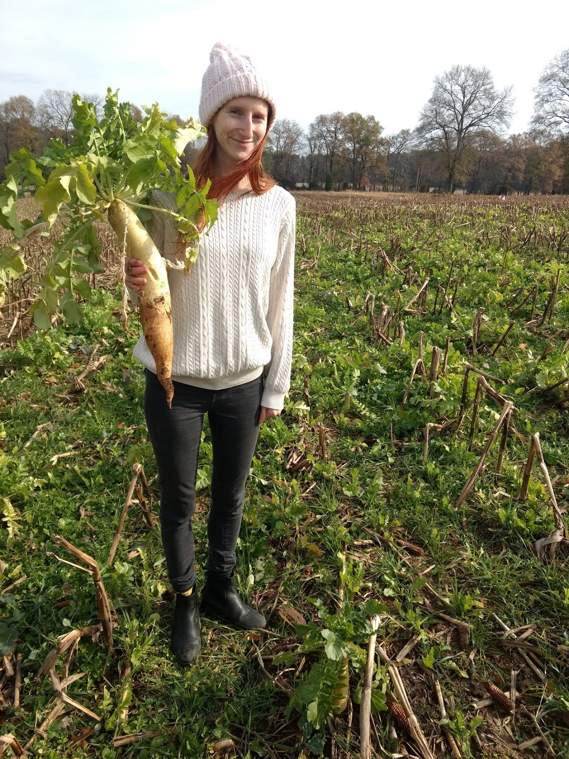
Communicating Conservation Goals
Landowners and farmers should know their own conservation goals and priorities.
Notes:
Come to the conversation prepared to discuss your priorities and opportunities to collaborate. Know where your go-no-go points are and be open to discussing cost-share opportunities.

Slide 7
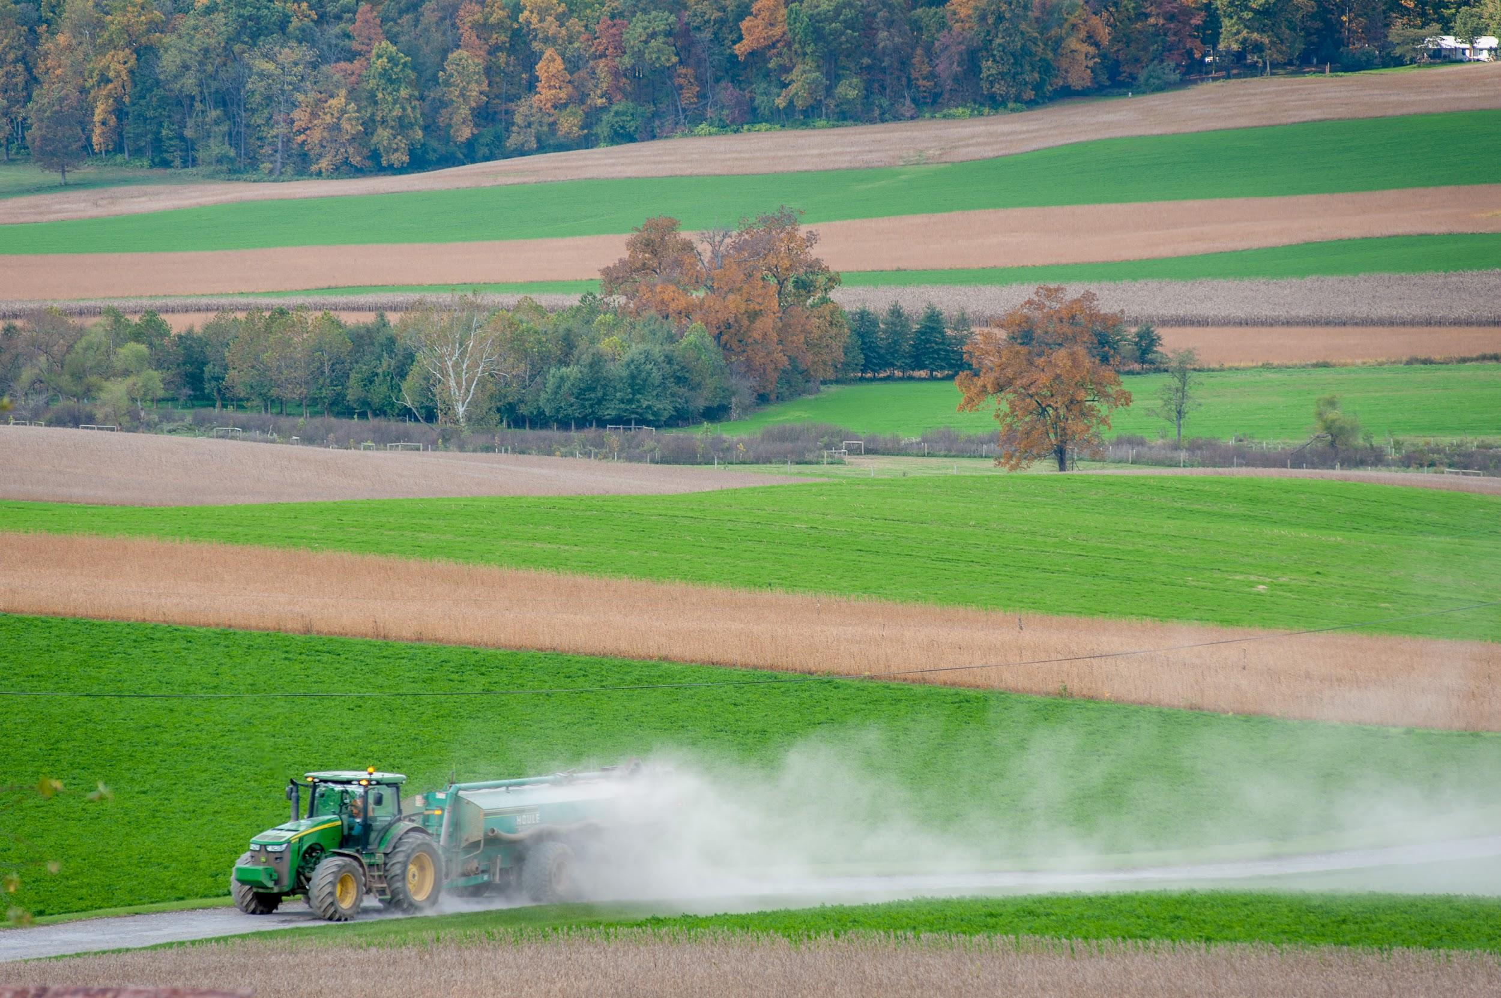
Landowners- Questions to Ask Yourself
Do you have a written lease with your farmer?
No: are you willing to enter into a lease?
Yes: does your lease address stewardship/conservation?

Slide 8
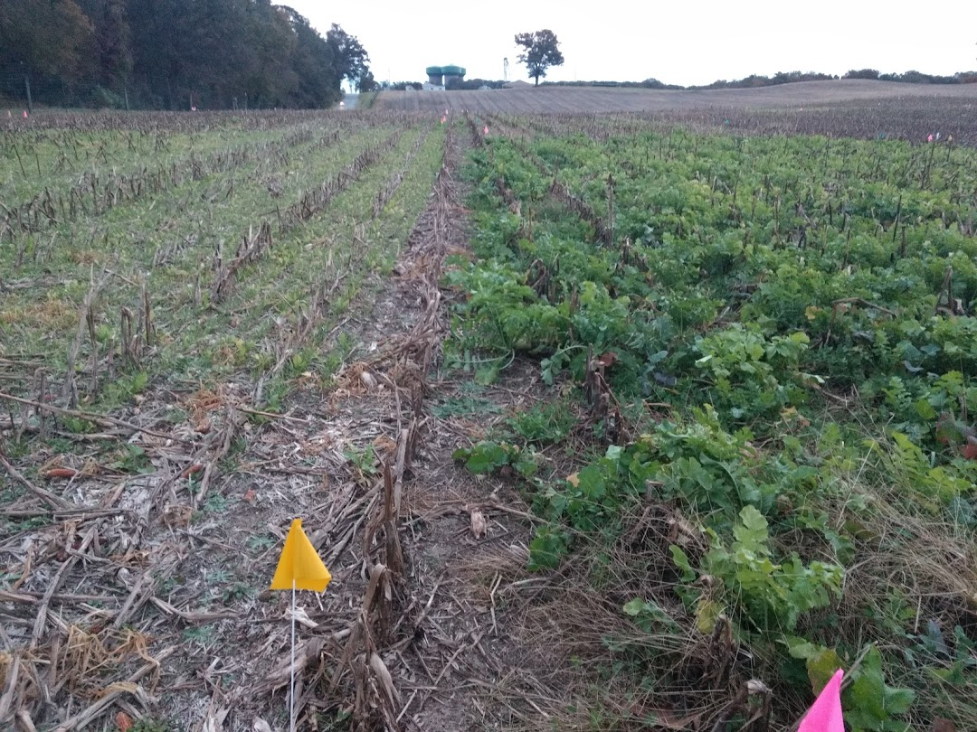
Landowners- Questions to Ask Yourself
How will conservation practices benefit your land?
Can you make agricultural conservation choices:
independently
collaboratively with tenant?

Slide 9
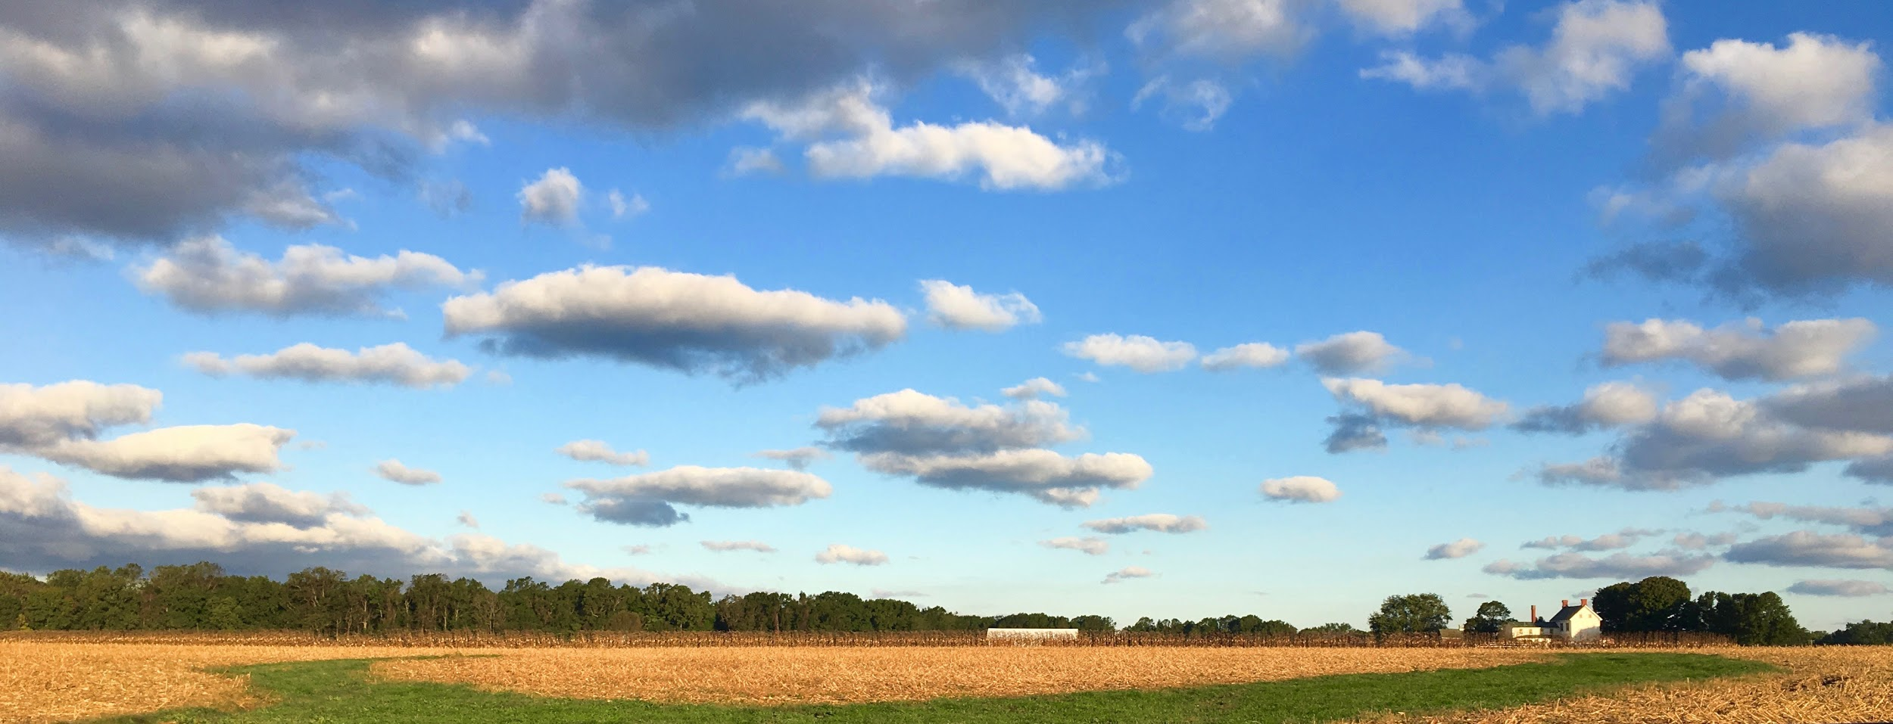
Landowners- Questions to Ask Yourself
Implementing conservation practice will cost the farmer $$
Are you willing to compensate the farmer?
ie. Temporary reduction in rent
Longer lease term
Notes:
longer-term lease to ensure the maintenance of a conservation practice?
See Appendix B, page 16 of Ag Conservation Leasing Guide

Slide 10
Resources for Assessing Conservation Priorities
Opportunities for cost share & technical input with federal, state and private partners:
Soil Conservation District (SCD)
National Resource Conservation Service (NRCS)
Maryland Department of Agriculture (MDA)
University of Maryland Extension
Non Profit Corporations
For contact info: Appendix A, pg. 15 of the Ag Conservation Leasing Guide.

Slide 11
Questions for a Landowner to Ask the Farmer
Would you be interested:
Implementation of a specific conservation practice:
ie forested buffer?
Working to apply for cost-share programs?
Contributing time and/or financial investments to establish a practice?

Slide 12
Questions for a Landowner to Ask the Farmer
What impact will new practice or structure have on farmer’s bottom line?
input costs,
reduced yields,
etc.
How can we collaborate to make the implementation and maintenance of conservation practices equitable?
Notes:
Thinking about farm practice profitability before your conversation especially from the landowners perspective will yield a more productive conversation.
Be prepared to have some skin in the game if you are the landowner.

Slide 13
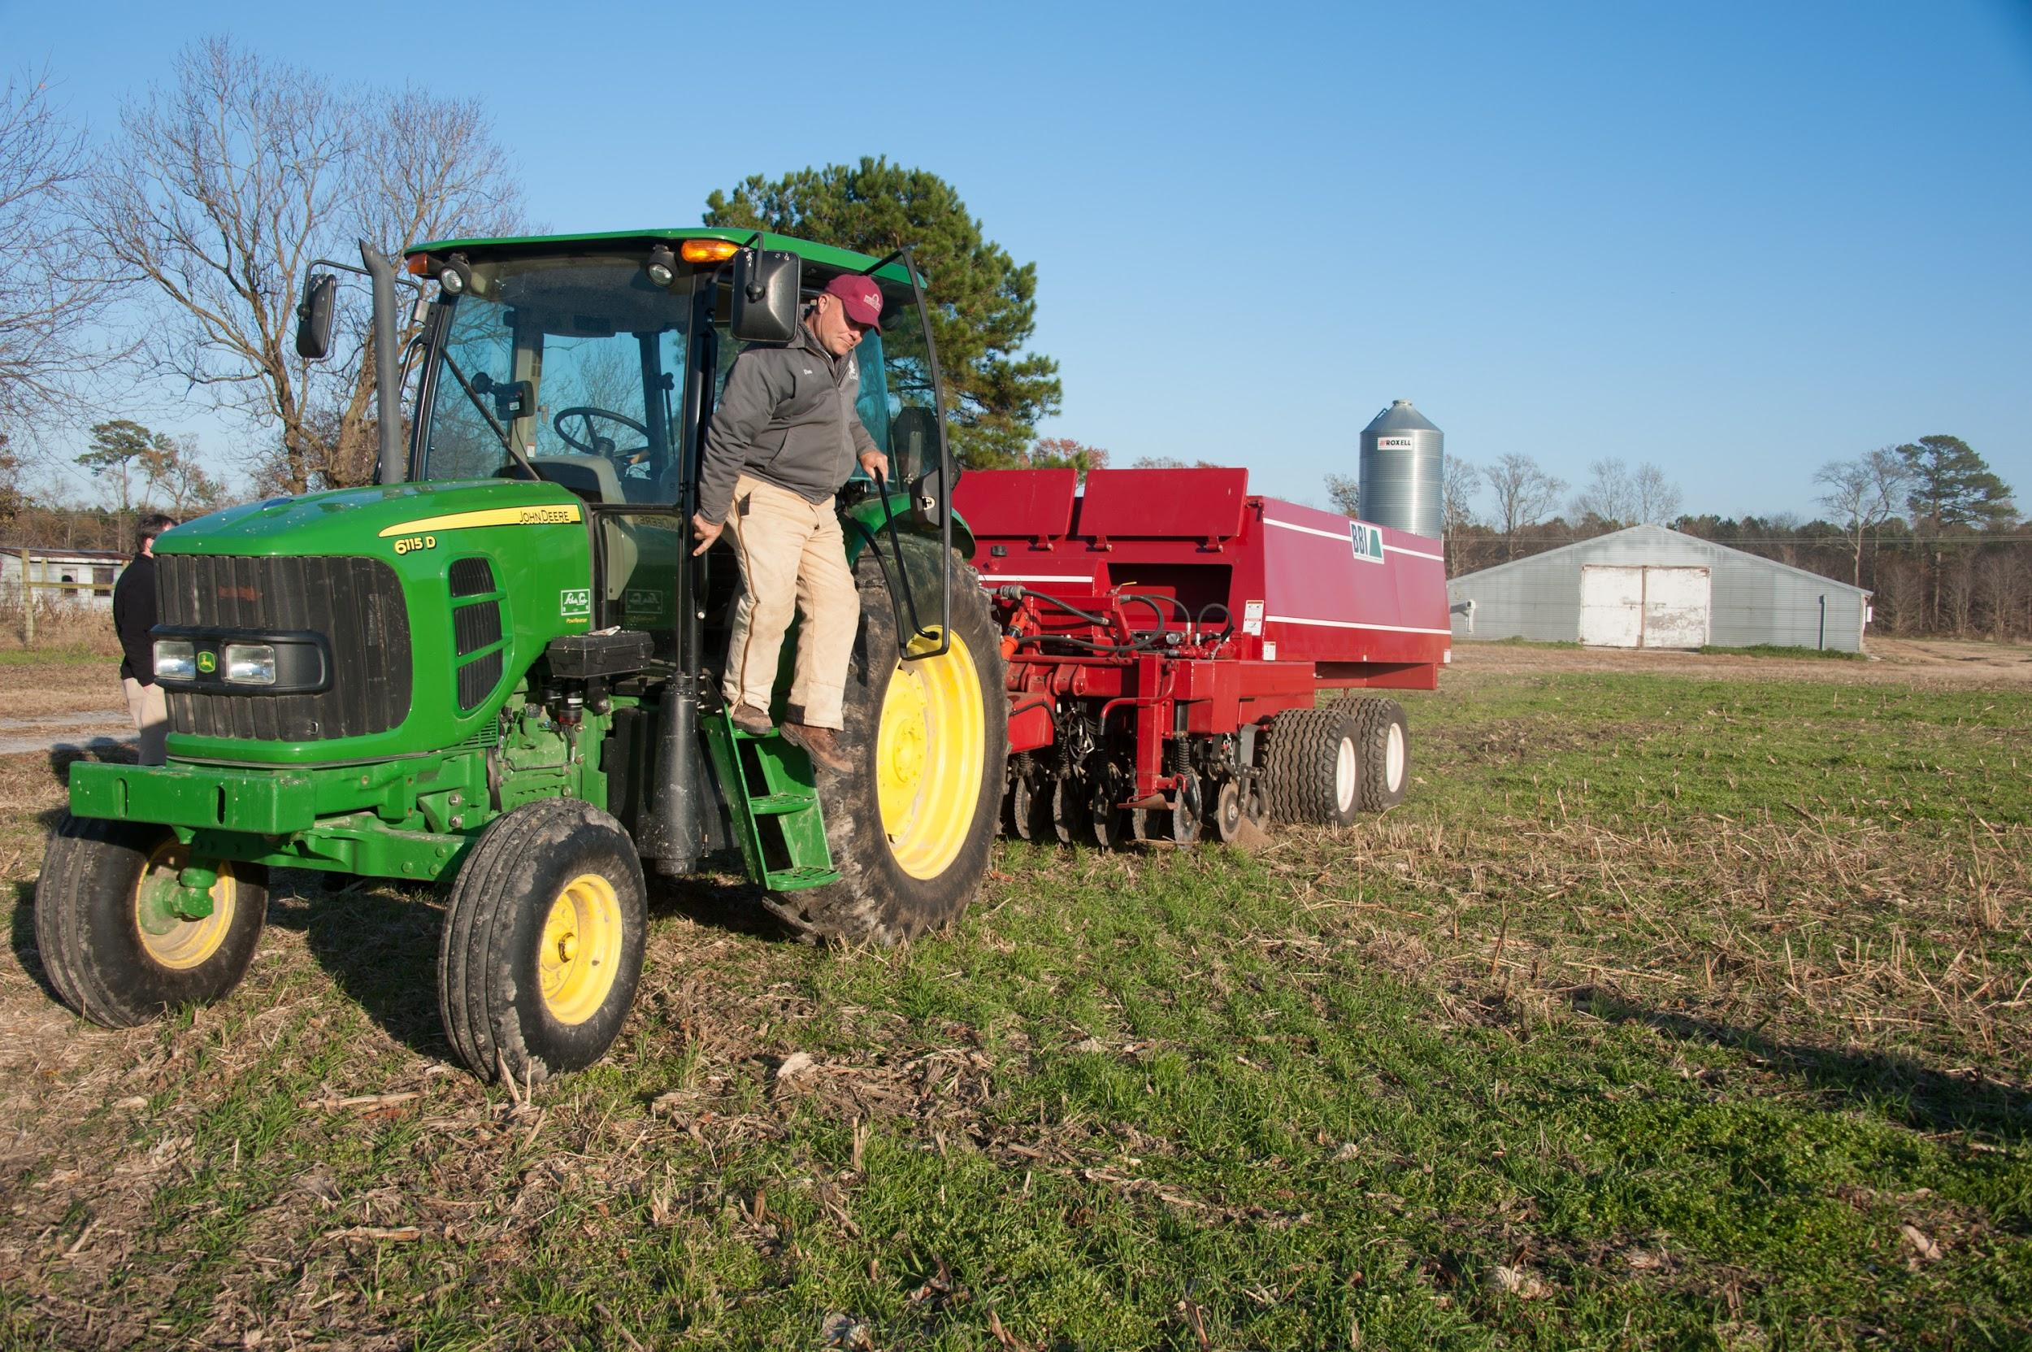
Farmers- Questions to Ask Yourself
What are your current practices and why?
Are there reasons why you practice conservation farming on you home farm but not on leased land?

Slide 14
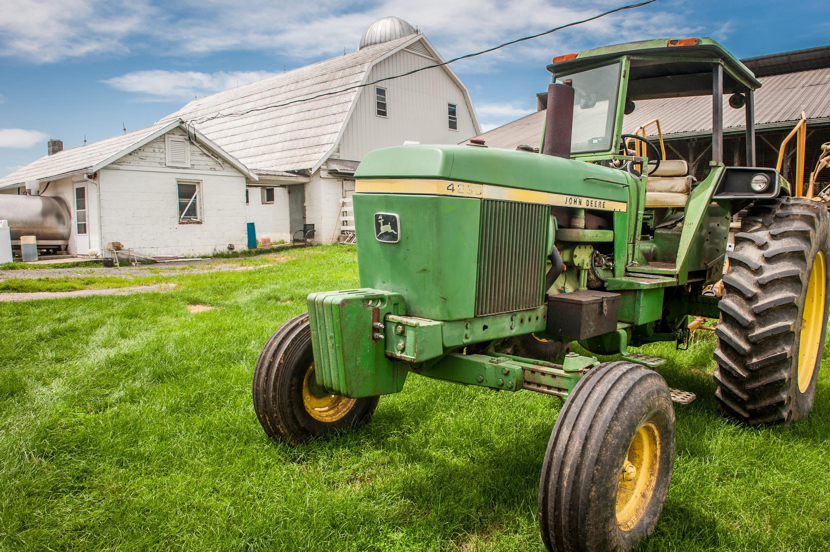
Farmers- Questions to Ask Yourself
What conservation practices would improve the leased farm?
soil erosion,
surface water runoff,
soil fertility
etc.

Slide 15
Farmers- Questions to Ask Yourself
What’s holding you back from putting conservation practices in place?
Lack of written lease
Lack of stability in lease term (example-year-to-year
lease)
Lack of funding
Impact on yields
Lack of communication with landowner

Slide 16
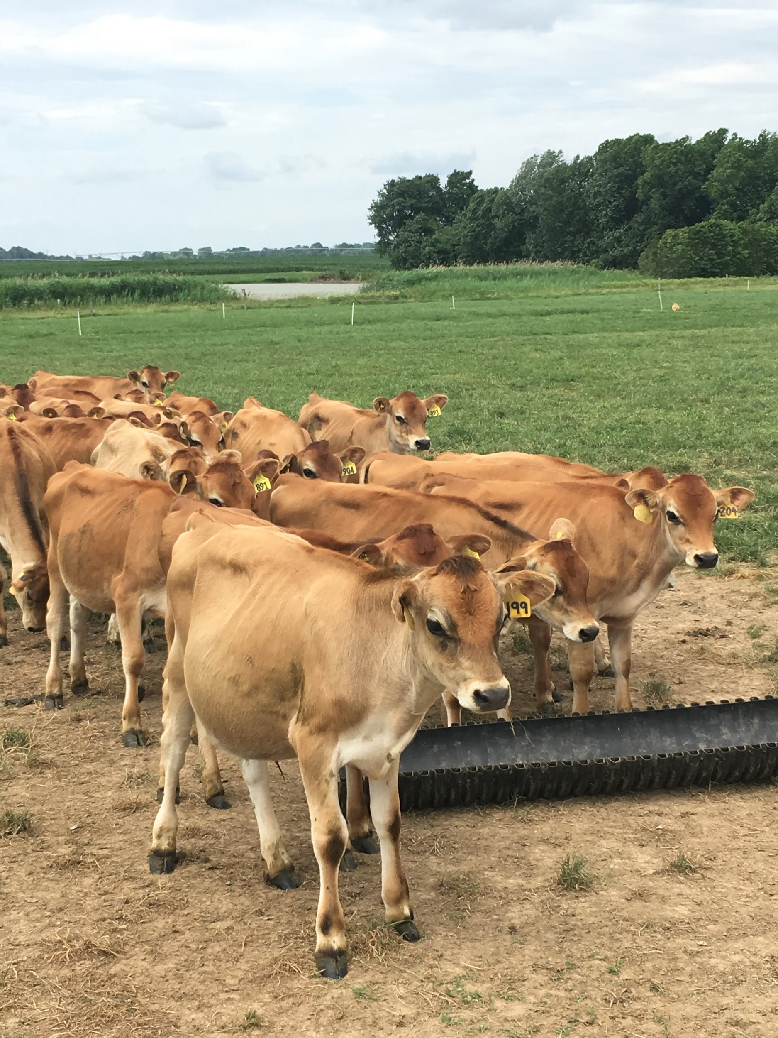
Farmers- Questions to Ask the Landowner
Prioritize your desired conservation practices
Familiarize yourself with cost-share opportunities
Notes:
Know which cost share requires landowner engagement

Slide 17
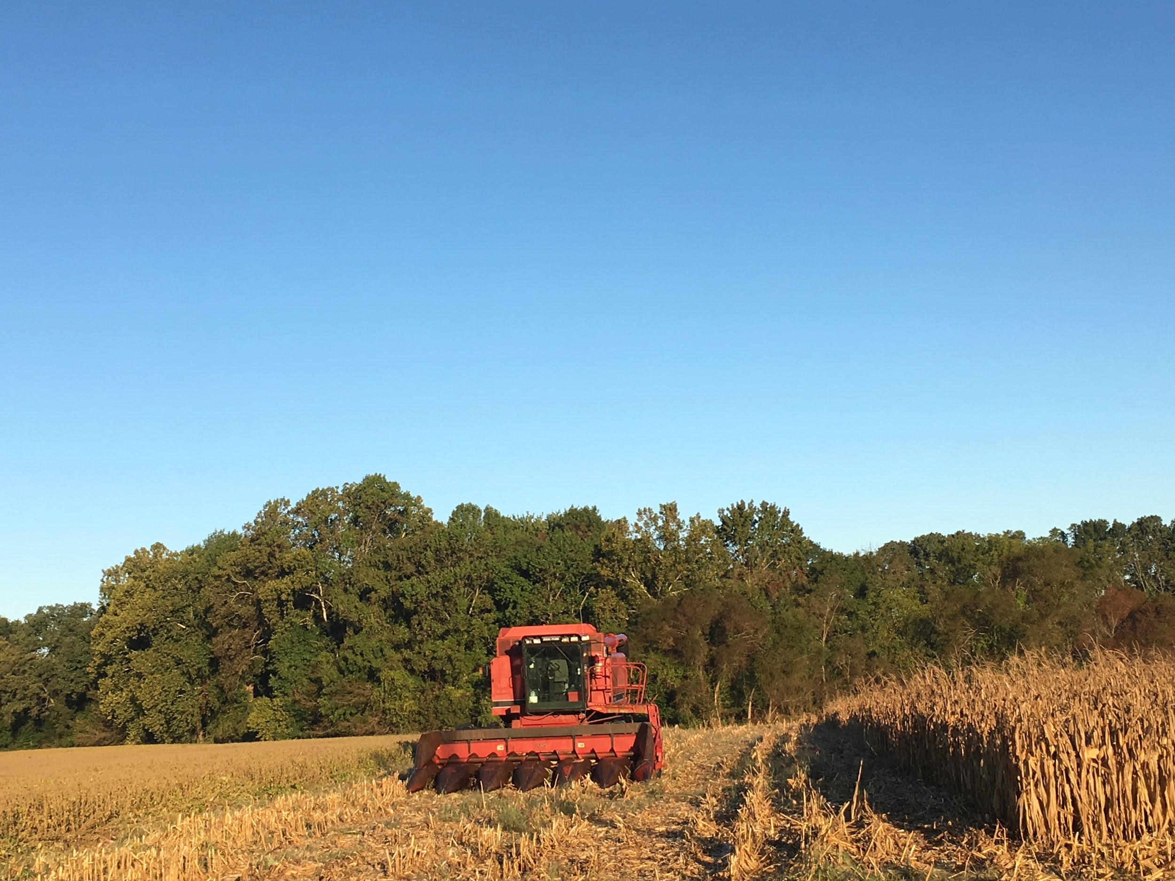
Farmers- Questions to Ask the Landowner
How much, if any, time and/or will you contribute?
Non-monetary approaches:
Graduated rent to compensate for decreased yields?
Extend Lease term
Right of first offer for land sale

Slide 18
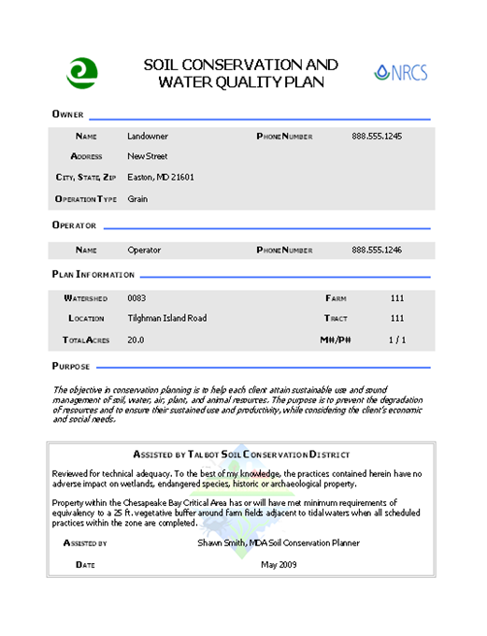
Use a Conservation Plan as a tool
Reviewing, updating, or creating conservation plan can:
initiate a conversation about conservation practices

Slide 19
Use a Conservation Plan as a tool
Review a plan annually to ensure conservation goals and to assess adjustments.
Lease language can make a compliance with a conservation plan a provision
Pg. 4 of the Agricultural Conservation Leasing Guide.

Slide 20
Maintaining Communication is the key
A good lease reflects the parties’ understanding and circumstances are bound to change over time.
Maintaining landowner/farmer communication ensures leasing arrangement remains mutually beneficial.

Slide 21
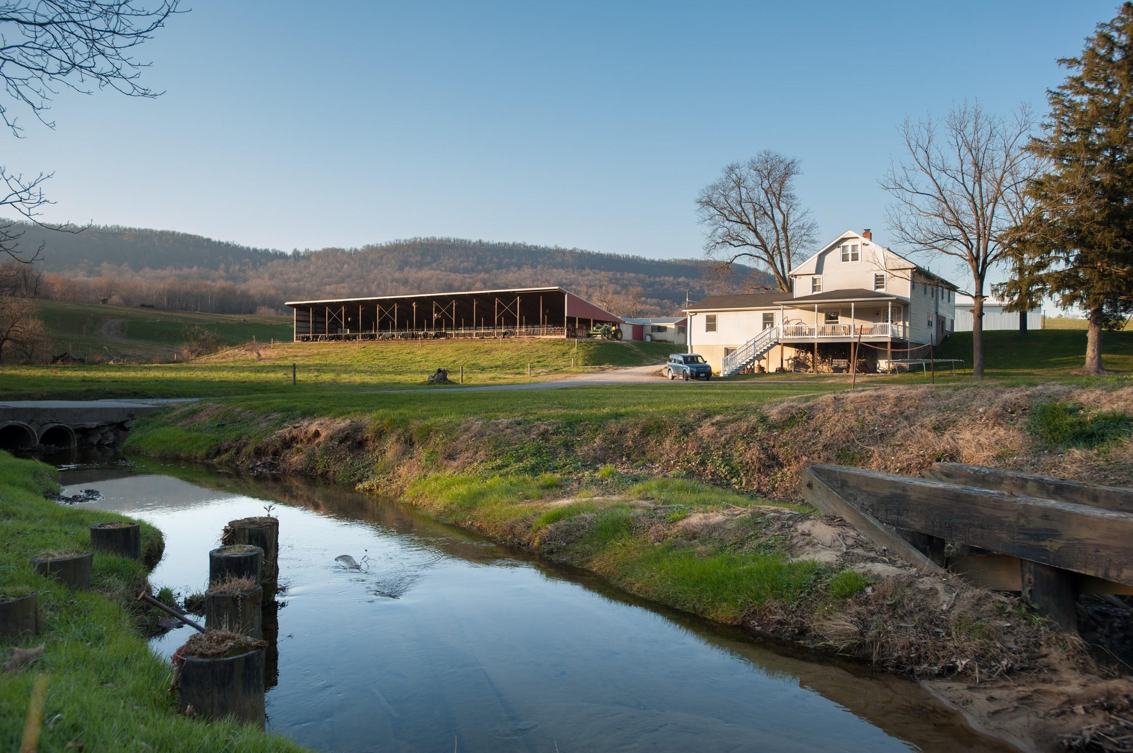
Questions?

