Slide 1
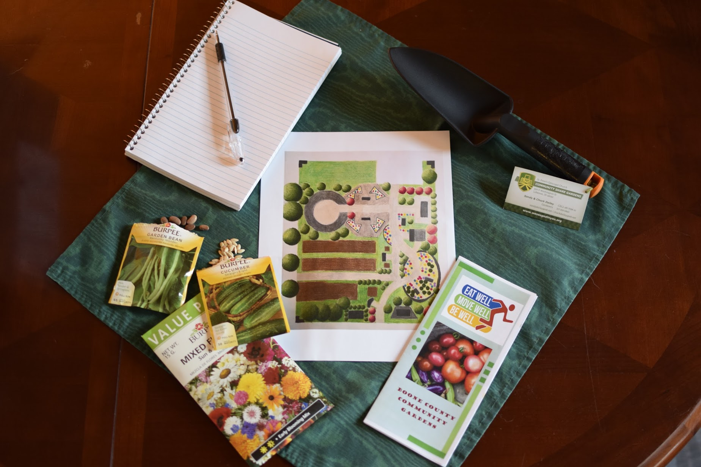
Cover Crops in a home garden

Slide 2
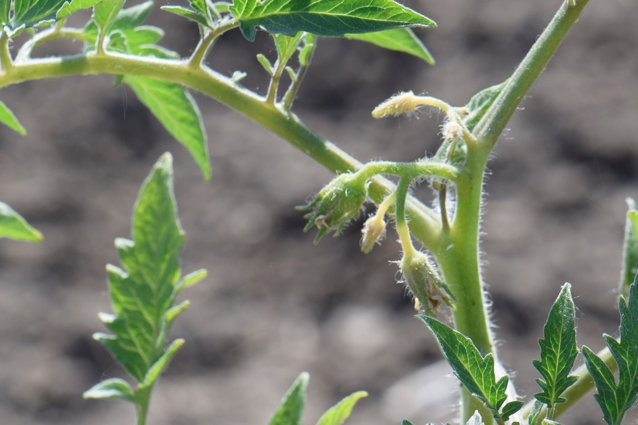
The state of your soil…
Do you use cover crops now?
Healthy soil is critical to plant growth, providing the necessary nutrients needed for healthy plants.
A sustainable way to build soil is through the use of cover crops sown after plants are harvested, usually in late summer to early fall.
Can cover crops do more?

Slide 3
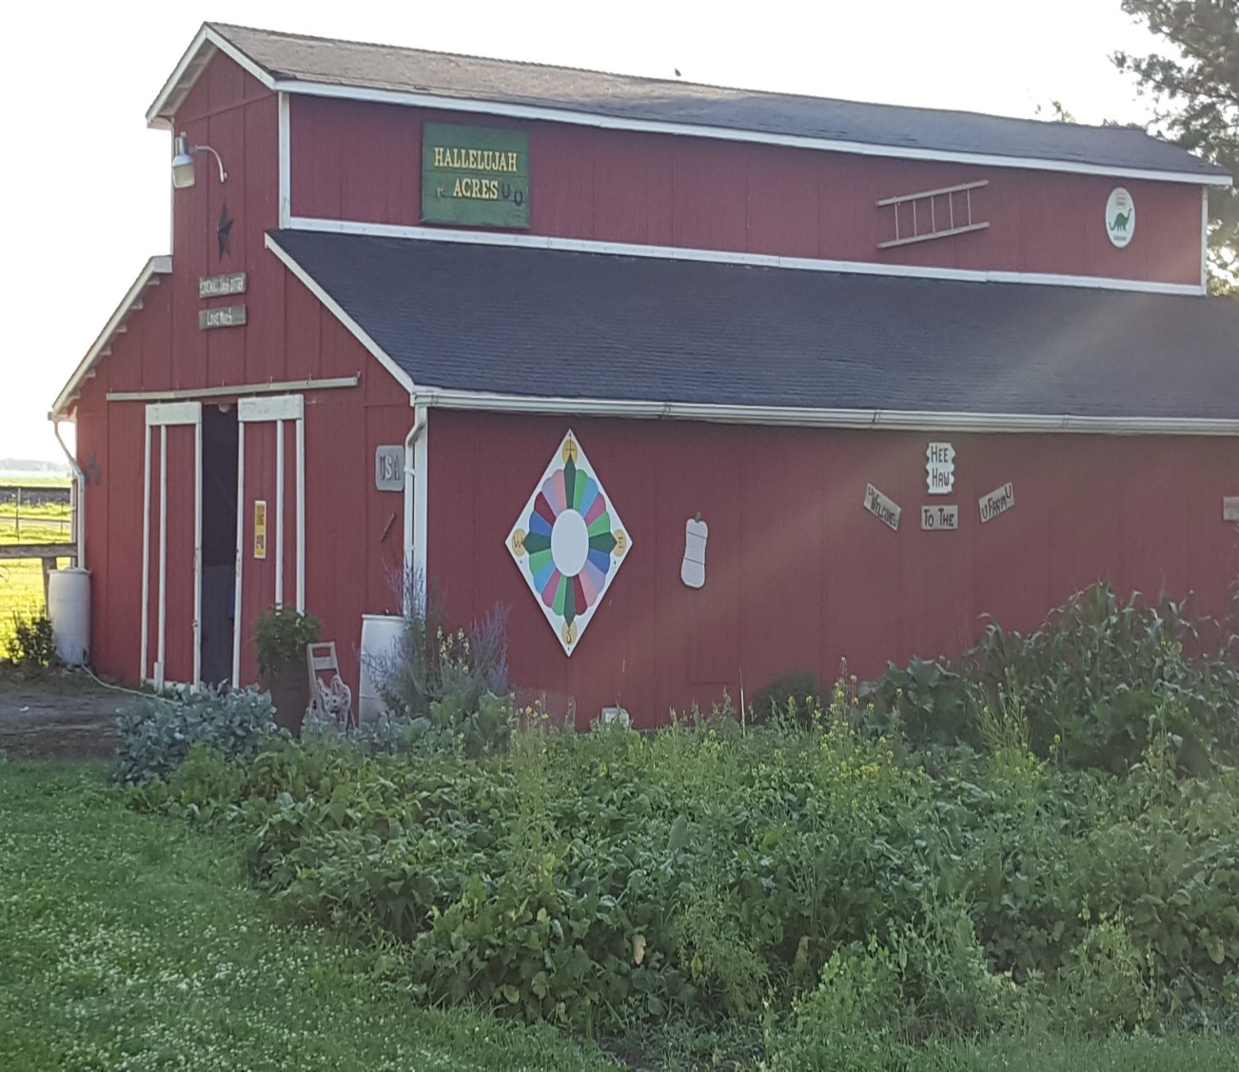
Hallelujah Acres Farm, Lebanon
2010-2016 Grow our own produce
Purchased a small tractor with a tiller and began to work our sandy loam soil.
State of the soil: clumpy, retained water, hard to plant seeds.
2013 - began to use winter cover crops and added compost – crimson clover, daikon radish, oats.
Results:
After two years, soil was easy to work, more porous, full of healthy earthworms. In many cases, we did not need to till at all.

Slide 4
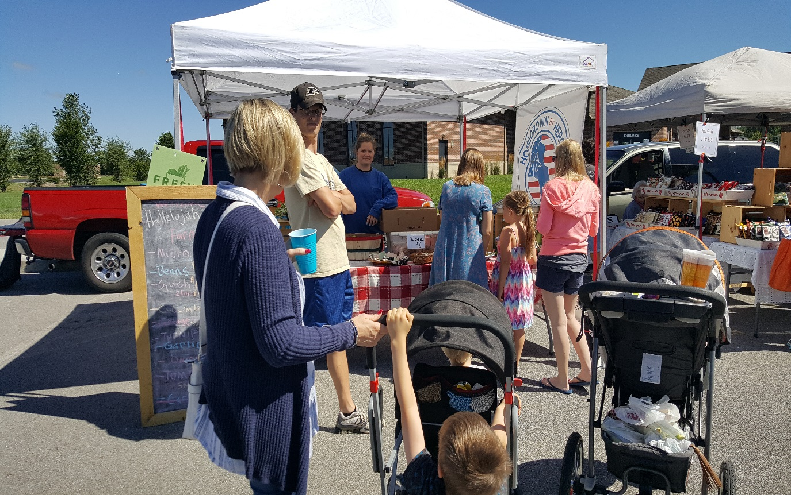
In 2016 we became a market garden
Goal: Provide healthy, chemical-free food to our community
Possible SARE projects:
Effect of succession planting on soil
Control weeds through interseeded cover crop
Control pests through companion planting
Sustainable Agriculture Research & Education (SARE) grants fund research and education projects. We applied for the Farmer/Rancher grant. Since 1988, the program, part of USDA’s National Institute of Food and agriculture, funds project and conducts outreach designed to improve agricultural systems.

Slide 5
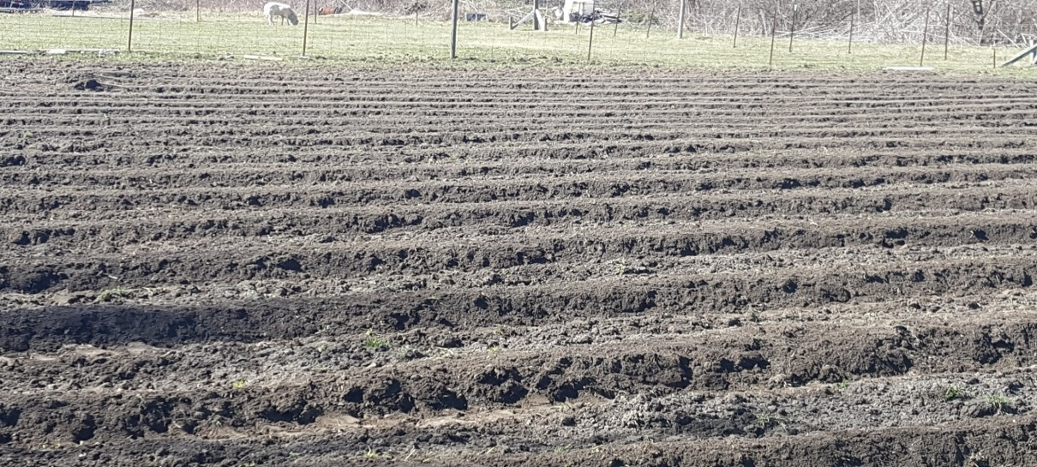
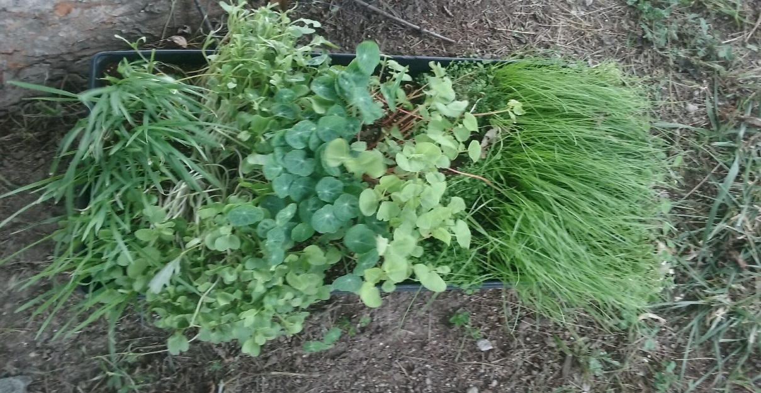
Project specifics
Our Goal: Measure the effectiveness of Interseeded Cover Crops for Proactive Weed Prevention in a chemical-free, low-till vegetable market garden operation.
Comparisons:
Labor to implement prevention strategy
Weed pressure
Labor to remove weeds
Impacts to soil health
$7,500 awarded

Slide 6
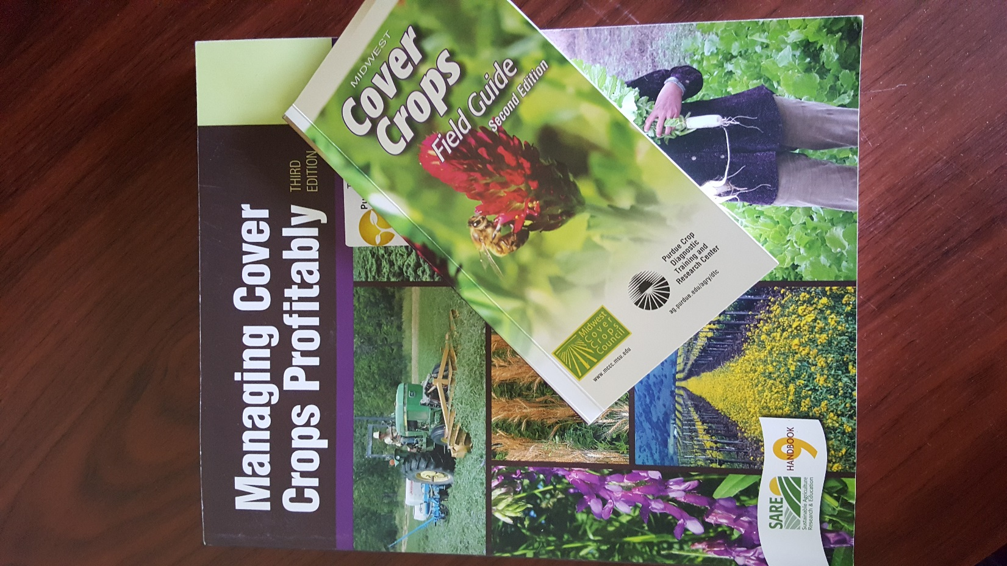
Cover crop selection
Not as easy as it seems…
Use or produce nutrients the plant needs?
Conserve or use soil moisture?
Encourage or discourage insect pests?
Length of growth cycle?
When to plant and impact on weed prevention?
U

Slide 7
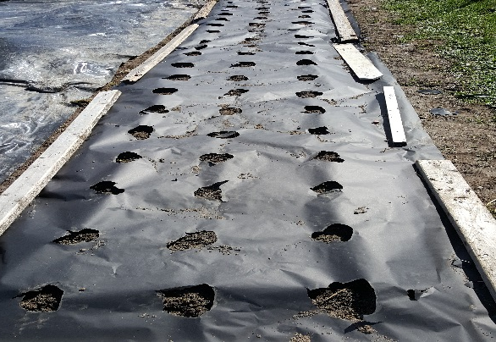
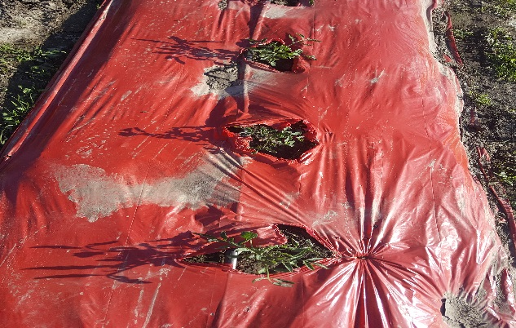
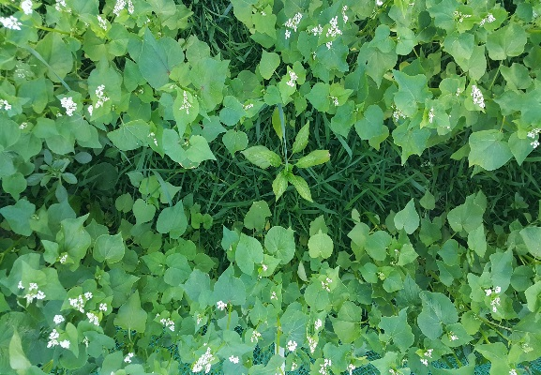
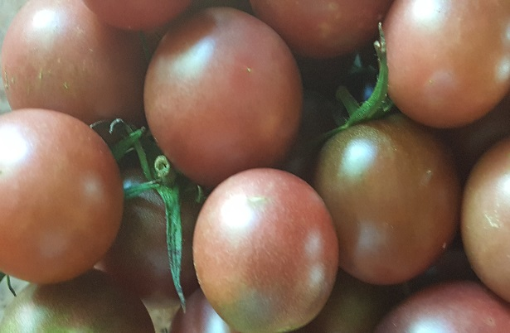
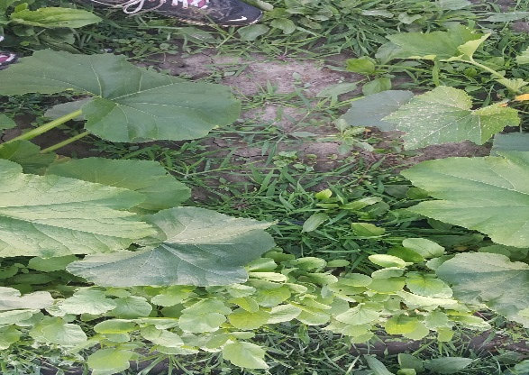
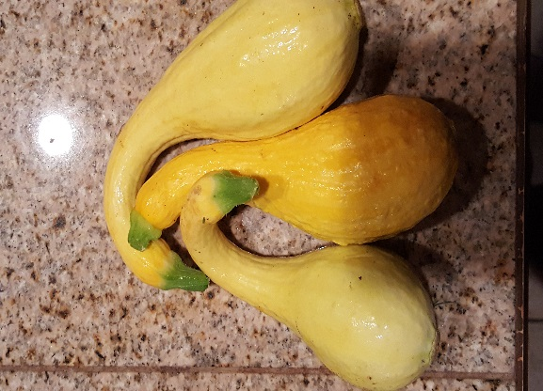
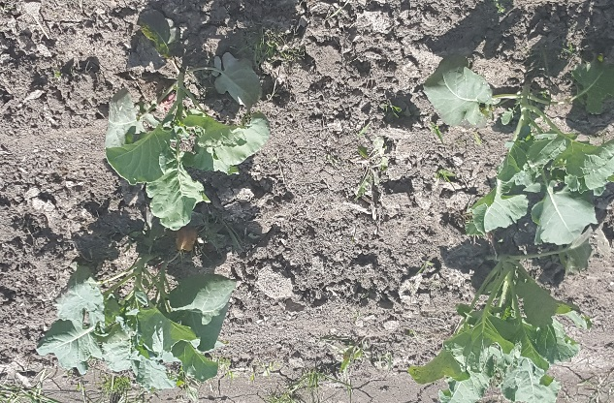
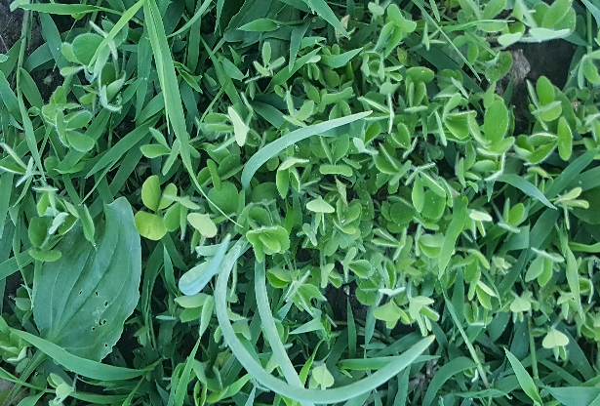
Final decisions
Green peppers - buckwheat, paper mulch,
hoeing
Tomatoes – crimson clover, red plastic mulch,
hoeing
U
Summer squash – icicle radishes, hoeing,
nasturtiums
Broccoli & Onion – crimson clover, plastic
Mulch (onion only), hoeing

Slide 8
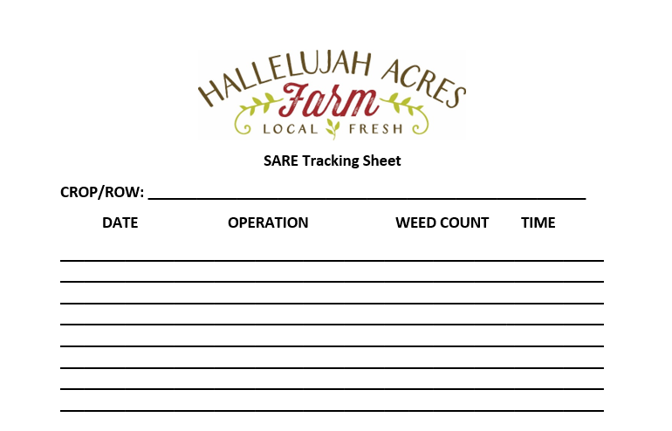
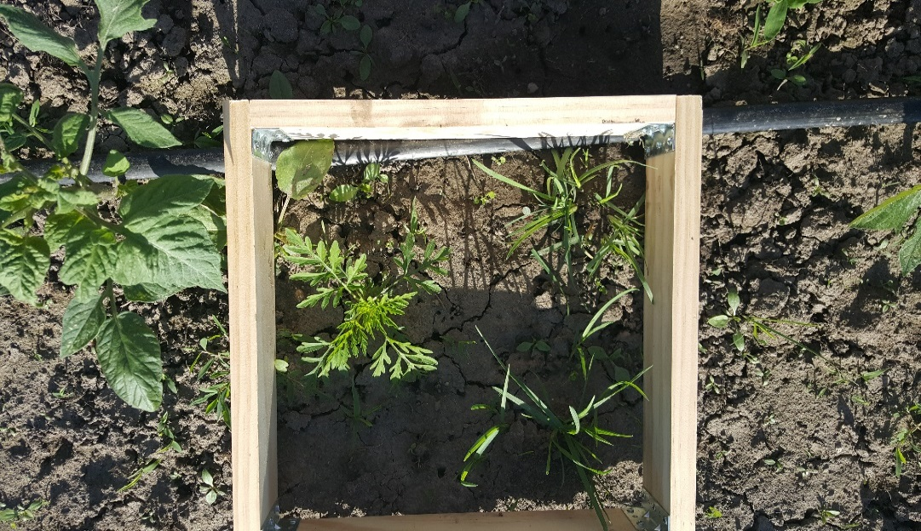
Process
Submit soil tests - pre
Count weed starts
Compare costs/time for installation
Track labor
Compare and report
Submit soil tests - post
U

Slide 9
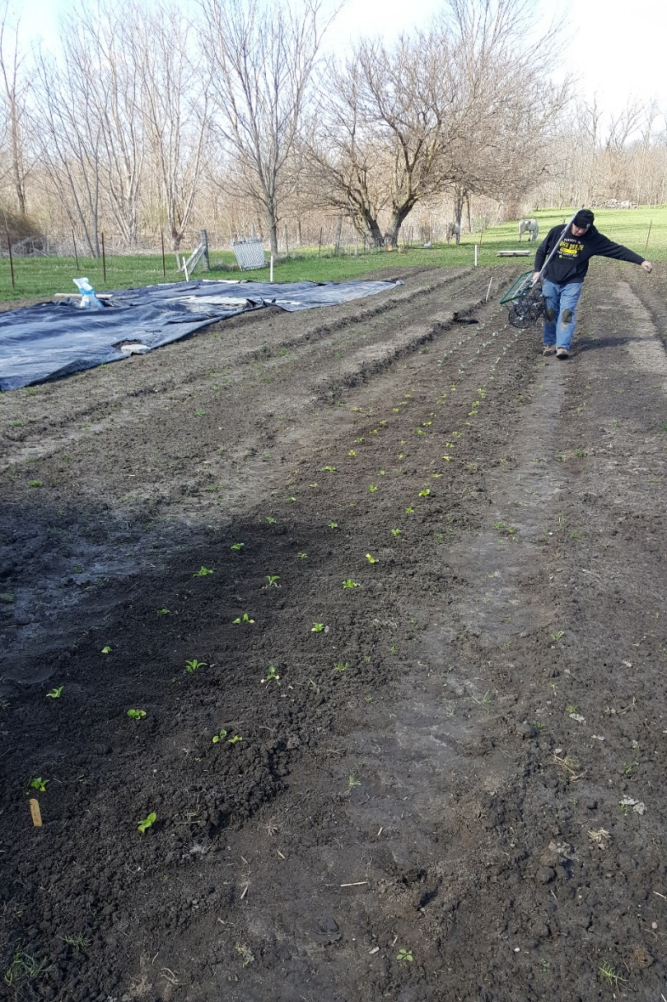
Results and Recommendations
Green Peppers
Buckwheat, paper mulch,
and hoeing
Will use plastic mulch for green peppers
U

Slide 10
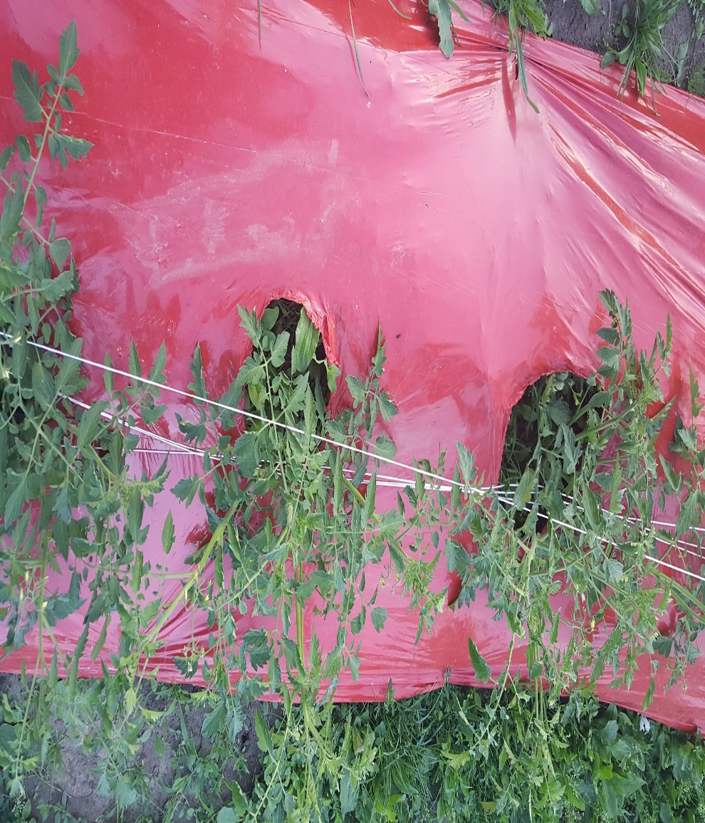
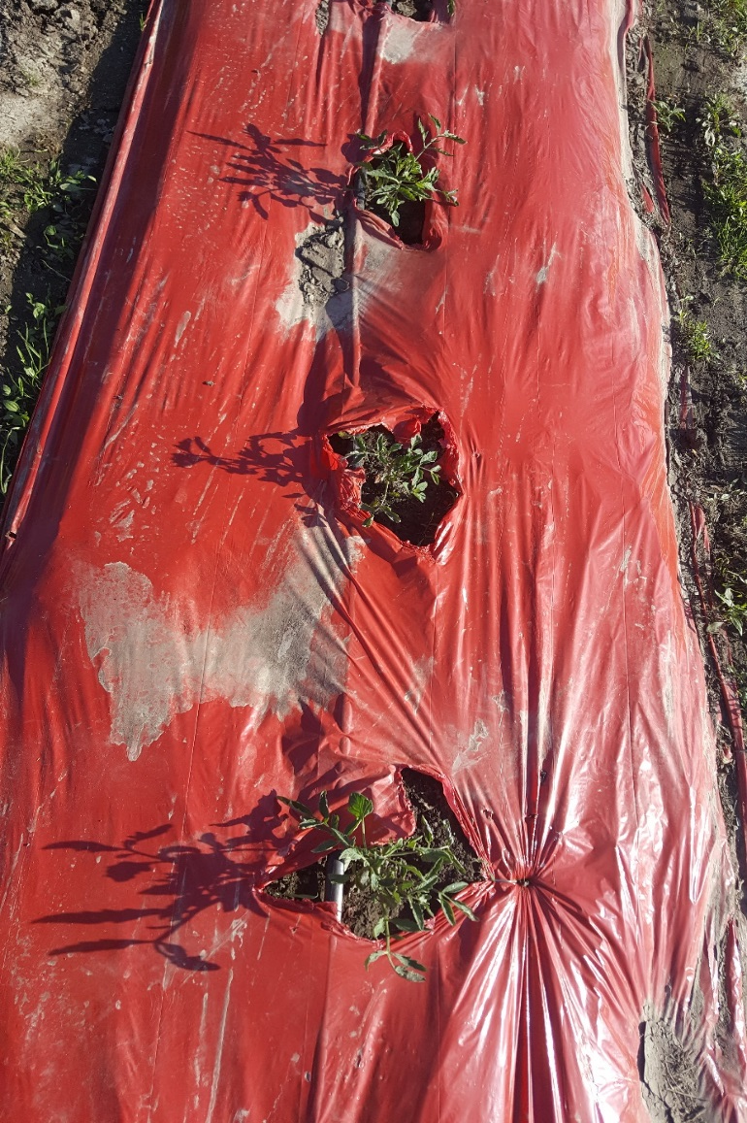
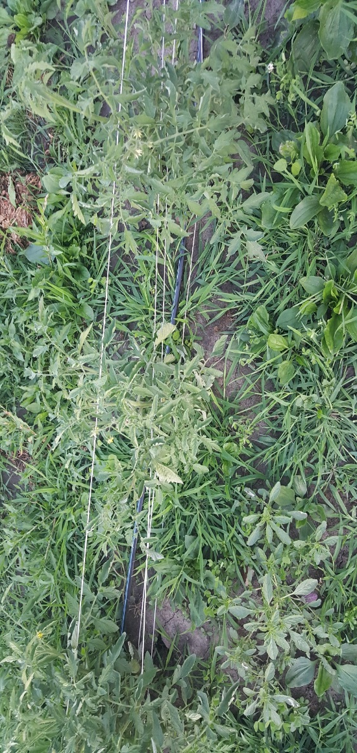
Results and Recommendations
Tomatoes
Crimson clover, plastic mulch
and hoeing
Will use plastic mulch for tomatoes
U

Slide 11
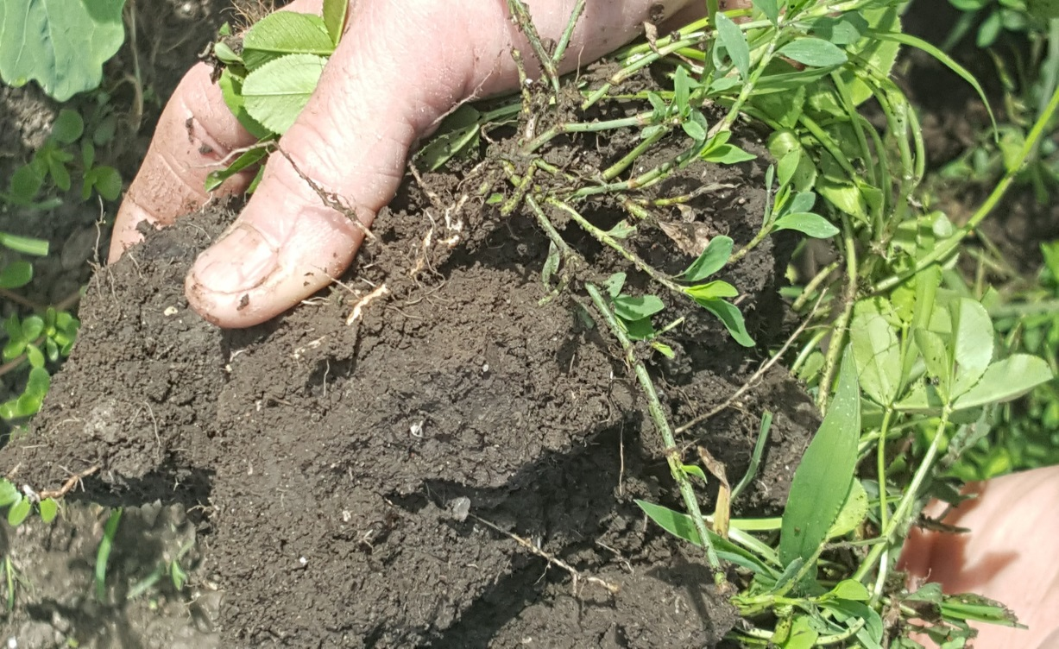
Results and Recommendations
Summer Squash
Icicle radish, hoeing,
nasturtiums
Will use icicle radish (multiple plantings) & go back to marigolds
U
White clover in aisles – fixed nitrogen

Slide 12
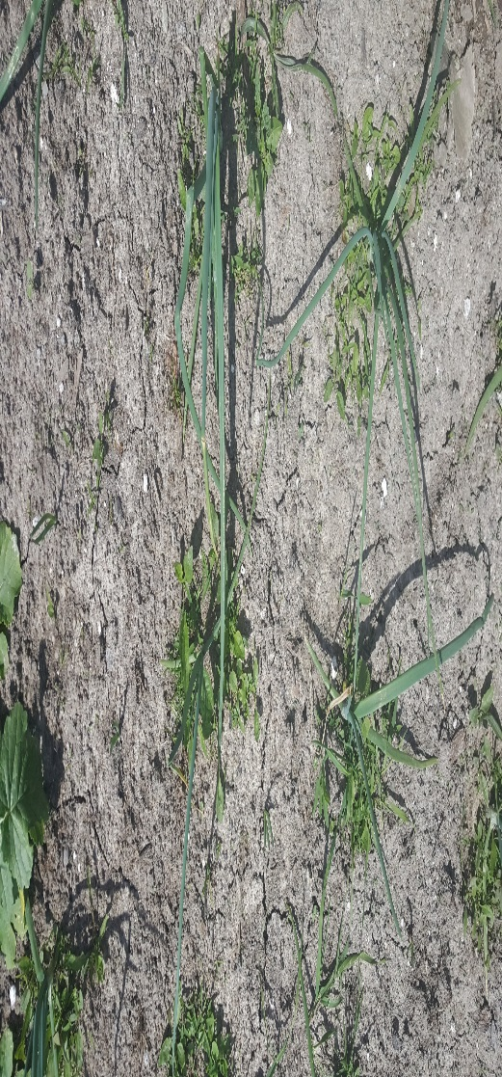
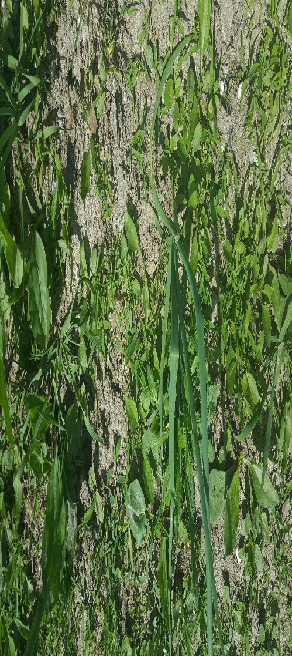
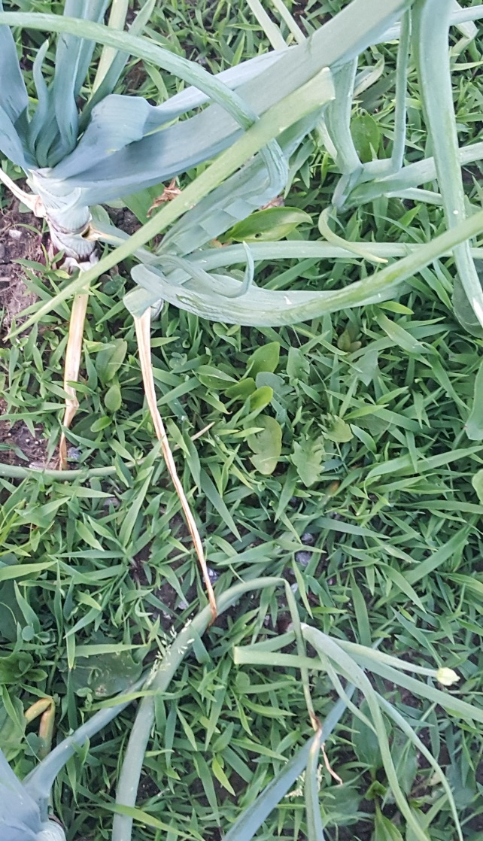
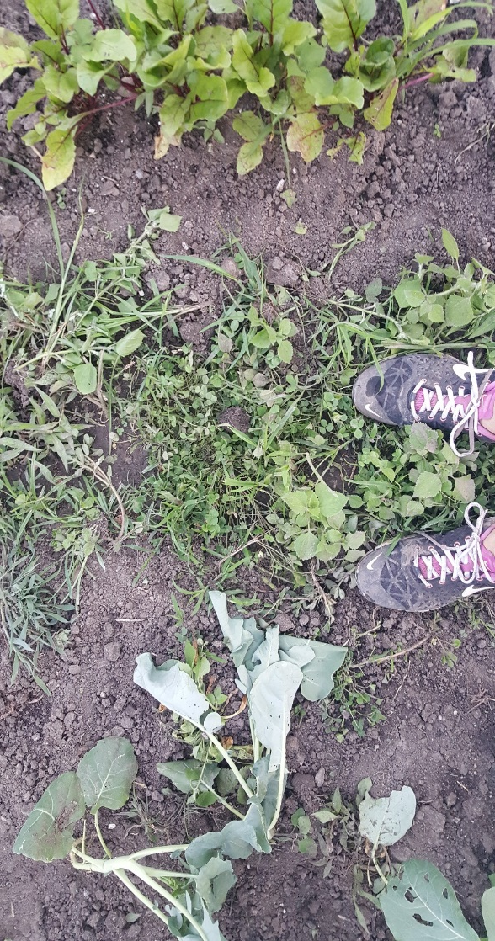
Results and Recommendations
Broccoli & Onion
Crimson clover and hoeing
Will use plastic mulch for onions & crimson clover for broccoli
U

Slide 13
U

Slide 14
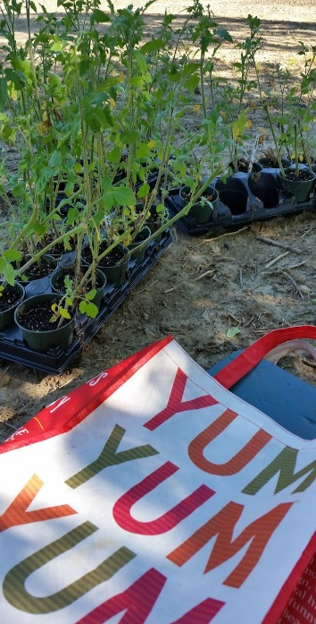
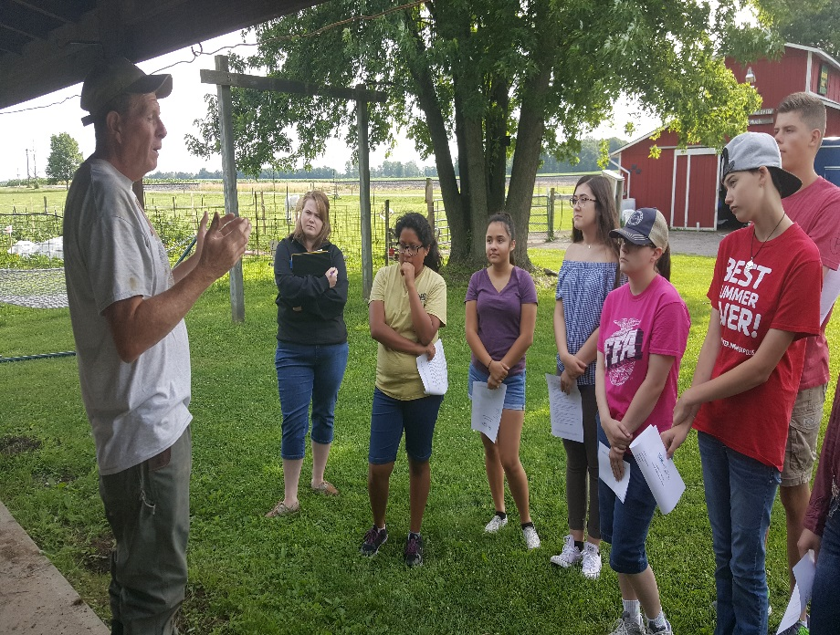
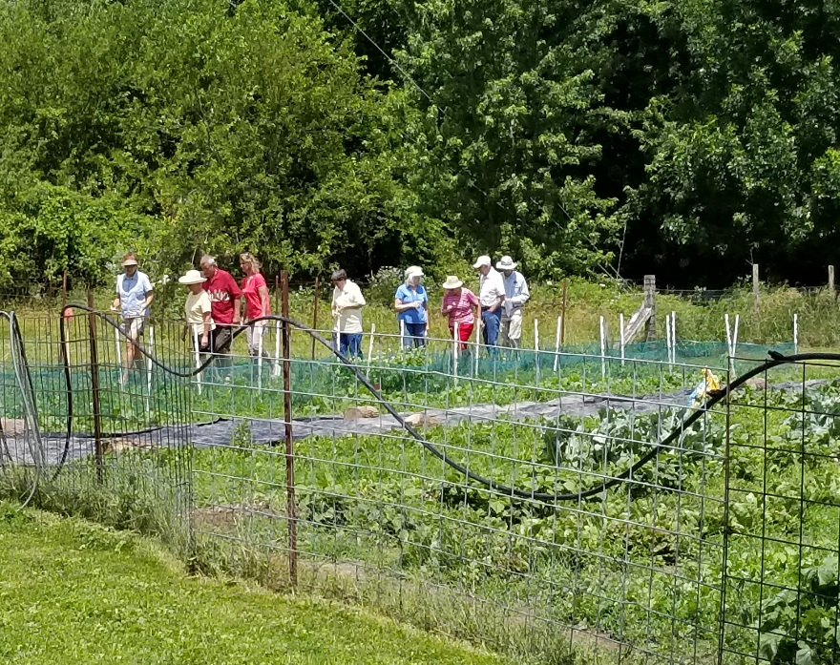
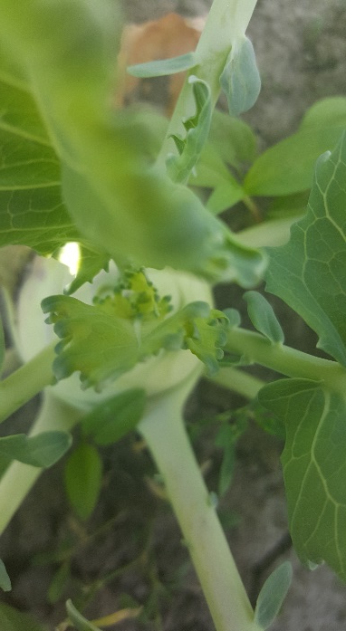
Summary
Hallelujah Acres Farm 2017 SARE grant field days – Boone County Master Gardeners
and LHS FFA

