Slide 1
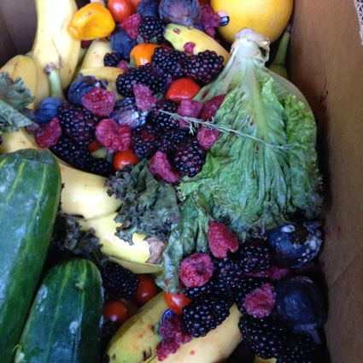
Farmer-Friendly Approaches to Combating Food Waste
Abbe Turner
Notes:
Introduction- who abbe is, what food waste for farms is, what we do
Problem- what is happening with food waste, how we affect it
Solution- what we do, what you can do moving forward
Collab- how can we work together, how can you reach us
Close- quick recap, wrap up, Q/A

Slide 2
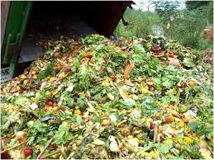
Farmer-Friendly Approaches to Combating Food Waste
In the U.S., up to 40 percent of our food ends up in the landfill
When disposed in landfills, rotting food becomes a significant source of methane, a dangerous greenhouse gas
Wasted food is also wasted money, time, and natural resources
Notes:
“In the U.S., up to 40 percent of our food ends up in the landfill, according to a 2013 report from the National Resources Defense Council (NRDC).”
“In 2011, 36 million tons of food ended up in landfills, according to a recent EPA study.”
“When disposed in landfills, rotting food becomes a significant source of methane, a dangerous greenhouse gas. Moreover, wasted food is also wasted money, time, and natural resources.”
“Environmentally speaking, reducing food waste diminishes the natural resources and energy involved in food production itself. Furthermore, from a financial standpoint, wasting less means buying less, therein cutting unnecessary spending. Additionally, costs associated with trash disposal are greater than those associated with the transferring of waste for reuse or composting.”

Slide 3
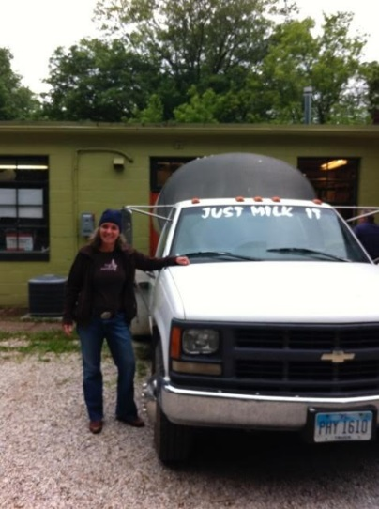
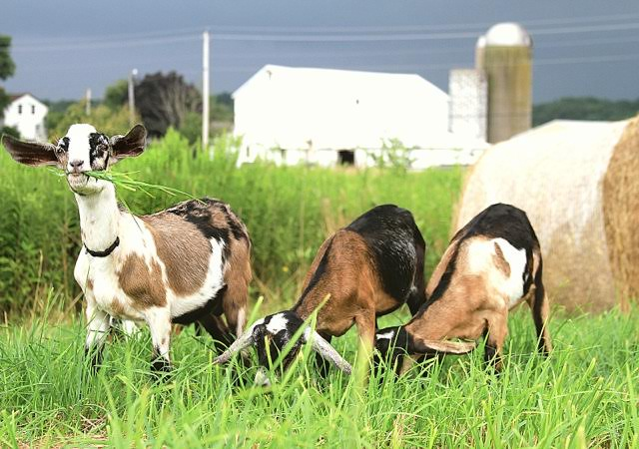
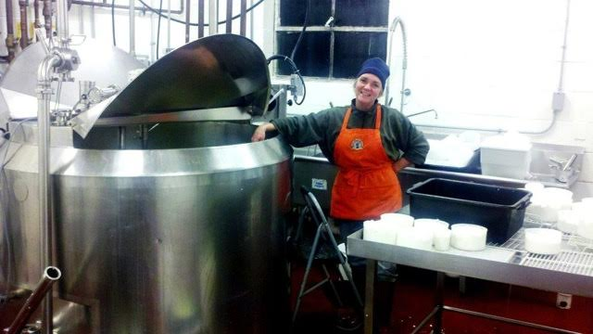
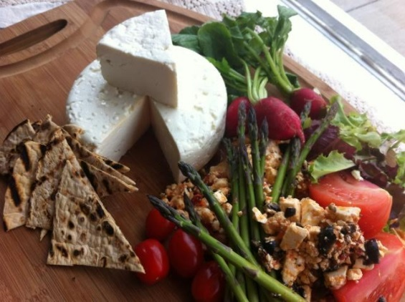
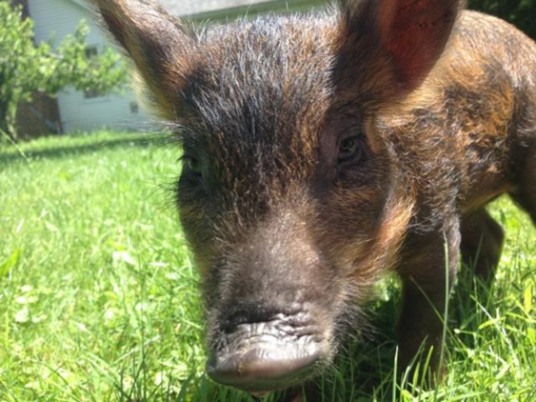
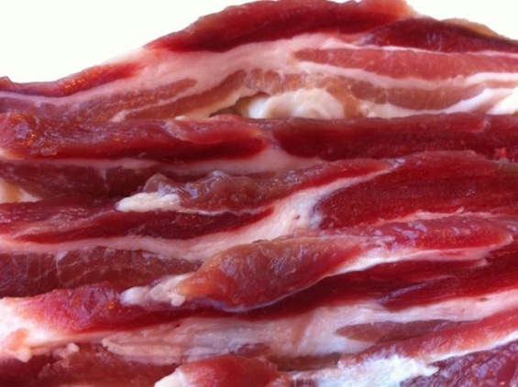
Farmer-Friendly Approaches to Combating Food Waste
Lucky Penny’s Food Waste Flow
Notes:
How Abbe got into Food Waste for Farms
“Whey management for artisan creameries is an issue that is costly and an inconvenient as small scale plants can’t meet the quantity or capital investment requirements to process this waste byproduct on site.”
“Turn this nutrient rich commercial waste product into “liquid gold” as a feedstuff for pigs and poultry on diversified family farms to create value added specialty meats, feed supplements for animals, and compost.”
“This directly lowers costs for farmers and producers, keeps waste out of the landfill, and increases profitability for both generators of waste and to the farms themselves.”
“The EPA suggests first and foremost that excess food, if possible, be used to serve the function it was always intended to serve: feeding hungry people. [with hunger still being a priority in the US, the social benefit of viewing leftovers not as waste but as a valuable food sources has the potential of helping feed the 50 million Americans who lack access to enough food in the US today. ] If feeding the hungry is not an option, however, scraps can and should be diverted in the following order: to feeding animals, then to helping industrial operations, then composting, and finally, only as a last resort – to landfills. ”

Slide 4
Farmer-Friendly Approaches to Combating Food Waste
Food Waste For Farms is a pilot project to link generators of commercial food waste with farms to utilize this nutrient rich asset as animal feed or compost material diverting it from the landfill. The goal is to use technology to optimize the systems for waste recovery, logistics and profitability.

Slide 5
Our Partners
Farmer-Friendly Approaches to Combating Food Waste
Farmers
Amber Sattleberg, Lucky Penny Farm
Gwen Volkert, Ferrum Morraine Farm
Nick Morris, Red Winged Acres
Olivia Hogue
Teresa Kaminski
John Gwinn, Composter
Chefs/ Restaurants
Drew Racin- Hodges
Ben Bebenroth- Spice Companies
Burt Bellison- Little City Grill
Food Manufacturers/Producers/Brewers
Main Street Brewery
Mad Cap Brewery
Platform Brewery
Cleveland Tofu
Lucky Penny Creamery
Green City Growers
Clover Road Cream Cheese
Food Waste Handlers/Consultants (3)
Greg- Groundz
Mike- Good land Sustainability
Dan- Rust Belt Riders
Food Retailers/ Distributors
Bon Appetit Catering
Whole Foods
Door -to -Door Organics
Educational Institutions
Laurel School
Case Western Reserve
Non Profits/ NGOS
NCR-SARE
Ohio EPA
OEFFA Farm Tour
OSU Extension
Stark County Parks

Slide 6
Farmer-Friendly Approaches to Combating Food Waste
Brewer Profile- Ryan Adams, Mad Cap Brewery
Notes:
3:49 https://www.youtube.com/watch?v=4G42KdGN520

Slide 7
Farmer-Friendly Approaches to Combating Food Waste
Farmer Profile- Nick Morris
Notes:
4:46 https://www.youtube.com/watch?v=eZXkmvmv-nE

Slide 8
Farmer-Friendly Approaches to Combating Food Waste
Feeding Pigs- Amber Sattleberg
Notes:
7:14 https://www.youtube.com/watch?v=s-195RwZEkY

Slide 9
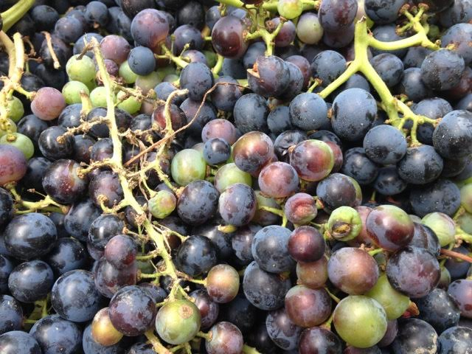
Farmer-Friendly Approaches to Combating Food Waste
Gleaning at Wolf Creek Vineyard
Notes:
Gleaning at Wolf Creek Vineyard
**Add picture of peaches

Slide 10
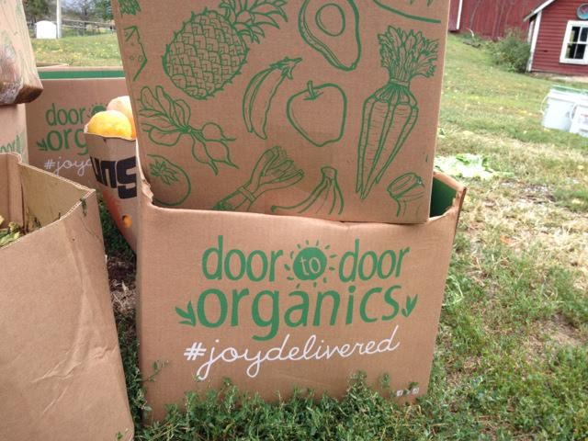
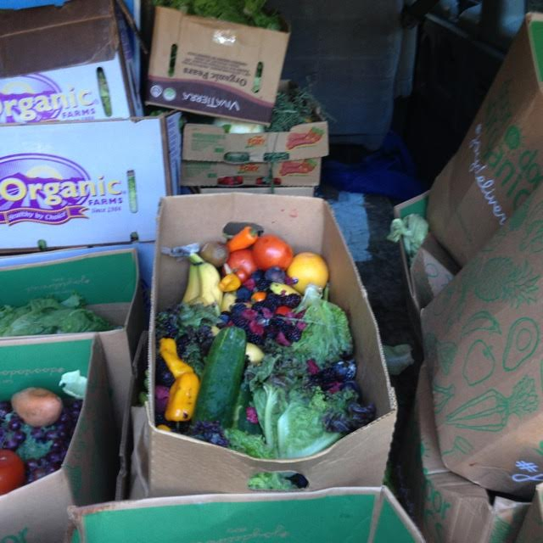
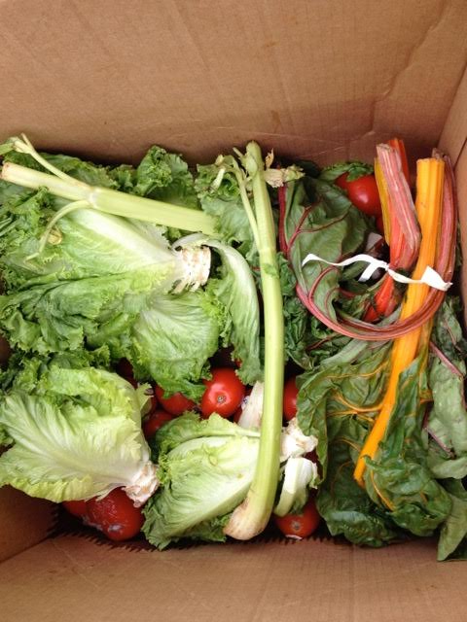
Farmer-Friendly Approaches to Combating Food Waste
Food Waste Prepared for Pick-Up
Notes:
Food wasteage
Take one of these pics out to use for title page; or use just 2 of cardboard boxes

Slide 11
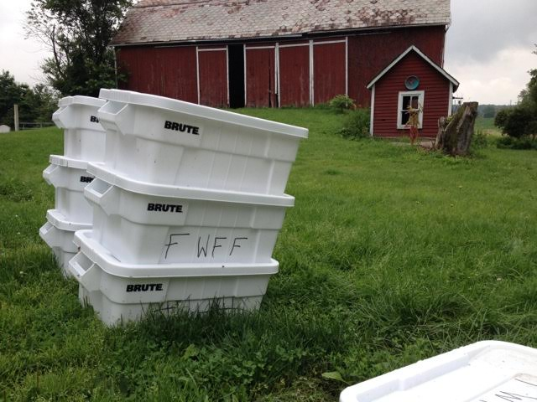
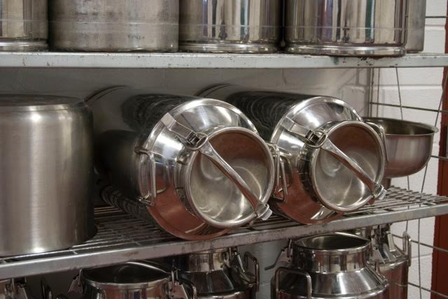
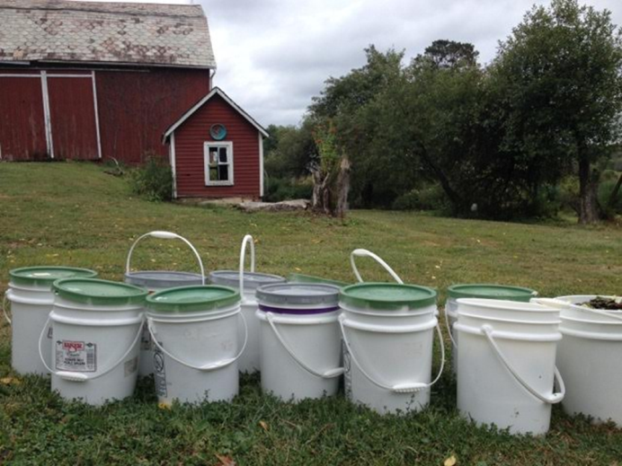
Farmer-Friendly Approaches to Combating Food Waste
Food Waste Storage Containers Ready for Pick-Up

Slide 12
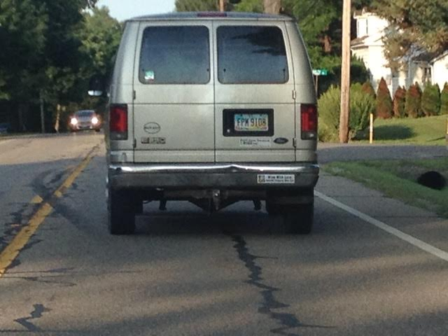
Farmer-Friendly Approaches to Combating Food Waste
Transporting Food Waste

Slide 13
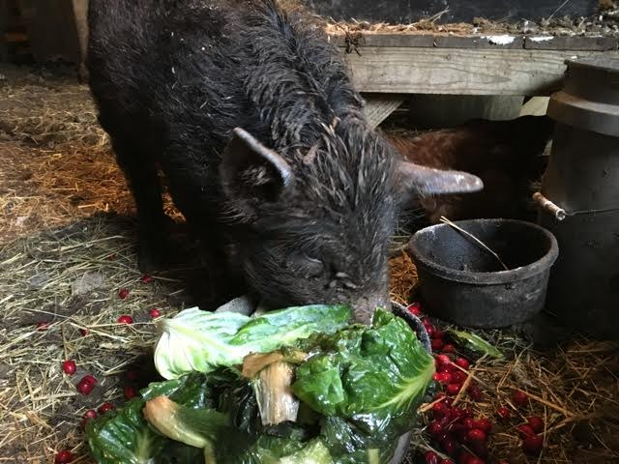
Farmer-Friendly Approaches to Combating Food Waste
Chrysanthemum Enjoying Food Scraps

Slide 14
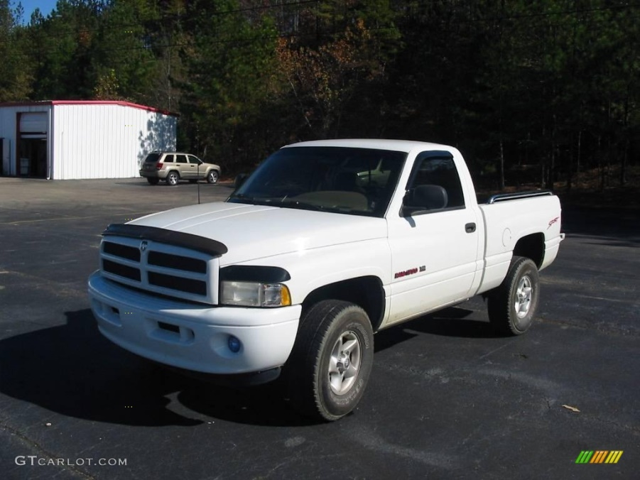
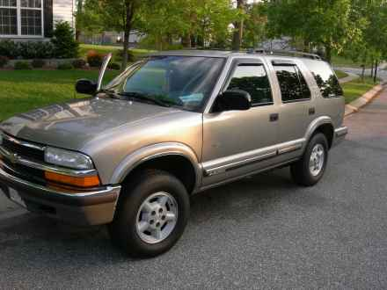
Lessons Learned
Farmer-Friendly Approaches to Combating Food Waste
Find the Right Vehicle
Notes:
Pictures of cars- you need the right vehicle
Scaling
people

Slide 15
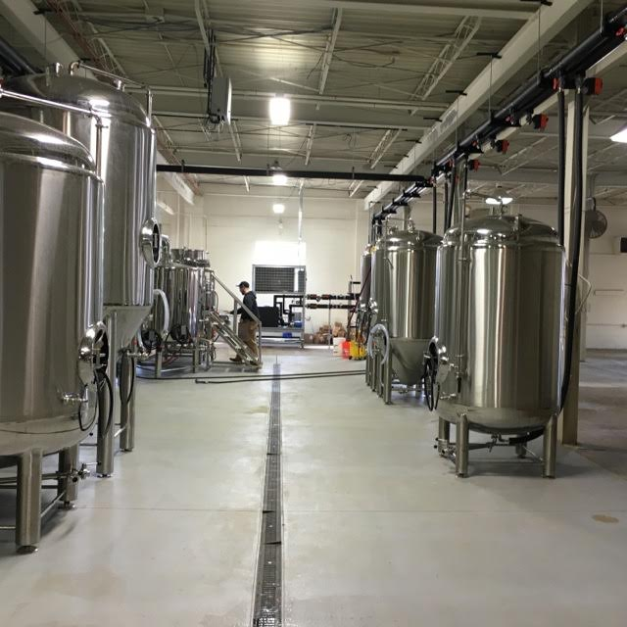
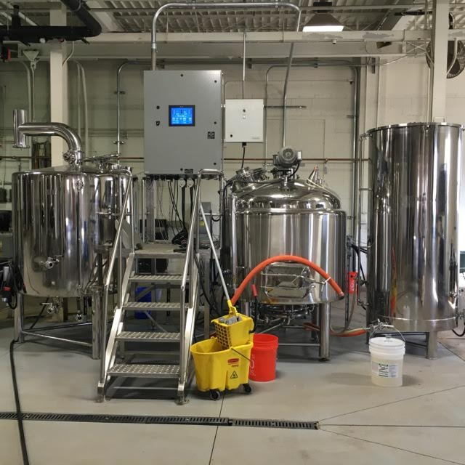
Farmer-Friendly Approaches to Combating Food Waste
Scale at Mad Cap Brewery
Notes:
Ryan 2- Brewery Pictures, where the feed comes from
** MOVE TO LESSONS LEARNED

Slide 16
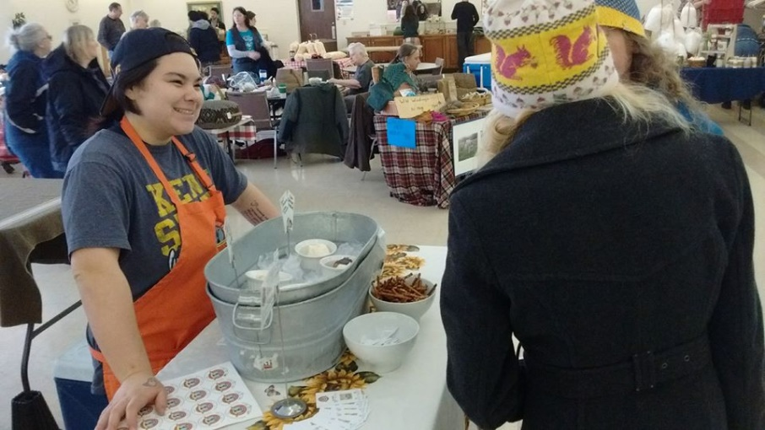
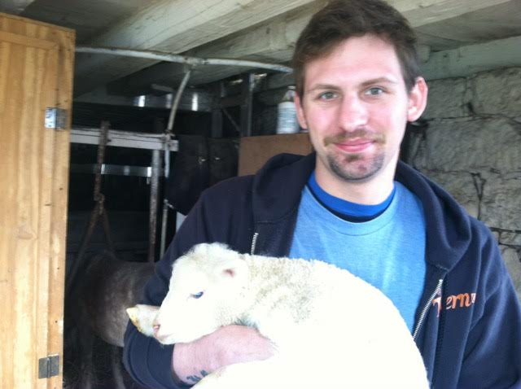
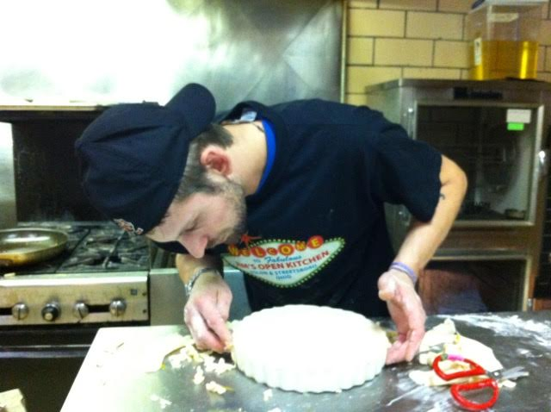
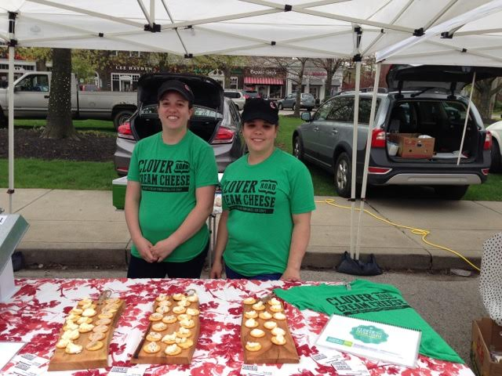
Farmer-Friendly Approaches to Combating Food Waste
Find the Right People

Slide 17
Our Partners
Farmer-Friendly Approaches to Combating Food Waste
Farmers
Amber Sattleberg, Lucky Penny Farm
Gwen Volkert, Ferrum Morraine Farm
Nick Morris, Red Winged Acres
Olivia Hogue
Teresa Kaminski
John Gwinn, Composter
Chefs/ Restaurants
Drew Racin- Hodges
Ben Bebenroth- Spice Companies
Burt Bellison- Little City Grill
Food Manufacturers/Producers/Brewers
Main Street Brewery
Mad Cap Brewery
Platform Brewery
Cleveland Tofu
Lucky Penny Creamery
Green City Growers
Clover Road Cream Cheese
Food Waste Handlers/Consultants (3)
Greg- Groundz
Mike- Good land Sustainability
Dan- Rust Belt Riders
Food Retailers/ Distributors
Bon Appetit Catering
Whole Foods
Door -to -Door Organics
Educational Institutions
Laurel School
Case Western Reserve
Non Profits/ NGOS
NCR-SARE
Ohio EPA
OEFFA Farm Tour
OSU Extension
Stark County Parks

Slide 18
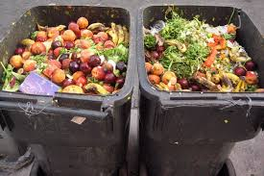
Next Steps/Policy
Farmer-Friendly Approaches to Combating Food Waste
The Bill Emerson Good Samaritan Food Donation Act -Created in 1996 under President Bill Clinton to encourage food donation to nonprofit organizations by minimizing liability.
Do Your Part, Take Action
Notes:
Cite law

Slide 19
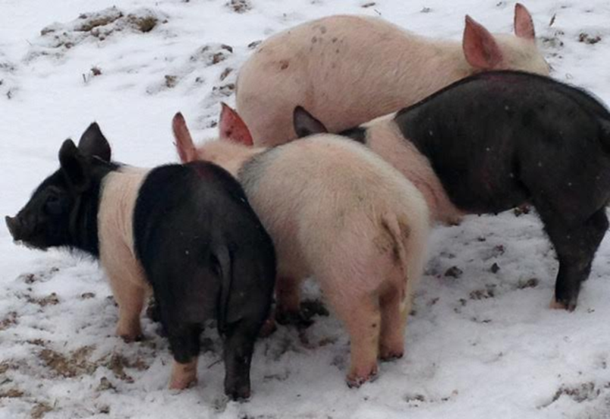
Thank You to SARE
Farmer-Friendly Approaches to Combating Food Waste

Slide 20
Farmer-Friendly Approaches to Combating Food Waste
Pigs Eating Feta

