Slide 1
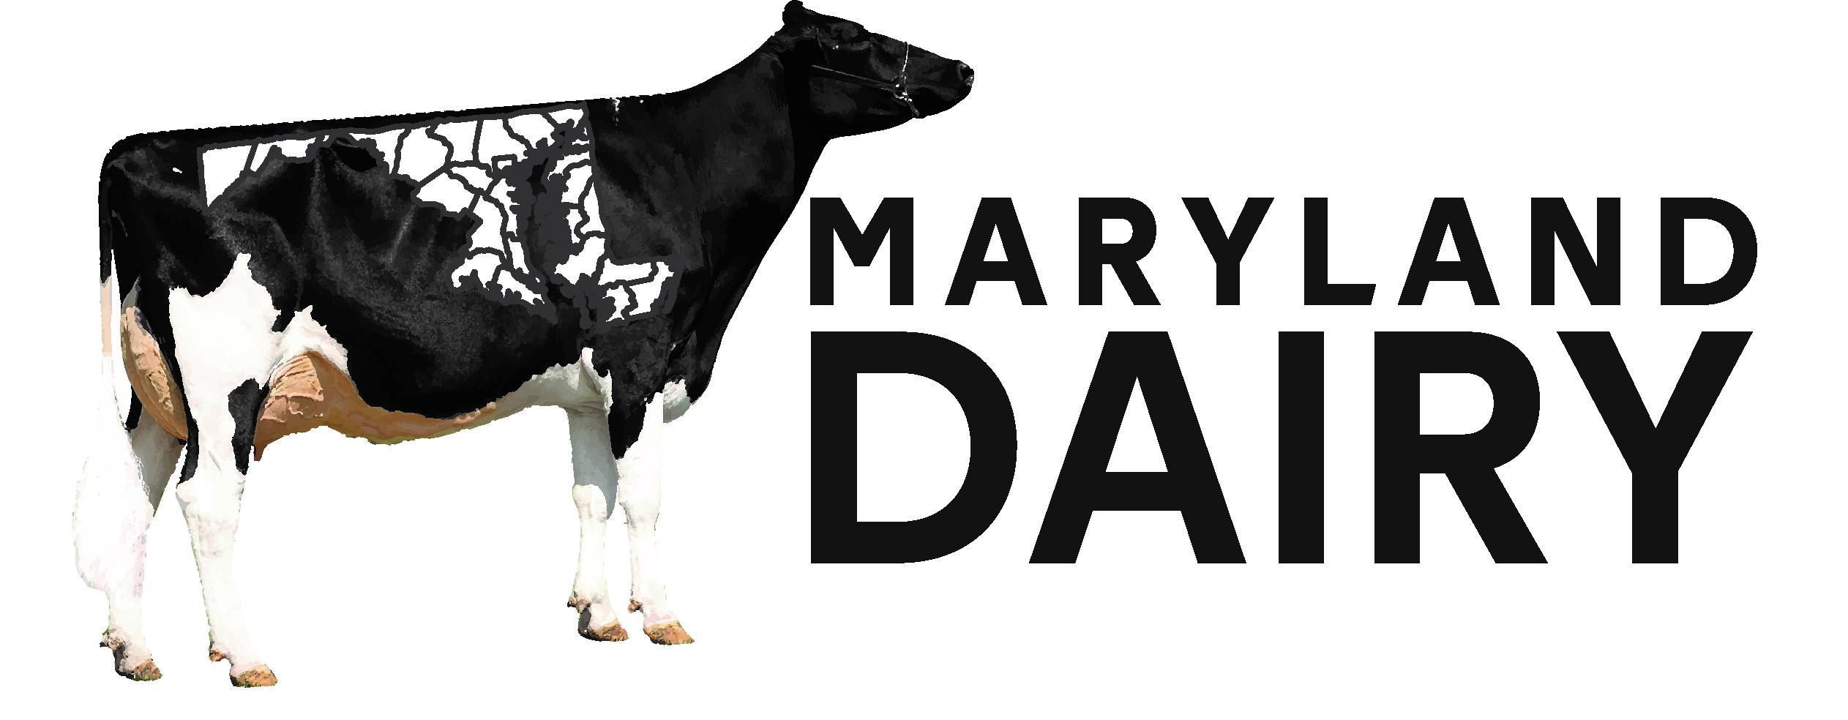
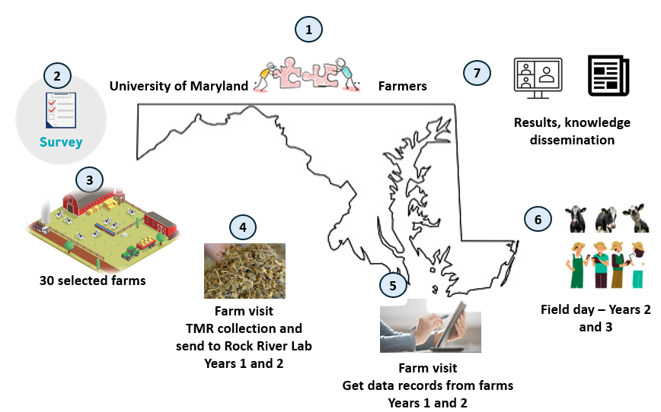
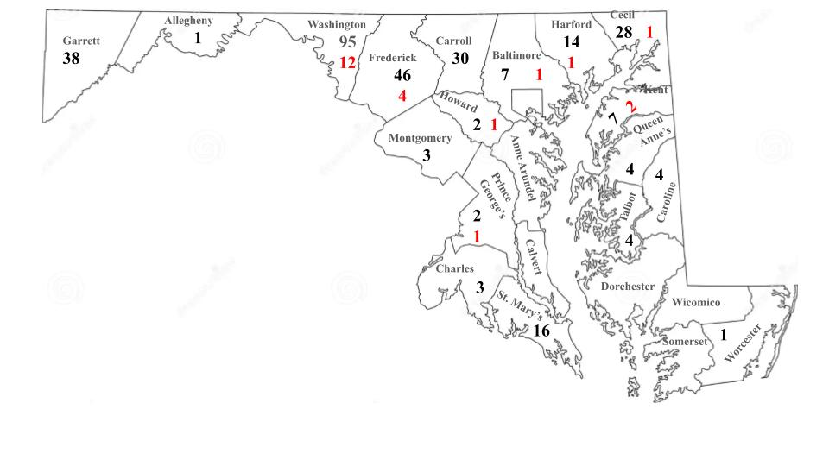
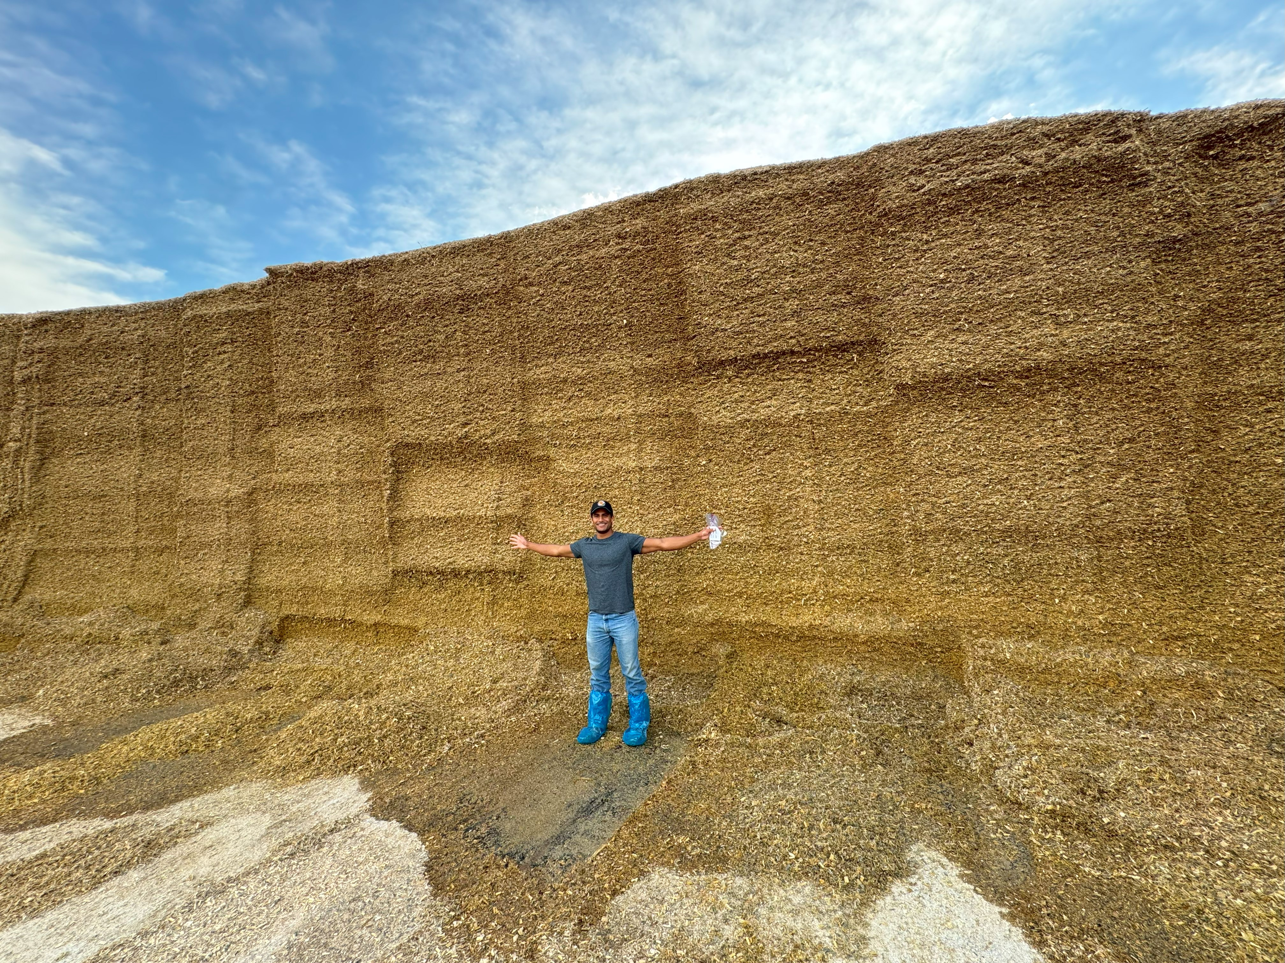
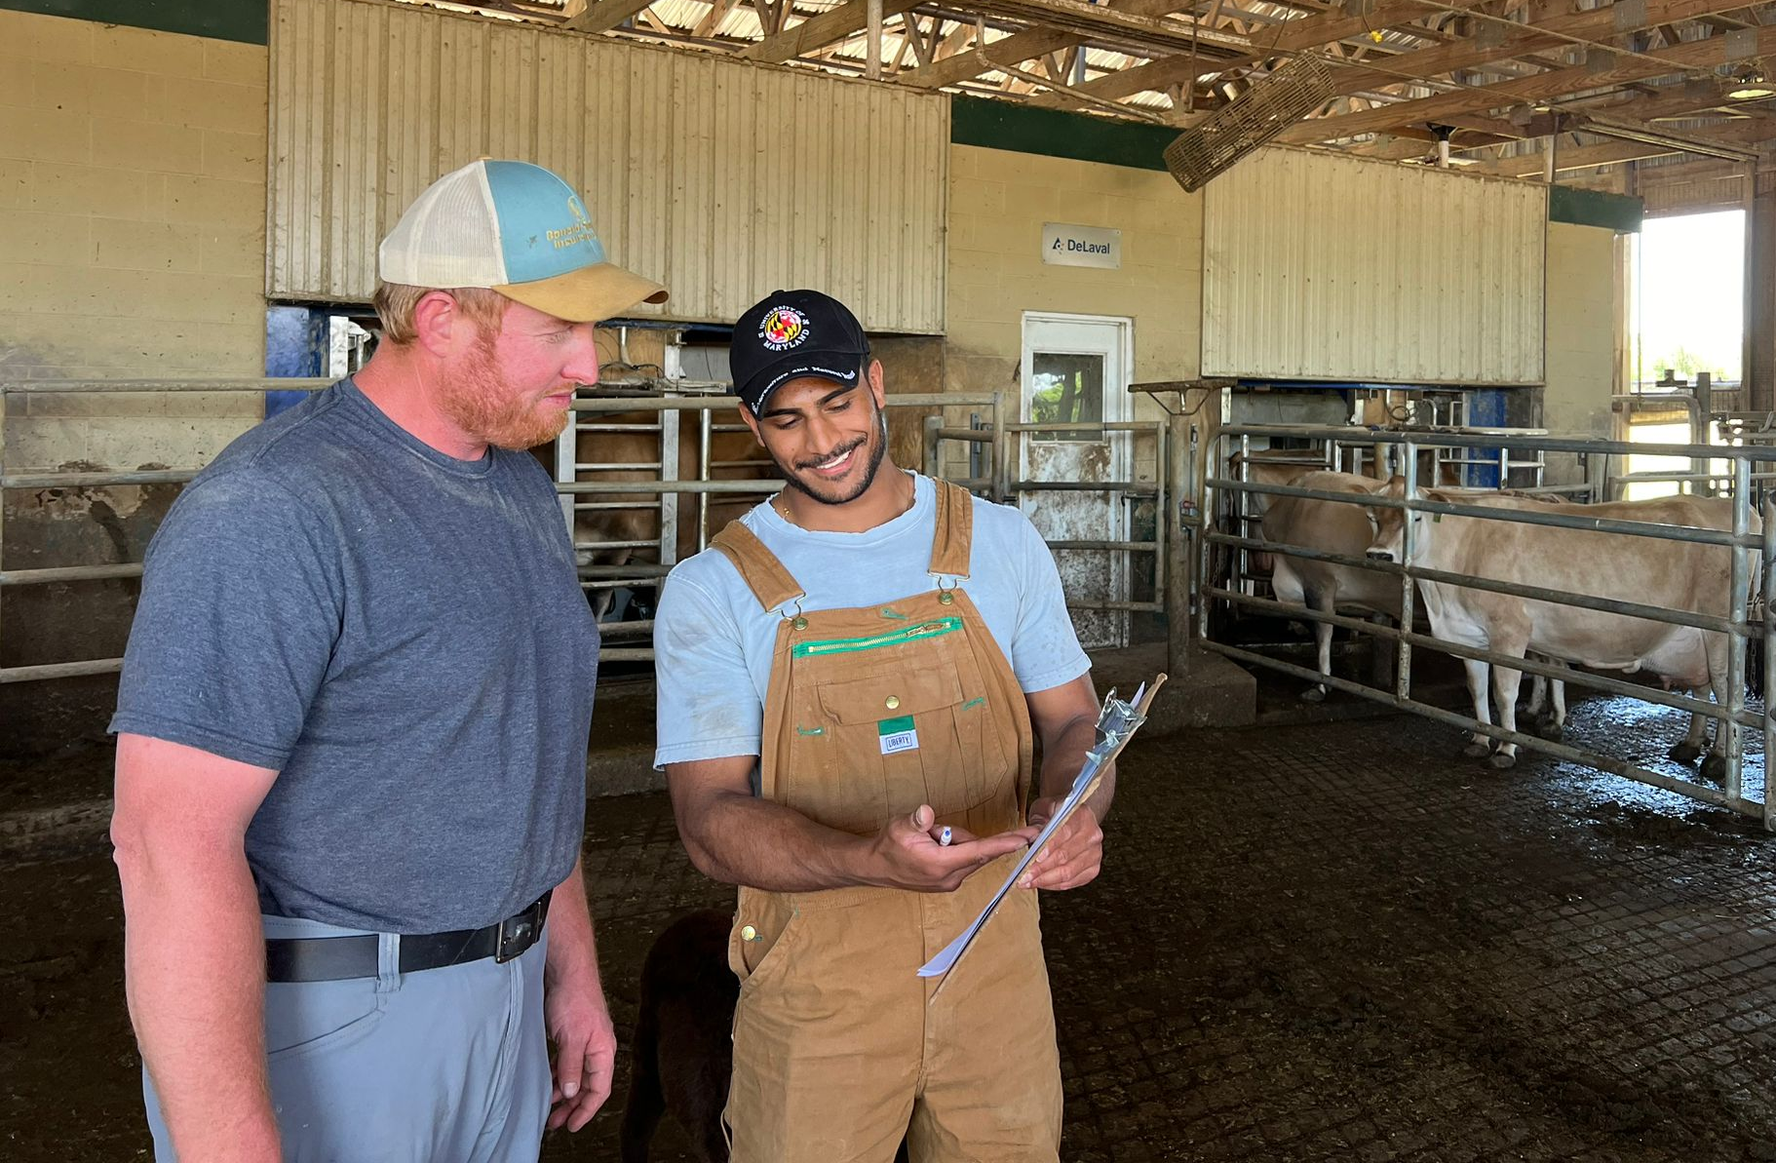
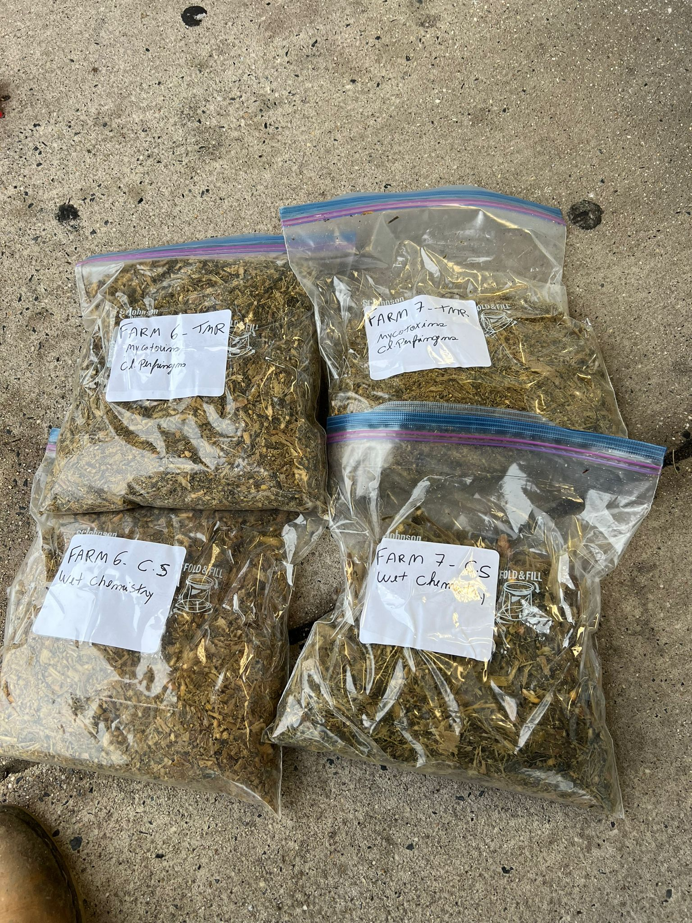
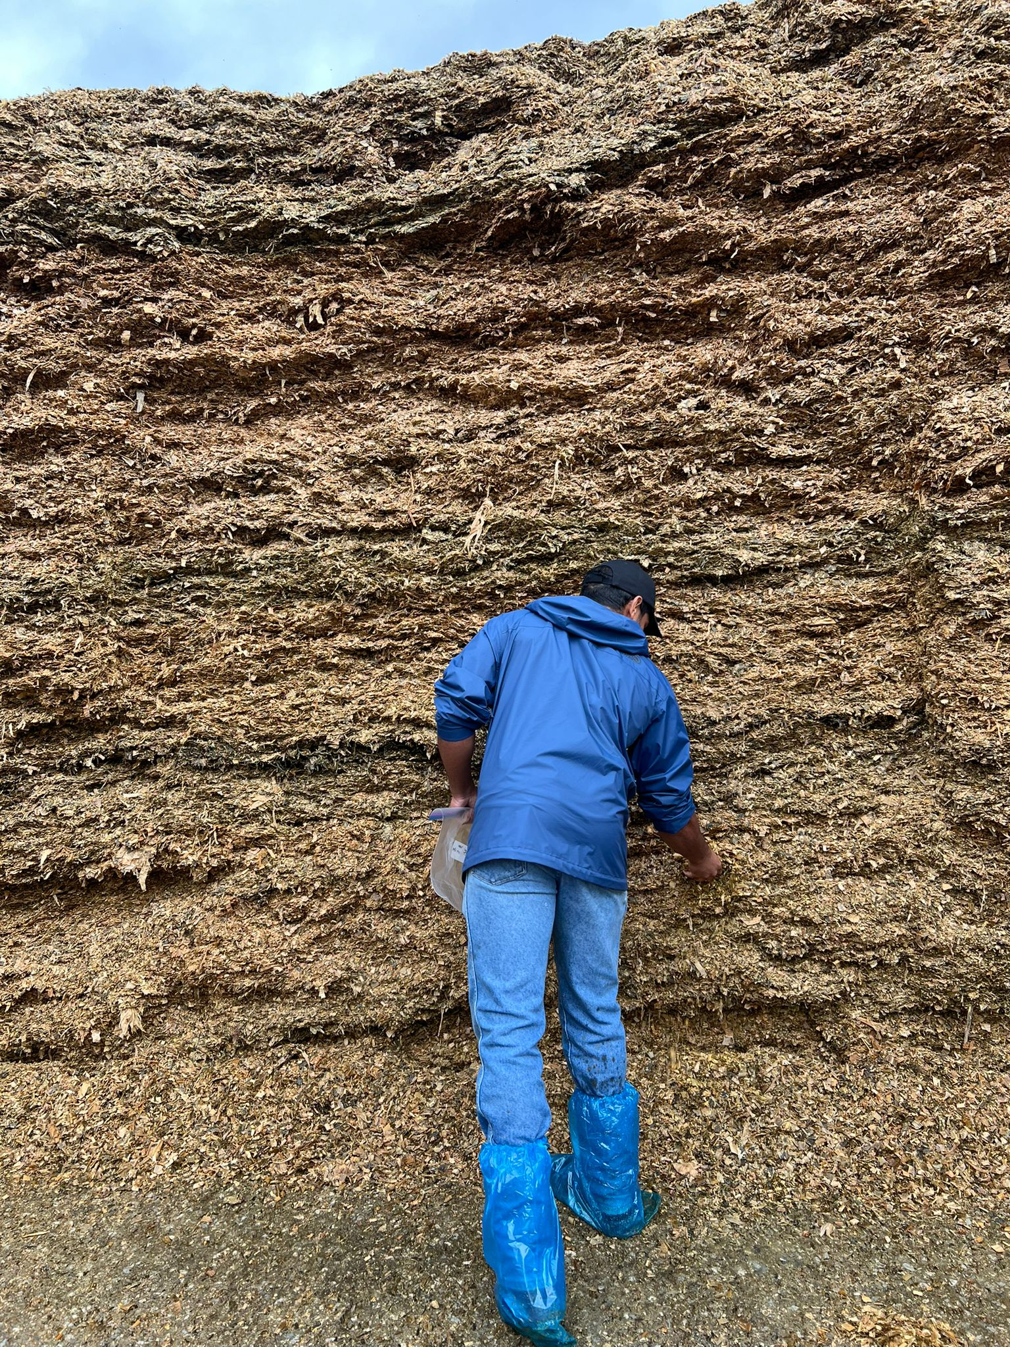
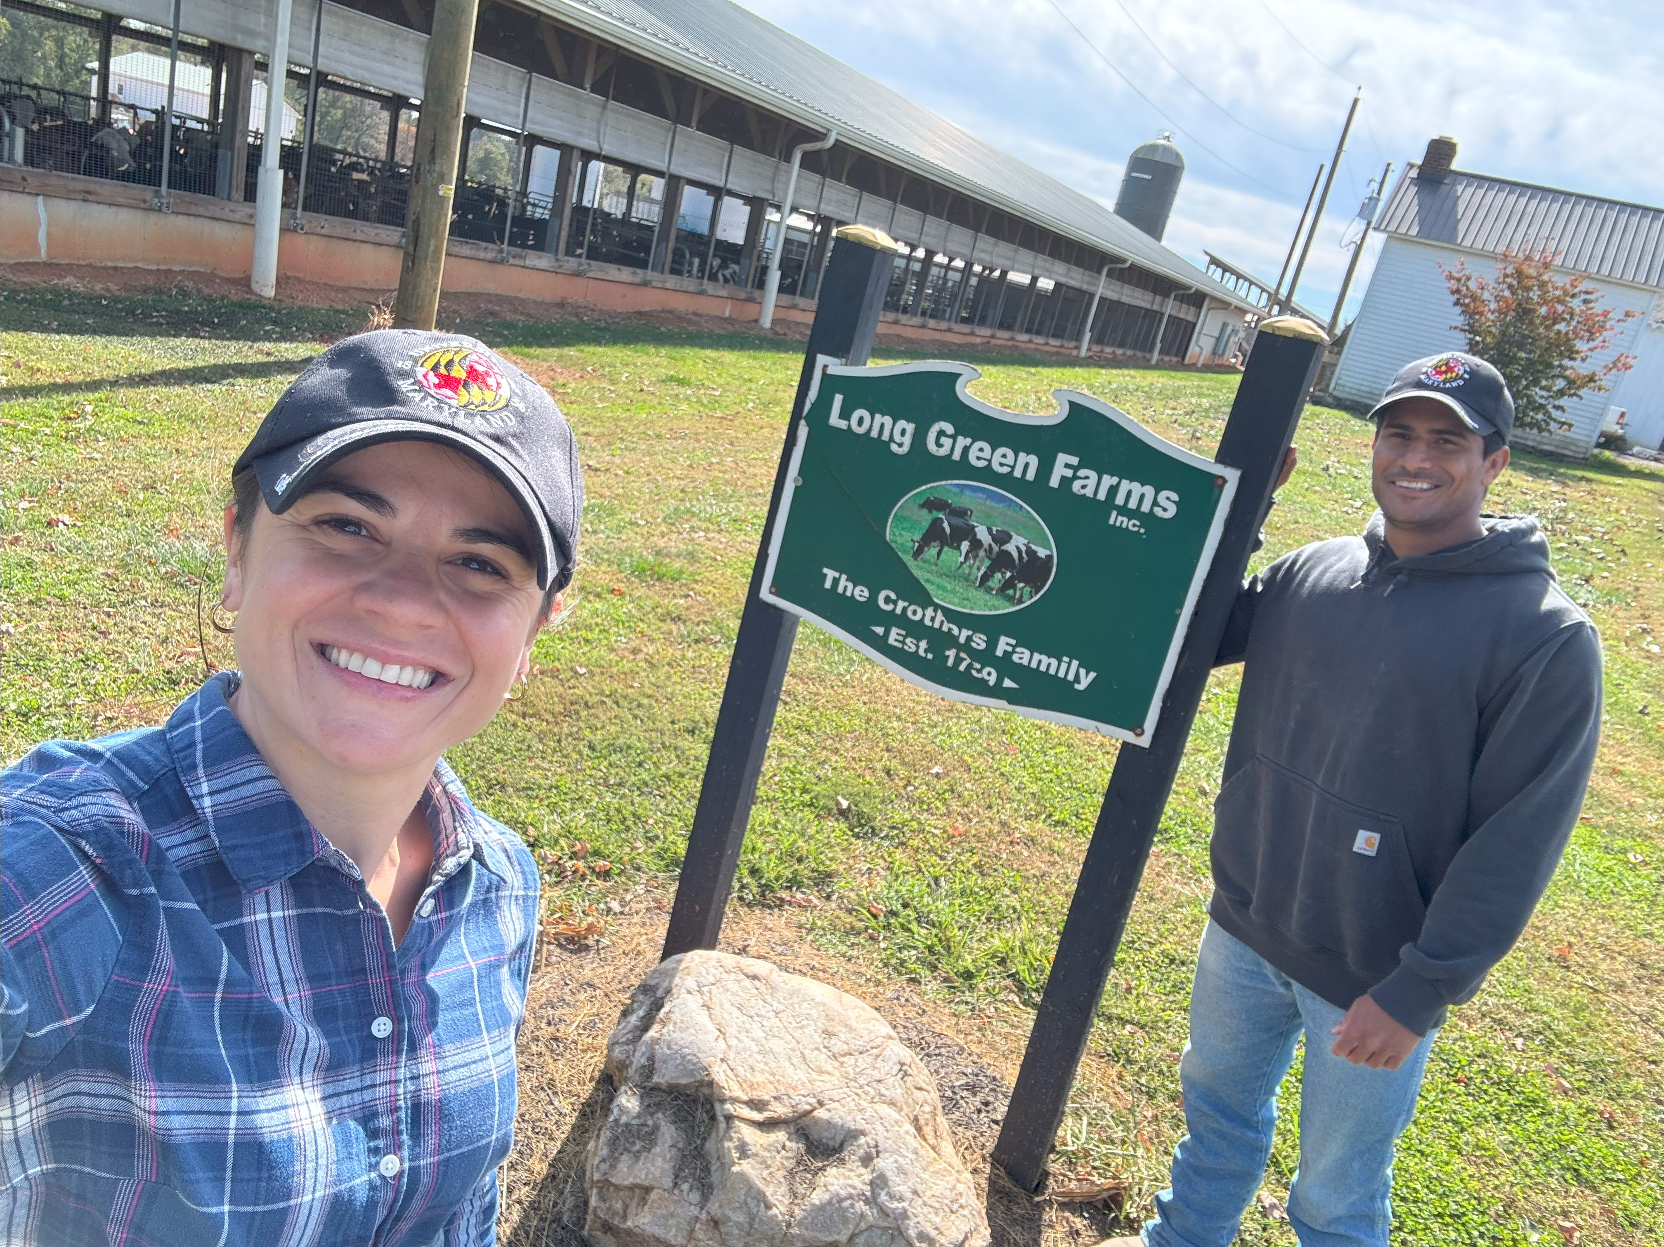
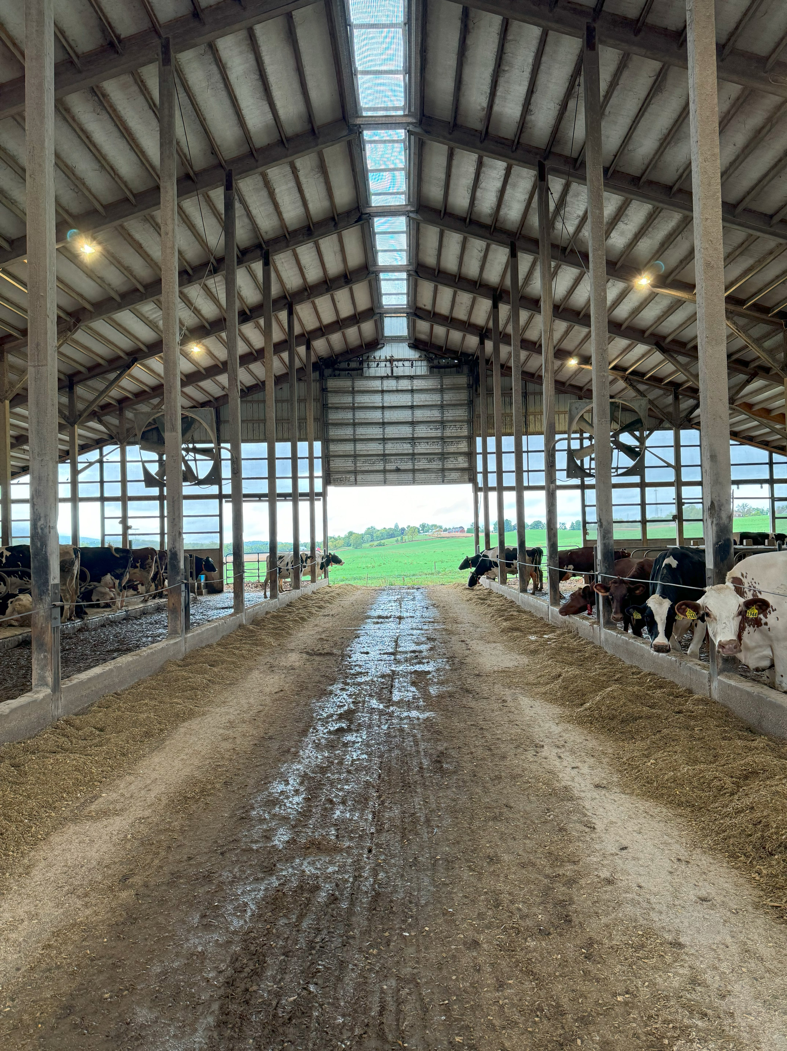
Needs Assessment to Understand and Prevent Future Mycotoxin and Clostridium Contamination in Feed for Maryland Dairy Farmers
N. Suresh*(1)(S), I. Coelho, J. Semler, T. Fernandes, F. F. Cardoso (1)(2) 1. University of Maryland, Department of Animal and Avian Sciences, College Park, MD
INTRODUCTION
The Maryland dairy industry has been rapidly declining in recent years, with economic struggles being a key factor (Tressler et al. 2018)
Feed is the number one cost for dairy farmers, reducing feed waste and increasing feed efficiency is imperative for success of a dairy operation
Mycotoxins and Clostridium are both known to cause feed refusals, adverse health effects, and reduce feed efficiency (Ogunade et al. 2018)
RESULTS
FUTURE DIRECTIONS
In the next phase of the project which is currently underway, farms will be visited to take feed samples to be tested for mycotoxins and Clostridium
After the test results are received, farmers will receive complementary educational materials to help prevent future contamination
Farms by County
Total
Visited
Small: 1-99 Lactating Cows | 23 Farms
Medium: 100-199 Lactating Cows | 18 Farms
Large: 200-799 Lactating Cows | 5 Farms
Extra Large: 800+ Lactating Cows | 5 Farms
OBJECTIVE
The purpose of this survey was to understand the knowledge and experiences of dairy farmers in Maryland regarding feeding management and mycotoxin and Clostridium contamination in feed
MATERIALS AND METHODS
Figure 1: Daily Milk Production in Pounds
A survey was sent by mail to every registered dairy farmer in Maryland (n=293)
All data was inputted into Qualtrics.
The survey inquired on general information on the operation, management strategies, facilities, and knowledge and experiences with mycotoxin and Clostridium contamination.
58% of farms wanted to participate on our applied research
59 responses were received, 30 Farms were visited to test for feed contamination
Figure 2: Confidence to Identify Issues Relating to Mycotoxins and Clostridium
Aside from grassfed operations, all farms used corn silage
All farms used manure as fertilizer
67% of farms used inoculants
64% of farmers had a desire for more affordable feed testing for mycotoxins and Clostridium
75.5% of farmers had previously tested their feed for mycotoxins and/or Clostridium
80 % of farmers were willing to adopt new technologies to improve detection of mycotoxins and Clostridium
References
Ogunade, I. M., Martinez-Tuppia, C., Queiroz, O. C. M., Jiang, Y., Drouin, P., Wu, F., Vyas, D., & Adesogan, A. T. "Mycotoxins in silage: Occurrence, effects, prevention, and mitigation. 2018. J. Dairy Sci. 101:4034–4059 https://doi.org/10.3168/jds.2017-13788.
Tressler, S.G., Rife, A., Debaugh, L., Vona, J., Milazzo, J., Young, K., Chomicki, W., Caplon, M., Haines, M. Fulton, J.S., Kilby, P., Hoff, M. (2018) Maryland’s Dairy Industry:2018, A Report to Governor Larry Hogan. Maryland Dairy Industry Oversight and Advisory Council.
ACKNOWLEDGEMENTS
The authors would like to extend a special thanks to the Northeast SARE for funding this project as well as all the Maryland dairy farmers who participated in the survey

