Slide 1
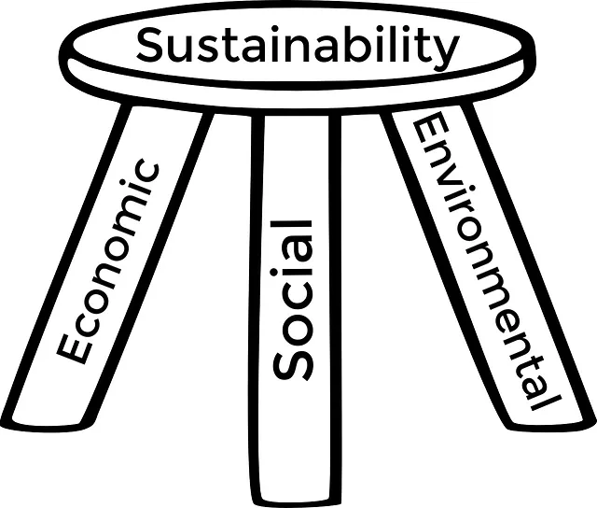
Cover crops with purpose: Climate-smart cover cropping in central and western Kansas
Logan Simon
Southwest Area Agronomist, KSU SWREC - Garden City

Slide 2
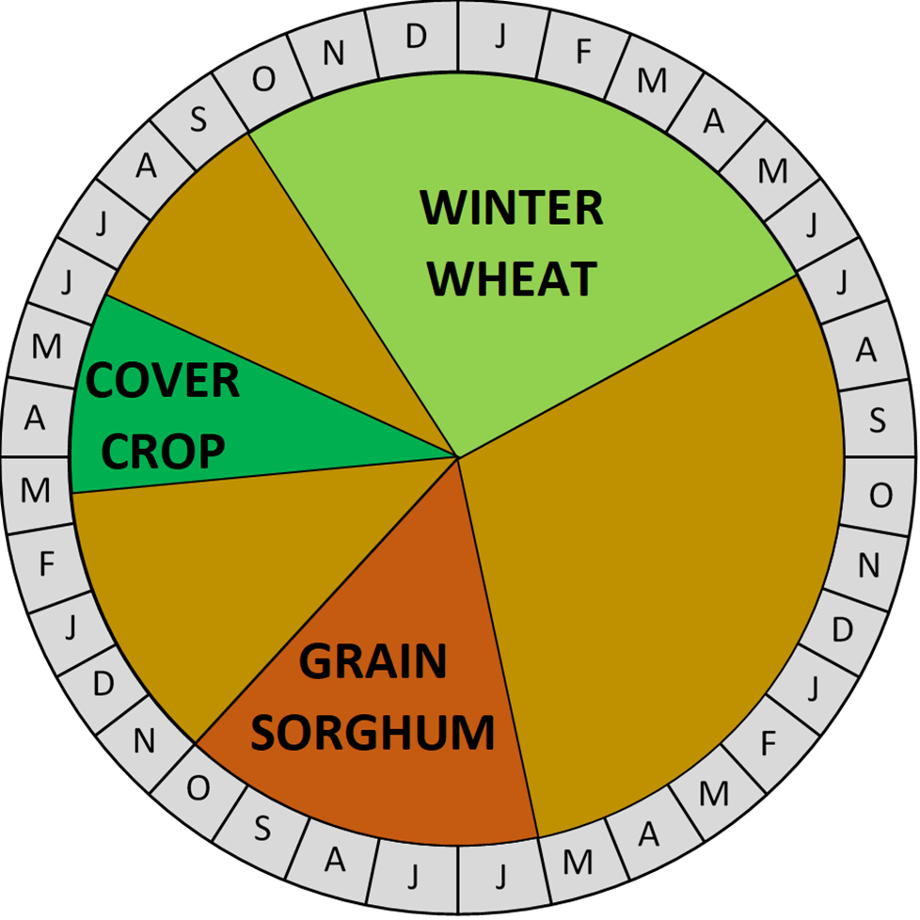
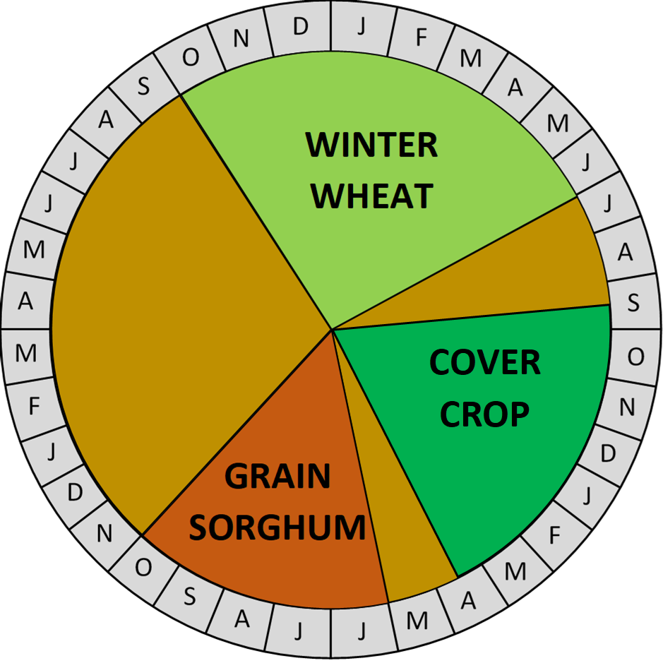
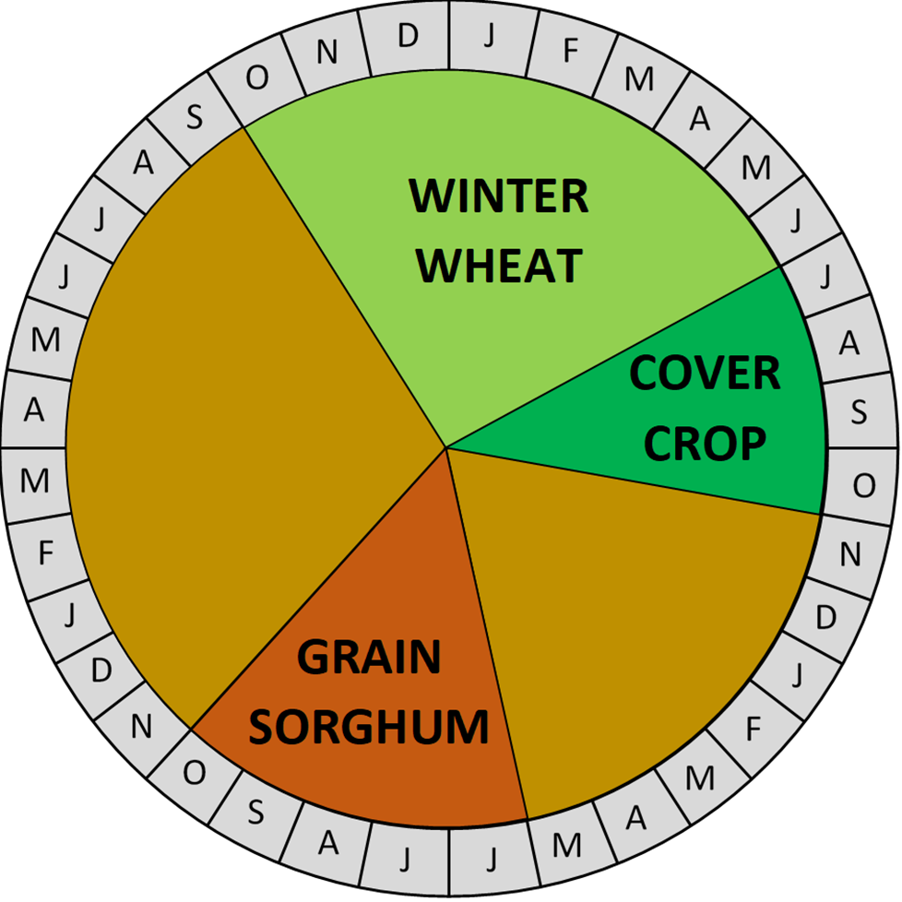
Cover crops in semi-arid Kansas cropping systems
Cool-season cover crops planted in the spring into sorghum/corn/wheat stubble
Cool-season cover crops planted in the fall into wheat stubble
Warm-season cover crops planted immediately after wheat harvest
2
| Western Kansas Research-Extension Centers

Slide 3
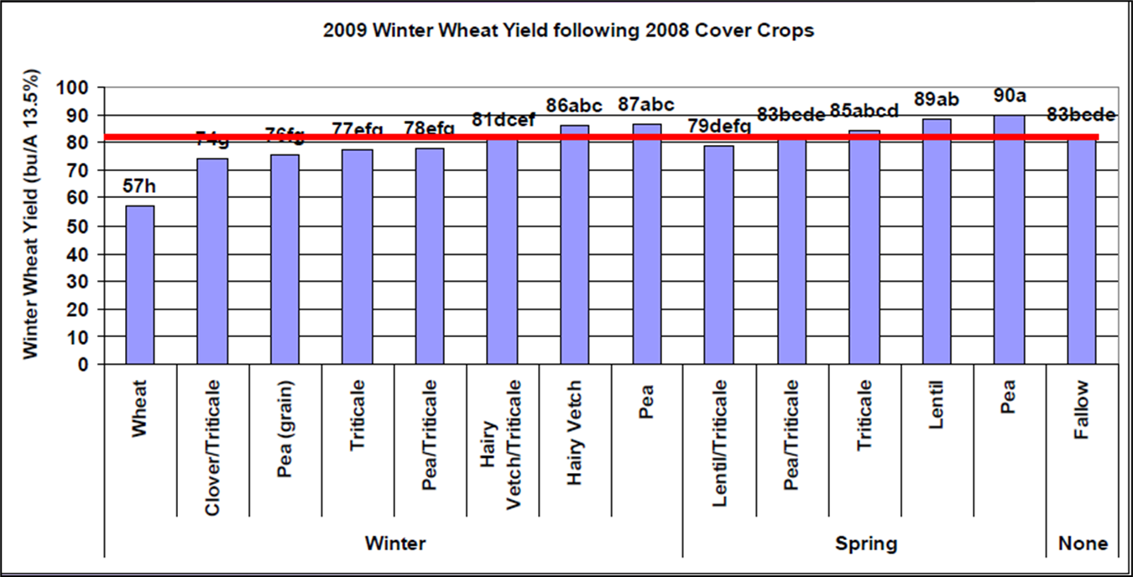
Replacing fallow with cover crops
Cover crops offer many benefits:
Provide residue cover to protect the soil and reduce erosion
Increase soil organic matter and soil structure
Suppress herbicide resistant weeds
Despite the benefits, cover crops use soil water that may limited subsequent crop yields, especially in dry years
3
| Western Kansas Research-Extension Centers

Slide 4
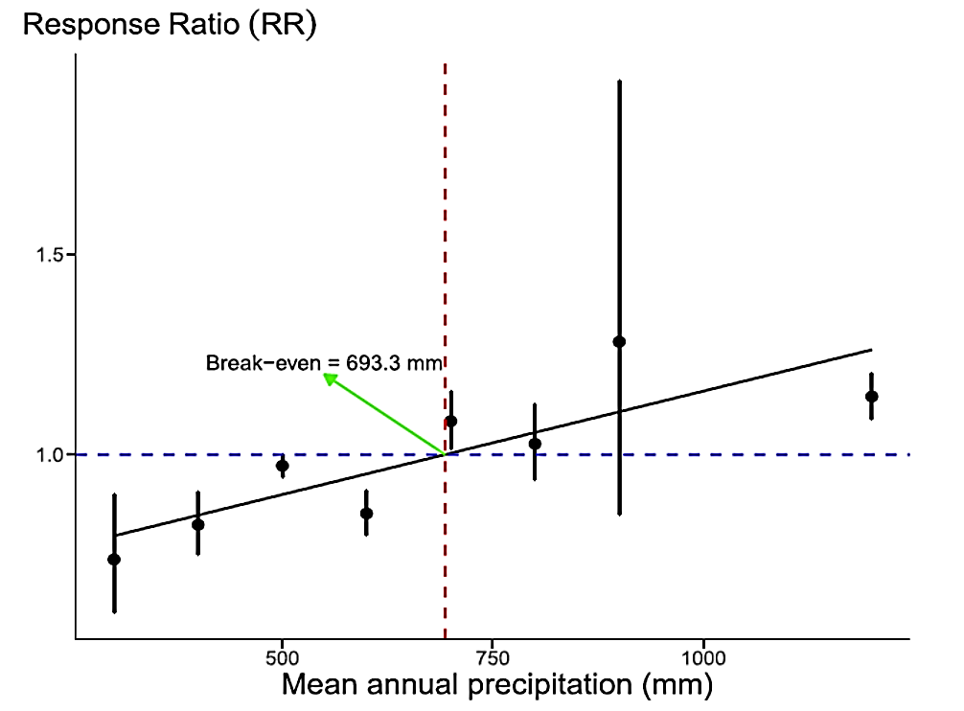
Relationship of cash crop yields following CC and mean annual precipitation
Crop yields changed by +15, +4, −11, and −12% following cover crops in tropical, continental, dry, and temperate dryland climates.
~ 27 in. of precipitation
Garba et al., 2022, Agron. Sust. Dev.
4
| Western Kansas Research-Extension Centers

Slide 5
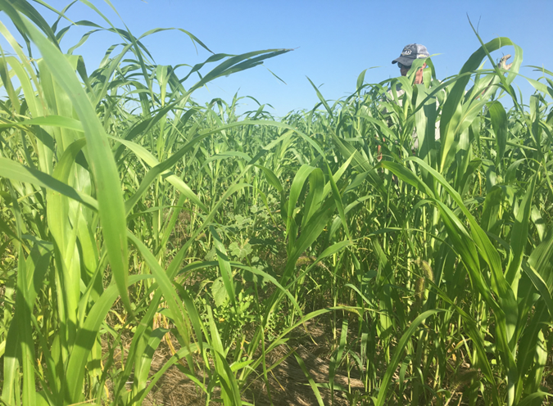
Using cover crops as a forage resource
Cover crops can provide immediate economic benefits in the form of high-quality forage
Drawbacks may include:
Reduced residue cover and increased exposure to erosive winds and rain
Increased soil compaction and decreased water infiltration
Reduced soil organic carbon accumulation
5
| Western Kansas Research-Extension Centers

Slide 6
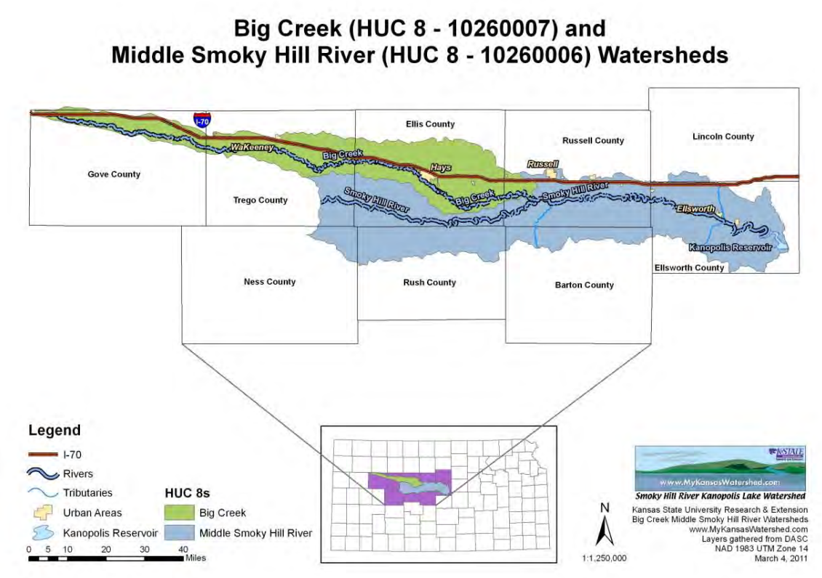
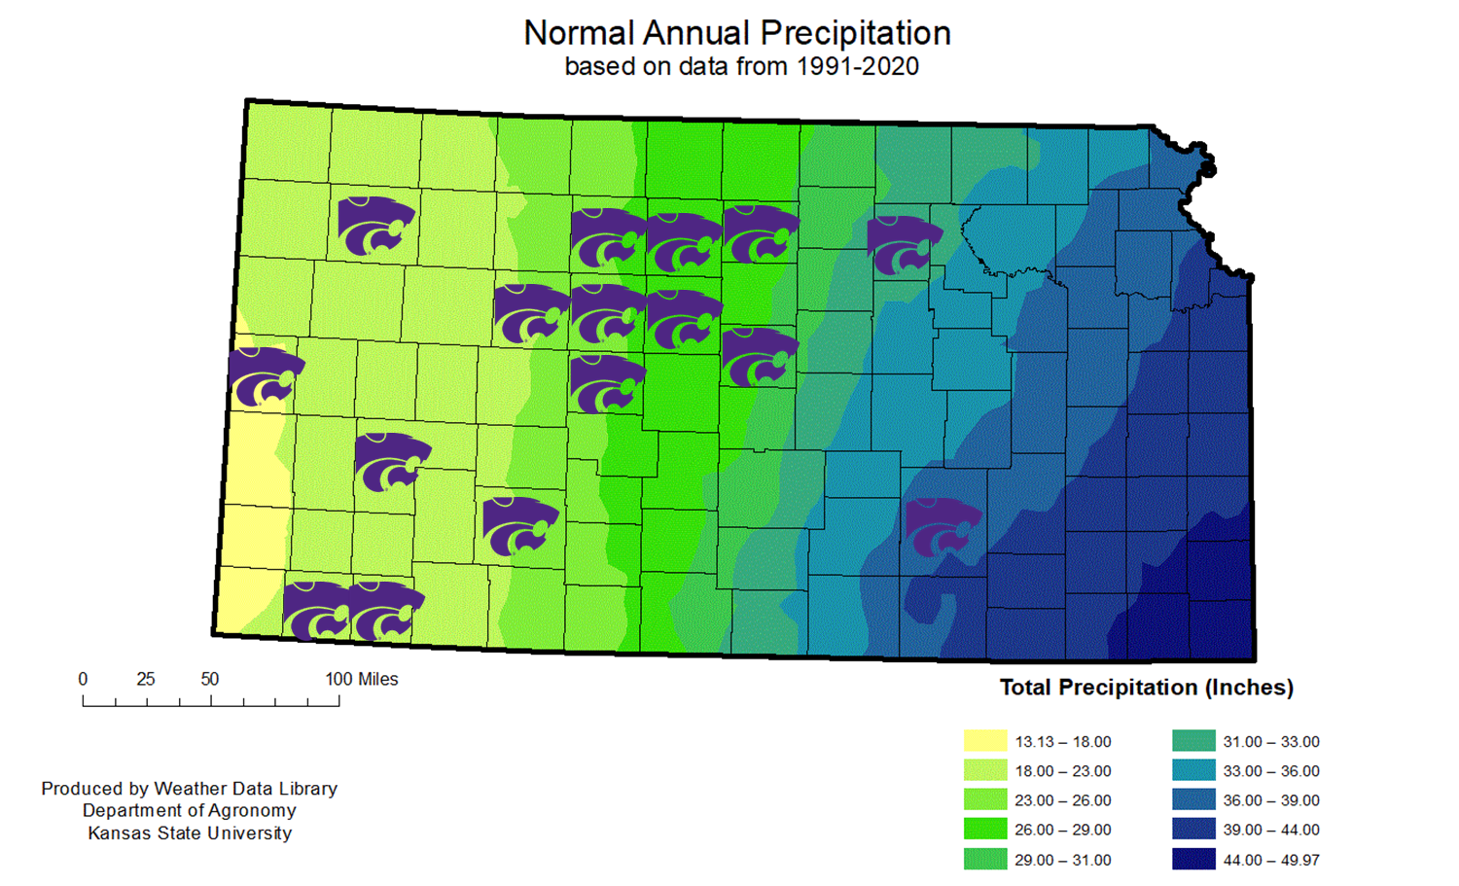
KSU WKREC Cover Crops/Soil Health Research Sites across Kansas
6
| Western Kansas Research-Extension Centers

Slide 7
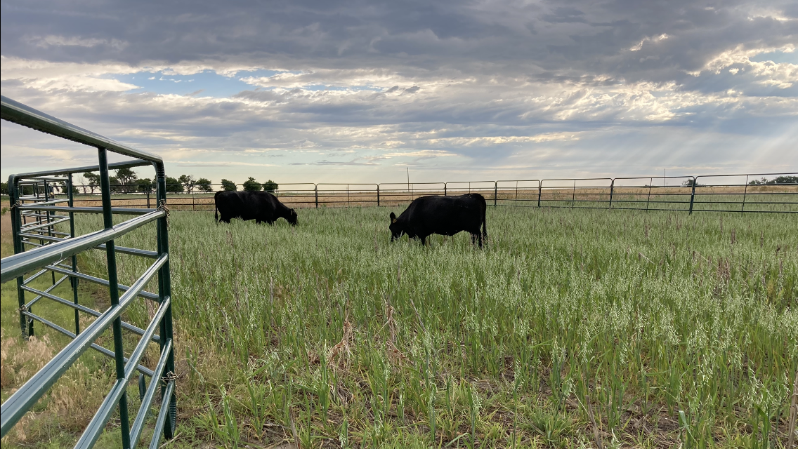
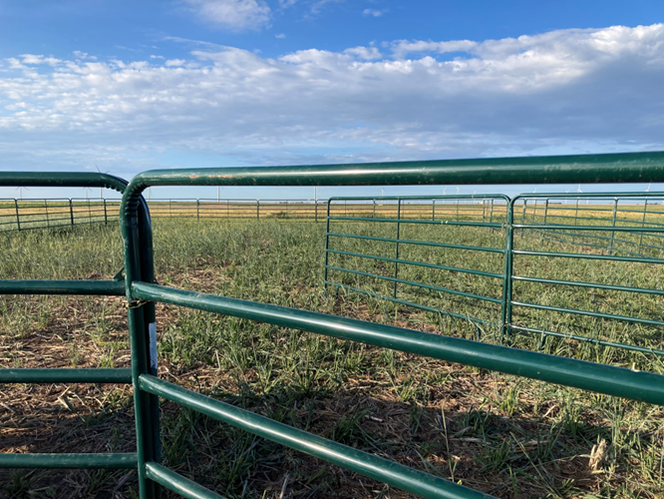
Dryland cover crop management studies at Brownell (Trego County)
Planted in WSF rotation
Treatments
Chem-Fallow
Standing cover crops
Hayed cover crops
Grazed cover crops
Flex-hayed cover crops
Hayed Cover Crops
At grass species heading stage
6 inches cutting height
Grazed Cover Crops
Yearling heifers
Generally, one week before haying takes place
1300 lb live weight per acre for four to seven days
7
| Western Kansas Research-Extension Centers

Slide 8
Cover crop biomass production is variable year-to-year based on weather
Haying and grazing retained about 30% and 60% of the available forage mass (about 3 ton/acre)
Average
8
Oats, Triticale or Barley, and Pea
| Western Kansas Research-Extension Centers

Slide 9
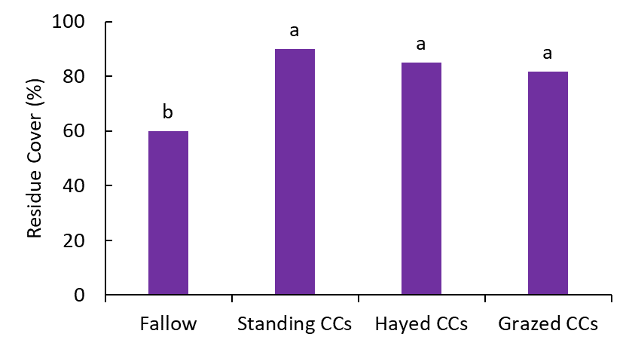
Haying and grazing cover crops does retain pretty good residue cover
9
| Western Kansas Research-Extension Centers

Slide 10
Cover crops can use a lot of water but sometimes we get adequate recharge (predicting this can be a challenge)
Cover crop treatments reduced plant available water by about 20% on average but up to 60%
10
| Western Kansas Research-Extension Centers

Slide 11
Subsequent crop yields have been limited by water (we knew this going in) but maybe not as often as we might have thought
Cover crop treatments reduced subsequent grain yields by 10% on average but up to 40%
Crop failure due to drought
11
| Western Kansas Research-Extension Centers

Slide 12
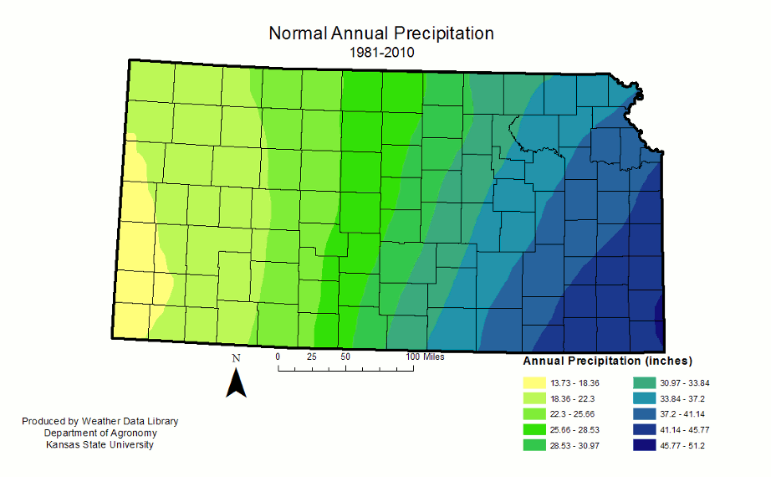
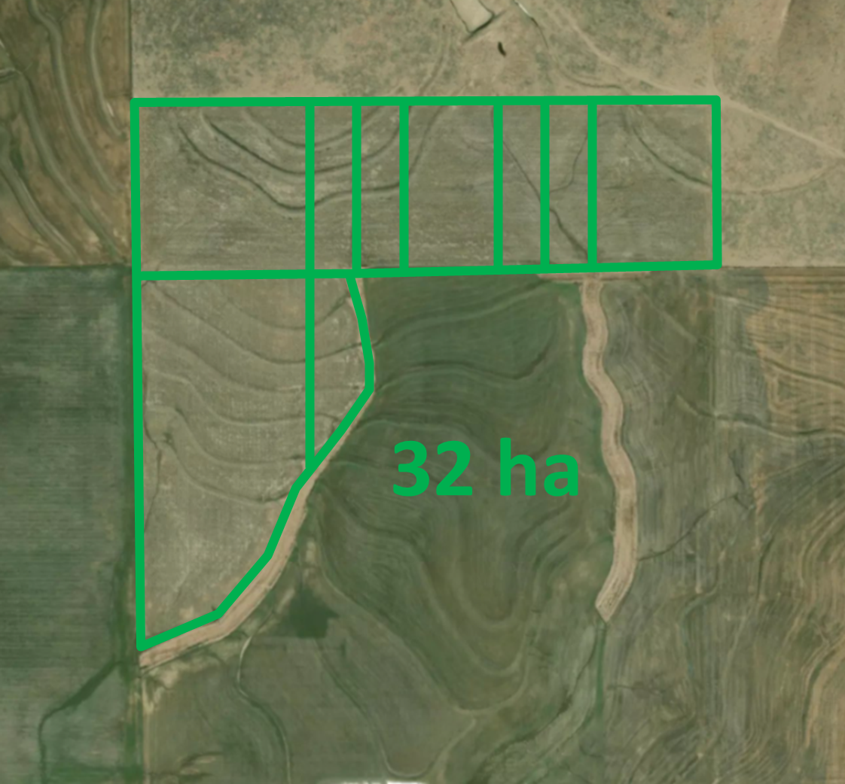
Grazing cover crops at Hays, Alexander, and Marquette, KS (2019 to 2021)
Treatments:
Non-grazed cover crop
Grazed cover crop
Cover crop species:
Summer: Forage sorghum, German millet, sunflower, sunn hemp, and radish
Spring: oat, triticale, barley, radish, sunflower, pea, rapeseed
Winter: triticale, rapeseed, radish
Cover crop grazing:
Cow-calf pairs at 575 to 1388 lb live weight per acre for 45 days at Hays
Yearlings at 350 to 575 lb live weight per acre for 30 to 40 days at Alexander
Yearlings at 550 to 575 lb live weight per acre for 45 to 60 days at Marquette
80 acres
12
| Western Kansas Research-Extension Centers

Slide 13
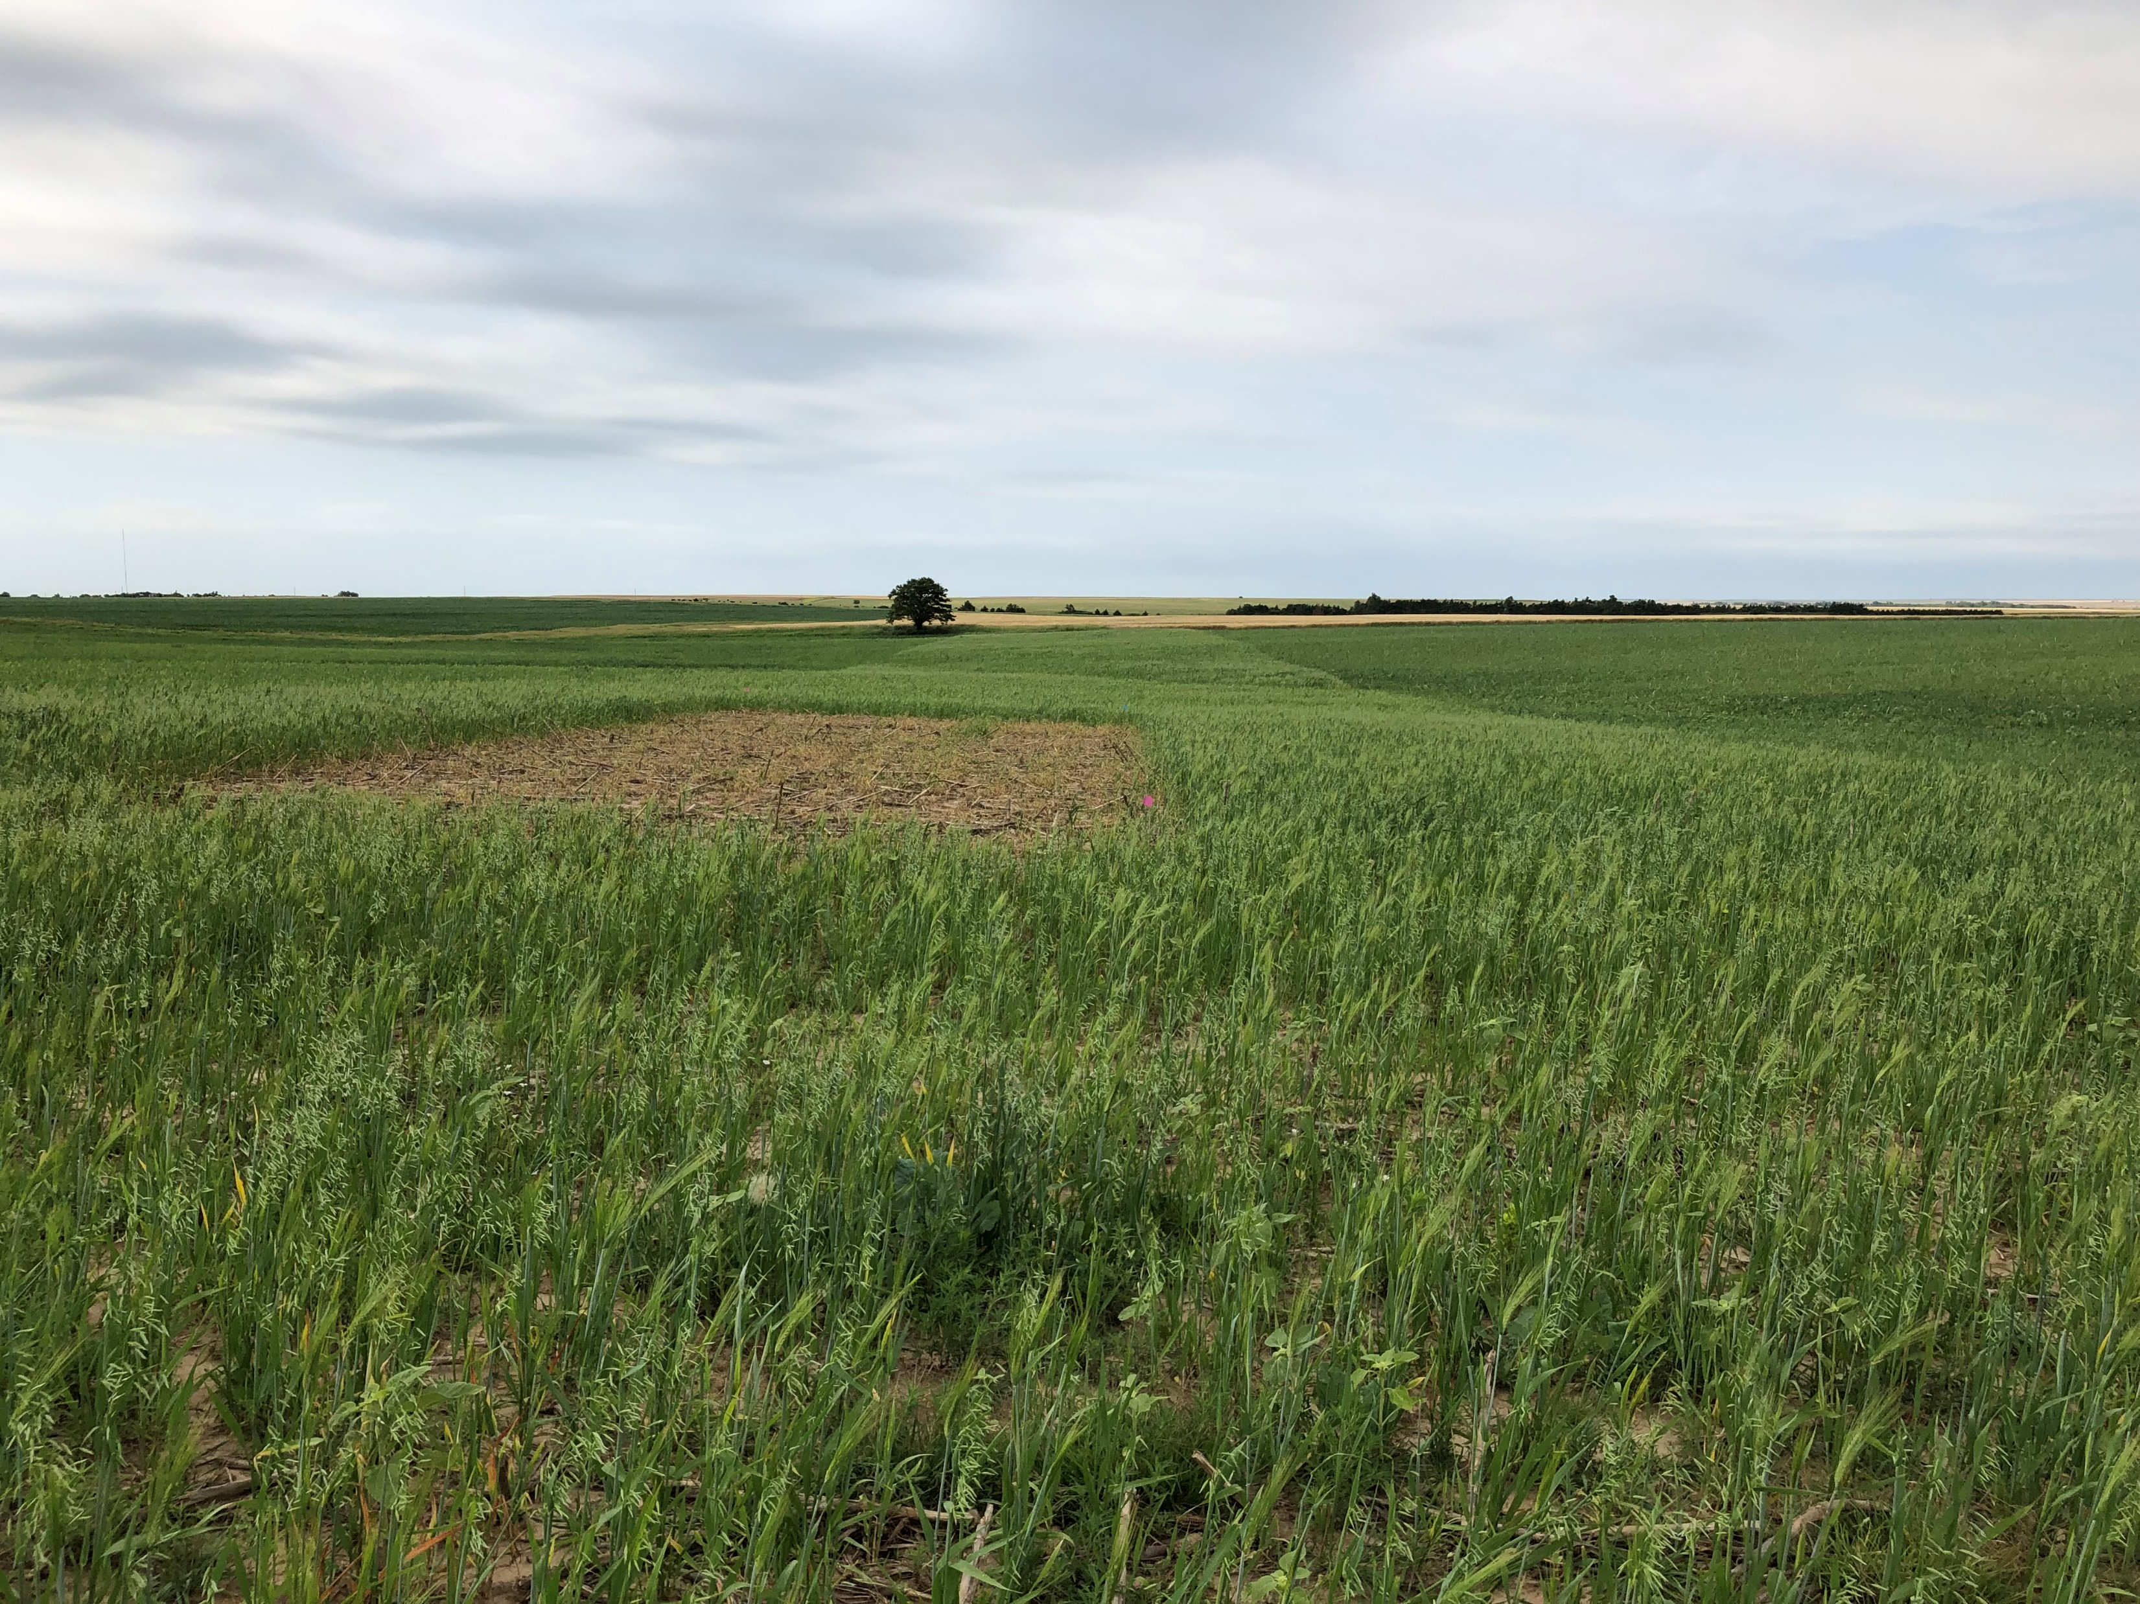
Spring grazing in 2019 at Alexander
13
| Western Kansas Research-Extension Centers

Slide 14
Most of the time, we left a far amount of cover crop biomass to build residue
Cover crop treatment | Alexander (Rush Co.) |  |  | Hays (Ellis Co.) |  | Marquette (Ellsworth Co.)
 | 2019 | 2020 |  | 2019 | 2021 | 2019 | 2020 | 2021
 | Cover crop biomass produced (lb/ac)
Pre-graze | 1337ab |  | 3948b | 6158a | 1063b | 1262b | 955b | 2136b
Post-grazing | 1000b |  | 3734b | 4744b | 429c | 1292b | 2068a | 2207b
Non-grazed | 2304a |  | 5189a | 6908a | 1436a | 2740a | 2653a | 3100a
Alexander: 2019, spring cover crop; 2020, summer cover crop
Hays: 2019, summer cover crop; 2021, spring cover crop
Marquette: 2019, 2020, & 2021 winter cover crop
14
| Western Kansas Research-Extension Centers

Slide 15
Residue after grazing in 2019 at Marquette
15
| Western Kansas Research-Extension Centers

Slide 16
Grazing never cause measurable compaction though hoof impact was quite visible
Marquette
16
| Western Kansas Research-Extension Centers

Slide 17
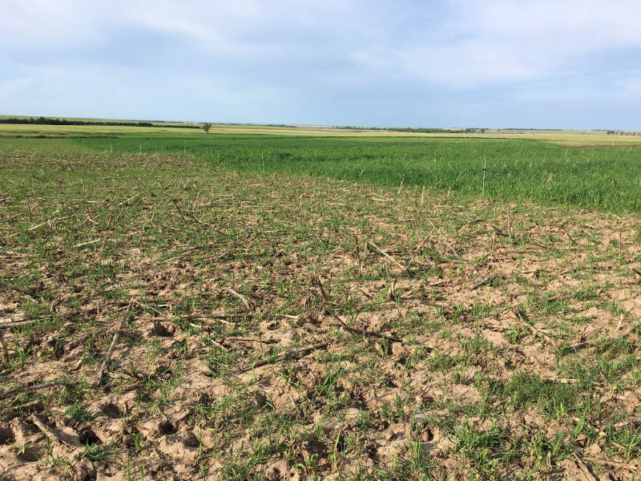
Soil bulk density at Hays in 2020 and 2021
0 to 2-inch depth
2 to 6-inch depth
17
| Western Kansas Research-Extension Centers

Slide 18
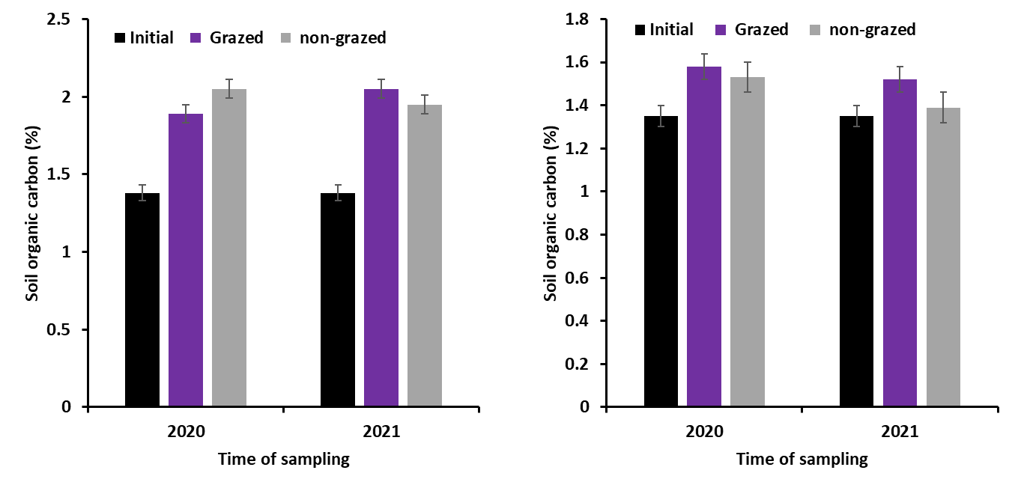
Cover crop increased soil carbon mostly at the soil surface where residue accumulates
0 to 2-inch depth
2 to 6-inch depth
18
| Western Kansas Research-Extension Centers

Slide 19
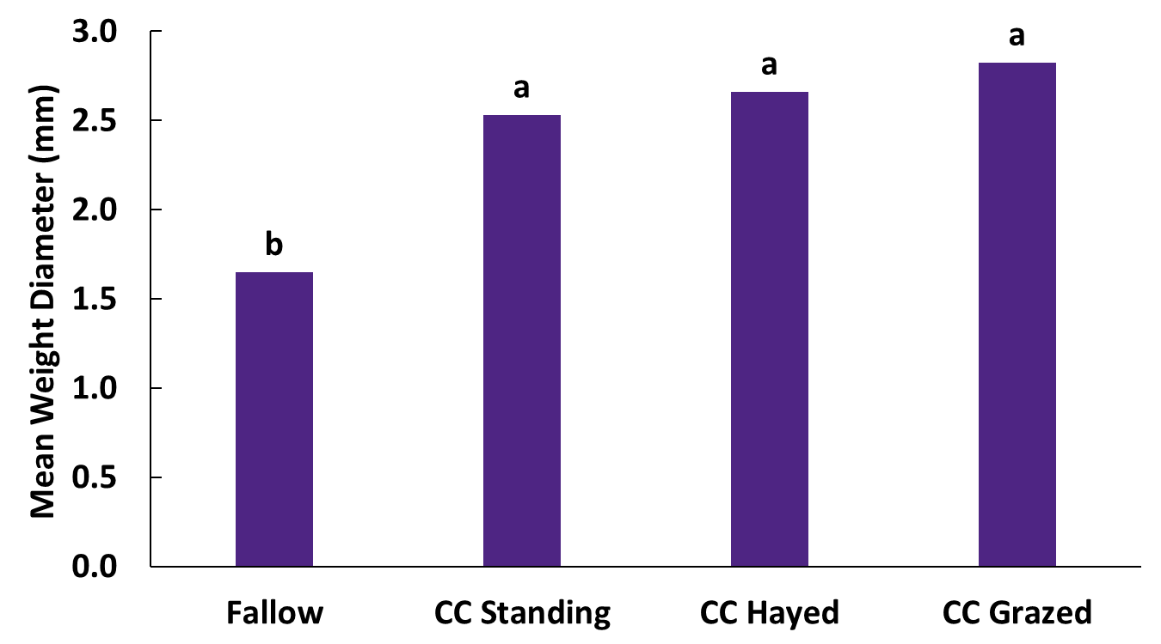
Cover crops build soil structure and aggregation even when we hay or graze
19
| Western Kansas Research-Extension Centers

Slide 20
Grazing did not limit water infiltration. Note: diverse cover crop did not affect water infiltration but did limit biomass…
20
| Western Kansas Research-Extension Centers

Slide 21
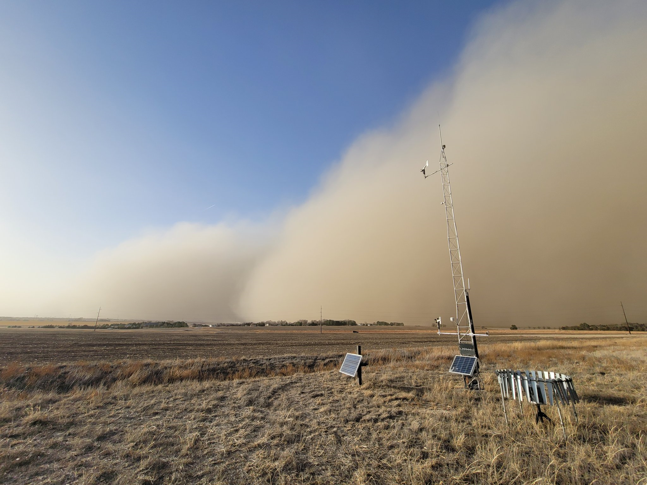
21
| Western Kansas Research-Extension Centers

Slide 22
Worst Case Scenario
Which plot had a cover crop planted?????
Hint: It’s not this one.
22
| Western Kansas Research-Extension Centers

Slide 23
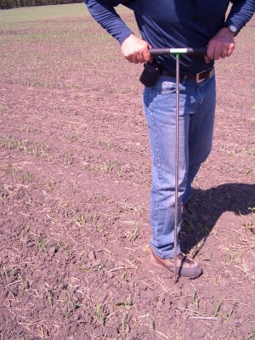
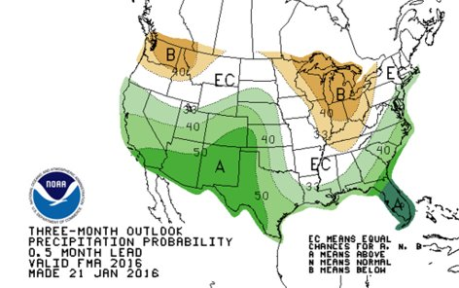
Flex-Fallow Concept
At CC planting, measure soil moisture with Paul Brown Probe
Plant if >12” of soil moisture AND Precipitation Outlook is neutral or favorable, otherwise implement fallow
Reduce losses in dry years and take advantage of wet years
23
| Western Kansas Research-Extension Centers

Slide 24
Flex-cover crops still increased water stable aggregates if they were planted (let’s manage our expectations)
Flex-cover crops WERE planted AND harvested in 2021 but not in 2018.
24
| Western Kansas Research-Extension Centers

Slide 25
What have we learned?
Utilizing cover crops for forage will allow cover crop use in water-limited farming systems to improve soil health and profitability
NOTE: Cover crop mixtures should be dominated by productive grasses species to maximize forage and residue production
Grazed or hayed cover crops can provide similar soil health benefits compared to standing cover crops
Residue management is critical to meeting soil health goals in water-limited farming systems
Flexible CC management systems might take advantage of available water in wet years while saving water in dry years.
25
| Western Kansas Research-Extension Centers

Slide 26
Cover Crop Biomass Removal Rates to Optimize Livestock Production and Soil Health
KSU Collaborators: Logan Simon^{1,2}, Augustine Obour¹, Zach Carson¹, Stacie Minson³, and Craig Dinkel⁴
¹KSU Agricultural Research Center-Hays, ²KSU Southwest Research-Extension Center, ³KSU Kansas Center for Agricultural Resources and the Environment, and ⁴KSU Midway Extension District
Farmer Collaborator: Frank Weber¹
¹Southern Russell County Farmer/Rancher

Slide 27
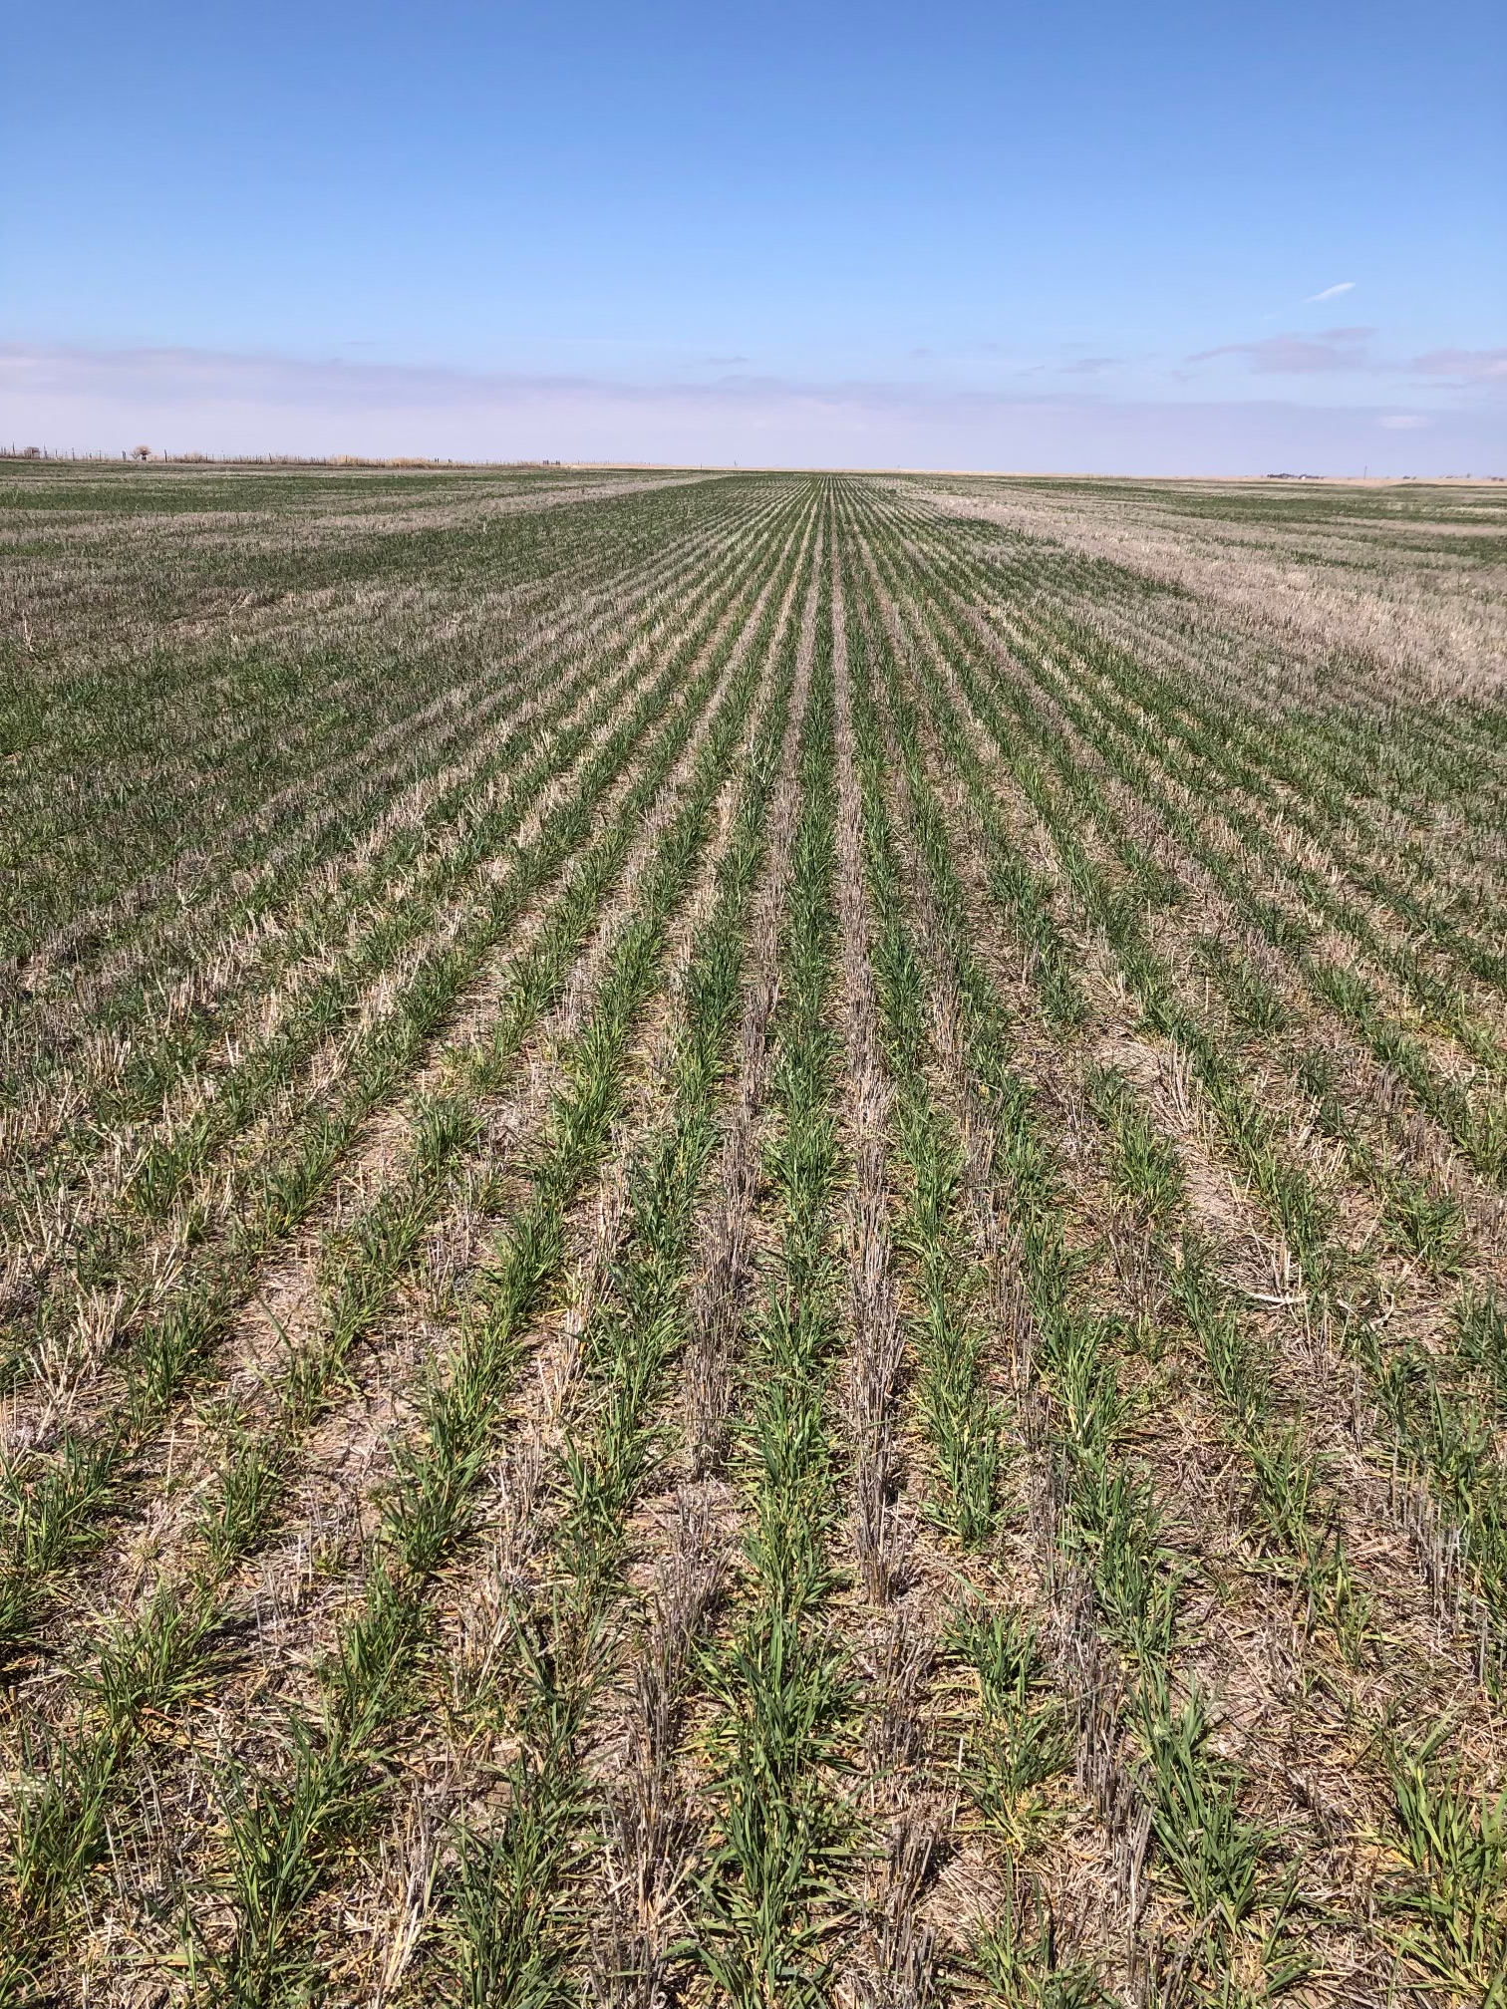
Study Objective
Determine optimum cover crop biomass removal with livestock grazing to optimize:
Farm profits
Soil health
27
| Western Kansas Research-Extension Centers

Slide 28
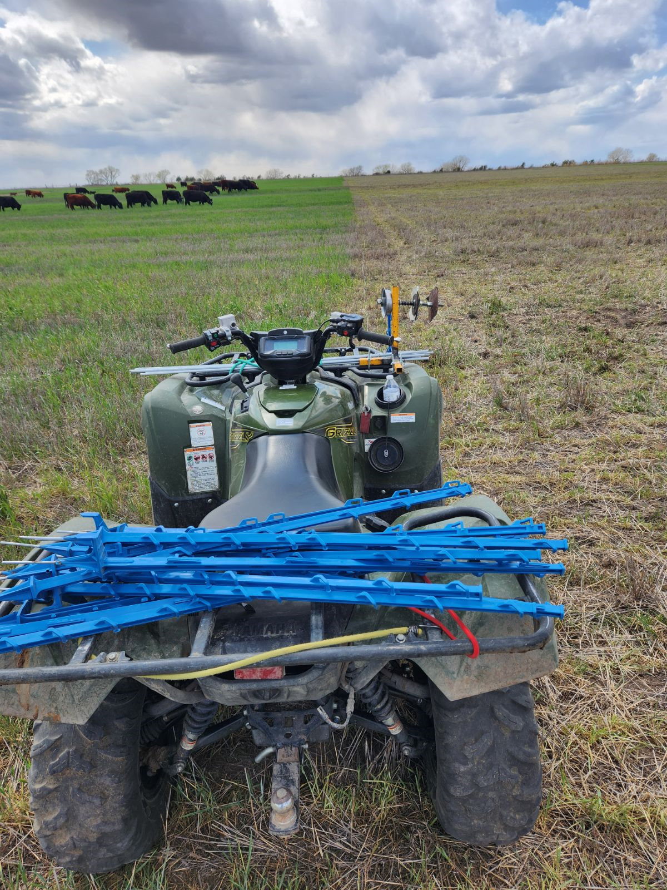
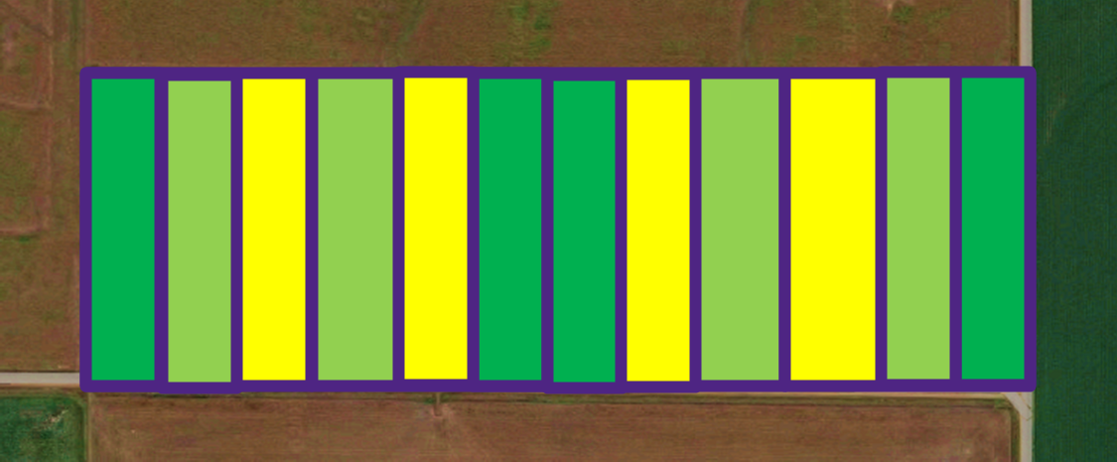
Location and design
Three treatments replicated 4 times across a 50-acre field:
Ungrazed
Take-half-leave-half (50% removal)
Grazed-out (90% removal)
28
| Western Kansas Research-Extension Centers

Slide 29
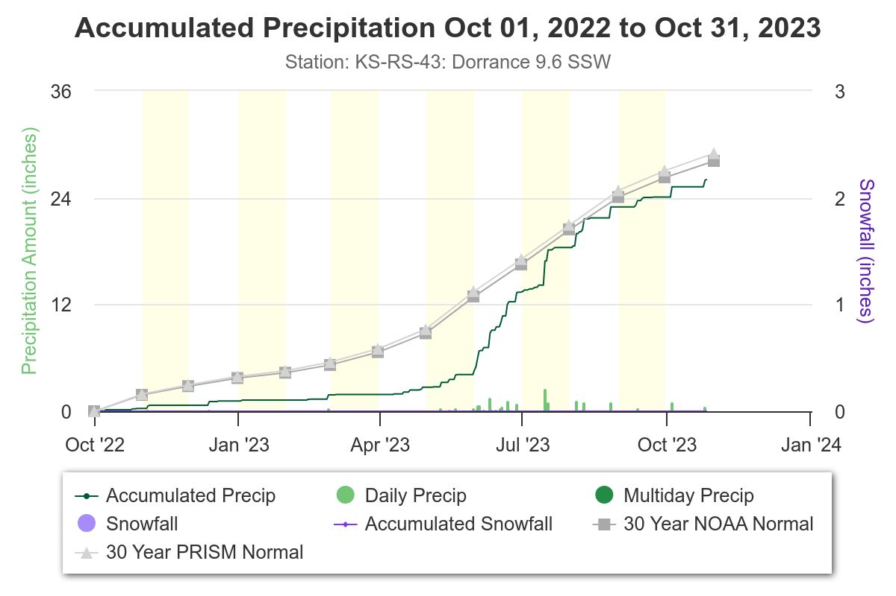
Grain Sorghum
Cover Crop
Source: https://www.cocorahs.org/state.aspx?state=ks
29
| Western Kansas Research-Extension Centers

Slide 30
Grazing reduced residue amount and height (as we would expect)
30
| Western Kansas Research-Extension Centers

Slide 31
Grazing maintained residue cover even when we graze heavier (Graze-Out)
31
| Western Kansas Research-Extension Centers

Slide 32
Ungrazed
Take-half-leave-half
Graze-out
(with regrowth)
32
| Western Kansas Research-Extension Centers

Slide 33
Soil properties were unaffected
Treatment | SOC | POM | NO₃-N | P
 | % | % | ppm | ppm
Management
Initial | 1.94† | 1.00 | 18.9 | 14.7
Ungrazed CCs | 2.11 | 1.17 | 13.7 | 23.5
Take-half-leave-half (50% removal) | 1.86 | 0.91 | 9.9 | 20.1
Grazed-out (90% removal) | 1.92 | 1.01 | 10.7 | 17.9
Depth
0-2 in | 2.38a | 1.56a | 21.0a | 25.1a
2-6 in | 1.54b | 0.49b | 5.6b | 13.0b
Type III test of fixed effects
Parameter | P-values
Management (M) | 0.3360 | 0.3956 | 0.3956 | 0.3360
Depth (D) | 0.0011 | 0.0006 | 0.0006 | 0.0011
M*D | 0.7043 | 0.8675 | 0.8675 | 0.7043
33
| Western Kansas Research-Extension Centers

Slide 34
Soil properties were unaffected
Treatment | BD | PR | MWD | WEF | TTR
 | g/cm³ | MPa | mm | % | min
Management
Initial | 1.25c† | - | 1.23 | 23.7b | 16.4
Ungrazed | 1.26bc | 1.04 | 1.78 | 33.2a | 10.1
Take-half-leave-half (50% removal) | 1.33a | 1.10 | 1.75 | 32.8a | 12.1
Grazed-out (90% removal) | 1.32ab | 0.99 | 1.90 | 29.7a | 9.0
Depth
0-2 in | 1.16b | 1.47a | - | - | -
2-6 in | 1.42a | 0.61b | - | - | -
Type III test of fixed effects
Parameter | P-values
Management (M) | 0.0377 | 0.3309 | 0.2027 | 0.0038 | 0.1654
Depth (D) | 0.0009 | <0.0001
M*D | 0.1019 | 0.7822
34
| Western Kansas Research-Extension Centers

Slide 35
Water infiltration was actually a little higher where we grazed heavier (might not have expected that)
35
| Western Kansas Research-Extension Centers

Slide 36
That’s all good and well, but did you manage to make a crop after that cover?
36
| Western Kansas Research-Extension Centers

Slide 37
Our sorghum yields were also unaffected
37
| Western Kansas Research-Extension Centers

Slide 38
What have we learned?
Increasing grazing intensity maintained soil health and subsequent grain crop yields similar to ungrazed cover crops.
Farmers and ranchers may be able to graze cover crops at greater intensities than take-half-leave-half to maximize livestock gains while maintaining soil health.
This could potentially increase adoption of CCs and benefit water quality protection and improvement efforts to reach the goals of the approved 9 Element Watershed Plan through KDHE and EPA.
Nevertheless, these observations were made in a 1-year study and under exceptional drought conditions, so further investigation will be necessary.
38
| Western Kansas Research-Extension Centers

Slide 39
Our Funding Sources and Major Collaborators
39
| Western Kansas Research-Extension Centers

Slide 40
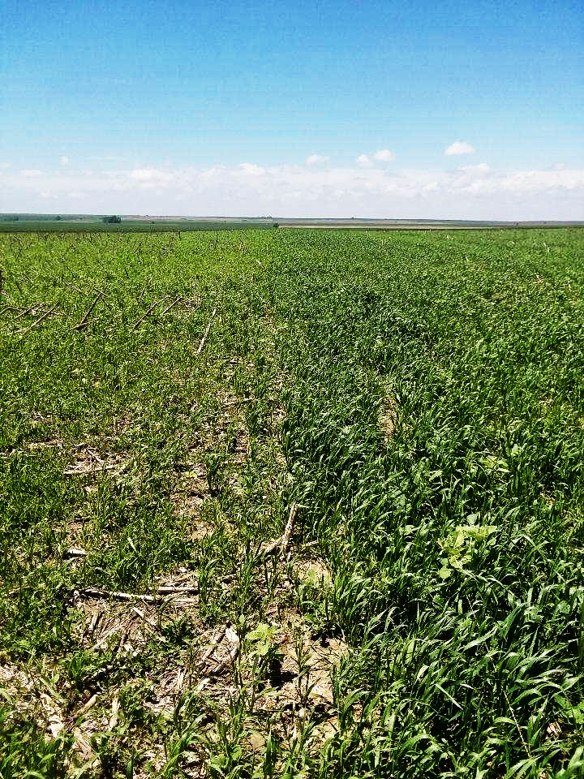
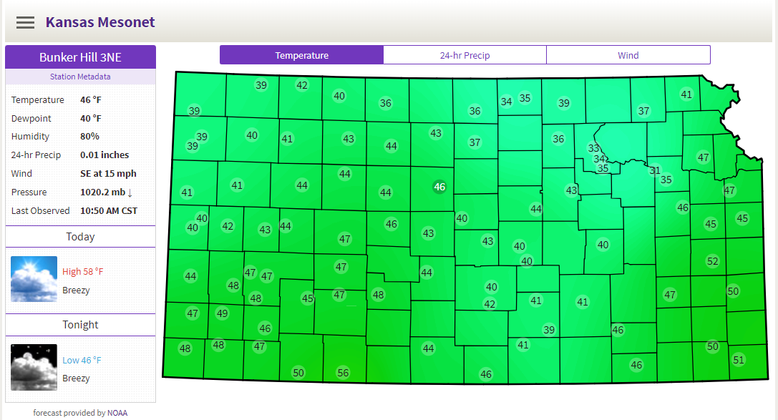
For my contact and more on WKREC research activities in western Kansas:
Also see some of our other KSRE resources:
The Kansas Mesonet: https://mesonet.k-state.edu/
The Agronomy eUpdate: https://eupdate.agronomy.ksu.edu/
40
| Western Kansas Research-Extension Centers

