Slide 1
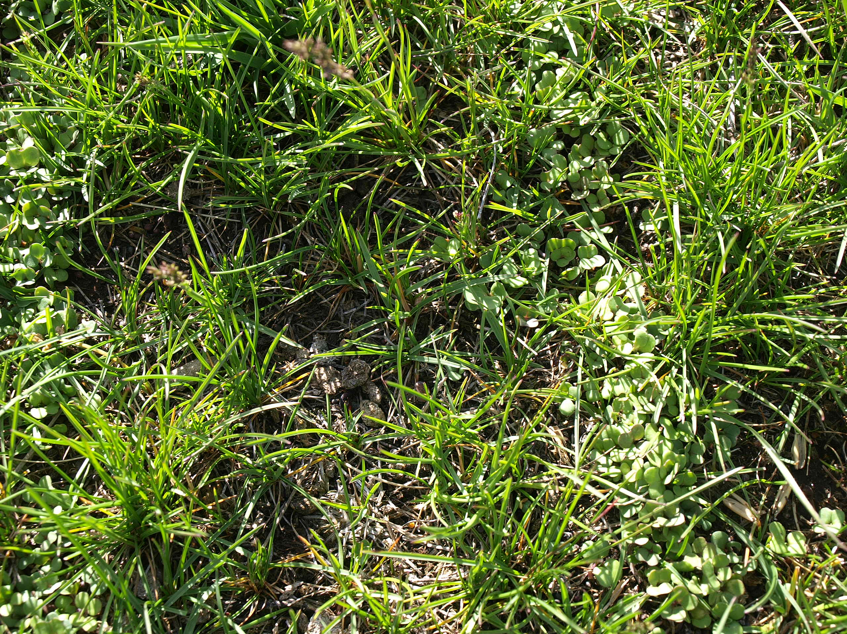
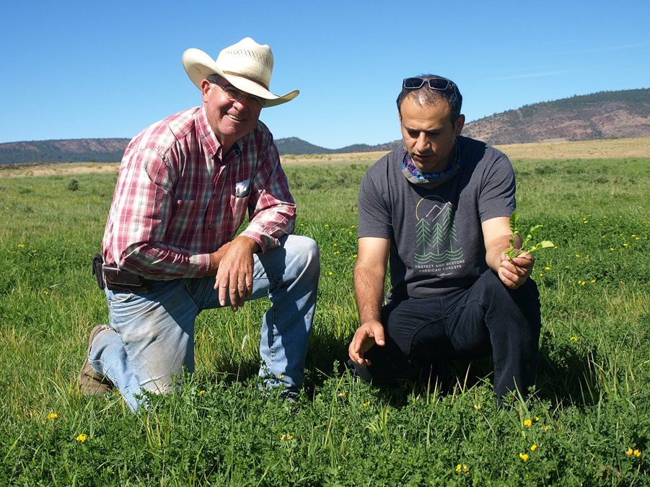
Overseeding novel forages in perennial pastures to increase grazing quality and soil health
John Shine – livestock producer
Fara Brummer – Oregon State University Extension
Serkan Ates – Oregon State University. Livestock and Forages
Notes:
Mention that this was funded by western SARE. “Improving Soil Biodivesrity and Grazing days with cover crops on irrigated pasture in Oregon's High Desert”

Slide 2
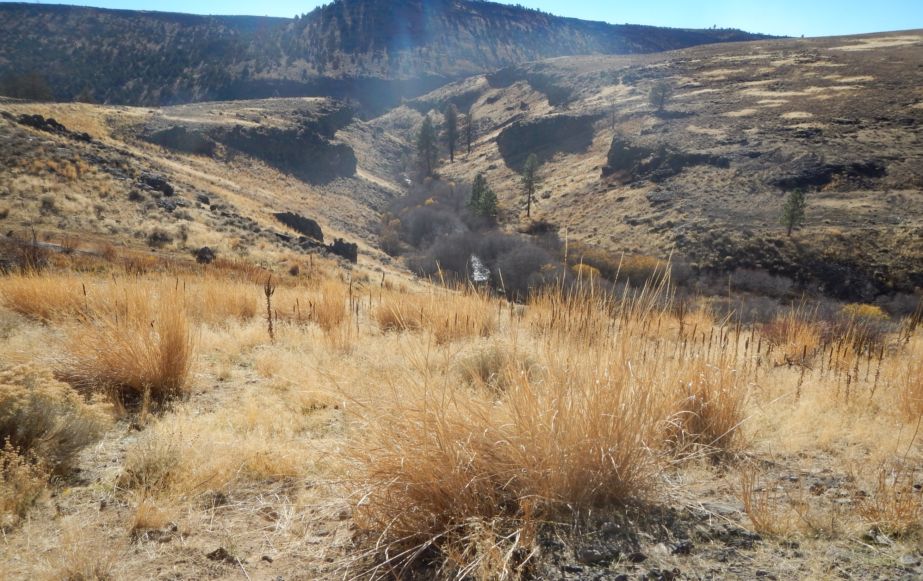
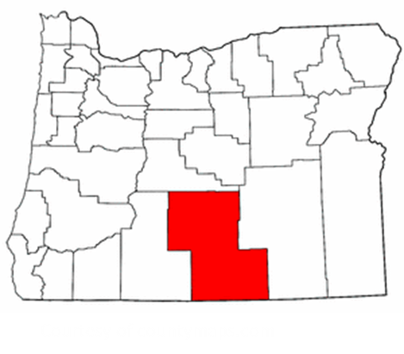
Location: Lake County. Oregon
Climate: High desert; average frost free period = 70-110 days. Elevation is from 4.300-5000 ft.
Average annual precipitation = 8-16 inches
HIGH VARIABILITY
The primary agricultural production system = beef cattle production

Slide 3
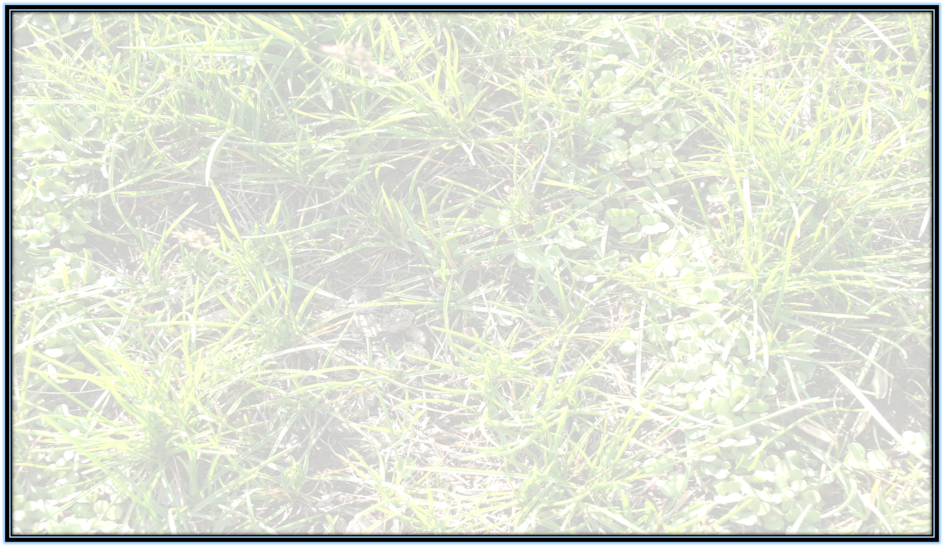
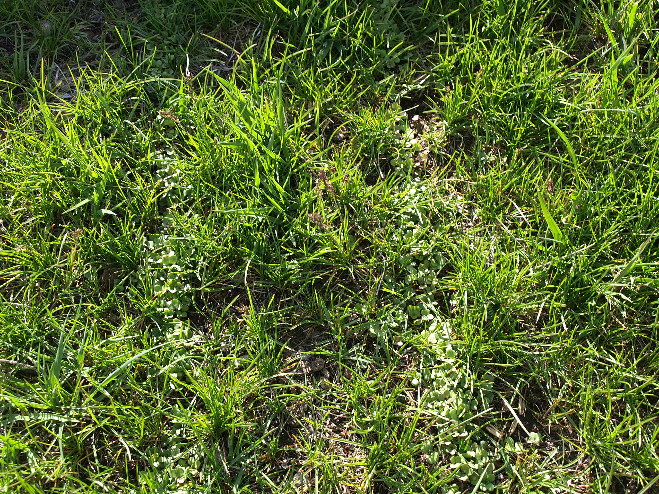
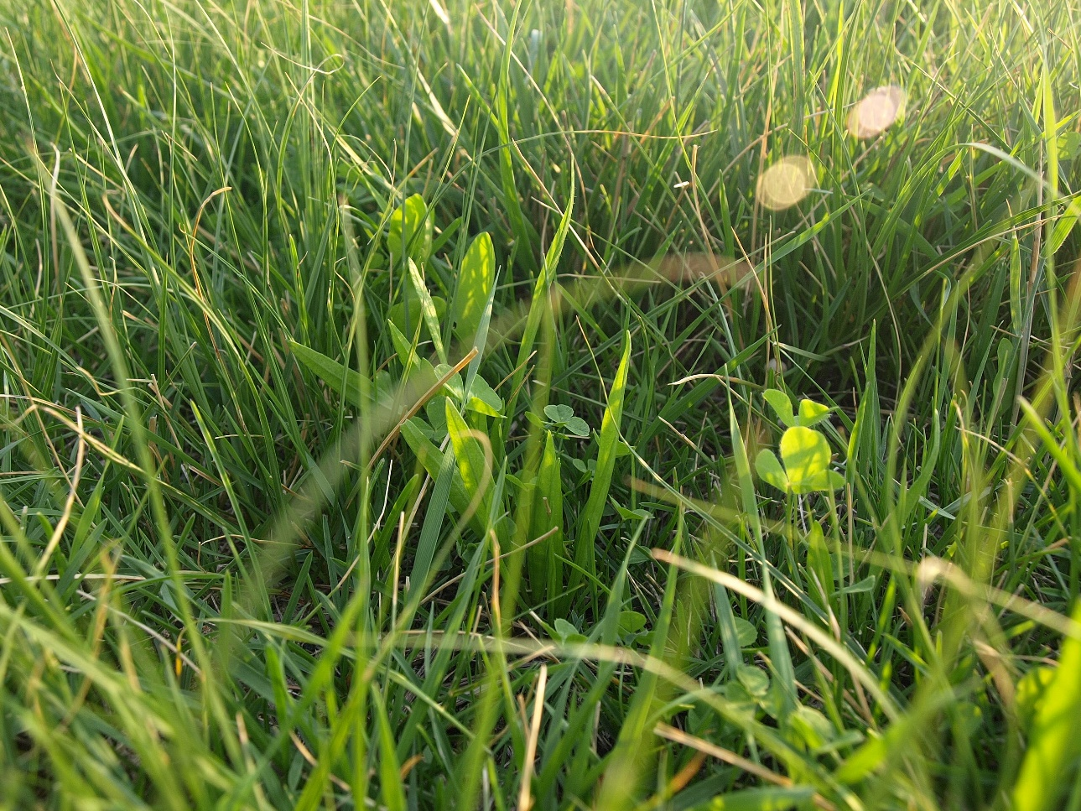
Irrigated and sub irrigated grounds provide opportunity for cover crops
Notes:
Sixteen percent of private land acres is irrigated (FSA, 2017). Estimated dry matter tons on irrigated acres for native grass is 2.08 tons, and estimated dry matter tons on irrigated acres for cereal grain hay is 3.80 dry matter tons per acre, both based on the 2016 crop yield. With the use of other forage species, these irrigated grounds could potentially produce 10% more dry matter forage, resulting in an additional 0.21 tons and 0.38 dry matter tons per acre which could potentially support an additional 0.5 AUM and 0.8 AUMs per acre (AUM is based on 1000 lb cow and calf under six months, consuming 913 lbs of air dried forage per month) (Meehan et. al, 2016). For a quarter section pivot, that would result in 80 and 128 additional AUMs, a significant increase in carrying capacity.

Slide 4
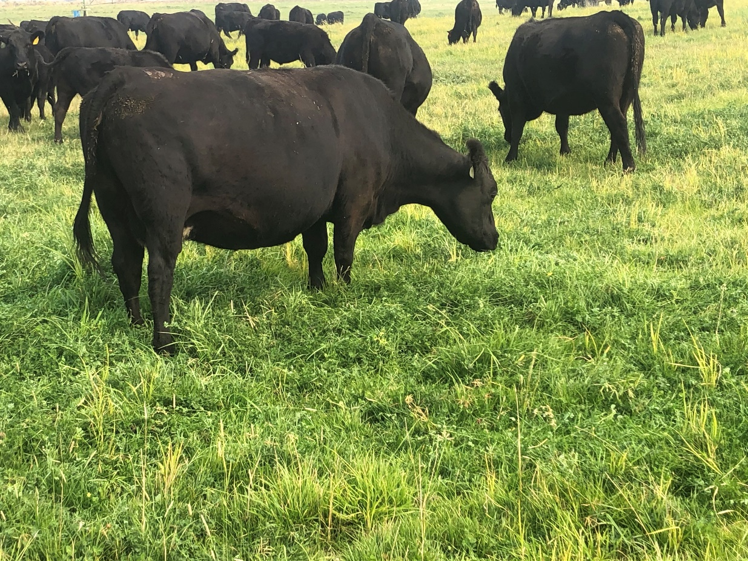
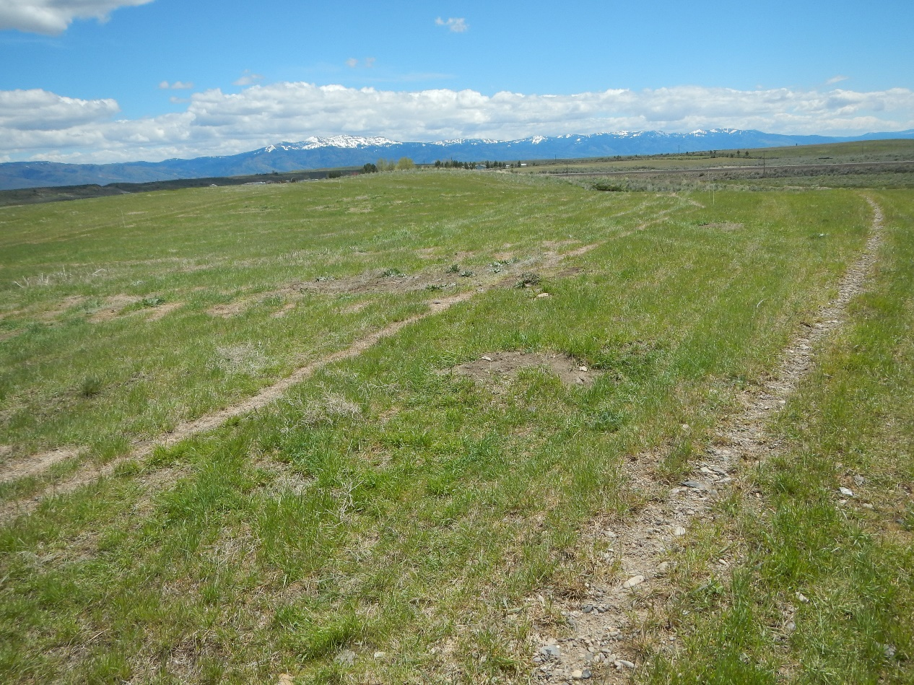
Why do we want this opportunity?
DEGRADED PASTURE
Increase grazing days
Increase grazing quality
Increase soil health
Decrease irrigation costs

Slide 5
Notes:
Center pivot design with 3 treatments plus control replicated over 4 quadrants

Slide 6
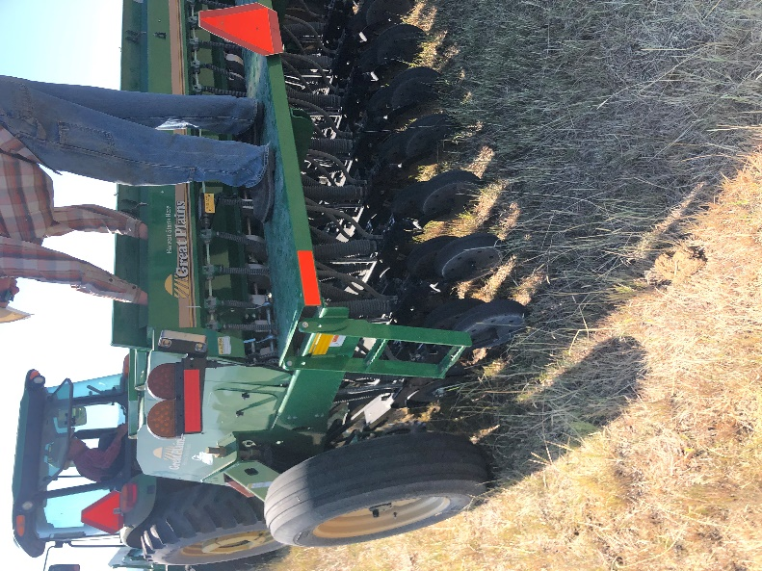
Seeding mixes. methods and dates
Dates | TRT1 | TRT2 | TRT3 | CON
2020 | Diverse Mix | Cover Crop | Clover Base
May 5th. 6th | Orchard grass Tall fescue Festulolium Chicory Plantain White clover Red clover | Kale Radish Forage Oats | Red Clover Birdsfoot Trefoil Sainfoin Alfalfa Arrowleaf Clover Balansa Clover Berseem Clover Medic
July 17th | Chicory Plantain White Clover Red Clover | Kale Radish Vetch Sudangrass | Red Clover Sainfoin Alfalfa Arrowleaf Clover Balansa Clover Berseem Clover
2017
June 13 | Birdsfoot Trefoil was drilled in a small quarter acre patch (10 lbs/acre) after grazing
Pasture was grazed pre-treatment
All plots were fertilized with a low rate of nitrogen. 50 lb. bag of ammonium sulfate per treatment only in May 2020
All legumes were appropriately inoculated
Quarter meter quadrat plots were clipped pre-fall grazing
Notes:
4 lbs of nitrogen / acre in May. Great Plains drill – 10 ft width, 7.5 inch spacing

Slide 7
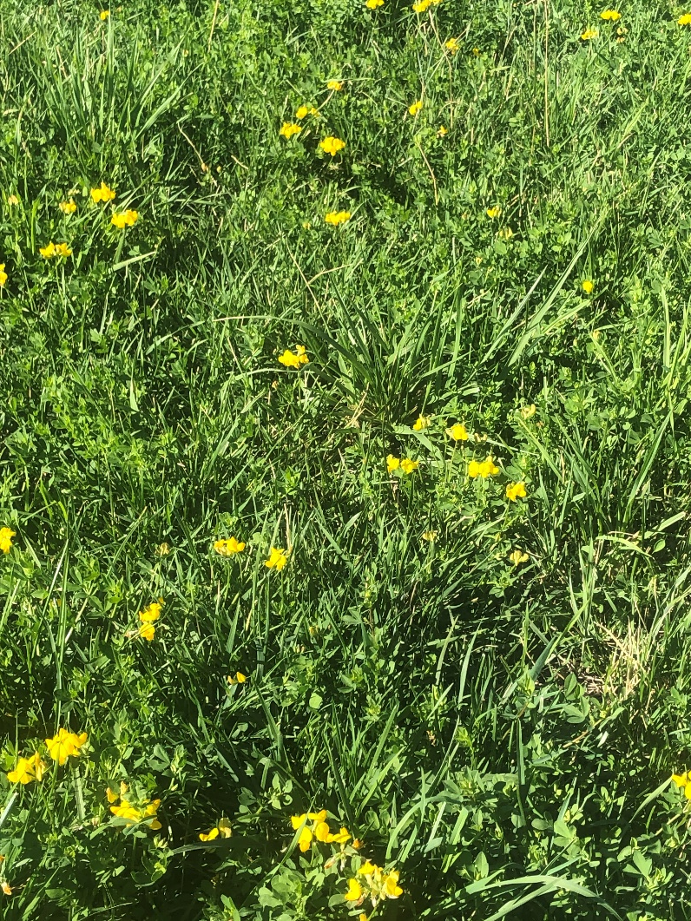
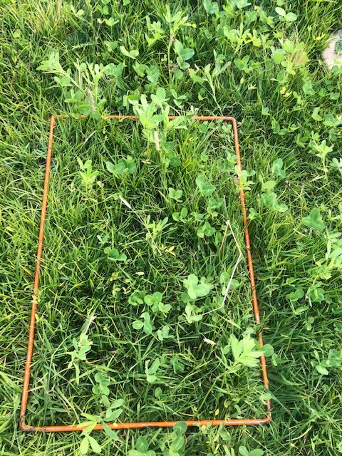
Field results
Spring seeding with nitrogen caused existing perennials to outcompete drilled forages
Mid July seeding produced better drilled forage crop
Sudan grass was a risk due to freeze/thaw early fall frosts
Interseeded brassicas did not perform well
Fall grazing was possible for one week with 92 cow/calf pairs

Slide 8
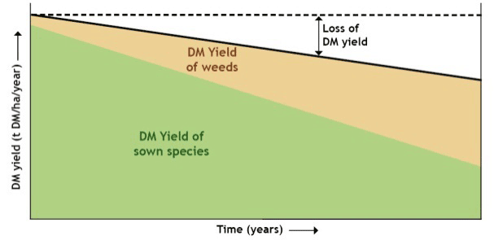
Why renew the pastures? Serkan Ates email: serkan.ates@oregonstate.edu
Forage production
Nutritive value
Feed intake
Renovated pastures produce more forage
Higher Metabolizable energy
Livestock are fed better
New pastures produce on average 0.5-0.9 MJME/kg DM more
Higher proportion of desirable species
Later and more uniform flowering
Leafier sward. with fewer seed heads produced
Less dead leaf material.
Cows on new pasture graze more grass. and that grass is leafier. higher in ME and more palatable. This will be reflected in:
More milksolids production
Faster liveweight gains
Higher stocking rates
More contented cows
Notes:
First of all, I would like to talk a bit why we need to renovate or overseed our pastures? Over time, pasture production and quality decreases due to agroecological and management factors. When the pastures lose 40-50% of their potential production and their desirable plant species, it may be a good idea to consider renovating pastures. Overall, newly established pastures provided more desirable forages with higher Metabolizable energy content. The carrying capacity of the pastures can be increased substantially. Higher forage production together with increased feeding value of pastures would be reflected in more milk production and rapid weight gains.

Slide 9
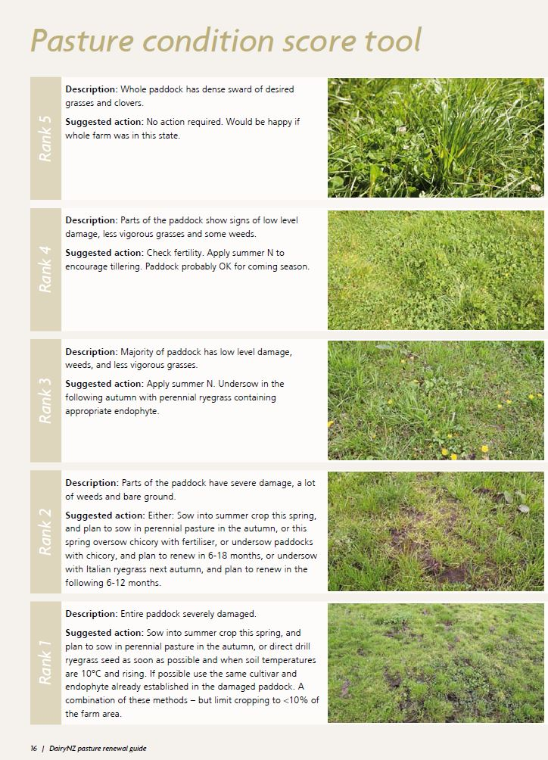
Total DM production drops
Decline in desirable species
Increase in weeds
Reducing feed value
Reasons why some pastures deteriorate
Soil fertility
Poor drainage
Pugging
Soil compaction
Overgrazing
Weeds and insect pests
Source: Dairy NZ pasture renewal guide
Notes:
Old pastures are characterized with low legume contents and poor feeding values. Depending on the pasture conditions and our farming capacity from availability of equipment such as tillage equipment and pasture seeder standpoints, pasture can be renovated from the scratch after tearing up and working the ground or can be overseeded with mix of grass and forb species. If the pastures are severely or partly damaged and contain lots of weeds and bare ground, then total renovation is preferred.

Slide 10
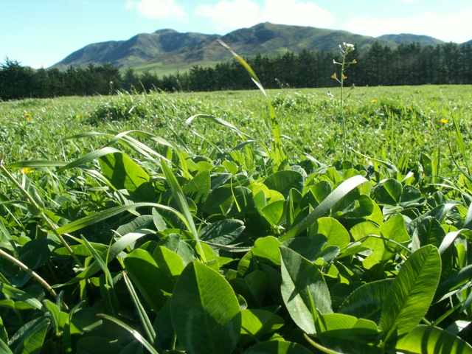
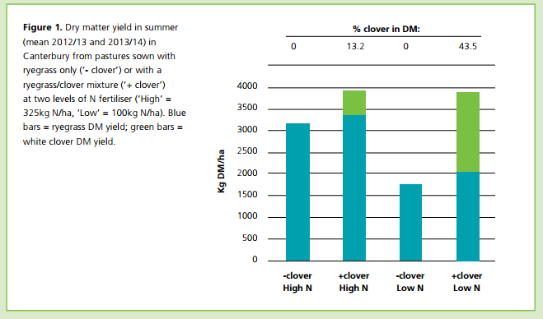
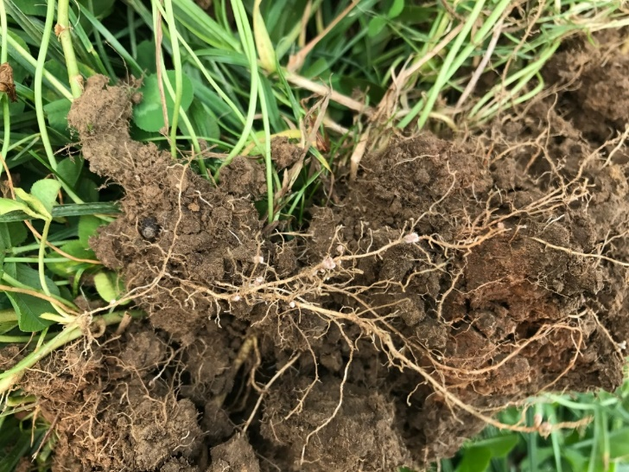
Role and importance of legumes
Grass-clover combination
N is the most limiting
Biological N fixation
~30% clovers in pastures are desirable
White clover can fix 300 lbs/ acre/y
Notes:
In renovation of pastures, one of the most critical decisions is the choice of pastures species that are compatible and will persist multiple years producing high quality forages. Overall, grass clover pasture mix form the basis of low input production systems. Overall maintaining 20-30% of legume content in pastures is a good target. We prefer including legumes from both agronomic and feeding value perspectives. In pastoral systems, Nitrogen is the most limiting factor for the plant growth and forage production. In particular, legumes with their symbiotic relationships with the soil bacteria, they can fix atmospheric N in their roots. White clover alone can fix up to 300 lbs/acre N annually. As you could follow from the graph. Legumes in pastures with additional moderate N fertilizer can double the forage production as compared to grass dominated unfertilized pastures. It is important to know that most temperate cool season grass species are N deficient and go dormant in summer even if the irrigation is available.

Slide 11
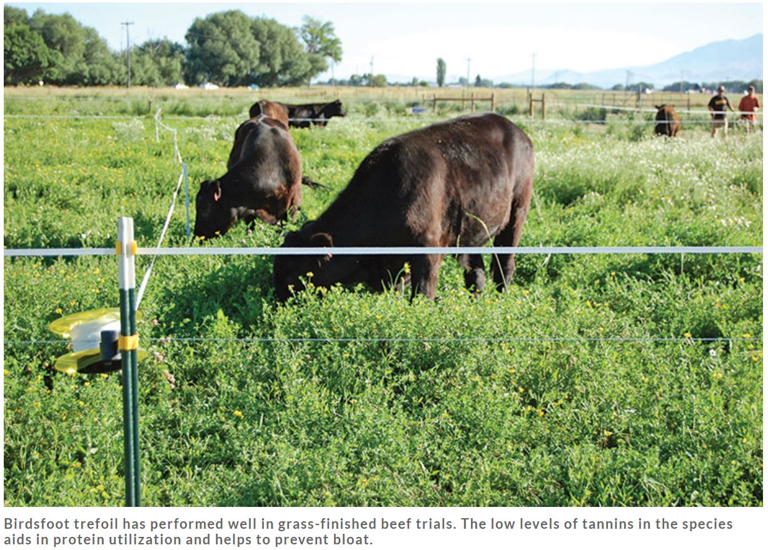
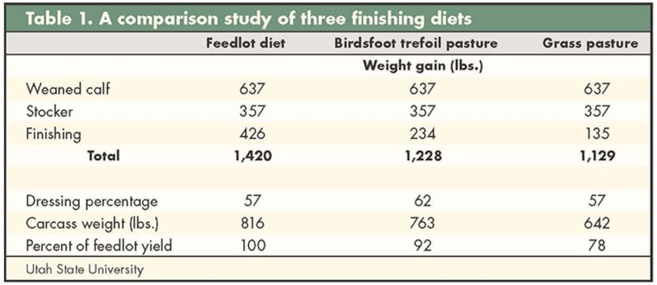
Feeding value of legumes
Legume-finished beef by Jennifer Macadam
https://hayandforage.com/article-1956-legume-finished-beef.html
80
% white clover
Notes:
Legumes also provide forages with superior feeding value and help improving the efficiency in grass-fed or pasture based livestock production systems. Overall higher the legume content of pastures greater the live weight gains of the cattle. Dr Macadam’s study in Utah indicated that birdsfoot trefoil can be highly effective forge crop in pasture based finishing systems. In her study cattle that grazed BFT as compared to those grazed grasses had greater liveweight gains. More importantly, the dressing percentages were significantly higher for the birdsfoot trefoil-finished steers than for either feedlot-finished or grass-finished steers, so the carcass weights of birdsfoot trefoil-finished steers were similar to grain-finished steers and higher than grass-finished steers. I highly recommend her article published in hay and forage magazine which I provided the link in this slide.
Of course, it is also important to be cognisant about some metabolic problems that may be caused by grazing legumes such as bloat or low conception rates in female cows depending on the legume species and cultivars. From the adverse effects standpoint birdsfoot trefoil is a very safe plant that does not cause bloat due to its secondary metabolite compounds called condensed tannins. Birdsfoot trefoil suited to both dry and wet conditions with poor drainage. Although its establishment is a bit slow, it can be successfully established with some nurse crops such as oats or annual legumes at planted with BFT at low seeding rates.

Slide 12
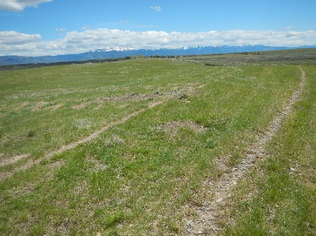
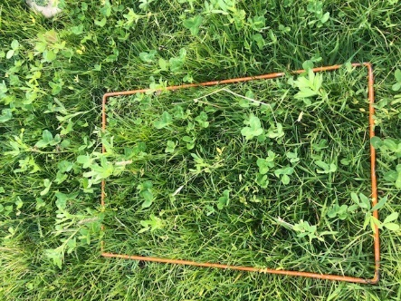
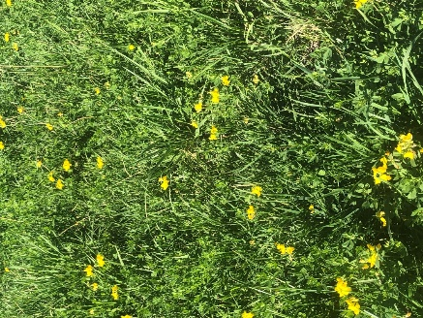
Results and Future Steps
Sep 16. 2020 | Control (Q4) | Forb mix (Q1) | Cover crop mix (Q2) | Legume mix (Q3) | Birdsfoot trefoil | SEM | P value
Forage production, kg DM/ha | 1482 | 1182 | 1028 | 1211 | 2500 | 421 | 0.17
Legume, % | 0b | 15a | 1b | 10a | 40 | 1.7 | 0.01
Acid Detergent Fiber, % | 26.5 | 23.7 | 24.4 | 25.3 | 21.3 | 0.79 | 0.14
Neutral Detergent Fiber, % | 52.4 | 48.5 | 50.7 | 50.0 | 35.0 | 1.01 | 0.12
Ether Extract, % | 2.6 | 2.7 | 2.6 | 2.6 | 2.5 | 0.19 | 0.99
Crude Protein, % | 9.4c | 12.7a | 10.6b | 11.3b | 21.1 | 0.30 | 0.01
Notes:
As Fara explained, bearing all these points and benefits of legumes in mind, we wanted to test the potential of overseeding some annual and perennial forage mixtures for their effect on pasture production and forage nutritive value. Basically John’s irrigated pastures were grass dominant and highly N deficient. His pasture production in summer was particularly disappointing even under irrigated conditions. This is in fact not a surprise to me as mostly these cool season grasses require high Nitrogen to produce forage and even if the soil moisture conditions are ideal due to high temperatures they go dormant in summer. From these perspectives he needed to increase both legume contents and diversity of his pastures. I am not going to repeat the establishment details or the mixtures that we used much but I will talk about our initial observations> first of all the botanical composition of the pasture in mid September indicated that our establishment on forb and legume mixtures were very successful. At this initial stage we were able to increase the legume content of the pastures up to 15 %. While the DM yield of pastures at the establishment phase did not change much, there was a small response in CP content. When we looked at the areas that were overseeded with BFT in summer 2017 and compared the quantity and quality of the forages, the results were impressive. In these areas the legume content of the pastures were over 40% and forage yield was doubled. More importantly the quality of the forage was far superior with low fiber and high CP content exceeding 20%. This already proves the potential of overseeding and shows where we will be heading with our newly established pasture mixtures.

