Slide 1


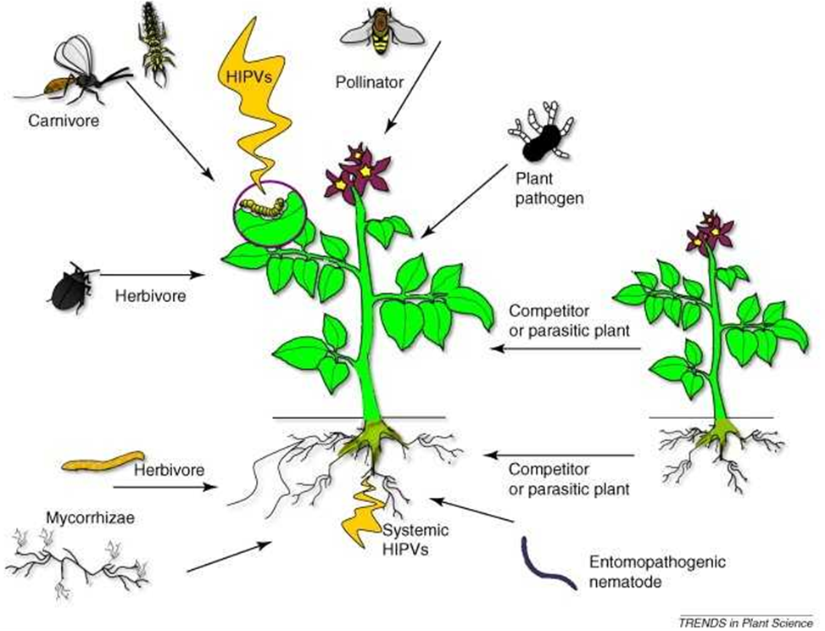
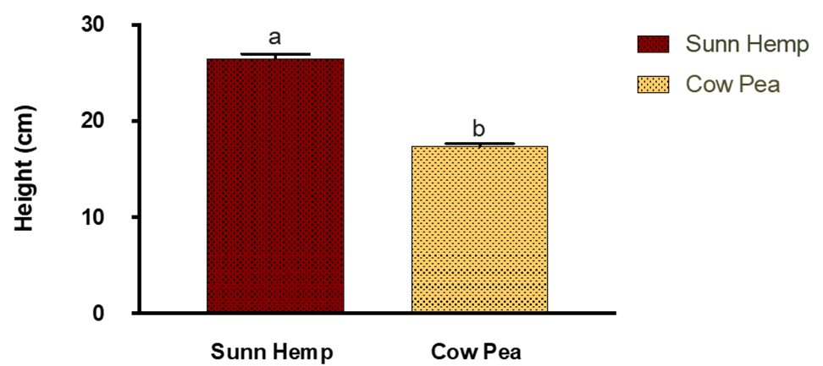
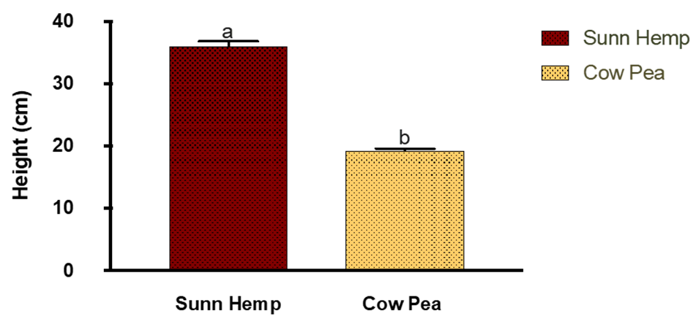
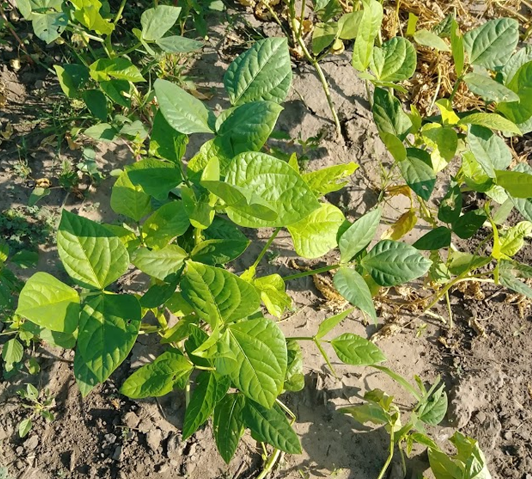
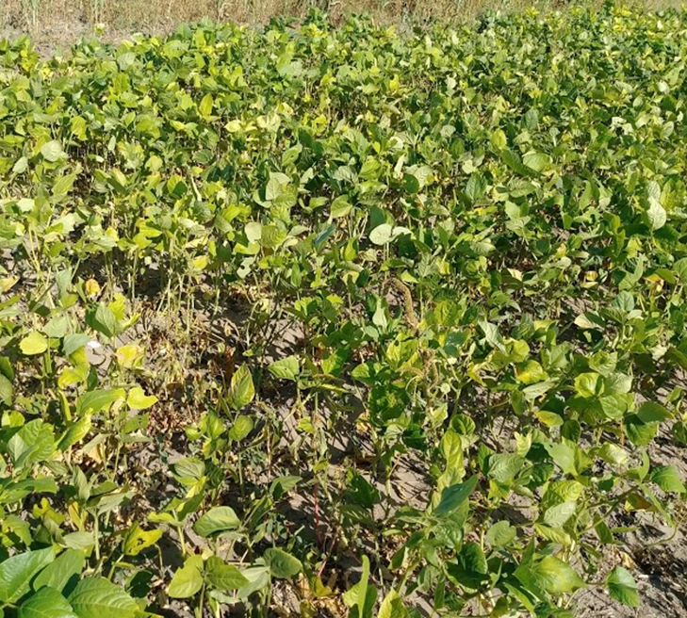
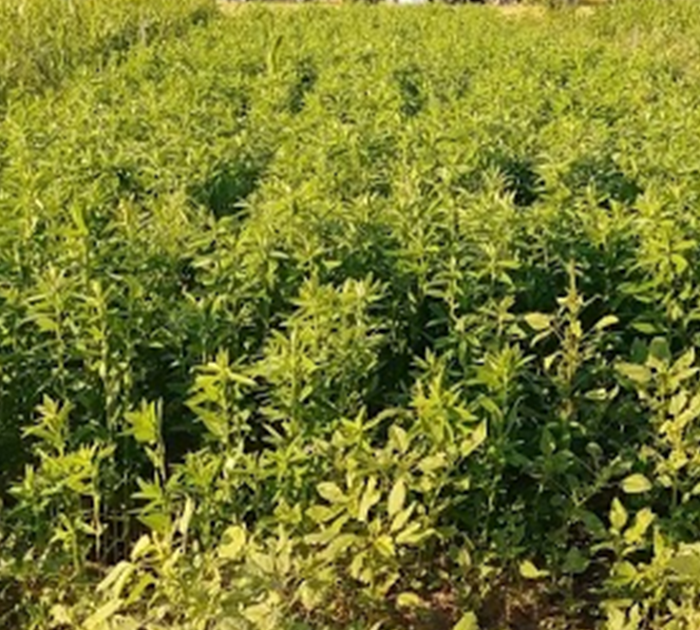
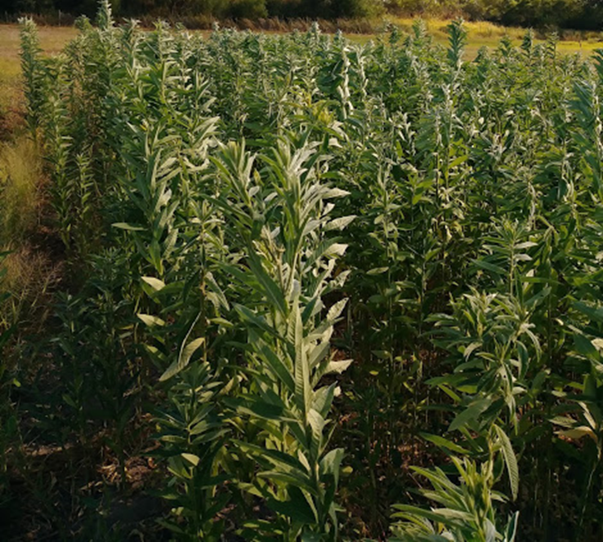
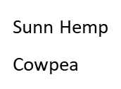


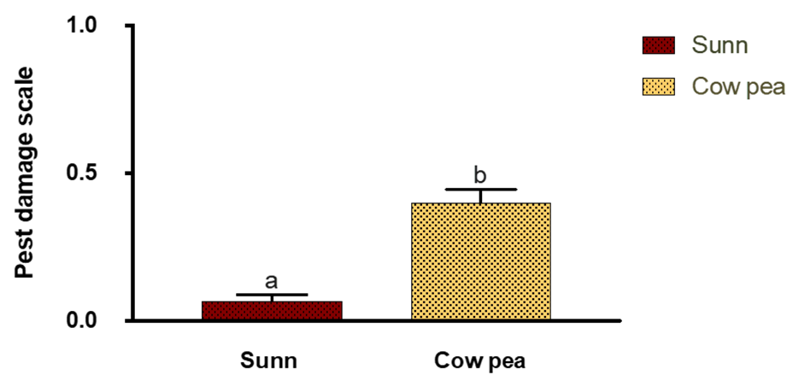
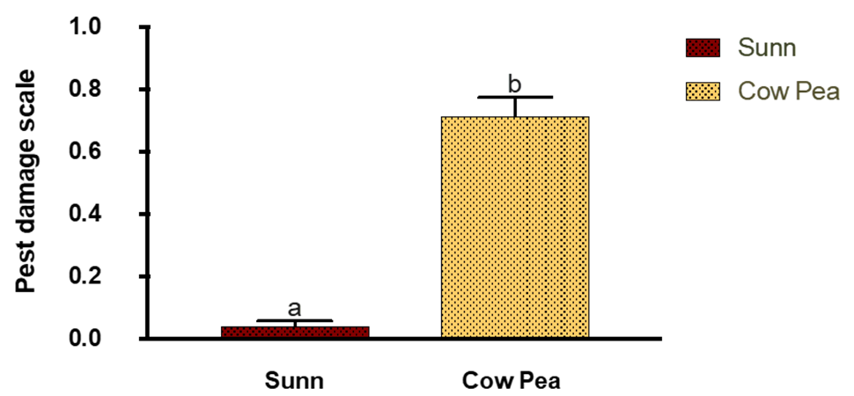
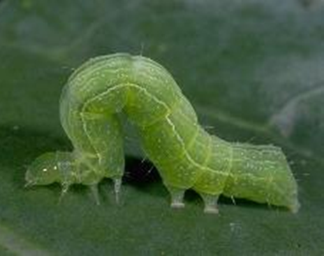
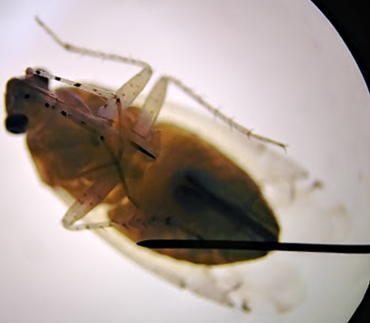
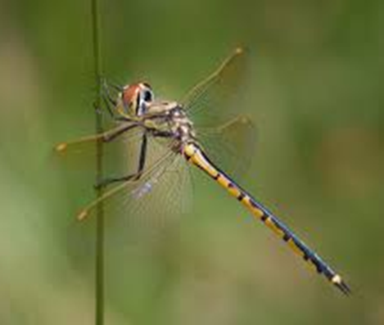
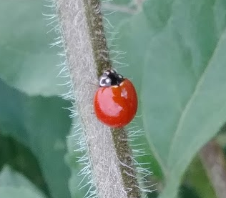
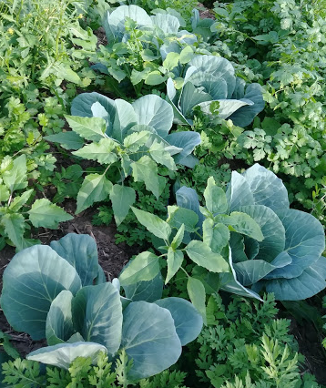
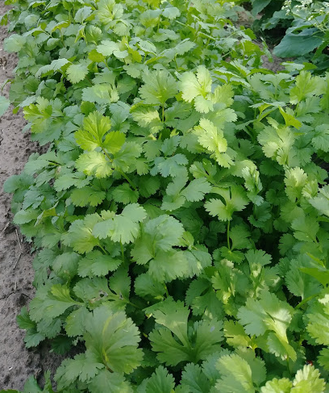
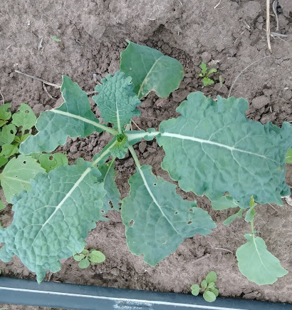
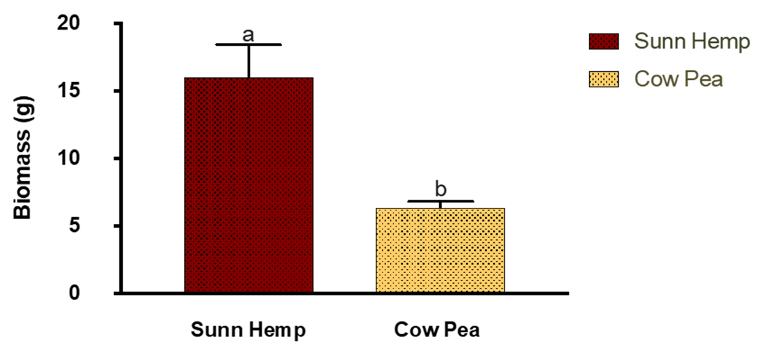
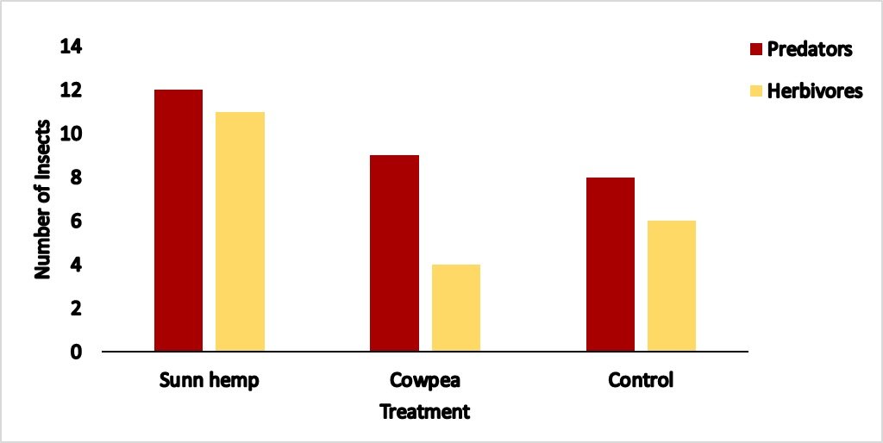
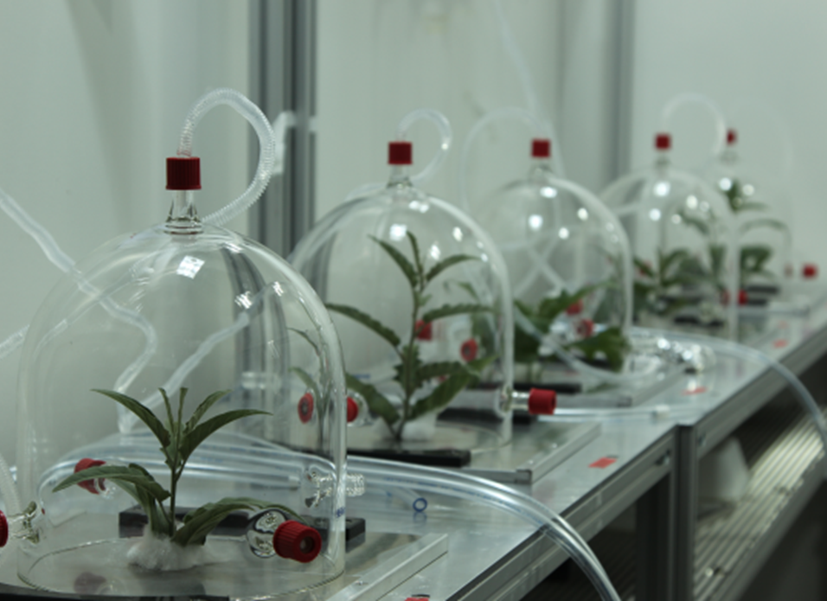
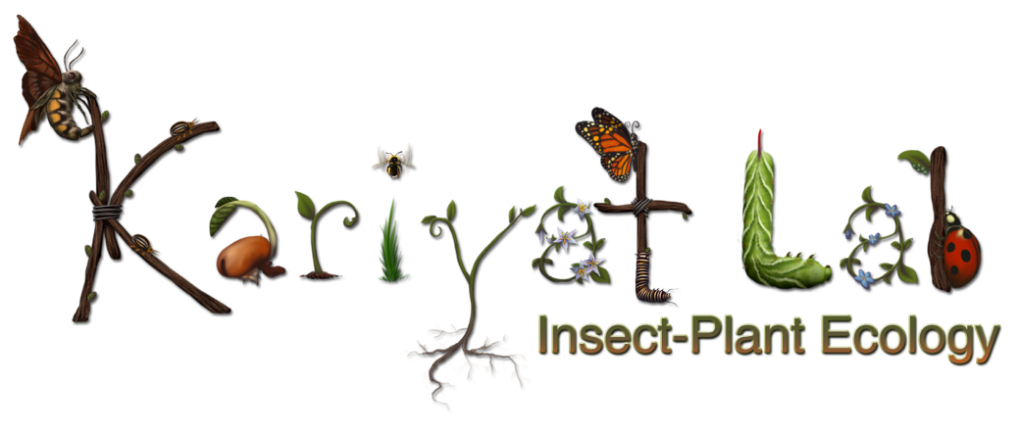

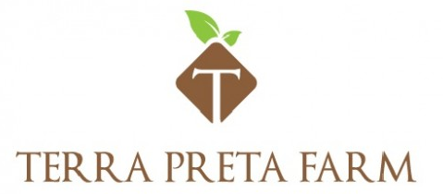
Effects of cover crops on insect community
dynamics in organic farming
Lili Martinez¹, Pushpa Soti^{1, 2}, Alexis Racelis^{1, 2}, and Rupesh Kariyat¹
¹Department of Biology, ²School of Earth, Environmental, and Marine Sciences, The University of Texas Rio Grande Valley
Introduction
The use of cover crops provides many direct and indirect benefits to agriculture. Some direct benefits include improved soil nutrient availability, improved moisture retention, weed suppression, and prevention of soil erosion.
Meanwhile, the indirect benefits include suppression of insect herbivory, and the attraction of beneficials.
The two commonly used leguminous cover crops, sunn hemp, Crotalaria juncea, and cowpea, Vigna unguiculate, were chosen for this study due to their observed effectiveness as they could possibly provide organic farmers with sustainable, simple, and economic methods of reducing pests even during growing season.
Biological controls require the use of natural enemies -predators, parasites, pathogens, and competitors.
Following these methods and strategic selection of cover crops, for their volatile properties, could possibly improve the local insect population in favor of future cash crops.
Methods
The cover crops were sown during summer at a recommended seed rate of 40 pounds per acre.
The underlying process, which allows plants to attract and repel insects is due to their volatile compounds.
Damage caused by herbivorous insects change the levels of a plants volatiles which then attract predatory insects.
These processes may then indirectly benefit the cash crops, cabbage, cilantro, kale, and broccoli, which were sown after termination of the cover crops.
Species interactions mediated by plant volatiles
Results
Height Comparison of Replicates 1 and 2
Cowpea
Sunn hemp
Sunn Hemp
Cowpea
Sunn Hemp Cowpea
Sunn Hemp Cowpea
Insect Pests
Insect Predators
Damage Comparison of Replicates 1 and 2
Lepidopteran & Hemipteran
Odonata & Coleoptera
Sunn Hemp
Cowpea
Sunn Hemp
Cowpea
Sunn Hemp Cowpea
Sunn Hemp Cowpea
Cash crop progress
Unpaired t tests, * P<0.05
Insect Samples
Biomass
Sunn Hemp Cowpea
Height was significantly different between sunn hemp and cowpea.
Early in the season both crops had low pest damage on a scale of 0 to 4.
By the end of the season, sunn hemp remain constant with pest damage but cowpea damage increased and showed significantly higher pest damage.
Plant samples were taken before termination, oven dried, and weighed for biomass analysis, and as expected, sunn hemp biomass was significantly higher than cowpea.
A preliminary analysis of insect samples showed high insect diversity in sunn hemp while cowpea showed a higher presence of predators when compared to pests, yet cowpea had lower insect diversity.
The cash crops, cabbage, cilantro, broccoli, and kale, are currently growing in the same plots that the cover crops were grown on and plowed into.
Data collection for the cash crops will consist of the same measures that were taken for the cover crops but to better understand the insect community there will be extra measures, such as pit fall cups and sticky traps.
Conclusions
Preliminary data shows that sunn hemp did significantly better in all aspects.
This crop had significantly better growth, less insect damage, and high predatory insect presence (coccinellids, wasps, and bees).
As well as a low observed pest presence and a high species richness.
Cowpea preformed poorly possibly due to the lack of resources provided, as it continuously showed a high degree of insect damage, a high observed pest presence and low predatory insect presence.
The differences may be due to a plants ability to produce constitutive and induced volatiles at varying levels. These volatiles depend on the type of stress (biotic or abiotic), but the volatiles of interest in this study are those produced by plants in response to insect herbivory which attract predators, in turn reducing insect pests.
This ongoing experiment will continue to test on the same land that was taken up by the cover crops to test any residual effects they may provide to cash crops and their efficiency as a method of pest management control in organic farms.
Future studies
Gather data on cash crop
Examine cash crop defenses
Collect more insect diversity samples
Lab analysis of cover crop plant volatiles
Acknowledgements
RISING STAR AWARD to Kariyat
Southern SARE to Drs. Soti and Kariyat
Thank you to Juan Raygoza from Terra Preta Farm
References
1. https://www.epa.gov/managing-pests-schools/introduction-integrated-pest-management
2. Natalia Dudareva, Florence Negre, Dinesh A. Nagegowda & Irina Orlova (2006) Plant Volatiles: Recent Advances and Future Perspectives, Critical Reviews in Plant Sciences, 25:5, 417-440
3. Baoqing et al., 2014

