Slide 1
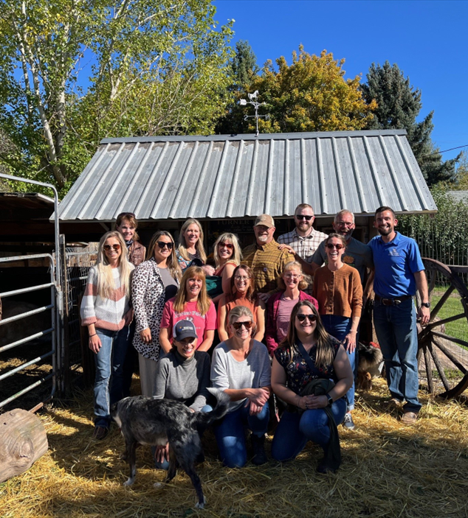
“Create your Own Agritourism Experience in Your County”
Shannon Arnold and Kim Woodring

Slide 2
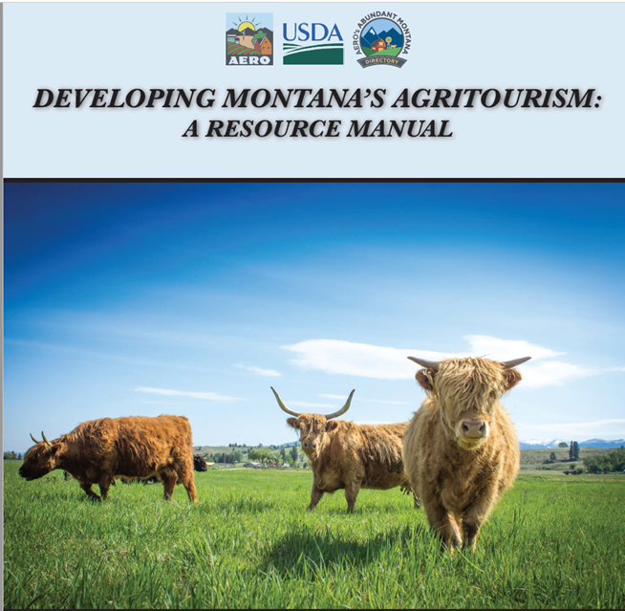
Defining Agritourism
What is agritourism? What words do you think of?
MT HB 342 (2017) “Agritourism means a form of commercial enterprise that links agriculture production or agricultural processing with tourism in order to attract visitors to a farm, ranch or other agricultural business for purposes of entertaining or educating visitors.”
Notes:
HB 342 officially added agritourism to the list of MT Recreational activities opening up opportunites to develop the industry
2017 Montana Agritourism Manual
AERO, MT Department of Ag and Commerce, MSU Extension, Governor’s Office for Economic Development, FADS, Montana Farmer’s Union, USDA Farmer’s Market Promotion program, and Agritourism Working Group
AERO has recently released Developing Montana’s Agritourism: A Resource Manual, the first of its kind in the state, to help Montana’s farmers, ranchers, and producers explore agritourism as a product offering and economic opportunity.
have been found to be strong motivators for starting an agritourism business on an existing farm or ranch (McGehee & Kim, 2004; Schilling et al., 2006).
Education of urban and suburban audiences
Motivators
Additional income stream
The ability to diversify operations

Slide 3
Agritourism Framework (Chase et al., 2018)
Core Activities:
Classical Agritourism activities on-the-farm connected to agricultural production and marketing
Peripheral Activities:
Non-Traditional activities on-farm but lack connection to ag
Notes:
An activity could be in either the core or peripheral category based on location, i.e., on-farm vs. off-farm, or how that activity is connected to traditional agriculture. Chase et al. (2018) defined core activities as “those that take place on a working farm or ranch and have deep connection to agricultural production and the marketing of a farm’s products”
Peripheral activities are defined as those that “may take place on a working farm, but they may lack deep connection to the actual farm or ranch, so they may be considered as peripheral activities and are located on the outer ring of the chart” (p. 17).

Slide 4
What are the sustainable benefits of agritourism?
Economic
Additional income stream
Increase opportunities for family employment
Increase traffic to the community
Social
Reconnect the public with our food system
Provide visitors with authentic agricultural experiences
Bridge the growing gap of knowledge between consumer and producer
Environmental
The ability to diversify operations
Stewardship and preservation of natural resources
Use the existing infrastructure

Slide 5
Montana Agritourism Steering Committee
Our Mission
Dedicated to promoting the Agritourism industry in Montana by working collaboratively with state and industry partners, providing resources, research, and education, and connecting our producers and community stakeholders with local, state, and global agritourism markets.
Core Values and Goals
Targeted marketing and branding.
Effective industry-driven networks.
Amended policies.
Regulatory Issues.
Meaningful standards.
Strengthen economic diversification.
Our Vision
Combining the essential elements of tourism and agriculture industries will attract the public, increase agricultural income, and provide recreation and/or educational experiences for visitors.
Notes:
Our Mission
Dedicated to promoting the Agritourism industry in Montana by working collaboratively with state and industry partners, providing resources, research, and education, and connecting our producers and community stakeholders with local, state, and global agritourism markets.
Montana’s strategic agritourism marketing plan combined with culinary tourism marketing and value-added products will put the spotlight on Montana as a world-class destination for interesting, fun and life-changing agriculture-based experiences.
. The goal is to develop and sustain an agritourism affiliation for the purposes of creating relationships, assisting operators with marketing, and learning best practices with an emphasis on stewardship.
To clarify and improve the state and local regulatory framework so agritourism businesses are compatible with the intent of land-use law and public health regulations and operating smoothly.
To lessen the barriers to entry by addressing inherent risks, limited liability laws, and insurance coverage needed to operate.
To collaborate with industry partners advocating for a bill that would provide Limited Liability for Agritourism Providers so that Montanans can afford to provide agritourism opportunities and do so with some peace of mind.
To pave the way for locals and visitors to discover agritourism products and services vetted for authenticity and quality.
We are committed to making resources readily available and providing advice and support for producers interested in growth and value-added opportunities in agritourism.

Slide 6
Characteristics of an Effective
Agritourism Operation
MT Dept of Ag Specialty Crop Block Grant
Logos, Website, Video Stories, Expert Interview Series, Data Visualization, and Social Media Presence
Notes:
Created
MT Department of Ag Specialty Crop Block Grant: Explore the industry
Develop an effective educational platform
Increase knowledge of agritourism for a wide population
Increase understanding of communication methods
Outcomes: Created Logos, Website, Video Stories, Expert Interview Series, Data Visualization, and Social Media Presence
For each episode, the project directors will invite current and prospective agritourism operators in Montana to discuss their challenges and questions. Then, industry experts, researchers and Extension professionals, and experienced agritourism operators from nearby states will be invited to respond to the questions and provide insights about overcoming specific challenges to be successful. A complementary website to host the podcast series and informational resources will significantly aid in expediting the development of a successful agritourism industry in Montana. The innovative podcast delivery mechanism is intended to engage groups of younger, potentially economically disadvantaged producers who are most likely to begin an agritourism business but are also more challenging to reach with more traditional educational efforts. This project will use a portfolio of marketing strategies—ranging from traditional press releases to targeted social media strategies—to maximize reach across varying demographic and socioeconomic groups. By tracking analytics, the project will provide insights about which communications and marketing strategies are most effective.
This communication approach seeks to engage varying demographic and socioeconomic groups
Recording is the easy part! Now what?
Post-Editing, Transcribing, and Text Analysis
Descript
Machine learning transcription service: 1 hour podcast = 5 minutes to transcribe = 95% accuracy
$199 year
Text Analysis
Nvivo- Qualitative Analysis Software
Post-Editing
Hired a Marketing and Consulting Company

Slide 7
Montana Agritourism Fellows Program: To establish and train a cohort of leaders, the Fellows, who can effectively educate others on sustainable agritourism
Video

Slide 8
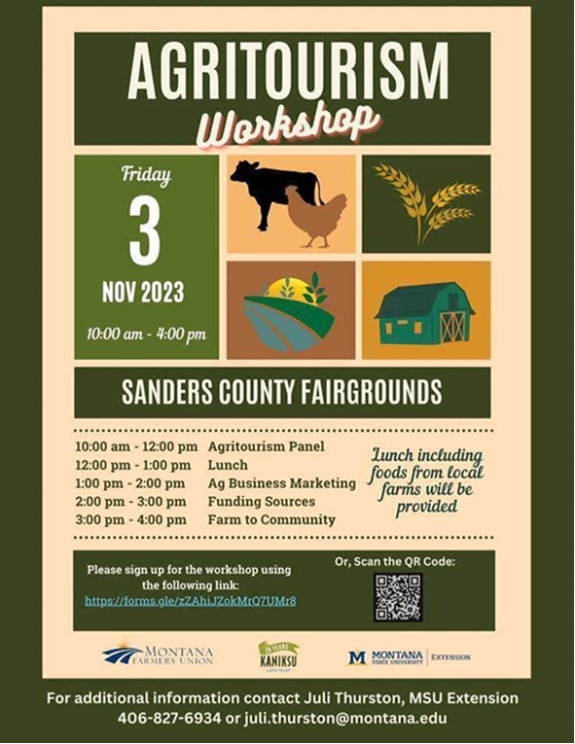
Agritourism Advancements
National Extension Tourism Conference
Governor’s Conference on Tourism
Montana’s Next Generation Conference
Global Agritourism Network and International Agritourism Conference
Farming Entrepreneurship Podcast and Governor’s Farm Visit
Wall Street Journal
Montana Ag Live Episode
Agritourism Directory on Abundant Montana
Agritourism Annual Conference
Listening Sessions
AgCorps Agritourism Specialist Position
Agritourism Panels
Agritourism Course and Certificate Program
Partnerships

Slide 9
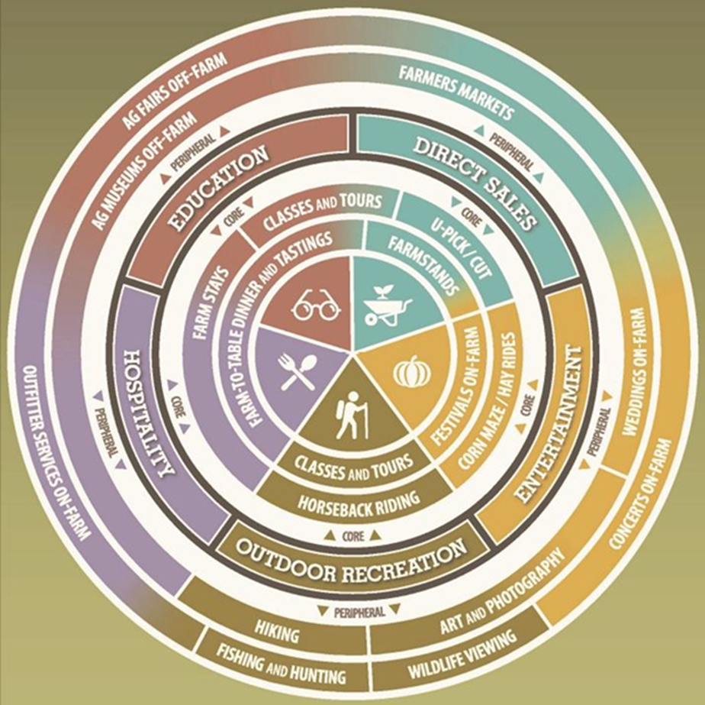
Planning Your Own Agritourism Activity Consider these 5 things:
Name
Date
Time
Location
Goals

Slide 10
Consider the message of your event
What is the theme of your event?
How does it relate to your culture or heritage? Does it relate to the season? Does it relate to the area?
What does the audience need to know? What do you want them to know? Event Elevator Speech “I really want people to know where their food comes from.”

Slide 11
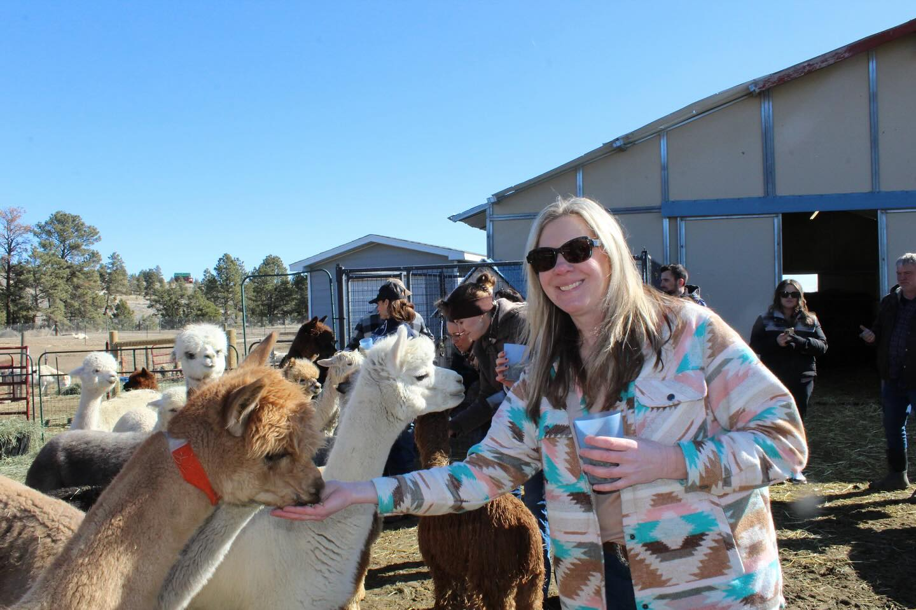
Activities & Entertainment
Will you be having….
Performers
Tours
Services like food, drink, shopping
Animals

Slide 12
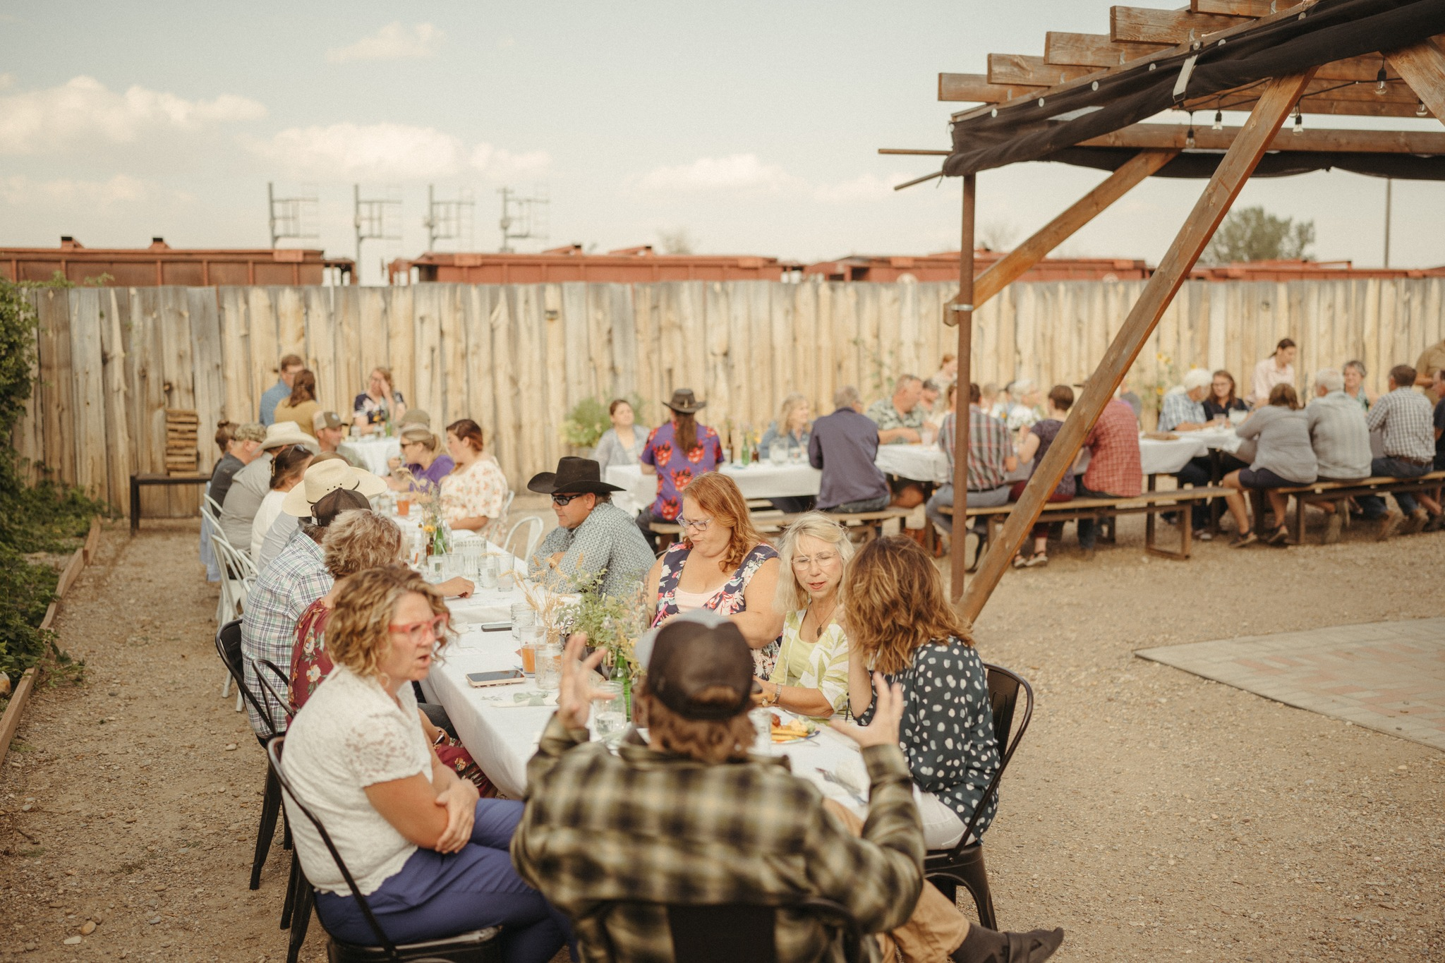
More things to consider
Marketing to your audience
Who will your partners be?
What type of budget do you have?
Cut Bank Longest Table Event 2024

Slide 13
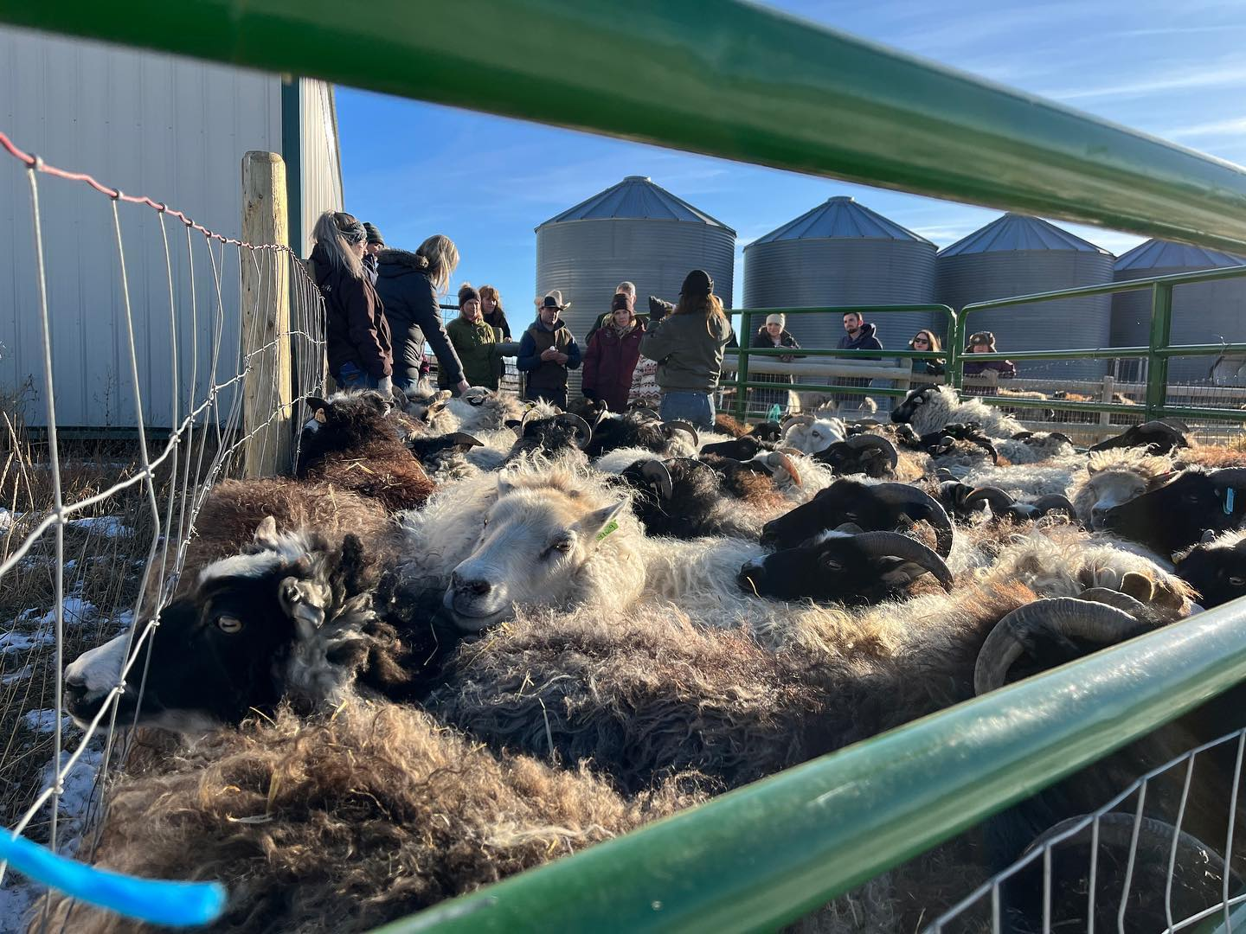
Montana Agritourism Examples
Little Creek Lamb Shepherd Camp
Mahlstedt Ranch
Wild Lavender Lamb and Lavender Festival
Lewistown Farm to Table
Turner Farms
ABC Acres
Barkley’s Homegrown Greenhouse in the Snow
Homestead Organics – Cultivating Connections
Wandering Acres

Slide 14
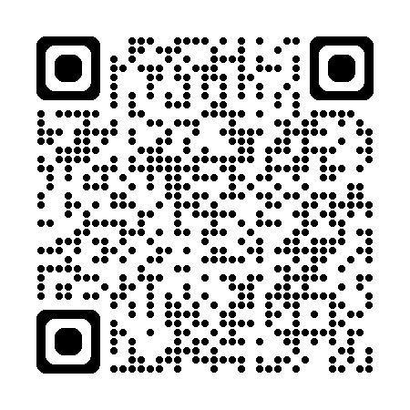
Thank you!
Check out the Montana Agritourism website!

