Slide 1

Diversifying Potato Cropping Systems in Maine
Jake Dyer
Maine Potato Board
Presque Isle, Maine 04769

Slide 2
About Me…..
University of Maine Class of 2001 – BS Sustainable Agriculture
University of Maine J.F. Witter Teaching and Research Center
  1998-2008: Farm Facilities and Field Coordinator
    Crop production, facility and equipment maintenance, livestock husbandry
  2008-2015: Farm Superintendent
    Budget oversight, facility planning, personnel management
Benedicta Grain Co., LLC
  2008-Present: VP
    200 acre farm producing organic grains and pulses for seed, food, and feed
Maine Potato Board
  2015-Present: Agronomy/Crop and Variety Development

Slide 3
Maine Potato Board
“The mission of the Maine Potato Board is to provide a competitive environment for our potato growers, processors, and dealers creating stability and the infrastructure for future growth, while promoting the economic importance to the state and quality of the product.”
Services Provided
Follow, introduce, and lobby legislative and regulatory issues
Engineering services related to water and storage management
Agronomy and crop production services
Pathology and laboratory services

Slide 4
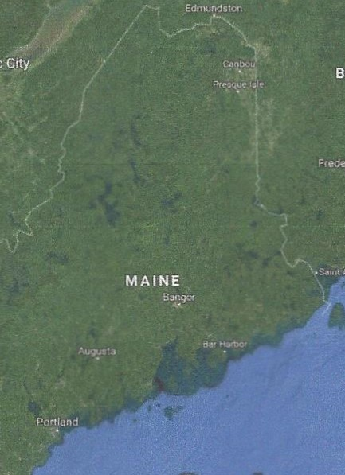
Maine Potato Industry
50,000 acres – average production
Utilization
  14% Tablestock
  22% Seed
  64% Processing
3 geographic areas
  Aroostook County
  Central Maine
  SW Maine

Slide 5
Crop Development – Why is it important to the Maine potato industry?
To remain competitive in the global marketplace
    Increase marketable yields and reduce cost of production
    Western yields 131 – 191% greater than East
    Advantage from volume and COP
Improve economic and environmental sustainability of potato cropping systems
    2 year P/SG 3 year P/SG/GM 4 year P/SG/SG/GM (Environmental >Economic)
    4 year P/SG/ALT $/GM 5 year P/SG/ALT $/GM/ALT $ (Environmental = Economic)
3. Ensure the viability of agriculture for next generation(s)

Slide 6
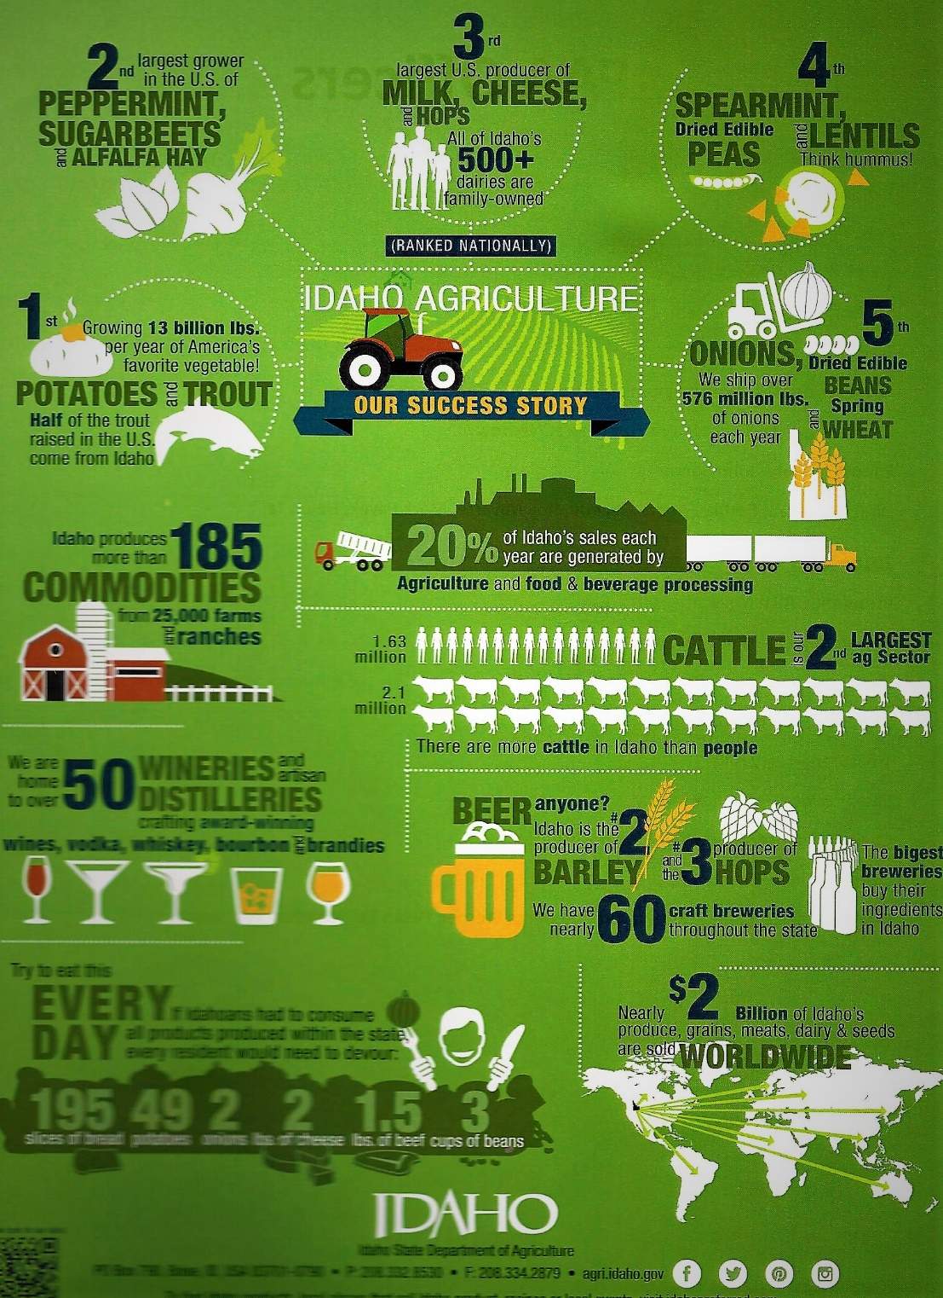

Benefits of Farm Diversification
Risk Management
Additional income from crop sales
Hedge against bad years
  Markets
  Weather
Maximize equipment and tech efficiency
  Make the investment pay
  Spread out equipment usage
Yield and quality increase from longer rotations
Environmental benefits
  Nutrient and water retention
  Soil conservation/improvement
  Reduce inputs
  Alternative cropping practices (no till)
Idaho State Department of Agriculture - www.agri.Idaho.gov

Slide 7
Crop Selection
Growing season – May through October (maybe??)
Marketing
  Consumer Trends – What’s hot/What’s not?
  Access
  Stability - For how long?
Grower Acceptance and Interest
  Infrastructure and equipment
  Labor resources
  Does it mesh with Potato? – disease/insects/weeds – chemical carryover?
  Cultural
Environmental Benefits
  Soil conservation, reduced tillage, no-till

Slide 8
Produce Crops
Very difficult to evaluate potential
Area of relatively low population
Lack of processing capability
Specialized equipment and storage facilities
Lack of local labor force
Difficulty accessing markets
High Value = Intensive Management = High Risk = High COP

Slide 9
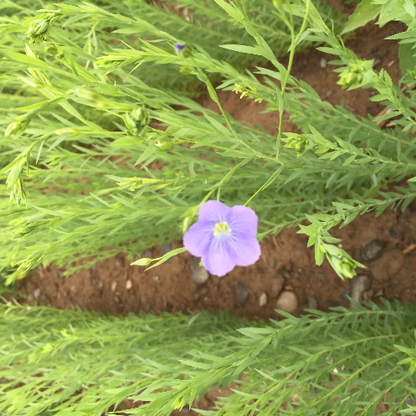
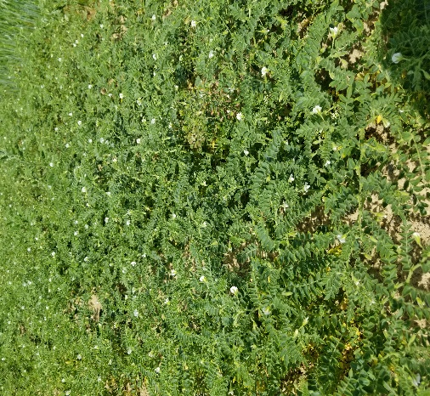
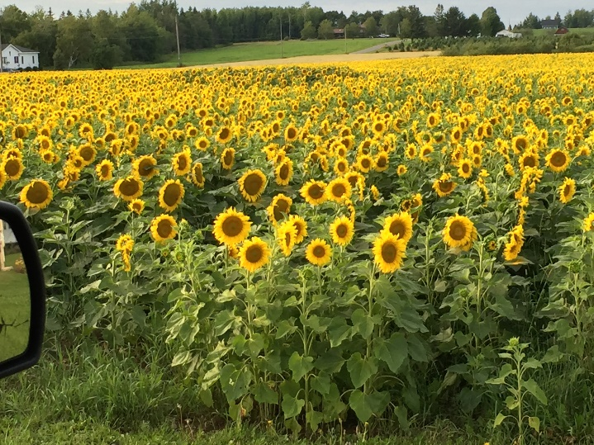
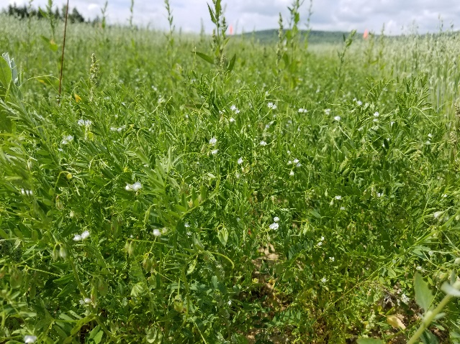
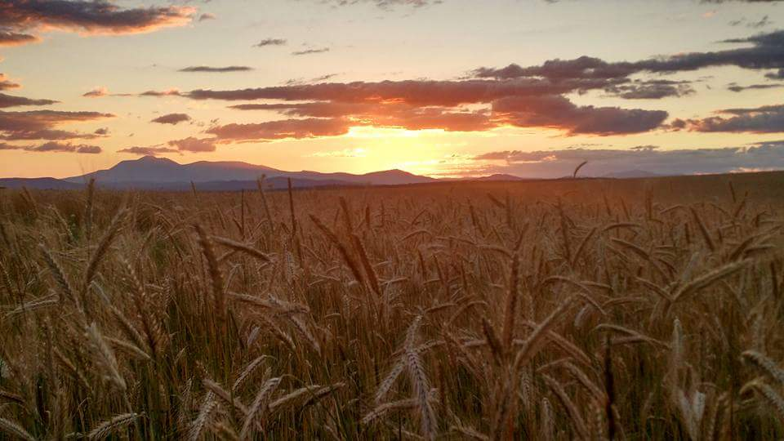
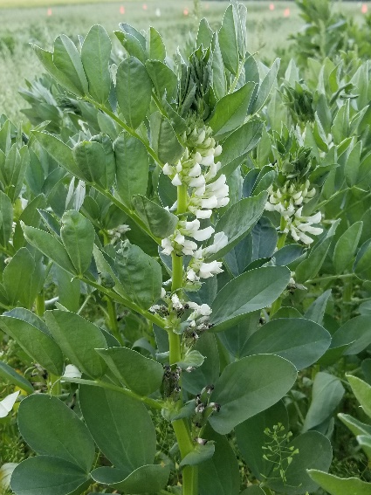
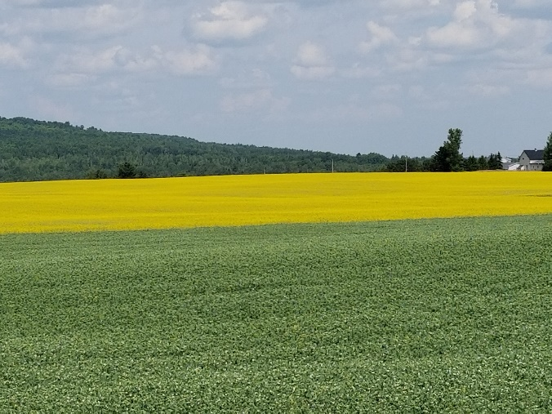
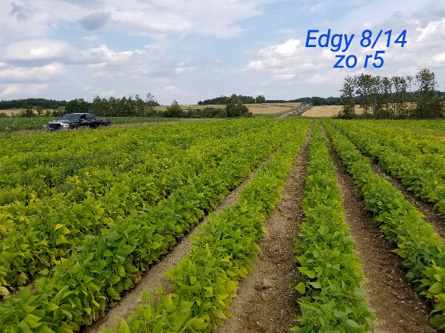
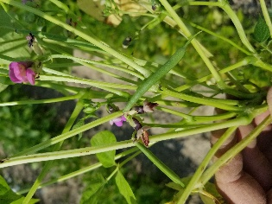
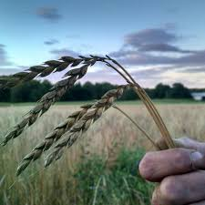
Maine Trials
Oilseed Flax
Chickpea
Lentil
Field Pea
Canola
Faba bean
Dry Bean
Sunflower
Malting Barley
Winter Grain – Rye/Spelt

Slide 10
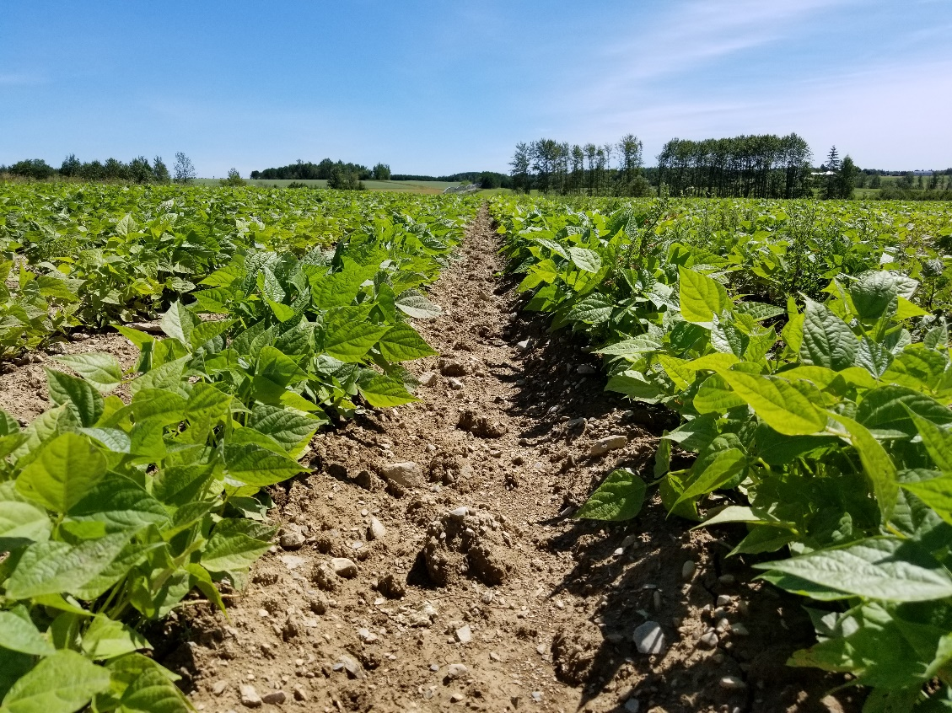
Dry Beans – Black Turtle
2017
  Limestone
  Littleton
  New Limerick
Varieties
Zorro and Zenith (2360 and 1836 spp)
  Small seeded – grain drill/corn planter
  Upright architecture suitable for direct harvest
  89 day RM
  Inoculated with N-Charge peat based dry bean specific

Slide 11
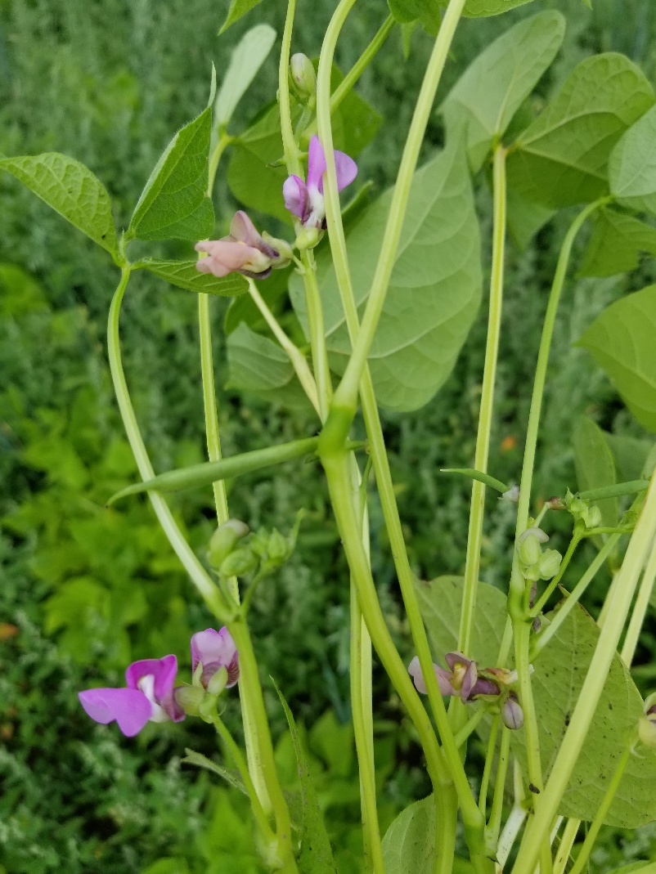
Dry Beans – Black Turtle
Planted June 07
  Soil Temp 55F
  Target population 100,000 pl/A
  Pre-emerge Dual II 1.5 pt/A
  300 lbs 11-14-17
Harvested October 10
  2370 – 3000 lb/a
  $32.00/cwt

Slide 12
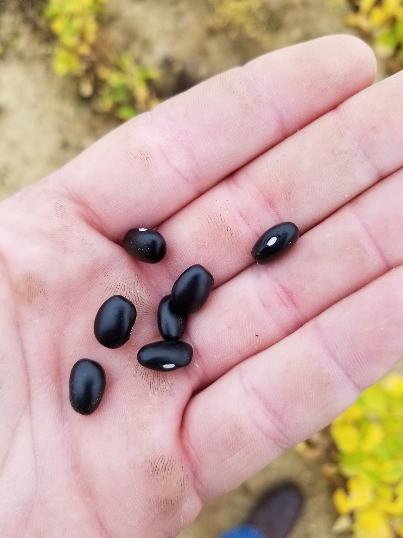
Dry Beans – Black Turtle
The Good!
  Yielded very well
  Marketable
  Plant after grain and potato – warm soil
The Bad!
  Volunteer potatoes
  Ready to harvest September 21 – guess what else was too??
  Shatter and high harvest loss

Slide 13
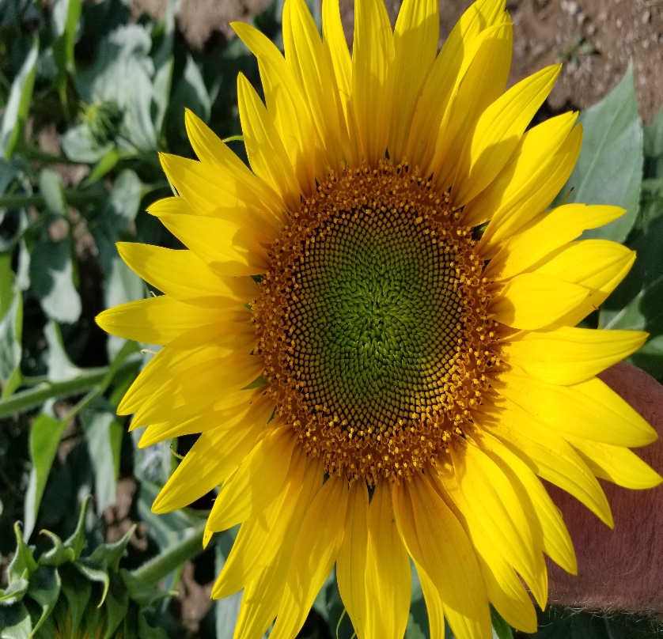
Sunflowers
2015 – 2018
  Monticello
  Mapleton
  Westfield
  Limestone
Varieties
Several hybrids – Mycogen, Croplan, Syngenta – Usually Clearfield
Typically 95 day to PM – 75 day to flower
Most use grain header – sunflower header fabricated

Slide 14
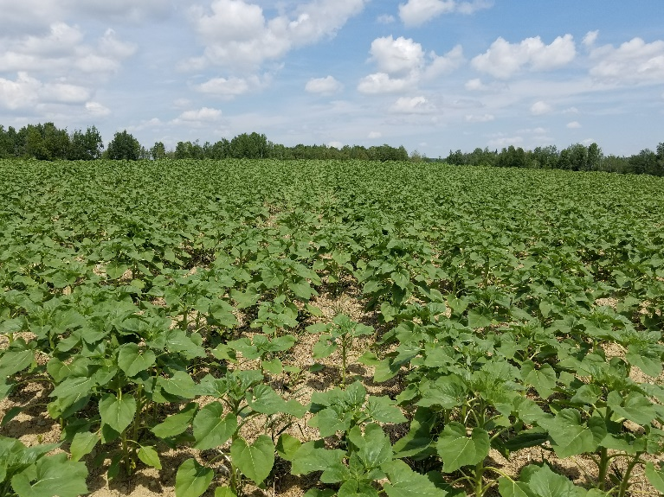
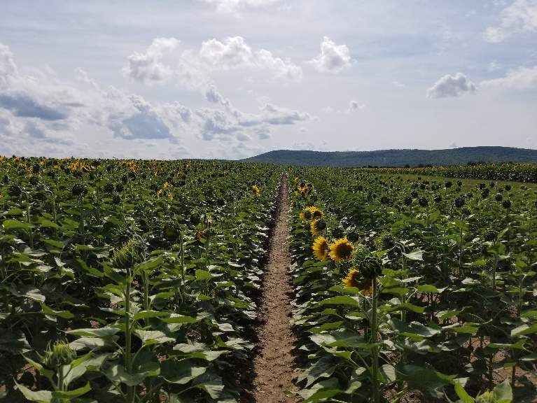
Sunflowers
Plant from May 25 to June 7
  Soil temp 55-60F
  Pre-emerge Dual II Magnum (1.6 pt) + Spartan (6 oz)
  Beyond (6 oz) option for CL hybrids
  65-75 lbs N at planting
Harvest October 18 – November 2
Typical yield - 1820-2660 #/A
Local market for birdseed

Slide 15
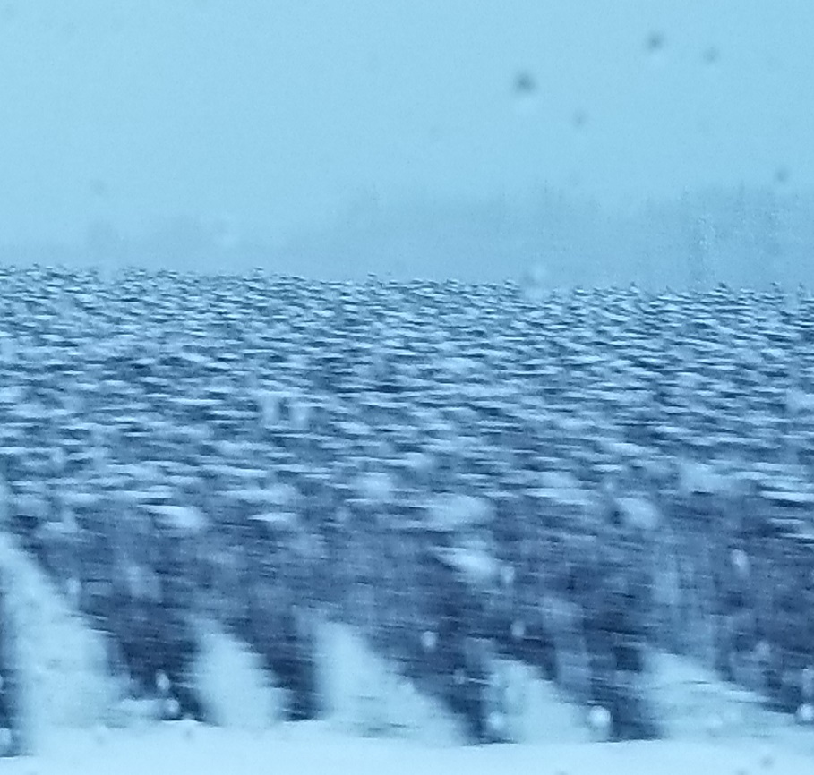
Sunflowers
The Good
  Increased yields each year
  Marketable
  Planted and harvested after grain
  Relatively low nutrient requirement
The Bad
  White mold magnet – difficult timing fungicide
  Target population is difficult to achieve
  Harvested late in season

Slide 16
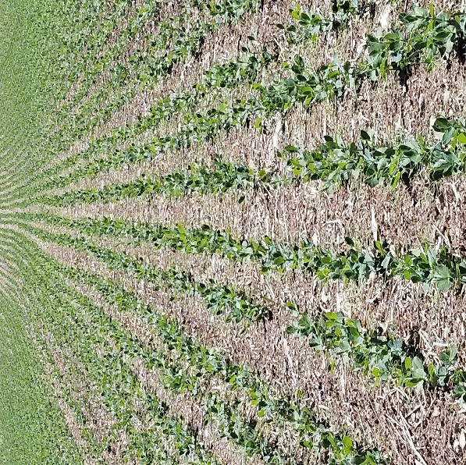
Field Peas
2016 – 2018
  Plot trials
  Benedicta
  Mapleton
Varieties
  Several – Nette 2010, Agassiz, SW Midas, Jetset, Saffron, Lacombe
  Typically 90 days from planting to harvest
  Direct cut with grain header

Slide 17
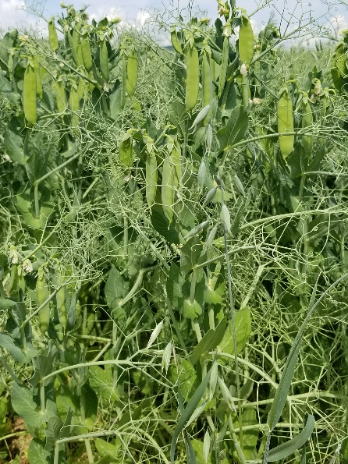
Field Peas
Growing season directly competes with small grain
Early planting = less heat stress, higher yield, lower foliar diseases
Pre-emerge Dual II Mag (1.6 pt) + Spartan (6 oz)
Have not seen response to fertilizer
Harvest from August 6 to September 6
Typical yield ranges from 3000 – 3800 lbs/A – weather!
Markets = work in progress

Slide 18
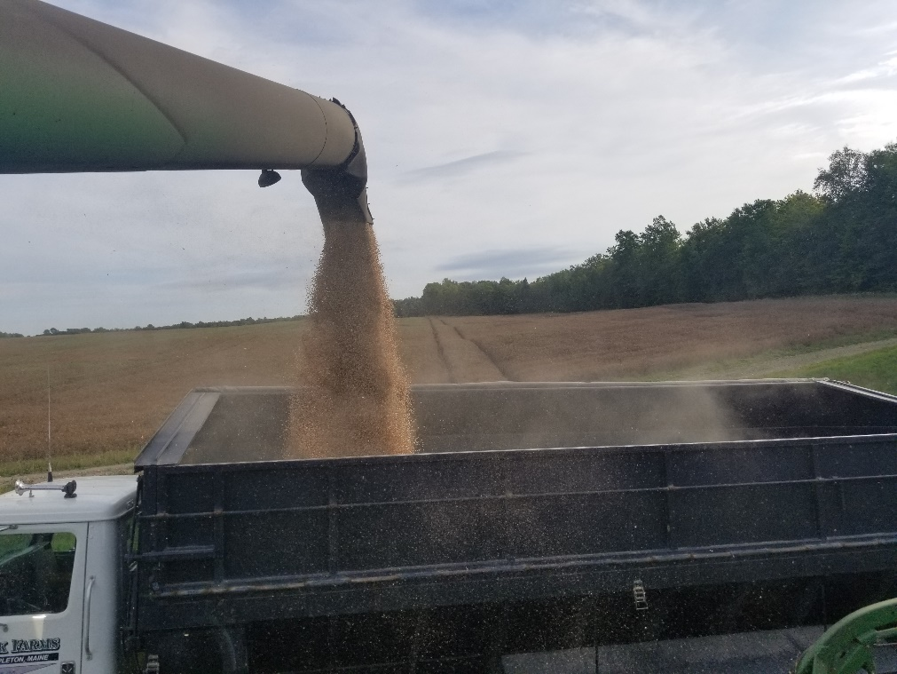
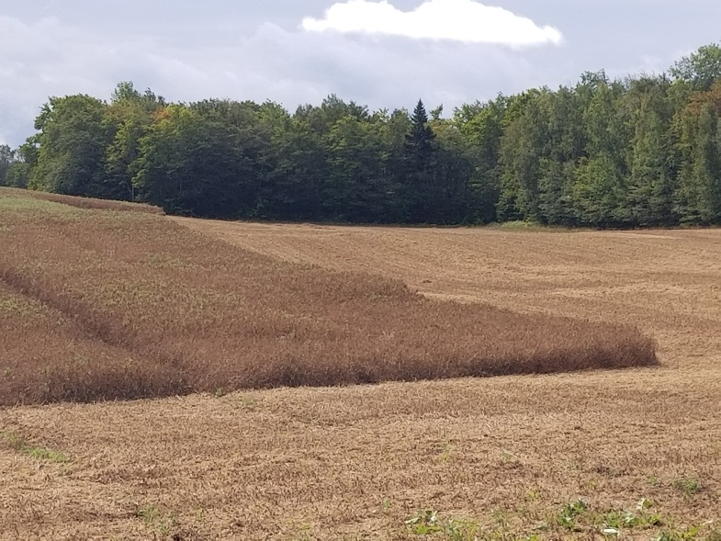
Field Peas
The Good
  Consistently high yields
  Low input crop
  Small grain equipment
  Early harvest allows for fall crop planting
The Bad
  Hate the heat – yields will suffer
  Timely harvest is key – lodging, bleach in greens
  Pay attention to handling

Slide 19
Challenges…
Securing market share to support large acreage
Transportation
Timing of field operations
Storage and cleaning
Additional acreage is not available in all cases

Slide 20
Successes…
Learning every year – Fine tuning production practices – Increasing yields
Value Adding on Farm – seed cleaning, bagging, marketing
Gaining grower interest
Incorporating no-till fall grain
Increase in cash crop production – increasing rotation length
Grant awards
  Specialty Crop Block
  Northeast SARE

Slide 21
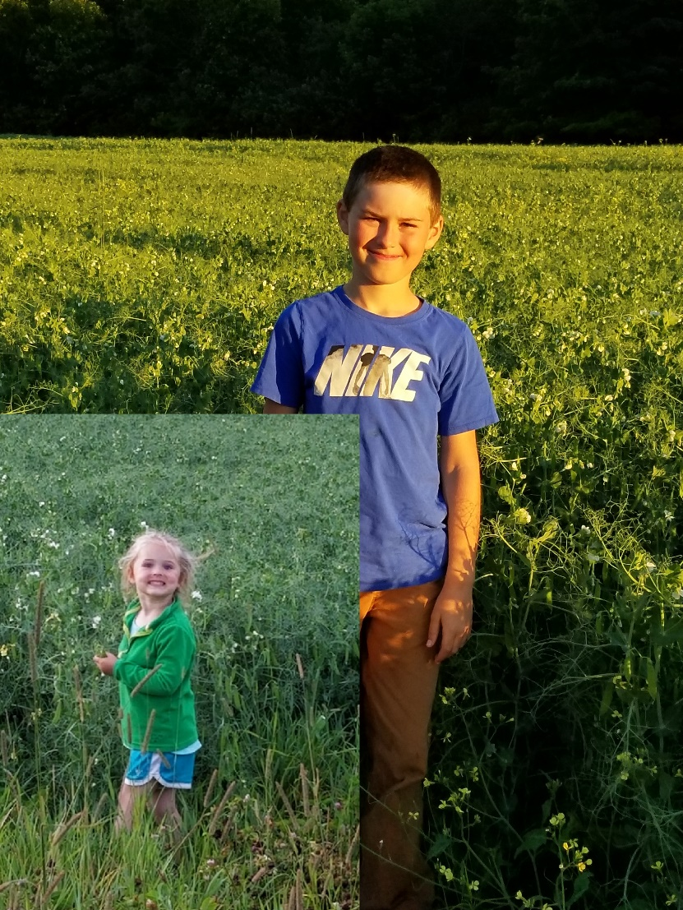
Thank You!!
  Jake Dyer
  Maine Potato Board
  207-769-5061
  jdyer@mainepotatoes.com

