Slide 1
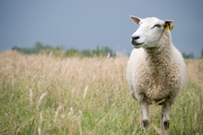


Definition of EBVs of Economically Relevant Traits in Sheep Production
Marlon Knights
Associate Professor
Division of Animal and Nutritional Sciences
West Virginia University

Slide 2
Trait Categories
Reproduction
Growth
Carcass
Parasite Resistance
Wool
Indexes

Slide 3
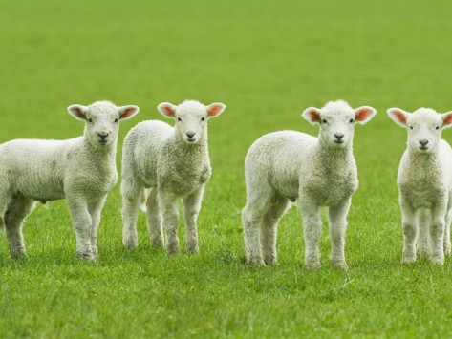
Reproduction Traits
Number of lambs born (NLB)
  Measure of prolificacy- expressed in %
  Number of lambs born per 100 ewes lambing
  If animals are bred with a combined NLB EBV = +5.0 its daughters will produce 5 more lambs per 100 lambings than the average ewe

Slide 4
Reproduction Traits
Number of lambs weaned (NLW)
  Measure of ewe effects on prolificacy and lamb survival – expressed in %
  Number of lambs weaned per 100 ewes lambing
  If animals are bred with a combined NLW EBV = +5.0 their daughters will wean 5 more lambs per 100 lambings than the average ewe
  NEED to collect lambing and weaning data

Slide 5
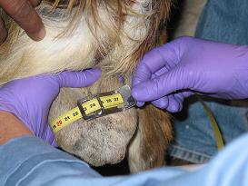
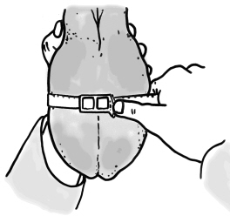
Reproduction Traits
Scrotal circumference (SC)
  Used to improve breeding capacity in males and reproduction efficiency in females
  Measured in cms
  Rams with +SC EPD produce daughters that attain sexual maturity earlier
  Need to measure scrotal circumference at postweaning or at postweaning and yearling age

Slide 6
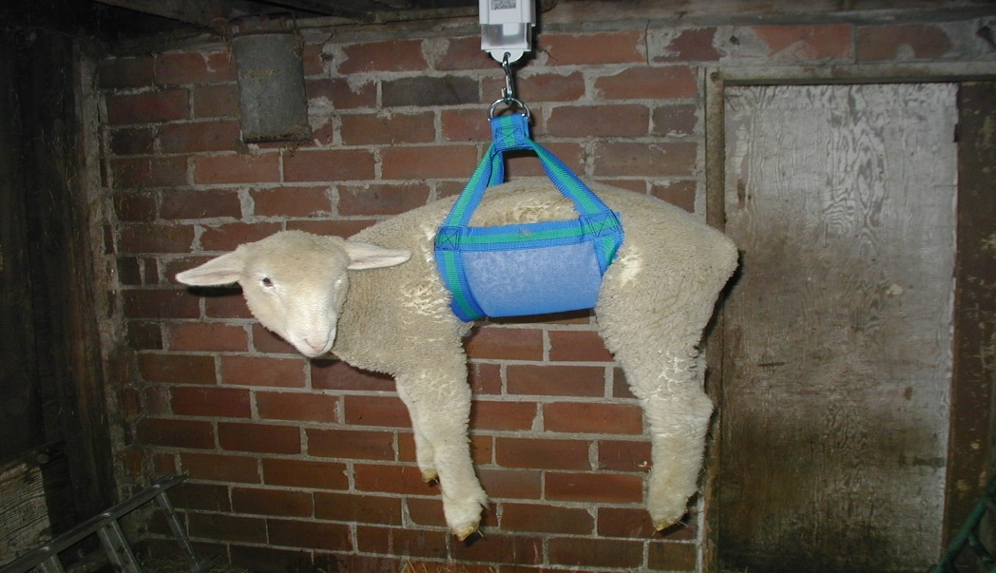
Growth Traits
Birth weight (BWT, kg)
  Negative (-) BWT EBV
    Desirable to reduce lambing difficulty (oversized lambs)
  Positive (+) BWT EBV
    Desirable to increase lamb survival in prolific breeds
    Positively correlated with weaning and post weaning weights

Slide 7
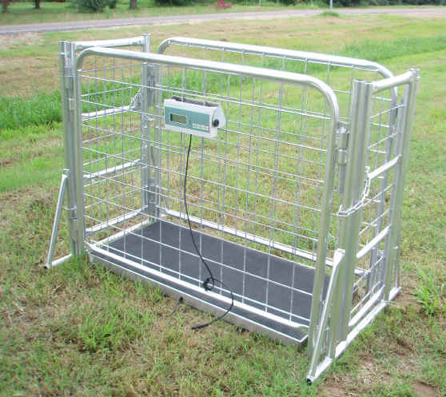
Growth Traits
Weaning weight (WWT, kg)
  Estimates pre-weaning growth potential
  Weight should be taken between 45-90 days
  + WWT EBV is desirable

Slide 8
Growth Traits
Maternal Weaning Weight (MWWT, kg)
  Estimates genetic merit for mothering ability
  Reflects genetic differences in ewe milk production ( and maternal behavior)
  Evaluates if individual ewes produce lambs that are heavier or lighter than expected based on the WWT EBV of the parents
  If an animal has + MWWT EBV its daughters are expected to produce more milk and have better mothering ability

Slide 9
Growth Traits
Post Weaning Weight (PWWT, kg)
  Estimates genetic merit for postweaning weight at 120 days
  Weights can be taken between 90-150 days (early) and or between 150-305 days
  If an animal has + PWWT EBV its progeny are expected to grow faster and reach market weight earlier

Slide 10
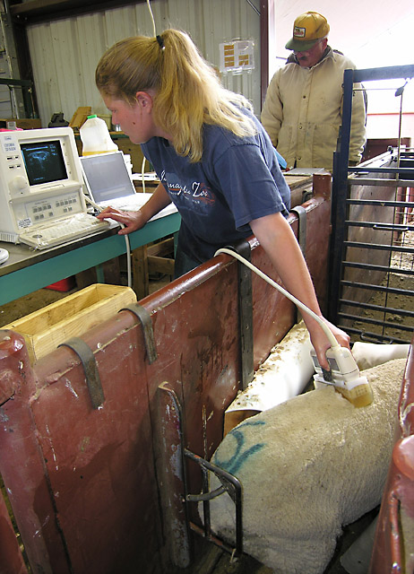
Carcass Traits
Loin Muscle Depth (EMD, mm)
  Estimates genetic differences in muscling
  Ultrasound measurements of loin muscle depth (12-13th rib) in live animals adjusted to 110 lbs (55 kgs) or 187 lbs (depending on breed)
  Animals should be weighed at the same time
  If an animal has + EMD EBV its progeny are expected to have larger loin eyes

Slide 11
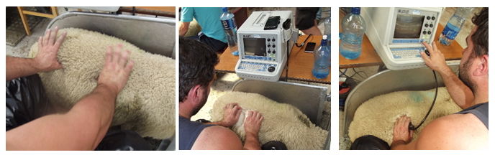
Carcass Traits
Fat Depth (CF, mm)
  Estimates genetic differences in carcass fatness
  Ultrasound measurements of fat depth (12-13th rib) in live animals adjusted to 110 lbs (55 kgs) or 187 lbs (depending on breed)
  Animals should be weighed at the same time
  If an animal has - CF EBV its progeny are expected to have leaner carcasses and more desirable yield grades

Slide 12
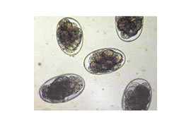
Parasite Resistance
Worm Egg Count (WEC, %)
  Estimates genetic value for parasite resistance based on fecal worm egg counts
  Recorded at weaning, early or late postweaning
  Animals with low WEC EBVs have greater parasite resistance

Slide 13
Indexes
Group certain EBV traits together
Allows selection of breeding stock that are suited to a particular situation – optimum
Very efficient
Can add a direct economic component

Slide 14
Carcass Plus
Uses EBVS for PWWT, CF and EMD
Carcass Plus EBV =
5.06 x PWWT EBV – 13.36 x Fat Depth EBV + 7.83 x Muscle Depth EBV
Assessment of value for Terminal Sire types in the USA
  Well muscled
  Grows rapidly

Slide 15
Maternal Wool Breeds Index
Predicts EBVs for Ewe Productivity, defined as the weight of lamb weaned per ewe lambing
Used to improve ewe productivity
F unction of EBVs for
  Weaning weight (WWT),
  Maternal weaning weight (MWW),
  Number of lambs born (NLB), and
  Number of lambs weaned (NLW) as:
Index = 0.583 x WW + 2.639 x MWWT + 0.406 x NLW – 0.035 NLB.

Slide 16
Self Replacing Carcass (SRC)$
Combines WWT, PWWT, BWT (-), PWEC

Slide 22
Getting Started Using Genetic Value EBVs in Selection
Commercial Producers
  Improve the traits you want by selecting and purchasing replacement with EBVs
  Visit NSIP website –list producers
Breeders
  Enroll with NSIP/lambplan to get EBVs on your animals
  Adds value to your animals
  Helps the industry

