Slide 1


Developing Best Management Practices for Pulse and Oilseed Crops in the Northeast
Jake Dyer
Maine Potato Board

Slide 2
Project Details
$105,527.00 awarded for 2 year project
Funded by Northeast SARE (LNE17-358)
Plot and field trial components
Build upon results from trials in 2016

Slide 3
Project Purpose
Work with growers to initiate the inclusion of pulse and oilseed crops in potato rotations
Work with existing growers to improve production
Highlight benefits that pulse and oilseeds can have on potato cropping systems
Develop best management practices specific to the Northeast

Slide 4
Plot Trials
Westfield
pH | OM | CEC | P | K | S | Mg | Ca
6.2 | 4.1 | 8.8 | 41.8 lb/a | 543 lb/a | 18 ppm | 330 lb/a | 3064 lb/a
Presque Isle
pH | OM | CEC | P | K | S | Mg | Ca
5.9 | 3.4 | 5.9 | 19.3 lb/a | 424 lb/a | 9 ppm | 289 lb/a | 1674 lb/a
Westfield
  Yellow Field Peas – vty, fertility, seed treatment
  Red Lentils – row spacing
  Kabuli Chickpea – row spacing
  Fava Beans – seeding rate
Presque Isle
  Canola – vty, fertility, seeding rate
All plot trials RCB X 3 Rep

Slide 5
Field Pea Plot Trials
Target Population = 9 pl/ft2 (392,040 pl/acre)
AAC Lacombe
96% germination
1391 SPP
340 lb/a
CDC Saffron
96% germination
1454 SPP
312 lb/a

Slide 6
Field Pea Plot Trials
Planting Date: May 16
Herbicide: May 18 (Dual II Mag @ 1.4pt + Spartan Charge @ 6oz)
Fertilizer: May 18
Flowering Date: July 07
Plant Counts: July 07
Plant Height: July 17
Desiccate: August 09
Harvest: August 16

Slide 7
Field Pea Plot Trials
7 Treatments
  Saffron Pea – untreated + 0 fertility
  Saffron Pea - treated seed + 100 lb/a KMAG (0-0-21-10.6Mg-21S)
  Saffron Pea – treated seed + 150 lb/a (7.3-18.6-16.8-5.45Mg-10.9S)
  Saffron Pea – treated seed + 0 fertility
  Lacombe Pea – treated seed + 100 lb/a KMAG(0-0-21-10.6Mg-21S)
  Lacombe Pea – treated seed + 150 lb/a (7.3-18.6-16.8-5.45Mg-10.9S)
  Lacombe Pea – treated seed + 0 fertility

Slide 8
Field Pea Plot Trial Results and Discussion
On average, plant stands were 120% of target population
Yields averaged 3512 lbs/a across treatments (3013-3978 lbs/a)
  No effect with regards to fertilizer, seed treatment, or variety
Lodging and diseases were not problematic
Plant heights averaged 25 inches
Test weight average 69 lb/bu (66-72 lbs/bu)
Pre-emergence herbicides worked well
Re-growth of peas due to late season moisture

Slide 9
Red Lentil Plot Trial
Target Population = 13.5 pl/ft2 (588,000 pl/a)
CDC Maxim
96% germination
11,869 spp
57.3 lb/a
2 Treatments
7 inch row spacing
14 inch row spacing

Slide 10
Red Lentil Plot Trial
Planting Date: May 16
Pre Emergence Herbicide: May 18 (Dual II Mag @ 1.4 pt/a)
Post Emergence Herbicide: June 20 (Beyond @ 6 oz/a)
Fertilizer: None
Fungicide: Priaxor @ 8oz/a on July 19
Flowering Date: July 12
Plant Counts: July 07
Plant Height: July 16
Desiccate: August 09
Harvest: August 16

Slide 11
Red Lentil Plot Trial Results and Discussion
Plant stands in 7 inch rows were 114% of target vs. 83% in 14 inch rows
Yield in 7 inch rows was 1666 lbs/a vs. 1380 lbs in 14 inch rows
Disease pressure was low and no foliar diseases were noted
Lodging was more severe in 14 inch row spacing
Plant height averaged 13.5 inches
Test weight average 65 lb/bu
Dual/Beyond combo worked well – best if use pre/post combination

Slide 12
Red Lentil Plot Trial

Slide 13
Chickpea Plot Trial
Target Population = 4 pl/ft2 (174,500 pl/a)
Frontier Kabuli Chickpea
88% germination
1281 spp
172 lb/a
1 Treatment
14 inch row spacing
No seed inoculant – Ammonium Sulfate split application

Slide 14
Chickpea Plot Trial
Planting Date: May 16
Herbicide: May 18 (Dual II Mag @ 1.4pt + Spartan Charge @ 6oz)
Fertilizer: 200 lb/a AS (41-0-0-48S) split (June 07 and July 19)
Fungicide: Priaxor @ 8oz/a on July 19
Flowering Date: July
Plant Counts: July 07
Plant Height: July 17
Desiccate: August 31
Harvest: September 07

Slide 15
Chickpea Yield Results and Discussion
Primarily for informational purposes to better see how crop performs
2016 trials used seed inoculant and 7 inch row spacing, diseases were an issue and plants would not die off naturally
2018 no inoculant used and 14 inch row spacing, diseases were not an issue, plants began to naturally senesce and were eventually desiccated.
Plant stands averaged 60% of target (depth/compaction)
Yields averaged 1930 lb/A

Slide 16
Faba Bean Plot Trial
Snodrop Faba Bean
87% germination
1315 spp
  3 Treatments
4 pl/ft2 = 174,2040 – 169 lb/a
6 pl/ft2 = 261,360 – 253 lb/a
8 pl/ft2 = 348,480 – 338 lb/a

Slide 17
Faba Bean Plot Trial
Planting Date: May 16
Herbicide: not used
Fertilizer: not used
Fungicide: not used
Flowering Date: July 03 – July 19
Plant Counts: July 07
Plant Height: July 17
Desiccate: August 31
Harvest: September 07

Slide 18
Faba Bean Plot Trial
Plant stands:
135% of target @ 4 pl/ft2
114% of target @ 6 pl/ft2
146% of target @ 8 pl/ft2
Plant height increased with population
Lodging increased with population
Disease pressure was low – late season disease difficult to diagnose as plant turns black with maturity

Slide 19
Faba Bean Yield Results and Discussion
1st year experimenting with Faba beans
Have the ability to fix >100 lbs/n/a
Need to be seeded as early as possible – long season crop
Struggled through hot dry weather
Had to hand harvest due to equipment constraints – likely led to yield loss
Yields:
1552 lbs/a @ 4pl/ft2
1794 lbs/a @ 6pl/ft2
1684 lbs/a @ 8pl/ft2

Slide 20
Canola Plot Trials
2 Trials: Management Practice + Variety Trial
Management Practice Trial
Fertility, Seeding Rate, Variety
Variety Trial
Variety, Seeding Rate

Slide 21
Canola Plot Trials
Management Practice Trial – GSP vs. Other
Goal: Evaluate seeding rate, variety, and fertilizer
Seeding Date: May 29
Fertilizer Date: June 01
Herbicide Date: June 22 – 16 oz/a glyphosate @ 2-3 leaf
Desiccate: August 27
Harvest Date: September 07

Slide 22
Canola Plot Trials
Management Practice Trial
GSP
5 lb/a : DK 30-42 : 78N-0-54K
Other
8.6 lb/a : CL HyClass 955 : 80N-30P-49K-34S-10.8Mg

Slide 23
Canola Plot Trials
Preliminary Results
Up to 60% reduction in seeding rate vs. actual population
  Soil conditions, depth, seedling mortality
  Plant stands improved with increased seeding rate
Canola responds to sulfur
  Yield increase when sulfur is added to fertilizer blend
Canola hybrid selection can increase yield
  Selecting modern hybrids bred for direct cutting systems
Highest yields were achieved when a combination of BMP’s are used

Slide 24
Canola Plot Trials
Variety Trial
Goal: Evaluate 5 varieties over 3 seeding rates
Seeding Date: May 29
Fertilizer Date: June 01 (80-30-50-1.6Mg-34S-6.8Ca)
Herbicide Date: June 22 – 16 oz/a glyphosate @ 2-3 leaf
Desiccate: August 27
Harvest Date: September 07

Slide 25
Canola Plot Trials
Variety Trial
DK 30-42
DynaGro 533G
DynaGro 544
Croplan HyClass 955
Croplan HyClass 970
All RR varieties
@ 5, 8, 11 lbs/A (5-10 plants/ft2)

Slide 26
Canola Plot Trials
Preliminary Results
Yields ranged from 890 – 2035 lb/A
Yield appears to be related to final plant stand
Yield appears to be related to variety
Weed control was unsatisfactory – pre-emergence product should have been used in combination w/glyphosate

Slide 27
Field Demonstration Trials
Westfield
  Sunflowers
Mapleton
  Sunflowers
  Yellow Field Peas
  Canola

Slide 28
Field Pea Field Trials
Mapleton
Variety: AAC Lacombe
Target Seeding Rate: 340 lb/a (392,040 pl/a)
Seeding Date: May 19
Herbicide: Pre – 1.33 pt/a Dual II Mag + 6 oz Spartan 4F
Fertility: 11-28-25-8Mg-16S applied pre plant incorporated
Emergence: May 30 (11 DAP)
Harvest Date: Sept 5+6 (91-92 DAP)

Slide 29
Field Pea Field Trials
Treatments (Strips)
  Reg. Seed, Treated, Pea Blend Fert, Rolled Prior
  Cert. Seed, Treated, Pea Blend Fert, Rolled After
  Cert. Seed, Treated, Pea Blend, KMAG, Rolled After
  Cert. Seed, Untreated, Pea Blend, Rolled After
  Cert. Seed, Untreated, Pea Blend, KMAG, Rolled After
  Cert. Seed, Treated, Pea Blend, KMAG, Rolled Prior
Fungicide (Strips) – Applied on July 09
  Stratego YLD @ 4.8 oz
  Aproach @ 12 oz
  Endura @ 11 oz

Slide 30
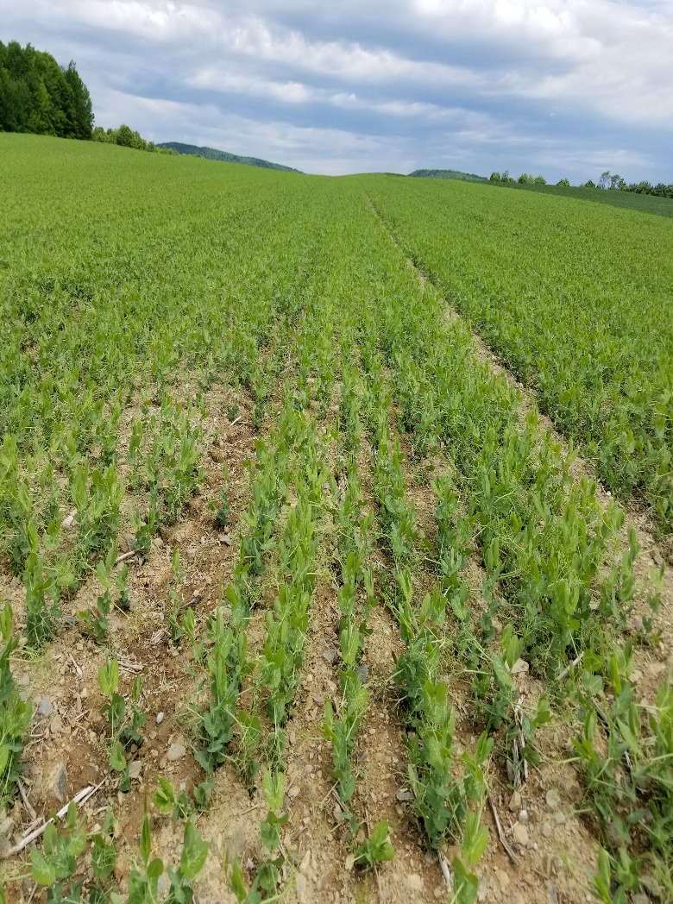
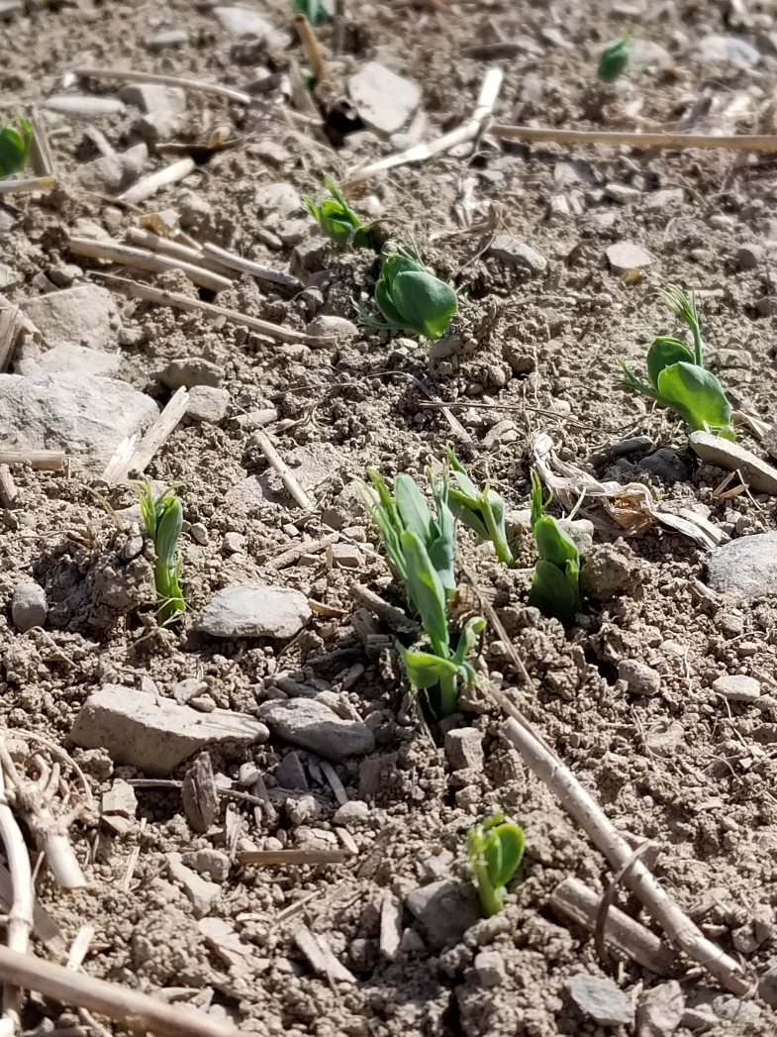
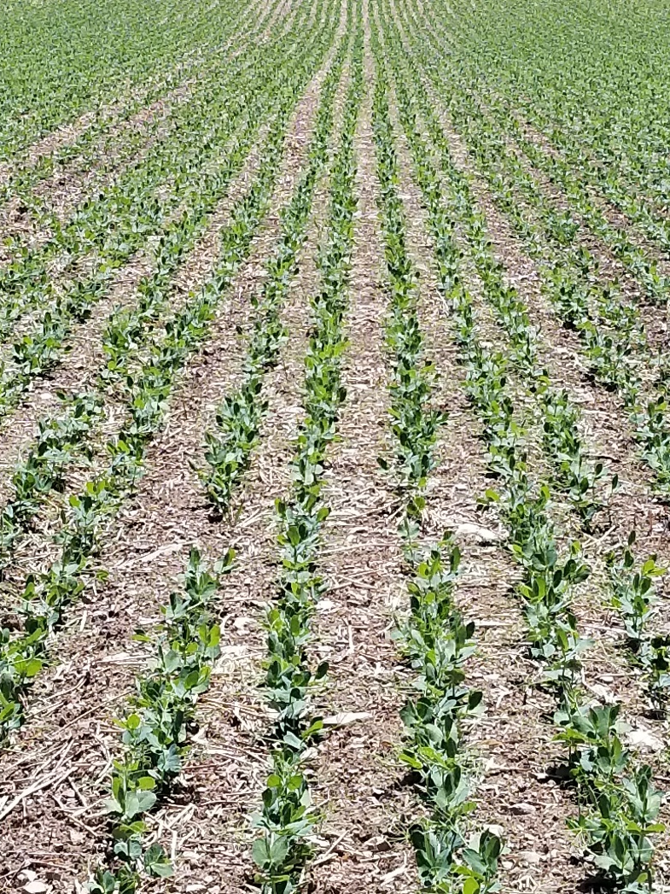
Field Pea Field Trials
May 30
June 11
June 20

Slide 31
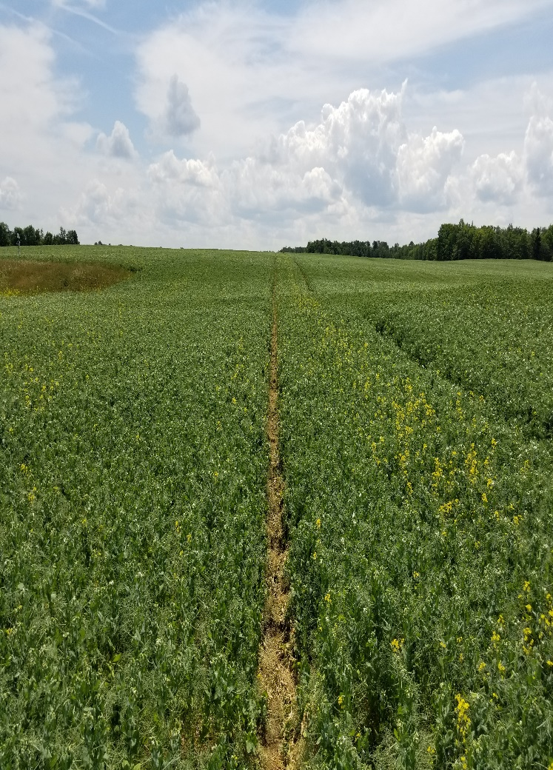
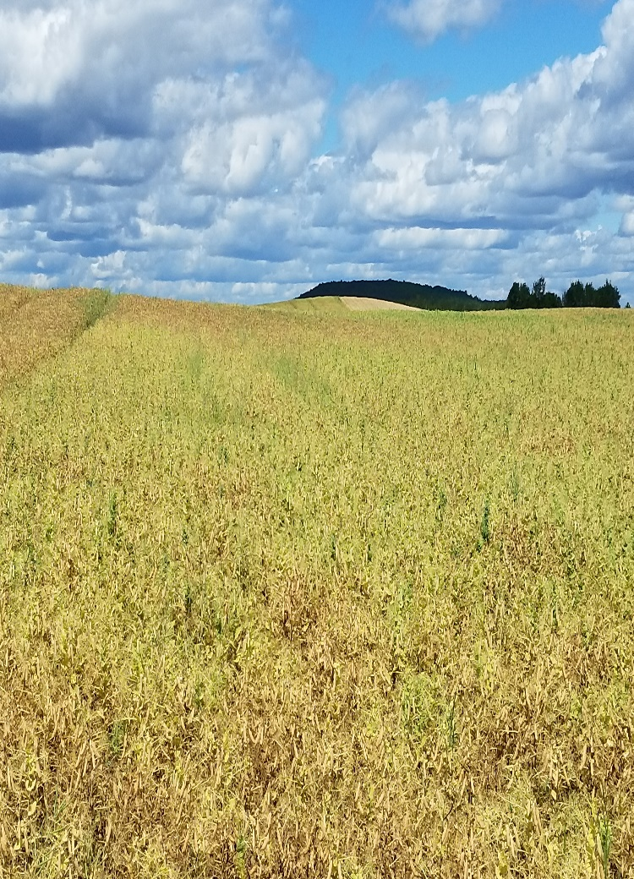
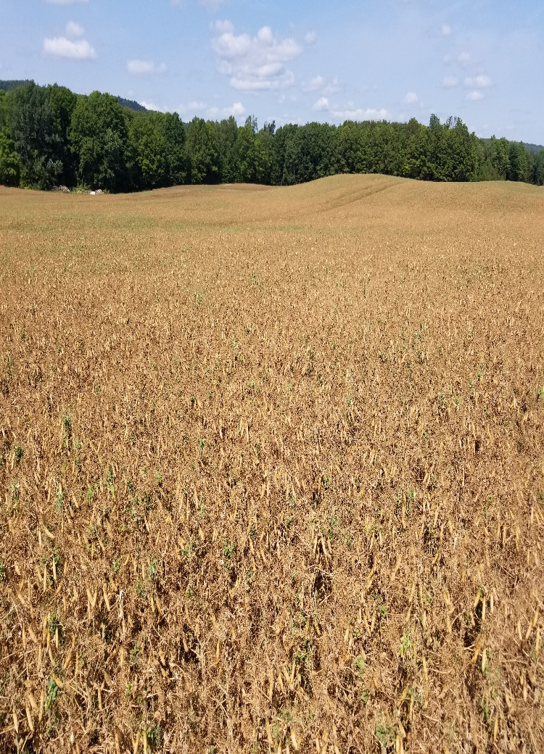
Field Pea Trials
July 16 - Fungicide
August 10 - Dessicated
August 21

Slide 32
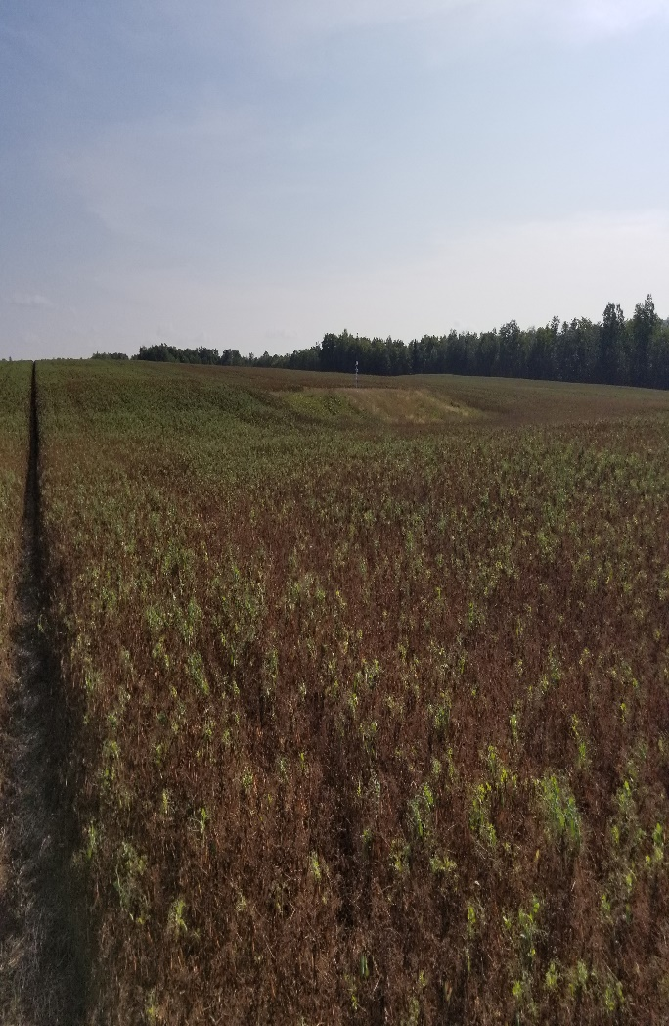
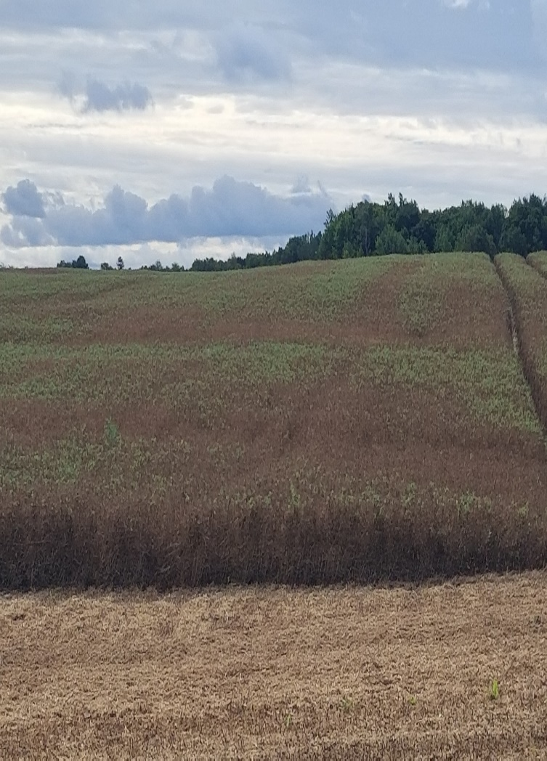
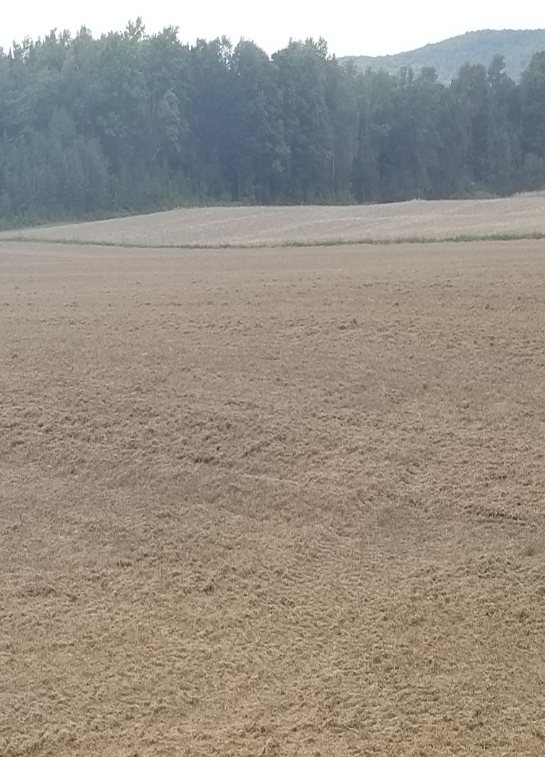
Field Pea Field Trials
August 27
September 06
September 06

Slide 33
Field Pea Trials Results and Discussion
Pre-Emergence herbicides worked very well
Low disease pressure – no noticeable difference between fungicides
Rolling after seeding = better emergence, although all treatments were above seeding target
Lodging – not an issue
Heat blast = increased pod abortion and reduced pod set and yield
Re-Flowering = 1st time seeing this…likely due to 4.6 in rain in August
Yields averaged 3007 lbs/a (50 bu/a)
Highest yielding strips had 100 lb KMAG 0-0-21-10.6Mg-21S

Slide 34
Sunflower Field Trials
Held on 2 farms in Mapleton and Westfield
Variety Info:
Croplan 549 CL
95 RM
Clearfield Trait

Slide 35
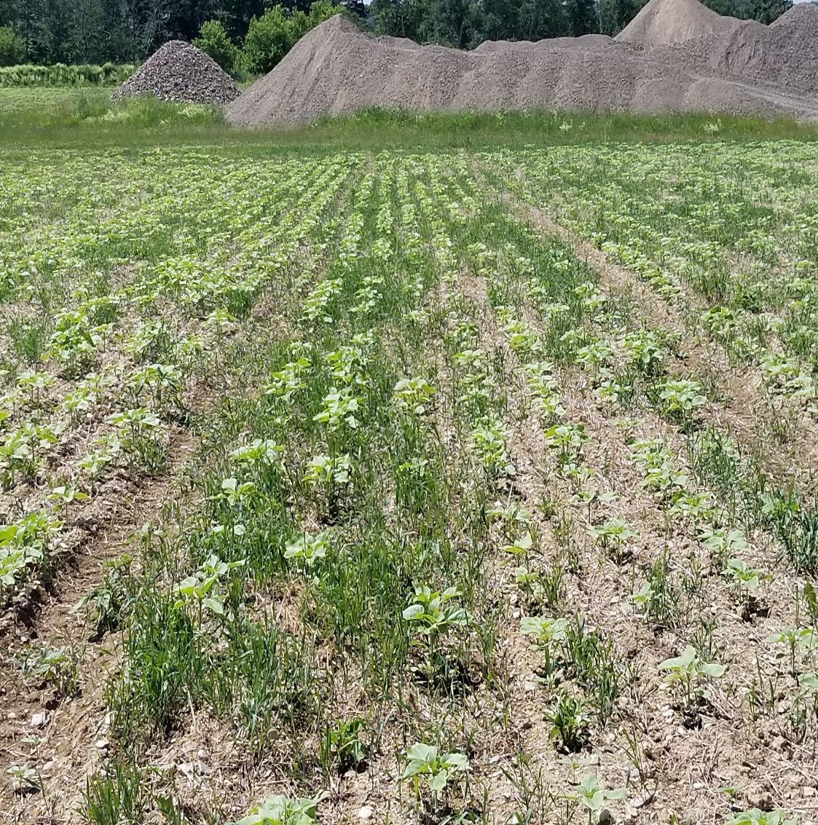
Sunflower Field Trials
Mapleton
Planting Date: May 29-30
Planting Method: Grain Drill
Herbicide: Beyond @ 6 oz/a post
Target Population: 28,000
Actual Population: 22,400 (80% of Target)
Row Spacing: 18”
Fertility: 50 lb N, 75 lb N, 100 lb N
Fungicide: Quash @ 4 oz/A

Slide 36
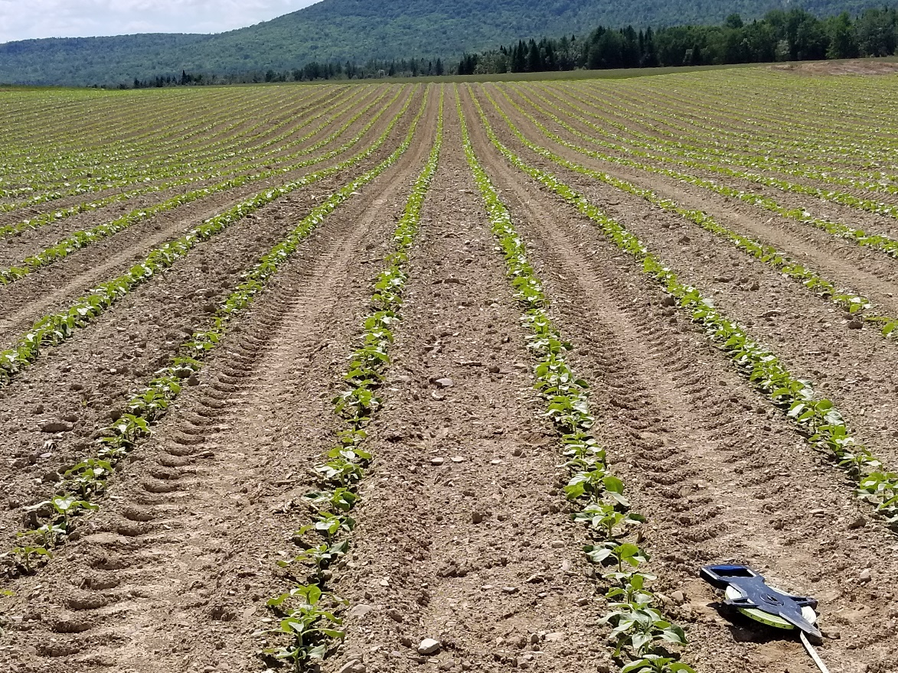
Sunflower Field Trials
Westfield
Planting Date: June 08
Planting Method: Precision planter
Herbicide: Dual II Mag @10.64 oz/a
Spartan 4F @ 6 oz/A
Target Population: 30,000
Actual Population: 27,351 (91% of Target)
Row Spacing: 36”
Fertility: 65 lb N
Fungicide: None

Slide 37
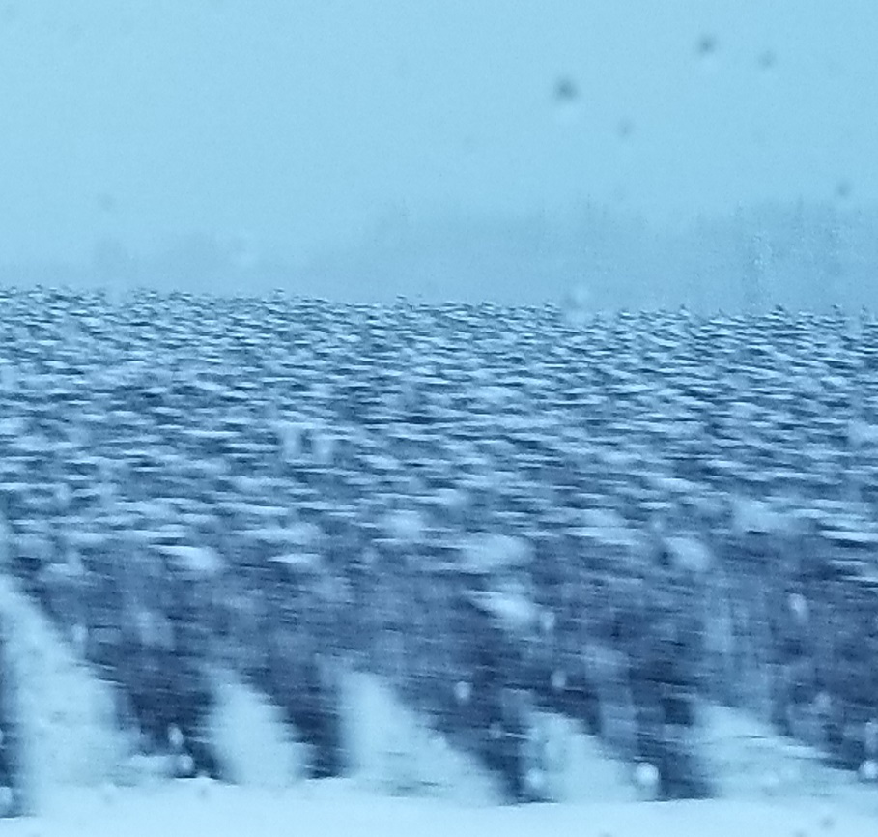
Sunflower Field Trials
Mapleton
Harvest Date: Oct 26
Yield: 50 lb/N = 1820 lb/a
75 lb/N = 2100 lb/a
100 lb/N = 2660 lb/a
Westfield
Harvest Date: Nov 02
Yield: 2428 lb/a
Yield would likely have been higher…
October 24

Slide 38
Sunflower Field Trial Results and Discussion
Sunflowers are slow to emerge…13 to 14 DAP – soil temp critical
Much more consistent stand when using planter vs. grain drill
91% vs. 80% of target planting population
Improved seed singulation
Consistent head size
Pre-emergence herbicide controlled weeds better than post product alone
White mold preventative fungicide should be considered ($40/a)
65-100 lbs N for best yields

Slide 39
Canola Field Trials
Mapleton
Planting Date: May 23
Fertilizer: 78-0-54
Variety: DK 30-42
Herbicide Date: June 15 (Glyphosate)
Topdress Fertility: June 27 (Kmag @ 100 and 200 lb/A)
Fungicide: Quash
Desiccate: August 22
Harvest: August 31-September 03

Slide 40
Canola Field Trial
Goal: To evaluate seeding rate and sulfur response
Strips of 5 and 6 lb/a seeding rate and 100 or 200 lb/Kmag
Yield monitor from combine used to estimate yield
Preliminary Results: Slight yield advantage to 6 lb/A + 200 lb/a Kmag

Slide 41
Acknowledgments
Buck Farms
W.C. Doyen and Sons
Smith’s Farm
Aroostook Farm
Cavendish Agri-Services
Nutrien Ag

