Slide 1
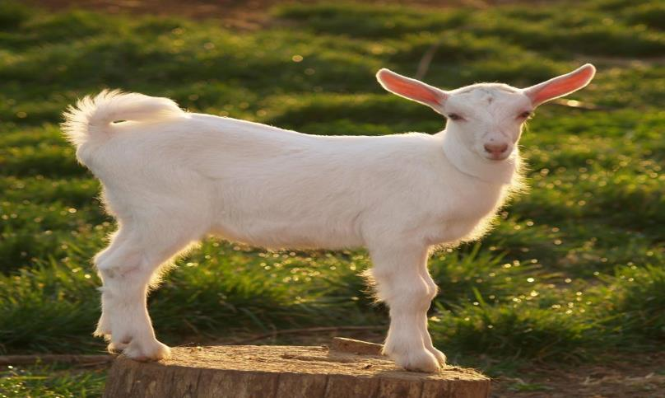
Baetje Farm LLC
Cheese class / Private group tour

Slide 2
Cheese class
To prepare for the cheese class we brainstormed on how to welcome potential customers into our facilities.
Then we created a class format that would be appreciated by beginners and others.
During the class presentation preparation we advertised the cheese class on our different social media platforms: Instagram and facebook.

Slide 3
How we proceeded and what we offered for the cheese class:
Advertised several dates of class in advance
Classes were open for 4 students at a time
The class would be confirmed if at least 2 students reserved a spot
First option
Scheduled on a weekend, featuring a local Wynyard/Inn
Cheese class
Cheese tasting/wine tasting
Cheese making ‘hands on’ with a French cheese maker
2 night in a villa at Chaumette Wynnyard
2 gastronomic meal at Chaumette
A cheese making kit
$650

Slide 4
How we proceeded and what we offered for the cheese class:
Advertised several dates of class in advance
Classes were open for 4 students at a time
The class would be confirmed if at least 2 students reserve a spot
Second option
Scheduled on one day
Cheese class
Cheese tasting/wine tasting
Cheese making ‘hands on’ with a French cheese maker
A cheese making kit
$250

Slide 5
How we advertised the class:

Slide 6
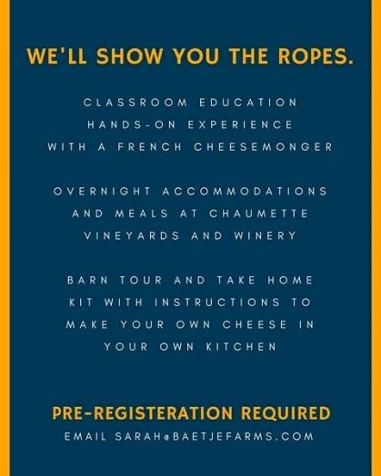

Slide 7
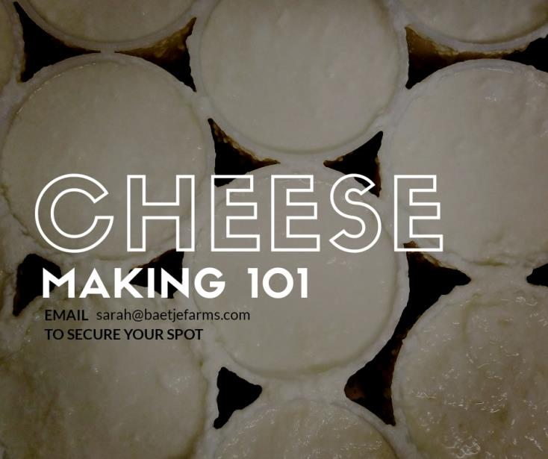

Slide 8
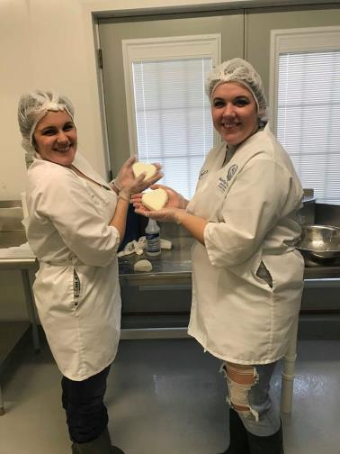
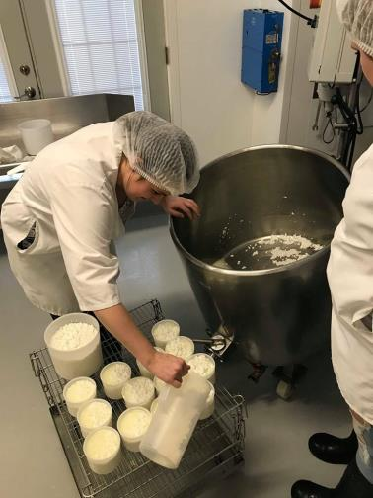
Cheese class

Slide 9
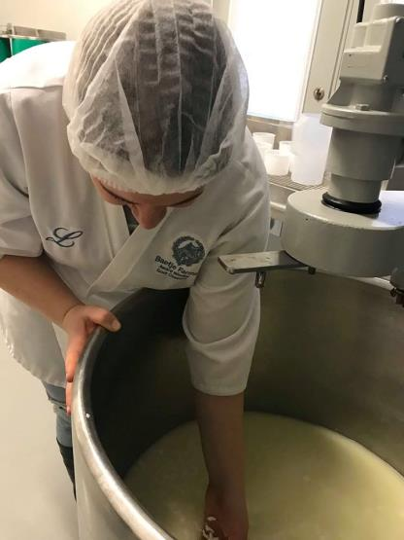
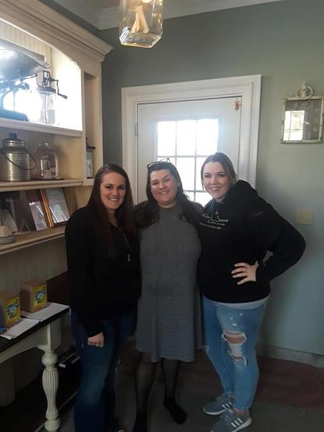

Slide 10
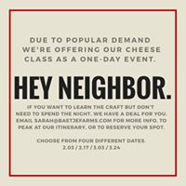
Due to very few responses for the first option, we quickly proposed the second as the only option
We fully booked 2 cheese classes

Slide 11
Farm tour
Due to the amount of requests from our customers for farm tours we brainstormed again on how to receive people at the farm and what to offer.
Minimum 10 pers/group
A farm tour
A barn tour
A cheese tasting
The possibility to purchase cheese in our store
$15/pers

Slide 12
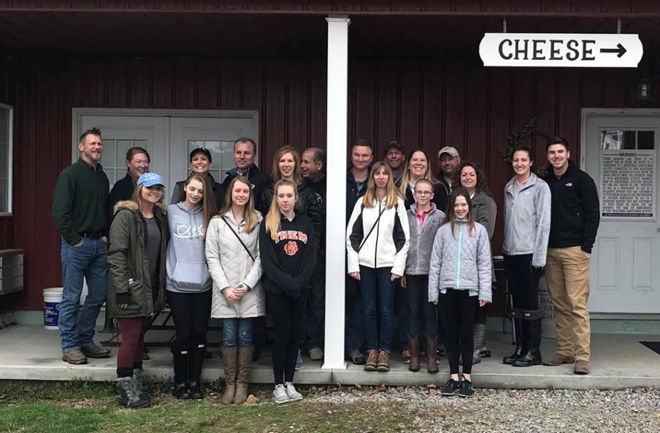

Slide 14
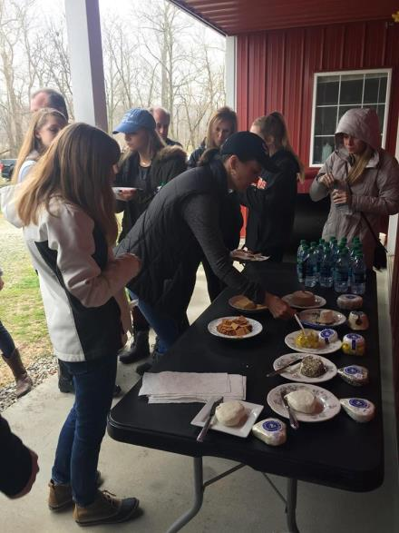
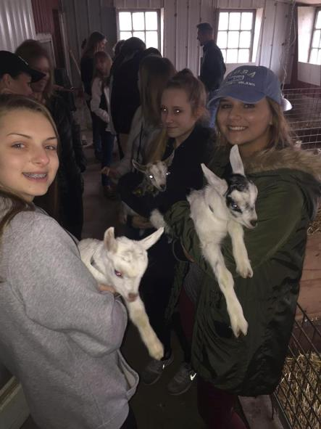

Slide 15
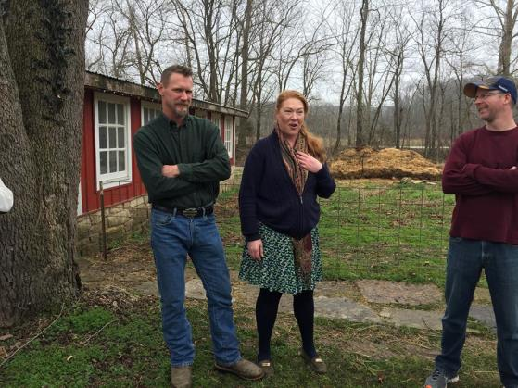
Conclusion
We’ve booked more than 10 farm tours. It was a success for the farm and we will repeat the process next summer.

