Slide 1


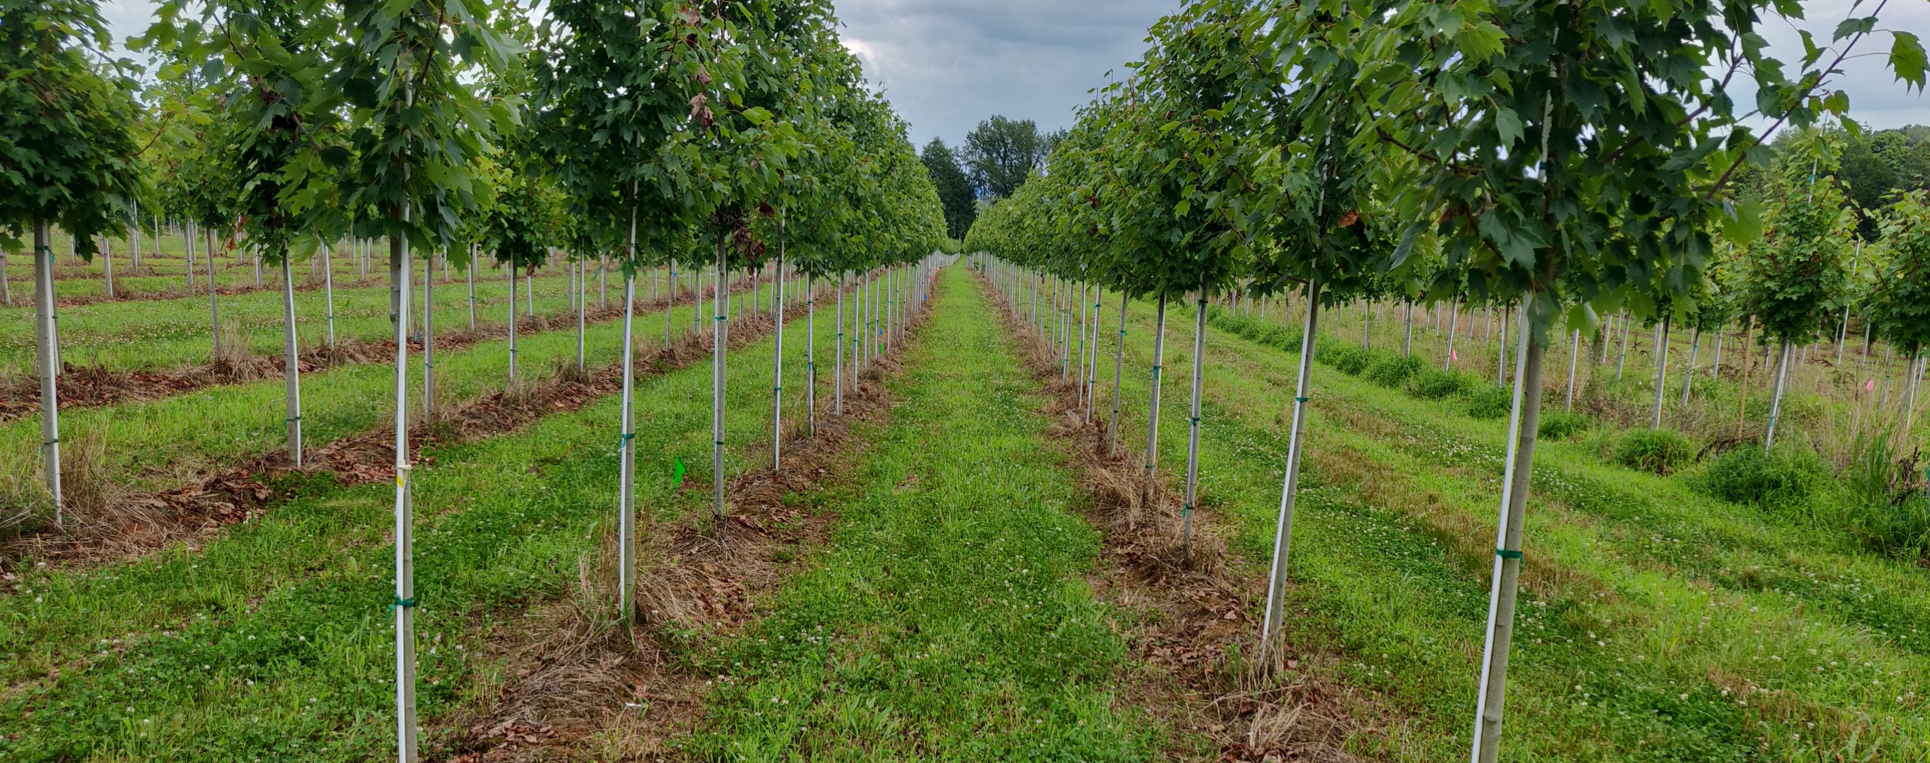
Development of a Cover Crop System for Management of Flatheaded Borers in Red Maple Production
Presented by:
Axel David Gonzalez

Slide 2
Presentation Outline
Red maple production
Flatheaded appletree borer (FHAB)
FHAB tretaments
Cover crops in nursery production
Materials and methods
Results
Conclusions

Slide 3
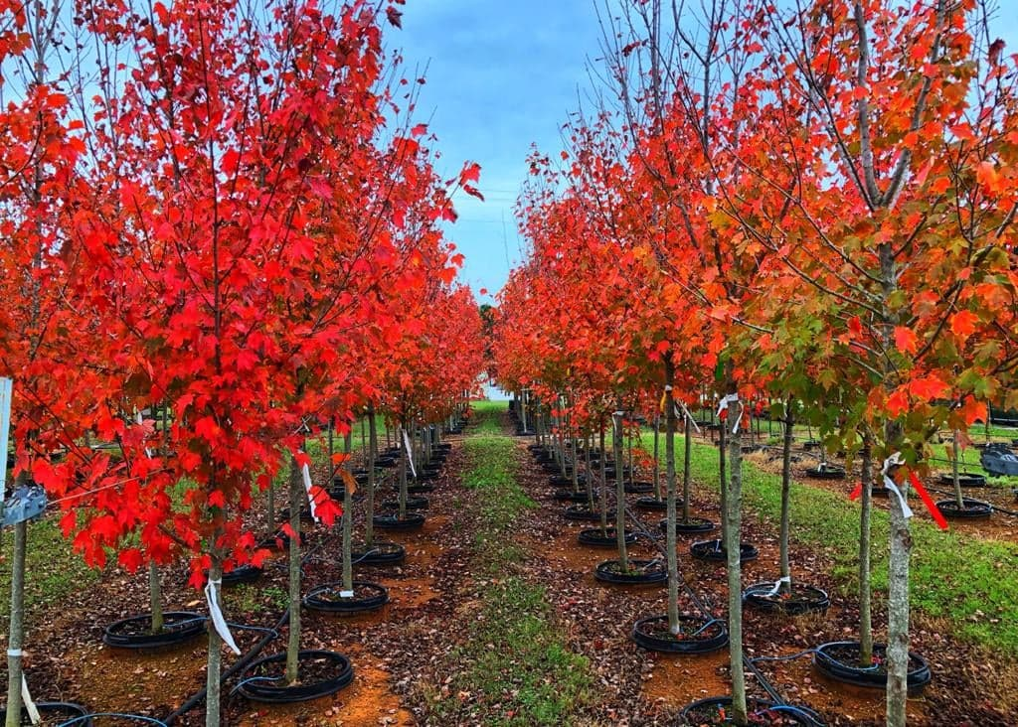
Red maple (Acer rubrum L.)
One of the most common ornamental plants in eastern North America.
Rapid growth rate.
Resistance to extreme soil-moisture conditions.
Sparkling fall colors.
Photo: Ravi Bika

Slide 4
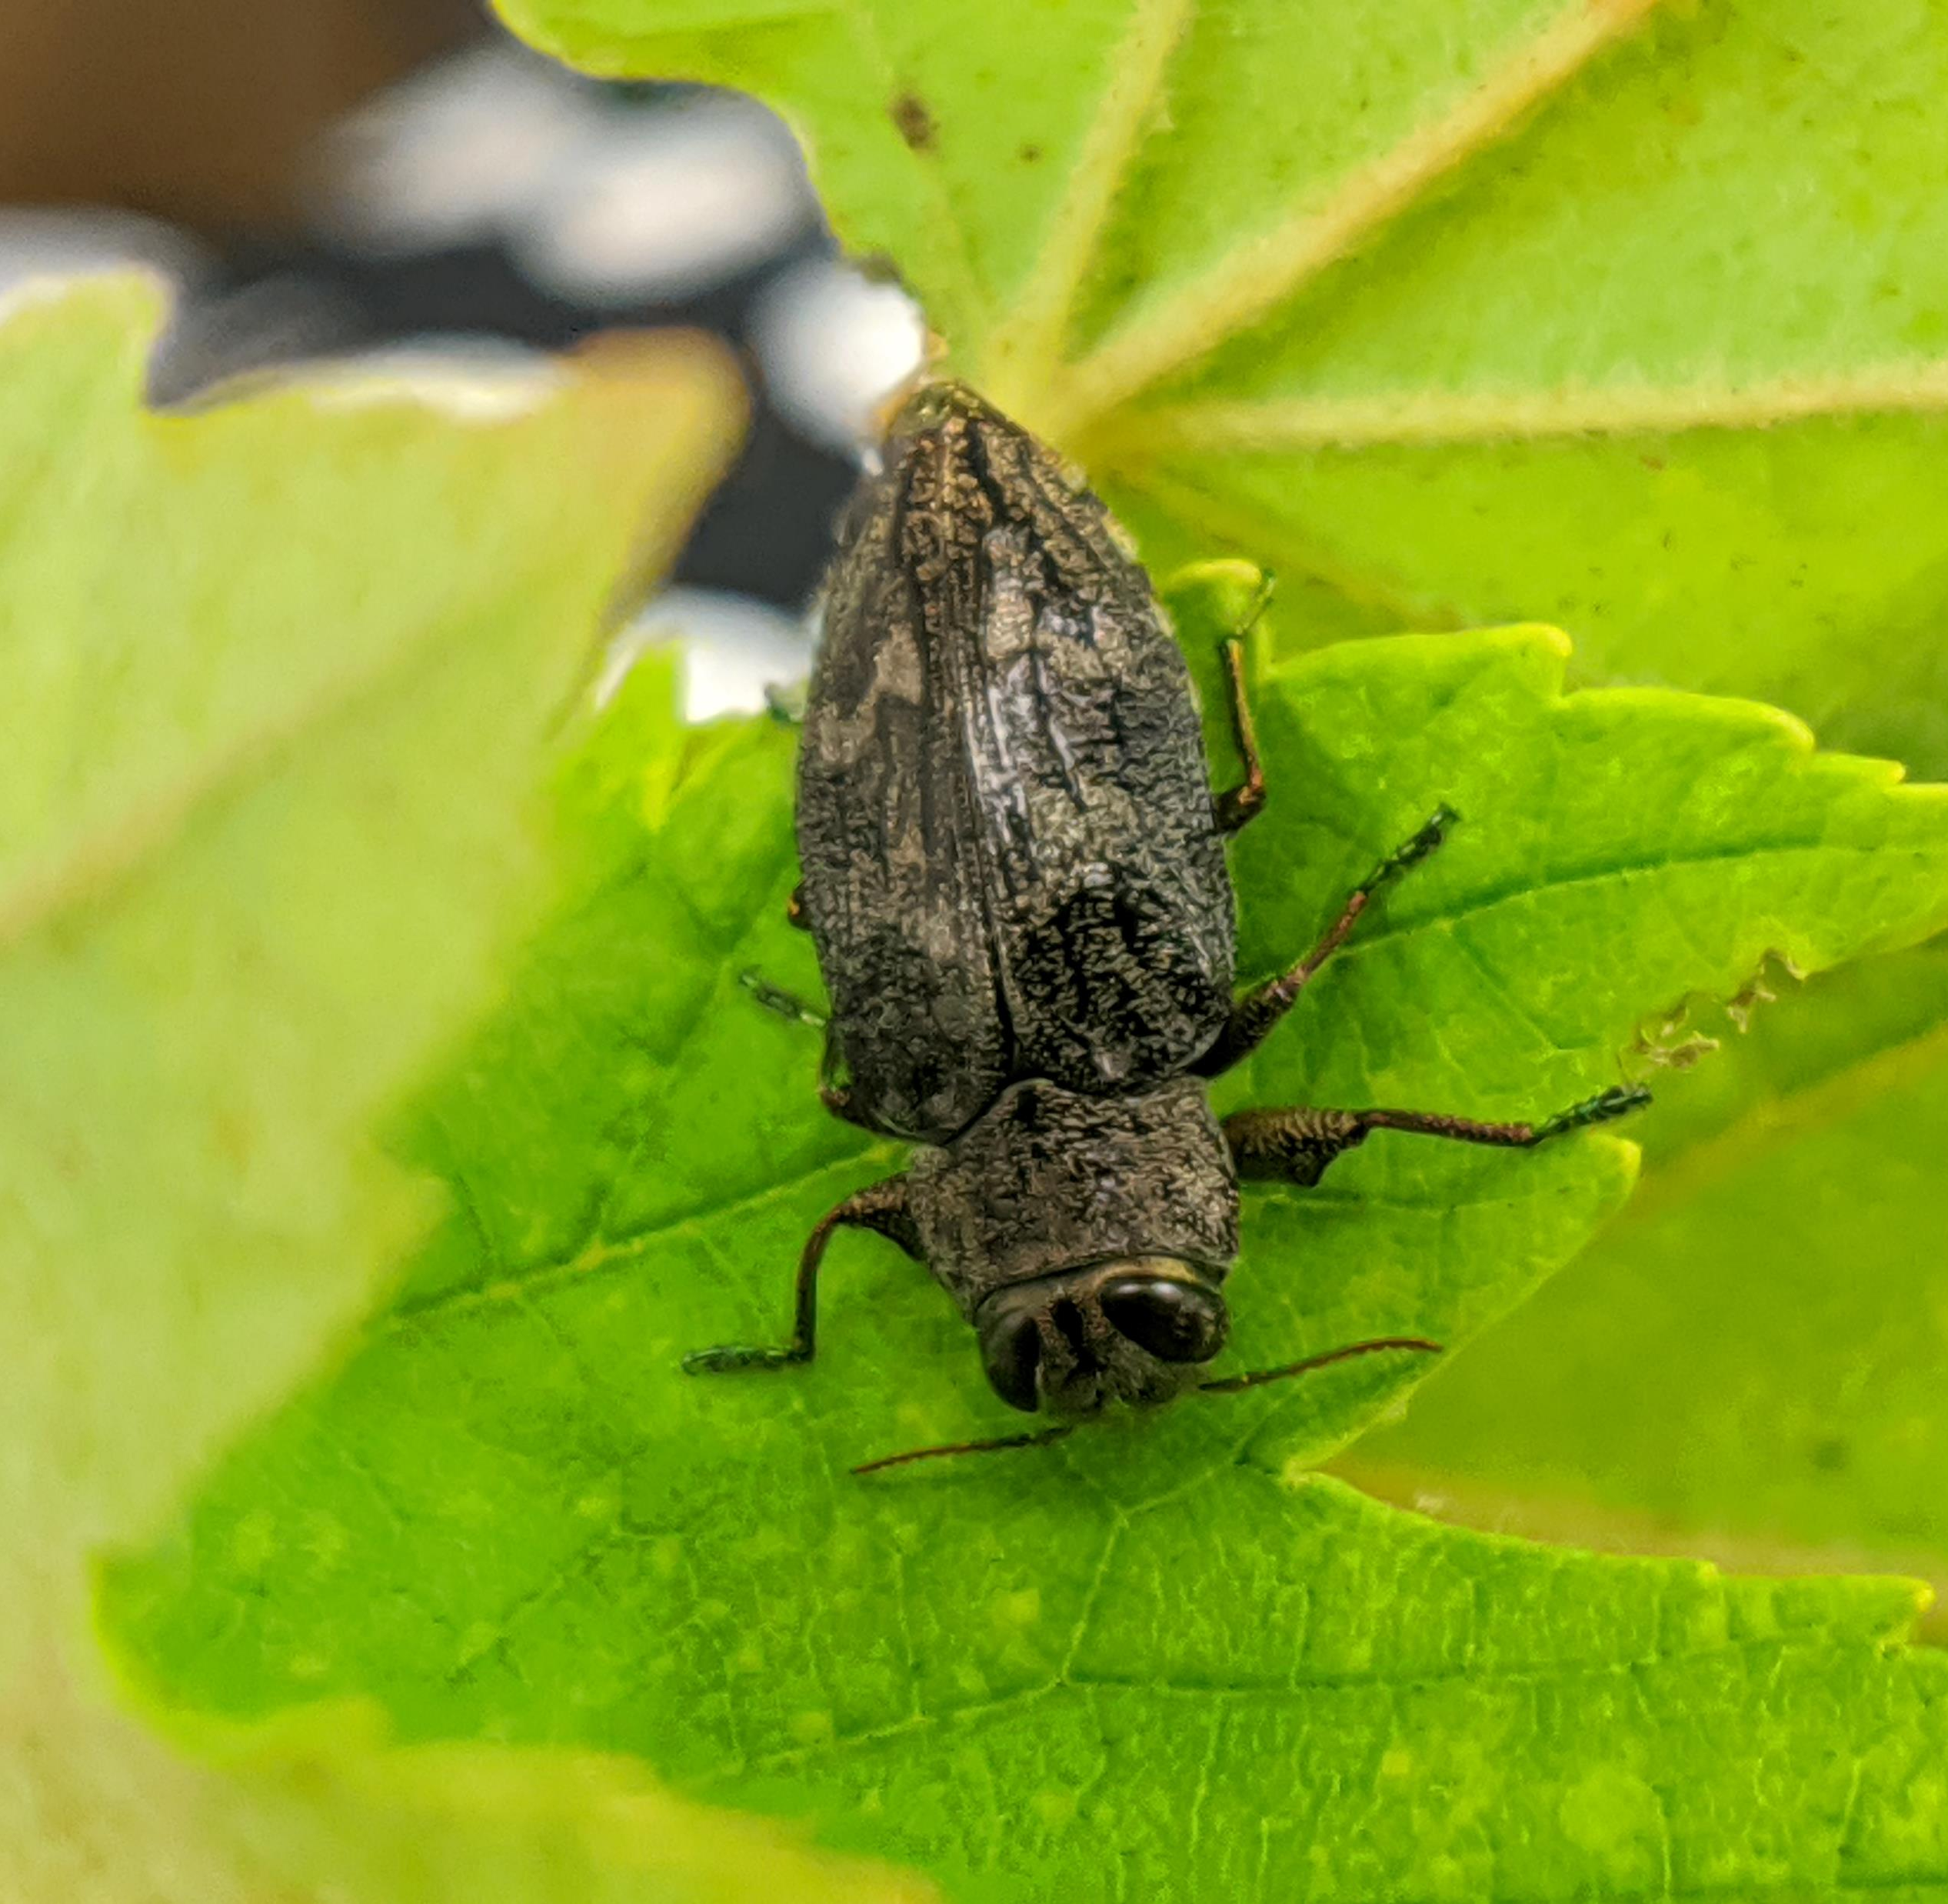
The Flatheaded appletree borer (FHAB)
Order: Coleoptera
Family: Buprestidae
Serious pest throughout the United States.
One larva can girdle a tree within one season.
Ruins the economic quality of the nursery trees.
Cultivars that show stress symptoms are more likely to be attack.
Chrysobothris femorata ?
Photo: Axel Gonzalez

Slide 5
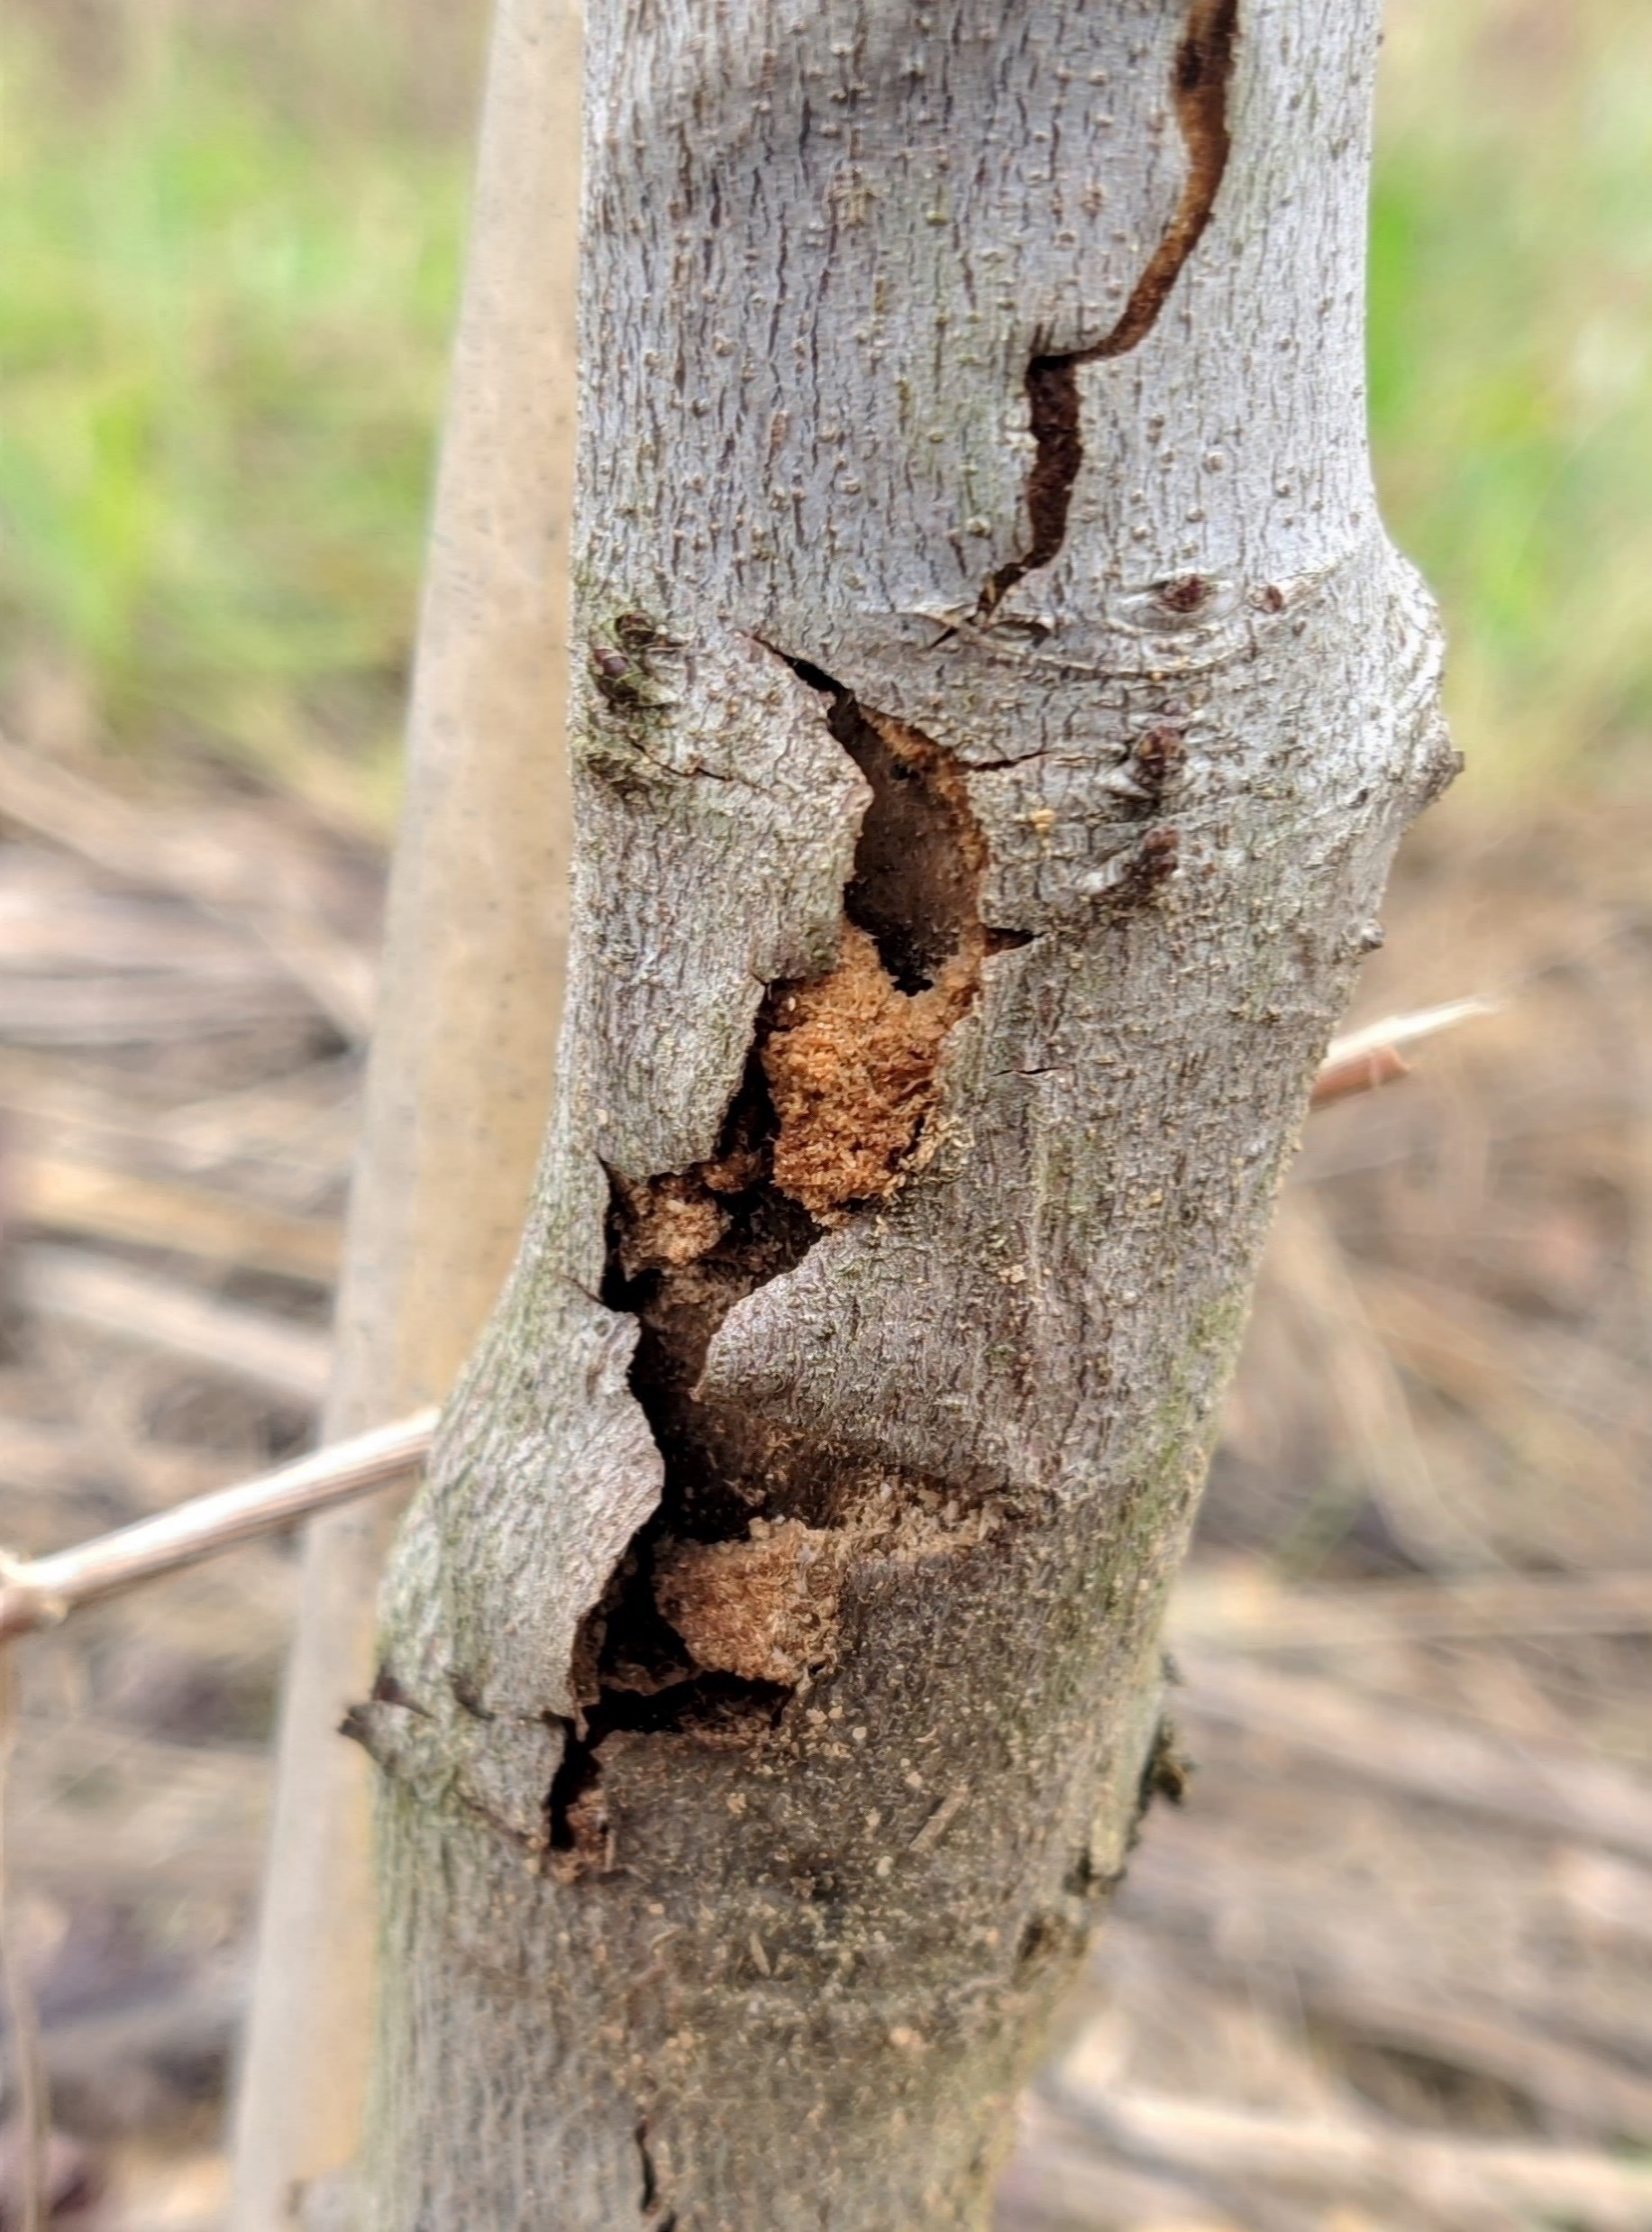
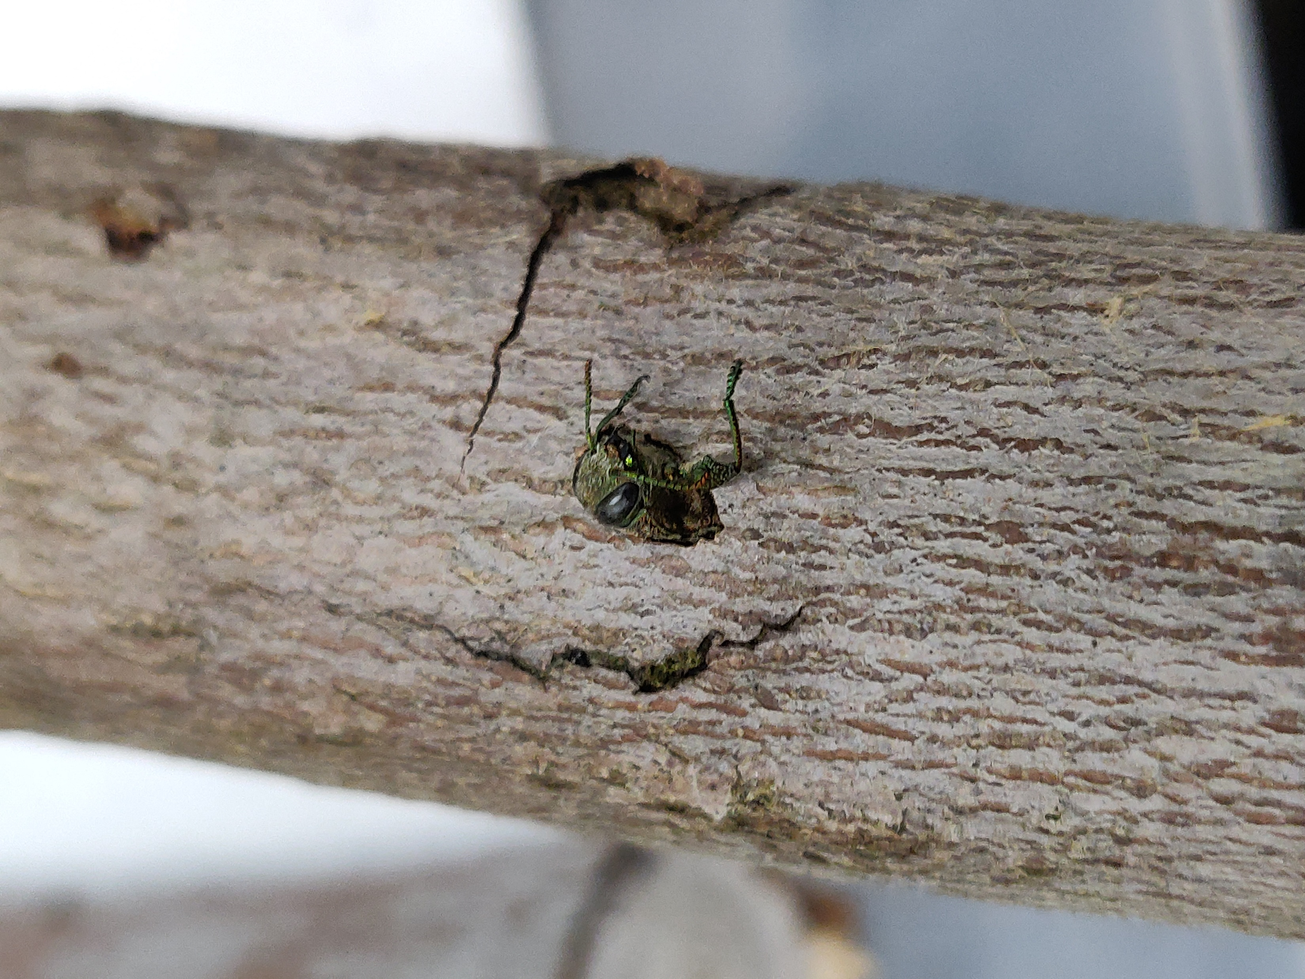
Damage symptoms (first 40 cm)
Photo by Axel Gonzalez
Photo by Nadeer Youssef
Photo by Axel Gonzalez
Photo by Nadeer Youssef
Larvae develop mainly in the cambium and sapwood.
Feeding tunnels packed with frass.
Characteristic “D” shape hole after emerging.
Adults are metallic olive-gray to brown with oval shape

Slide 6




The imidacloprid insecticides are the standard treatment for FHAB.
The seasonality of adult borer flights and egg deposition.
Issues with insect resistance.
Increased demand for organic and sustainable production.
They are broad spectrum products that kill beneficial insects at the same time.

Slide 7
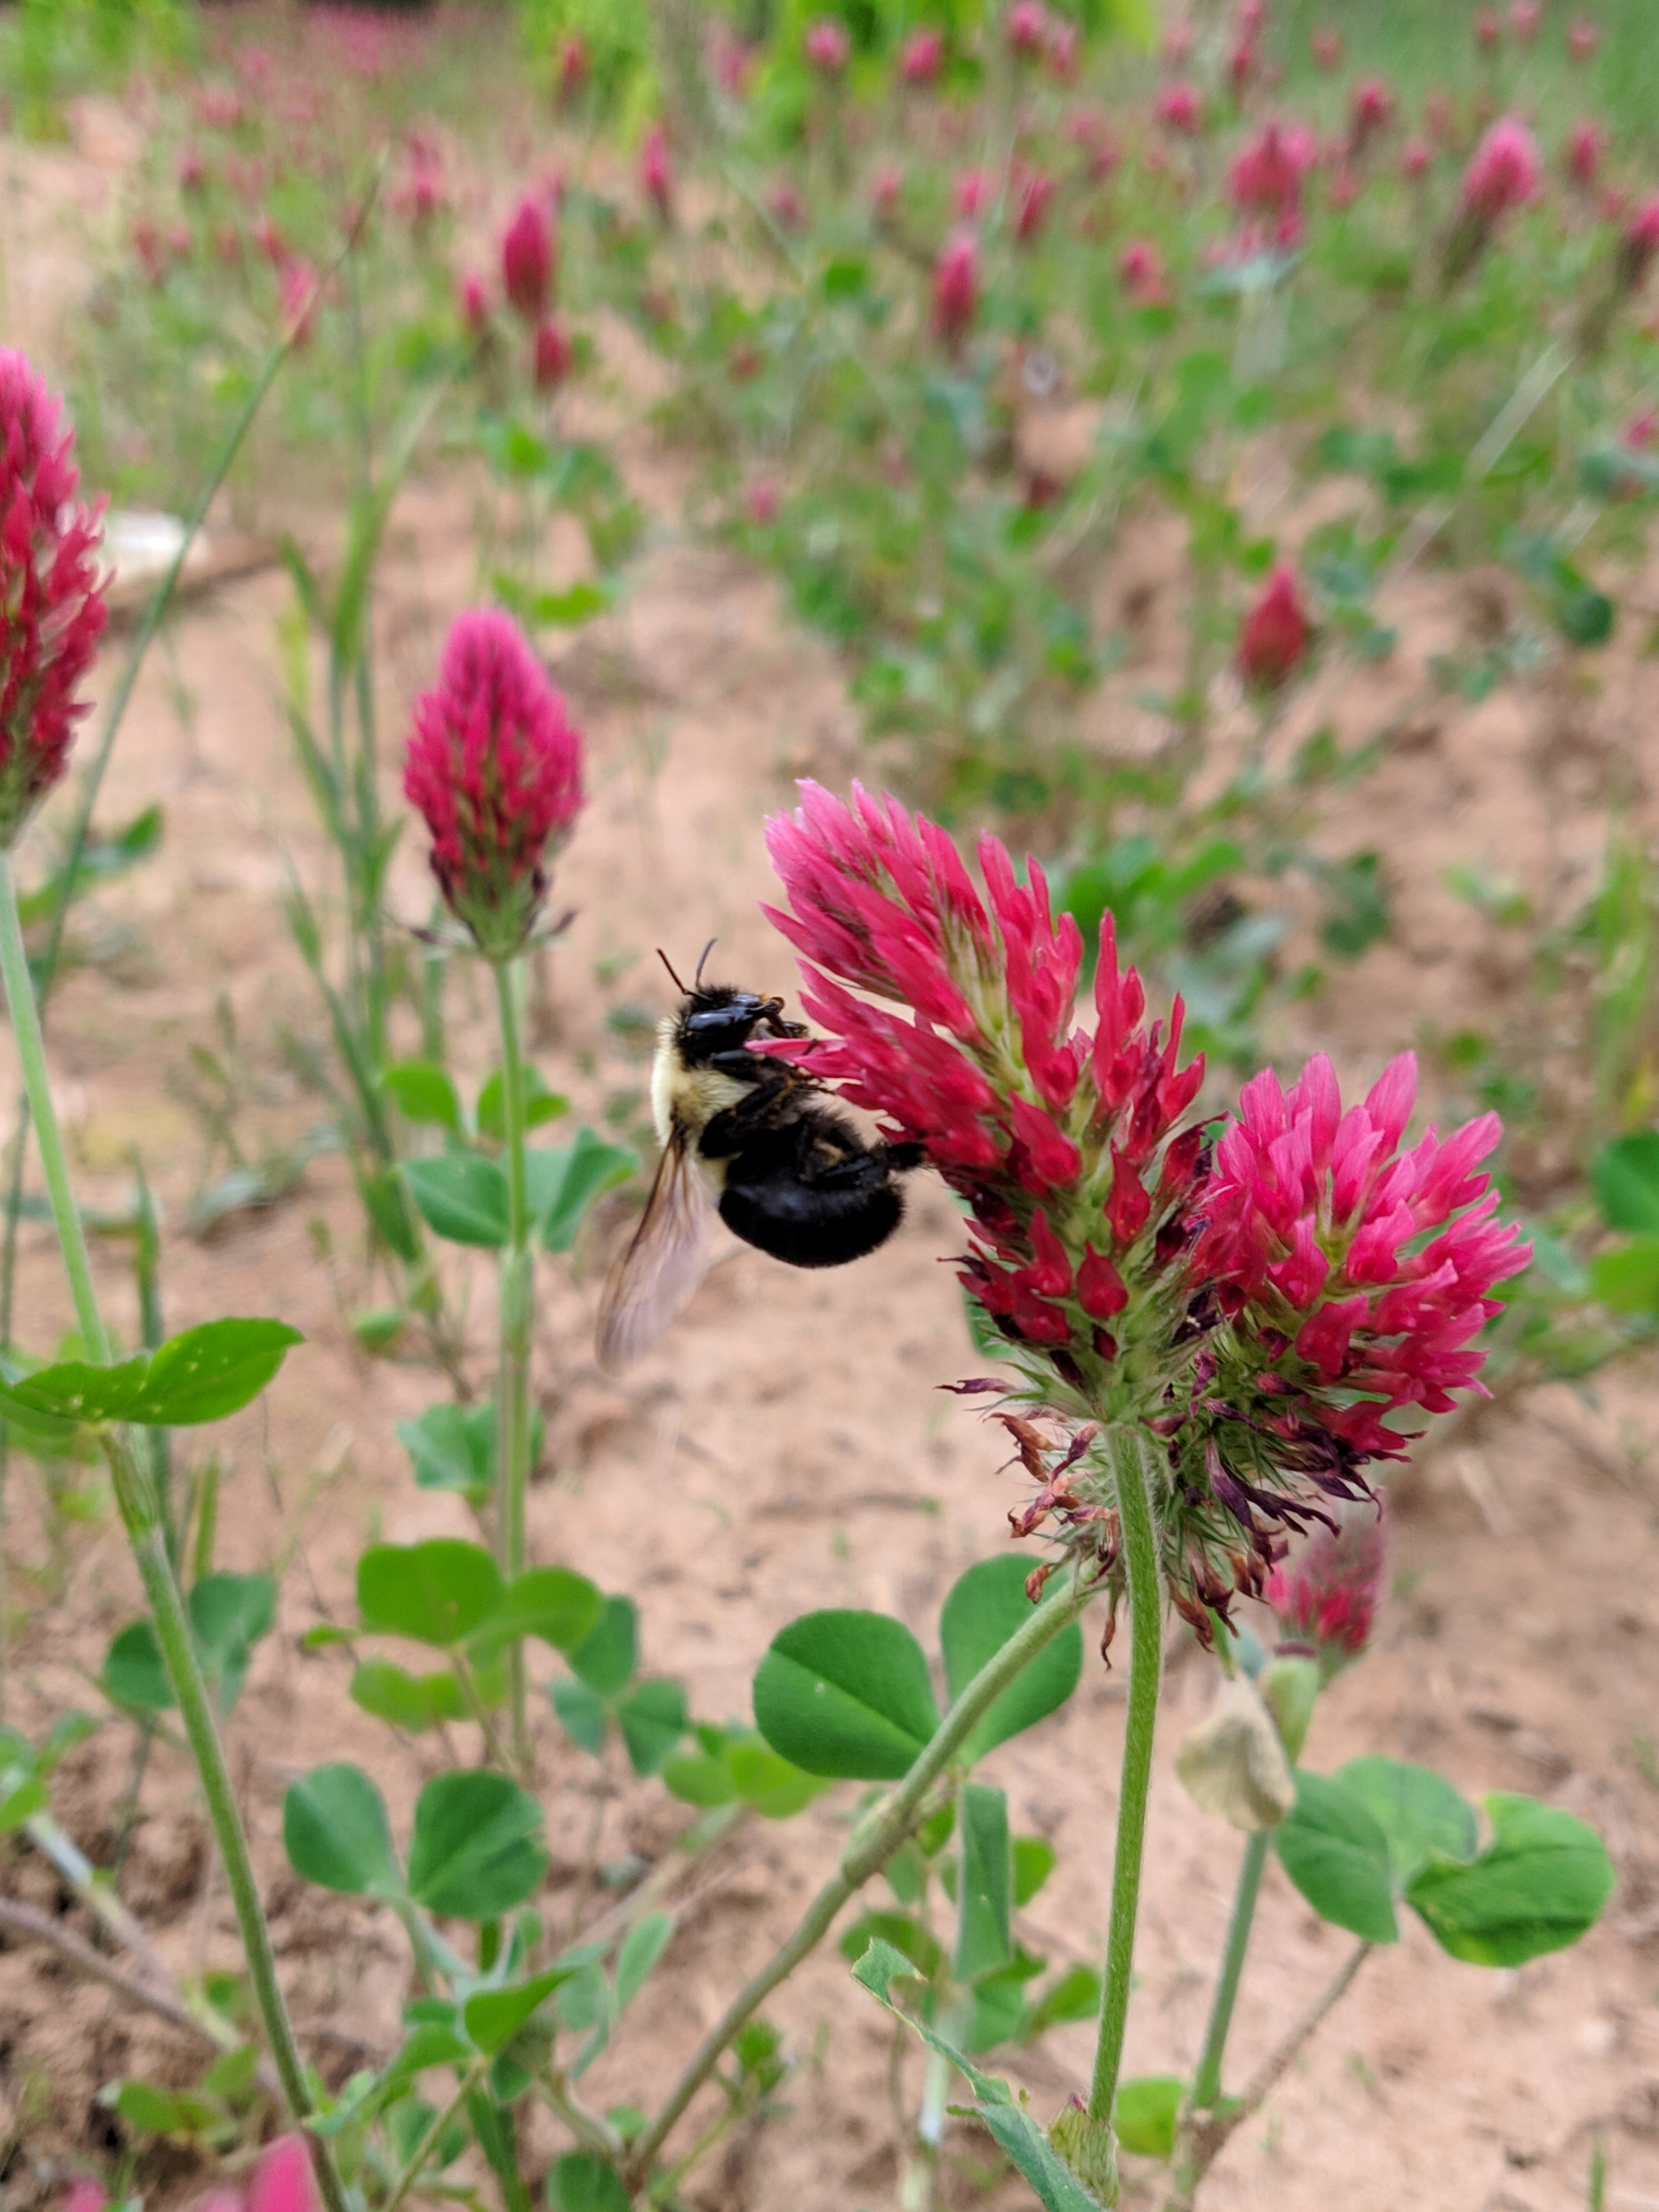
Cover Crops in Nursery Production
In experiment conducted by Nursery Research Center in McMinnville Tn, shows that the usage of winter cover crops such as rye (Secale cereal L.), Wheat (Triticum aestivum L.), clover (Trifolium spp.), vetch (Vicia spp.), and other crops in red maple production can reduce the oviposition sites for the flatheaded appletree borer (Dawadi, Oliver, O’Neal, & Addesso, 2019).

Slide 8
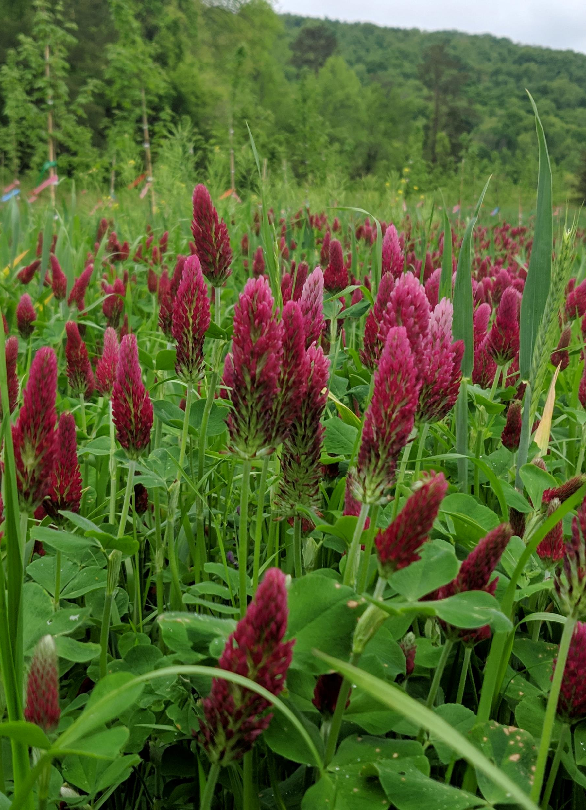
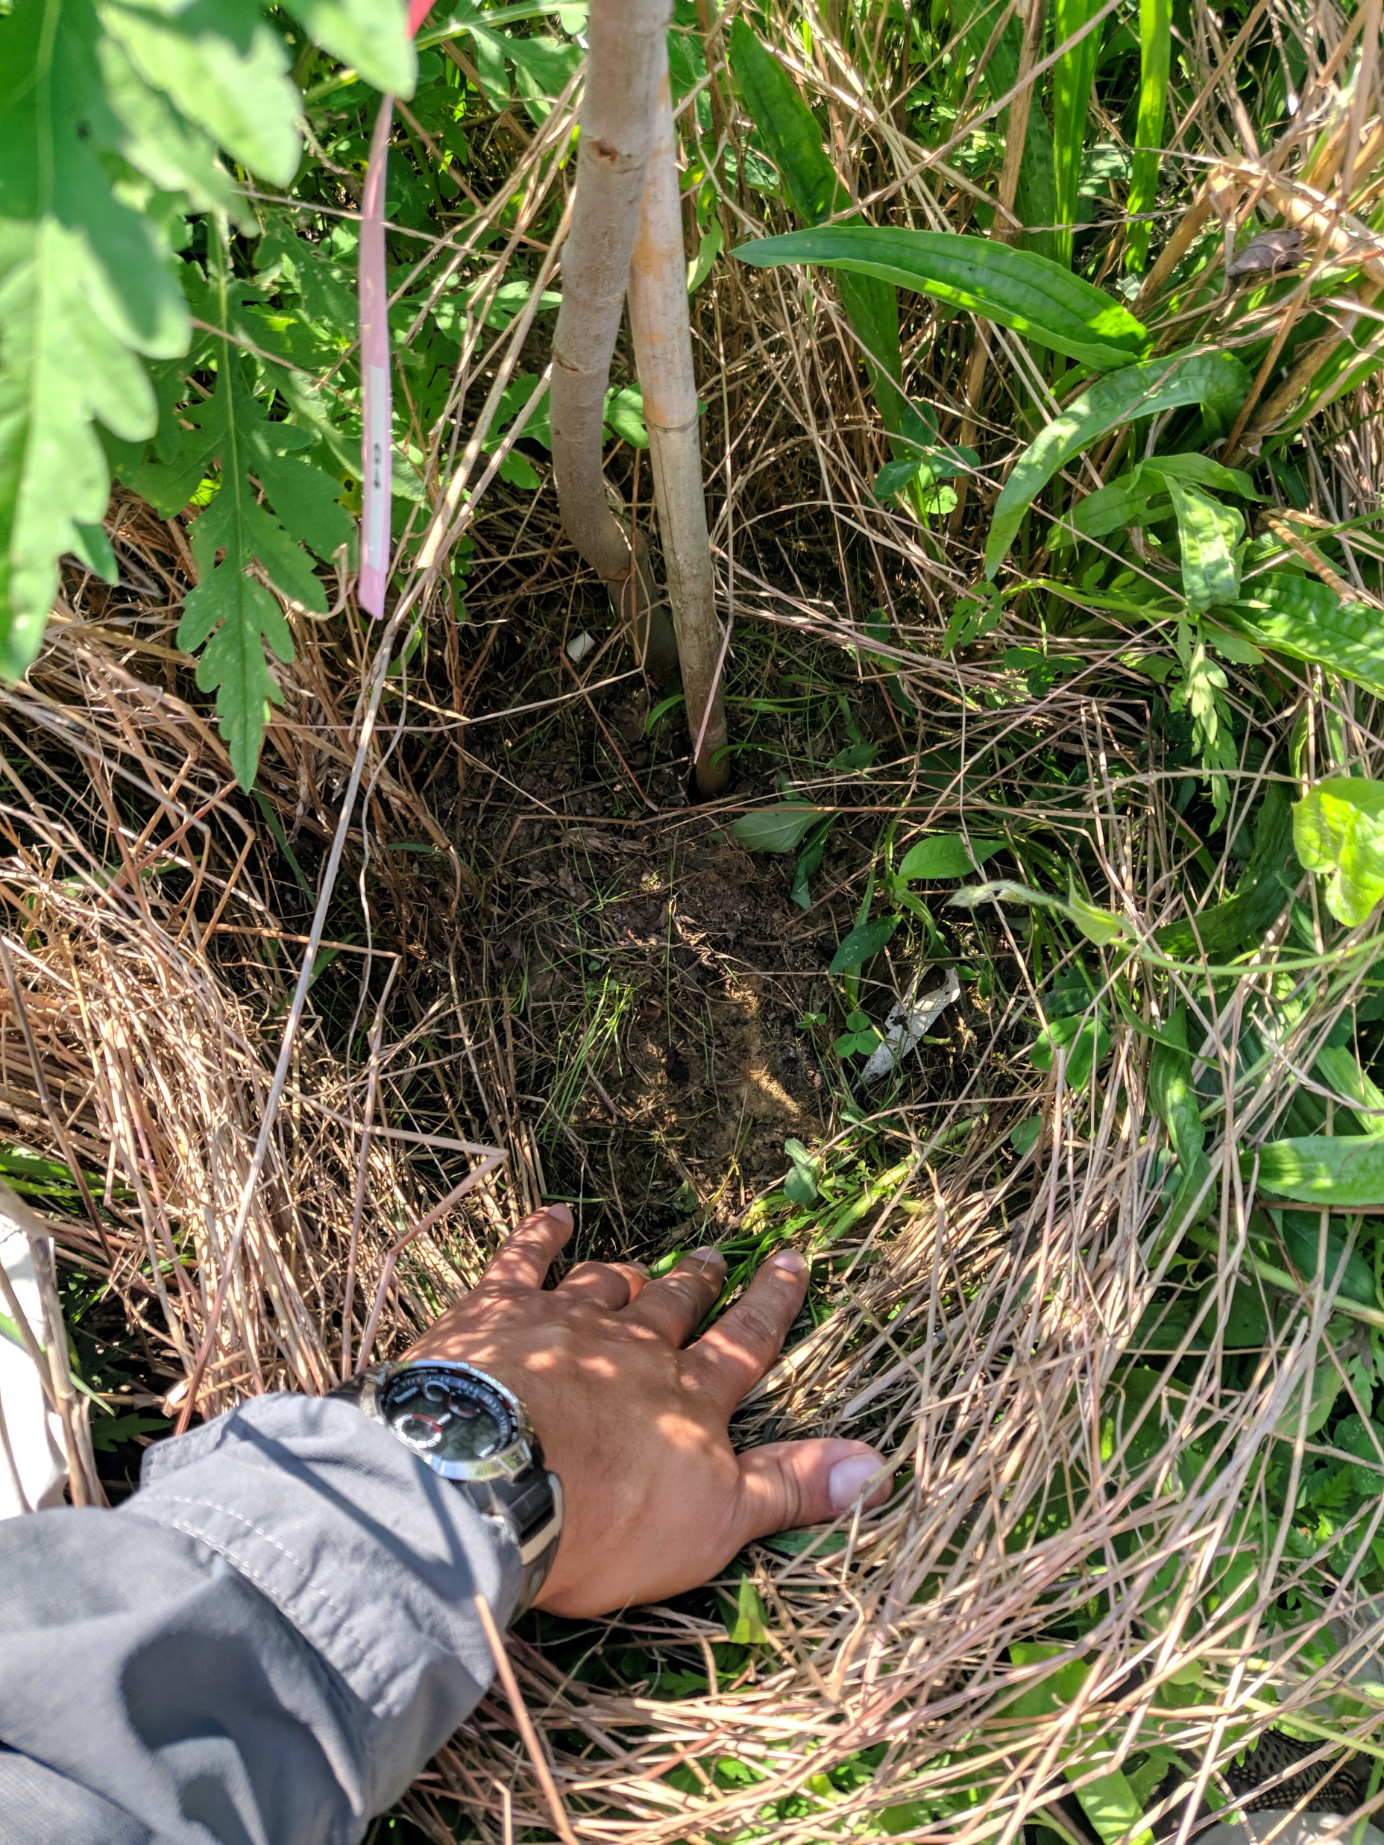
Winter Cover Crop
Tolerate adverse environmental conditions.
Fast seed germination and emergence period.
Low cost of establishment.
Crimson clover (Trifolium incarnatum L)
Winter wheat (Triticum aestivum L.)

Slide 9
Study Design (2015-2017)
Four treatments:
1. Herbicide + no insecticide (HerbNoIns)
2. Herbicide + insecticide (HerbIns)
3. Cover crop + insecticide (CoverIns)
4. Cover crop only (Cover)
Four replicates
400 trees
RCB Design
SAS version 9.3; SAS Institute, Cary, NC

Slide 10
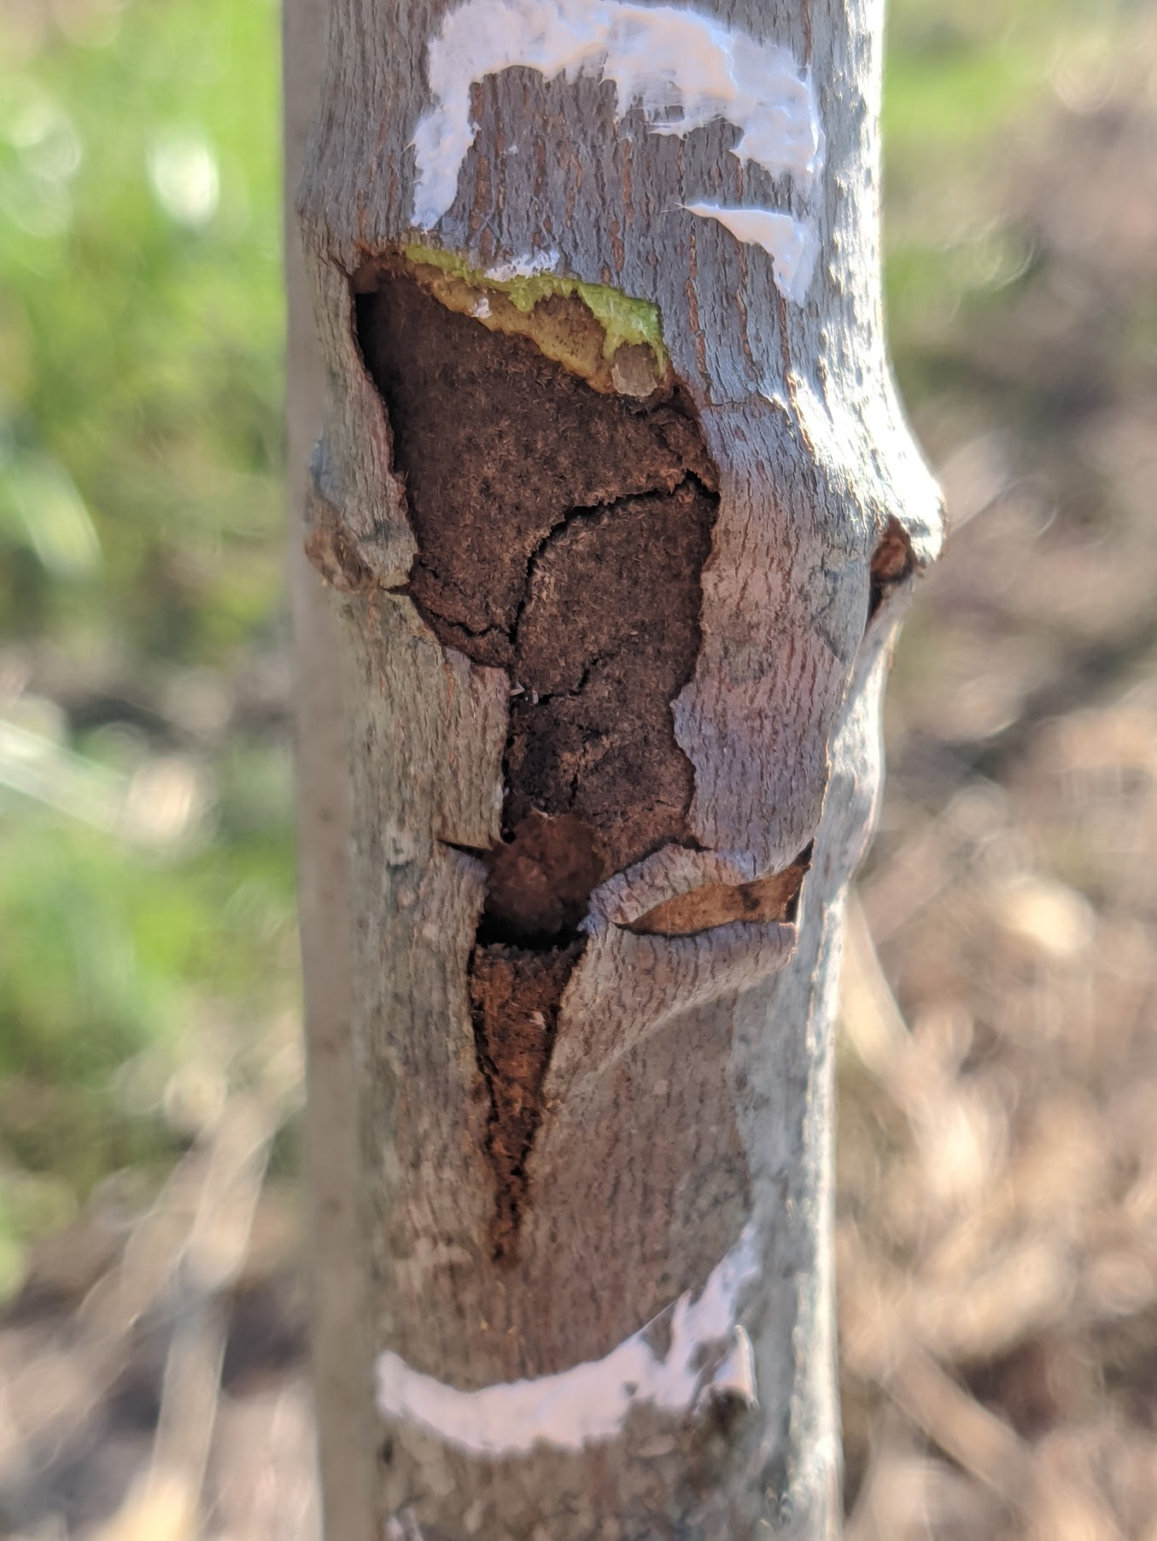
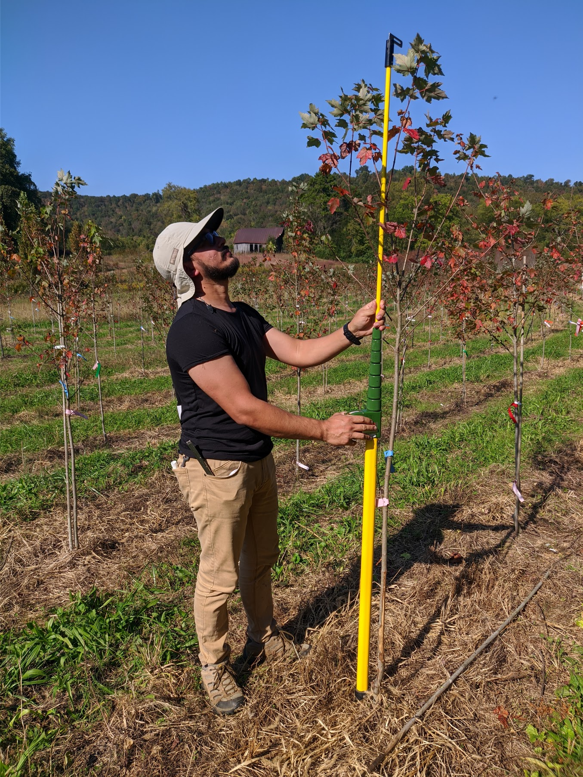
Evaluation Parameters
FHAB Damage Evaluation
Tree Growth Measurements
Trees were rated annually in October and April of the following year.
Tree height and trunk diameter were recorded in September for each year.

Slide 11
Results (2016-2017)
Cover crop treatments prove to reduce FHAB damage on trunk trees with similar results with the current recommended treatment.

Slide 12
Total FHAB Attacks
 | 2016 | 2017 | 2018 | 2019 | Total Attacks
Cover | 1 | 1 | 0 | 0 | 2
CoverIns | 0 | 0 | 0 | 0 | 0
Herb | 21 | 2 | 1 | 1 | 25
HerbIns | 1 | 0 | 1 | 0 | 2

Slide 13
trees in the cover crop treatment showed some growth recovery, however, they remained smaller than trees growth under standard insecticide and herbicide production practices for all four years (24% smaller trunk diameter, 18% shorter).
Final Caliper 2017
Final Diameter After 4 Years
Final Height 2017
Final Height After 4 Years

Slide 14
Tree Height Growth Over Years
 | Height 2015 | Height 2016 | Height 2017 | Height 2018 | Height 2019
Cover | 153.72 | 161.93 | 219.21 | 289.12 | 389.96
CoverIns | 157.23 | 167.82 | 224.29 | 285.61 | 375.78
HerbIns | 155.74 | 193.63 | 305.7 | 378.57 | 473.99
HerbNoIns | 153.03 | 221.02 | 276.11 | 343.04 | 440.79
 | Height % Growth 2015-2016 | Height % Growth 2016-2017 | Height % Growth 2017-2018 | Height % Growth 2018-2019
Cover | 5 | 35 | 32 | 35
CoverIns | 7 | 34 | 27 | 32
HerbIns | 24 | 58 | 24 | 25
HerbNoIns | 44 | 25 | 24 | 28

Slide 15
Tree Caliper Growth Over Years
 | Caliper 2015 | Caliper 2016 | Caliper 2017 | Caliper 2018 | Caliper 2019
Cover | 1.13 | 1.54 | 2.28 | 3.56 | 5.18
CoverIns | 1.13 | 1.45 | 2.31 | 3.6 | 5.17
HerbIns | 1.12 | 2.29 | 3.93 | 5.3 | 6.7
HerbNoIns | 1.28 | 2.56 | 3.6 | 4.97 | 6.5
 | Height % Growth 2015-2016 | Height % Growth 2016-2017 | Height % Growth 2017-2018 | Height % Growth 2018-2019
Cover | 36 | 48 | 56 | 46
CoverIns | 28 | 59 | 56 | 44
HerbIns | 104 | 72 | 35 | 26
HerbNoIns | 100 | 41 | 38 | 31

Slide 16
Conclusion
The results for the tree growth reinforce the previous data collected in 2016 and 2017, suggesting that the presence of cover crop will reduce tree growth.
Data collected in 2019 on FAB hits by treatment indicated that cover crop at the base of the trunk was effective at reducing FAB attacks.
Additional management techniques will be required to mitigate the growth disparities between treed grown with cover crops and standard methods.

Slide 17


Acknowledgements
Thanks to the Addesso Lab for assistance
Paul O’Neal
Victoria Deren
Vivek Ojiha
Millan Panth
Megan Winkle
Faith Womack

Slide 18

Questions?

