Slide 1
Winter Feeding Strategies in Drought Years
Kim Mullenix, Ph.D.
Extension Beef Cattle Systems Specialist/Assistant Professor
Auburn University

Slide 2
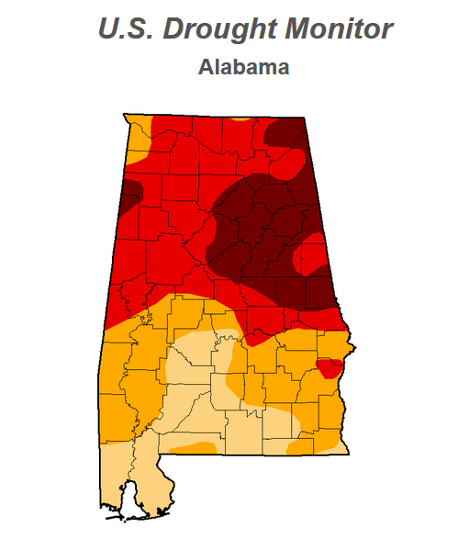

Outline
Five Keys
  Hay Management
  Supplemental Feeds
  Alternative Feedstuffs
  Mineral Management
  Know the Limitations
Notes:
Updated Map Can Be Found at: http://droughtmonitor.unl.edu/Home/StateDroughtMonitor.aspx?AL

Slide 3
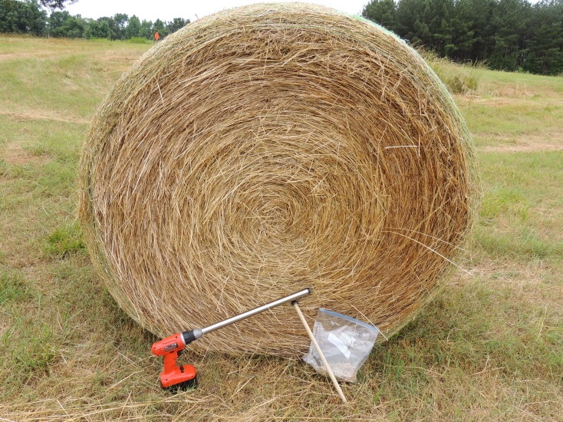
Hay Management
Match Hay to Cattle Needs
  Nutrient requirements
    Weight
    Class
    Stage of Production
Conditions
Forage nutritive value
Helps determine if supplementation is needed

Slide 4
Hay Management - Quality
Dry matter
Total digestible energy
Crude Protein
Fiber
Minerals
Nitrates (nitrate-nitrogen, ppm)
Notes:
Neutral detergent fiber can be related to forage intake, 120/%NDF will provide an estimate of expected forage DMI
Acid detergent fiber can be related to forage digestibility
Nitrates can be reported as either nitrate-nitrogen or nitrate ion. The Auburn lab reports this in the concentration of nitrate-nitrogen present in the plant.

Slide 5
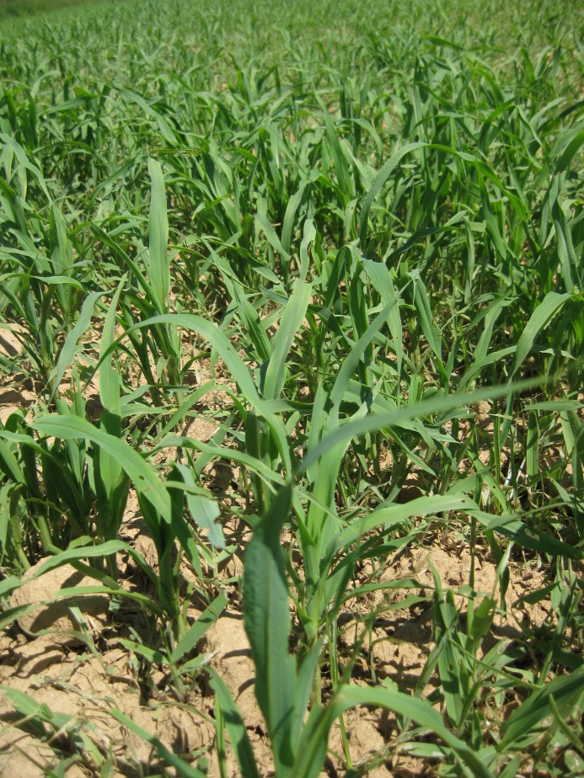
Hay Management
Nitrate Concerns
Occurs under conditions of plant stress:
  Low soil moisture
  High temperatures/humidity
Heavily fertilized summer annuals, bermudagrass, Johnsongrass are most common suspects
Test forages
Remember: Nitrates may remain in stored forages

Slide 6
Hay Management - Quality
Nitrate Nitrogen (NO₃-N), ppm | Nitrate Ion (NO₃), ppm | Level of Risk
0 to 1,500 | 0 to 6,500 | Generally safe
1,500 to 5,000 | 6,500 to 22,000 | Limit to ½ of DMI
5,000 + | 22,000 + | Toxic – Use no more than 15% of total ration
*A sample that contained 1,000 ppm NO₃-N would contain 4,430 ppm NO₃
Nitrate-NO₃ ₌ 4.4268 x Nitrate-N (mg/L)

Slide 7
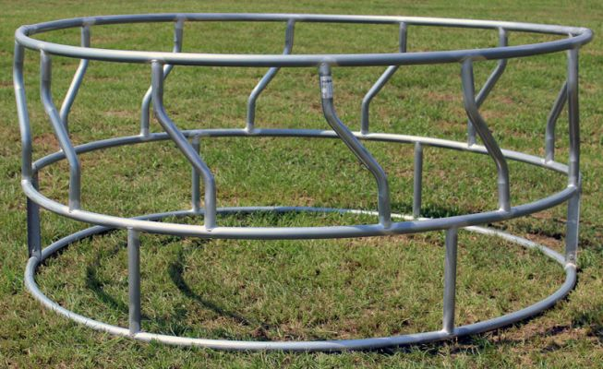
Hay Management
Manage Waste
  Use a feeder
    Open or cone style ring, cradle, trailer
  If unrolling, only unroll enough that can be used in a day

Slide 8
Hay Management
Conditions
Adequate forage nutritive value
  At least 52% TDN and 8% CP
Already in good body condition
Works best with dry cows
Limit Feeding
  Can reduce intake by 20 to 25%
  Limiting the time animals have access to hay or the amount of hay provided
    Six hours per day

Slide 9
Hay Management
Limit Feeding
  Reduced intake, reduces rate of passage in rumen
  More time digesting = increased use of forage
  Cows more aggressive about eating hay, less waste

Slide 10

Hay Management
Logistics
  Use a ‘sacrifice’ paddock
  May have multiple ones in large operations
  500 to 800 sq feet per pair – drylot
  Conditions: Level, well-drained area
Sacrifice paddock

Slide 11
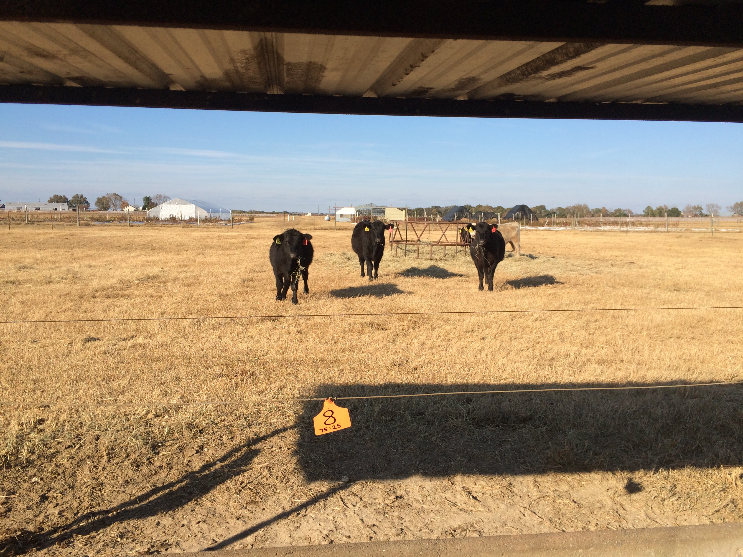
Hay Management
Area needed:
  700 square feet per pair
  30 cow-calf pairs
  21,000 sq ft /43,560 sq. ft. per acre
  0.5 acre – minimum

Slide 12
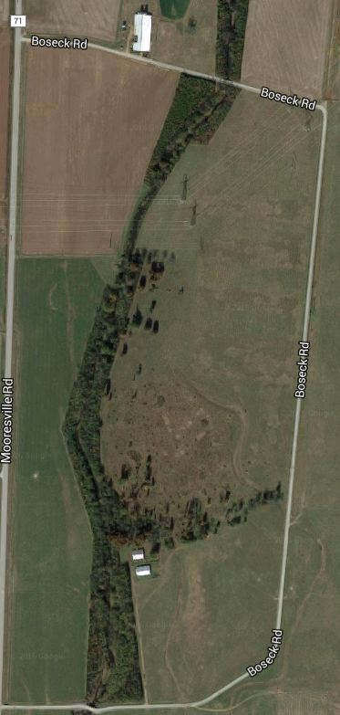
A plan for now and one for later
Pick one and shut the gates!
Pasture 1
Pasture 2

Slide 13
Outline
Five Keys
  Hay Management
  Supplemental Feeds
  Alternative Feedstuffs
  Mineral Management
  Know the Limitations
Notes:
Updated Map Can Be Found at: http://droughtmonitor.unl.edu/Home/StateDroughtMonitor.aspx?AL

Slide 14
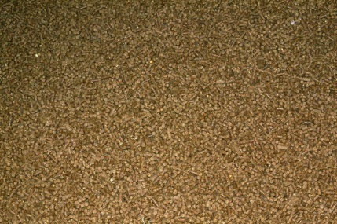
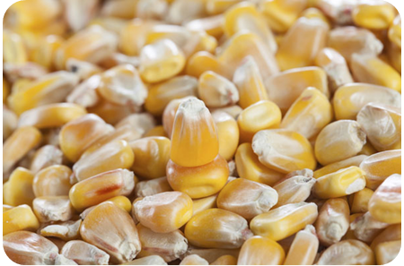
Supplemental Feeds
Common Commodity Feeds
  Corn
  Whole cottonseed
  Soyhulls
  Corn gluten feed
Some Availability
  Dried Distillers Grains
“Complete” Feed Options
  Often bagged mixtures of the above commodities and other byproducts

Slide 15
Corn
Starchy energy supplement
90% TDN, 8.8% CP
5 to 8 lb per head per day – lactating cows
Whole shell vs. Cracked
  Cracked = greater digestibility, may be more appropriate for stockers
  Whole shell may be more economical for brood cows

Slide 16
Whole Cottonseed
90-95% TDN
24% CP
Limitation is fat concentration
  24%
Brood cows can be fed 6 to 8 lb/day
5 lb/day max for growing animals

Slide 17
Soybean hulls
Non-starch, high in digestible fiber
10 to 12% CP, 78% TDN
Loose vs. pelleted
Effective when fed at < 1% BW
  Ex. 12 lbs or less for a 1,200 lb brood cow
  Bloat potential at high levels

Slide 18
Corn gluten feed
CP and TDN
  Variable, Up to 25% CP and 85% TDN
Minerals – Ca is low, S and P are high
  Limit feed to 50% or less of total dry matter intake
  May require additional Ca in mineral

Slide 19
Corn gluten feed
Color matters – yellow to tan
  Usually produced wet, then dried and pelleted
  Excessive heat can decrease feeding value
Heat damaged loads
  Average 18 to 20% CP
  Indigestible protein – 4 to 5%
  13 to 15% CP available

Slide 20
DDGS
Product of ethanol production
87% TDN, 30% CP, 10% fat
    Some sources may have less fat due to improved refining processes
    3 lb DDGS = 2 lb corn + 1 lb soybean meal
High in P
  Feed a mineral low in P, but high in Ca to balance

Slide 21
Common Mixtures
Protein
Cottonseed Meal
Soybean Meal
Common “Mixes”
50:50
Corn gluten feed: Soybean Hulls
OR
Dried Distiller’s Grains: Soybean Hulls
60:20:20
Soybean Hulls: Corn gluten feed: corn
Corn Gluten Feed*
Dried Distiller’s Grains*
Whole Cottonseed*
Energy
Soybean Hulls

Slide 22
Practicality – Economics
Value based on cost per pound of nutrients
Sources
TDN,
%
CP, %
$/ton
$
/pound TDN
Soybean
hulls
78
12
160
0.11
Corn gluten
85
25
150
0.10
feed
Dried
distiller’s
85
30
200
0.12
grains w/
solubles
Whole
90
24
200
0.12
cottonseed
Corn
90
8
168
0.10
Alabama Weekly Feedstuff/Production Cost Report, November 7, 2016
Notes:
Current Prices can be found at: https://www.ams.usda.gov/mnreports/mg_gr210.txt. Updated every Monday.

Slide 23
Cost Per Day
 | Cost per Ton ($/ton) | Cost per Pound ($/lb)
Corn | 168 | 0.08
Soybean hulls | 160 | 0.08
Corn gluten feed | 150 | 0.08
50:50 SH:CGF | 155 | 0.08
Whole cottonseed | 200 | 0.10

Slide 24
Cost per Day
1,200 lb lactating cow
 | Cost per Day (Supplement Only) | Cost per Day (Hay + Supplement)
10 lb Soyhulls | $0.80 | $2.80
8 lb 50:50 SH:CGF | $0.64 | $2.40
6 lb WCS | $0.60 | $2.52
8 lb ‘Complete’
†Assumes $160 per ton for low quality hay (less than 6% CP), average 25 lb hay needed per day

Slide 25
Supplemental Feeds
Self-limiting supplements
Pros
  Convenience
  Reduced labor
  Can increase forage intake to a point
Cons
  May or may not meet nutritional need (dry vs. lactating)
  OK for source of protein to supplement low to mid-quality hay for dry, pregnant cows
  Not designed to overcome a large deficiency…particularly ENERGY
  ck tanks

Slide 26
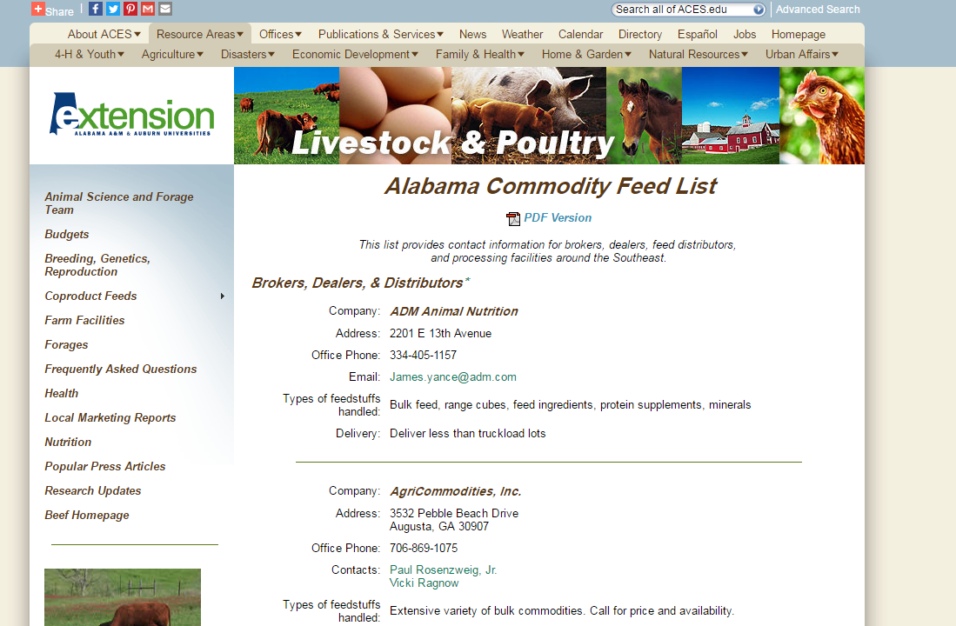
Alabama Commodity Feed List
www.alabamabeefsystems.com

Slide 27
Outline
Five Keys
  Hay Management
  Supplemental Feeds
  Alternative Feedstuffs
  Mineral Management
  Know the Limitations
Notes:
Updated Map Can Be Found at: http://droughtmonitor.unl.edu/Home/StateDroughtMonitor.aspx?AL

Slide 28
Consider Alternatives
Baled crop residues
  Corn
  Peanuts
  Wheat straw
  Soybeans*
Feed value

Slide 29
Consider Alternatives
Gin trash – cotton
  Boll residues, leaves, stems, and lint
  Bulky, high fiber, low energy
  Can be decent quality depending on amount of lint and seed left after ginning
 | Gin Trash | Gin Trash + 3 lb/day corn
Initial BW, lb | 1215 | 1215
Final BW, lb | 1198 | 1217
ADG, lb/d | -0.30 | +0.04
Initial BCS | 4.9 | 4.6
Final BCS | 4.3 | 4.4
Gin trash intake, lb/d | 32 | 33
*Adapted from Stewart et al., 2010
Notes:
*Note: Feed costs were calculated based on a cost of $15 per ton for gin trash and $175 for corn

Slide 30
Consider Alternatives
Gin trash
    55% TDN, 11% CP on average, usually lower
Cost
  Usually very cheap or sometimes free
  Be cautious as prices are going up – more comparable to hay

Slide 31
Consider Alternatives
Feeding seed wheat
  Projected conditions remain dry
  Plant or feed?
    60% TDN, 14% CP
    Hard seat coat = decreased digestibility
    15 to 20% of diet max

Slide 32
Outline
Five Keys
  Hay Management
  Supplemental Feeds
  Alternative Feedstuffs
  Mineral Management
  Know the Limitations
Notes:
Updated Map Can Be Found at: http://droughtmonitor.unl.edu/Home/StateDroughtMonitor.aspx?AL

Slide 33
Mineral Management
Consider the use of an ionophore
  Feed additive – improves feed efficiency
  Acts like antibiotic – selects for more efficient microbes in the rumen
  Improves feed efficiency by up to 10%
  Useful for cows and growing calves

Slide 34
Mineral Management
Table 1. Cost of mineral supplementation with an ionophore.
 | Cost per Bag (50 lb) | Cost per Head ($/hd/d)†
Complete mineral + ionophore | $19 | $0.03
†Assumes intake of 4 ounces per head per day

Slide 35
Mineral Management
Feed a complete mineral
    Not just a trace mineral
    Ingredients to look for: Ca, P, Mg, K, S, Cu, Zn, Se
No winter grazing = No Hi-Mag
  1 to 4% sufficient

Slide 36
Mineral Management
Hot mixes are not appropriate under limited forage conditions
  White salt (sodium chloride) plus the addition of a protein supplement, often cottonseed or soybean meal, often a 50/50 mix
  Used to stimulate forage intake

Slide 37
Outline
Five Keys
  Hay Management
  Supplemental Feeds
  Alternative Feedstuffs
  Mineral Management
  Know the Limitations
Notes:
Updated Map Can Be Found at: http://droughtmonitor.unl.edu/Home/StateDroughtMonitor.aspx?AL

Slide 38
Don’t Try to Fit a Square Peg into a Round Hole
A “good deal” can sometimes be costly!
Cost
Fit for the Operation
Nutritional Value
Time

Slide 39
Practicality
Availability
Price
Dry Matter
CP and TDN*
Transportation and Storage
Time
Effort
Need

Slide 40
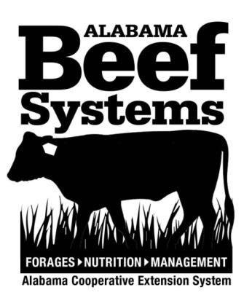

ACES Resources
Your Local Animal Science and Forage Agent
Websites
  aces.edu/drought
  aces.edu/beefsystems

Slide 41
Questions?

Slide 42
Labor and Frequency of Supplementation
Depends largely on the supplement type, weigh with labor availability
Corn and DDGS (Kunkle et al. 2000)
  Daily > Alternate Days
  Alternate days: reduced forage digestibility, changing ruminal pH, decreased total intake
  - Candidates: Corn, DDGS

Slide 43
Labor and Frequency of Supplementation
Coproduct feeds:
  50:50 Soyhulls and Corn Gluten Feed
  3x week will not reduce performance (Drewnoski and Poore, 2012)
    0.75% of animal body weight
    Forage DMI reduced
    Total digestible energy intake = same
  Implications: Every other day is OK

Slide 44
Labor and Frequency of Supplementation
Whole cottonseed
  Tends to be more self-limiting (due to fat %)
  Best when hand-fed or top-dressed onto hay or other feeds
    0.5% of body weight per day
  Can be fed “free-choice” with caution ($$$)
    Often underestimate the amount of WCS cows will consume
    10 – 12 lb per day in a GA study (Hill et al., 2006)
    Could be cost prohibitive, also may negatively impact forage use, health, etc.

Slide 45
Labor and Frequency of Supplementation
Coproduct feeds:
  More complex mixtures – “3 or more”
    Less work has been done on frequency of supplementation in these mixtures
    Implications: Every day until proven otherwise

