Slide 1
Evaluation of biochar for biogas desulfurization in dairy manure digesters
Abhinav Choudhury, PhD Candidate, abhinavc@terpmail.umd.edu
Advisor:
Dr. Stephanie Lansing, Associate Professor, slansing@umd.edu
Department of Environmental Science and Technology, University of Maryland, College Park, MD

Slide 2
Outline
My Journey and Dissertation
Introduction
  Anaerobic Digestion and Biogas Composition
  Hydrogen sulfide and its effects
  Management of hydrogen sulfide in biogas
  What is biochar?
  Biochar as an additive for hydrogen sulfide reduction
Objectives and Research Questions
Methods
  Lab scale anaerobic digester tests
  Biochar characterization tests
Results and Discussion
  Effect of biochar concentration
  Effect of biochar particle size and total surface area
  Effect of iron impregnation
Conclusions
Acknowledgements
Notes:
I will start of with my journey in ENST and how my dissertation took shape with all the different projects that I have been involved in. Then I will give an introduction on AD and biogas, h2s and its management, and then focus a bit on biochar and its role in my dissertation. We will discuss my the objectives and research questions for the work that I will be presenting, with the methods for the experiment and how we characterized the biochar/or investigate the properties of the biochar. Then we will talk about the results for the 3 different parameters that we tested and end with the conclusions and the acknowledgements

Slide 3

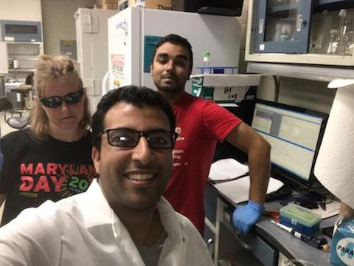

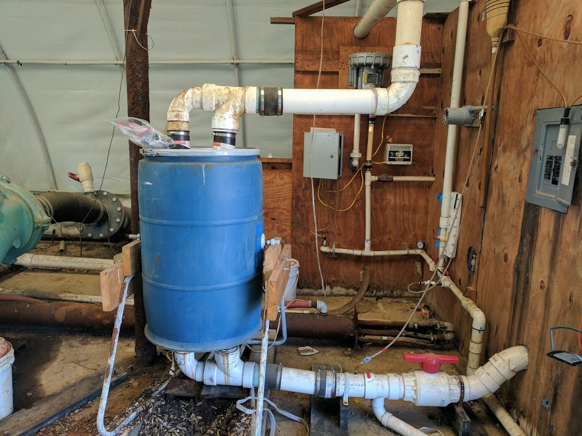
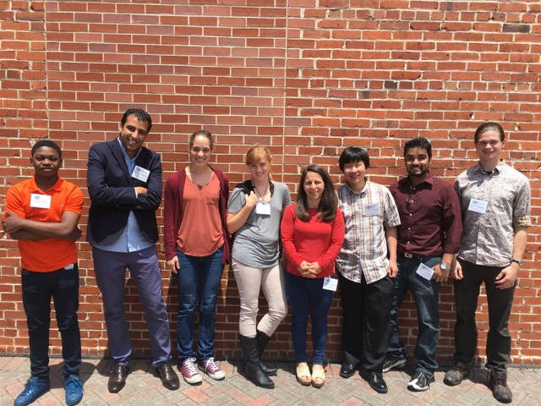
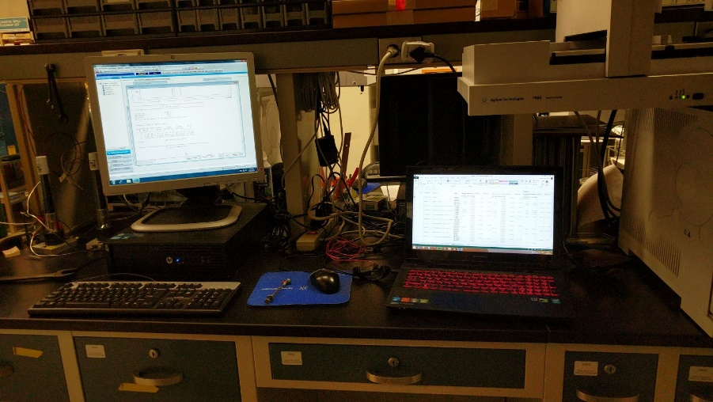
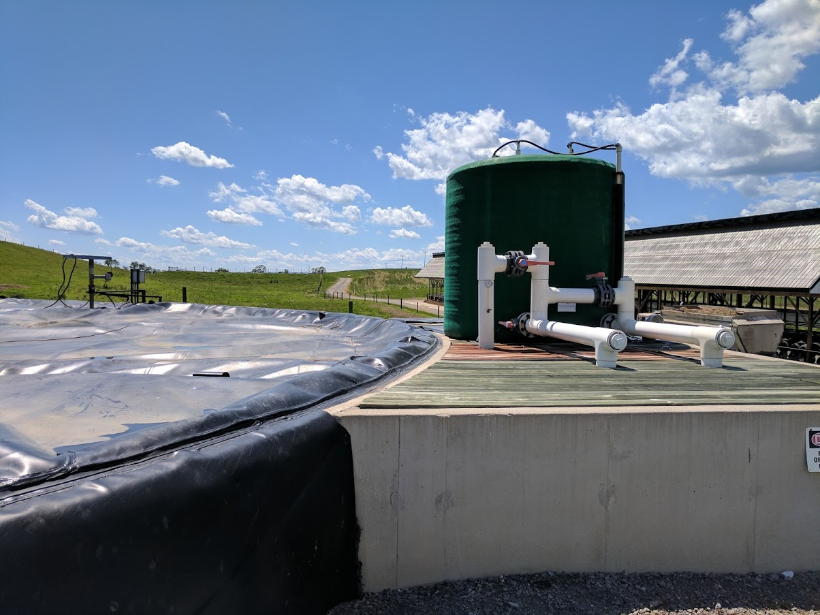
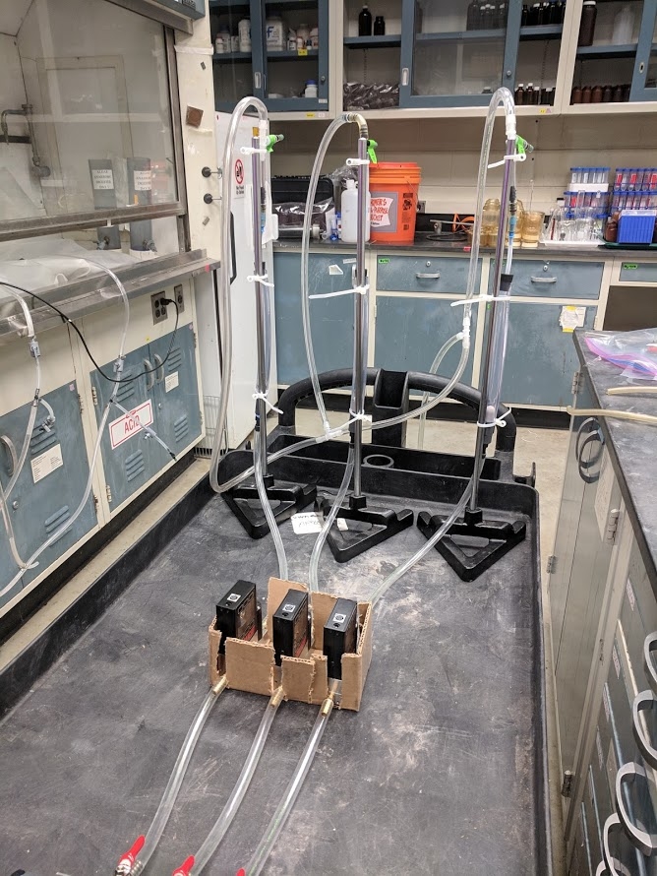
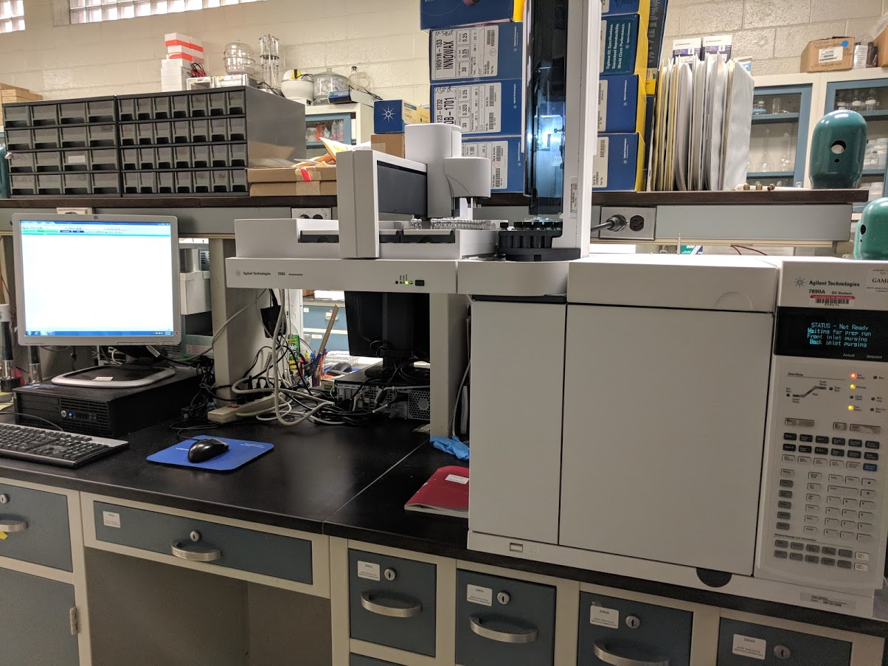
My Journey
Notes:
Its been 4 years here in this department, 3 years 9 months to be exact. From visiting farms in MD, PA and NY, communicating with different farmers about their AD systems, and playing with cute baby cows (and covered in manure during field trips) , to spending hours and hours in lab designing my own experiments and setups and running GC and then going to several conferences to present the research that I have done, its been a very interesting ride.

Slide 4
My Dissertation
Chapter 1: Introduction
Chapter 2: Methane and Hydrogen Sulfide Production from Co-digestion of Gummy Waste, Food Waste and Dairy Manure
Chapter 3: Evaluation of hydrogen sulfide scrubbing systems for anaerobic digesters on dairy farms
Chapter 4: Impact of biochar addition on hydrogen sulfide production from anaerobic digestion
Chapter 5: Enhancing adsorption of hydrogen sulfide through modification of biochar surface
Chapter 6: Performance monitoring and life cycle assessment of a fluidized bed poultry litter combustion system
Chapter 7: Conclusions
Notes:
I will have 5 main chapters in my dissertation, not including the intro and the conclusions. My work started when I was assigned to a 2 year NESARE project where we monitored different h2s scrubbing/removal systems that were available in the market to understand its cost, efficiencies and management protocols on farms. This was how I developed a very good working relationship with the farmers we worked with and as a result, they would come to us with their problems. My first project or chapter 2 came about because a farmer we worked with wanted to understand whether it was feasible to add gummy waste into his digester and how it affected methane and h2s. My next chapter focuses on the different scrubbing technologies being used in 4 NE US farms with AD systems, like I already mentioned. One of the primary outcomes of this project was how a some of the scrubbers on farms were not functioning efficiently or how farmers were having trouble managing the systems because the company that sold the system to them went bankrupt so they had no technical service options in case of performance issues. So we decided to come up with alternative solutions that could low cost, and less labor intensive. So for the biochar project, I wrote a grant with Stephanie and managed to get my own research funds. Chapters 4 and 5 are the outcomes of this grant proposal. And for my last year and half, I was funded by an MDA grant where we monitored the performance of a poultry litter fluidized bed combustion system to conduct a life cycle assessment of the process to understand its environmental impacts and benefits. For this presentation, I will focus on Chapter 4 – Impact of ……………

Slide 5
Anaerobic Digestion and Biogas Composition
Compound | Chemical | Range %
Methane | CH₄ | 50-75
Carbon Dioxide | CO₂ | 25-50
Nitrogen | N₂ | 0-10
Hydrogen | H₂ | 0.01-5
Oxygen | O₂ | 0.1-2
Water Vapor | H₂O | 0-10
Hydrogen Sulfide | H₂S | 10-30,000 ppm
Notes:
Biogas consists of Methane, CO2 and H2S and traces of H2O, Ammonia, Hydrogen, etc. CH4 Can vary from 50 – 75 % and H2S can vary from 10 – 30000 ppm, depending on the feed, digester conditions, etc. 10000 ppm is 1% by volume, . Dairy manure between 1000-4000 ppm.

Slide 6
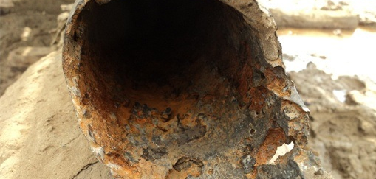
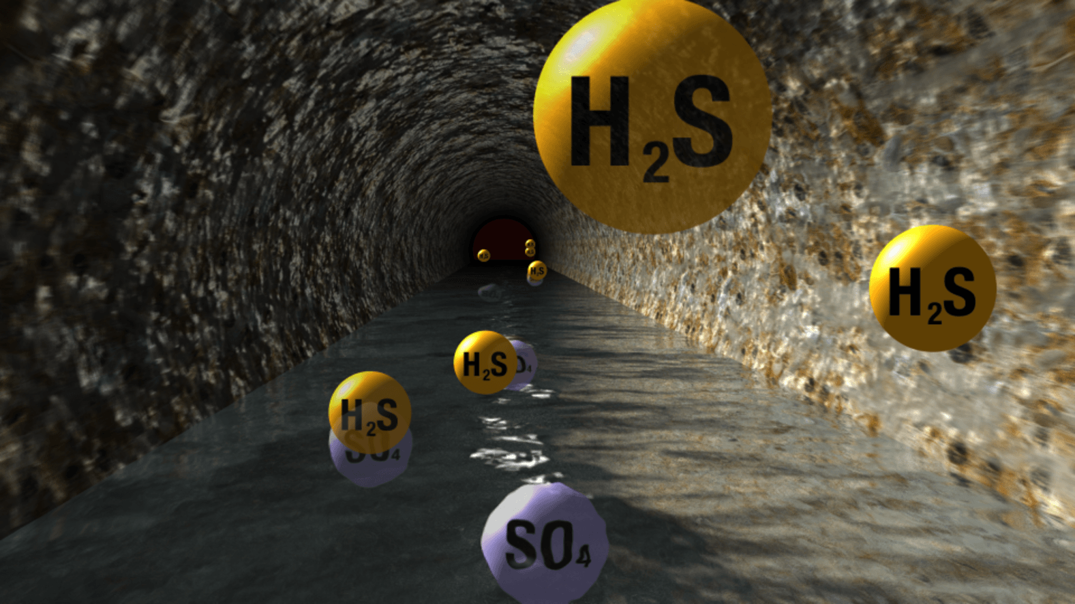
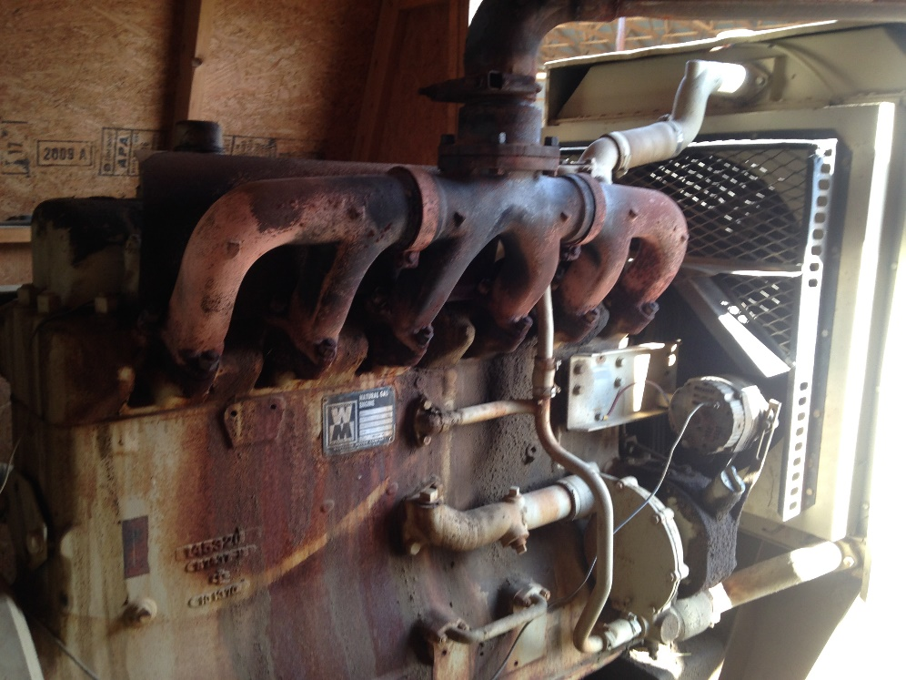
Formation of H₂S and its effects
Reduction of sulfur-containing compounds under anaerobic conditions by sulfate reducing bacteria (SRB) –> H₂S production
H₂S is corrosive and damages pipelines, compressors, engine generator sets (EGS) and gas storage tanks
Corrosion after-effects
Corroded engine generator at a dairy farm
H₂S generated from sulfates in waste water
Notes:
SRB produces H2S from dissolved SO4 in the feed in reducing conditions. It competes with methanogens for the same carbon source and converts sulfates into sulfides, which leads to h2s production. Talk about picture

Slide 7
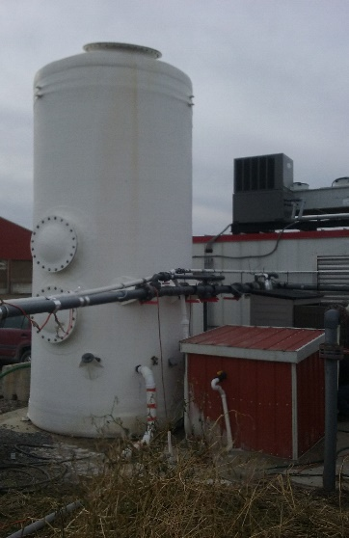
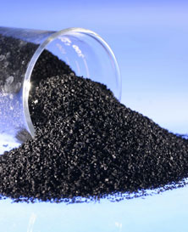
Hydrogen Sulfide Limits and Control Technologies
Technologies | Hydrogen Sulfide Limits (ppm)
Heating (Boilers) and Stirling Engines | < 1,000
IC Engines/ Engine Generator Systems | < 500 (depending on the engine type, it can be < 50 ppm)
Fuel Cells | < 1
Natural Gas Upgrade | < 4 (variations among countries)
Biological Desulfurization
Iron Oxide Scrubbing
Activated Carbon Adsorption
Air Injection/Microaeration
Chemical Addition to the digester
Iron Oxide Scrubber
Biological Scrubber
Activated Carbon
Notes:
Here, we have some limits on H2S for some systems such as boilers for heat production, IC engines, Fuel Cells for electricity production and Upgraded biomethane (which is 99% methane after co2 and h2s removal, commonly seen in Europe and some WW treatment plants in California) and some of the tech that is in use for h2s removal. Talk about farm stories, farmers are great at farming, and experienced farmers that have AD systems on farms have a good understanding on how to operate it but face difficulties when it comes to troubleshooting and managing these systems. Sometimes the cost of service and repair may not be economically feasible.
Biological Desulfurization – Biological process where microbes oxidize h2s into elemental sulfur under low oxygen conditions
Iron Oxide Scrubbing – Chemical process where the sulfur binds to iron. High affinity. This is important because it plays a role in our experiments
Activated Carbon Adsorption – Expensive process not generally used on farms in the US, but adsorption on the microporous surface of AC
Air Injection/Microaeration – Same as biological desulfurization but the process happens inside the digester headspace
Chemical Addition to the digester – Addition of different chemical compounds that can bind and precipitate the dissolved sulfides. Our work described in the following slides comes under this.

Slide 8

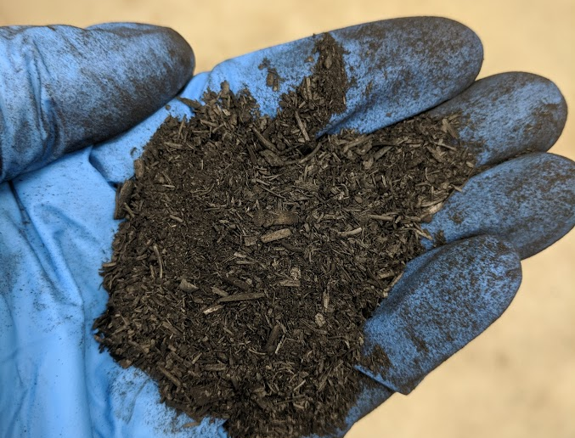
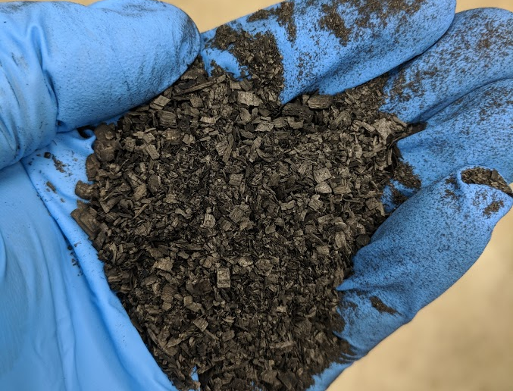
What is biochar?
Biochar is produced by the thermal degradation of biomass under an oxygen-starved environment (pyrolysis) or in a low oxygen environment (gasification)
Biochar is a carbonaceous solid with energy density (18 MJ/kg) similar to pulverized coal
Research has shown that biochar can act as a sorbent for contaminants in water, soil and sediments, improve crop productivity, increase water retention in soils, and enhance carbon sequestration.
Biochar is resistant to microbial degradation, can have surface areas comparable to activated carbon.
Corn Stover biochar (top) and maple biochar (bottom)
Notes:
So biochar is an umbrella term that is used for any and all kinds of biochar, but it is very important to understand that every biochar is different and that’s why we characterize it. We know when we burn a biomass, we get ash, but biochar is produced in conditions without oxygen or with controlled oxygen input. At high temperatures, biomass breaks down and produces syngas, and bio-oil that can be used for energy generation but instead of ash, it also produces a carbon rich microporous by-product, similar to activated carbon, that we refer to as biochar. It has a high energy density and there is a lot of research out there that discusses its benefits and use, such as a sorbent for inorganic and organic contaminants, water retention in soils, act as soil amendment for improved crop productivity, etc.

Slide 9
Biochar as an additive for H₂S reduction
Managing and operating external scrubbing systems require technical expertise and manpower that may be unavailable on smaller-scale farms.
Biochar could be a possible low-cost and less labor intensive solution for H₂S removal, if added directly into a digester
Previous work on direct biochar addition has shown some positive effects on CH₄ production and CO₂ sequestration in waste water sludge digesters
Biochar has also been shown to be comparable or even better than activated carbon at H₂S adsorption from a biogas stream in an external scrubber
Notes:
So, trying to find a solution that can be comparatively low cost, and more manageable for a farmer, we thought about direct biochar addition for h2s removal. Talk about point with Shen research and how there has been no focus on h2s removal using biochar, so there is no research out there about this, but we do know that biochar has been shown to act as a comparable or even better adsorbent for h2s in external biogas scrubbing systems, which is basically a column packed with biochar through with the biogas passes and the h2s gets adsorbed/stuck to the biochar surface and the pores.

Slide 10
Objectives
Investigate the effect of direct addition of two types of biochar on CH₄ and H₂S production in lab-scale anaerobic digestion systems
Research Questions
Does increasing the concentration of added biochar lower the volume of produced H₂S?
Does the biochar particle size and total surface area affect H₂S removal?
Does increasing the iron content in biochar enhance H₂S removal compared to unmodified biochar?

Slide 11
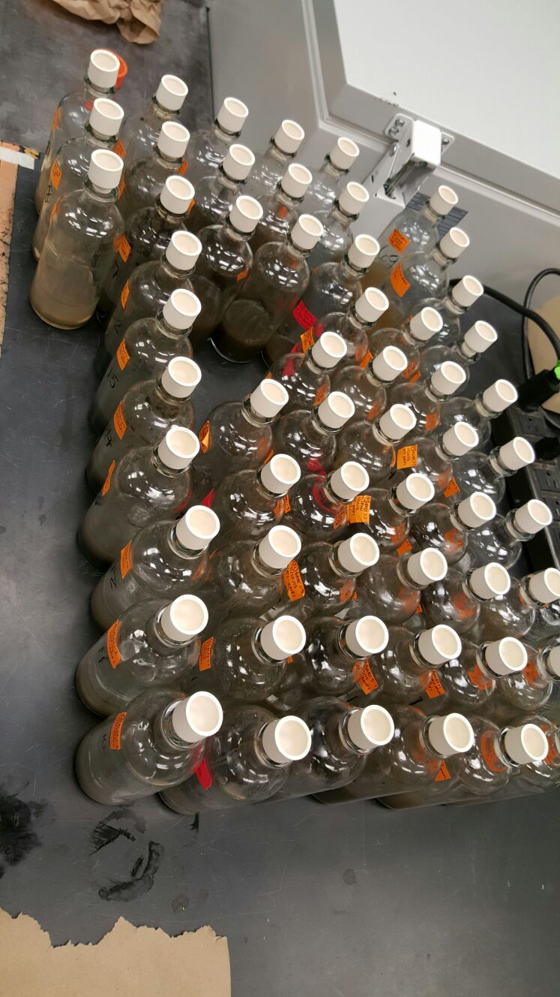
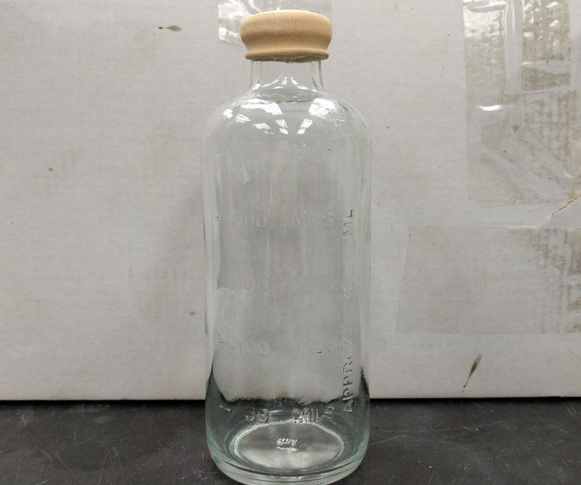
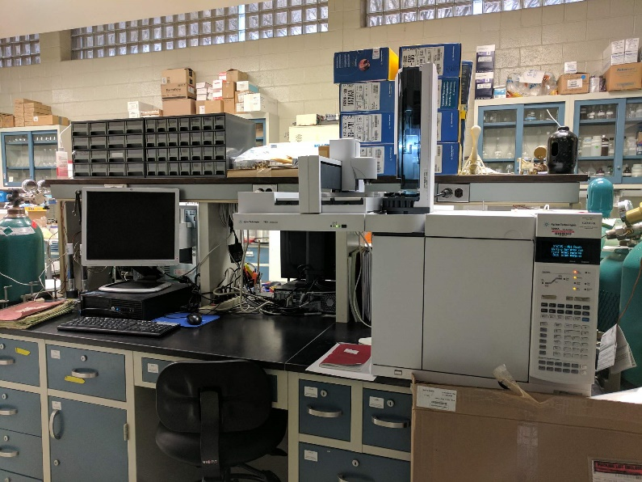
Lab Scale Reactor Tests
Substrate + Biochar
Purge using N₂
Incubate
Measure
Gas Chromatography
Inoculum
Lab Scale reactor bottle
Full set of experimental units
Notes:
Inoculum is basically the effluent taken from a functioning digester that is rich in the microbes that are essential for methane production, and it helps lower the initial start up time for biogas production. Substrate is fresh dairy manure

Slide 12
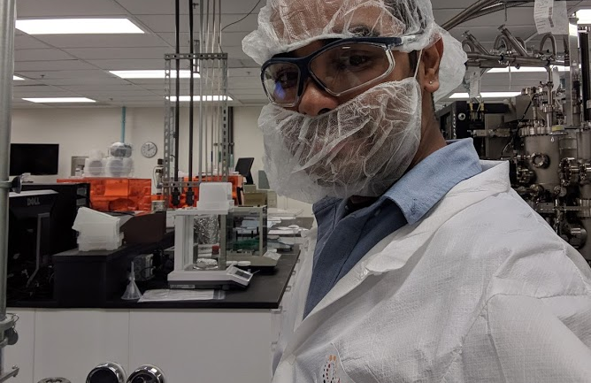
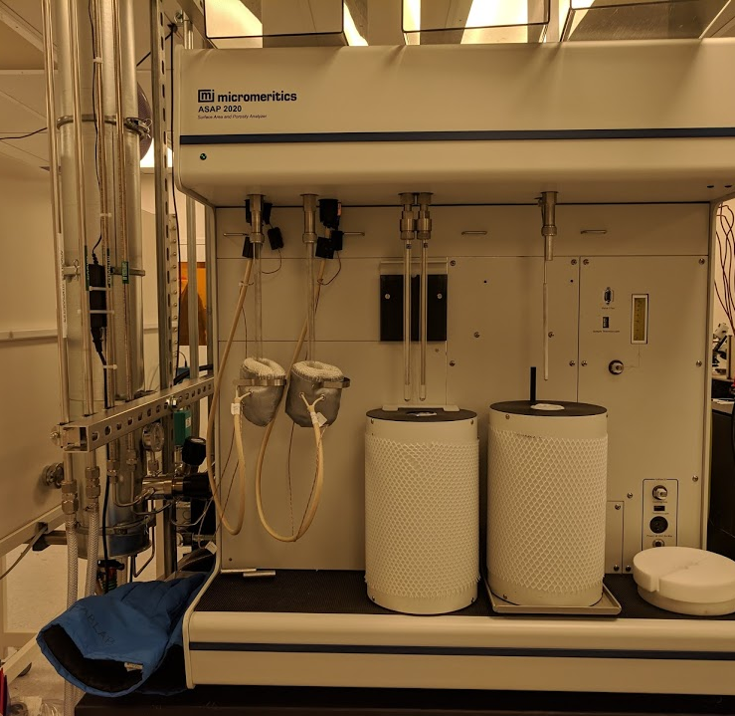
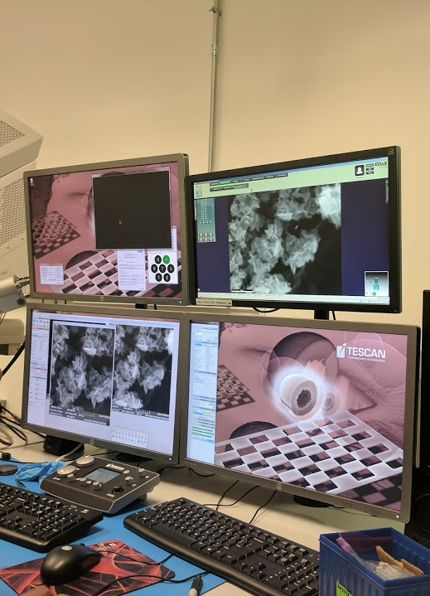
Biochar Characterization
C, H, N content
Mineral analysis
BET Surface area
Scanning electron microscopy with energy dispersive X-ray spectroscopy (SEM-EDS)
Electrical Conductivity
pH
Moisture and ash content

Slide 13
Biochar Composition
 | Corn Stover Biochar (CSB) | Maple Biochar (MB)
Carbon (%) | 62.9 | 81.5
Hydrogen (%) | 3.1 | 3.4
Nitrogen (%) | 1.16 | 0.79
Phosphorus (% P) | 0.55 | 0.19
Potassium (% K) | 2.98 | 0.57
Sulfur (% S) | 0.04 | 0.02
Calcium (% Ca) | 1.33 | 1.22
Magnesium (% Mg) | 0.33 | 0.14
Sodium (% Na) | 0.04 | 0.02
Iron (ppm) | 6194 | 2659
Moisture (%) | 0 | 0
Biochar obtained from ArtiChar prepared at 550 °C and a 20 min residence time
Notes:
Important to note the differences in biochar composition and we know that every biochar is different. Twp substrates - CS is basically the leftover components of the corn plants after the corn is harvested and the other substrate is maple wood chips.

Slide 14
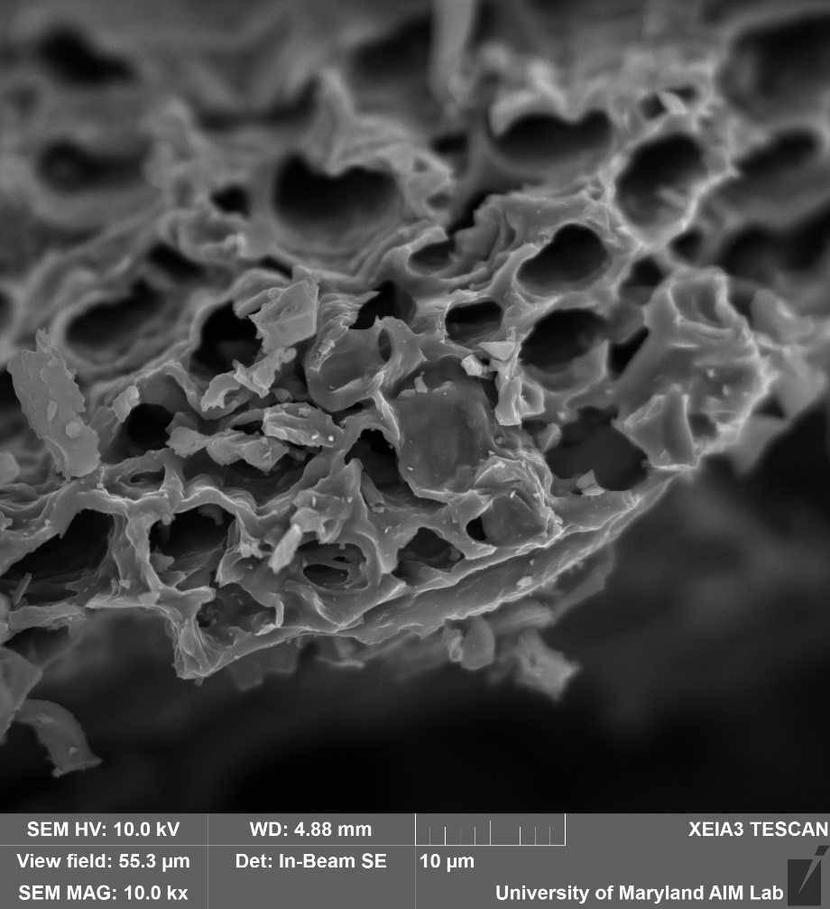
Maple biochar SEM-EDS
Surface Area : 161.2 m²/g
Pore volume : 0.095 cm³/g
Notes:
High surface area and pore volume which can be effective in removing contaminants via adsorption process

Slide 15
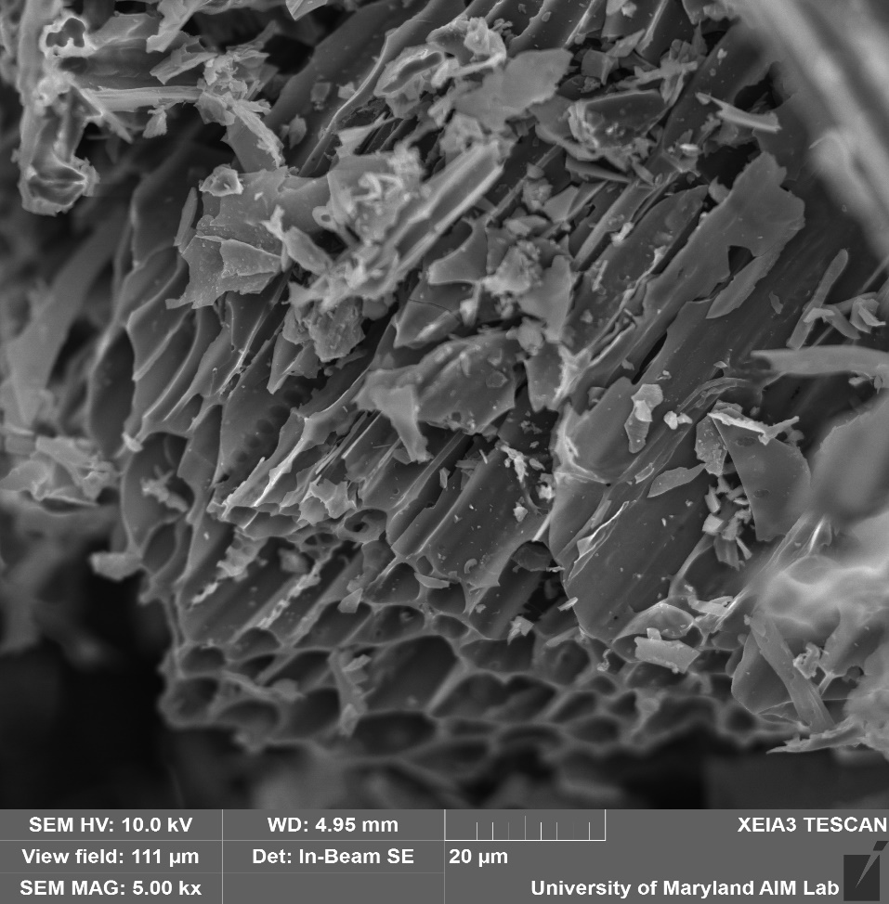
Corn Stover biochar SEM-EDS
Surface Area : 23.5 m²/g
Pore volume : 0.011 cm³/g
Notes:
Focus on mineral and ash content in CS

Slide 16
Experimental Design : Effect of biochar concentration
CONTENTS | Biochar amount added (mg)
Inoculum Control
Manure Control (DM)
0.1 g Corn Stover Biochar : 1 g TS of manure (CSB-0.1) | 55
0.5 g Corn Stover Biochar : 1 g TS of manure (CSB-0.5) | 277
1 g Corn Stover Biochar: 1 g TS of manure (CSB-1) | 554
1.82 g Corn Stover Biochar: 1 g TS of manure (CSB-1.82) | 1007
0.1 g Maple Biochar : 1 g TS of manure (MB-0.1) | 55
0.5 g Maple Biochar : 1 g TS of manure (MB-0.5) | 277
1 g Maple Biochar: 1 g TS of manure (MB-1) | 554
1.82 g Maple Biochar: 1 g TS of manure (MB-1.82) | 1007
3 replicates for each treatment
Total volume of manure and inoculum: 200 mL
An inoculum : substrate (manure) ratio (ISR) of 2:1 was used on a volatile solids basis.
Notes:
The corn stover is ground with a hammermill 1/2" screen and dried to less than 15% moisture.
biochar from sawdust that as another treatment. It is Maple Sawdust, ground 1/4" screen over a hammermill (previously debarked, it is pure wood).
ISR is important because you don’t want to add too much substrate because then the microbial consortium may get affected because of acidification.
The abbreviations for each treatment are in brackets

Slide 17
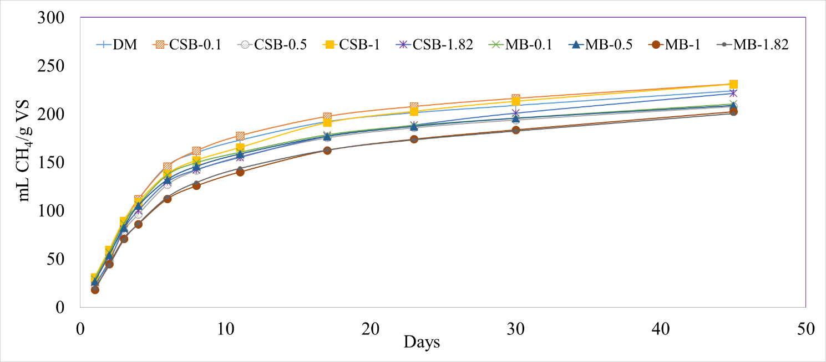
Effect of biochar concentration
Results: CH₄ Production
No significant differences in CH₄ concentration, yield
Cumulative CH₄ production varied from 200 – 231 mL/g VS, with CSB-1 having the highest and MB-1 having the lowest CH₄ volume.
Notes:
VS – it is a useful parameter for normalizing the methane production because it represents the organic compounds that are available for microbial degradation. There have been results that show that biochar addition to a digester has a positive effect on methane production but we did not see that in our experiments but there were no adverse effect either.

Slide 18
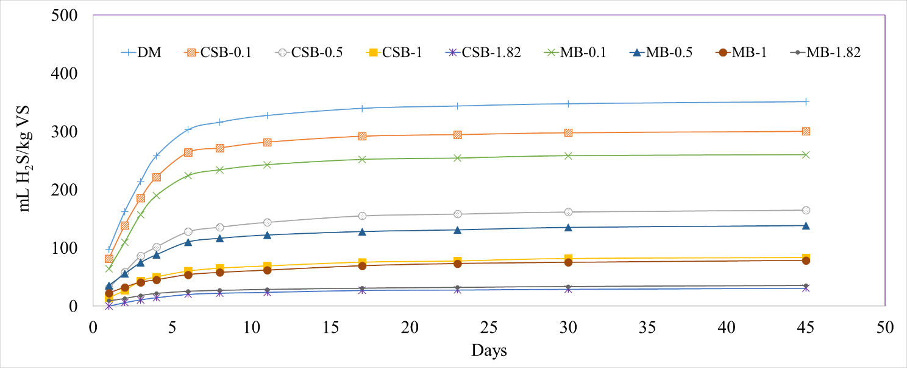
Results: Cumulative H₂S Production
Effect of biochar concentration
The treatment with no biochar (DM) had the highest H₂S volume after the study period (351 ± 9 mL H₂S/kg VS)
Volume of H₂S generated decreased as the concentration of biochar increased
At the highest dose of biochar added (1.82 g biochar/g Manure TS), the % reduction in H₂S was 91.1% and 90.0% for CSB and MB, respectively

Slide 19
Results: H₂S removal
Effect of biochar concentration
Treatment | H₂S volume reduction (uL)* | Normalized H₂S reduction (mg H₂S/g biochar) | Percent Reduction (%)
CSB-0.1 | 17.87 | 0.45 | 14
CSB-0.5 | 65.43 | 0.33 | 53
CSB-1 | 94.08 | 0.24 | 76
CSB-1.82 | 112.6 | 0.16 | 91
MB-0.1 | 32.00 | 0.81 | 26
MB-0.5 | 74.91 | 0.38 | 61
MB-1 | 95.89 | 0.24 | 78
MB-1.82 | 111.0 | 0.16 | 90
*When compared to DM control
Notes:
Because manure is a complex material that contains organic matter, nitrogen, phosphorus, different inorganic cations and anions, increasing the amount of biochar increases the possibility of the biochar reacting with these other components and not just h2s. It shows that biochar is not selective at removing H2S and interacts with all the species present in the digester in some form. AT higher doses, similar results. We did follow up experiments with only sulfides and the capacity of the biochar was much higher in a pure system. And also….next slide.

Slide 20
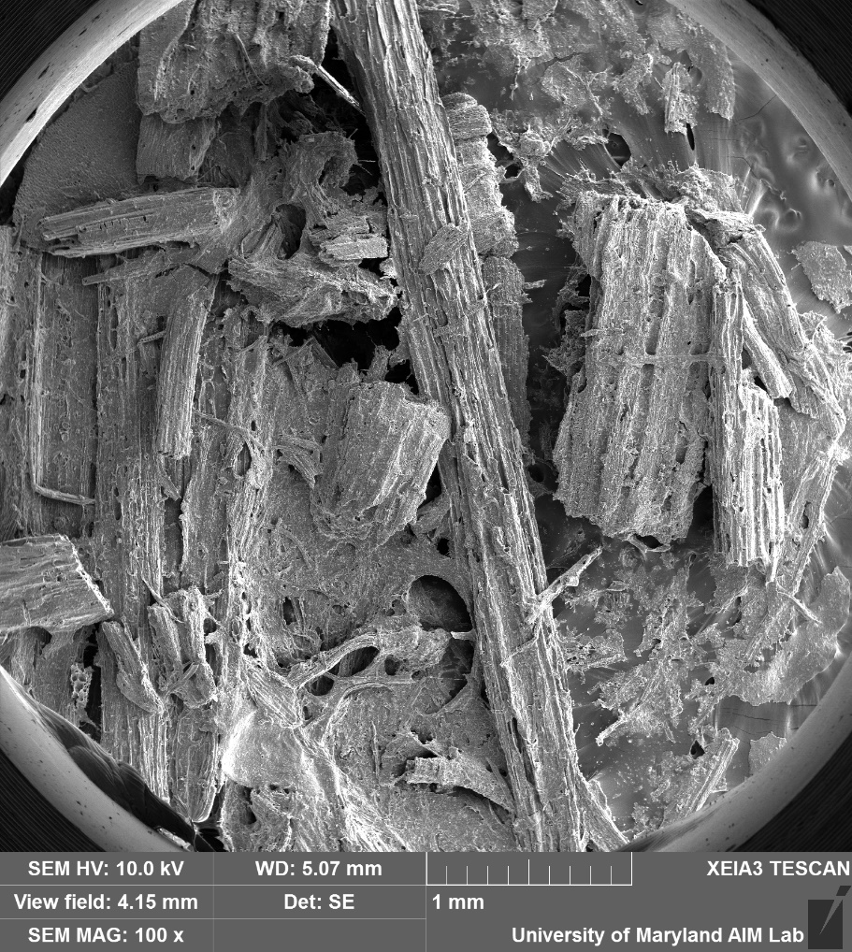
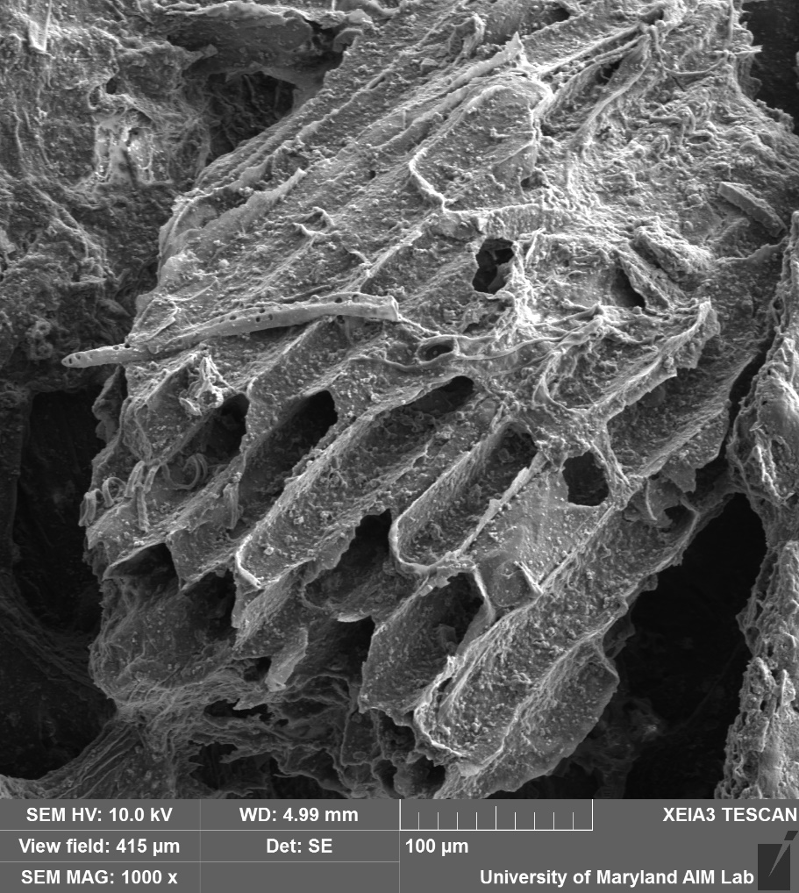
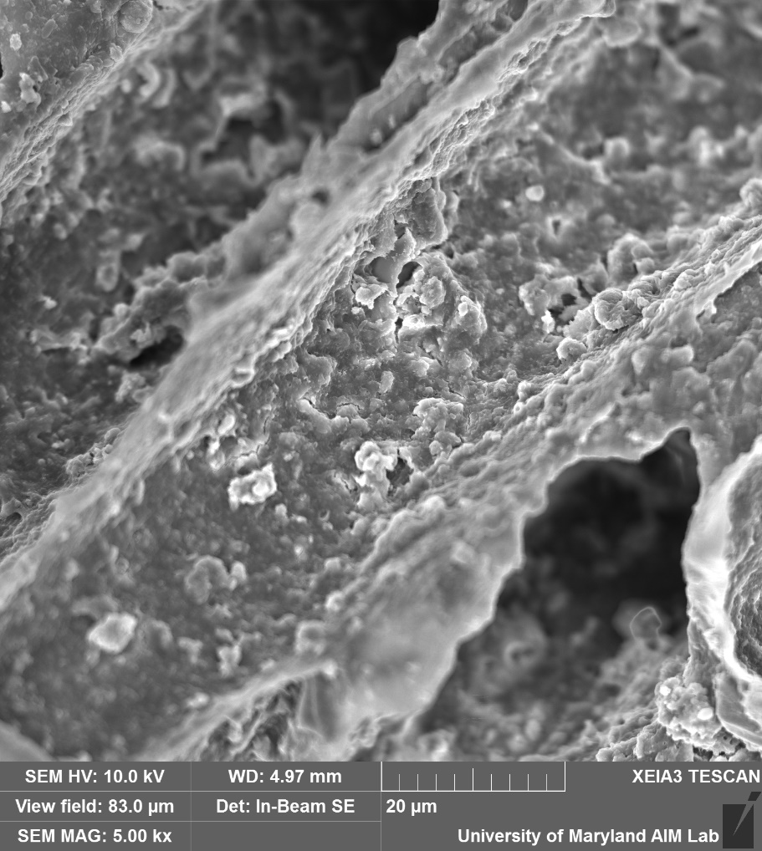
Post-treatment biochar samples
Notes:
This is the aftermath. As you can see, the biochar surface and pores are covered in microbial biofilms that completely cover the active sites where the h2s can adsorb to, thereby reducing its activity.

Slide 21
Experimental Design : Effect of biochar particle size and total surface area
CONTENTS | Biochar amount added (mg)
Inoculum Control | 0
Manure Control (DM) | 0
0.5 g Large CSB particles : 1 g TS of manure (CSB-L) | 701
0.5 g Medium CSB particles : 1 g TS of manure (CSB- M) | 701
0.5 g Small CSB particles : 1 g TS of manure (CSB-S) | 701
0.5 g Large MB : 1 g TS of manure (MB-L) | 701
0.5 g Medium MB : 1 g TS of manure (MB-M) | 701
0.5 g Small MB : 1 g TS of manure (MB-S) | 701
0.5 g Activated Carbon : 1 g TS of manure (AC-S) | 701
3 replicates
Volume of manure and inoculum: 200 mL
ISR - 2:1
Three different particle size ranges:
  Large - 841 µm – 707 µm (CSB-L and MB-L),
  Medium - 177 µm – 149 µm (CSB-M and MB-M),
  Small - less than 74 µm (AC-S, CSB-S and MB-S)
Notes:
Here we fixed the concentration to 0.5 g biochar/ manure TS because higher concentrations may not be economically feasible and could potentially lead to increased digester working volumes.

Slide 22
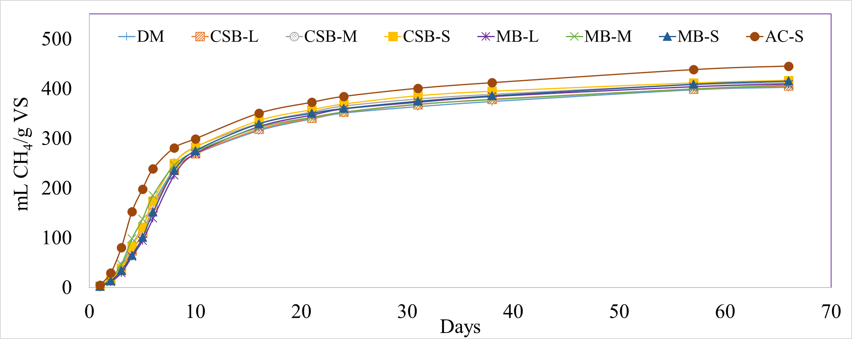
Effect of biochar particle size and total surface area
Results: CH₄ Production
No significant differences in CH₄ yield in the biochar amended treatments compared to no biochar addition
Addition of activated carbon led to a significant increase (10.7%) in the normalized CH₄ production
Notes:
DIET - These benefits have been attributed to a phenomenon called direct interspecies electron transfer (DIET). Conventionally, IET or interspecies electron transfer is the primary route for CH₄ production where hydrogen (H₂) acts as the electron carrier between fermentative bacteria and methanogenic archaea. Conductive materials can bypass the use of H₂ as the indirect carrier of electrons by promoting DIET. High conductivities of GAC (3000 µS/cm) resulted in enhanced methanogenesis by providing an electrical connection between fermentation bacteria and CH₄ producing archaea.

Slide 23
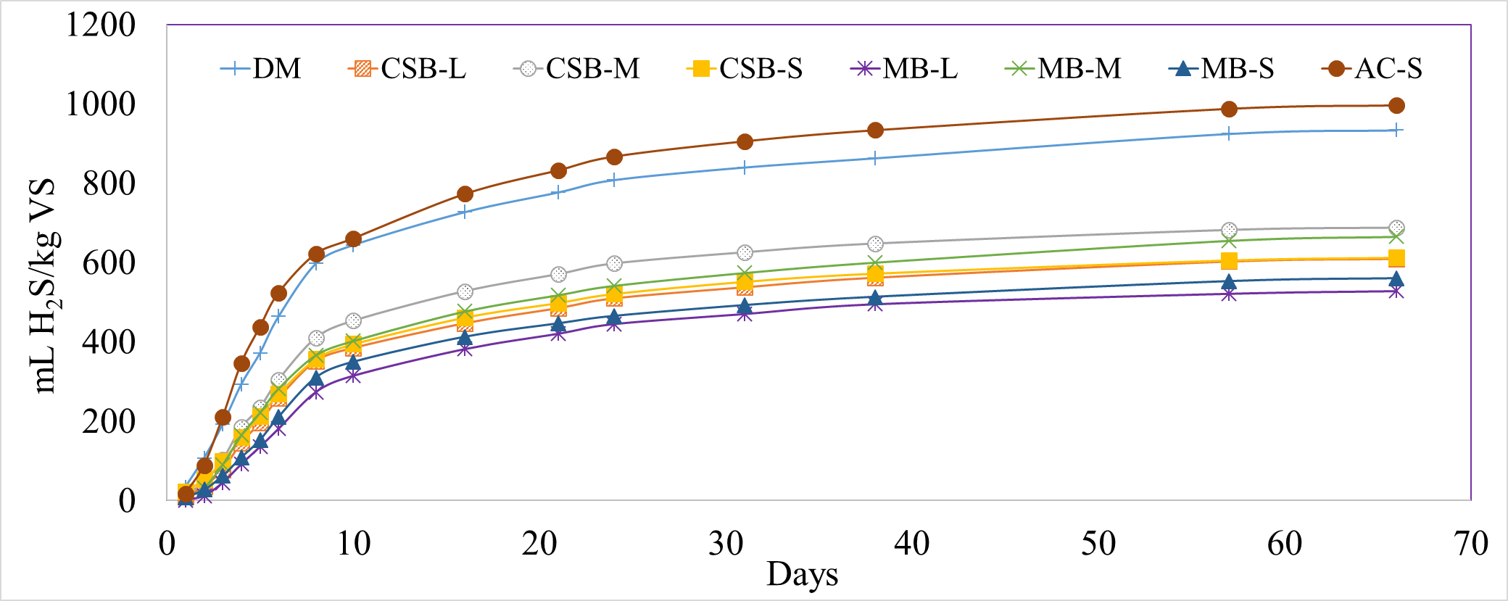
Results: Cumulative H₂S Production
Effect of biochar particle size and total surface area
DM had the highest H₂S production after the study period (934 ± 32 mL H₂S/kg VS)
Different biochar particle sizes significantly lowered the normalized H₂S volume compared to DM control and AC-S
The differences in H₂S production between the biochar treated reactors were not significant.
Notes:
Basically the particle size differences did not lead to any significant differences in h2s reduction.

Slide 24
Results: H₂S removal
Effect of biochar particle size and total surface area
Treatment | H₂S volume reduction (uL)* | Normalized H₂S reduction (mg H₂S/g biochar) | Percent Reduction (%)
CSB-L | 246.3 | 0.50 | 35
CSB-M | 184.9 | 0.37 | 26
CSB-S | 236.7 | 0.48 | 34
MB-L | 321.4 | 0.65 | 43
MB-M | 220.9 | 0.44 | 29
MB-S | 291.8 | 0.59 | 40
*When compared to DM control

Slide 25
Iron Impregnation
Pre-pyrolysis and post pyrolysis methods to modify biochar and enhance anion sorption capacity (adapted from Sizmur et al, 2017).

Slide 26
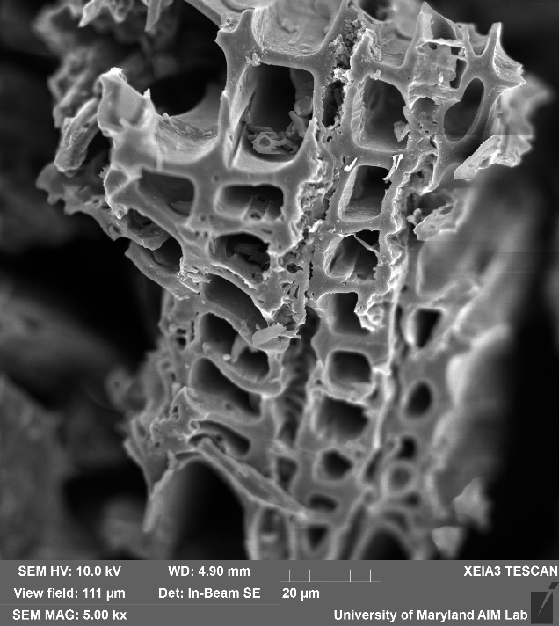
Iron impregnated maple biochar
34.9 m²/g
Iron
Surface Area - 59.8 m²/g
Pore volume - 0.040 cm³/g
SEM image and EDS data of maple wood chips biochar
Notes:
Reduction in surface area and pore volume and iron peaks in the EDS graph

Slide 27
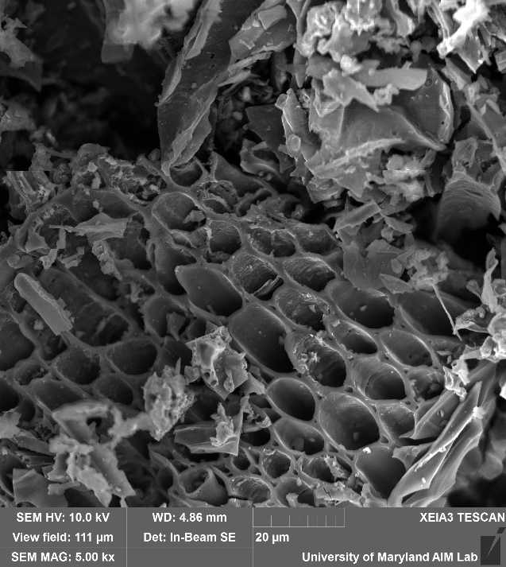
Iron impregnated corn stover biochar
Iron
SEM image and EDS data of corn stover biochar
Surface Area - 34.9 m²/g
Pore volume - 0.004 cm³/g

Slide 28
Experimental Design : Effect of iron impregnation
CONTENTS | Biochar amount added (mg)
Inoculum Control | 0
Manure Control (DM) | 0
0.5 g CSB : 1 g TS of manure (CSB) | 1049
0.5 g iron-impregnated CSB : 1 g TS of manure (CSB-Fe) | 1049
0.5 g MB : 1 g TS of manure (MB) | 1049
0.5 g MB iron-impregnated : 1 g TS of manure (MB-Fe) | 1049
3 replicates for each treatment
Total volume of manure and inoculum: 150 mL
ISR – 2:1

Slide 29
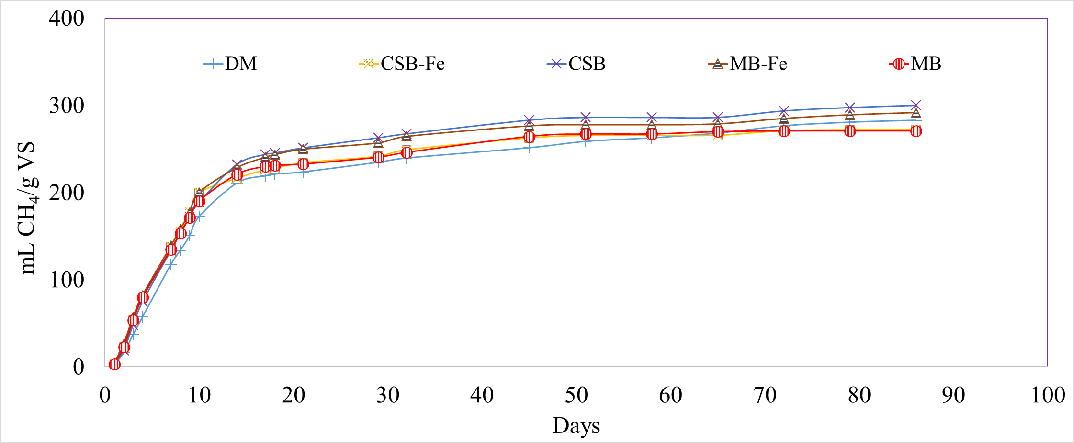
Effect of iron impregnation
Results: CH₄ Production
The CH₄ production for the treatments with both unmodified and Fe-modified biochar did not significantly differ from the treatment with no biochar addition
The CH₄ production varied from 270 - 304 mL CH₄/g VS, with MB having the lowest and CSB having the highest volume
Notes:
Basically all 3 three experiments showed no adverse effects on ch4 but………….

Slide 30
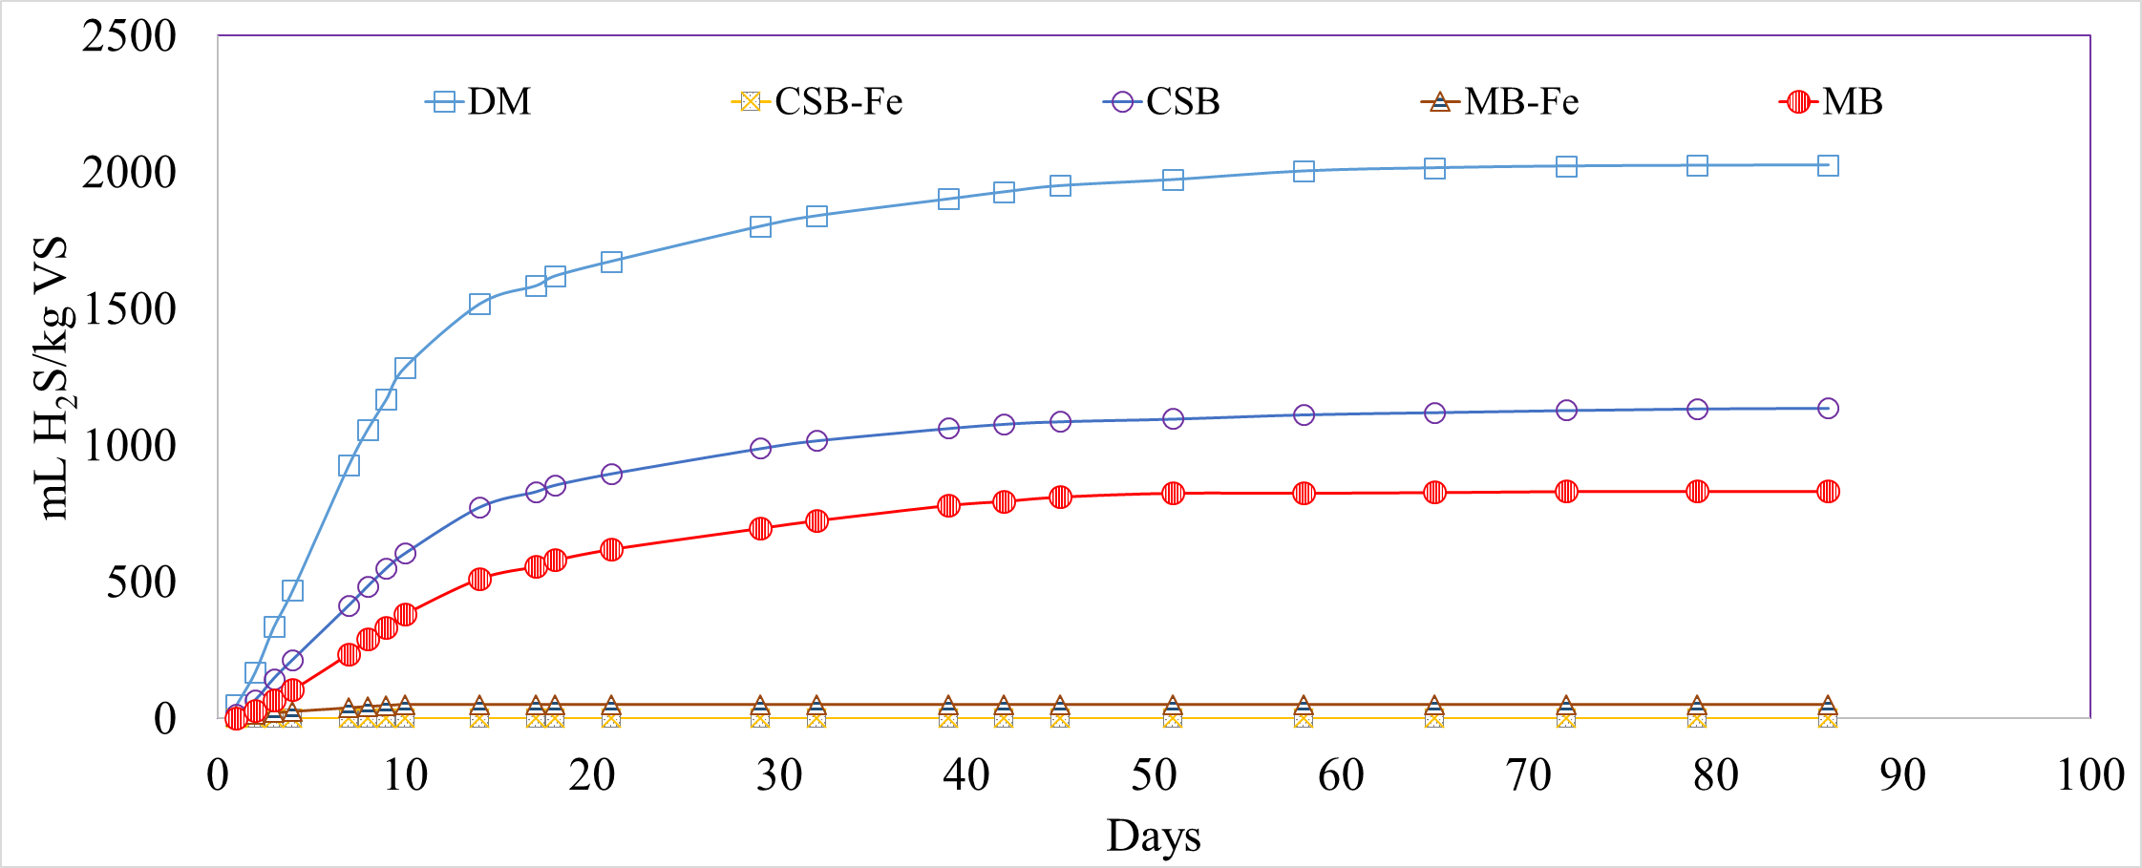
Results: Cumulative H₂S Production
Effect of iron impregnation
DM had the highest H₂S volume after the study period (2025 ± 33 mL H₂S/kg VS)
The normalized H₂S production for the Fe-impregnated biochar treated reactors varied from 0 to 51.3 ± 3.7 mL H₂S/kg VS for CSB-Fe and MB-Fe, with removal efficiencies of 100% and 97%, respectively
Notes:
was effective in h2s reduction.

Slide 31
Results: H₂S removal
Effect of iron impregnation
Treatment | H₂S volume reduction (uL) | Normalized H₂S reduction (mg H₂S/g biochar) | Percent Reduction (%)
CSB-Fe | 2002 | 2.69 | 100
CSB | 960 | 1.30 | 44
MB-Fe | 1930 | 2.59 | 97
MB | 1292 | 1.74 | 59
*When compared to DM control
Notes:
100% reduction and it could lead to use of the biogas directly in fuel cells that requires <1 ppm h2s and as biomethane injected into natural gas pipelines (<4 ppm)

Slide 32
Conclusions
In-situ biochar addition to anaerobic digestion systems was effective in reducing H₂S in biogas.
H₂S reduction efficiency increased to >90% for each biochar type (CSB and MB) at the highest dosage (1.82 g biochar/g manure TS).
Different biochar particle sizes (L,M, and S) showed an H₂S removal efficiency of 26% - 43%, but were not significantly different from each other.
The H₂S removal efficiencies in the Fe-impregnated biochar treated reactors were 100% and 97% for CSB-Fe and MB-Fe, respectively.
There were no significant differences in % CH₄ and yield between treatments in all three experiments.

Slide 33


Acknowledgments
Committee Members: Dr. Stephanie Lansing (advisor), Dr. Gary Felton, Dr. Walter Mulbry, Dr. Ashwani Gupta, and Dr. Alba Torrents
Waste to Energy Lab group
Department of Environmental Science and Technology (ENST)
Northeast Sustainable Agricultural Research and Education (NESARE) – LNE15-341 and GNE18-167
Maryland Department of Agriculture (MDA)

Slide 34
Thank You
Questions?

