Slide 1
Understanding Stakeholder Perspectives to Increase IPM Adoption in Pear
Molly Sayles, Robert Orpet, Louie Nottingham
Washington State University

Slide 2
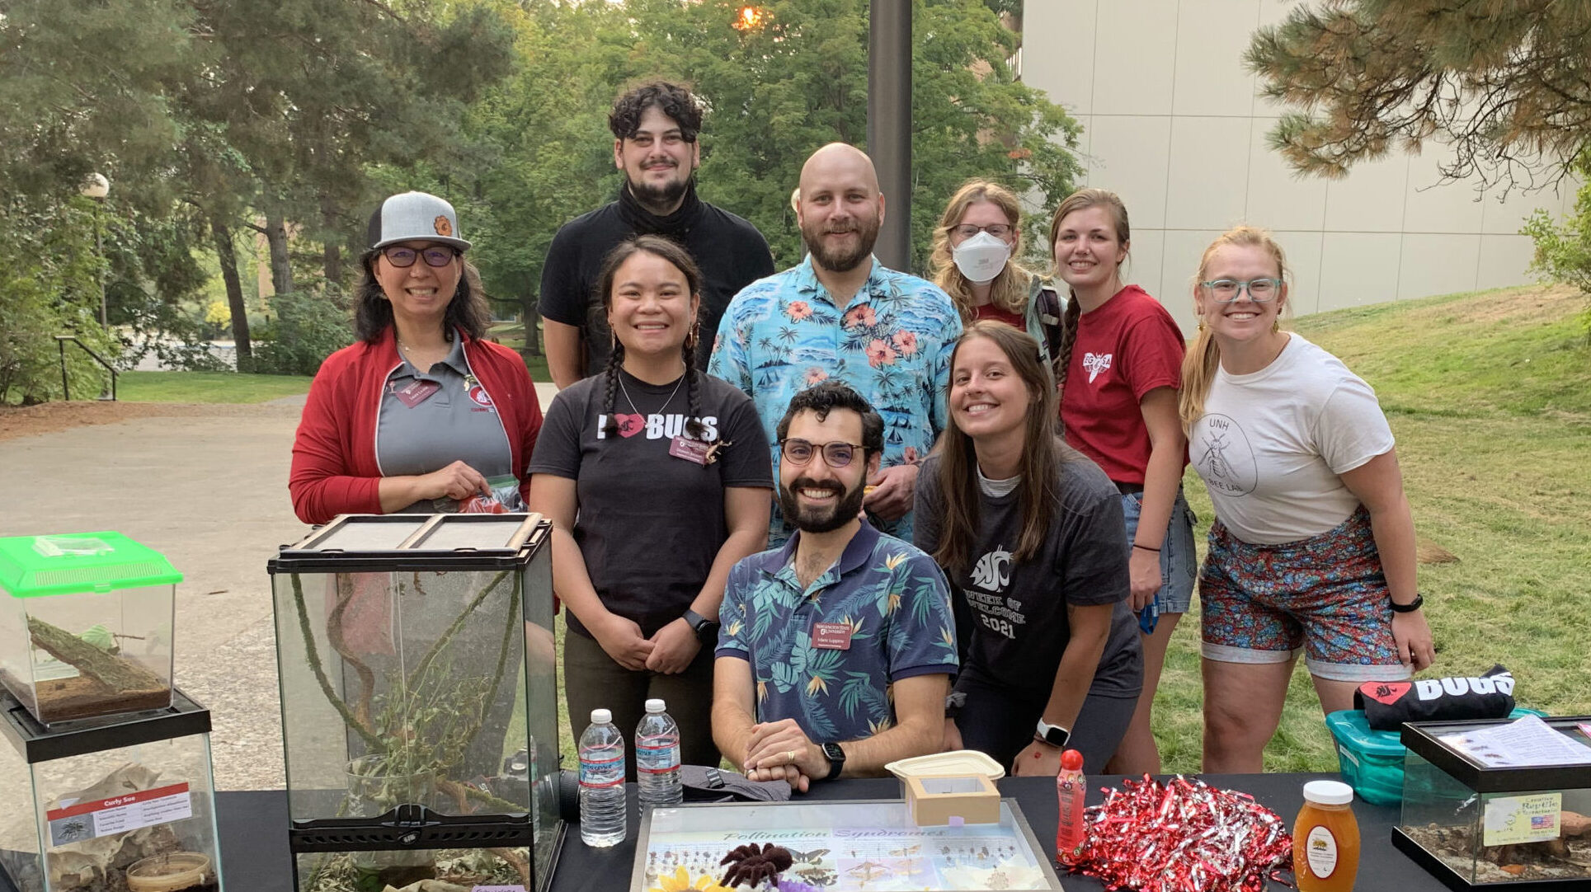
Third year grad student
Entomology PhD student at WSU
Notes:
I knew I wanted to study entomology and to get to interact with growers, but I didn’t even know what Extension was at the time! I joined Louie Nottingham’s lab to study pear entomology and IPM and when Louie moved, Robert Orpet took over the pear entomology lab

Slide 3
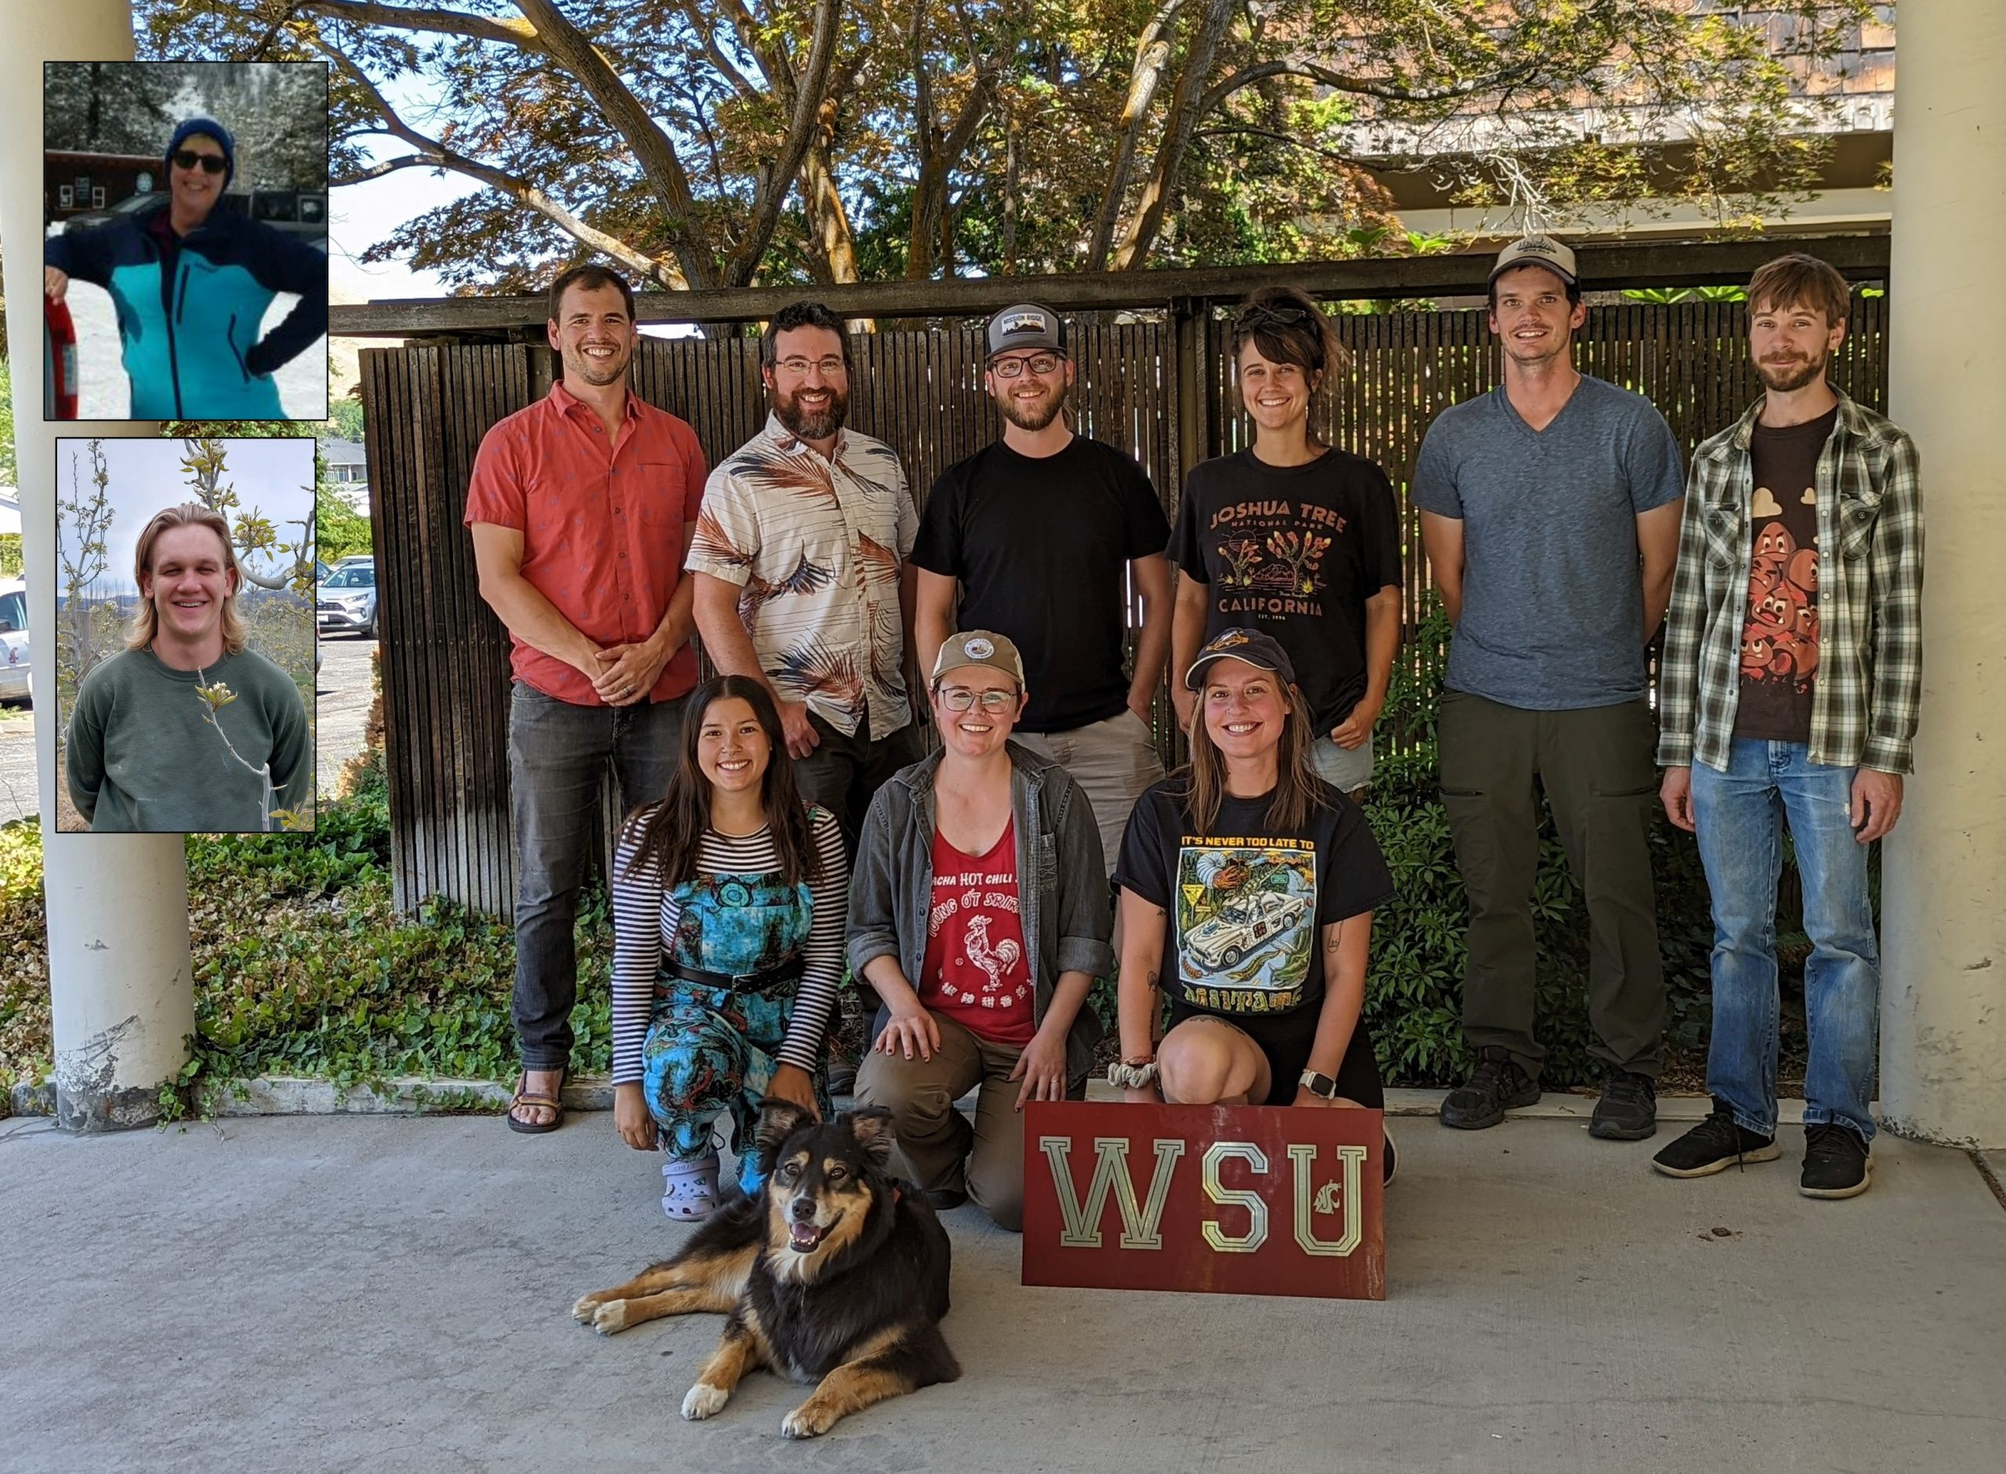
Third year grad student
Entomology PhD student at WSU
Nottingham Lab and Orpet Lab
Notes:
I knew I wanted to study entomology and to get to interact with growers, but I didn’t even know what Extension was at the time! I joined Louie Nottingham’s lab to study pear entomology and IPM and when Louie moved, Robert Orpet took over the pear entomology lab

Slide 4
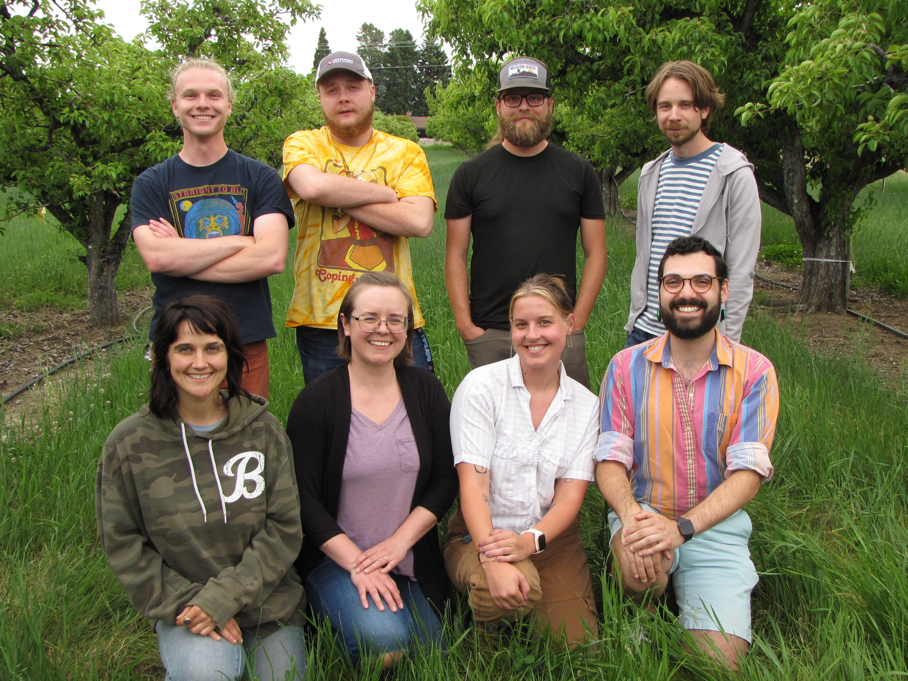
Third year grad student
Entomology PhD student at WSU
Nottingham Lab and Orpet Lab
Notes:
I knew I wanted to study entomology and to get to interact with growers, but I didn’t even know what Extension was at the time! I joined Louie Nottingham’s lab to study pear entomology and IPM and when Louie moved, Robert Orpet took over the pear entomology lab

Slide 5
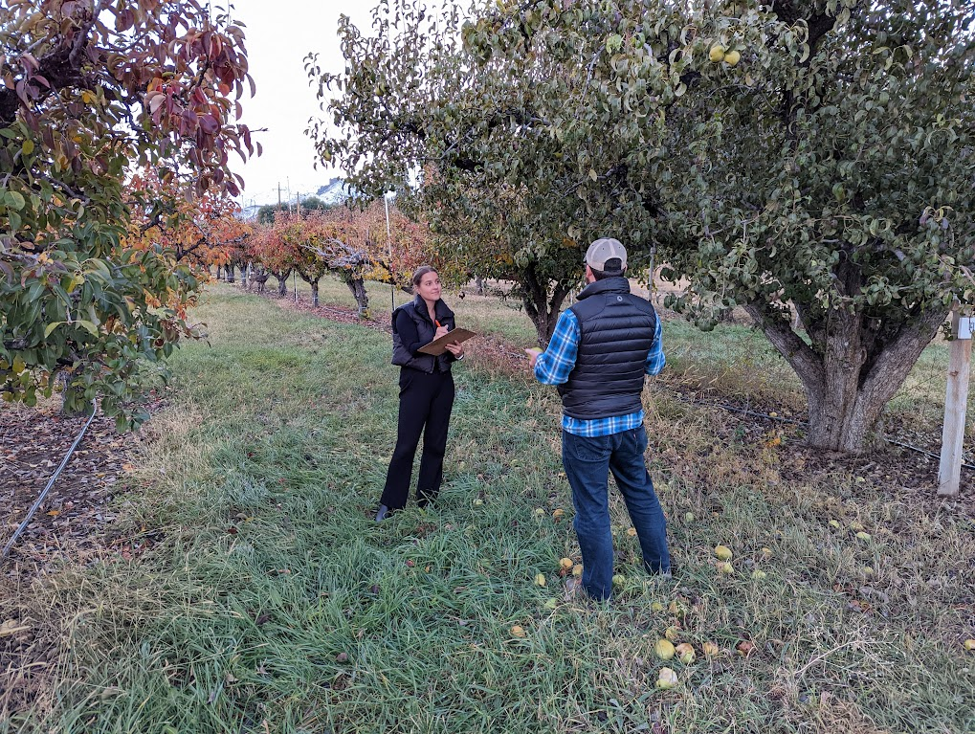
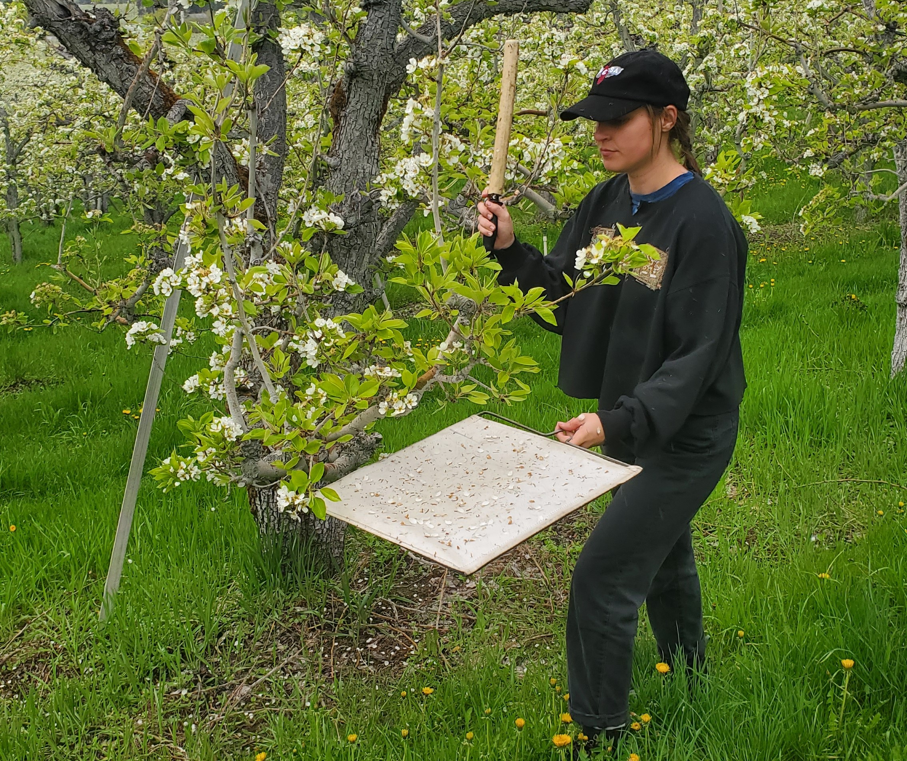
Career goal in Extension
Notes:
A large aspect of my pear entomology work aside from the bug counting part is Extension and interacting with growers, which will be most of this presentation, and my hope is to go into a career in Extension in some way

Slide 6
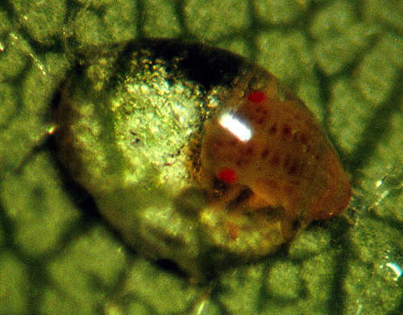
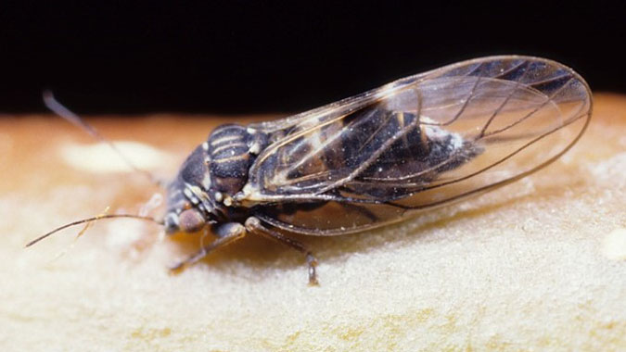
Pear psylla
#1 WA pear pest
Honeydew causes fruit damage
Secondary pest, controlled by natural enemies
Msu.edu
C. André
Tfrec.wsu
Notes:
This is the system that I work in and that I will be talking about for the rest of the talk

Slide 7
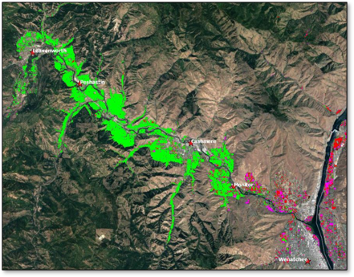
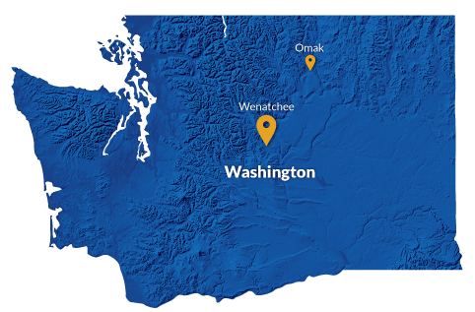
Wenatchee Valley, WA
One of the top 5 pear growing regions
Monoculture of pear
Pear
Cherry
Apple
Cropscape

Slide 8
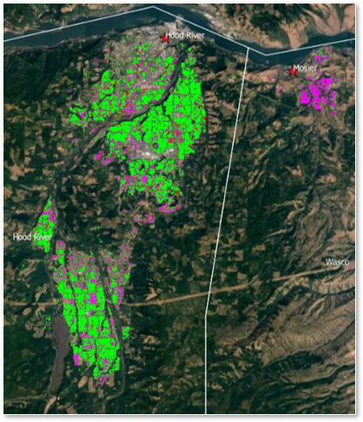
Hood River, OR
Monoculture of pear
Not as bad of a psylla problem
More IPM implementation, $300-500/acre
Pear
Cherry
Apple
Cropscape

Slide 9
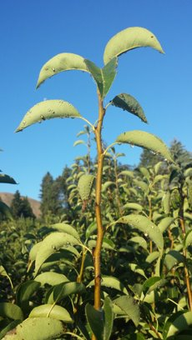
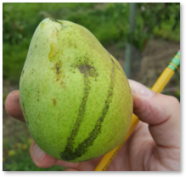
Wenatchee struggles to control pear psylla
Conventional management: broad-spectrum insecticides, many sprays
$1100-$1500/acre

Slide 10
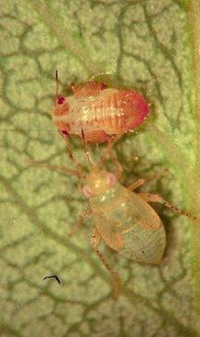
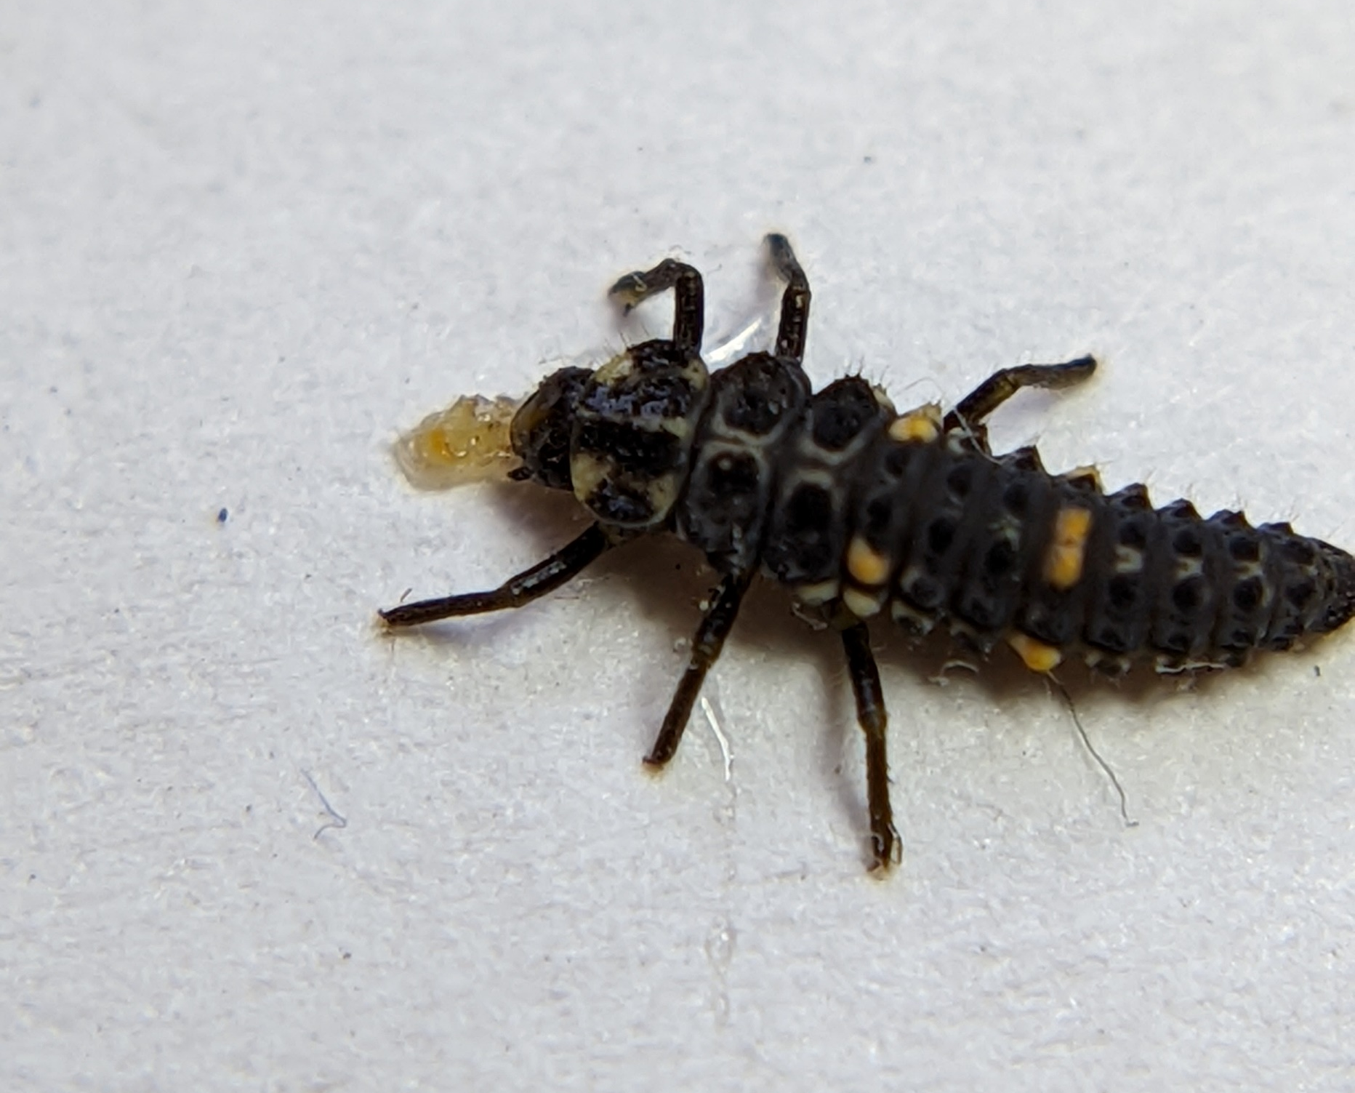
Solution: Pear psylla IPM
Emphasis on biological control – but not a standalone method
Best approach:
Selective sprays to conserve natural enemies
Cultural controls

Slide 11
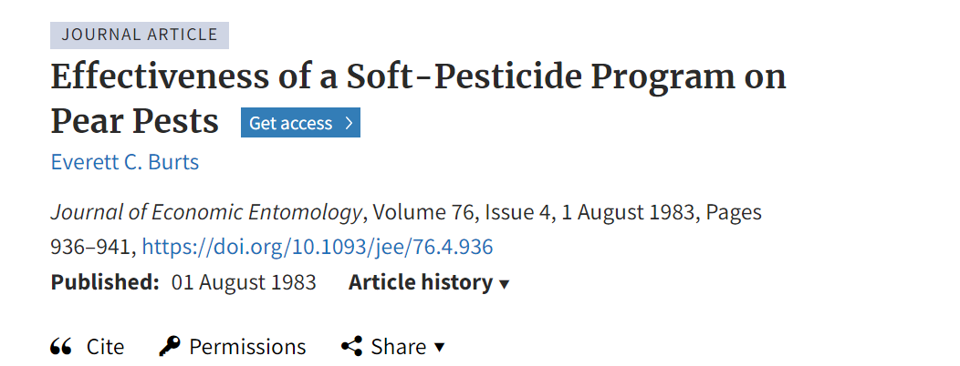
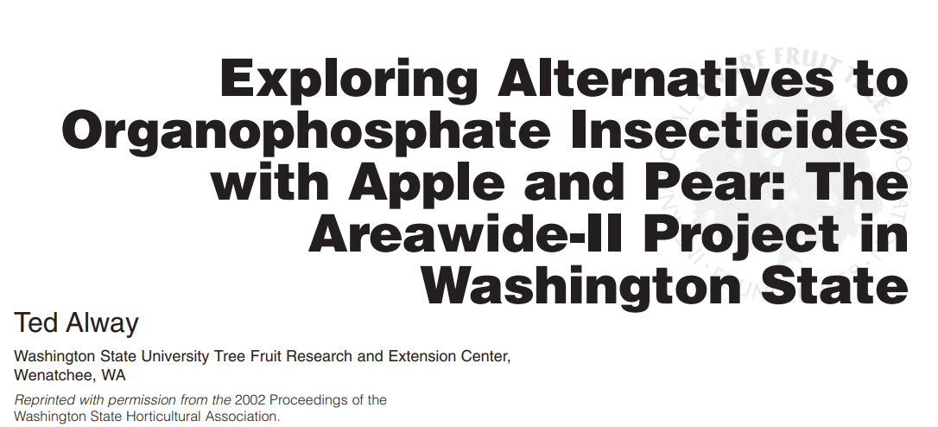
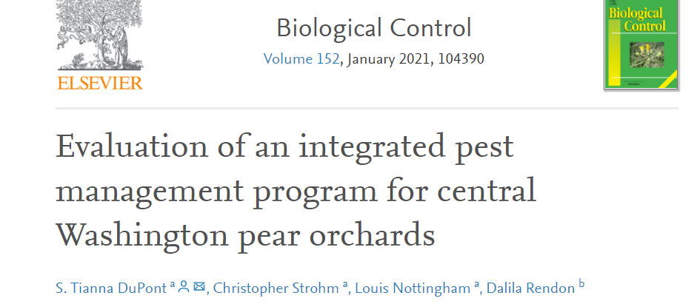
Pear psylla: An Extension problem, not a research problem
Notes:
There ahave been several studies throughout the last few decades that show that pear psylla IPM in Wenatchee is effective going backt ot he 1980s with Everett Burts
In other pear growing regions, such as Hood River, OR, iPM is implemented more and there is less pear psylla pressure
There are programs for IPM control (one of which I will go into in a minute) and regions that are using them but wenathcee is not for an unknown reason

Slide 12
Lack of implementation
Vague recommendations
Confusing and complicated
This is what we are want to address!

Slide 13
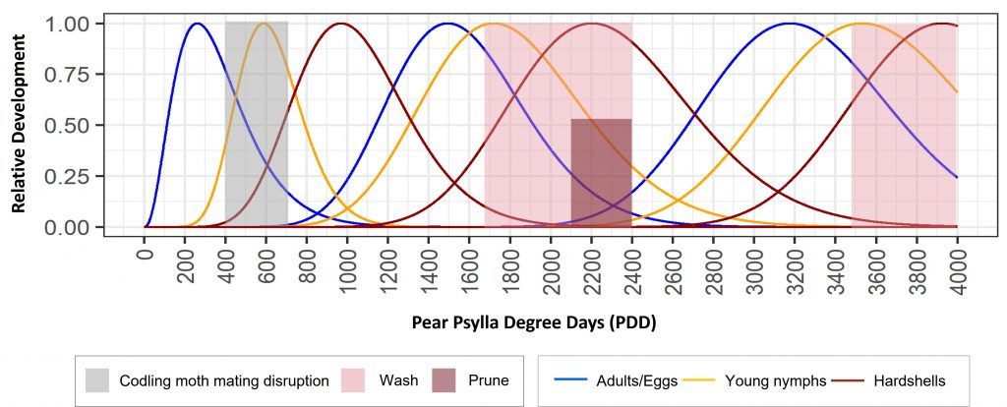
Enter: Pear psylla phenology model
Jones 2019
Notes:
The research showing pear psylla IPM’s effectiveness has clearly not been lacking. But growers have shared with us that previous IPM efforts were “confusing’ so in 2019 jones created a phenology model that is a degree day model that shows the life stage of the pest throughout the season.

Slide 14
Pheno-IPM
Nottingham and Orpet 2021
Notes:
In 2021 Nottingham and orpet created IPM guidelines that go along with the phenology model that prioritize biocontrol populations by including only selective sprays when necessary and cultural controls l ike tree washing and pruning. These guidelines we call pheno-ipm. You can see heer that they are associated with degree days and literally spell it out for you, impossible to mess up. But its still not being implemented much!!
The good news is that WSU has developed a pear psylla phenology model along with IPM recommendations
My co-advisor Robert Orpet is leading the research side of this project that is documenting how these IPM guidelines work in wenathcee
that go along with the model so now we need to tackle the impelemntation of it and my role for my dissertation is to tackle the extension part

Slide 15
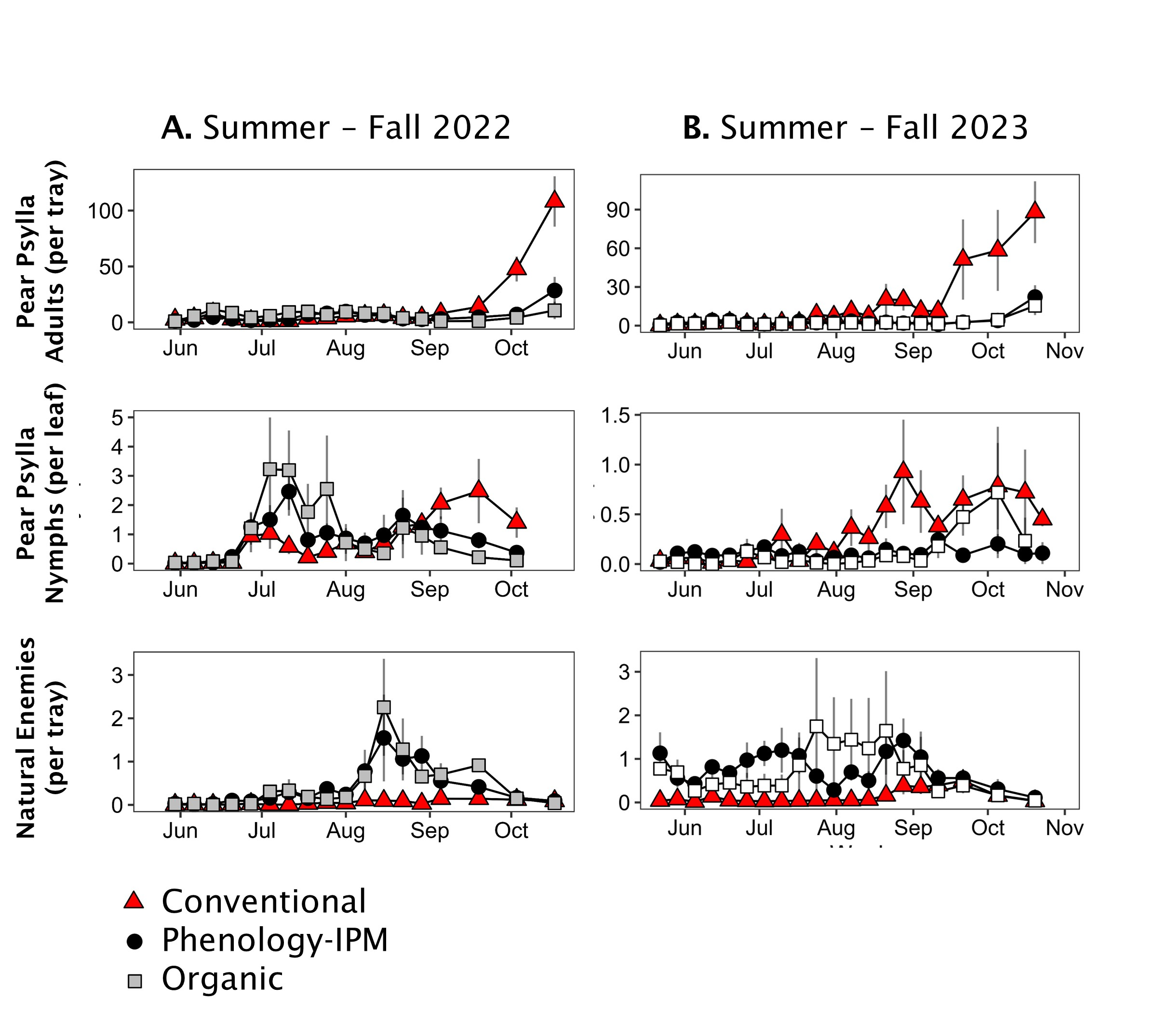
Commercial orchard trials: Pheno IPM vs. Conventional
Monitoring pear psylla and natural enemies
Notes:
Here are data from this year and last year that show that

Slide 16
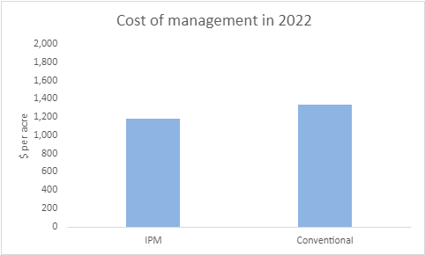
IPM is more cost-effective than conventional psylla management
$1,190
$1,340

Slide 17
Tackling the lack of pear IPM adoption in Wenatchee
How:
Outreach to promote IPM adoption
Social science methods to determine IPM perceptions
Notes:
Given the amount of research that presents pear psylla IPM as effective and cheaper than conventional management, our lab is curious why there is hardly any IPM use in the Wenatchee valley and what we can do to help move along its implementation

Slide 18
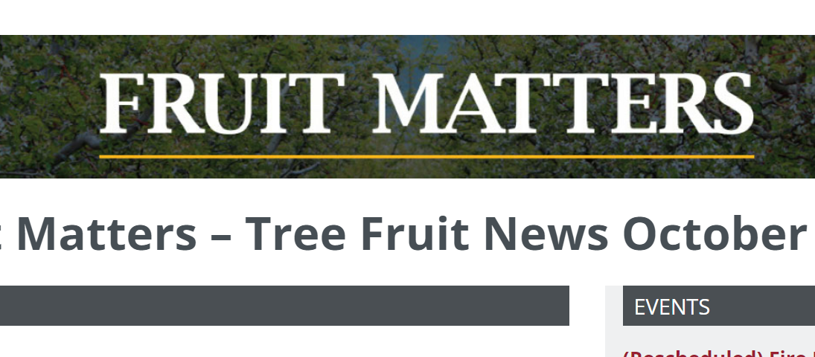
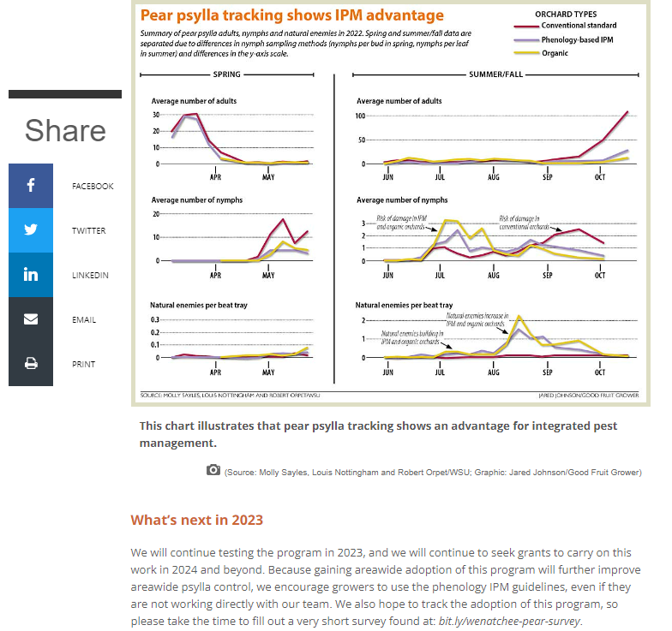
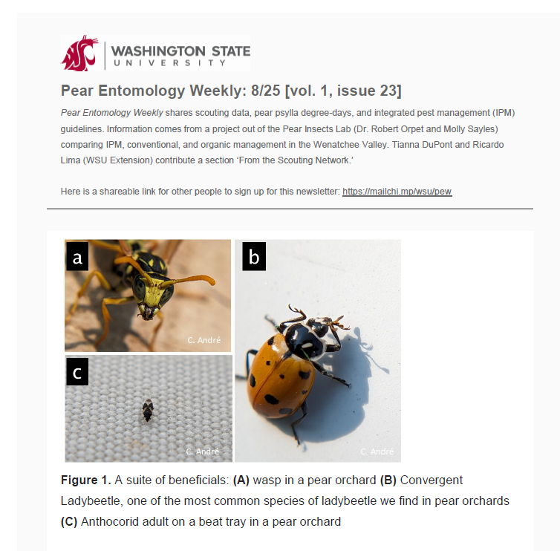
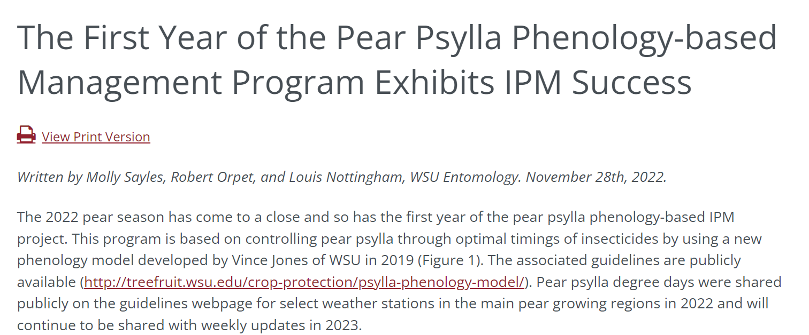
Newsletters and articles
Notes:
Write fruit matters articules which is…
And good fruit grower artucles which is an internationally renowned magazine read by basically anyone that grows fruit “best in industry”

Slide 19
Pear Entomology Weekly
144 subscribers (tripled since last year)

Slide 20
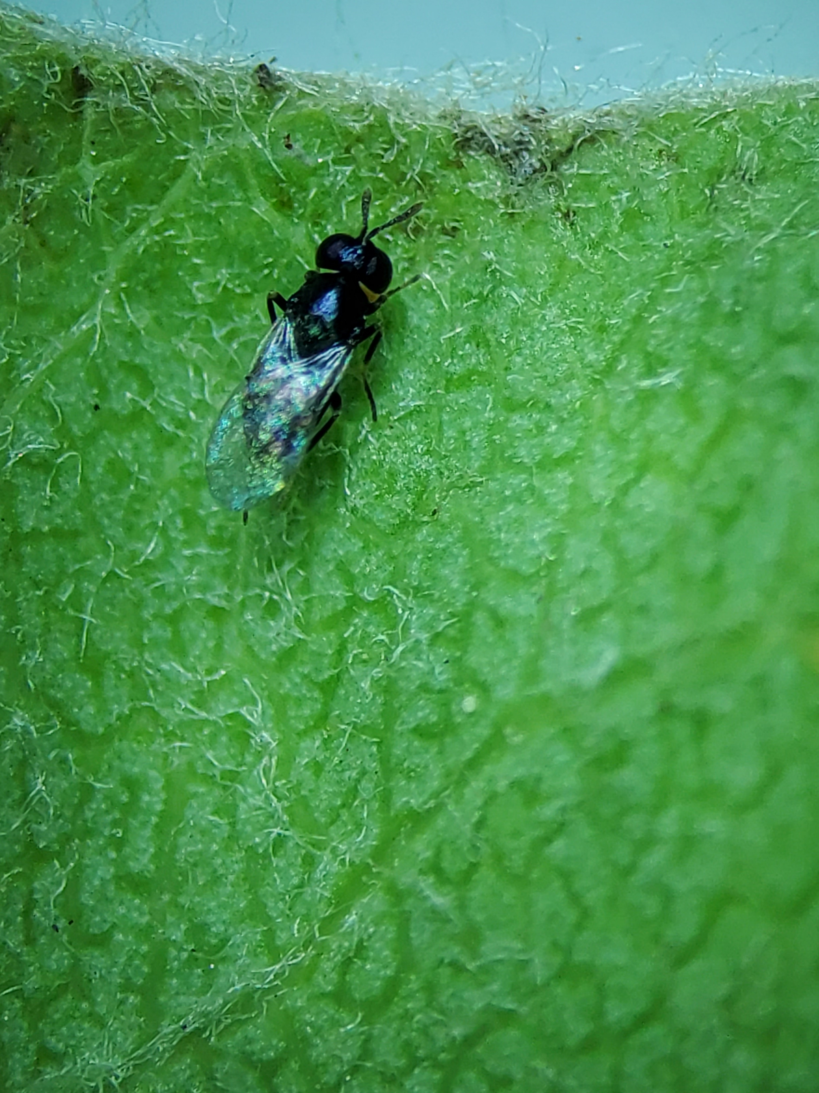
VIDEOS
Trechnites insidiosus
Starting now!
Demonstrate scouting for pests and natural enemies
Goal: 5/year
Identifying hard-to-see beneficials
Seeing is believing!
1 mm
L Nottingham
Notes:
Another formal communication strategy is videos
This is a nymph that has surround on it that liouie took and growers love it, makes them feel like its working
I will begin these this summer and they will include demonstrations of effective scouting for pest and natural enemies, including those that can be really hard to see
Some growers Ive talked to specifically say they don’t know what trechnites looks like bc its too small and trechnites is one of the most important pear psylla parasitoids soits important to know if its there
And I will involve gorwrs and other stakeholders in the development of the video so I know its getting at questions they want answered

Slide 21
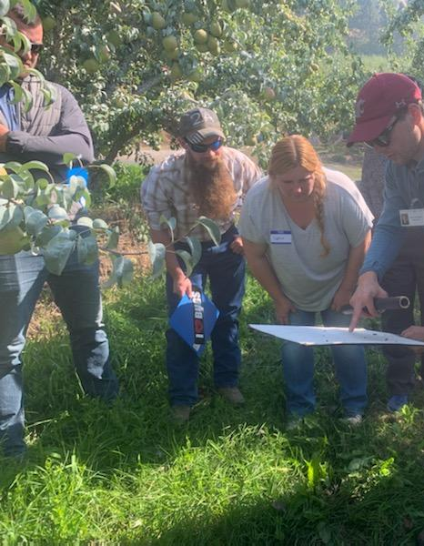
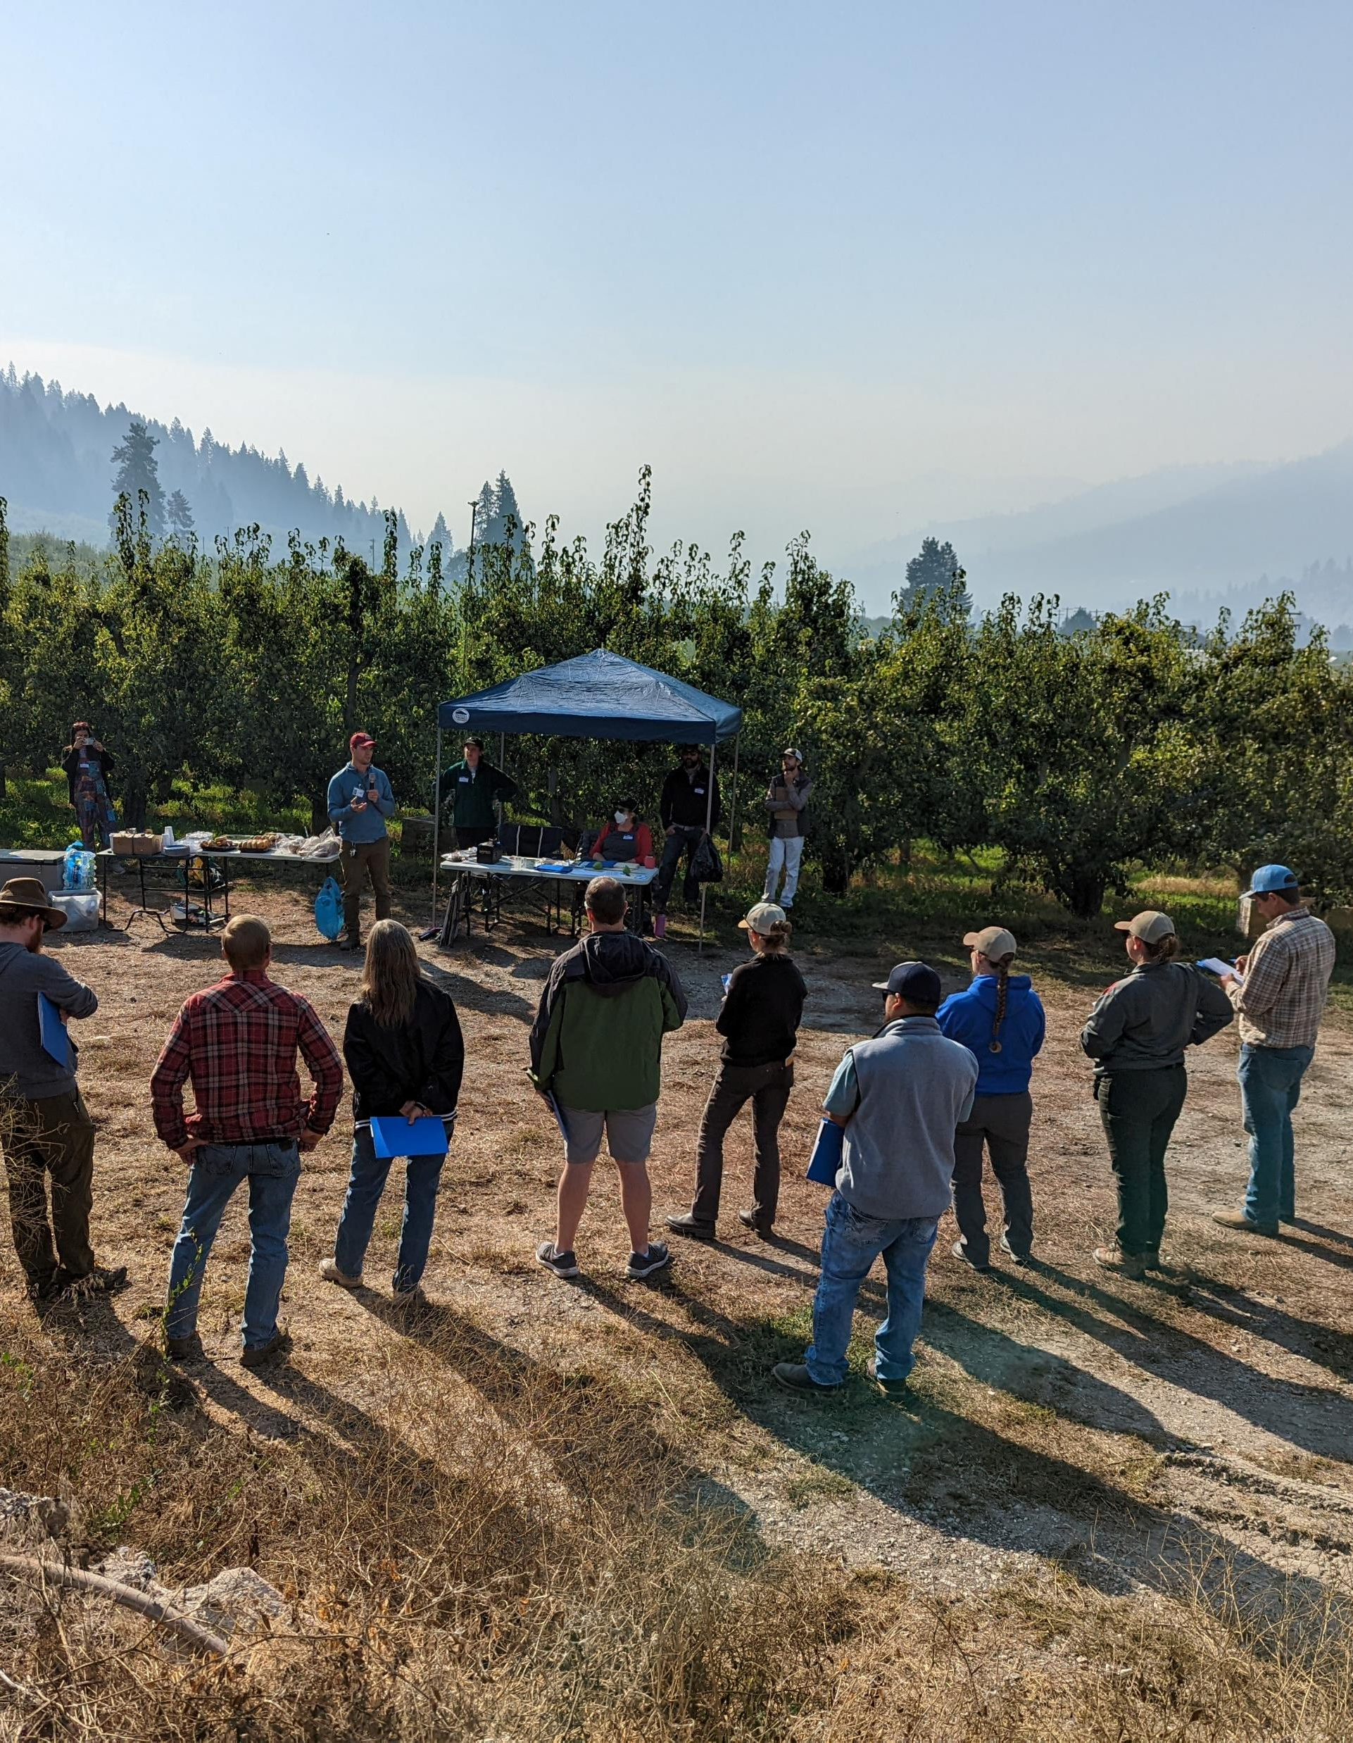
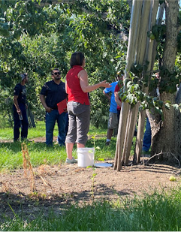
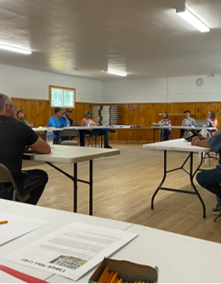
2022 Pear psylla field day
2023 Pear psylla field day
Field days
Goal: 1/year
Completed: 2
Notes:
For experiential learning, I plan to hold an annual pear psylla field day
Here is one that I organized in Sept of 2022
We held it at one of our cooperating growres’ orchards and so we were able to show attendees a conventionally managed pear orchard next to an IPM orchard and we had them beat sample for natural enemies

Slide 22
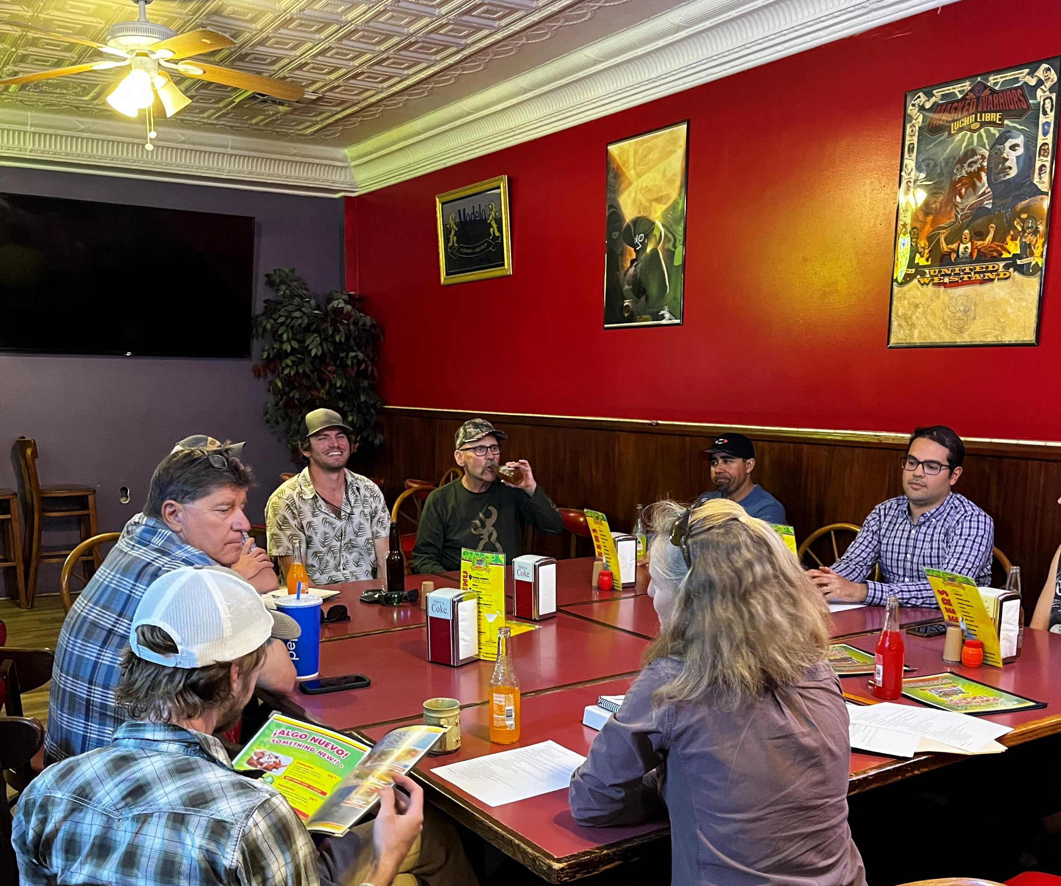
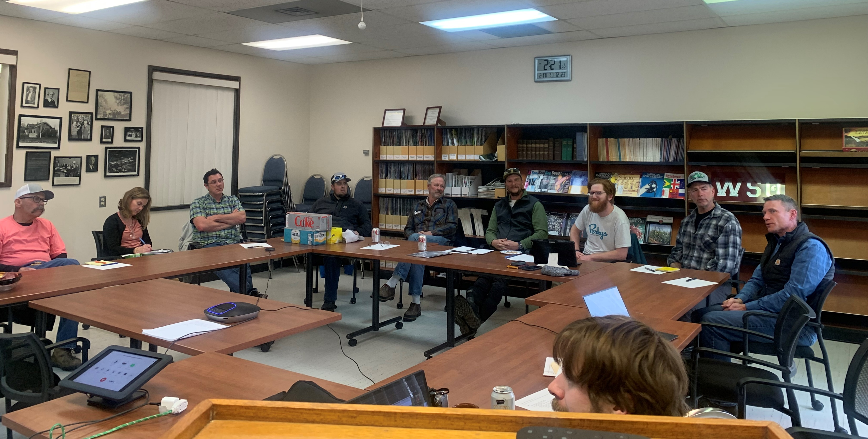
Discussion groups
Cooperator-specific
Goal: 1/year, completed: 1
Summer roundtables
Goal: 3/year, completed: 3
Notes:
For social learning, I am holding a discussion roudntbale event on the 17th where I have invited all participants frpom the project together and they can hear orm each other about their experiences this last season and we can learn what worked and what didn’t
Also, throughout this summer, I am planning on holding biweekly meetings where ti will be like an open office hours event and growers or consultants canc ome and discuss what they are seeing
I got this idea from Rick Hilton, who does Extension down in Medford OR and growers he works with seem to like that he does this

Slide 23
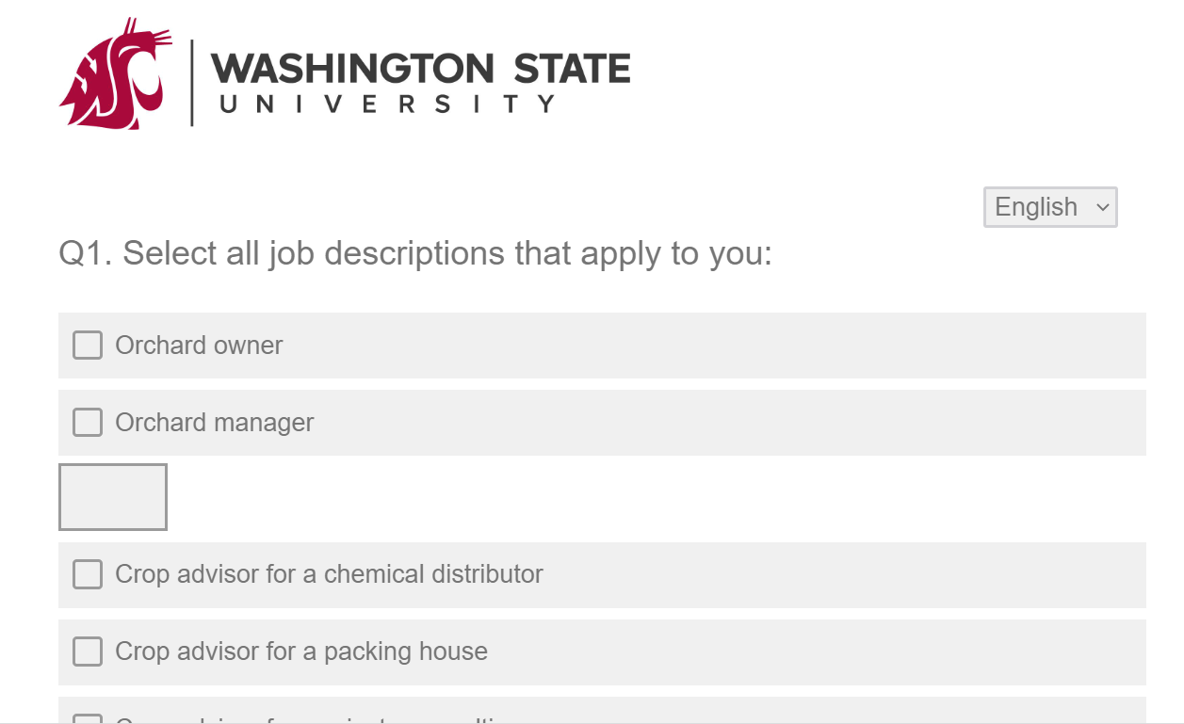
Measuring impact: Annual pheno model survey
Sent to listserv, chemical distribution companies and warehouses
43 total responses
Demographics
Orchard owner/grower
Crop advisor for chemical company
Accounts for 5,334 acres of pear across WA (78%) and OR (22%)
2023 Phenology Model Survey

Slide 24
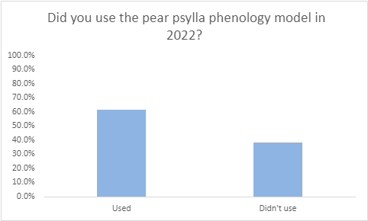
Use of the phenology model
n=34

Slide 25
Use of the phenology model
n=34
Reasons for not using:
Lack of awareness/understanding
Skepticism of its usefulness

Slide 26
Will you use the phenology model and guidelines next season?
Yes
No
Seen that it is effective
“Allowing beneficial insects to survive earlier in the season has worked far better than previous programs. The phenology program and washing with overhead irrigation has been way more effective and cheaper.”

Slide 27
Will you use the phenology model and guidelines next season?
Yes
No
Seen that it is effective
“Allowing beneficial insects to survive earlier in the season has worked far better than previous programs. The phenology program and washing with overhead irrigation has been way more effective and cheaper.”
Need for change from current strategies
“Because what we have been doing isn't working. 65.4% of our culls were due to psylla in 2022. We need to try something different this year.”

Slide 28
Will you use the phenology model and guidelines next season?
Yes
No
Seen that it is effective
Allowing beneficial insects to survive earlier in the season has worked far better than previous programs. The phenology program and washing with overhead irrigation has been way more effective and cheaper.
Need for change from current strategies
Because what we have been doing isn't working. 65.4% of our culls were due to psylla in 2022. We need to try something different this year
Trust researchers

Slide 29
Will you use the phenology model and guidelines next season?
Yes
No
Seen that it is effective
Allowing beneficial insects to survive earlier in the season has worked far better than previous programs. The phenology program and washing with overhead irrigation has been way more effective and cheaper.
Need for change from current strategies
Because what we have been doing isn't working. 65.4% of our culls were due to psylla in 2022. We need to try something different this year
Trust researchers
Client pushback
“My belief that the client will not follow directions and pushback.”

Slide 30
Will you use the phenology model and guidelines next season?
Yes
No
Seen that it is effective
Allowing beneficial insects to survive earlier in the season has worked far better than previous programs. The phenology program and washing with overhead irrigation has been way more effective and cheaper.
Need for change from current strategies
Because what we have been doing isn't working. 65.4% of our culls were due to psylla in 2022. We need to try something different this year
Trust researchers
Client pushback
My belief that the client will not follow directions and pushback.”
Not effective
Stages of psylla development is not that critical.”

Slide 31
Will you use the phenology model and guidelines next season?
Yes
No
Seen that it is effective
Allowing beneficial insects to survive earlier in the season has worked far better than previous programs. The phenology program and washing with overhead irrigation has been way more effective and cheaper.
Need for change from current strategies
Because what we have been doing isn't working. 65.4% of our culls were due to psylla in 2022. We need to try something different this year
Trust researchers
Client pushback
My belief that the client will not follow directions and pushback
Not effective
Stages of psylla development is not that critical.”

Slide 32
Tackling the lack of pear IPM adoption in Wenatchee
How:
Extension to promote IPM adoption
Social science methods to determine IPM perceptions
Notes:
I mentioned before that the pheno model and guidelines were created to make it easy for ppl but for some reason it is still not being adopted…this is where social science comes in

Slide 33
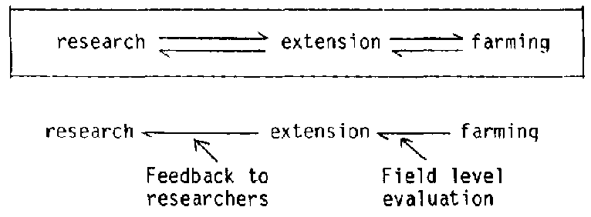
Extension: “A two-way transfer of knowledge”
Early Extension: Reciprocal
Gibbons 1984
Ostrom 2020 AFHVS 37
Notes:
Shift in Extension practices?? Explain Ostrom 2020
In Marcie Ostrom’s 202o piece she describes a shift in Exnteion practices that I would like to highlight
In 1914 the smith lever act established the cooperative Extension programs at Land grant universities
Early Extension efforts emphasized a reciprocity between researchers and farmers, university Extension held events to learn from farmers and hear their ideas about solutions
Extension has evolved however, over time and today it is easy for Extension to be this one-way effort of communication of scientific discoveries to the public
Here is a quote from the USDA NIFA’s page that describes the cooperative extension program and it highlights this one-way transfer of knowledge that current Extension is reflecting today
So that being said, I aim to conduct my extension work in this chapter with the two way framework

Slide 34
Extension: “A two-way transfer of knowledge”
Early Extension: Reciprocal
Gibbons 1984
Today: One-way
Ostrom 2020 AFHVS 37
Notes:
Shift in Extension practices?? Explain Ostrom 2020
In Marcie Ostrom’s 202o piece she describes a shift in Exnteion practices that I would like to highlight
In 1914 the smith lever act established the cooperative Extension programs at Land grant universities
Early Extension efforts emphasized a reciprocity between researchers and farmers, university Extension held events to learn from farmers and hear their ideas about solutions
Extension has evolved however, over time and today it is easy for Extension to be this one-way effort of communication of scientific discoveries to the public
Here is a quote from the USDA NIFA’s page that describes the cooperative extension program and it highlights this one-way transfer of knowledge that current Extension is reflecting today
So that being said, I aim to conduct my extension work in this chapter with the two way framework

Slide 35
USDA NIFA

Slide 36
Interviews
Formally include stakeholders in research (different than outreach)
Questions like:
How are pear pest management decisions made?
Perceptions of IPM for pear psylla
Why hasn’t IPM caught on in the Wenatchee Valley?

Slide 37
80% said that conventional pear psylla management is not effective
“Conventional orchards used to be very predictable. And effective. Now what we've got is it's unpredictable and not particularly effective.”
Notes:
Make sure they kniw you are talking about conventional!

Slide 38
80% said that conventional pear psylla management is not effective
“Conventional orchards used to be very predictable. And effective. Now what we've got is it's unpredictable and not particularly effective.”
“the cost of it is too much and one wrong timing, one off spray and everything falls apart, you got to be basically perfect on your spray program to keep your things in great shape year long, its just too small of an error window can just make things off for the remainder of the year.”

Slide 39
80% said that conventional pear psylla management is not effective
“Conventional orchard used to be very predictable. And effective. Now what we've got is it's unpredictable and not particularly effective.”
“the cost of it is too much and one wrong timing, one off spray and everything falls apart, you got to be basically perfect on your spray program to keep your things in great shape year long, its just too small of an error window can just make things off for the remainder of the year.”
“ …its the straight definition of insanity, we just can't keep banging our heads against the wall and expect to not have a headache...I think we're in a pretty poor place.”

Slide 40
Why is conventional pear psylla management the norm if it’s not effective?
Need for area-wide adoption
“I don't think unless its an area wide deal, I don’t think its feasible in [the Wenatchee River Valley]”.
Pear
Cropscape
Notes:
“given that growers say that conv is NOT working and that they recognize that biocontrol is effective, we then ask why is conventional still the norm?”

Slide 41
Why is conventional pear psylla management the norm if its not effective?
Perceived risk/Enduring practices
“So, we’re getting more confident in the program but it’s a big ask to move it to a bigger block. If it goes south, I go bankrupt.”
" Growers are very conservative. And we apparently don't see the big picture as well as we could. That every year the emphasis has always been so much on hard chemistry its sort of part of our fiber.”

Slide 42
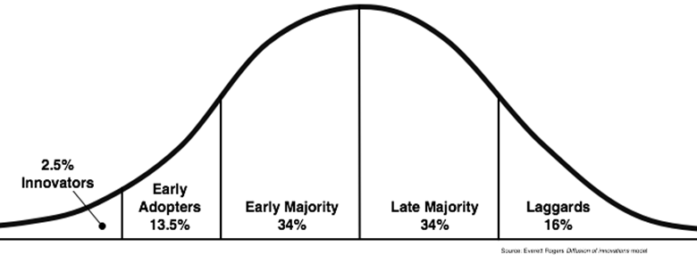
Why is conventional pear psylla management the norm if its not effective?
Lack of proof
“I think that it is possible for IPM to be more effective, but I haven't seen it yet.”
Rogers 1962

Slide 43
Bottom line
Pear psylla Pheno-IPM will
Save $
Produce good fruit
Stabilize the pear orchard ecosystem
Notes:
Long history of research
We don’t know why its not adopted!

Slide 44
Bottom line
Pear psylla Pheno-IPM will
Save $
Produce good fruit
Stabilize the pear orchard ecosystem
We don’t know why Wenatchee pear growers aren’t implementing IPM
Addressing issues like:
Lack of consistent leadership
Repetition
Making it easy
Notes:
Long history of research
We don’t know why its not adopted!

Slide 45
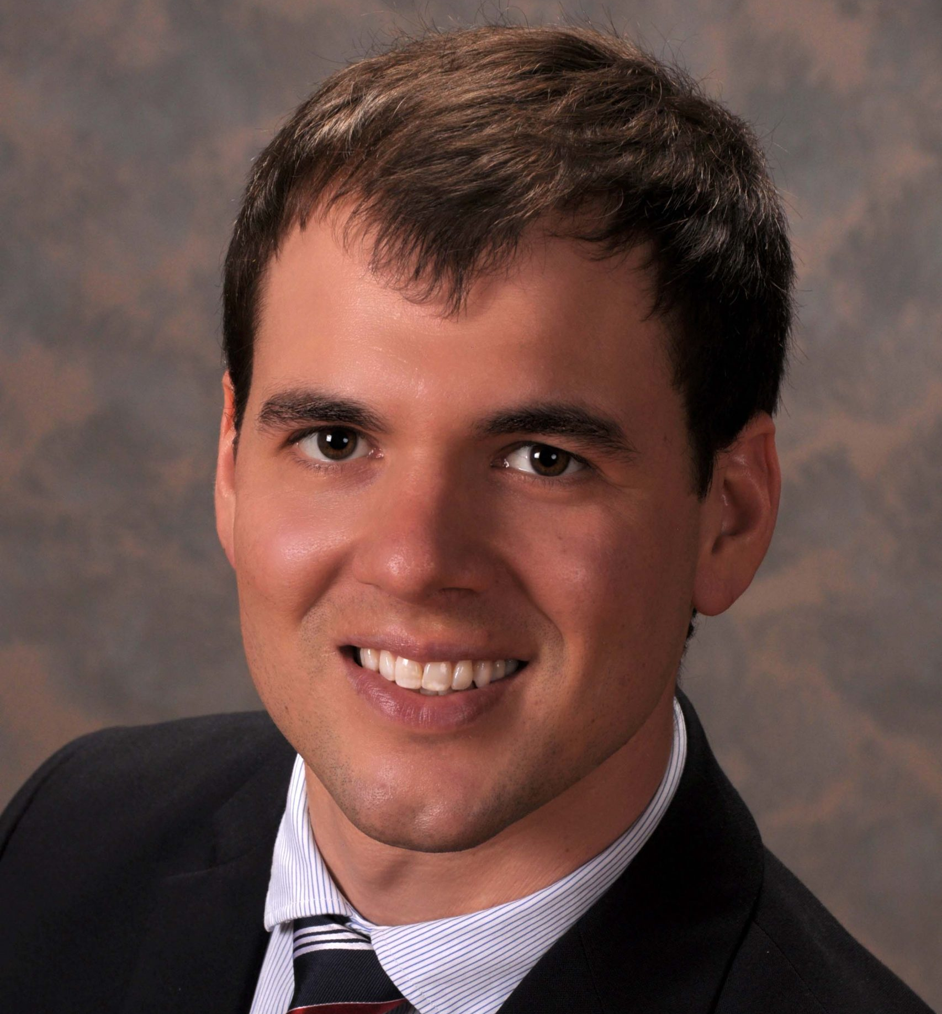
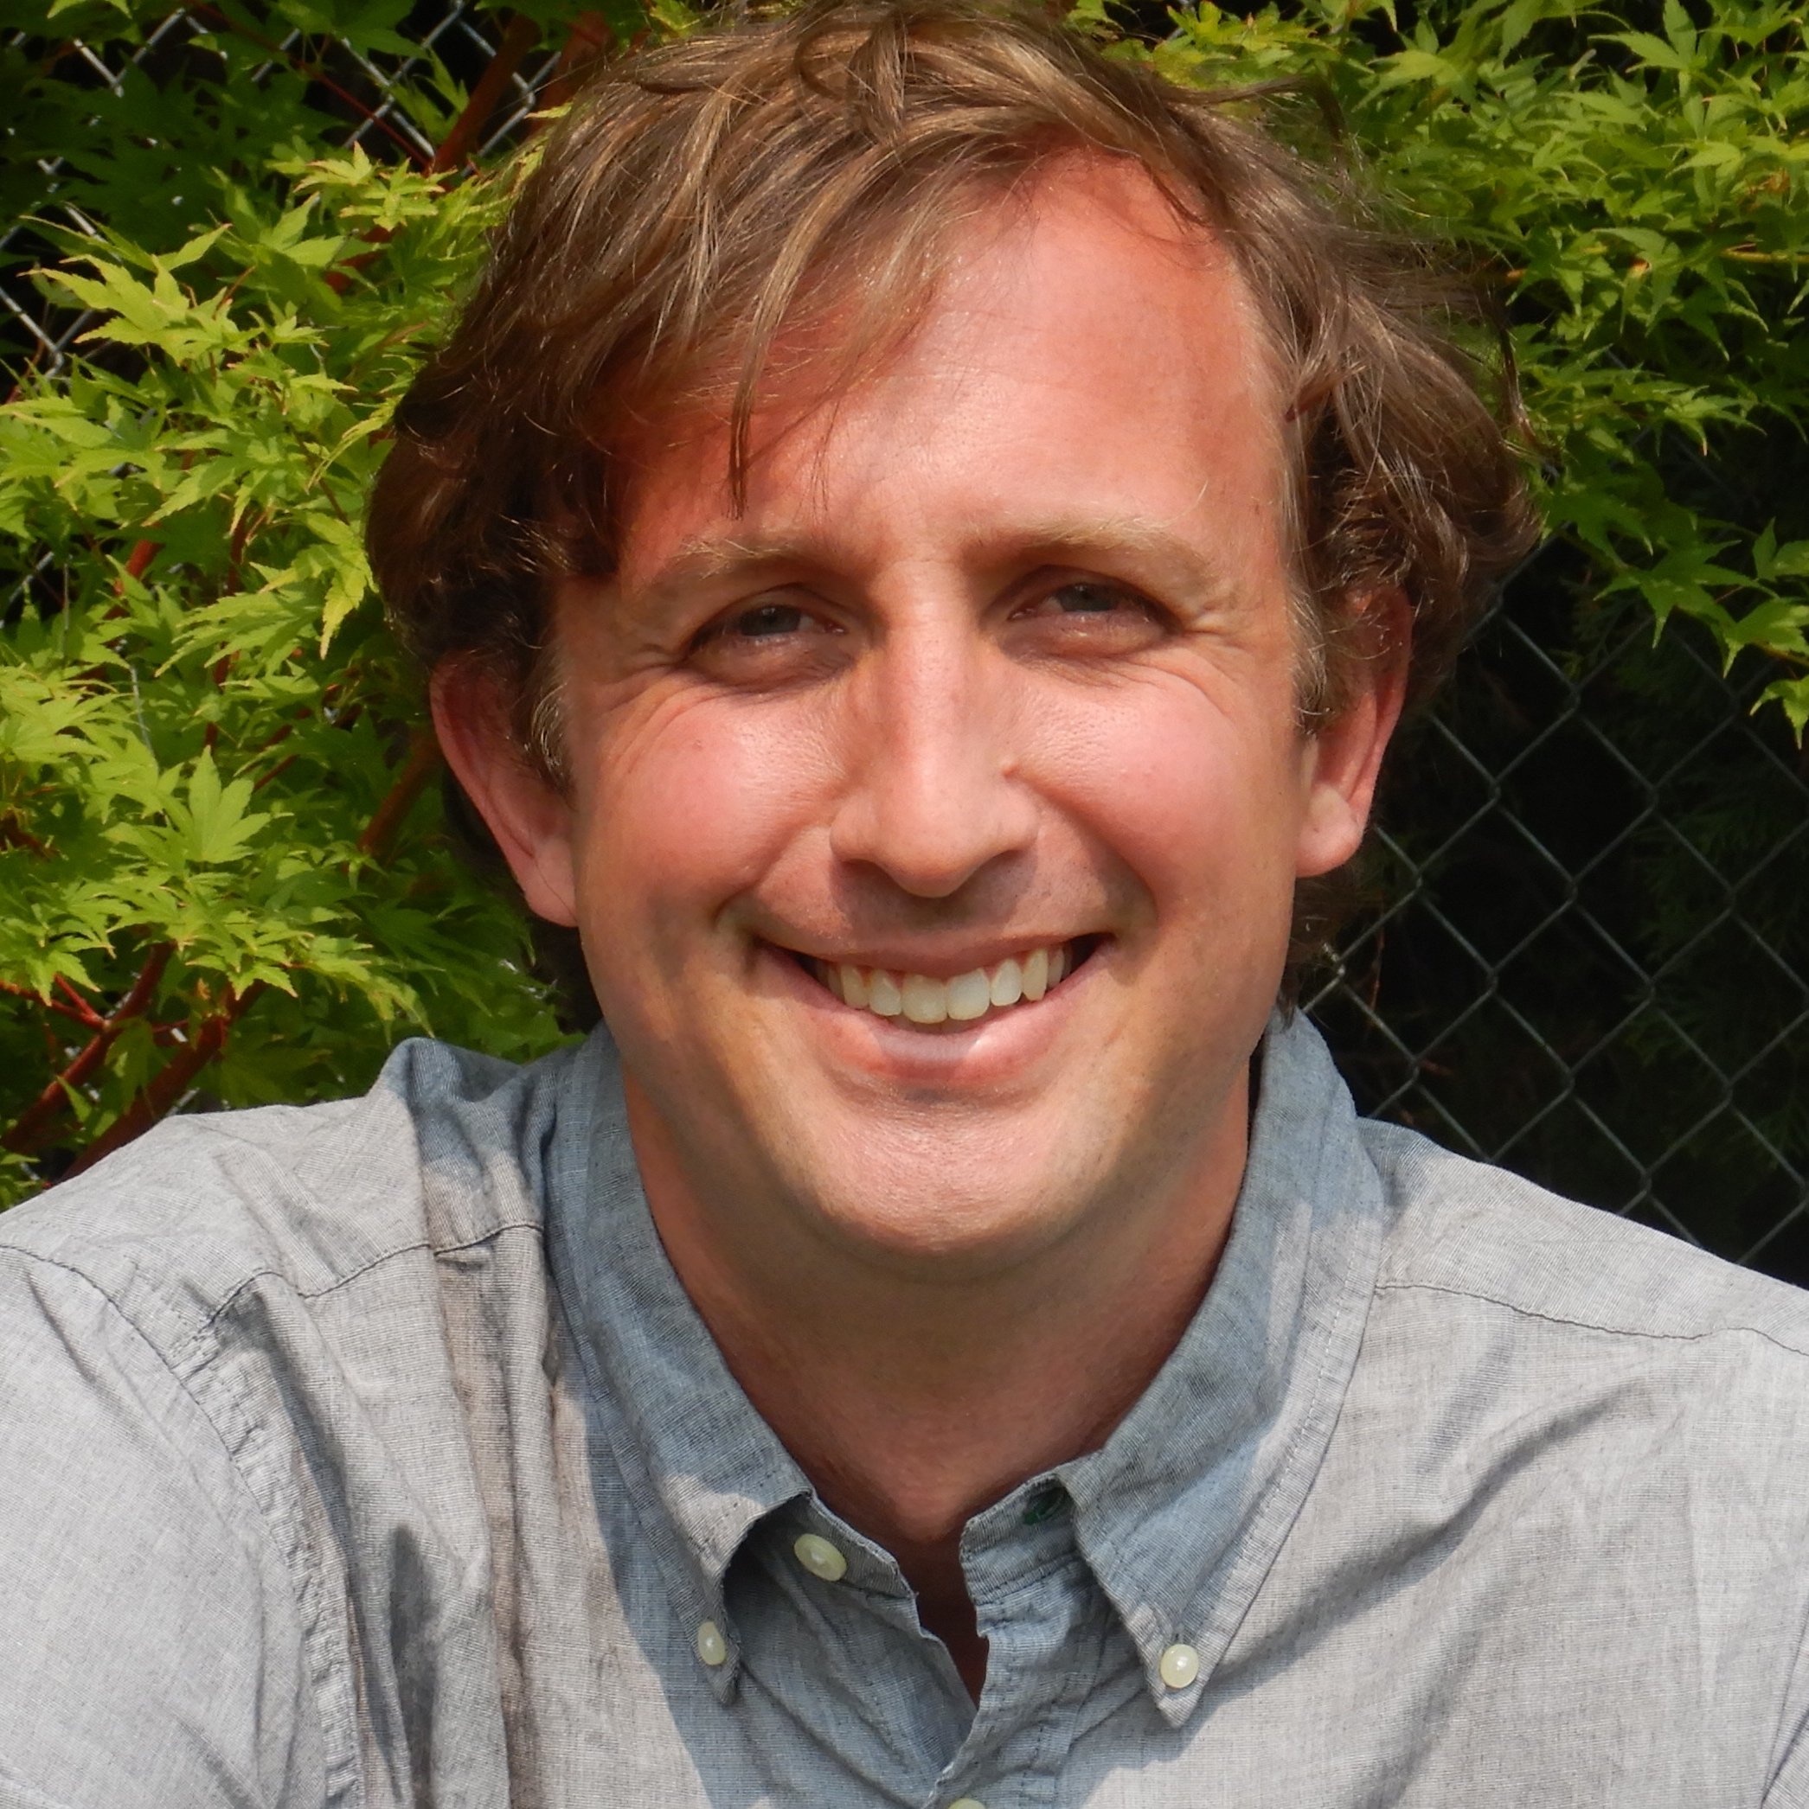
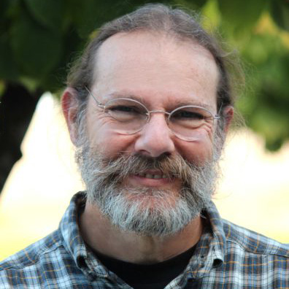
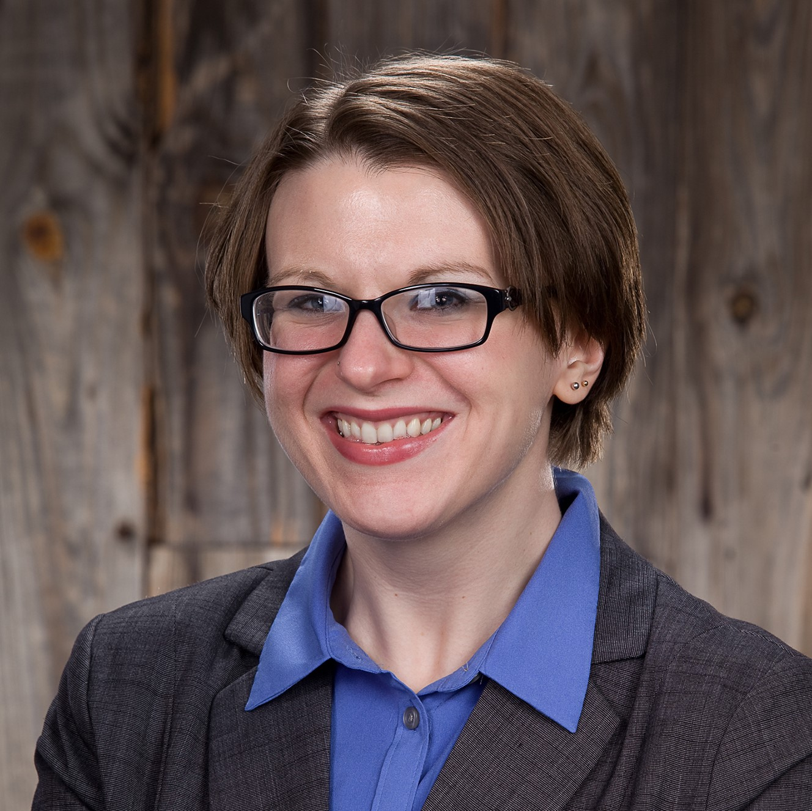
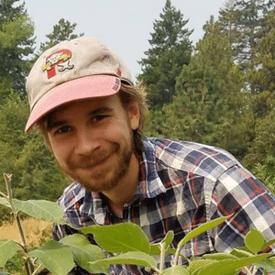
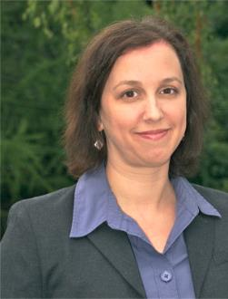
Acknowledgements
PhD Committee
Dr. Louie Nottingham
Dr. Tobin Northfield
Dr. Allan
Felsot
Dr. Rebecca Schmidt-Jeffris
Dr. Robert
Orpet
Dr. Jessica
Goldberger
The Orpet lab
And industry cooperators!

Slide 46
Questions?
email: molly.sayles@wsu.edu

