Slide 1
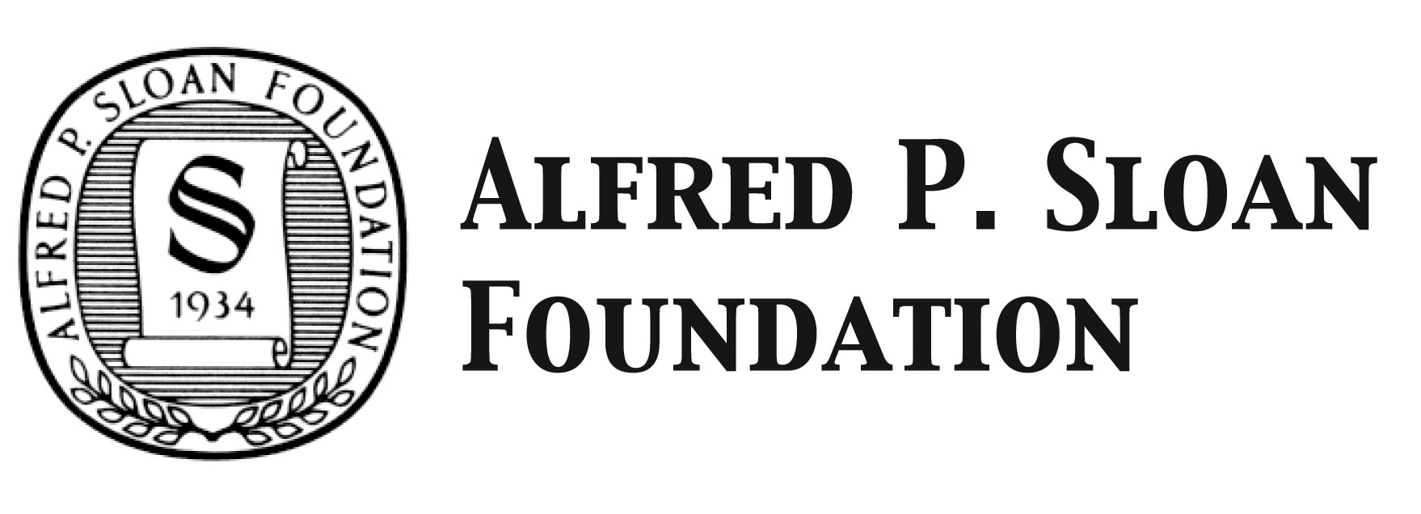
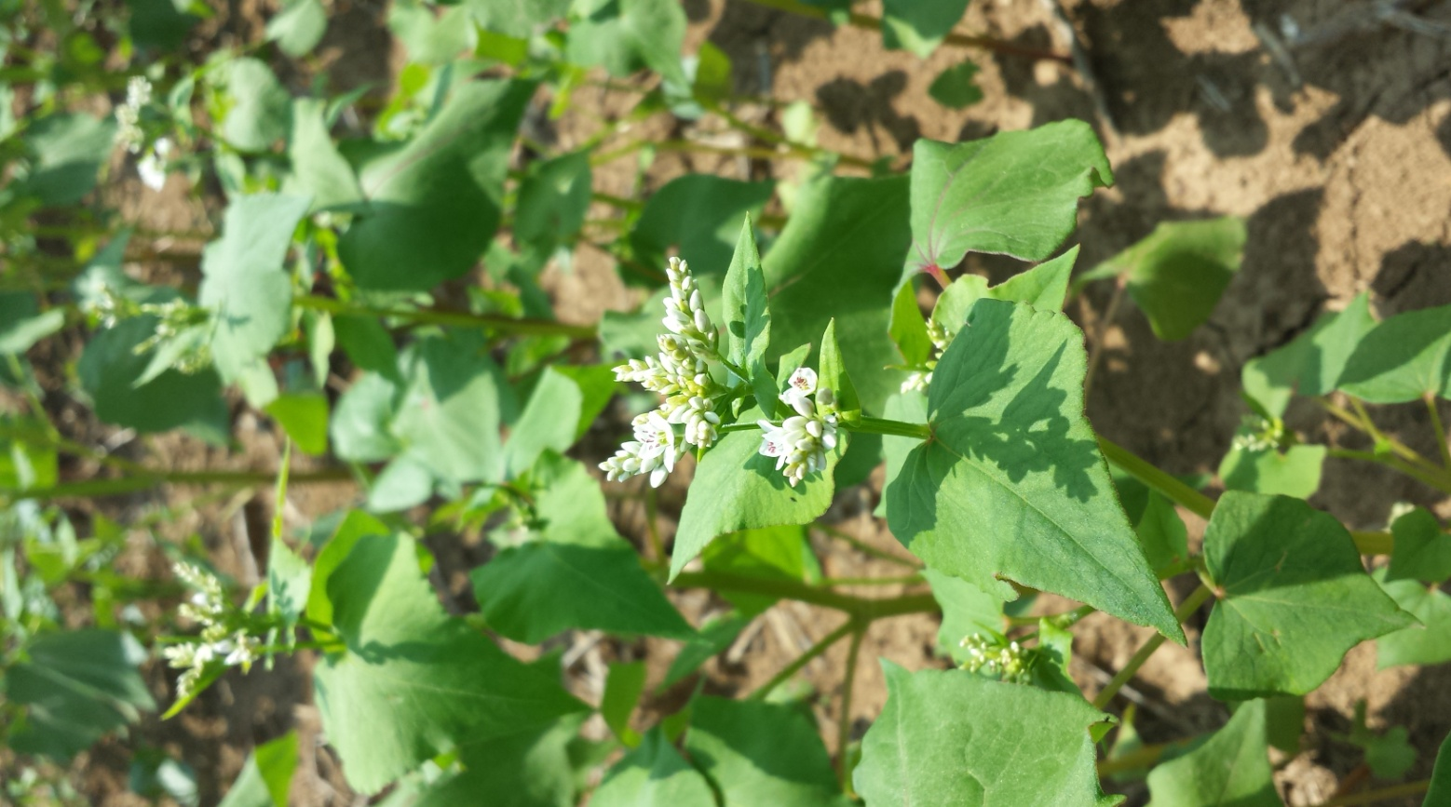
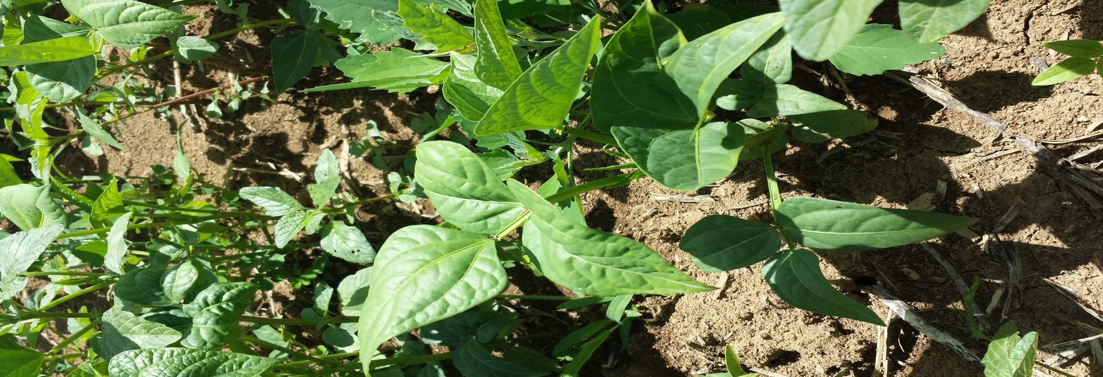
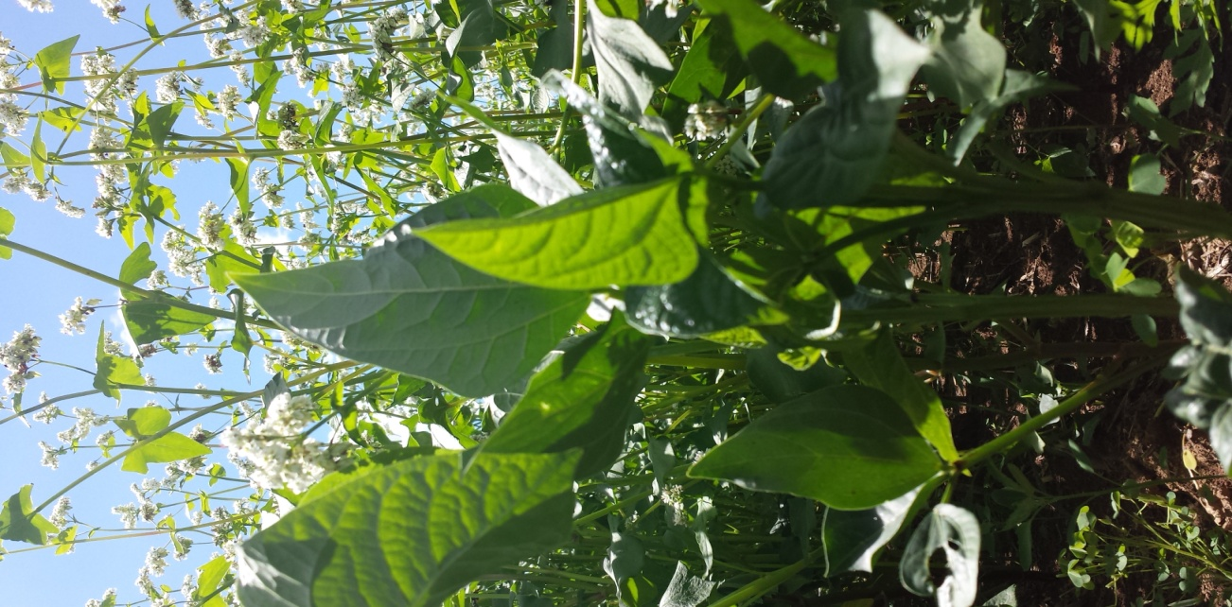
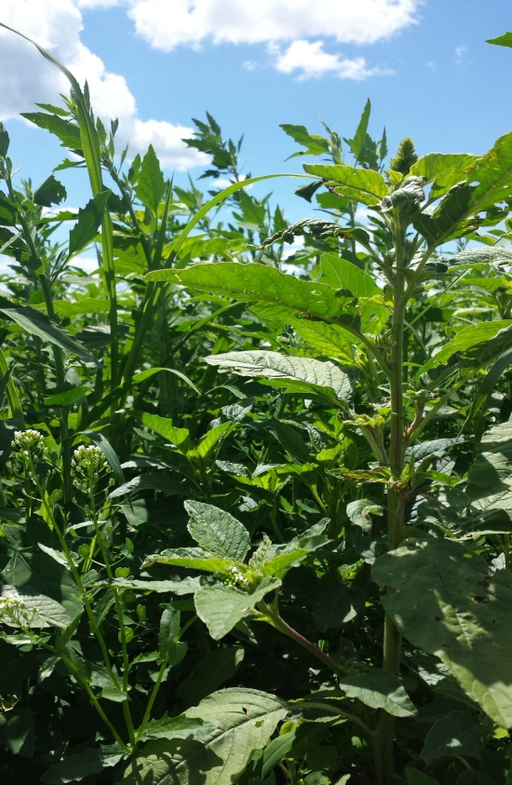
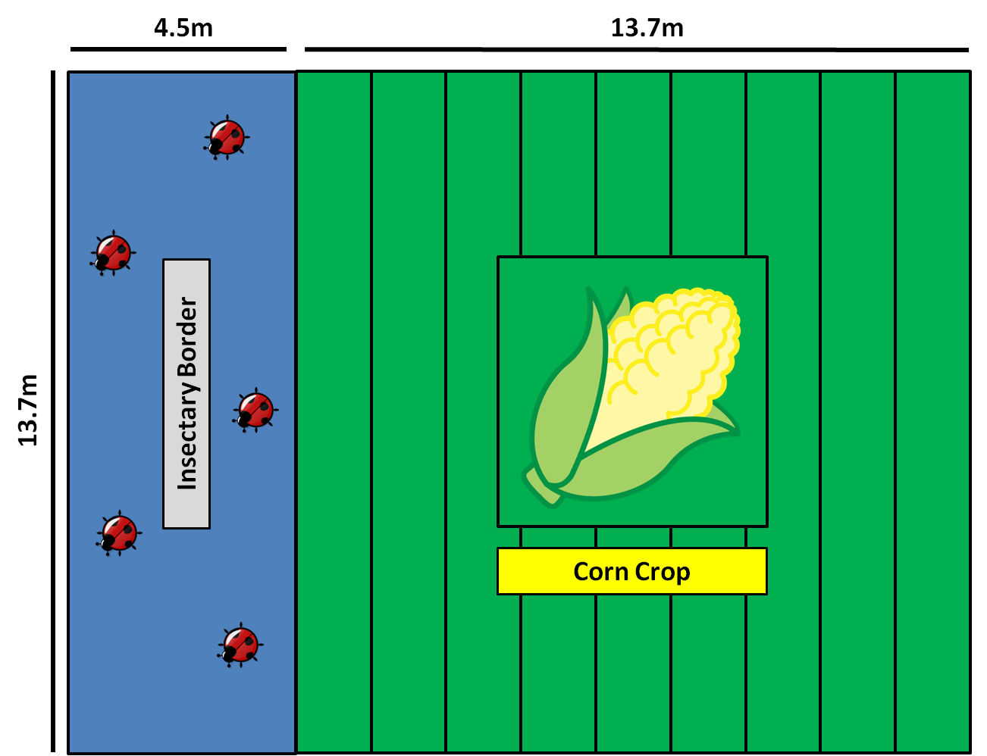
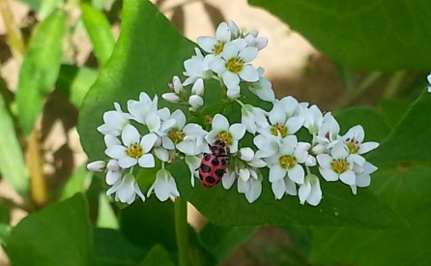
The role of insectary plants in promoting pest suppression by key generalist natural enemies
Jermaine Hinds & Mary E. Barbercheck
Department of Entomology, Pennsylvania State University, University Park, PA 16802 E-mail: jxh557@psu.edu
Introduction
Results - Resource Abundance
Findings & Discussion
Generalist predators are important contributors to pest suppression in agroecosystems.
These predators depend on plant-based resources such as nectar and pollen provided by insectary plant species to supplement their diet and meet nutrient goals when prey items are scarce. ¹
Deliberate introduction of floral resources into the landscape can enhance the presence of generalist predators and pest suppression. ²
Predators differentially respond to the presence of floral resources. ³
Providing complementary resources in a mixture through plant species diversification may support greater numbers of generalist predators.
Resource Abundance
Vigorous buckwheat establishment and floral
production. Antithesis 5 weeks after
planting.
Relatively poor cowpea establishment.
Extrafloral nectary production 3 weeks
after planting.
Natural Enemy Abundance
Significantly greater predator abundance in
BW and MX compared to CP and BG
treatments suggest strong predator attraction.
Low numbers of predators present in CP
suggest they are not strongly attracted.
Sentinel Egg Predation
No apparent effect of treatment on levels of
predation in crop adjacent to insectary
border.
Sentinel egg predation appear to be depressed
within insectary borders.
Do natural enemies utilizing insectary borders
suppress prey in adjacent crop?
a.
b.
Figure 1. Mean density of a.) buckwheat inflorescences and b.) cowpea extrafloral nectaries measured through the growing season. Buckwheat bloomed 5 weeks after planting. Cowpea produced extrafloral nectaries 3 weeks after planting.
Objectives
Results - Natural Enemy Abundance
Examine the potential for two insectary plant species to support natural enemies by assessing:
Floral resource availability in an insectary strip
Natural enemy abundance in an insectary strip
Predation levels in an insectary strip and main crop
a.
b.
Experimental Design
Future Directions
To further understand how natural enemies utilize resources provided by insectary borders, I will use a protein based immunomarking assay to track insect movement between the insectary border and main crop ⁴
Additionally, protein marked sentinel prey may be used to examine the proportion of eggs attacked by predators that previously inhabited the insectary border. ⁵
Studies such as these contribute to the understanding of conservation approaches to biological control. By understanding natural enemy preferences and floral use patterns, we can better design planting schemes to enhance pest suppression in agroecosystems
Figure 2. Mean number of generalist predators, a.) C. maculata and b.) O. insidiosus collected from sweep net sampling throughout growing season. Predators are strongly attracted to flowering buckwheat. No apparent preference for cowpea extrafloral nectaries.
Results – Sentinel Egg Predation
Treatments (from left): Buckwheat (BW), Cowpea (CP), Buckwheat-Cowpea Biculture (MX), Weedy fallow (BG).
Plot Layout
Target Insects
Coleomegilla maculata- pink spotted ladybeetle
Acknowledgements
This research is funded by a:
USDA-Organic Research and Extension Initiative (OREI) grant administered to J. Kaye, M. Barbercheck, D. Mortensen, D. Luthe.
USDA – Northeast Sustainable Agriculture Research and Education program graduate student grant. administered to Jermaine
Hinds and Mary Barbercheck.
Alfred P. Sloan Minority Ph.D programs Scholarship administered to Jermaine Hinds
Photo Credits: Jermaine Hinds and Jeremy Sell thelifeofyourtime.wordpress.com
Orius insidiosus -insidious flower bug
Sampling:
Plant measurements and resource counts
Sweep net samples and timed counts
Predation via sentinel eggs (Ostrinia nubilalis)
Literature Cited
Figure 3. Mean proportion of Ostrinia nubilalis sentinel egg masses attacked by predators in insectary border treatments (0m) and increasing distances (1.5m, 4.5m, 7.6m, and 12.2m) into the adjacent main crop. No treatment effects on sentinel egg predation were observed. Predation within insectary borders are low relative to levels within the crop.
1.Choate, B.A., Lundgren, J.G. 2013. Why eat extra floral nectar? Understanding food selection by Coleomegilla maculata (Coleoptera: Coccinellidae).
Biocontrol. 58(3):359-367.
2. Letourneu, D.K, et al. 2011. Does plant diversity benefit agroecosystems? A synthetic review. Ecological Applications 21(1): 9-21.
3. Begum, M., Gurr, G., Wratten, S.D., Hedberg, P.R., Nicol, H.I. 2006. Using selective food plants to maximize biological control of vineyard pests. Journal of
Applied Ecology. 43: 547-554.
4. Jones, V.P., Hagler, J.R., Brunner, J.F., Baker, C.C., Wilburn, T.D. 2006. An inexpensive immunomarking technique for studying movement patterns of
naturally occurring insect populations. Environmental Entomology 35(4): 827-836
5. Kelly, J.L., Hagler, J.R., Kaplan, I. 2012. Employing immunomarkers to track dispersal and trophic relationships of a piercing-sucking predator, Podisus
maculiventris (Hemiptera: Pentatomidae). Environmental Entomology. 41(6): 1527-1533.

