Slide 1
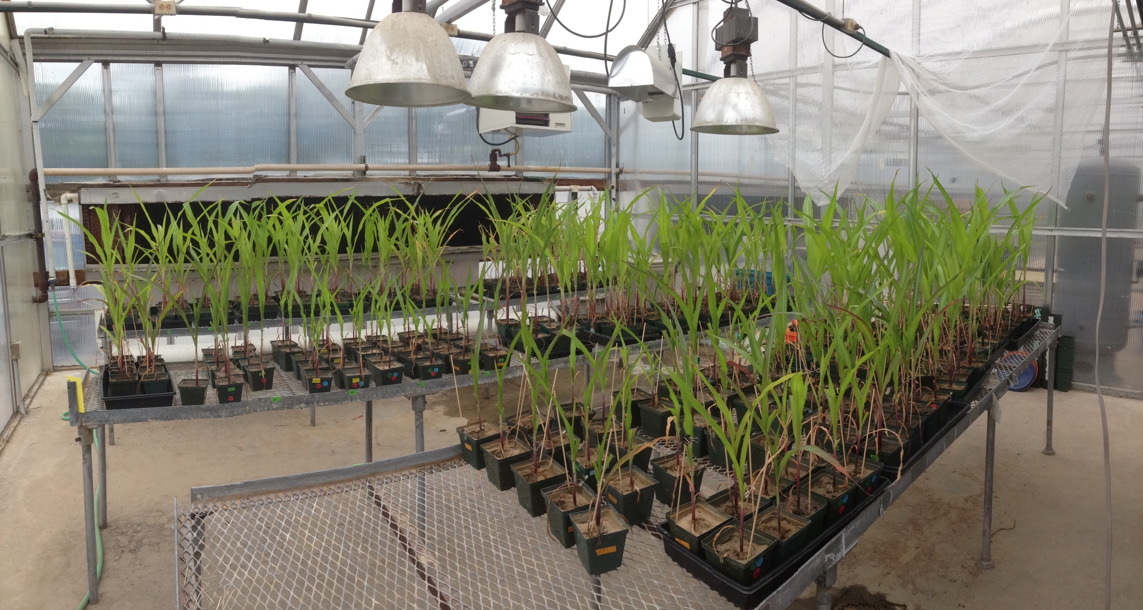
Do biotic components of healthy soils increase plant resistance to herbivores?
Elizabeth Rowen, John Tooker
The Pennsylvania State University
University Park, PA

Slide 2
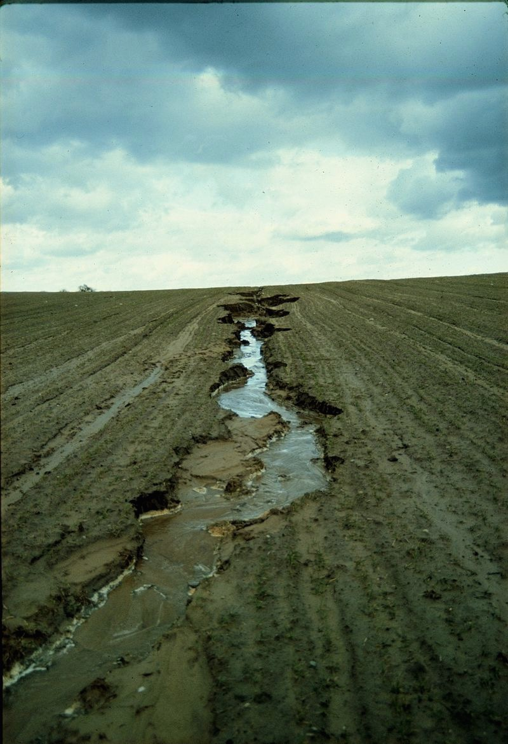
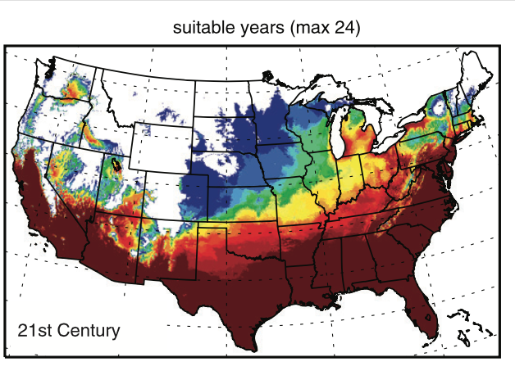
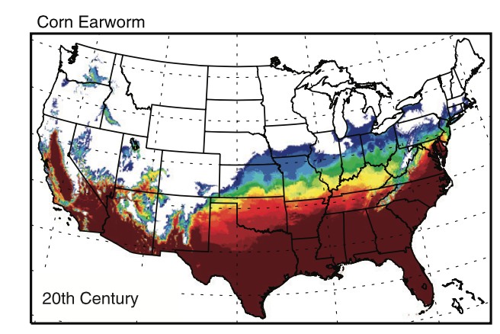
Photo: https://en.wikipedia.org/wiki/Soil_erosion
Diffenbaugh et al. 2008

Slide 3
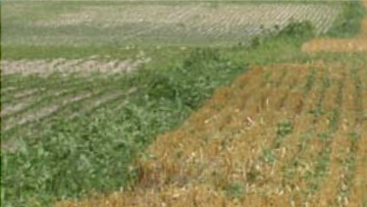
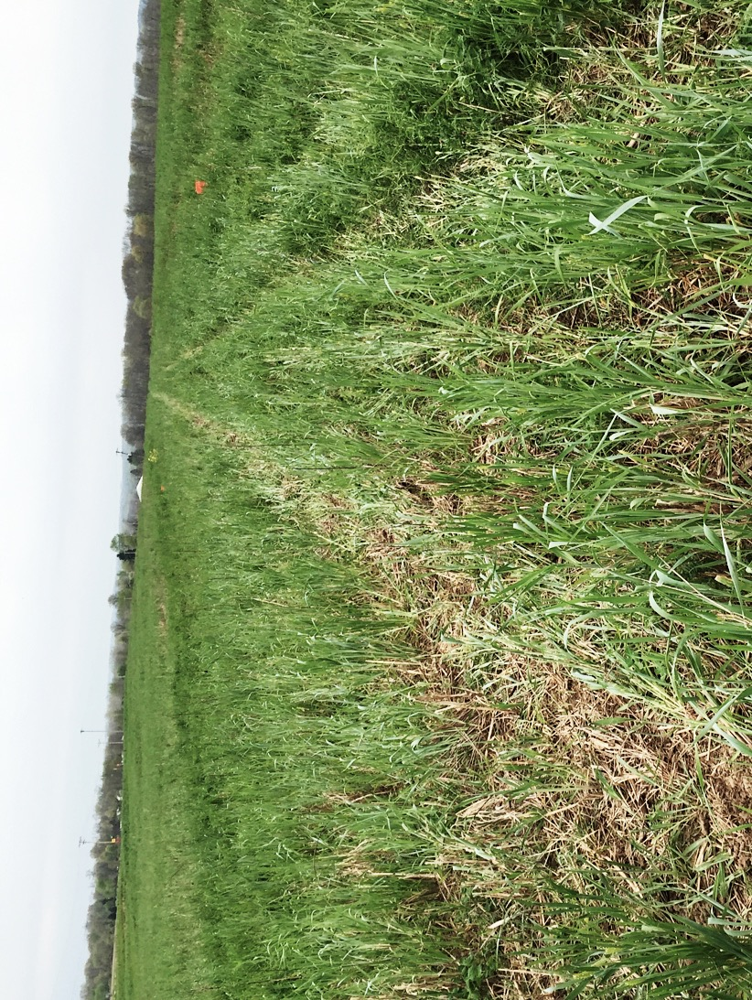
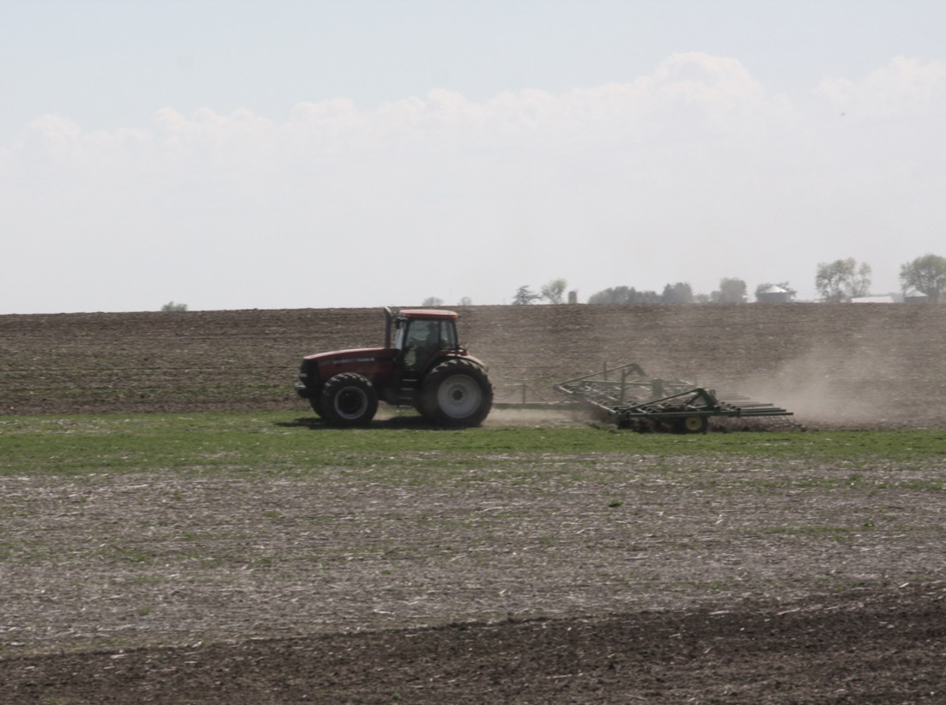
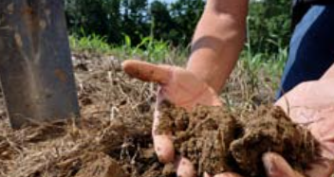
Crop Rotation
Soil health
= capacity to function, optimal for soil type, promotes plants, animals and ecosystems
Cover crops
No Till
Nutrient Management
Pest Management
Adapted from NRCS Soil Health Checklist

Slide 4
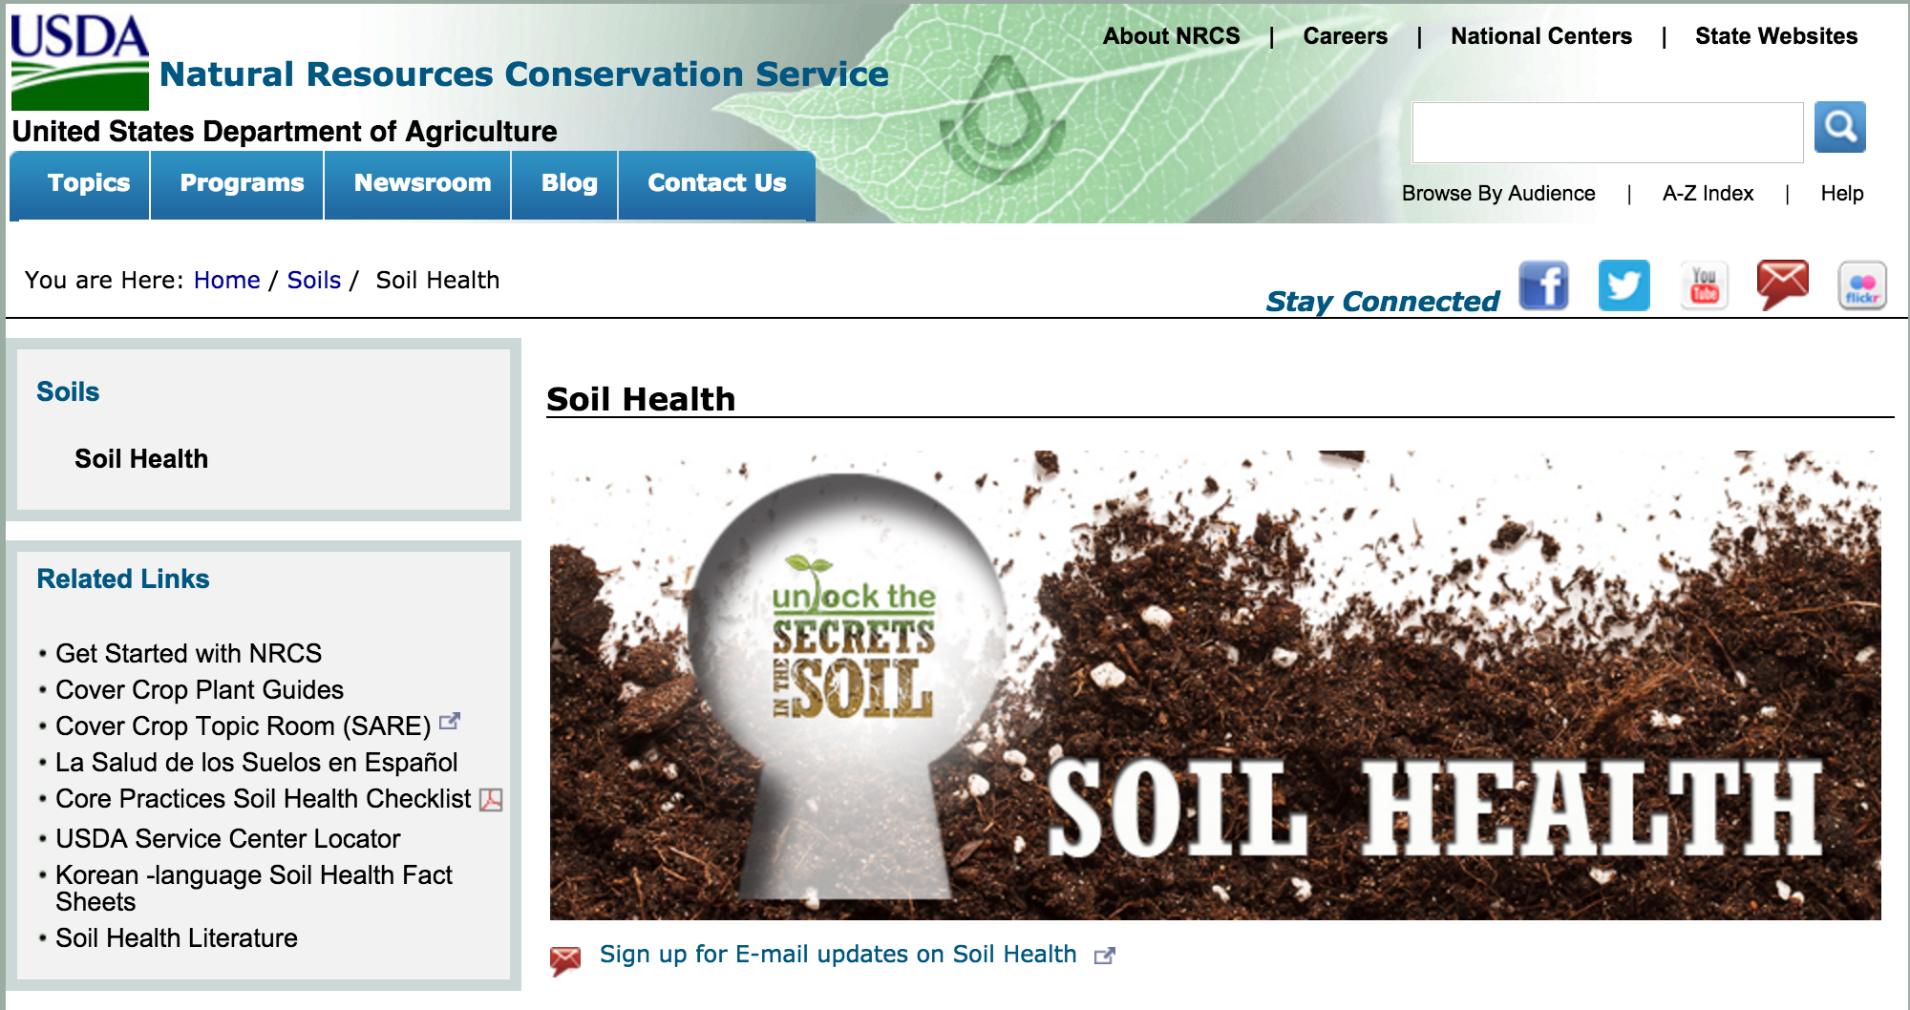

Slide 5
Soil Health management
No-till/cover crops
Conventional
Tillage/no cover crops
More organic matter
Roots + exudates
= more microbes
Less organic matter
No roots
= less microbes

Slide 6
79-100% of maize hectares were insecticides in the US in 2011
Douglas & Tooker, 2016

Slide 7
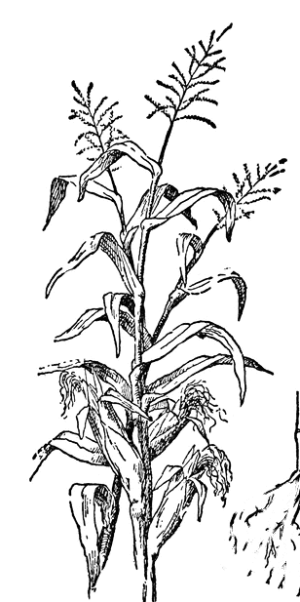
Herbivores
Single microbe strains affect plant growth and defenses
Suppressive Soils
Whole communities interact with disease agent
SOIL
Microbes
Lugtenberg et al., 2001 Huang et al., 2009; Mendes et al., 2011 ; Song et al., 2013; An et al., 2016

Slide 8
Managing for soil health promotes more diverse microbe community
Some microbes affect plant growth and defense
Is “soil health” management a way to promote plants that are less pest friendly ?

Slide 9
Objective 1: How does managing for soil health affect plant-insect interactions?
Hypothesis: Managing for soil health makes caterpillars feeding on plants smaller

Slide 10
Objective 2: Determine if the effect of soil health on plant resistance is due to microbial communities
Hypothesis: Changes in microbial communities drive changes in caterpillar mass
Alternative Hypothesis: Changes in nutrient availability drive changes in caterpillar mass

Slide 11
Collect soils
Steam soils
Grow plants
Feed plants to herbivores

Slide 12
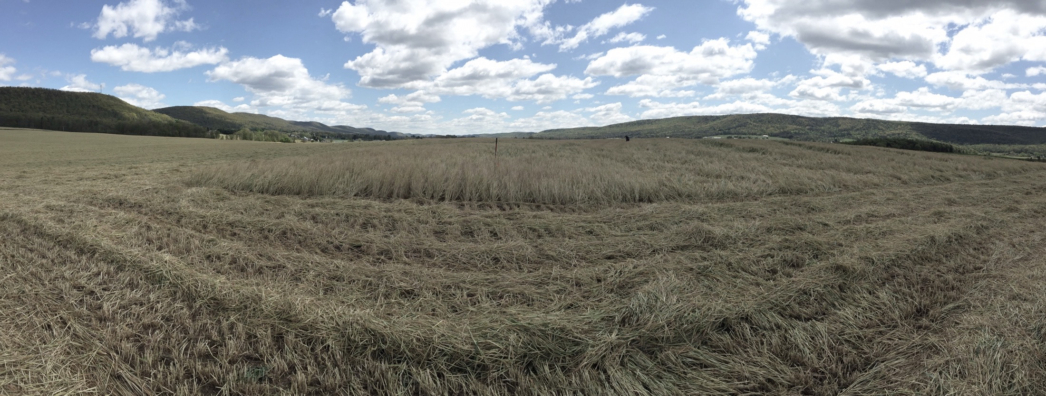
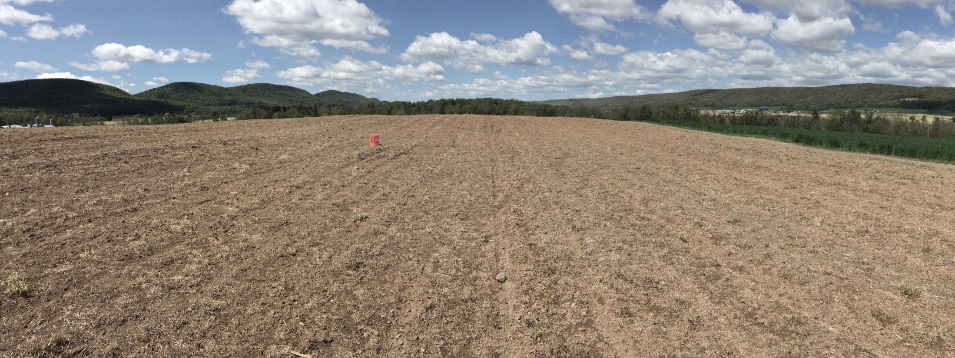
Soil Health
45 years no-till
Rye cover crops
Conventional Till
0 years no-till
NO cover crops

Slide 13
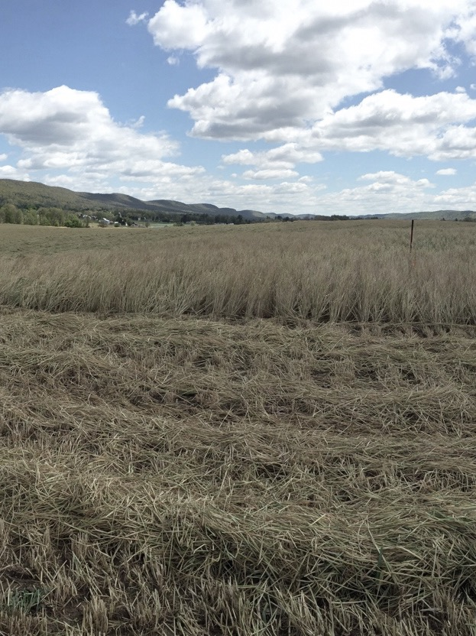
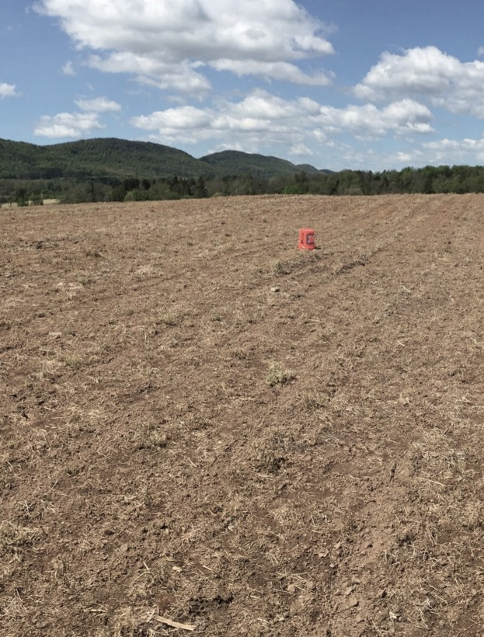
 | ‘Soil health’ | Conventional
Nitrate | Low | High
Phosphorus | High | High
Potassium | High | High
Organic Matter | High | High
Microbial Resp. | High | High
Soil Health
Conventional Till
Both soils should support good plant growth and big microbial biomass
The conventional field will have more problems with nutrient run-off

Slide 16
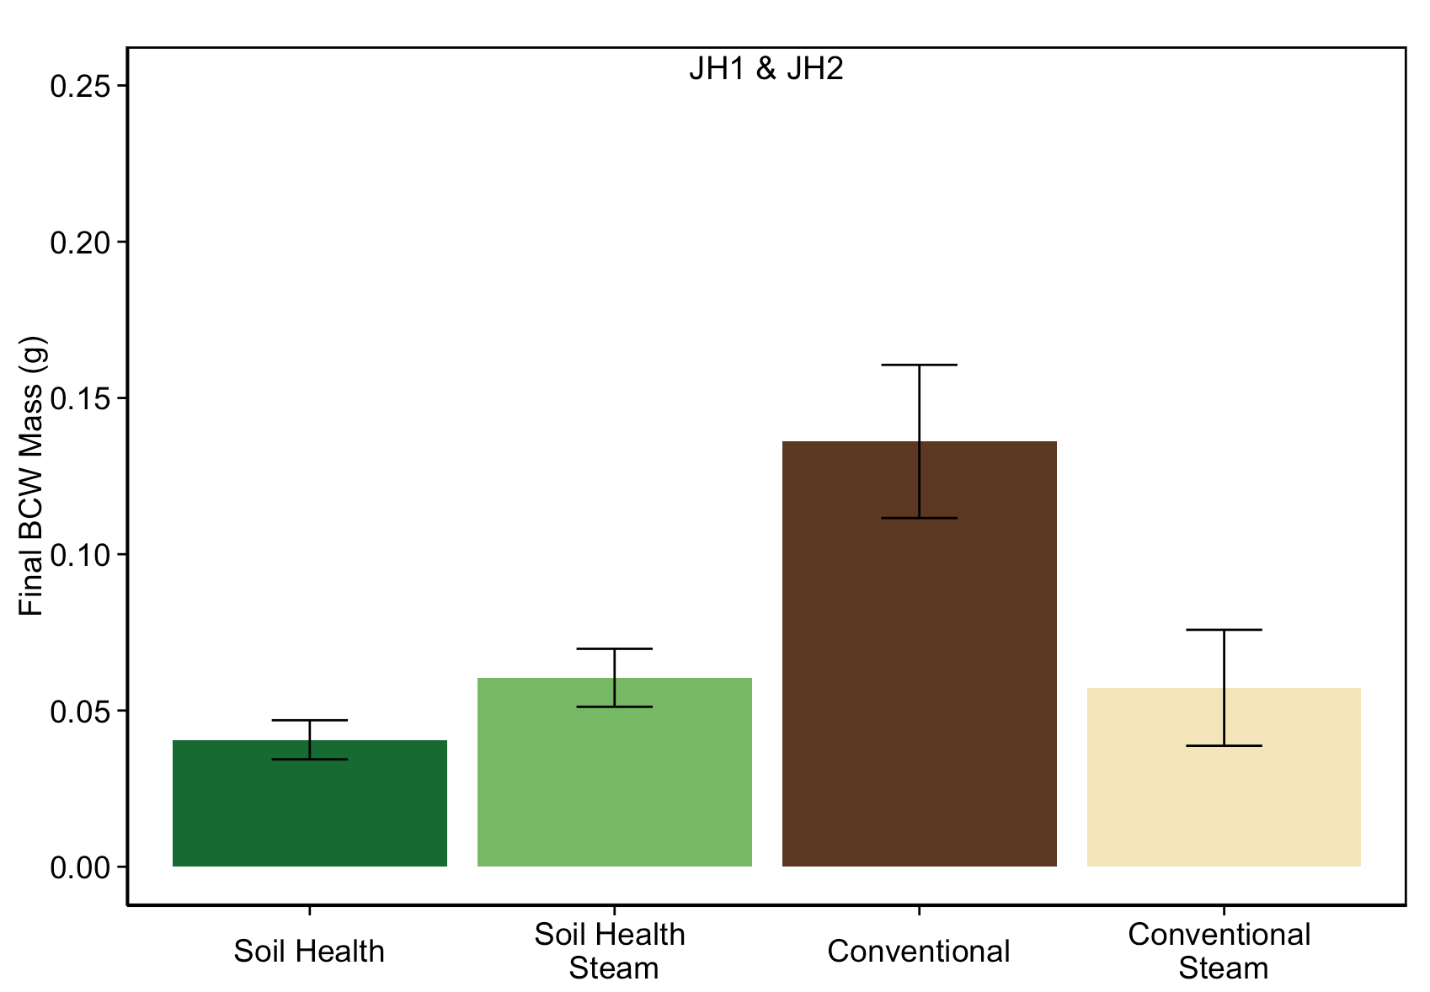
Hypothesis: Changes in microbial communities drive changes in plant quality
Hypothesis: Managing for soil health makes caterpillars feeding on plants smaller.
***
**
ANCOVA: F_{4,19}=9.218, P<0.001; Soil: P<0.001; Soil*Steam Treatment: P=0.01

Slide 17
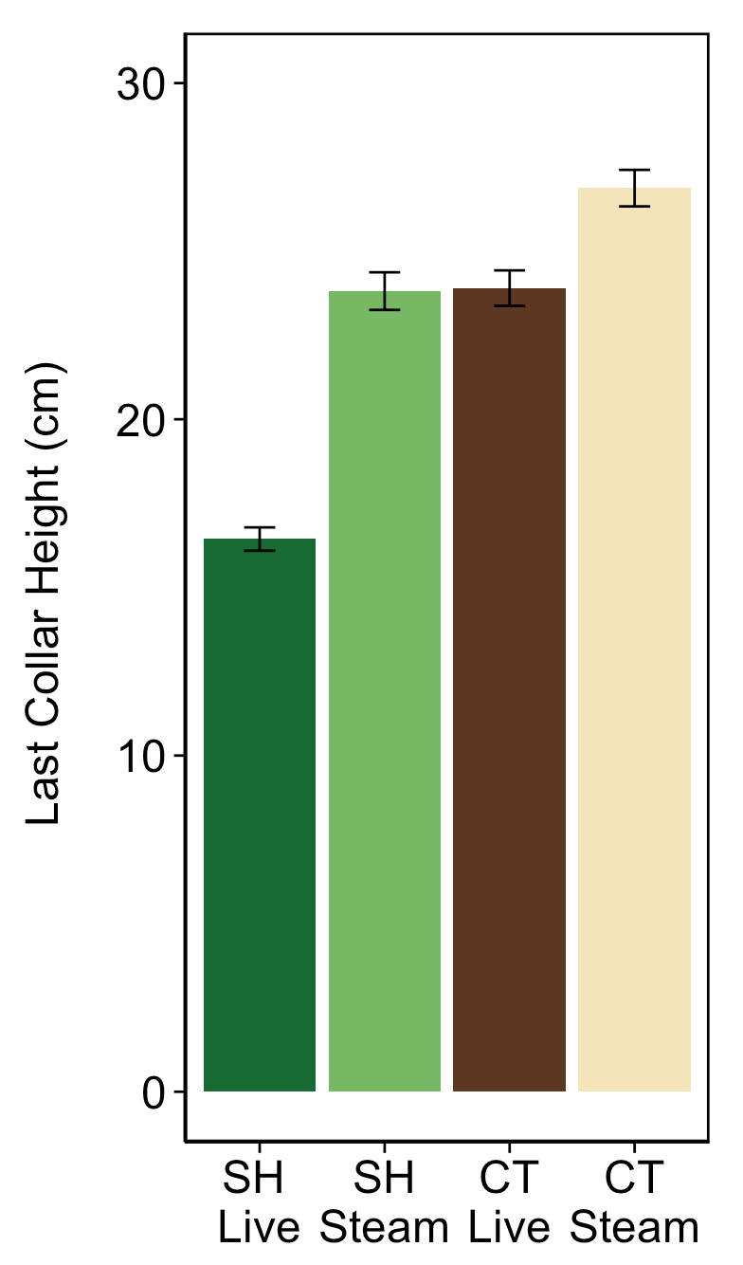
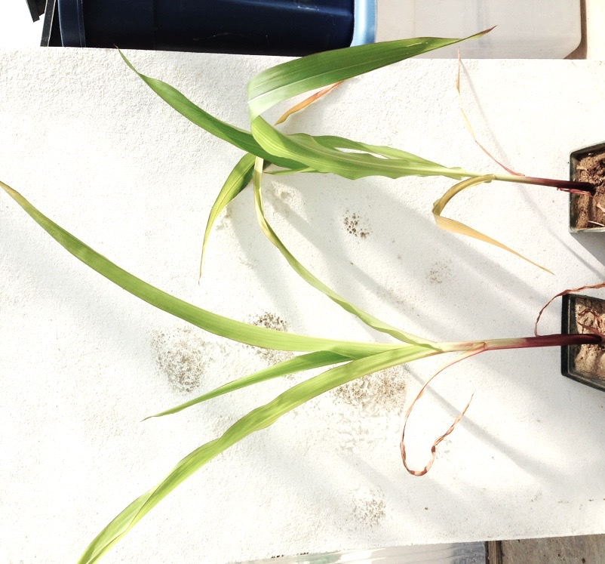
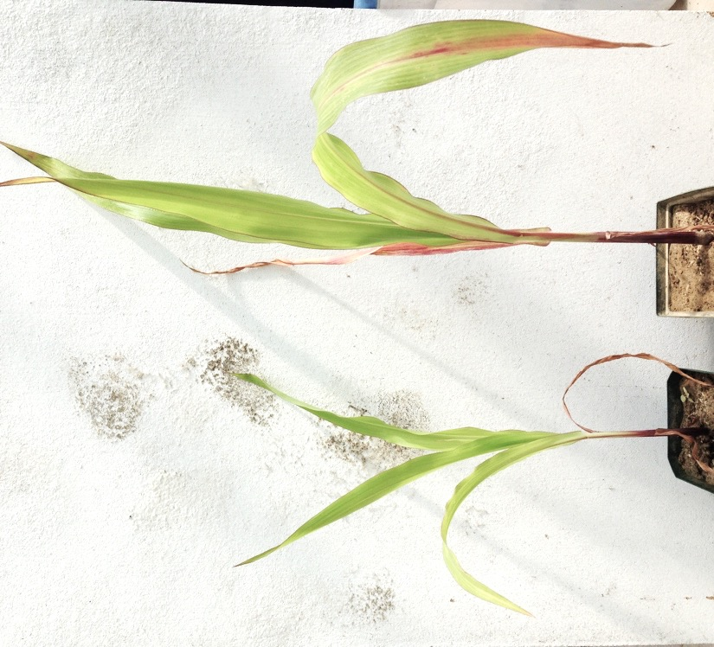
Conventional
CT
c
L
S
b
b
a
Soil Health
SH
L
S
ANOVA: F_{3,59}=79.91, P<0.001; Tukey HSD test

Slide 18
 | ‘Soil health’ | Conventional
Nitrate | Low | High
Phosphorus | High | High
Potassium | High | High
Organic Matter | High | High
Microbial Resp. | High | High
Soil Health
Conventional Till
Nutrient content changes as a result of steaming soils

Slide 19
Objective 2: Determine if the effect of soil health on plant resistance is due to microbial communities
Hypothesis: Changes in microbial communities drive changes in caterpillar mass
Alternative Hypothesis: Changes in nutrient availability drive changes in caterpillar mass

Slide 20
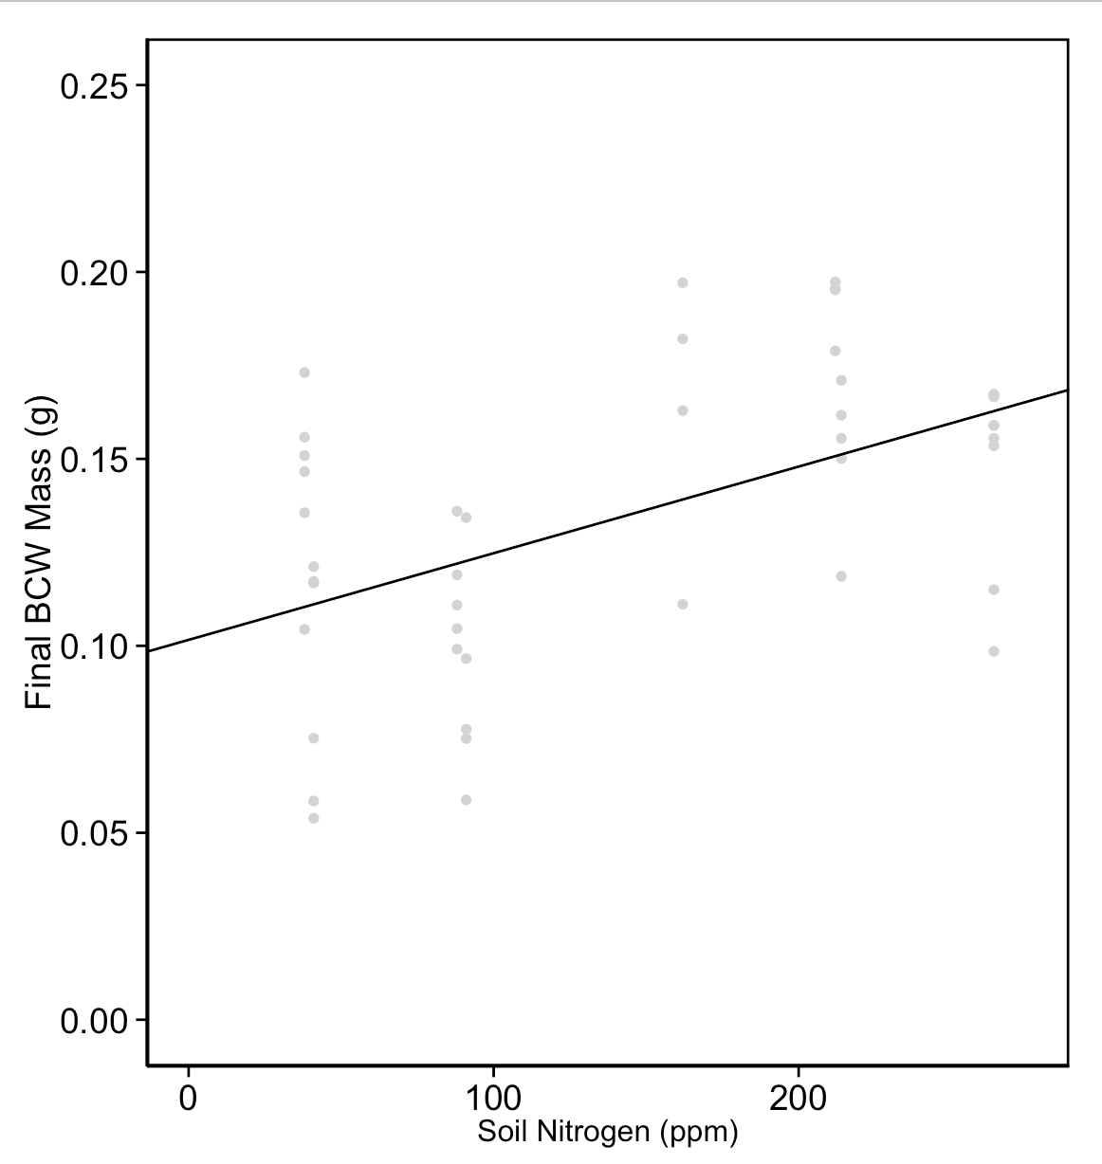
Soil Health
Conventional
**
Nitrogen is not influencing caterpillar mass!
**
steam
steam
steam
ANCOVA: F_{5,28}=7.263, P<0.001; Nitrogen not significant!

Slide 21
Objective 1: How does managing for soil health affect plant-insect interactions?
Hypothesis: Managing for soil health makes caterpillars feeding on plants smaller
YES Managing for soil health DOES make caterpillars feeding on plants gain less mass.

Slide 22
Objective 2: Determine if the effect of soil health on plant resistance is due to microbial communities
Hypothesis: Changes in microbial communities drive changes in caterpillar mass
YES, Probably.
Alternative Hypothesis: Changes in nutrient availability drive changes in caterpillar mass
Nutrients contribute somewhat–but its not the whole story

Slide 23
There are some limitations
1 study site Steaming soil has some flaws

Slide 24
First time looking at ‘soil health’ influencing plant defenses

Slide 25
Future Directions
Plant biochemistry/defenses
Add farms
Separate effects of microbes from nutrients more effectively and look at interactions

Slide 26
Acknowledgements
Tooker Lab
Kirsten Pearsons
Maggie Douglas
Marion Le Gall
Eric Yip
Anna Busch
Mackenzie Hodges
Andrew Awschwanden
Lab techs
Charlie White (soil respiration)
John Spargo
Farmers
Jim Harbach
Dave Brandt
Gerard Troisi
Backed by Anne W. Baker, Leslie Baker, Gina Angelella, Ian Kaplan, Christina Tran, Ngoc Phan, Brittany Sanders, Adam Michael Alford, Karen Ferriere, Carmen Blubaugh, Andrew Hyde, Michelle Ichikawa, Seana Davidson, DeCourcy O'Grady, Kirsten Pearsons, Wythe Marschall, Pureum Kim, Roberta Chan, Jacob Shiach, WEE MING, Cindy Wu, and Eric Damon Walters

Slide 27
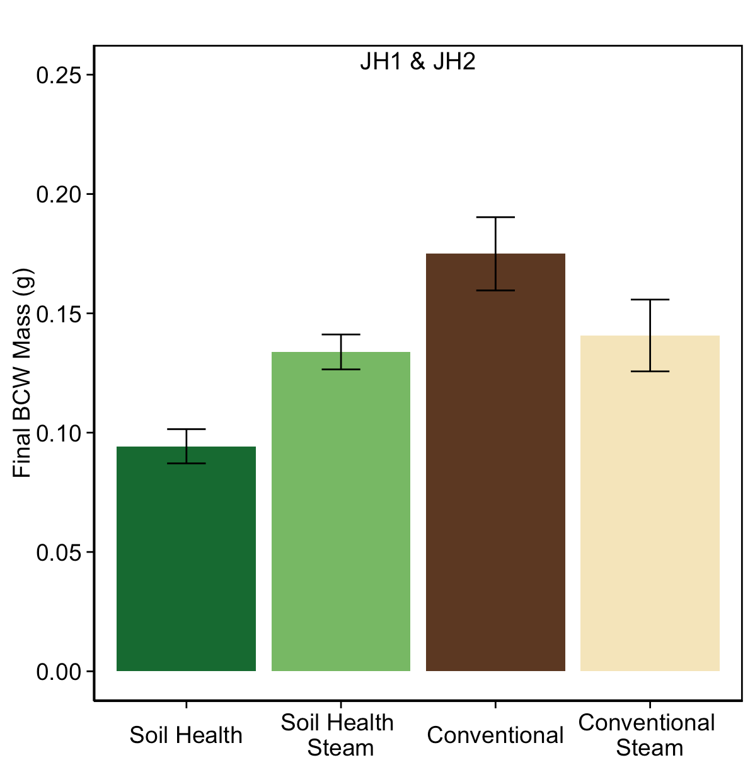

Slide 28
Hypothesis: Changes in microbial communities drive changes in plant quality
Hypothesis: Managing for soil health makes caterpillars feeding on plants smaller.
***
**
ANCOVA: F_{4,16}=9.218, P=0.002; Soil: P<0.001; Soil*Steam Treatment: P=0.01

Slide 29
Correlation between mass and damage

Slide 30
Herbivores
Plant quality
Tillage
SOIL
Nutrients
Microbes
Cover Crops

Slide 31
More pathogens in conventional system?
Herbivores
Plant quality
SOIL
nutrients microbes
Soil health practices

Slide 32
Above ground predators/parasitoids
Plant-feeding herbivores
Plant quality
Ground dwelling predators
Plant volatiles
SOIL
nutrients microbes
Entomopathogenic fungi
Soil health practices

Slide 33
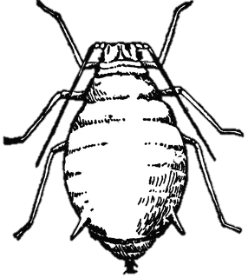
Collect soils
Steam soils
Grow plants
Feed plants to herbivores
Microbial respiration
Nutrient differences
JA, carb/protein
Growth/
reproduction

Slide 34
Objective 1: Determine if managing for soil health make plants more resistant to insects
Herbivores
Hypothesis 1: Managing for soil health makes caterpillars feeding on plants gain less mass.
Plant quality
SOIL
Soil health management

Slide 35
Objective 2: Determine if the effect of soil health on plant resistance is due to microbial communities
Herbivores
Hypothesis 2a: Changes in microbial communities drive changes in plant quality
Plant quality
Hypothesis 2b: Changes in nutrient availability drive changes in plant quality
SOIL
Nutrients
Microbes
Soil health management

Slide 36
Objective 1: Determine if managing for soil health make plants more resistant to insects
Hypothesis 1: Managing for soil health makes caterpillars feeding on plants gain less mass.
Objective 2: Determine if the effect of soil health on plant resistance is due to microbial communities
Hypothesis 2a: Changes in microbial communities drive changes in plant quality
Hypothesis 2b: Changes in nutrient availability drive changes in plant quality

Slide 37
Soil Health –
No-till / cover crops
Microbial Communities
Objective 1: Determine if managing for soil health make plants more resistant to insects
Objective 2: Determine if the effect of soil health on plant resistance is due to microbial communities
??
Plant Resistance to Insects

Slide 38
Soil Health –
No-till / cover crops
Microbial Communities
YES, Probably.
Hypothesis 2a: Changes in microbial communities drive changes in plant quality
Objective 2: Determine if the effect of soil health on plant resistance is due to microbial communities
??
Hypothesis 2b: Changes in nutrient availability drive changes in plant quality
Nutrients contribute somewhat–but its not the whole story
Plant Resistance to Insects

Slide 39
“The capacity of a specific kind of soil to function, within natural or managed ecosystem boundaries, to sustain plant and animal productivity, maintain or enhance water and air quality, and support human health and habitation” (Karlen et al., 1997)

Slide 40
Soil Health –
No-till / cover crops
Microbial Communities
Can change resistance:
SH increases
CT decreases
OBJECTIVES
??
??
YES
Plant Resistance to Insects

Slide 41
Soil Health
pH: 7.6
Nitrate: 40.9 ppm
Phosphorus: 133 ppm
Potassium: 566 ppm
OM: 4.1 %
pH: 7.6
Nitrate: 38.1 ppm
Phosphorus: 165 ppm
Potassium: 495 ppm
OM: 3.8 %
45 years no-till
Rye cover crop
Conventional Till
pH: 7.2
Nitrate: 214 ppm
Phosphorus: 533 ppm
Potassium: 472 ppm
OM: 4.4 %
pH: 7.4
Nitrate: 162 ppm
Phosphorus: 662 ppm
Potassium: 464 ppm
OM: 3.4 %
0 years no-till
NO cover crop

Slide 42
Soil health
= supporting optimal function of plants, animals and ecosystems
changes with management
Picture of db1

Slide 43
Soil Health
Conventional Till
45 years no-till
Rye cover crop
0 years no-till
NO cover crop
 | ‘Soil health’ | Conventional
Nitrate | Low | High
Phosphorus | High | High
Potassium | High | High
Organic Matter | High | High
Microbial Resp. | High | High

Slide 44
Soil Health –
No-till / cover crops
Microbial Communities
Hypothesis 2a: Changes in microbial communities drive changes in plant quality
Objective 2: Determine if the effect of soil health on plant resistance is due to microbial communities
Hypothesis 2b: Changes in nutrient availability drive changes in plant quality
??
Plant Resistance to Insects

Slide 45
Soil Health –
No-till / cover crops
Objective 1: How does managing for soil health affect plant-insect interactions?
YES Managing for soil health DOES make caterpillars feeding on plants gain less mass.
Hypothesis 1: Managing for soil health makes caterpillars feeding on plants gain less mass.
Plant Resistance to Insects

Slide 46
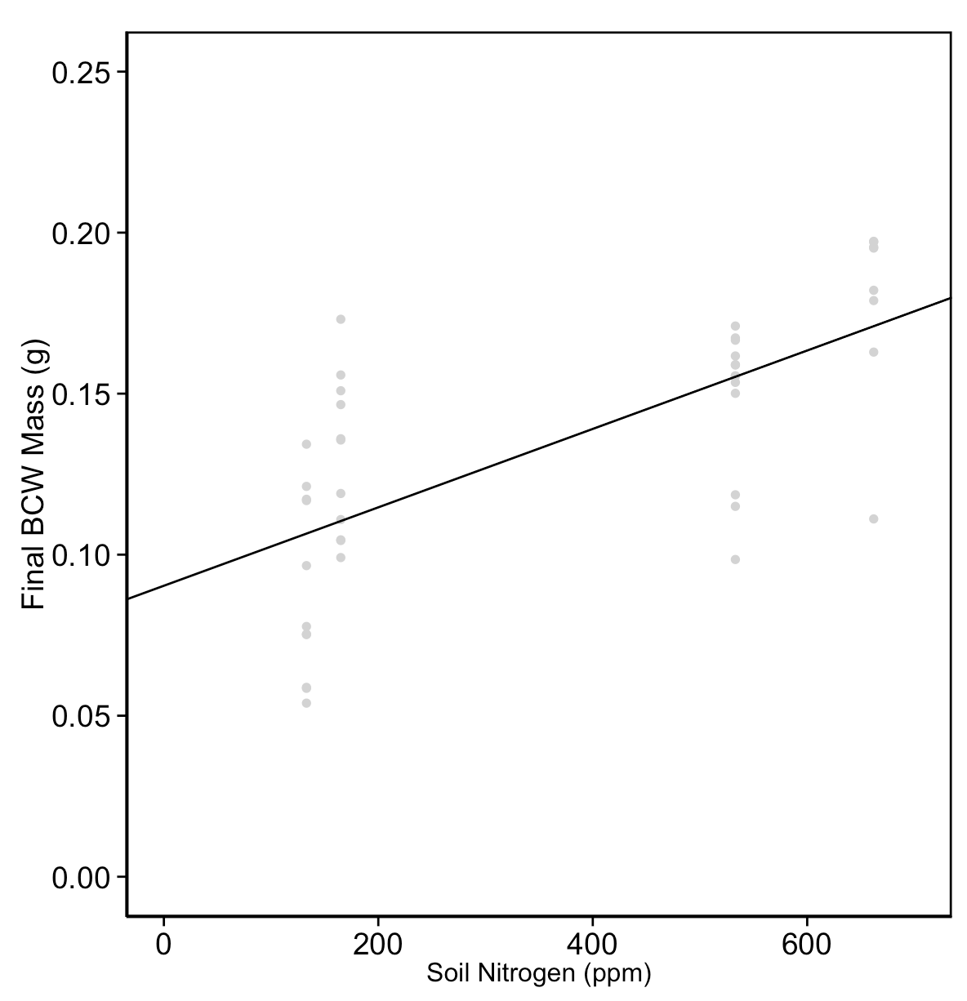
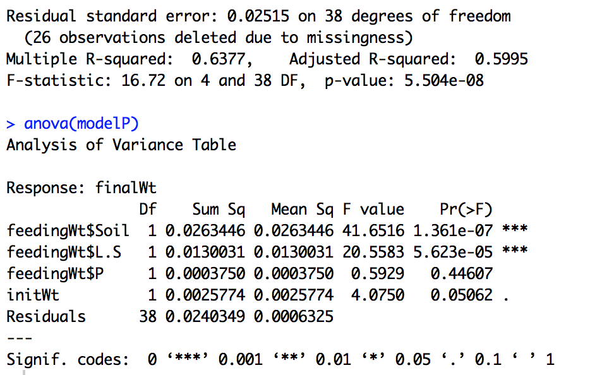

Slide 47
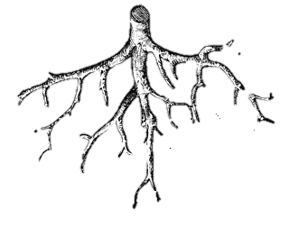
Conventional
Tillage/no cover crops
Soil Health management
No-till/cover crops
Less organic matter
No roots
Erosion
= less microbes
More organic matter
Roots + exudates
Water retention
= more microbes

