Slide 1
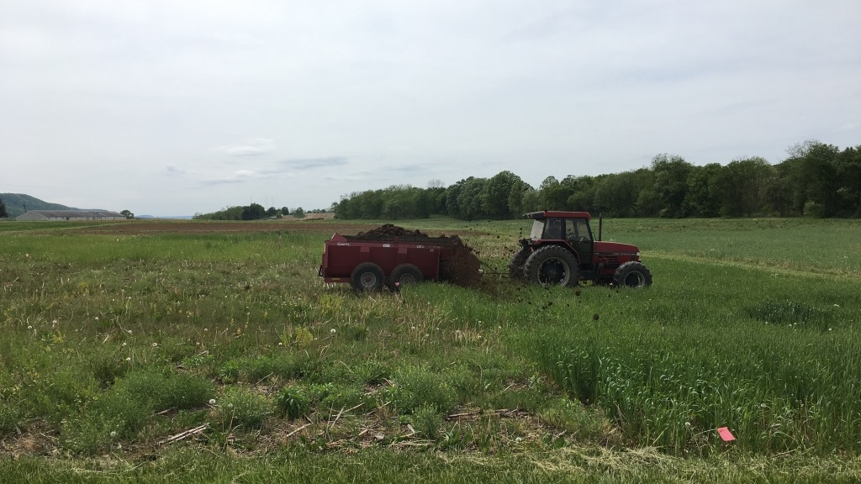
Manure increases corn resistance to some lepidopteran herbivores
Elizabeth Rowen & John Tooker
The Pennsylvania State University

Slide 2
Manure used widely, especially Northeast US
10% acres of cropland were fertilized with manure (2012)
Manure is cheap fertilizer
and in excess from farm operation
Darker yellow = higher proportion manure fertilizer
Based on 2012 Ag Census data
Notes:
Manure comes from cows/chicken – manure lagoon – cow standing on a pile of shit
jojo1 photography
—Getty Images/Flickr Select
https://www.omlet.us/guide/chickens/chicken_care/handling
Ron Kimball/KimballStock

Slide 3
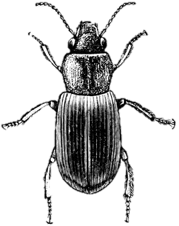
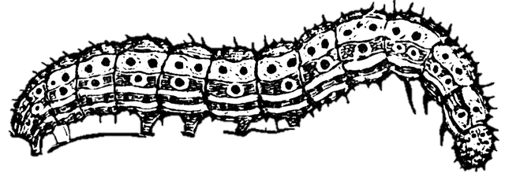
Manure has advantages
Manure helps build soil organic matter, water infiltration, and soil invertebrate community
Manure increases
arthropod predator communities
Manure lowers herbivore performance
USDA 2015
Garrett et al. 2010; Birkhofer et al. 2008
Garrett et al. 2010; Phelan 1996; Staley et al., 2010
Rowen, Tooker & Blubaugh, in prep

Slide 4
How does manure change herbivore performance?
NPK availability
Micronutrients
Defense
Manure releases N (&P,K) more slowly than inorganic fertilizers (Azeez and Van Averbeke, 2010)
Most herbivores respond positively to N (Mattson 1980)
Micronutrients in manure but not inorganic fertilizer
(Warman and Cooper, 2000)
May contribute to increased defense, lowered free nutrients in plants (Borpatragohain et al., 2016; Dordas, 2008)
Increased production of secondary metabolites
(Wszelaki et al., 2005; Hsu et al., 2009; Staley et al., 2010; Koh et al., 2013)
Rowen, Tooker & Blubaugh, in prep

Slide 5
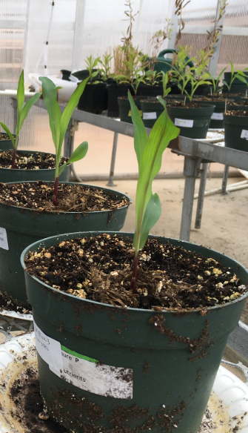
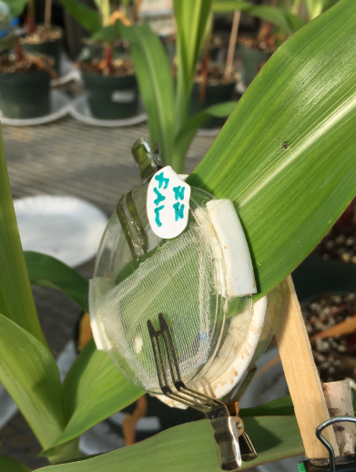
Fertilized with Manure or Inorganic NPK
Grew corn in GH for 5 weeks
Tissue for elemental nutrient content
Fall armyworm (FAW) or black cutworm (BCW) feed for 48 h
Tissue for defensive protein induction
FAW or BCW
feed for 6 d
Weighed larvae
Elemental nutrient content of leaves
Protein

Slide 6
Predictions
NPK availability
Micronutrients
Defense
Manure-fertilized plants will have lower NPK in tissue than inorganic fertilized plant
Manure-fertilized plants will have higher micronutrients.
Previous studies suggest that certain micronutrients are negatively correlated with herbivore growth in manure-amended plants
Inducible defensive proteins, PIs, PPOs and PODs, are important digestibility reducers in corn.
Manure may affect inducibility of defenses
Rowen, Tooker & Blubaugh, in prep

Slide 7
Manure reduces BCW growth,
not FAW
BCW
FAW
P = 0.001
NS
Manure
Inorganic
ANCOVA: final weight ~ fertilizer + initial weight
Notes:
Partial least squares regression

Slide 8
Manure does not increase NPK
NPK availability
Manure-fertilized plants will have lower NPK in tissue than inorganic fertilized plants
N.S.
N.S.
N.S.
Manure
Nitrogen (% dry weight)
P (% dry weight)
N (% dry weight)
Phosphorus (% dry weight)
K (% dry weight)
Potassium (% dry weight)
Inorganic

Slide 9
No differences in foliar nutrients
2) Micronutrients
Higher in manure plants
Foliar Nutrient Concentrations
Also looked at each nutrient individually
PCA – with one outlier removed
Notes:
B not reported on manure test

Slide 10
No differences in foliar nutrients except boron
Micronutrients
Fertilizer: P=0.03
N.S.
N=8
n=10
Hypothesis
n=8
Boron (ppm)
B deficient corn
Manure
Inorganic
Boron (ppm)
Notes:
Remove the line
Point out that it is a small sample size

Slide 11
No difference in protein content
NPK availability
Micronutrients
N.S.
N=3
N=4
Manure
Inorganic
Notes:
Make it clear that these data are preliminary

Slide 12
Defense
Defensive proteins induced differently by BCW & FAW in manure
Manure increase induction of digestibility reducing proteins
B
Tukey HSD
B
Tukey HSD
Tukey HSD
B
A
Manure
A
A
A
A
A
A
Inorganic
A
A
A
A
AB
AB
AB
A
A
B
Control
Control
Control
Control
Control
Control
Notes:
Make into grams of protein – also fix spelling of protein – reduce legend for y axis

Slide 13
Changes in B explain results so far
NPK availability
Micronutrients
Defense
No differences between nutrients in plant tissues…
B responsible for decreased BCW growth?
Translocation of starch and sugar (Duggar et al. 1953)
Can affect PPOs/PODs and other chemical defenses in tobacco and birch (Ruiz et al. 1999; Ruuhola et al. 2011)
FAW suppressing PIs & not inducing PPOs/PODs
BCW inducing PPO/POD in inorganic treatment
– although does not explain growth

Slide 14
What does this all mean?
Response to manure is caterpillar specific
Boron higher in manure treated plants
Leaf protein not different between manure and inorganic fertilizer
Possibly, BCW responding to unknown defense or physical structure
Notes:
Go back to circle things

Slide 15
Thank you
Funded by NE SARE grant GNE16-135
Tooker Lab
Special thanks to undergrads Hayden Bock, Jennifer Halterman, Sonia Klein, Ken Kim, Kyra Hoerr, Garrett Reiter, Amanda Seow, Brandon Wilt, and Dan Wisniewski
Felton Lab – especially Michelle Peiffer
Hoover Lab – Charlie Mason
Farm manager Austin Kirt

Slide 16
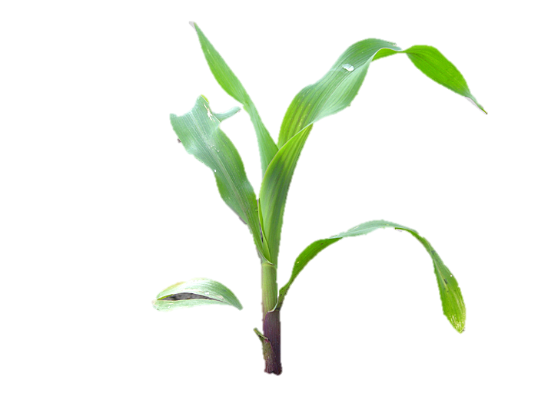
Bleh – poopy!
Elizabeth Rowen
epr5119@psu.edu

Slide 17
Manure does not increase micronutrients
Micronutrients
Manure-fertilized plants will have higher micronutrients.
Predicted by Murrell and Cullen, 2014; Phelan, 1997
Predicted by Phelan, 1996
N.S.
N.S.
N.S.
N.S.
N.S.
Manure
Inorganic
Notes:
Write out elements to not get tripped up
Multivariate thing - replace with multivariate slide – and even when we looked at all individually
Predicted – correlated – these publications
Change Mn mg/kg to ppm

Slide 18
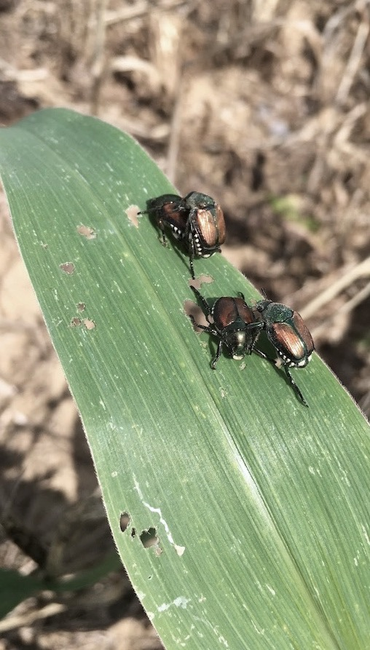
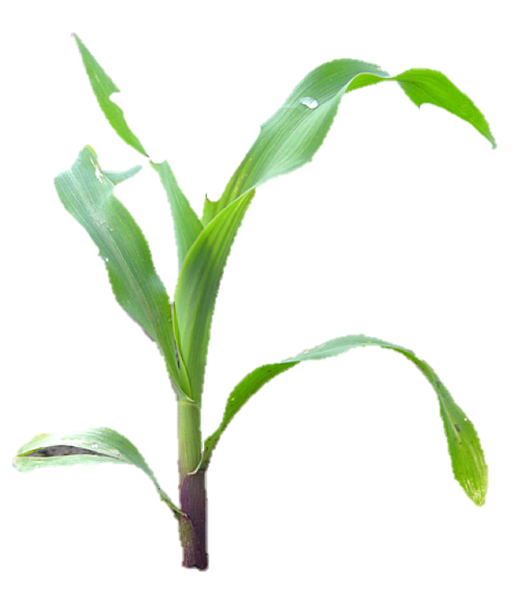
Early damage higher in manure in 2017
Manure
Inorganic
Early-Season Damage Assessment
2016
2017
2018
N.S.
P < 0.001
N.S.
0-4 scale
Notes:
Make years bigger and
Make legend and get rid of bottom legend
Switch left to right with damage assessment and animate in.

Slide 19
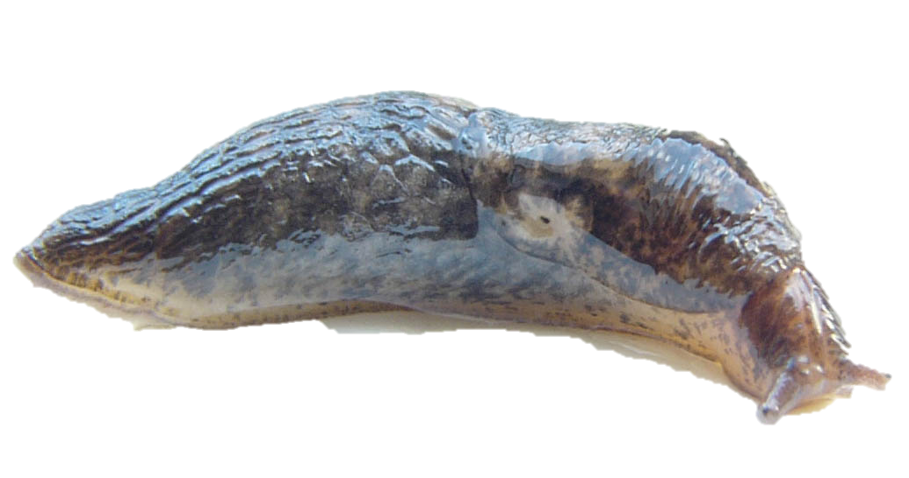
Slugs damage more plants in manure
Manure
Inorganic
2016
2017
2018
N.S.
P = 0.005
N.S.
Proportion plants damaged
Maggie Douglas
Notes:
More time – make pictures!!!!! Dominate pests in our systems
Remove axis on 2017 and 2018
Introduce problem before rather than after

