Slide 1
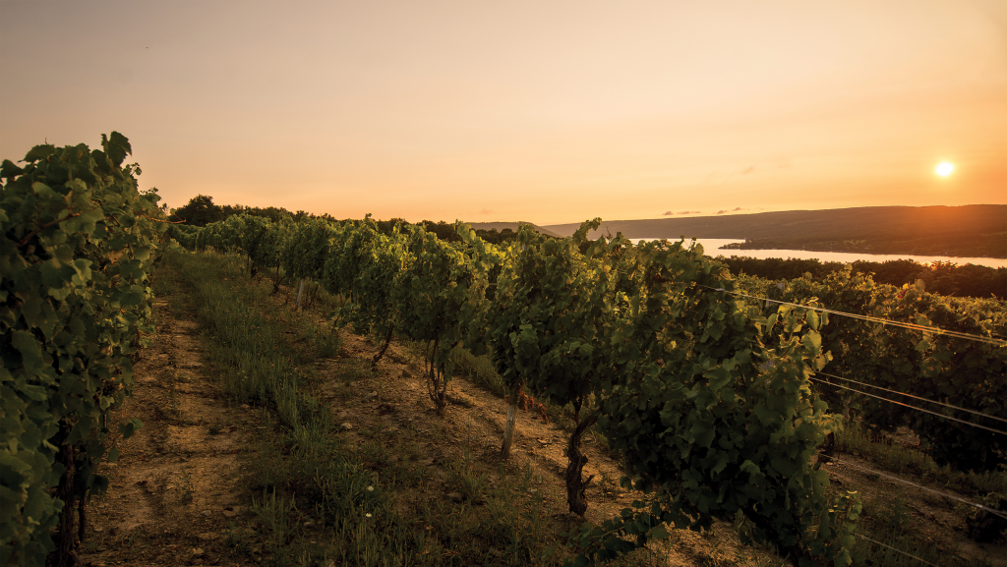


ROLE OF BERRY INJURIES AND DROSOPHILA FRUIT FLIES IN GRAPE SOUR ROT
Rekha Bhandari, Stephen Hesler, Katie Gold, Greg Loeb
Cornell University, Cornell AgriTech, Geneva, 14456
Notes:
Sour rot …….disease ……

Slide 2
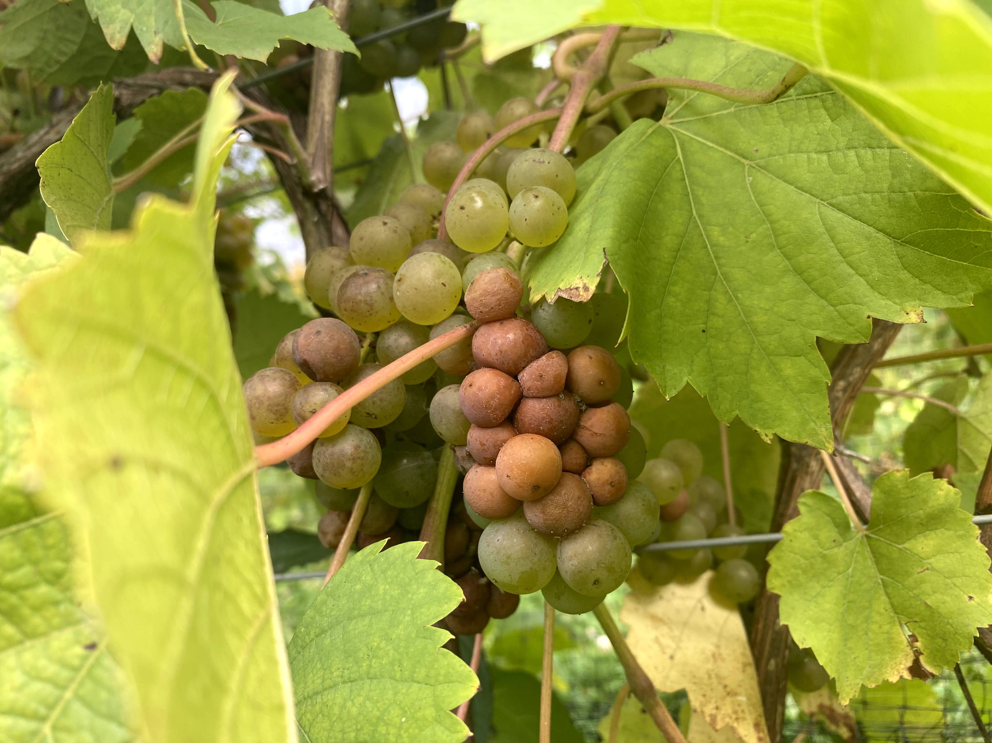
Background Method Result Discussion Conclusion
Sour rot
Economically important disease of grapes
Impacts grape production and wine industries
Reduces production and productivity
Increases management costs
Degrades quality of wine
(McFadden-Smith and Gubler 2015)

Slide 3
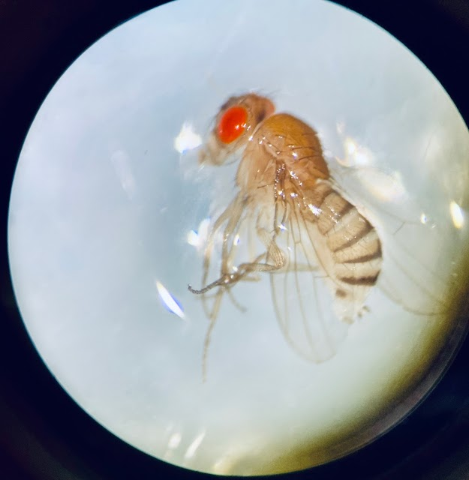
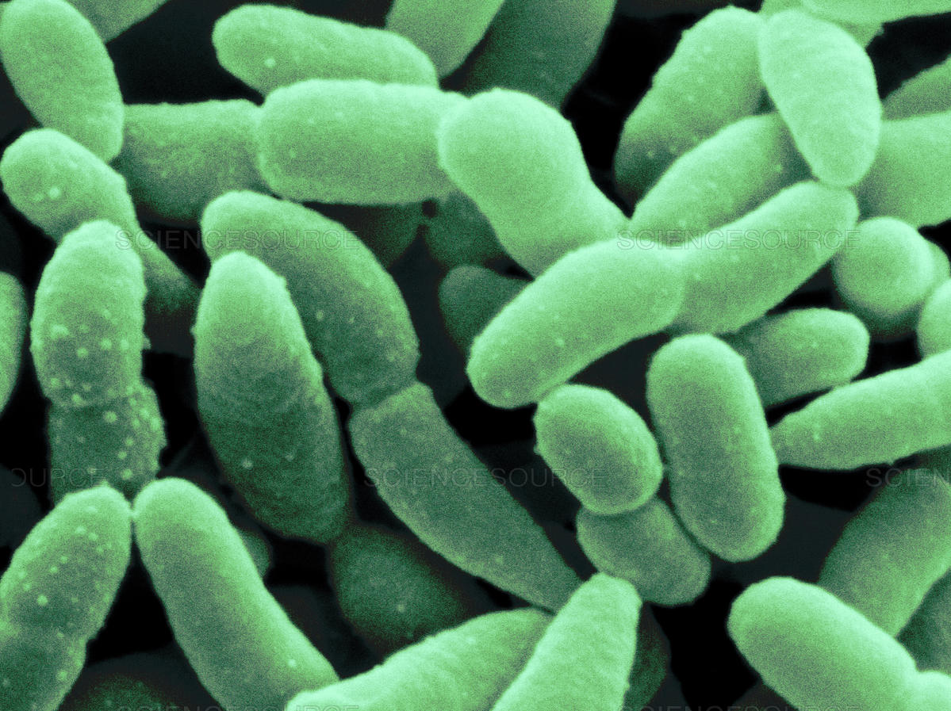
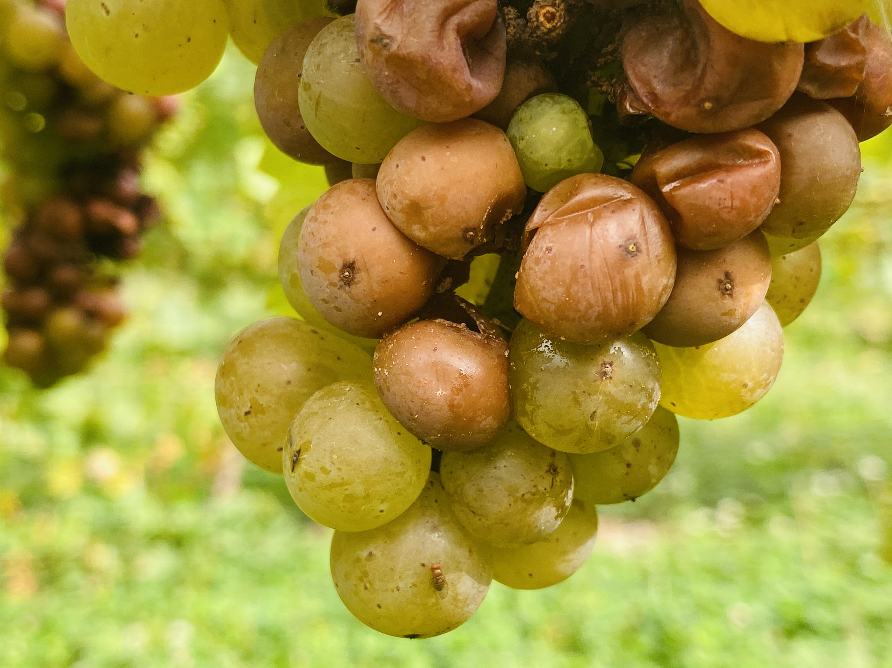
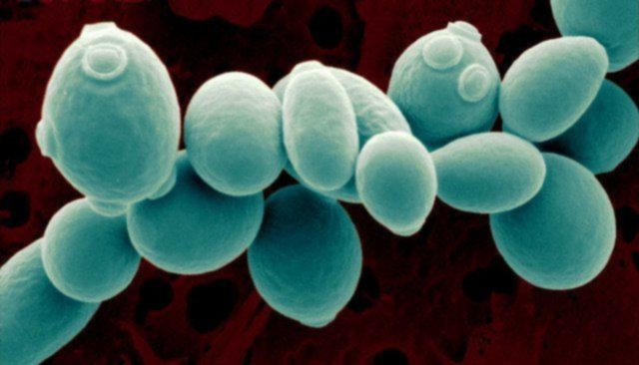
Background Hypothesis Method Result Discussion Conclusion
Causes of sour rot
Caused by
Acetic acid bacteria
Yeasts
Drosophila fruit flies
Sugar Yeast Ethanol
Ethanol Acetic acid bacteria Acetic acid
Drosophila melanogaster
Spread yeast and bacteria in healthy berries
Directly contributes to disease symptoms
Creates injury and pathways for microbes
Acetic acid bacteria
Sour rot
Yeast
Pungent vinegar smell
(Barata et al. 2012; Hall et al. 2018; Ioriatti et al. 2018)
Notes:
Host :

Slide 4


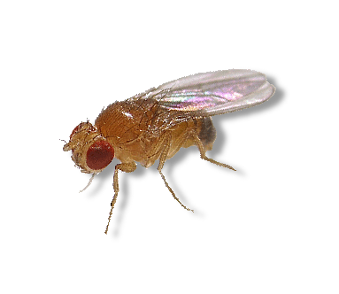
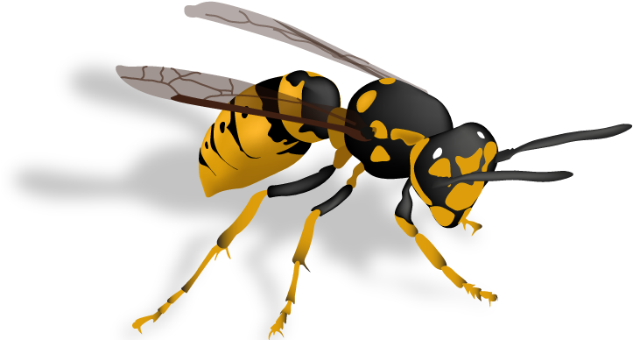
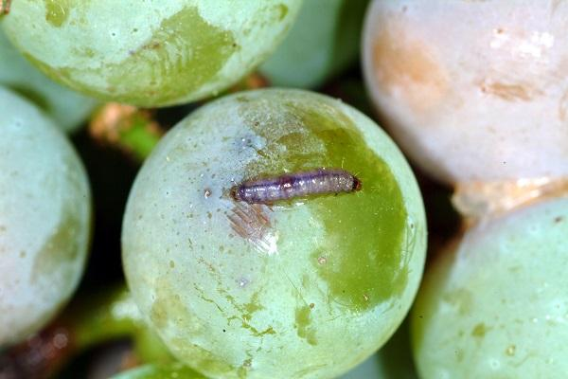
Background Hypothesis Method Result Discussion Conclusion
Birds and rain events
Yellow jackets
Grape berry moth

Slide 5
Background Hypothesis Method Result Discussion Conclusion
Injuries promote sour rot especially in the presence of Drosophila fruit flies.

Slide 6
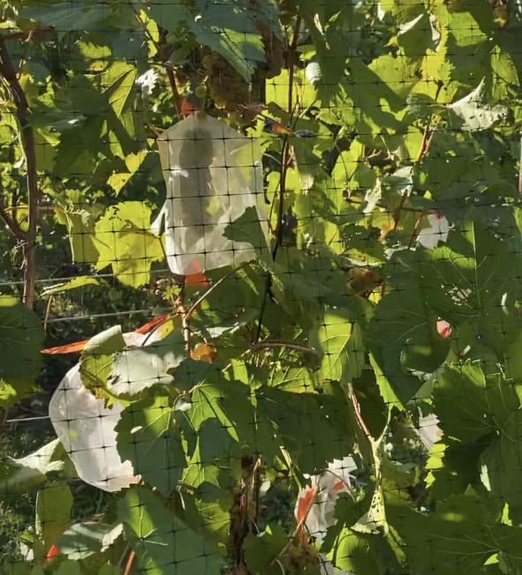
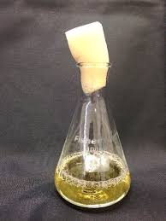
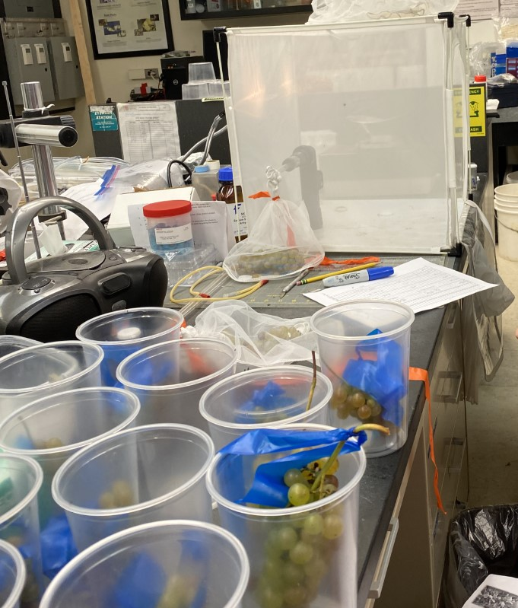
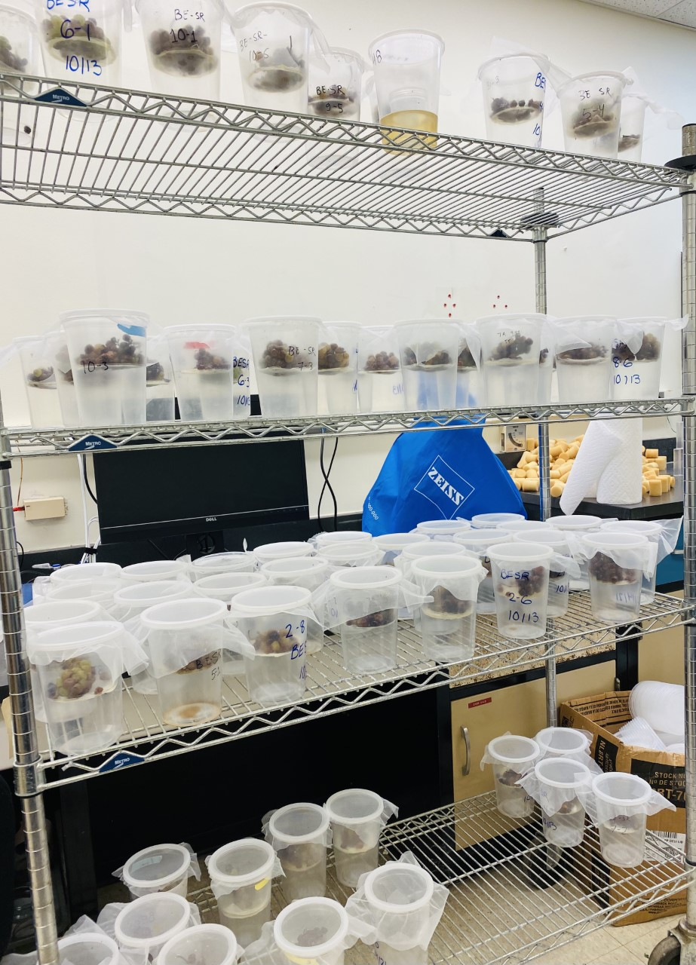
Background Hypothesis Method Result Discussion Conclusion
Semi field experiment
Source of injury
Presence or absence of D. melanogaster
Control
Present
Absent
Grape berry moth (GBM)
Present
Absent
Mechanical Damage
Present
Absent
Clusters were enclosed using fine mesh bags.
Inoculation of clusters with acetic acid bacteria and yeast
Yellow jacket
Present
Absent
Year : 2021 and 2022
Clusters were assessed for sour rot severity.
Flies were reared from bagged cluster after assessing sour rot percentage.

Slide 7

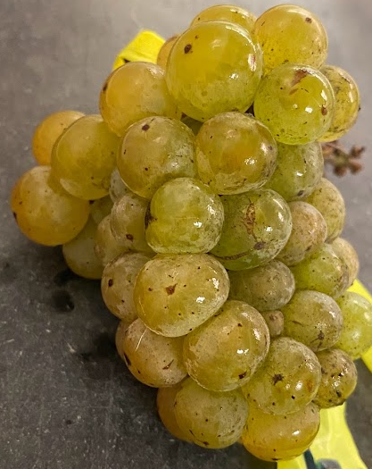
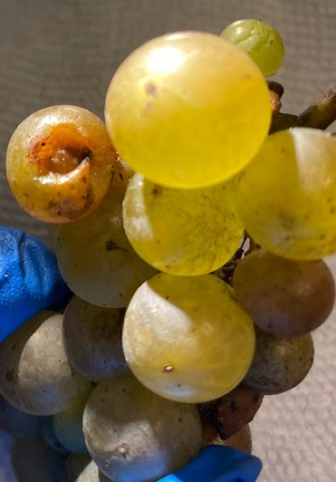
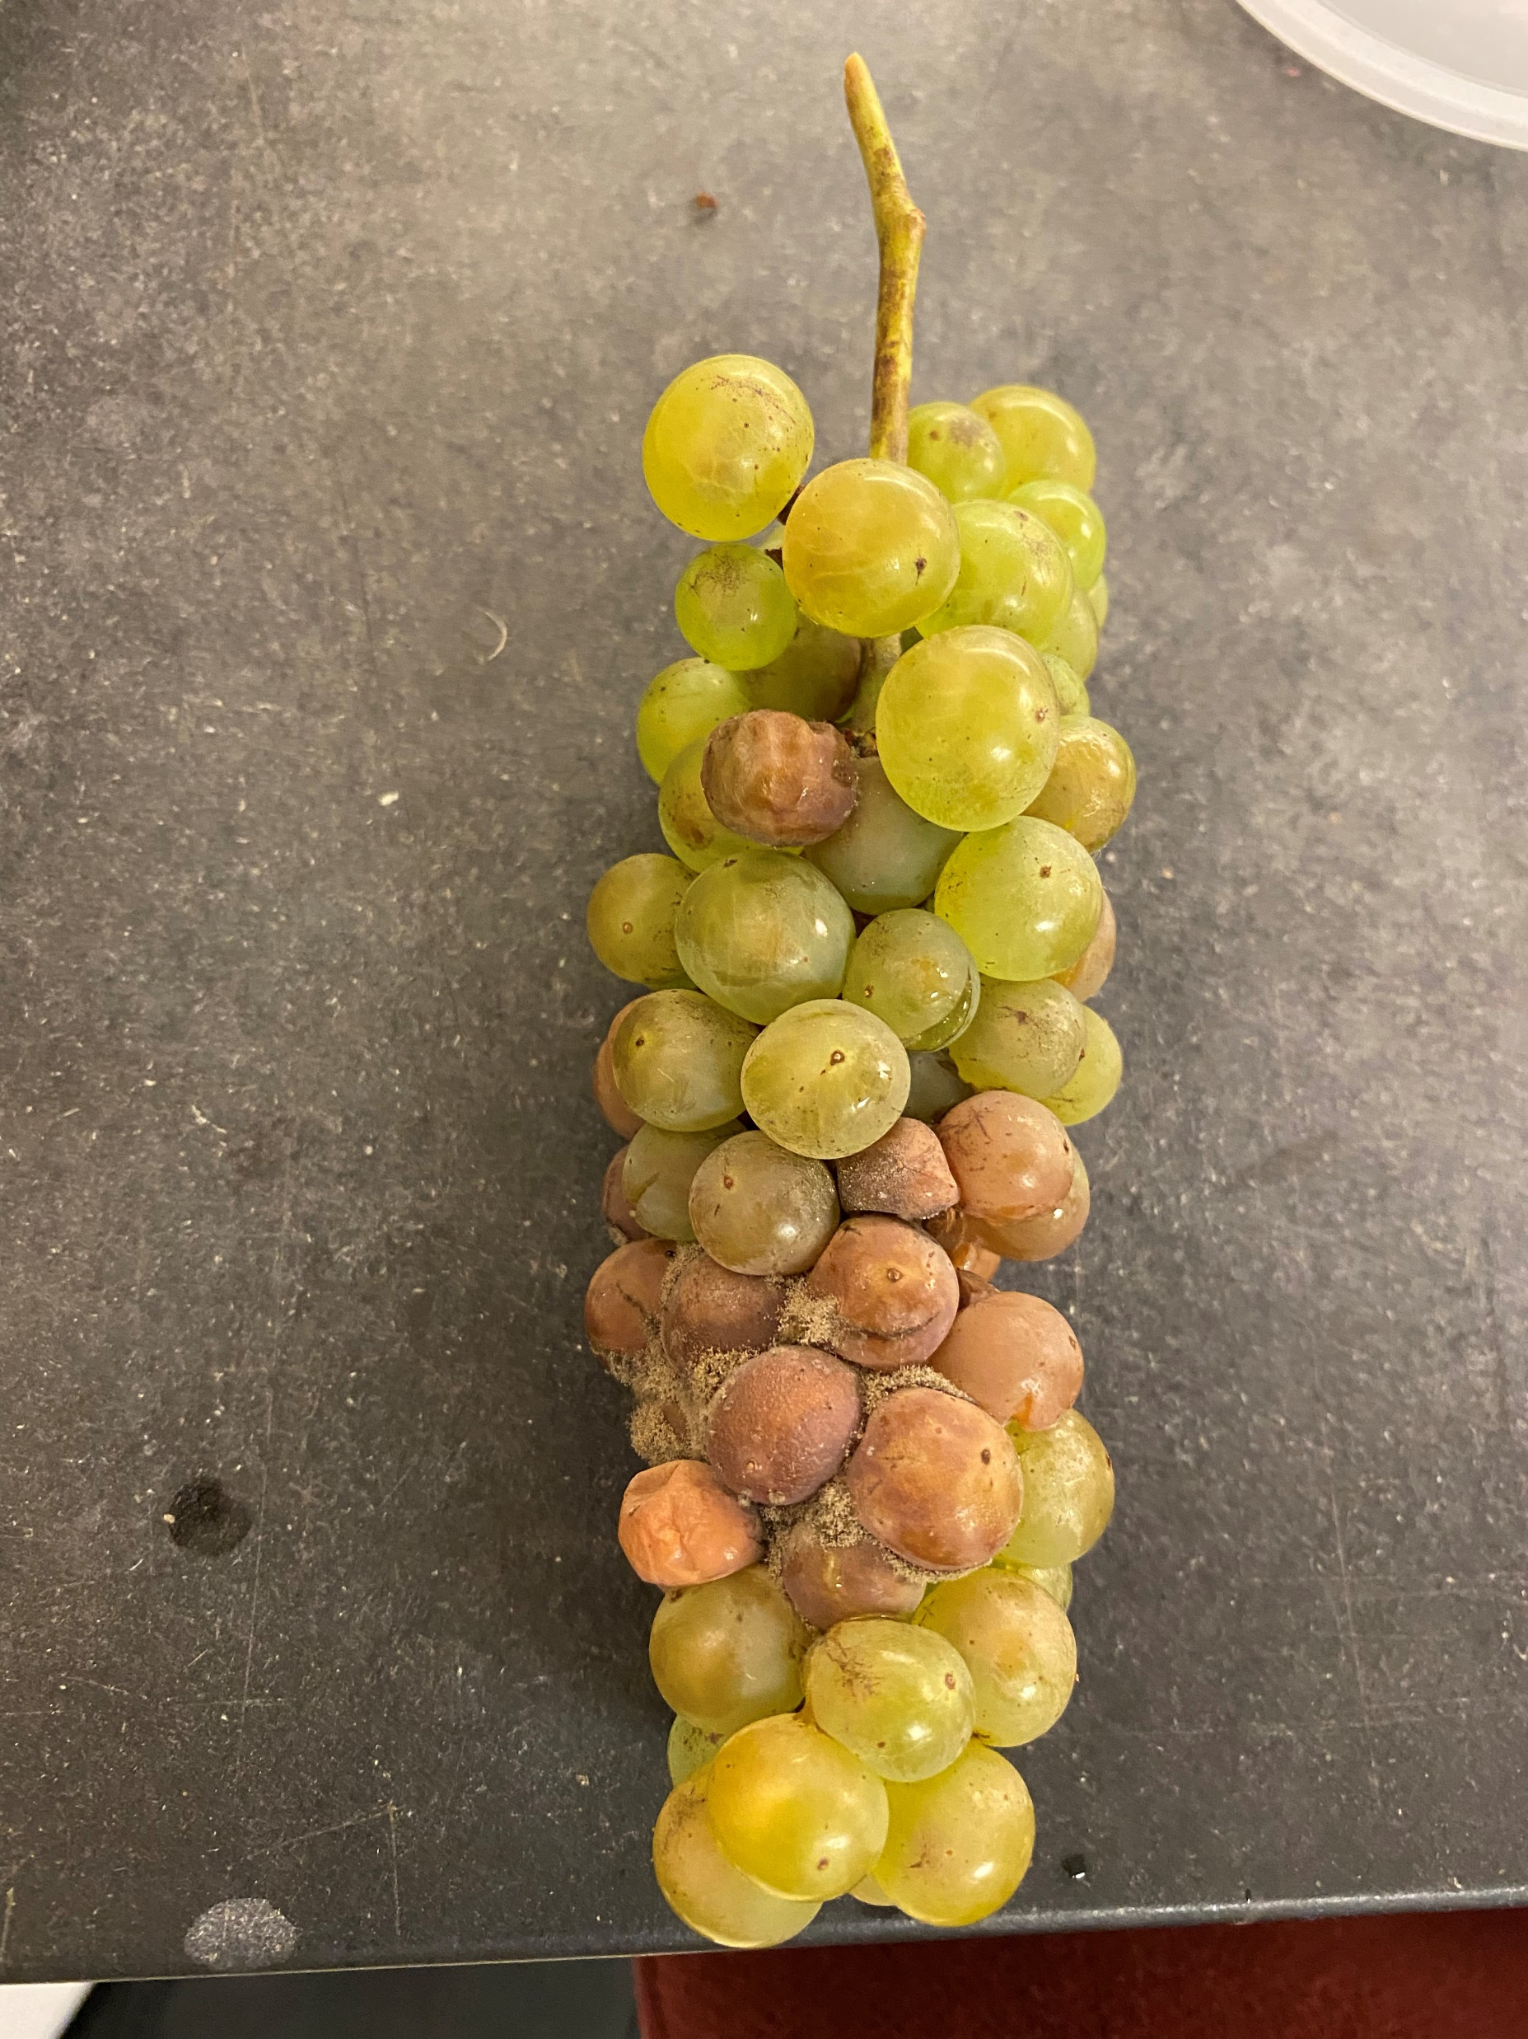
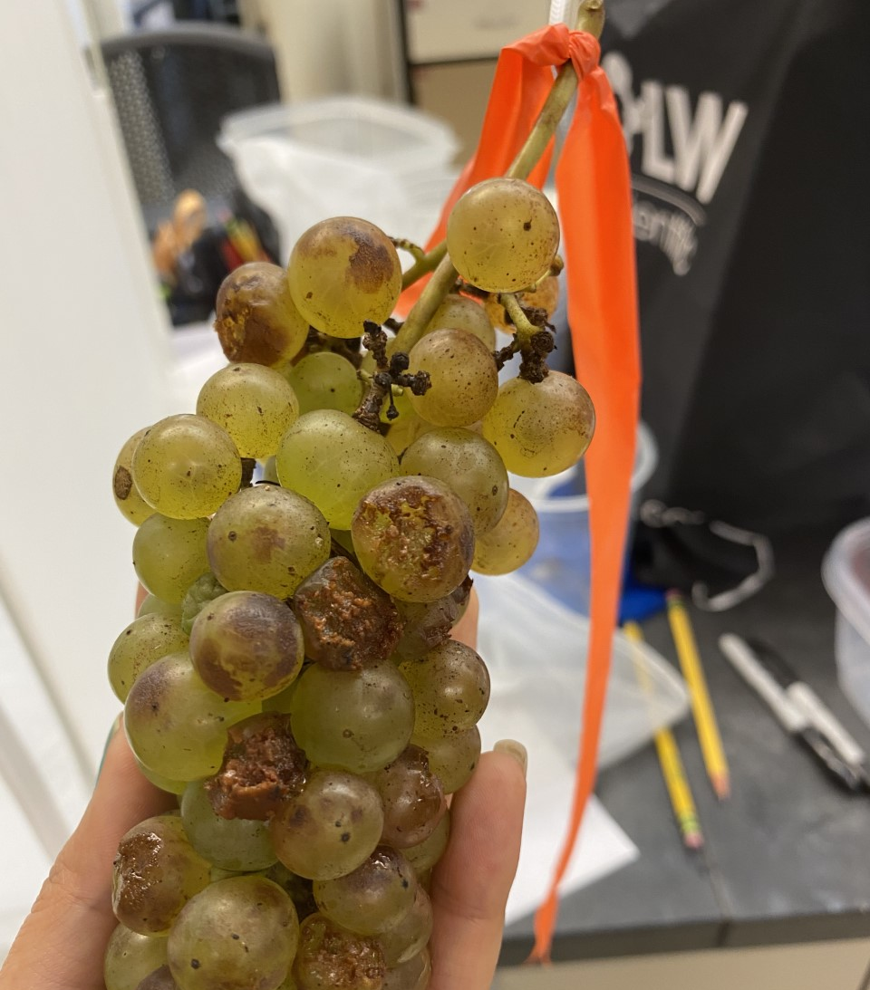
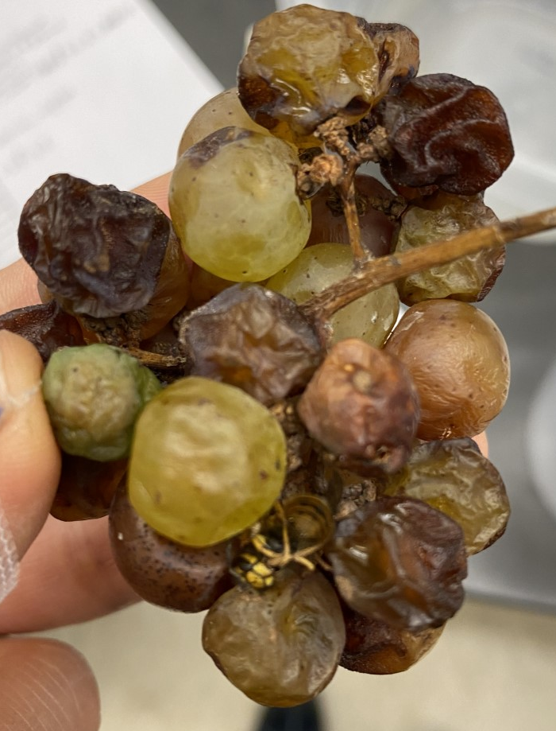
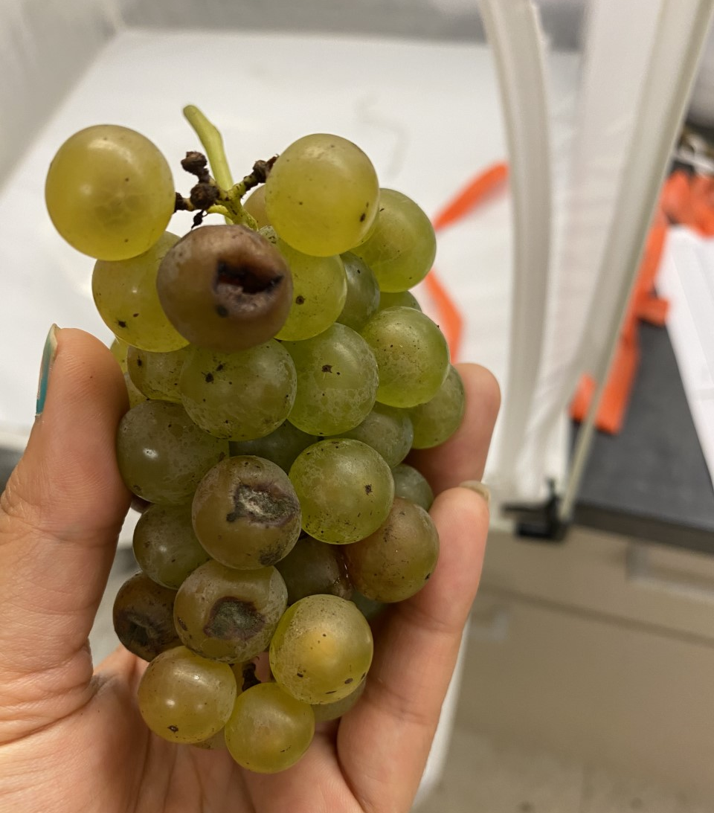
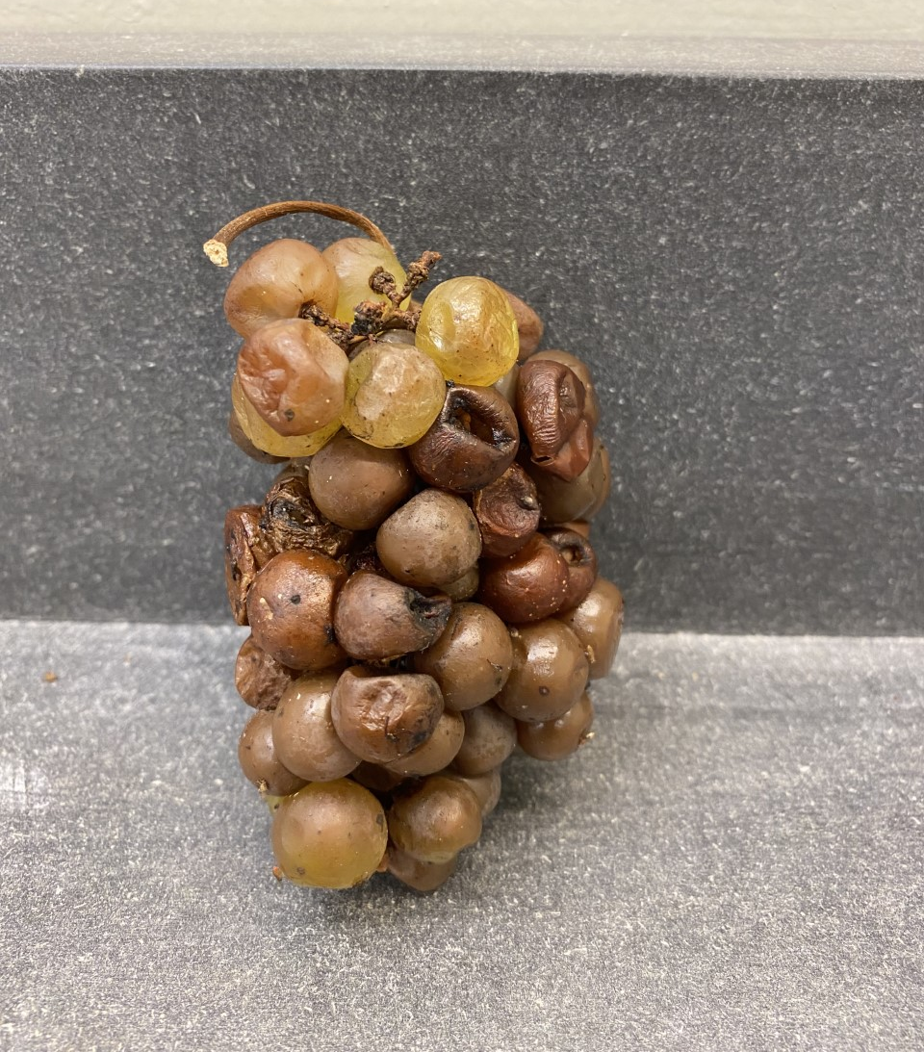
Background Hypothesis Method Result Discussion Conclusion
χ2
χ2 = 6.28, df = 3
Without flies
With flies
Sour rot severity
a
ab
c
c
d
c
d
bc
Figure showing mean percentage of sour rot in different treatments
Linear Mixed model

Slide 8
Background Hypothesis Method Result Discussion Conclusion
χ2 = 416.04, df = 3
Fly emergence
a
b
d
c
Figure showing mean number of D. mel reared from different treatments
Generalized linear mixed model “Poisson”

Slide 9
Background Hypothesis Method Result Discussion Conclusion
Mechanical damage drastically increases sour rot in the presence of D.mel.
Yellowjackets cause injury and increase sour rot in the presence of D.mel.
GBM may not contribute much to the sour rot.

Slide 10
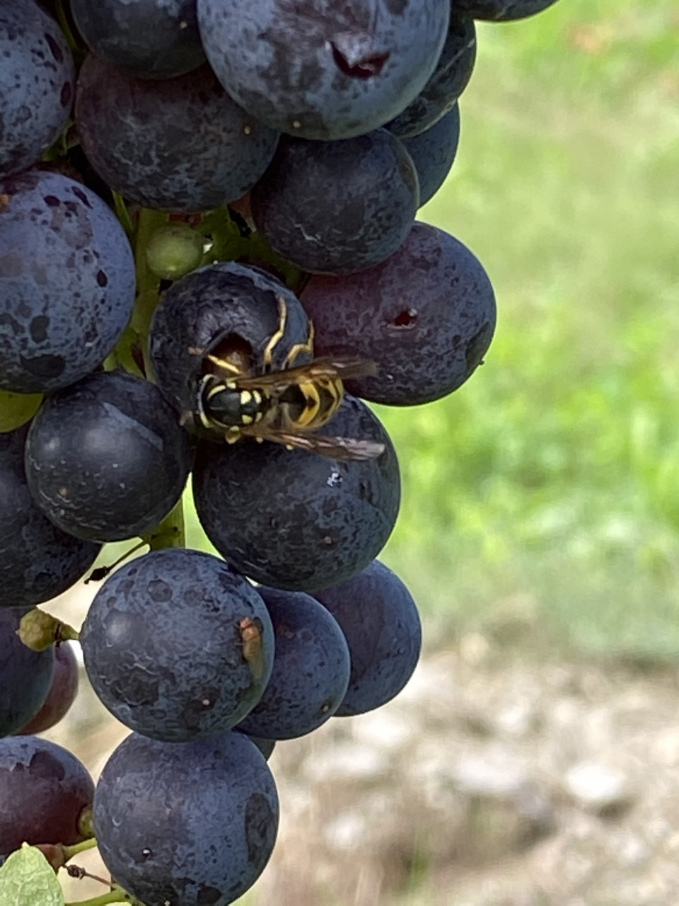
Future Directions
Assessing microbiota on and in body of yellowjackets.
Assessing predominant species and species-specific injuries in grape clusters in vineyards.
Investigating the possible use of IPM tactics to minimize sour rot.
Traps/repellants
Exclusion nettings
Cuticle thickener

Slide 11

Acknowledgements:
Loeb Lab
Dr. Greg Loeb
Stephen Hesler
Yaroslav Grynyshyn
Keren Wentworth
Erica Miller
Gabrielle Brind’ Amour
Emma Rosser
Cox lab in Cornell University
Cornell University Insect Collection

Slide 12
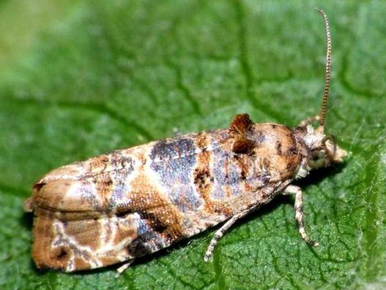

Thank you
Questions?

