Slide 1
Economic Wellbeing Data Collection
Part of the project “Values and Adoption in Regenerative Grazing Practices and Associated Wellbeing Outcomes for Cow-Calf Producers” funded by the USDA Sustainable Agriculture Research and Education program
May 30, 2023
This session is being recorded for those who could not attend live and those who would like to watch again

Slide 2
PROJECT OVERVIEW: Values and Adoption in Regenerative Grazing Practices and Associated Wellbeing Outcomes for Cow-Calf Producers
Grazing management
Education
Research
Ecological Wellbeing
Social Wellbeing
Economic
Wellbeing

Slide 3
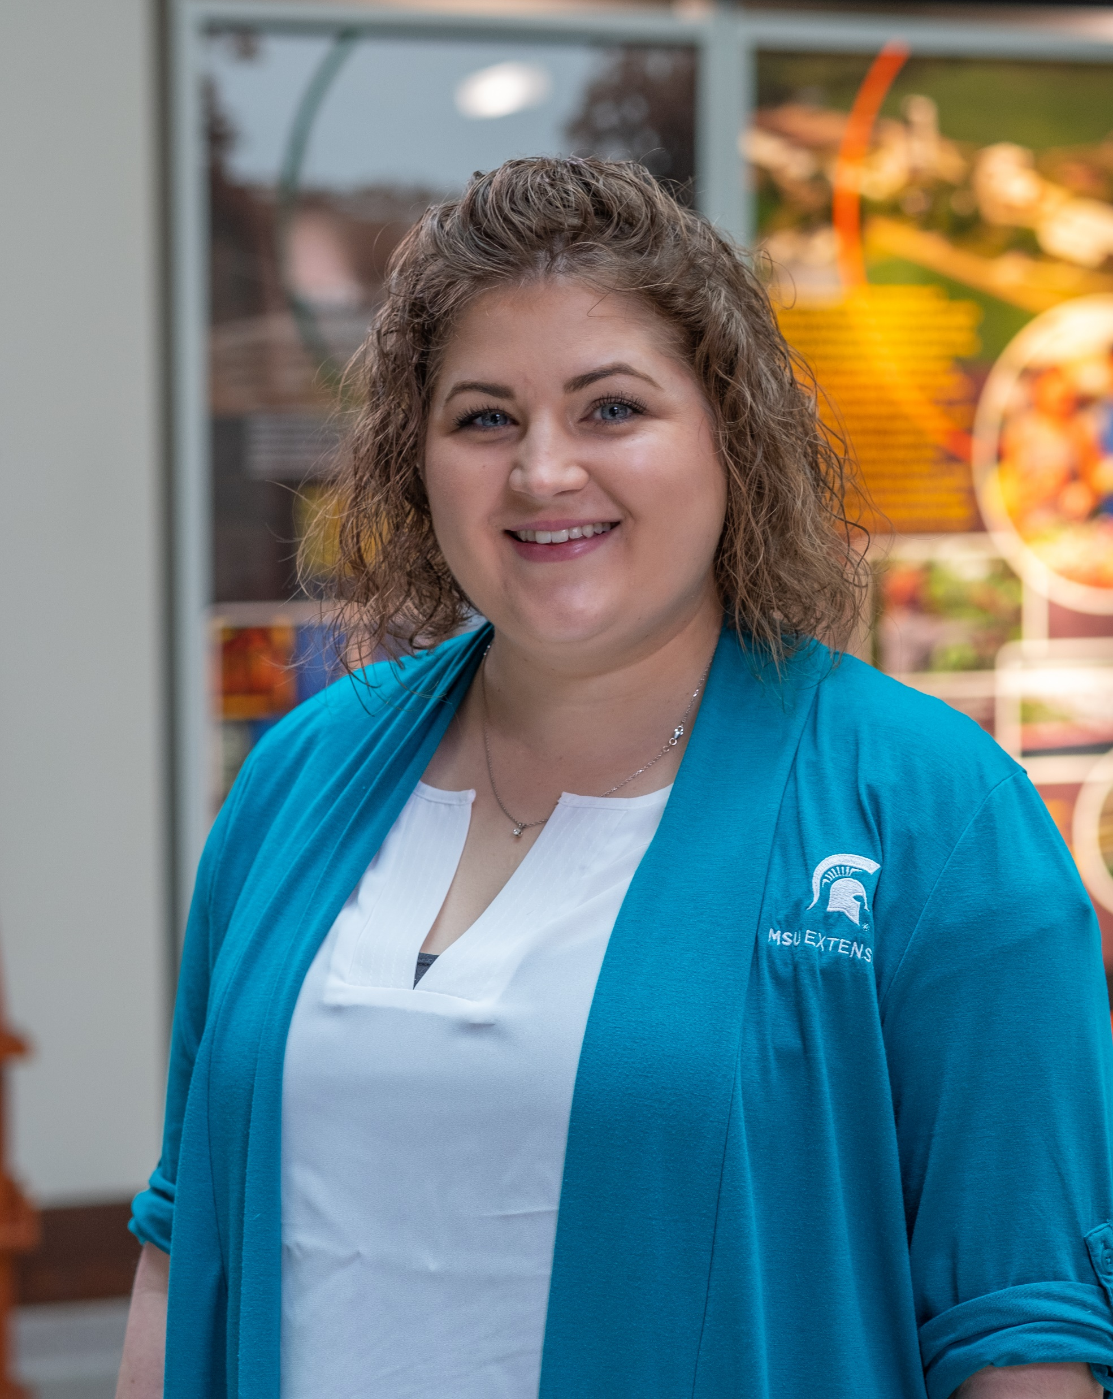
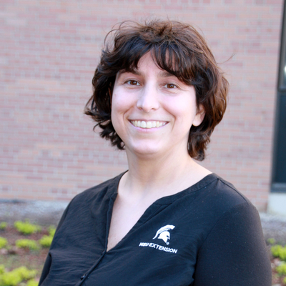
ECONOMIC TEAM MEMBERS
Dr. Melissa McKendree
Assistant Professor
Florencia Colella
Extension Educator
Zekuan Dong
PhD Student
Jose Maria Martinez
PhD Student

Slide 4
ECONOMIC OBJECTIVES
Record keeping education and improvement
Understanding economic/financial wellbeing
Both household and farm/ranch level

Slide 5
ECONOMICS ACTIVITIES
Wellbeing survey in conjunction with social wellbeing group
Financial wellbeing data collection for farm/ranch and household
Focus of today’s webinar
Online educational modules
Will be available in June

Slide 6
WHAT ARE THE BENEFITS?
Through project participation you’ll get:
Access to financial record keeping training and support
Financial Statements (Balance Sheet, Cash Flow, Accrual Adjusted Income Statement)
Farm Financial Analysis - Ratios to evaluate financial wellbeing
Cow-calf enterprise budget
Broad benefits
Education and tool development to help fellow cattle producers
Contribute to research about wellbeing of cattle producers
Contribute to research about barriers and facilitators of grazing management principles/practices
More sustainable grazing practices

Slide 7
THANK YOU!
Thank you for your willingness to participate
We appreciate that financial data can be sensitive
We have MSU IRB approval
We will work hard to keep your data protected
We will not publish data individually! Only in aggregate form in research and extension publications

Slide 8
FINANCIAL DATA COLLECTION PROCESS
Informational webinar
Sharing of 2022 financial information
Send farm cash flow statement
You’ll get an email with templates (tomorrow)
Send back the completed templates
In person meeting on your farm or on Zoom
Clarifications, discussion of enterprise allocations, accrual adjusted income statement
Follow up clarification questions on phone and email
We will share your farm financial analysis and enterprise budget
Repeat this all again next year (it will be easier)
Notes:
Note that we will be available to answer question throughout- don’t get stuck

Slide 9
Note on cash flow statement
Options (hopefully you have one of the following):
2022 Cash flow statement from your record keeping software
2022 farm/ranch tax forms (like Schedule F)
List of income and expenses
You can send that as soon as possible
Notes:
TAlk about Telfarm

Slide 10
Templates for financial information
Formats:
Spreadsheet
Word
PDF (for printing)
Four parts
Instructions
Household net worth calculation (don’t have to send details here, just final totals)
Production information for enterprise budget
Farm balance sheet (Net Worth)

Slide 11
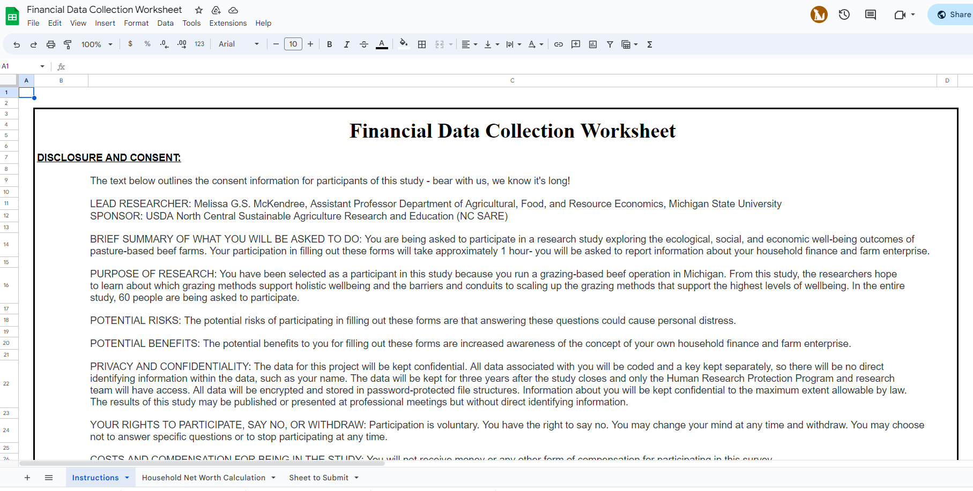
GO TO SPREADSHEET

Slide 12
HOUSEHOLD FINANCIAL DATA
Although your farm finance is highly related to your household finance, there are many reasons to analyze them separately. For example, your household may have a lot of off-farm income, or your farm is in a form of partnership and you only own a small share of it
We will help you figure it out through the form “Household Net Worth Calculation Form”
For your privacy, you only need to submit five aggregated numbers to us instead of very detailed finances

Slide 13
PRODUCTION INFORMATION FOR ENTERPRISE BUDGET
GOAL: Calculate profit on a per cow per year basis for cow-calf enterprise
We will get a lot of information from cash flow and balance sheet
Questions in templates for information needed that cannot be found in those statements
Quantities for cattle (breeding and market)
Inputs used in production where cash doesn’t change hands:
Cattle born on your operation but retained for breeding or grass finishing (for example)
Unpaid labor and management
Homegrown feed/hay

Slide 14
FARM FINANCIAL DATA
REVENUE
EXPENSE
ASSET
LIABILITY
EQUITY
CASH FLOW STATEMENT
BALANCE SHEET

Slide 15
FARM FINANCIAL DATA
Level 1: Taxes
Level 2: Financial
Level 3: Decision-making at the whole farm level
Level 4: Decision-making for individual units

Slide 16
FARM FINANCIAL DATA
Level 1: Taxes
Level 2: Financial
Level 3: Decision-making at the whole farm level
Level 4: Decision-making for individual units
TAX FORMS/CASH FLOWS
+
BALANCE SHEETS
=
INCOME STATEMENT
FINANCIAL ANALYSIS
(benchmarking, COP)
ENTERPRISE ANALYSIS

Slide 17
FARM FINANCIAL DATA
Level 1: Taxes
Level 2: Financial
Level 3: Decision-making at the whole farm level
Level 4: Decision-making for individual units
TAX FORMS/CASH FLOWS
+
BALANCE SHEETS
=
INCOME STATEMENT
FINANCIAL ANALYSIS
(benchmarking, COP)
ENTERPRISE ANALYSIS
-30,000
+
+60,000
=
+30,000
+20,000
+10,000

Slide 18
FARM FINANCIAL DATA

Slide 19
FARM FINANCIAL DATA
TelFarm Program
chart of accounts
benchmarks
accounting help
review of books
backups
reports for taxes
tax strategies

Slide 20
FILE SHARING
FileDepot- MSU
https://filedepot.msu.edu/
We will send specific instructions with screenshots
Two main files to share:
2022 Cash flow (or farm/ranch tax forms with SSN redacted)
Templates
Files can be encrypted for an added layer of security (use 7Zip for this)

Slide 21
SCHEDULING
We will be emailing you to schedule our in-person meetings
June (as early as Friday!), July and August
These can take place on Zoom or in person

Slide 22
SOME ENCOURAGEMENT
YOU CAN DO THIS! Yes, finances are tedious
Better records can help you improve your farm/ranch management
You should have most of this information
Take it in chunks
If you are not sure about something flag it in some way (highlight, star)
You can text or call us! We can even hop on Zoom
WE WILL PROTECT YOUR INFORMATION

Slide 23
Please call or text with any questions
Dr. Melissa G.S. McKendree, mckend14@msu.edu, 352-494-1676 (cell)
Florencia Colella, colellaf@msu.edu, 231-224-6439 (cell)
Zekuan Dong, dongzeku@msu.edu, 517-348-3035 (cell)
Jose Martinez, mart2388@msu.edu, 517-249-1571 (cell)

Slide 24
NEXT STEPS
Sharing of 2022 financial information
Send farm cash flow statement
You’ll get an email with templates (tomorrow)
Send back the completed templates
In person meeting on your farm or on Zoom
Clarifications, discussion of enterprise allocations, accrual adjusted income statement
Notes:
Note that we will be available to answer question throughout- don’t get stuck

Slide 25
THANK YOU!
What questions do you have?

Slide 26
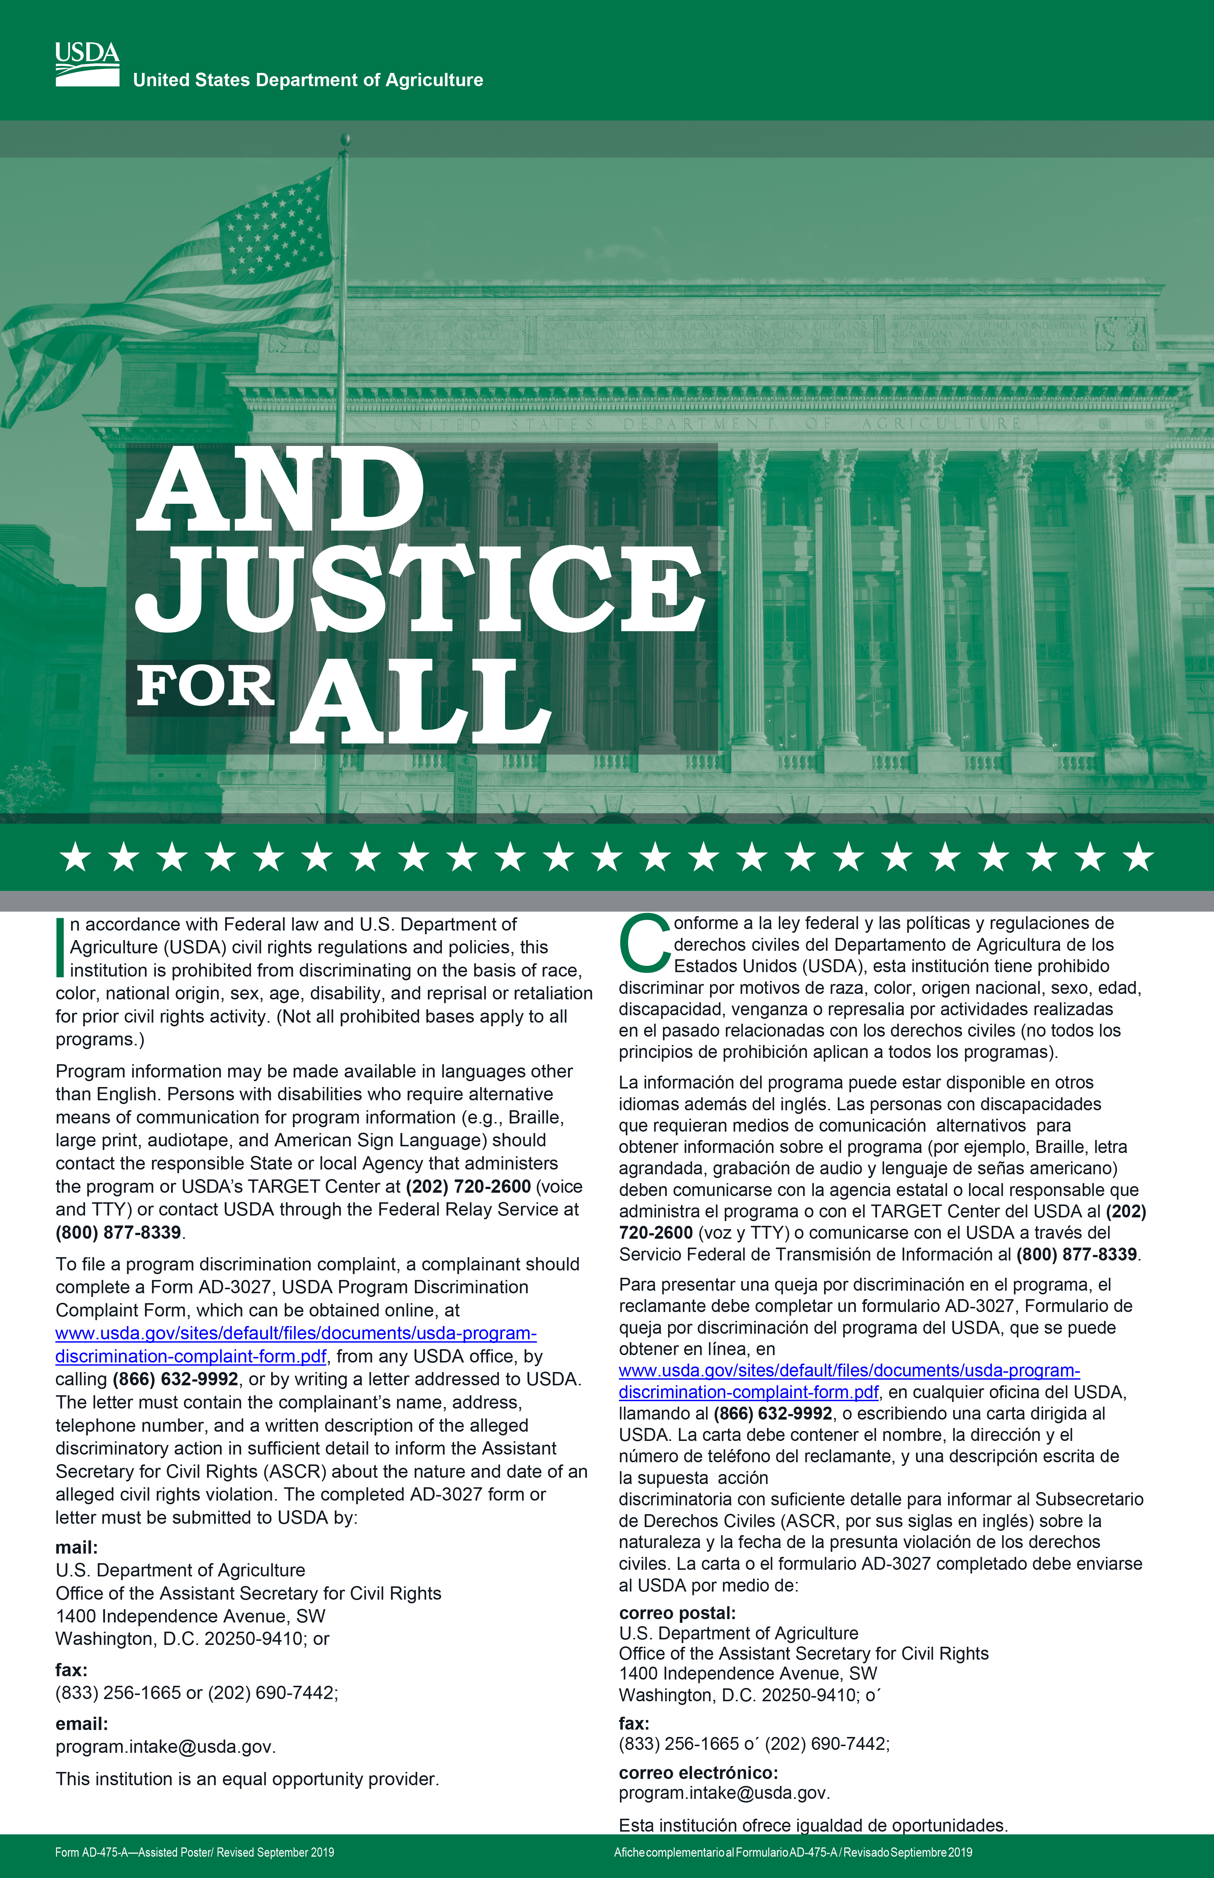
MSU is an affirmative-action, equal-opportunity employer. Michigan State University Extension programs and materials are open to all without regard to race, color, national origin, sex, gender, gender identity, religion, age, height, weight, disability, political beliefs, sexual orientation, marital status, family status or veteran status.

Slide 27
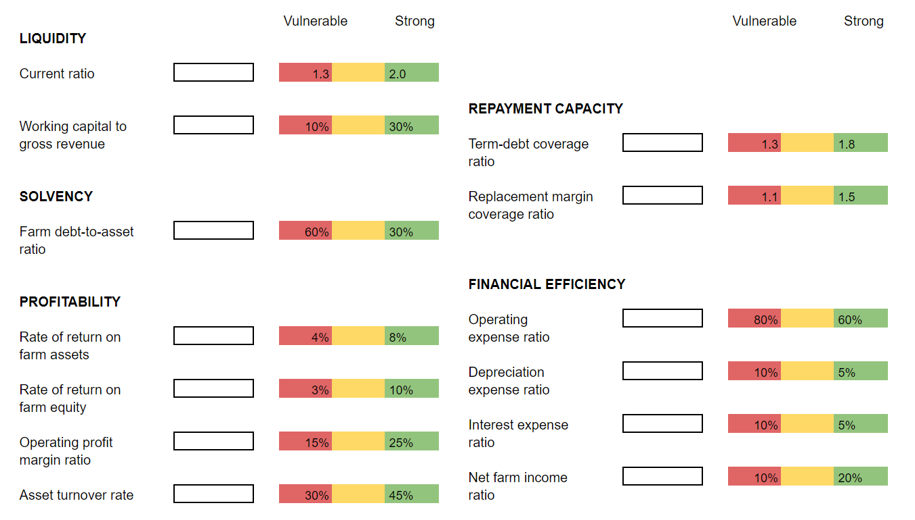
FARM FINANCIAL DATA

