Slide 1
Reading the Land Using the Four Ecosystem Processes
Elizabeth Marks
August 2020
Northeast SARE Ag Professionals Program
Holistic Management and Holistic Management International are registered trademarks of Holistic Management International. Copyright ©2020 Holistic Management International. All rights reserved. 4.23.2020

Slide 2
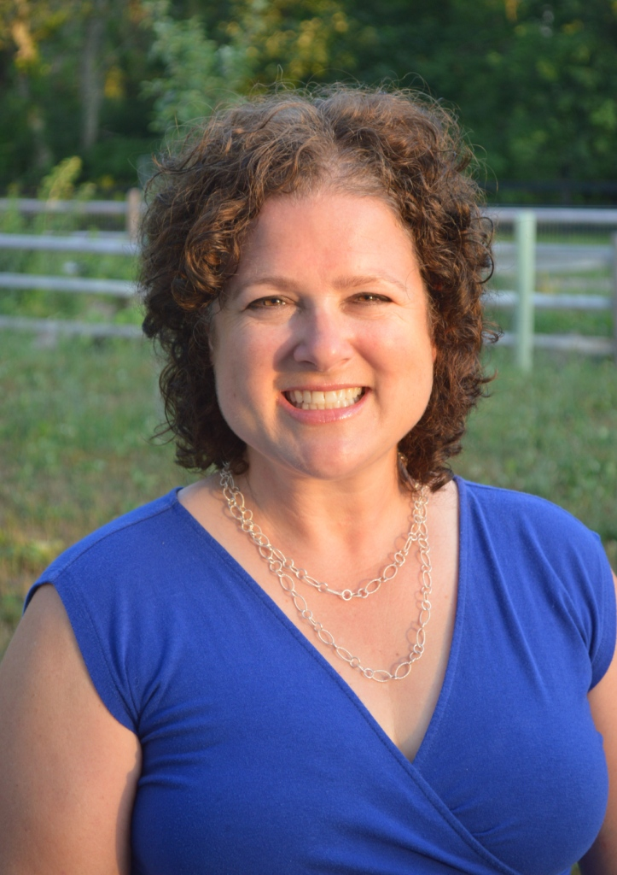
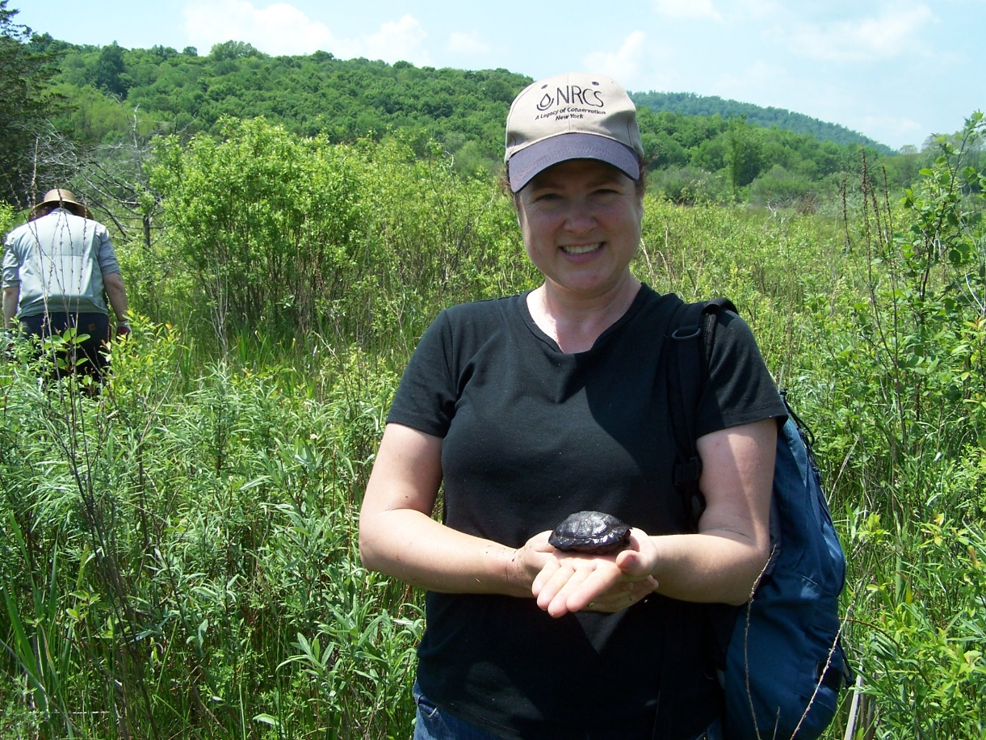
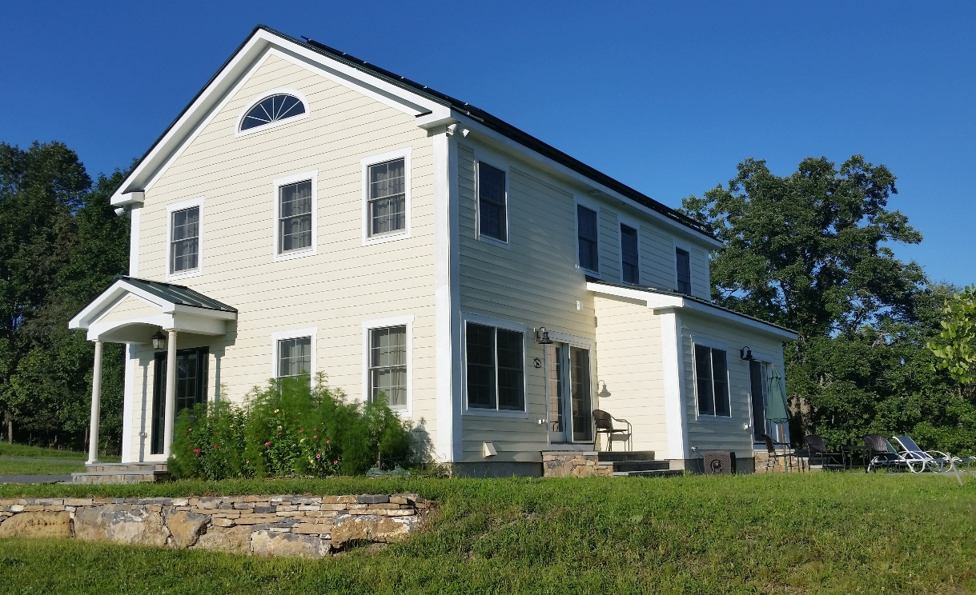
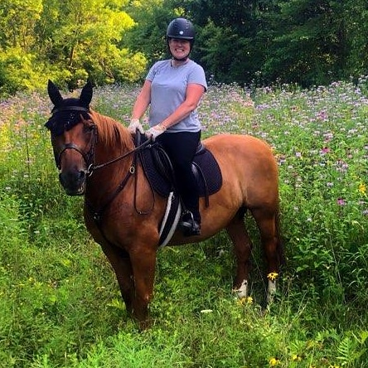
Notes:
- Graduate of Mount Holyoke College
Biologist with the USDA NRCS upstate NY - 2.5 hours directly north of New York City in the Hudson Valley)
After I completed the 2 year course, I became a certified educator in 2013. I teach introduction to HM, holistic planned grazing, soil health, and financial planning.
Current love of my life is my 1 year old niece Ama who lives in NYC
Avid horseback rider and hunt with the Old Chatham Hunt Club
Live on 10 acres off a dirt road in a net-zero home I designed and oversaw the construction of myself
In 2007 I took the HMI class taught by my colleague Phil Metzger and it was life changing.
Removed most of the anxiety I had about my current job
Dramatically changed and improved the way I work with farmers – first thing I ask now is “What are your goals?”, listen more, become more of a sounding board for farmers, provide technical information only when I see gaps.
Enabled me to save money for the first time in my life so that by 2011, I paid cash for my new car and a trip to Ireland
In 2014, I clarified my future vision and decided to build my first home in a community I love.
IF you would like to learn more about the net-zero house and how I built it holistically, read the article I wrote for HMI’s “In Practice”

Slide 3
Holistic Management Practices
1. Define what you manage
2. State what you want
3. Aim for healthy soil
4. Consider all tools
5. Test your decisions
6. Monitor your results
Notes:
Show the list of practices quickly, adding to the list by sharing additional information e.g. #1 Define what you manage includes getting clarity on your inventory – those involved in decision making and all your assets (resources)
Comment that we will go into each of these in much greater detail in the order listed.

Slide 4
What is Farming All About?
It’s a solar energy business!
It’s about working with the environment to turn sunlight into food, fiber, and building materials!
Learning to read the health of your land is critical
Utilizing ecosystem processes - when you improve one, you improve them all! Key to building wealth on the farm.

Slide 5
Four Ecosystem Processes
Water Cycle
Mineral Cycle
Community Dynamics
Energy Flow

Slide 6
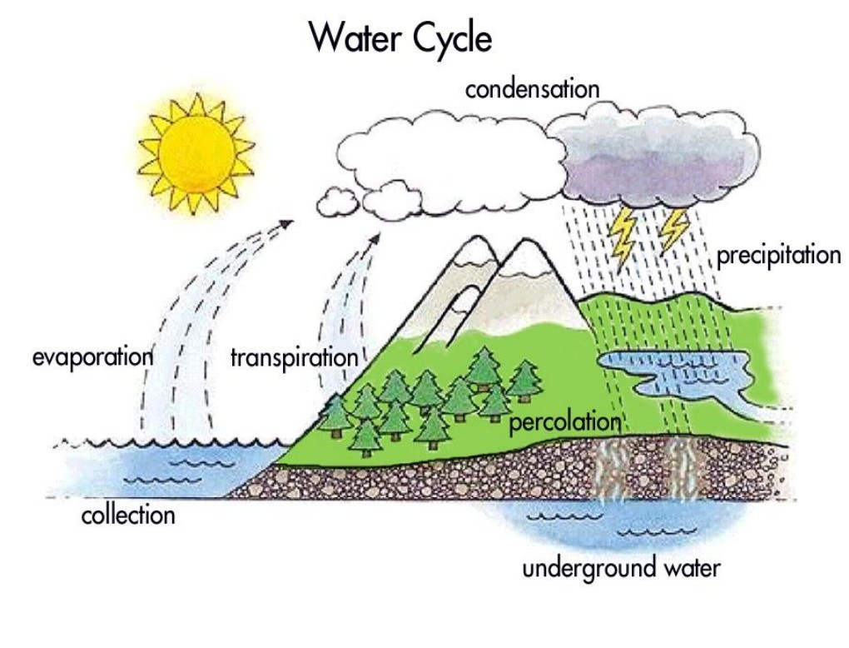

Slide 7
Key to Holding Water IN not ON (and Nutrients/Soil)
Soil pore spaces = Absorpbtion
Organic matter = Holding (like a sponge) 1% of soil organic matter up to 20,000 gal of water retention per acre (USDA-NRCS)
Compaction and capping = Ponding and/or runoff (taking nutrients and organic matter with it)
Bare soil = Evaporation
Notes:
Research shows that bare soil can lose up to 83% of rainfall to evaporation. Healthy grasslands can absorb up to 75% of rainfall - which can then be used to grow more plants and recharge groundwater!

Slide 8
Indicators of Effective Water Cycle
Covered soil surface
Pores in the soil can be seen
Cottage cheese like appearance
Stable soil temps
High infiltration rates
High organic matter (darker color)
Deep and straight plant roots
Notes:
The key to an effective water cycle is the condition of the soil surface. If it is bare and/or capped, much of the water that soaks in will quickly evaporate, as the dry soil particles at the surface pull water from wetter soil particles below them. If the surface is covered with litter or closely-spaced plants, it will retain moisture and so will the soil particles below.
Management tools that break up a capped or thatched or sod-bound soil surface or increase the soil's organic matter speed up penetration. They create a surface that slows the flow of water, which allows more to soak in before running off.

Slide 9
Indicators of Poor Water Cycle
Bare soil
Erosion
Compaction/ponding water
Droughty soils
Low organic matter
Dying plants in times of low rainfall
High soil temps

Slide 10
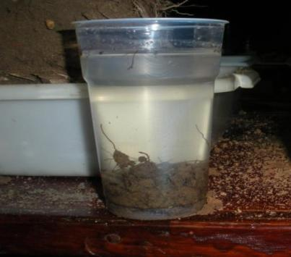
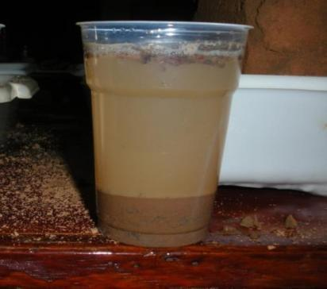
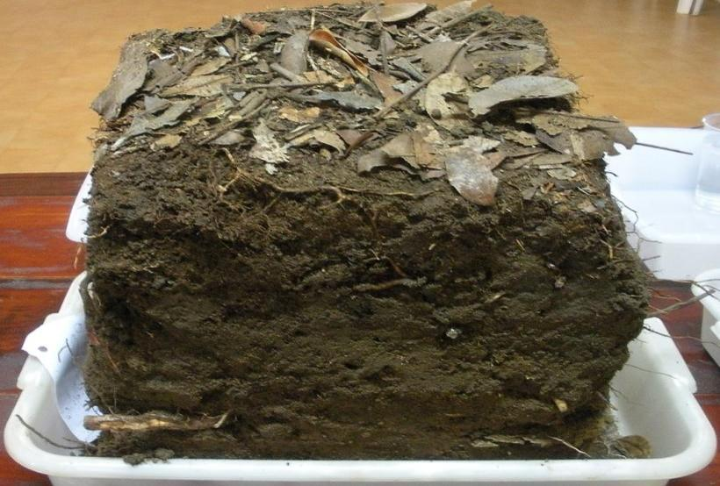
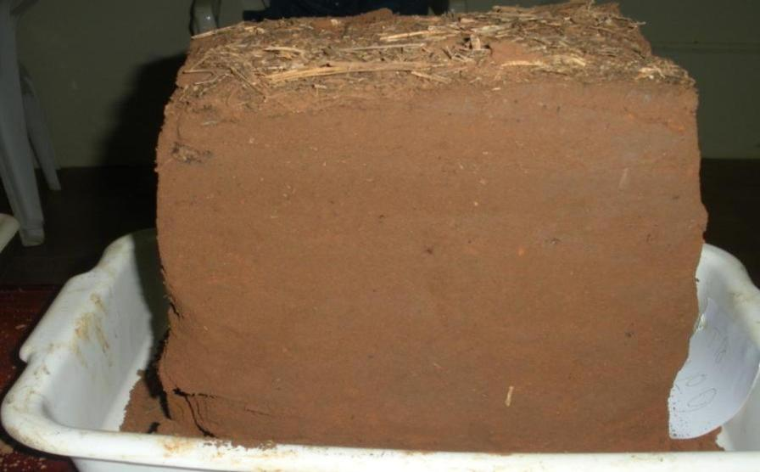
Same Soils – Different Management
Forest
SOM = 4.3 %
CT 17 yr- Soybean monoculture SOM = 1.6 %
Notes:
Disturbance changed this soils.

Slide 11
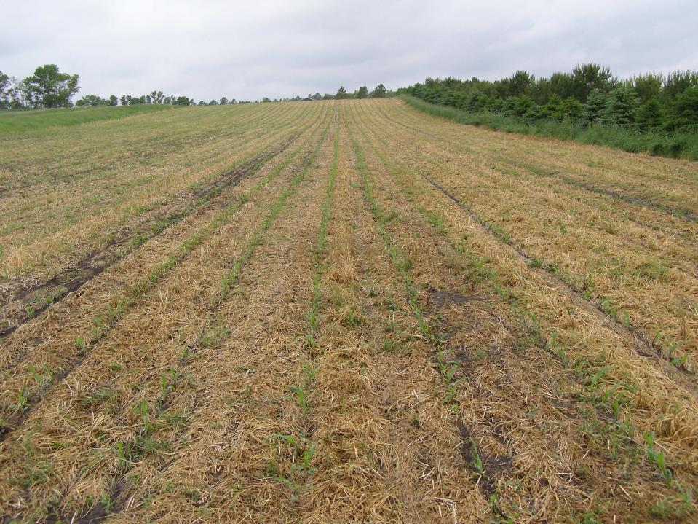
Brown Ranch near Bismarck, ND after 13” of rainfall in 24 hours in 2009
Infiltration Rates increased with management:
1991 – 0.5 inches per hour
2011 – 8 inches per hour

Slide 12
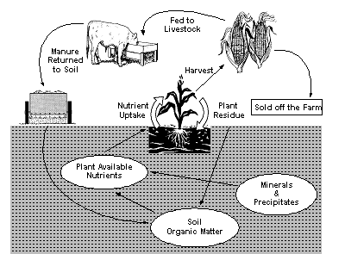
Mineral Cycle

Slide 13
Indicators of Effective Mineral Cycle
Covered soil surface
Organisms (worms, bugs, fungal threads etc. can be seen)
Vegetation and manure breaks down quickly
Fine root hairs found in abundance
Gradual changes in soil color; dark color on top
Vigorous, dense plant growth
Good soil aggregation
Sweet smell
Notes:
The key to an effective water cycle is the condition of the soil surface. If it is bare and/or capped, much of the water that soaks in will quickly evaporate, as the dry soil particles at the surface pull water from wetter soil particles below them. If the surface is covered with litter or closely-spaced plants, it will retain moisture and so will the soil particles below.
Management tools that break up a capped or thatched or sod-bound soil surface or increase the soil's organic matter speed up penetration. They create a surface that slows the flow of water, which allows more to soak in before running off.
First and foremost, they look to see if the soil is covered either by living plants or plant litter. In non-brittle environments, breakdown is generally rapid because of the year-round presence of decaying organisms. But, land managers should look for a mix of plants with varying root depths so that nutrients can be brought up from many layers: fibrous-rooted grasses as well as the deeper-penetrating tap-rooted brush, forbs and trees. If the soil feels spongy when they walk across it, they know it is porous and likely to be full of life.
A good mineral cycle implies a biologically active, living soil, with adequate aeration and energy underground to sustain an abundance of organisms that make up the soil food web. Soil organisms need energy derived from sunlight, but often do not come up to the soil surface to get it for themselves. They depend on a continuous supply of decomposing plant and animal residues to provide their energy needs

Slide 15
Indicators of an Ineffective Mineral Cycle
Bare soil – public enemy #1!
Low organic matter (light color)
Manure paddies/plant material that doesn’t break down quickly
Reliant on chemical fertilizers
Low pH or high pH
Sour smell
Notes:
The key to an effective water cycle is the condition of the soil surface. If it is bare and/or capped, much of the water that soaks in will quickly evaporate, as the dry soil particles at the surface pull water from wetter soil particles below them. If the surface is covered with litter or closely-spaced plants, it will retain moisture and so will the soil particles below.
Management tools that break up a capped or thatched or sod-bound soil surface or increase the soil's organic matter speed up penetration. They create a surface that slows the flow of water, which allows more to soak in before running off.

Slide 16
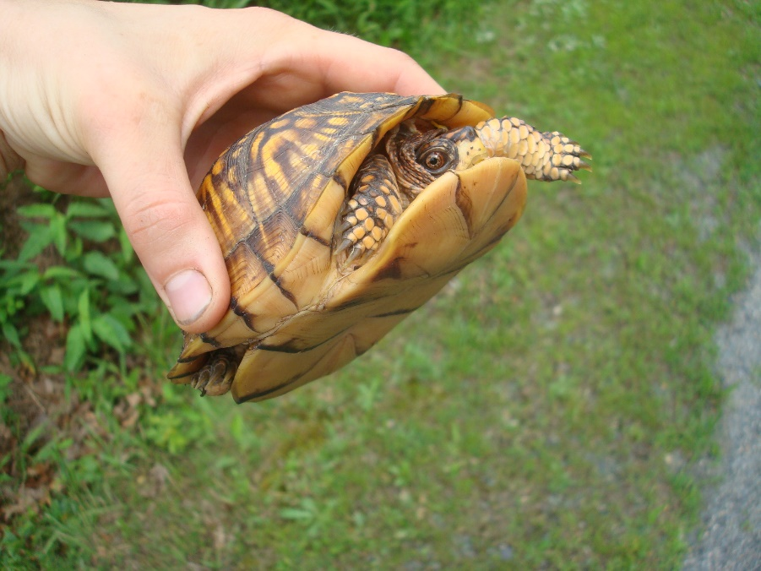
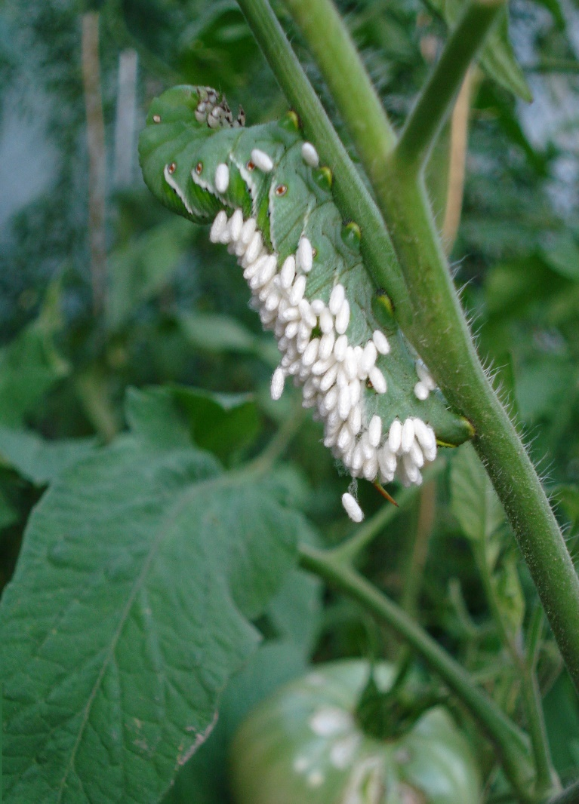
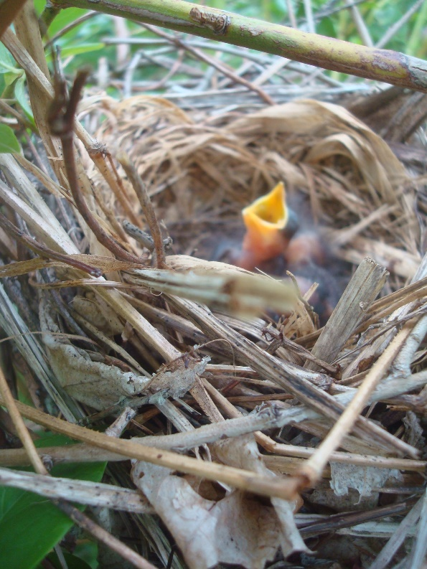
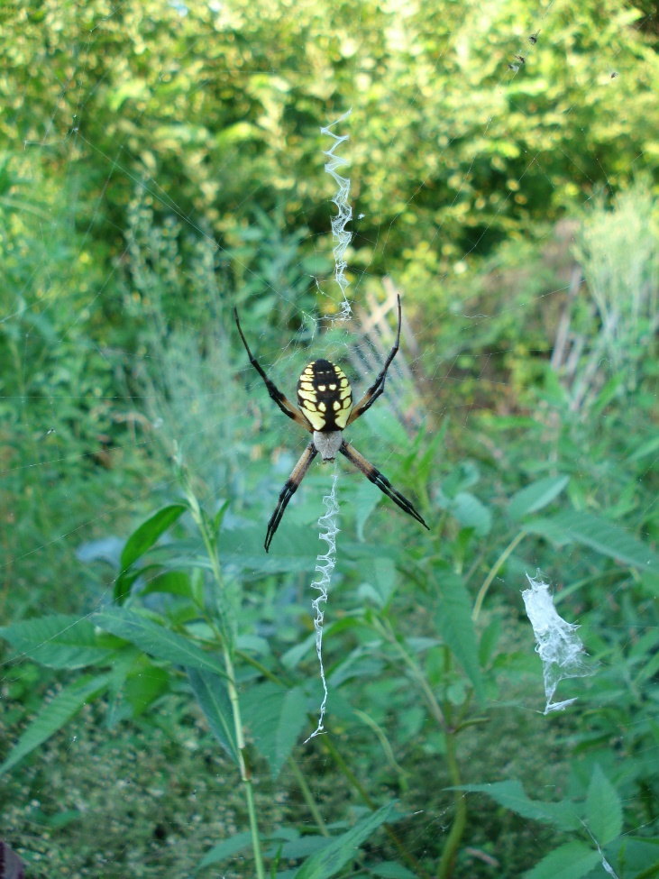
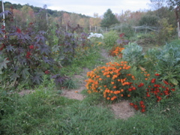
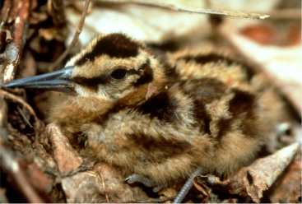
Community Dynamics
Notes:
Also Succession – the dynamic relationship between organisms in and above the soil. Also the idea that organisms change their environment and that even ecosystems that appear stable for many years are still in flux – always dynamic in their never-ending development
You can gauge a community’s health by looking at the diversity of species, numbers of populations of those species, and the age structures of those populations. (ex: forest in CA that appeared healthy but there were no new trees germinating)
Greater species diversity = greater complexity = greater stability

Slide 17
Indicators of Effective Community Dynamics
A covered soil surface
Diversity
The numbers of species
Age diversity within species
Decaying organic matter
Good soil drainage
Minimal or no soil disturbance
Notes:
The key to the advance of any terrestrial biological community toward greater complexity is soil cover. When soil is bare and exposed, the community loses complexity and begins to break down. If bare soil is covered with living plants or dead plant material (litter), biodiversity and community complexity increases.
When a community is in the early stages of development, or is reduced from a complex to a simplified community of few species, it is less stable. Populations of a single plant, insect or small animal species can boom to annoying numbers, and we then label them weeds, pests, or invaders. The more complex and diverse communities become, the fewer the fluctuations in numbers within populations of species, and the more stable communities tend to be.
You can gauge a community’s health by looking at the diversity of its species, the numbers within populations of those species and the age structure (how many young, adult, and old?) within those populations. The greater the diversity of species, the greater the complexity, which tends to promote greater stability within the community. If you want to protect a certain species, you can create an environment in which it thrives. Likewise, if you want to reduce the numbers within a species, you can create an environment that is less than ideal. In either case, look to the age structure to tell you which direction you’re heading. If there are many young of the species in question, that species is likely to be increasing; if only mature members can be found, that species is likely to die out.
Anything that changes above ground is likely to cause even greater changes below ground, simply because there's generally more life underground than above it. For example, a healthy pasture carrying large numbers of cattle has been calculated to carry a population of earthworms that alone are double the weight of the cattle. Likewise, the root structures of plants add to the biomass, as do the tons of microorganisms that inhabit an acre of healthy soil. It has been estimated that as many as a billion microorganisms live in a single teaspoon of healthy soil.
It's important to recognize just how much life exists beneath the soil surface. Excess soil compaction, exposure and capping of soil, inadequate drainage, over-fertilization, pesticide poisoning or other such actions alter the biological community below ground. And what happens underground will eventually show itself above ground.

Slide 18
Indicators of Poor Community Dynamics
Bare soil
Tillage
Compaction
Monocultures
Poor water infiltration
Increasing pest problems
Increased susceptibility of plants to diseases
Increased inputs such as fertilizer, pesticides and herbicides.
Poor yields of pollinated plants

Slide 19
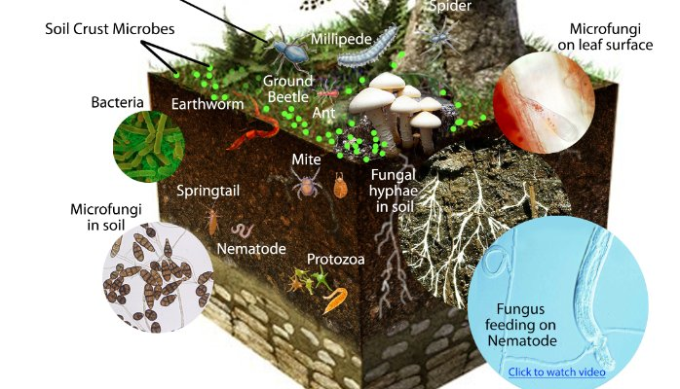

Slide 20
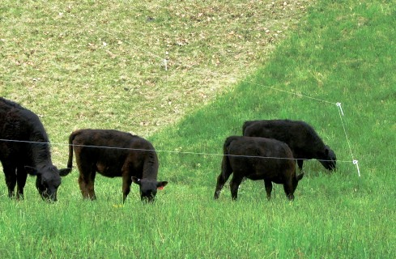
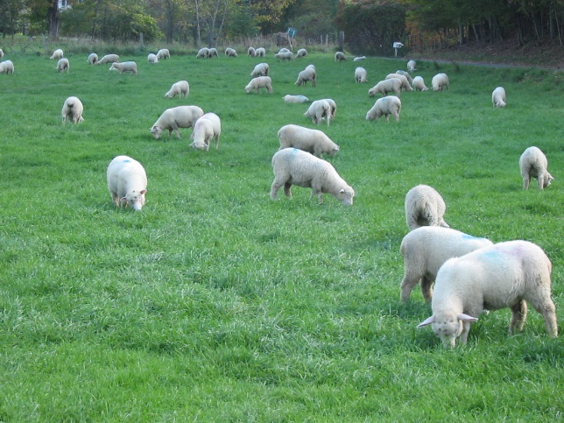
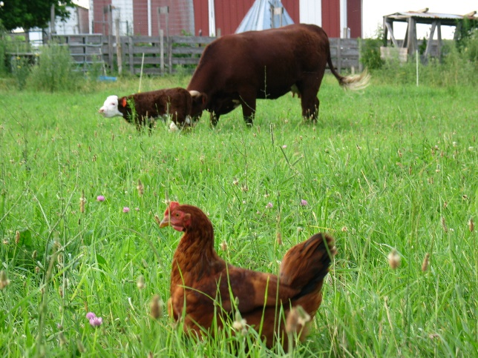
Diversity also includes animals!
Manure and urine stimulate microbes in the soil and plant regrowth.
Plants respond to hoof traffic.
Saliva from grazing animals triggers a chemical response in plants to signal roots and microbes to start supplying more nitrogen for regrowth.
You don’t get these same signals from mowing.

Slide 21
Biodiversity in Plants

Slide 22
Services Provided by Soil Biological Communities
Nitrogen fixation
Decomposition – turning organic material into a usable form by a plant
Soil structure – both pore spaces and soil “glue”
Disease and pest resistance
Capture nutrients and give it to the plant
Stimulate or produce plant growth hormones

Slide 23
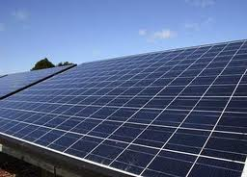
Energy Flow
Notes:
Our ecosystem runs on solar energy
Plants - the key player!

Slide 24
Indicators of Effective Energy Flow
Healthy, vigorous roots
Large, green surface area
Large leaf surfaces
Plants that regrow quickly after being picked or grazed
Plants that grow year round
Cover crops
Notes:
Most of the sunlight that strikes the land and water is reflected back immediately, while some is absorbed as heat to be radiated back later. A very small portion is converted by green plants into food for their own use and that of other organisms in the food chain. Thus, green plants form the base or Level 1 of the energy pyramid and support almost all other forms of life, including humans.
The energy pyramid also extends below ground - where the energy flow greatly affects the function of the other three ecosystem processes—water cycle, mineral cycle, and biological community. All three require a biologically active soil community that in turn requires solar energy to be conveyed underground by plant roots or surface-

Slide 25
Indicators of Ineffective Energy Flow
Bare soil
Plants overgrazed to the point that they are taking energy from the roots
Weak plant growth
Slow growing plants
Notes:
Most of the sunlight that strikes the land and water is reflected back immediately, while some is absorbed as heat to be radiated back later. A very small portion is converted by green plants into food for their own use and that of other organisms in the food chain. Thus, green plants form the base or Level 1 of the energy pyramid and support almost all other forms of life, including humans.
The energy pyramid also extends below ground - where the energy flow greatly affects the function of the other three ecosystem processes—water cycle, mineral cycle, and biological community. All three require a biologically active soil community that in turn requires solar energy to be conveyed underground by plant roots or surface-

Slide 26
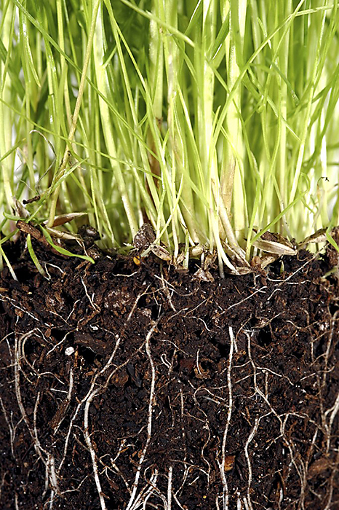
Improve Energy Flow and Soil Carbon Over a Longer Period
Plants
Solar Collectors
Soil
Battery

Slide 28
Importance of Soil Cover: Bare soil is public enemy number 1!
What role does soil cover play?
In the functioning of the water cycle?
In the mineral cycle?
In biological community and succession?
In the effectiveness of energy flow?
Notes:
Ask about the role soil cover plays in each of the ecosystem processes by responding to the questions. Option: assign one question to each of four groups to discuss.

Slide 29
Growth and Soil Temperature
∼ 95° F Plant and root growth stops
∼ 80 ° F: Many plants reach peak growth of roots and plants and peak nutrient uptake. James A. Tindall, H.A. Mills & D.E. Radcliffe (1990) The effect of root zone temperature on nutrient uptake of tomato, Journal of Plant Nutrition, 13:8, 939-956
65° – 86 ° F: Ideal range for nitrification, plant growth and planting

Slide 30
Temperature Effect on Soil Biological Communities
Micro-organisms:
Ideal temperature range 50-96 F (Davidson and Janssens 2006)
Macro-organisms:
Ideal temperature range 50-75.2 F (Bristow 1998)
Soil organisms begin to die above 130 F.
When soil temperatures increase, biological activity increases and organic matter decreases.

Slide 31
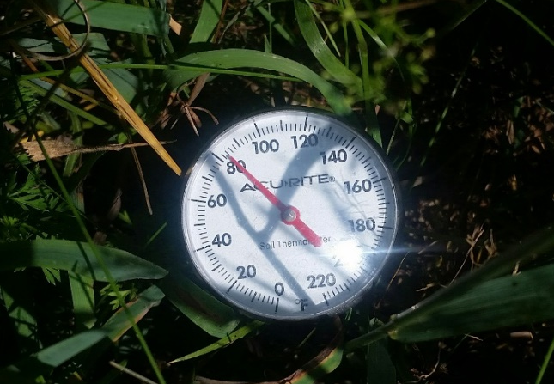
Effects of Cover on Soil Temperature At 1” depth – same day Chatham, NY Farm 45 degree difference
Ambient Temperature: 93 F Tall Pasture (8-10”): 83 F Mulched Veggie Beds: 90 F
Overgrazed Pasture (<1”): 108 F Bare Soil: 115 F Black Plastic: 128 F

Slide 32
So what do we do with this information?
Understand management tools
What does your holistic goal say?
Test possible courses of actions
Monitoring
Notes:
**Everything we do to the land - even when we “do” nothing - has an impact on the ecosystem processes. This is a key lesson for today!**
Whether that impact is positive or negative can only be determined in relation to your holistic goal, and you will only know if you have some kind of monitoring program in place. We’ll talk more about monitoring, but first let’s look at these management tools.

Slide 33
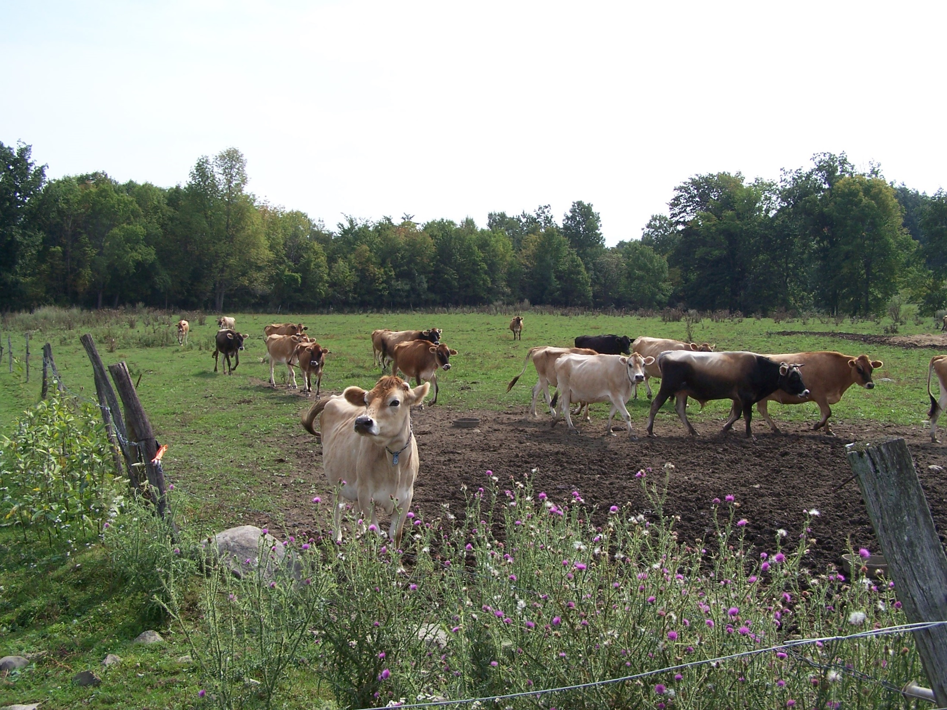
Notes:
Tool of rest

Slide 34
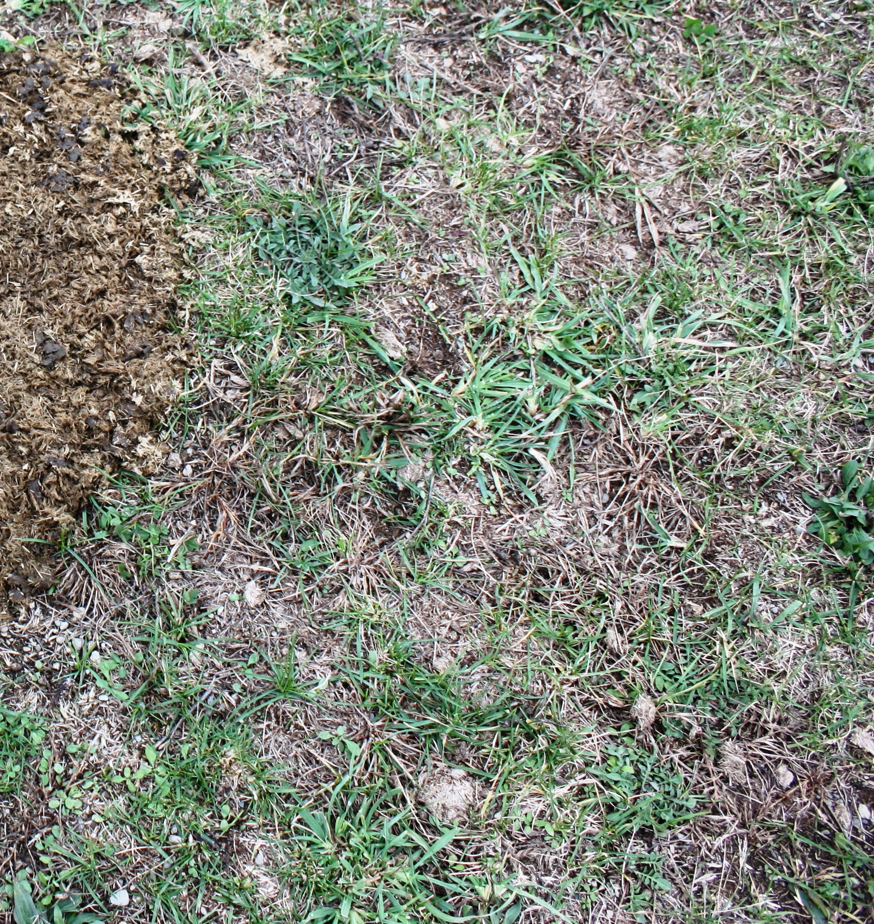

Slide 35
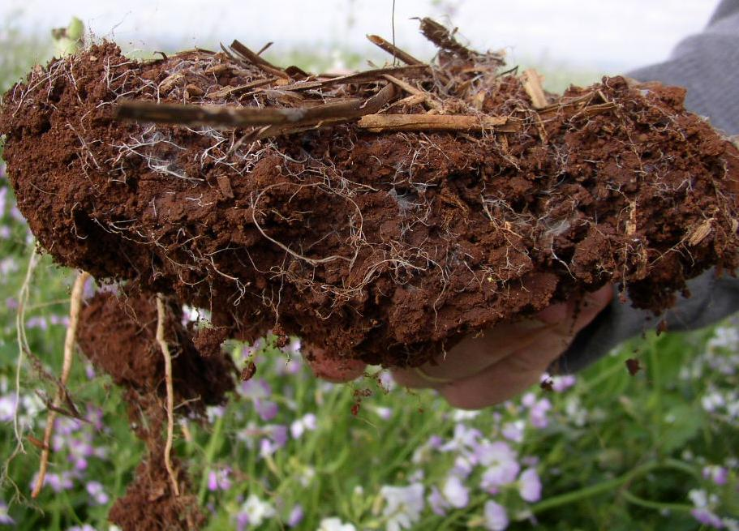

Slide 36
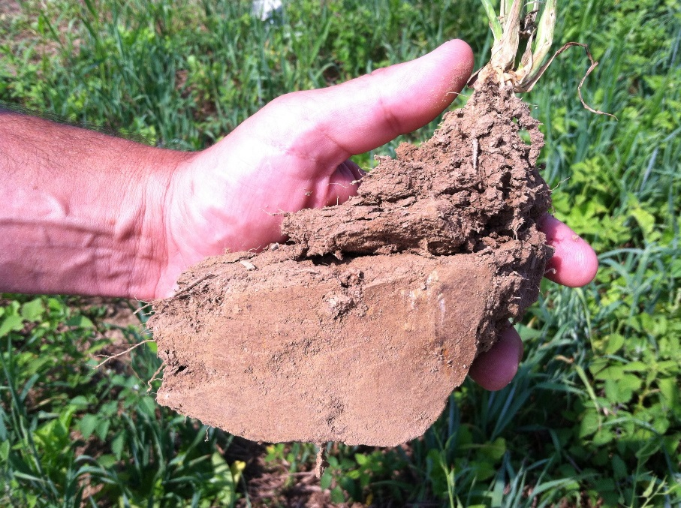

Slide 37
Notes:
What is happening with the:
Water Cycle?
Mineral Cycle?
Community Dynamics?
Energy Flow?
What tools can we use?
“We don’t have a runoff problem, we have an infiltration problem” – Ray Archuleta

Slide 38
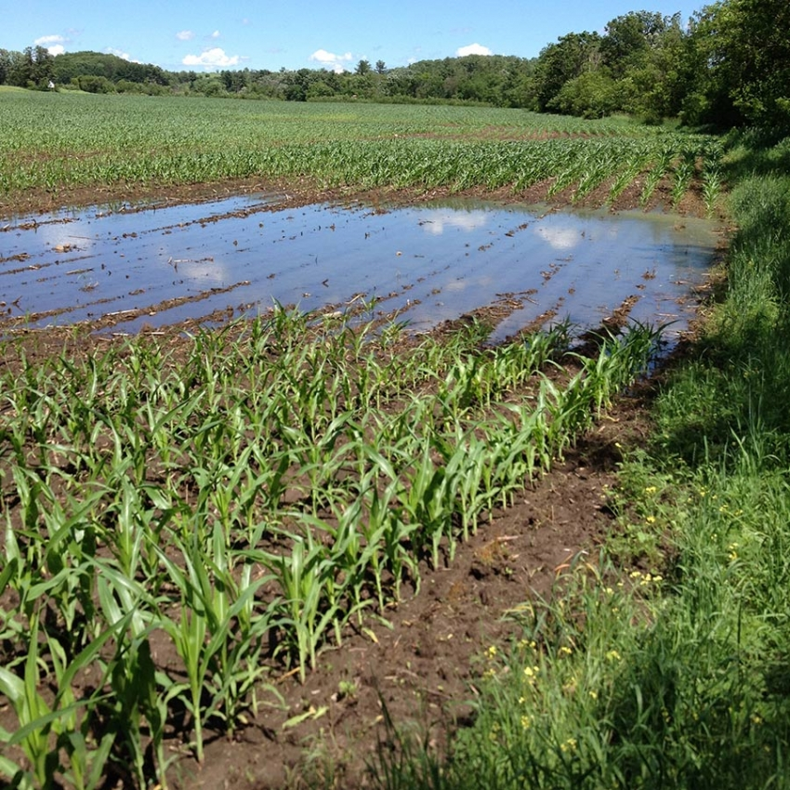

Slide 39
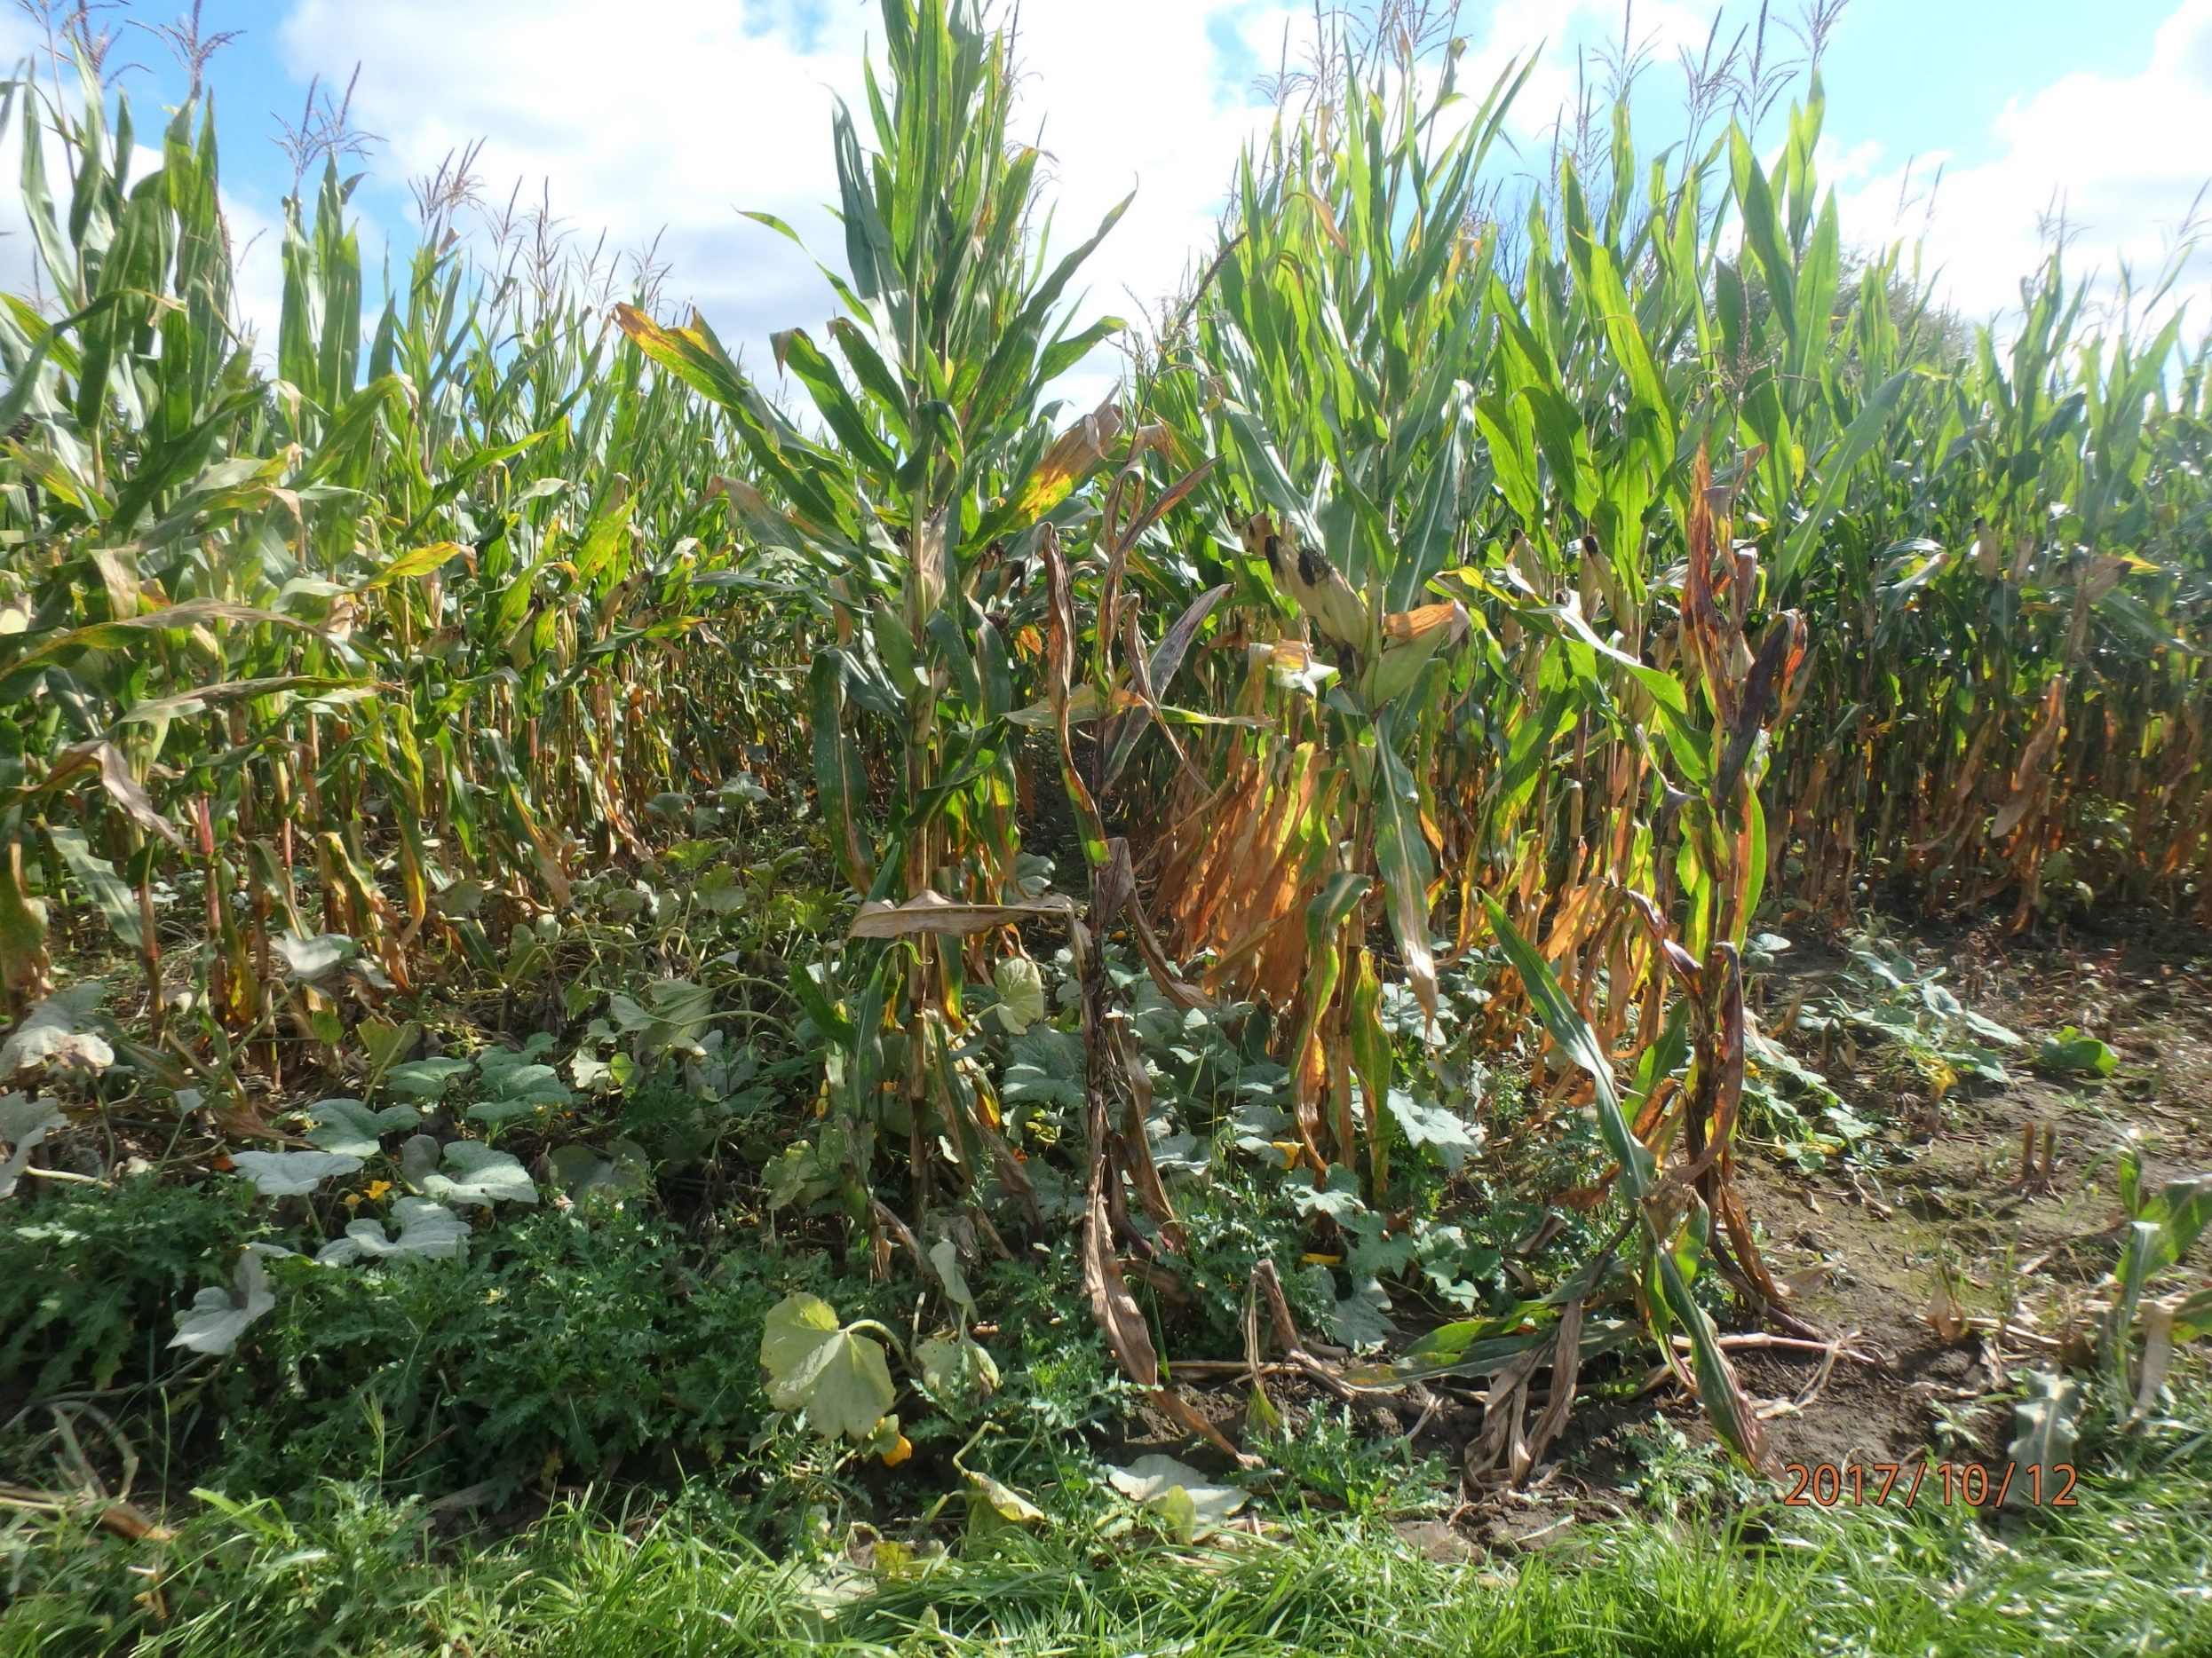

Slide 40
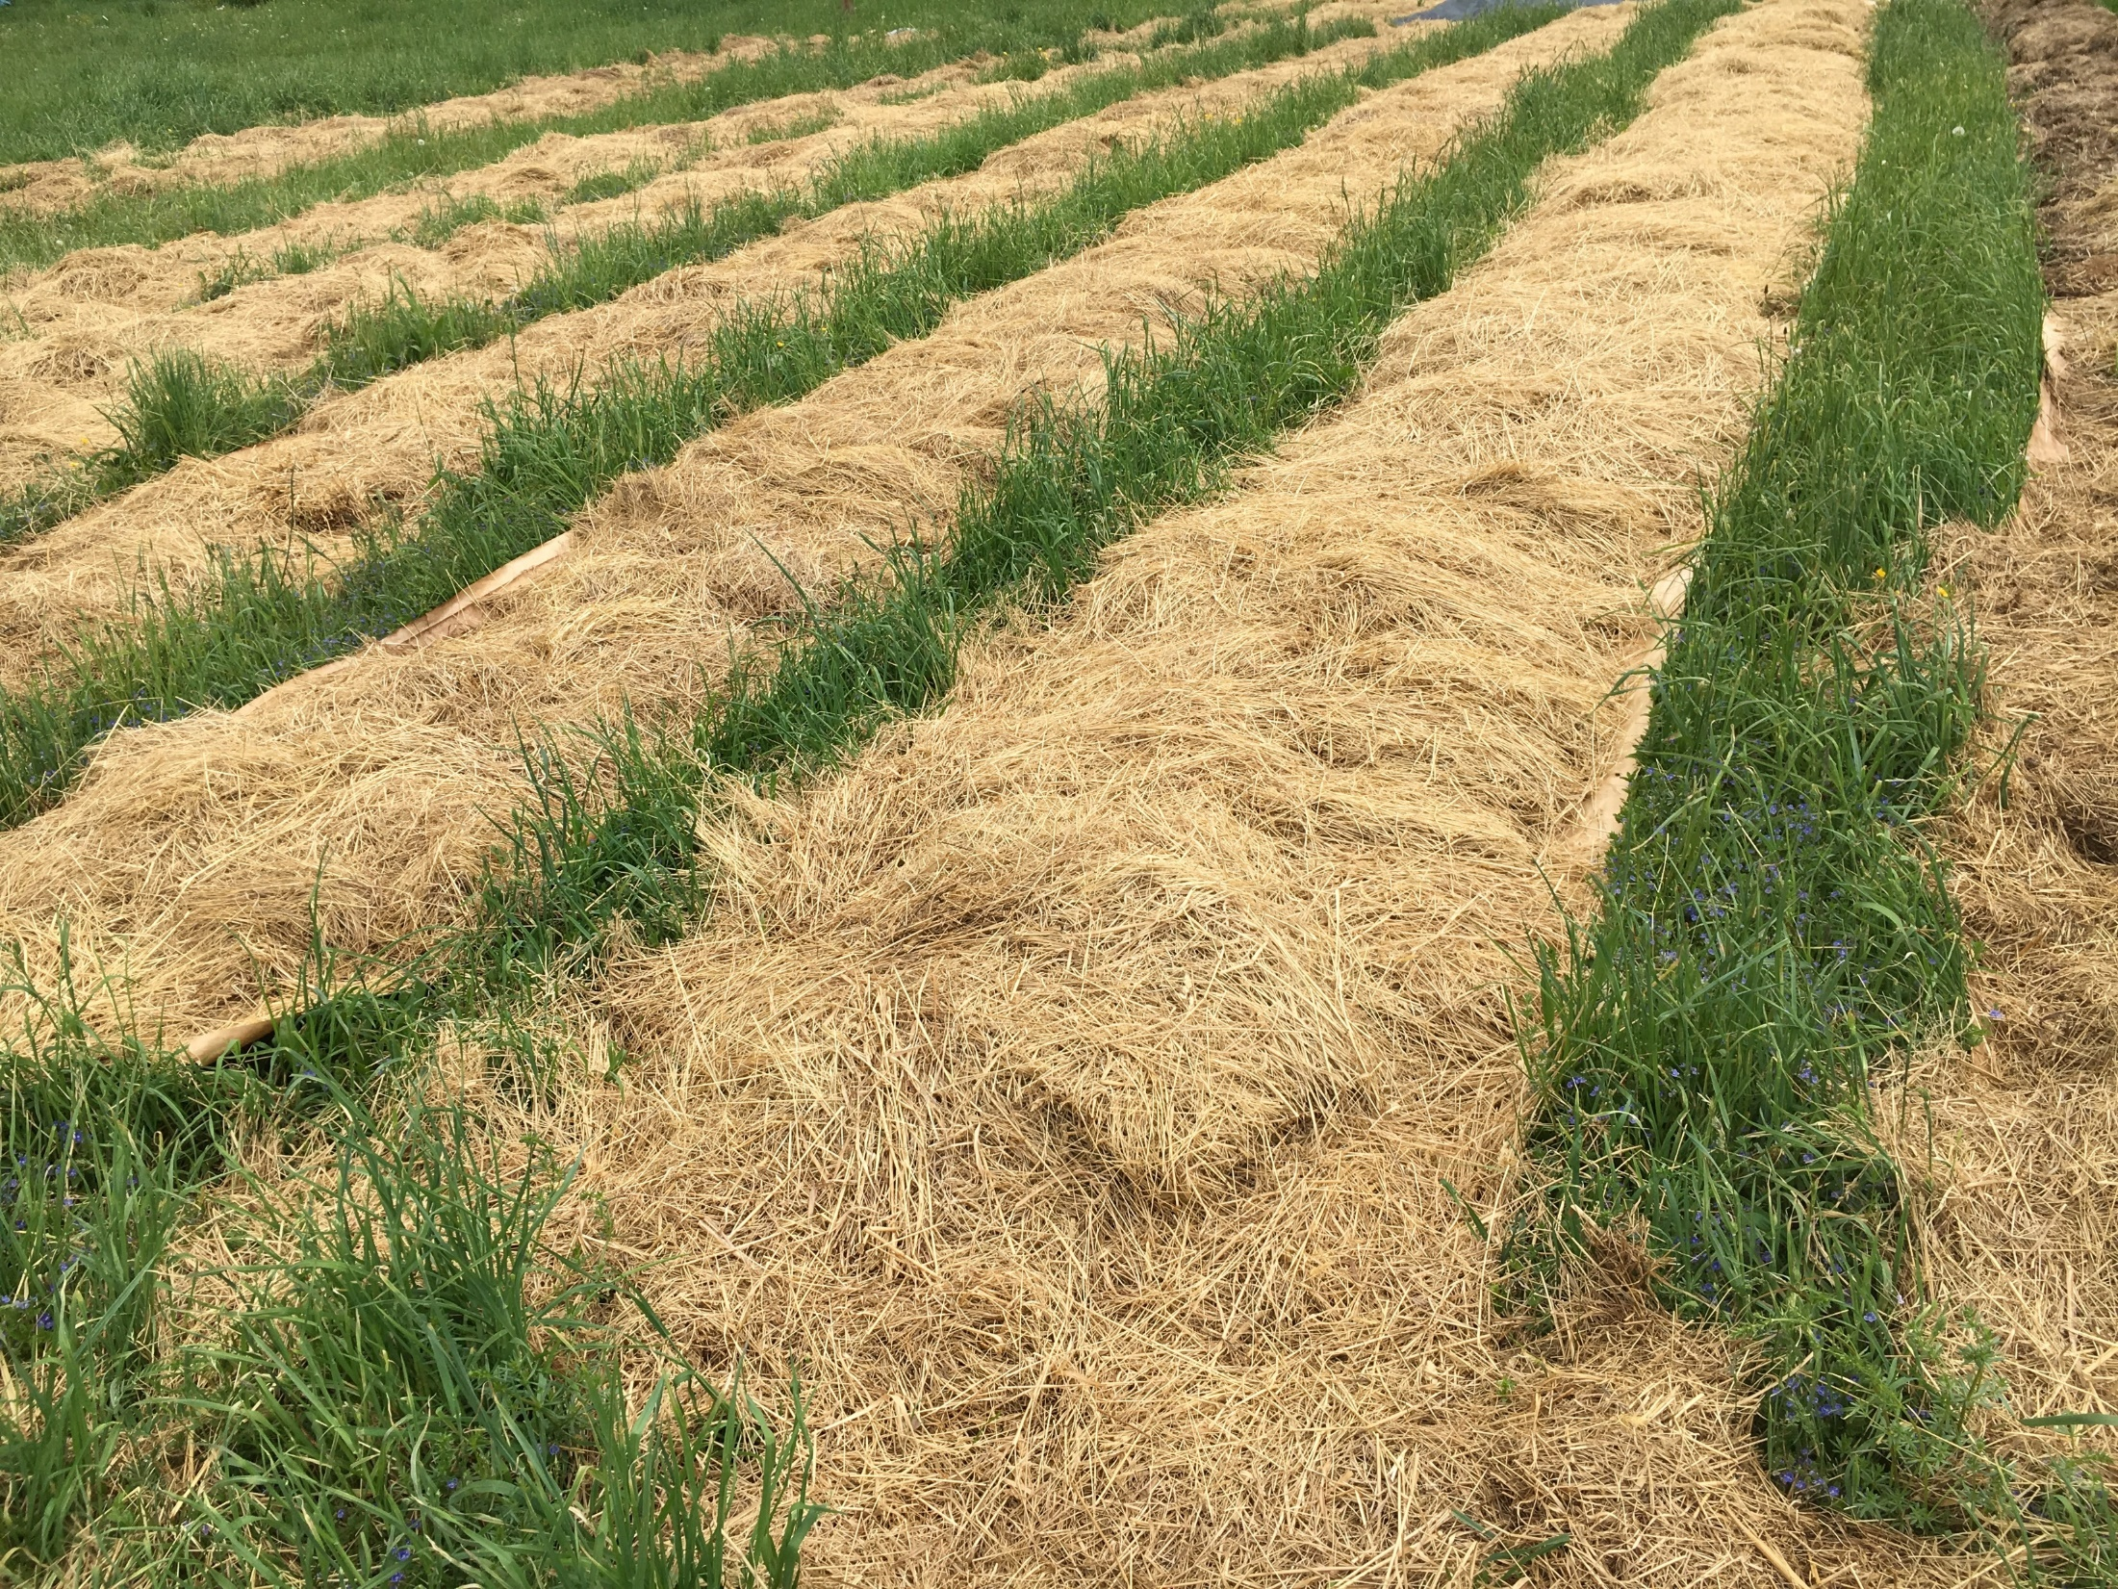

Slide 41
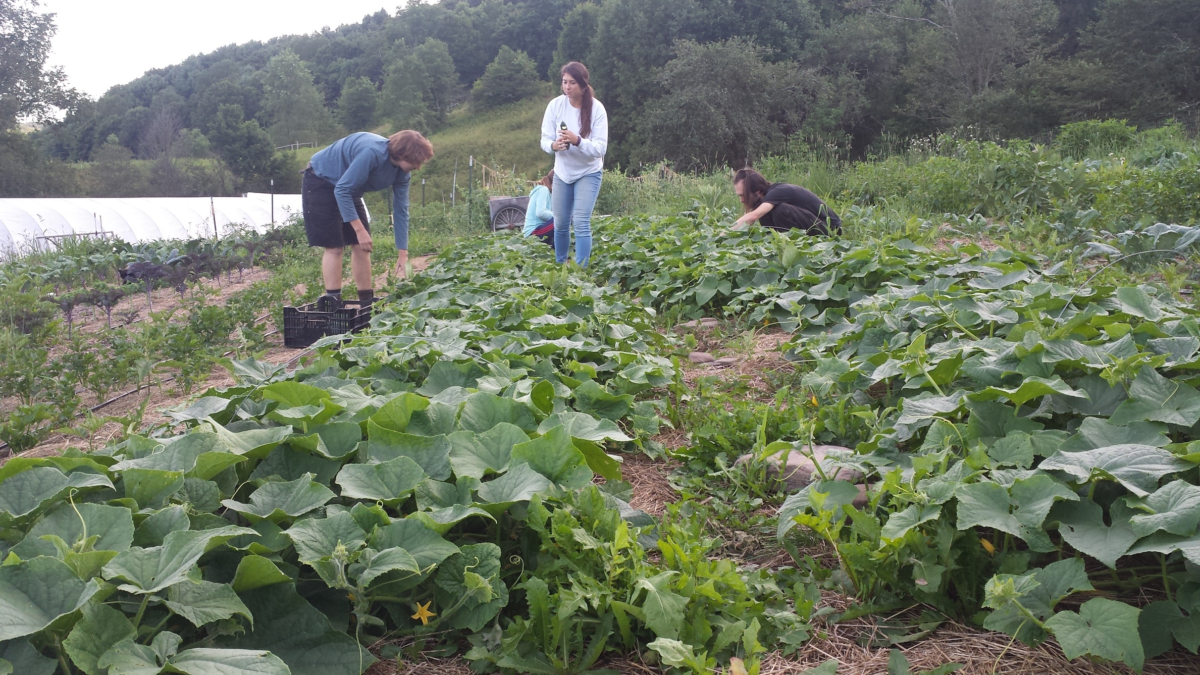

Slide 42
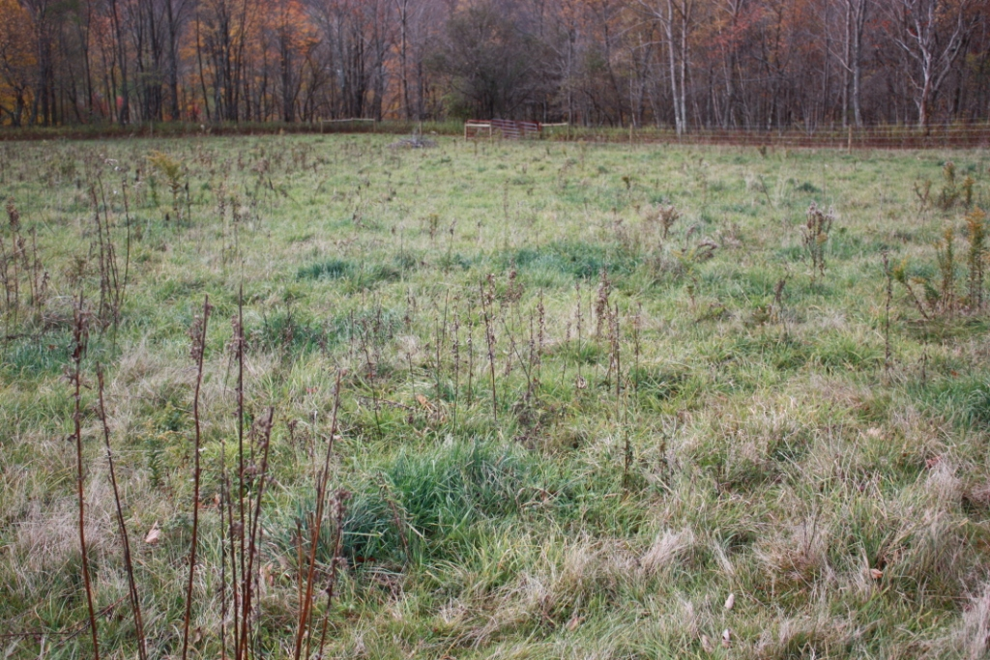

Slide 43
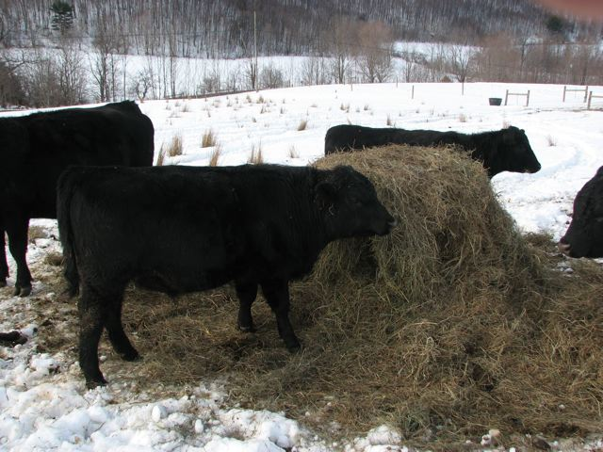

Slide 44
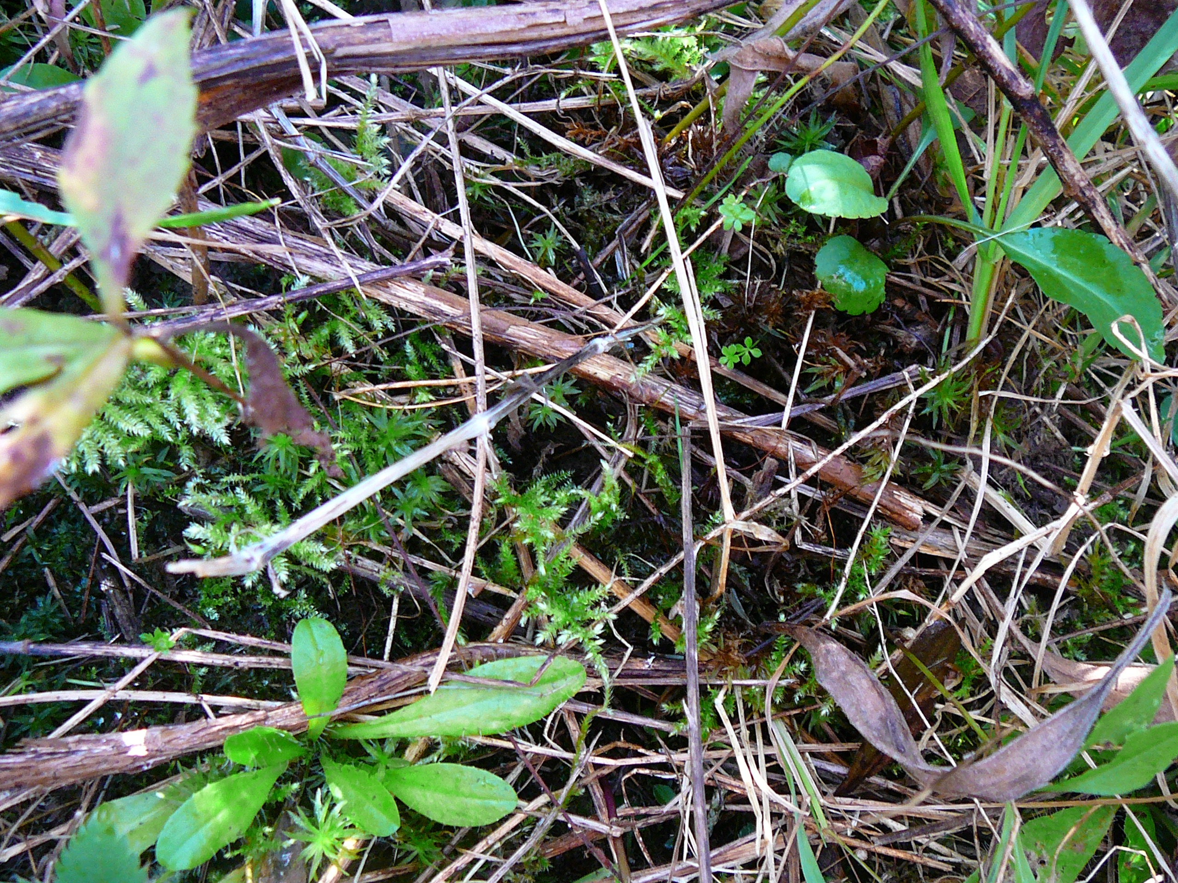

Slide 45
Winter Annual Cover Crop

Slide 51
Thank you for what you do!
And the people who serve them!

Slide 52
Questions?
Elizabeth Marks
Certified Holistic Management Educator
Chatham, New York
(518) 567-9476
elizabeth_marks@hotmail.com

