Slide 1
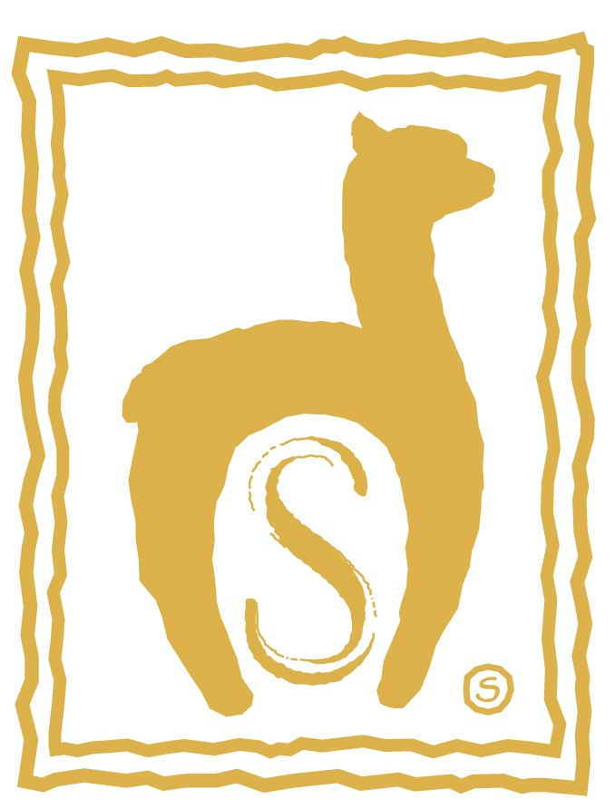
Navigating the Fiber to Finished Goods Supply Chain
Lynn Edens for LocalFiber
July 27, 2019
Conference funded in part by SARE grant ONE18-321

Slide 2
Fiber Business Navigators Need:
To understand where they are today
Current market conditions, opportunities, and risks
To know where they want to be
Desired business results, preferably taken from a business plan
To understand possible routes from where they are to where they’d like to be
Business models
The characteristics of their current businesses, including objectives, financial health and access to resources
Desired personal and social/community results
Resource identification
Strategic partnerships
Conference funded in part by SARE grant ONE18-321

Slide 3
The Wool Grower Industry
Over 101,000 sheep growers in the U.S. had over 5.4 million sheep and lambs in 2017
More than 32,000 growers sold wool in 2017
Farms with over 2500 head made up 1% of all farms but produced 39% of the wool sold by weight and 43% of the animals sold.
100% of farms this size sold animals
96% also sold wool
Farms with less than 100 head made up 85% of all farms but produced just 15% of the wool sold and 19% of the animals sold, despite owning 32% of all the stock in the country
52% sold animals in 2017
Just 29% of farms of this size recorded wool sales
On average they sold wool at a per-pound price that was just 60% of that achieved by the largest growers.
The aggregate value of the U.S. wool clip was, at $42.8 million, the highest seen since the record year of 2011.
85% of growers own less than 100 sheep
They produce just 15% of the raw wool sold
And earn 9% of the revenue
Conference funded in part by SARE grant ONE18-321

Slide 4
Niche U.S. Animal Fiber Sectors
Angora Goats (Mohair)
Over 11,000 growers owned 154,000 goats and kids in 2017
2,800 growers produced 686,000 lbs of mohair worth $2.6 million in 2017. This was just over 60% of the amount that growers earned by selling the animals themselves, as breeding stock and for processing.
The number of farms reporting owning angora goats grew by 19% between 2012 and 2017, but the U.S. herd size stayed constant.
Alpacas
According to the USADA, 10,000 farms owned 122,000 alpacas in 2017 (how accurate?)
Just under 2000 of them reported revenue animal and animal product revenue of $15.5 million in 2017.
No one knows how much U.S. alpaca fiber is sold and processed each year. A reasonable guess at the total value of the raw clip is $3 million.
Even taken together these two markets likely produce less than 10% of the annual revenues produced by the the raw sheep’s wool market. Animal fiber business opportunities in this country will largely derive from and be driven by the sheep industry.
Sheep’s Wool
Mohair
Alpaca
Conference funded in part by SARE grant ONE18-321

Slide 5
Market Conditions are a Source of Potential Concern
Wool prices have begun to look vulnerable as economic growth in key wool-consuming countries – most notably China -- has slowed.
China is the single largest consumer of wool at retail in the world, and in addition purchased half of the raw U.S. wool clip in 2018. Tariffs, current and threatened, as well as volatility in trade policy more generally, add risk to grower economics. A recent article in the April 2019 Sheep Industry News opined that the threatened 25% tariffs would “kill” the wool industry in the US.
Trade developments affecting the markets for lamb and mutton are worth watching as as revenues from animals sales were 24 times that earned from the sale of wool in 2017. However, currently the U.S. imports much more lamb and mutton than it exports. The primary market is in the Northeast.
Where go wool prices, so will follow prices for other animal fiber, including mohair and alpaca.
Conference funded in part by SARE grant ONE18-321

Slide 6
Wool Production Has Dropped In The US, But Wool Processing Has Declined Even More
1976 1982 1988 1994 2000 2006 2012 2018
1976 1982 1988 1994 2000 2006 2012 2018
Conference funded in part by SARE grant ONE18-321

Slide 7
While Surviving Mills are Reporting Growth, The Overall Market is Still Shrinking and Profitability is Constrained
Do you expect your business to grow in 2019?
Fiber processing businesses are generally booming, at least volume-wise, with longer wait times for many services. Processing prices have also risen on average.
But in our annual mill survey, just 67% of respondents were profitable in 2018, down from 100% of those surveyed in 2017.
Recent increases in fiber prices have likely played a role in compressing profits
“Processors are left having to buy hand to mouth to run machinery while not being able to pass the cost of production down the pipeline” (ASI Wool Market Weekly Report, 3/1/19)
In our survey more processors reported developing branded lines of their own and are seeking additional ways to diversify and enhance their bottom lines.
Was your business profitable in 2018?
Source: The 2019 Annual Alpaca Processors Survey, produced by Little Creek Farm.
Conference funded in part by SARE grant ONE18-321

Slide 8
Wait, Why Do I Care Again? Because Even Small Farms and Fiber Businesses Are Affected By These Larger Trends
They can affect the sales prices and options for raw fiber of all types and quantities, as well as what is available for purchase and product development
They can affect the price and availability of fiber processing of various types
They can affect the wholesale cost and range of products available for sale in farm stores and other business efforts
They can affect the value of other business assets, including everything from land to equipment and distribution facilities
These trends can create opportunities for as well as risks to our businesses
Conference funded in part by SARE grant ONE18-321

Slide 9
Speaking of Opportunity: Another Important Trend in Agriculture is Agritourism
Reported agritourism revenues rose to nearly $1 billion in 2017, with over 28,000 farms reporting agritourism revenue (Source: USDA 2017 Census of Agriculture). But this likely dramatically understates the economic value of on-farm retail, as the sales of all value-added products are excluded from this calculation.
Approximately 20% of those farms reported revenues of $25,000 or more, and the average per farm agritourism revenues for all farms was over $33,000 – meaning for some farms, agritourism has likely become their primary source of farm revenue
This mirrors the broader shift toward entertainment and experienced-based retailing, and favors small farms located closer to major population centers
Both single farm- and locally-branded products have increased opportunities to reach consumers with geographic and values-centered interests.
Conference funded in part by SARE grant ONE18-321

Slide 10
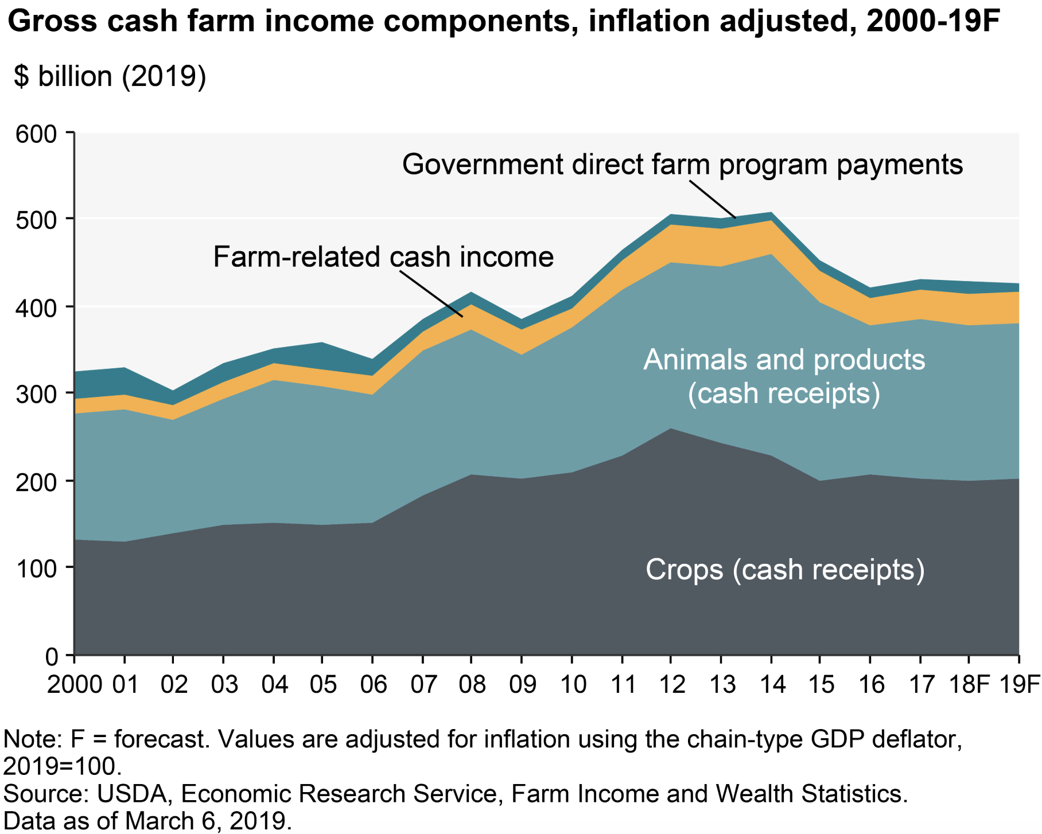
Agritourism Revenues are Part of an Income Diversification Trend
Conference funded in part by SARE grant ONE18-321

Slide 11
Routes to Commodity Wool Sales
Wool warehouses
Receive large lots of consigned wool and mohair, typically from individual growers, test to establish quality and sell on behalf of growers at auction or via private treaty sales.
Roswell Wool is currently the largest in the country, and handles about 20% of the U.S. wool clip.
Wool Pools
Collect and grade wool from smaller growers to create larger lots for sale.
Operate at many different scales and with different structures and ownership/membership.
Direct sales of raw wool to processors
Some brands and processors want to retain traceability or other production-based sources of branding
NEAFP is an example of a company that brands US grown and manufactured alpaca products.
Imperial Yarn buys wool directly from large growers that have certified their practices as Climate Beneficial.
Brooklyn Tweed is a hand-knitting yarn company that sells breed specific American grown and made yarns.
Hybrids
Midstates Wool Growers is a large co-op that provides both wool pooling and warehouse type services. They currently handle about 15% of the annual U.S. wool clip and represent over 5000 growers.
Conference funded in part by SARE grant ONE18-321

Slide 12
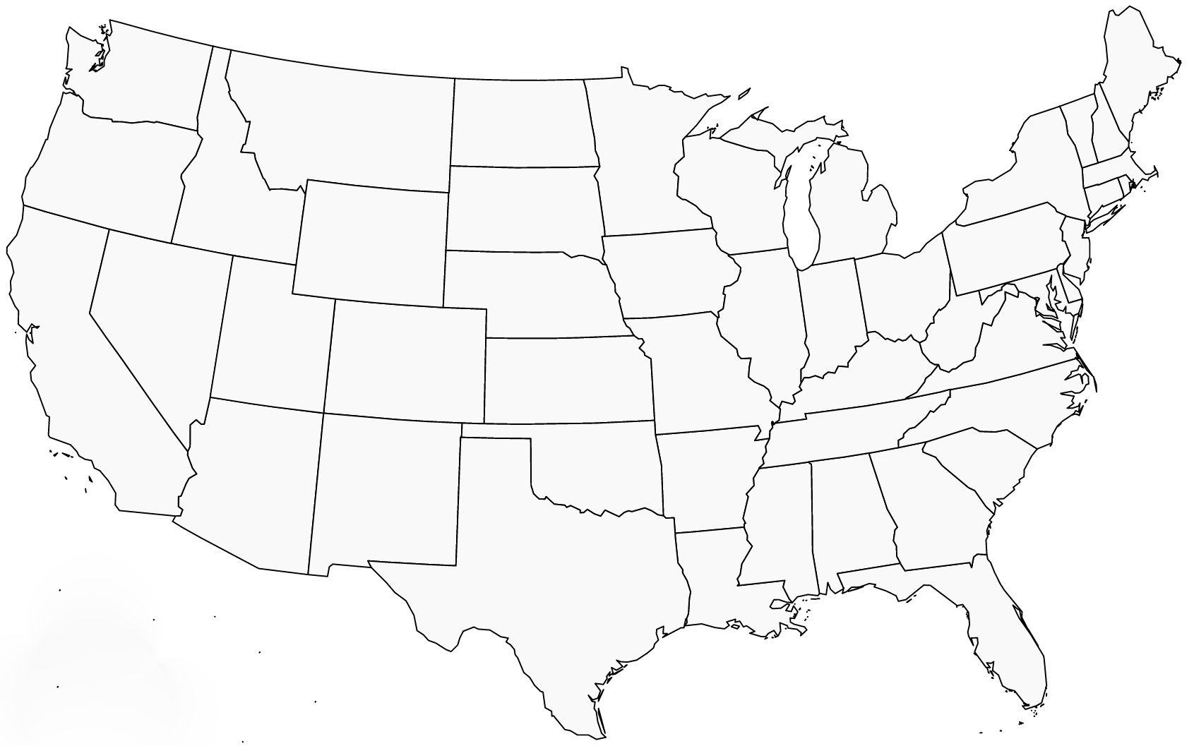
Warehouses, Wool Pools and 1st Stage Processing Facilities
New York’s annual wool clip scaled for comparison
Top areas for wool
production scaled by volume
Wool Pool
Warehouse
1st stage processing (scouring +)
Data sources: American Sheep Industry Association
US Department of Agriculture
Conference funded in part by SARE grant ONE18-321

Slide 13
How Wool Pools Work: Two Examples
Midstates Wool Growers
The Alpaca Coalition of America
Cooperative ownership
Consignment sales based on grade for producers with 25 head or more with payments made in December of shearing year.
Payments at delivery for very large customers willing to sell at grade and yield, or for anyone willing to sell for a very low price on an ungraded basis
The typical grower consigning to Mid-States is small, with 30 or 40 animals
There are over 100 wool handlers in 23 states (there are two in NY) helping collect over 3 million lbs annually (equivalent to 30% of all wool milled in the U.S.)
The average AFD of wool consigned ranges from 27-32 microns.
Most of the wool collected is sold to U.S. purchasers
Alpaca fiber under 32 microns and at least 2” in length can be consigned at 4 locations in the U.S.
ACOA grades, bales and sells the fiber in a competitive bidding effort, taking 15% of the proceeds to pay for professional grading and relying on volunteers for the rest
Growers are typically paid in November or December of shearing year
Most of the fiber is sold to U.S. purchasers
Prices paid have ranged from $1.25 to $19 per pound depending on quality and characteristics, and can vary a lot from year to year
The collection is very small and normally collects 10,000-12,000 lbs.
Conference funded in part by SARE grant ONE18-321

Slide 14
Starting A Wool Pool
Sales Plan
A high-confidence fiber sales plan is the starting point for any pooling effort.
The plan will almost always require constraints on the type of fiber accepted, and therefore on the constituents served.
Management Plan
Collection points and facilities for grading, baling and storage must be established with an eye to minimizing transport costs for both purchaser and grower.
The plan must anticipate and produce a scale of operations significant enough to generate graded lot sizes that will command a premium over smaller lot sales (the whole point of a wool pool.)
A corporate structure may be required.
The pool operators need to decide how the effort will fund its expenses, including grading/core testing; baling/shipment packaging, banking arrangements, communications costs, etc.
Service Plan
Potential conflicts of interest must be identified and managed.
Assessment Plan
The pool operators need to develop an annual assessment and reporting process.
Annual financial results will need to be documented for tax and other purposes.
The pool operators must plan for its future.
Conference funded in part by SARE grant ONE18-321

Slide 15
Wool Pool Economics for Growers
Small growers can overcome some of the disadvantages of their size to get a commodity market price for their fleece at minimal incremental cost (transportation and pool fees) and effort
But all potential value associated with the unique characteristics of the animals, farm, etc is lost, to the farm and perhaps to the community as well
This trade-off tends to make sense for the majority of growers whose primary revenue source is not fiber and/or who do not have additional business resources available to invest in developing higher yielding sales opportunities.
Changing these growers’ fiber sales preferences in favor of value-added markets will likely require helping reduce the investment and risk associated with these approaches
Conference funded in part by SARE grant ONE18-321

Slide 16
Value Adding Through Vertical Integration
Connections to a specific farm or farming practice
Local and regional business collaborations
Differentiation through unique designs, quantity and availability
Opportunity to leverage other parts of a farm or business
Vertically-integrated operations will invest in one or more steps of processing raw fiber before selling it as anything from roving or top to finished product
In addition to processing costs, additional investments are required for inventory as well as branding, marketing and sales efforts
Because these vertically integrated businesses will often be smaller and less efficient at each stage, they typically position themselves for success by monetizing the unique, non-commodity qualities of their products.
Conference funded in part by SARE grant ONE18-321

Slide 17
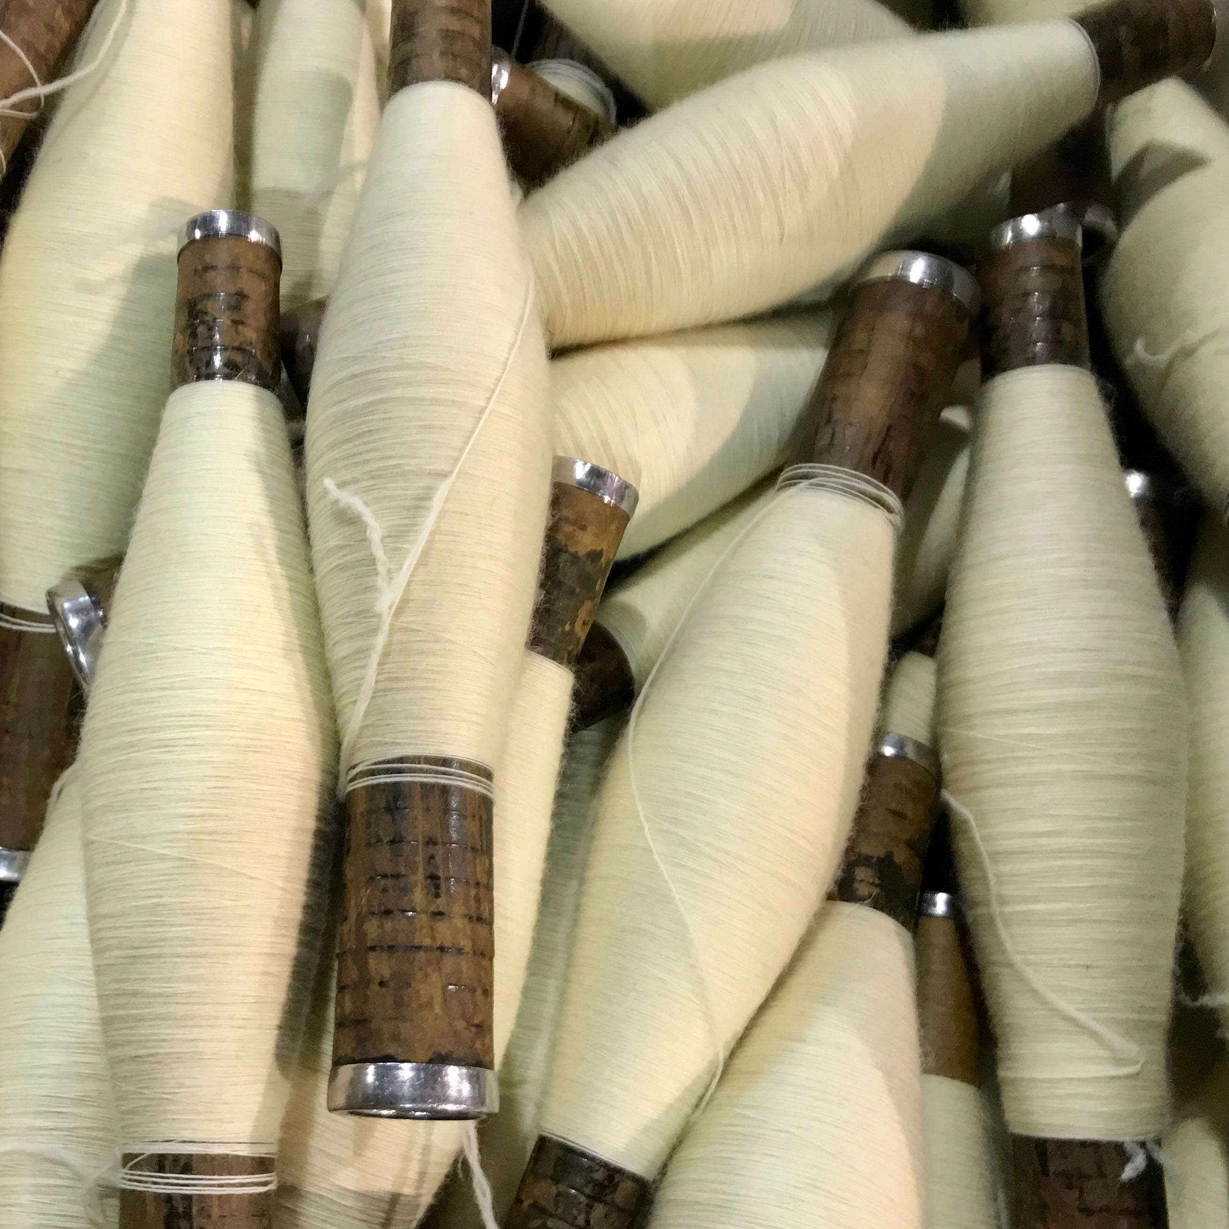
What Do We Mean When We Talk About Manufacturing and Market Access For Small Fiber Businesses?
Someone must be willing and able to perform the work the business needs done
The business must be able to finance the production of the product from the animal to the point of sale
The market value of the end product less the cost of producing and selling it must represent a reasonable profit.
Smaller fiber businesses are usually challenged in all of these areas.
Conference funded in part by SARE grant ONE18-321

Slide 18
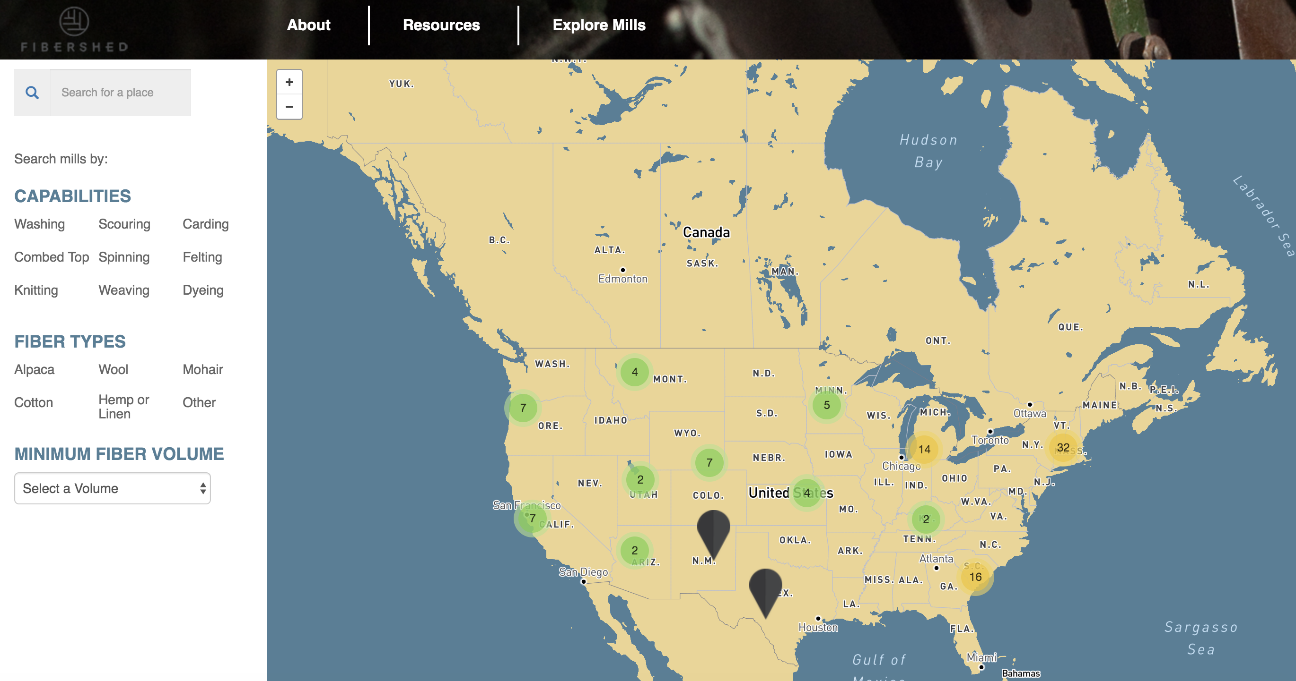
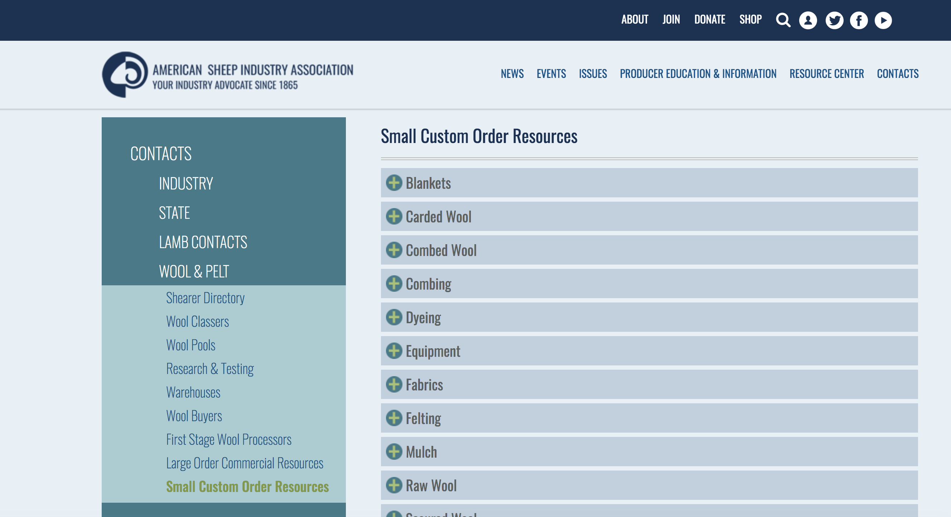
U.S. Processors Are Able
Source: Fibershed National Mill Inventory: Nationalmillinventory.com
Source: American Sheep Industry Association: Sheepusa.org
But with current U.S. animal fiber processing capacity likely less than half of U.S. annual animal fiber production, time in the production queue can be long and brands ranging from individual farm stores to nationally-known retailers need to be both flexible and opportunistic.
Conference funded in part by SARE grant ONE18-321

Slide 19
The “Willing” Challenge: Access To Small Scale Processing
Mini Mills
Volume minimums are not an issue, but processing cost is typically 3 to 4 times higher than commercial mills
Product options are limited even in experienced hands
Some mini mills can wash fiber but the results may be different than with commercial scouring
Generally only a financially viable option if the result is unique product that can sell for double or more the price of comparable commercial products (For instance, “Yarn from Bob the Sheep”) or to produce loss leaders that drive sales of higher margin commercial product.
Commercial Mills
Minimum run sizes can range from 200 lbs to more than 5000 lbs for a single yarn product.
Blending with wool may be required for less common fiber types to conform with equipment needs
Prices are much superior to those offered by mini mills and the range of products that can be produced is usually larger.
Scouring and/or dyeing may need to be sourced separately.
Smaller customers’ jobs may not be prioritized.
Processing wait times for some smaller commercial mills in particular have gotten heinously long – as much as 18 months in some cases.
Conference funded in part by SARE grant ONE18-321

Slide 20
Grower Collaborations
Regional growers with similar animals and production goals combine their fiber to make products that are shared among them.
This type of collaboration can preserve many of the brand-able elements of smaller scale production but achieve cost efficiencies in production, as well as create product options that might not have been available to growers as individual customers
Shared branding, marketing, and sales efforts can further increase efficiency
Some uniqueness and ability to serve different markets is inevitably lost
Identifying like-minded fellow growers with shared interests may be challenging, and managing the partnership over time may present issues
Conference funded in part by SARE grant ONE18-321

Slide 21
Fiber-Related Co-Ops
Some co-ops create access to commodity markets
In 2017, 35 wool co-ops representing over 8000 members sold $9 million in wool (Source: USDA).
Other co-ops help create access to processing
Processing organizations like Natural Fiber Producers
Breed organizations like the International Association of German Angora Rabbit Breeding
Retail co-op efforts can provide economies of scale for small fiber businesses
The bricks and mortar version of this model is challenged by the increasing importance of on-line sales and the resulting disconnect from place/provenance.
All of these efforts require some degree of specialization to be functional, which results in a smaller pool of potential cooperators.
Conference funded in part by SARE grant ONE18-321

Slide 22
Financial Access: The Challenge of Creating Profitable Products in Lower Volumes
Competitive challenges for the small maker/retailer
Long manufacturing time with capital invested
Smaller scale manufacturing and higher pricing
Small scale to support marketing and branding
Conference funded in part by SARE grant ONE18-321

Slide 23
Time is Money: How Can Grower/Retailers Fund A Three- to Four- Year Revenue Cycle?
Year One: Grow The Fiber
Years 2 - 3: Make The Products
(Work in process capital requirement: 25-50% of annual sales)
Years 3 - 4: Sell The Products
(Inventory capital requirement: up to 50% of annual sales)
Non-vertically integrated brands/retailers generally don’t pay for most of the costs of their products until they are delivered.
Conference funded in part by SARE grant ONE18-321

Slide 24
Ways To Shorten Production-Time Costs
Sell more/all of your own fiber raw and buy finished products made with other fiber for resale.
You lose farm “provenance” but can still create other unique product characteristics by getting involved in later stages of manufacture without having to wait for your fiber to get there.
This might affect your right to sell products on farm or to participate in farmers’ markets, so check this first.
Move up the queue by combining fiber/processing runs with others.
Develop a retail business model focused on products with shorter processing times, at least for your own fiber.
For example, sell yarn and roving made from your own fiber, but scarves and socks made from others’.
Conference funded in part by SARE grant ONE18-321

Slide 25
Ways To Add Efficiencies of Scale Without Growing Your Business
Maintain a uniform herd of fiber animals.
Design all your retail products using a single yarn type to achieve the best pricing for this stage of the process.
Combine your clip with others and share the resulting products
Identify other growers with complementary business models and work together
Also creates cross-promotional opportunities
Work with a larger business that will accept some smaller custom orders
Develop your product diversity in other stages of the process – skein dyeing, accessory design, etc.
Build products from just one or two yarns
This will help keep your product batch sizes as large as possible
They will have more financial leverage and may receive better pricing.
They may be able to help you identify other businesses with which to collaborate.
Conference funded in part by SARE grant ONE18-321

Slide 26
Working Together, You Can Make Competitively-Priced Products: Here’s One Example
Imperial Yarn started a private label manufacture business program for small farms. A farm or group of farms submits at least 200 lbs of fiber (or agrees to blend smaller amounts with wool to get to that amount) and choose from a menu of end products.
At this volume Imperial can produce a range of competitively priced products, all the way from socks at $7.80/pr to knit throws at $65 each. This leaves room for full retail mark ups for most farms, but keeps the individual farm brand value and product selection options in place.
We earn a profit by providing this service, as does every other value chain member – this makes it sustainable.
This has been a popular addition to our offerings. Other businesses likely offer this kind of option also, or will if you approach them.
There are commercial mills in our region which will provide both access and competitive pricing at the 200 lb order level.
Conference funded in part by SARE grant ONE18-321

Slide 27
Customer Access: Marketing and Branding Support
Your Fiber Business
Other Fiber farms
Agritourism businesses
Tourism businesses
Designers branding sourcing
Mills and other service suppliers
Regional and industry support groups
Economies of scale are available here also
Look for other businesses or efforts that are or could be vested in your success
Often the benefits are not just shared promotion but also new business opportunities
Conference funded in part by SARE grant ONE18-321

Slide 28
Some Favorite Regional Examples…
You guys are doing a great job!
Hudson Valley Textile Project
New York Textile Lab
Watershed Agricultural Council
Ryder Farm (one example of an art, food and fiber collaboration!)
Dutchess County Sheep and Wool Growers Association
Conference funded in part by SARE grant ONE18-321

Slide 29
…And Some Examples of What They are Doing
Watershed Agricultural Council
WAC’s mission is to protect the New York City water supply through conservation while supporting the economic value of agriculture and forestry in the region.
Their work has included the development of the Pure Catskills buy local campaign as well as a small agricultural business planning service and micro grants program.
New York Textile Lab
Founded by Parsons professor Laura Sansone, New York Textile Lab connects fashion designers with the regional textile value chain, helping them create brands that reflect their support of sustainable, ethical, and transparent sourcing and production practices
The New York Regional Yarn Sourcebook has70 sample yarns and swatches produced by 20 farms in the state and is a resource for designers.
Ryder Farm
Ryder Farm is a 225 year old farm in southern NY that provides an amazing example of how a farm can connect a broader community economically and culturally.
They operate a residency program for regional artists as well as a CSA that provides shares at a price that adjusts for family income. Many of the shares are free to the neediest families. Regular on-farm events connect the community.
Recently, WAC has begun helping regional farms certify their wool production as Climate Beneficial per Fibershed’s seminal program.
The organization also collects and makes available market data.
This year for the first time they are including a locally source fiber product with their CSA shares in a cross promotion that highlights the links between three woman-operated farms in the region and provides valuable cross promotion.
Conference funded in part by SARE grant ONE18-321

