Slide 1
Edible Winter Peas
New Solutions to Old Problems

Slide 2
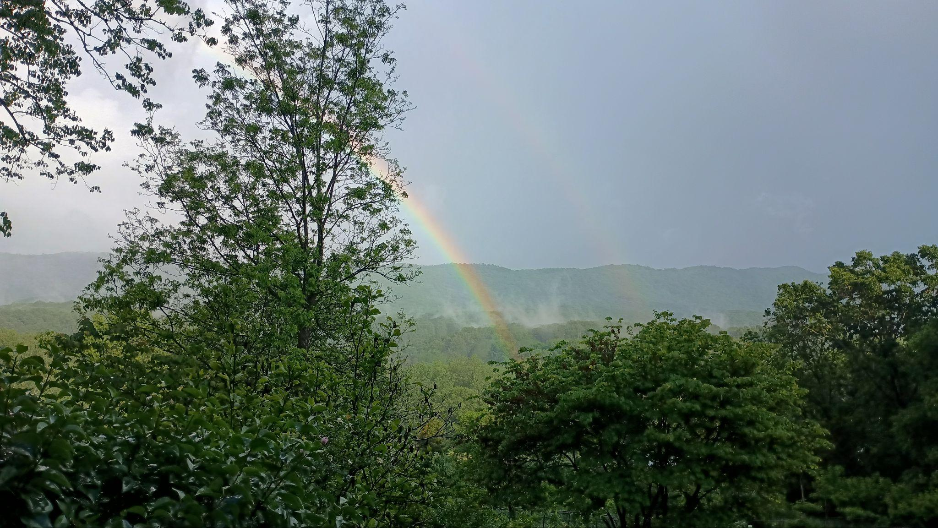
Let’s start with gratitude:
~to the first stewards of our land
~to Pam Arnold
~to the ancestors whose work we continue
~to my family

Slide 3

With Thanks to SARE
With thanks to SARE
This presentation is part of a SARE grant we were awarded to study our new pea varieties
Links: Our SARE project
A SARE article about it

Slide 4
The Backstory (all old dates approximate)
1980–Jason’s Pea Patch (age 3-4)
1994–EMU, International Agriculture major
2000–Sugar Snap obsession
2004–Seed saving (W. W. Weaver)
2004–Caught the breeding bug (Carol Deppe)
2010–Getting into cover crops/grains
2012–Pilfered AWP from the neighbors
2013–AWP looked very familiar, amplified
2014–The lucky cross
2015–Diversity happens, AWP displaced
2016-2023–Selecting for edibility
2020-2023–Wishing for a dwarf version
2023–Thought I saw some, collected seed
2023–Built seed sanctuary
Fall 2023~Sowed possible dwarf seed in SS
Early 2024–awarded SARE grant

Slide 5
Edible Winter Pea Orientation
Why bother?

Slide 6
The Old Problems
~Soggy soil in early spring
-Inconvenience
-Soil damage
~Variable spring weather
-Tempting to plant in a warm spell
-Cold weather can set plants back
~Cover crop type winter peas inedible for humans and unpalatable as forage
~Pre-pea winter cover crop challenges
-Have to find something that winter-kills
-Till or plant through?
-Expense and time
~Winter grain monocultures need a companion
-Oxidative soil conditions?
-Nitrogen demands

Slide 7
The New Solutions
~Sow in September/October
-Soil often in easy working condition
-Soil drier and friable-little soil damage
-Flexible planting dates
-Plants have time to get established
~Improved edibility/palatability with new winter pea types
~No winter cover needed
-Photosynthesis/exudates all winter
-Root systems grow strong
-Leaves offer some soil protection
~Winter grain companion
-May prevent soil oxidation?
-Provides nitrogen

Slide 8
Bonuses From Edible Winter Peas
~Early flowering makes earlier crops a possibility
~Utilizes a neglected part of the growing season
~More-developed root systems make for lower water demands
~Makes dry peas a more viable crop for this latitude
~Soy alternative
Advantages versus soy:
-low allergy
-no roasting or fermenting needed
-uses off-season for bulk of growth
-grows well as winter grain companion
-niche market crop for feed and food
-easy to cook for human consumption

Slide 9
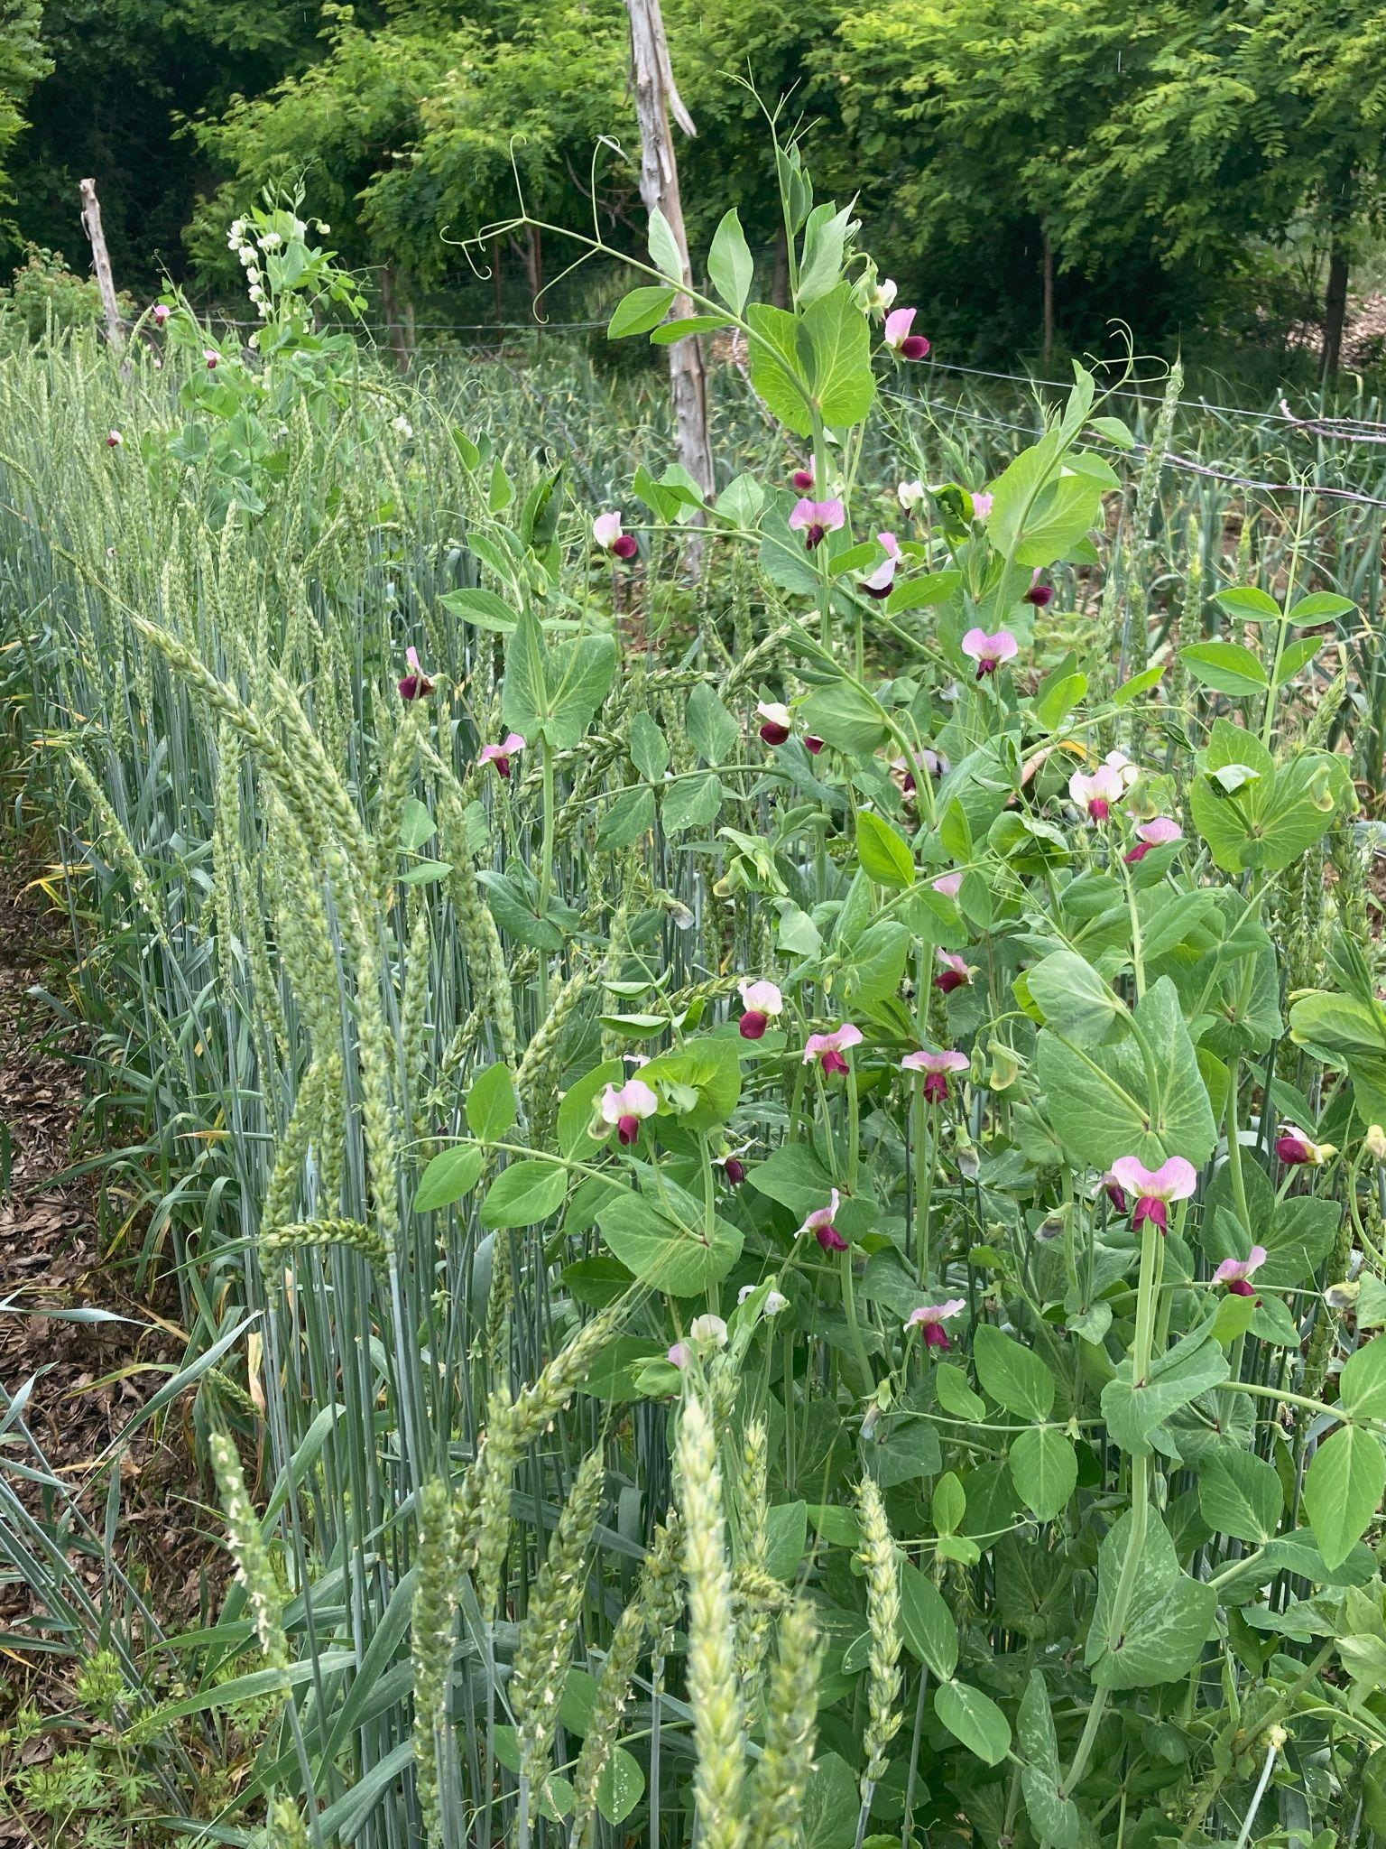
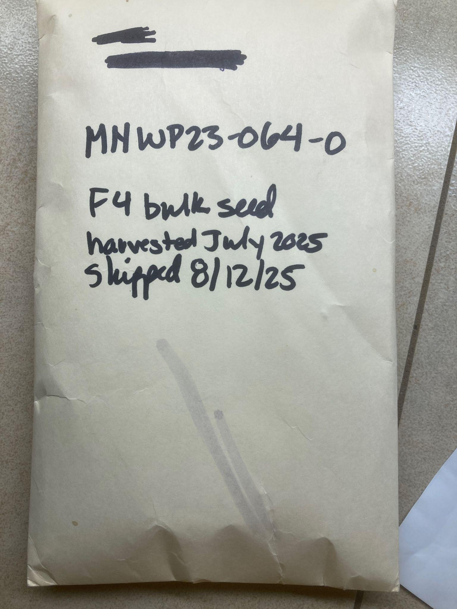
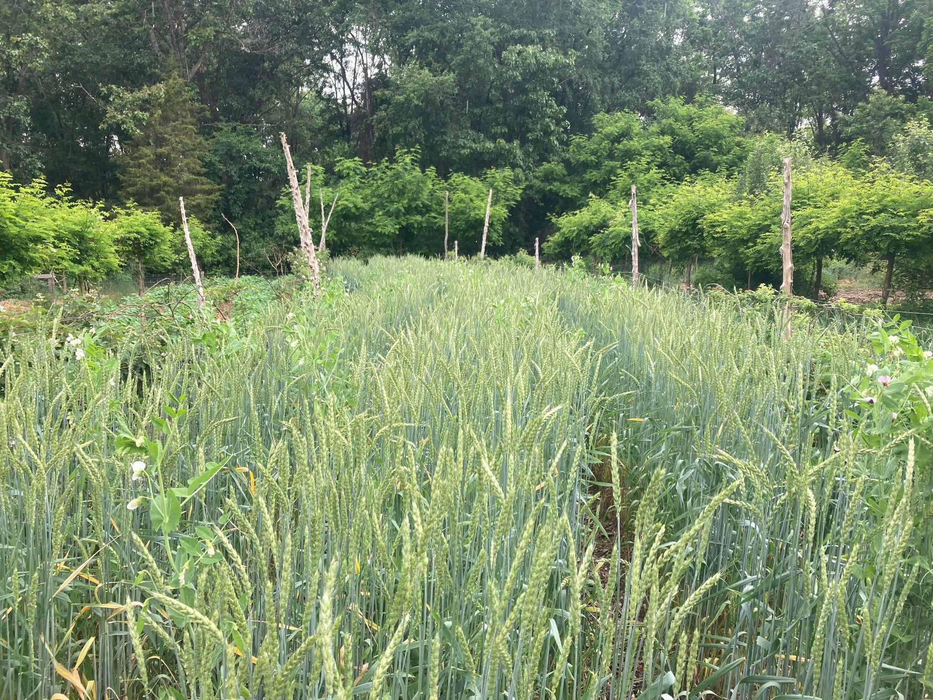
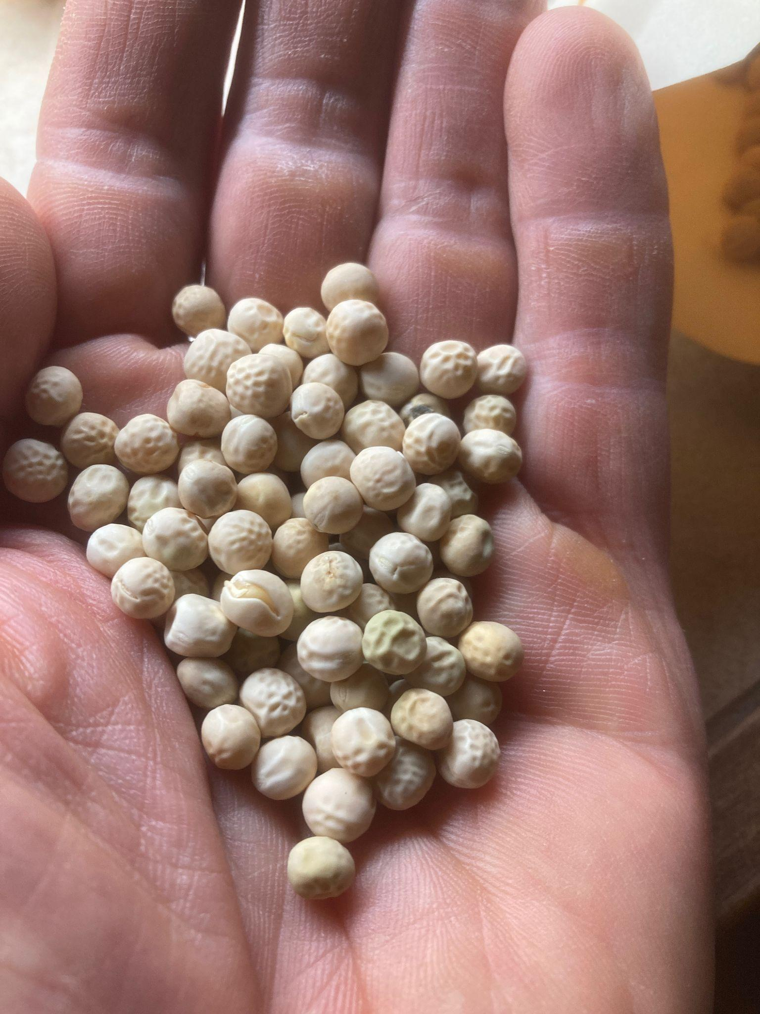
The State of an Obscure Art

Slide 10

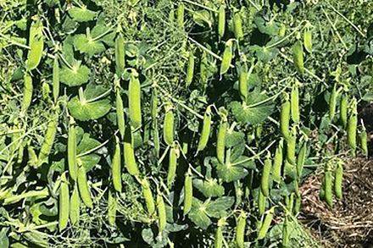
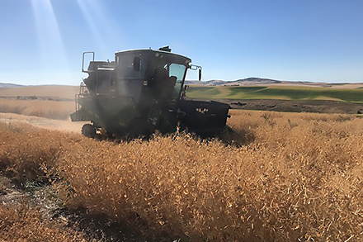
Winter Pea Breeders
Dry Seed/Grain Crop:
~Rebecca McGee (retired) WSU
-Dint, MiCa, and Klondike
~Steve Mulkey, U of Minnesota
~ProGene
~Me
Cover/Forage Crop:
~Solveig Hanson, Cornell
Veggie Types:
~Me
*Maybe someone in Canada, maybe someone in France. Anybody know of anyone else?

Slide 11
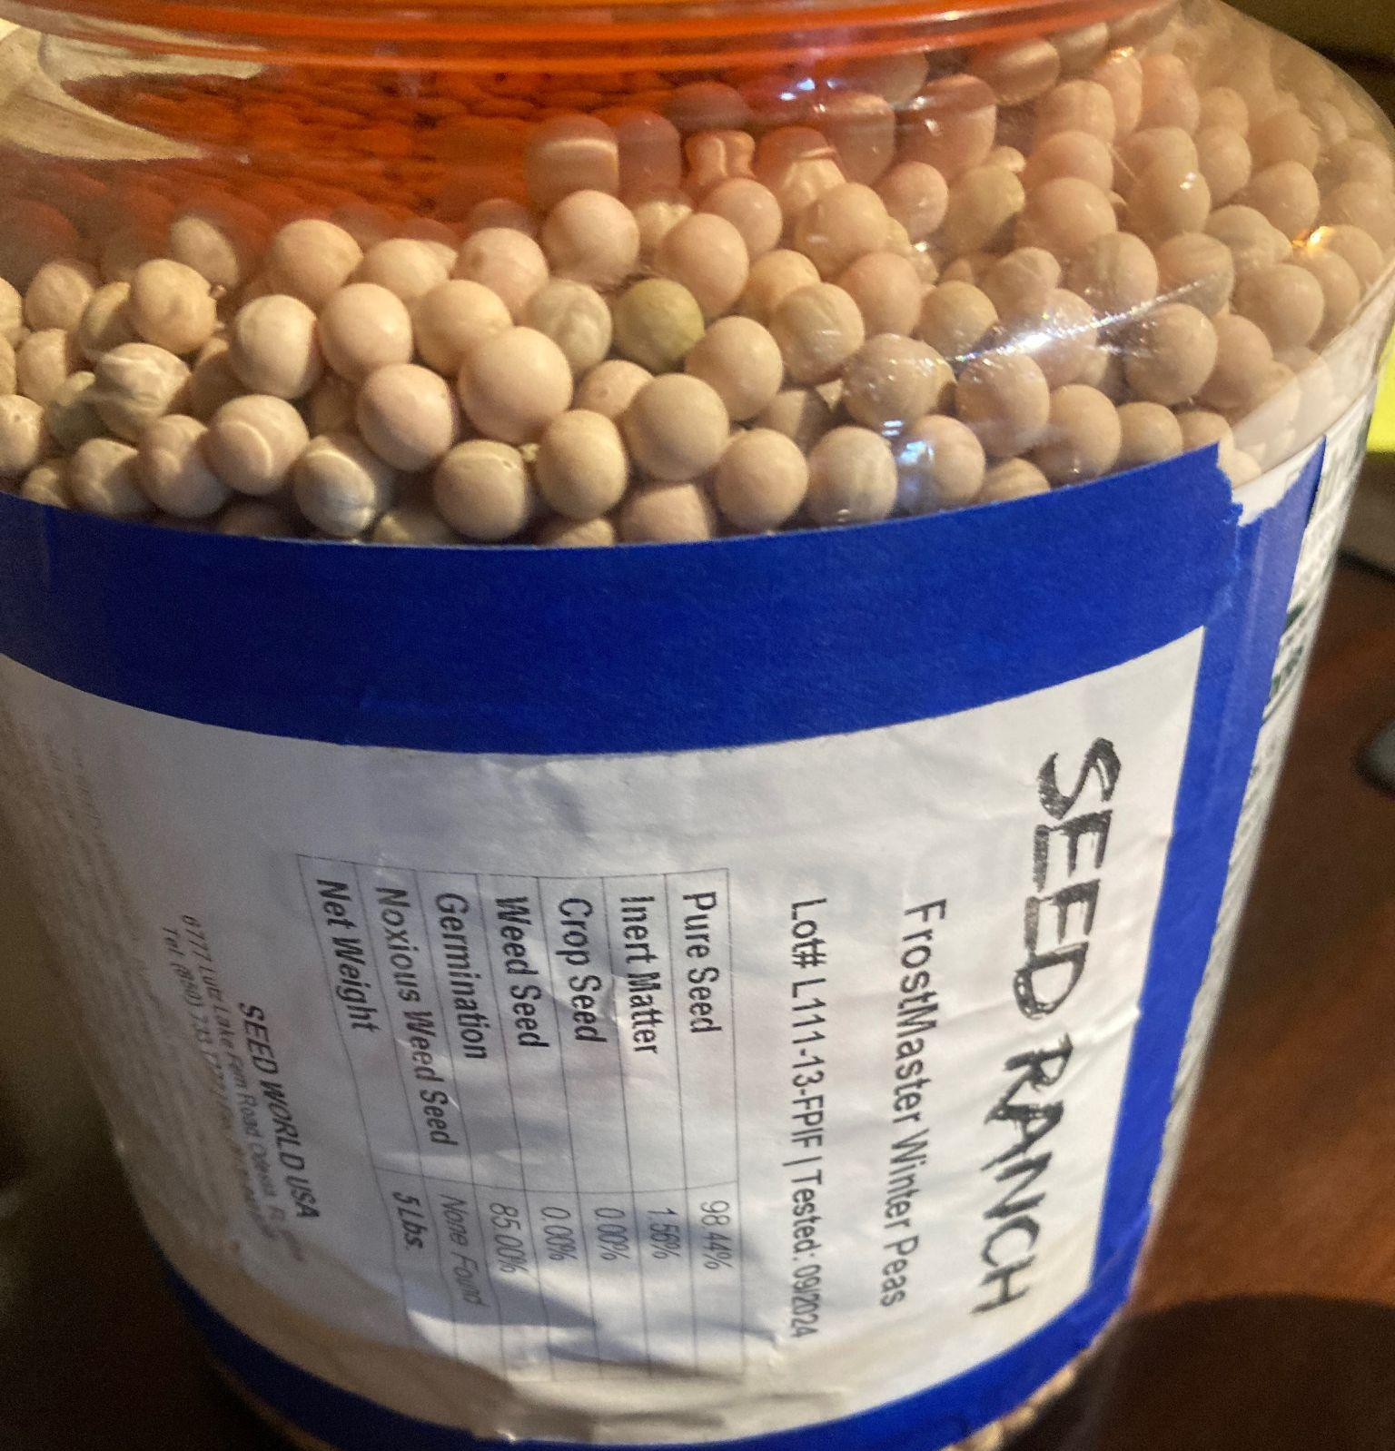
Some Commercially Available (Dry Pea) Varieties
Dry Seed/Grain Crop:
~Blaze
~Keystone
~Klondike (and MiCa and Dint?)
“Wildlife Forage” Crop:
~Frost Master
~Lynx
Notes:
~“Edibility” is a carefully regulated term by the USDA. Many of these can make good, safe food, but don’t meet the criteria
~It is challenging to get small quantities of any of these, and all can be hard to find at all. Keep looking, keep asking!
~Some of these are dwarf, and some full vining, some may be green, some yellow
~May or may not be locally adapted for you

Slide 12
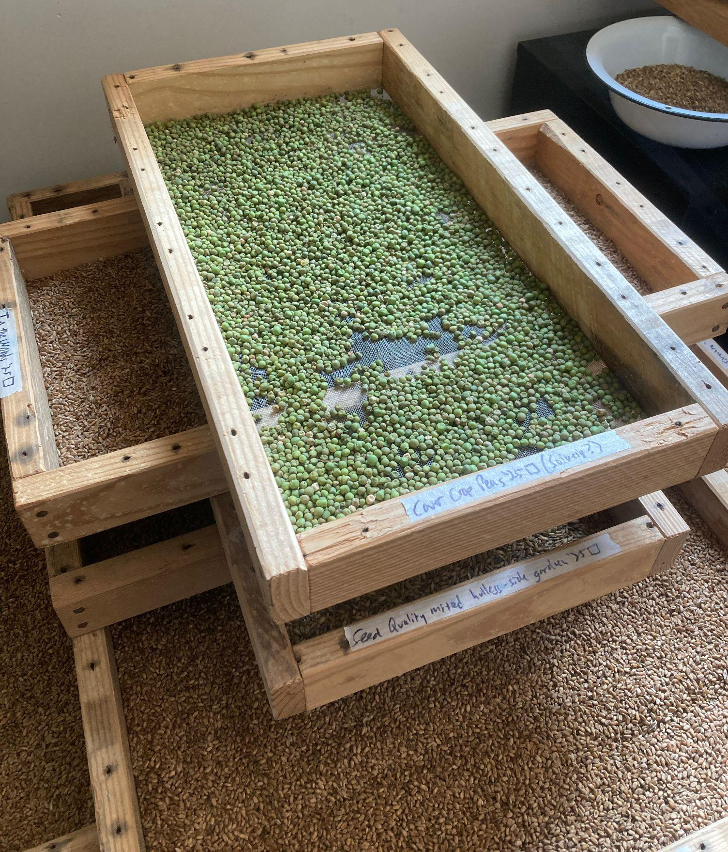
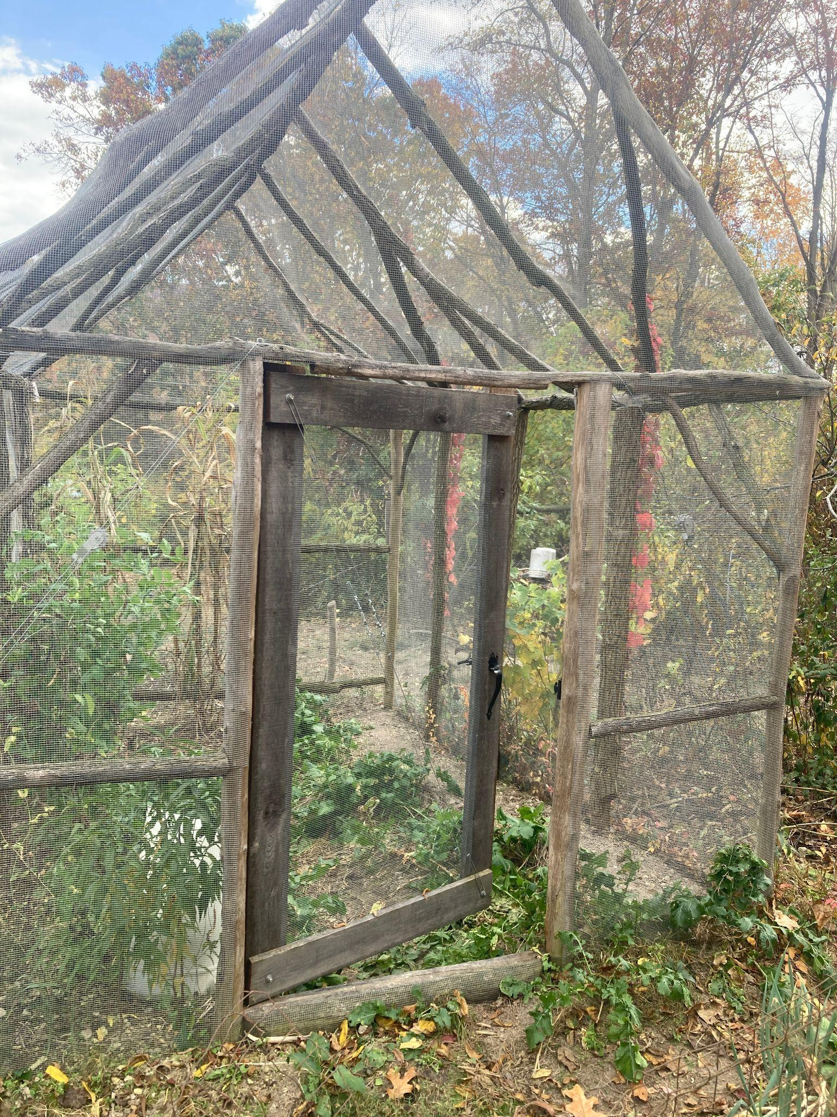
The Tangly Woods Edible Winter Pea Adventure

Slide 13
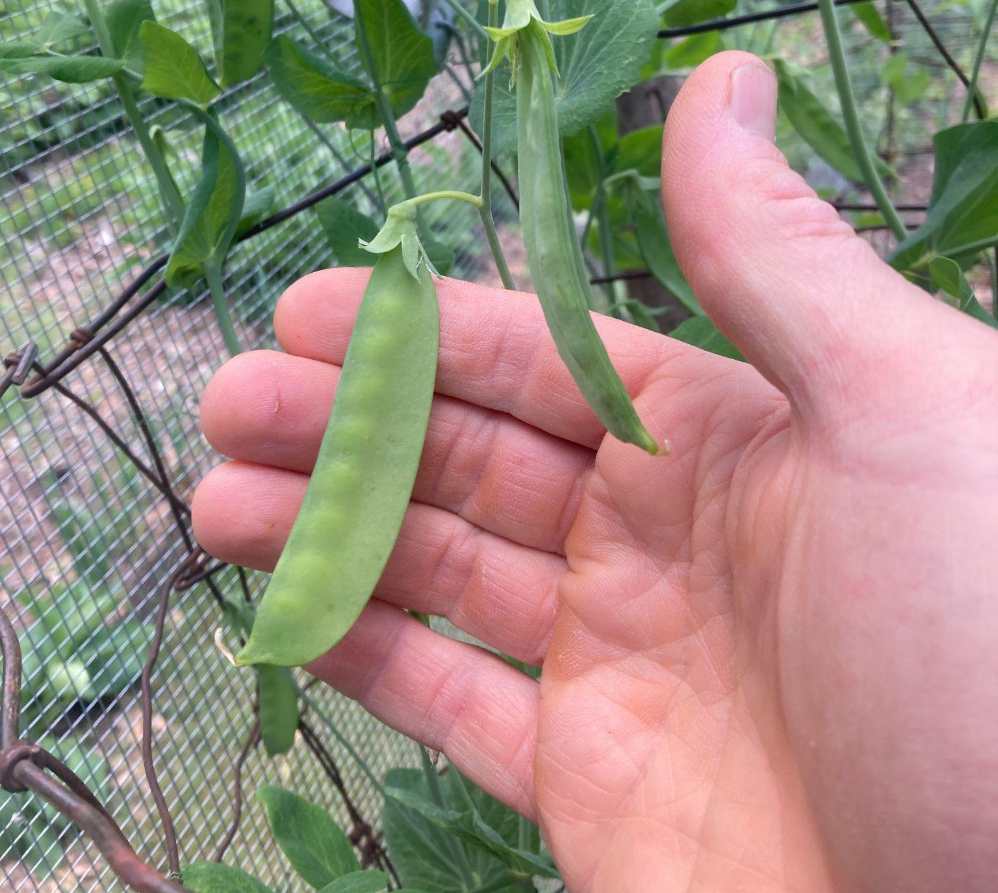
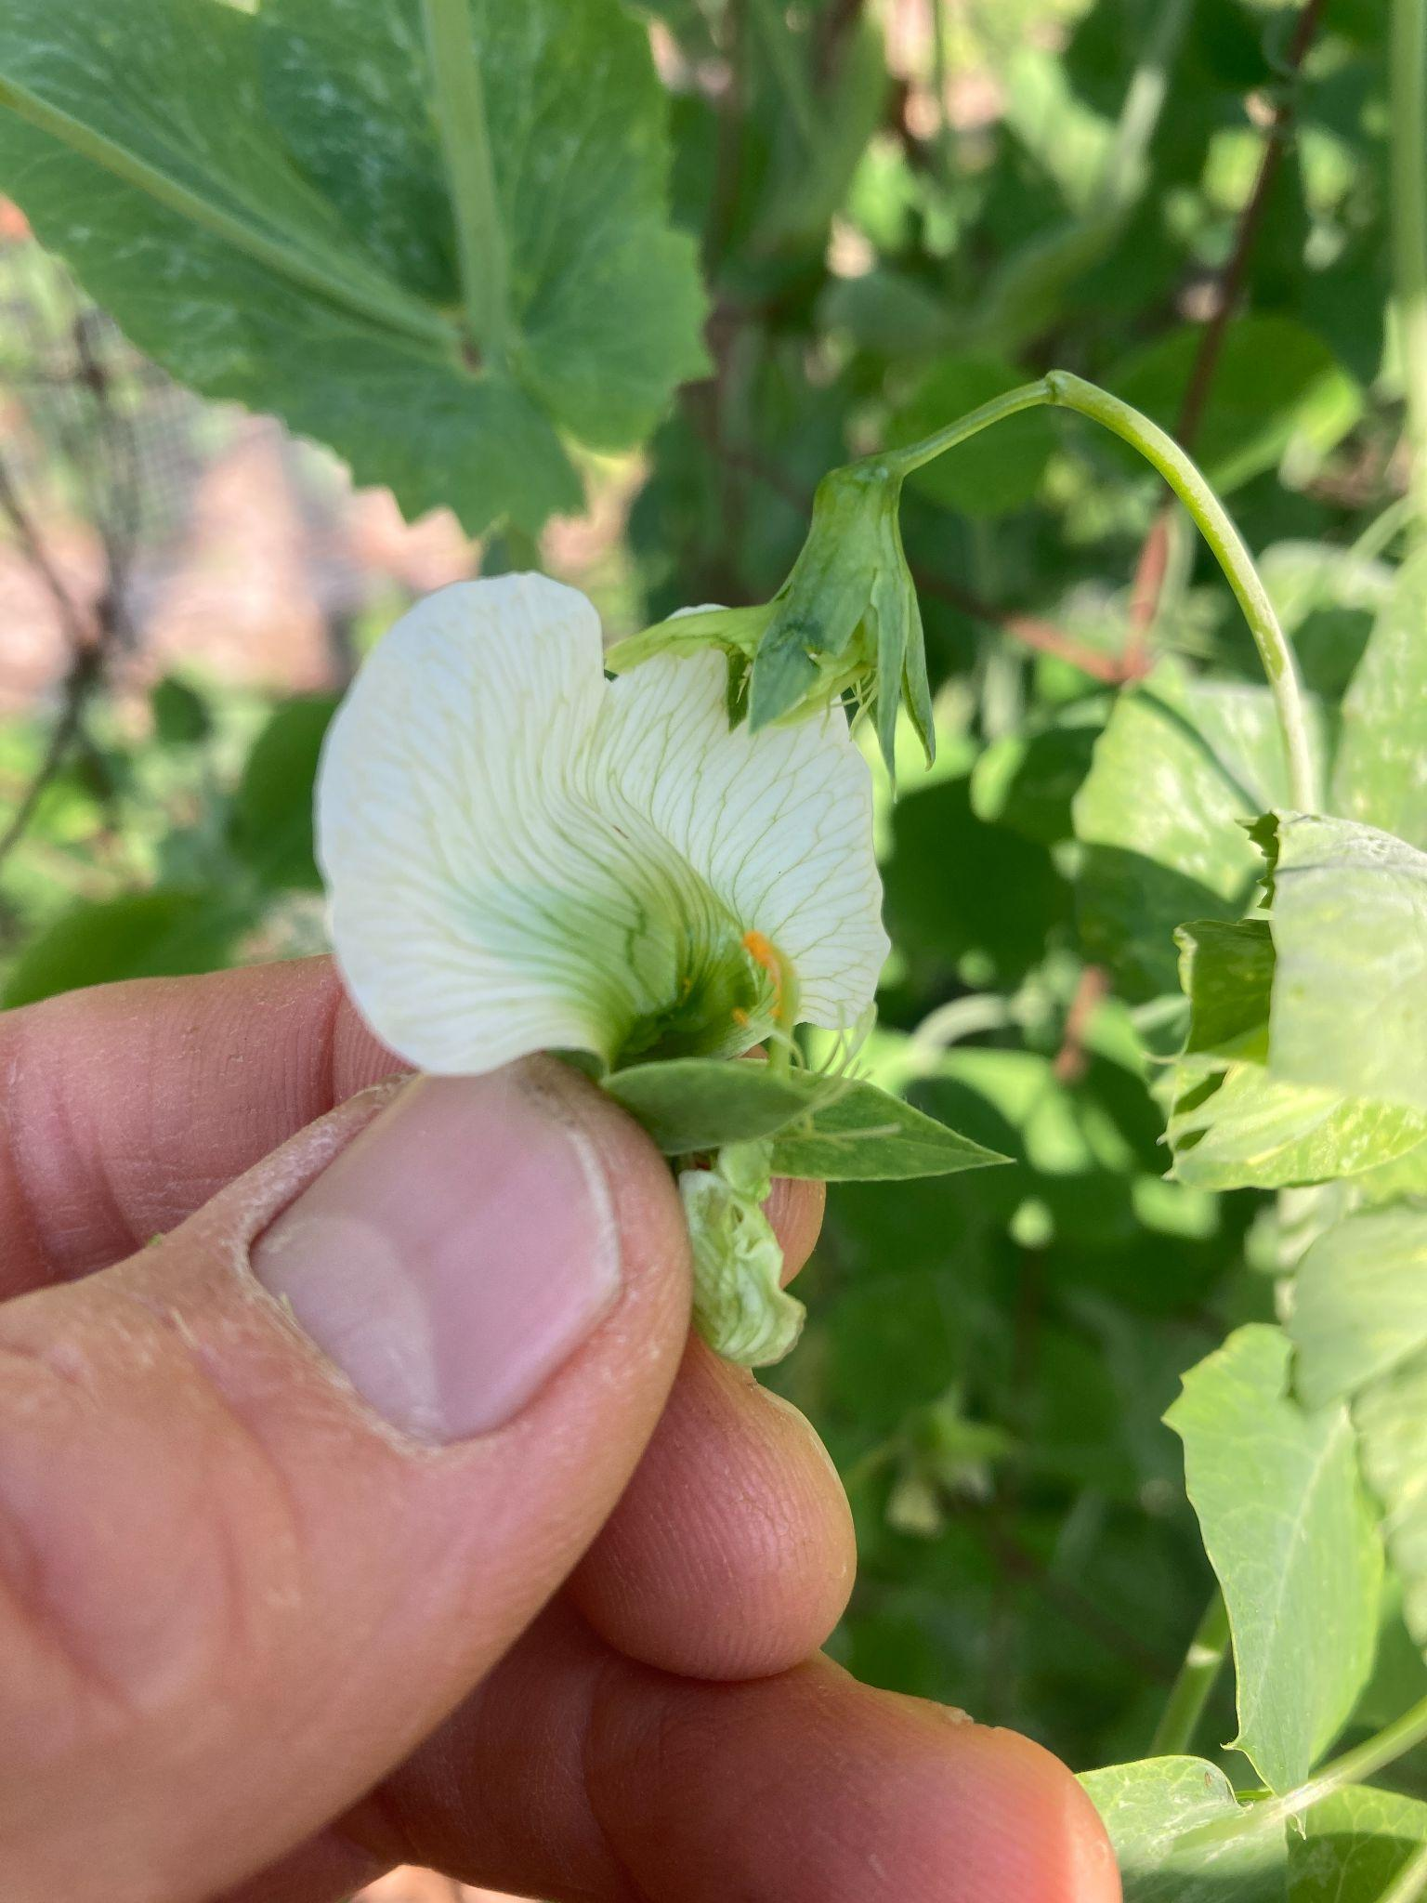
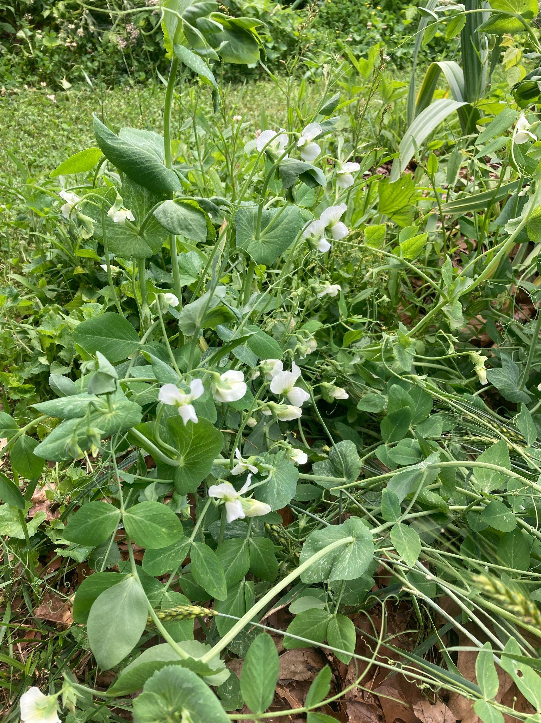
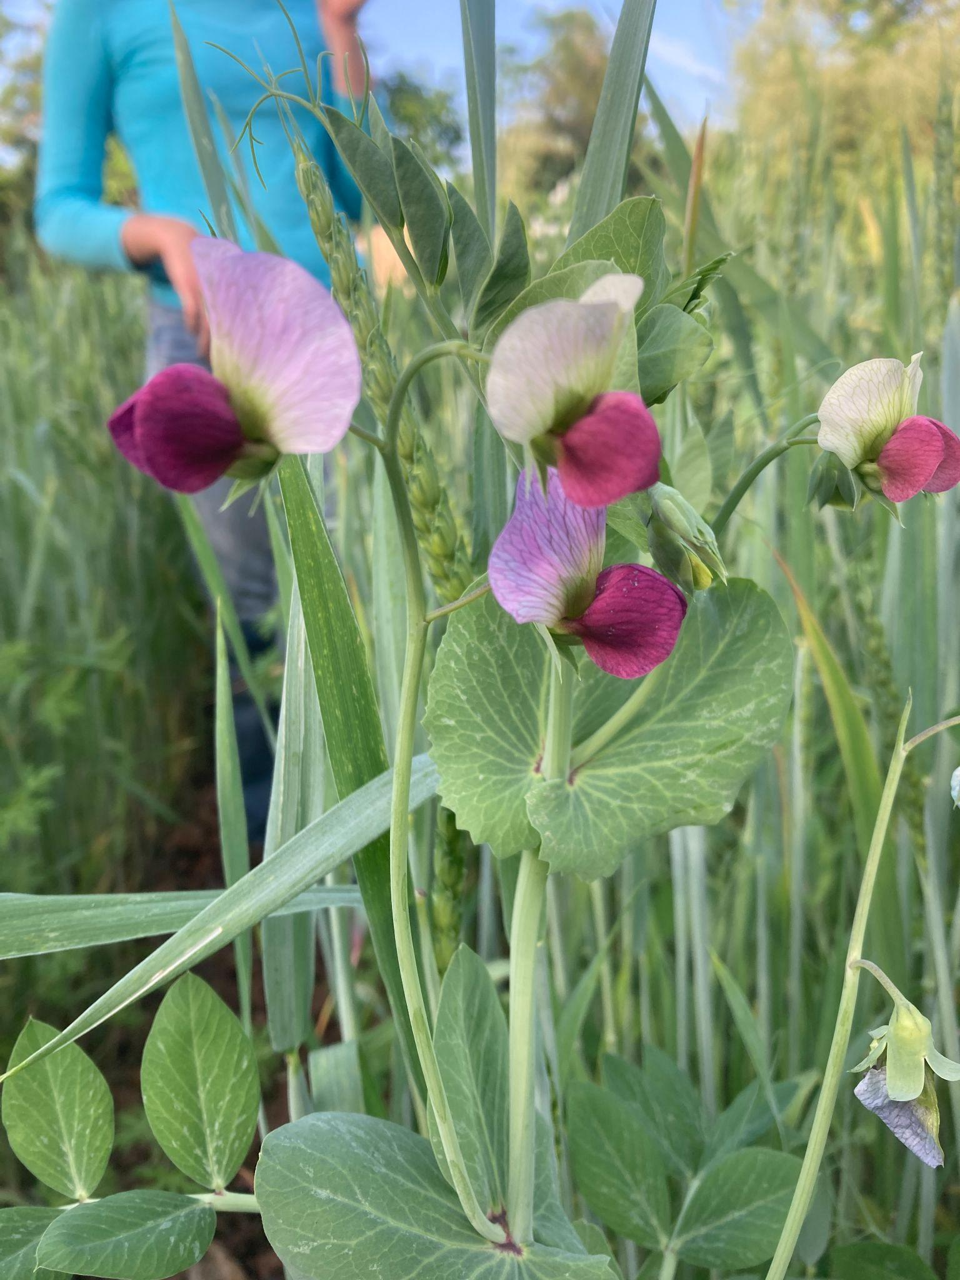
Here we go!

Slide 14
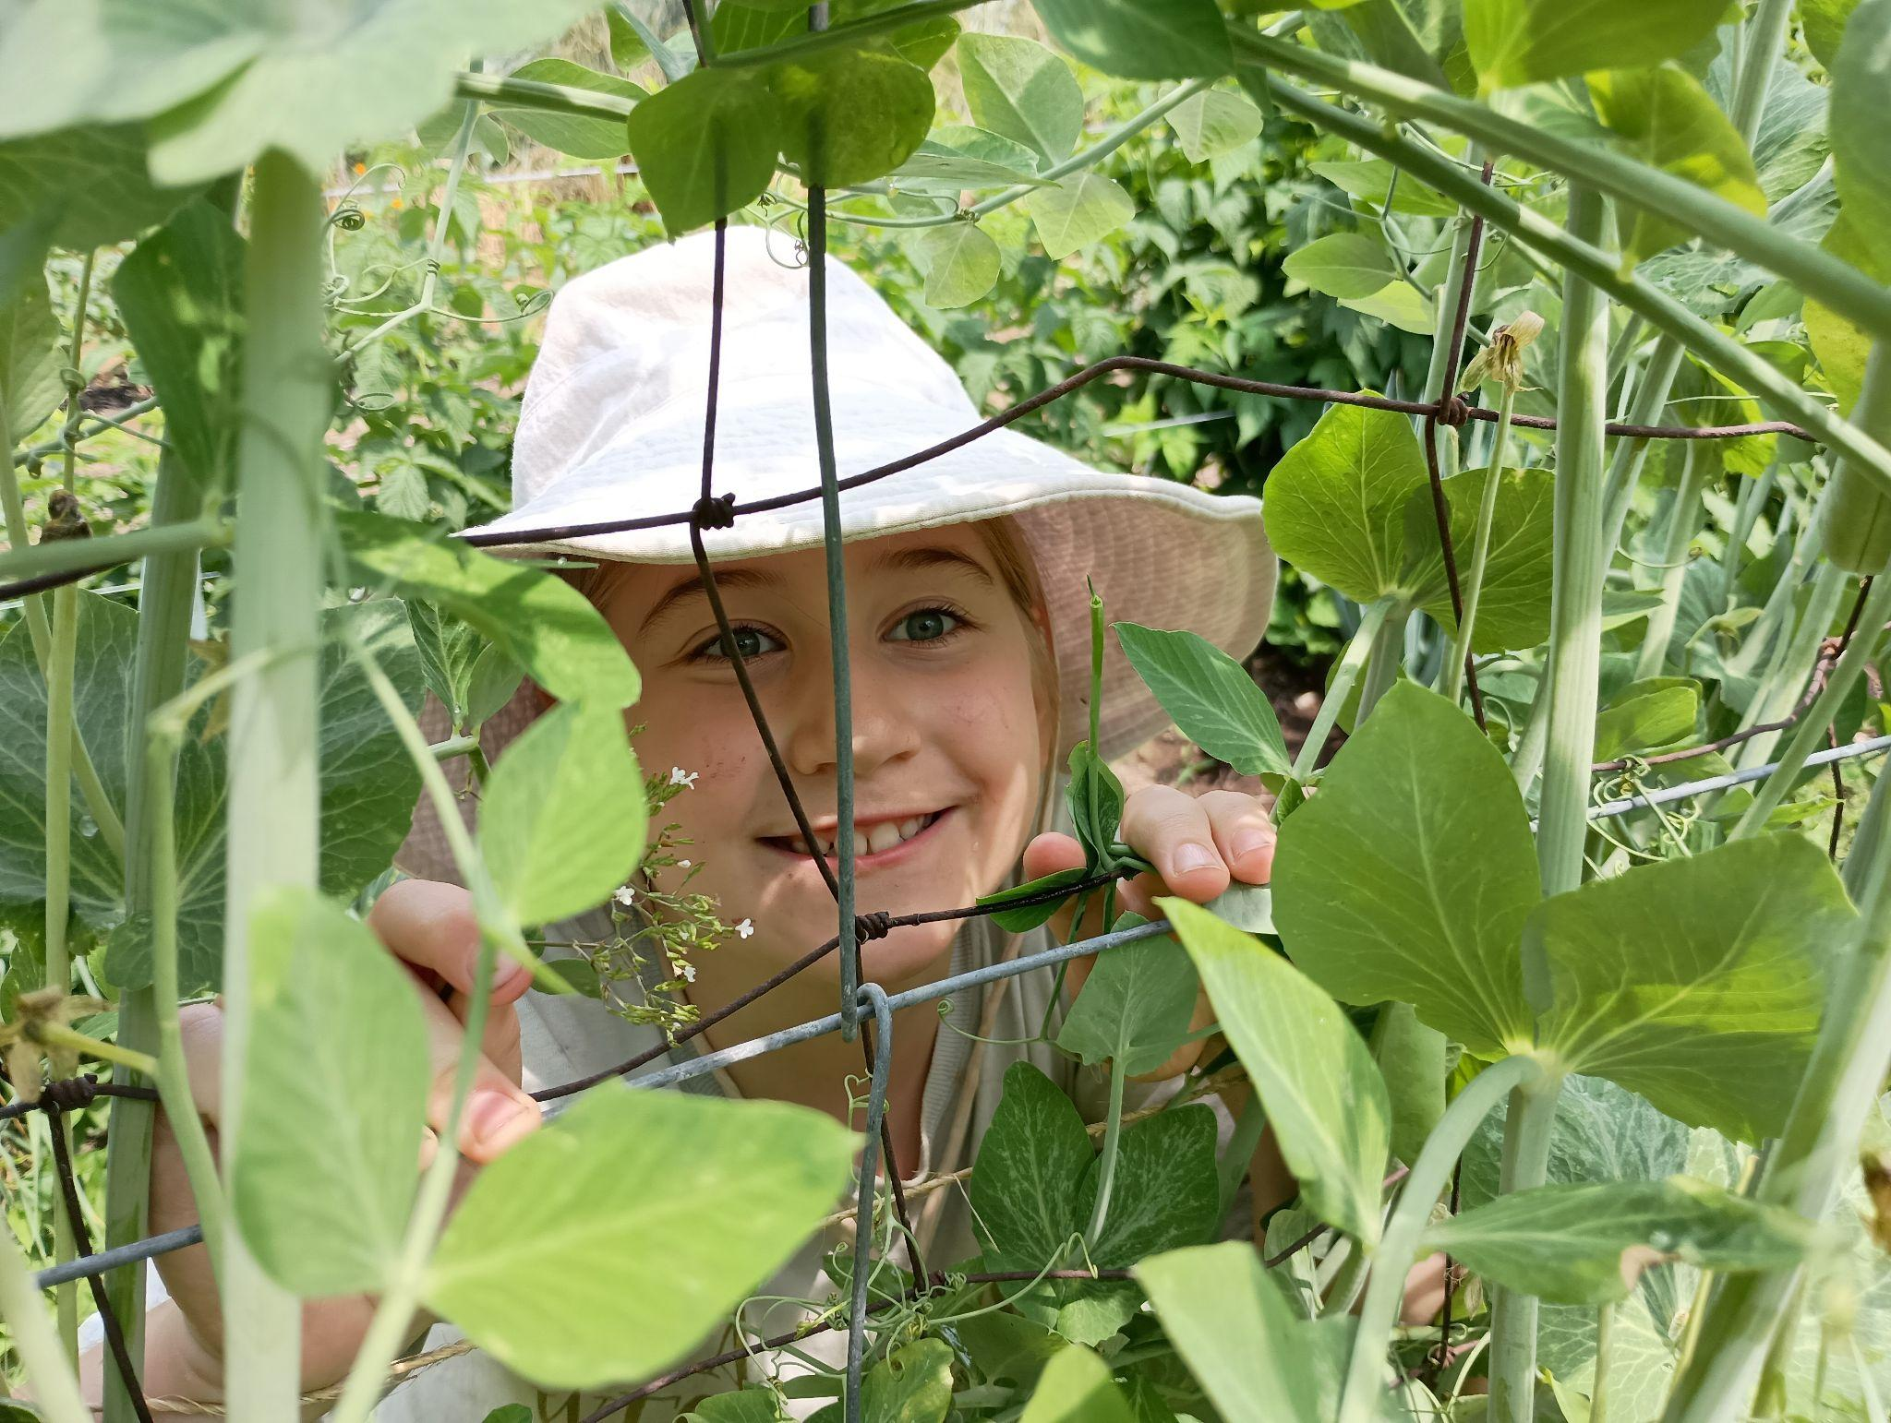
Playing Towards a Solution
~We loved growing Sugar Snaps
~We loved growing overwintered crops (garlic, spinach, etc.)
~I was fascinated by breeding
~I got interested in cover crops
~Austrian Winter Pea looked a lot like a wild Sugar Snap
~I got excited about trying for an overwintering snap type pea
~I gave them a chance; they took it!

Slide 15
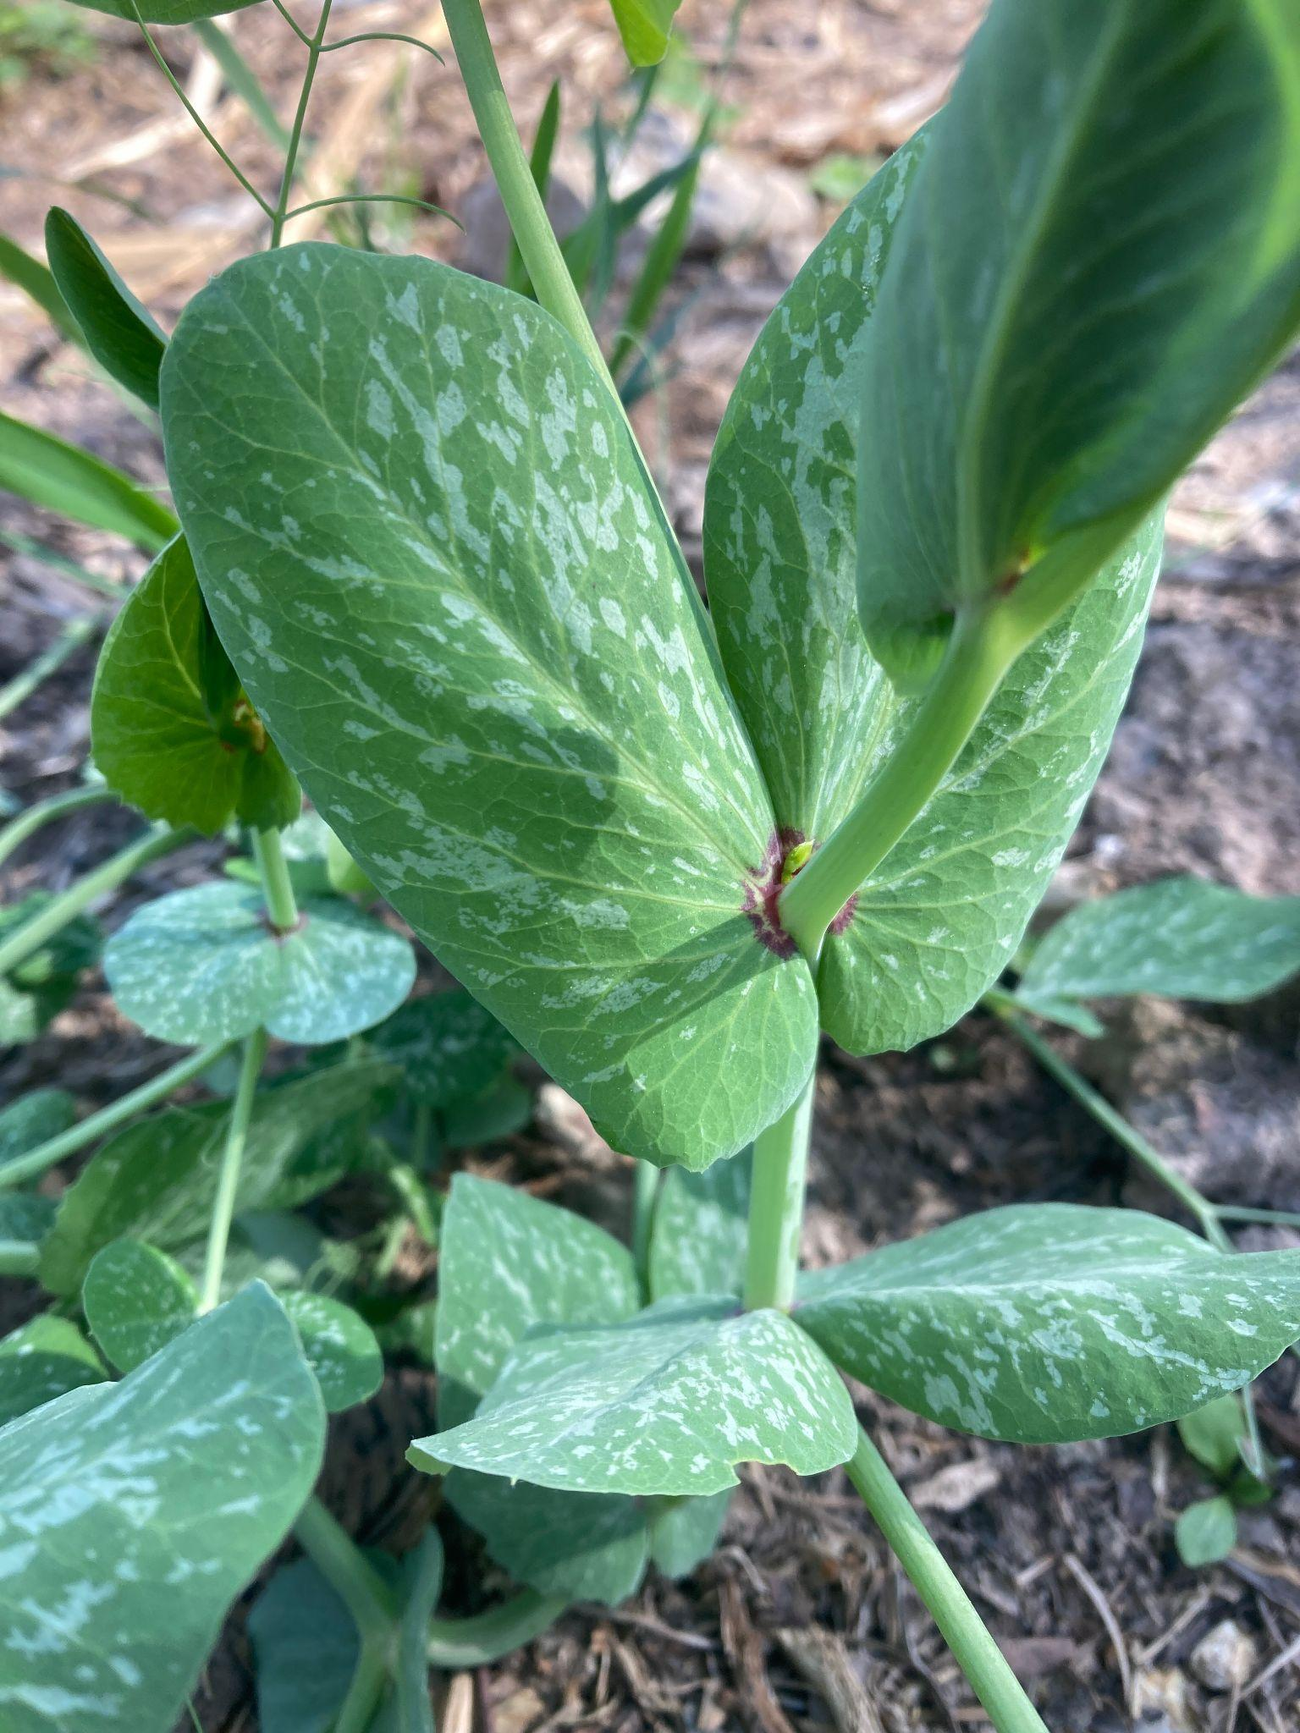
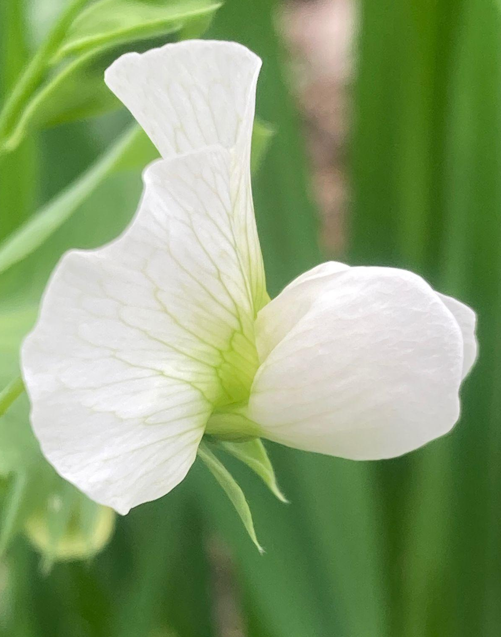
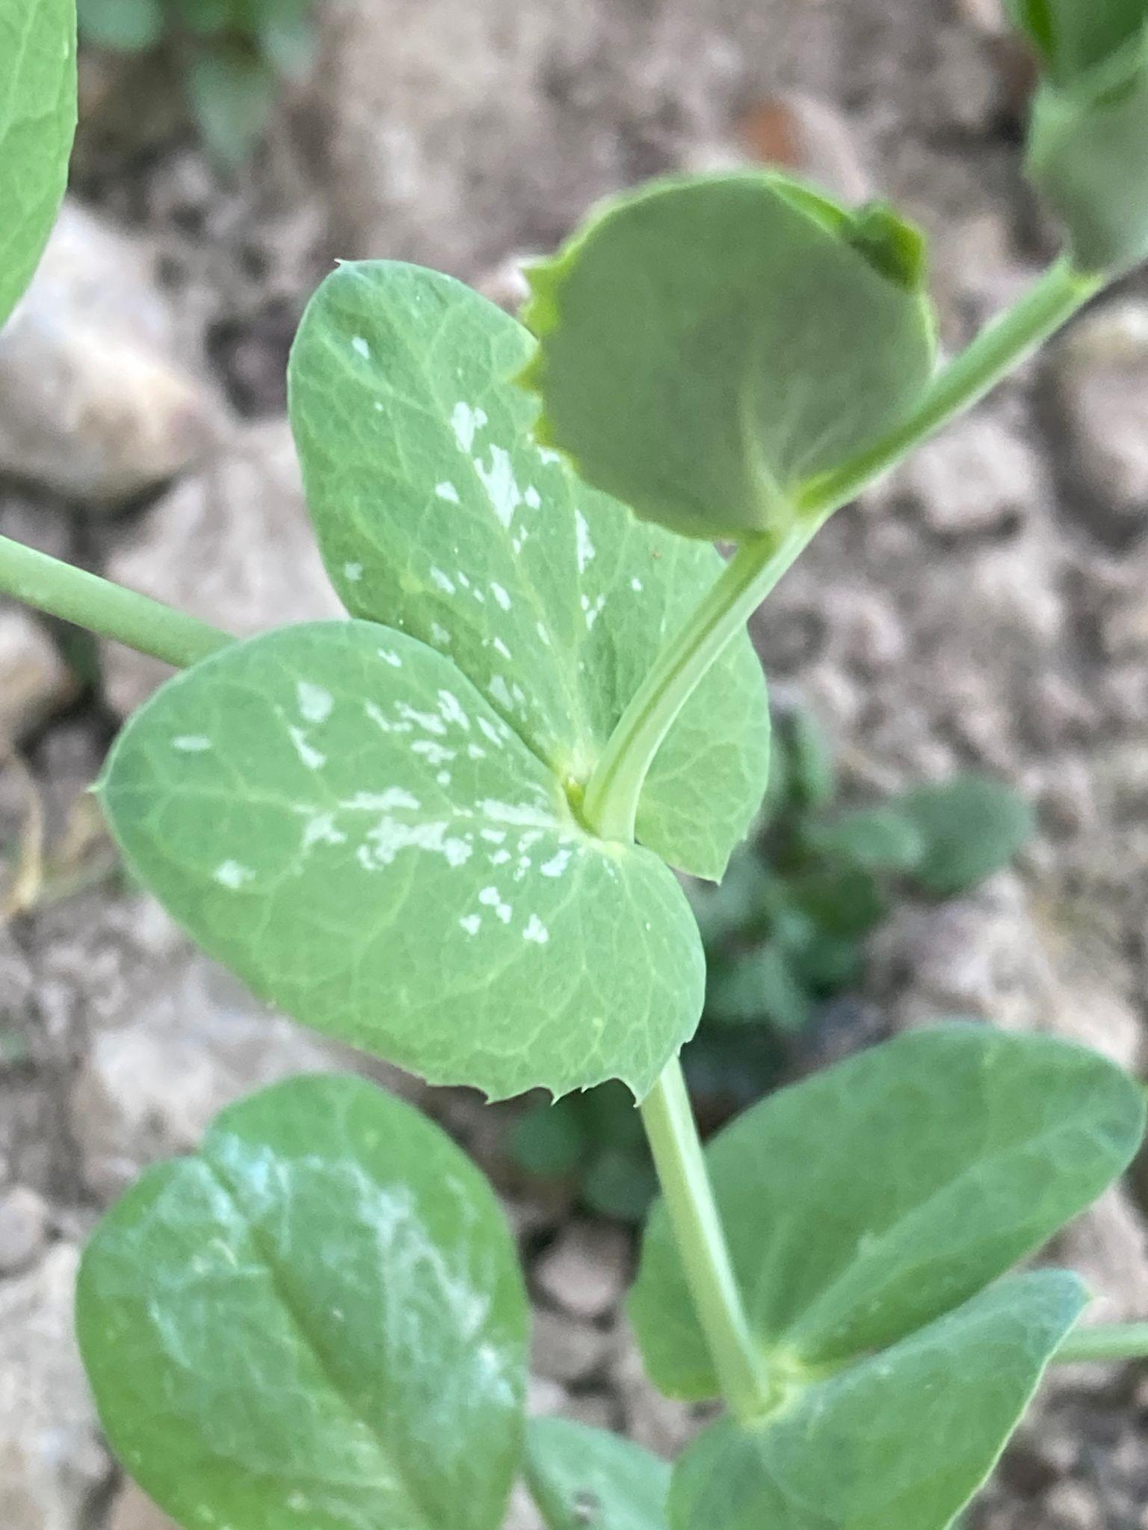
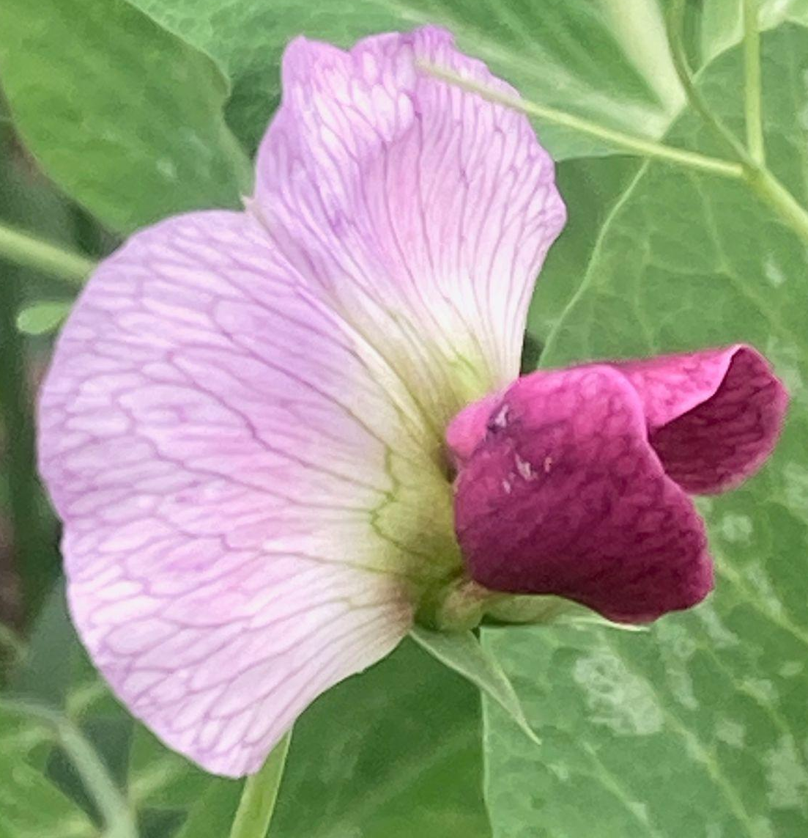
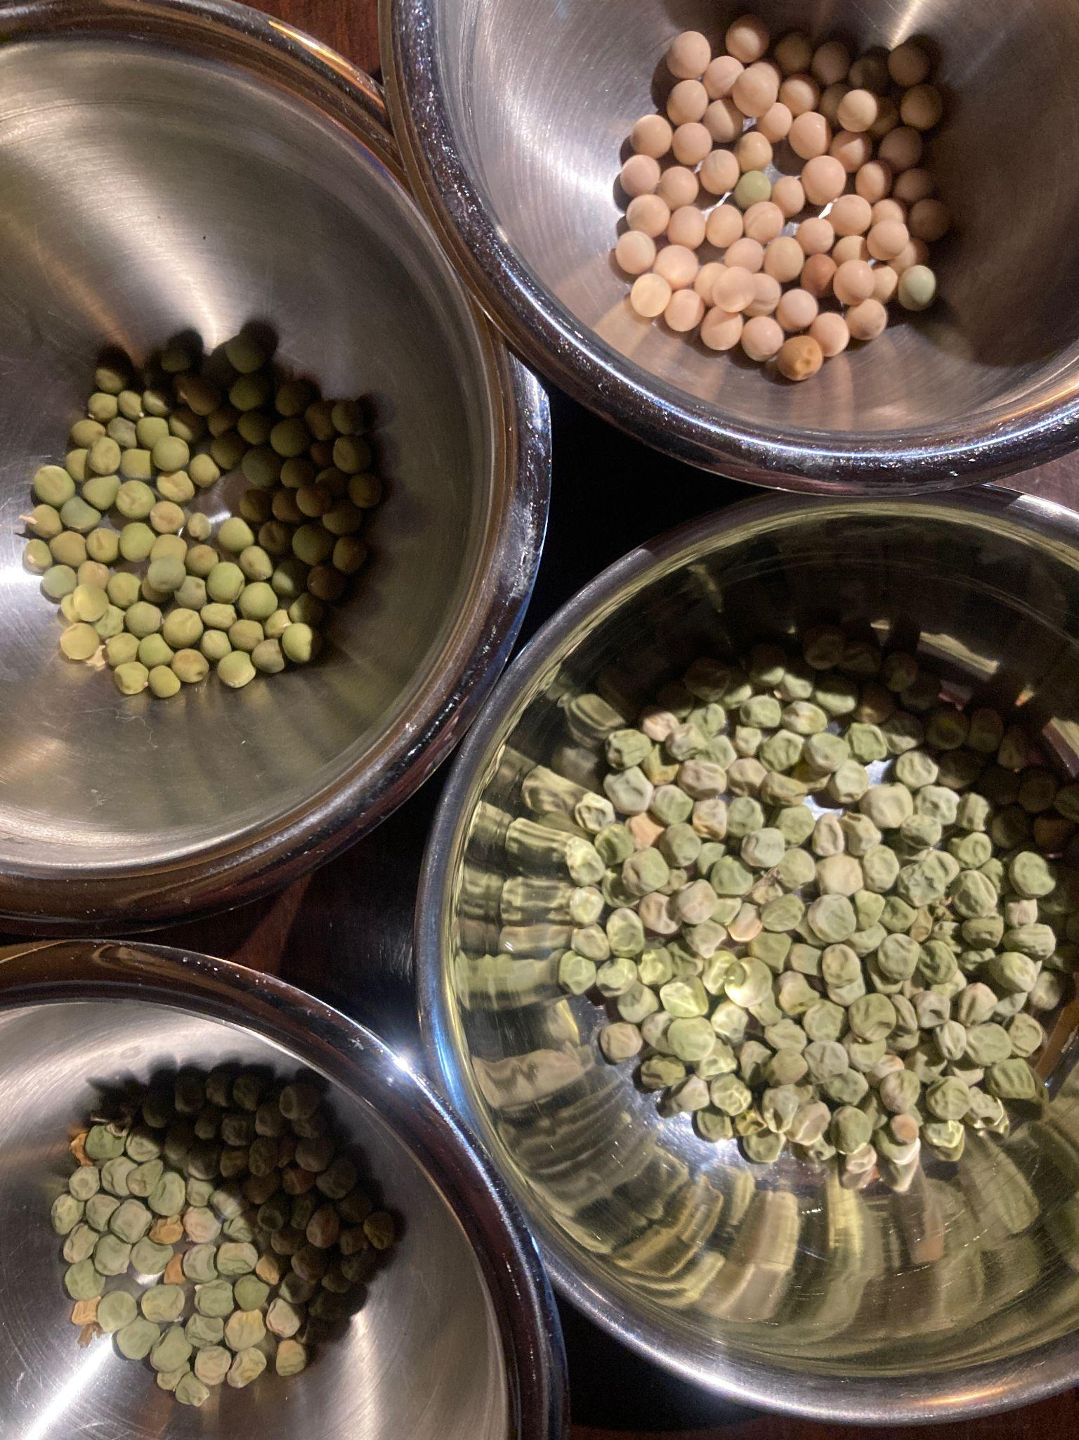
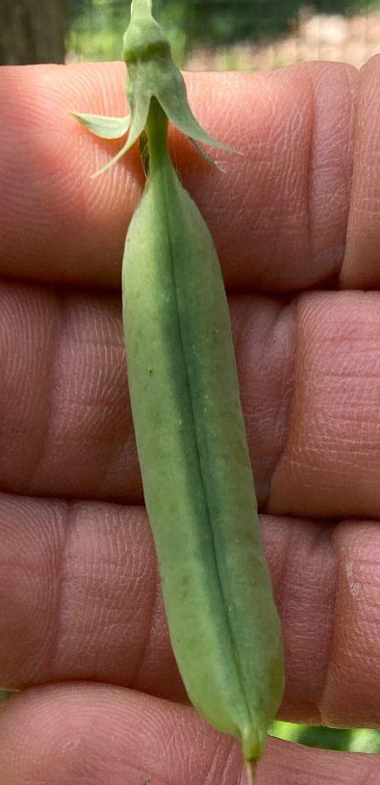

A Tiger By the Tail
~F1 generation was uniform: Inedible, but BETTER than AWP
~F2 generation was all over the map! Nature loves to diversify. All long vine
~Types emerging: Snap, Snow, Shelling, Grain
~Seeds: Yellow, Green, Wrinkled, Smooth
~Low fiber, high fiber
~Flowers: Purple, White
~Selection begins

Slide 16
Types We Began Selecting For
~winter hardy snap pea
-low fiber
-thick pod walls
-green, wrinkled seeds
-sweet, low-tannin flavor
-large pod size
-indeterminate growth habit
-white flowers
~winter hardy snow pea
-low fiber
-large, flat, fleshy pods
-indeterminate growth habit
-sweet, low-tannin flavor
~edible dry seed winter wheat companion
-determinate growth habit
-short stature, but productive

Slide 17
Types We Began Selecting For
~winter hardy snap pea
-low fiber
-thick pod walls
-green, wrinkled seeds
-sweet, low-tannin flavor
-large pod size
-indeterminate growth habit
-white flowers
~winter hardy snow pea
-low fiber
-large, flat, fleshy pods
-indeterminate growth habit
-sweet, low-tannin flavor
~edible dry seed winter wheat companion
-determinate growth habit
-short stature, but productive

Slide 18
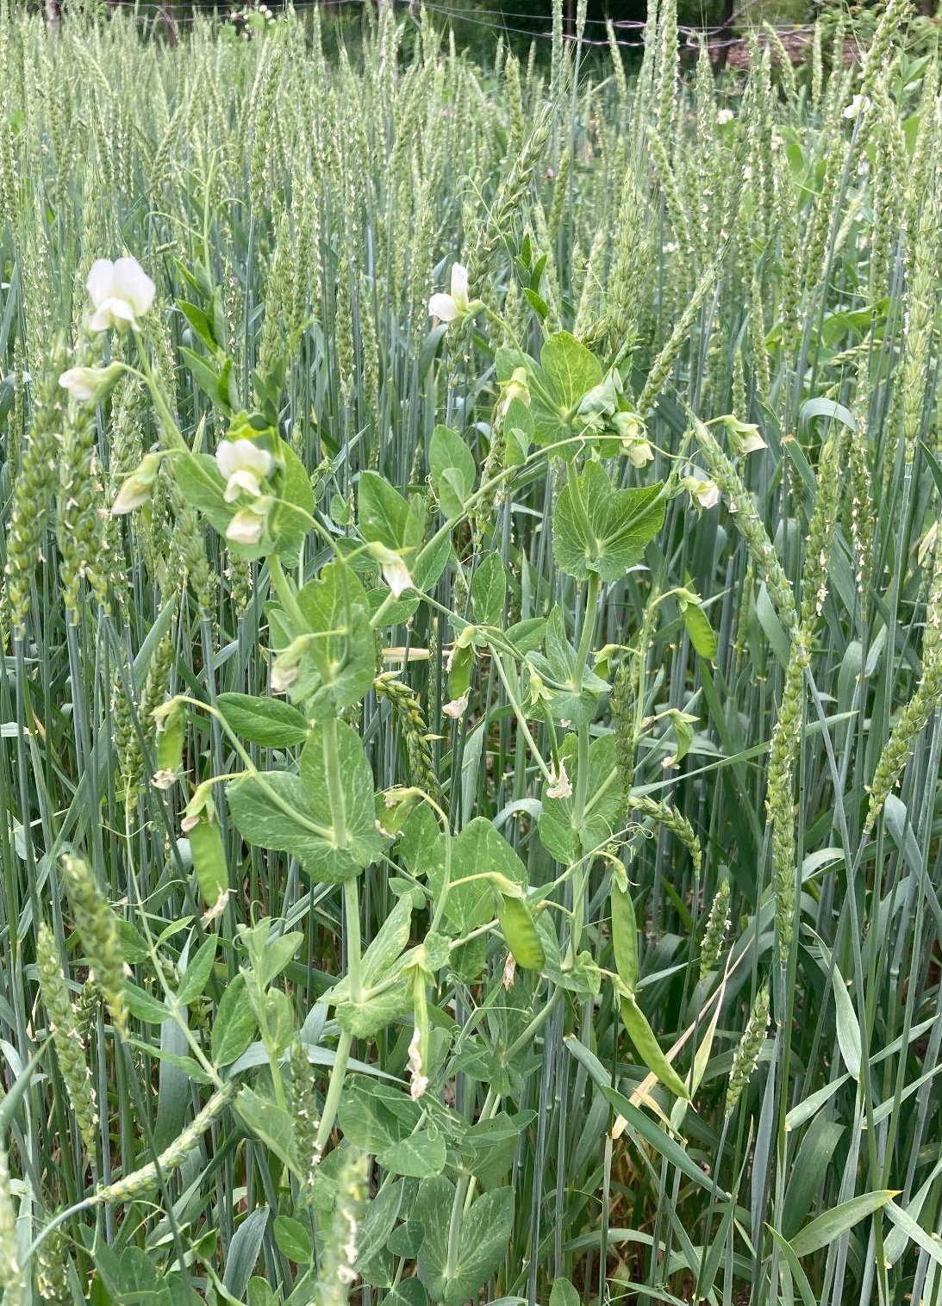
What were we aiming for with this one?
Winter hardy dry pea
Dwarf growth habit
High palatability
Easy threshing
Non-shattering
Well-adapted
Disease resistant
Early bearing (ripening with wheat)
Simultaneous flowering
Large seed size

Slide 19
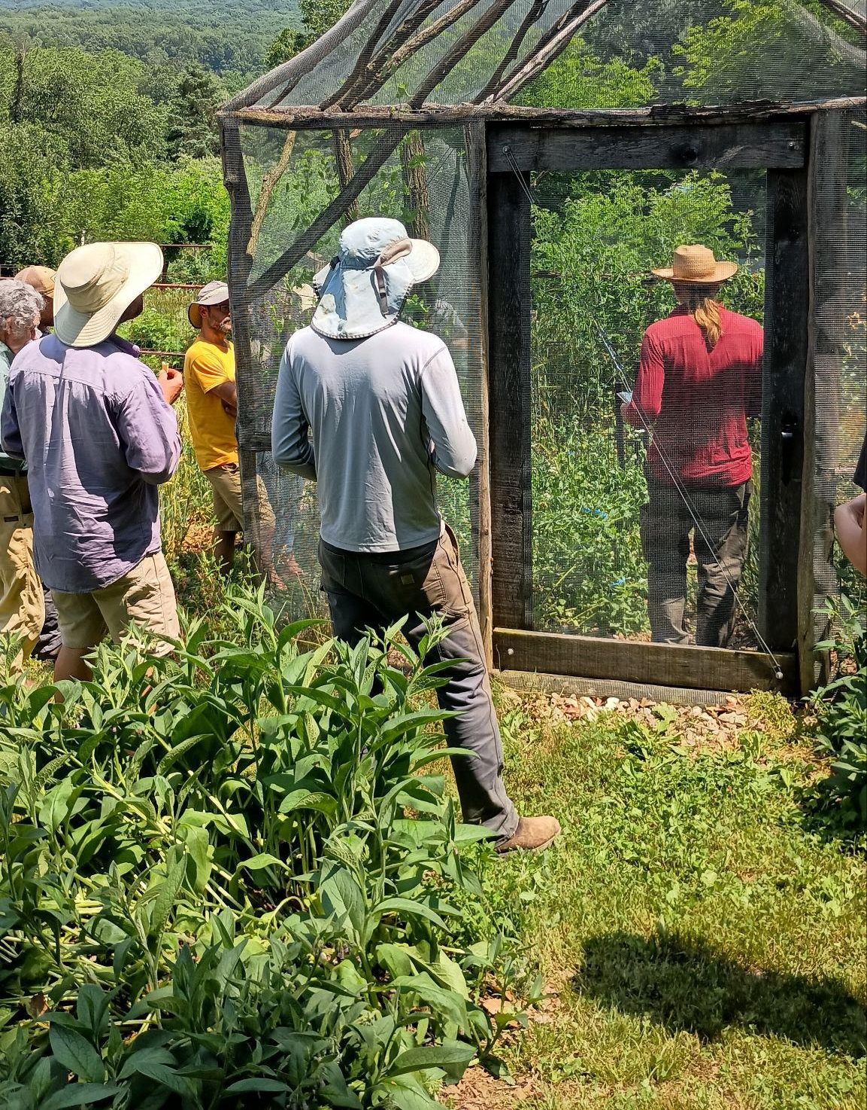
The SARE Project
Progress Towards a Dwarf Edible Winter Pea for Companion Planting with Wheat
~Collect data on the offspring of some excellent individuals
~Propagate and amplify the most promising lines
~Cross lines and individuals if it seems advantageous
~Analyze data, evaluate results
~Share (field day and presentations: here we are!)

Slide 20
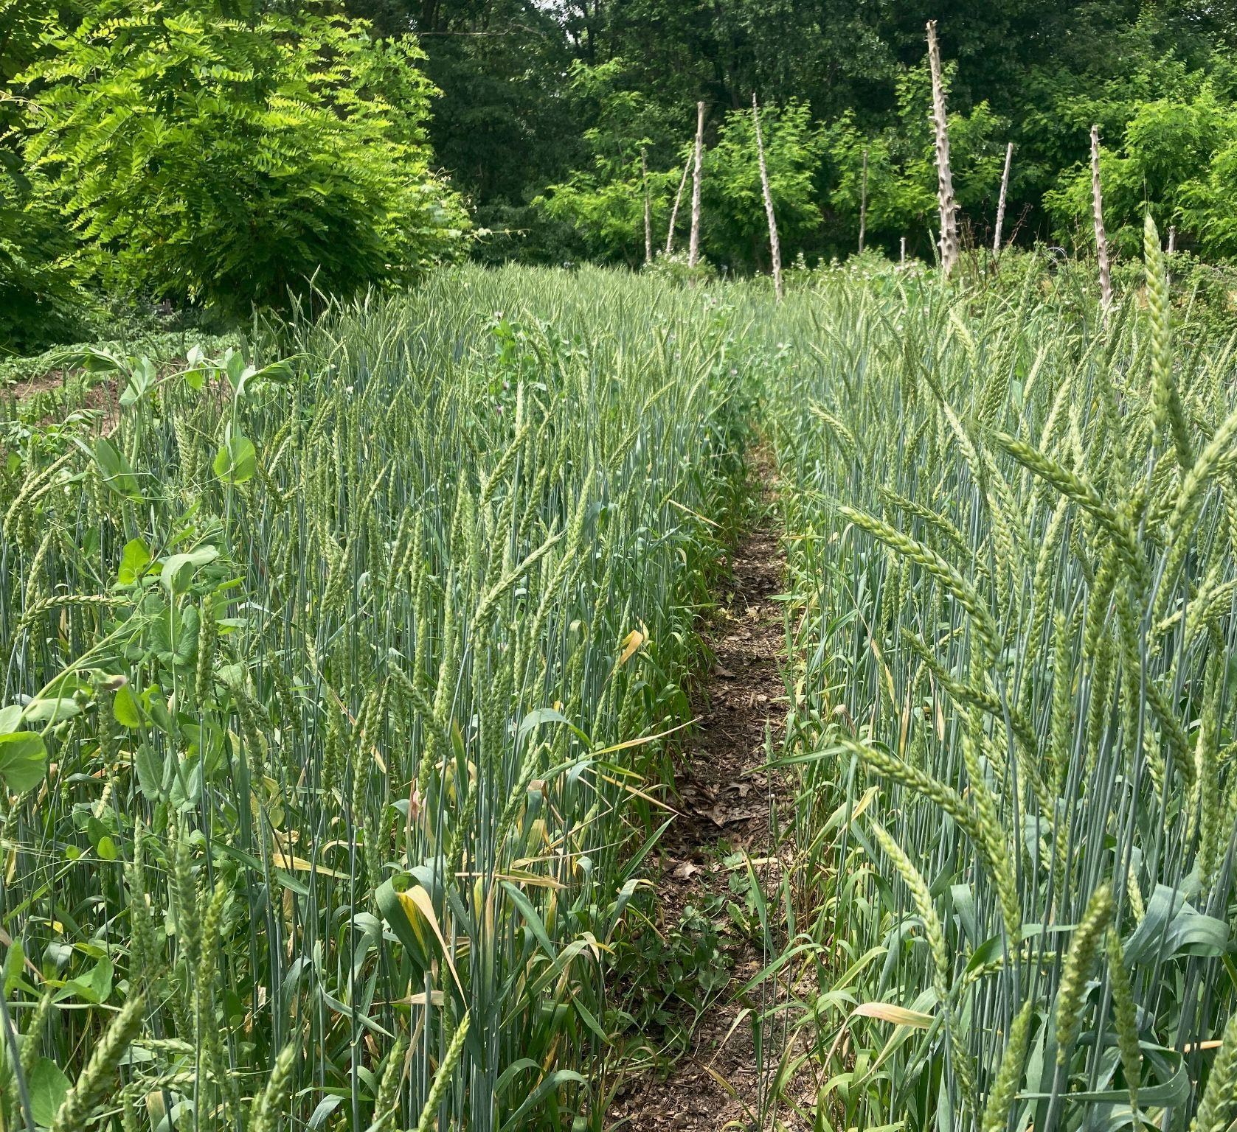
The Goal
A population/landrace/variety of regionally adapted edible winter peas that will grow, ripen and stand with winter wheat

Slide 21
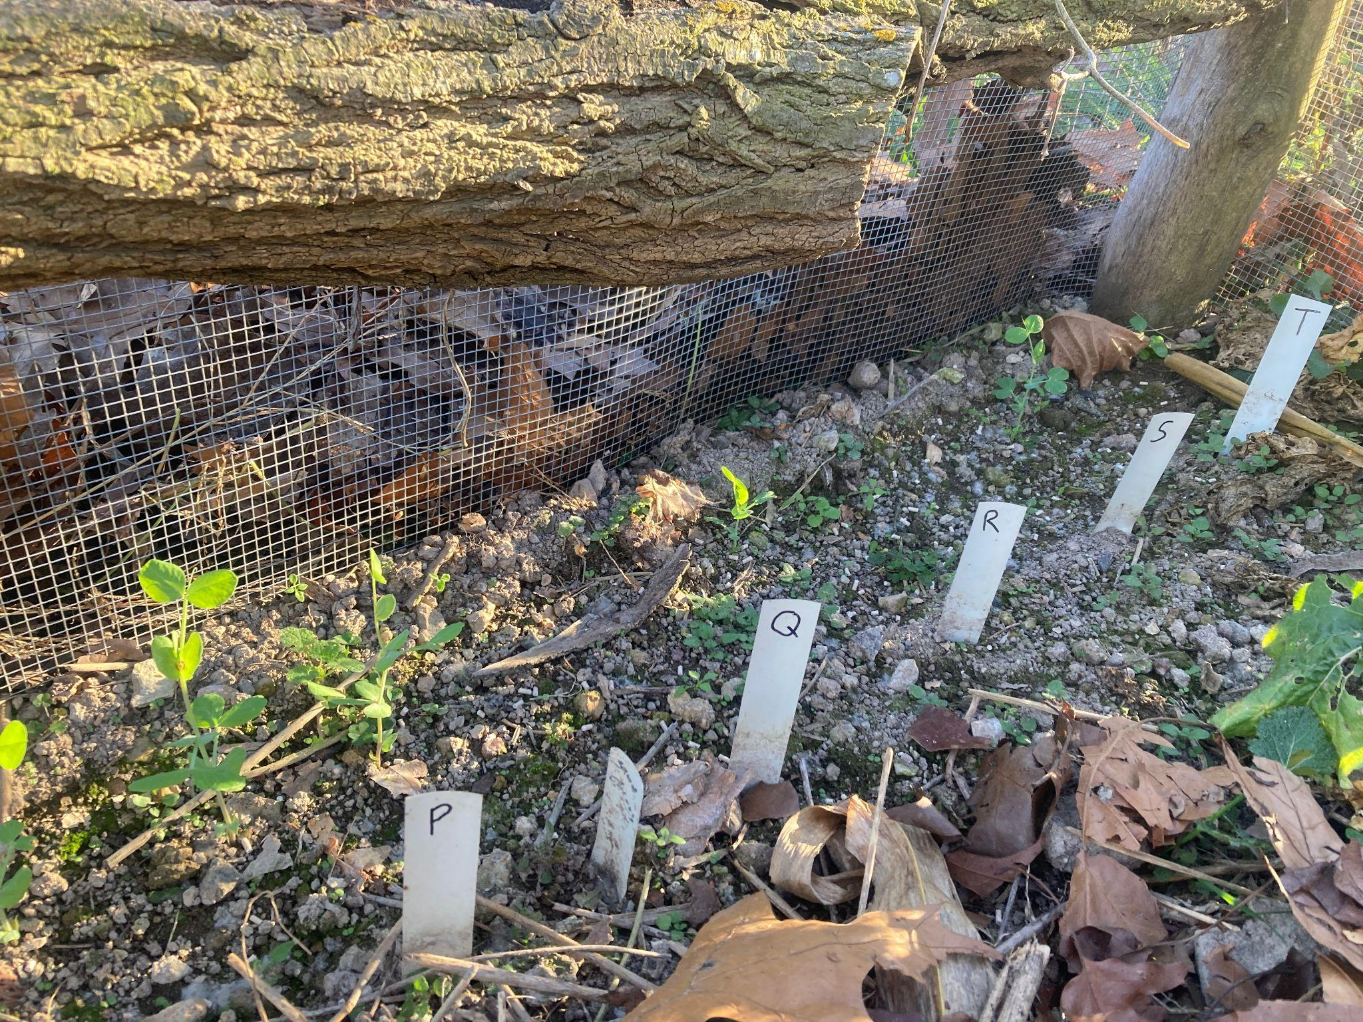

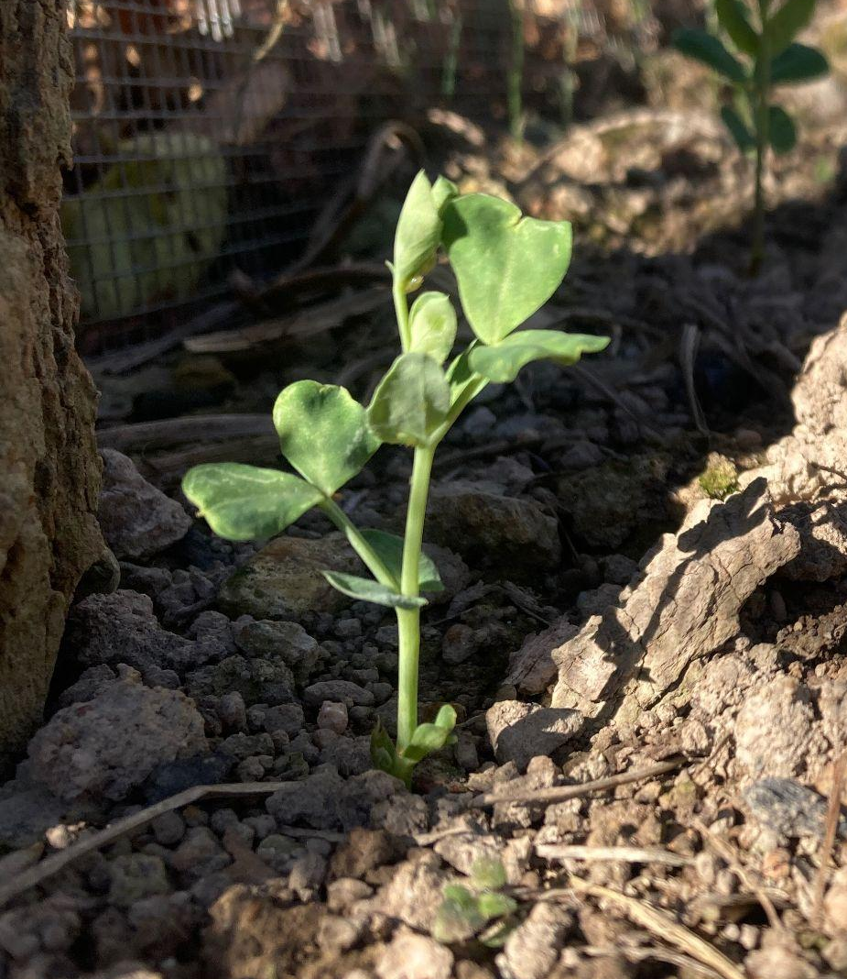
Main Data Points
~Simultaneous flowering
~Plant vine length
~Number of vine branches near base
~Flower color
~Dates of development stages
~Number of pods
~Total seed yield (in grams)
~Seed types (color/texture/size)

Slide 22
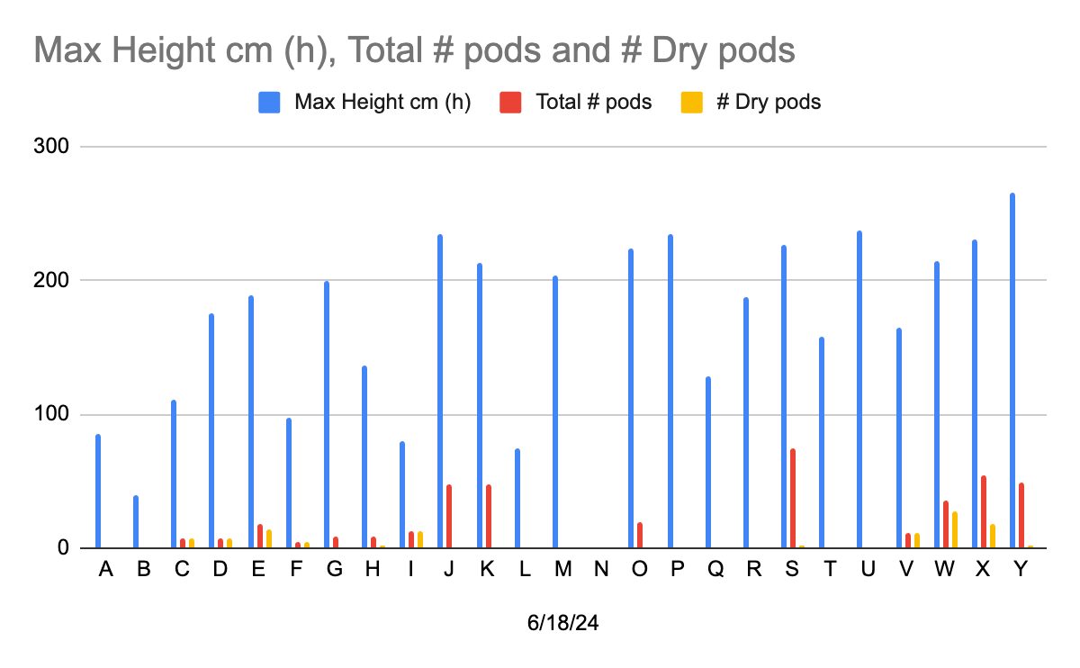
Emerging Results
~No true dwarfism present
~Lots of variability, a few surprises
~Simultaneous flowering may be as important as dwarfism
~A few more lines available from others than I had known previously
~Very few active breeders worldwide
~But very generous! Acquired a rather promising breeding line from Steve Mulkey by way of Solveig Hanson
2024
Shorter, matured on time. “H” seeds immature, only two sprouted, one winner!

Slide 23
The 2025 standout “H-S2”
~simultaneous flowering
~good early vigor
~branched five times
~all stems stayed alive until maturity
~shorter max vine length
~white flowered
~senesced by July 1 wheat harvest
~some triple-pod fruiting nodes
~78 mature pods–30 more than closest competitor
~all pods mature at harvest date
~medium to large pod type
~medium sized seeds
~wrinkled seeds
~mix of green and yellow seeds
~above average total yield mass, but not high

Slide 24
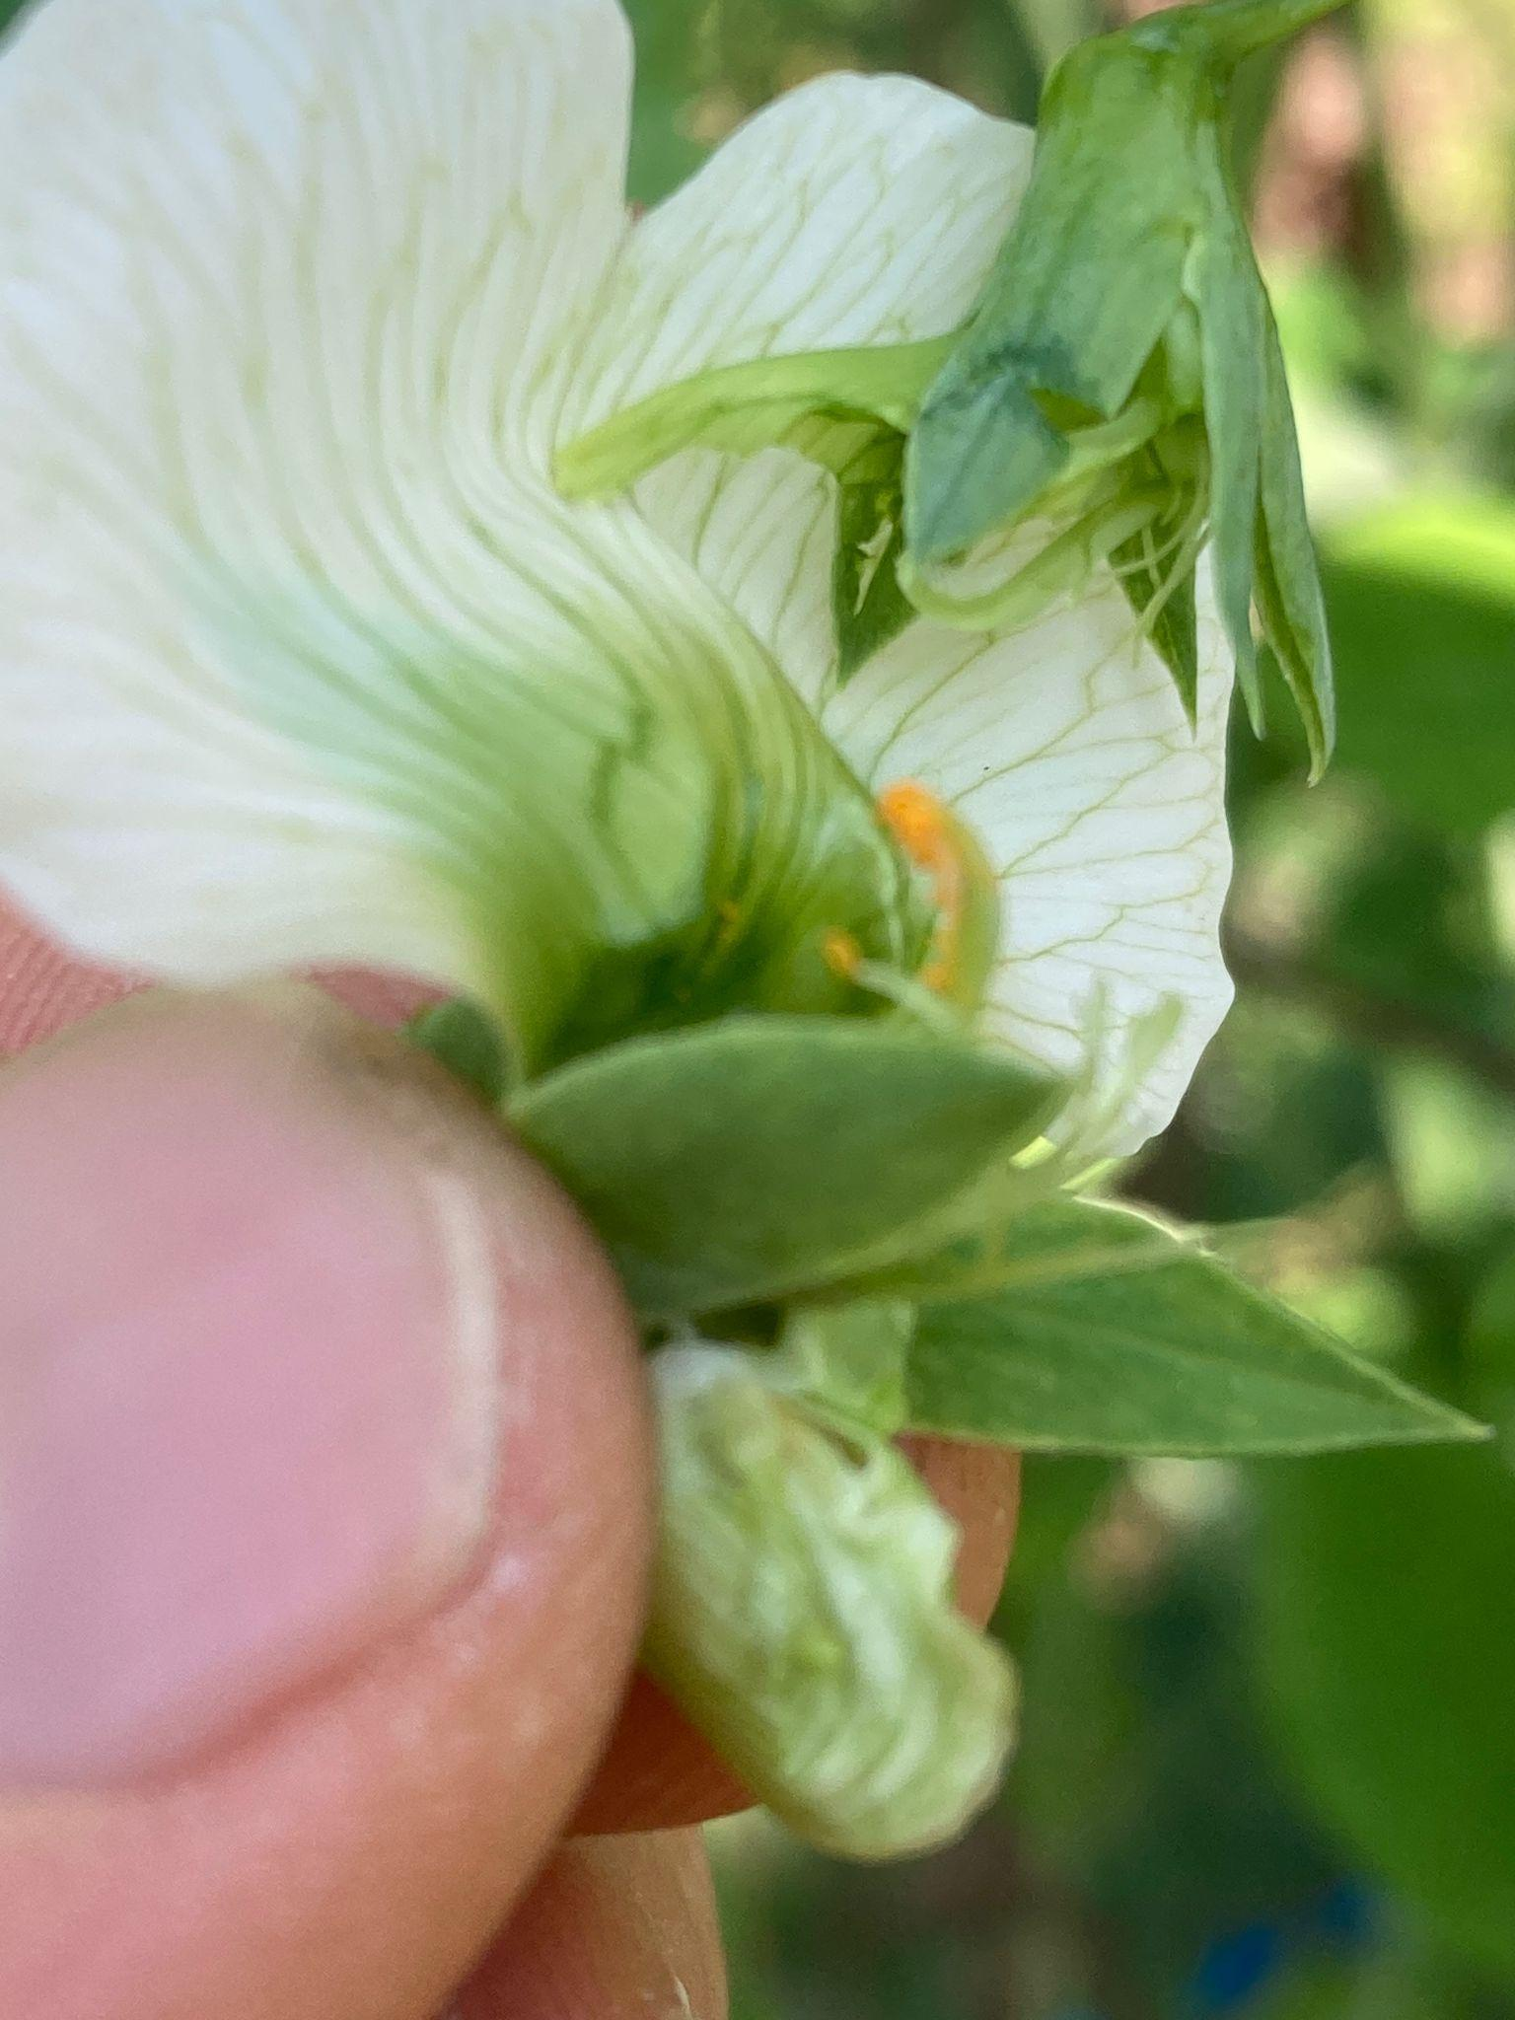
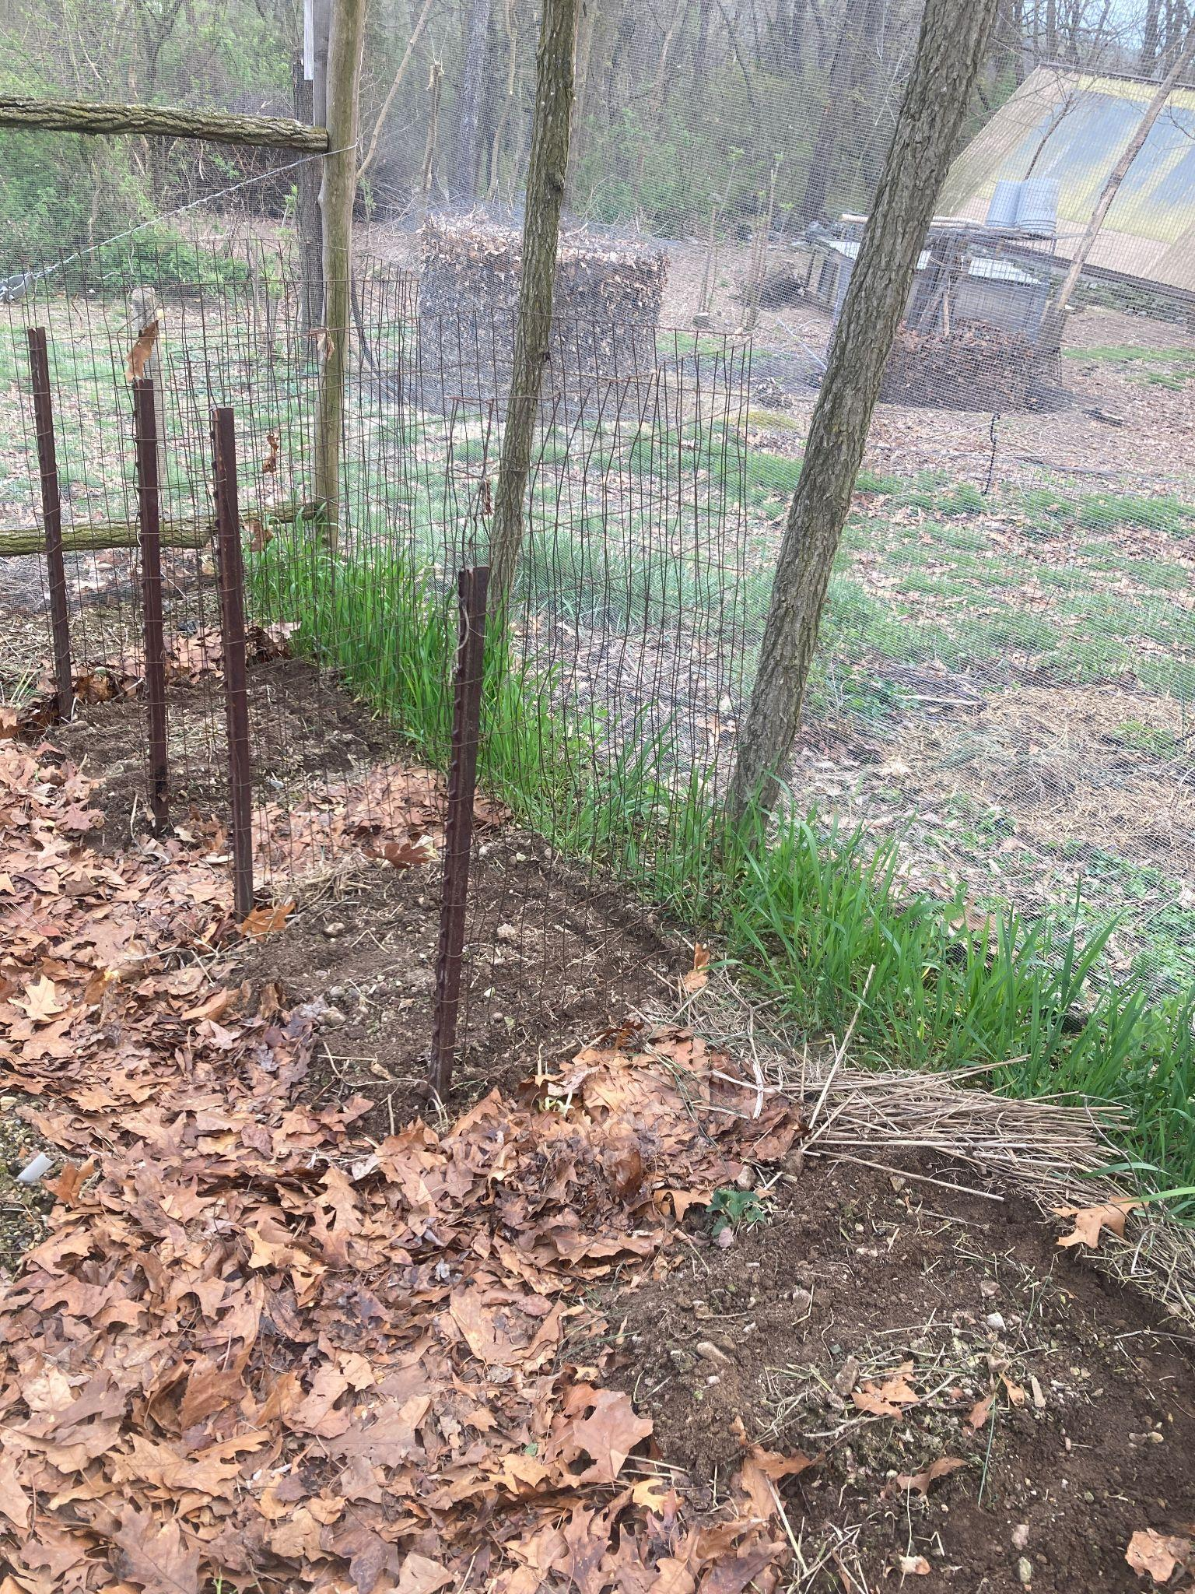
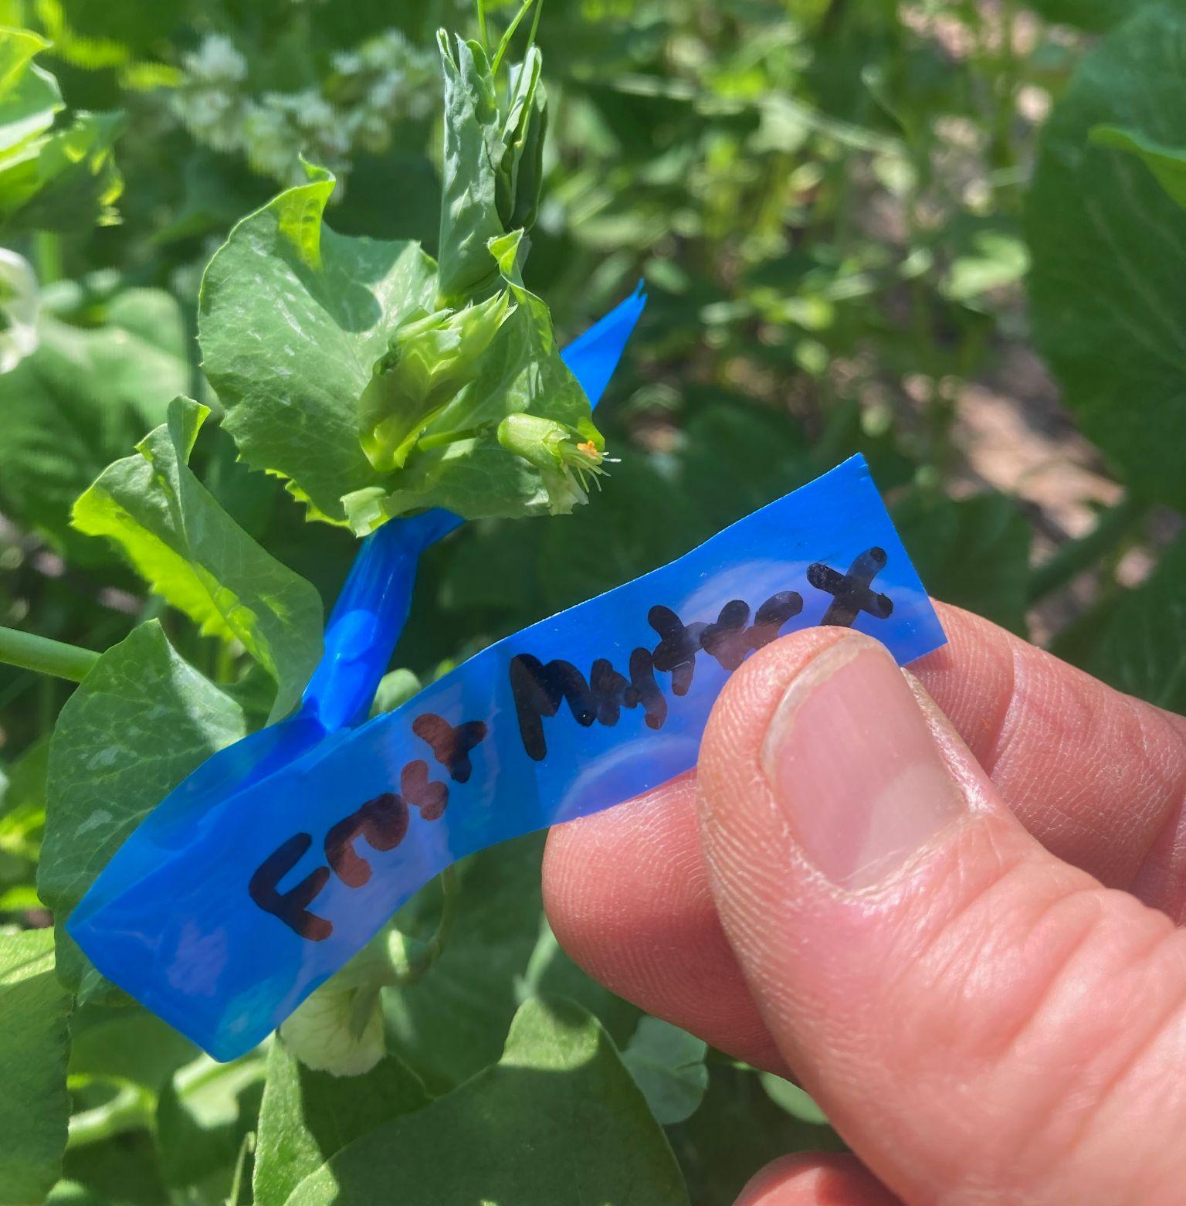
Adapted Approach
~Still replanted best of old guard
~Crossed existing lines
~Planted out Lynx, FrostMaster, Mulkey line for evaluation, possible crossing
~May seek extension to grant to finish evaluation of lines, do the crossing.
~Also could apply in fall to continue this work with new grant

Slide 25
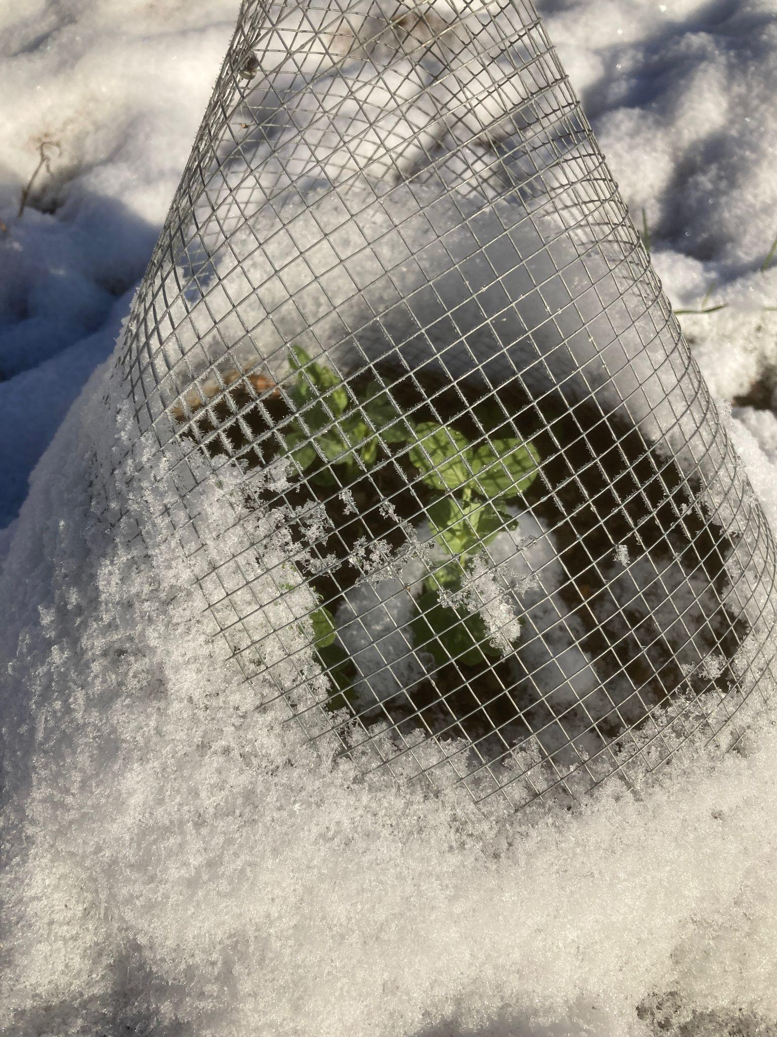
Are We There Yet?
~Maybe! Mulkey line, Lynx, our best
~If not, we’re on the threshold
~Remaining questions:
-Who cares?
-How will this work in real life?
-Feed or food?
-Weed control?
-Allergen labeling issues?
~Collaborators desired!

Slide 26
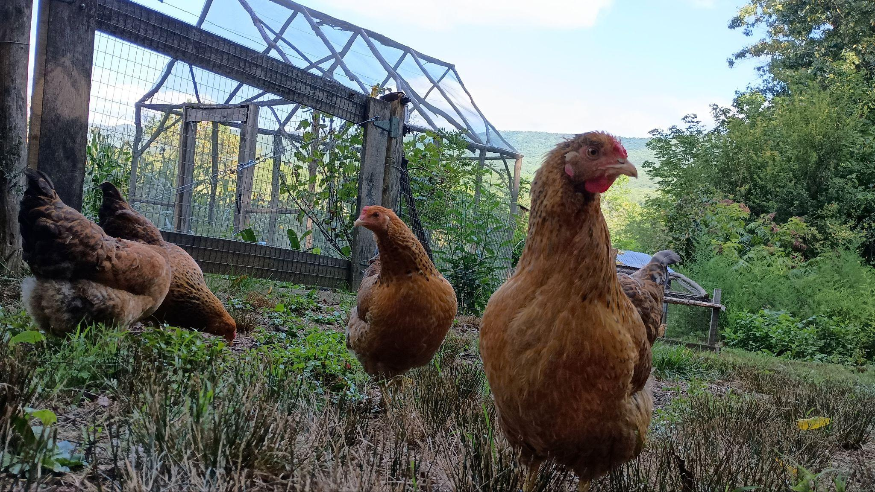
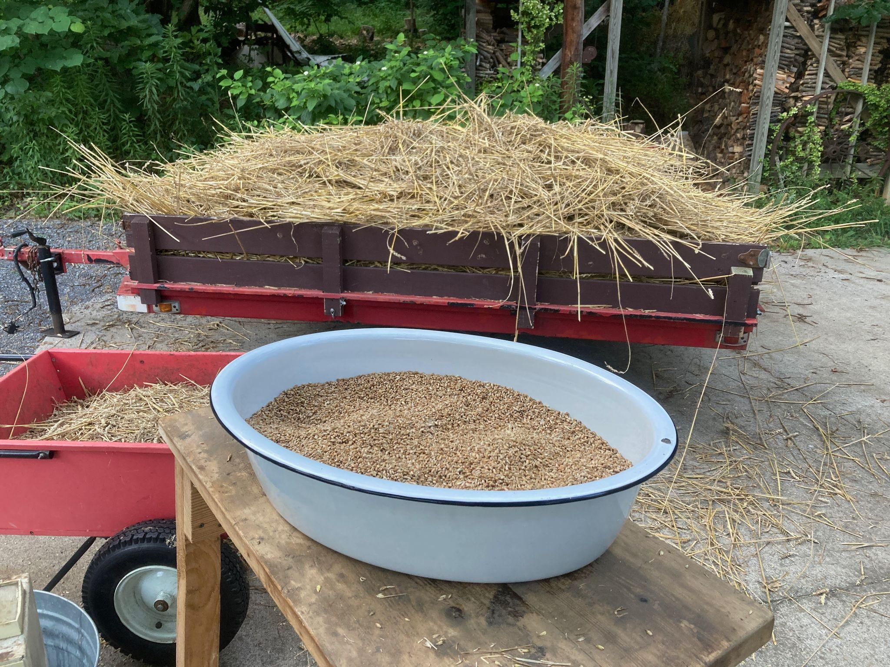
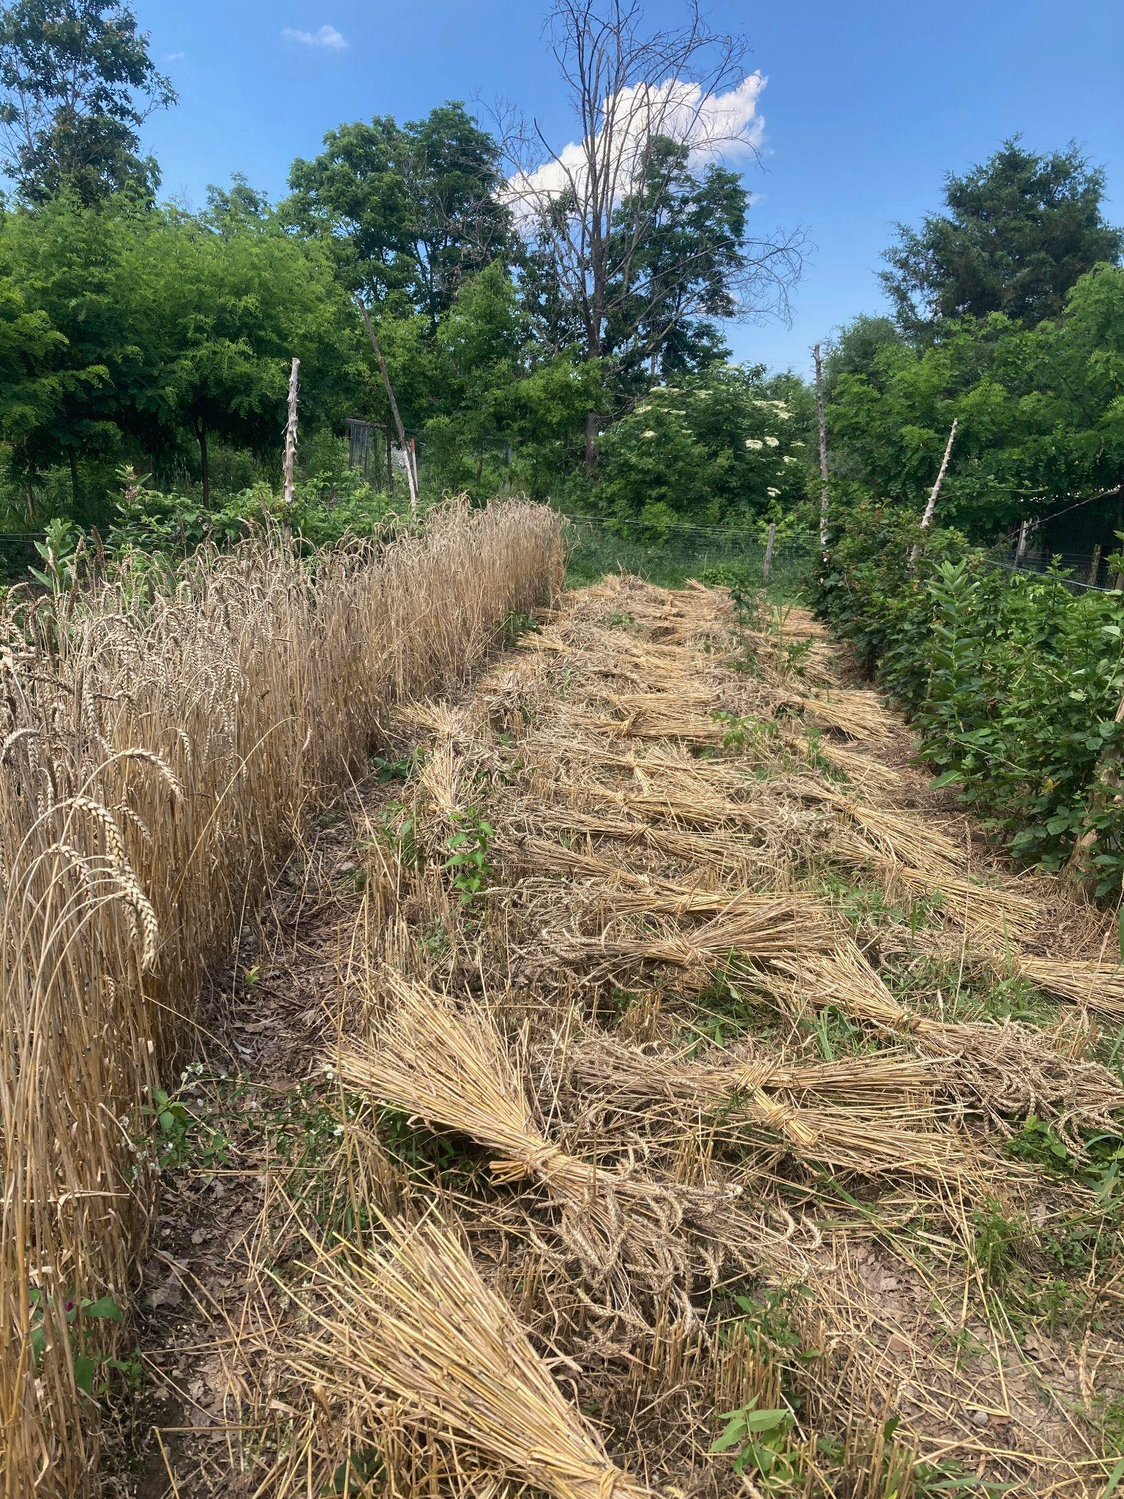
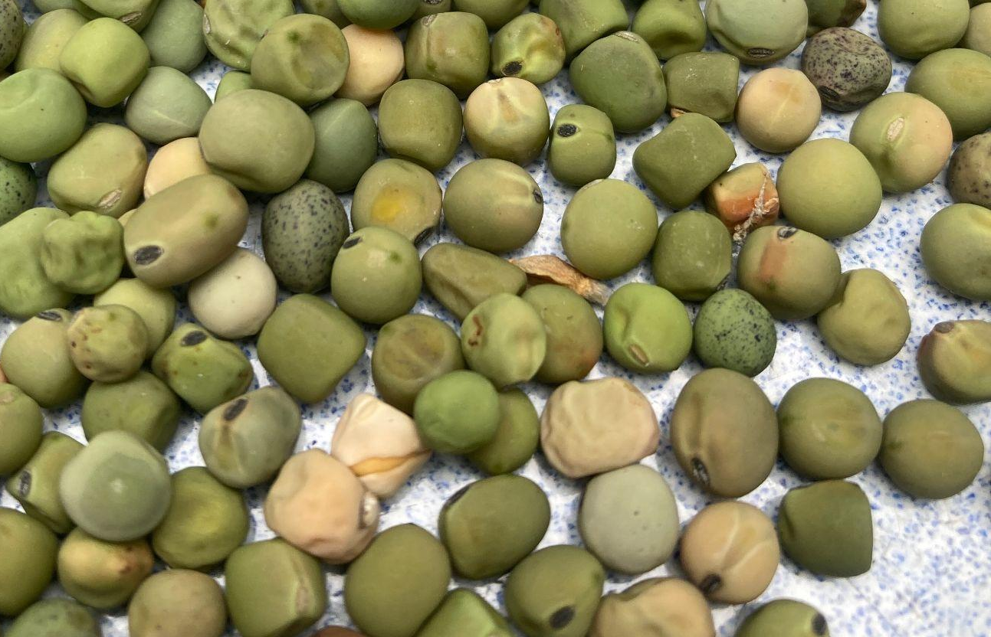
The Dream
Dwarf edible dry winter peas, grown with wheat, become a practical, familiar option for regional farmers, for animal feeds and human food

Slide 27
Bonus Section!
Winter Hardy Snow and Snap Peas on the Horizon

Slide 28
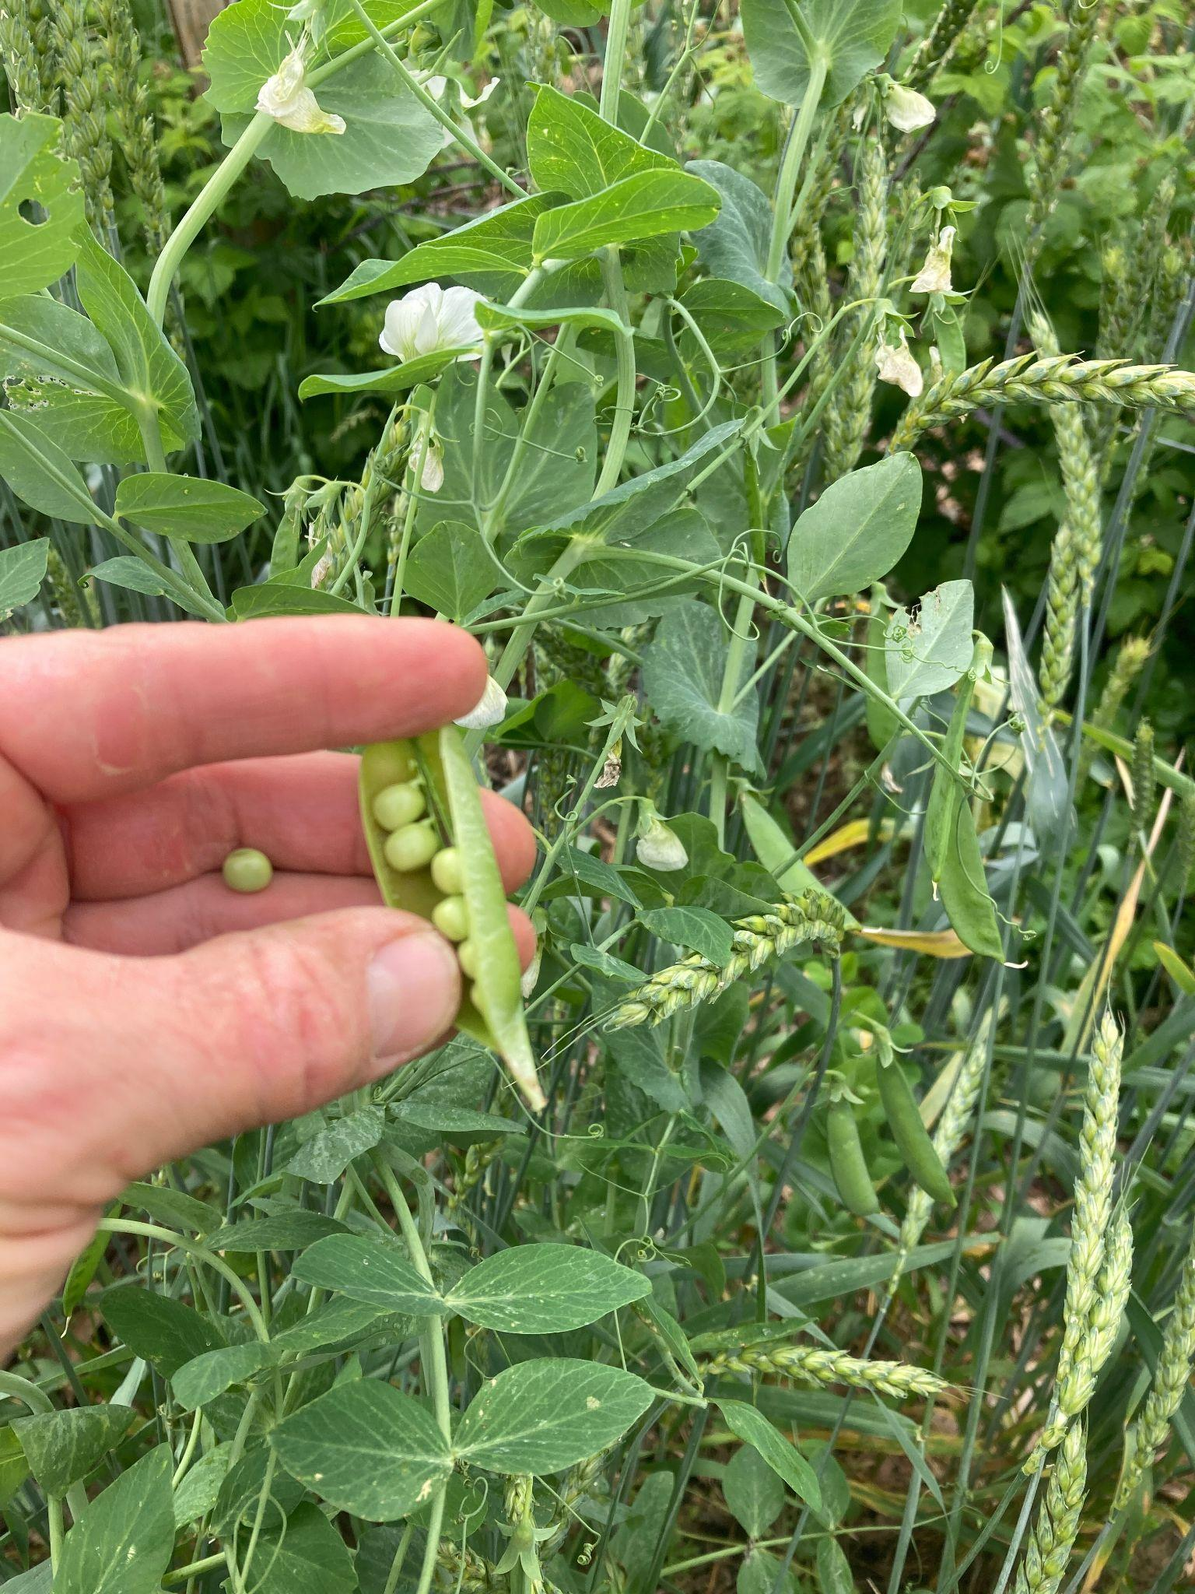
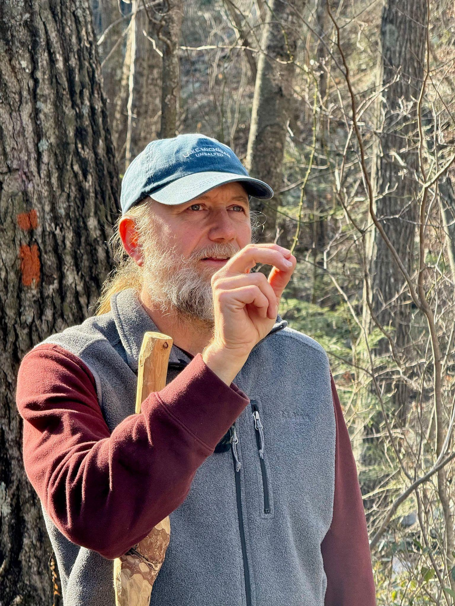
Here’s your option for a seed source

Slide 29
Types We Began Selecting For
~winter hardy snap pea
-low fiber
-thick pod walls
-green, wrinkled seeds
-sweet, low-tannin flavor
-large pod size
-indeterminate growth habit
-white flowers
~winter hardy snow pea
-low fiber
-large, flat, fleshy pods
-indeterminate growth habit
-sweet, low-tannin flavor
~edible dry seed winter wheat companion
-determinate growth habit
-short stature, but productive

Slide 30
Types We Began Selecting For
~winter hardy snap pea
-low fiber
-thick pod walls
-green, wrinkled seeds
-sweet, low-tannin flavor
-large pod size
-indeterminate growth habit
-white flowers
~winter hardy snow pea
-low fiber
-large, flat, fleshy pods
-indeterminate growth habit
-sweet, low-tannin flavor
~edible dry seed winter wheat companion
-determinate growth habit
-short stature, but productive

Slide 31
A Type We Haven’t Yet Selected for:
Edible Winter Shelling Peas!
~With last year’s crosses, these may emerge
~We would prefer:
-dwarf vines
-multi-branched, vigorous plants
-a condensed flowering/maturity season
-long, straight pods with lots of peas
-pods borne high on the plant
-an early, prolific crop
Other traits I would look for:
-Yumminess!
-Large pea size
-Wrinkled when dry
-White flowers
-Disease resistance
-Winter survival
-Easy threshing of mature seed
-Dual use with wheat for sweet dahl?

Slide 32
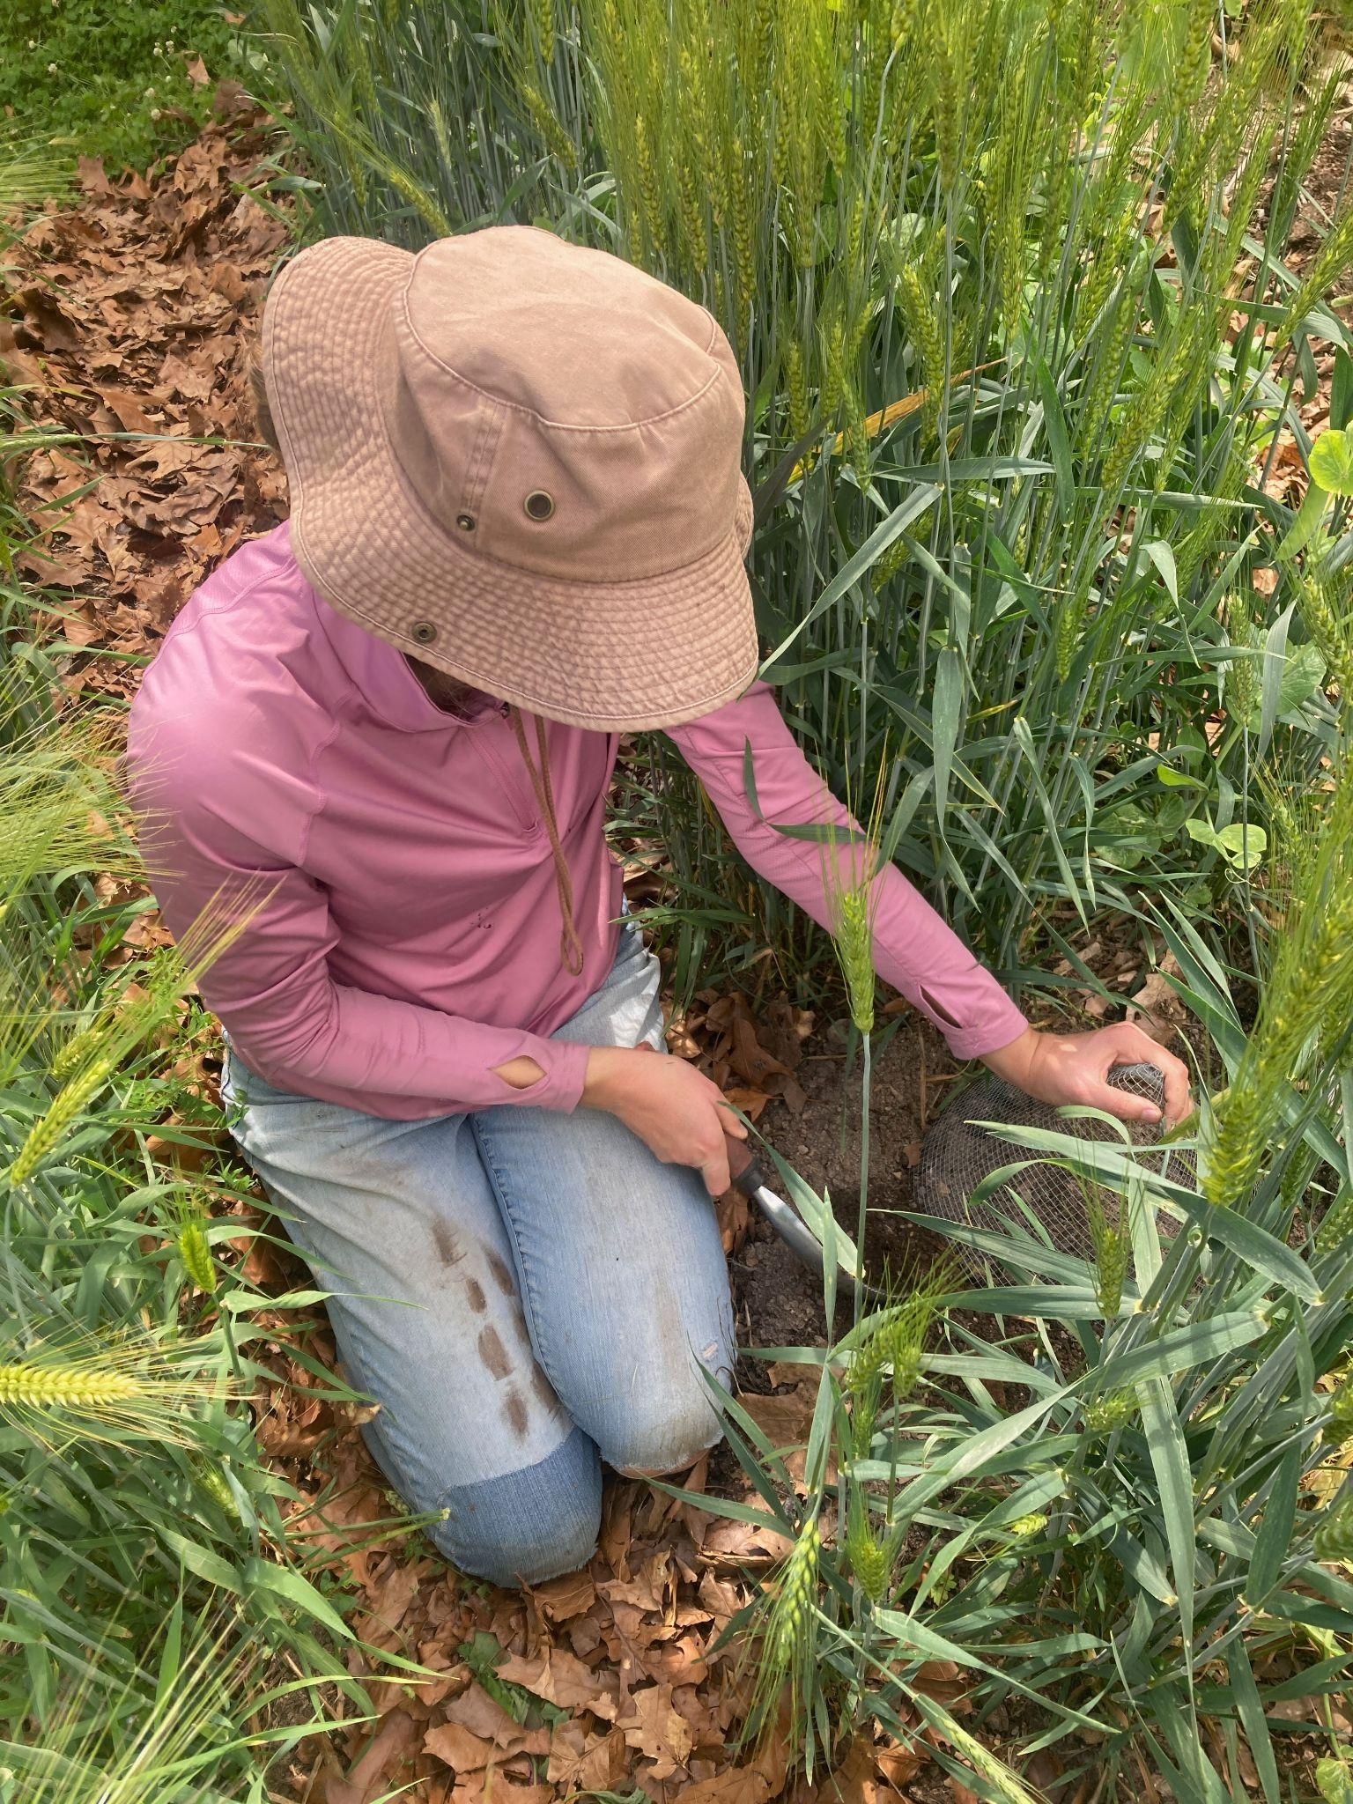
How you can get involved:
~Connect us to funding streams
~Recommend your favorite pea varieties
~Tell us about YOUR growing conditions
~Tell us what traits YOU would want
~Grow out some of our seed, give feedback
~Believe in your power of observation/selection
~Learn to cross peas (it’s not that hard)
~Get inspired for your own breeding project!

