Slide 1
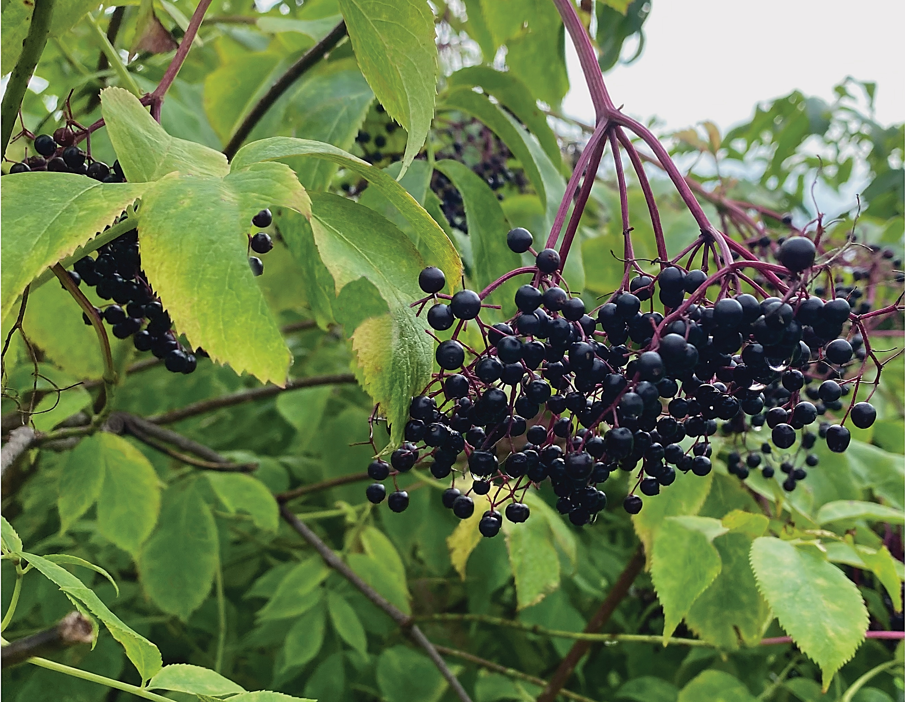

Elderberries:
A Potential Cash Crop for West Virginia

Slide 2

Production and Value-Added Processing of Cultivated and Wild-Harvested Elderberries in West Virginia

Slide 3
Interesting facts about elderberries (Sambucus sp.)
The elderberry (Sambucus canadensis) is native, adapted plant to West Virginia (North America) and Europe (Sambucus nigra).
A large percentage of elderberries are imported from Europe.
European elderberries are less winter-hardy than American species.
Elderberries are rich in vitamins A and C, phosphorous, potassium and iron.
Elderberry fruit and flowers can be made into teas, tinctures, drinks, distilled spirits, wines and cordials, baked goods, jams and jellies.

Slide 4
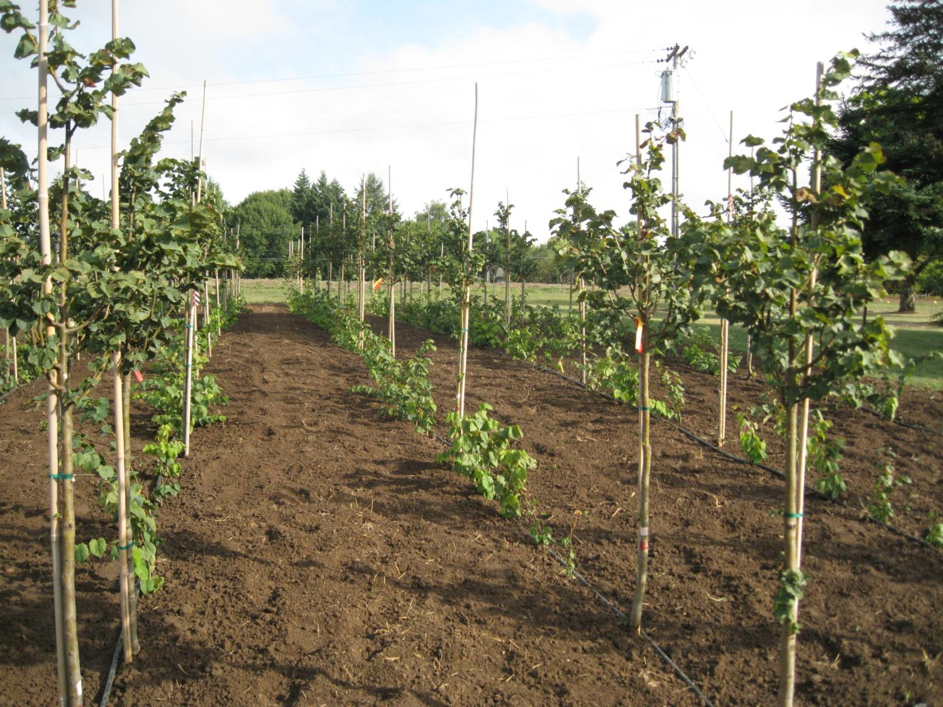
Potential Fruit & Nut Crops:
Apples (Heirloom)
Blueberries (high and low bush)
Blackberries
Raspberries
Grapes
Elderberries
Figs
Honeyberries
Saskatoons
Raspberries (black, red, yellow)
Strawberries (June-bearers and everbearers)
Peaches
Cherries
Nectarines
Paw Paw
Plums
Pears (Asian)
Mulberries
Persimmons
Hazelnuts
Chestnuts

Slide 5
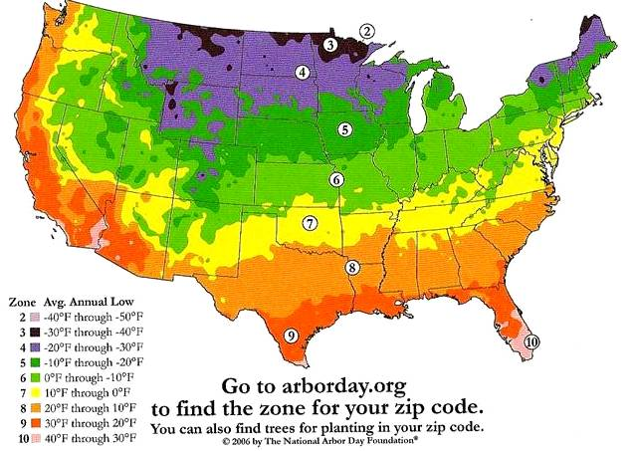
Sambucus is hardy from Zones 3-8.

Slide 6
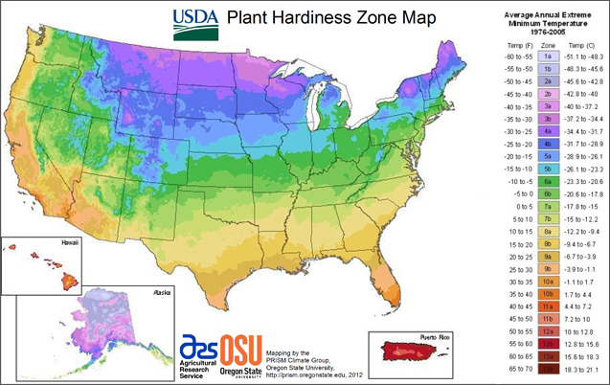

Slide 7



Some health benefits of elderberries…
Reduced severity of colds and flu
Enhanced immunity
Some anti-cancer properties

Slide 8
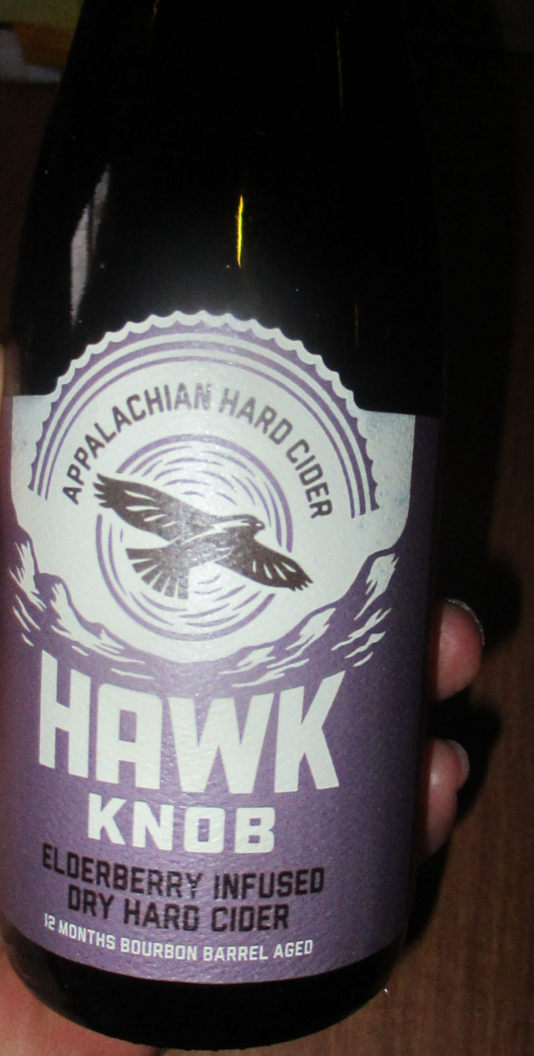
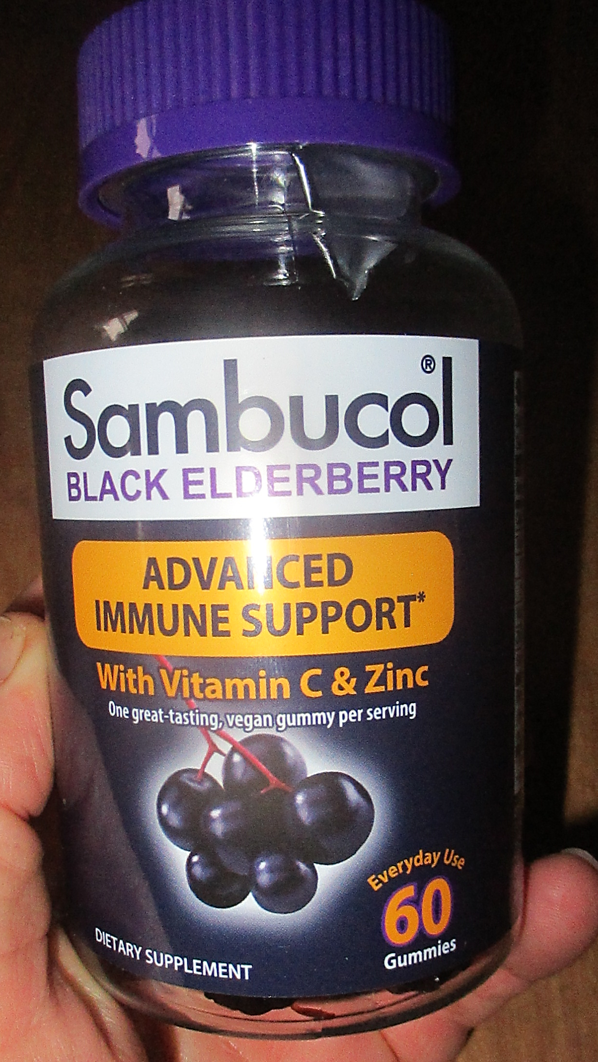

Slide 9
Is there a market for elderberries in West Virginia?
Tame or domesticated cultivars

Slide 10
Is there a commercial market for elderberries in West Virginia?
Tame or domesticated cultivars
Native clones

Slide 11
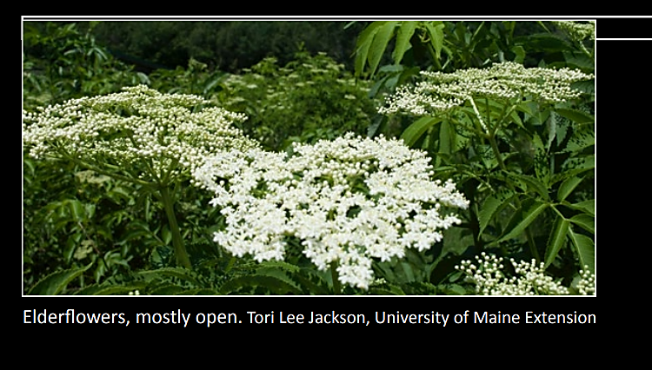
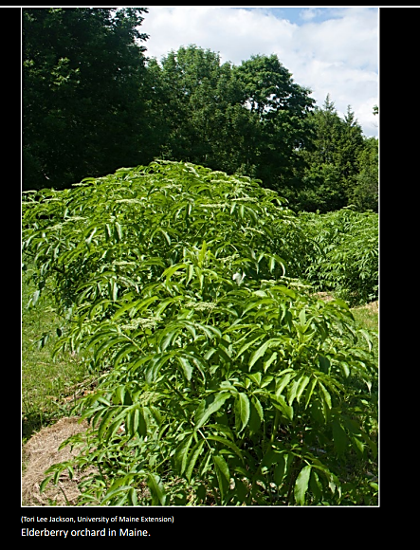
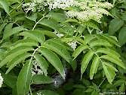
Elderberry Botany
The elderberry is a shrub or small tree with pinnately compound leaves and stems with raised bumps or lenticels.

Slide 12
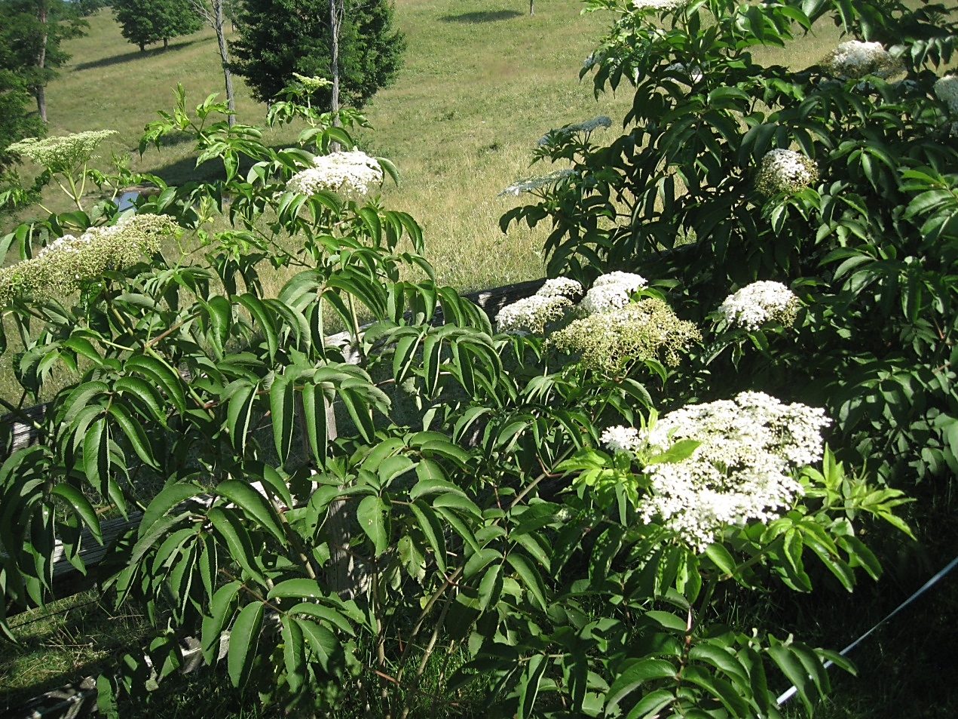
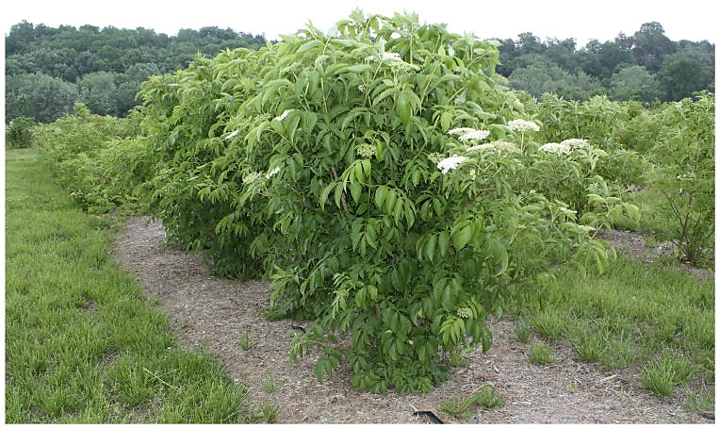
The elderberry can be determinate or indeterminate in growth habit making it grow 6-10 feet in height.

Slide 13
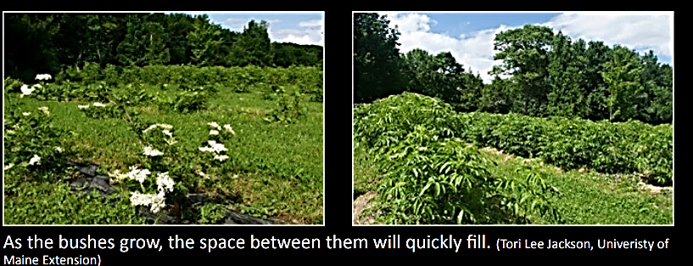
Elderberry Botany
The elderberry is a shrub or small tree that is approximately 6-10 feet tall and 3-6 feet wide.

Slide 14
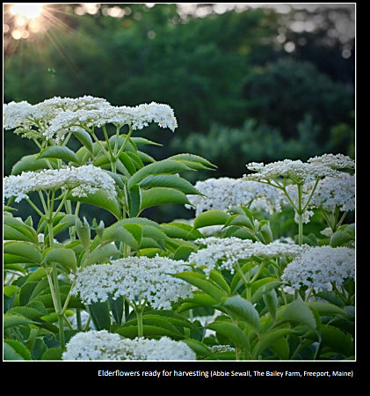
Elderberry Botany
The elderberry flower is a flat panicle (cyme) which blooms in early to mid-Summer.

Slide 15
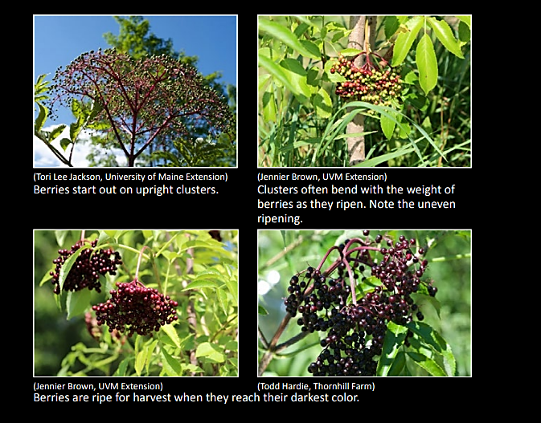
Elderberry Botany
The elderberry fruit ripens in mid- to late-summer in West Virginia.

Slide 16
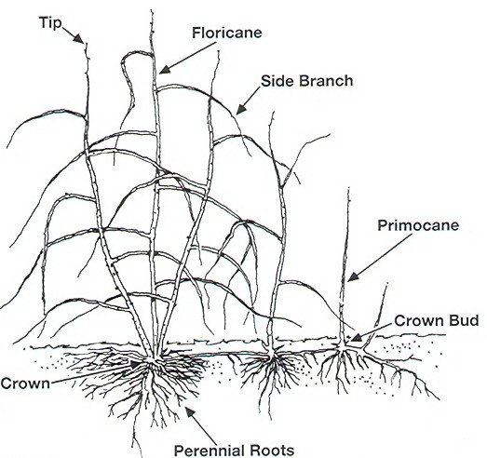

Slide 17
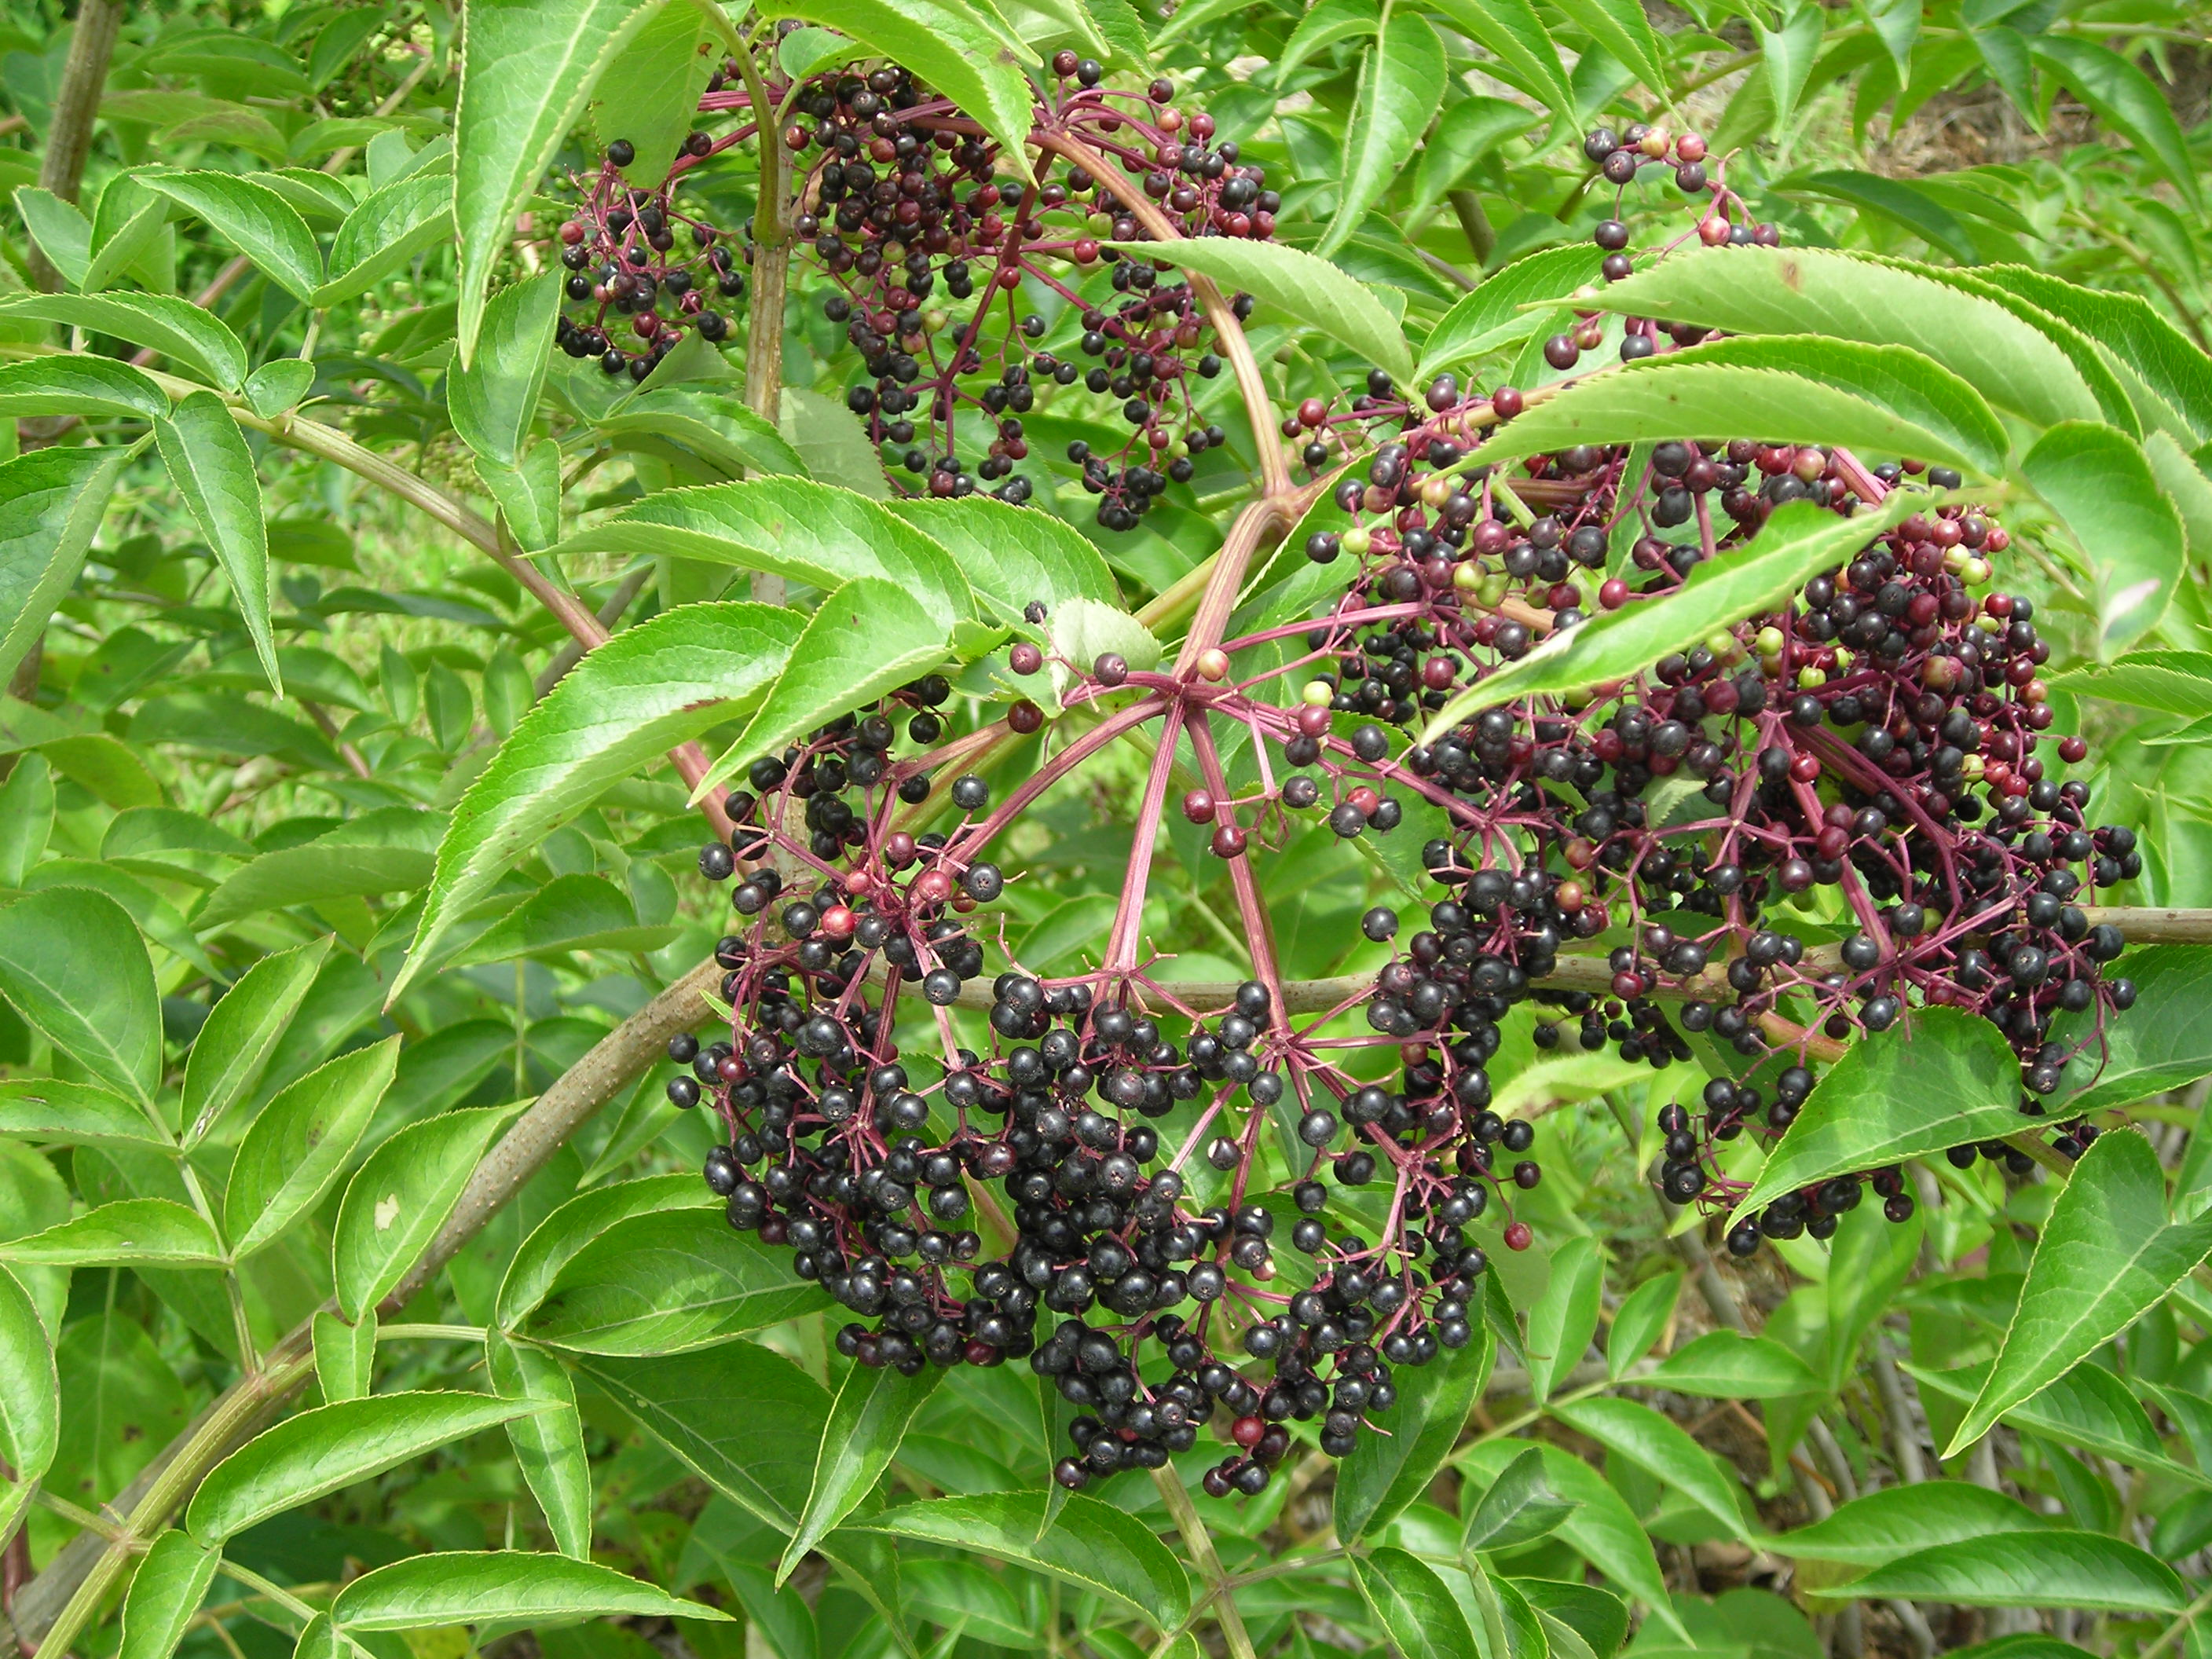
Elderberry Botany
The elderberry fruit ripens in mid- to late-summer in West Virginia.

Slide 18
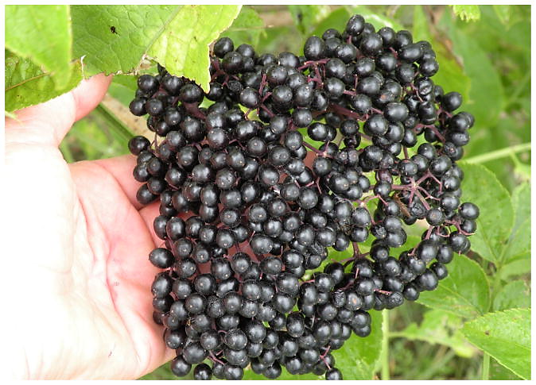
Photo credit: A. J. Thomas and P. L. Byers)

Slide 19
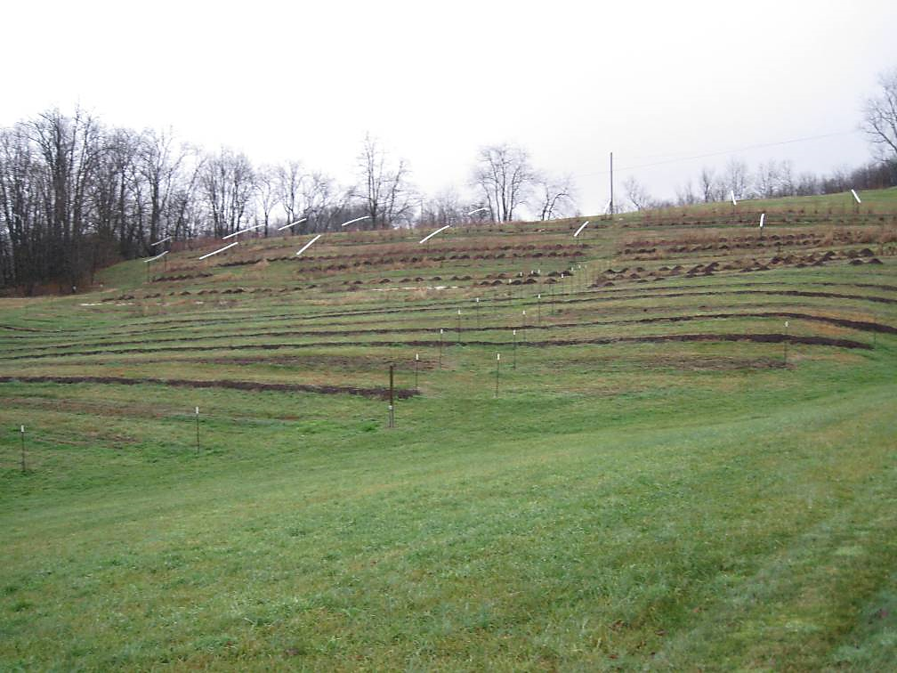
Planting Site
Elderberries tolerate a wide-range of soil types, but do best in well-drained, soils with a pH of 5.5-6.5.
Prefer high organic matter and full-sun.

Slide 20
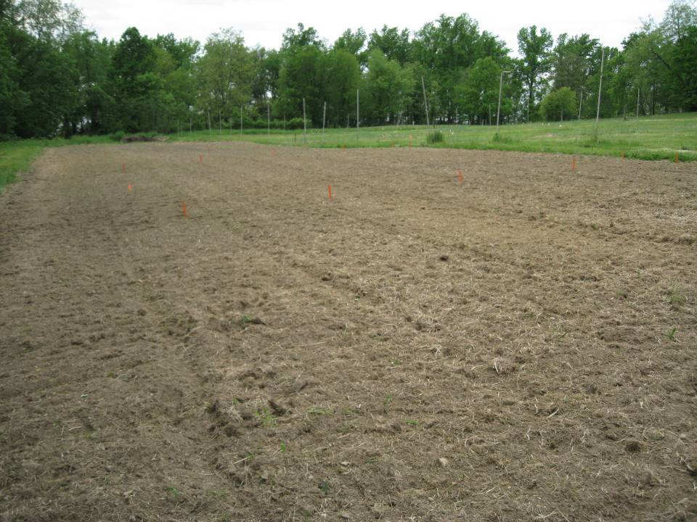

Slide 21
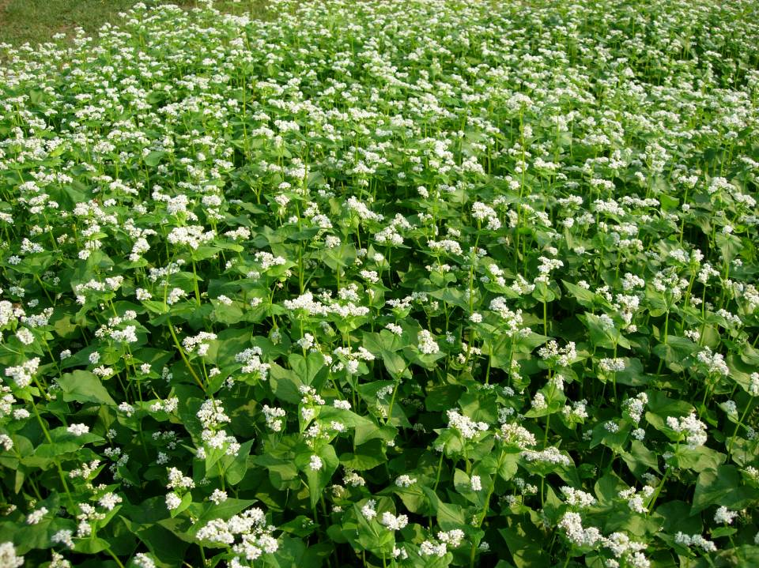

Slide 22
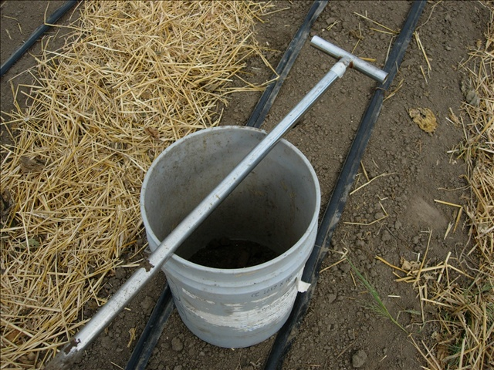
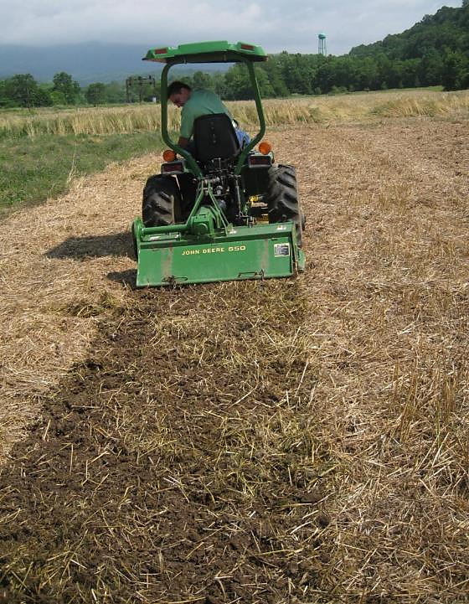
Soil test prior to planting.
Strip till planting rows.

Slide 23
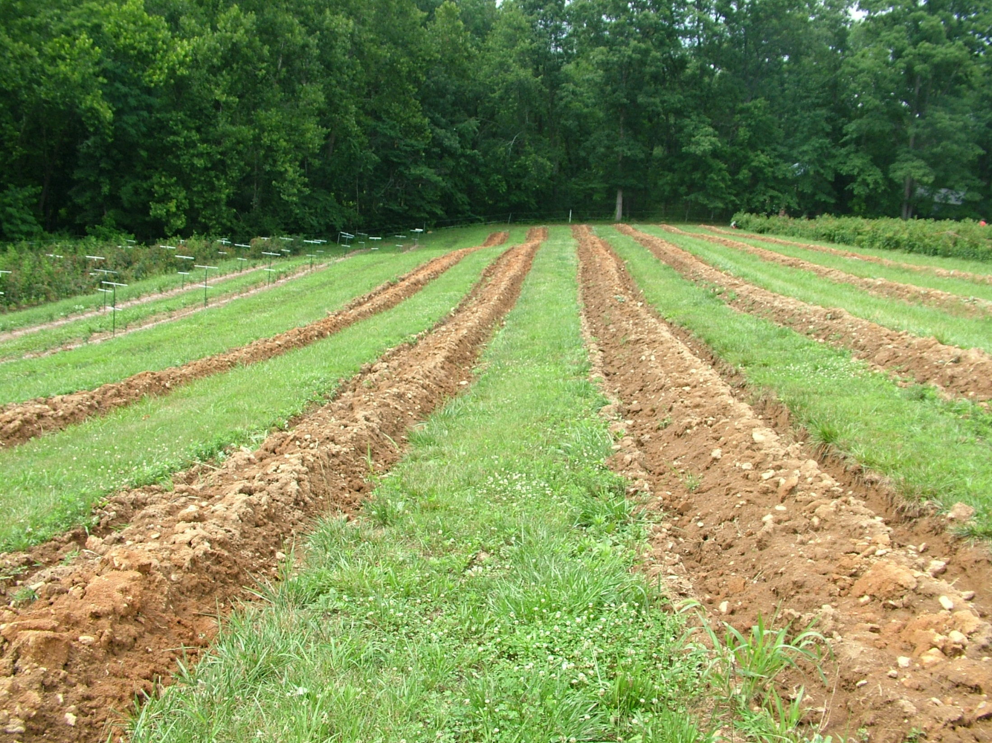

Slide 24
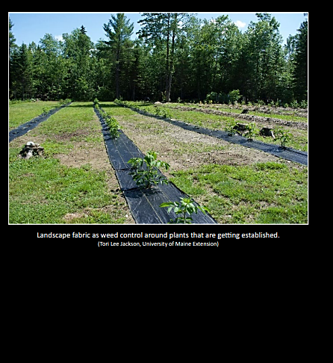
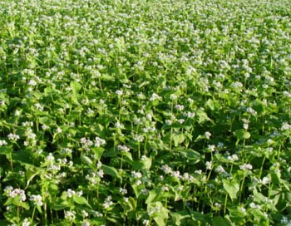
A soil-building cover crop such as buckwheat can be used as a cover crop the year before planting elderberries
Mulch or landscape fabric can be used for elderberries.

Slide 25
Photo credit: A. J. Thomas and P. L. Byers)

Slide 26
Elderberry Varieties

Slide 27
Variety | Description & Characteristics
Adams-1 | Selected in NY from wild species. Very winter hardy. Adams-2 has large fruit and fruits early.
Adams-2
Bob Gordon | Released from Univ. of MO in 2011. Flowers from late May through mid-June with harvest in July and August. Sweet berries.
Johns | Open-pollinated Adams 1 or 2. Fruit ripens in Mid-August
Marge | European elderberry
Nova | Ripens in early August
Pocahontas | Late fruiting variety
Samdal | European elderberry. Requires cross-pollination with ‘Samyl’
Samyl | European elderberry Requires cross-pollination with ‘Samdal’
York | Early fruiting
Wyldewood | Selected from Mo. Large flower clusters,

Slide 28
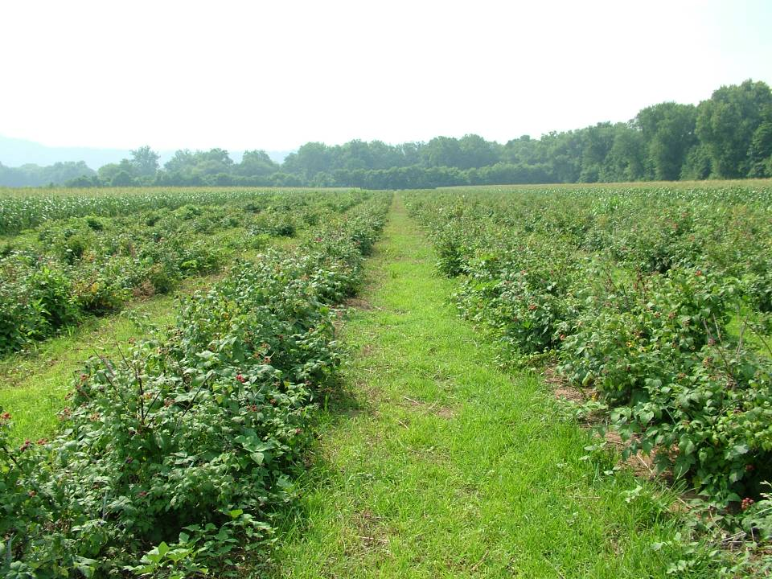
Establishing a Cultivated Elderberry Planting in West Virginia

Slide 29
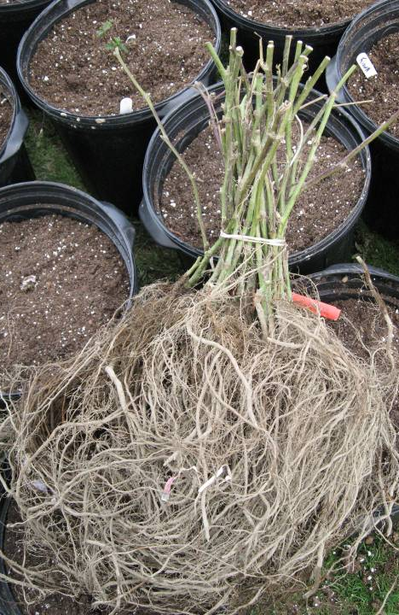
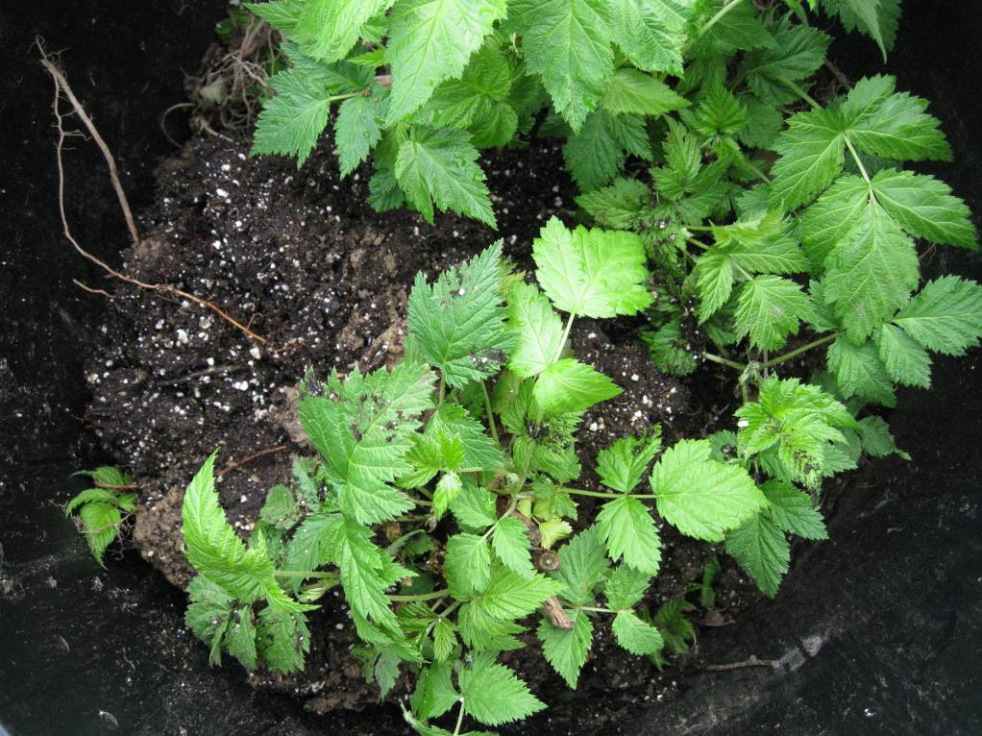
Most of the planting material is bare-root plants.

Slide 30
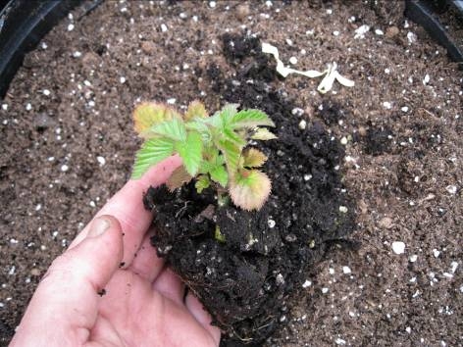
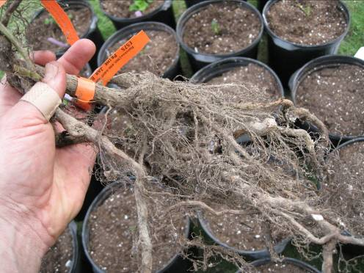
Tissue-culture plugs
Dormant bare root

Slide 31
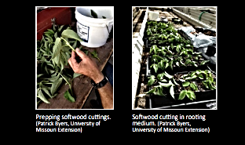


Slide 32
Planting Arrangement
O O O O O O O O
O O O O O O O O
O O O O O O O O
O O O O O O O O
4-8 ft.
8-12 ft.
Space plants 4-8 feet apart within the row and 8-12 feet between rows.

Slide 33
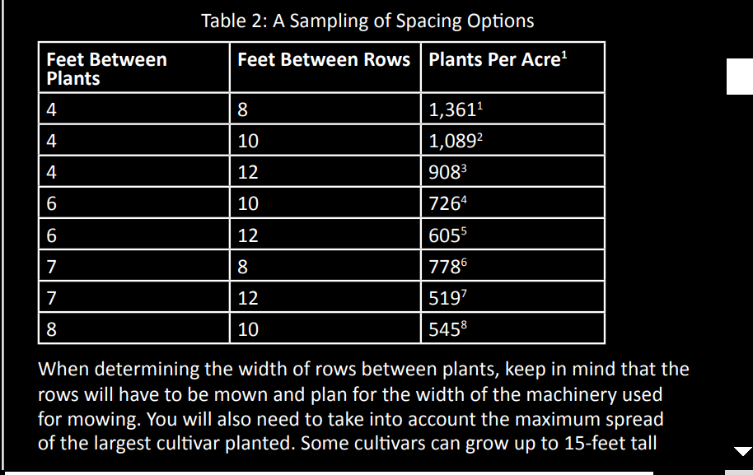

Slide 34
Planting Notes……
One acre of elderberries is approximately 800-900 plants.
We recommend starting with 1/5 acre which is approximately 150 plants.

Slide 35
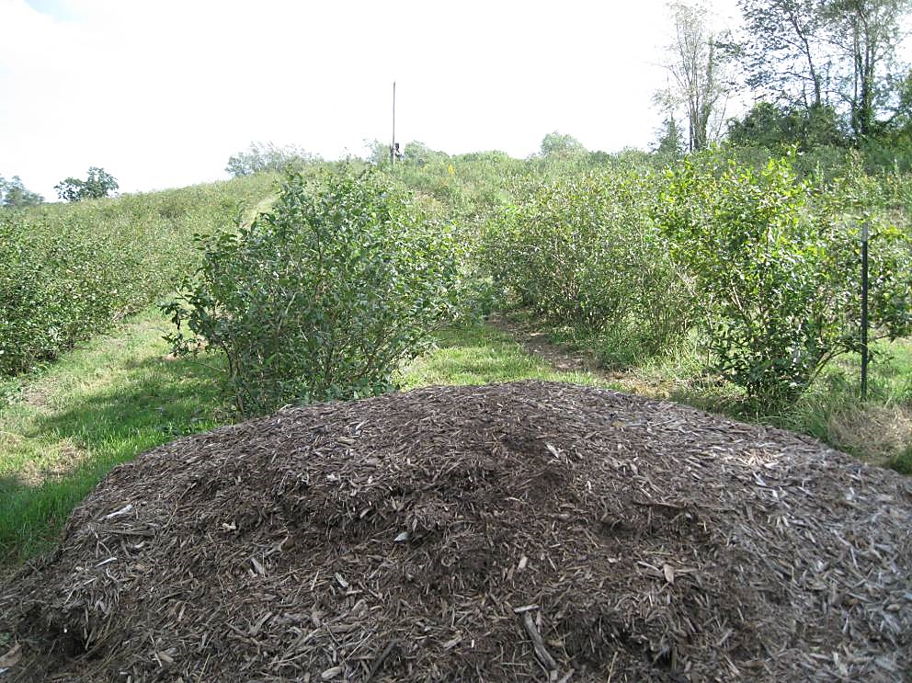
Organic mulches such as wood chips can be used to reduce soil moisture loss and suppress weeds.

Slide 36
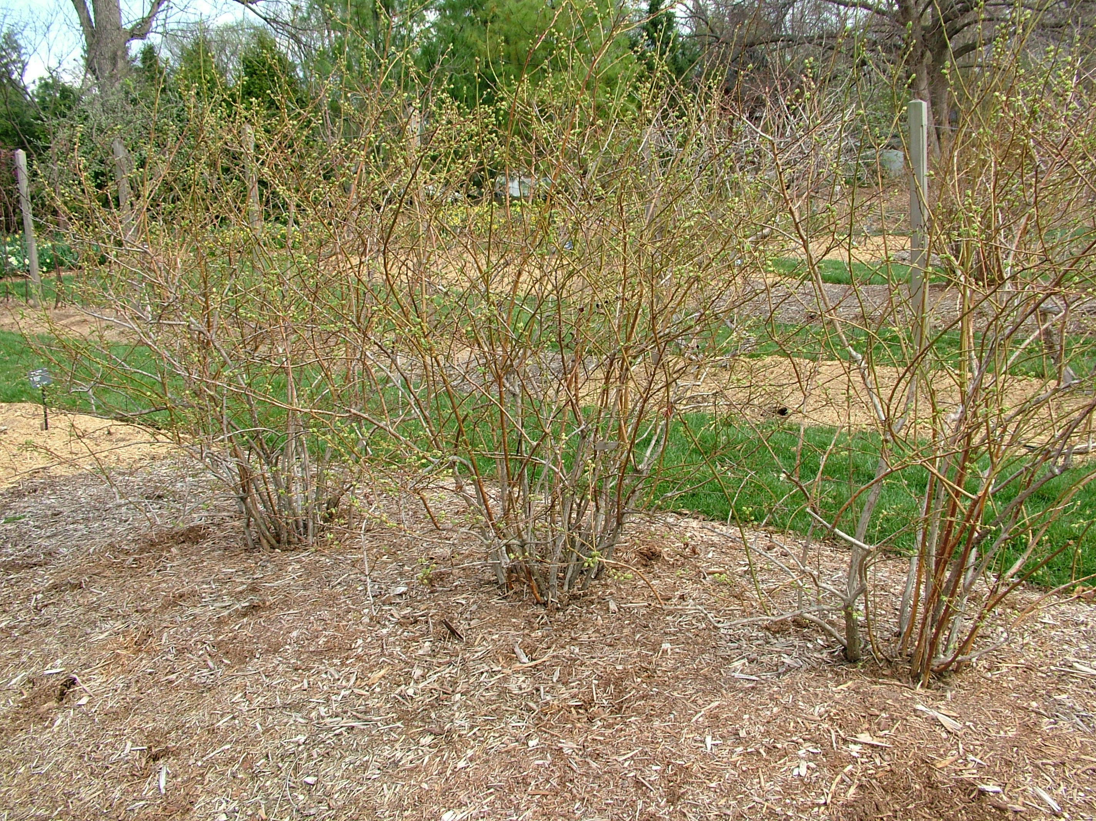

Slide 37
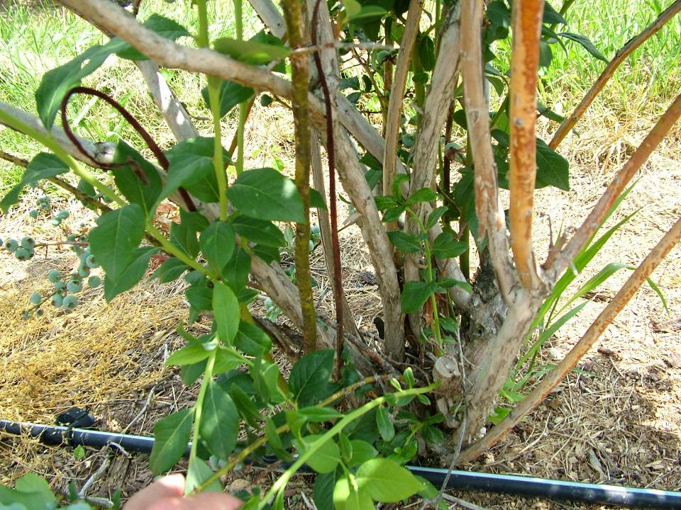

Slide 38
Sources of Elderberry Plants
One Green World
Molalla, OR
877-353-4028
Nourse Farms, Inc.
41 River Rd.,
South Deerfield, MA 01373
413-665-2658
Indiana Berry and Plant Co.,
5218 West 500 South
Huntingsburg, IN 47542
800-295-2226
River Hills Elderberry Cooperative
Riverhillsharvest.com

Slide 39
Fertilization of Elderberries
Do not fertilize at planting, but a light application of nitrogen (N) can be applied 8 weeks after planting.
Succeeding years, the planting will require 60-80 lbs. of N/acre @ budbreak.

Slide 40
Crop Maintenance
Remove blooms the first year (establishment) to encourage more vegetative and root development.
Pruning is done starting Year 3

Slide 41
Pruning Elderberries
Source: Cornell University, 2015)
Elderberry bushes will send up new canes or primary branches each year.
It usually takes five years or more for bushes to reach full height, depending on the cultivar.
Beginning in the second year, bushes will also send out lateral branches.
Flowers and fruit develop on the tips of that season’s canes and lateral branches.
The best yield is usually on the second year canes with lateral branches.

Slide 42
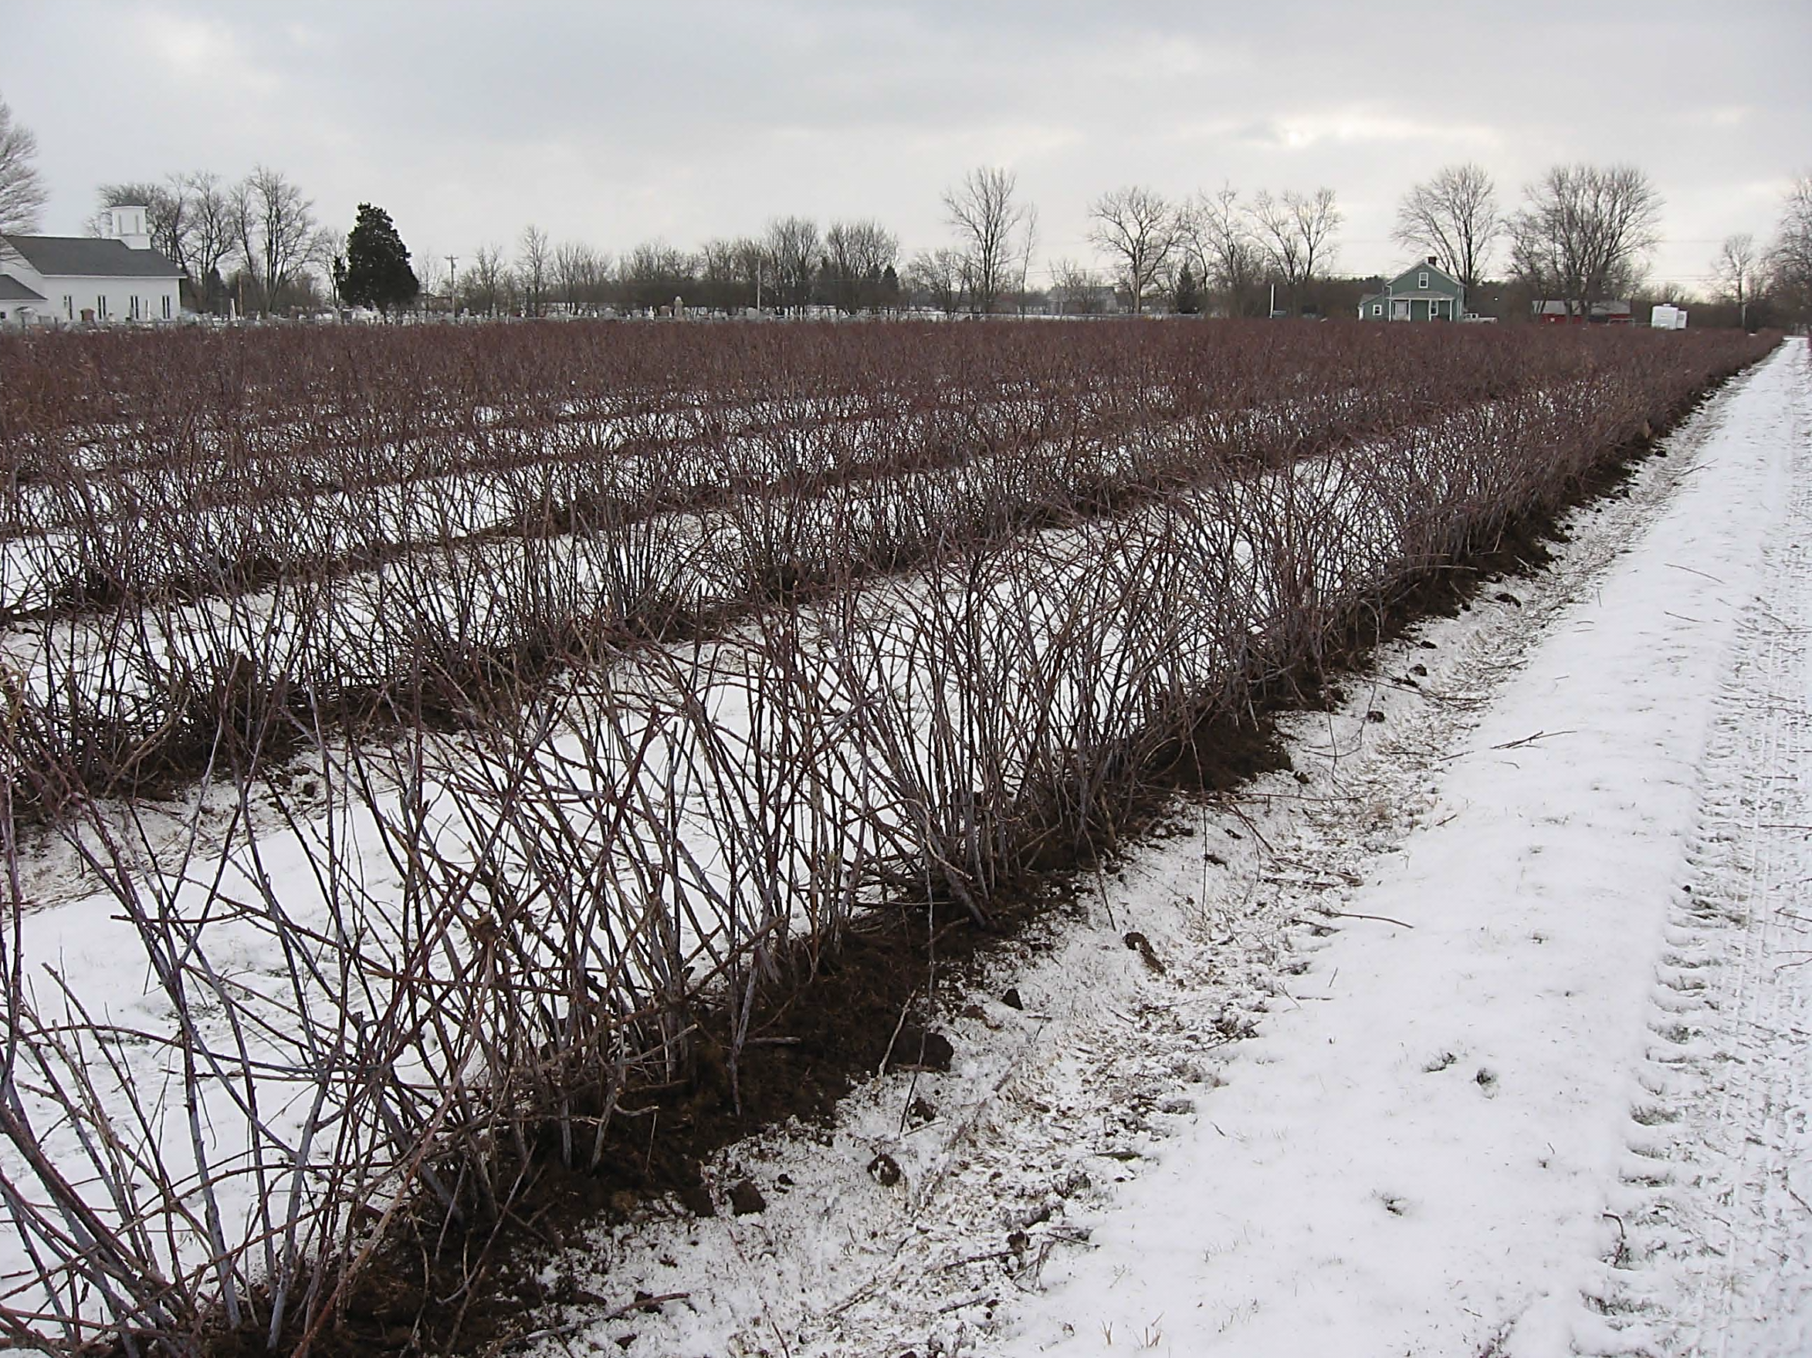
Pruning Elderberries
Remove all canes that are dead, damaged or over three years old.

Slide 43
Propagation of Elderberries
Hardwood cuttings can be taken in late winter.
Harvest branches from the previous years’ growth – the wood should be brown, not green, and free of any damage.

Slide 44
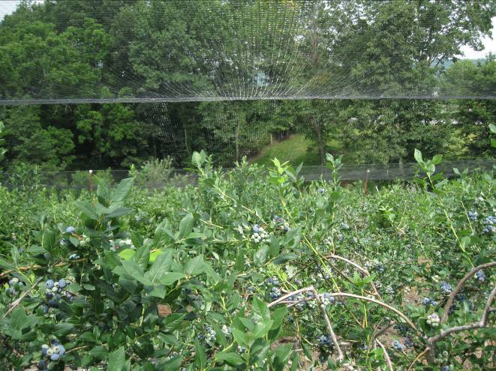
Elderberry Pest Management

Slide 45
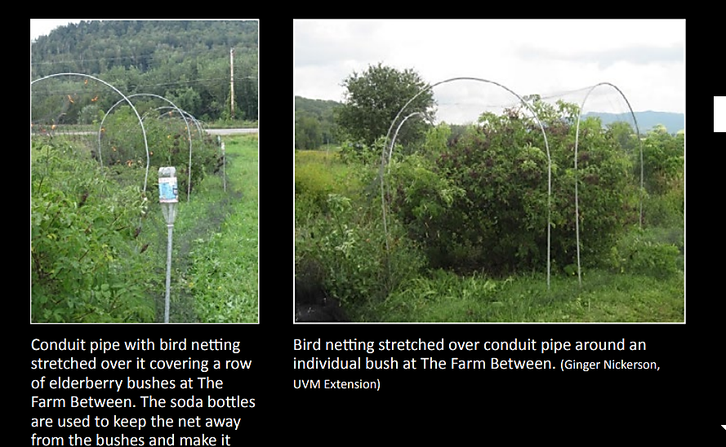

Slide 46
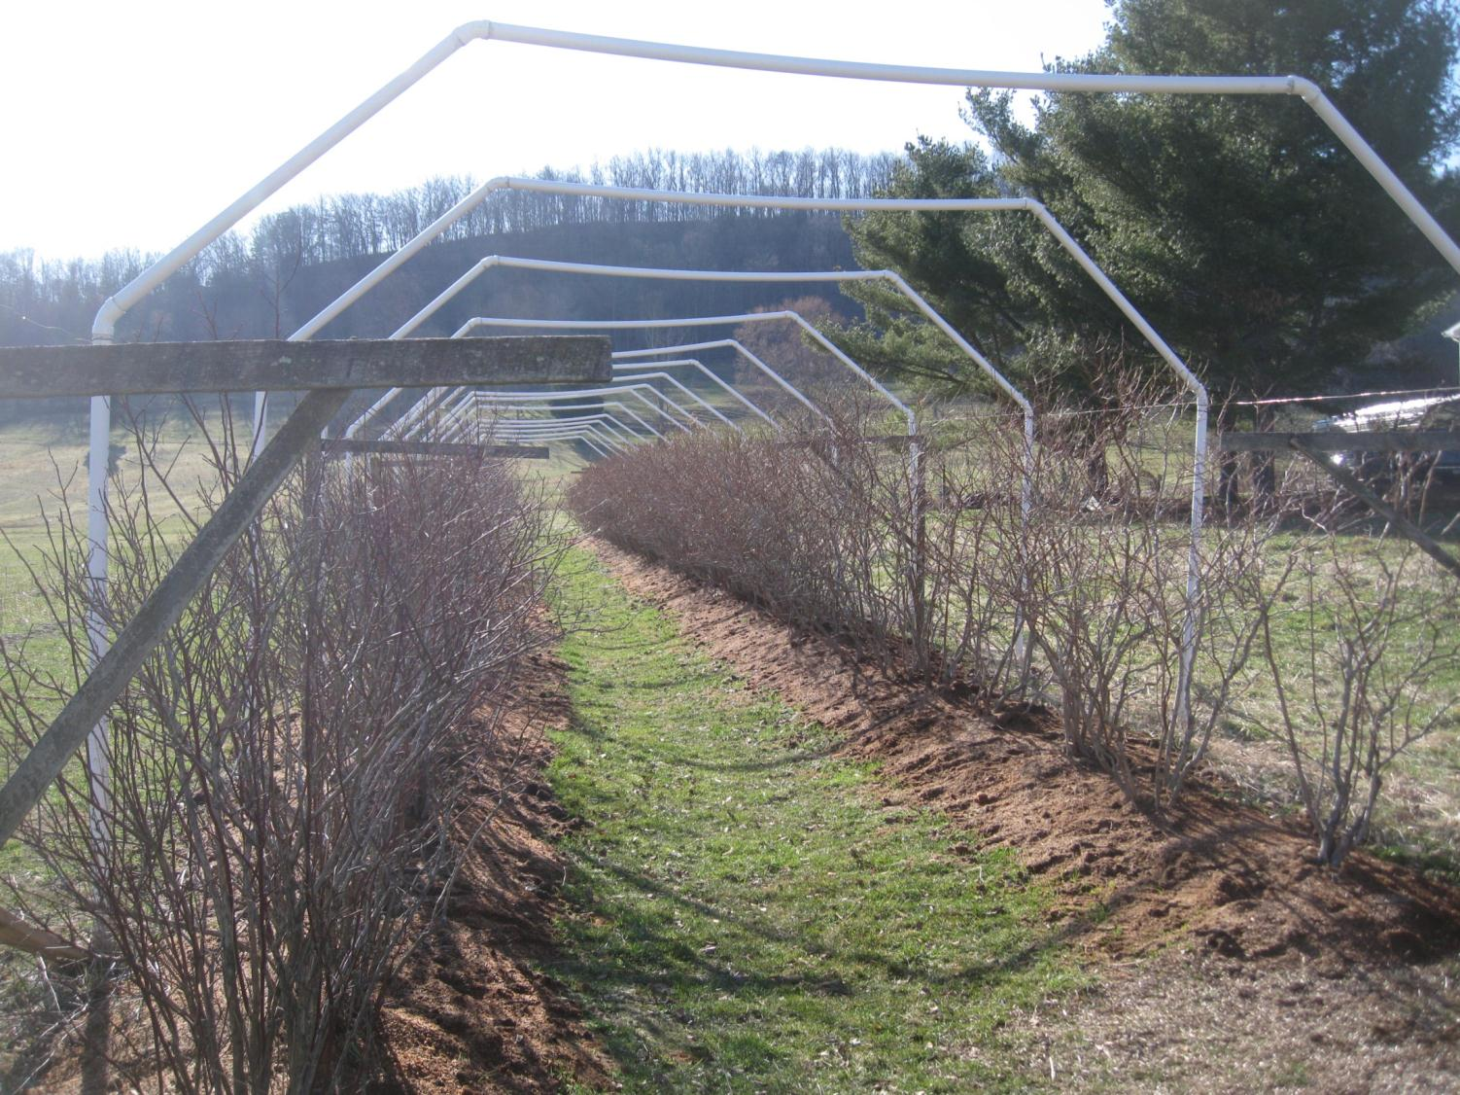

Slide 47
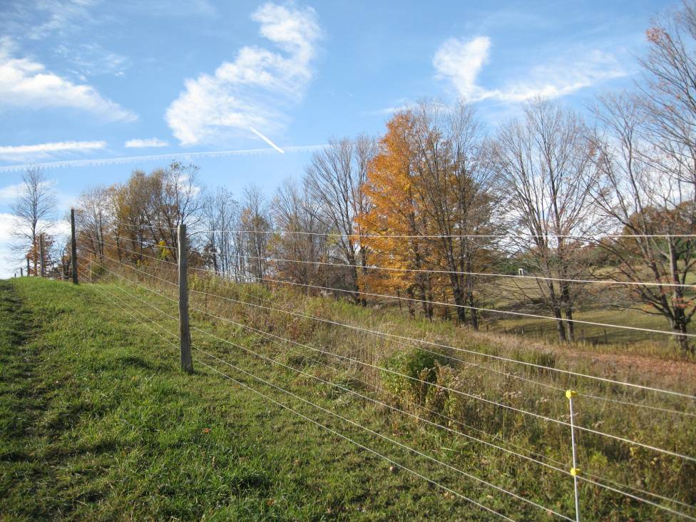

Slide 48
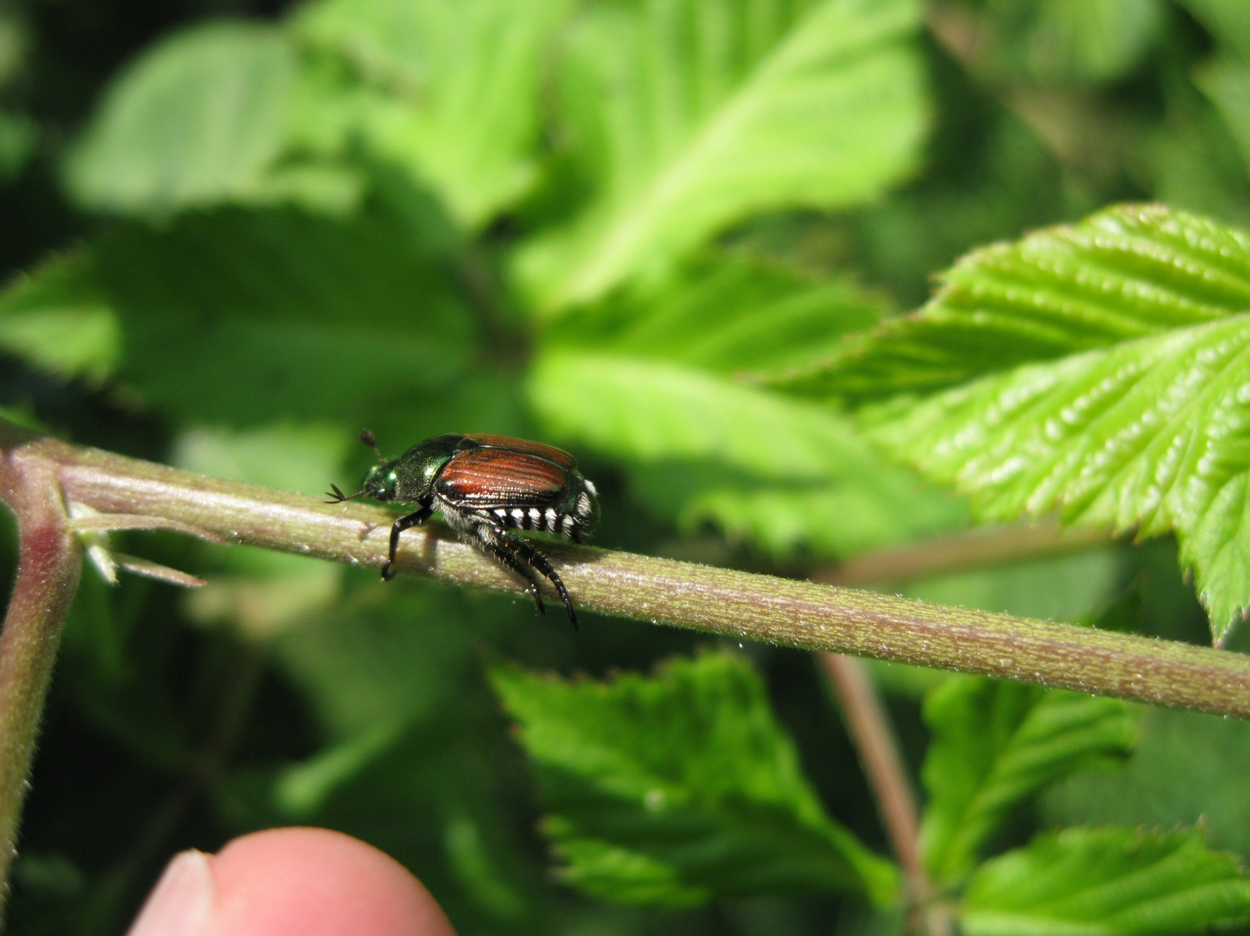
Japanese Beetle

Slide 49
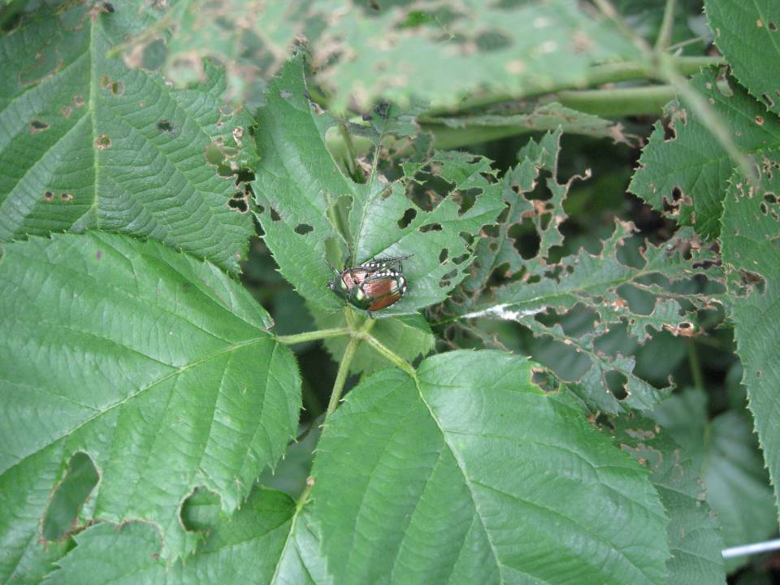

Slide 50
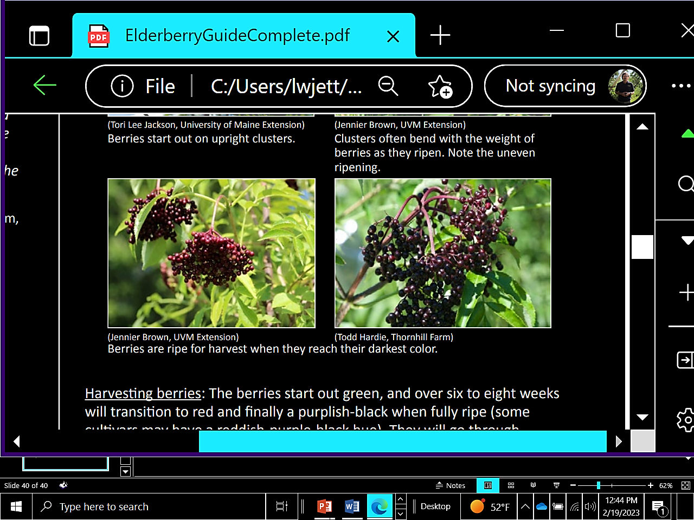
Harvesting Elderberries

Slide 51
Harvesting Elderberries

Slide 52

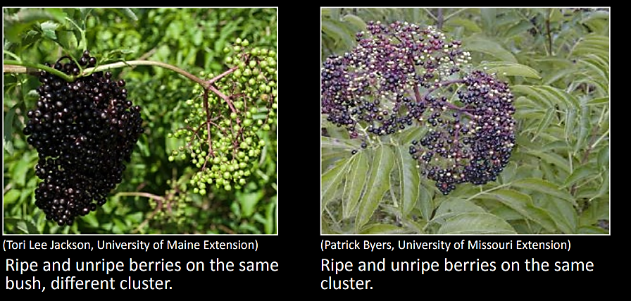
Berries ripen unevenly over a 4-6 week week period.

Slide 54
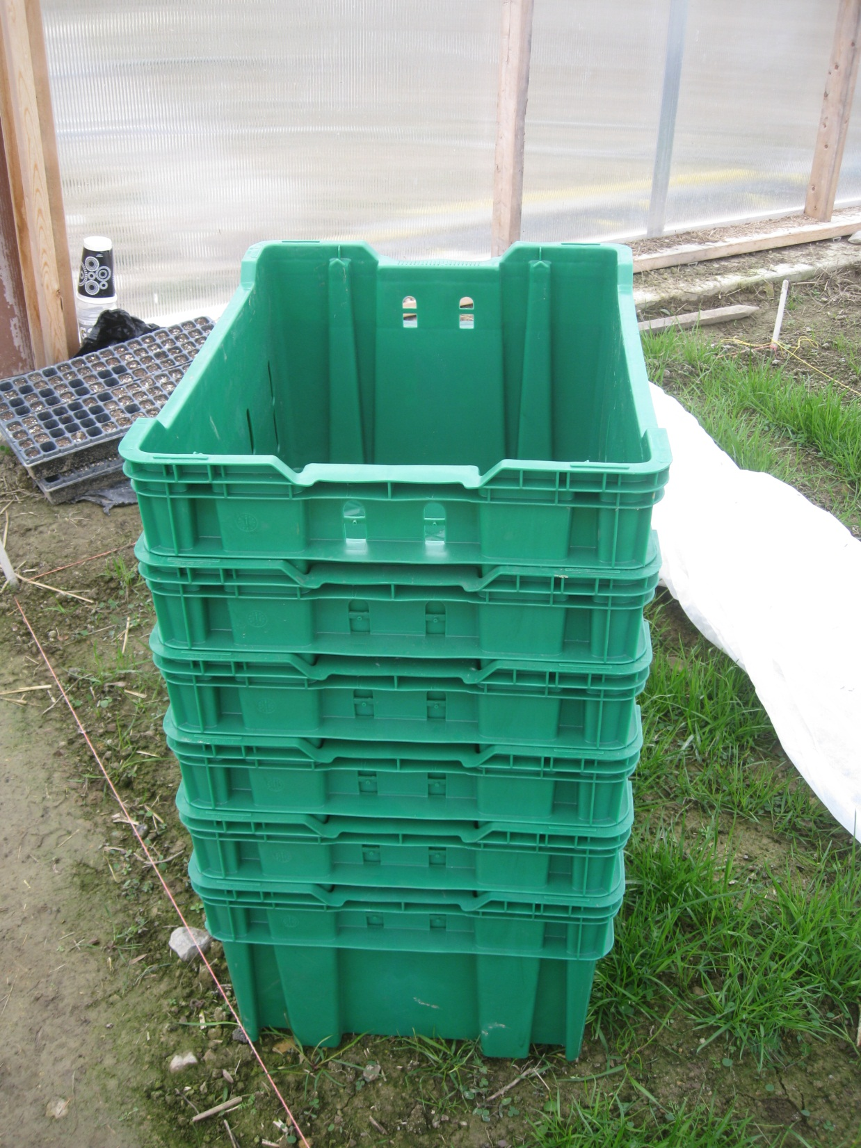
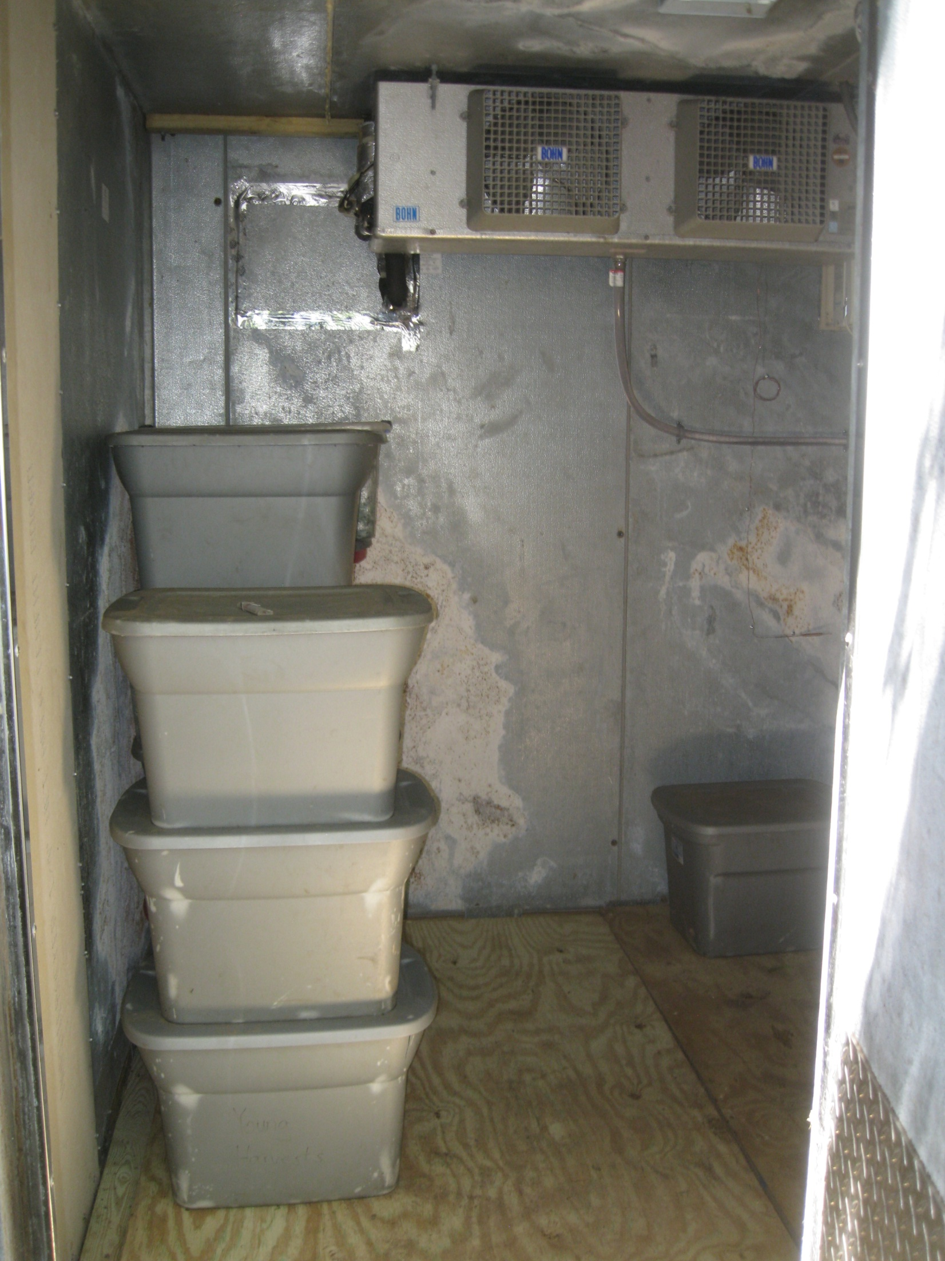
Elderberries should be placed in a cooler 34-36F within 4 hours after harvest!

Slide 55
Conclusions
Elderberries may have tremendous production potential for small farms in WV.

Slide 56
Conclusions
Elderberries may have tremendous production potential for small farms in WV.
Elderberries have potentially strong market potential for sales in and outside of WV.

Slide 57
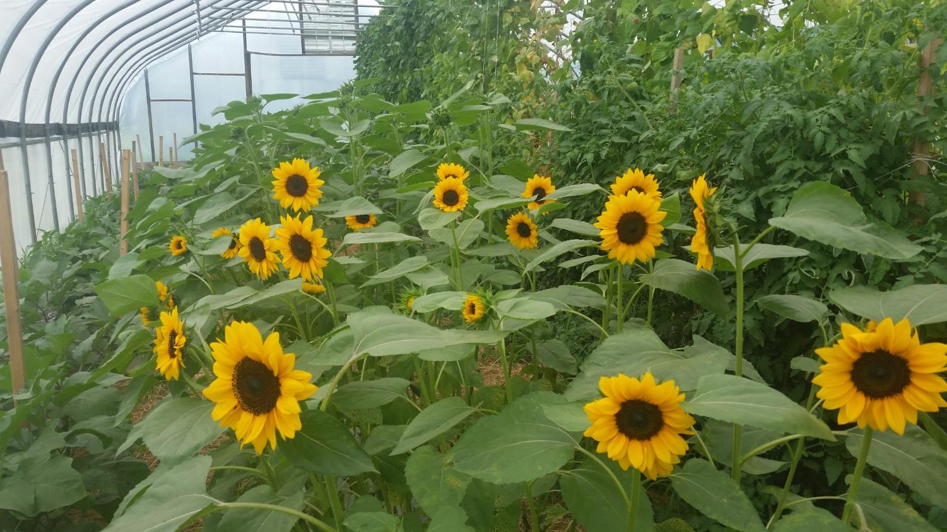
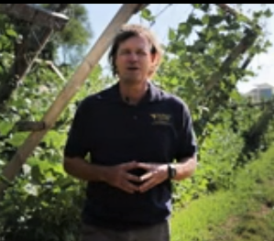

Thanks!
Send any questions or publication requests directly to my email:
Lewis.Jett@mail.WVU.edu

