Slide 1


Ergonomic Evaluation of Scoop Shovels and Pitchforks: Impact on Women in Agriculture
Improving Efficiency and Reducing Physical Strain through Ergonomic Design
Felix Oguche, Jianfeng Zhou, Karen Funkenbusch,
Marcia Shannon
FarmTechForHer

Slide 2
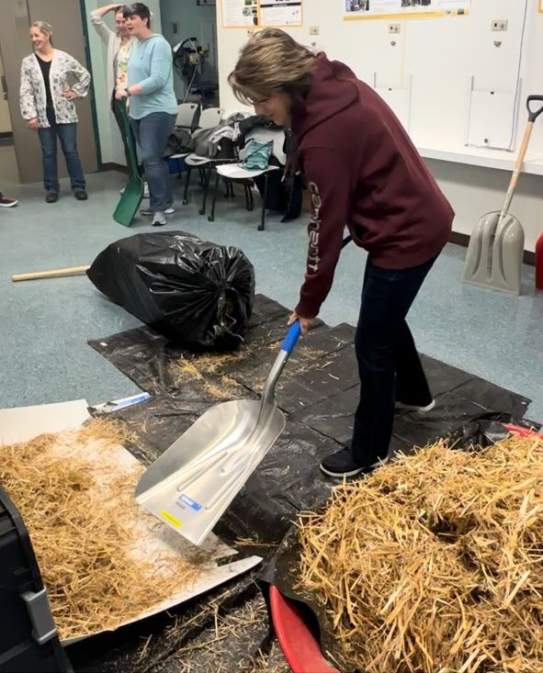
Introduction
Tools used are not designed with their unique needs in mind.
Our study aims to change that.
Every day, women farmers worldwide endure physical strain and fatigue.
1.2 million female producers
36% of U.S. farmers
Notes:
Images of women farmers at work overlaid with the statistics and key figures Every day, women farmers worldwide endure physical strain and fatigue.Tools used are not designed with their unique needs in mind.
Our study aims to change that.Bringing comfort, efficiency, and safety.Empowering the hands that feed us.

Slide 3
Objectives
Evaluate shovel and pitchfork design for women farmers
Focus on specific ergonomic needs of women
Provide recommendations for tool redesign
Reaching, Bending, Stooping
Improved Posture
Awkward, Positions,
Repetition
Understand factors influencing MSD risks and physical strain.
Ensure tools are tailored to the needs of women farmers
Frequency, Strength
Repetition
Assess the impact on body mechanics and physical strain.

Slide 4
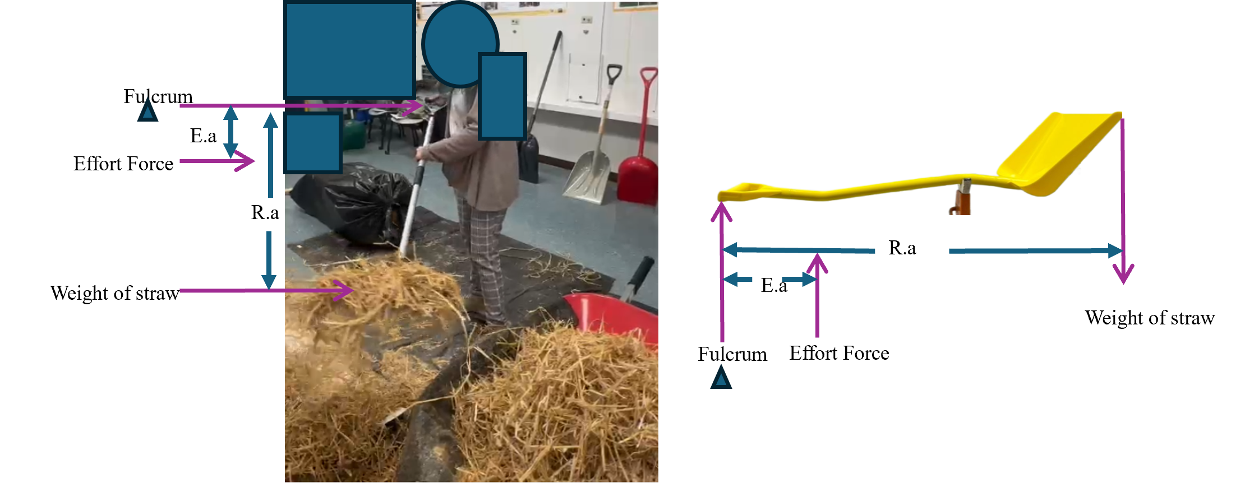
Methodology
24 shovels and 19 pitchforks selected
7 female participants with diverse body types
Tasks: scooping and throwing straws
AI software used for motion capture and force analysis

Slide 5
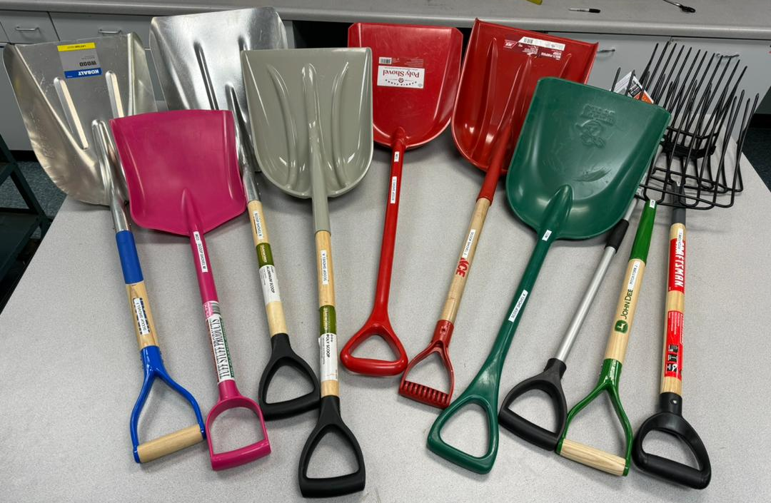
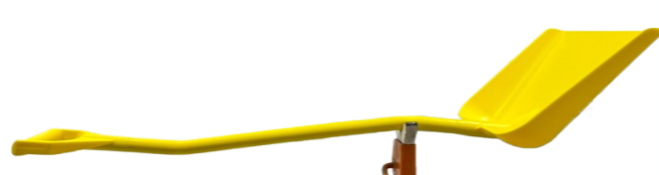
Tool Characteristics
SSB
Handle: Length, diameter, grip
dimensions.
Blade: Length, width, and thickness.
Critical: Lift angle, Handle lift height, and weight, characteristics.
SSF
SSC
SSJ
SSA
SSK
SSM
PFE
PFL
PFJ
Grip
Handle diameter (mm)
Handle lift height (mm)
Tool | Lift angle (degree) | Handle lift height (mm) | Weight (kg)
SSB | 56 | 781 | 1.61
PFA | 49 | 1124 | 2.00
PFE | 39 | 537 | 0.77
Blade thickness (mm)
Blade width (mm)
Blade Height
Lift angle (degree)
Blade length (mm)
Notes:
High-resolution images of different tools with labels showing their ergonomic features.
Close-up images of the handles and blades.

Slide 6
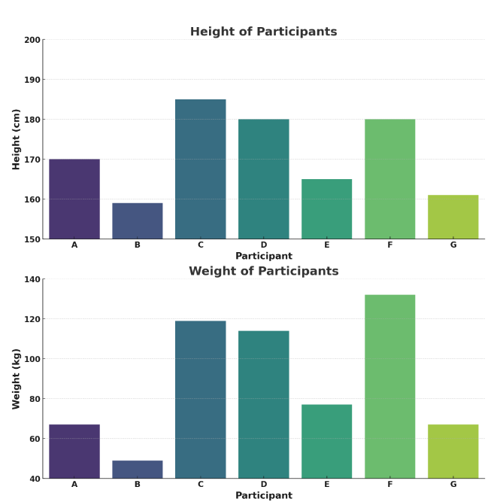
Participant Profile
Demographics: Age, height, weight, body mass index (BMI).
Physical Characteristics: Overview of participants' physical attributes.

Slide 7
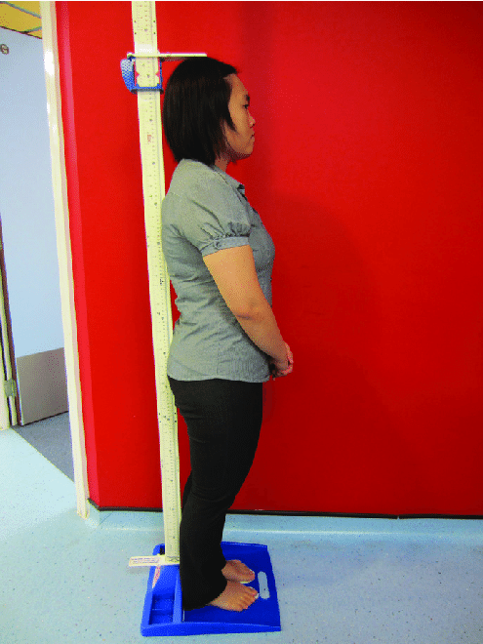
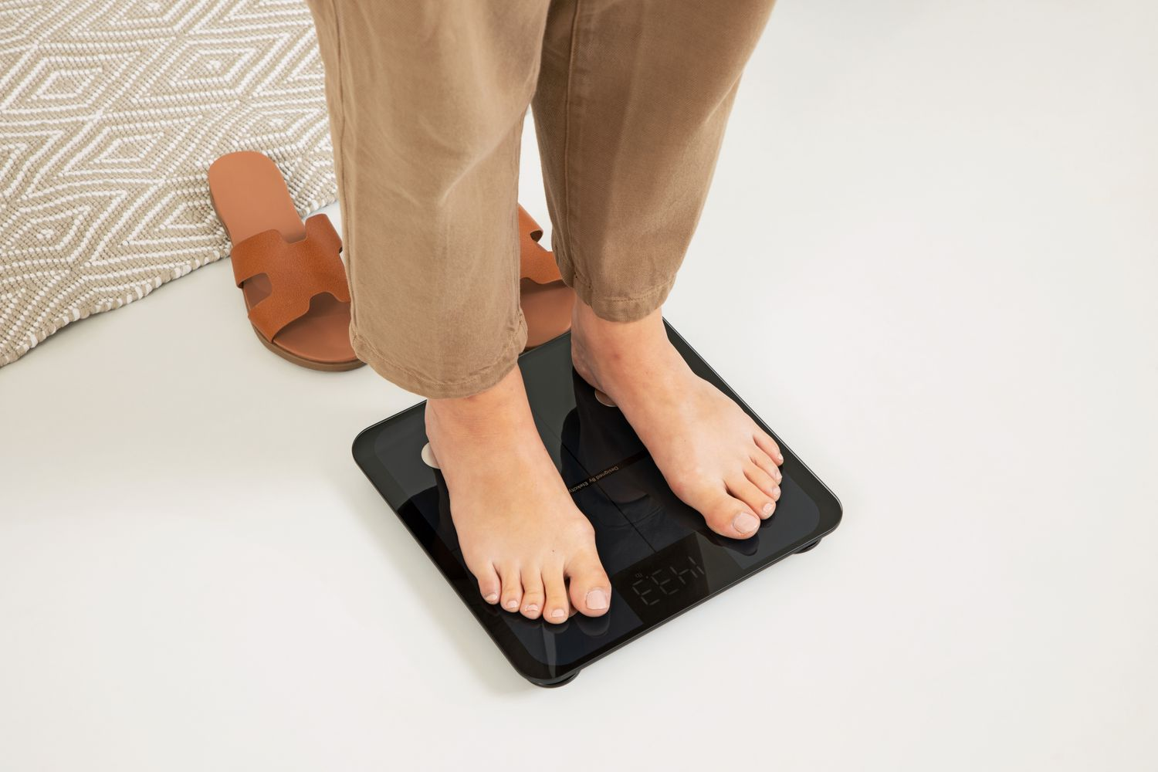
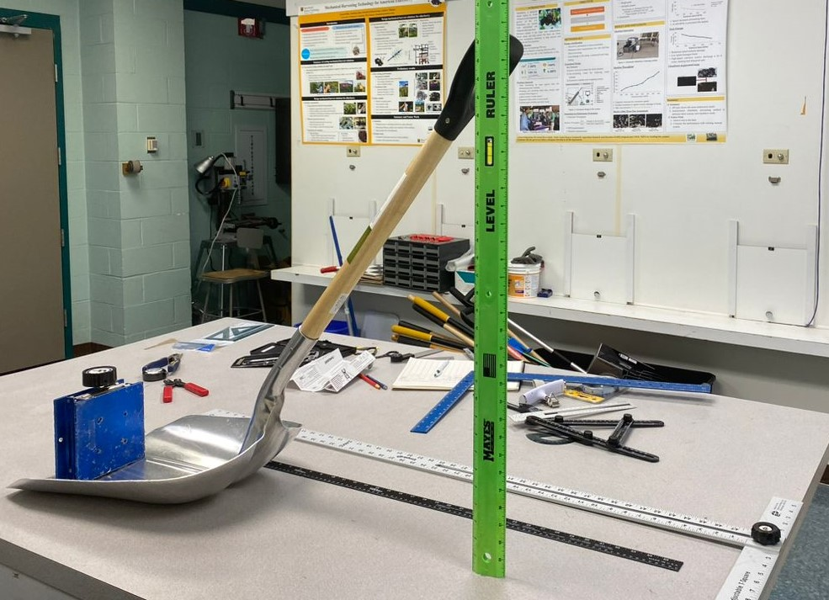
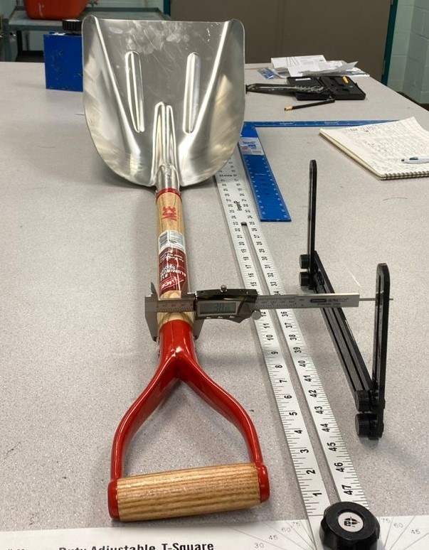

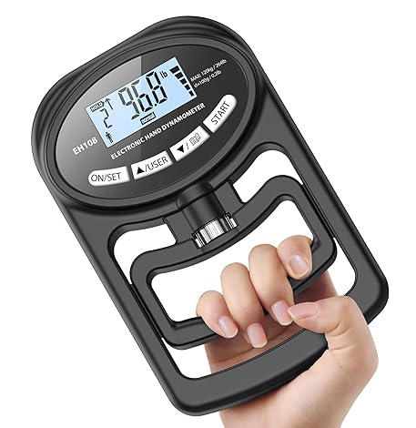
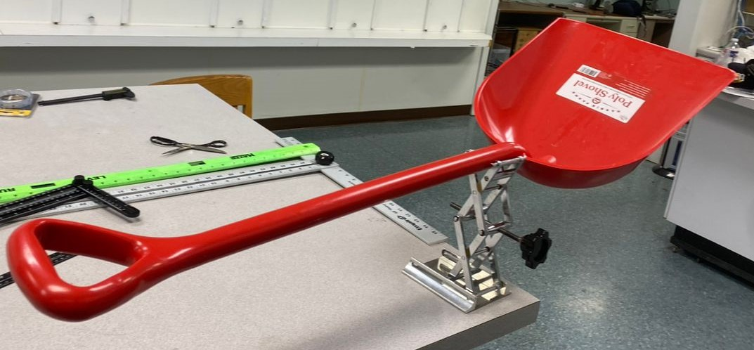

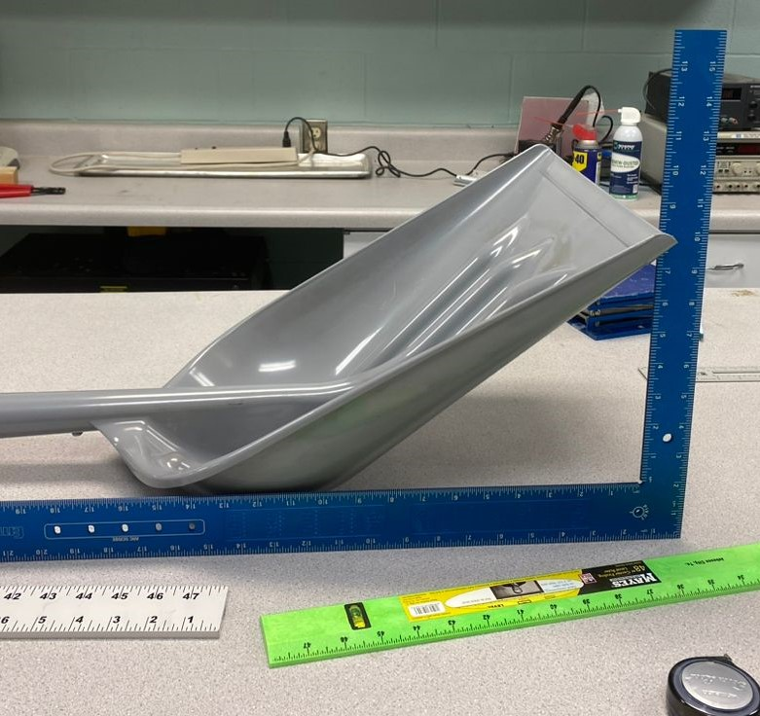
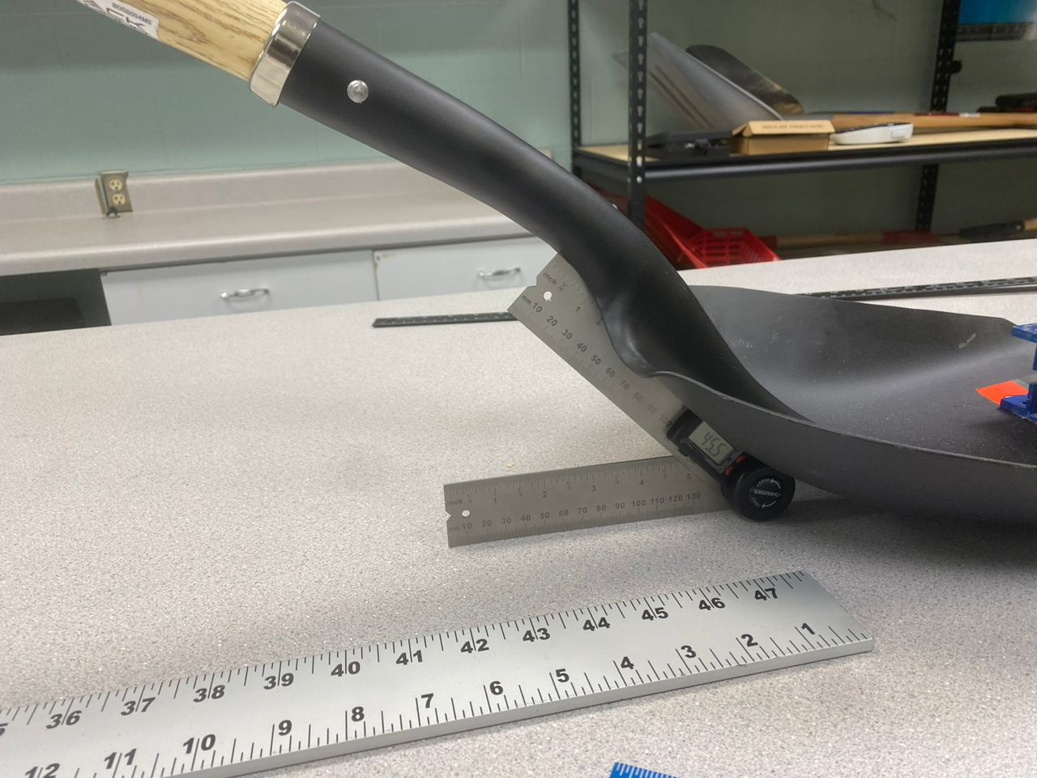
Data Collection
Physiological measurements and ergonomic variables.
Digital goniometers, dynamometers, and stadiometers for standard engineering data collection.
A GoPro camera was used to capture sessions.

Slide 8
Statistical Analysis
Univariate regressions: Joint angles and MSD risk scores.
Multivariate regressions: Combined effects of user characteristics and tool features.
Two-way ANOVA: Used to analyze differences in joint angles and MSD risk scores across different tool conditions.
Tukey Test: Post-hoc analysis to identify specific differences between groups

Slide 9
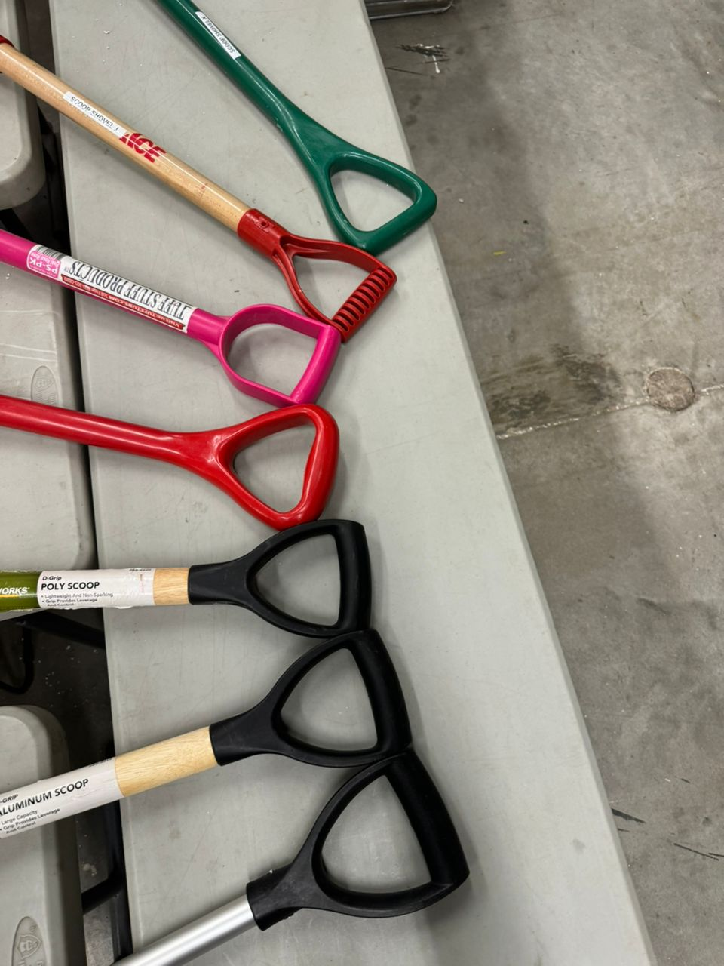
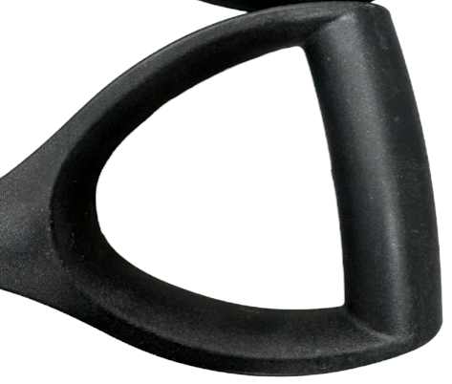
Tool Preferences
Strong preference for pitchforks PFE, PFA, shovels SSA, SSB, and SSC.
D-grip handles aligning with the natural inward curve of the hand.
Images of the preferred D-grip handle.
114(mm)
93.13 (mm)
32(mm)
NIC: Natural Inward Curve
NNIC: Non-Natural Inward Curve
D-grip: the natural inward
curve of the hand.

Slide 10
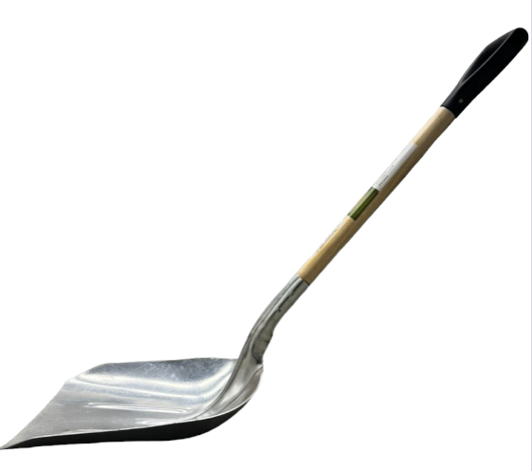
Ergonomic Factors
Significant factors: lift angle, handle lift height, mechanical advantage, tool weight.
The combined model explains 84% of the variance in user preferences.
SSB
56⁰
Notes:
Bar graph comparing the significance of different ergonomic factors.
Highlighted images of tools with annotations pointing out ergonomic features.

Slide 11
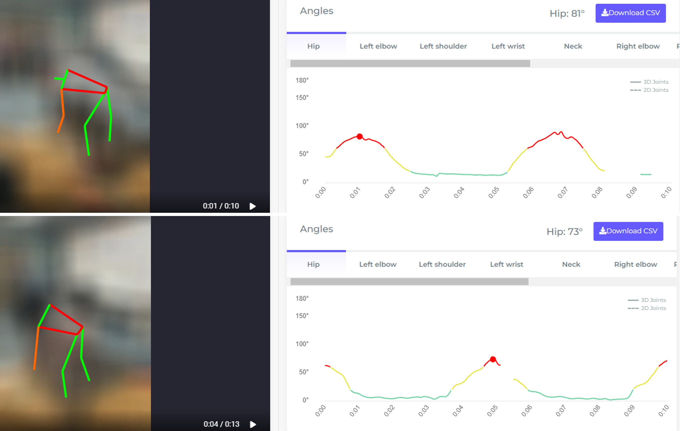
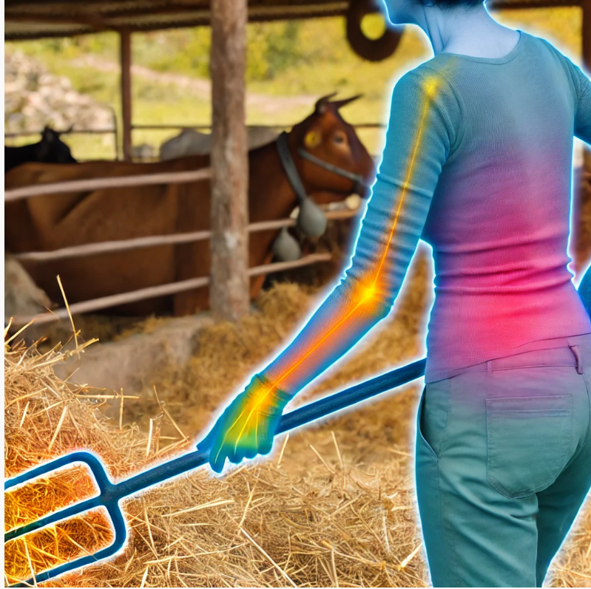
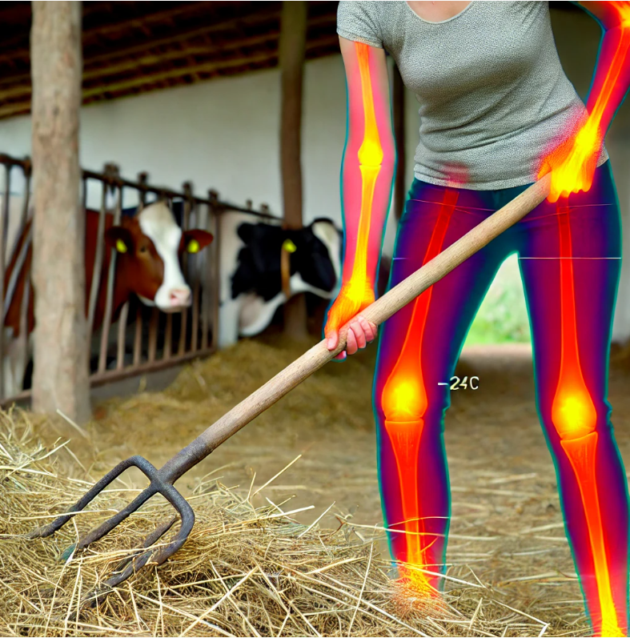
Physical Strain Analysis
MSD risk scores for Favorite shovel/Pitchfork | p-value | MSD Risk Score (%)
REBA..MSD.RISK | 0.0833 | 8.33
RULA..MSD.RISK | 0.0171 | 17.1
Impact of tool design on upper body strain, particularly arms and shoulders.

Slide 12


Predictive Models
Subject B PFE
Subject C PFE
Lift Angle:
35–45-degree lift angle reduced lower back strain by 15% (p < 0.05).
Lower REBA scores, indicating decreased MSD risk.
Handle Height:
Adjustable handles decreased shoulder and upper back strain by 20% (p < 0.05).
Reduced wrist and elbow effort angles (p < 0.01).
Auxiliary Handles:
Reduced heart rate by 6 bpm (p < 0.05).
Lower energy expenditure by 0.69 KJ/kg (p < 0.01).
Increased elbow strain, highlights need for balanced design.
Subject B SSA
Subject C SSA
Notes:
Insights from statistical models on ergonomic outcomes.
Emphasis on lift angle, handle lift height, and mechanical advantage.

Slide 13
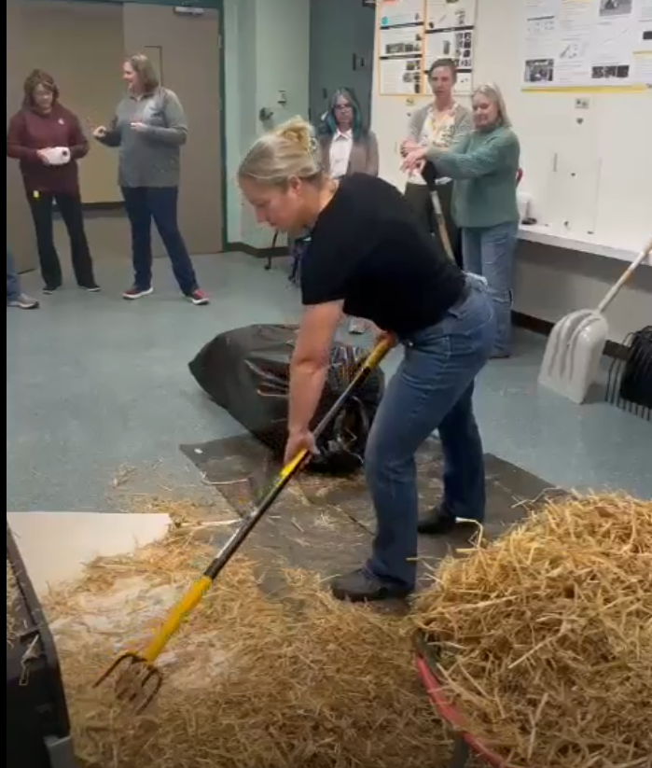
Conclusion
Key Takeaways:
Ergonomic Design: Reduces physical strain and improves efficiency.
Body Mechanics: Optimal lift angles and handle heights minimize strain.
Critical Factors: Lift angle, handle height, and mechanical advantage.
Continuous Improvement: Essential for enhancing ergonomic benefits.
Adjustable Tool
Improved Posture
Reduce Strain
Increased Efficiency
Notes:
Key Takeaways:
Ergonomic Design: Reduces physical strain and improves efficiency.
Body Mechanics: Optimal lift angles and handle heights minimize strain.
User Preferences: Preference for ergonomic D-grip handles and adjustable tools.
Critical Factors: Lift angle, handle height, and mechanical advantage.
Continuous Improvement: Essential for enhancing ergonomic benefits.

Slide 14
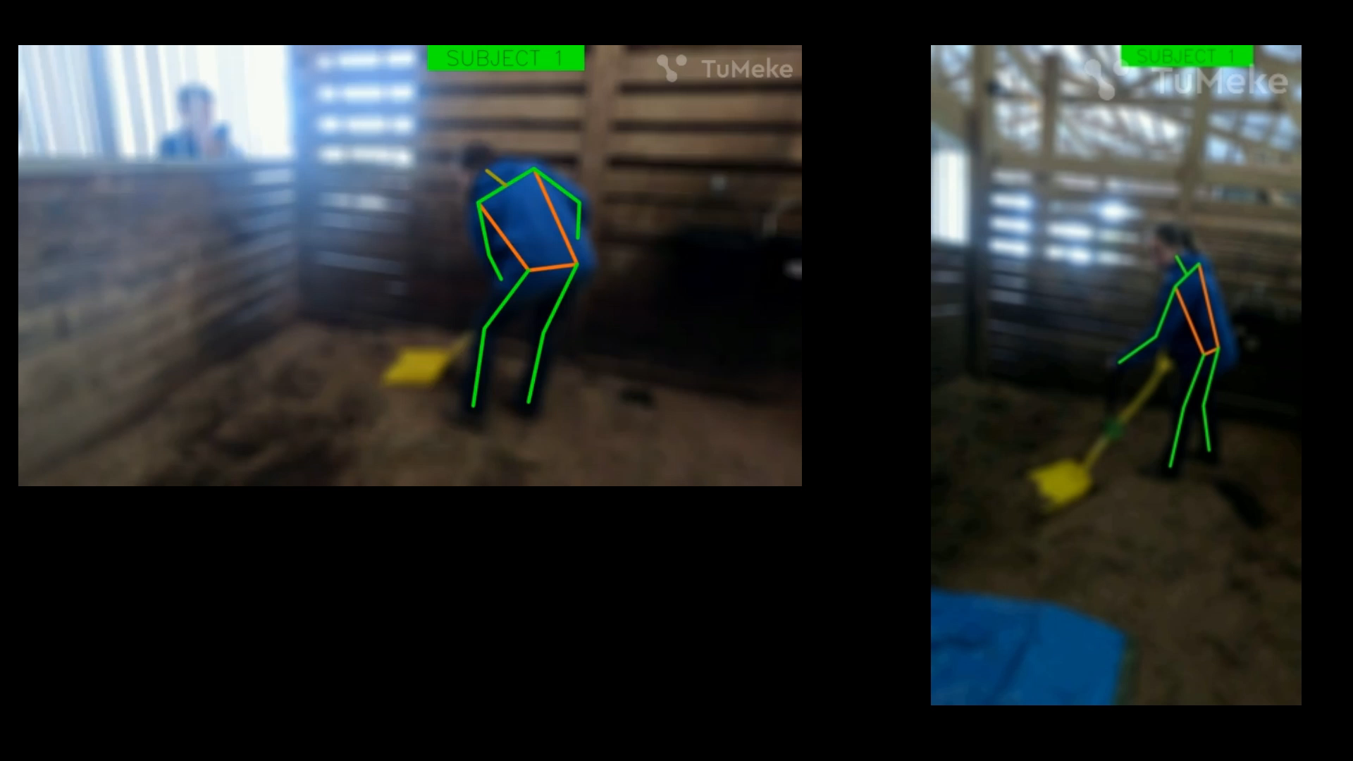
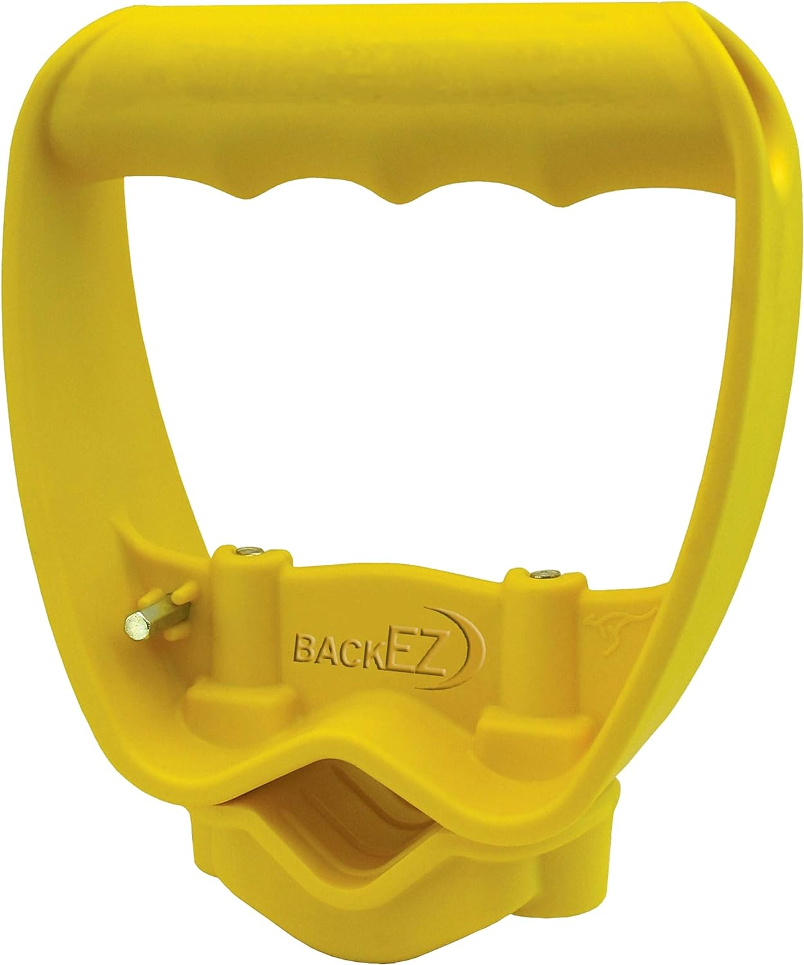
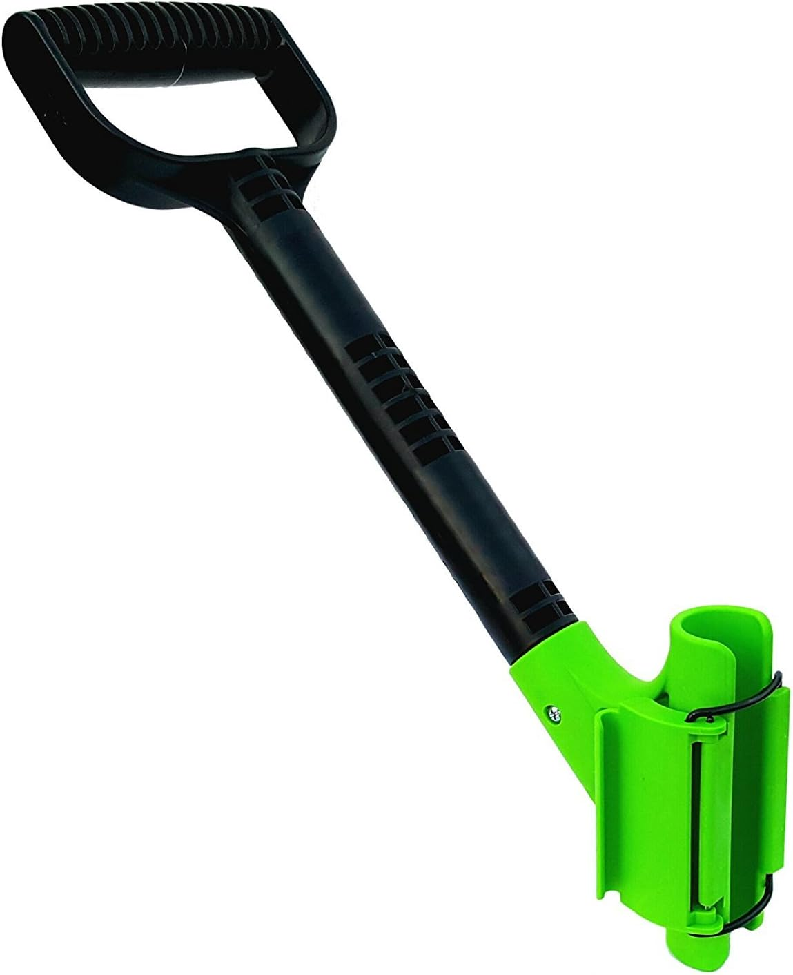
Recommendations
AI-Enhanced Posture Analysis
Design tools with lift angles between 27-49 degrees and handle heights 517-984 mm.
Ensure tools are adjustable and customizable for individual needs.

Slide 15





Acknowledgments
Special thanks to the North Central Sustainable Agriculture Research & Education (SARE) for their generous support and funding.
Appreciate the National Institute for Occupational Safety and Health (NIOSH) and the United States Department of Agriculture (USDA) for their support and guidance.
Jianfeng Zhou, Karen Funkenbusch, and Marcia Shannon, University of Missouri for their mentorship and guidance.
Aaron Yoder and Central States Center for Agricultural Safety and Health at the University of Nebraska Medical Center for their support.
Thank you to the women at the University of Missouri who participated in this research study
Grateful to my colleagues for their feedback and assistance.
Jianfeng Zhou
Karen Funkenbusch
Marcia Shannon
Notes:
Visual Aid: Summary infographic highlighting key findings and recommendations. Statement: "Future research will refine ergonomic designs for better health outcomes."
Imagine starting your day with the tools designed to ease your workload, but ending it with intense back pain and sore wrists. This is the daily reality for many women farmers using conventional tools. Our study aims to change that."

