Slide 1


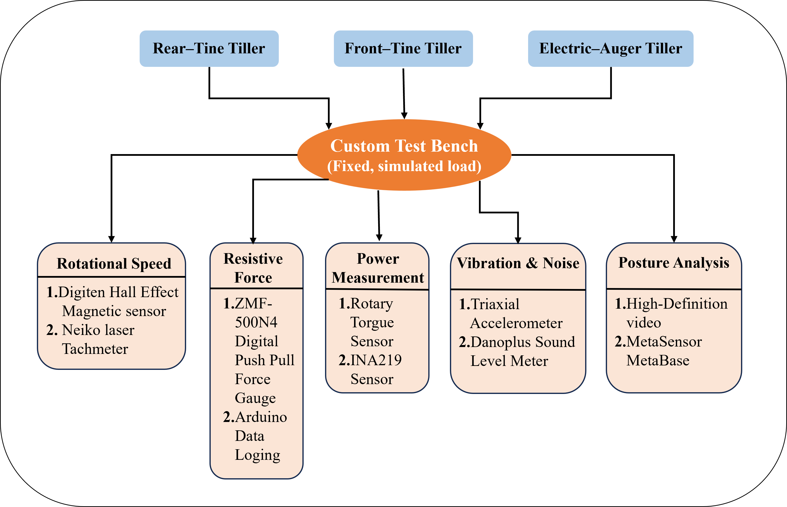
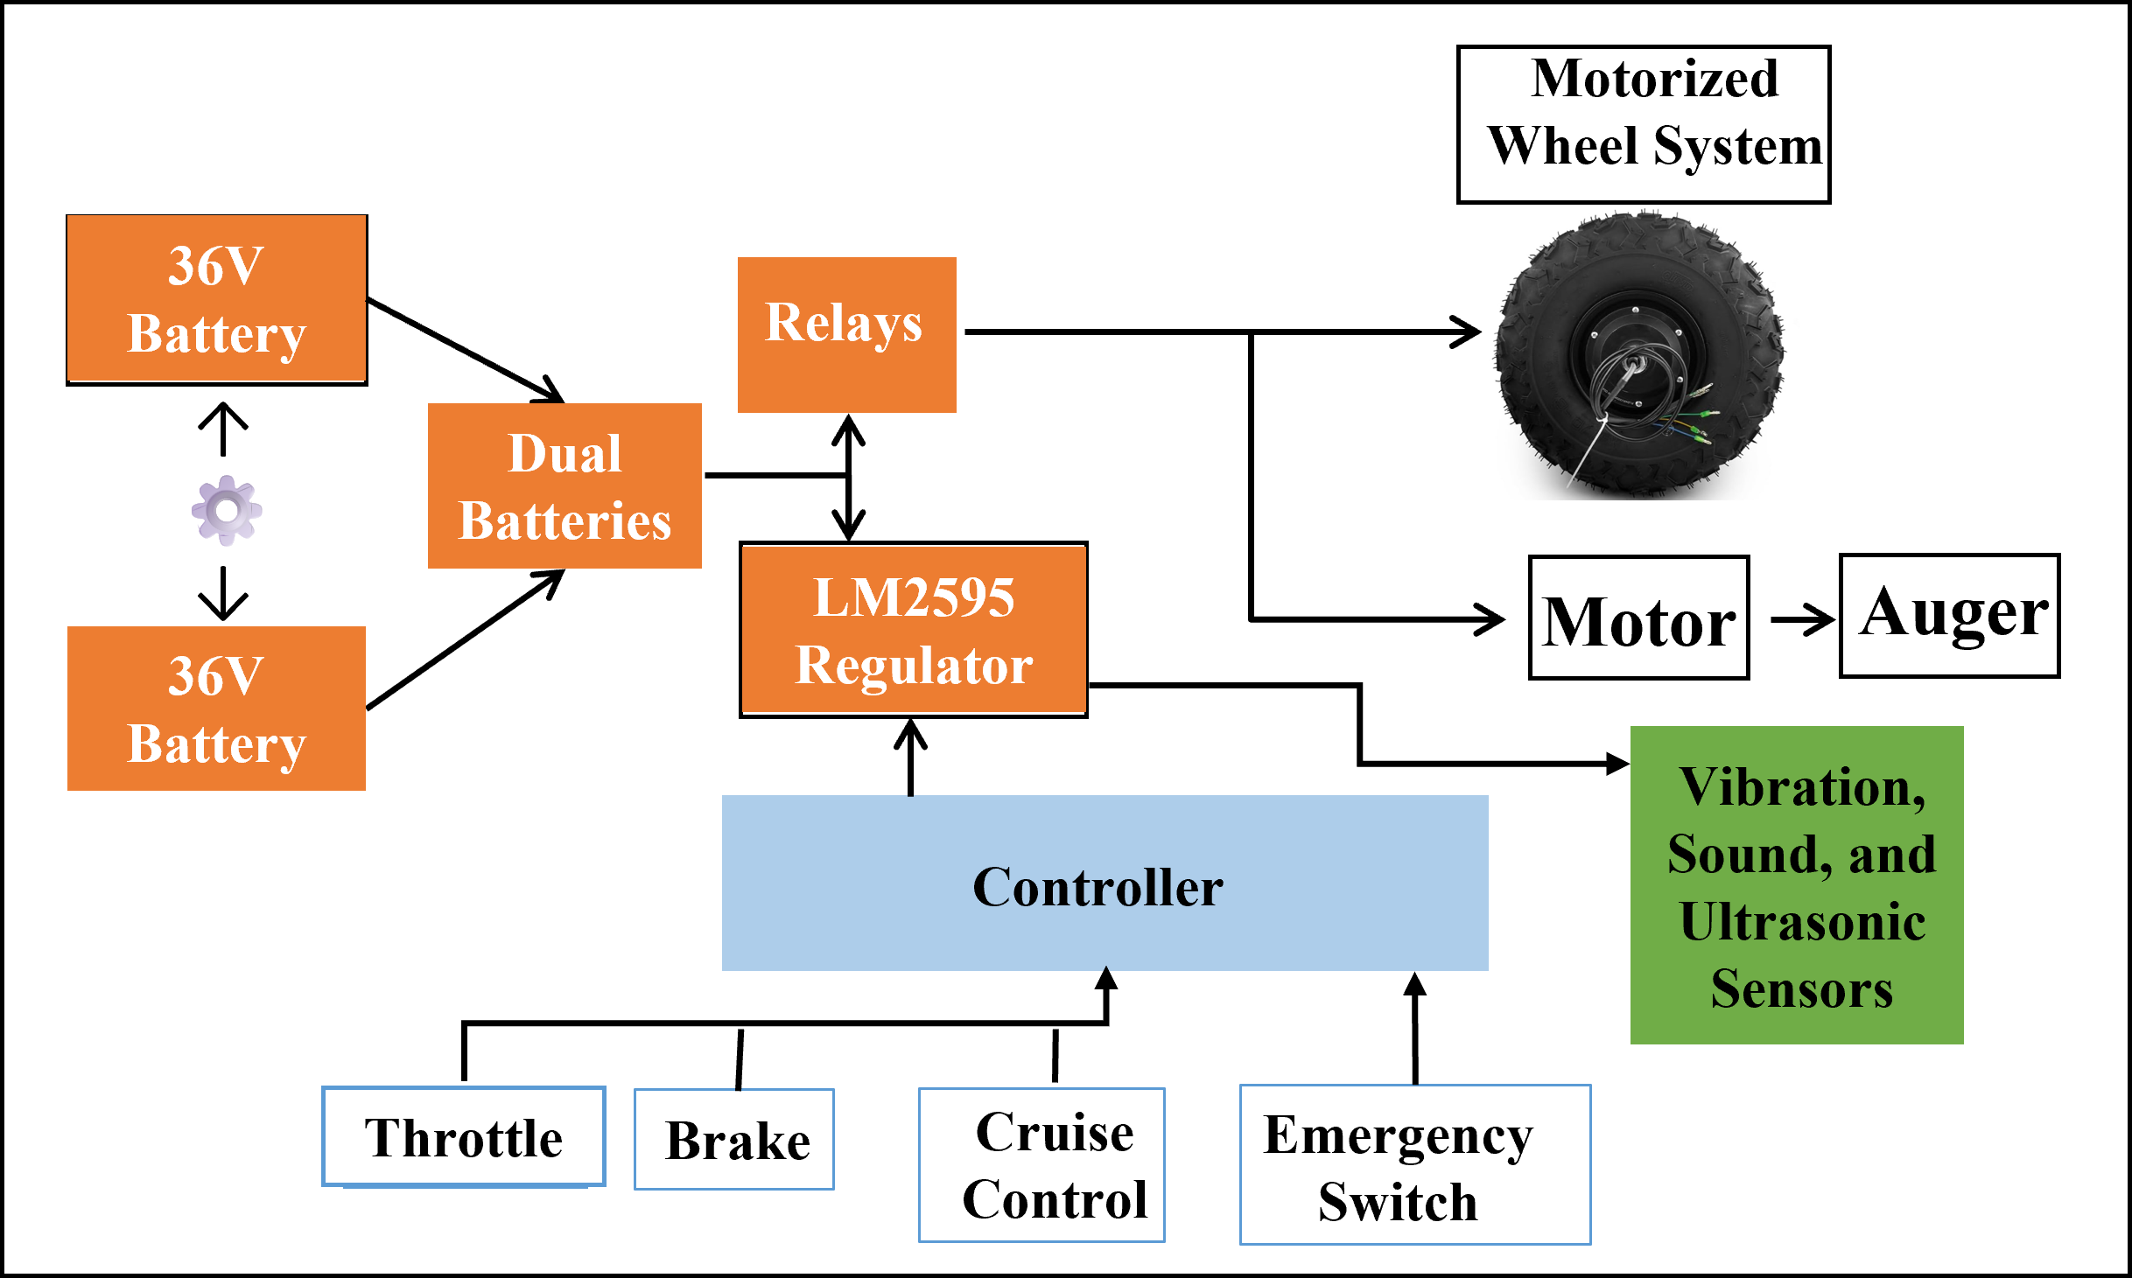
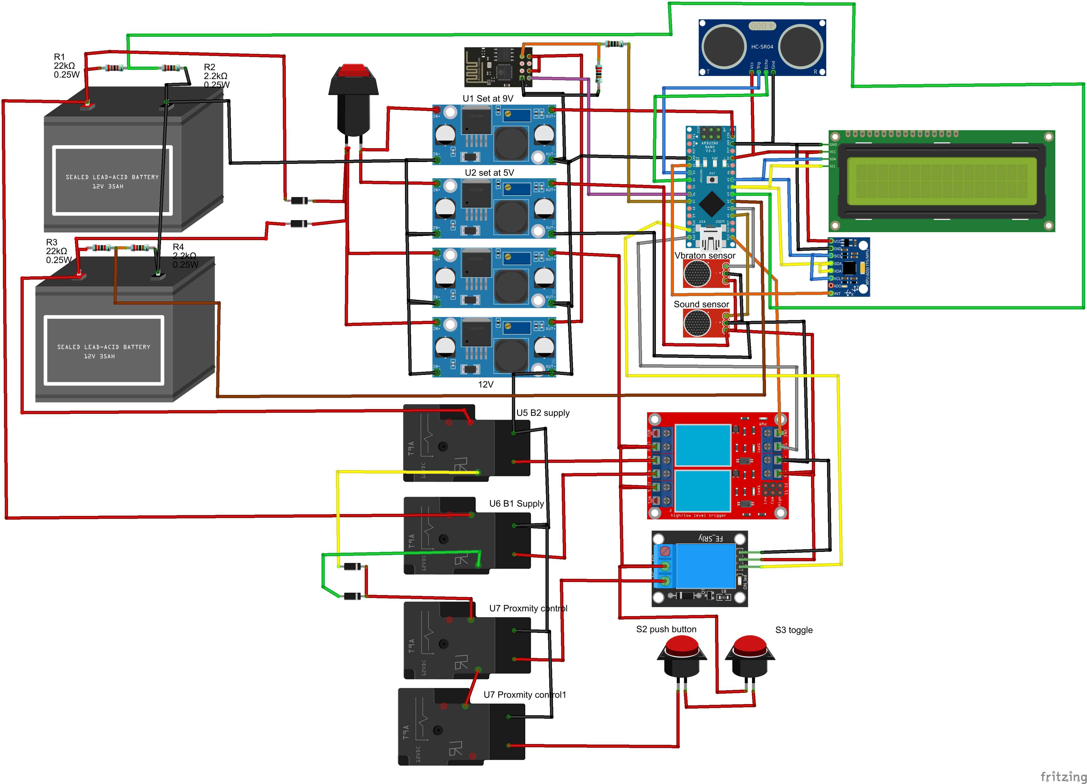
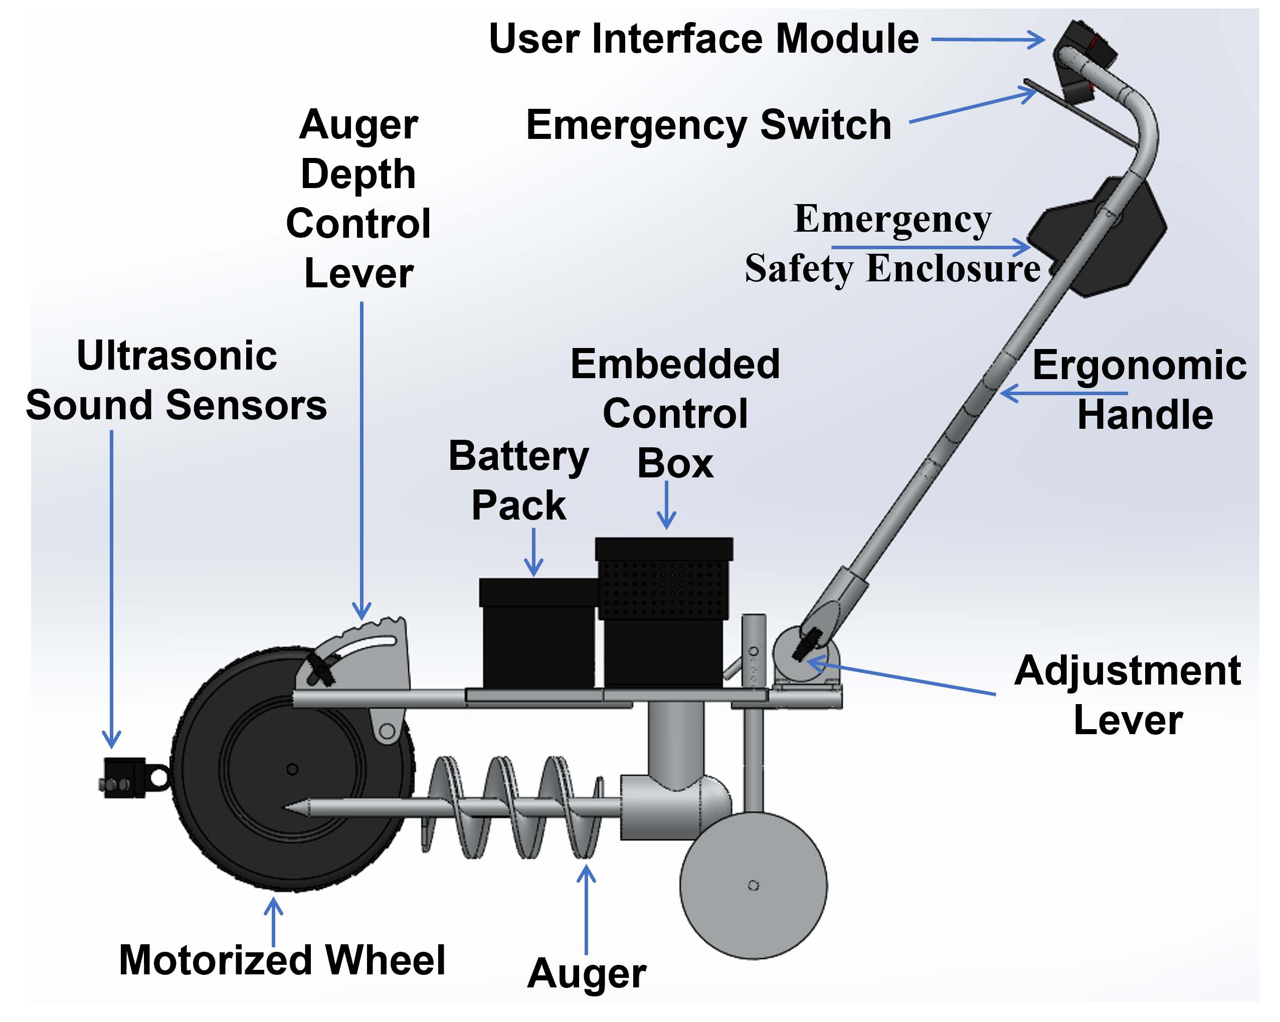
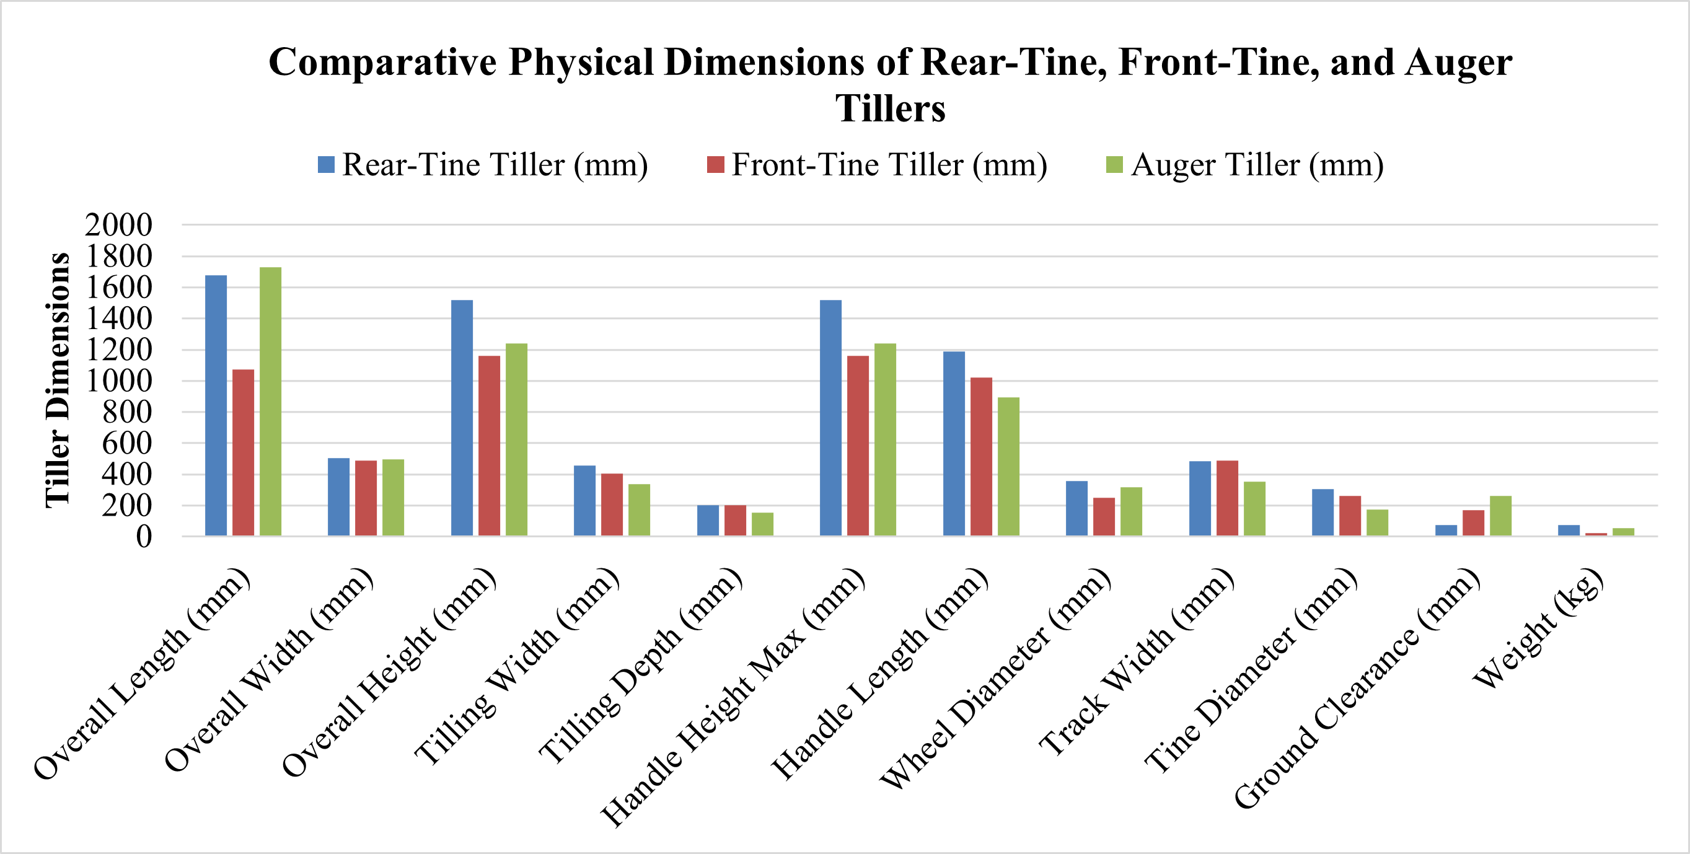
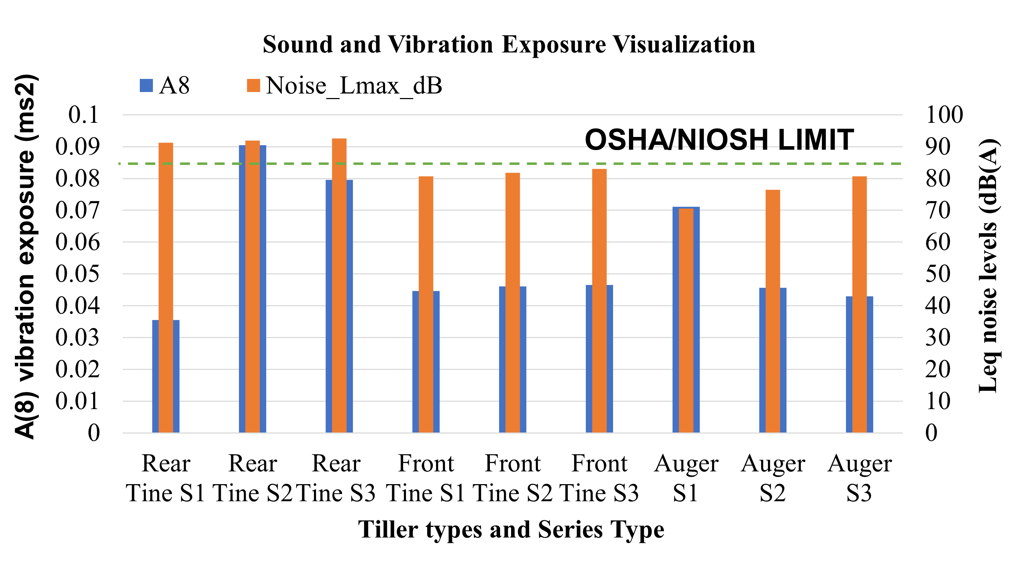
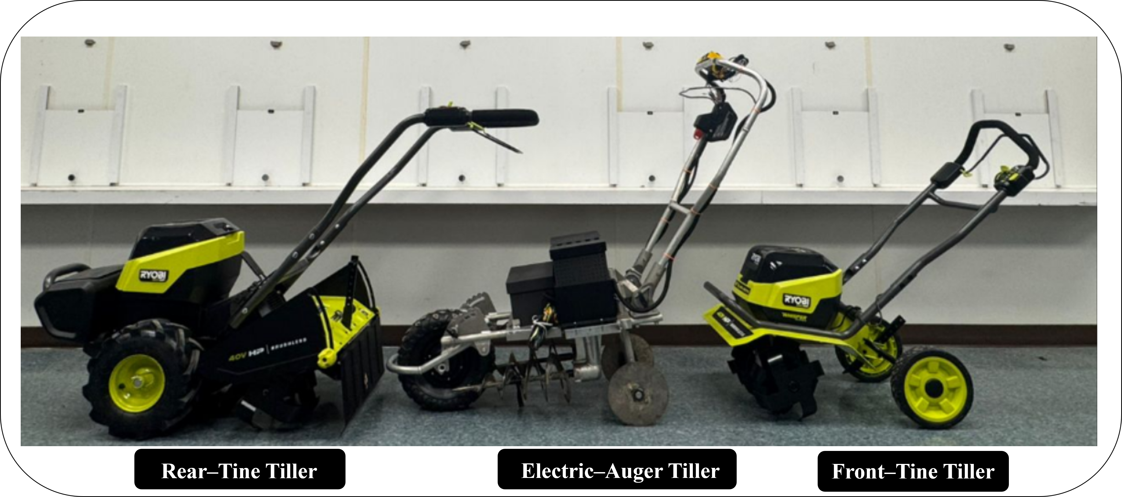
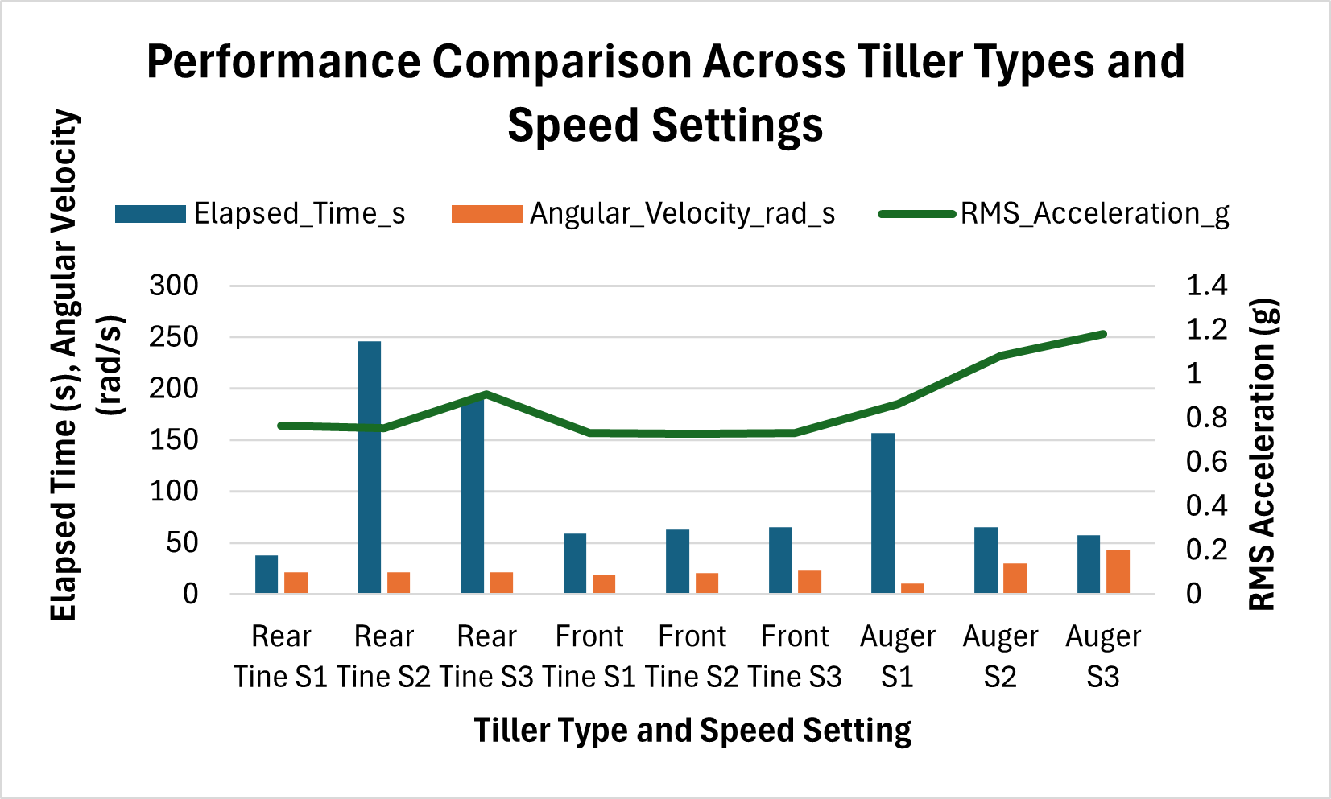
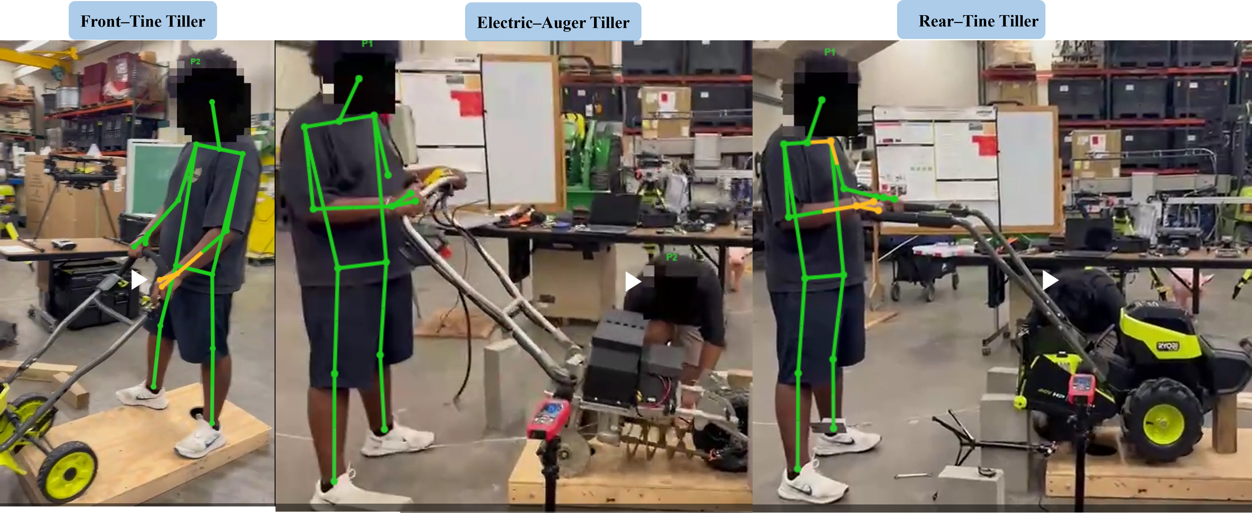
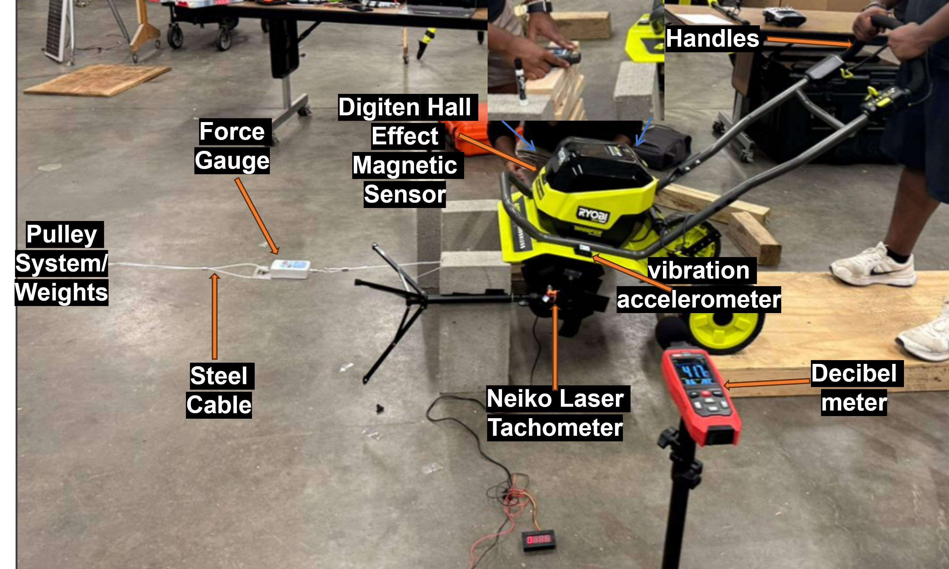
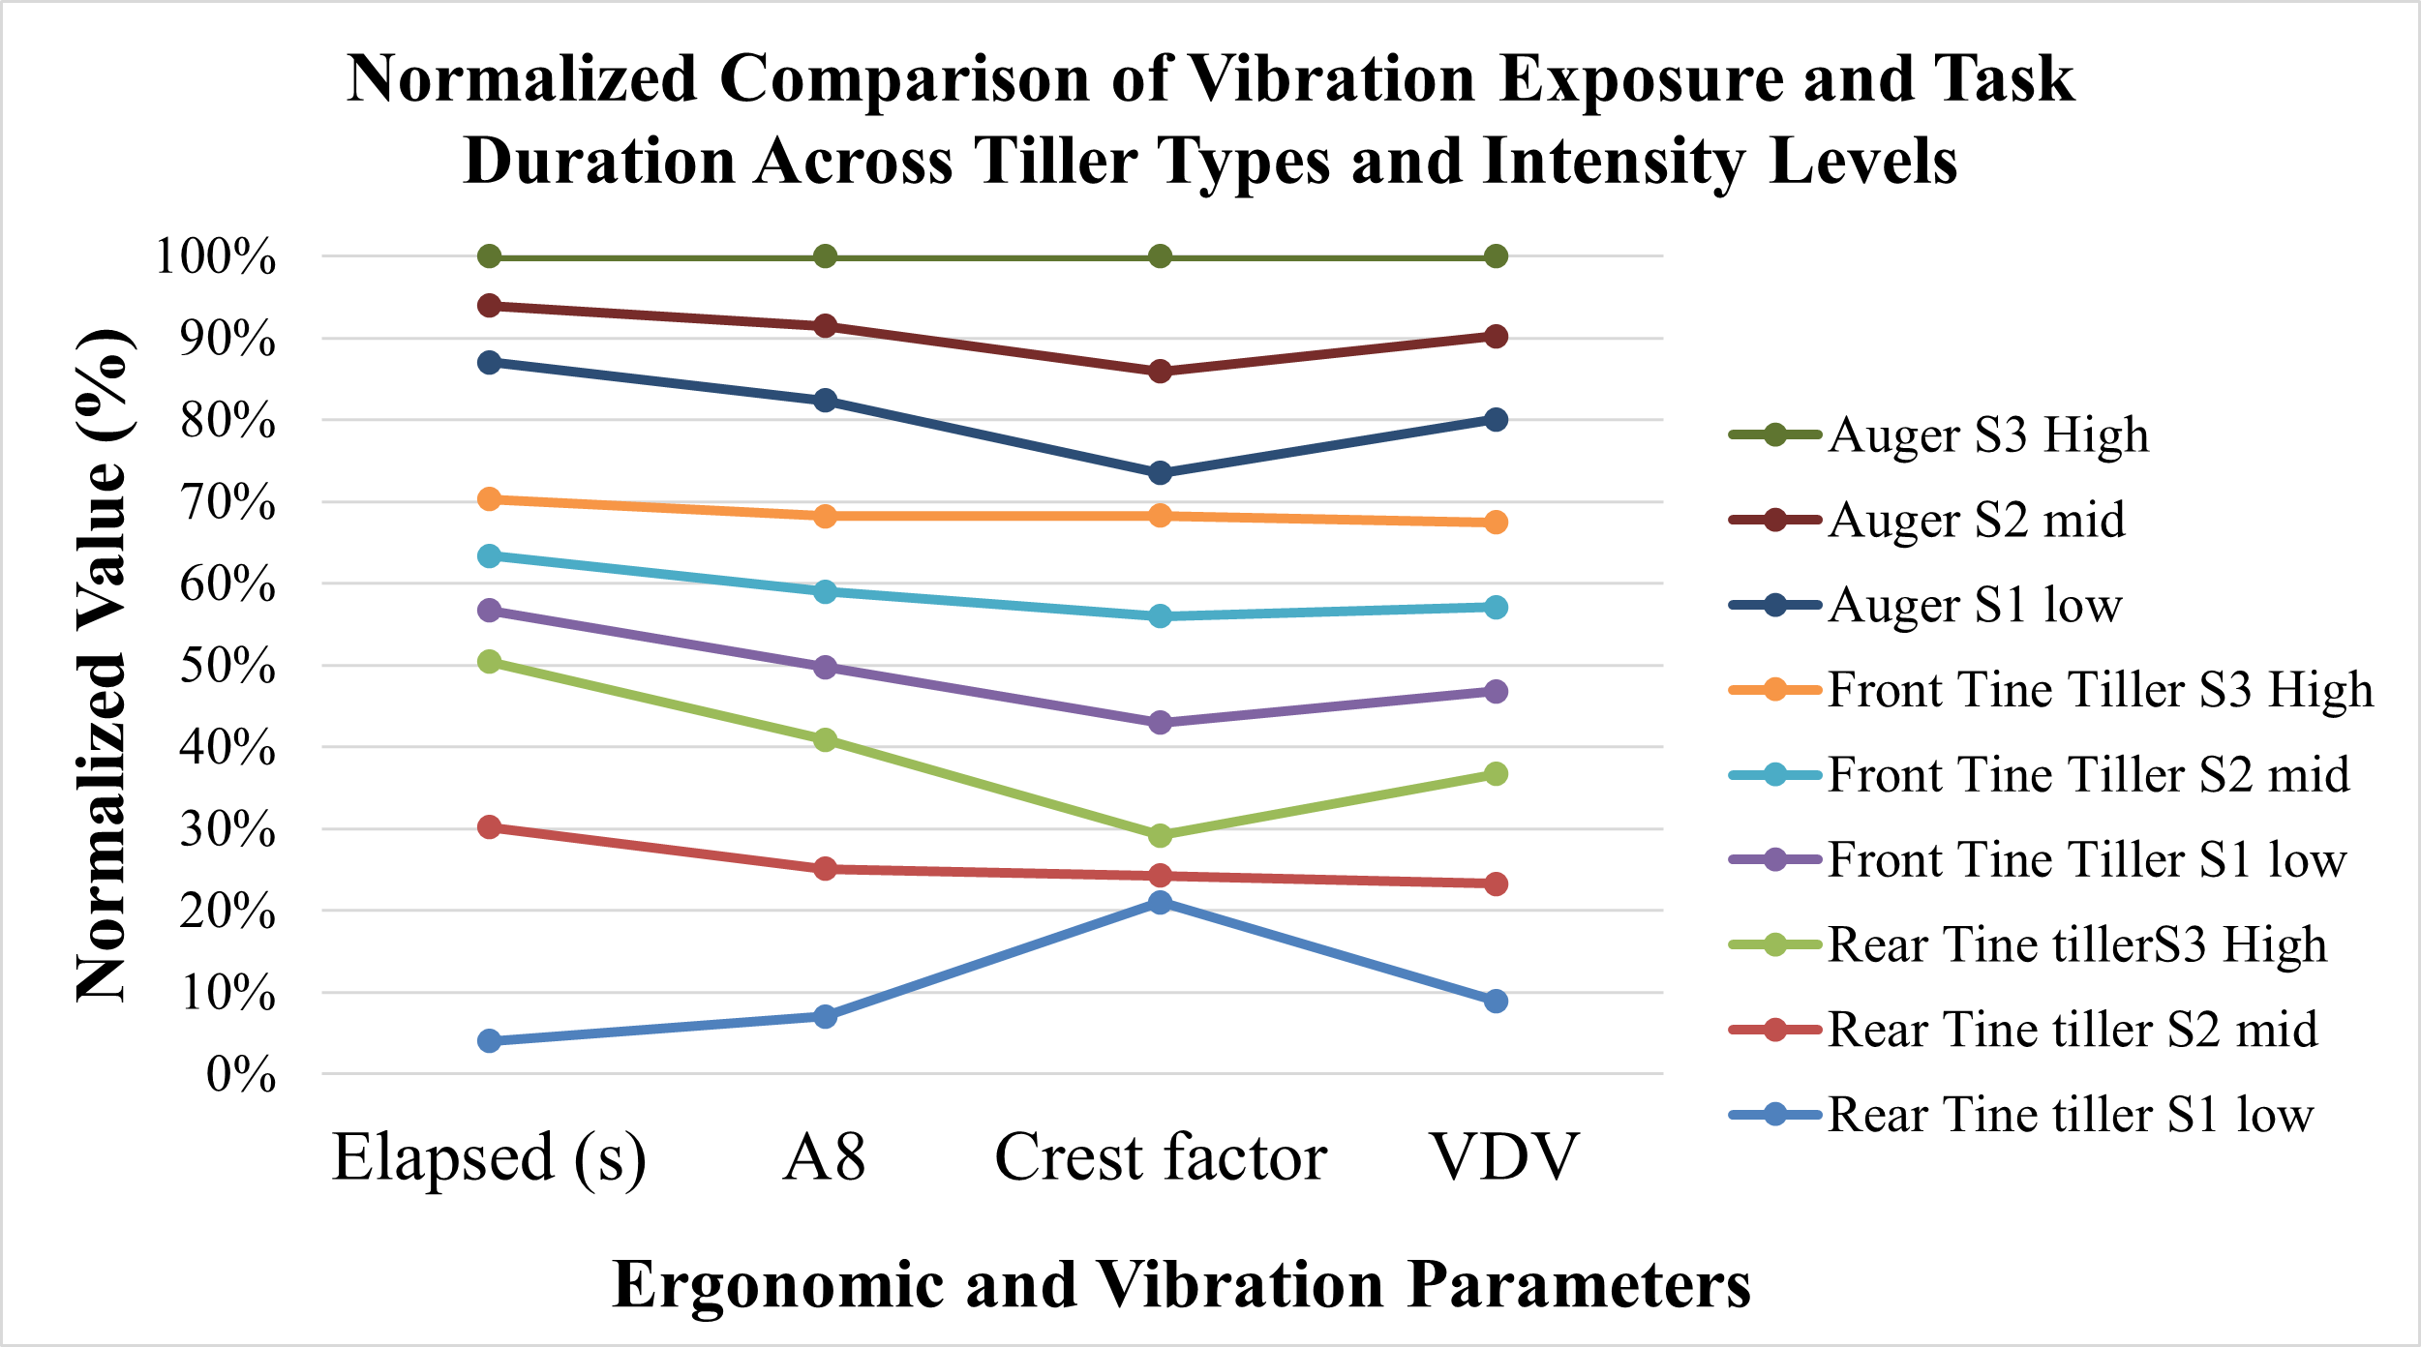

Ergonomic and Performance Optimization of a Smart Electric Auger Tiller: Comparative Evaluation with Rear- and Front-Tine Models
Felix Michael Oguche, Jianfeng Zhou, Karen Funkenbusch, Marcia C. Shannon
University of Missouri, Columbia, MO (contact: fofdt@missouri.edu)
Introduction
Materials and Methods (cont.)
Smallholder farmers, especially women, experience high rates of musculoskeletal disorders (MSDs) from poorly designed tillers.
Traditional tillers often ignore ergonomics, leading to injury and inefficiency.
Our project addresses this gap by developing and testing a smart auger-based electric tiller.
The design integrates ergonomic optimization, mechanical evaluation, and smart control systems.
Figure 5. Wiring diagram of the smart control system for the Electric–Auger Tiller.
Figure 4. Power and control system layout of the smart auger tiller.
Objectives
Design and test an ergonomic electric tiller tailored to underserved farmers.
Evaluate vibration, force, and posture metrics across rear-tine, front-tine, and auger tillers.
Reduce operator strain while maintaining or improving tilling performance.
Figure 3. Block Diagram of Experimental Setup
Results
Figure 8. Sound level comparison across tillers. Auger tiller remains below OSHA noise limits.
Materials and Methods
Tiller Types Evaluated:
Rear-Tine Tiller
Front-Tine Tiller
Smart Electric Auger Tiller
(prototype)
Figure 7. Dimensional comparison of rear-tine, front-tine, and auger tillers.
Discussion
Figure 6. Smart Electric Auger Tiller System Design.
Ergonomic handle design and motor-driven wheels lowered biomechanical strain.
Auger’s vertical digging motion outperformed horizontal tines on soft soil.
Real-time monitoring enabled by IoT sensors improved safety.
Instrumentation:
Load cells to measure peak draft force
Triaxial vibration meters for HAVS analysis
High-speed camera and AI-pose software for joint angle tracking
Arduino/ESP32-based current and voltage sensors
Noise level meter for auditory hazard assessment
Angular Velocity @ S3:
Rear-Tine: 31.85 rad/s
Front-Tine: 36.26 rad/s
Smart Auger: 43.46 rad/s
Draft Force & Vibration:
Draft Force: Auger (18.6 N) ≈ Rear-Tine (18.0 N) > Front-Tine (7.5 N)
Vibration A(8): Rear (0.068) > Front (0.059) > Auger (0.053 m/s² )
Operator Noise Levels (dB A):
Rear-Tine: 92.6 (Above OSHA)
Front-Tine: 86.2
Smart Auger: 80.4 (Safe & compliant)
Figure 1. The three tiller types evaluate
Figure 9. Comparison of task time, angular speed, and vibration across tiller types. Auger tiller shows highest speed and lowest vibration.
Testing Protocol:
Tasks: Tilling simulated (modeled through torque/force test bench)
Data collected: Noise exposure, vibration (A8, VDV), draft force, and shaft speed.
Figure 11. Pose analysis of operator using Tillers
Conclusion
The Smart Electric Auger Tiller is a viable tool for improving farm safety and productivity.
Ergonomic and smart design features reduce physical burden for smallholder farmers.
Figure 10. Normalized comparison of vibration exposure and task duration across different tiller types and intensity levels (S1–S3).
Figure 2. Experimental Setup
Reference
This material is based upon work that is supported by the National Institute of Food and Agriculture, U.S. Department of Agriculture, under agreement number 2021-38640-34714 through the North Central Region SARE program under project number LNC21-458.
McPhee, B., & Ferguson, D. (1992). Ergonomic design for people at work: Volume II. New York, NY: John Wiley & Sons.
Khidiya, M., & Bhardwaj, A. (2012). An ergonomic approach to design hand tool for agricultural production. Work, 0320-1335.

