Slide 1


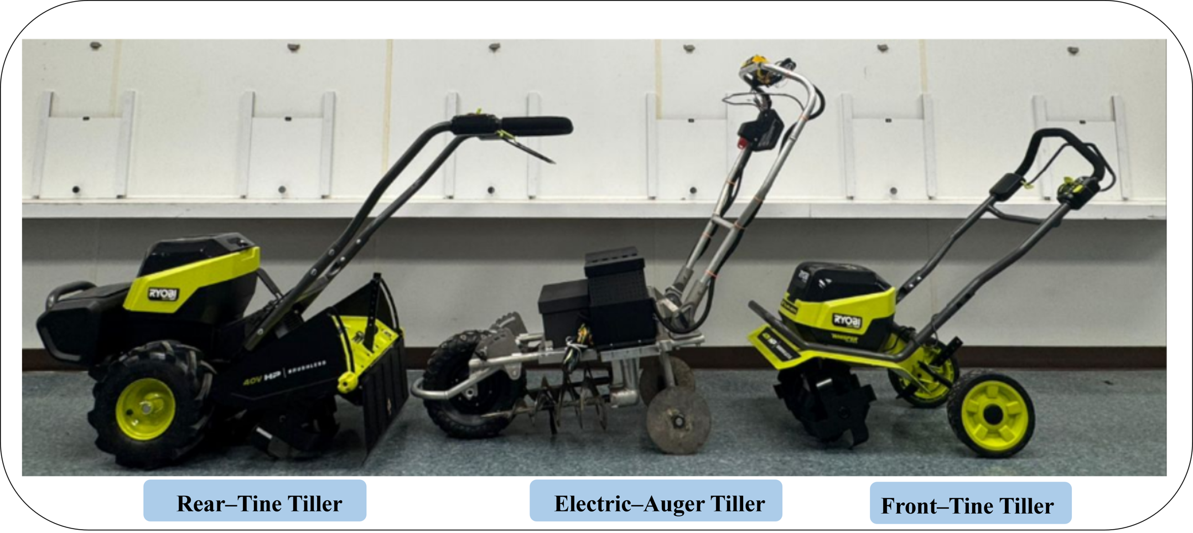
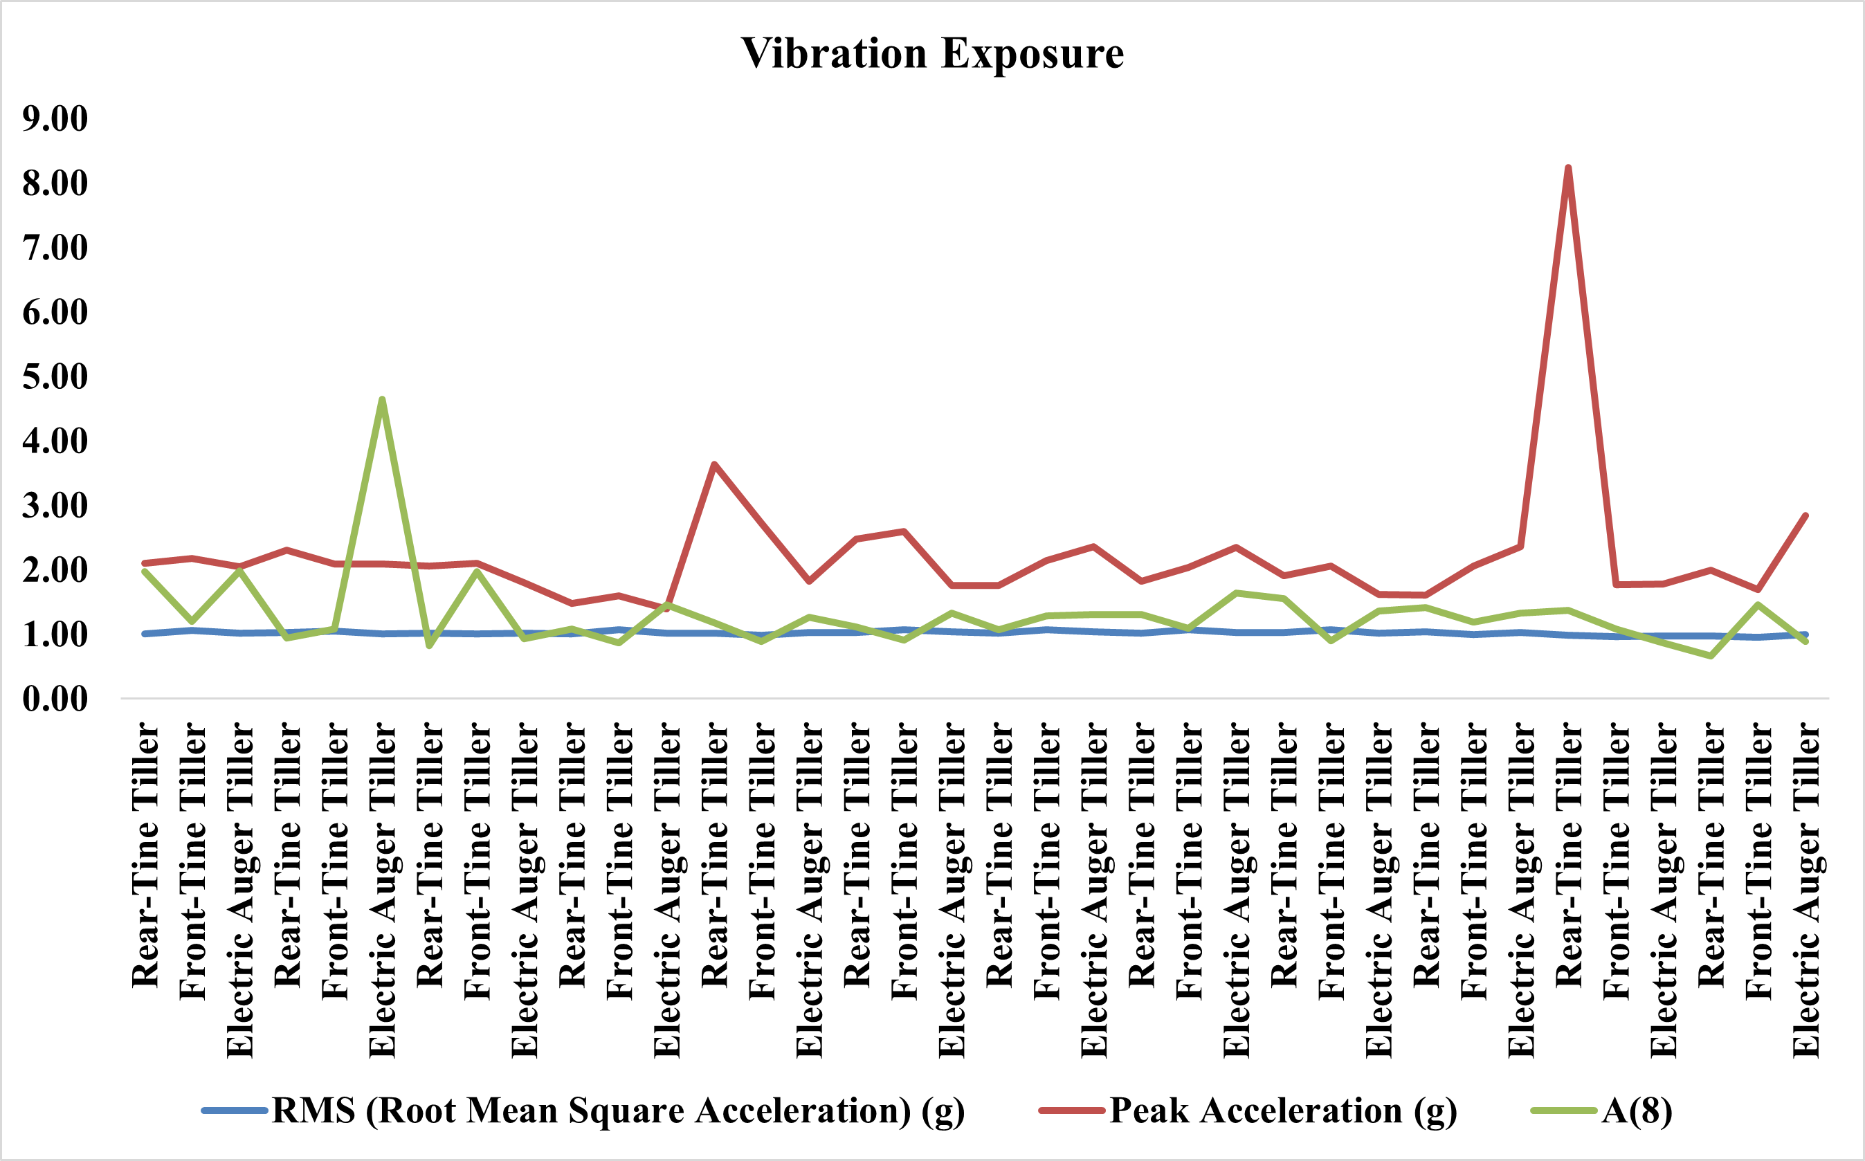
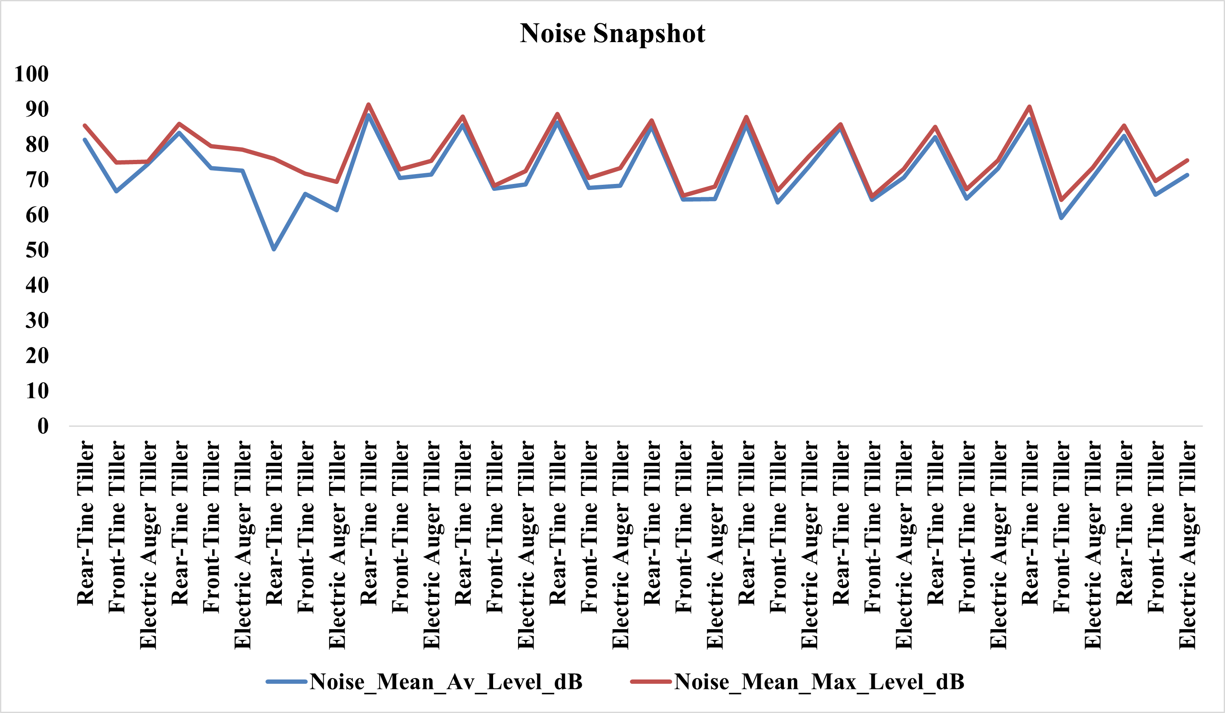
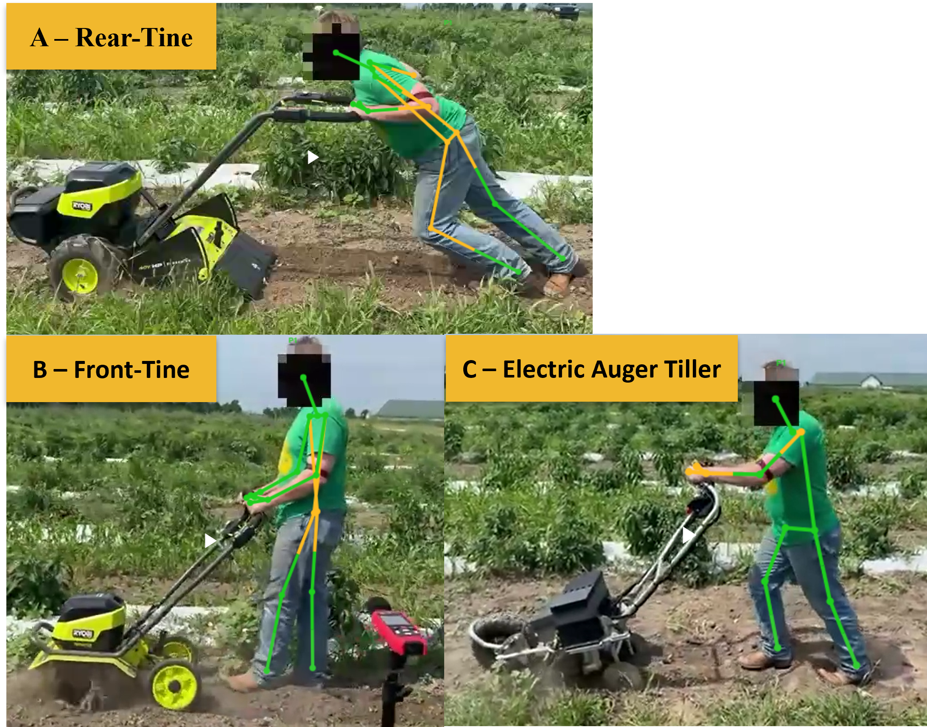
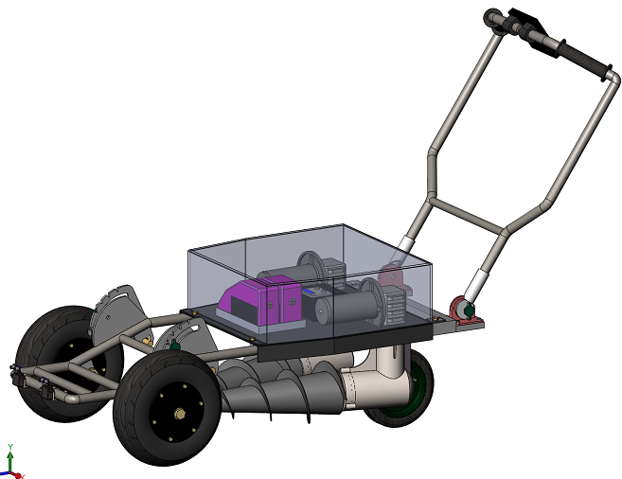
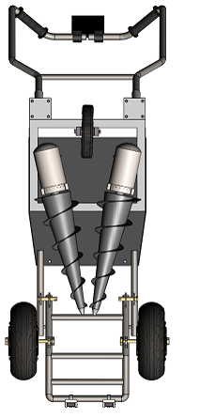
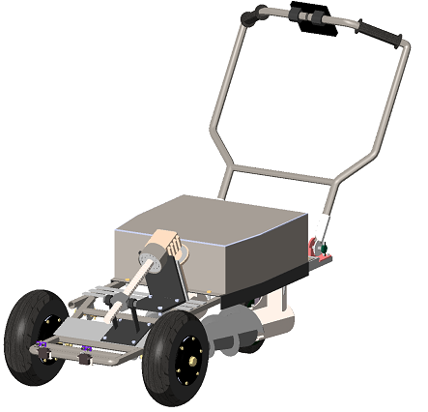
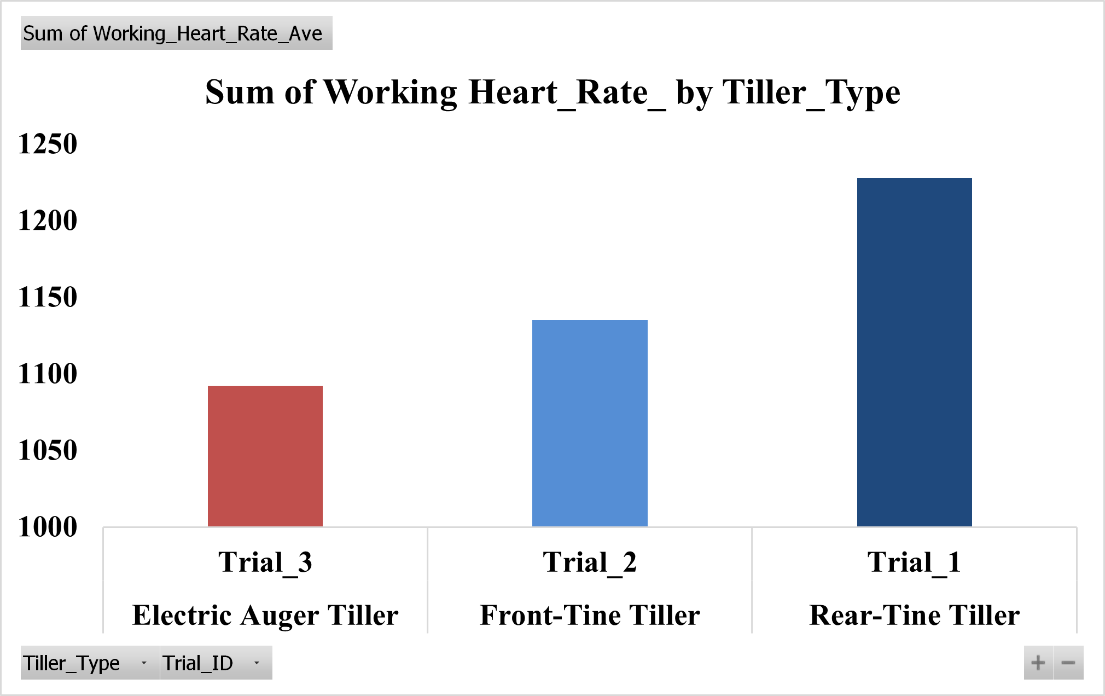
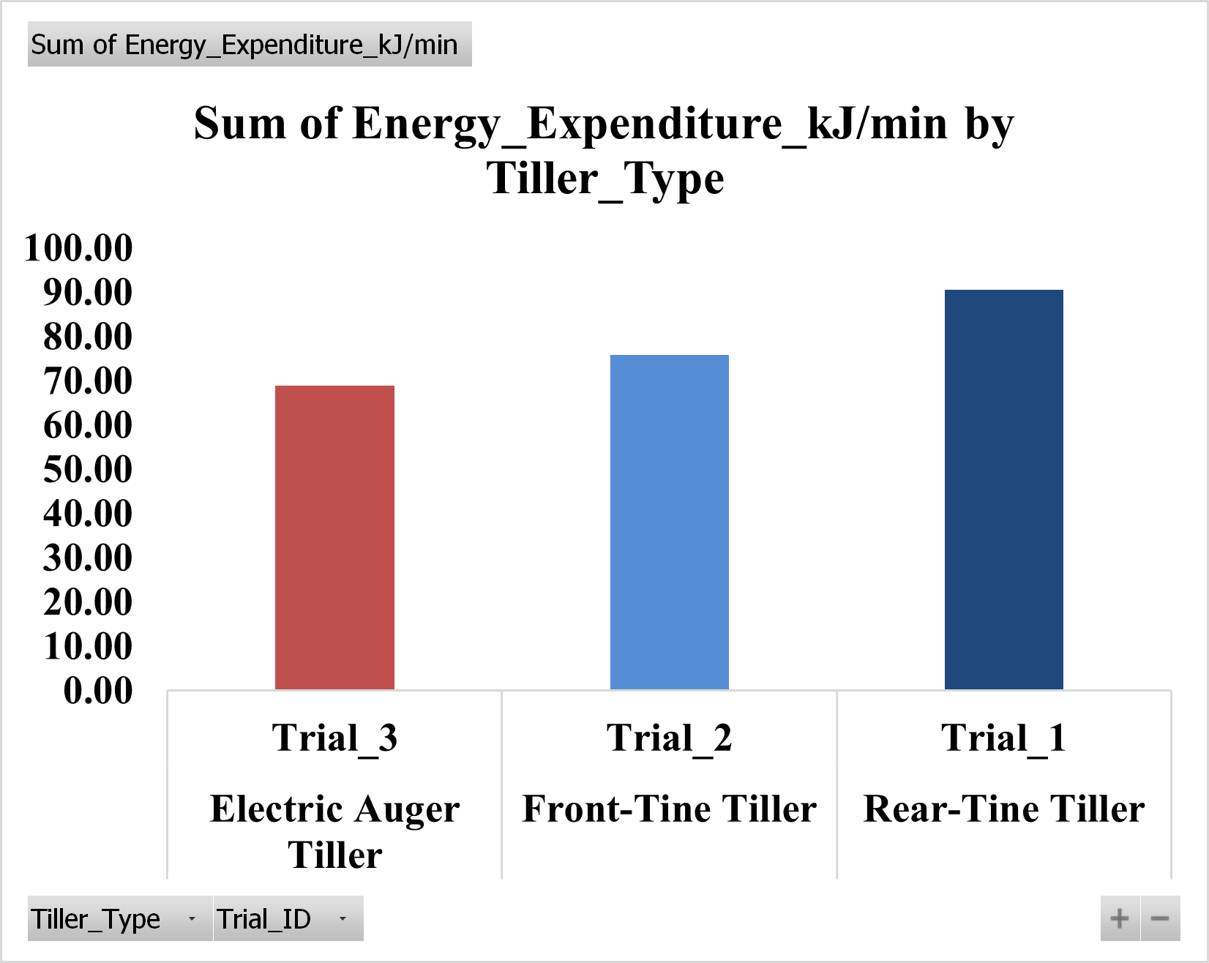


Ergonomic and Soil Performance Comparison of Electric Rear-, Front-, and Auger Tillers
Felix Michael Oguche, Jianfeng Zhou, Karen Funkenbusch, Marcia C. Shannon, Noel Aloysius, Teng Teeh Lim
University of Missouri, Columbia, MO (contact: fofdt@missouri.edu)
RESEARCH PROBLEM
COMPARATIVE VIEW OF THE THREE TILLER PROTOTYPES
VIBRATION AND NOISE EXPOSURE
Smallholder farmers often depend on compact tillers that are heavy, vibrate excessively, and cause over-compaction.
Such machines create ergonomic strain and reduce efficiency- especially for women and older farmers.
There is limited comparative data connecting soil outcomes with human physiological and ergonomic responses.
Goal
Vibration, noise, and A(8) exposure across tillers. The Electric Auger shows moderate vibration
To compare Electric Rear-Tine, Front-Tine, and Auger tillers in overall ergonomic and soil performance, focusing on:
    Soil performance - compaction, bulk density, and tilth
    Operator physiology - heart rate, energy expenditure, and workload
    Exposure and posture risk - vibration, noise, and joint angles
WHY IT MATTERS
Lower strain: Auger tiller cut working HR by 11% and
energy by 25% vs. rear-tine.
Balanced exposure: RMS 1.02 g, VDV 50.6 m/s¹·⁷⁵, A(8)
1.59 m/s², similar tine tillers; noise 73.8 dB (vs. rear 86 dB).
Improved posture: More upright trunk and smoother control
indicate reduced fatigue and higher comfort.
OPERATOR POSTURE ANALYSIS ACROSS TILLERS
RESEARCH OBJECTIVES
Pose estimation shows high trunk flexion and backward pull in A and B, increasing lower-back strain, whereas C supports a more upright and balanced posture with reduced ergonomic load.
Quantify and improve soil and ergonomic performance metrics across tillers.
Identify the tiller type that minimizes operator strain while maintaining soil quality.
Provide design recommendations for safer, more efficient tiller development.
NEW DESIGN SOLUTIONS
Methodology – Human-Centered Design Approach
Design: Repeated-measures field experiment (12 participants, 3 tillers × 3 plots).
Measurements:
    Soil: Compaction, Bulk Density (BD), Mean Weight Diameter (MWD)
    Human: Heart Rate, Energy Expenditure, Cardiac Cost of Work (CCW)
    Exposure: Vibration (RMS, A(8)), Noise (dB)
    Posture: Trunk, Wrist, Shoulder Angles (RULA, REBA)
Analysis: Summary averages; ANOVA planned
Conical Auger Shape: Triangular pattern eliminates blind strips and throws soil outward.
Dual Front-Wheel Layout: Tricycle setup stabilizes motion; rear wheel now guides instead of digs.
Tilt-Adjustment Linkage: Angle-adjustable fork improves depth control and reduces fatigue.
Ergonomic Design
CONCLUSION
RESULTS
The Auger tiller improves ergonomics and tillage quality, reducing strain and maintaining moderate vibration and noise, but with smallest footprint area. Slightly higher VDV and A(8) result from tilt shifts toward softer soil caused and longer duration.
Anthropometric Fit
OPERATOR PHYSIOLOGY
TILLER COMPARISON
WHAT’S NEXT?
Tiller Type | Mechanism | Key Characteristics
Rear-Tine | Dual rotating tines | High vibration, strong penetration
Front-Tine | Forward blades | Moderate soil breakup
Electric Auger | Twin augers | Smooth motion, low vibration, better control
Apply mixed-effects ANOVA for validation.
Finish the fabrication of the new design and test.
This material is based upon work that is supported by the National Institute of Food and Agriculture, U.S. Department of Agriculture, under agreement number 2021-38640-34714 through the North Central Region SARE program under project number LNC21-458.
🔍Learn more: Scan the QR code
Prototype & Testing

