Slide 1
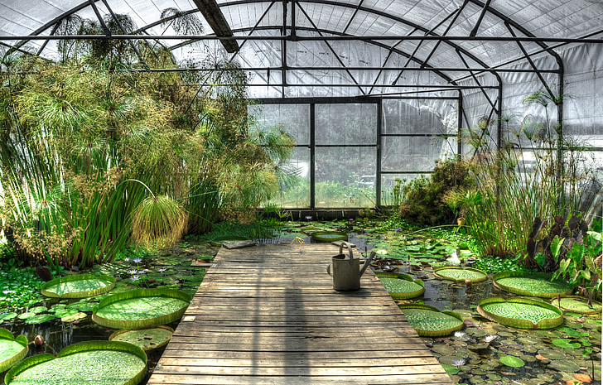
Forest Elementary Greenhouse
Forest Elementary Garden Beds
by:Southward, and Kaavya
By Southward,and Kaavya

Slide 2
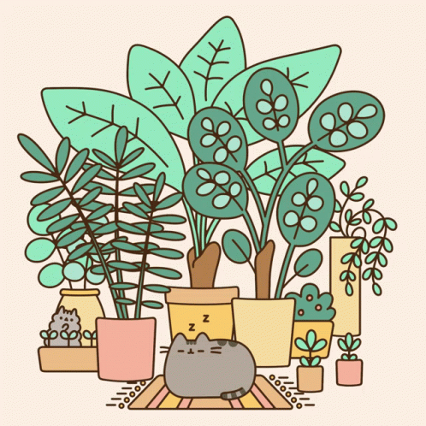
How it Works
_We water it on Monday, Wednesday, and Friday for different classes in 5th grade (signup sheet is on 5th grade door)
_We planted Beets, Spinach, Green Peas, and Carrots
_Our plants mainly need water and sunlight, which is why we water every other day
_The planting takes at least 45-70 day

Slide 3
How you can help
Just today Milania, and Stella helped us clean, but you can help by signing up on the signup sheet and help us water we have had a lot of students help in 2 months!!
Please don’t play in the garden beds as you can damage them or the young plants growing.

Slide 4
Harvesting
-All plant are harvested differently
-For example, you can cut spinach and it can grow back, but if you harvest carrot you pluck them out and they won’t grow back.
-We just harvest the spinach
-We harvested them by cutting the stems

Slide 5
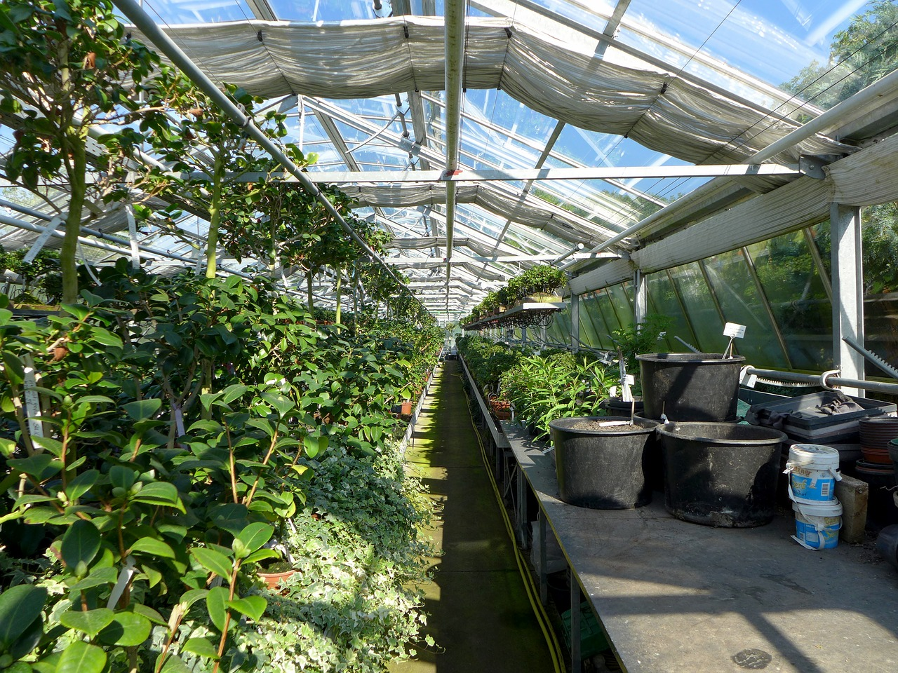
Thank you to Mr. John

