Slide 1
Creating a Culture of Data Collection and Use for Ohio Farmers Markets
Jaime Hadji, Ohio Farmers Market Network Chair
Christie Welch, OSU South Centers
Darlene Wolnik, FMC Farmers Market Support Director
February 12, 2022
OEFFA Conference

Slide 2
Project Overview
Evaluate the strengths and weaknesses of Ohio Farmers Markets work in data collection
Train managers and extension educators on the suite of available tools and appropriate methodologies
Create a culture of shared data collection and use to increase farmers markets sustainability and success.
This material is based upon work that is supported by the National Institute of Food and Agriculture, U.S. Department of Agriculture, under agreement number 2019-38640-29879 through the North Central Region SARE program under project number ENC19-185. USDA is an equal opportunity employer and service provider. Any opinions, findings, conclusions, or recommendations expressed in this publication are those of the author(s) and do not necessarily reflect the view of the U.S. Department of Agriculture.

Slide 3
Project Overview
Oct. 1, 2020 – Sept. 30, 2022
PI – Eric Barrett
Co-PI – Christie Welch
Funder North Central SARE
Collaborators – Farmers Market Coalition
https://farmersmarketcoalition.org/
Ohio Farmers Market Network
https://ohiofarmersmarketnetwork.org/

Slide 4
Project Activities to Date
Created a database of Ohio farmers markets and if/how they collect data
Visited farmers markets throughout Ohio to learn how they collect data
Provided training to OSU Extension Educators on tools to assist farmers markets with data collection

Slide 5
Project Activities – In Process
Create a database of the data-collection projects among Ohio markets and vendors
A "train the trainer" training on market data collection needs and processes
Conduct case studies of Ohio direct marketers that sell at one or more Ohio farmers markets to learn how they use data for business decision making.

Slide 6
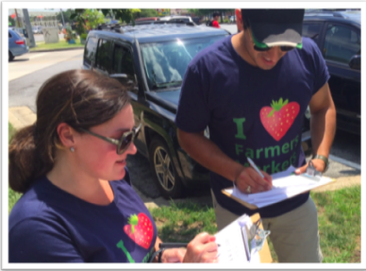
Culture of Data Collection at Markets
Since 2013: Evaluation resources, one on one and network support, software development, and analysis

Slide 7
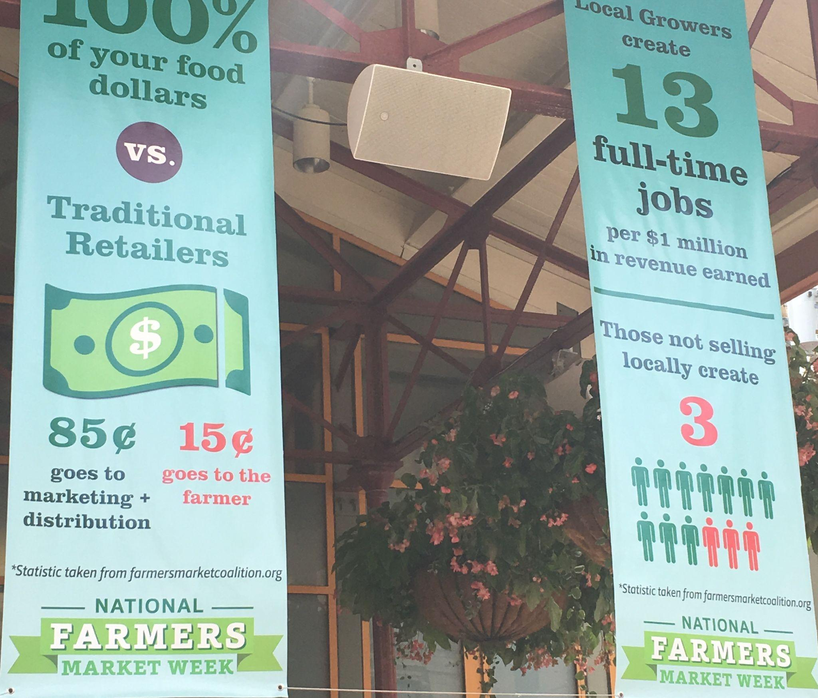
Culture of Data Collection
Findlay Market National Farmers Market Week

Slide 8
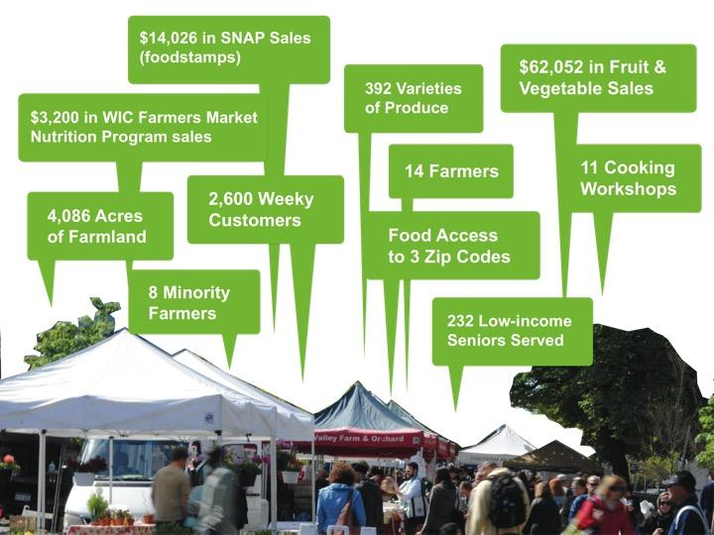
Culture of Data Collection at Markets

Slide 9
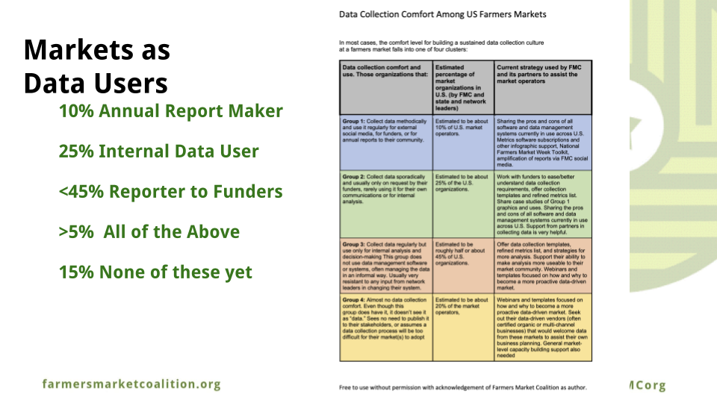
Culture of Data Collection at Markets

Slide 10
Culture of Data Collection at Markets

Slide 11
Culture of Data Collection at Markets
But could use their vendors help!
What data points would YOU use to describe your market(s)?
we’ll come back to this later on…

Slide 13
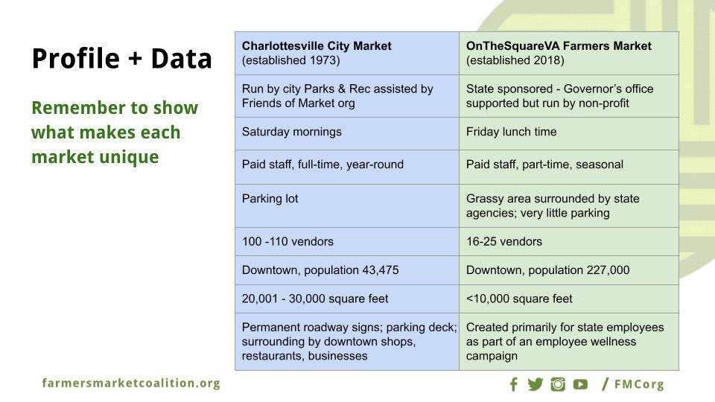
Culture of Data Collection at Markets

Slide 14
Farmers Market Coalition Evaluation Resources
https://farmersmarketcoalition.org/education/evaluation-101/
https://farmersmarketmetrics.guide/resources/
https://lfscovid.localfoodeconomics.com
https://farmdirectincentives.guide/
Designing an effective, scalable data collection tool to measure farmers market impacts Journal of Agriculture, Food Systems, and Community Development
Volume 8, Supplement 3 / January 2019

Slide 15
Data Collection at Ohio Markets

Slide 16
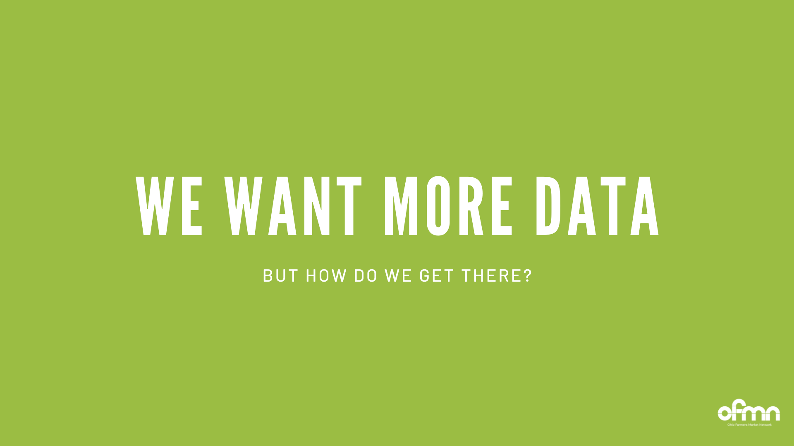
Data Collection at Ohio Markets

Slide 17
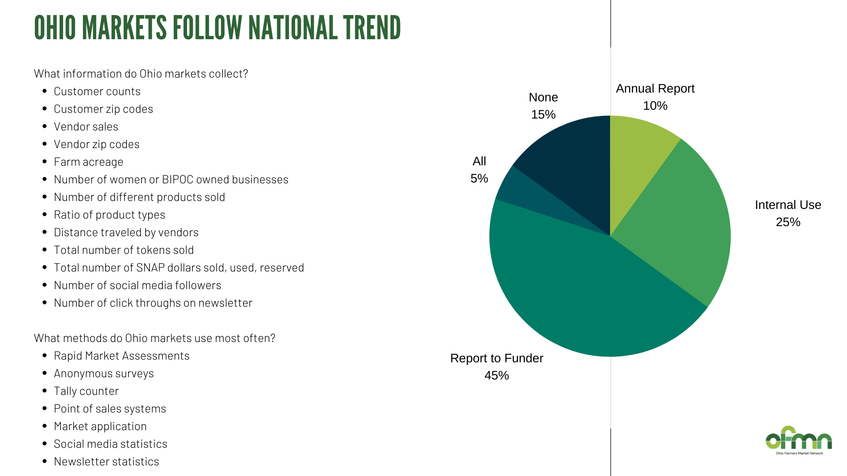
Data Collection at Ohio Markets

Slide 18
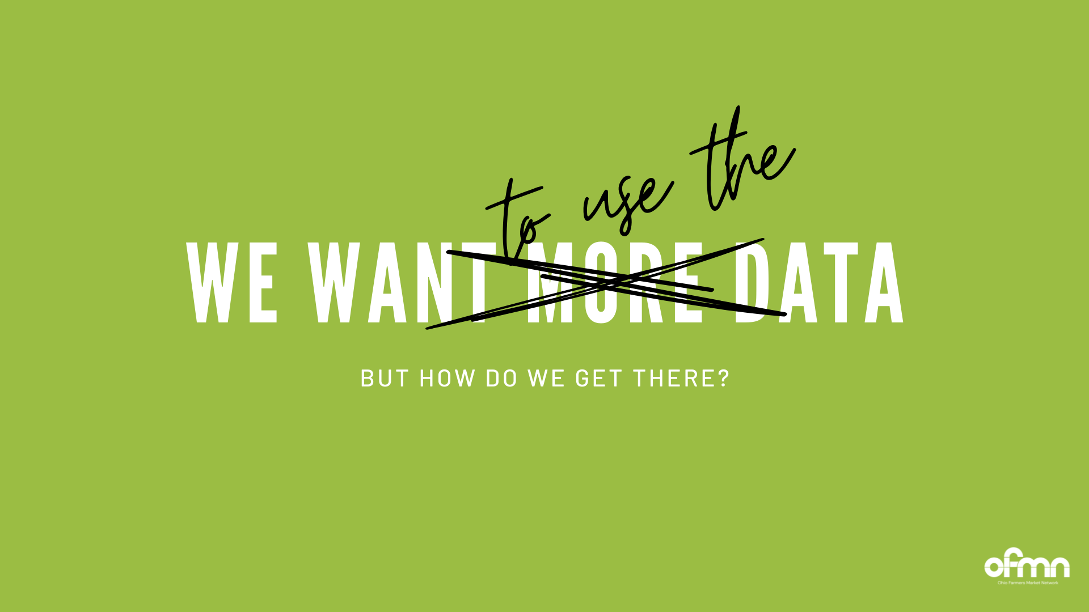
Data Collection at Ohio Markets

Slide 19
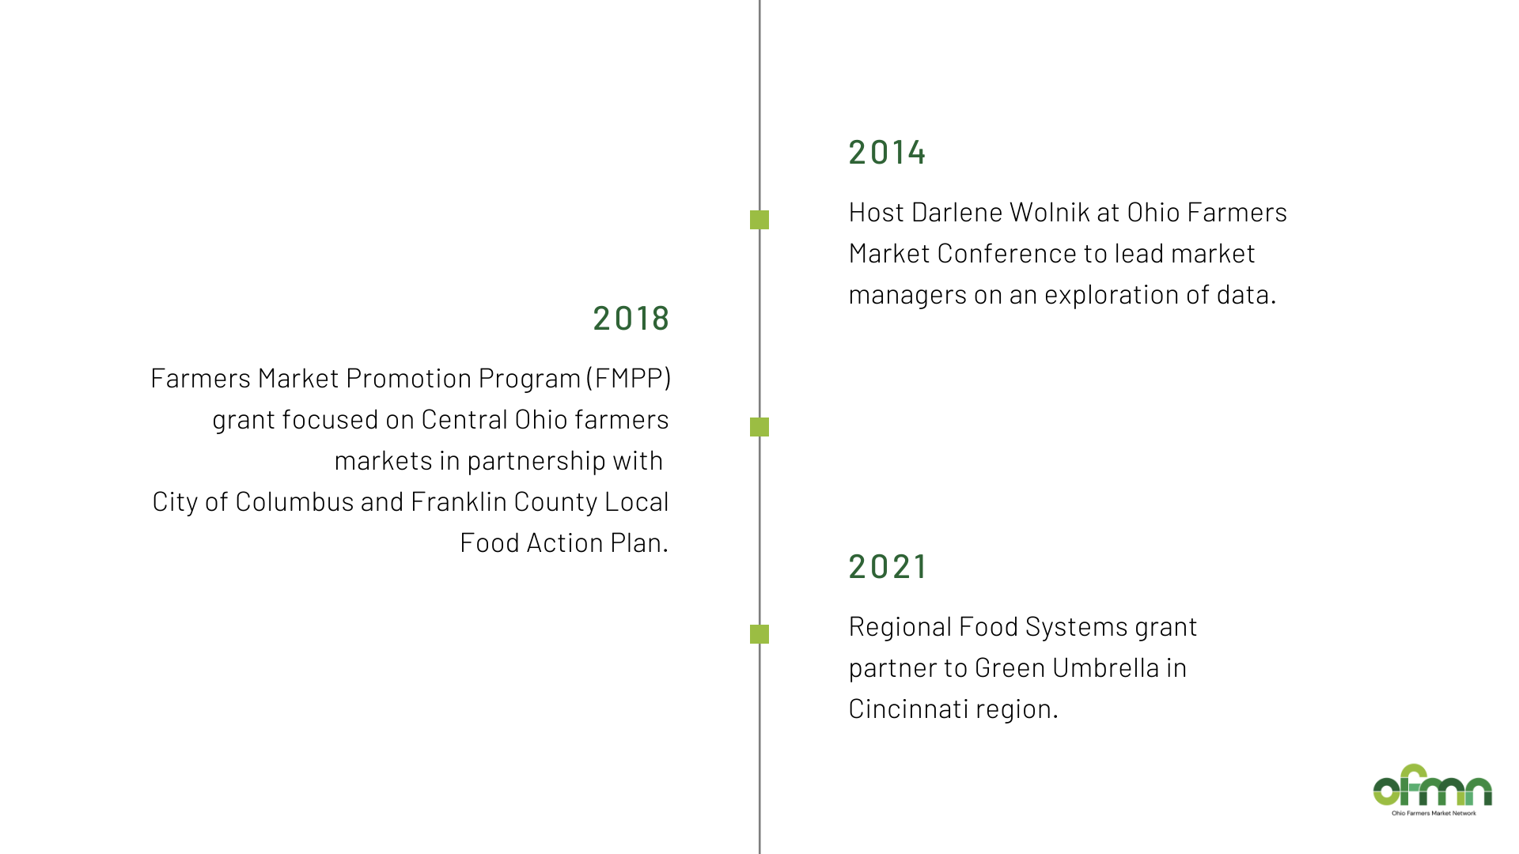
Data Collection at Ohio Markets

Slide 20
Data Collection at Ohio Markets

Slide 21
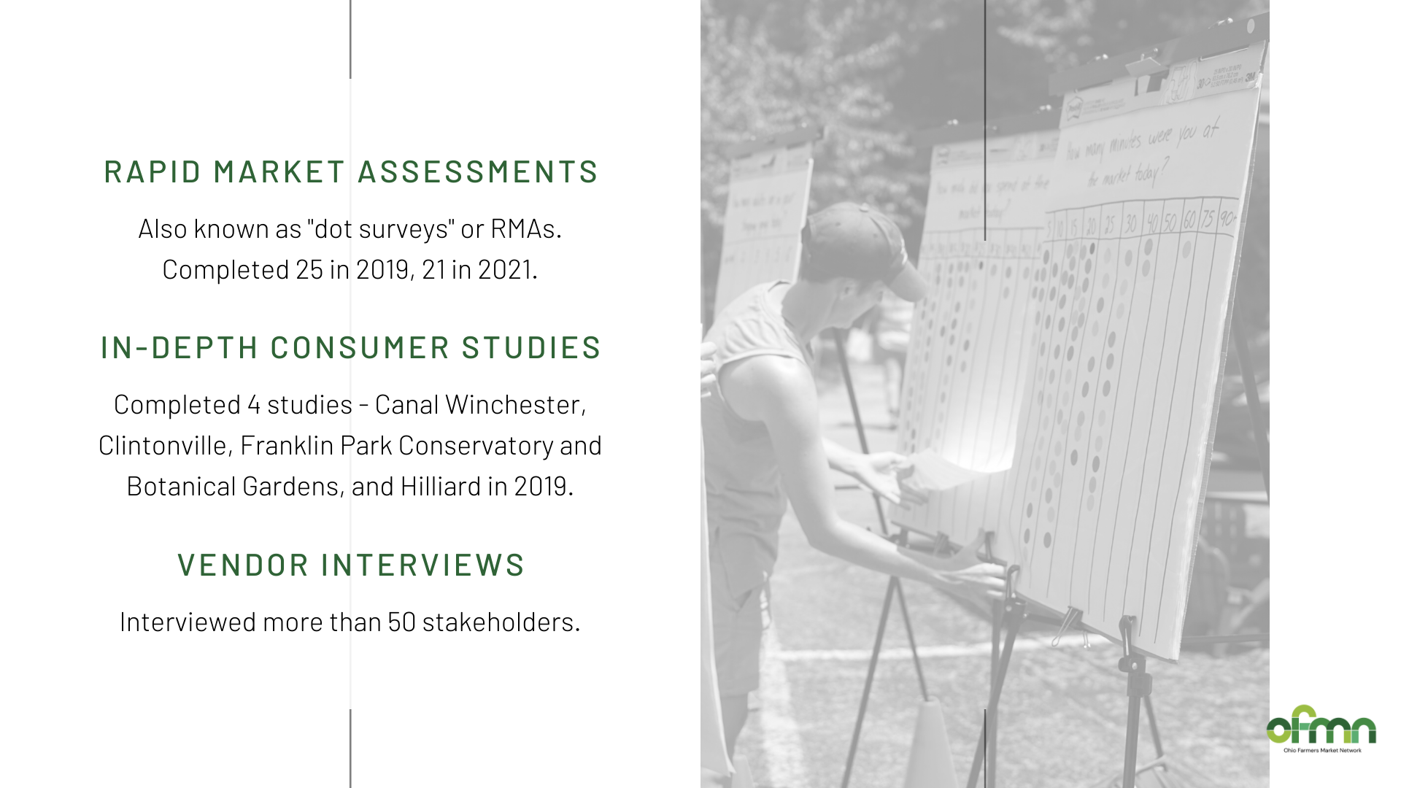
Data Collection at Ohio Markets

Slide 22
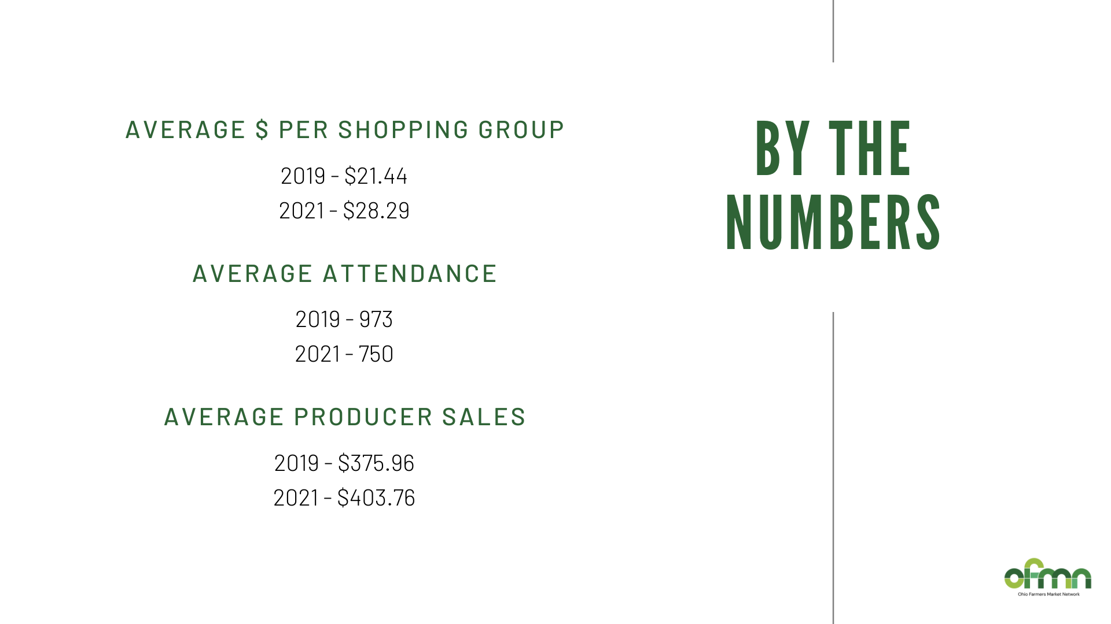
Data Collection at Ohio Markets

Slide 23
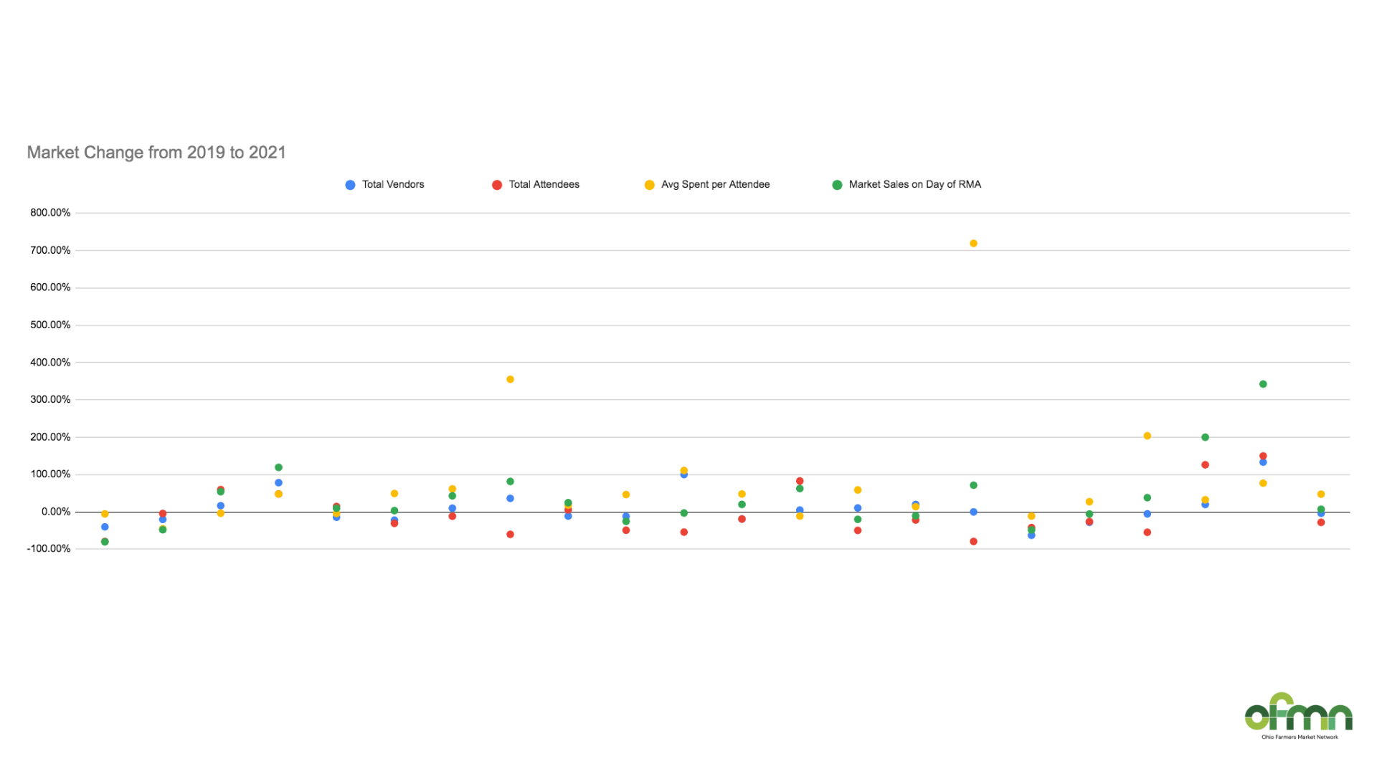
Data Collection at Ohio Markets

Slide 24
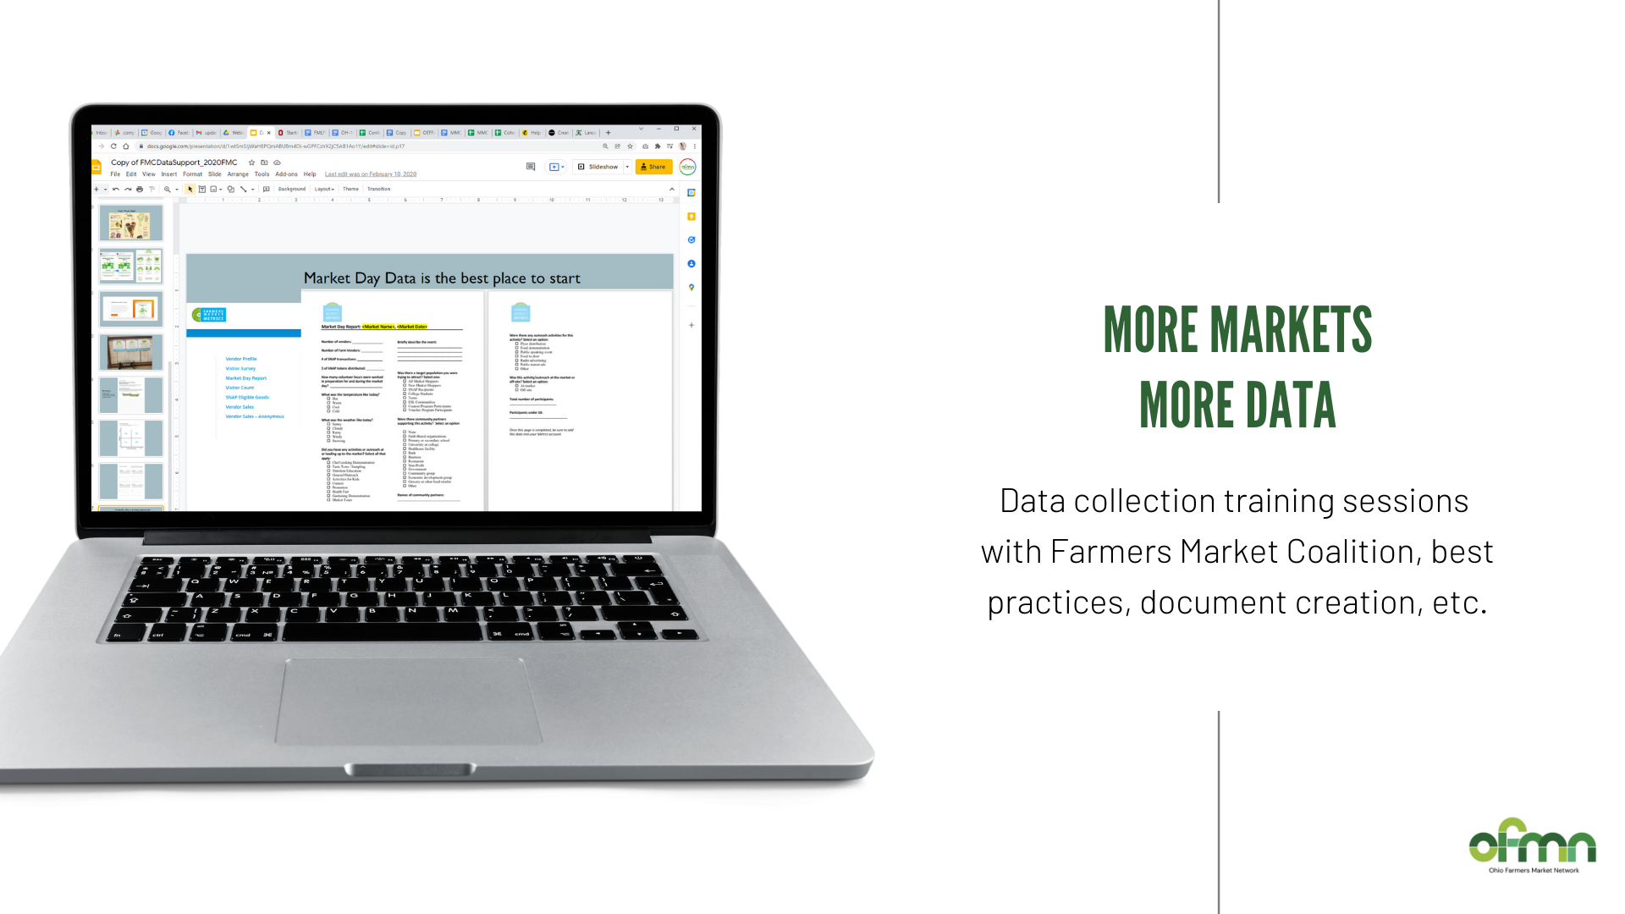
Data Collection at Ohio Markets

Slide 25
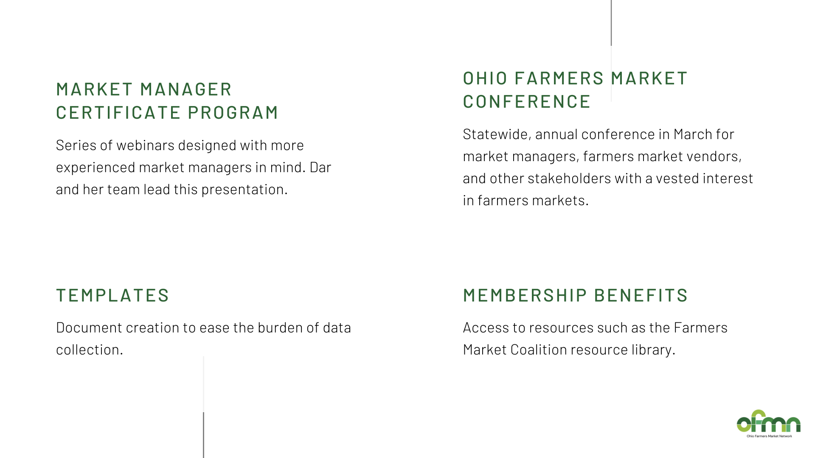
Data Collection at Ohio Markets

Slide 26
Data Collection at Ohio Markets

Slide 27
Data Collection at Ohio Markets

Slide 28
Project Activities – In Process
Conduct case studies of Ohio direct marketers that sell at one or more Ohio farmers markets to learn how they use data for business decision making.
We would appreciate your input.

Slide 29
Project Activities – In Process
How do direct marketers that participate in one or more Ohio farmers markets use data to make business decisions?
How do the direct marketers collect and analyze this data?
What data does the farmers market collect? How is this data shared with the direct marketer?
What data collected by the farmers market would be helpful for the direct marketer to improve their business?

Slide 30
Project Activities - In Process
If you would like to be a case study participant?
Email Christie Welch
welch.183@osu.edu

Slide 31
How can you be involved?
Volunteer to participate in a case study.
Share information about farmers markets in your county/community
Attend the train-the-trainer session on available tools to assist with data collection
Connect with the OSUE Direct Food & Ag. Marketing Team, Farmers Market Coalition, and the Ohio Farmers Market Network

Slide 32
OSU Extension Direct Food and Agricultural Marketing Program
Christie Welch
welch.183@osu.edu
Darlene Wolnik
darlene@farmersmarketcoalition.org
Jaime Hadji
hello@ohiofarmersmarketnetwork.org
Contact Info

