Slide 1


Project Update
2022 Season
13 Dec 2022
Grants:
FNC21-1297
FNC22-1348

Slide 2
Agenda
Context of my work
High Level Results: 2 Plots in Waterloo
Plans for 2023
One More Thing…

Slide 3
Executive Summary
In 2021, a mix of Cover Crops demonstrated great adaptability to highly variable soil and weather conditions, but there was little corn harvestable
In 2022, the corn yield varied greatly between replications due to highly variable soil conditions, corn variety, & corn row configuration experiments
Alternate corn row spacing to provide an Opportunity Space for Soil-Building Cover crops or alternate cash crops appears promising
  60” rows reduce corn yield by up to 20%, but provide 66% of the field space for Opportunity Space
  90” rows reduce corn yield by up to 30% but provide 77% of the field space for Opportunity Space
Preliminary data shows soil health metrics moving in the right direction

Slide 4
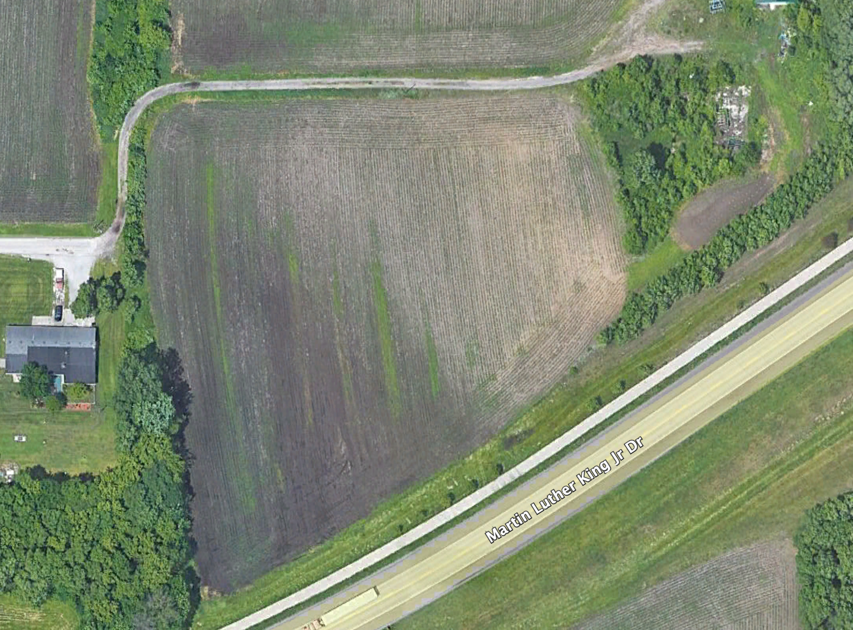
Plot 30011 “Shop”
3.2 Acres
Plot Initial Conditions
Highly variable soil
”Too Light, Dry” at top (NE)
“Good Soil” in middle
“Too Heavy, Wet” at bottom (SW)

Slide 5
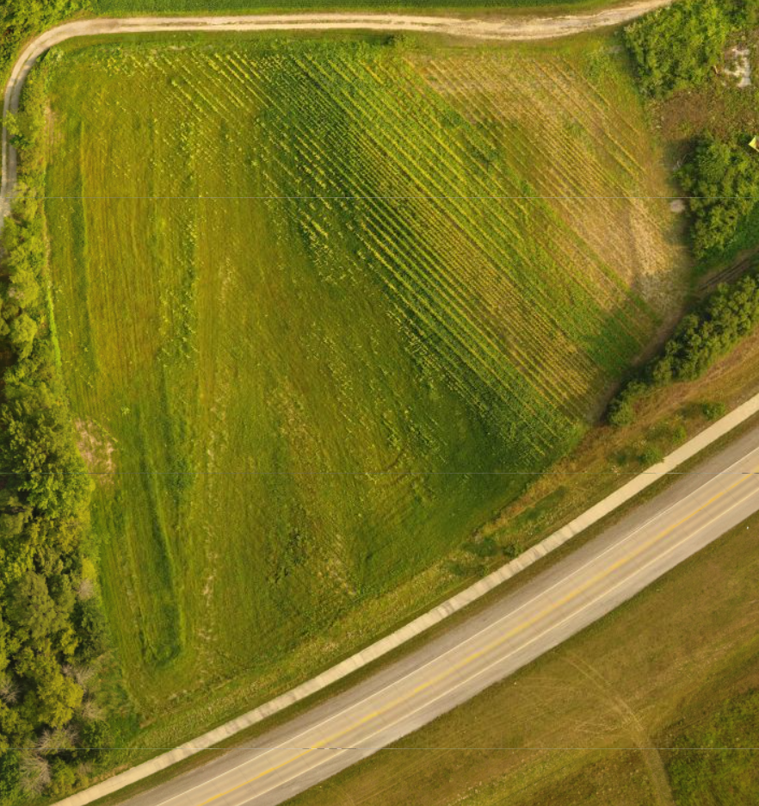
Plot 30011 “Shop”
Learning from 2021
Severe Nitrogen Shortage
Severe Rainfall Shortage
Potential excellent site for vegetables
Low land heavy soil is very thin
Now has cover crop-Benefit
Complete Row Crop Failure in 2021

Slide 6
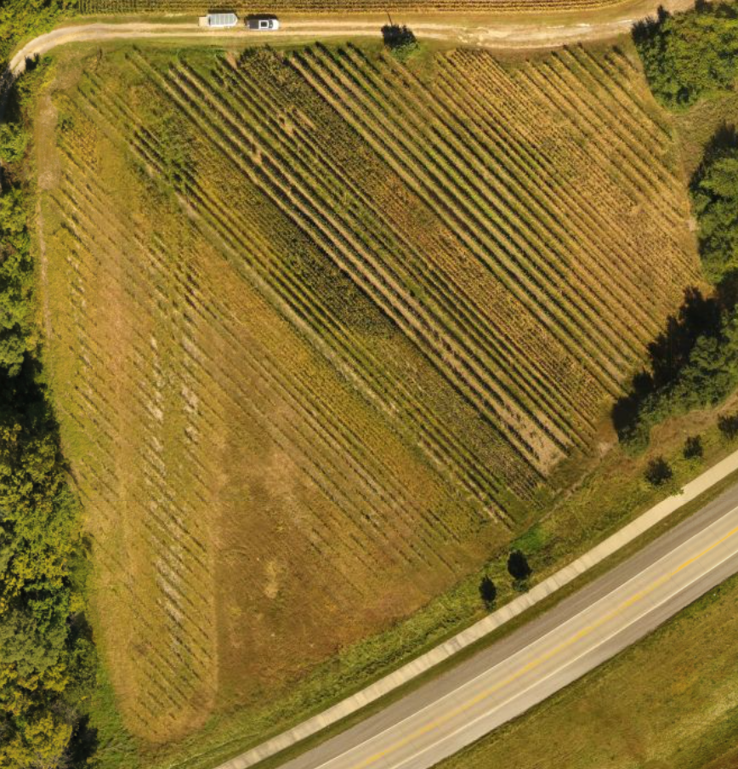
Plot 30011 “Shop”
Field Day
Layouts
Rep 1
350’
Rep 2
Repeated treatments as in 2021 Season
Plot Variables:
30” Baseline
60” Single Row,
90” Twin Row
30 Sep 2022 Field Day was recorded
Posted in 11 videos on YouTube
Search “Bob Recker”
Rep 3
Rep 4

Slide 7
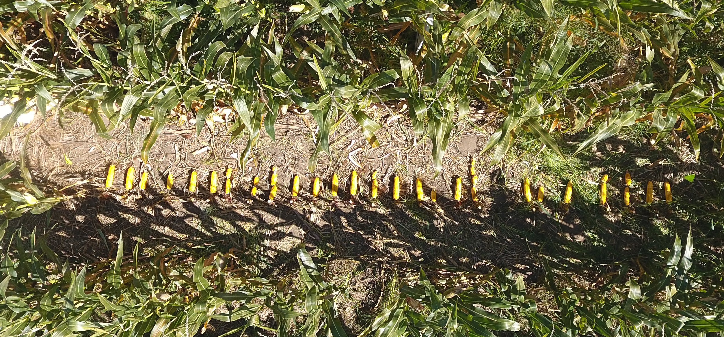
30” Row, Field Day Layout
30” Row, 209” (1/1000 Acre)
26 Plants, 36 Ears
211 Bu/a
Avg Ear Wet Wt: 0.72 Lbs
Ear Weight C.O.V: 28%

Slide 8
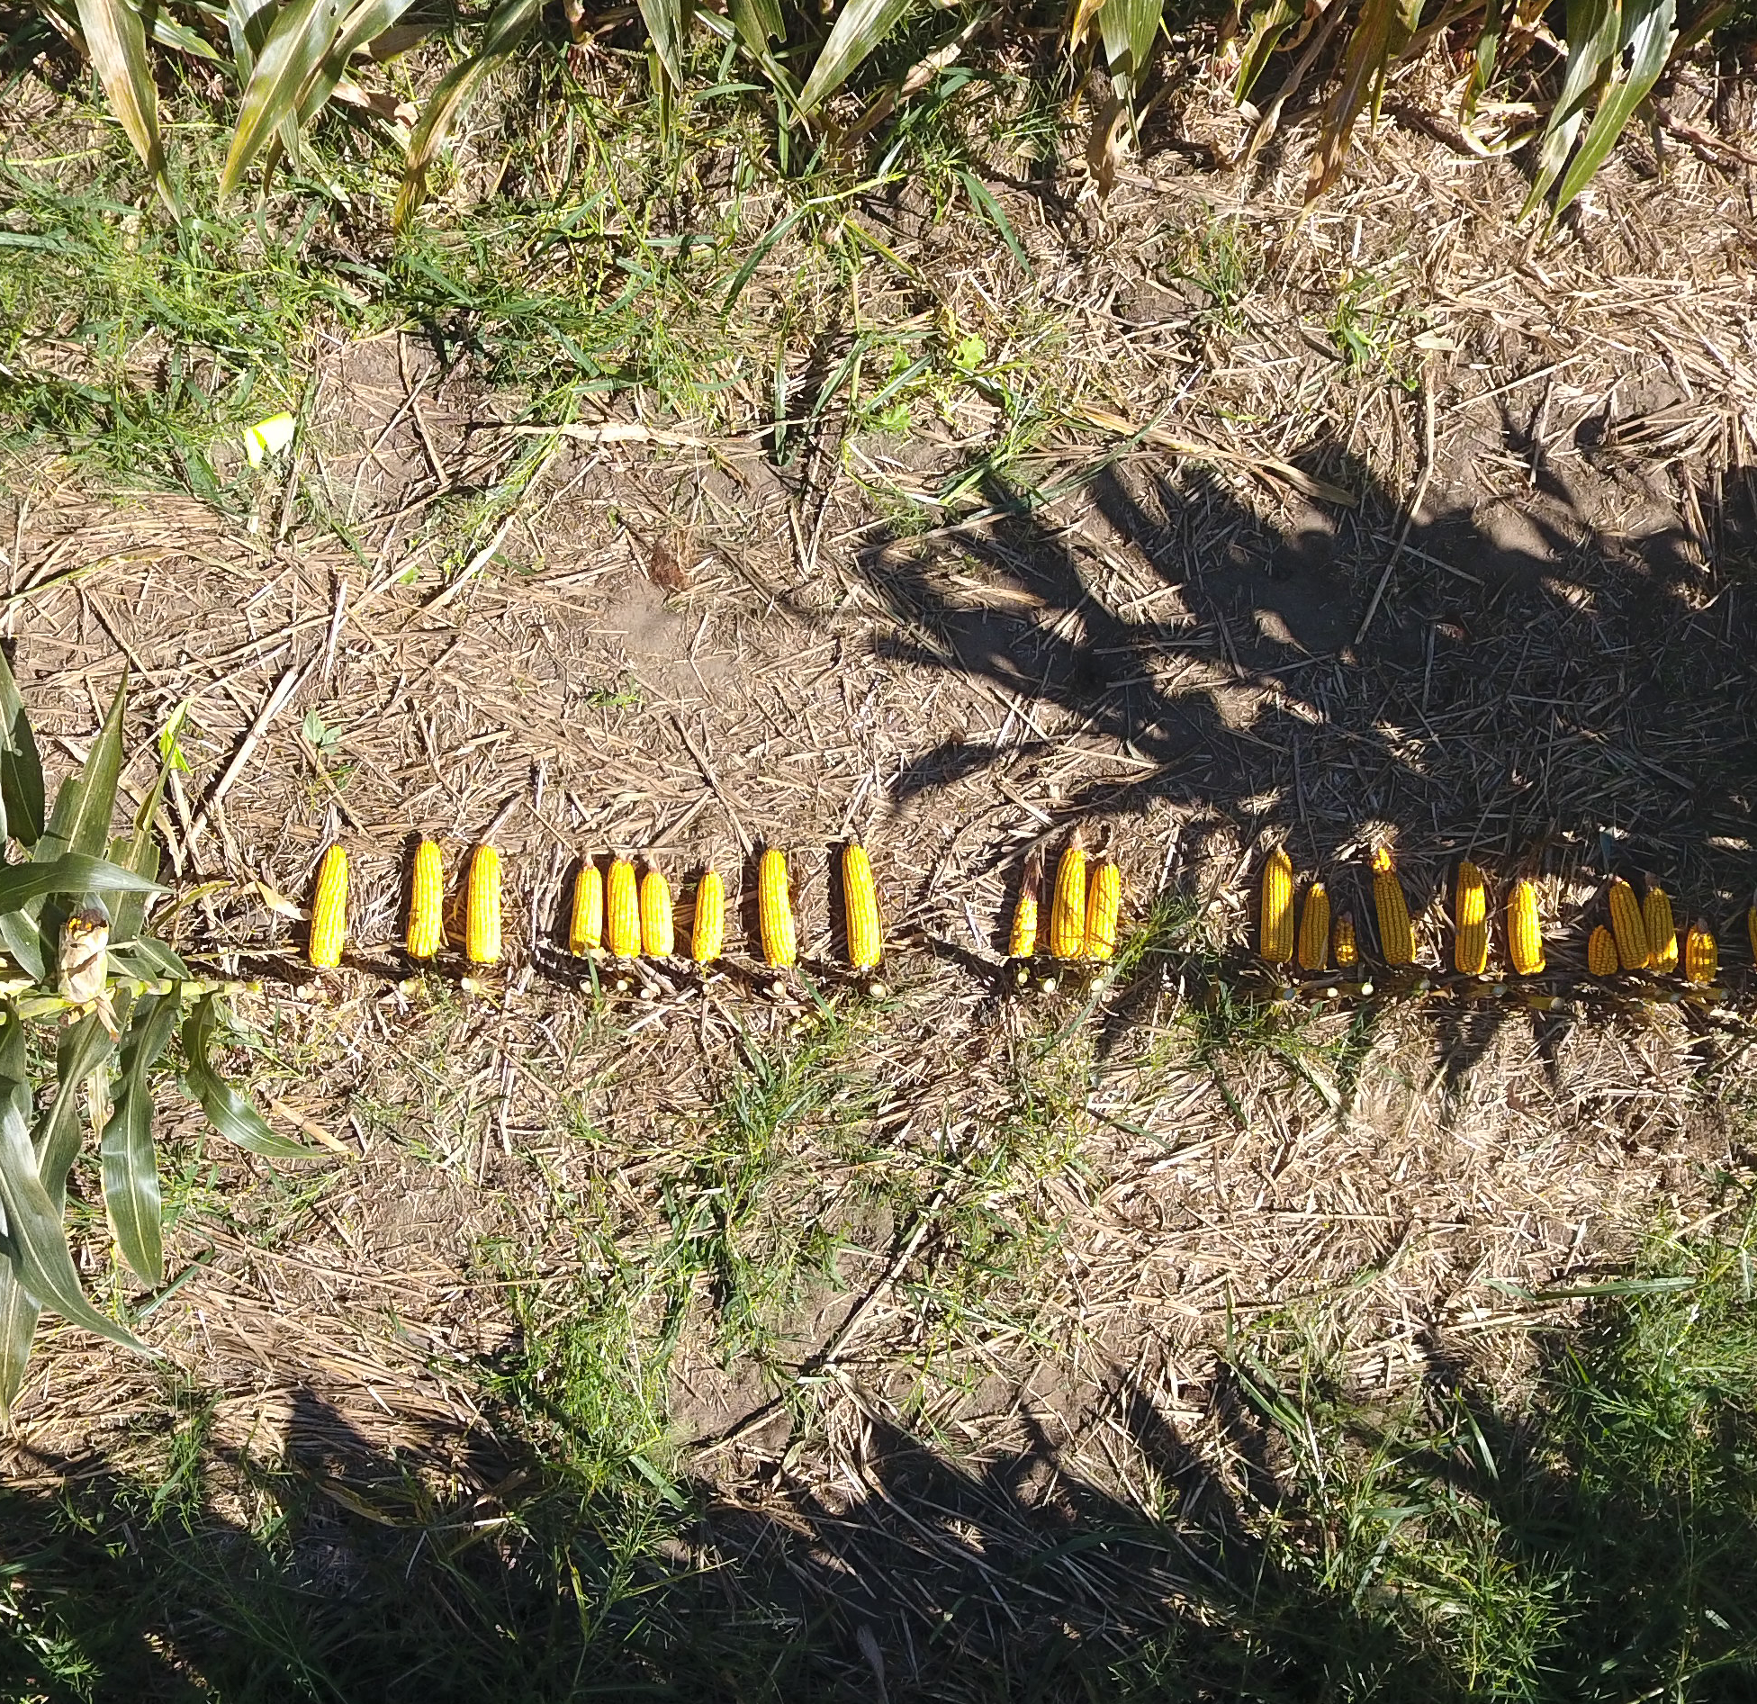
60” Row, Field Day Layout
60” Row, 104.5” (1/1000 Acre)
24 Plants, 24 Ears
153 Bu/a
Avg Ear Wet Wt: 0.56 Lbs
Ear Weight C.O.V: 41%

Slide 9
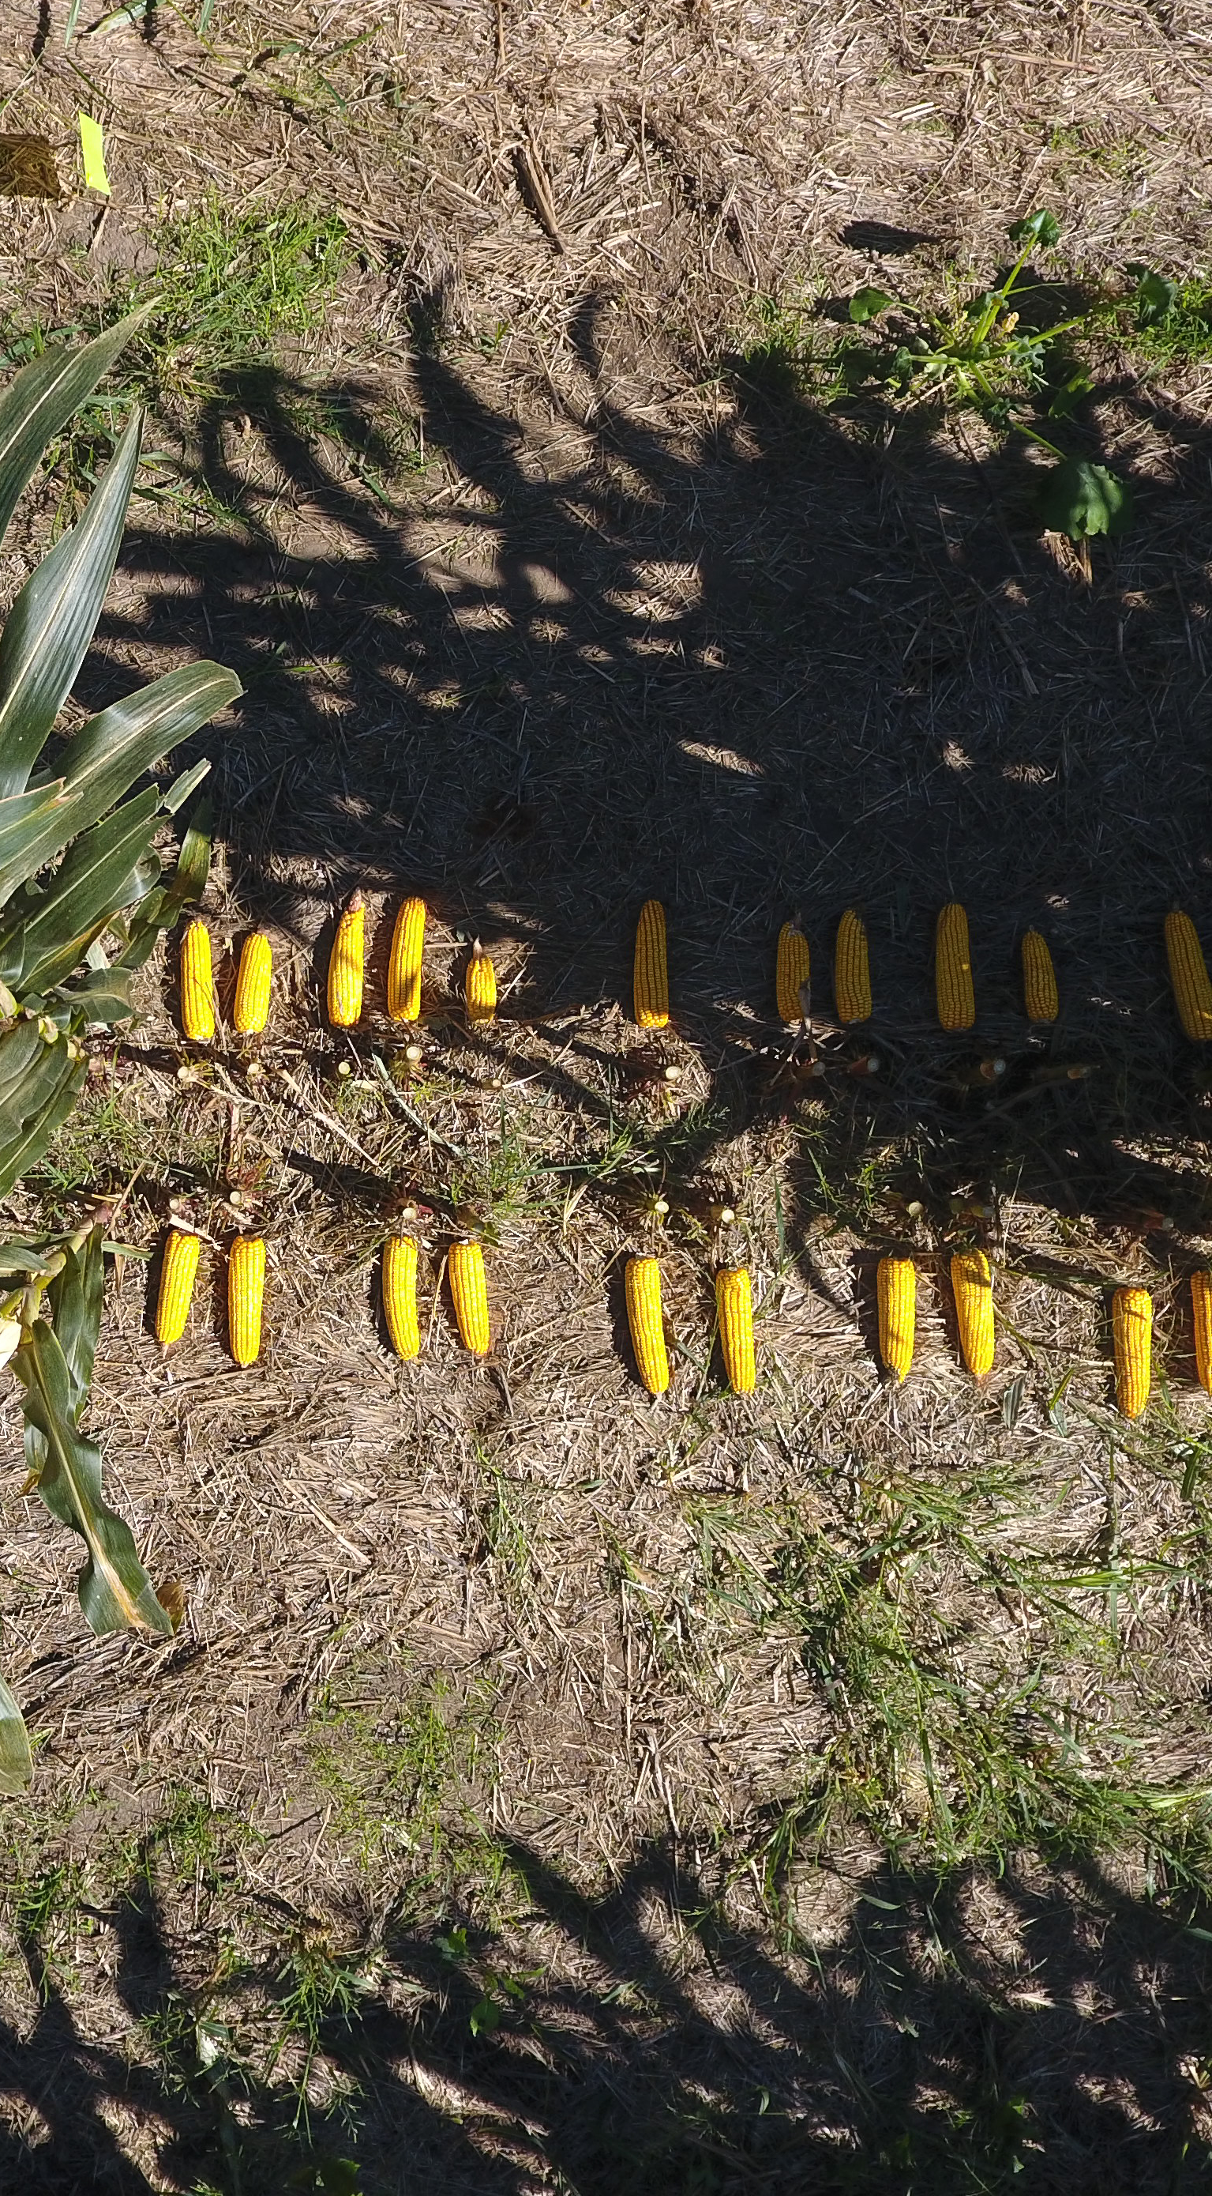
90” Twin Row
90” Twin Row, NE Side, 70” (1/2000 Acre)
11 Plants, 11 Ears
185 Bu/a
Avg Ear Wet Wt: 0.72 Lbs
Ear Weight C.O.V: 26%
90” Twin Row, 70” (1/1000 Acre)
21 Plants, 21 Ears
195 Bu/a
Avg Ear Wet Wt: 0.79 Lbs
90” Twin Row, SWW Side, 70” (1/2000 Acre)
10 Plants, 10 Ears
205 Bu/a
Avg Ear Wet Wt: 0.86 Lbs
Ear Weight C.O.V: 8%

Slide 10
1/1000 acre
(Field Day Layout)
Conclusion:
Surprisingly good results from 90” Twins, but each half of the twin was distinctively different
60” Single row had multiple-ear plants, but disappointing overall yield
30” Yield excellent for this plot. Last year was zero!
Approx. 300’ Row
(Field Day Row)
All of Rep 2

Slide 11
350’
Conclusion:
Soil Matters!
Single Row Plot Yield, Bu/a
Data based on Machine Harvest, In-Tank scale on Combine

Slide 12
Plot 30011 “Shop”
Field Day
Layouts
Rep 1
Overall: 39 Bu/a
350’
Rep 2
Overall: 108 Bu/a
Repeated treatments as in 2021 Season
Plot Variables:
30” Baseline
60” Single Row,
90” Twin Row
Rep 3
Overall: 98 Bu/a
Rep 4
Overall: 0 Bu/a

Slide 13
1/1000 acre
(Field Day Layout)
Conclusion:
Selecting “Sweet Spot” is useful, but can be misleading
Approx. 300’ Row
(Field Day Row)
All of Rep 2

Slide 14
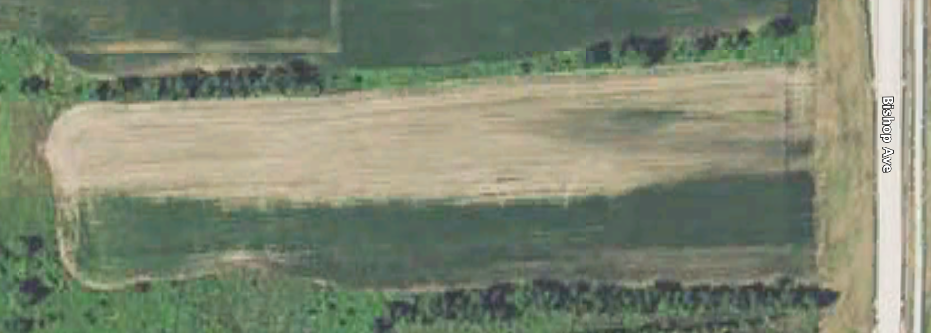
Plot 30181
3.6 Acres
Conclusion:
Rebuilding the North Half of the Plot is a major undertaking
Dramatic North-South Variability
May be residual of 1990’s Road Construction Dirt Stockpiles, etc
950’

Slide 15
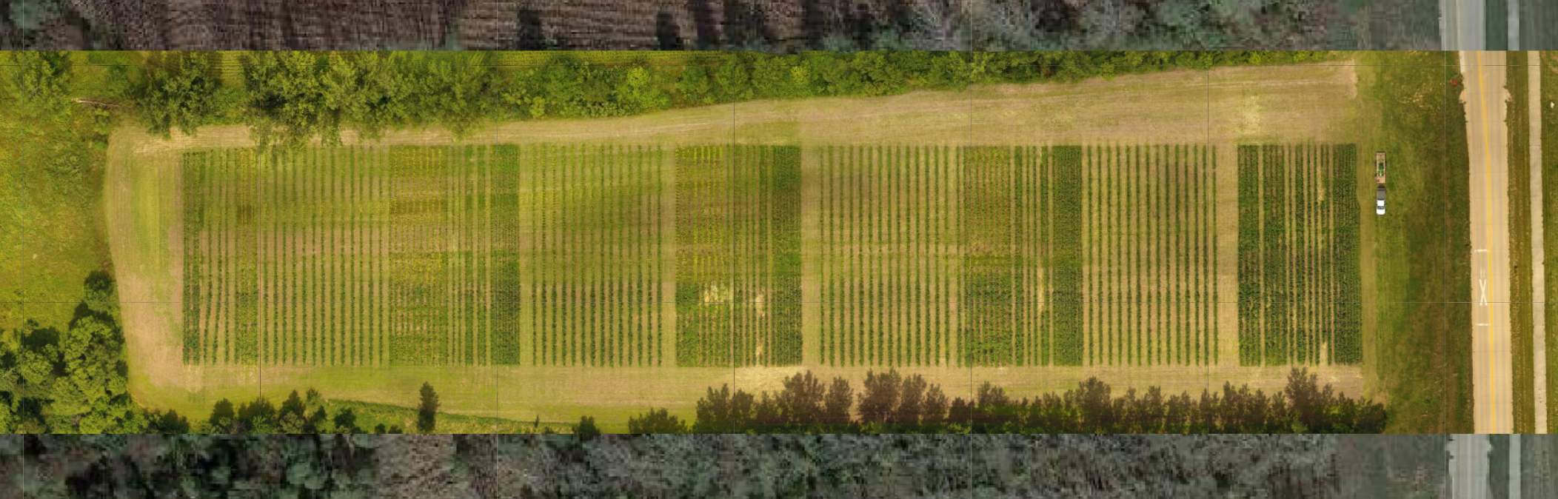
Plot 30181: Highly Variable Soil Plot
(Historic Google Earth Image) Dramatic North-South Variability
May be residual of 1990’s Road Construction Dirt Stockpiles, etc
Conclusion:
Useful to treat rows as two different entities
(2022 Season Plot Image)
Plot Plan:
4 Replications
Split data on North vs South half
Alternate Row/Cover Crop configuration in Highly Variable Soil

Slide 16
Plot 30181 Replications
2022 Season
3.6 Acres
4 Replications (South Side of Plot)
1st 4 Rows in Each Rep the “Baseline” Variety
Plot Variables: 30” Baseline, 60” Single, 60” Twin Row, 90” Twin, Various in-Row plant arrangements
950’
100’
60’

Slide 17
Plot 30181 Replications
3.6 Acres
4 Replications (South Side of Plot)
1st 4 Rows in Each Rep s the “Baseline” Variety; All other rows in each are a different variety by rep
Plot Variables: 30” Baseline, 60” Single, 60” Twin Row, 90” Twin, Various in-Row plant arrangements
950’
Rep 4
Overall: 5 Bu/a
Rep 3
Overall: 20 Bu/a
Rep 2
Overall: 36 Bu/a
Rep 1
Overall: 62 Bu/a
100’
Rep 4
Overall: 43 Bu/a
Rep 3
Overall: 86 Bu/a
Rep 2
Overall: 89 Bu/a
Rep 1
Overall: 97 Bu/a
60’

Slide 18
950’
Single Row Plot Yield, Bu/a
Data based on Machine Harvest, In-Tank scale on Combine
Row in Plot, starting on East side of plot

Slide 26
71 bu/a
Spread
Conclusion:
Variety Matters!
36 bu/a
Spread
26 bu/a
Spread

Slide 27
Recker Conclusions
Soil is a major driver of ”regional” yield differences
Soil not likely a driver of “local” differences
Variety appears to matter significantly
Several in-plot variables likely impacted results
  Lack of sidedress on 60” Twin Rows
  Population control on 90” Twin Hills
I continue to believe there is potential for 90” Twin Rows
This plots triggers thoughts about further development

Slide 28
Quick Historical Perspective

Slide 29
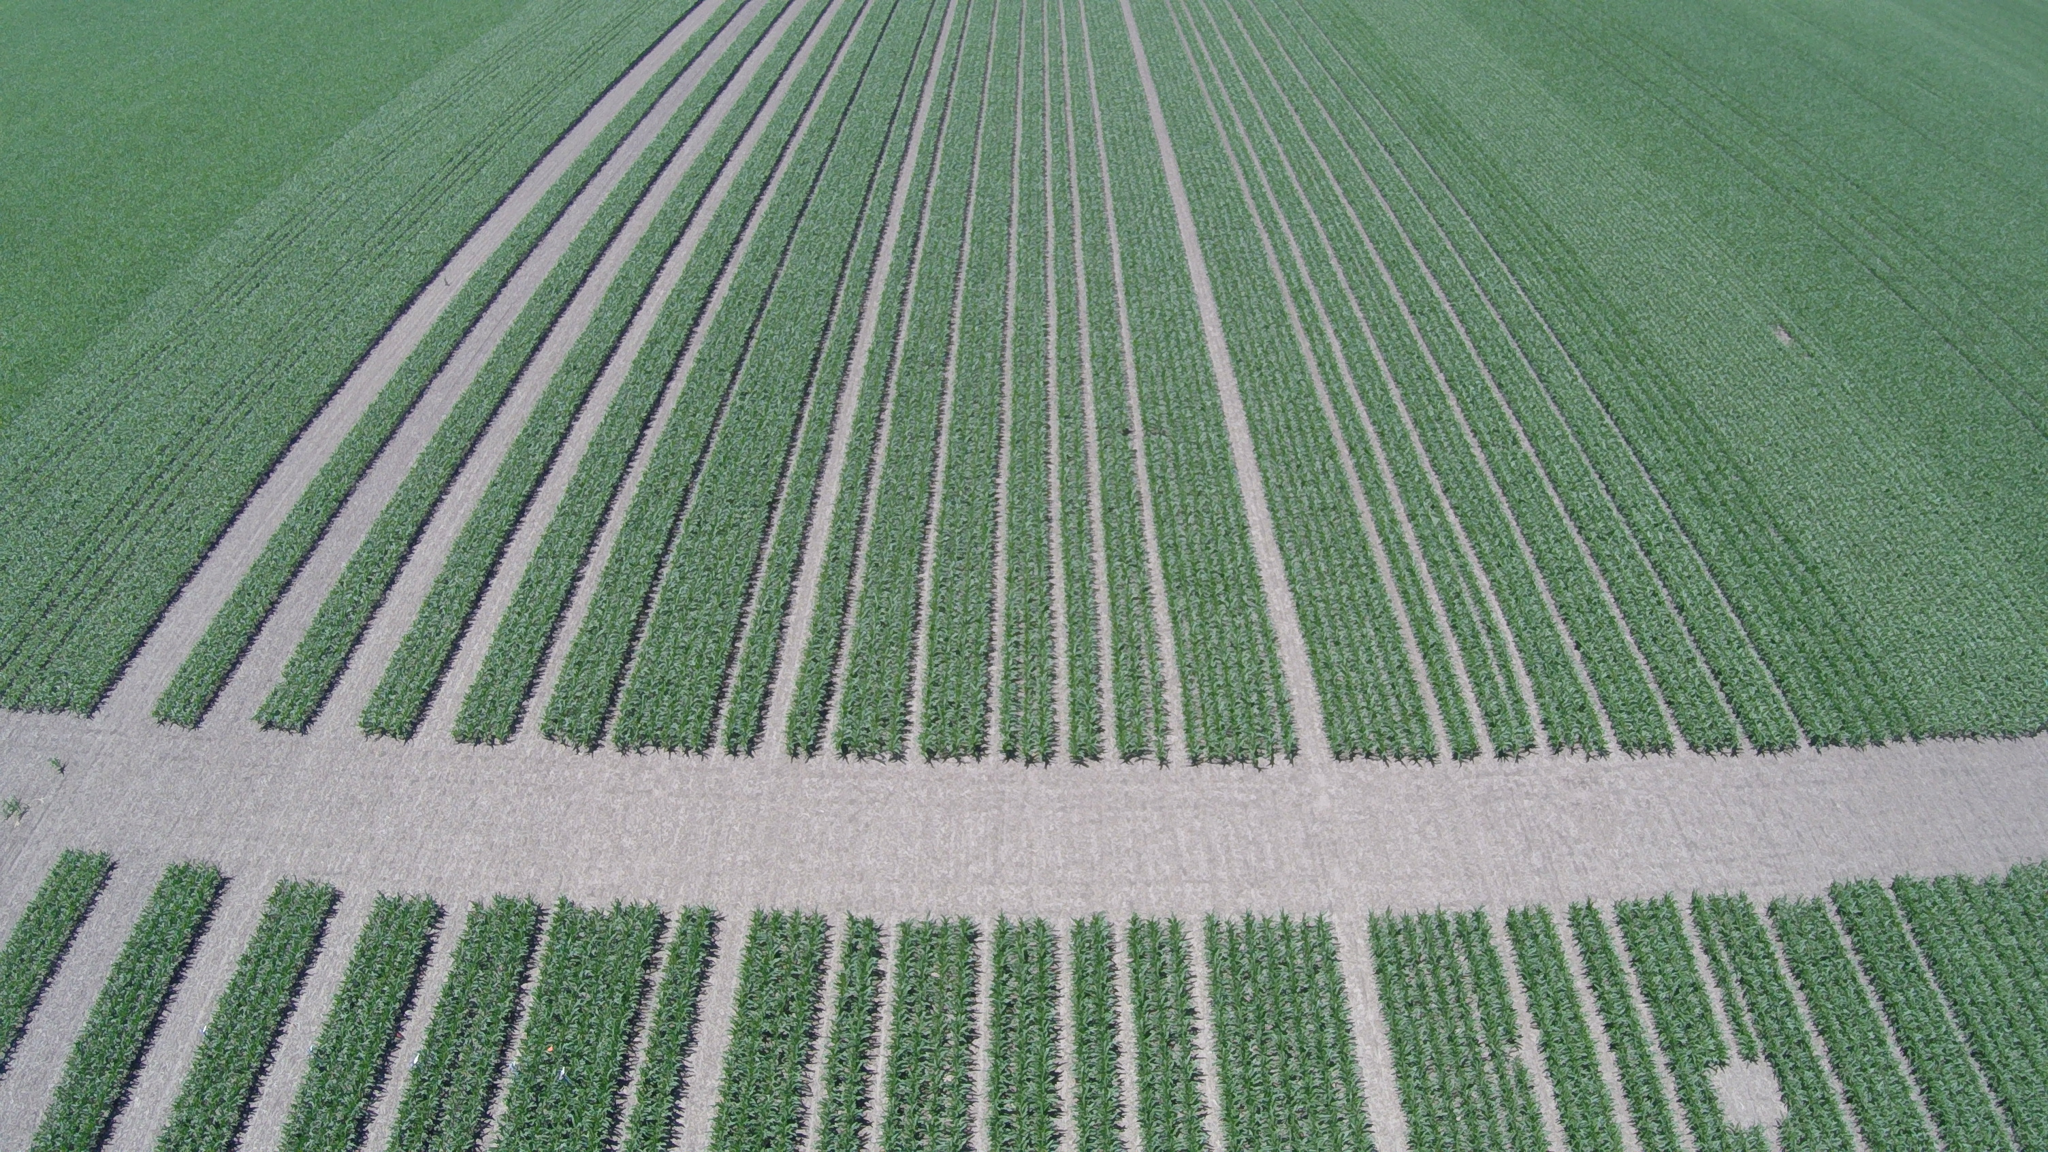
2016 Experiment:
Variable Sunlight Opening Plot
P0157AM5
The focus of this work is based on data from these rows
Note significant difference in yield due to Corn Variety Selection
247 (Center 4 rows)
311
332
316
309
310
Strip Average Yield, bu/a
363
348
356
341
335
262
Plot 52051
Photo Date 16 June 2016
P1197AM

Slide 30
Historical Reference
Plot 52051
2016 Season

Slide 31
Historical Reference
Plot 52051
2016 Season

Slide 32
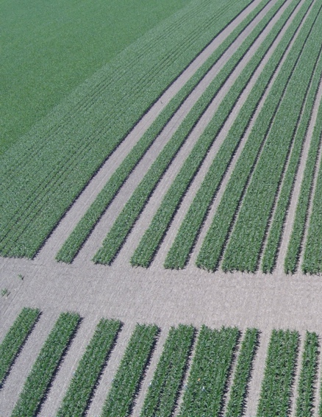
2016 Sunlight Harvest Plots:
“How Much Sunlight is Enough?”
Important Distinction:
Row vs Strip vs Field Yield
Tramline/Controlled Traffic Zone
Soil Health Improvement Focus
Secondary Cash Crop Required: Strip Intercropping
The Answer: Anything more than an additional 30” of row opening is wasting* the sunlight resource
* Only from a Corn Yield Perspective!
© 2017 Cedar Valley Innovation LLC
All Rights Reserved

Slide 33
Plot 30011
2023 Plan
Field Day
Layouts
Rep 1
350’
Rep 2
Repeated treatments as in 2021 & 2022 Season
More Emphasis on vegetable production
Food Bank Support with Greens as a focus
Rep 3
Rep 4

Slide 34
Plot 30181 2023 Plan
3.6 Acres
Continue Corn Variety vs row configuration studies
Earlier, more aggressive cover crop activities
Community/Public “Drive Around” Invitation
Compaction Reduction Trial
Pollinator Trial

Slide 35
For more information:
YouTube: @CedarValleyUncleBob
Facebook: www.facebook.com/bob.recker
Twitter: @OldBobRecker

Slide 36


Thank You for your support

