Slide 1
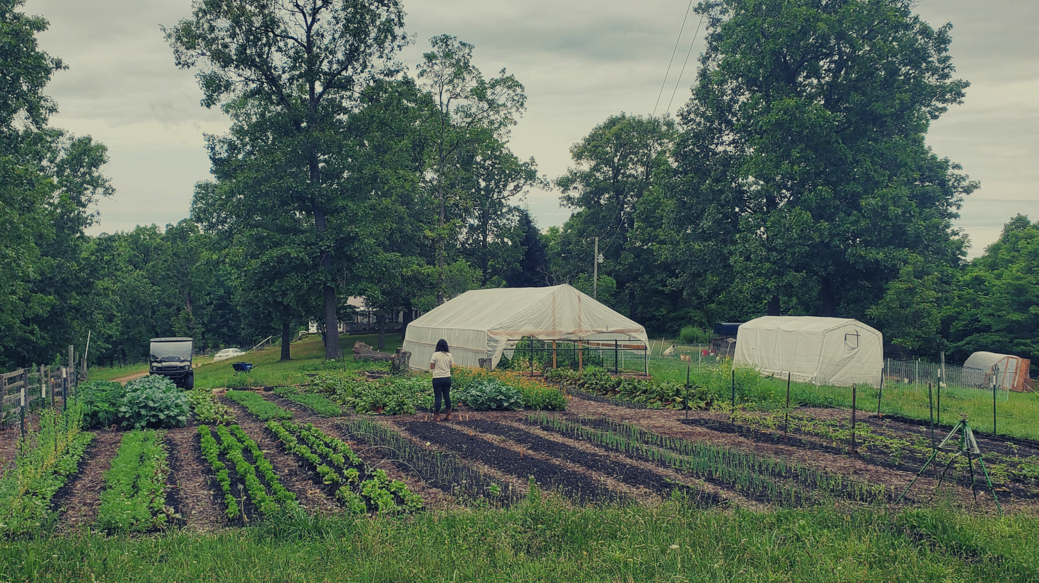

Slide 2


Slide 3
SUN AND BLOOM FARMS
SARE Funded Benefits of On-Farm Vermicomposting
Agenda:
Who We Are, What We Do & How We Got Here
Our Market Garden Growing Practices & Role of Vermicompost
Our SARE Grant Application Approach & Experience

Slide 4

SUN AND BLOOM FARMS
SARE Funded Benefits of On-Farm Vermicomposting
1. Who We Are, What We Do & How We Got Here

Slide 5
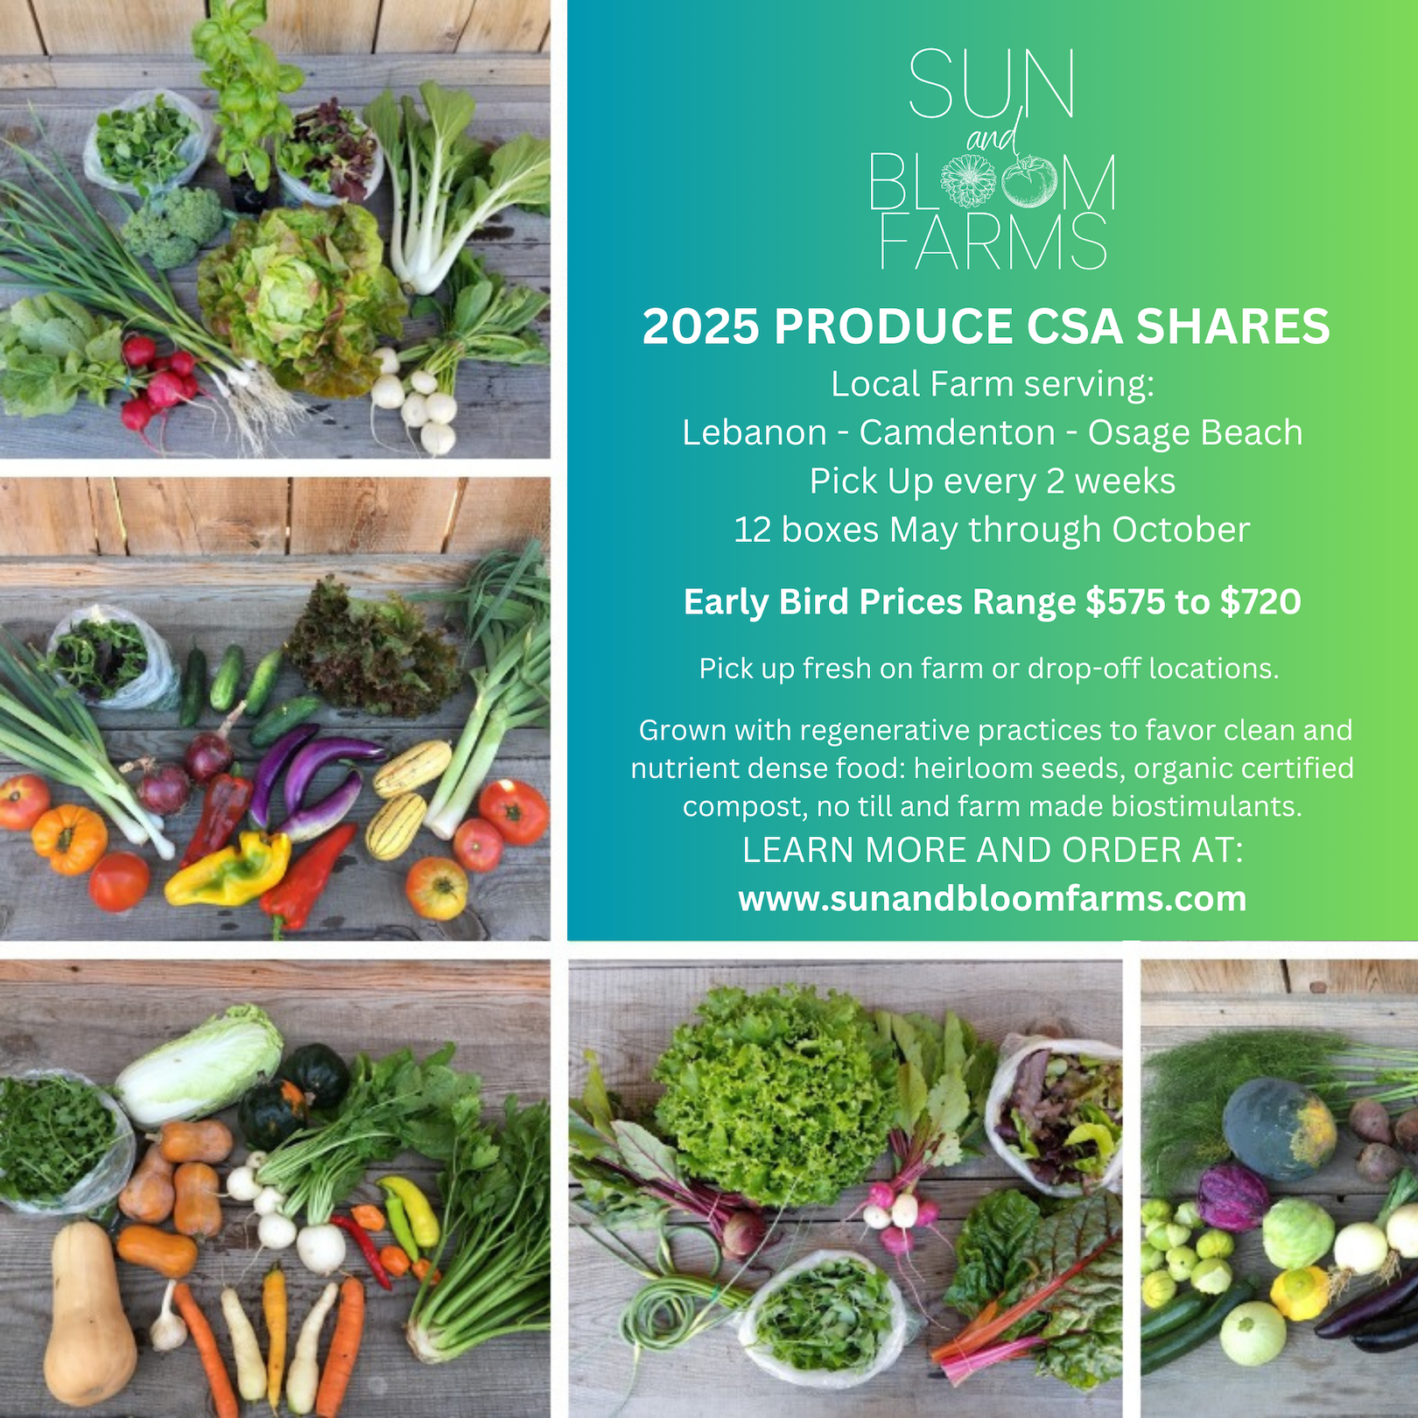
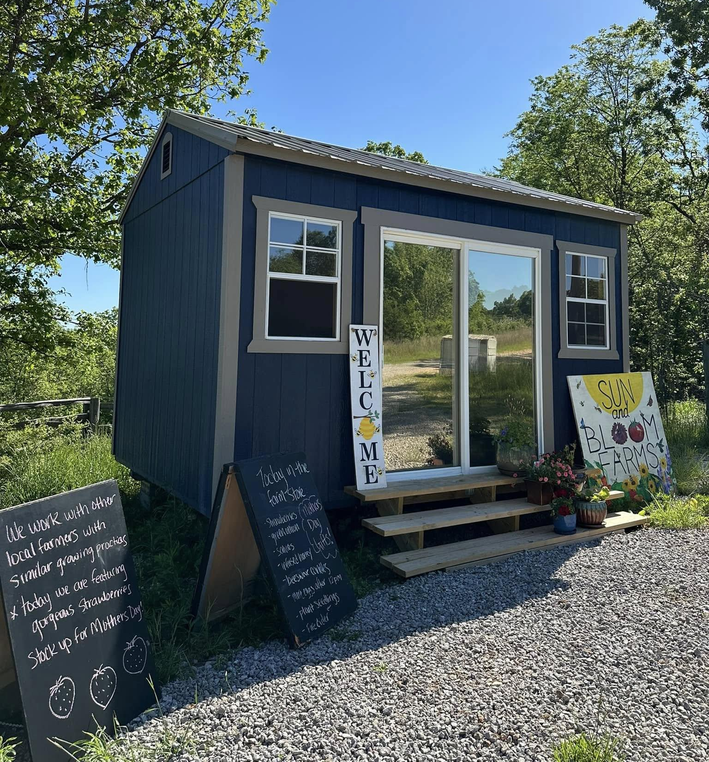
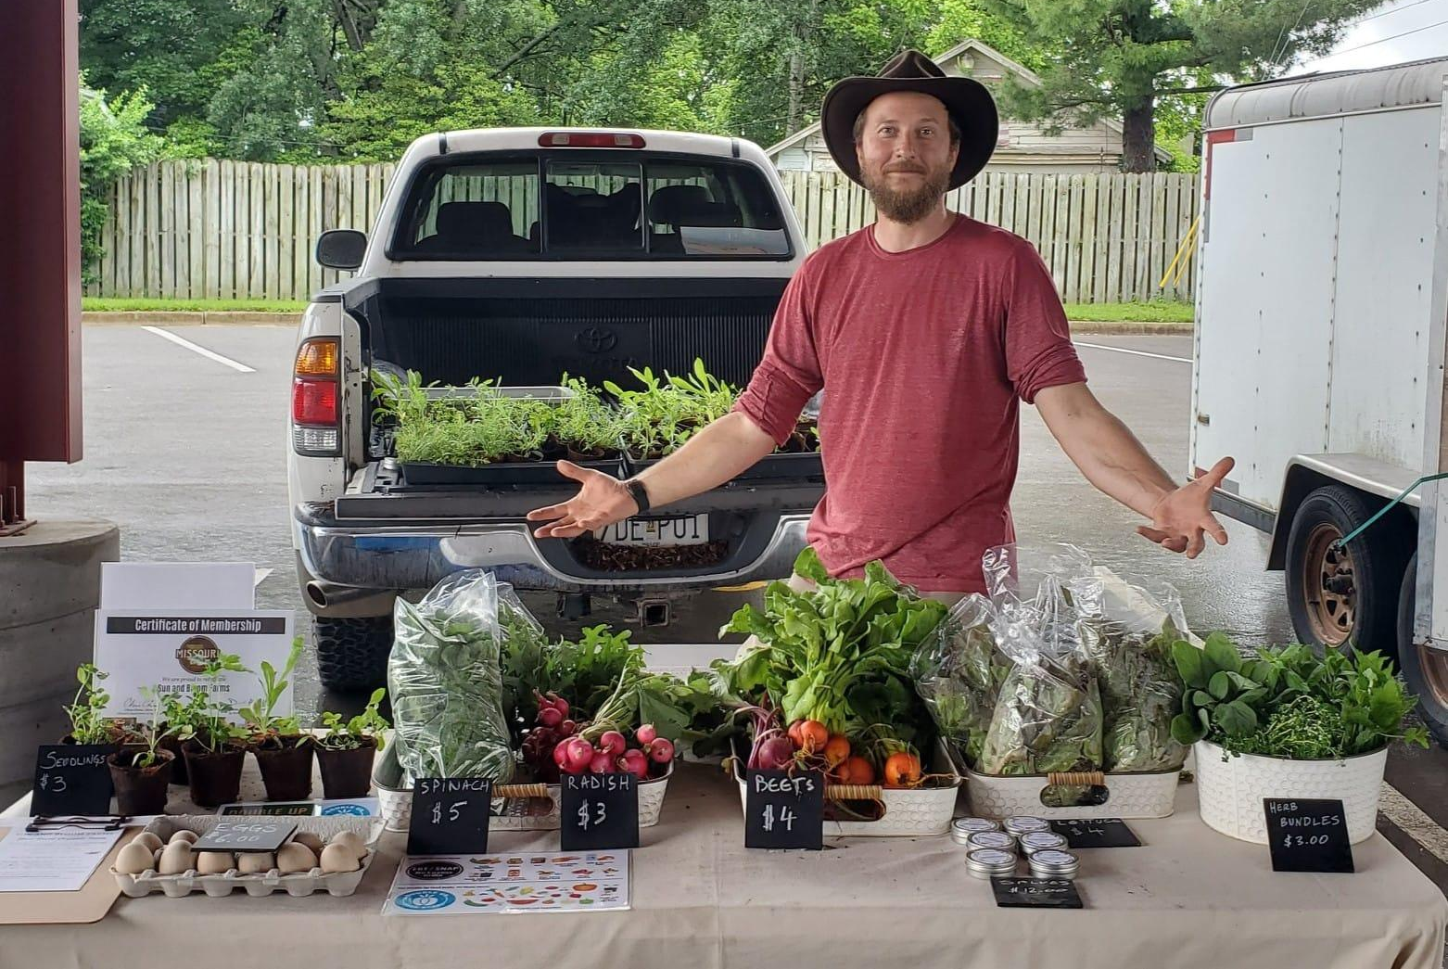
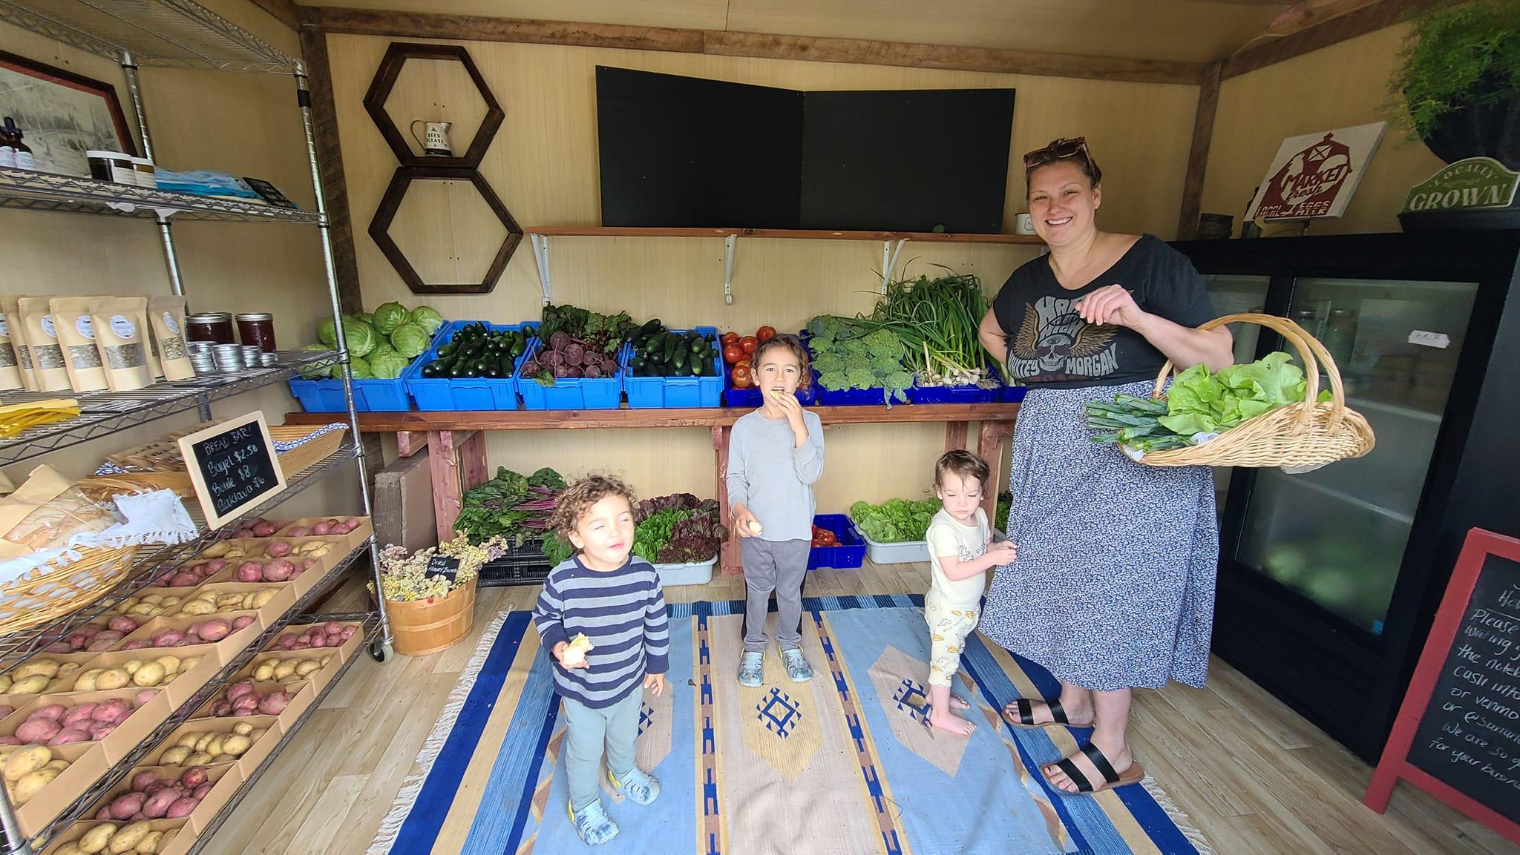
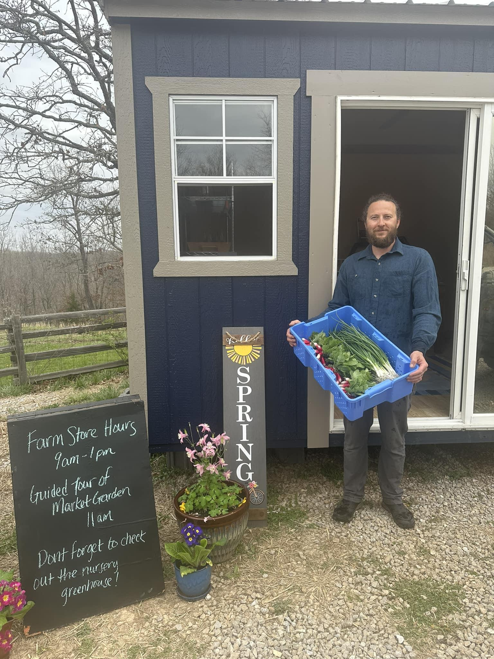
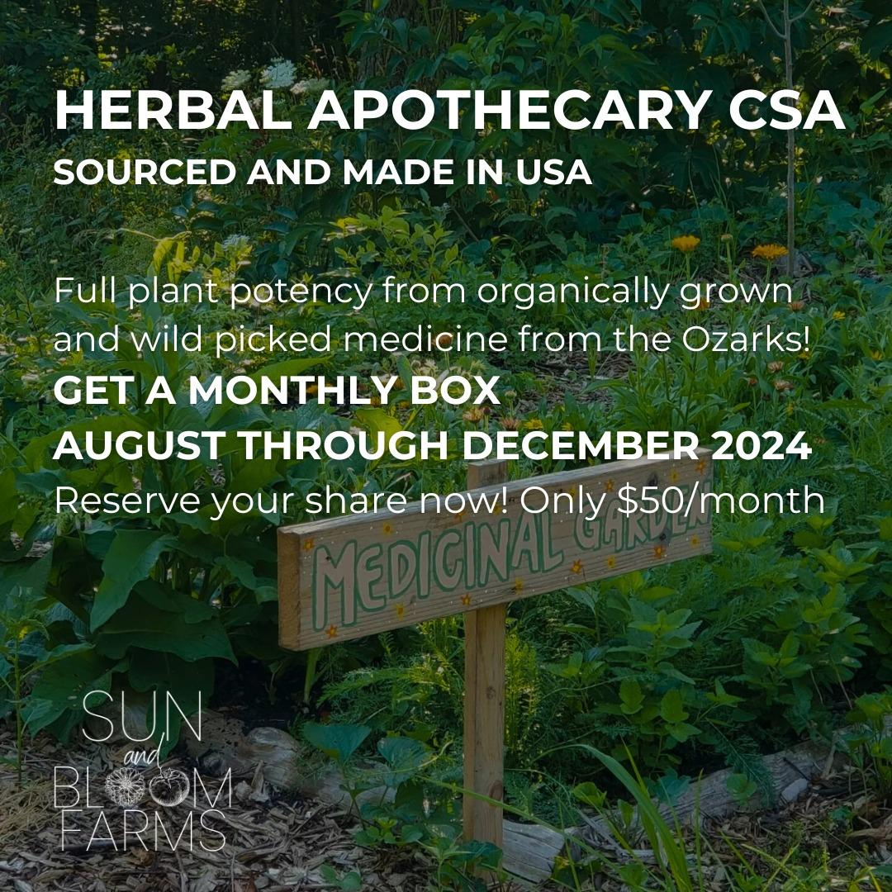

SUN AND BLOOM FARMS
SARE Funded Benefits of On-Farm Vermicomposting
1. Who We Are, What We Do & How We Got Here
FARM GOODS

Slide 6
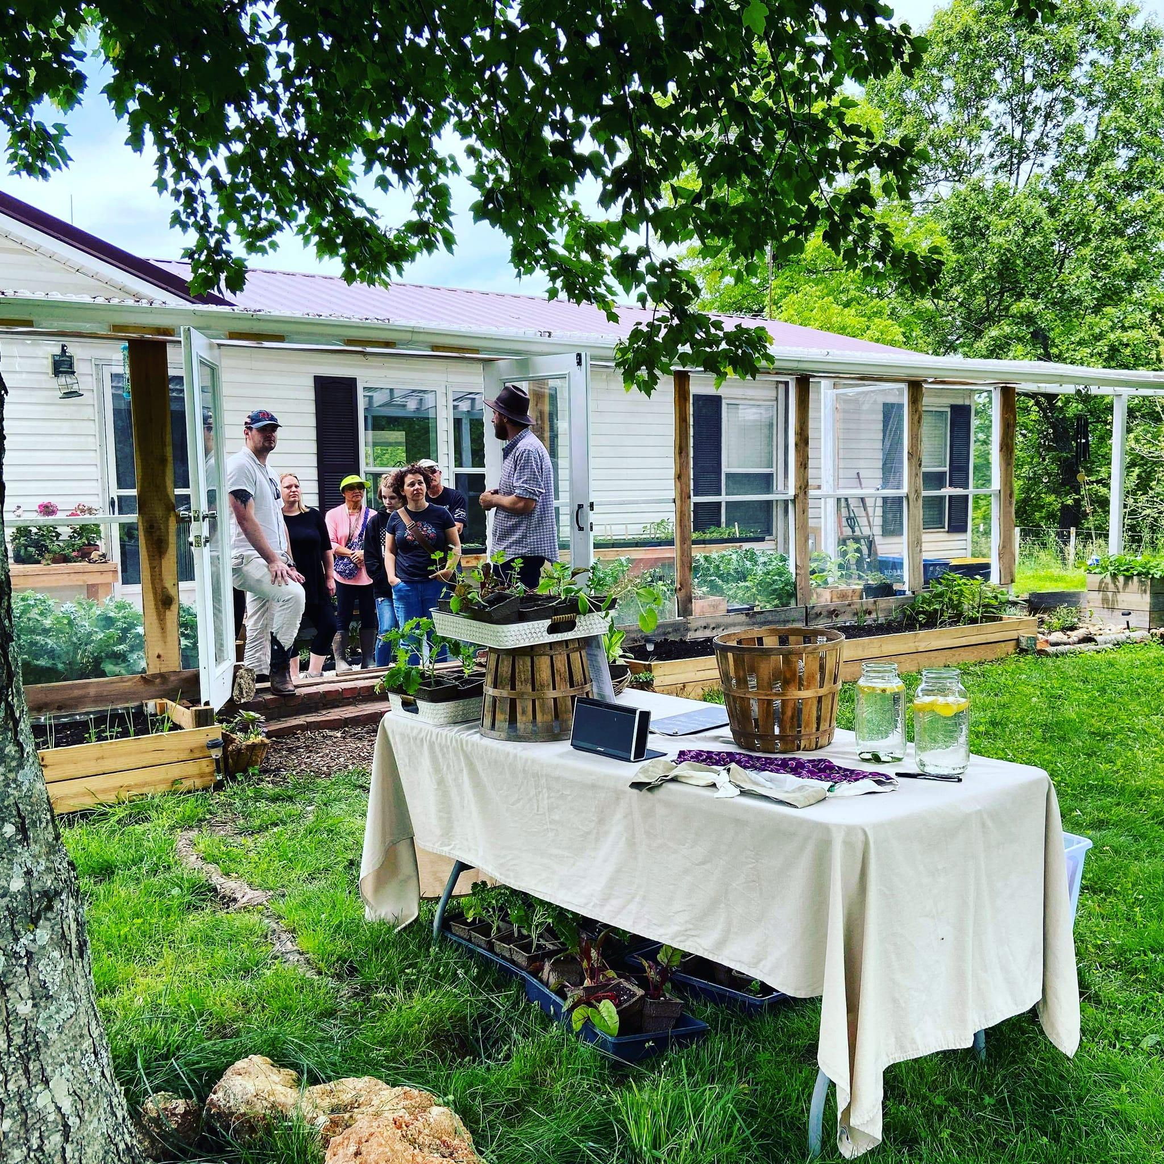
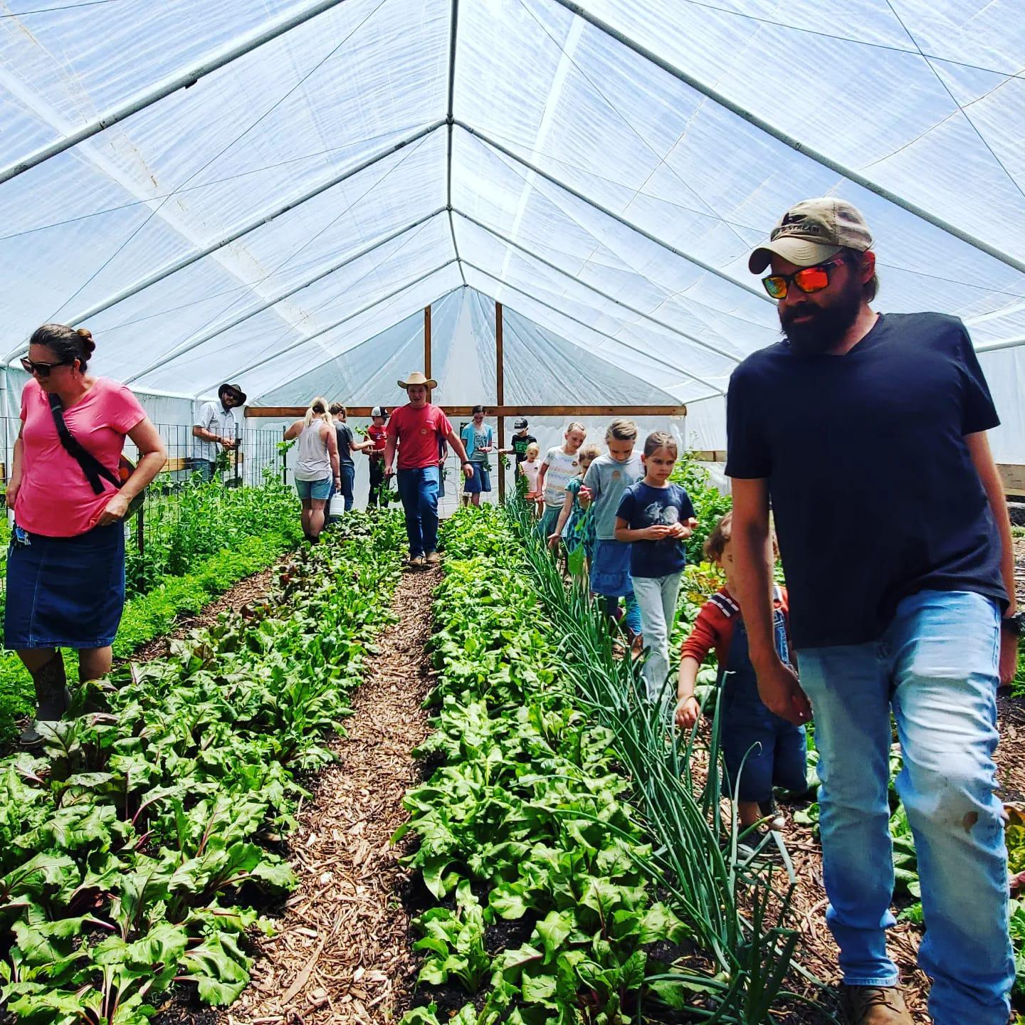
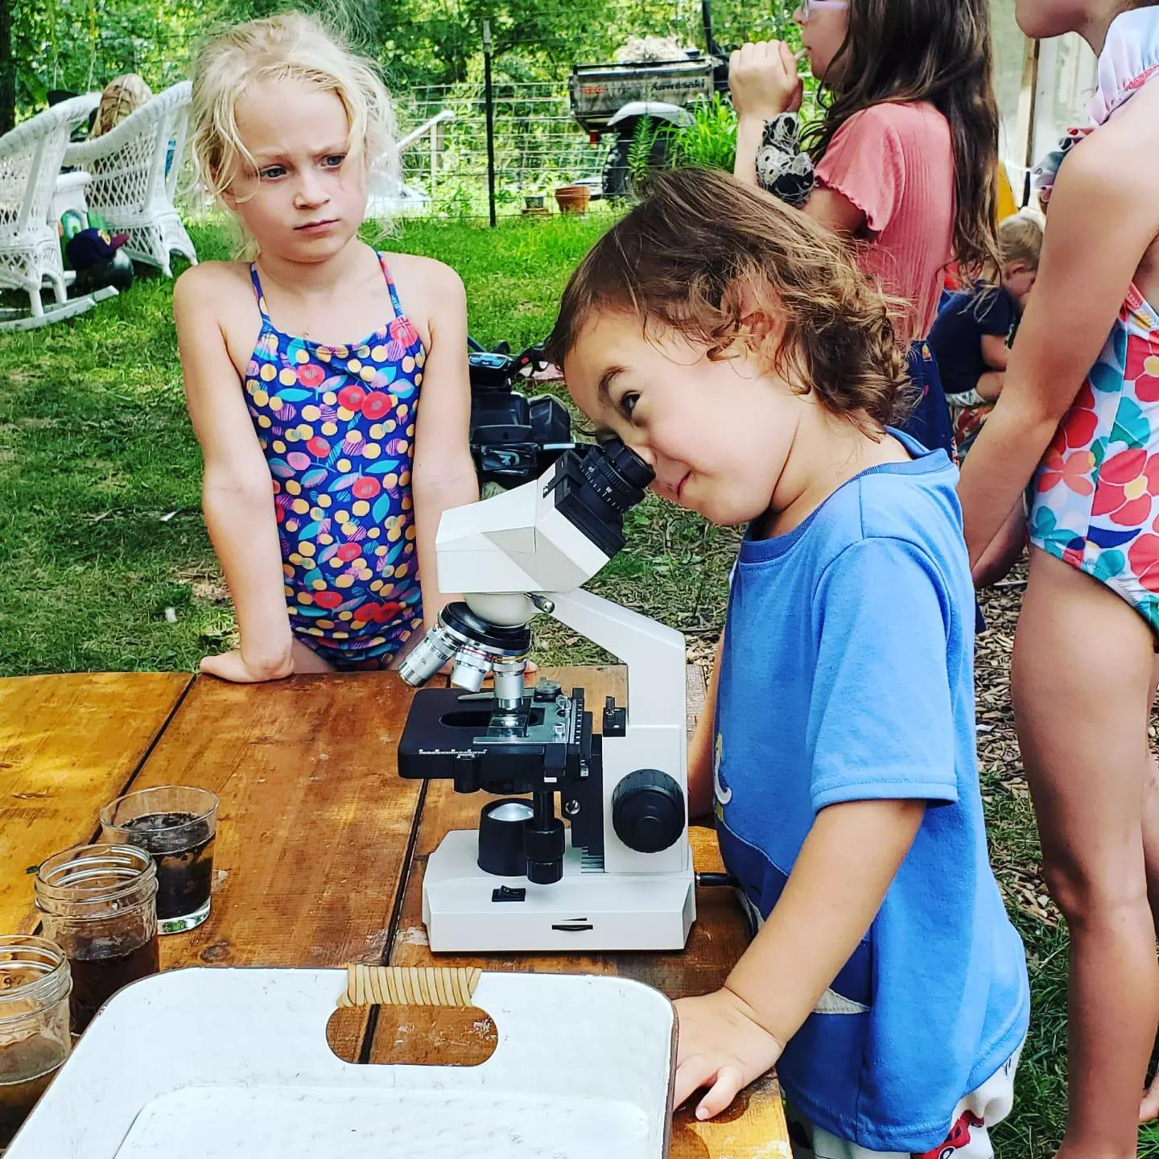
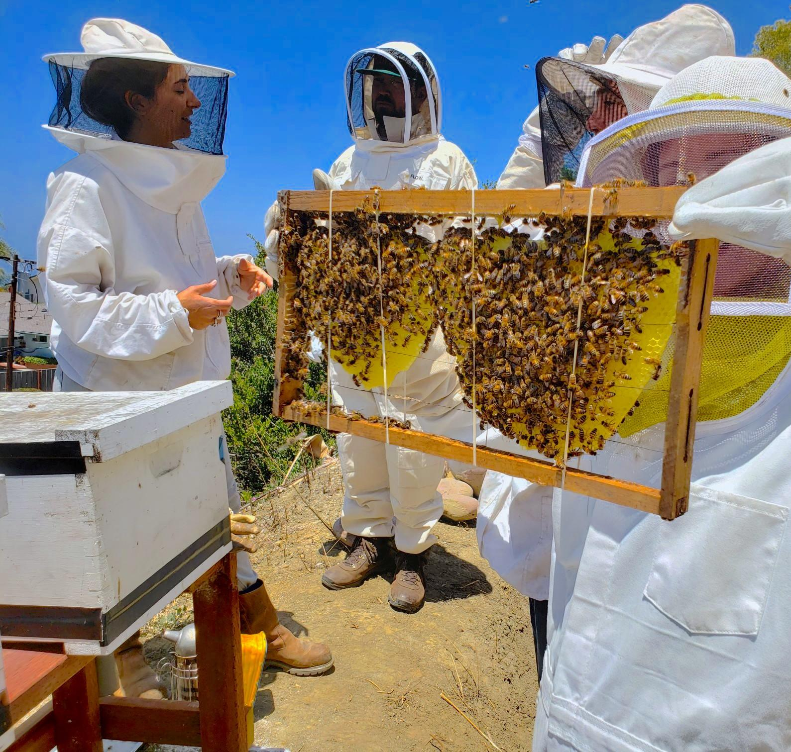
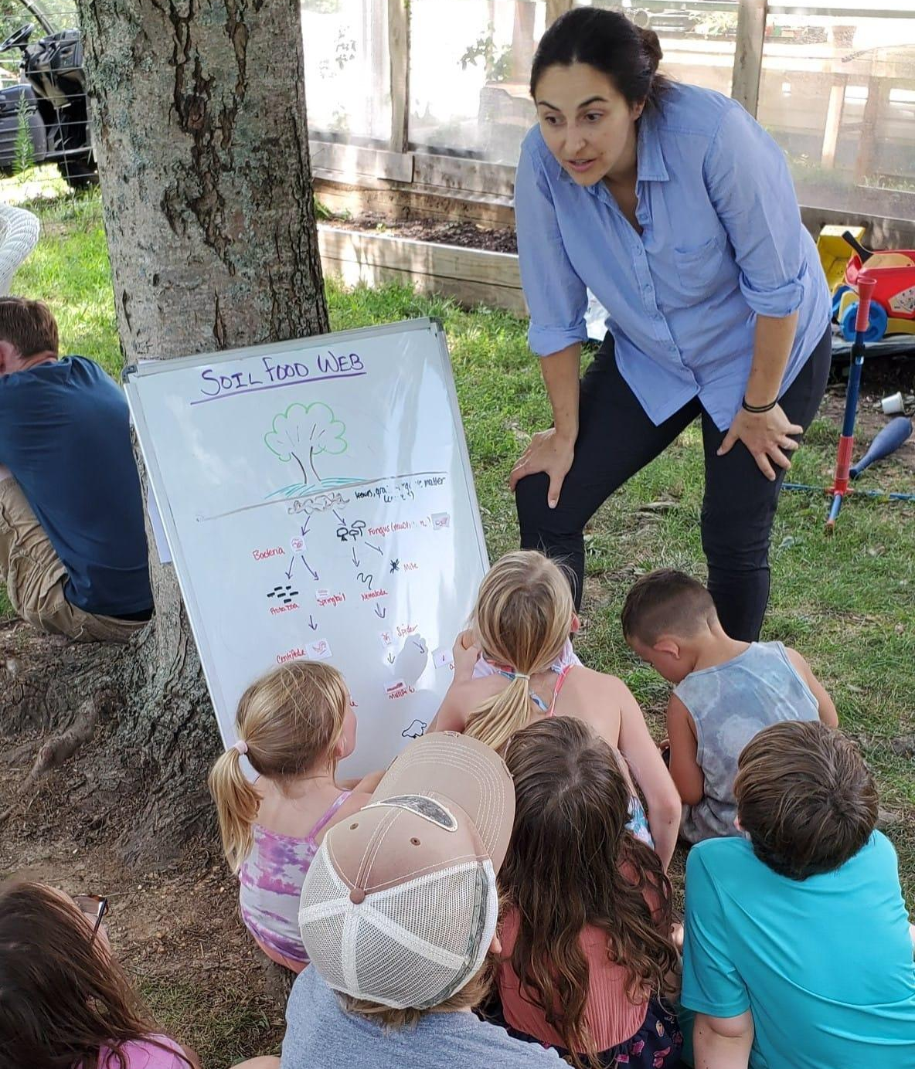
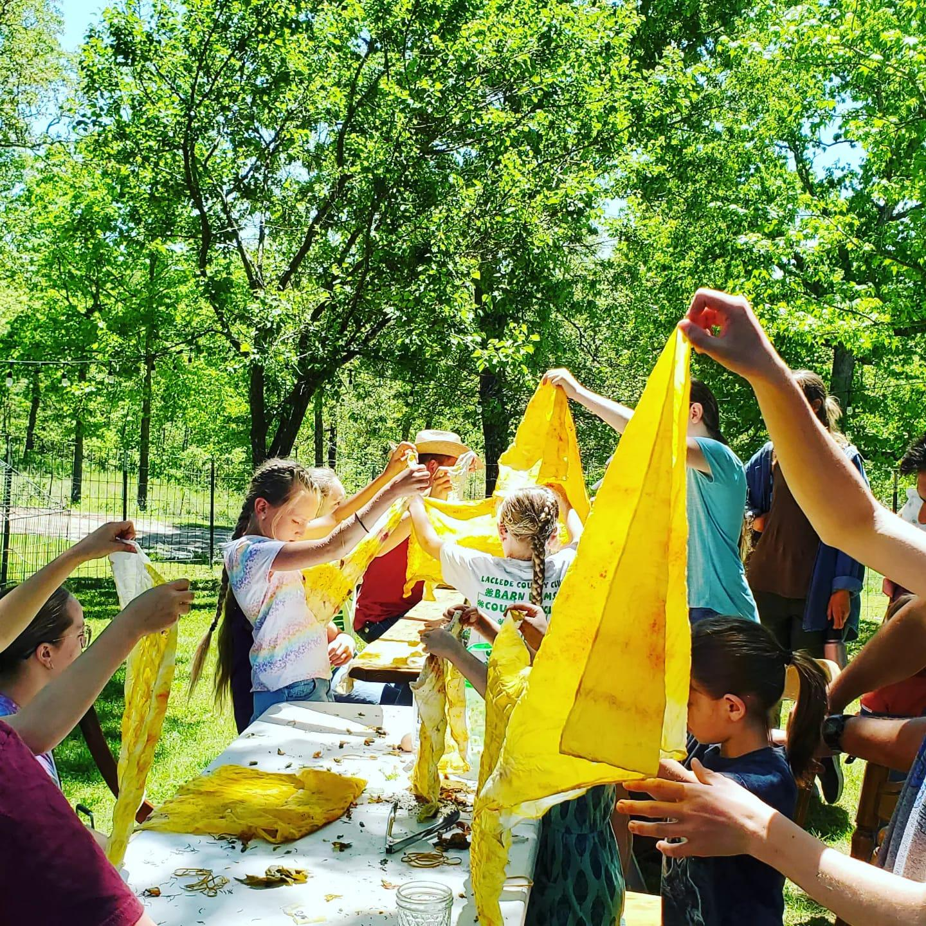
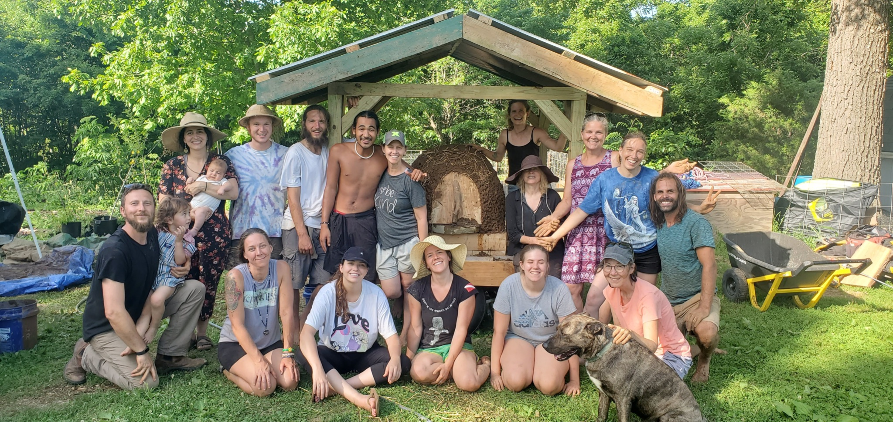
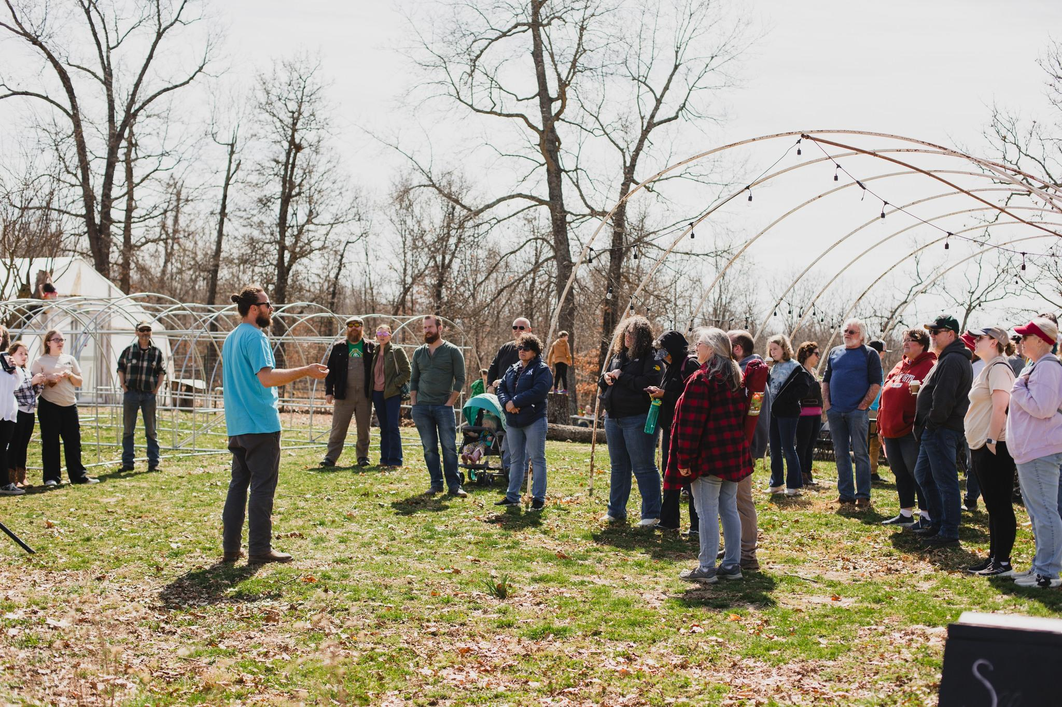
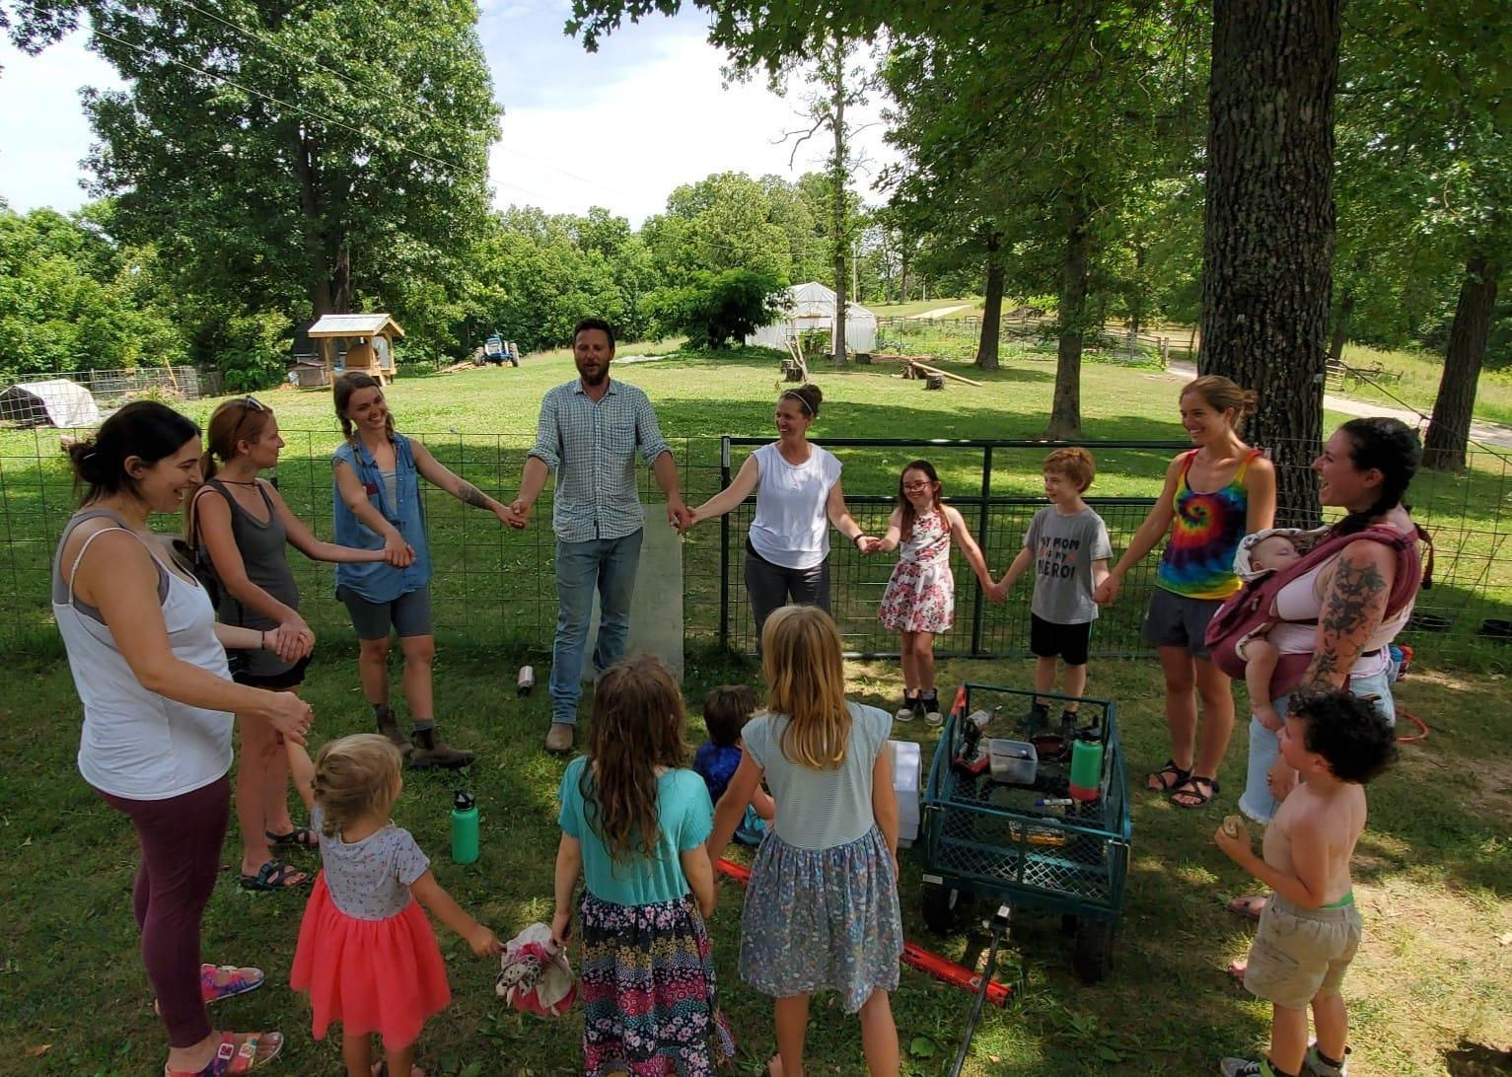
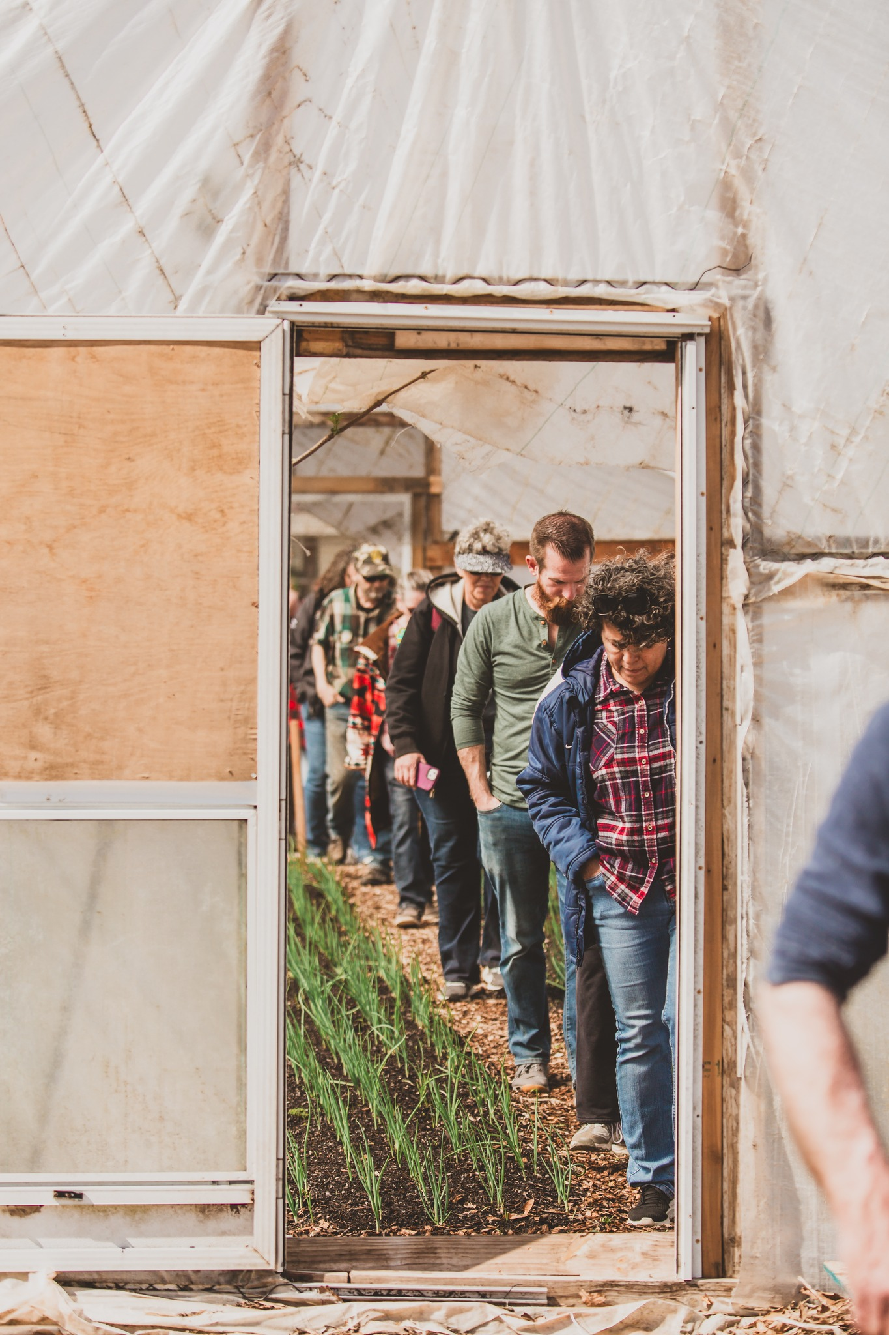
SUN AND BLOOM FARMS
SARE Funded Benefits of On-Farm Vermicomposting
1. Who We Are, What We Do & How We Got Here
ON FARM CHILD & ADULT EDUCATION

Slide 7

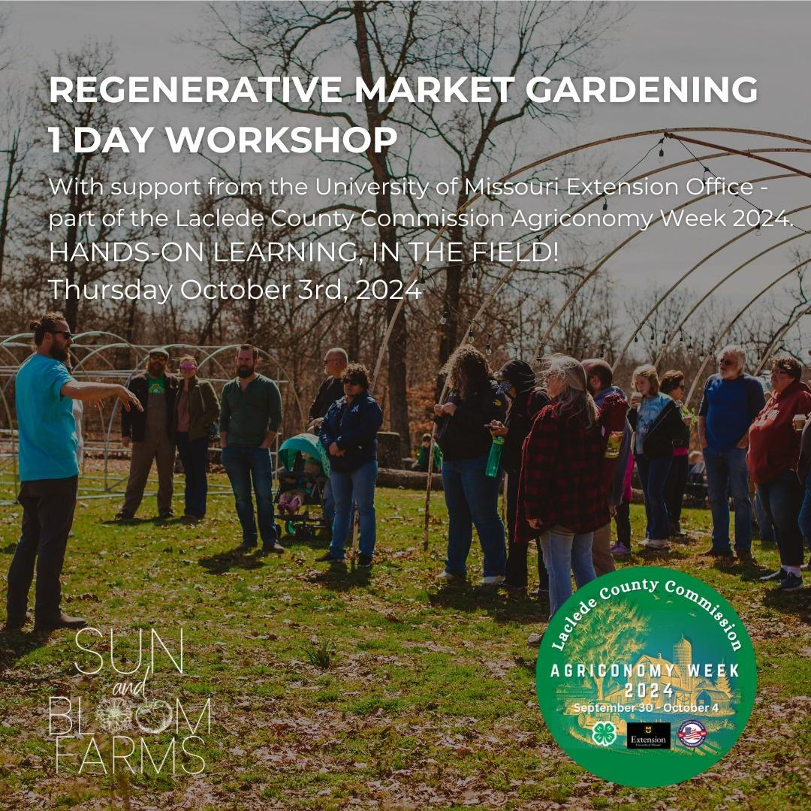
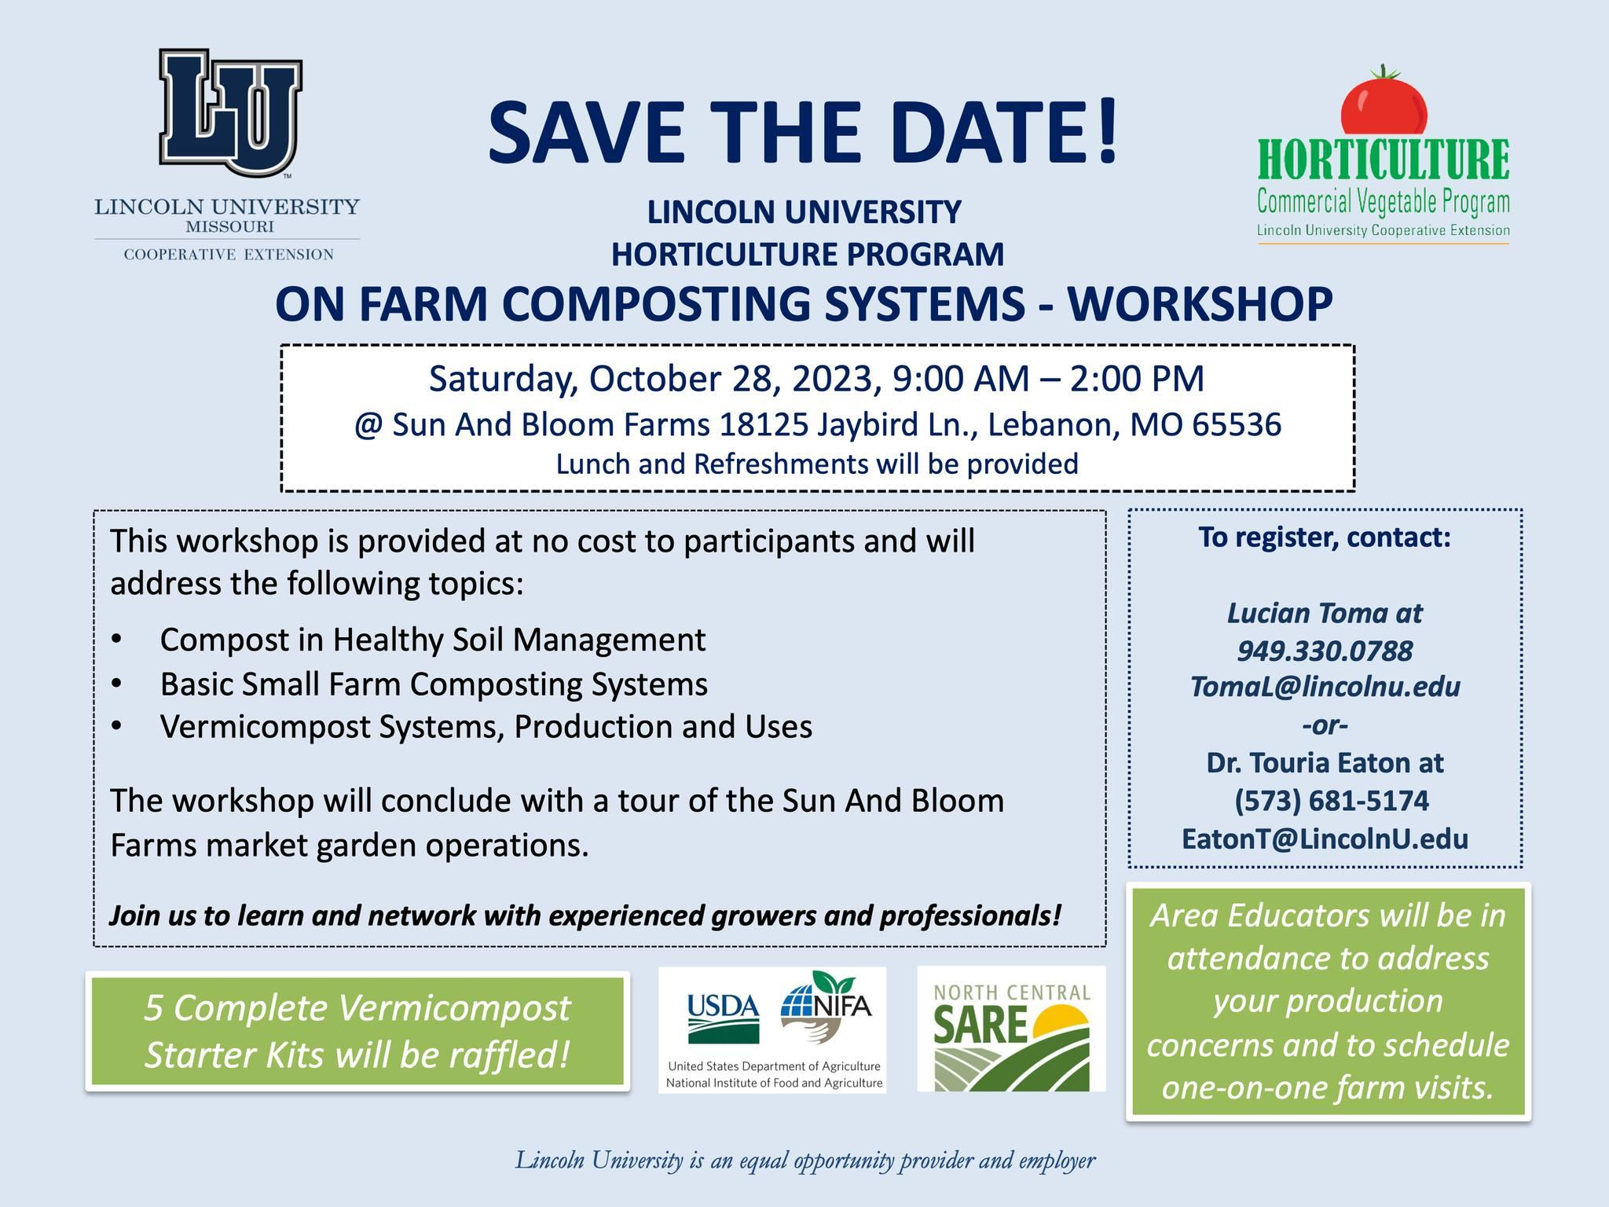
SUN AND BLOOM FARMS
SARE Funded Benefits of On-Farm Vermicomposting
1. Who We Are, What We Do & How We Got Here
ON FARM CHILD & ADULT EDUCATION / IN PARTNERSHIP WITH OTHER COMMUNITY LEADERS

Slide 8



SUN AND BLOOM FARMS
SARE Funded Benefits of On-Farm Vermicomposting
1. Who We Are, What We Do & How We Got Here
COMMUNITY GATHERINGS

Slide 9
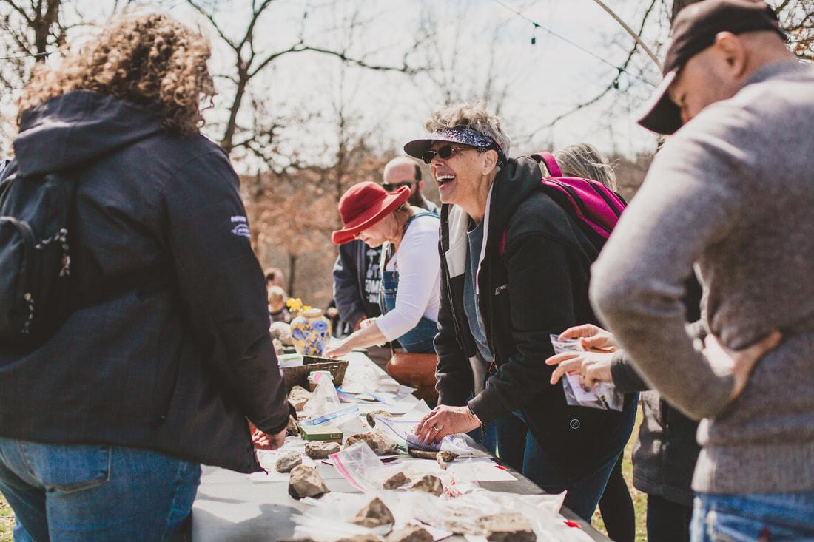
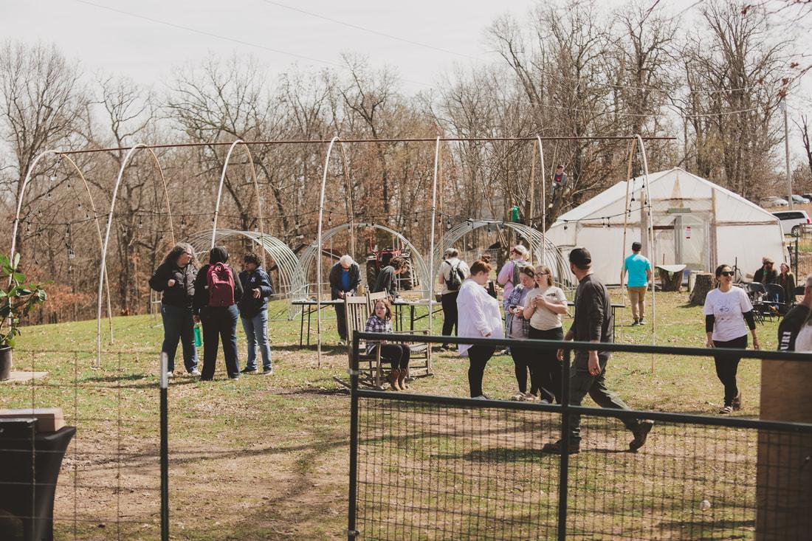
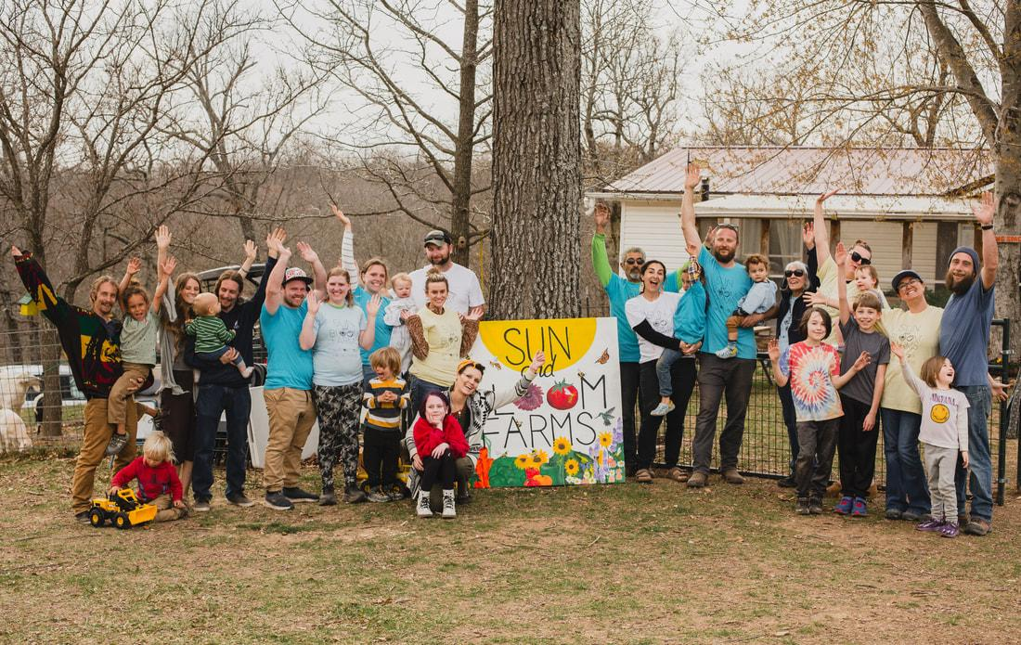
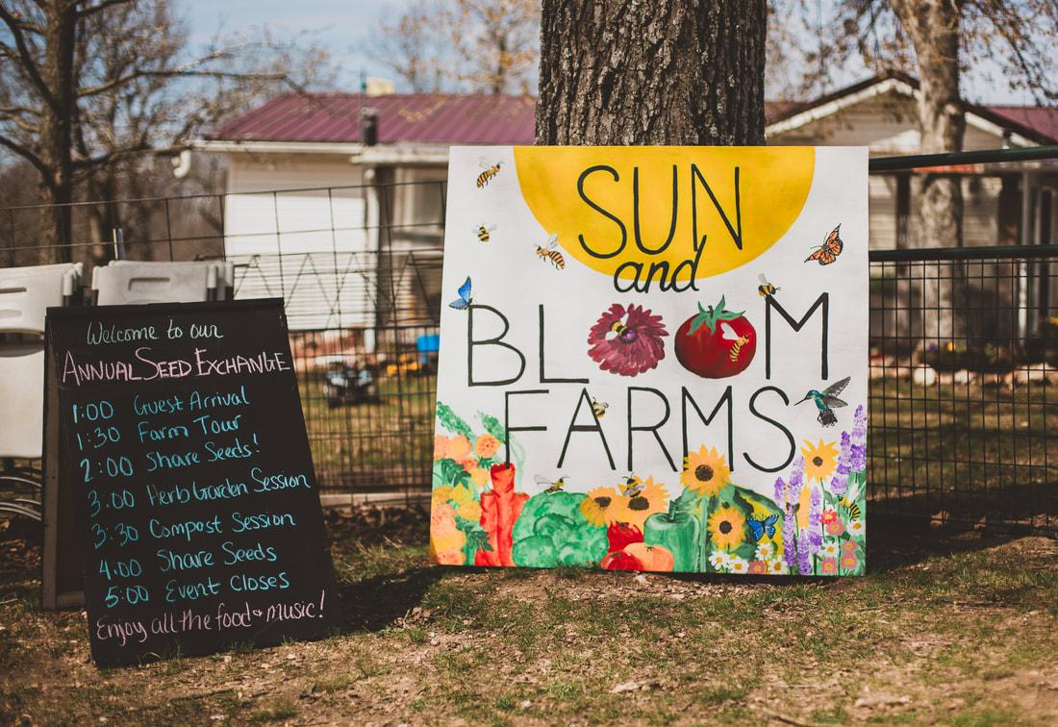


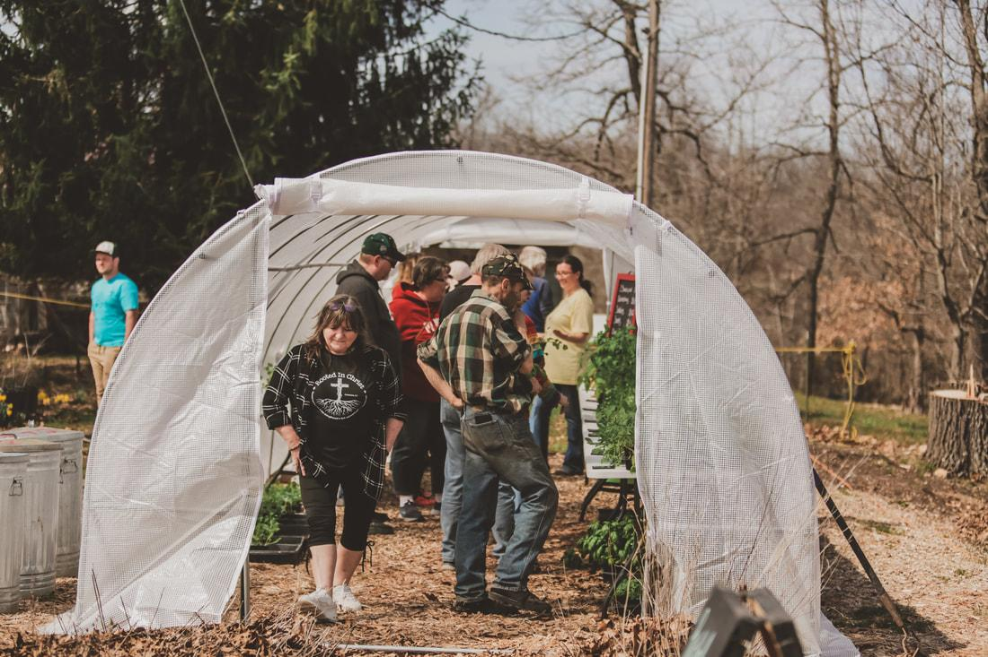
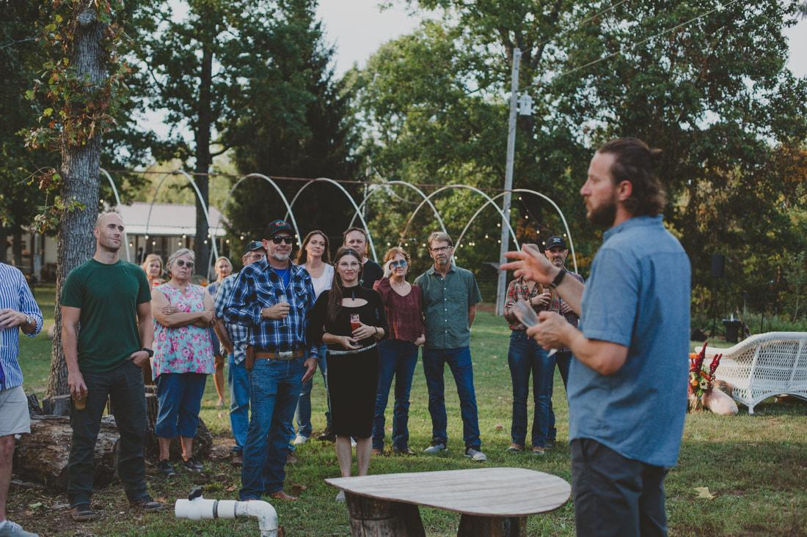
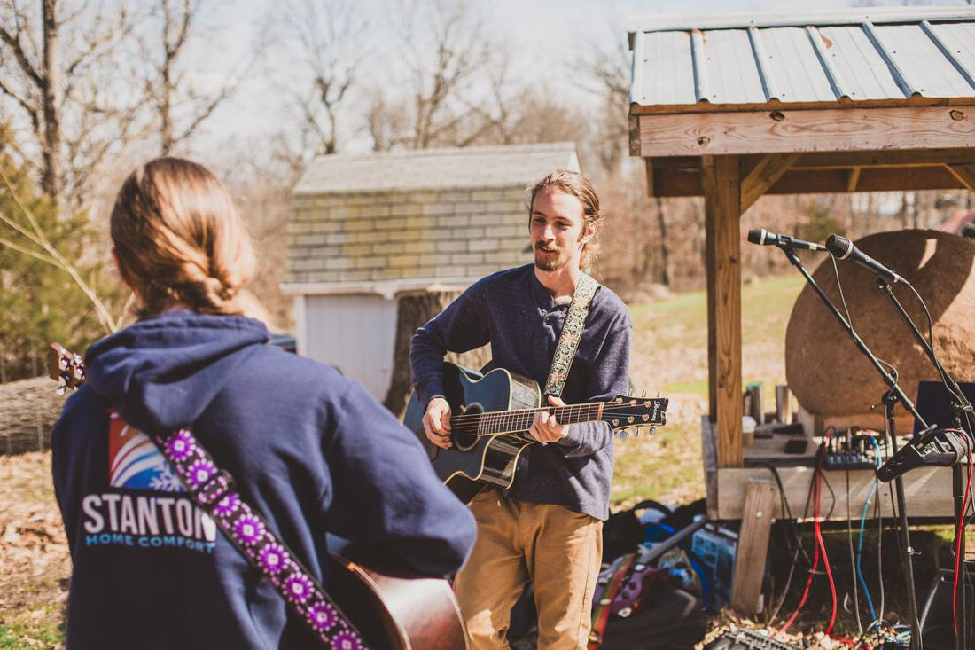
SUN AND BLOOM FARMS
SARE Funded Benefits of On-Farm Vermicomposting
1. Who We Are, What We Do & How We Got Here
COMMUNITY GATHERINGS

Slide 10


SUN AND BLOOM FARMS
SARE Funded Benefits of On-Farm Vermicomposting
1. Who We Are, What We Do & How We Got Here
ONLINE EDUCATION

Slide 11
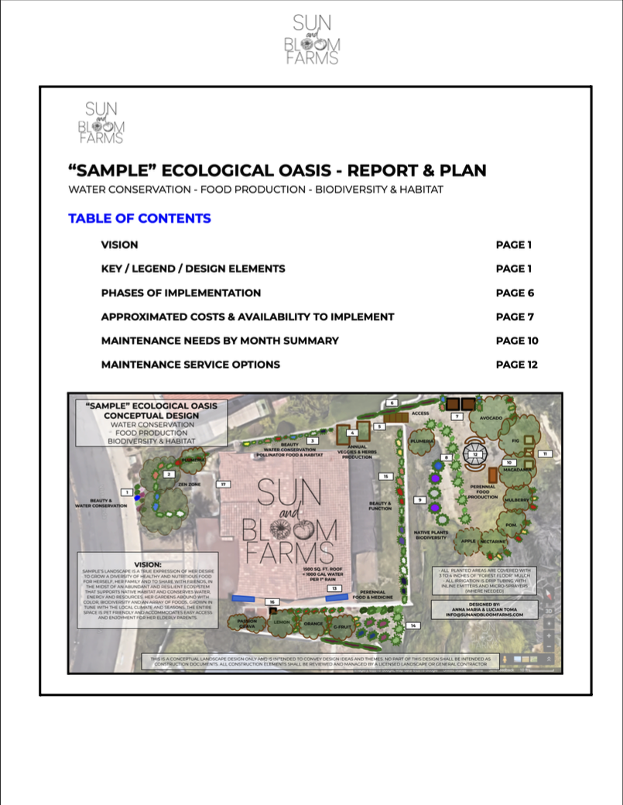

SUN AND BLOOM FARMS
SARE Funded Benefits of On-Farm Vermicomposting
1. Who We Are, What We Do & How We Got Here
GARDEN & FARM DESIGN & BUSINESS CONSULTING

Slide 12
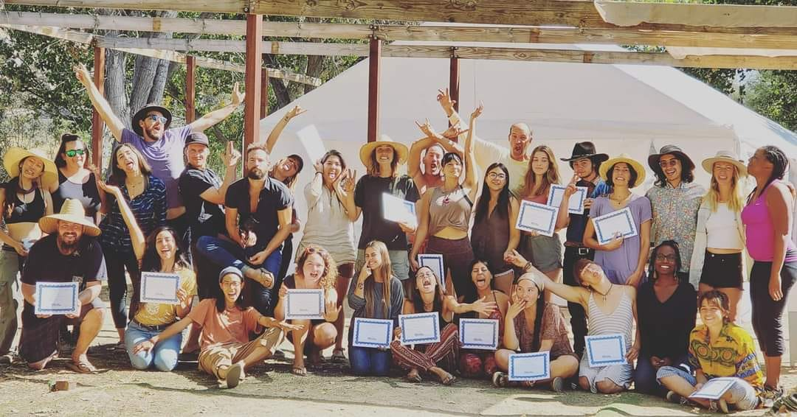
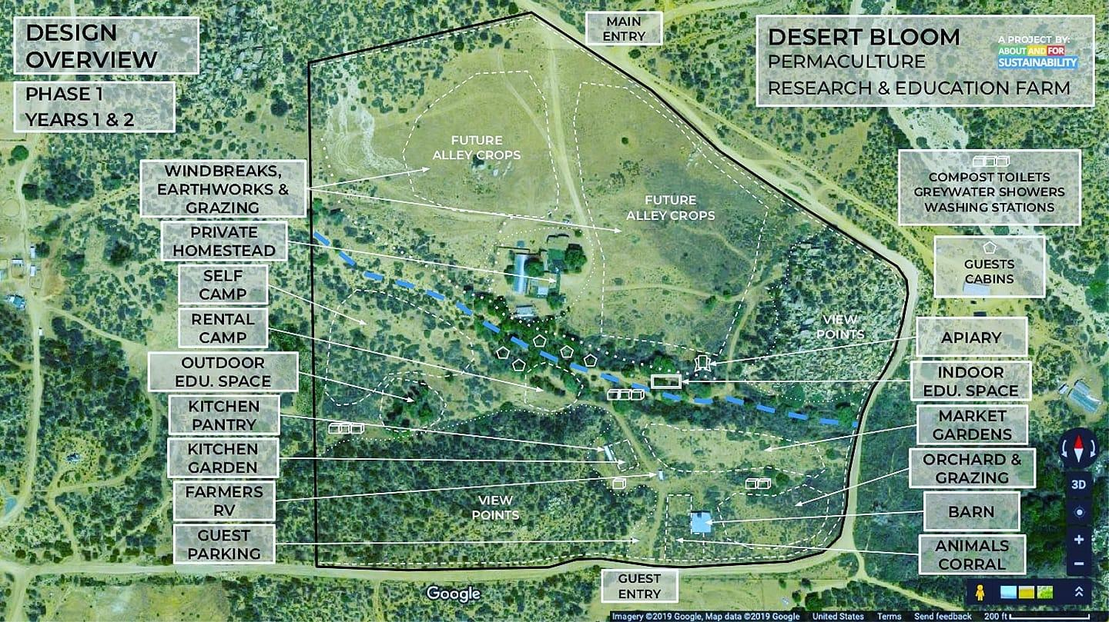
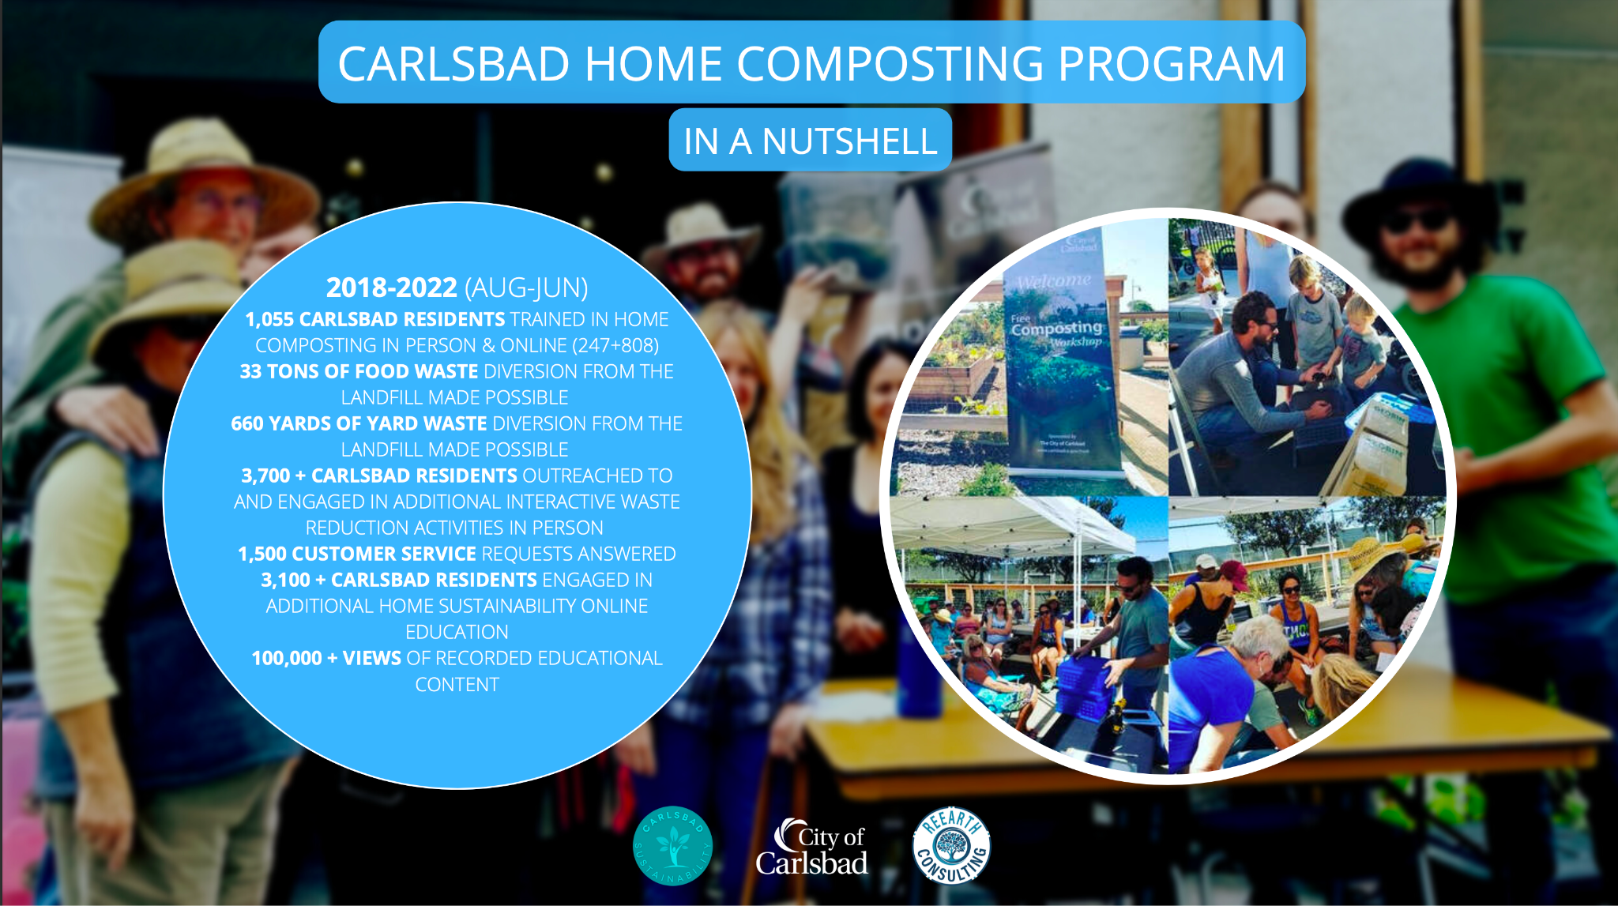
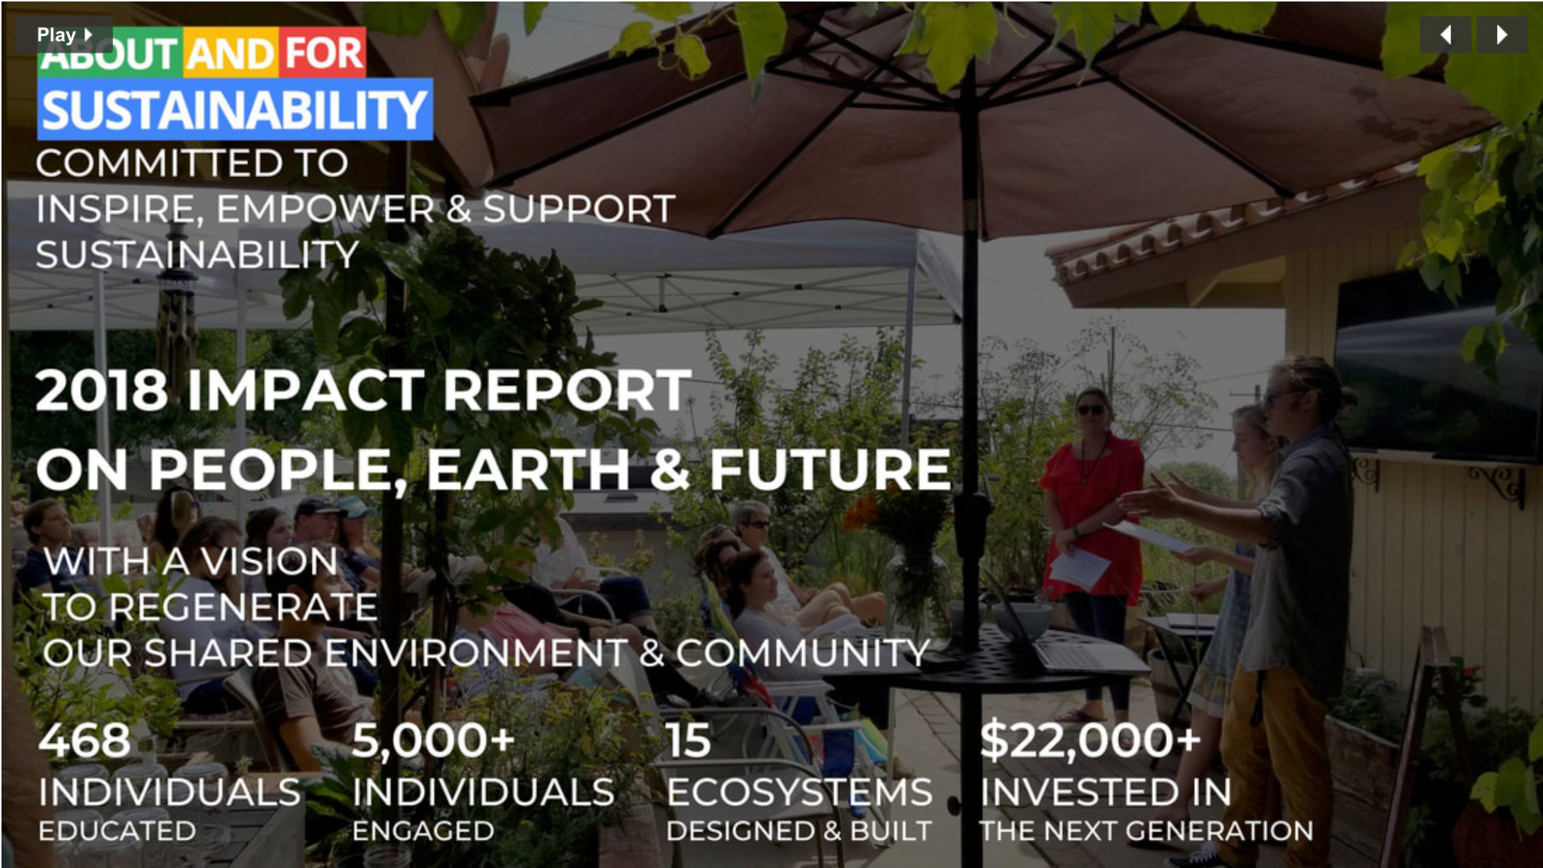
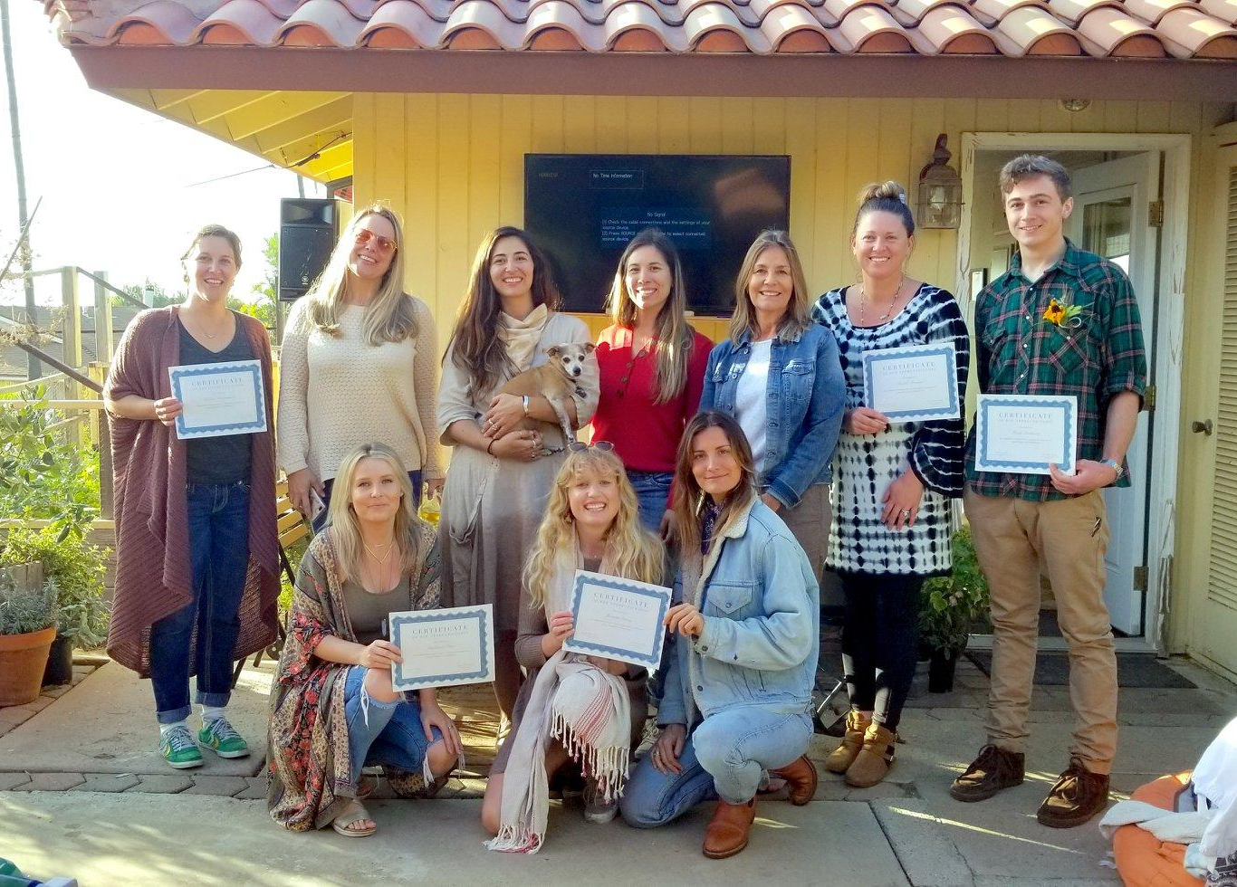
SUN AND BLOOM FARMS
SARE Funded Benefits of On-Farm Vermicomposting
1. Who We Are, What We Do & How We Got Here
OUR BACKGROUND

Slide 13
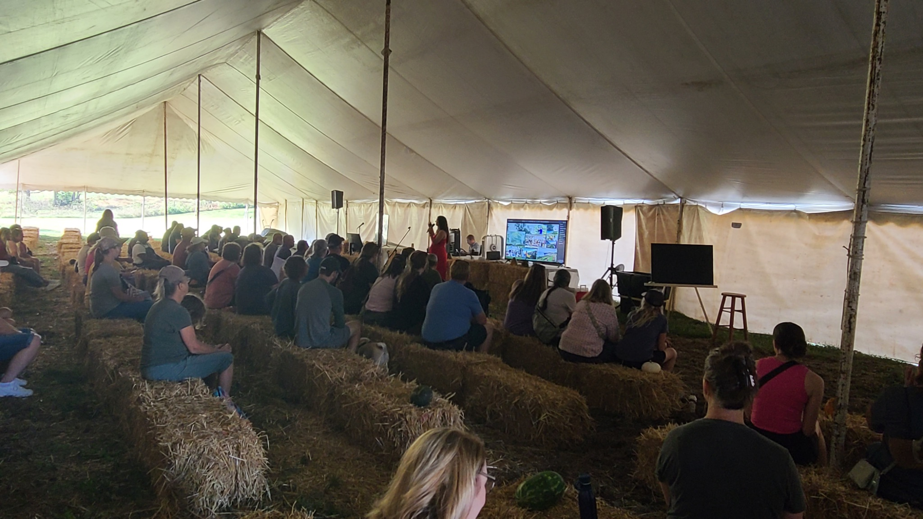
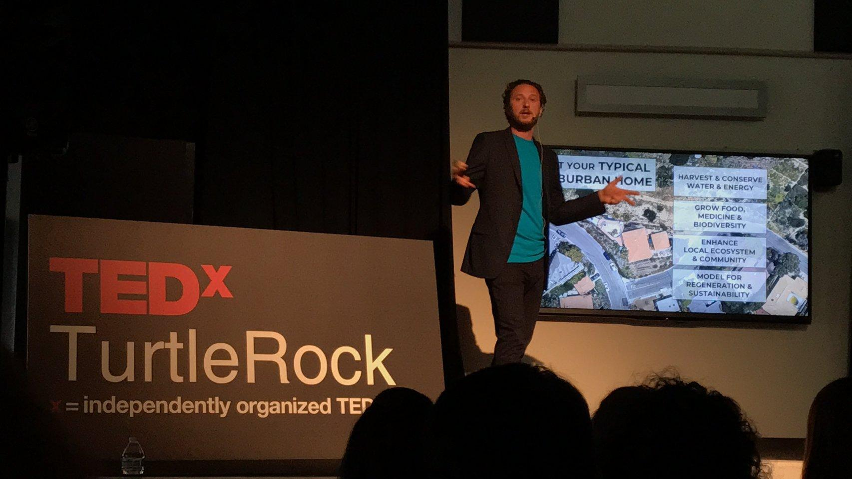

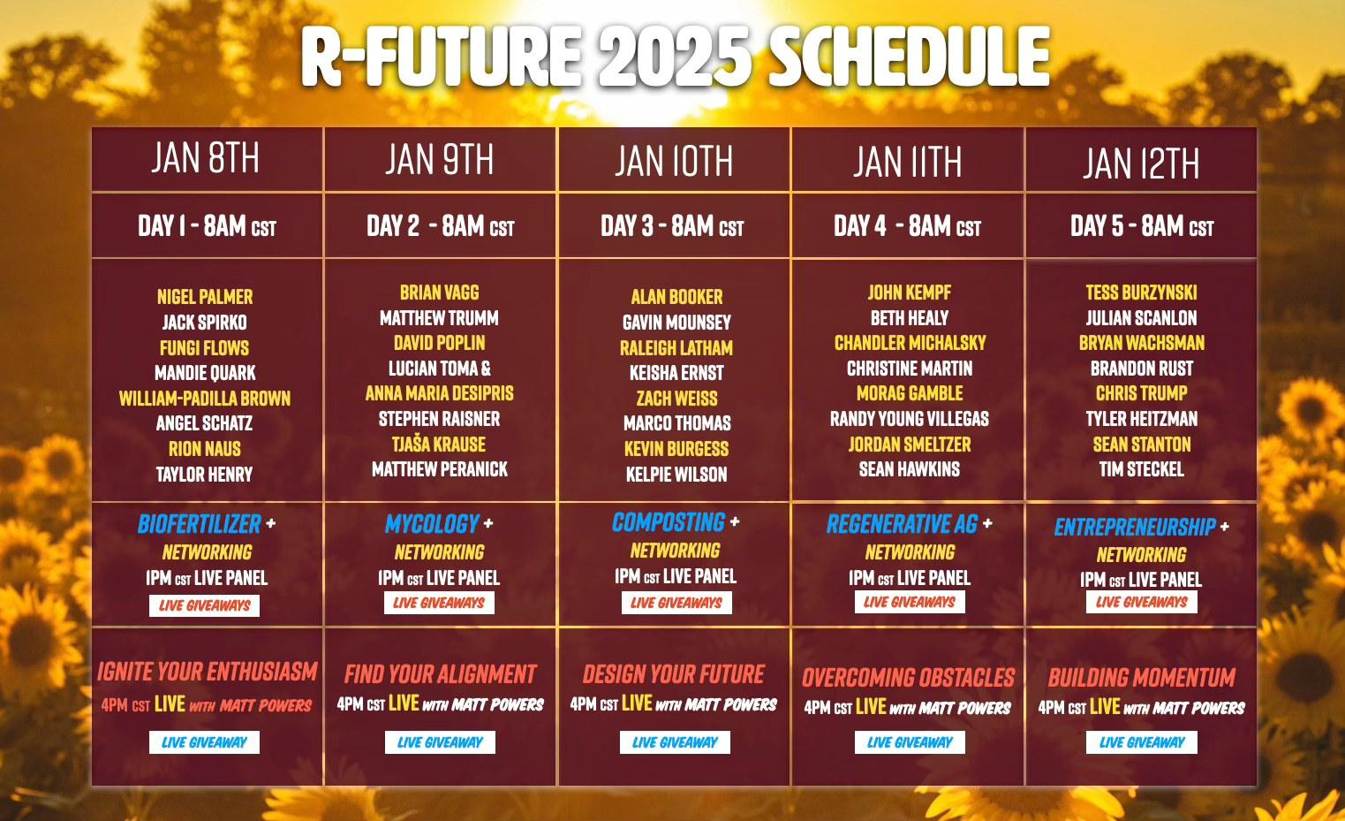
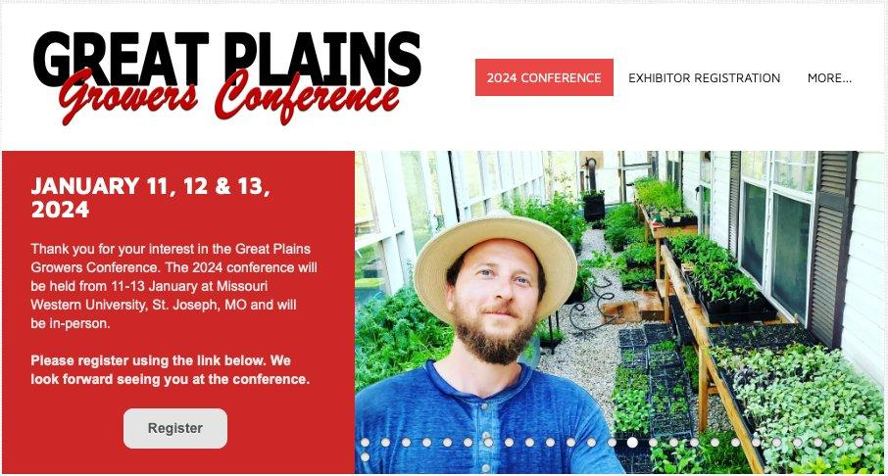
SUN AND BLOOM FARMS
SARE Funded Benefits of On-Farm Vermicomposting
1. Who We Are, What We Do & How We Got Here
OUR BACKGROUND

Slide 14
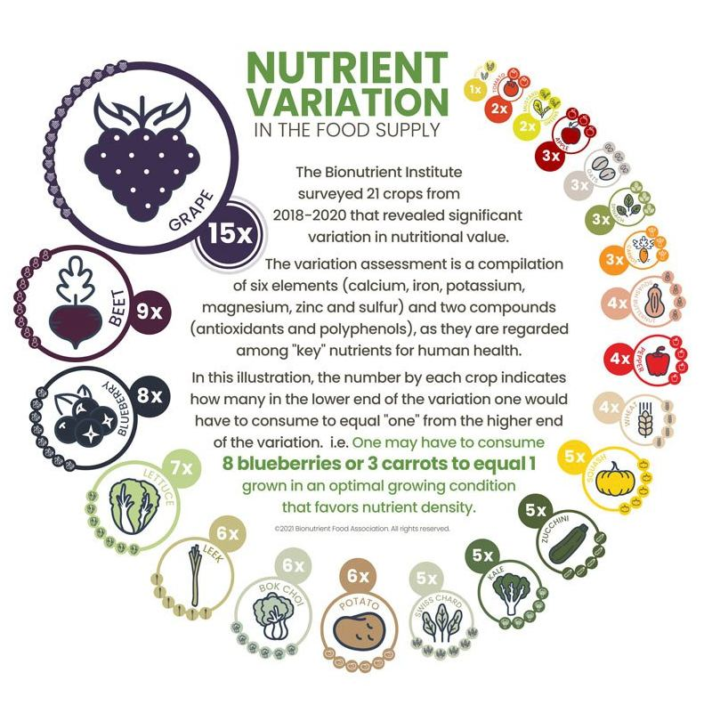
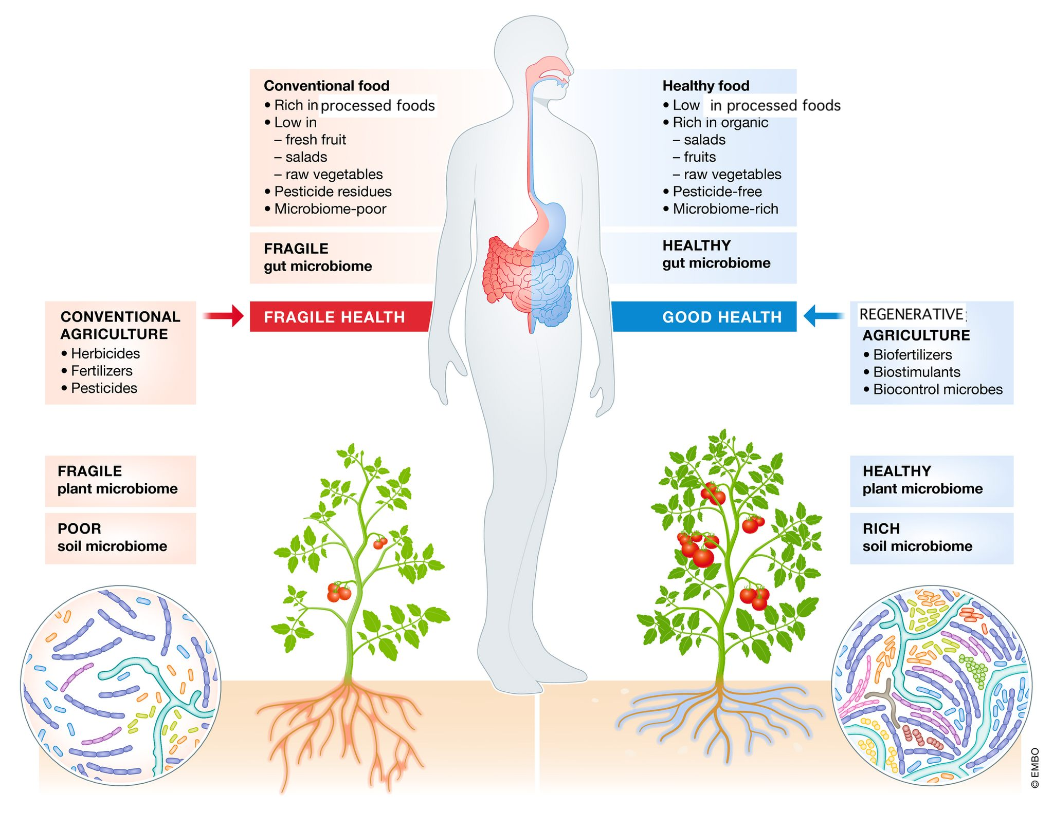
SUN AND BLOOM FARMS
SARE Funded Benefits of On-Farm Vermicomposting
2. Our Market Garden Growing Practices & Role of Vermicompost

Slide 15
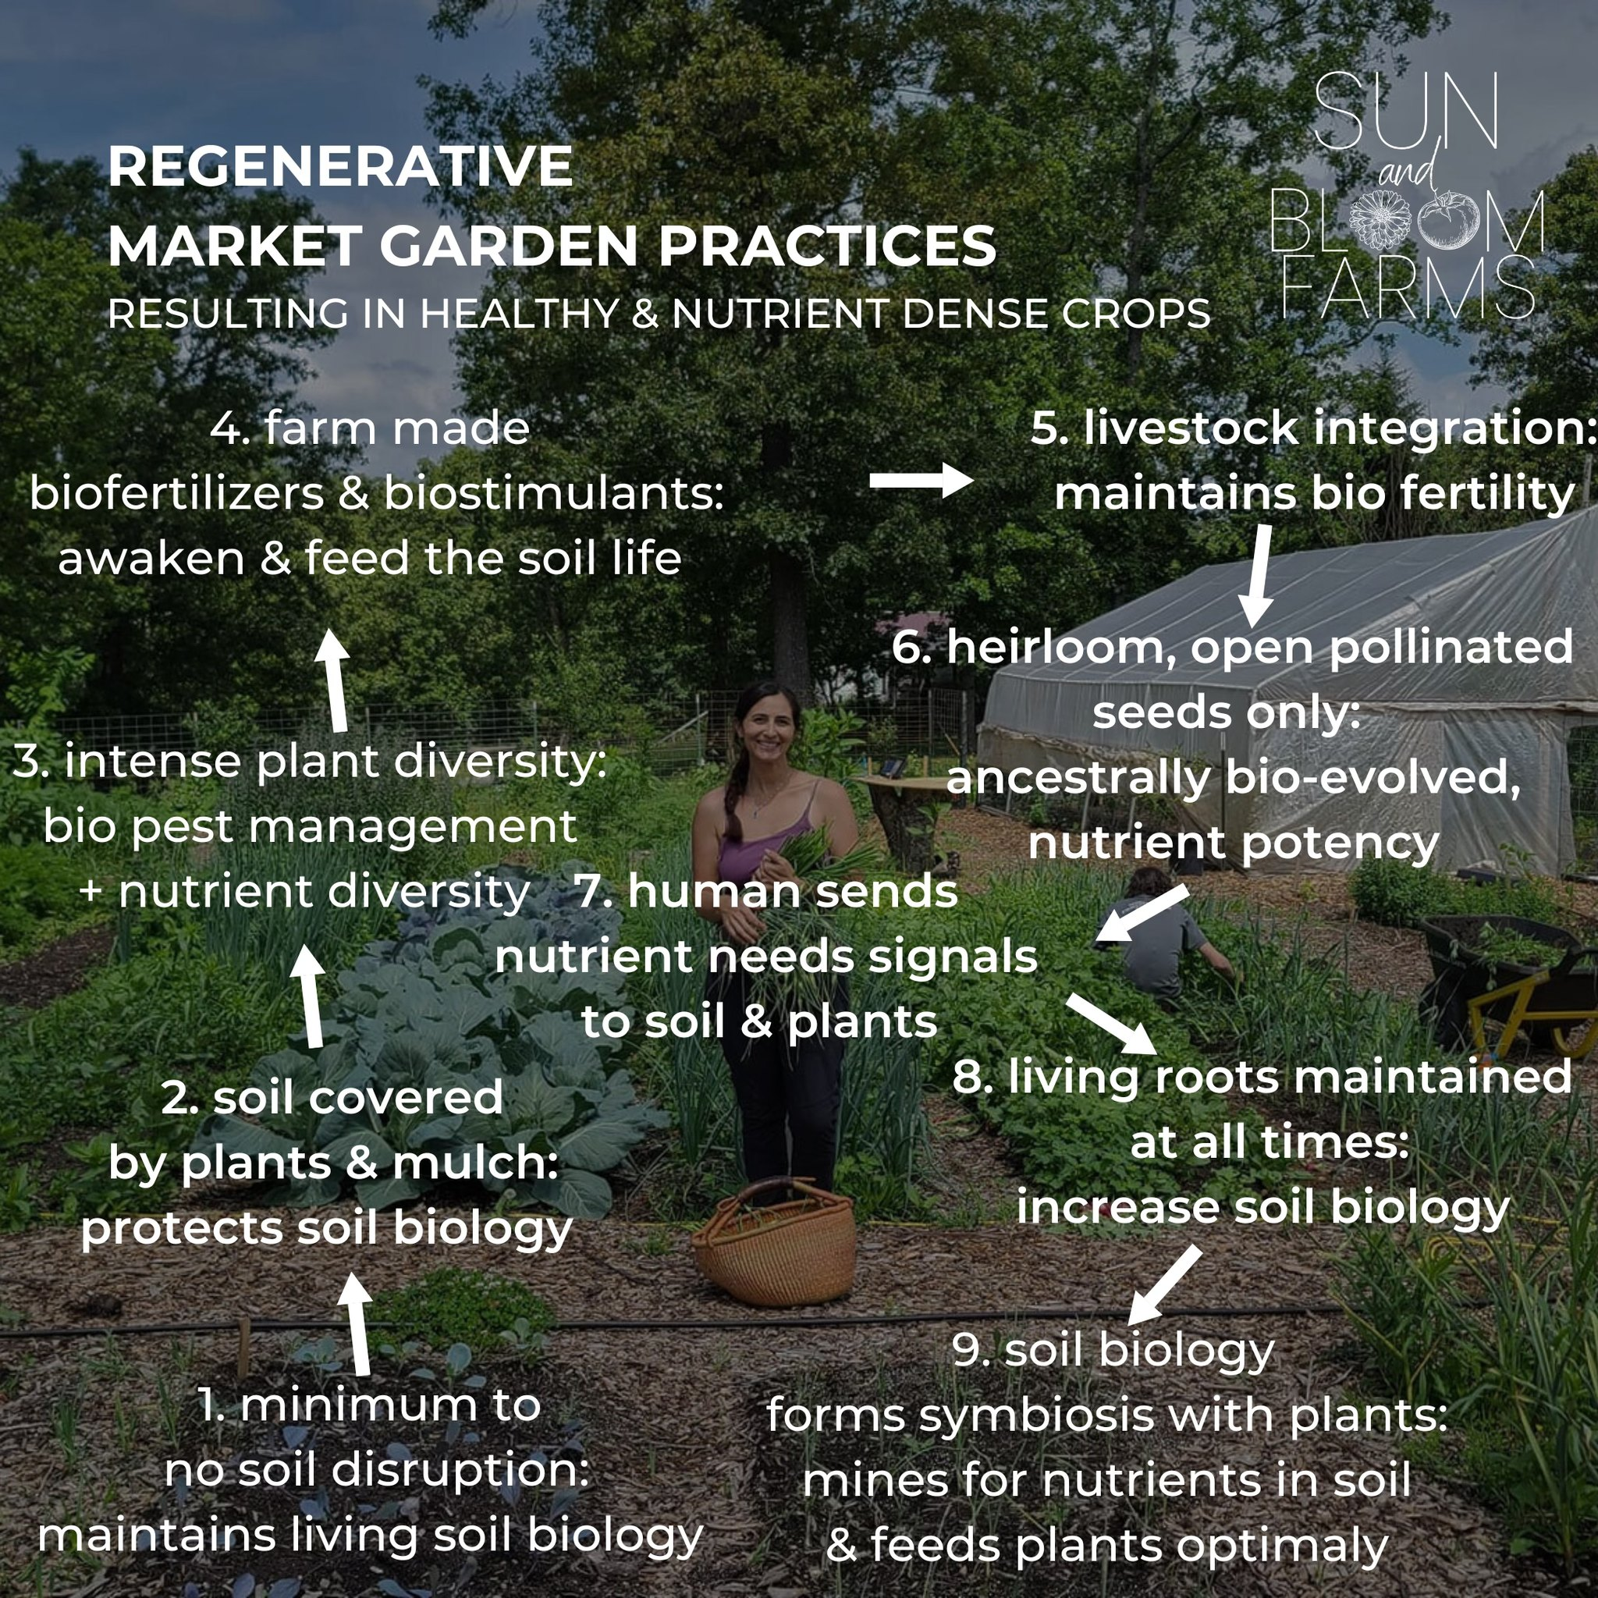
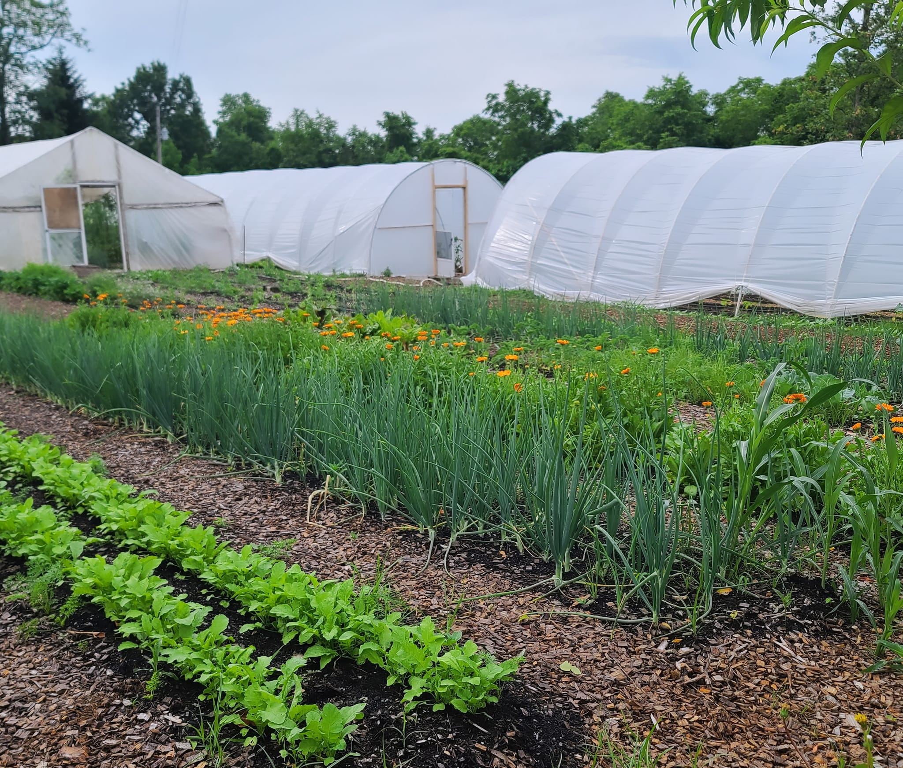
SUN AND BLOOM FARMS
SARE Funded Benefits of On-Farm Vermicomposting
2. Our Market Garden Growing Practices & Role of Vermicompost
SUN & BLOOM FARMS’ FERTILITY MANAGEMENT IS BASED ON SUSTAINING & REGENERATING SOIL BIOLOGY RATHER THAN USING “MINERAL APLICATIONS”
- IMPROVES THE SHORT & LONG TERM SOIL HEALTH & PRODUCTION
- PRODUCES HEALTHIER CROPS
- PROVIDES FARM “INDEPENDENCE”

Slide 16
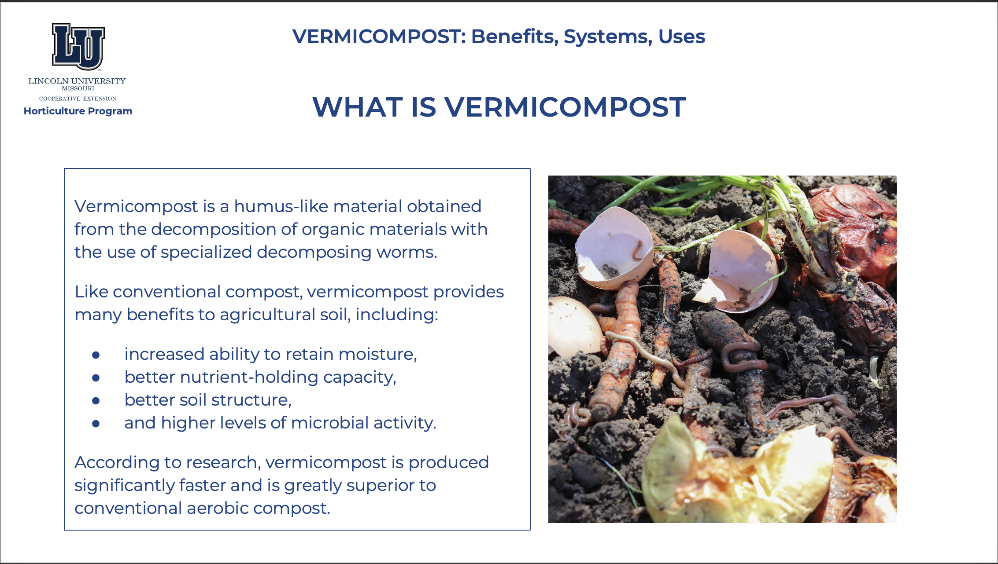
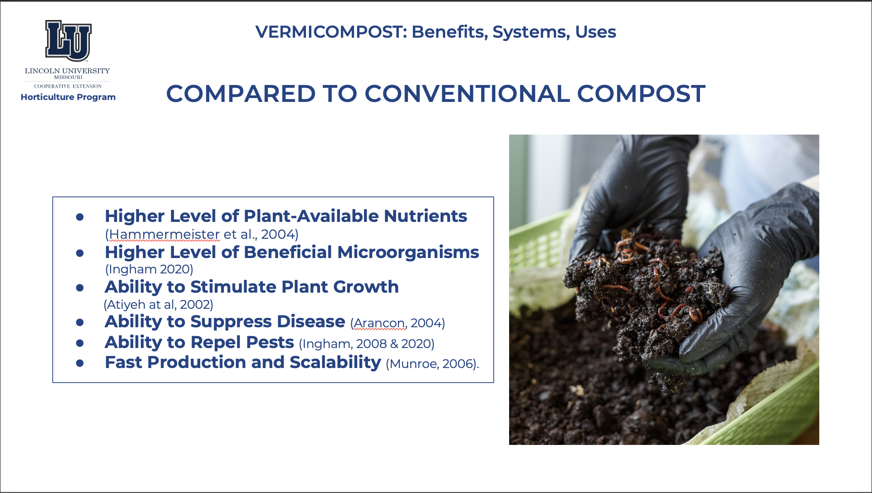
SUN AND BLOOM FARMS
SARE Funded Benefits of On-Farm Vermicomposting
2. Our Market Garden Growing Practices & Role of Vermicompost

Slide 17
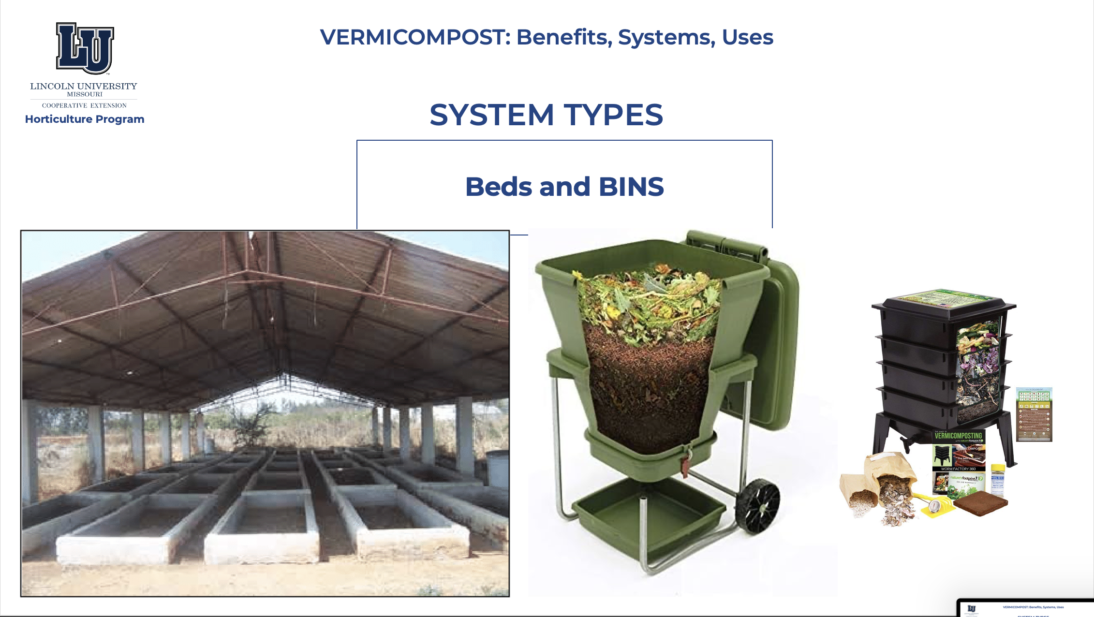
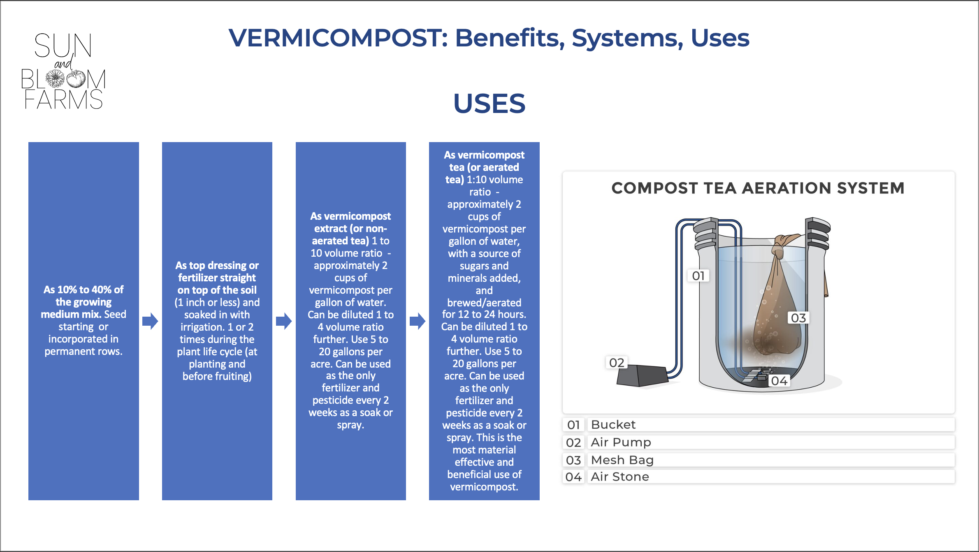
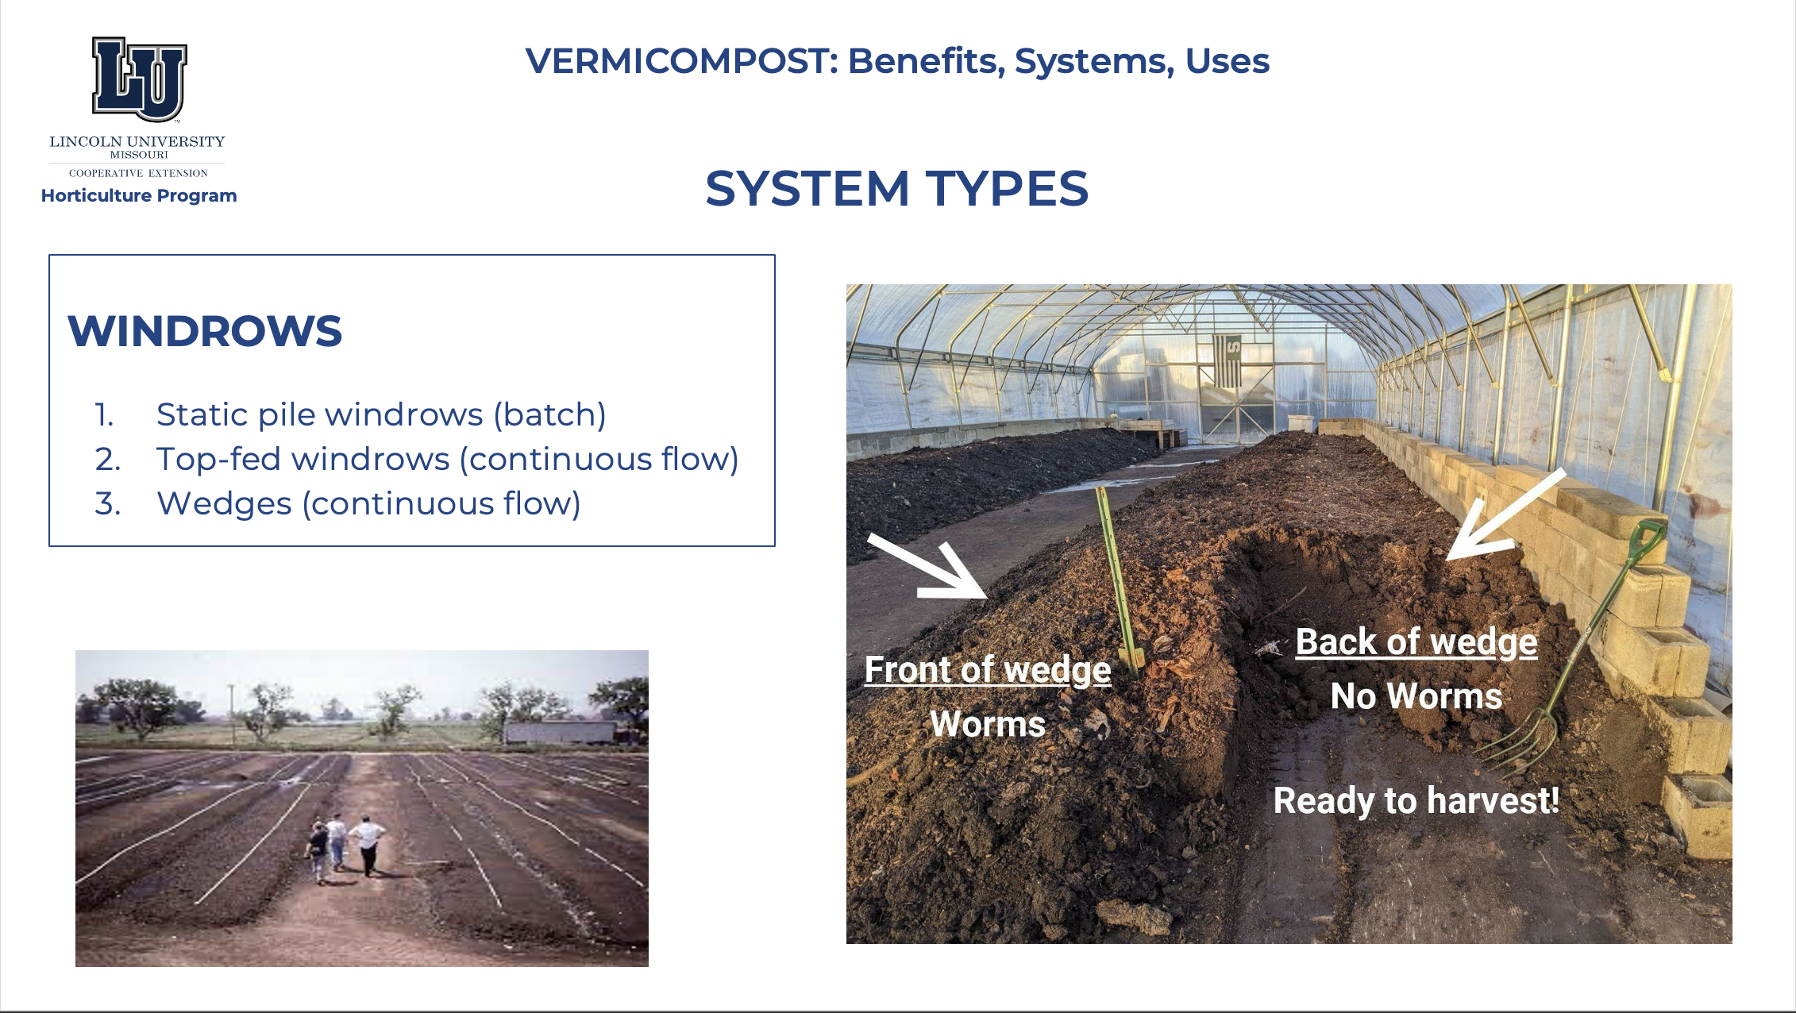
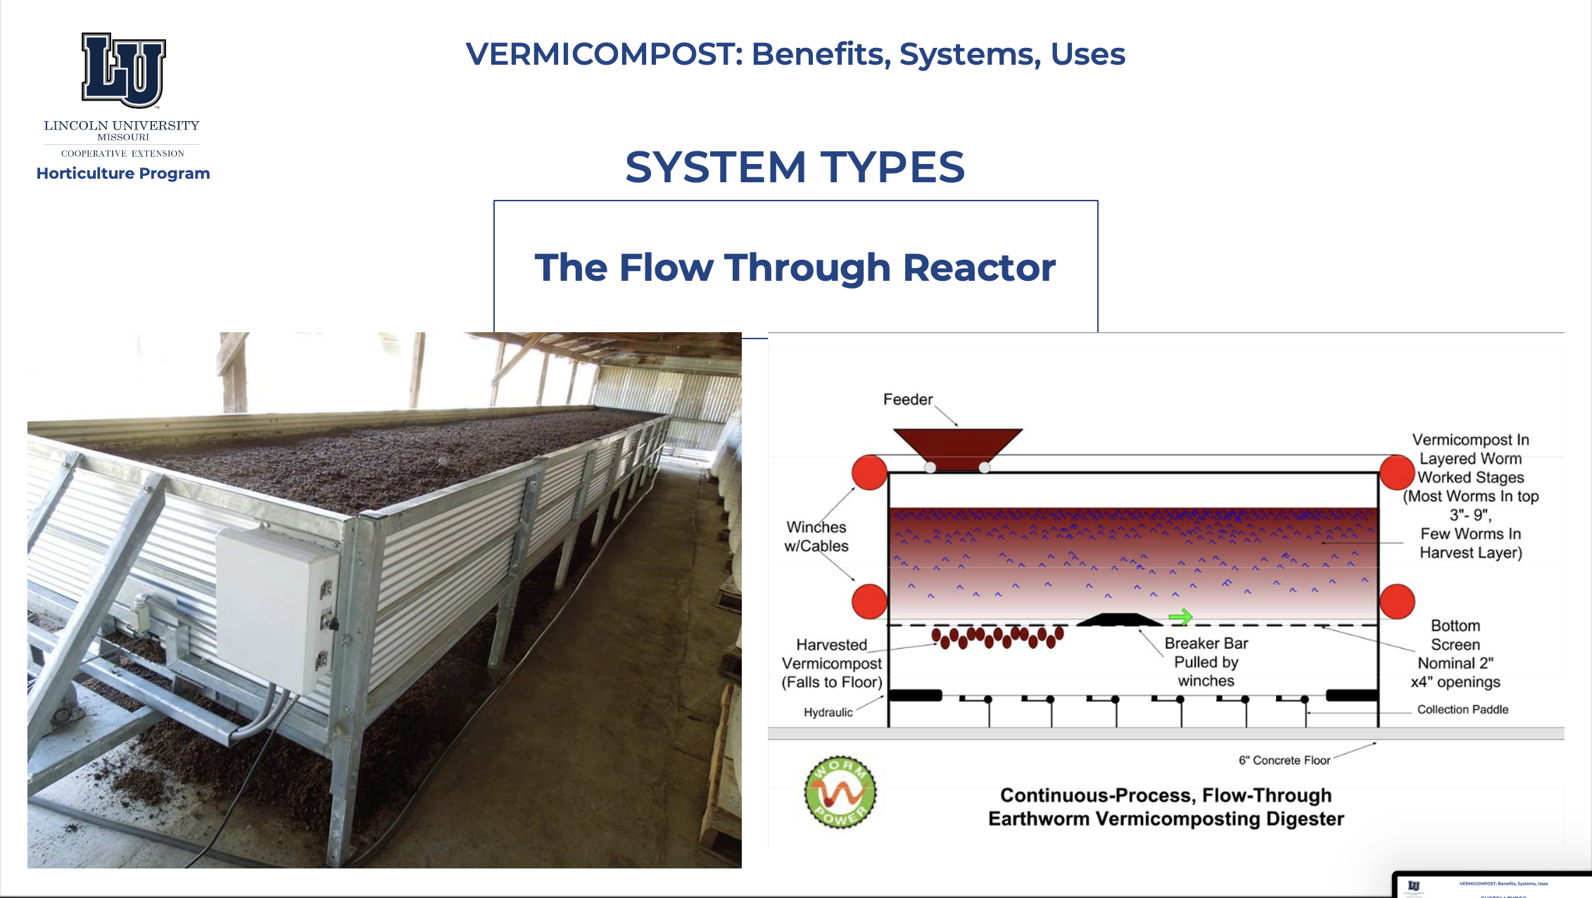
SUN AND BLOOM FARMS
SARE Funded Benefits of On-Farm Vermicomposting
2. Our Market Garden Growing Practices & Role of Vermicompost

Slide 18
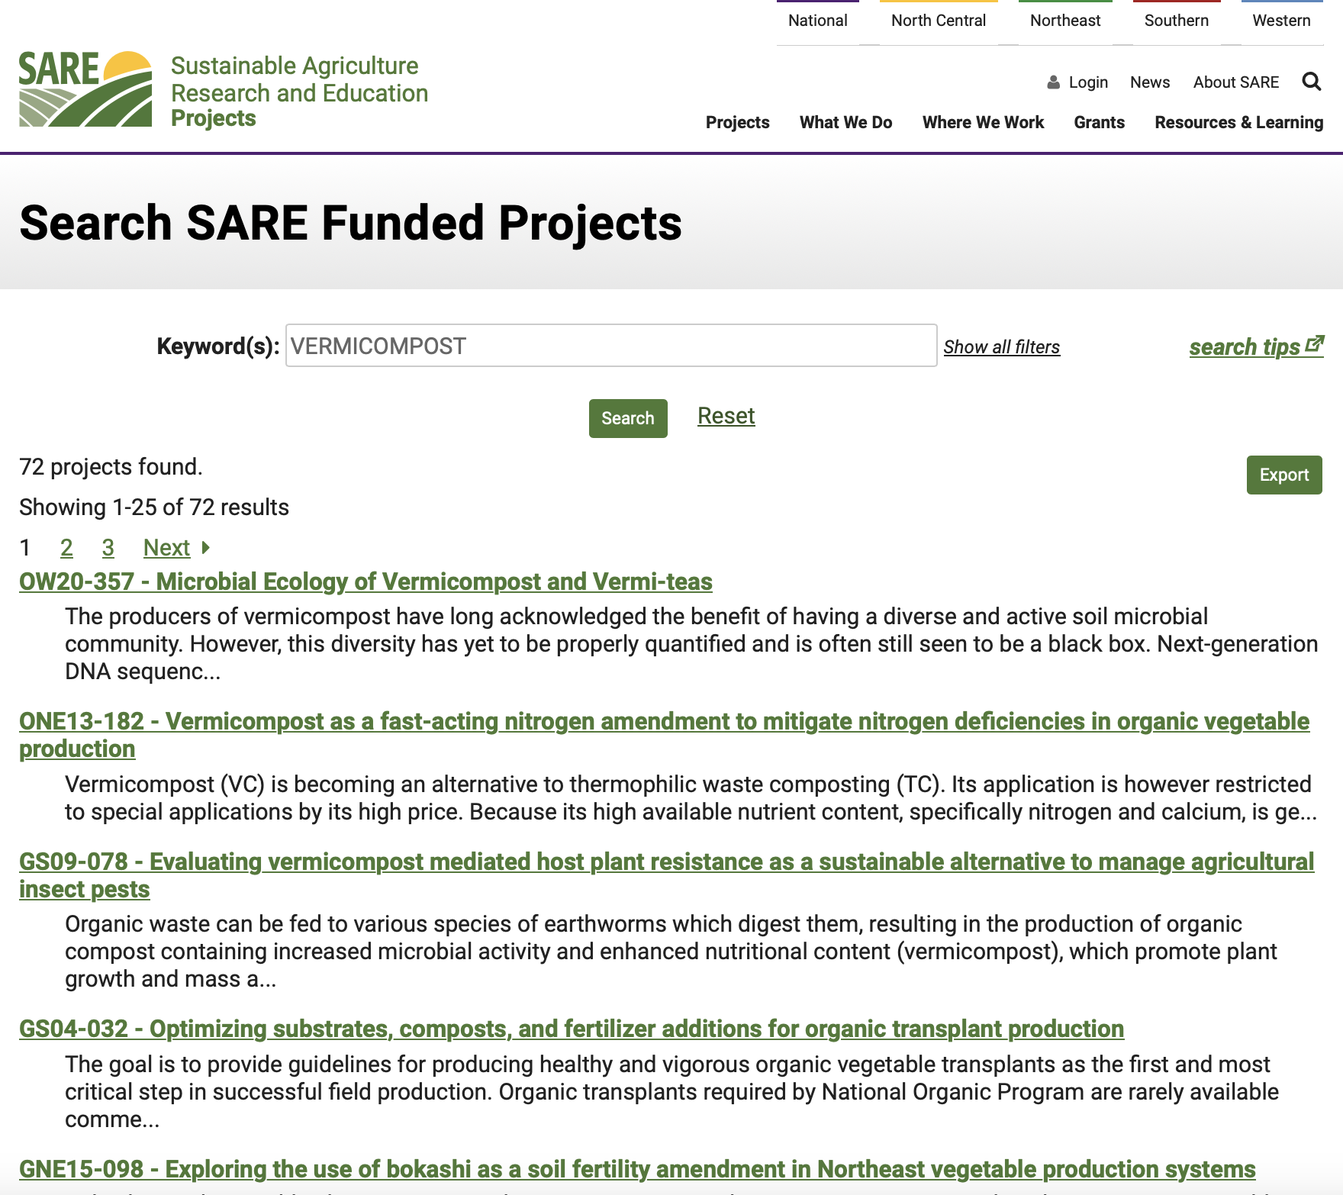
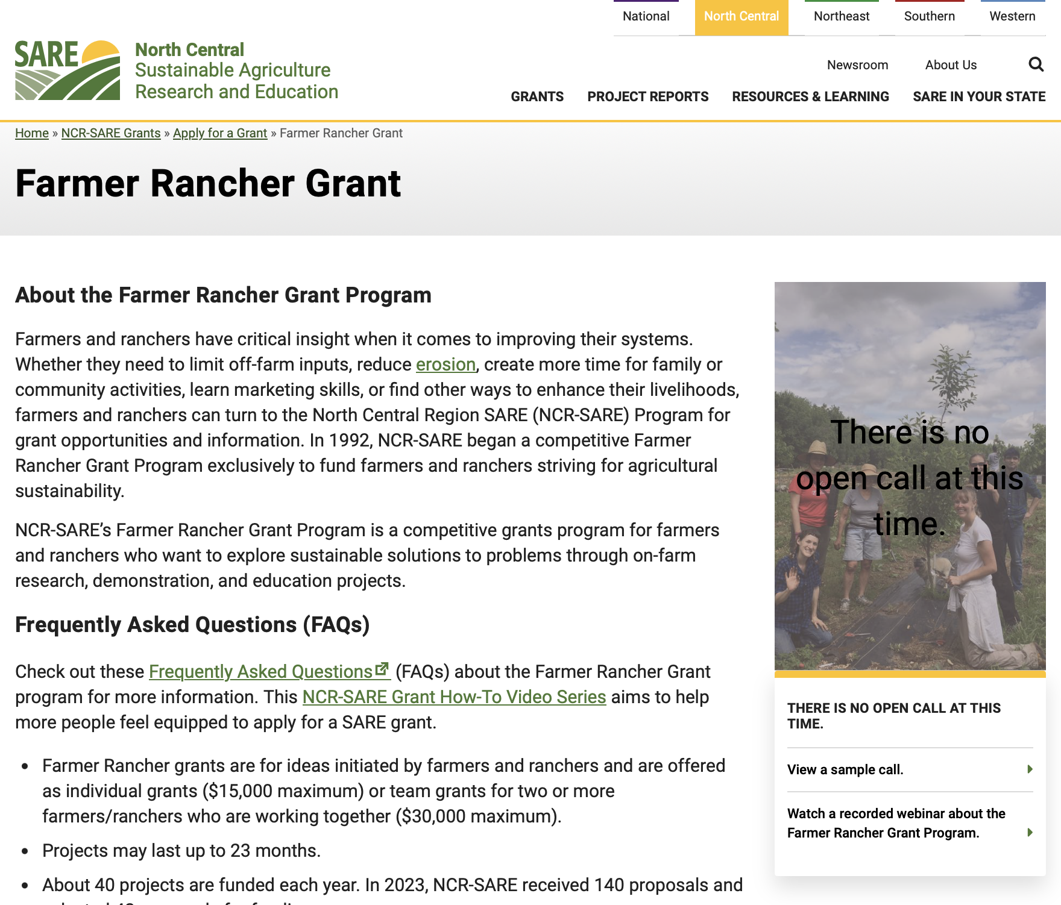

SUN AND BLOOM FARMS
SARE Funded Benefits of On-Farm Vermicomposting
3. Our SARE Grant Application Approach & Experience

Slide 19
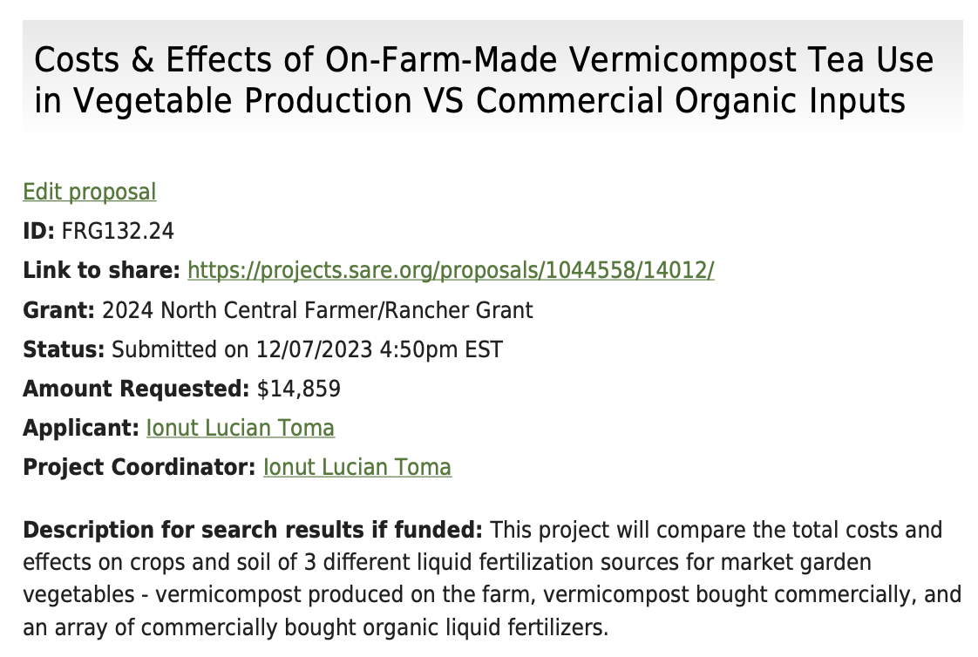
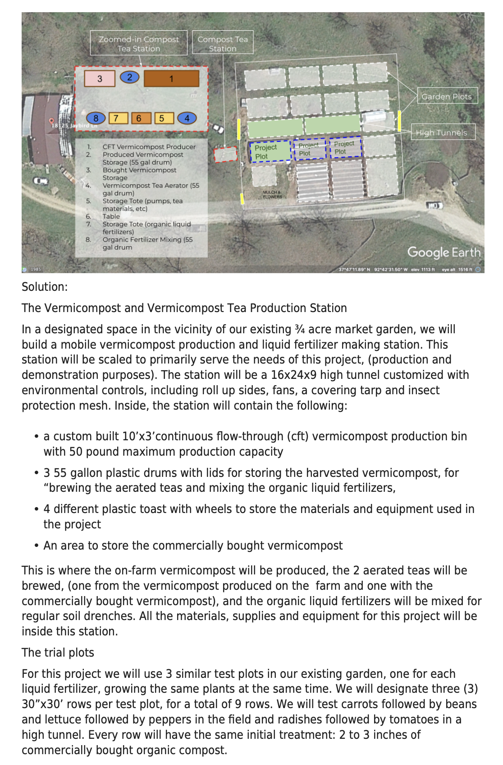


SUN AND BLOOM FARMS
SARE Funded Benefits of On-Farm Vermicomposting
3. Our SARE Grant Application Approach & Experience

Slide 20







SUN AND BLOOM FARMS
SARE Funded Benefits of On-Farm Vermicomposting
3. Our SARE Grant Application Approach & Experience

Slide 21


SUN AND BLOOM FARMS
SARE Funded Benefits of On-Farm Vermicomposting
3. Our SARE Grant Application Approach & Experience

Slide 22




SUN AND BLOOM FARMS
SARE Funded Benefits of On-Farm Vermicomposting
3. Our SARE Grant Application Approach & Experience

Slide 23

SUN AND BLOOM FARMS
SARE Funded Benefits of On-Farm Vermicomposting
3. Our SARE Grant Application Approach & Experience
FOLLOW UP
FOR INSPIRATION:
- WWW.SUNANDBLOOMFARMS.COM
- @SUNANDBLOOMFARMS on Instagram, Facebook, YouTube
FOR EMPOWERMENT AND SUPPORT:
- JOIN OUR ONLINE & IN PERSON COURSES
- REACH OUT FOR FARM AND FARM BUSINESS DESIGN & CONSULTING info@sunandbloomfarms.com

