Slide 1
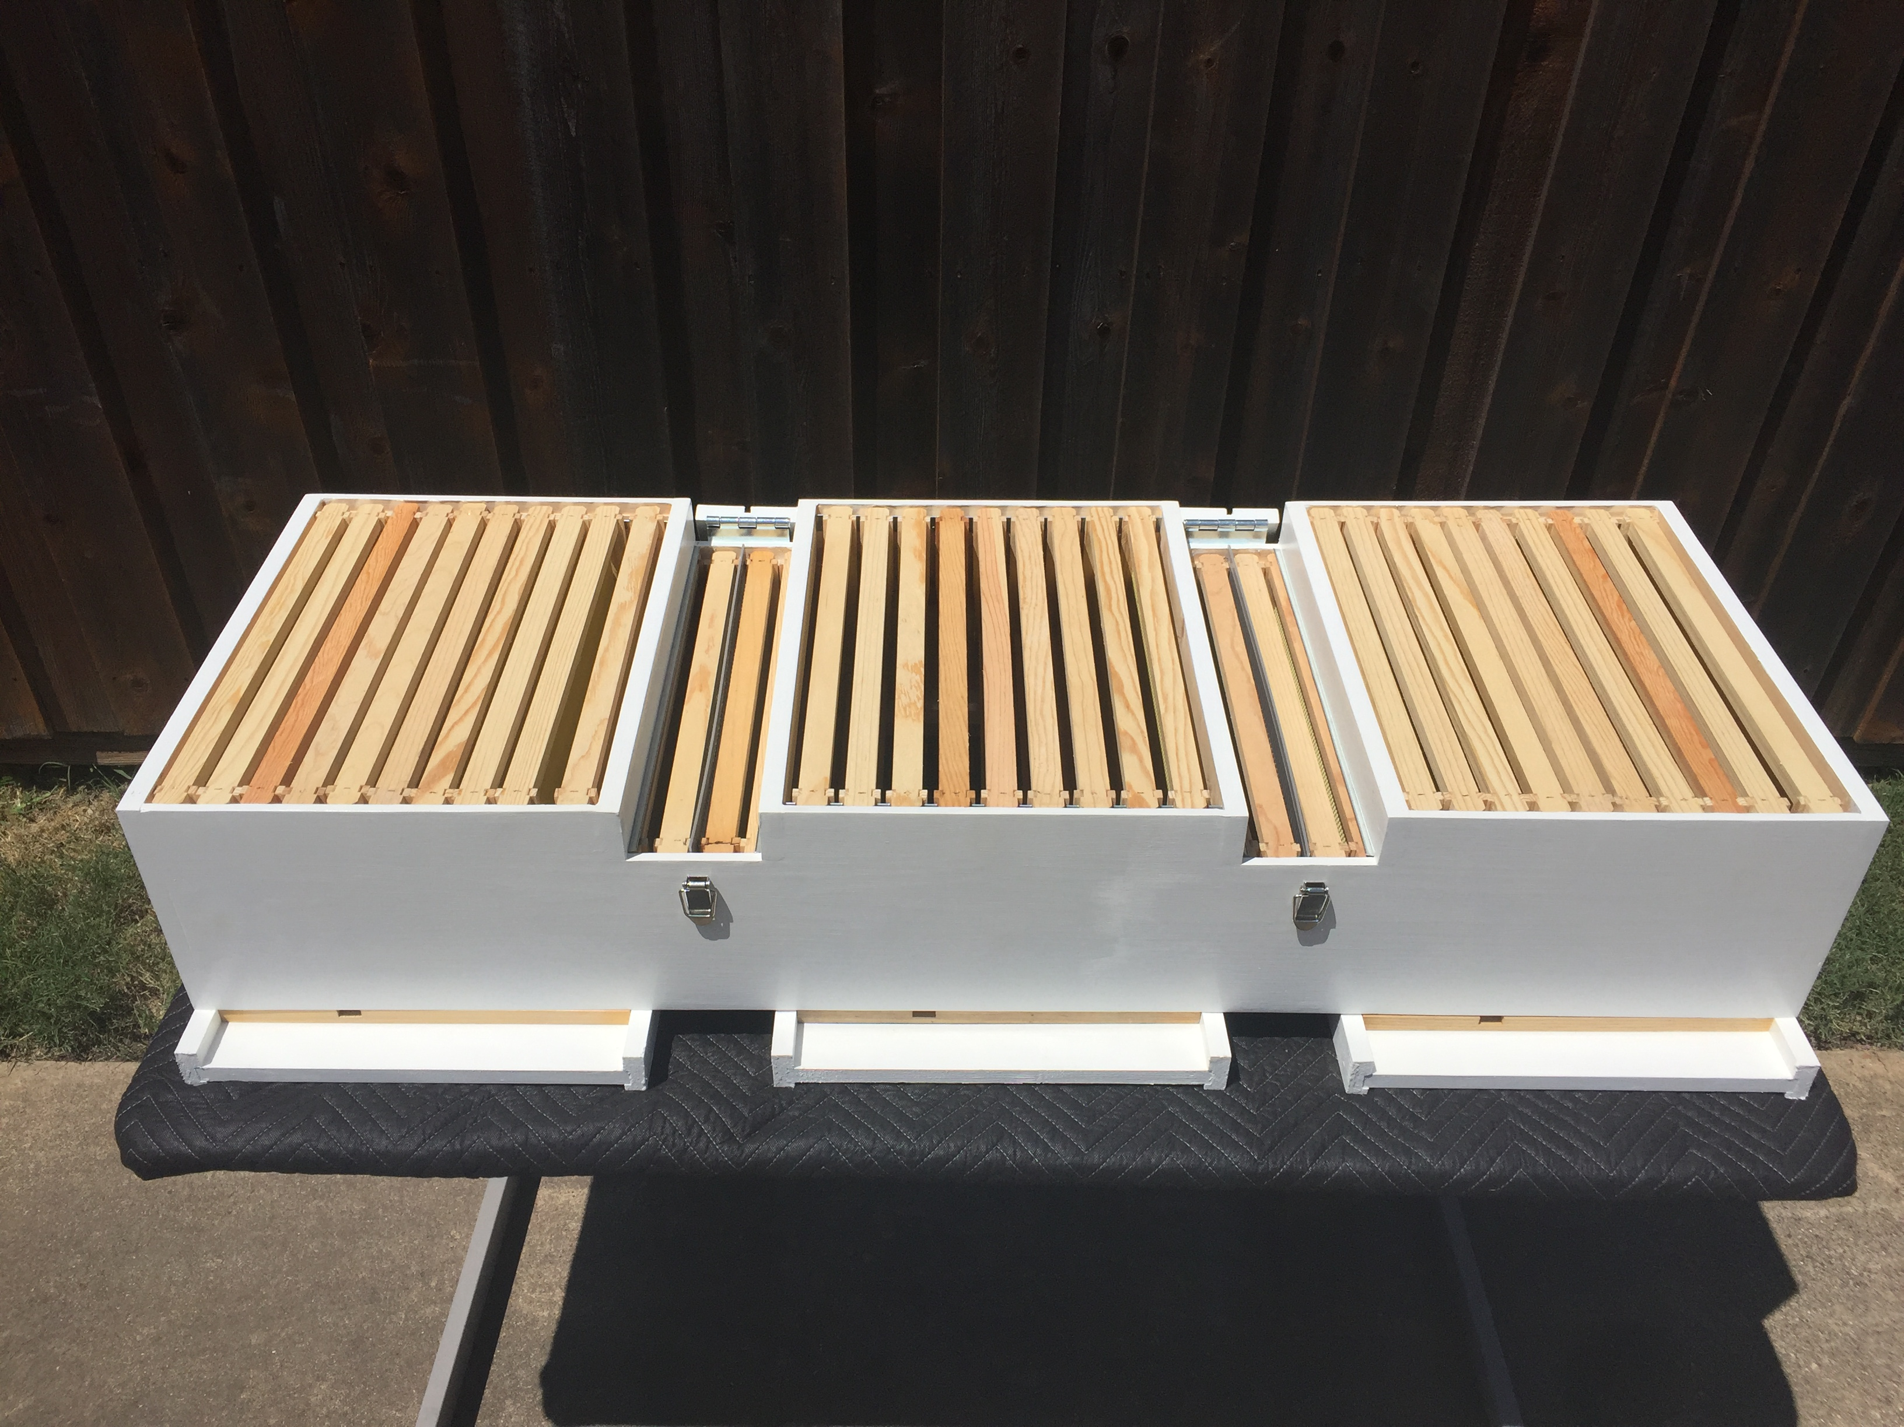
New Design of Two Queen Horizontal Honey Bee Hive Bases for Commercial and Small-Scale Beekeeping Operations
SARE Farmer/Rancher Grant
Subrecipient: Texas Honey Company LLC
Reference: SUB00002843
Final Report August 25, 2025
Daniel Brantner
Texas Master Beekeeper

Slide 2
SARE Grant:
Problem
Statement
Beekeeping operations of all sizes throughout the United States are facing challenges related to colony losses and the impact that those losses have on overall honey production.
Approximately 1/3 of all foods available in your local grocery store rely on pollinators. Honey bees contribute over $15 billion each year to the value of US crops. Without honey bees the US would lose 100% of almond, 90% of apple, 90% of blueberry, 90% of cucumber, 80% of cherry and 70% of watermelon crops. Over the last decade, beekeepers have experienced an alarming increase in colony losses. A nationwide survey revealed 1.6 million colonies lost, with commercial beekeepers reporting an average loss of 62% between June of 2024 and March f 2025. A recent study by the Bee Informed Partnership identified Varroa mites as the leading cause of colony losses, followed closely by Queen issues. Regarding colony losses due to Queen issues, the Bee Informed Partnership study stated; “While a queen issue like death or poor performance can lead to the loss of a bee colony, there are possible interventions. For example, colony losses can sometimes be prevented by providing a queen less colony with a queen or by actively replacing a queen with a younger one.” In order to replace lost colonies, beekeepers must generate colony “splits”. These splits in effect cut the population of an existing colony in half in order to start the new replacement colony. The new replacement colony formed from the split off of an existing colony then needs additional time to generate a new queen or the beekeeper has the option of supplying a mated queen at a cost of approximately $40. Therefore, the beekeeper loses either time or money in generating a new replacement colony. In addition, the reduction in bee population of the original colony has an adverse effect on the honey production of that colony.
I have witnessed firsthand the frustration and disappointment new beekeepers experience when they lose a colony. Often times this loss can be an economic setback that a novice beekeeper is unable to overcome and the beekeeper decides to give up on beekeeping.
2

Slide 3
SARE Grant:
Proposed
Solutions
During the process of obtaining my Texas Master Beekeeper certification, I learned that Lorenzo Langstroth was granted a U.S. Patent for a bee hive configuration that provided 3/8” “Bee Space” between removable frames of foundation on October 5, 1852. Langstroth’s design has served the beekeeping world as the gold standard for more than 170 years. From as early as 1892, there have been countless attempts to improve upon Langstroth’s design by creating a hive configuration that would allow two queens to coexist within a single colony.
On June 15, 1937 C.L. Farrar’s extensive research regarding the impact that bee colony population has on honey production was published in the Journal of Agricultural Research. Farrar’s research showed that one colony with 60,000 bees will probably produce 1.54 times as much honey as four colonies each with 15,000 bees; one colony with 45,000 bees will probably produce 1.48 times as much honey as three colonies each with 15,000 bees; one colony with 30,000 bees will probably produce 1.36 times as much honey as two colonies each with 15,000 bees. Farrar’s research proved that there would be benefits, in terms of honey production, if a two-queen colony that provides the potential for an early increase bee population within a colony could be successfully developed and managed.
It was C.L. Farrar’s research on the effects that bee colony population has on honey production that inspired me to design two new multiple queen bee hives. One of my new designs is specifically for small scale beekeepers who do not transport their colonies on pallets for pollination purposes. The other new design is intended primarily for commercial beekeepers who transport their colonies across the country for pollination purposes. Both of the new two queen horizontal hive bases that I have developed provide a simple and economical method to potentially increase honey production in a bee colony by providing for a larger bee population within a single colony.
3

Slide 4
SARE Grant:
Proposed
Solution for
Small Scale
Beekeepers
My new bee hive design for small scale beekeepers received a US patent on May 13, 2025. This new design allows for the use of two solid panel dividers that allow two separate bee nucs, each with their own queen, to initially develop within a common hive body. Once each of the nucs has developed and requires additional space for expansion, the solid panel dividers are removed and a double screen board is installed in the center of the bee hive base. This double screen board allows the pheromones from both queens to be distributed throughout the entire colony, thereby creating a total bee population that is receptive to both queens. The double screen board also prevents the two queens from coming in direct physical contact with each other. A horizontal queen excluder is then placed above the center brood box. This horizontal queen excluder will allow worker bees from both sides of the hive base to freely circulate throughout the entire hive, thereby creating a “super colony” with a total bee population equal to the population of the two individual brood boxes located on each side of the double screen board. All the honey storage occurs within honey supers that are stacked directly above the horizontal queen excluder that is above the center brood box. Due to the fact that the honey supers will not be stacked on top of the two outer brood boxes, as is the traditional configuration in the industry standard vertical beekeeping method, the health of both brood boxes can be easily monitored without having to remove heavy honey supers. This is a tremendous advantage to beekeepers during the hot summer months and is also much less disruptive to the bee colony when checking on the health of the hive. The following four (4) pages, containing images from the patent submittal, show how the new two queen hive design for small scale beekeepers is configured.
4

Slide 5
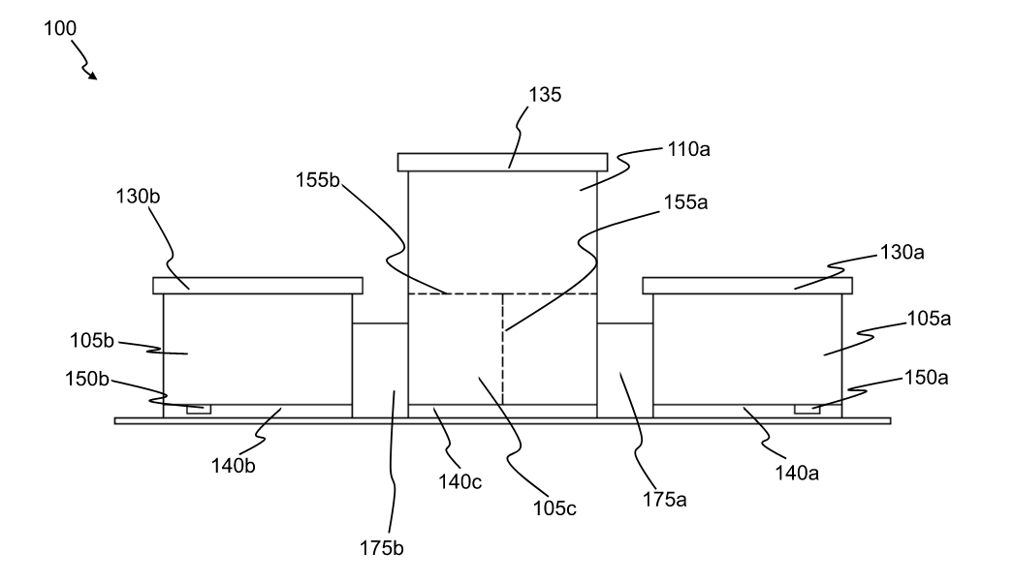
Two Queen Hive for
Small Scale
Beekeepers
5

Slide 6
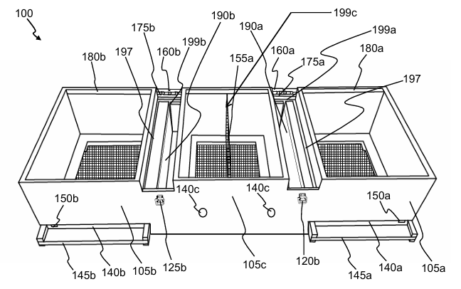
Two Queen Hive for
Small Scale
Beekeepers
6

Slide 7
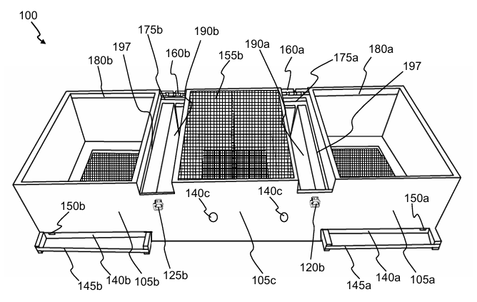
Two Queen Hive for
Small Scale
Beekeepers
7

Slide 8
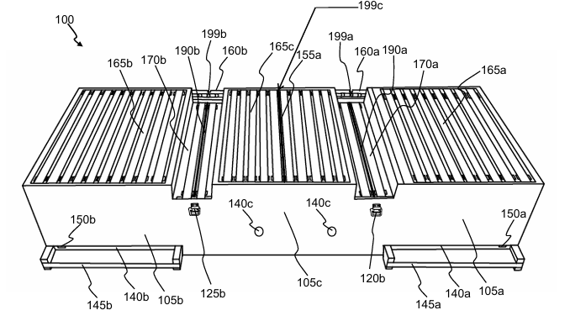
Two Queen Hive for
Small Scale
Beekeepers
8

Slide 9
SARE Grant:
Proposed
Solution for
Commercial
Beekeepers
My new two queen bee hive design for commercial beekeepers is US patent pending.
Pollination services generate a large percentage of many commercial beekeepers' income. Therefore, it is imperative that the industry standard two-hive wide configuration, for stacking on pallets for transportation purposes, be maintained in the new two queen design. The new two queen horizontal bee hive base that I have designed for commercial beekeepers provides a two-hive wide configuration that is compatible with industry standard pallets for ease of transportation and also allows two queens to coexist in a single “super colony” that shares worker bees.
The five (5) pages that follow this page contain images from the patent submittal and show how the new two queen hive design for commercial beekeepers is configured. As you will see, many of the design concepts for both the small scale and commercial beekeeper two queen hive designs are similar. The primary difference in the commercial two queen hive design vs. the small scale two queen hive design is that the two brood boxes do not share honey supers. Each of the two brood boxes in the commercial hive base store their honey in supers that are placed directly above the brood boxes, similar to a traditional industry standard Langstroth configuration. However, using the removable vertical queen excluder divider panel between the two queen brood boxes allows worker bees form each brood box to freely circulate through the entire hive configuration and thereby creates a “super colony” that has a total workforce bee population that is equal to the total bee population of the two individual colonies. This increase in bee population makes it possible to potentially achieve the increase in honey production identified in C.L. Farrar’s research. The use of the removable vertical queen excluder divider panel also allows for the colony to survive and thrive in the event that one queen dies, thus preventing the potential loss of an individual queen less colony.
9

Slide 10
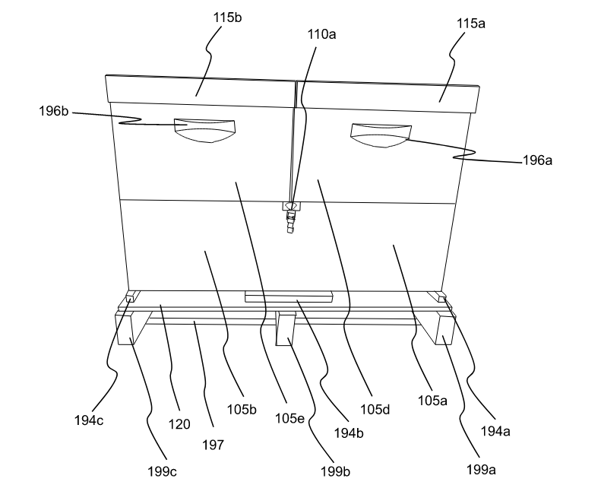
Two Queen Hive for Commercial
Beekeepers
10

Slide 11
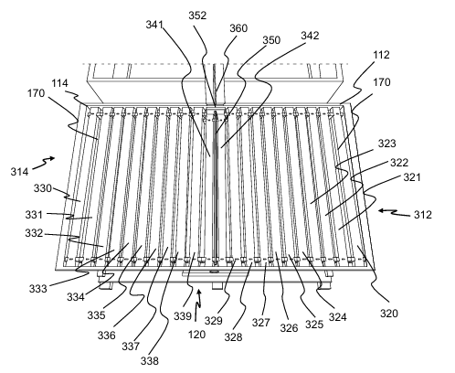
Two Queen Hive for
Commercial
Beekeepers
11

Slide 12
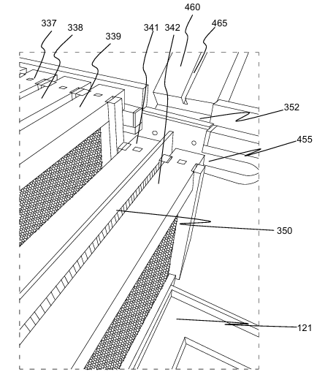
Two Queen
Hive for Commercial Beekeepers
12

Slide 13
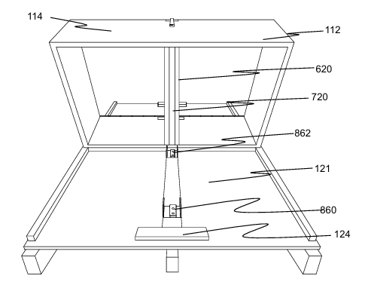
Two Queen Hive for
Commercial
Beekeepers
13

Slide 14
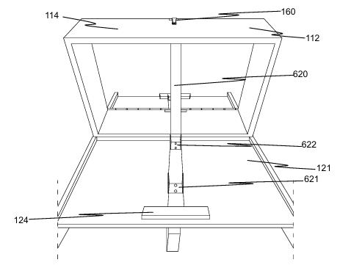
Two Queen Hive for
Commercial
Beekeepers
14

Slide 15
SARE Grant
Research:
Methodology
The following basic steps were followed in my research study:
Construct three new two-queen horizontal hive bases (for a total of six (6) colonies) for small scale beekeepers and three new two-queen horizontal hive bases (for a total of six (6) colonies) for commercial beekeepers based on the two queen hive designs described herein.
Use six (6) industry standard double deep Langstroth colonies as the control group.
Stock each of the eighteen (18) new colonies with five frame nucs that each have one queen from the same common stock.
Distribute the three (3) different types of colony configuratons in the array shown on the following two pages.
Allow all of the eighteen (18) nuc colonies to develop for one calendar year before harvesting honey.
Provide equal access to supplemental feedings of protein patties, sugar syrup and medical treatments to all eighteen (18) colonies in the study.
Monitor the condition of all eighteen (18) colonies by collecting data related to; Presence of Queen, Eggs, Larvae, Capped Brood, Laying Pattern, Colony Condition, Activity Level, Temperament, Number of Honey Frames, Brood Frames, Open Comb Frames, Foundation Frames, Weather Conditions, etc., and record the data using “BeePlus” software.
At the end of the nectar flow of year two, harvest the honey in all eighteen (18) colonies.
Compare the average amount of Honey produced in the three (3) different types of hive configurations used in the study.
15

Slide 16
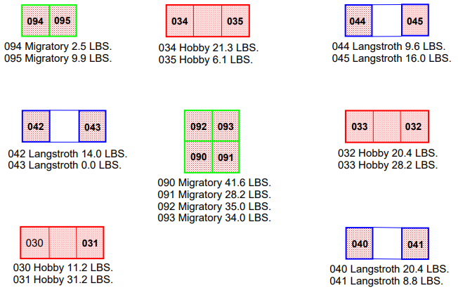
Apiary Layout with Honey
Production
Data
16

Slide 17
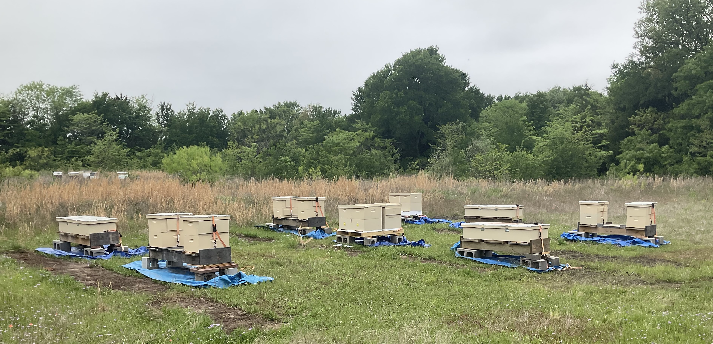
Photo of
Actual
Apiary Layout in the Field
17

Slide 18
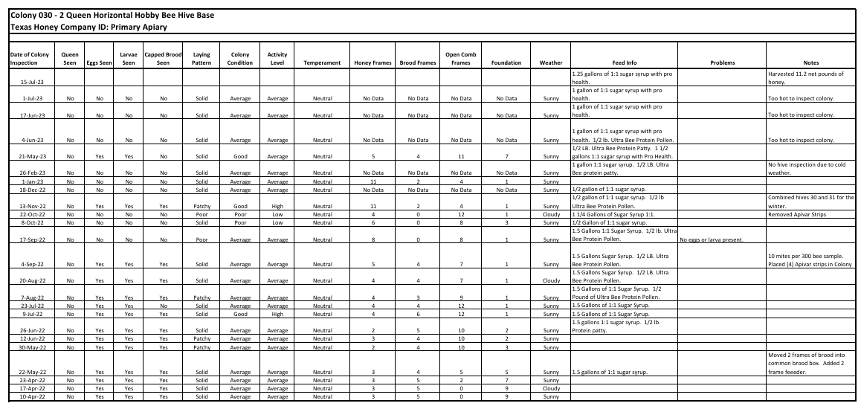
Field Data:
Colony 030
Hobby Hive 11.2 Pounds of Honey
Produced
18

Slide 19
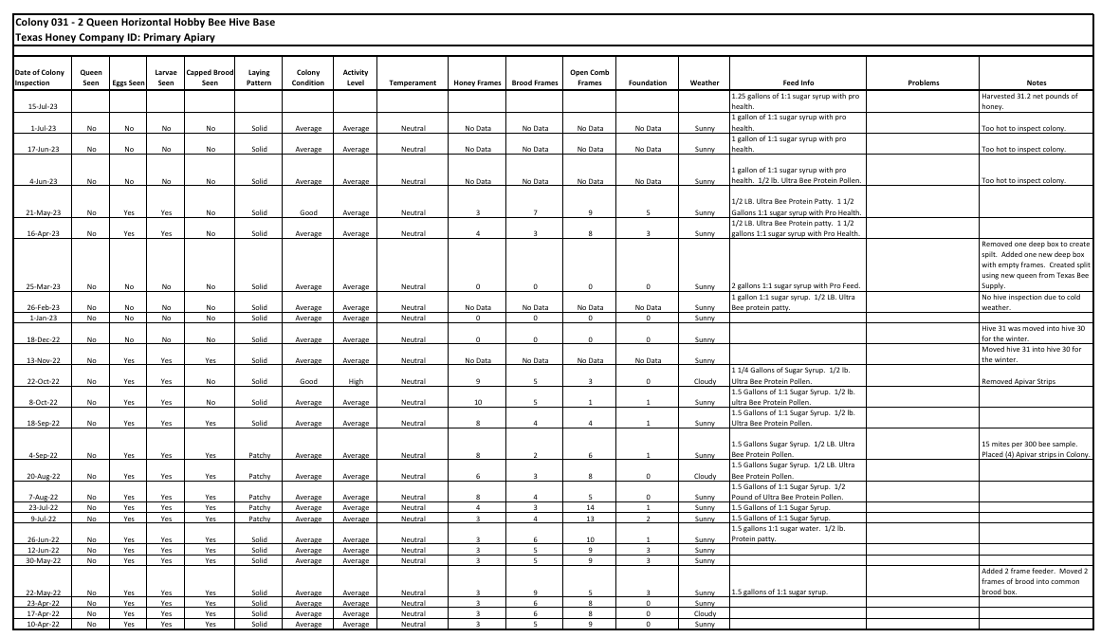
Field Data:
Colony 031
Hobby Hive 31.2 Pounds of Honey
Produced
19

Slide 20
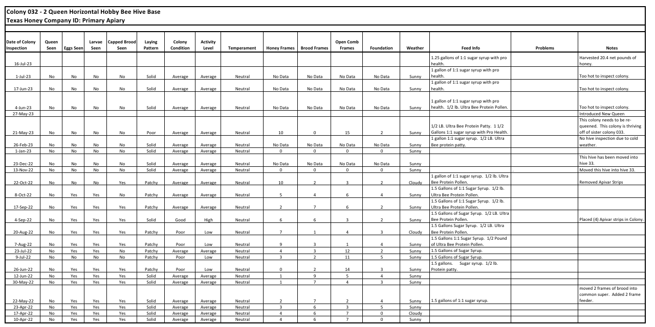
Field Data:
Colony 032
Hobby Hive 20.4 Pounds of Honey
Produced
20

Slide 21
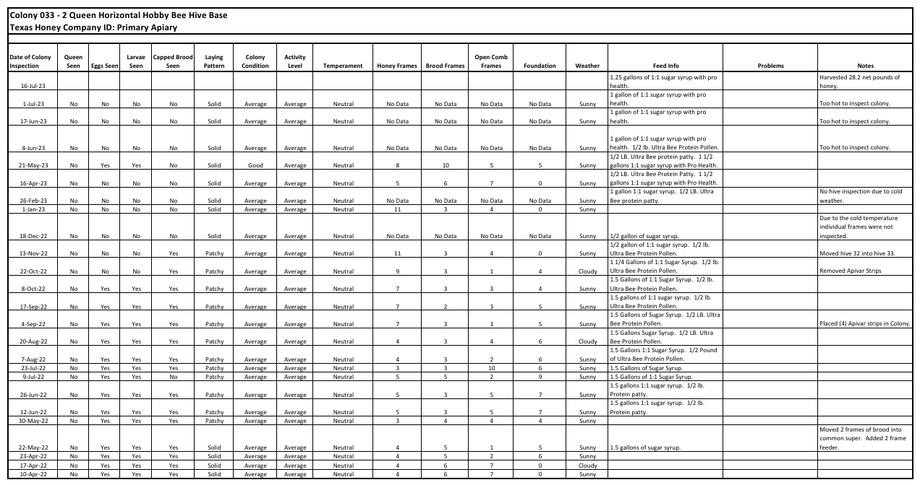
Field Data:
Colony 033
Hobby Hive 28.2 Pounds of Honey
Produced
21

Slide 22
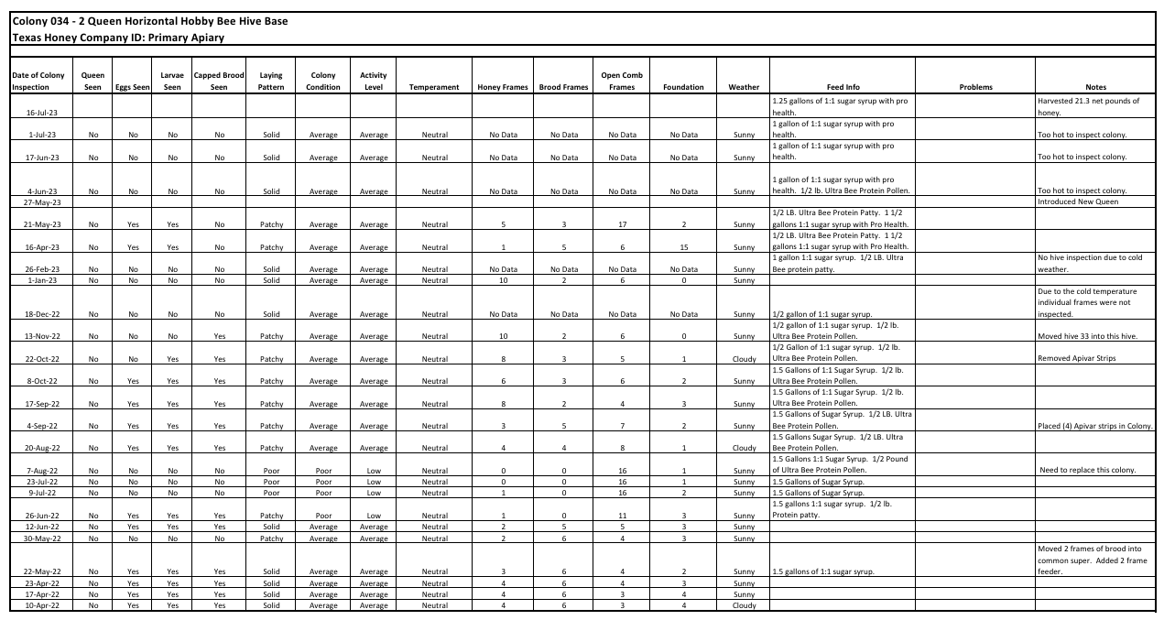
Field Data:
Colony 034
Hobby Hive 21.3 Pounds of Honey
Produced
22

Slide 23
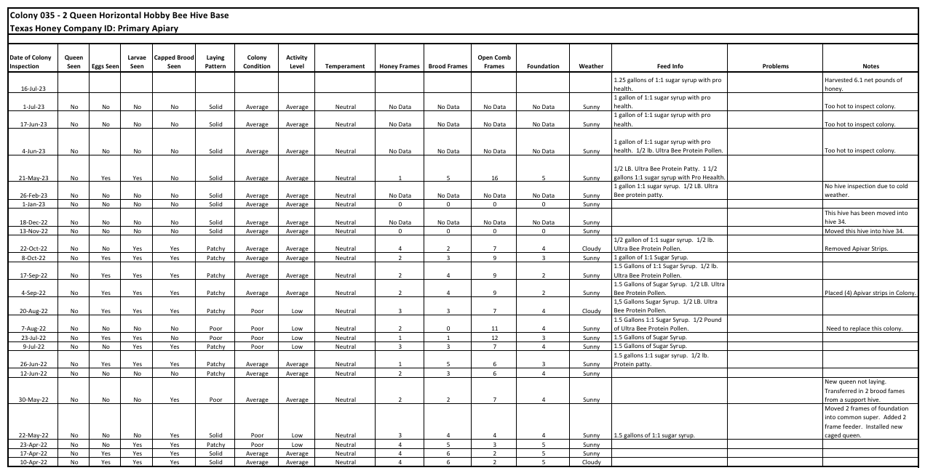
Field Data:
Colony 035
Hobby Hive 6.1 Pounds of Honey
Produced
23

Slide 24
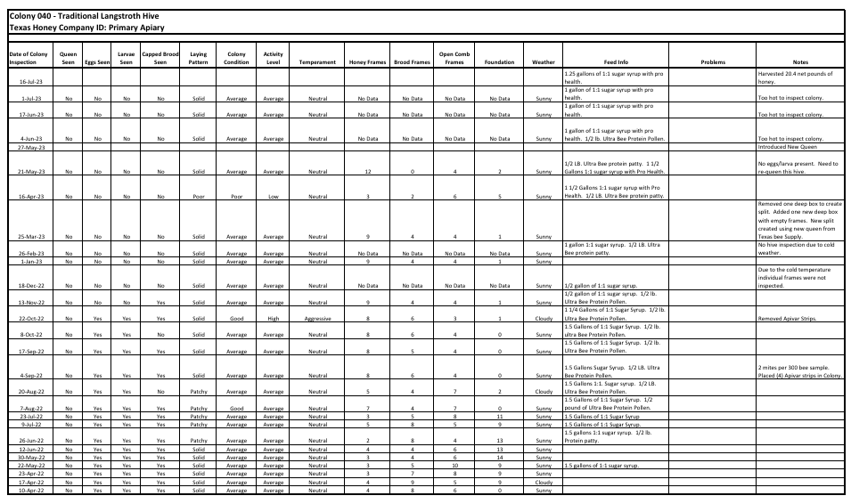
Field Data:
Colony 040
Traditional Hive
20.4 Pounds of Honey
Produced
24

Slide 25
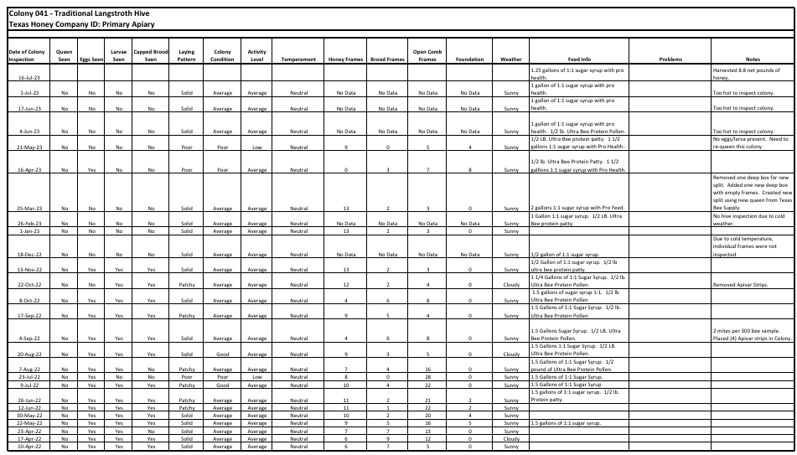
Field Data:
Colony 041
Traditional Hive
8.8 Pounds of Honey
Produced
25

Slide 26
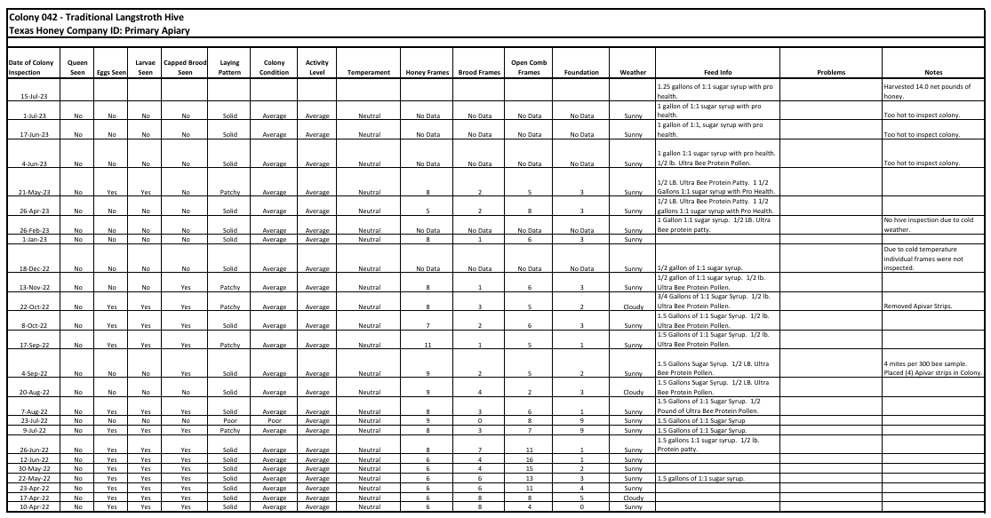
Field Data:
Colony 042
Traditional Hive
14.0 Pounds of Honey
Produced
26

Slide 27
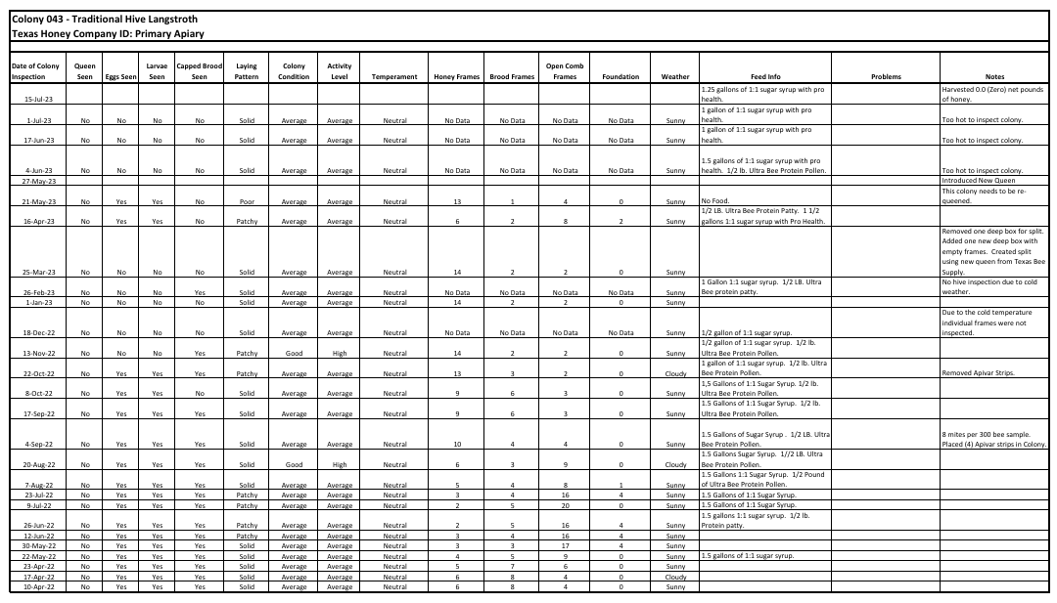
Field Data:
Colony 043
Traditional Hive
0.0 Pounds of Honey
Produced
27

Slide 28
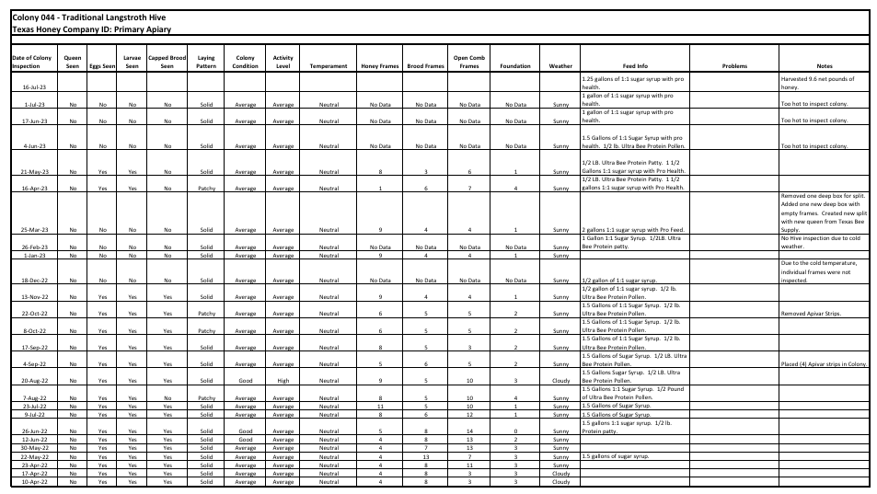
Field Data:
Colony 044
Traditional Hive
9.6 Pounds of Honey
Produced
28

Slide 29
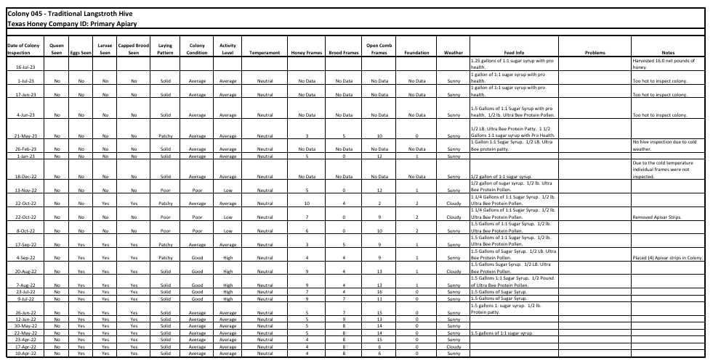
Field Data:
Colony 045
Traditional Hive
16.0 Pounds of Honey
Produced
29

Slide 30
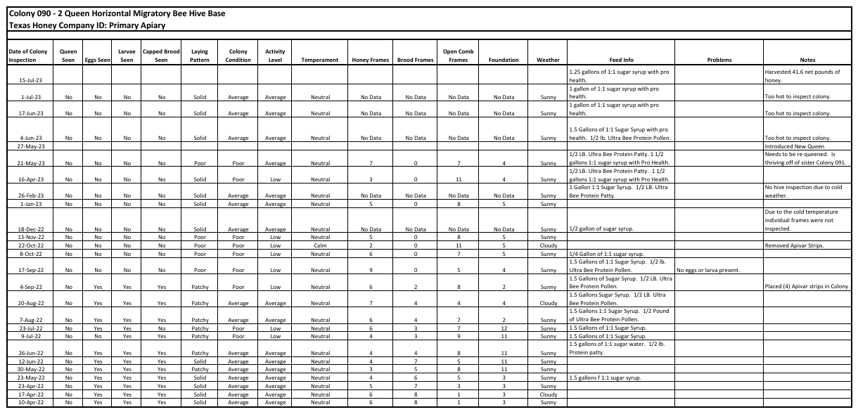
Field Data:
Colony 090
Migratory Hive
41.6 Pounds of Honey
Produced
30

Slide 31
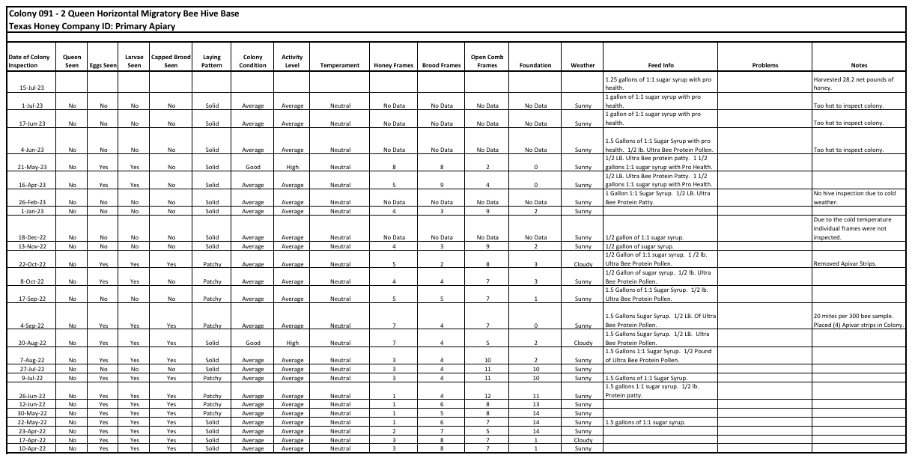
Field Data:
Colony 091
Migratory Hive
28.2 Pounds of Honey
Produced
31

Slide 32
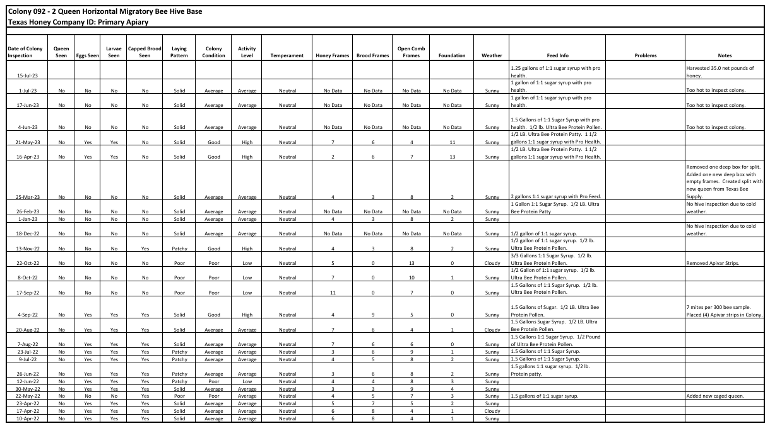
Field Data:
Colony 092
Migratory Hive
35.0 Pounds of Honey
Produced
32

Slide 33
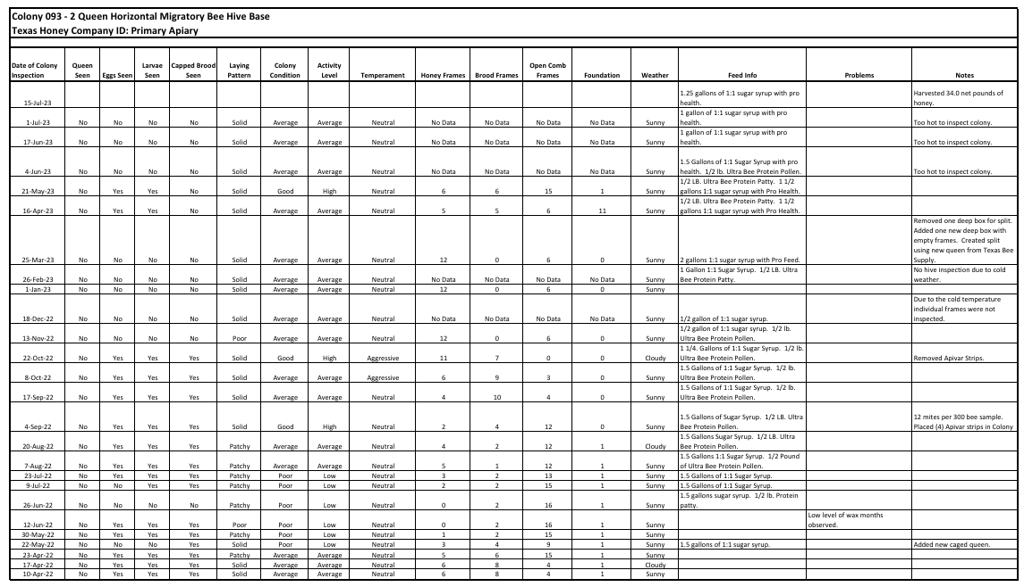
Field Data:
Colony 093
Migratory Hive
34.0 Pounds of Honey
Produced
33

Slide 34
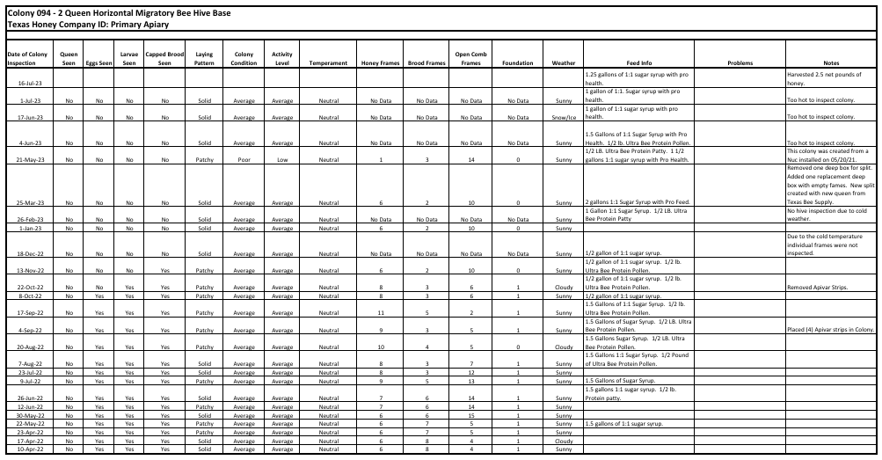
Field Data:
Colony 094
Migratory Hive
2.5 Pounds of Honey
Produced
34

Slide 35
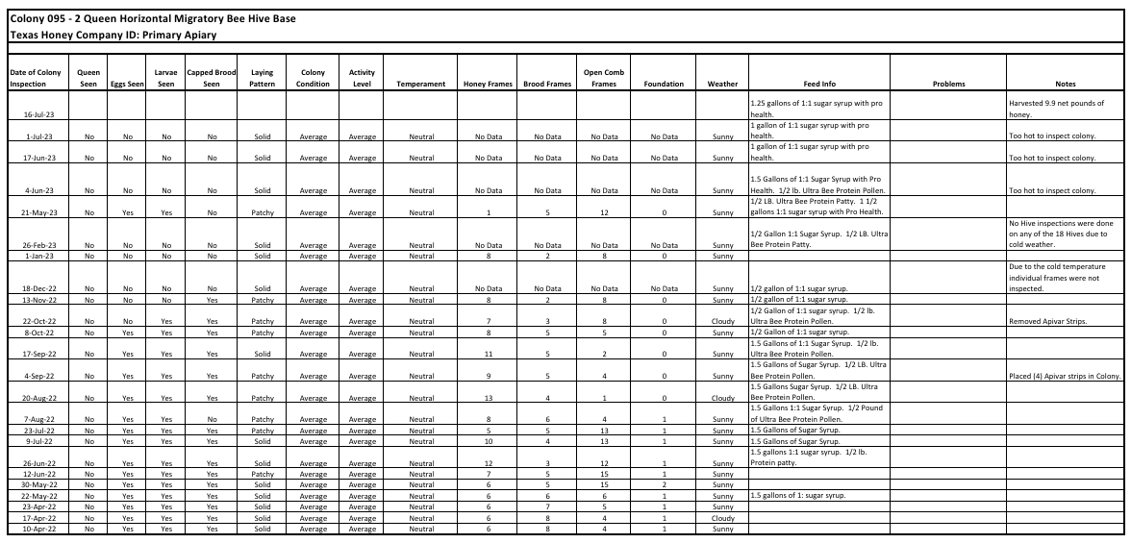
Field Data:
Colony 095
Migratory Hive
9.9 Pounds of Honey
Produced
35

Slide 36
SARE Grant:
Research
Results
Summary
HONEY HARVEST RESULTS:
Five (5)* Langstroth Colonies produced a total of 68.8 pounds of honey for an average of 13.76 pounds per colony. (*Note: The sixth Langstroth colony collapsed prior to the honey harvest and was NOT factored into the average amount of honey produced per Langstroth colony.)
Six (6) of the new Two Queen Commercial-Migratory colonies produced a total of 151.2 pounds of honey for an average of 25.2 pounds per colony. This is an average increase of 83.14% compared to the Langstroth colony average.
Six (6) of the new Two Queen Hobby colonies produced a total of 118.4 pounds of honey for an average of 19.73 pounds per colony. This is an average increase of 43.39% compared to the Langstroth colony average.
36

Slide 37
SARE Grant:
Research
Conclusions
Initial findings show Multiple Queen Hives have the potential to increase honey production.
In order to achieve widespread acceptance by both Commercial and Small Scale beekeepers, multiple queen hives must be relatively easy to manage and be compatible with readily available industry standard hive components.
Due to the limited number of colonies tested in this study, additional studies using larger sample sizes are required in order to confirm initial findings.
37

Slide 38
SARE Grant
Research:
Outreach
The SARE Grant for the “New Design of Two Queen Horizontal Honey Bee Hive Bases for Commercial and Small Scale Beekeeping Operations” has provided a platform to share the research results with beekeepers at local, state and national levels, via the following presentations and publications:
Presentation at the Brazos Valley Beekeepers Association 2023 Fall Beekeeping School, Bryan, Texas.
Presentation at the 82nd Annual American Beekeeping Federation 2025 National Conference and Tradeshow in Reno, Nevada.
Presentation to the Trinity Valley Beekeepers Association of Dallas, Texas, February 25, 2025.
Published article in the Mar/Apr 2025 Issue 25-2 of the Texas Beekeepers Association Journal.
Presentation at the Texas Beekeepers Association 2025 Summer Clinic in Abilene, Texas.
As a final step in obtaining my Texas Master Craftsman Beekeeper certification, I will be making a presentation regarding this SARE Research Study at the Texas Beekeepers Association Annual Convention in November of 2025.
38

