Slide 1
On-Farm Trials (and tribulations)
Flint Hills Lavender Farm
Aaron and Mary Yoder

Slide 2
Preview
Farm Overview
NCR-SARE project: Weed barrier evaluation (2018-2019)
  Overview
  Project Results
  Project summary
  Ideas for further research
Other happenings at FHLF
Q&A

Slide 3
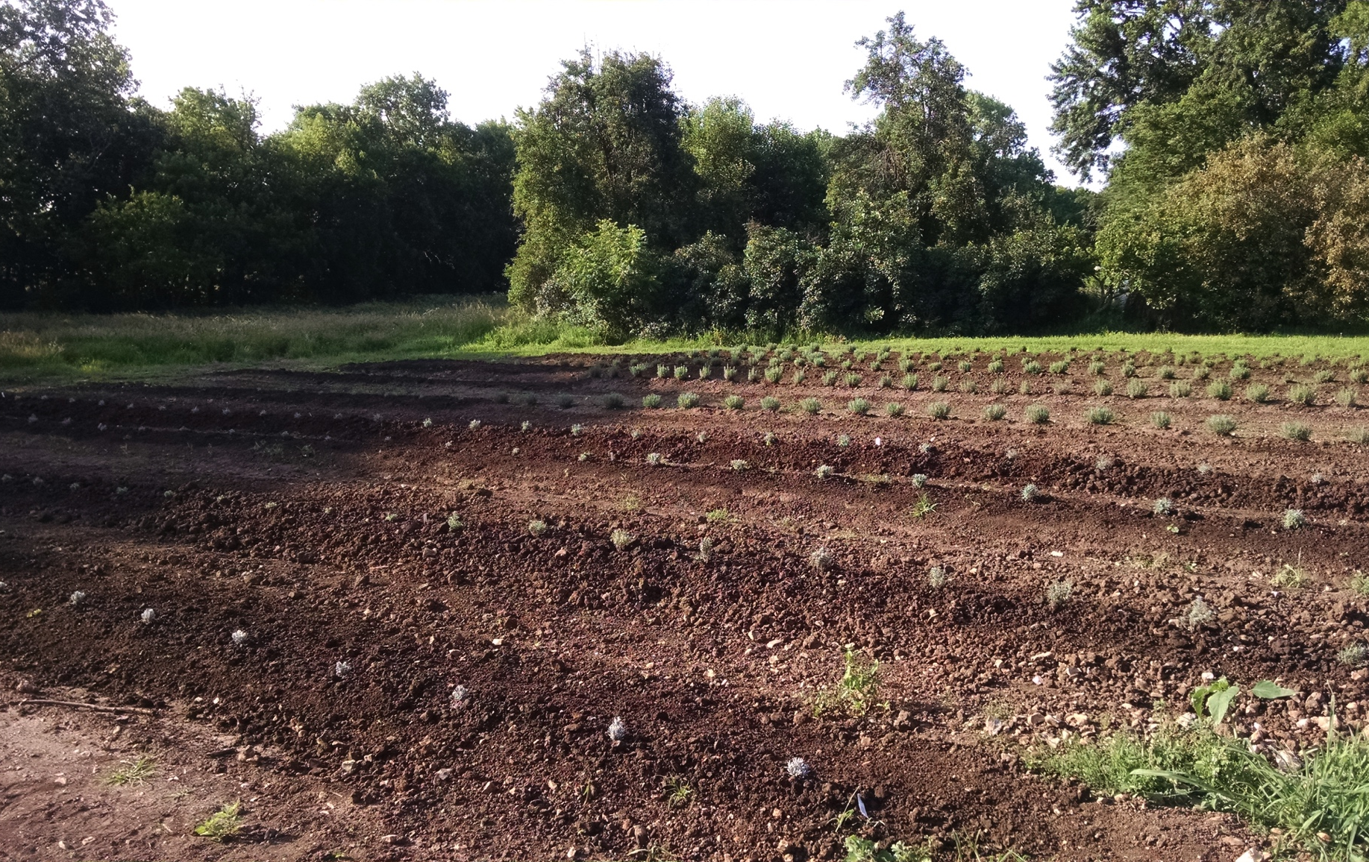
Flint Hills Lavender Farm
First ‘Test’ field planted in 2014

Slide 4
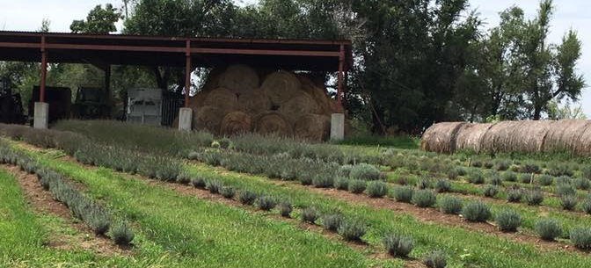
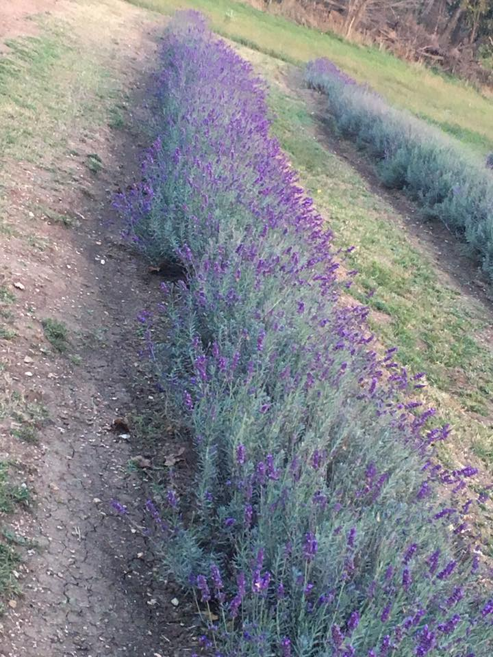
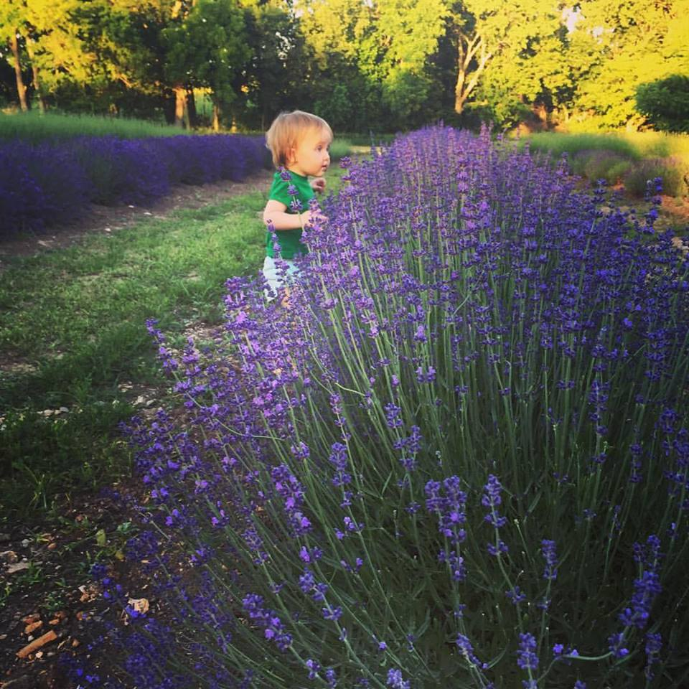
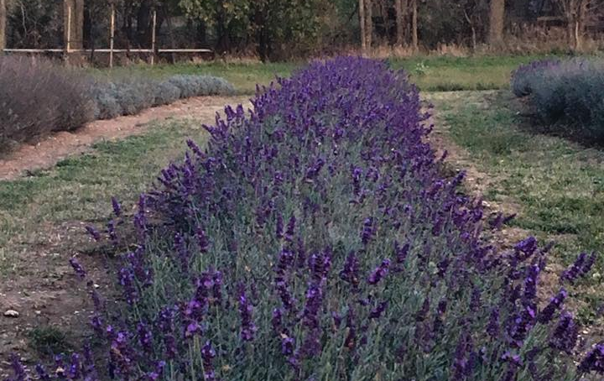
Flint Hills Lavender Farm
Lookin good in 2015

Slide 5
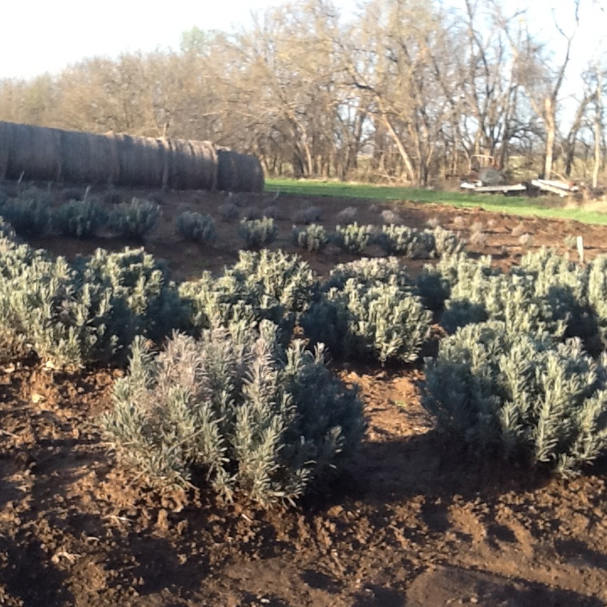
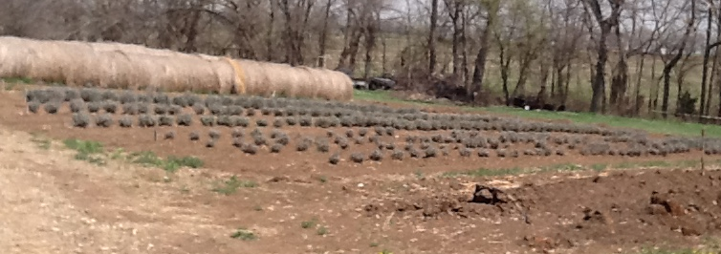
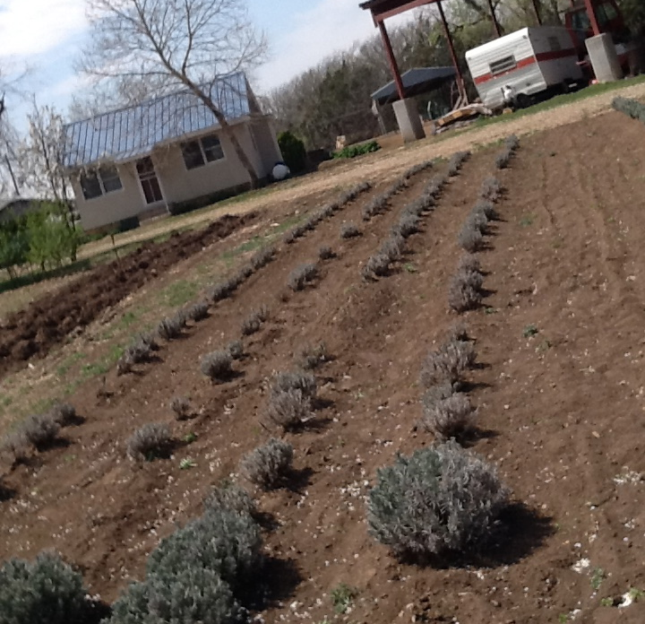
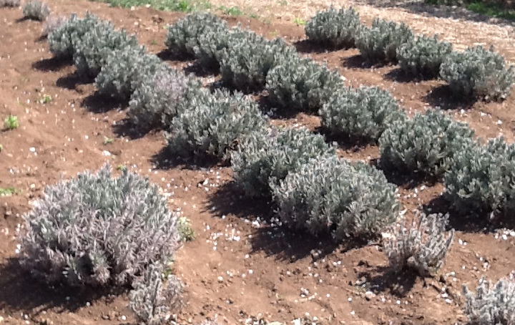
Flint Hills Lavender Farm
Not so good in 2016…winter damage

Slide 6
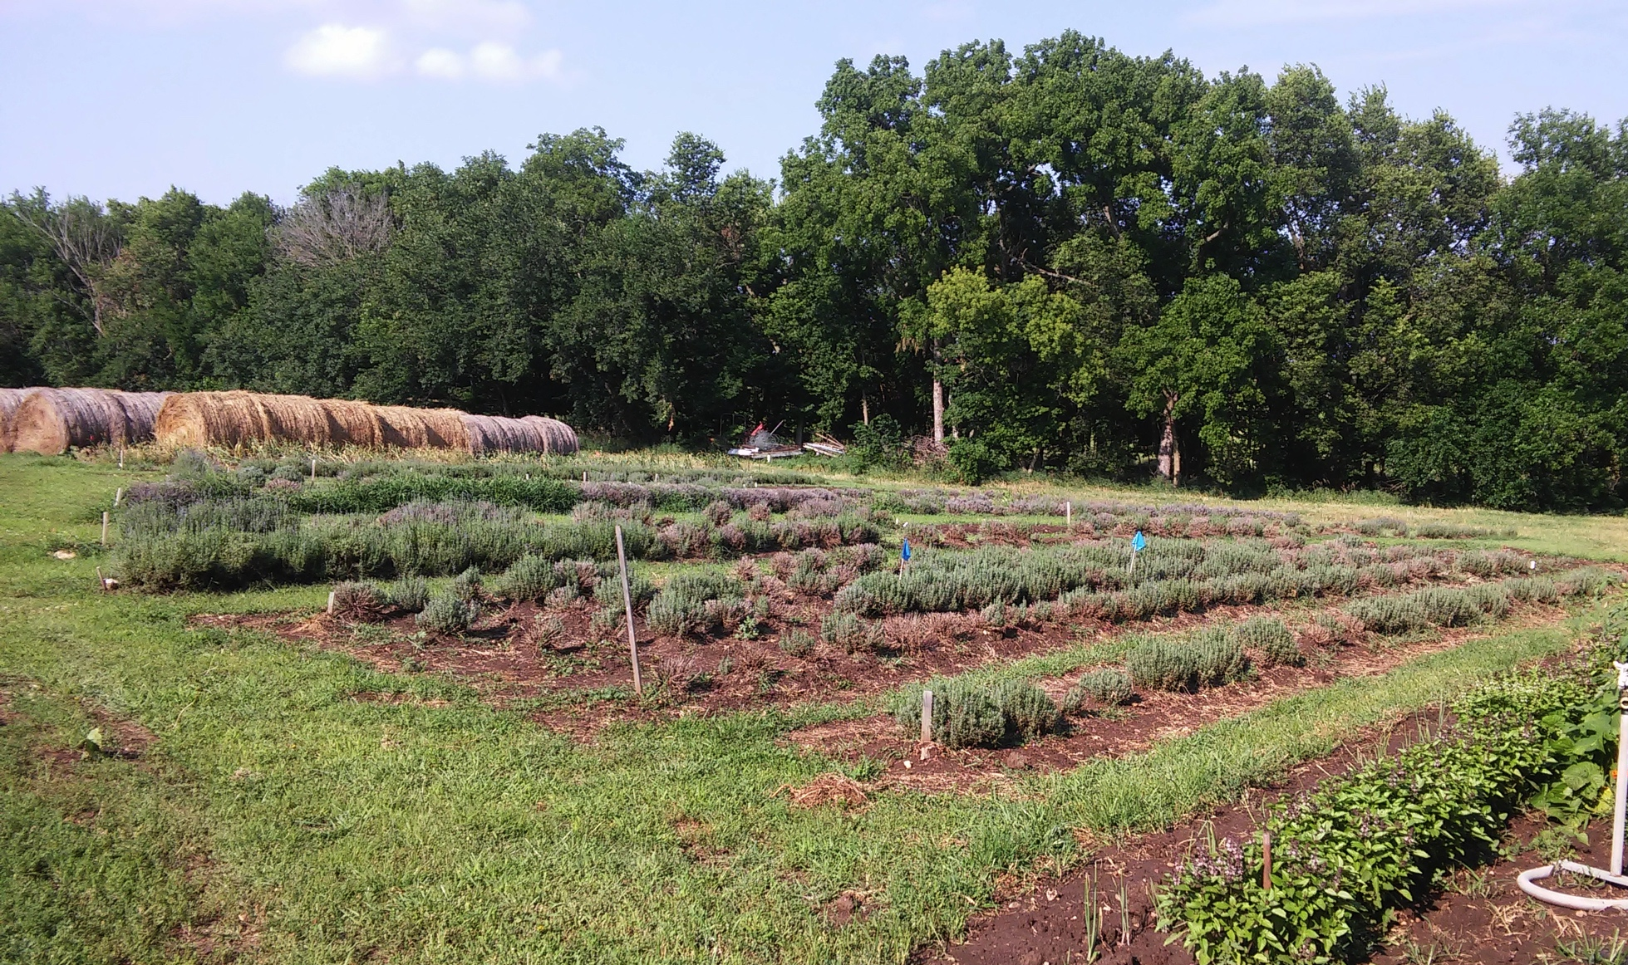
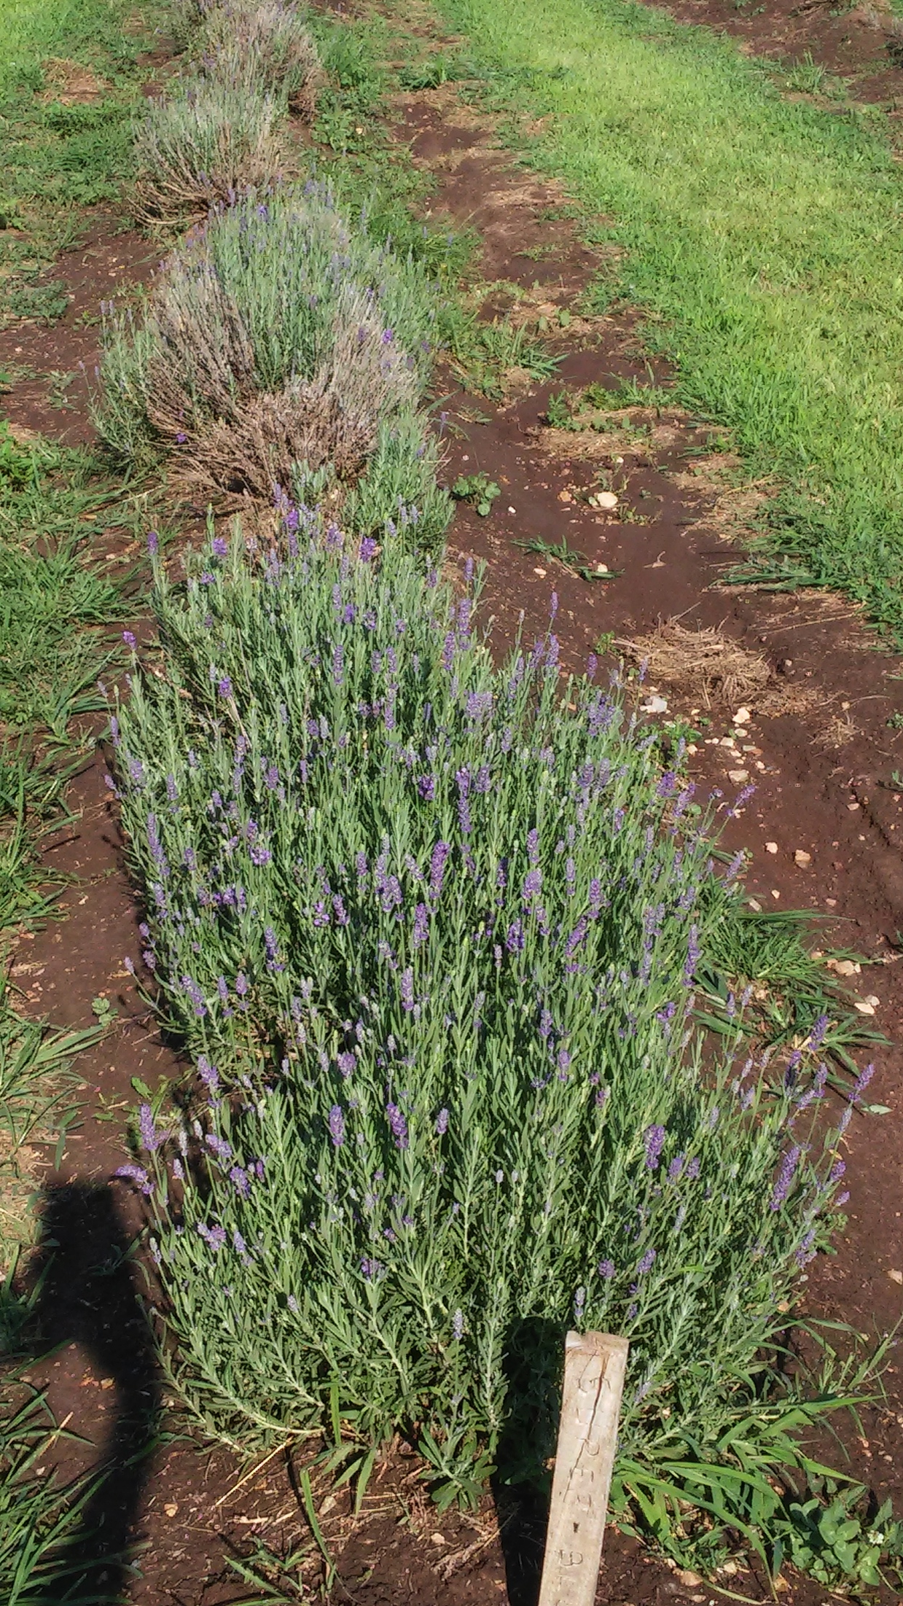
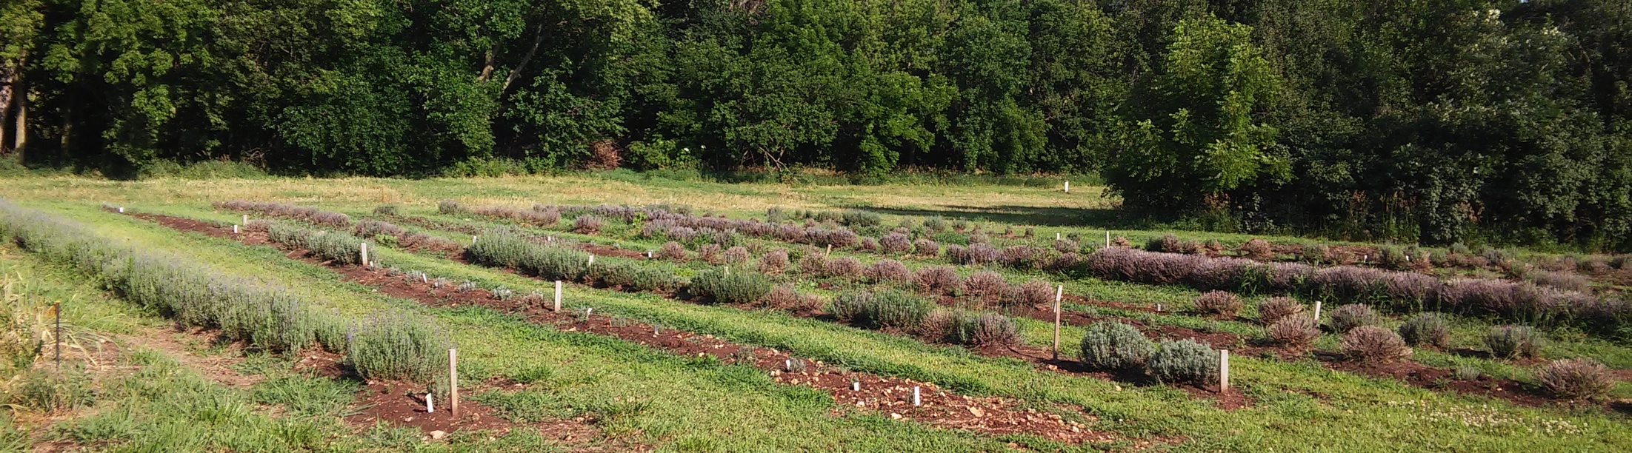
Flint Hills Lavender Farm
Registered as LLC in 2017 (following move from Michigan)

Slide 7
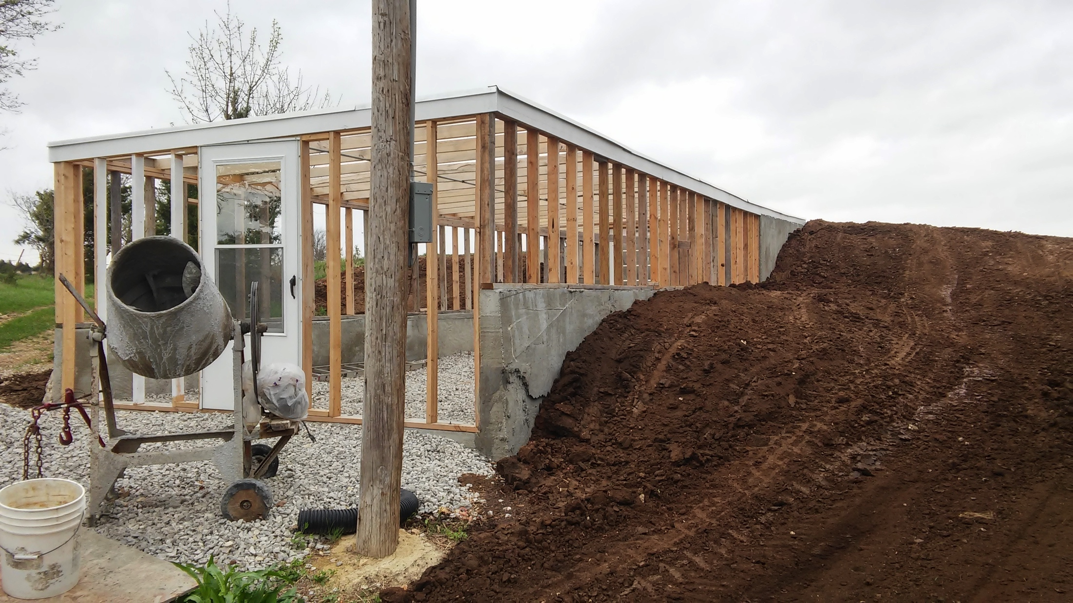
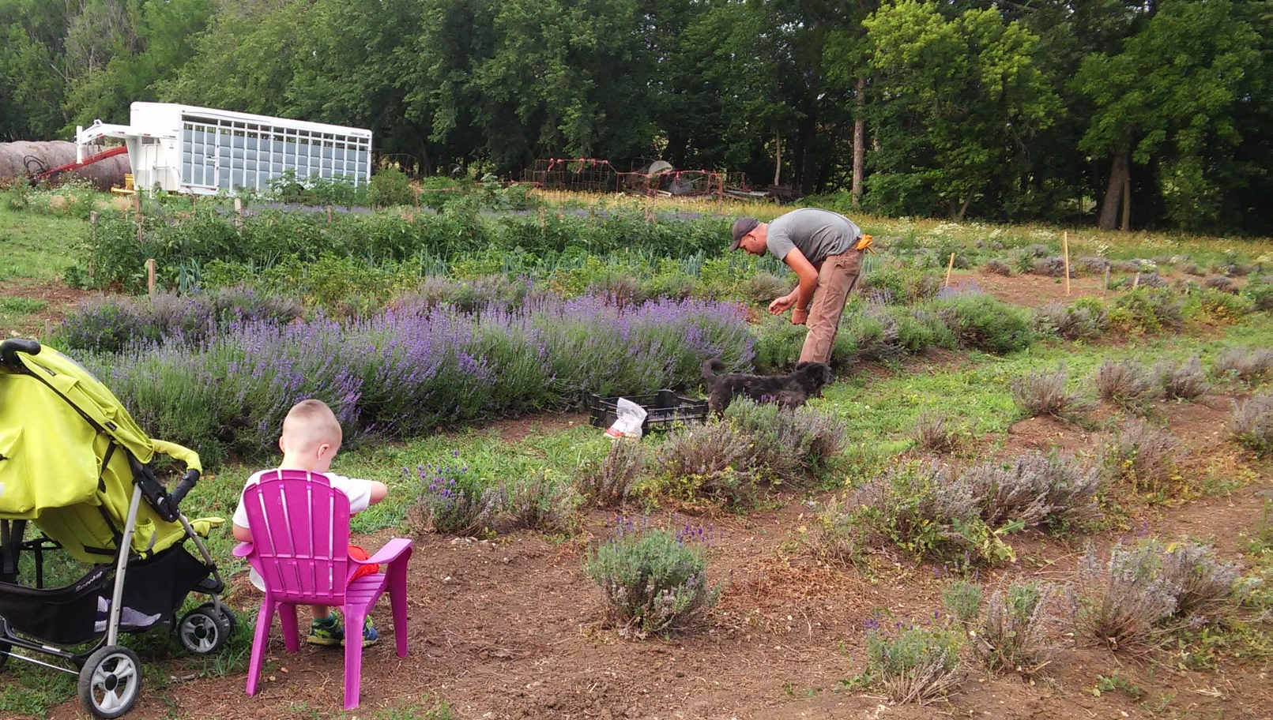
2018

Slide 8
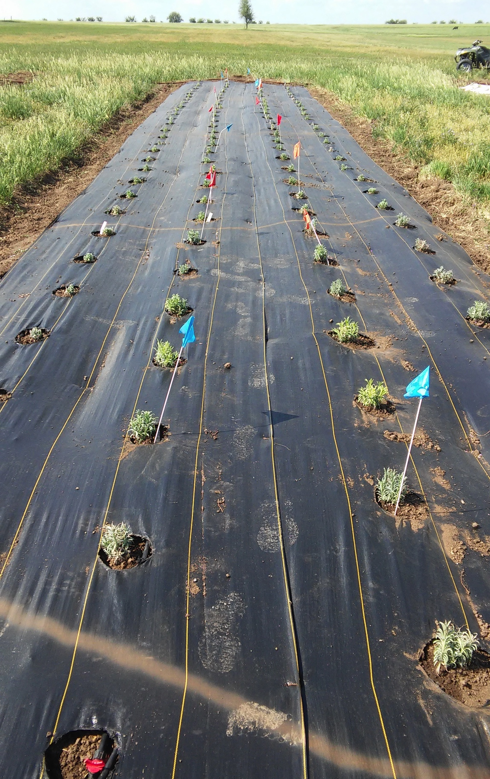
NCR-SARE project-2018-2019
Project Background:
-The Flint Hills and production constraints
-variable temperatures
-water availability
-Need to reduce labor inputs (weeding in particular)
Project Design:
3 management treatments:
-Bareground
-Black Fabric- Dewitt, 3.2 oz.
-White Fabric
4 varieties: Grosso, Phenomenal, Croxton’s Wild, Munstead

Slide 9
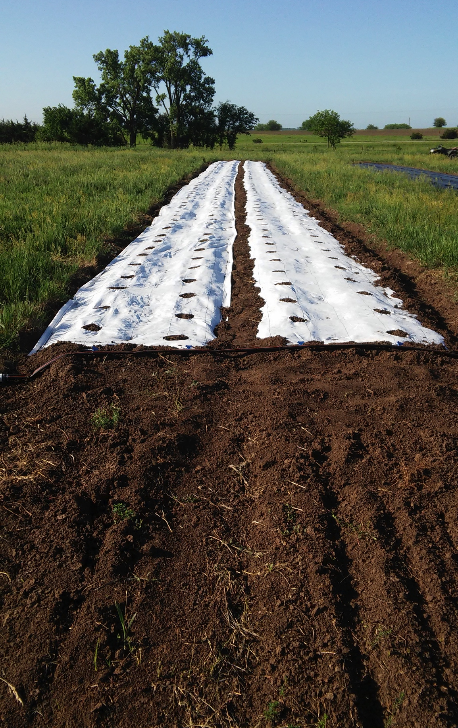
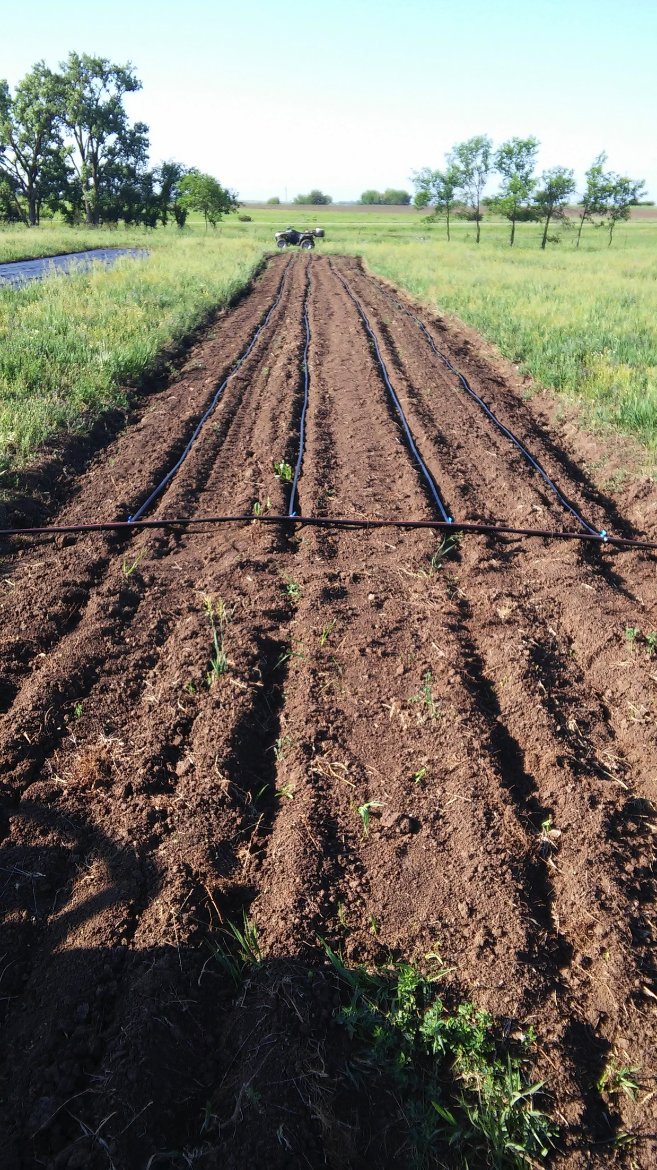
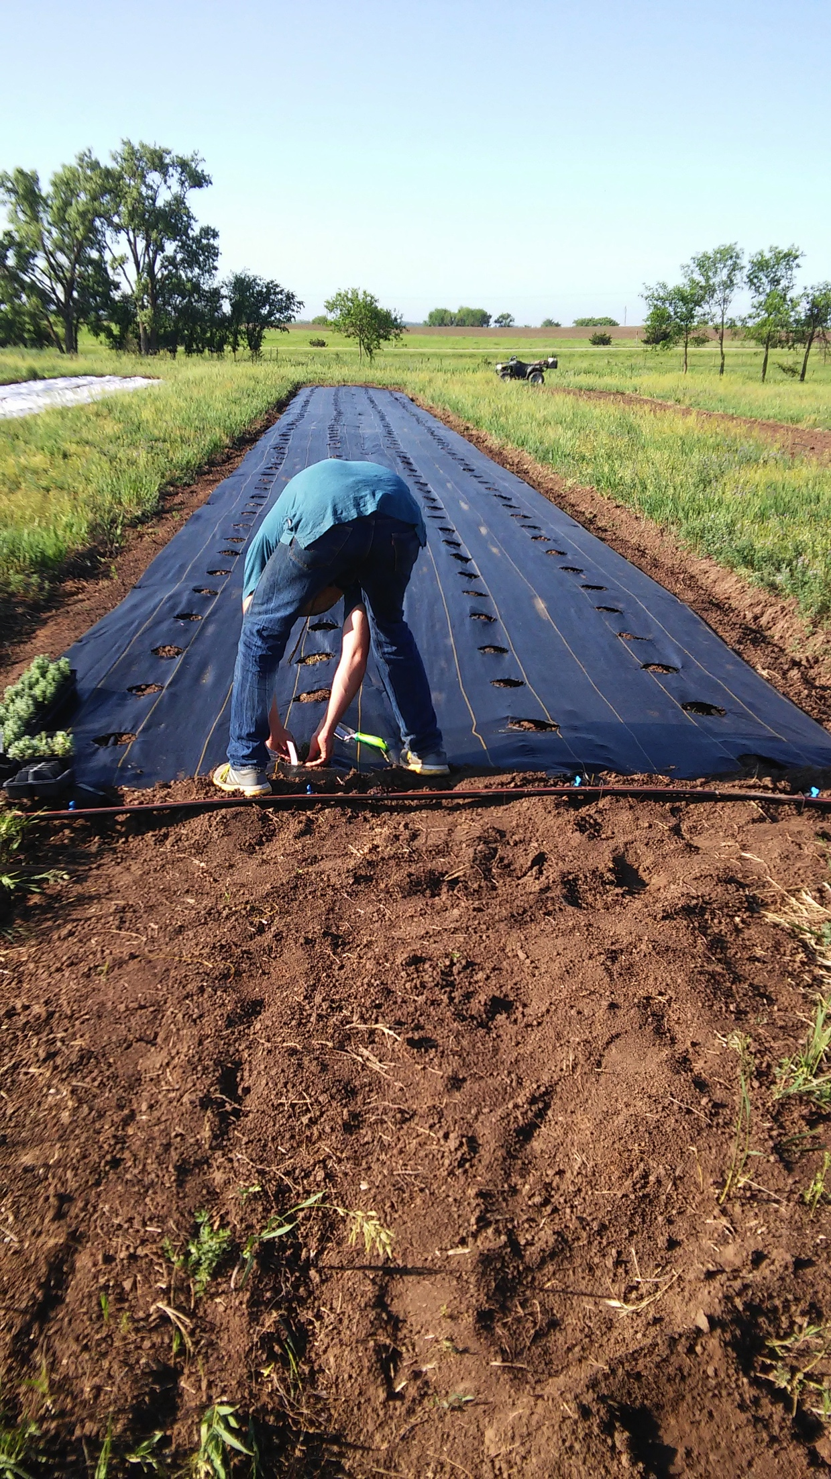
Management Treatments
Bareground
Black Fabric
White Fabric

Slide 10
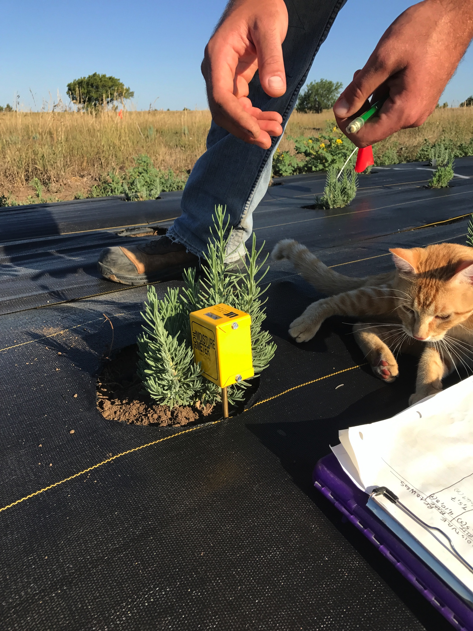
Data Collection
Soil moisture content measured for scheduling irrigation-monitored water usage for each mgmt treatment
  Drip irrigation (in-line, 30” centers)
Plant Survival- previous experience led us to assume some plant losses initially:
  Coldest April on record followed by warmest May
Plant Vigor, Height and Diameter
  Measured late summer
Yield Bundles, bud weights from 10 aggregated ‘sample’ plants in 2nd year
Also track labor hours spent in each Mgmt treatment

Slide 11
Early Mortality

Slide 13
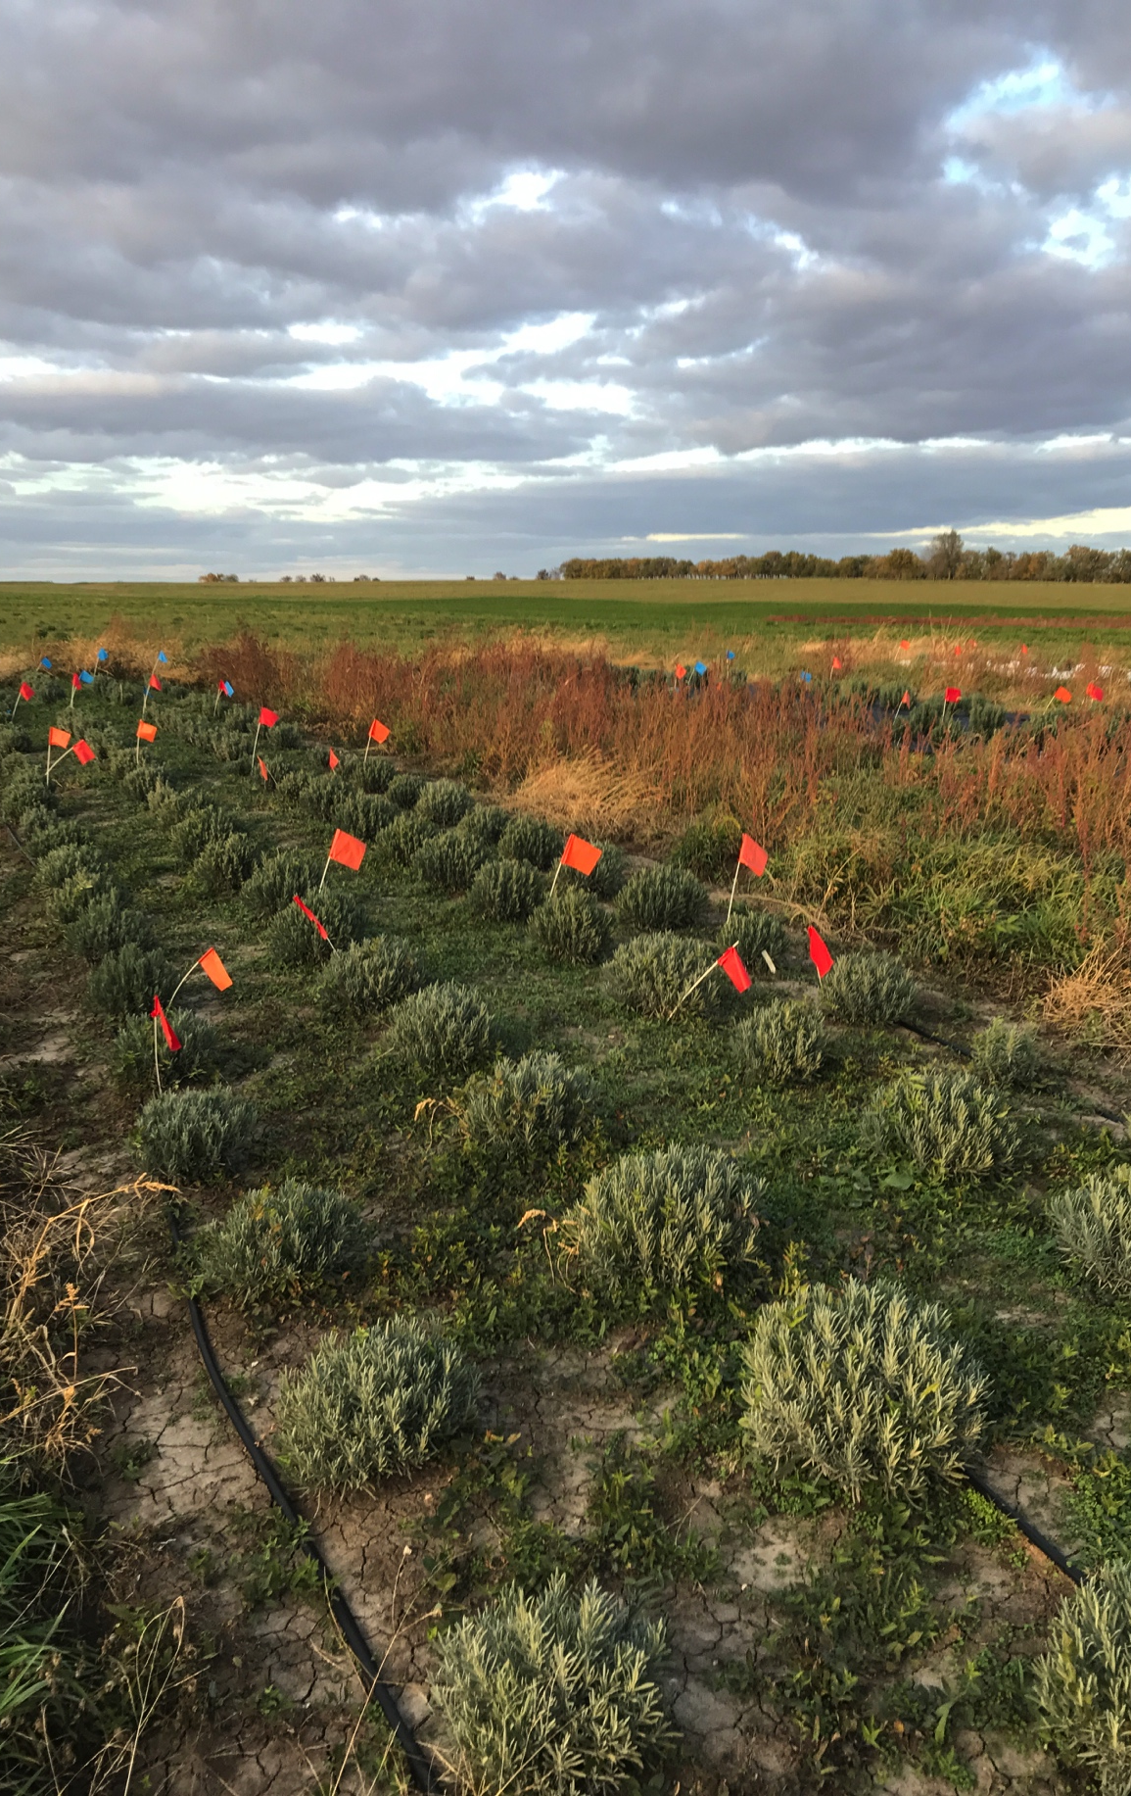
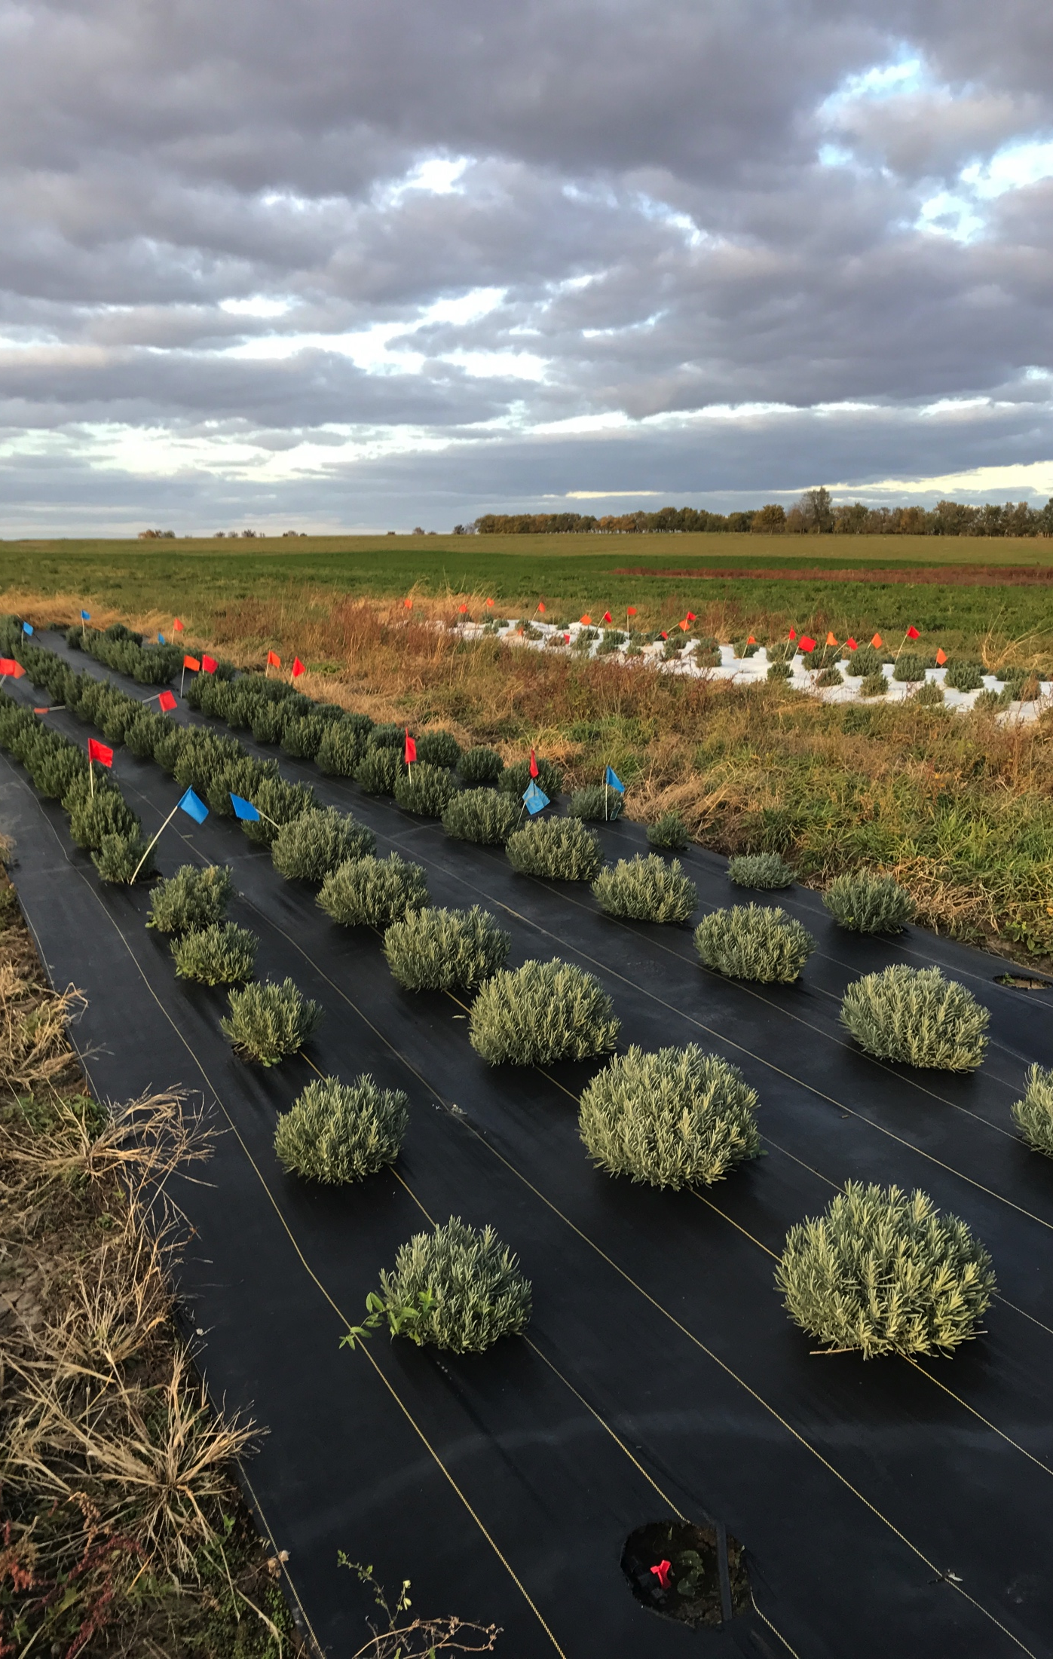
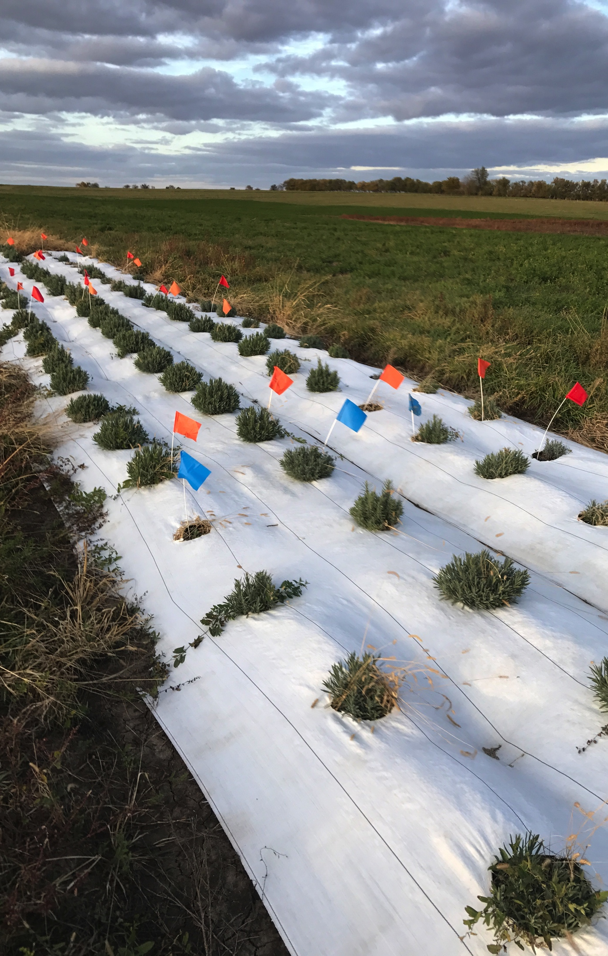
November 2018

Slide 14
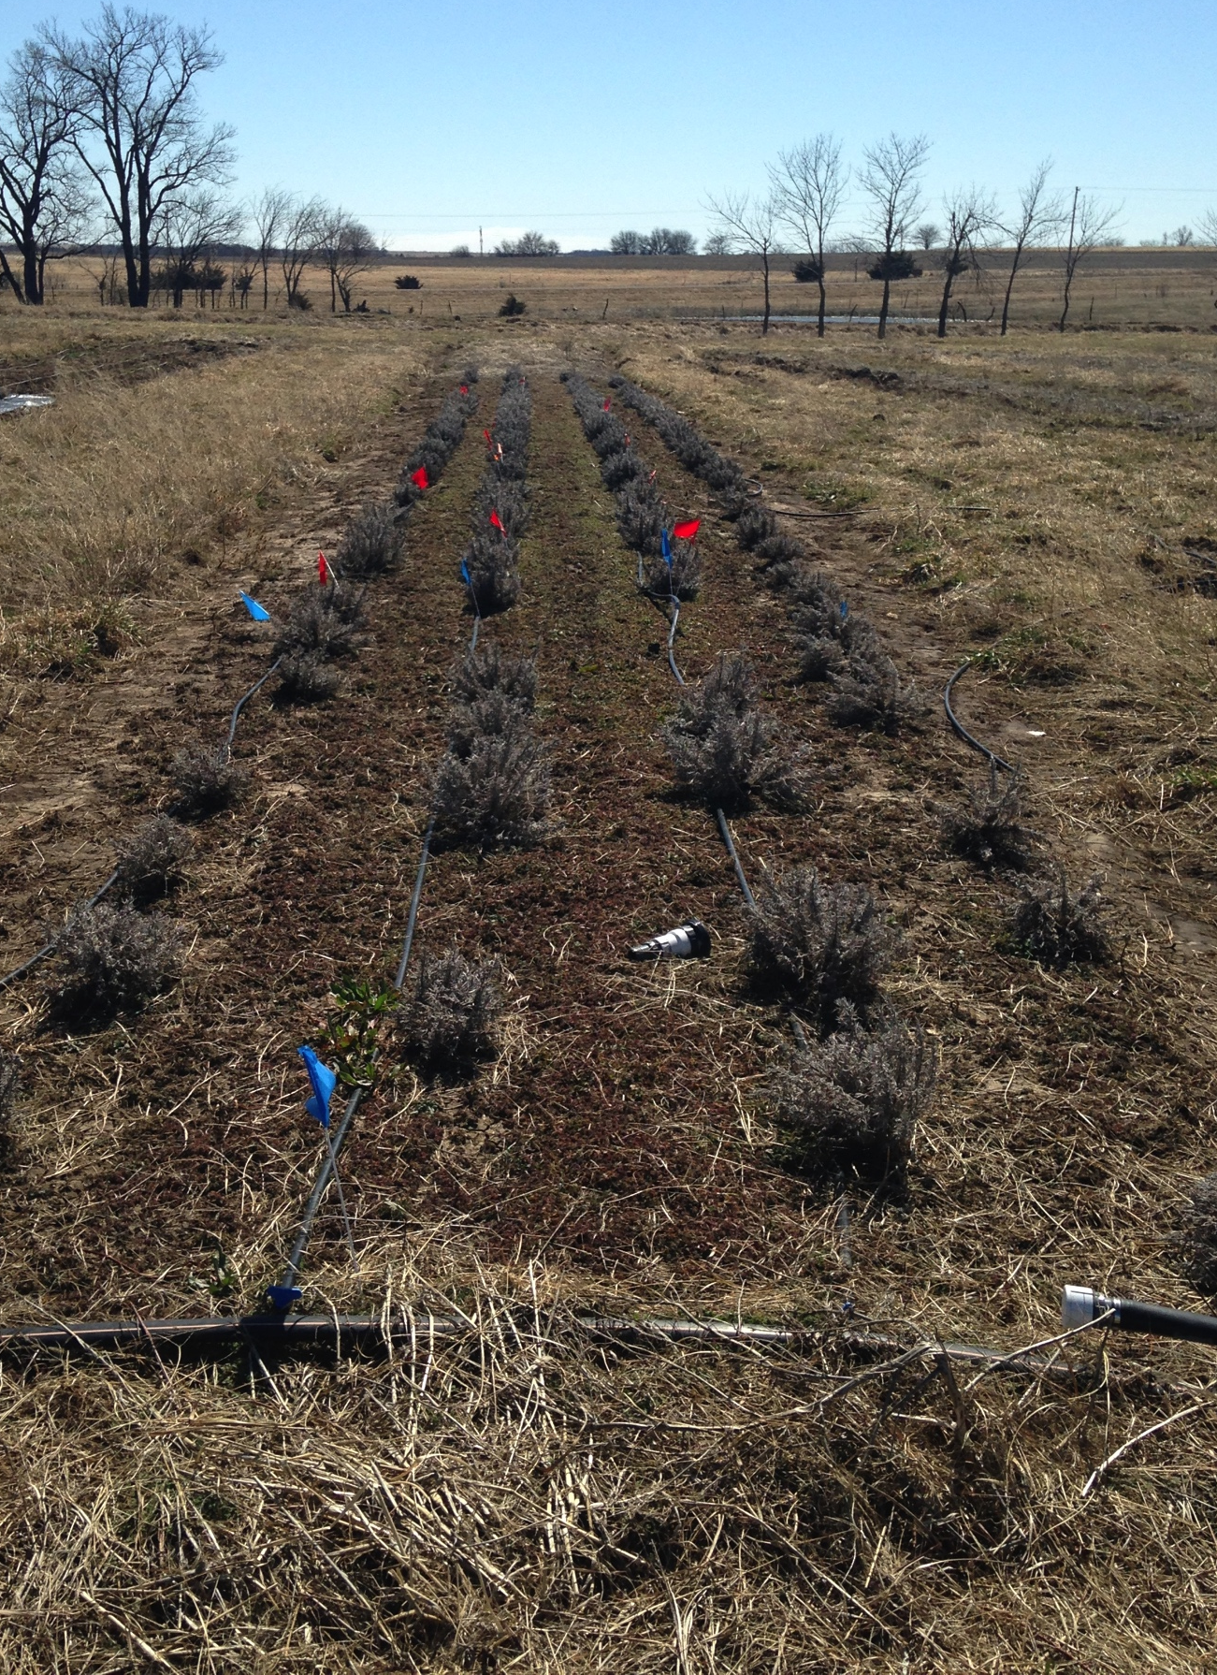
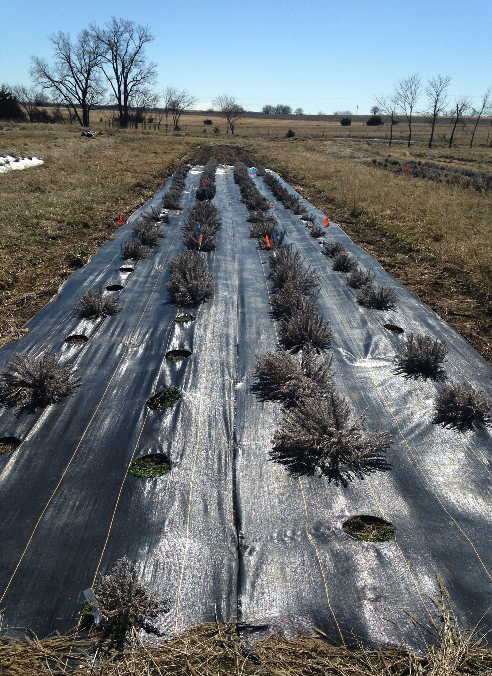
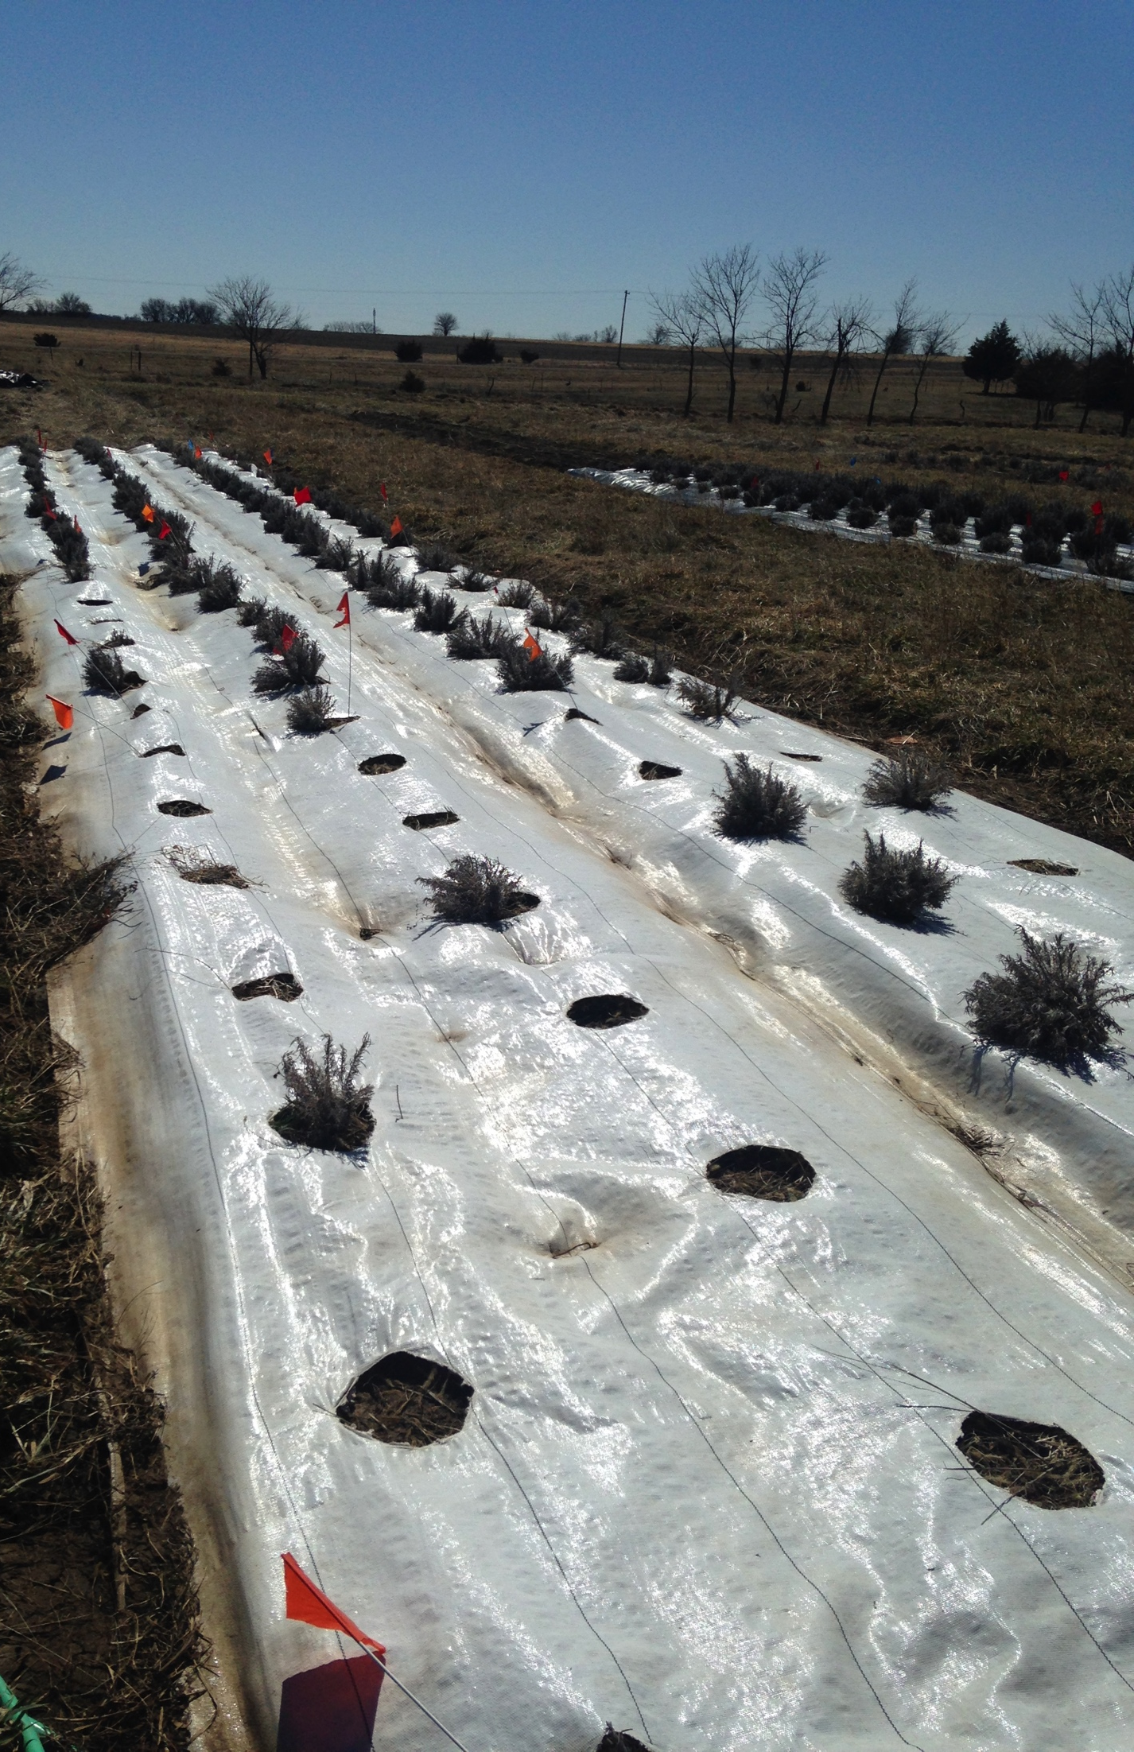
March 2019

Slide 15
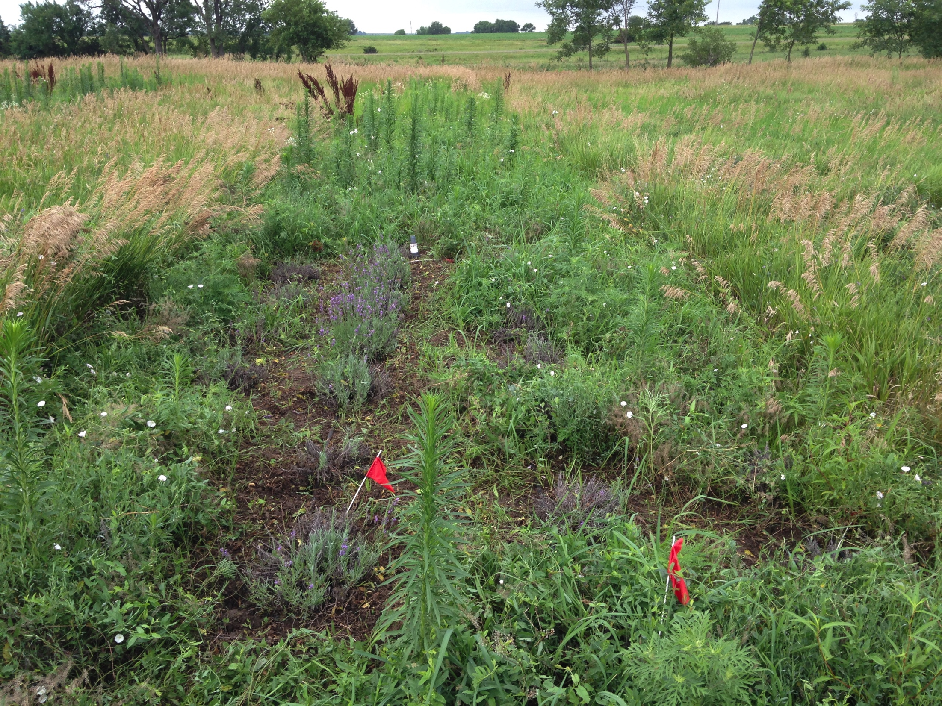
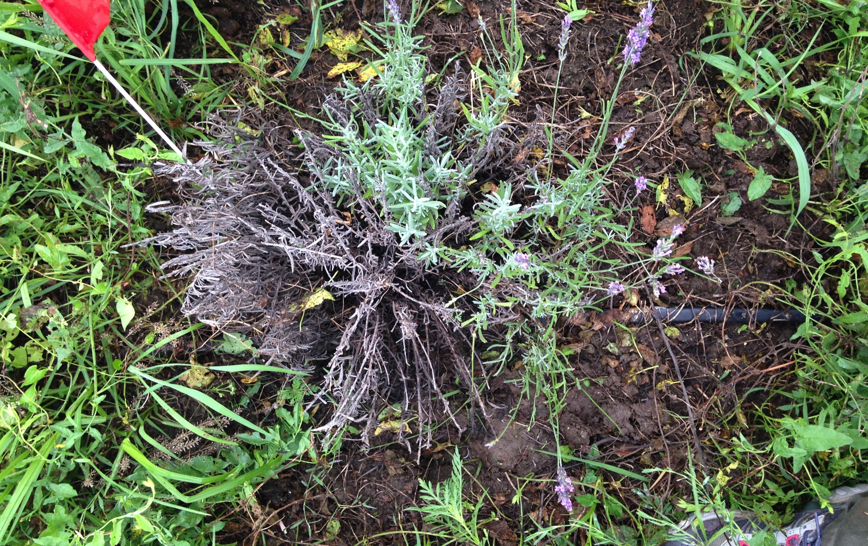
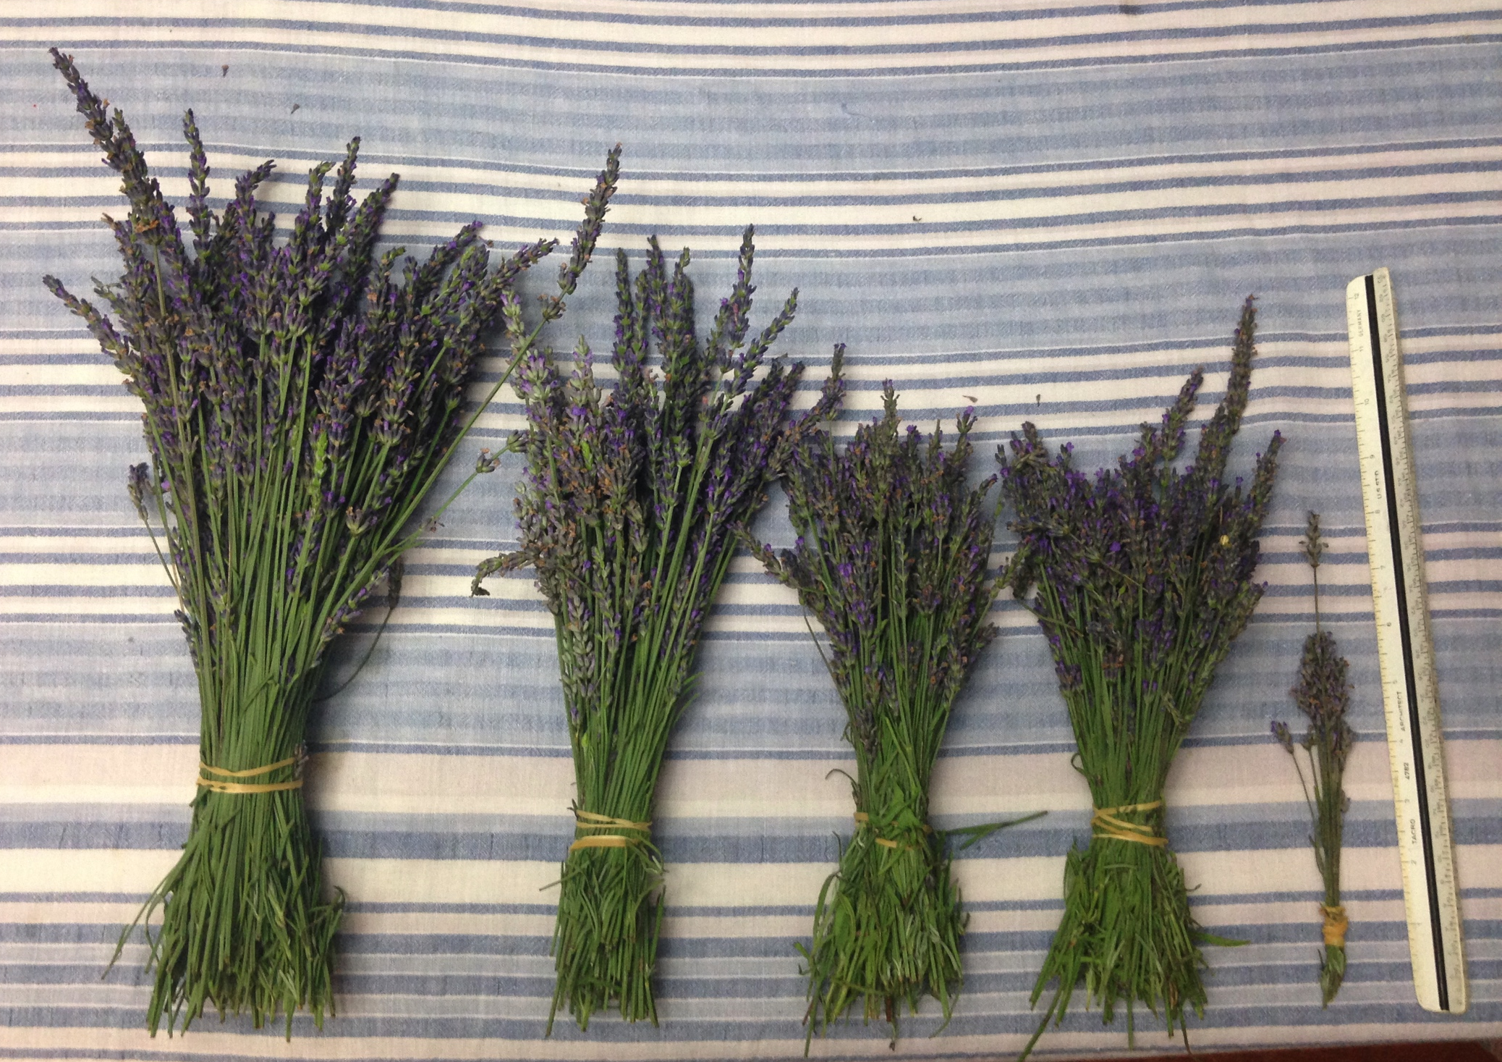
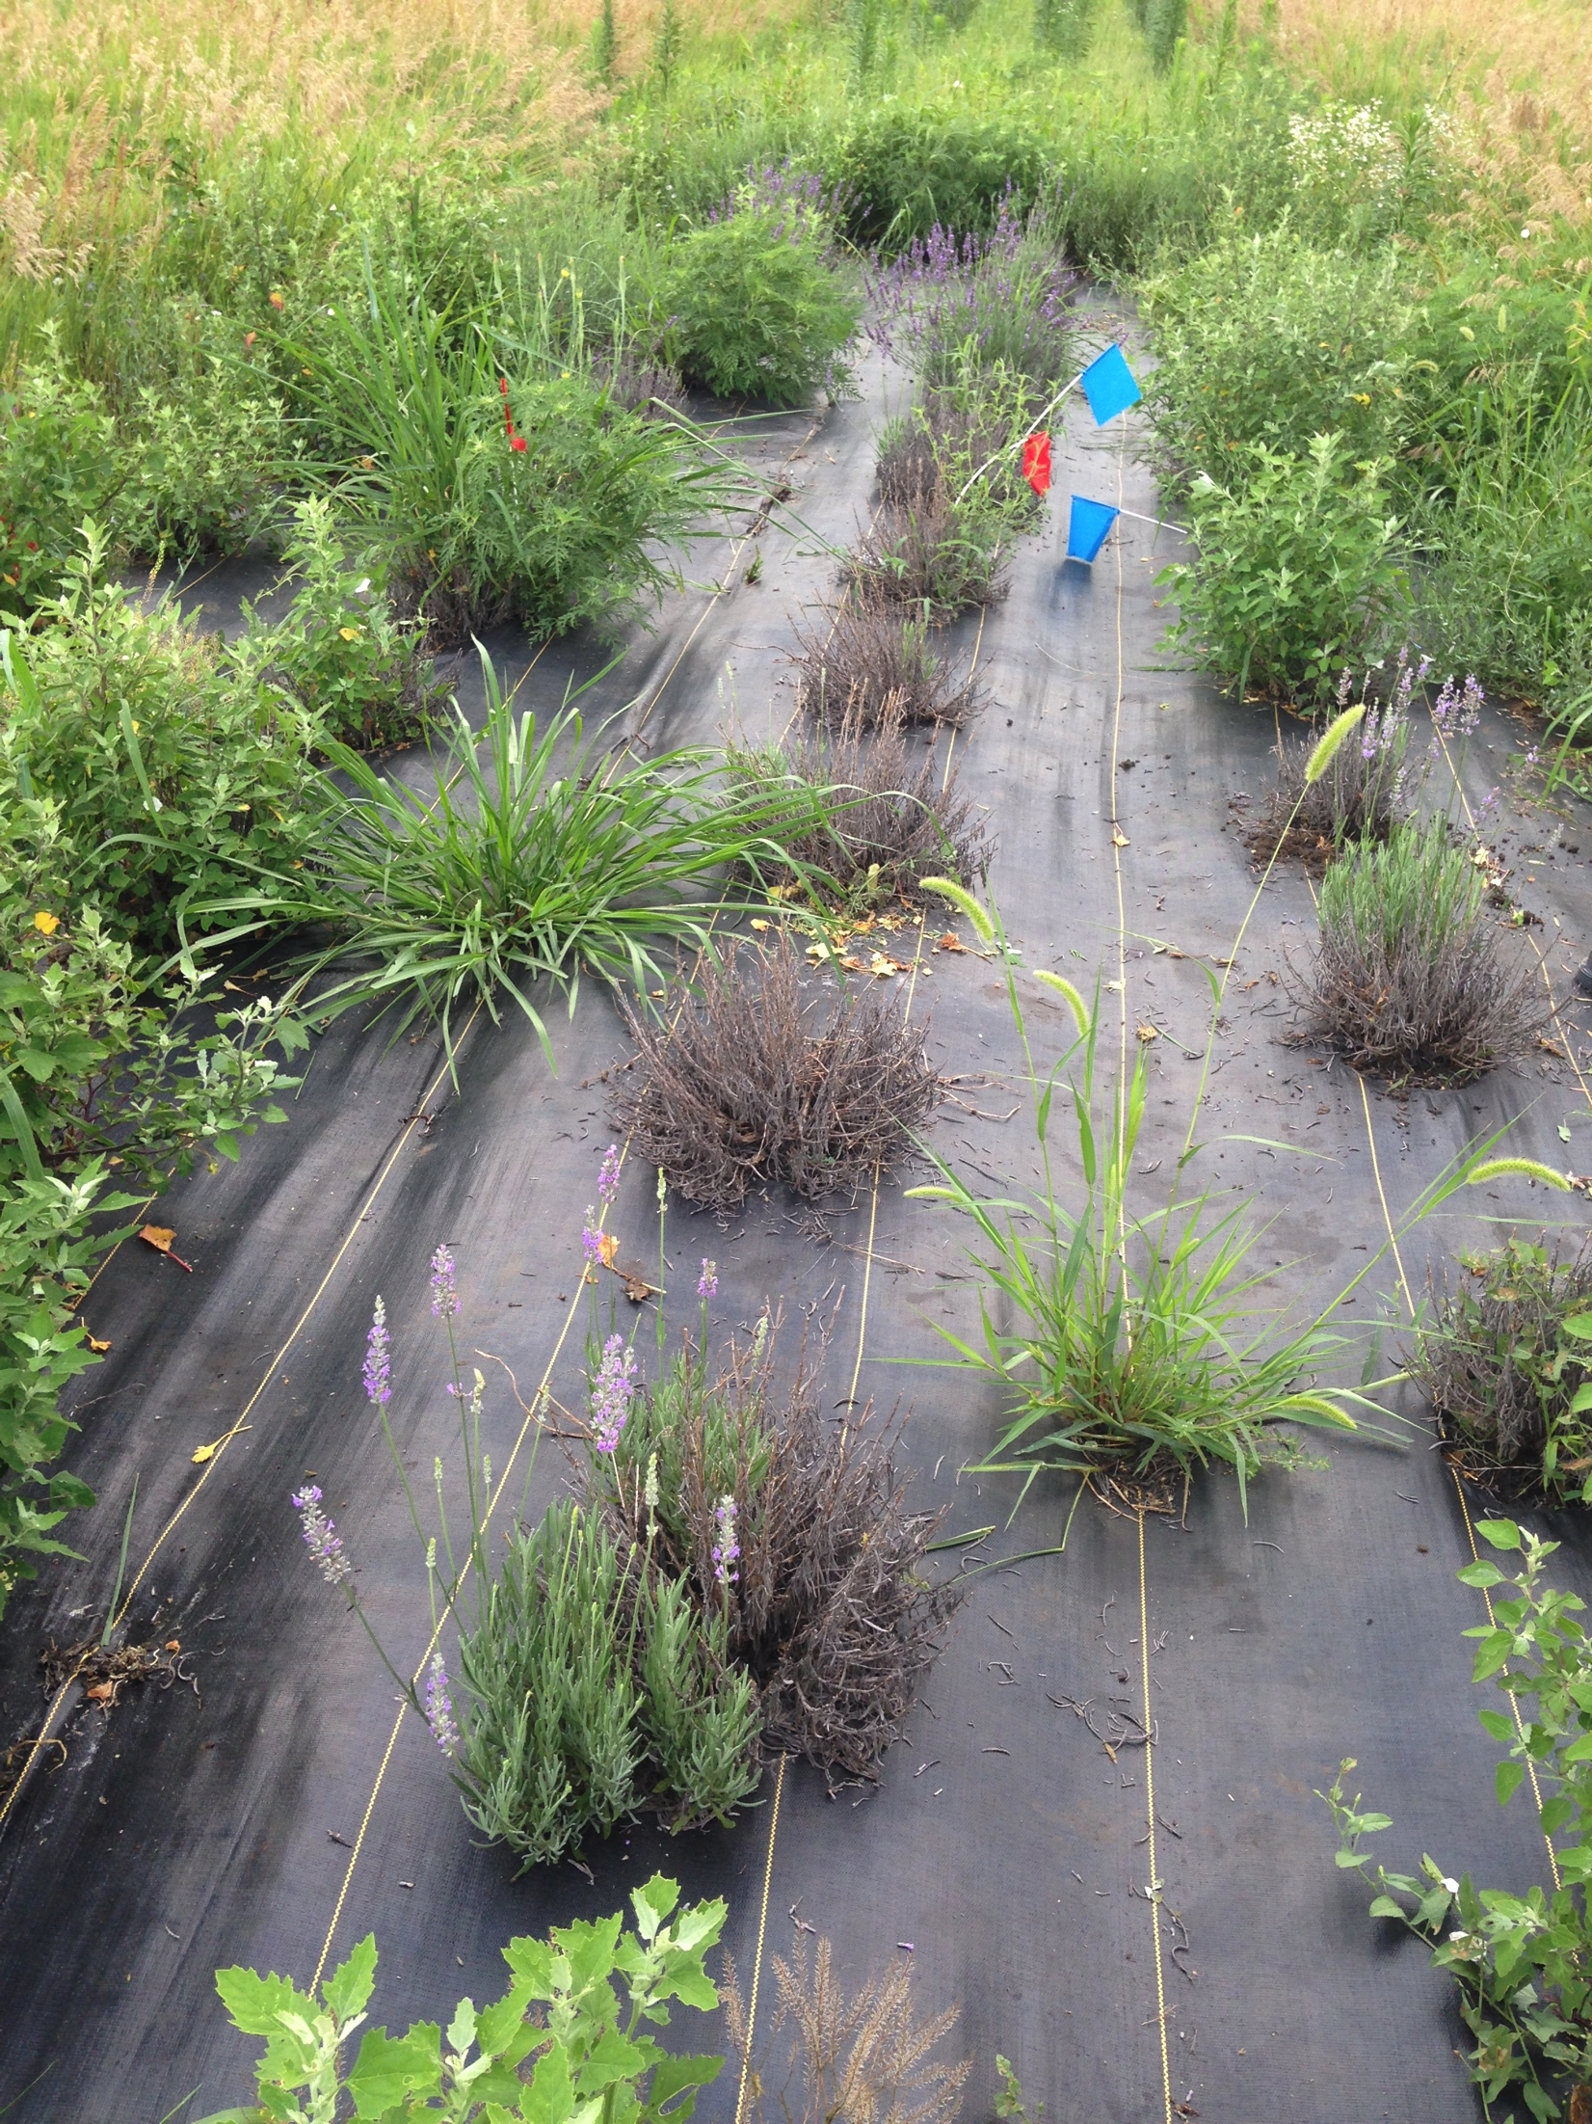
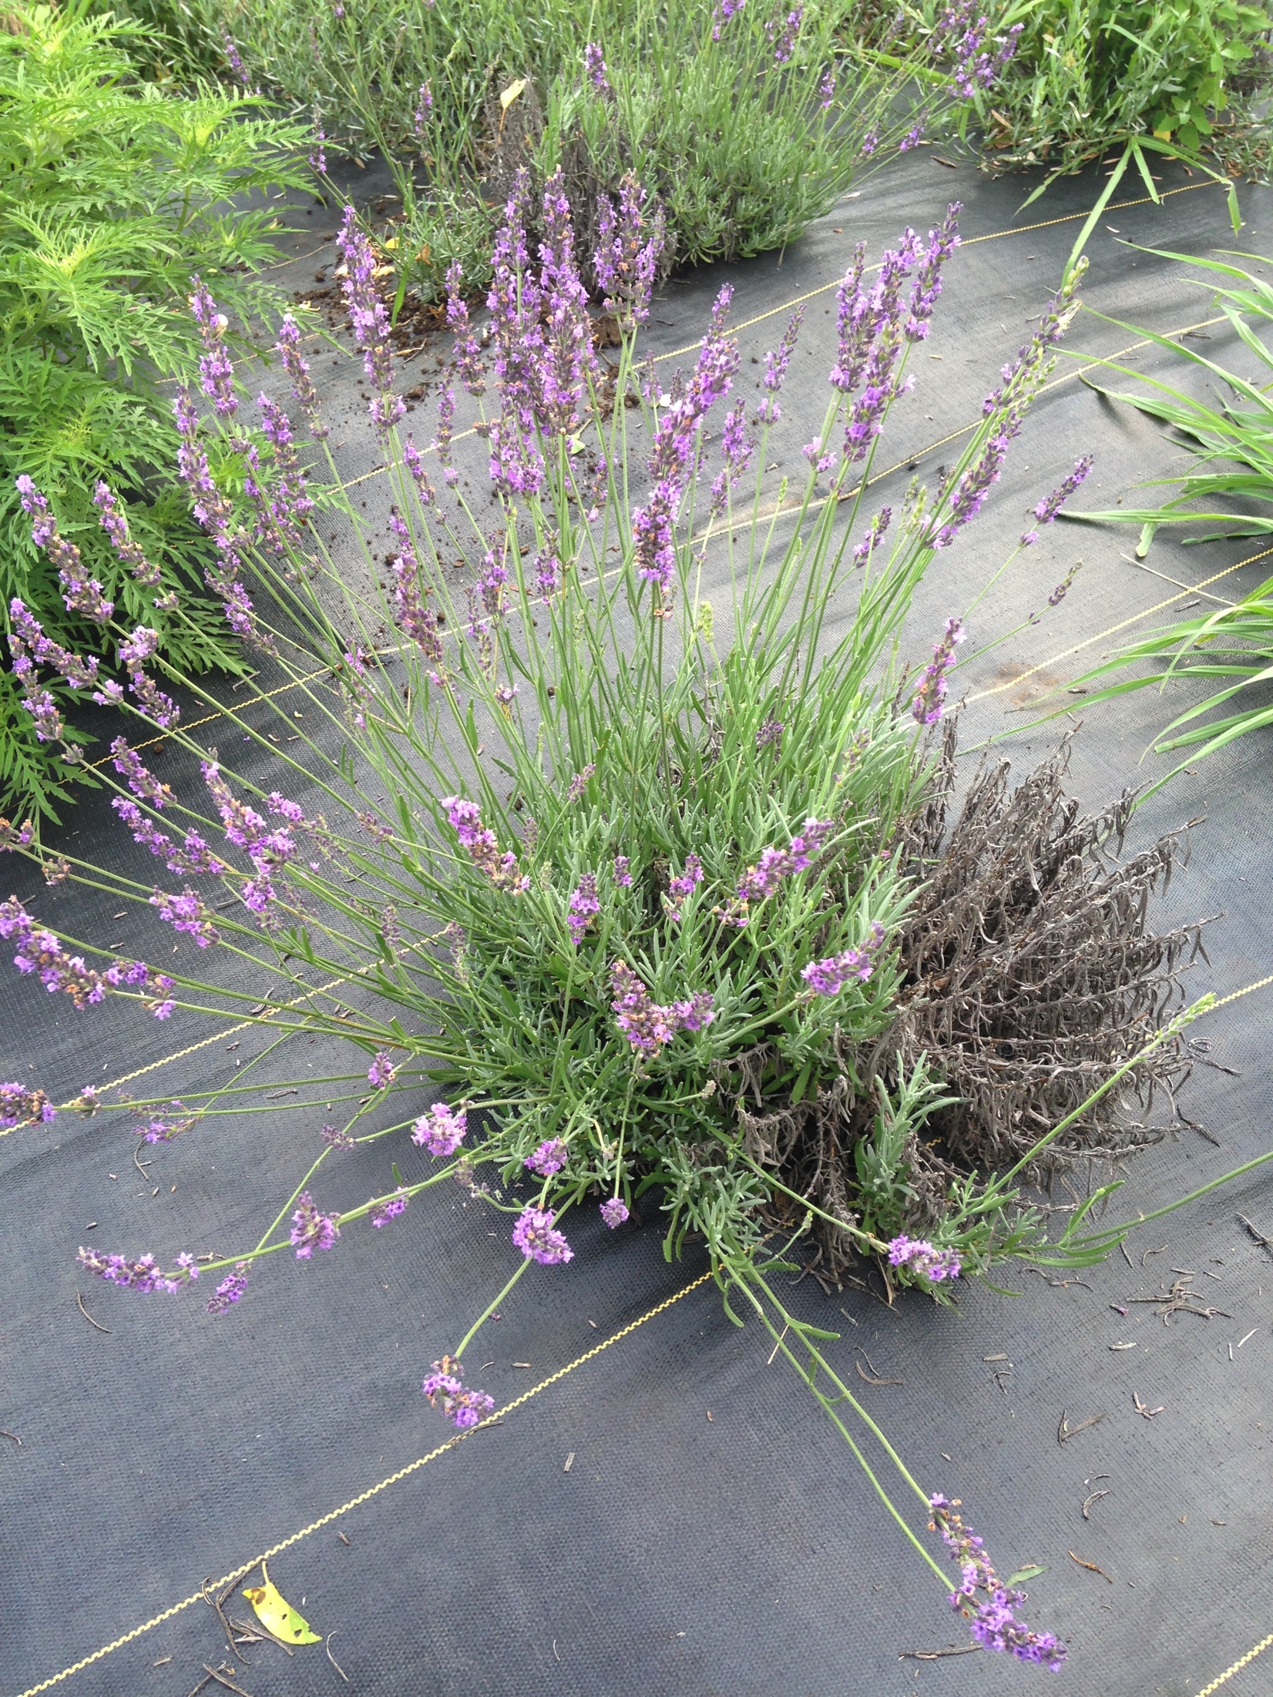
Summer 2019

Slide 16
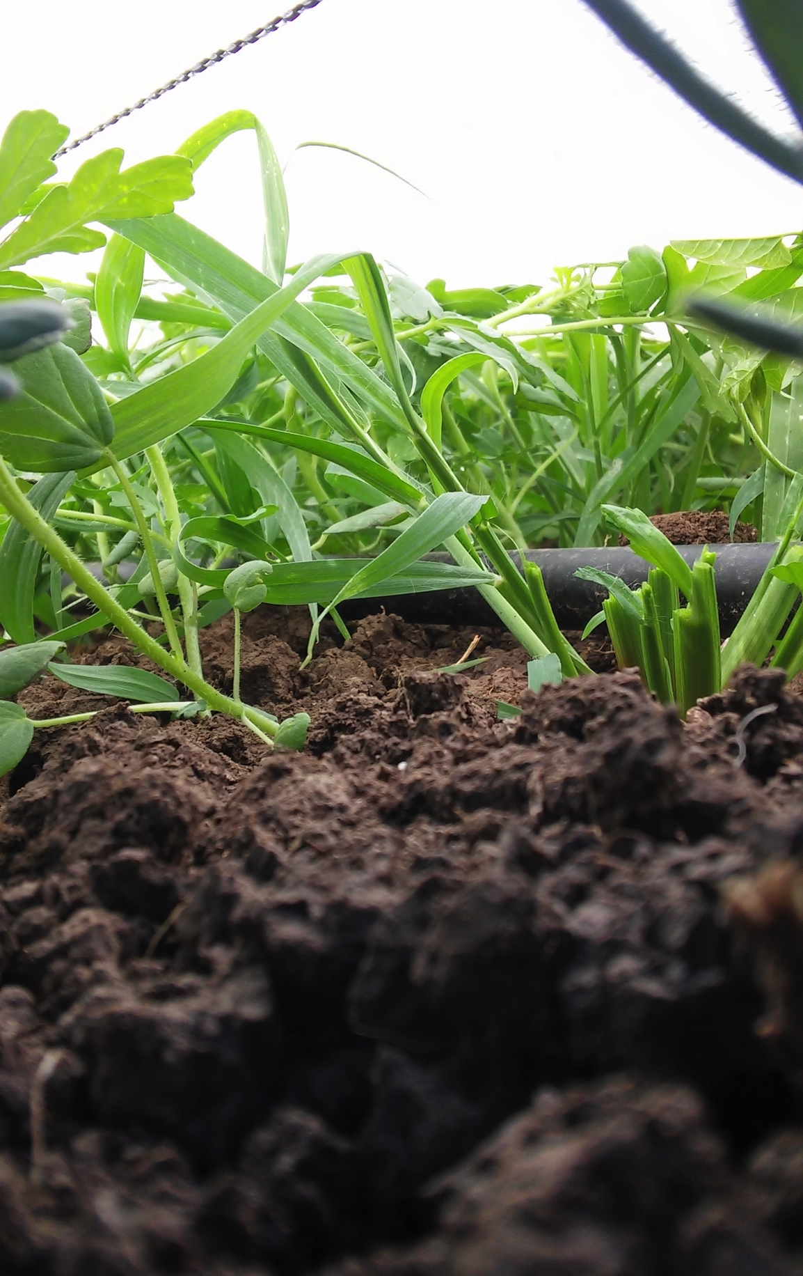
Observations
White fabric- not suitable for field production (won’t block out light sufficiently)
Install drip tape above fabric
  Much easier to repair and install
  Could make fabric installation much less expensive as well
  Concern with precipitate clogging emitters…
Bury the edges, don’t just staple in place
  Freeze thaw heaving
24 plants that survived all but 1 were ‘phenomenal’; none were in very good shape (2-3?)

Slide 17
Research ideas-commentary?
Winter injury management
  Soil moisture mgmt during fall/winter
  Protective covering/wind barrier
Continue with variety testing:
  Replication: making data more robust
    Replicate within farm (soil types, management, etc.)
    Replicate across farms (regional factors)
    Keeping data consistent (what measured and how)
Planting methods
  Spring vs. fall
  Fertilization

Slide 18
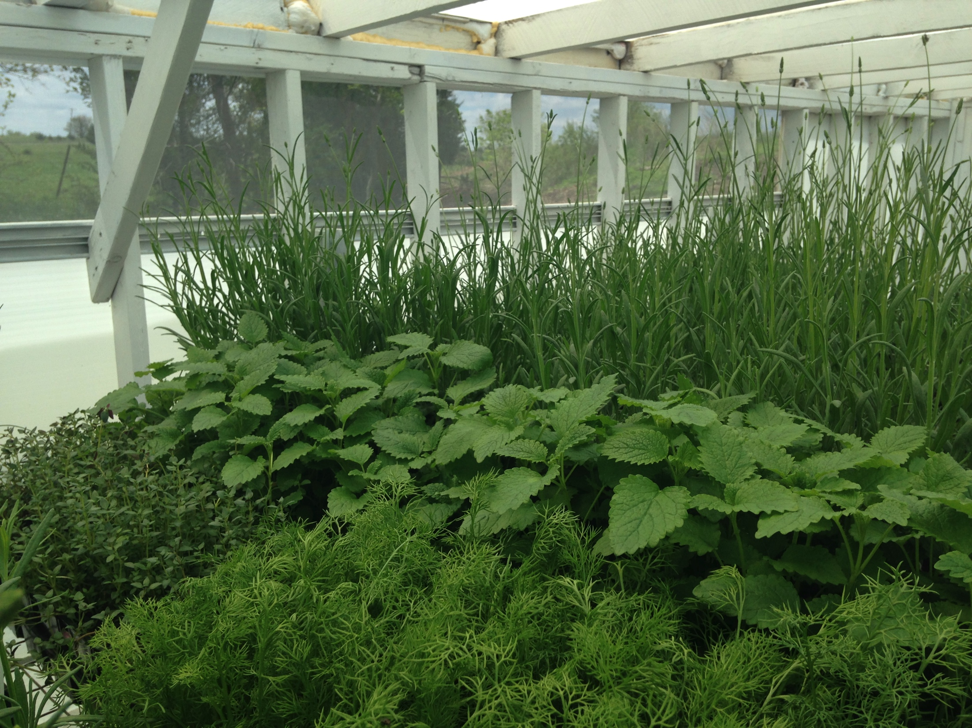
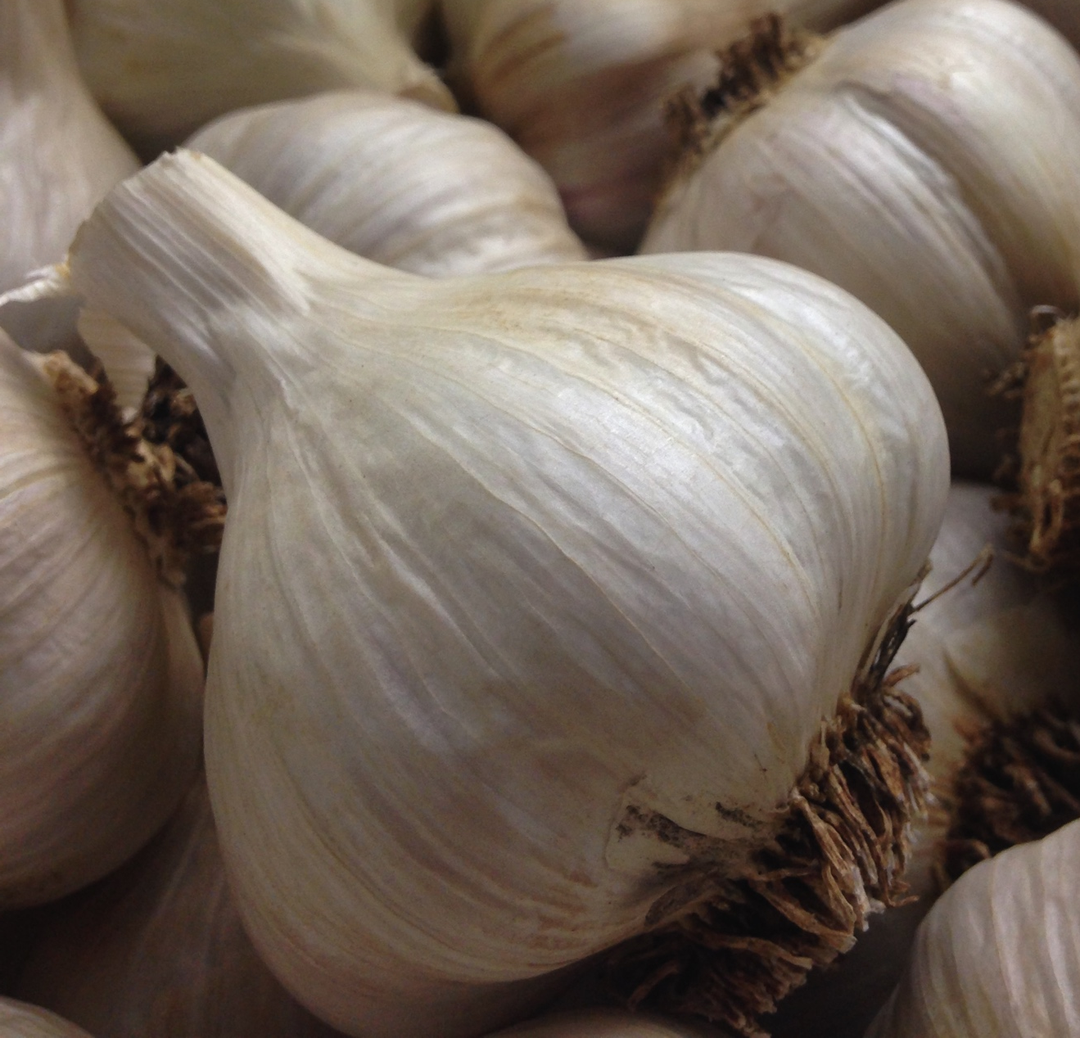
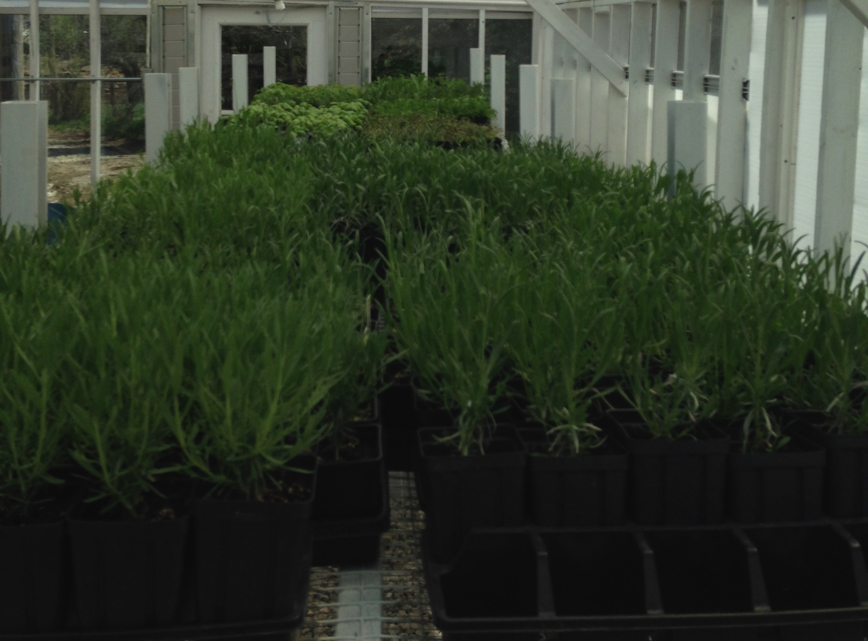
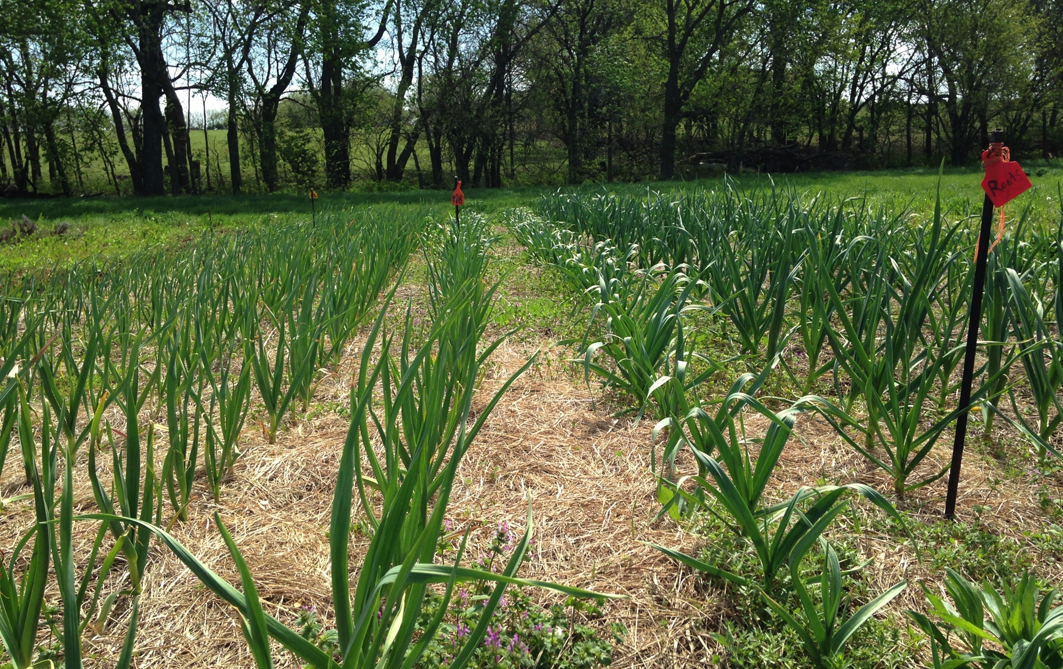
Diversification

Slide 19
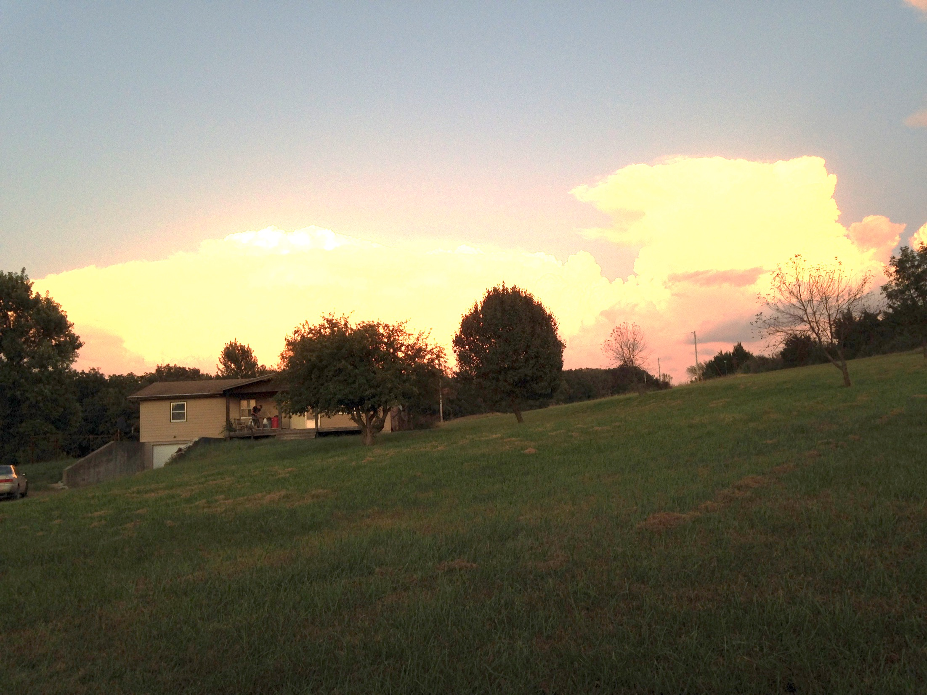
The New FHLF

Slide 20
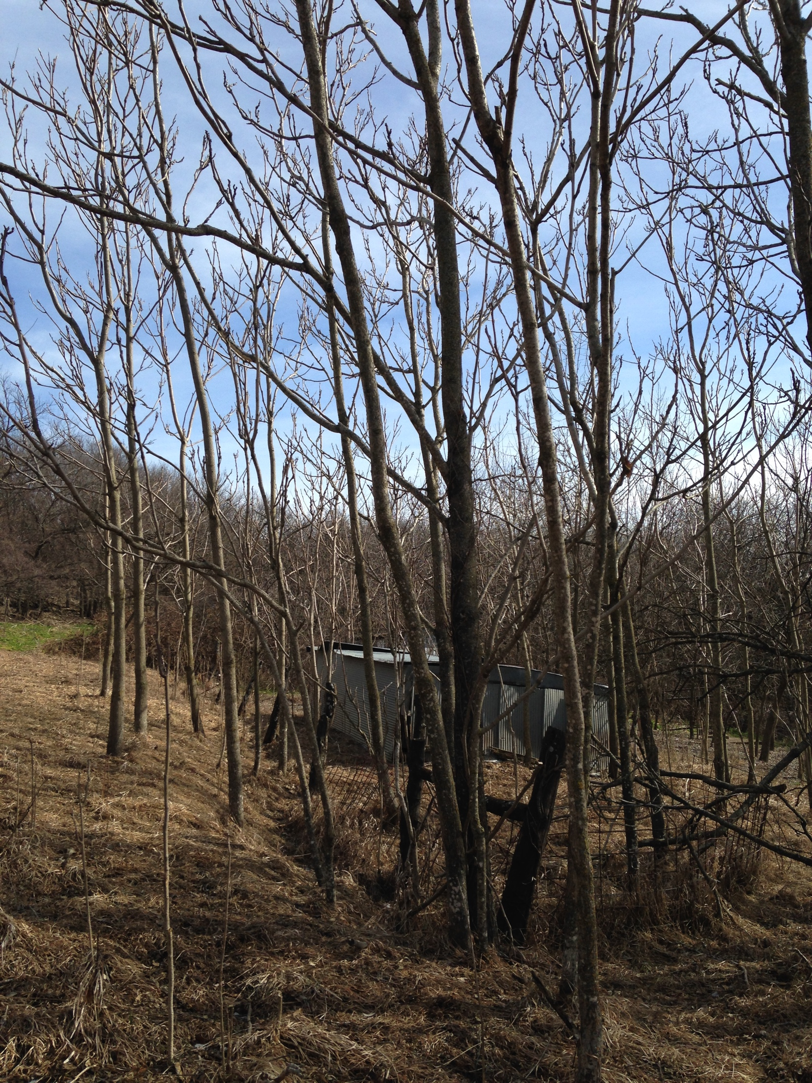
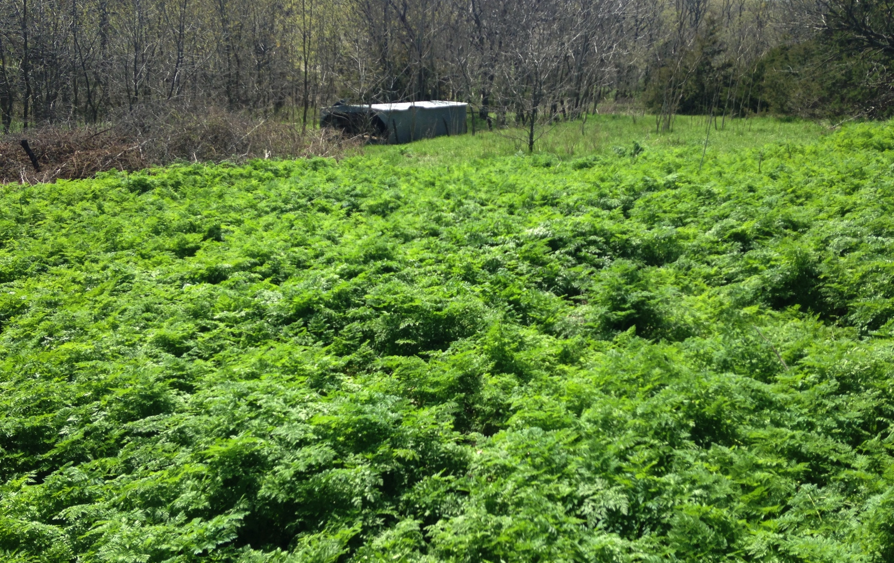
The New FHLF

Slide 21
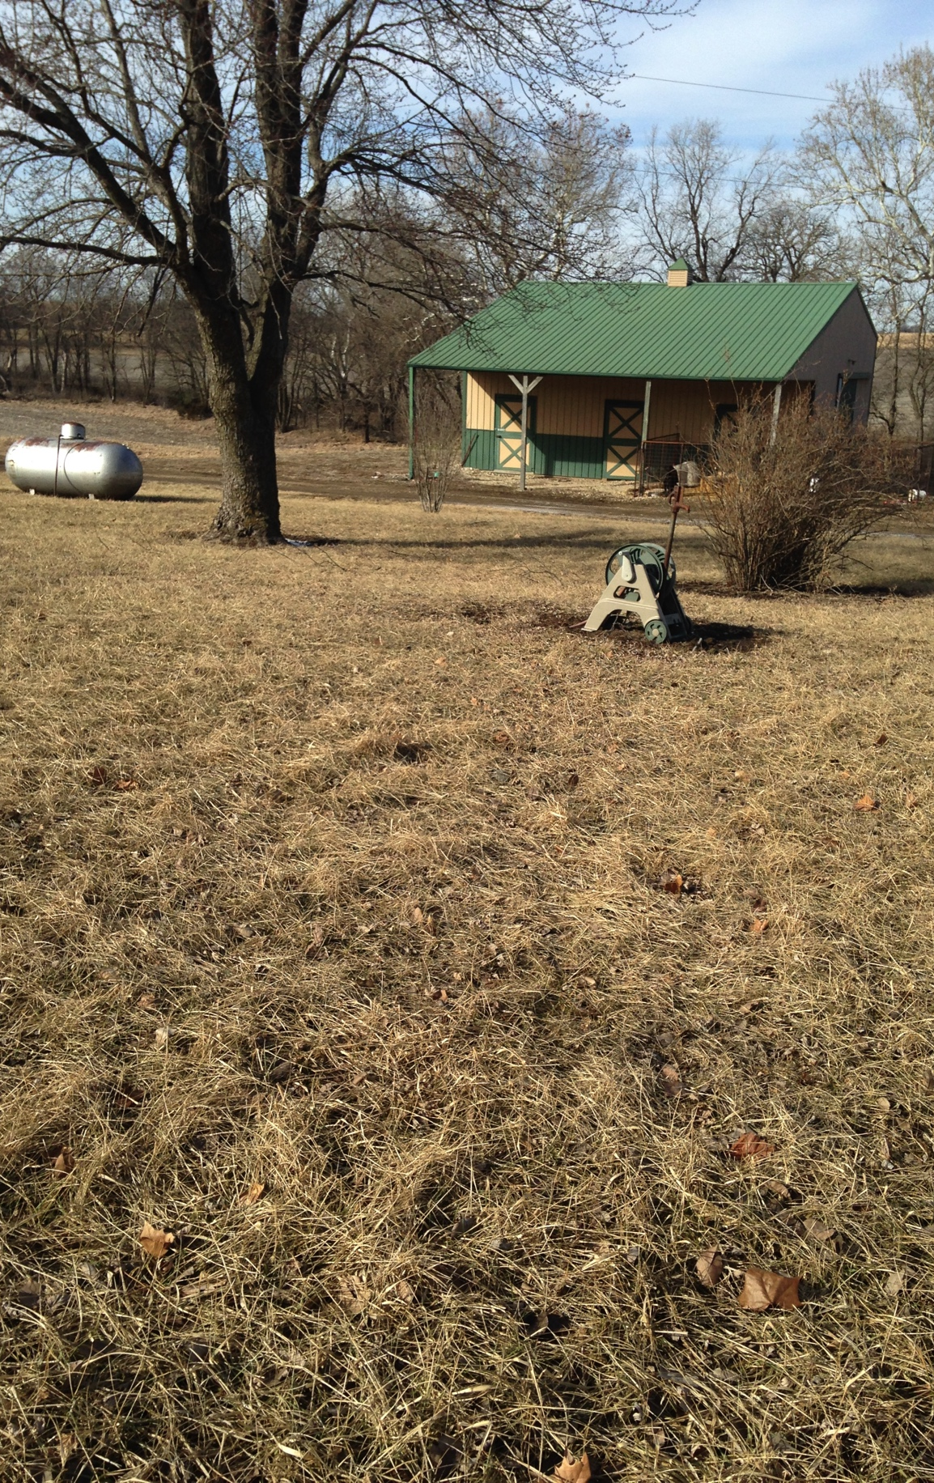
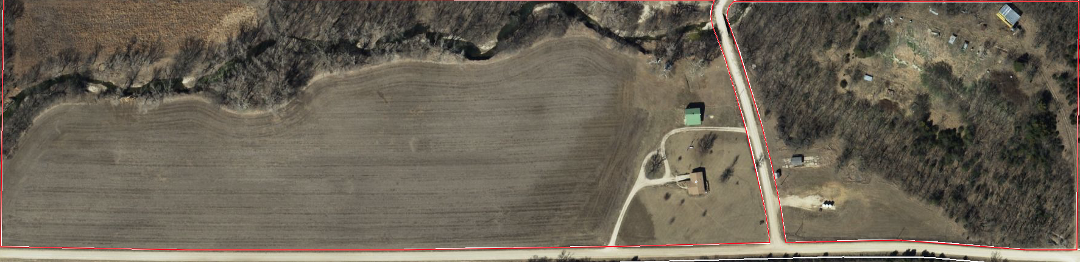
The New FHLF
Plans for 2020:
Lavender planting- 500 plants
  Various locations within the farm
  Test new varieties
Garlic production
Alfalfa production

Slide 22

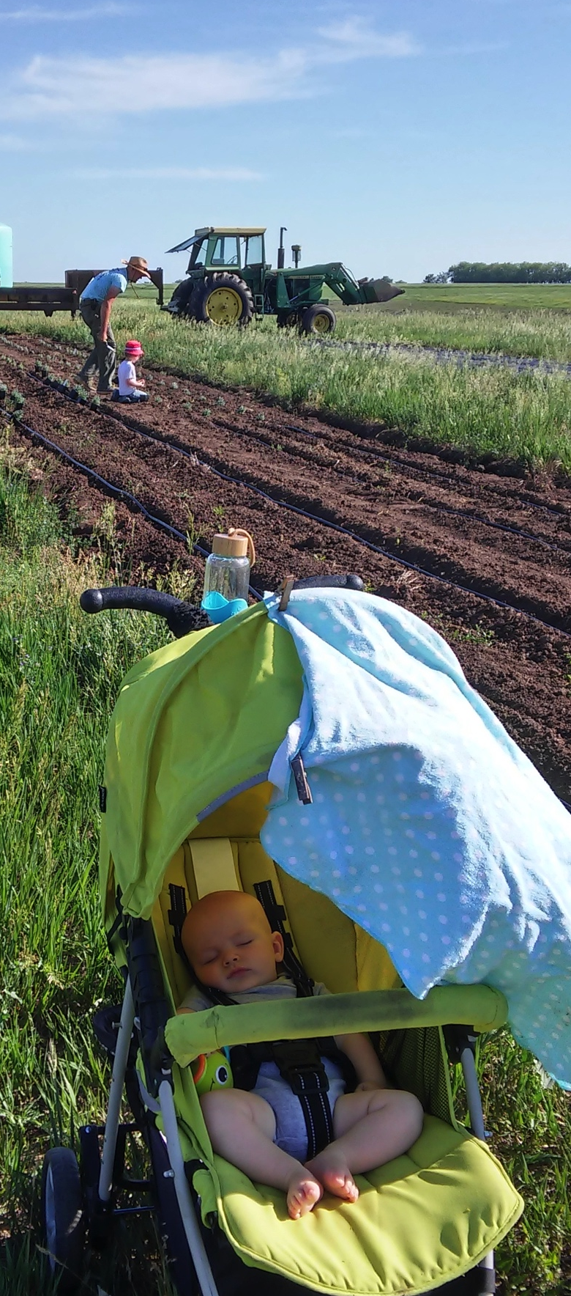
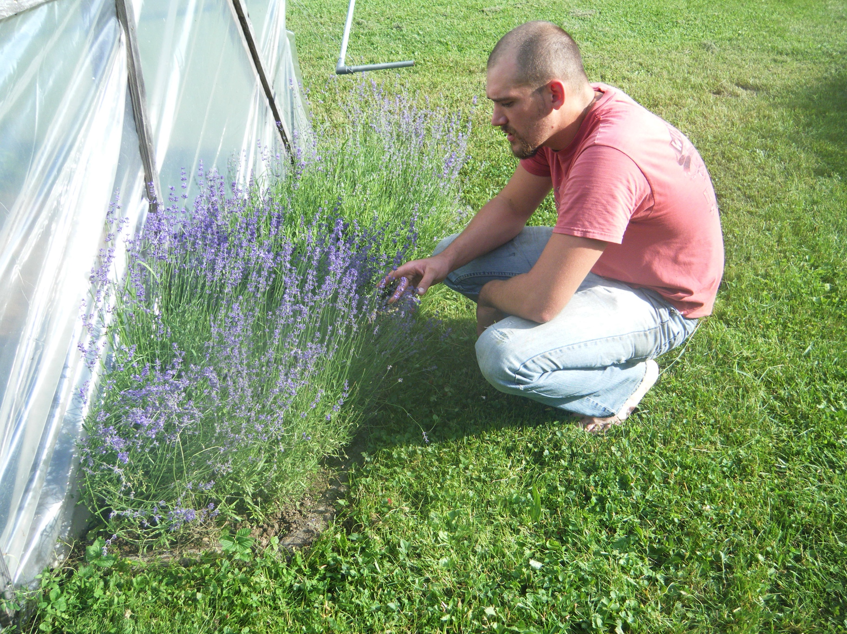
Questions?
Special thanks to NCR-SARE for funding the on-farm project

