Slide 1
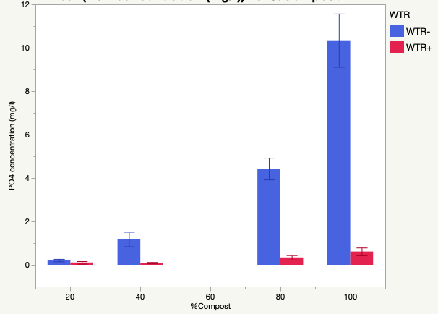
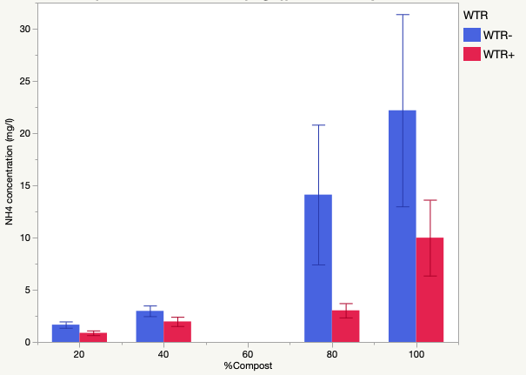
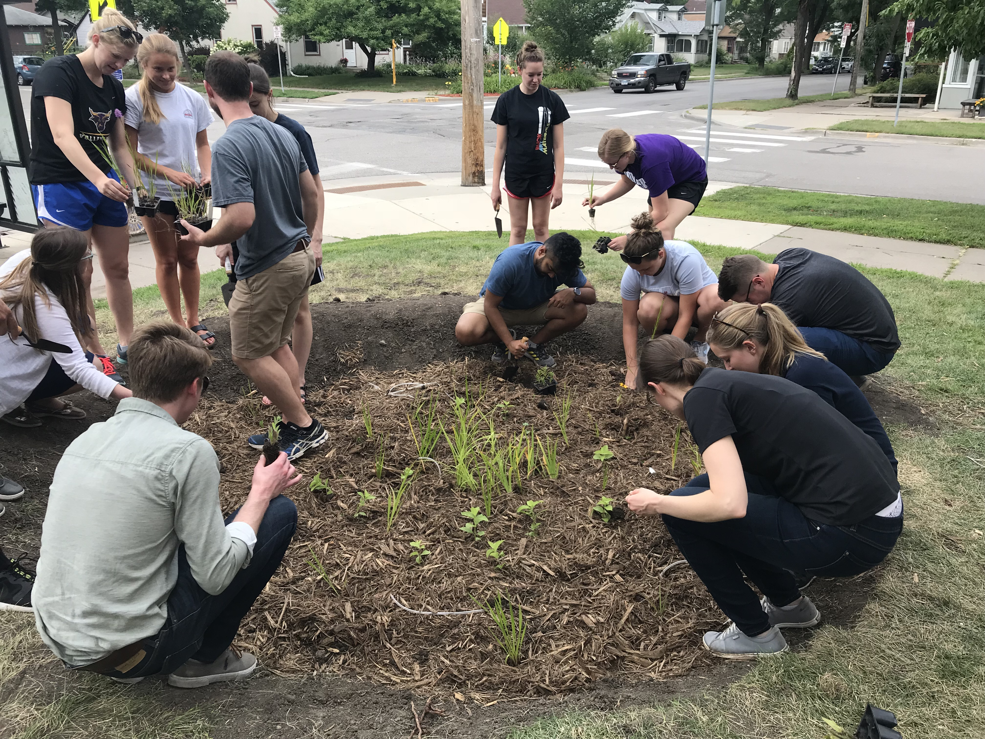
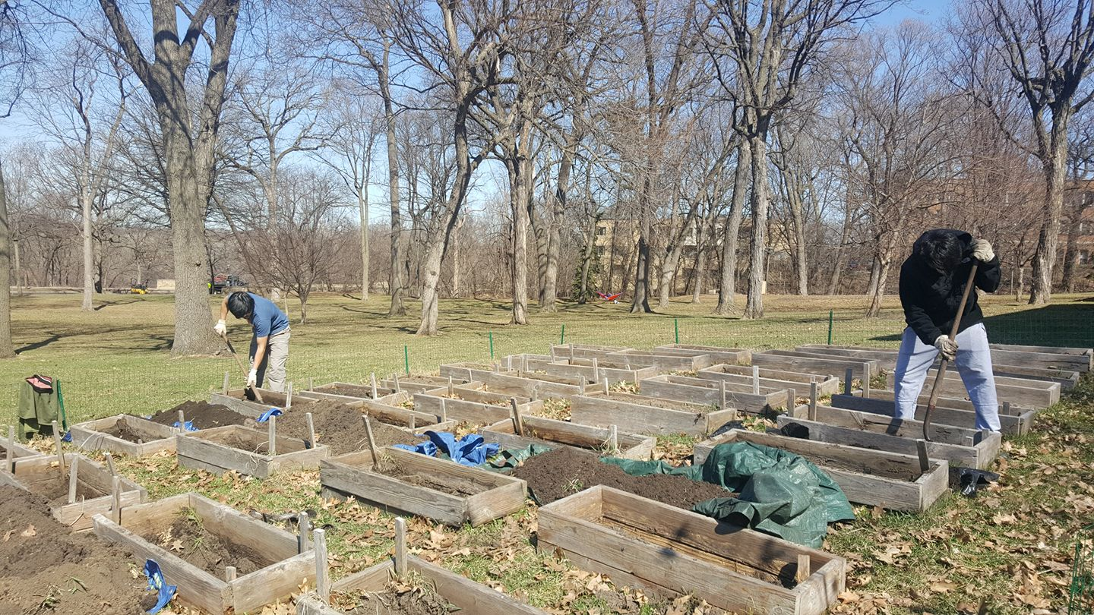
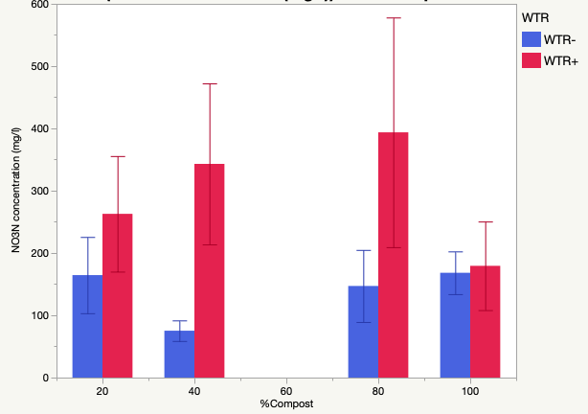
Effect of water treatment residual (WTR) on nutrient retention for raingarden application Hannah Wallace¹, Jenna Abramhson¹, Paliza Shrestha¹, Gaston Small¹ ¹Biology Department, University of St. Thomas
Background:
Raingardens are ecological stormwater treatment systems consisting of vegetated and porous soil media that filter and treat urban runoff. Raingardens receive high amounts of phosphorus (P) and nitrogen (N) inputs from storm water runoff and also from nutrients that leaches out of compost present in the soil media for plant growth. These nutrients can enter groundwaters and surface waters where they can eventually become a pollutants.
We are investigating the effectiveness of water treatment residuals (WTR) to capture P that leaches out of compost amended raingarden like cells to improve storm runoff quality. WTR is a calcium-rich byproduct of drinking water pretreatment that is currently sent to landfills. The chemical properties of WTR allow it to bind and trap high amounts of P. We hypothesize that the cells containing WTR in the soil media layer will remove P from the leachate compared to cells without WTR. Additionally, we explored benefits of WTR for N removal.
Conclusion:
Figures 2 and 3 illustrate the effectiveness of WTR at reducing both PO₄³⁻ and NH₄⁺ seen at all levels of compost application. P reduction in the leachate is likely due to chemical sorption reactions with the calcium present in the WTR. While sorption of NH₄⁺ also improved under WTR presence, NO₃⁻ leaching increased, as it is a highly mobile ion and does not participate in sorption reactions in the soil media.
Data shows that WTR incorporation improves water quality performance of cells, particularly for dissolved P and certain forms of N. Our results have positive design implications for raingardens built in nutrient-sensitive watersheds.
Figure 2: Mean PO₄³⁻ concentration vs. percent compost amendment in the soil media with and without WTR.
Ongoing and Future Work:
A raingardens were installed at Roosevelt High School in Minneapolis in July 2018 (Figure 5). An impermeable barrier split the raingarden into two halves where one half contained a layer of WTR, while the other served as a control. Data collection is ongoing. If granted further funding from the EPA, more raingardens will be built using WTR as a soil media amendment, and field monitoring will be conducted. A column study is also being conducted to compare effects of WTR and coconut coir for nutrient removal. Nutrient leachate data from these various studies will be presented at the National Sustainable Design Expo in Boston in June 2019.
Methods:
The study examines a combination of eight different soil media treatments, with 4 replicates per treatment resulting in 32 experimental raised-bed cells (Figure 1). The different soil media treatments included mixes of compost and sand at various ratios (100% compost, 80:20, 40:60, 20:80 compost: sand) in the top 1ft layer. Half the plots in the bottom 0.5 ft layer either comprised of WTR: sand mix at 60:40 ratio or sand (control). A lysimeter consisting of a 1-L collection bottle was installed in the center of each cells. Lysimeters were sampled weekly for leachate collection from May to October 2018. The total volume of leachate water was recorded, and subsequently analyzed for nutrients.
Figure 3: Mean NH₄⁺ concentration vs. percent compost amendment in the soil media with and without WTR.
Figure 5: Installation and planting of Roosevelt raingarden.
Acknowledgments
This research is supported by a Community-Based Research Grant from the University of St. Thomas Undergraduate Research Office to H. Wallace, the Spark-Y Summer Internship Program, and EPA Grant #83945601-0 to G. Small and P. Shrestha.
Figure 1: Experimental raised bed cells with potential to function as raingardens.
Figure 4: Mean NO₃⁻ concentration vs. percent compost amendment in the soil media with and without WTR.
Notes:
Error bars
Fluxes

