Slide 1
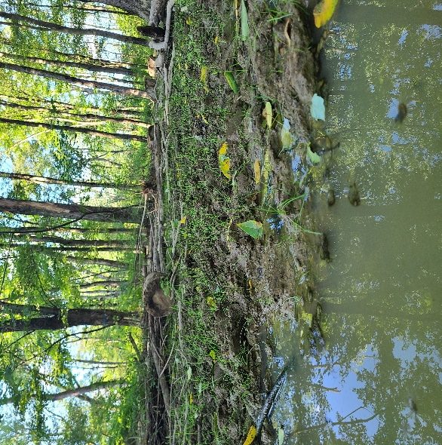
Silvopasture Pigs
Many farms have large wooded or brushy areas that are either too steep to be cropped or are intentionally set aside as windbreaks and dividers between fields. These areas are typically neglected and underutilized.
Using these wooded or brushy areas to create an additional income stream through pig propagation with minimal inputs will help farmers produce high-quality pork sustainably and profitably while improving the diversity of the fodder plantings on their farms.
Skyline Pastures
96 Skyline Drive
Mohrsville, PA 19541
(215) 833-7647
skylinepastures@gmail.com
www.skylinepastures.com
Notes:
To change this brochure, replace our sample content with your own. Or, if you'd rather start from a clean slate, press the New Slide button on the Home tab to insert a new page. Now enter your text and pictures in the empty placeholders. If you need more placeholders for titles, subtitles or body text, copy any of the existing placeholders, then drag the new one into place.
And did you notice we made fold marks for you? They are really light, but if you don’t like them showing on your brochure, select and delete them before you print.

Slide 2
This material is based upon work supported by the National Institute of Food and Agriculture, U.S. Department of Agriculture, through the Northeast Sustainable Agriculture Research and Education program under subaward number FNE23-053
Project Goals
Our goal is to clearly and quantifiably demonstrate that swine can be used to clear land while improving grazable space and producing additional income for farmers
Show fertility change (soil testing)
Compaction testing
Plant inventories
Pork costs and marketability
Project Timeline
Project Info
This project began in the spring of 2023 and will continue through the fall of 2024
2 full years of pig production
4 consecutive soil tests per paddock (every 10 months)
Paddocks will rest between pig rotations (essentially one month on, and eleven off)).
Northeast Sustainable Agriculture Research and Education (NE SARE) Project FNE23-053 is a 2 year Silvopasture Research Project focusing profitably raising swine in a forested setting while improving the landscape, increasing forage species, increasing fertility, and increasing stability for small-scale producers.
Farmer: CJ Lafferty
Technical Advisor: John Hopkins from Susquehanna Tree Care
Key Cooperator: Troy McClung
Additional Info
There is no shortage of information available concerning Silvopasture, and while much of it does not involve swine, it may help us achieve our goal.
YouTube /skylinepastures
Books
Podcasts
Pastured Pig Podcast
NE SARE projects (many similar projects – reports are free to the public)
Notes:
To change this brochure, replace our sample content with your own. Or, if you'd rather start from a clean slate, press the New Slide button on the Home tab to insert a new page. Now enter your text and pictures in the empty placeholders. If you need more placeholders for titles, subtitles or body text, copy any of the existing placeholders, then drag the new one into place.
And did you notice we made fold marks for you? They are really light, but if you don’t like them showing on your brochure, select and delete them before you print.

