Slide 1
Pollination Suggestions on Small Scale Farms Developing a Method to Capture and Authenticate Single Varietal Honey on Diverse Landscapes
Rachel Coventry, SARE Grant FNC15-1019
NCR-SARE’s Farmers Forum, 2017

Slide 2
The Changing Landscape of Farms
1900s - most farms were diversified, growing several crops and raising livestock.
1992 – most farms were larger in size and specializing in one or two major farm commodities
Notes:
http://www.livinghistoryfarm.org/farminginthe50s/life_11.html

Slide 3
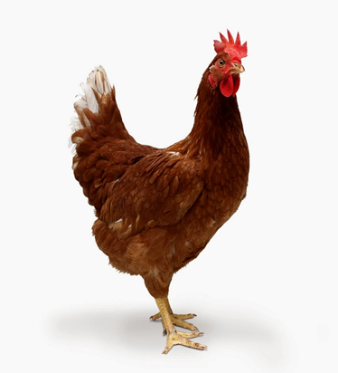
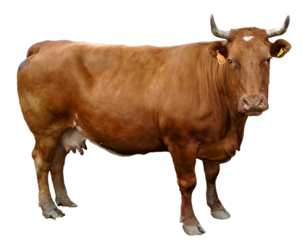
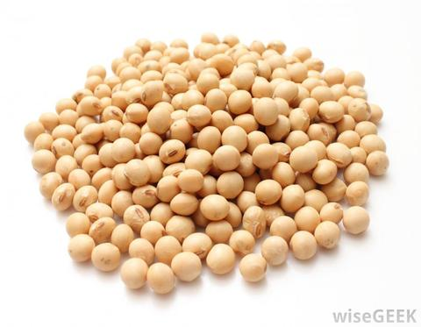
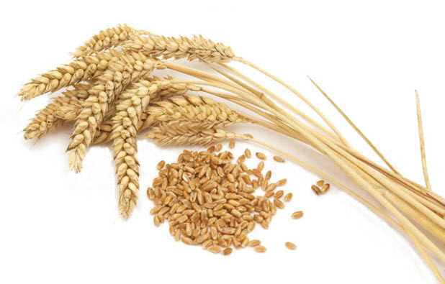
Today’s typical farm: 2 commodities

