Slide 1
Feeds and Feeding

Slide 2
Natural Diet
Rabbitfish are generally herbivorous grazers
Tend to eat macroalgae (seaweed) with inadvertent ingestion of invertebrates and zooplankton
The literature shows rabbitfishes prefer soft algae such as Caulerpa, Gracilaria, Enteromorpha, and even Sargassum.
They will eat blue green algae but don’t prefer them

Slide 3
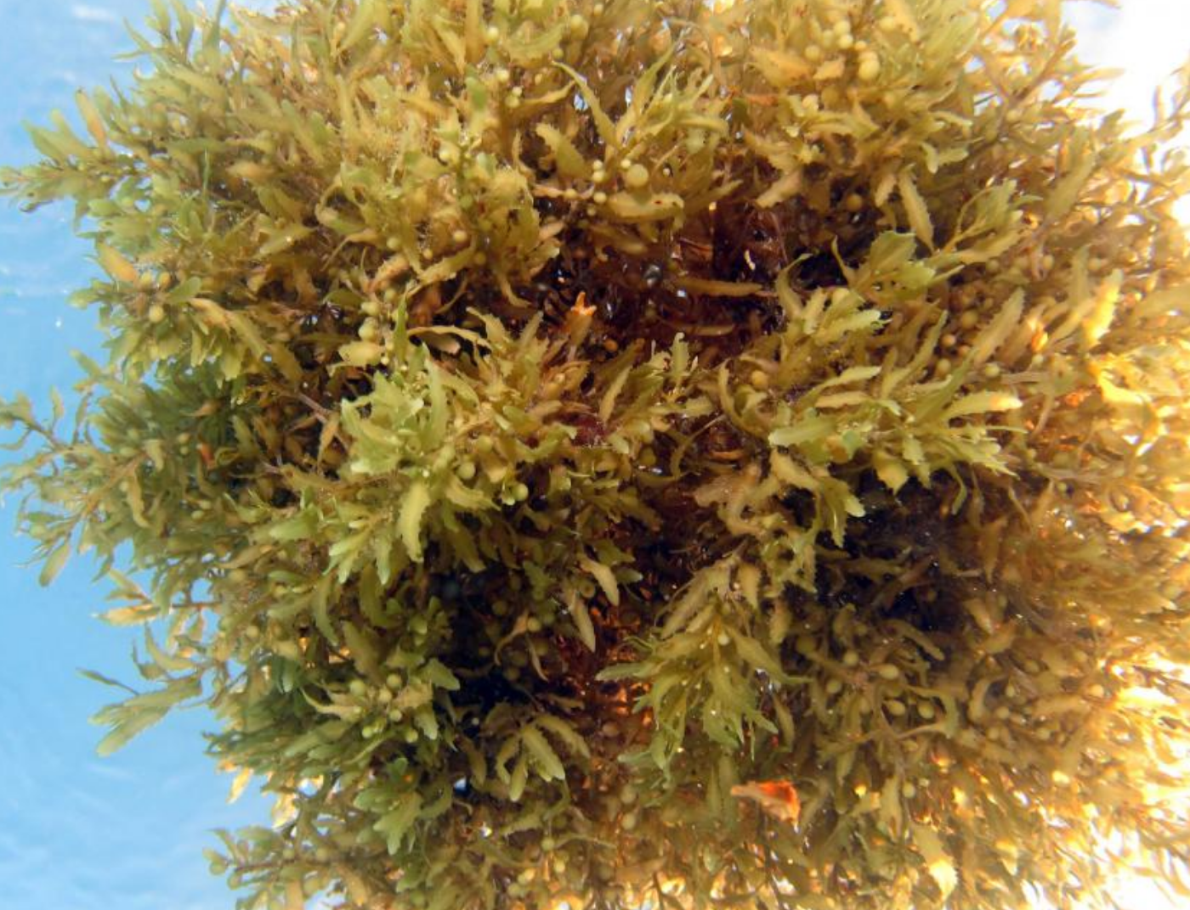

Slide 4
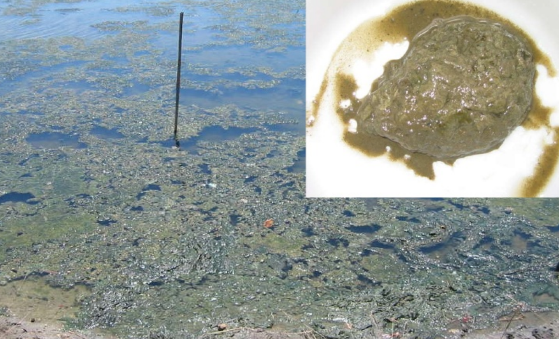
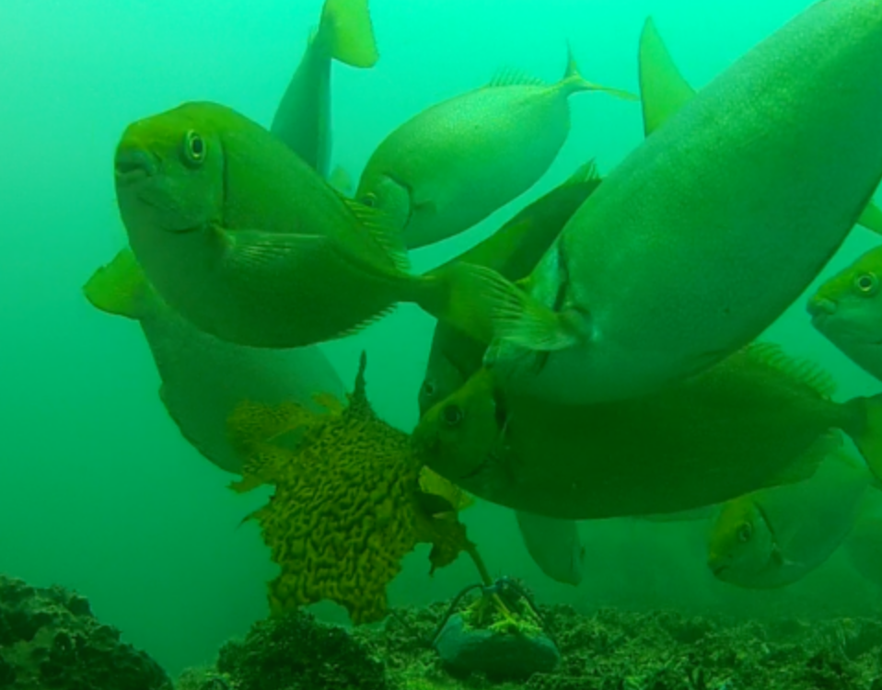

Slide 5
Diets under Culture
Herbivorous means they can tolerate a diet lower in protein which is the most expensive component of fish feeds.
Rabbitfishes could be fed just algae. Cheapest option. Growth rates slower
Best growth is on formulated diets. Most expensive option.
They may also eat grated coconut or other available land-based foods.
More experimentation needed. Some work being done in Palau and RMI

Slide 6
Cage Feeding of Rabbitfishes
Formulated diets containing 30-55% protein seem to provide the best growth
S. cannaliculatus grew to 181g in 89 days on 45% protein diet
Juvenile S. randalli in Guam grew better on a 55% protein diet than at 36% protein diet
Feeding rates for smaller fish 3-7% of body weight per day. 3-5% for older fish
Feed conversion ratios as low at 1.2 but generally around 1.7-2.2

Slide 7
Feed Conversion Ratio (FCR)
Feeds are usually most expensive part of raising fish and proper feeding practices save money
FCR is the amount of dry food fed versus wet weight gained.
Fish are generally more efficient than land animals. Pigs 3+:1
Fish FCR can be as low as 1:1
Fish grown in ponds usually have lower feed conversion as they find natural foods
Feeding fish more than one time per day usually leads to better FCR and growth

Slide 8
Feeding at MERIP
Fed a variety of flake and pelleted feed in 2016 and 2017
Tilapia starters 1 mm and 2mm floating
Catfish feed broken into smaller pieces
Flake feeds as a starter
Growth rates in 2016 and 2017 were generally poor
Some species adapted poorly to formulated diets and barely grew
Catfish food can be ordered through Ray and Dors

Slide 9
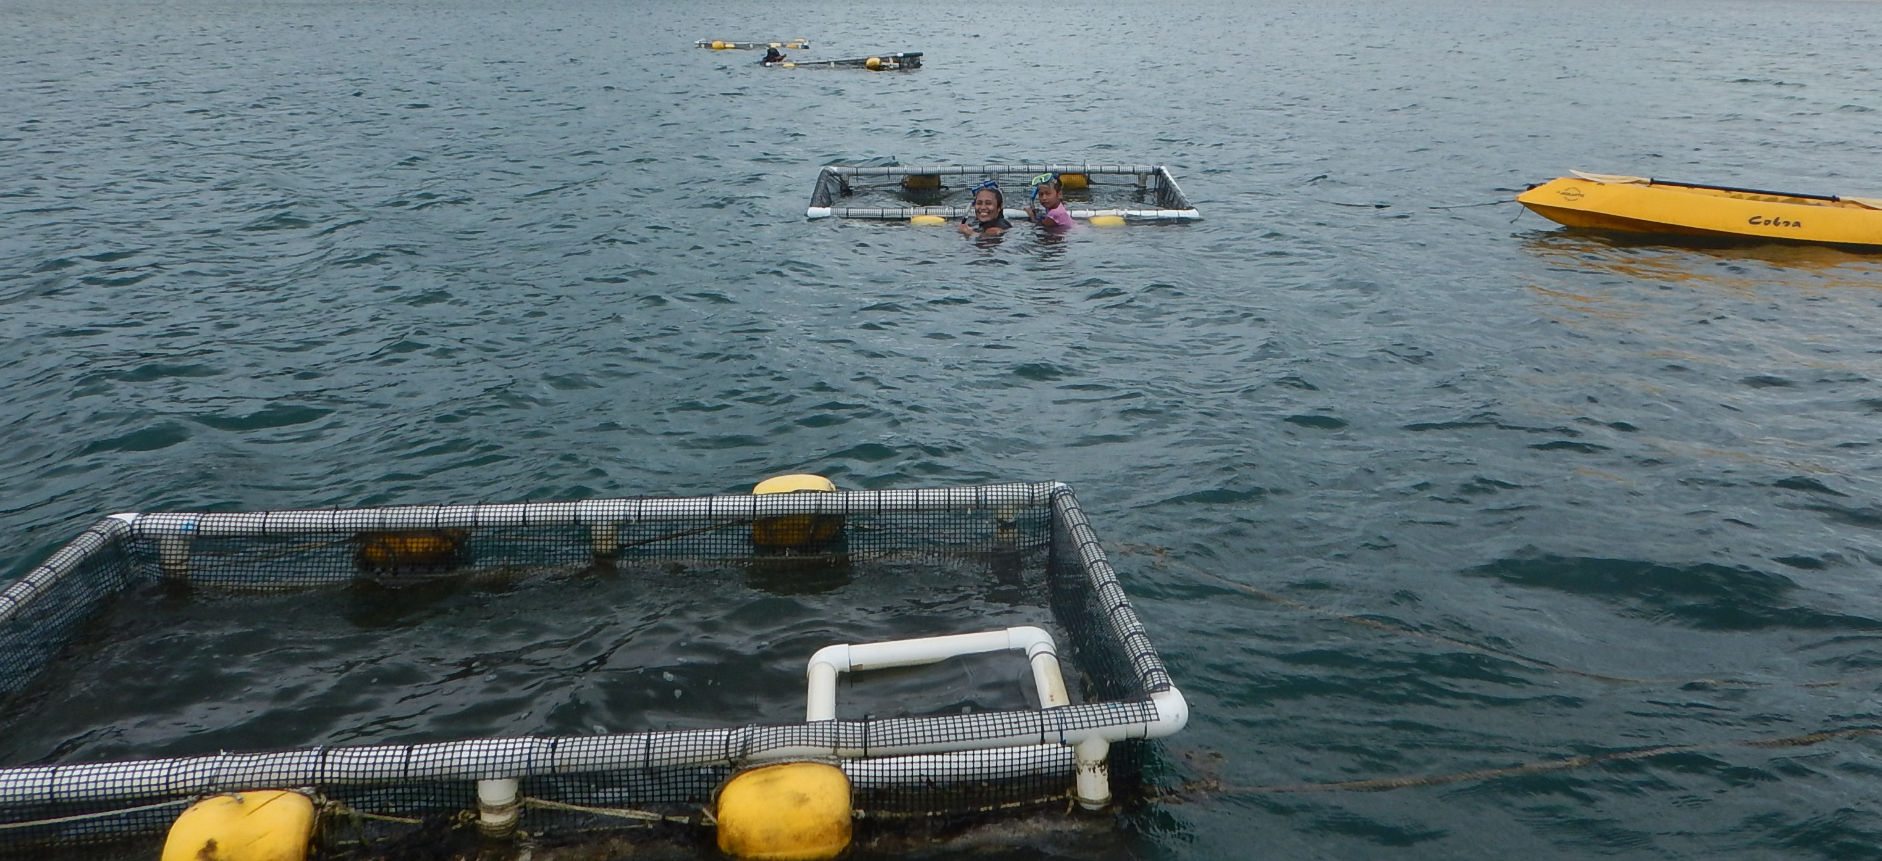
2018
2018 – mainly tilapia sinking crumble and floating starters.
Feeding twice daily
Use of feeding ring or square to keep feed in the cage
Results are much better and looking very promising for the S. argenteus and S. randalli.

Slide 10
Summary
Protein levels of 35%-45% are best
Feed at least twice daily
Can supplement with locally harvested algae
Feed 5-7% of body weight in the first 2 months and 3-5% after that
Experimentation with coconut or other land-based foods necessary
Use feeding ring or square when using floating feeds

