Slide 1
Organic Fertilizers
Valerie Dantoin
Organic Soil Course
Northeast Wisconsin Technical College

Slide 2
What is a fertilizer?
A substance added to soil (or a growing medium) to provide nutrients that a plant needs to grow.
A soil amendment, on the other hand, is a substance added to soil to enhance it’s physical properties like pore space or water holding capacity.

Slide 3
What’s the difference between and organic and not organic fertilizer?
Organic fertilizers are naturally occurring.
Non-organic fertilizers are manufactured or synthesized.
Remember – the definition from NOP is: “approved in organic systems”

Slide 4
NOSB – Nation Organic Standards Board
This is a board that meets frequently to approve or deny applications for products.
Some fertilizers – like blood meal, are natural, but it is dried and flaked and is from non-organic animals so ……Organic Valley prohibits it’s producers from using it on their fields.

Slide 5
Macro Nutrients
Nitrogen-Phosphorus- K Potassium-: These are 3 macro nutrients most often needed by plants.
They are typically not supplied by soil alone, thus – they are added as fertilizers.
There are 16 elements required by plants. Three other MACRO nutrients are calcium, magnesium, and sulfur.

Slide 6
Micro Nutrients
Iron, Chlorine, Manganese, Boron, Zinc, Copper, Molybedenum, (Cobalt, Sodium required in just a few species of plants).
The concentrations in plants are measured in parts per million (ppm) and can almost always be found in sufficient amounts in the native soil.
Round-up herbicide works by chelating micro-nutrients important in making cell walls.

Slide 7
Nitrogen Fertilizers
Nitrogen is very abundant in the earth’s atmosphere.
Nitrogen is not a limiting factor in normal plant growth. Plants have grown for millions of years with only the N that naturally cycles through the soil. (forests.)
It is only in high production systems of modern agriculture that nitrogen becomes a limiting factor.

Slide 8
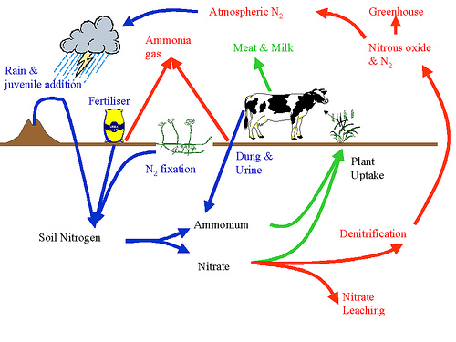
Nitrogen Cycle
fixation
NH4
Mineralization
NO3

Slide 9
Nitrogen Cycle
To FIX atmospheric nitrogen takes a lot of energy:
Lightning
Manufacturing
Symbiotic soil bacteria
This is why nitrogen fertilizer is expensive
Industrially fixed nitrogen adds 10 million tons of N2 to the atmosphere
Industry fixes several times more N than natural systems
fixation
NH4
Mineralization

Slide 10
Nitrogen Cycle
This is why organic farmers
use
MANURE
BACTERIA
Green Manures
Green Manure
fixation
NH4
Mineralization
NO3

Slide 11
Organic farmers grow our own nitrogen
A “per acre furrow slice” of soil contains about 1000 lbs of nitrogen for each 1% of organic matter (OM) measured in the soil.
Most is in the fixed form. About 20-30 lbs of N are mineralized each year for the plant to use for each 1% of OM.
A soil with 3.5% OM may contain 3,500 lbs of fixed nitrogen and 105 lbs of available N.

Slide 12
Growing Nitrogen
Therefore, when organic farmers can improve their soils by increasing organic matter, they make more nitrogen available to their plants.
Organic farmers do this by increasing the soil “livestock” – the micro and macro fauna that lives below the soil surface. These soil livestock concentrate N in their bodies and become a slow release form of nitrogen.

Slide 13
Nitrogen fertilizers
Nitrogen Fertilizers | % N | Cost/ton
Compost | 1.5
Cow manure | 5
Horse Manure | 6
Pig Manure | 6
Sheep Manure | 8
Poultry Layer Litter | 15
Poultry Broiler Litter | 13
Green Manure | 17
Mined Chilean Nitrate | 15
Fish Emulsion | 5
Tankage | 6.5
Fish Meal | 9
Blood Meal | 13
Ammonium Sulfate | 20
Ammonium Nitrate | 33
Urea | 43

