Slide 1
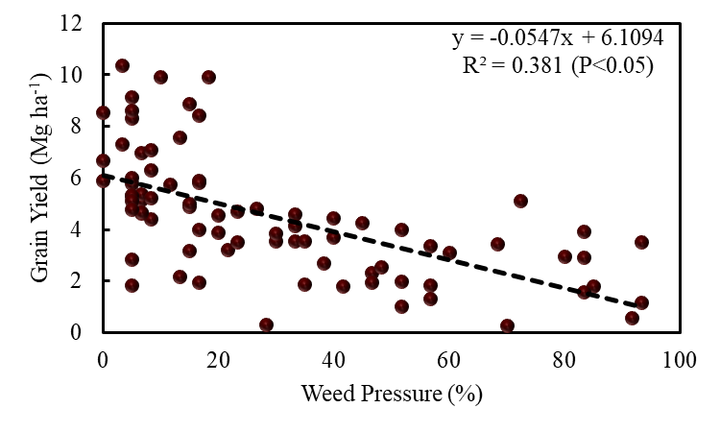
Fig 4: Relationship between weed pressure and main rice crop yield in 2023

