Slide 1
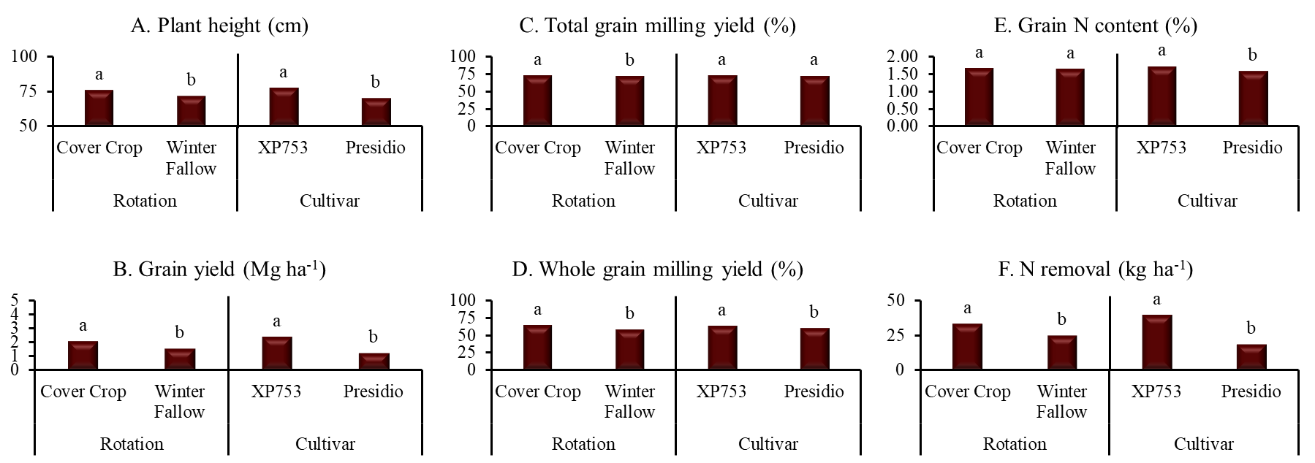
Fig 5: Effect of rotation (Cover crop vs winter fallow) and cultivar (XP753 vs Presidio) on ratoon crop’s plant heigh (A), grain yield (B), total grain milling yield (C), whole grain milling yield (D), grain N content (E) and N removal (F). Columns with different letters indicate significant difference at P<0.5 for the mean effect of either rotation or variety.

