Slide 1
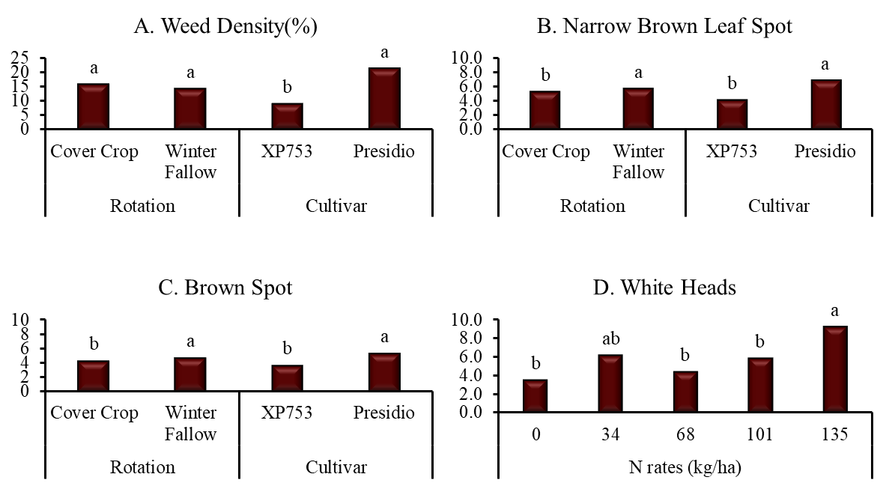
Fig. 7: Effect of rotation, cultivar and N rates on pest pressure in ratoon rice crop. Columns with different letters indicate significant difference at P<0.5 for the mean effect of either rotation, cultivar or N rate.

