Slide 1
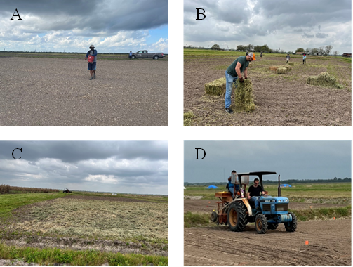
Fig 1. Field activities during the 2022-2023 season. A) Planting of winter cover crop using a belly planter in 2022; B) Application of alfalfa hay; c) Field plots after hay application; and D) planting of rice in 2023.

