Slide 1
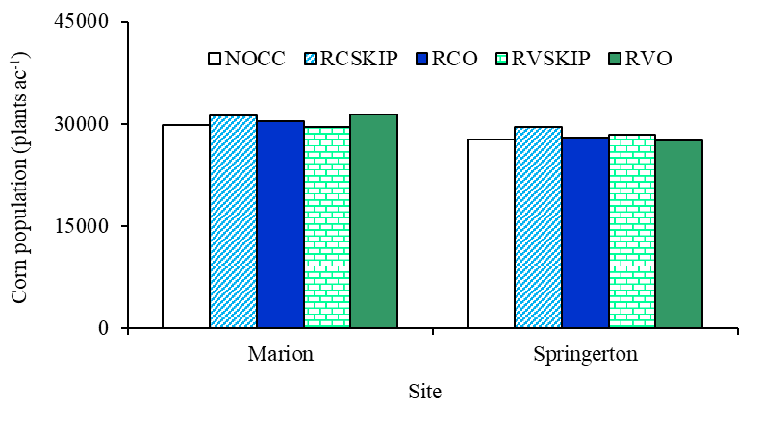
Fig. 2. Corn plant population (stand density) as influenced by site.
NOCC: no cover crop; RCSKIP: rye clover skip (nothing on the corn row); RCO: rye clover + oat on the corn row;
RVSKIP: rye vetch skip (nothing on the corn row); RVO: rye vetch + oat on the corn row.

