Slide 1
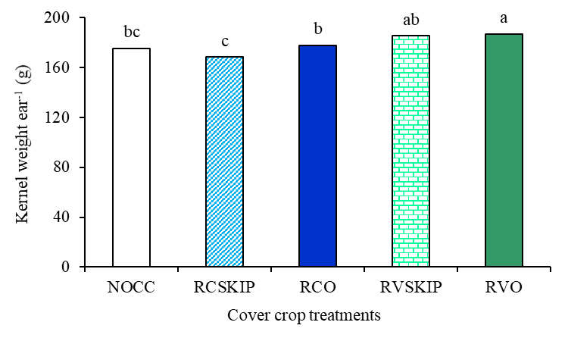
Fig. 3. Corn kernel weight ear⁻¹ as influenced by cover crop treatments (averaged over the two sites)
NOCC: no cover crop; RCSKIP: rye clover skip (nothing on the corn row); RCO: rye clover + oat on the corn row;
RVSKIP: rye vetch skip (nothing on the corn row); RVO: rye vetch + oat on the corn row.
Different letters indicate significant difference (P<0.05).

