Slide 1
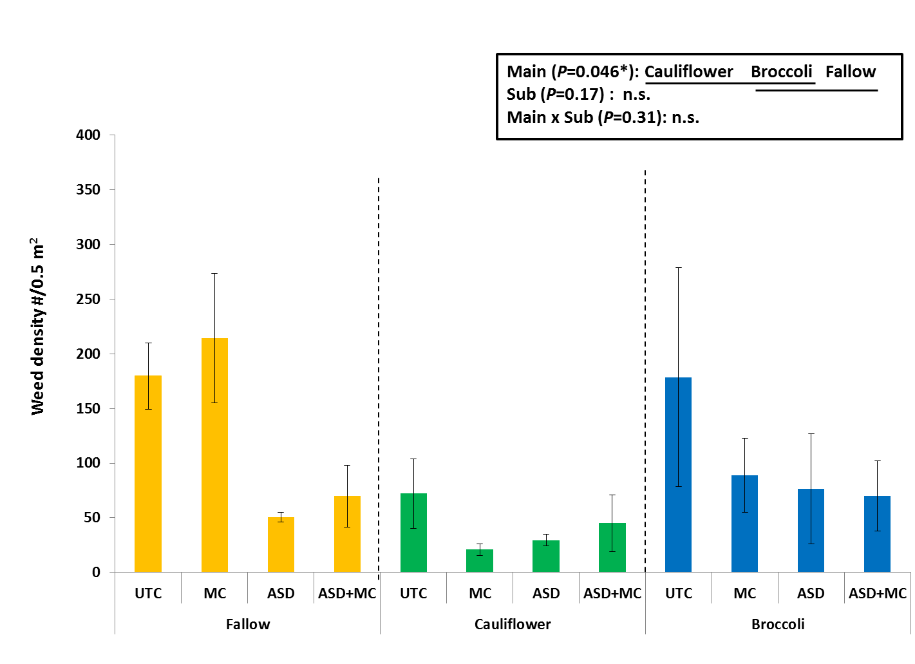
Notes:
Figure 5. Weed density during strawberry production at the Santa Cruz site. Total # of weeds/0.5 m² from Jan 2012 to Aug 2012. Main plots are fallow, cauliflower and broccoli. Sub plots are UTC (untreated check), MC (mustard cake), ASD (anaerobic soil disinfestation) and ASD+MC. Statistical analysis was performed for log-transformed data. Each bar shows mean ± SEM (n=4) of the original data. Treatments on the same line are not significantly different (Tukey’s HSD test (P=0.05)).

